Slide 1
Managing Projects Effectively without
Stress
Presented by : Thijs Wijnands
CERN PMMU #7 – 17 April 2018

Slide 2


Stress
Project Team
Risks
Earned Value
Milestones
Budget
Acute
Physical
Chronical
Psychological

Slide 3


Slide 4
Project
Final State
Ideas
Structure
Next actions

Slide 5
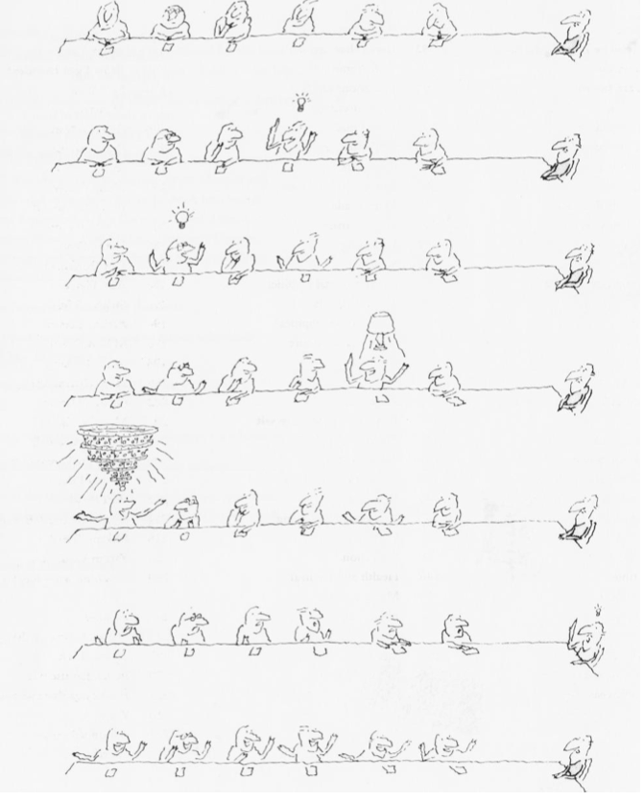

Slide 6
Worrying
Anxious
Overwhelmed
Confused
Unable to make decisions
Experiencing mood changes
Increasing consumption of cigarettes or alcohol
Neglecting your personal appearance

Slide 7
PERSPECTIVE

Slide 8
Missed milestones
EV << PV
Scope creep
Long hours at work
Project team not motivated
Incidents

Slide 9
CONTROL

Slide 10
Perspective
‘mad physicist’
Project
Manager
victim
micromanager
Control
From : David Allen, GTD

Slide 11






Sources

