Slide 2
Alternative for MS Project
PMMU 17th April 2017
Maria Alandes – IT/CDA

Slide 3
Outlook
Why an alternative for MS Project?
Project plan
User community
User survey
User communication
Initial list of alternative tools

Slide 4
Why an alternative for MS Project?
It is very likely that MS product licenses will suffer a dramatic increase as of 2019
This is an opportunity to understand better what most of the users need from a planning and scheduling tool
  Assumption is that most don’t use the extensive features of MS Project
IT would like to offer a product suitable for user needs that costs less to CERN
  ideally zero license costs if a suitable open source tool is found!
  while this should be fine for most users, those really needing MS Project will still be able to use it, although probably at a higher cost

Slide 5
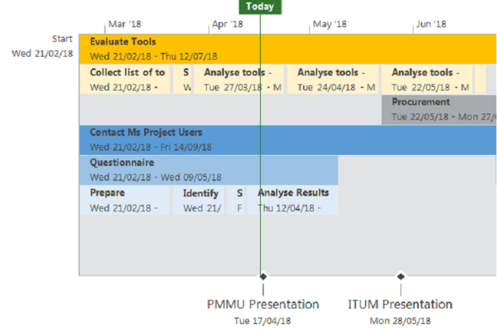
Project plan – Evaluation Phase

Slide 6
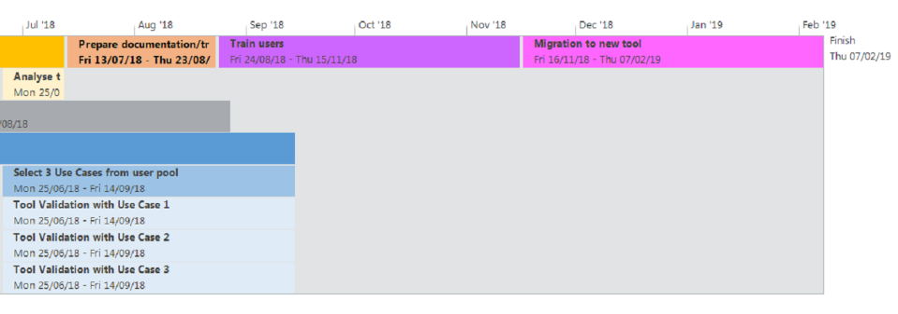
Project plan – Validation and Deployment Phase

Slide 7
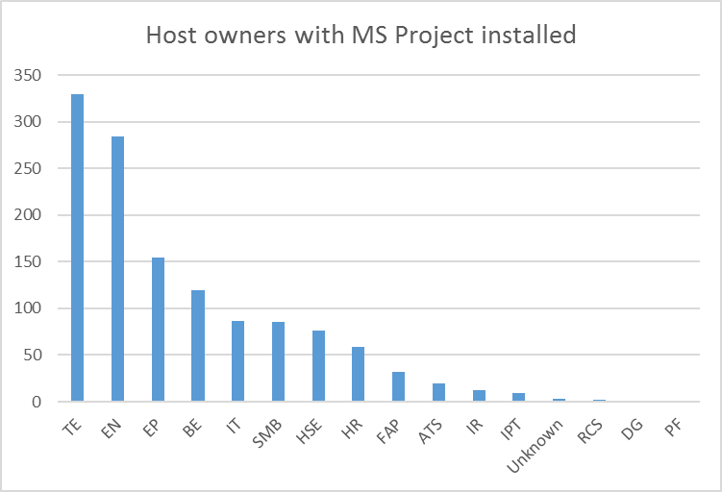
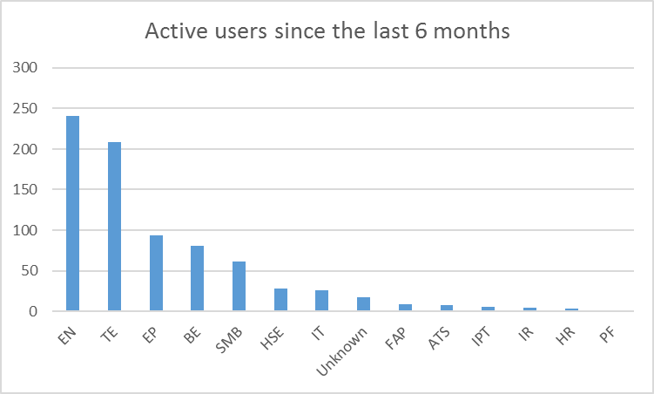
User community
1558 CMF hosts
1273 users
787 active users
Approached users in these departments

Slide 8
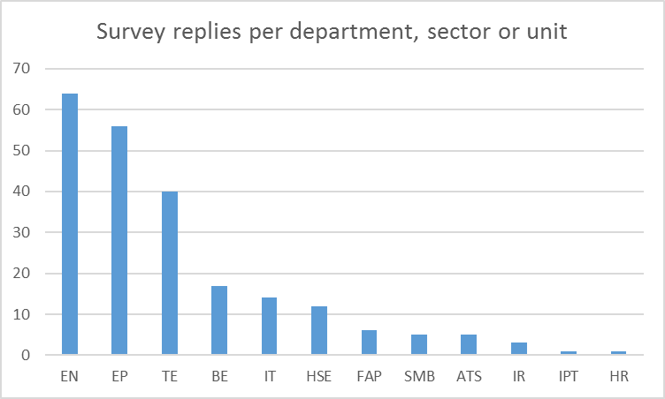
User survey
https://cda-surveys.web.cern.ch/webform/microsoft_project_survey
17 questions
  To help us understand better how MS Project and other project scheduling/planning tools are being used today at CERN
  Statistics about departments, user roles, collaboration, etc
Sent to the following people:
  Users that according to CMF have MS Project installed
  Merlin Users (list obtained internally in IT-CDA)
  Users who answered the IT-CDA user survey launched in 2017 and who gave feedback to the Project Management Tools related questions
1520 users – 225 replies so far (14%)

Slide 9
User communication
Upcoming Presentations
  28th May – ITUM - : https://indico.cern.ch/event/709461/
Mattermost Channel
  Technical discussions
    https://mattermost.web.cern.ch/it-dep/channels/malt-msproject
Your input is very important – please help us to get this right!

Slide 10
Initial list of alternative tools
Ongoing evaluations
  Open Project
  Project Libre
  Gantt Project
  Project Manager
  Genius

Slide 11
Feedback, suggestions, questions
Please, do not hesitate to get in touch with me:
Maria.Alandes.Pradillo@gmail.com

Slide 12
Thanks a lot!
Please, fill in the survey if you haven’t done this yet:
  English
    https://cda-surveys.web.cern.ch/form/microsoft-project-survey
  French
    https://cda-surveys.web.cern.ch/fr/form/microsoft-project-survey

