Slide 1
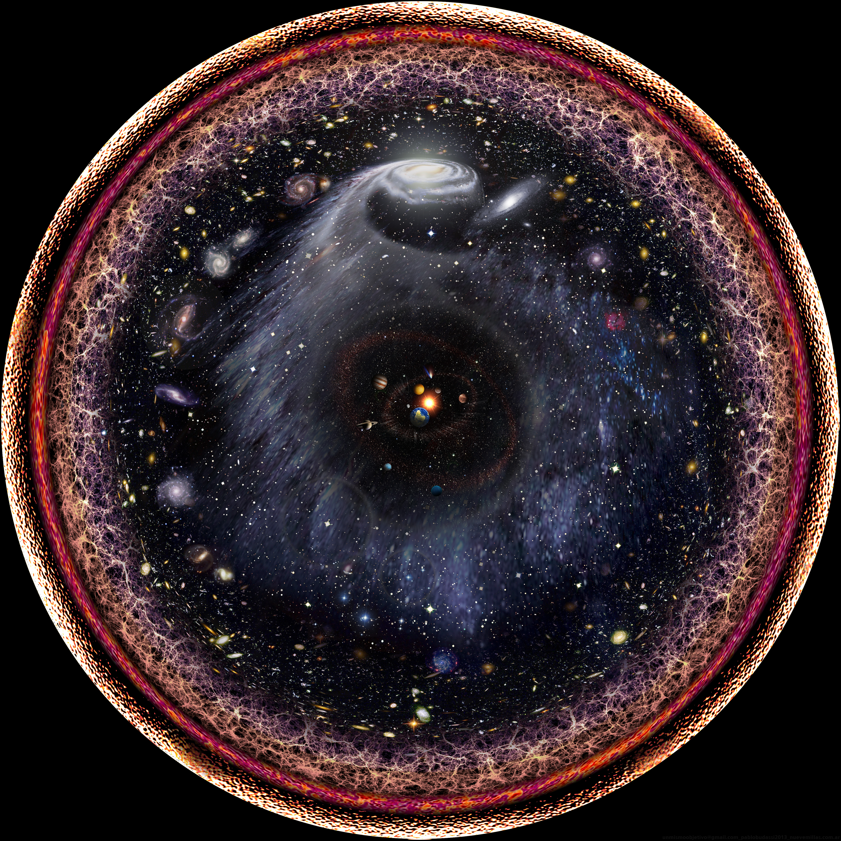
Cosmological Probes of Dark Matter Interactions
PPC Zurich, August 2018
Vera Gluscevic
Princeton University
University of Florida
Image credit: Budassi

Slide 2
Outline*
[case study: DM-baryon elastic scattering]
CMB
21-cm cosmology
Distinguishability of signals
What’s next?
*Not covered in this talk:
Self-interactions, photon interactions, annihilations, inelastic scattering, etc.
Notes:
I will not have time to talk about some tightly related topics, in particular the axion-like DM candidates, astrophysical probes of DM physics and detailed model-dependent comparison of cosmological and experimental limits.
What I want to do is give you good sense of the possibilities we are able to cover with observational probes that directly address DM and in its cosmological context.

Slide 3
I. CMB on DM-baryon scattering
Notes:
Like subir noted after jordi’s talk yesterday…. This is why we look to gaia with hope.

Slide 4
Lab-based low-energy searches
Assumptions about local astrophysics of DM.
Sensitivity ceiling due to shielding.
Masses << GeV are poorly explored.
Emken and Kouvaris, 2018
Notes:
I was at a conference a few months ago where people started discussing which limits can we safely put on the same plots… and in tihs case, limits from cosmological and direct detection probes can almost trivially presented in such a way; this is how they are complementary. Dd, as the most sensitive traditional mode of looking for DM in the local halo currently does not explore high cross sections and low masses.

Slide 5
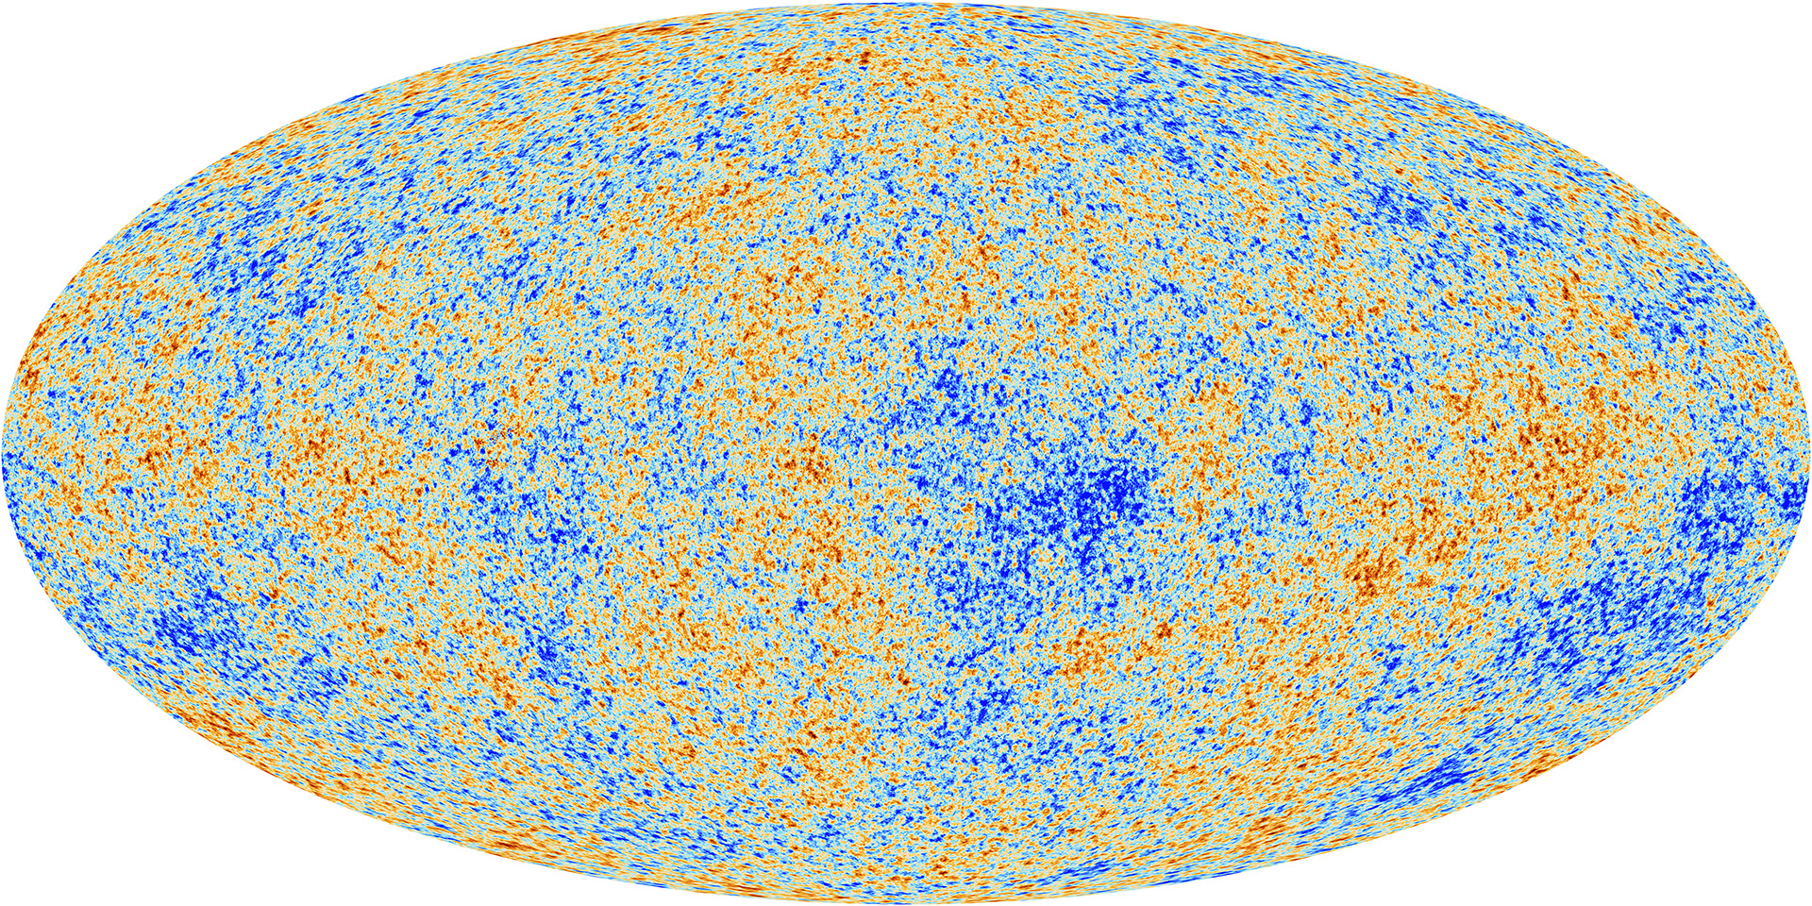

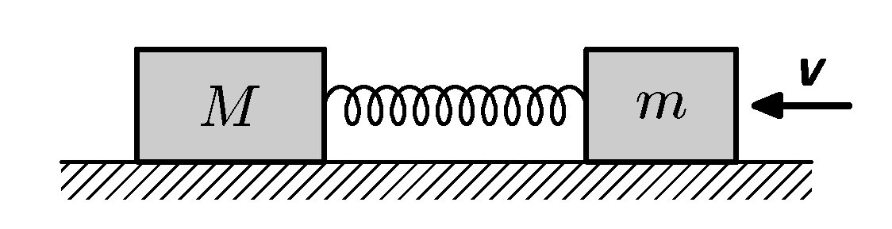
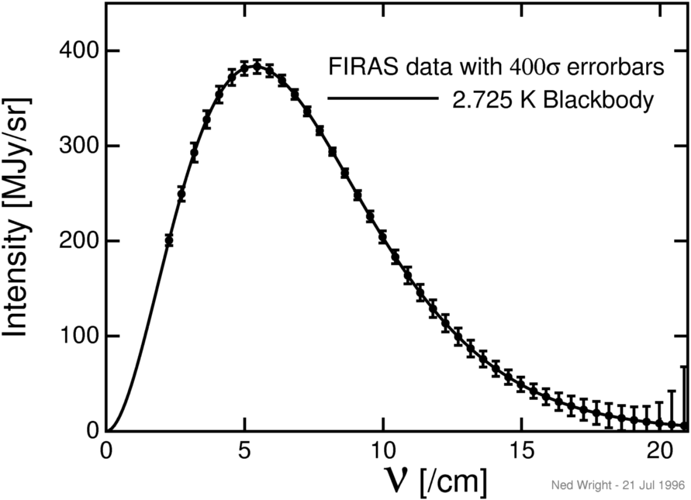
Cosmic microwave background [CMB]
Thermal history:
Black body
[energy injection→ spectral distortions]
Acoustic oscillations:
Fk
Fg
Frequency spectrum
Angular power spectrum
Plot by E. Calabrese (for ACTPol)
Notes:
With cosmological observables, on the other had, we probe the same physics of elastic scattering of DM with the SM model particles, through two main effects: heat transfer to baryonic fluid, which causes spectral distortions of the cmb. And momentum-transfer to baryons which changes the evolution of cosmological perturbations and shows up the cmb power spectrum and the matter power spectrum and related observables.

Slide 6
Heat transfer: spectral distortions
Ali-Haimoud, Chluba, Kamionkowski, 2015
Notes:
Compton scattering with baryons already causes a small amount of distortion in the standard cosmo; Maintaining the baryons and the DM in thermal equilibrium with the radiation therefore requires an increased rate of energy extraction from the photons. BTW, Direct scattering of DM particles with photons have the same outcome. At a fixed cosmo abundance, this is inversely proportional to the DM mass…. Thus, for a fixed sensitivity in delta, there is a maximum mass one is sensitive to.

Slide 7
Momentum transfer: power-spectrum distortions
Boehm+ (2002), Chen+ (2002), Dubovsky+ (2004), Sigurdson+ (2004),
Dvorkin+ (2014), VG and Boddy (2017), Boddy and VG (2018), Xu+ (2018), Slatyer+ (2018), etc.
scattering →drag force→
suppression of small scales
Fk
Fg
Observables: CMB temperature and polarization power spectra

Slide 8
Momentum transfer: power-spectrum distortions
Boehm+ (2002), Chen+ (2002), Dubovsky+ (2004), Sigurdson+ (2004),
Dvorkin+ (2014), VG and Boddy (2017), Boddy and VG (2018), Xu+ (2018), Slatyer+ (2018), etc.
scattering →drag force→
suppression of small scales
Fk
Fg
Observable: matter power spectrum
Boddy and VG (2018).

Slide 9
v-independent DM scattering with proton: 95% confidence upper limit
Momentum transfer: Planck limits
VG and Boddy
(PRL, 2018)
High cross sections, sub-GeV mass
Notes:
First studies looked at >GeV dm, then this study extended all the way
Note: first early-universe (linear cosmo) model-indep constraint in this mass range

Slide 10
Momentum transfer within EFT
Fan et al, 2010; Fitzpatrick et al, 2012; Anand et al, 2013

Slide 11
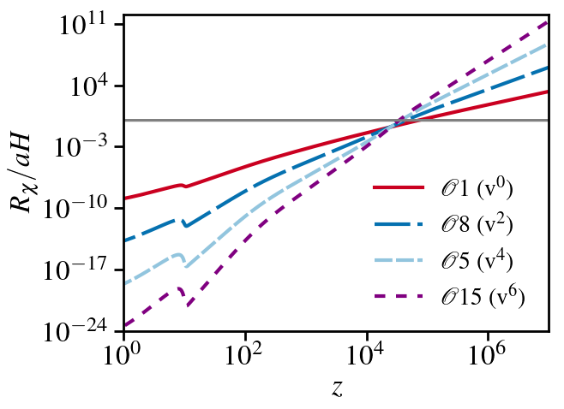
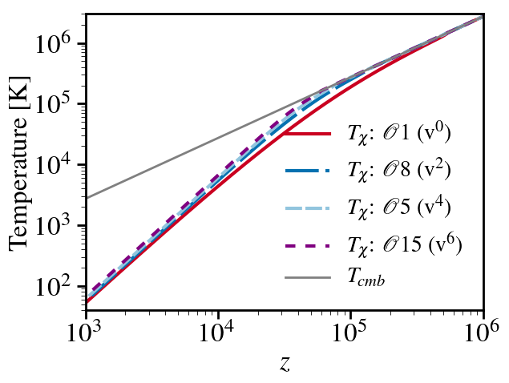
Momentum transfer within EFT
Each operator -> cross section with a different dependence on relative particle velocity, different thermal history:
Boddy and VG (2018)
Notes:
So we chose to think in the framework of the effective theory first developed by…. for characterizing all possible dm signals in dd experiments. The main idea of this approach was to produce a model-independent framework where, instead of considering individual complete dm models, one considers a full set of nonrel ops that couple dm to nucleons, including vel and mom dependent ones… so in that sense going beyond the standard si and sd interactions typically discussed for the purposes of esclusion limits... And these effective interactions that the operators describe provide an empirical categorization of the theory space for low-energy experiments. And then also, this previous work discussed mapping between the EFT observables---coefficients that stand in front of the eff operators---onto constraints on possible underlying complete high energy theories of dm. I will not go

Slide 12
Momentum transfer within EFT
Limits from Planck
Boddy and VG (2018)

Slide 13
Momentum transfer: power-law cross section
Dvorkin+ (2014); Xu+ (2018); Slatyer+ (2018); Boddy, VG+ (2018)
Late-time: n <-2
Early-time: n≥-2
------------------------
n=0: Hard-sphere scattering
n=-2: Electric dipole
n=-4: Coulomb-like (millicharge)
n>0: EFT operators
Complications: including He, making contact with experimental limits.
Boddy, VG+ (2018)

Slide 14
Late-time momentum transfer
Limits on interaction from Planck
Theoretical uncertainty
[bulk-relative velocity]
Boddy, VG+ (2018)
Notes:
ADD here S4 and EDGES

Slide 15
II. 21-cm cosmology
Notes:
Like subir noted after jordi’s talk yesterday…. This is why we look to gaia with hope.

Slide 16
Post-recombination heat transfer: 21-cm H line
Munoz, Kovetz, Ali-Haimoud (2015)
See also: Tashiro, Kadota, Silk (2014)
Scattering transfers heat between fluids
Baryons heat up/cool down
When H spin T tracks baryon T, 21-cm signal is modified
Notes:
We didn’t have data before and this was all in the future, but then edges experiment came along and as soon as they saw any signal, they saw something that looks like this cooling…

Slide 17
Post-recombination heat transfer: EDGES
?
Systematics?
Foregrounds?
Astrophysics?
Cold baryons?
EDGES: Bowman+ (2018) Barkana (2018)
NB: Is it in the sky? → Is it cosmological? → Is it DM?

Slide 18
EDGES vs Planck
From Planck limits on momentum transfer: EDGES cannot be 1% of millicharged DM, but could be 100% with some other v⁻⁴ interaction.
Boddy, VG, + (2018)
Barkana+ (2018)
See also: Berlin+ 2018
Notes:
Many studies looked at millicharge interpretation… ADD REFS

Slide 19
Limits on interacting fraction (v⁻⁴ scattering)
EDGES with < 0.4% in millicharged subcomponent can be consistent with Planck.
Boddy, VG, + (2018)
See also: Kovetz, Poulin, VG, + (2018); Dolgov+ (2013); de Putter+ (2018)
Notes:
ADD here S4 and EDGES

Slide 20
III. Distinguishability of DM signals
Notes:
Like subir noted after jordi’s talk yesterday…. This is why we look to gaia with hope.

Slide 21
How distinct are DM signals really?
Li, VG, + (2018)
Notes:
Like subir noted after jordi’s talk yesterday…. This is why we look to gaia with hope.

Slide 22
How distinct are DM signals really?
CMB lensing breaks degeneracy between:
neutrino mass
DM-baryon scattering
DM annihilation/decay
relativistic DoF
Li, VG, + (2018)
Notes:
Like subir noted after jordi’s talk yesterday…. This is why we look to gaia with hope.

Slide 23
IV. What’s next?
Notes:
Like subir noted after jordi’s talk yesterday…. This is why we look to gaia with hope.

Slide 24
Notes:
SO: say that towards S4 we will build SO, new tels will have same canadian contributiion (mcgill involved too); will have 40 000 in the large and in some small tels, each large can fit ~80000
S4: we now have a few experiments, each with a few thousand detectors; all colabs are coming together to builld a single project which will have half a million detectors on a few tels in south pole and chile, supported by doe and nsf
Add also here a more general thing that this high res cmb will be a powerful way of probing other fundamental physics… to indicate i’ll be involved with all that

Slide 25
Next up: high-resolution CMB observations
Gain ~2 orders of magnitude with CMB-S4.
Li, VG, + (2018)
Notes:
I dont have figures like these for other observables, but they should be

Slide 26
To-do
Understand theoretical uncertainties.
Accurately model nonlinearities in modified cosmologies.
Cross-correlate CMB with LSS for cleaner probe of small scales.
Analyze data from galaxy surveys and other LSS probes [Lyman-α]
Forecasts and figures of merit for upcoming and future surveys.
Ultimately: consistently combine analyses of experimental and observational data to robustly and broadly test DM physics.
Notes:
If there is a debate of whether there is something at a low mass…these results are readily comarable with dd results
Forward modeling of the cmb power spectra is a slow operation (~seconds) so its hard to do inference

Slide 27
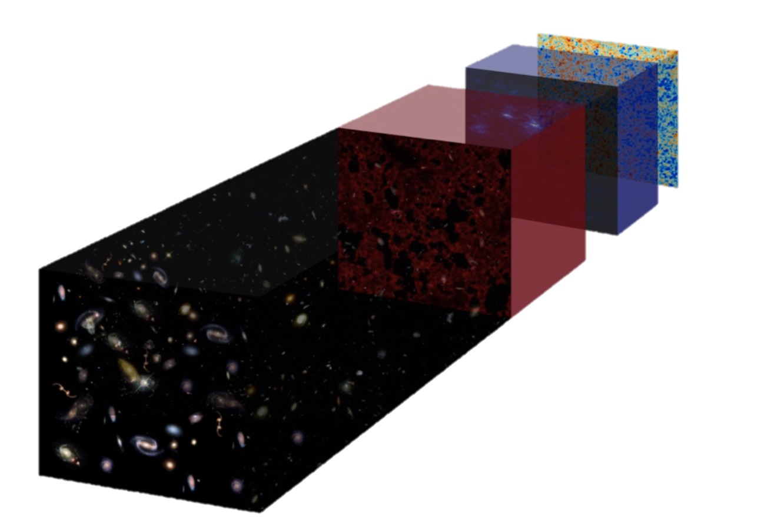
1100
200
30
13
7
Abundance of new observations in near future:
ACT, SPT, SO, CMB S4, DES, LSST, 21-cm cosmology,…
1
0
z
Timeslices by E. Kovetz
Notes:
This is where the lamppost of dd lies, We havent found what we were looking for, we are not done… and as we tile this parameter space of possibillities, and start to get a better taste of the dark sector, we probably are up for surprises...

Slide 28
Summary
Cosmological observables probe vast parameter space (sub-GeV mass and large cross sections).
Abundance of new data on the horizon:
CMB, galaxy surveys, 21-cm experiments, direct detection, LHC, fixed targets, +
Synthesizing information is important to guide searches and will be essential in discovery era.
Notes:
Uptake in recent work on dm interactions with cmb due to availability of high res measurements

Slide 30
Scattering in the early universe
Momentum transfer between baryon-photon fluid and DM affects perturbations and thermal history:
  Rotation in the CMB
Gluscevic and Boddy (2017), Boddy and Gluscevic (2018),
Chen et al (2002), Sigurdson et al (2004); Dvorkin et al (2014); etc.

Slide 31
Late-time scattering: relative bulk velocity
Tseliakhovitch and Hirata (2010)
Problem: non-linear equations
Only for Vbulk << Vthermal

Slide 32
CMB residuals
Boddy and VG (2018)

