Slide 1

Introduction to DM direct detection
WIMPs
1-1000GeV
In our Milky Way
Charling Tao
May 2019,
HUST China

Slide 2
The lab experiment
Concept of keV particle detection with a NaI(Tl) detector and a SiPM LySO detector
Energy calibration with radioactive sources
Energy resolution
Background measurements: rates and identification of background observed
Comparison with measurements underground with a Germanium detector
Design you ideal deector!

Slide 3
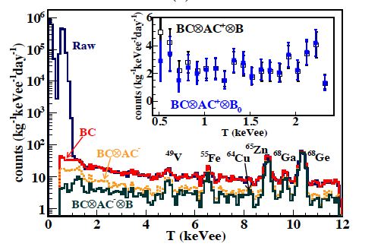
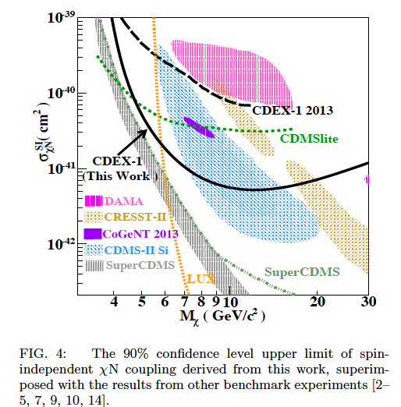
CDEX: reaching best present Ge limits in 5 years!
10 kg Ge crystal
Y.Qian et al., arxiv 1404.4946
Cosmogenics Ge-68 has 270.8 days half-life!

Slide 4
Usual assumptions of DM distribution in our Galaxy
Usual assumptions:
« Simplified Model »of Matter in our Galaxy: SMMG
Used for most comparisons…
But is it the reality? Clumps? Corotation?
?

Slide 5
WIMP searches: Direct detection
Principle : (Goodman and Witten,1985, Drukier and Stodolsky 1984)
Elastic scattering of galactic DM off detector nuclei
Nuclear recoils of a few keV
M_{χ}
M_{N}
Ge, Si, NaI, LXe, …

Slide 6
WIMP searches: Direct detection
Principle : (Goodman and Witten,1985, Drukier and Stodolsky 1984)
Elastic scattering of galactic DM off detector nuclei
Nuclear recoils of a few keV
M_{χ}
M_{N}
Ge, Si, NaI, LXe, …
Exponential recoil energy distribution
10
total event rate
(point like nucleus)
9
event rate per
unit mass
8
7
dR
R_{o}
-E_{R}/E_{o}r
6
=
e
5
dE
R
E_{o}r
recoil
energy
incident
energy
4
3
kinematic factor
= 4M_{χ}M_{N}/(M_{χ}+ M_{N})²
2
1
0
0
1
2
3
4
5
6
7
8
9
10
Rates: Weak interactions or smaller
E/(E₀r)

Slide 7
Differential rate for WIMP elastic scattering

Slide 8
Direct detection: Interaction rates
Depend on several parameters
Astrophysical hypothesis: model of DM in Galaxy (SMMG)
ρ_{DM}, f(v)
Nuclear form factors F² important for heavy nuclei
Detector response Quenching factors, resolutions, thresholds,....
Particle physics Nature of WIMP and cross-sections
σ_{χ}
Coherent Axial
Spin Independent (SI) Spin Dependent (SD)
eg, Dirac ν eg, Majorana ν
Neutralinos are a linear combination of higgsinos and gauginos
with cross-sections < 0.1 σ_{ν}

Slide 9
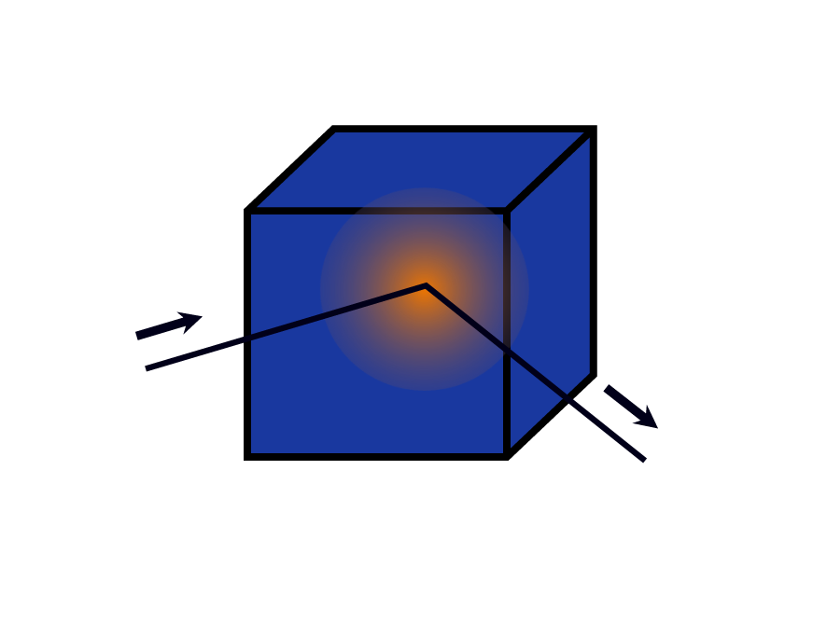
WIMP direct detection with and w/o background rejection
Elastic scattering off nuclei
Liquid Xe
NaI,
CaF₂,
LXe,
…
Ge
Ionization Scintillation
mixed detections
WIMP
target
WIMP
CaWO4,
BGO, …
Ge, Si
Phonons
He 3 detector
Superconducting granules
Freon aerogel
Al₂O₃, LiF, …

Slide 11
Need mountain coverage

Slide 12
Chinese Underground Laboratory in Jinping CJPL
Yue Qian 岳骞, 2009

Slide 13
CDEX: reaching best present Ge limits in 5 years!
10 kg Ge crystal
Y.Qian et al., arxiv 1404.4946
Cosmogenics Ge-68 has 270.8 days half-life!

Slide 14
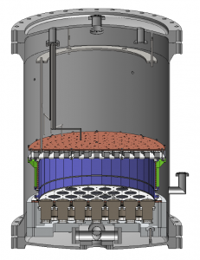
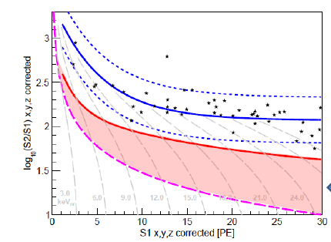

Pandax: inauguration end march 2014 – First results 2016
Ton scale liquid Xenon two phase (liquid and gas) TPC
Project lead by SJTU

Slide 15
WIMP searches Direct detection : a summary
Principle : (Goodman and Witten,1985, Drukier and Stodolsky 1984)
Elastic scattering of galactic DM off detector nuclei
Nuclear recoils of a few keV
M_{χ}
M_{N}
Exponential recoil energy distribution
Ge, Si, NaI, LXe, …
10
total event rate
(point like nucleus)
9
event rate per
unit mass
8
7
dR
R_{o}
-E_{R}/E_{o}r
6
=
e
5
recoil
energy
dE
R
E_{o}r
incident
energy
4
3
kinematic factor
= 4M_{χ}M_{N}/(M_{χ}+ M_{N})²
2
1
0
0
Rates: Weak interactions or smaller
1
2
3
4
5
6
7
8
9
10
E/(E₀r)
Need of signatures for identifying galactic origin
  Annual modulation with MASSIVE detectors
  Directionality : low pressure TPC?
  Dependence on nucleus

Slide 16
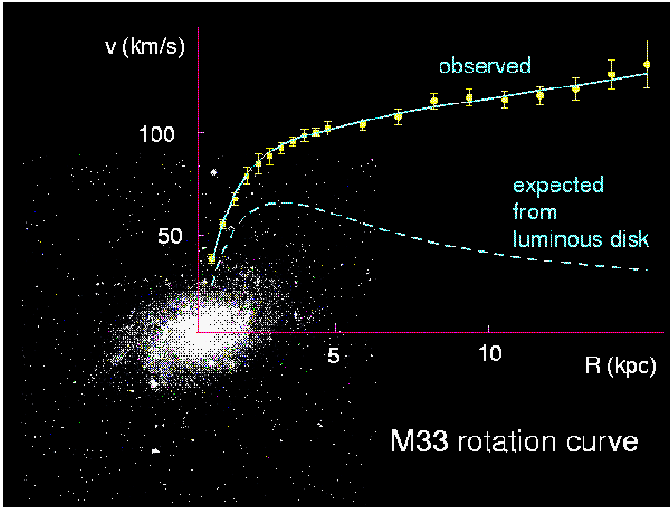
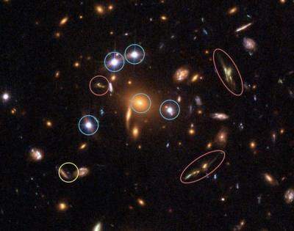
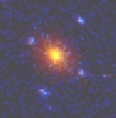

Wealth of Evidence for DM
Galaxy rotation curves (V. Rubin)
Dynamics of galaxy clusters (Zwicky)
Gravitational lensing mass reconstruction
Bullet cluster (Clowe+,2006)

Slide 17
Wealth of evidence for DM
is astrophysical
More Complexity!

Slide 18
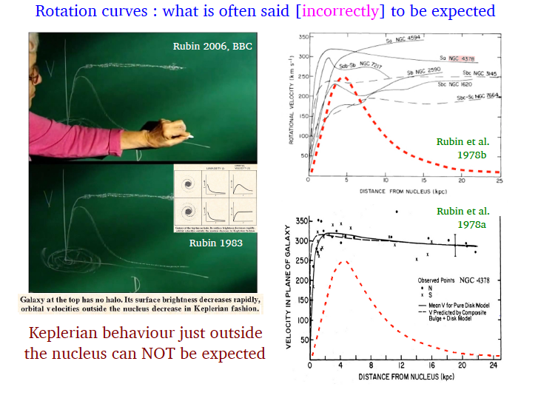
A. Bosma

Slide 19
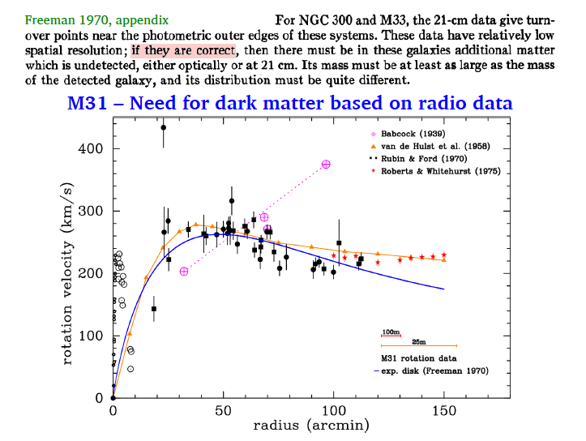
A. Bosma

Slide 20
Wealth of Evidence for DM
Galaxy rotation curves (V. Rubin) Bosma (HI)
Dynamics of galaxy clusters (Zwicky)
Gravitational lensing mass reconstruction
Bullet cluster (Clowe+,2006)

Slide 21
N-Body simulations: CDM
Preferred paradigm: CDM
Most N-Body simulations use stable CDM halos as seed for structures:
structures evolve, merge and cluster
Properties of CDM halos
  cuspy density proﬁles,
  Triaxial halos
  - central density depends on the mass of the halo.

Slide 22
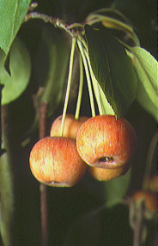
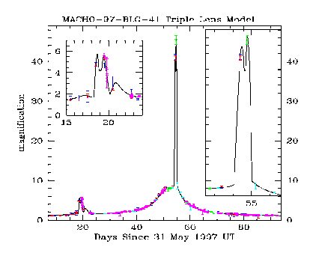
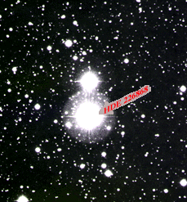
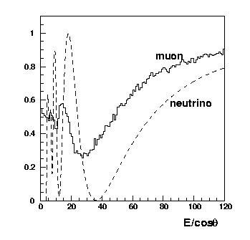
Very different DM candidates
Modified Gravity
dust
Cold Molecular Hydrogen
MACHOs
Black holes
SIMPs
2. WIMPs
Weakly interacting
massive particles
10-1000GeV
1Neutrino
3. Light axions
Exotica

Slide 23
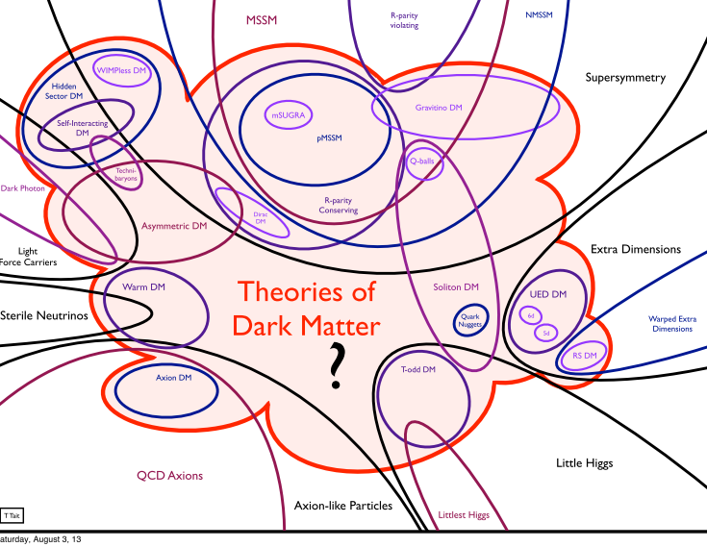
Snowmass
2013

Slide 24
Why WIMPs?
“WIMP”= “Weakly Interacting” Massive Particles
Arguments in the 1980’s:
Need for Cold Dark Matter from Large Scale Structures
Very good Particle physics candidate: SUSY LSP
Weak neutrino size cross sections expected which our detectors Ge, NaI were sensitive to…

Slide 25
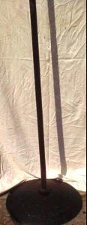
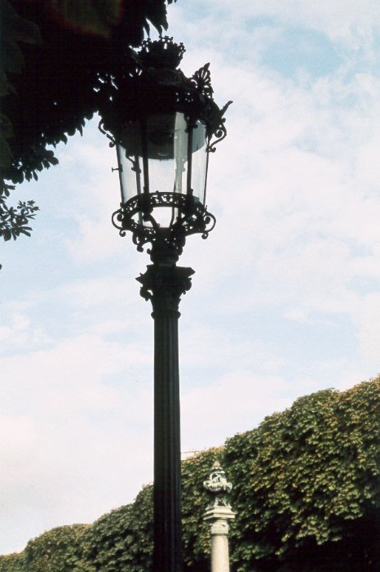
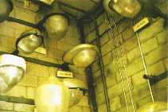
Particle physics preferred DM: SUSY Neutralinos ?
A natural particle physics solution
Stable linear combination gauginos and higgsinos (LSP)
SUSY > 7 parameters MSSM ➔ no predictive power
Experimental Constraints LEP, pp, b-->sγ, + LHC ...
Look everywhere possible !
Direct and Indirect
Detections

Slide 26
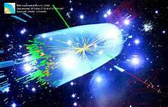
WIMP searches
Direct detection
Indirect detection
χ
M_{χ}
M_{N}
Ge, Si, NaI, LXe, …
ν, γ, p, e⁺
Accelerator particle production,
eg, LHC
+ Galactic, cluster, Universe scales…

