Slide 1


Introduction to Magnets
Attilio Milanese
JUAS
26 Feb. 2018
Thanks to the many colleagues from which I borrowed much material, in particular Davide Tommasini

Slide 2


Slide 3
Introduction
Fundamentals 1: Maxwell and friends
3. Fundamentals 2: harmonics

Slide 4
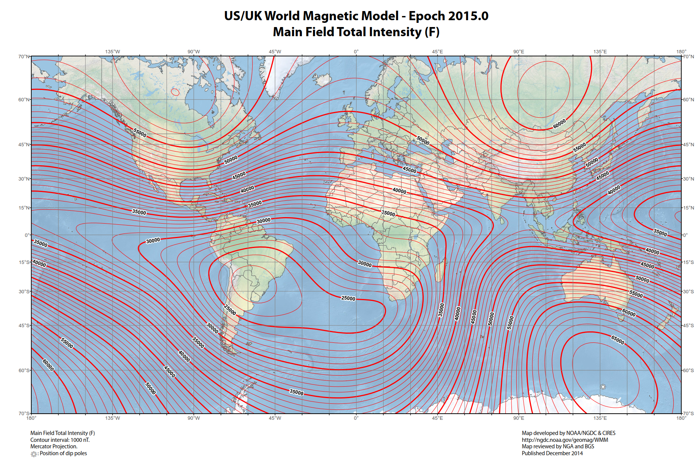
In Archamps, on 26/02/2018, the (estimated) magnetic field is
|B| = 47435 nT = 0.047435 mT = 4.7435·10⁻⁵ T ≈ 0.5 Gauss
Notes:
The Earth’s field at our latitudes is about 0.5 Gauss, that is, 5·10⁻⁵ T.
The value above was computed using the World Magnetic Model (WMM) and the latitude / longitude / elevation of Archamps. The date also matters, because the Earth’s magnetic field changes (in direction and amplitude) with time.
You can check that out at www.ngdc.noaa.gov/geomag/WMM.

Slide 5
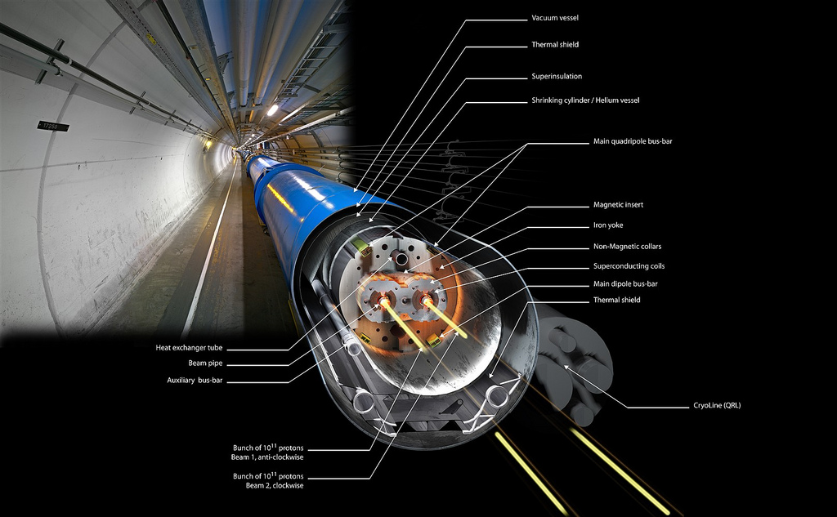
This is a main dipole of the LHC at CERN: 8.3 T × 14.3 m
Notes:
The LHC main dipoles (MB = Main Bending) are superconducting magnets, built in the 2000’s.
The coils are wound in Nb-Ti and they are cooled by superfluid helium at 1.9 K.
At the nominal current of 11.8 kA, the dipole field is 8.3 T, in a 56 mm diameter circular aperture.
Each dipole bends the beam by 360 / 1232 = 0.29 deg.
They are slowly ramped (about 20 min.) and then used in dc mode, as the LHC operates as a collider.
These magnets are the result of many years of R&D and they are basically at the limit of what can be achieved with Nb-Ti superconducting technology.
Note as of Feb. 2018: LHC ran in 2017 at 6.5 TeV, corresponding to 7.71 T; out of the 8 sectors, 2 have already been “trained” – with quenches – up to about 8.1 T.

Slide 6
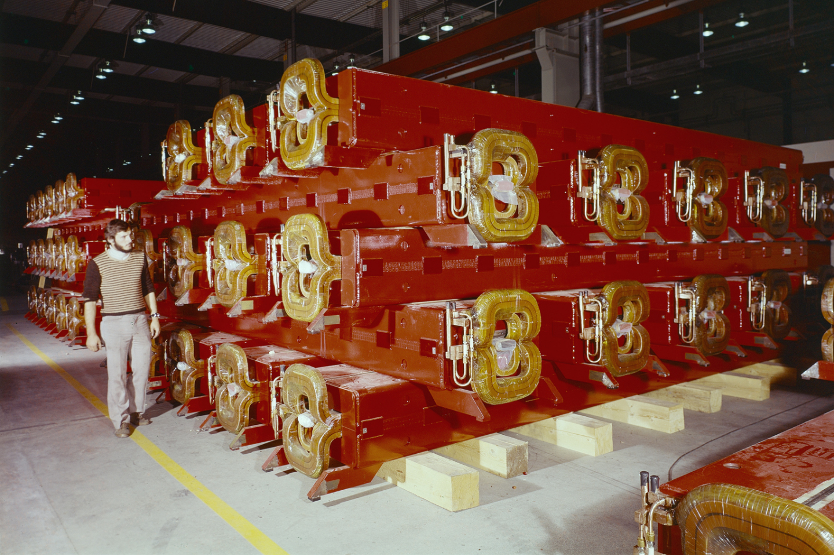
These are main dipoles of the SPS at CERN: 2.0 T × 6.3 m
Notes:
The SPS main dipoles are resistive magnets, with coils in copper. Demineralized water flows in the conductor to remove the Joule heating.
At the peak current of 5.8 kA, they provide a dipole field of 2.0 T in a rectangular aperture. Two types of magnets with a smaller (39 mm, MBA) and larger (52 mm, MBB) vertical aperture are used.
Each dipole bends the beam by 360 / 744 = 0.48 deg.
They now work in a cycled mode and they can be ramped in a few seconds.
In the 1970s, also a superconducting option was studied (but then abandoned) for the SPS.
The main SPS power converters can give a peak (active) power of ≈ 100 MW, which is drawn directly from the 400 kV lines. The average (rms) power depends on the duty cycle, though it is usually ≈ 30 MW.
The photo was taken in 1974.

Slide 7
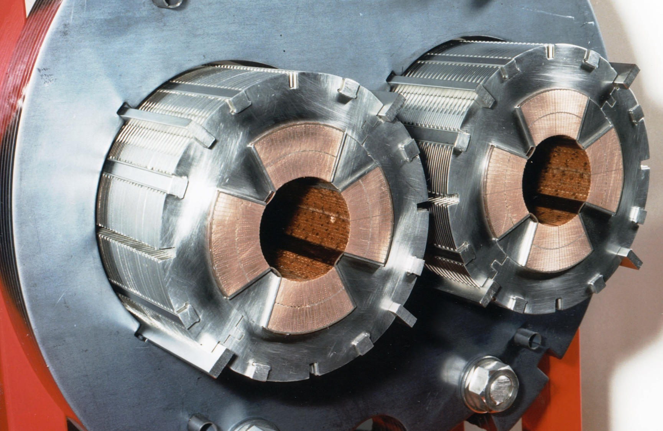
This is a cross section of a main quadrupole of the LHC at CERN: 223 T/m × 3.2 m
Notes:
The LHC main quadrupoles (MQ) are superconducting magnets.
The coils are wound in Nb-Ti and they are cooled by superfluid helium at 1.9 K, like the LHC dipoles.
At the nominal current of 11.8 kA, they provide a gradient of 223 T/m. Considering their aperture of 56 mm diameter, this corresponds to a pole tip field of 6.2 T ( = 223 × 0.028). The peak field in the conductor is about 10% higher, at 6.8 T.

Slide 8
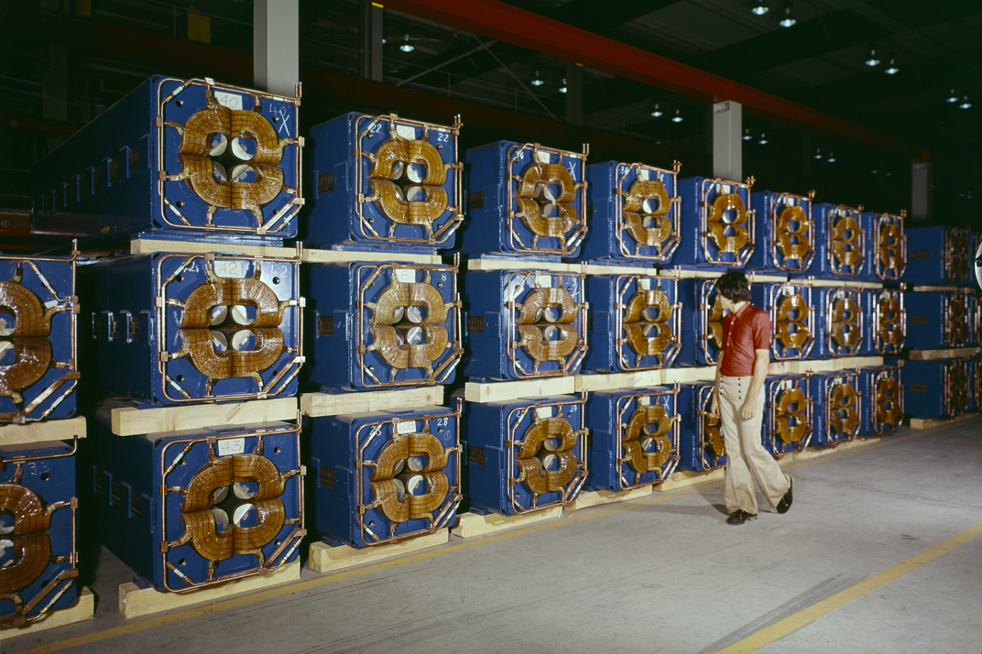
These are main quadrupoles of the SPS at CERN: 22 T/m × 3.2 m
Notes:
The SPS main quadrupoles are resistive magnets, with coils in copper.
Demineralized water flows in the conductor to remove the Joule heating, as for the SPS dipoles.
At the peak current of 2.1 kA, the quadrupole gradient is 22 T/m in a 88 mm diameter circular aperture. The pole tip field is then 1.0 T ( = 22 × 0.044).

Slide 9
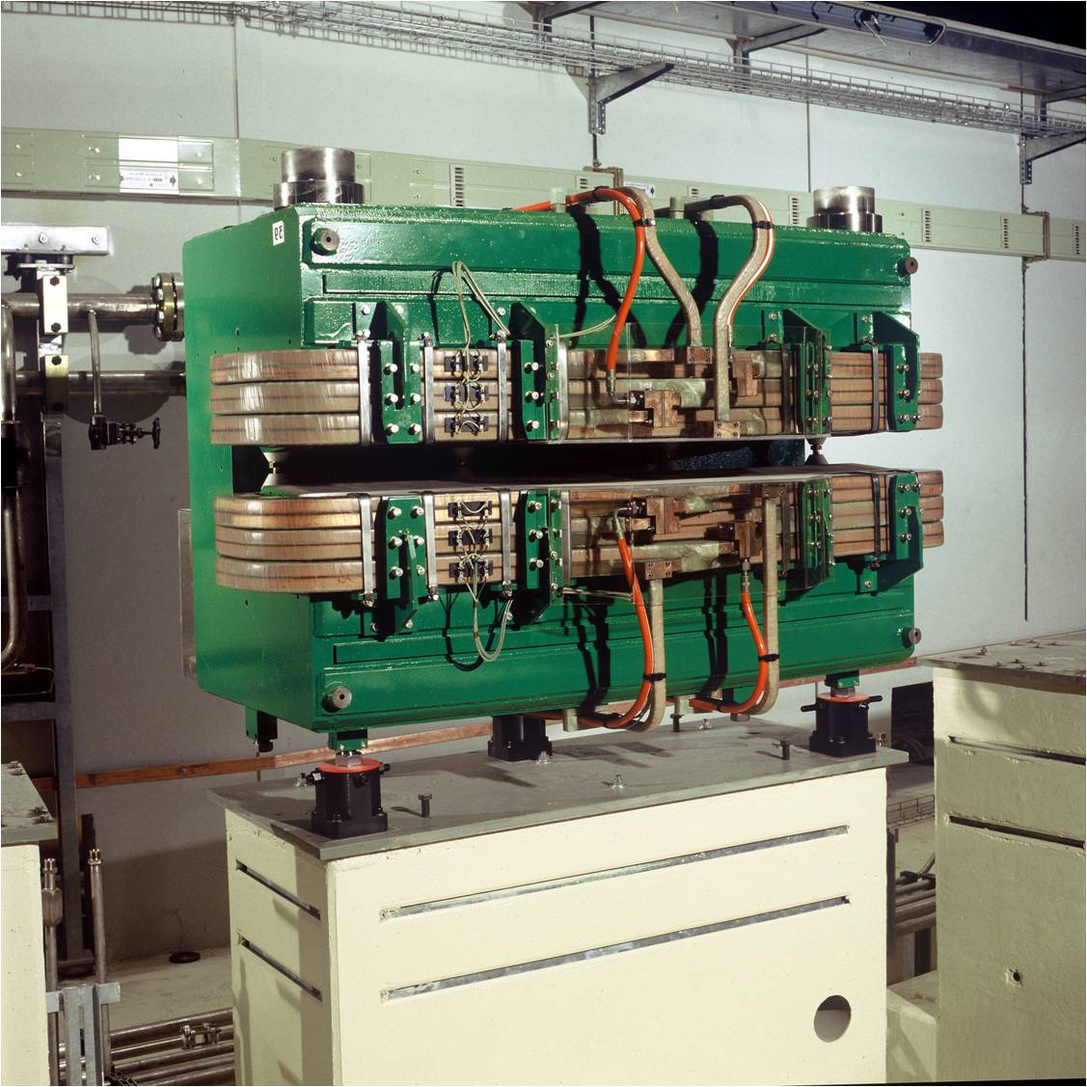
This is a combined function bending magnet of the ELETTRA light source
Notes:
This is an example of a combined function (dipole + quadrupole) bending magnet, found for example in third generation synchrotron light sources. The technology is the same as that for the SPS dipoles shown before, just with a different design of the ferromagnetic yoke.
In ELETTRA, there are 24 such magnets. At the nominal current of 1420 A, the dipole field is 1.2 T, together with a quadrupole gradient of 2.9 T/m. The vertical gap is 70 mm; the bending radius of the machine is 5.5 m.
These magnets were built in the 1990s.

Slide 10
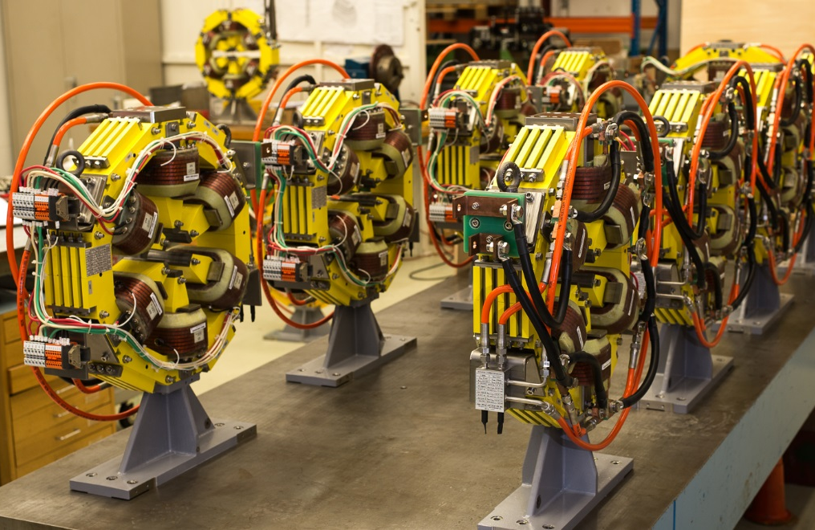
These are sextupoles (with embedded correctors) of the main ring of the SESAME light source
Notes:
This is an example of a common design found in synchrotron light sources, where the (short) sextupoles have additional windings so that they can be used also as corrector magnets.
In this case, the correctors are a horizontal / vertical dipole, which can provide up to 0.5 mrad kick at 2.5 GeV – and a skew quadrupole.

Slide 11
We can classify magnets based on their geometry (that is, what they do to the beam)
dipole
solenoid
quadrupole
combined function bending
sextupole
corrector
octupole
skew magnet
kicker / septum
undulator / wiggler
Notes:
In brief:
- dipoles bend the beam, in fact they are also called bending magnets
- quadrupoles focus the beam
These are usually the main magnets in synchrotrons and transfer lines.
A combined function bending magnet is a superposition of a dipole and a quadrupole: it bends and focuses the beam at the same time. They are less popular now with respect to the early days of synchrotrons; still, they are used in some modern machines, for ex. light sources. There are examples of both resistive and superconducting combined function bending magnets.

Slide 12
We can also classify magnets based on their technology
electromagnet
permanent magnet
iron dominated
coil dominated
normal conducting (resistive)
superconducting
static
cycled / ramped slow pulsed
fast pulsed
Notes:
In electromagnets the field is produced by electrical currents going through the windings. In permanent magnets, on the other hand, the field is produced by hard magnetic material, such as NdFeB or SmCo.
Iron dominated magnets use a yoke (usually in electrical steel or iron) to guide, shape and reinforce the field; the position of the coils (or permanent magnets) is of minor importance for the strength and homogeneity of the field. Coil dominated magnets use the flux directly generated by the electric current flowing in the windings to shape the field; the position of the iron yoke (if any) is of minor importance for the strength and homogeneity of the field.
Normal conducting (or resistive) magnets have resistive coils, in copper or aluminum, and they are operated around room temperature. Joule heating has to be taken into consideration; when air cooling (natural convection) is not enough, typically a forced flow of demineralized water is added.
Superconducting magnets have superconducting coils, with no Joule heating. The known technical superconductors need to be cooled at cryogenic temperatures to work.
The mode of operation can be static (dc, ex. main magnets in a collider or synchrotron light source), cycled / ramped / slow pulsed (ex. main magnets in a synchrotron for hadron therapy) or fast pulsed (ex. kickers).
In some cases, there might be some hybrids, e.g. an electromagnet with some permanent magnet.

Slide 13
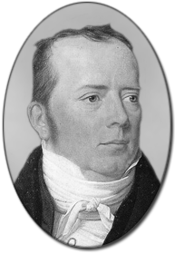
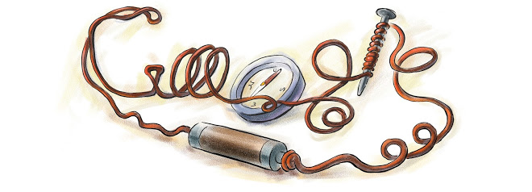
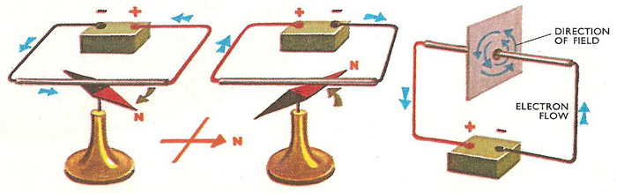
Ørsted showed in 1820 that electricity and magnetism were somehow related
Notes:
Hans Christian Ørsted showed that closing an electric circuit induces an effect on a compass needle. The flux lines are concentric circuits around the wire.
You can find two nice animations on the internet:
- by Museo Galileo, www.youtube.com/watch?v=-w-1-4Xnjuw
- by the National MagLab, www.youtube.com/watch?v=RwilgsQ9xaM

Slide 14
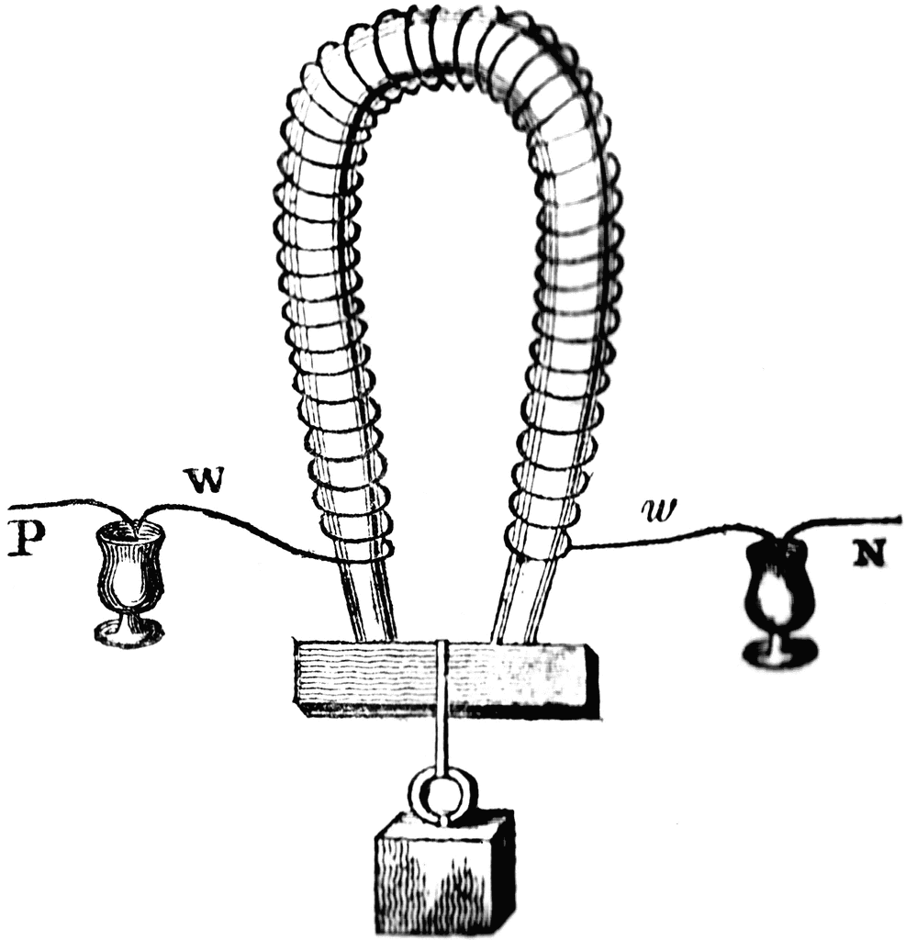
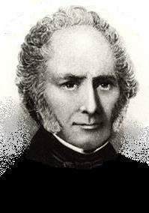
The first electromagnet was built in 1824 by Sturgeon
Notes:
In 1824 William Sturgeon found that having iron inside the coil greatly increased the resulting magnetic field. Sturgeon also bent the iron core into a U-shape to bring the poles closer together, thus concentrating the magnetic field lines.
The electromagnet was made of 18 turns of bare copper wire (insulated wire had not yet been invented), with mercury cups acting as switches.
He displayed its power by lifting nine pounds (4.1 kg) with a seven ounce (200 g) piece of iron wrapped with wire through which a current from a single battery was sent.
sources:
Wikipedia
http://physics.kenyon.edu/EarlyApparatus/Electricity/Electromagnet/Electromagnet.html
http://etc.usf.edu/clipart/galleries/380-magnetism (for this and other cliparts)

Slide 15
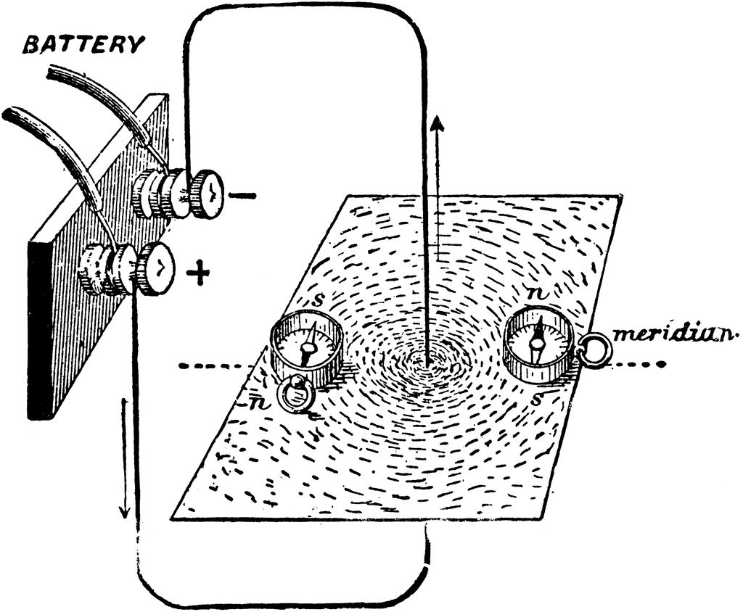
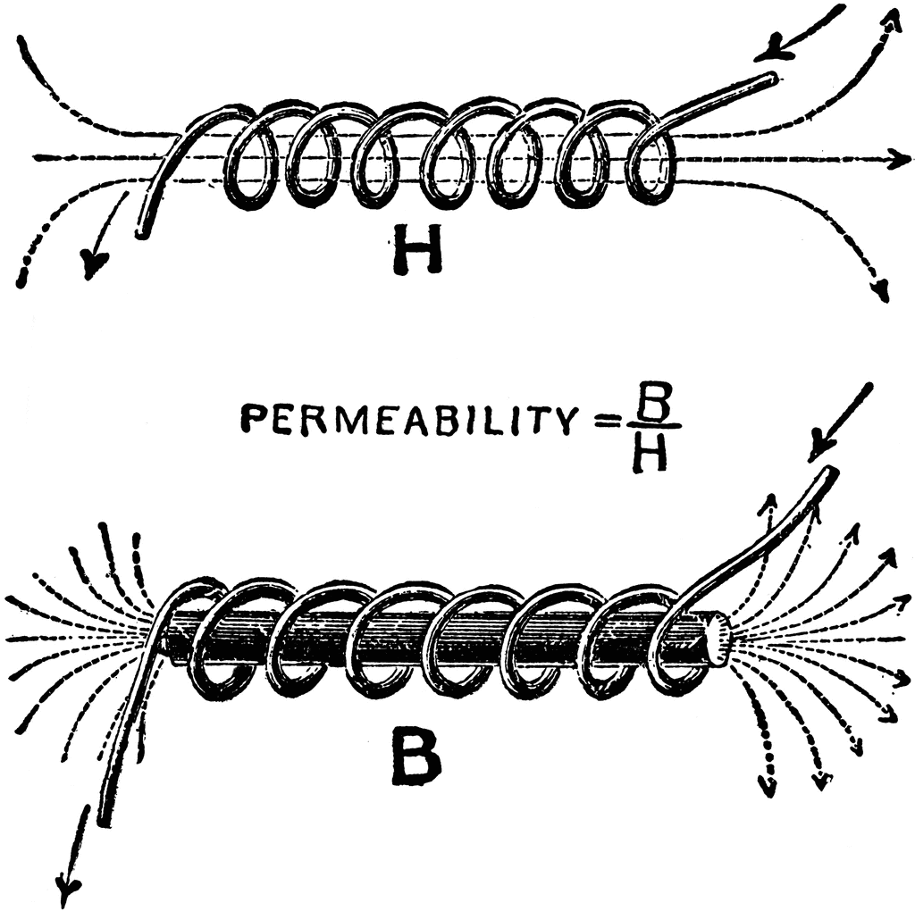
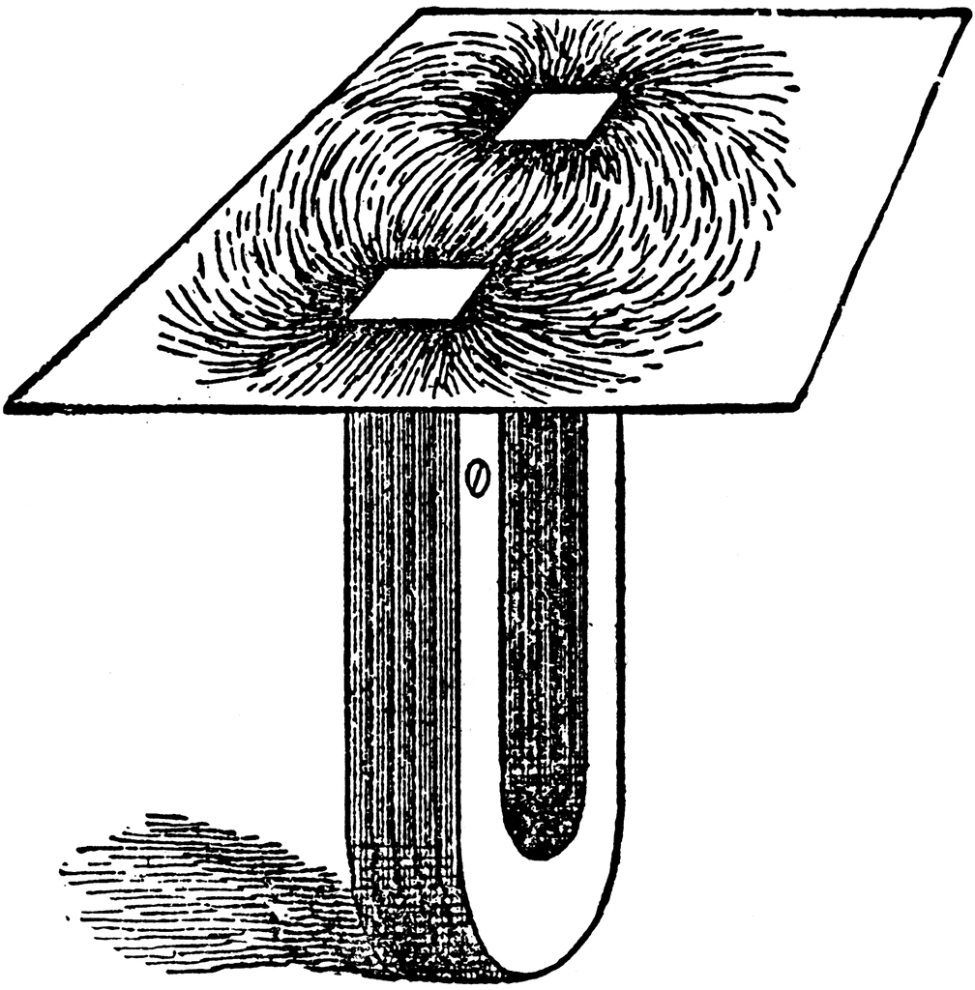
Our magnets work on a few basic principles (steady state only)
an electrical current induces a magnetic effect
some materials (e.g. iron) greatly enhance these effects
some other materials produce these effects even without electrical currents
Notes:
The experiments of Ørsted and Sturgeon show the basic principles on which our magnets work, at least in static conditions.
Macroscopically also the most modern superconducting magnets work on the first two principles (an electrical current induces a field and iron reinforces it) – just the material of the coil itself has no electrical resistance.

Slide 16
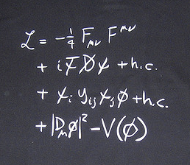
So, how do we properly describe all this?

Slide 17
Introduction
Fundamentals 1: Maxwell and friends
3. Fundamentals 2: harmonics

Slide 18
We need to agree on some nomenclature first
B magnetic field T (Tesla)
B field
magnetic flux density
magnetic induction
H H field A/m (Ampere/m)
magnetic field strength
magnetic field
μ₀ permeability of vacuum 4π·10⁻⁷ H/m (Henry/m)
μ_{r} relative permeability dimensionless
μ permeability, μ = μ₀μ_{r} H/m
Notes:
The jargon used in particle accelerator magnets is somewhat different from that used in classical electromagnetism.
B is usually referred to as the magnetic field and it is measured in Tesla [T], or Weber/m² [Wb/m²]. This is the field seen by the beam, through Lorentz force.
H is mostly used when dealing with iron dominated magnets, in particular to compute the magnetomotive force, produced in a ferromagnetic material by the electrical current in the coils. H is measured in Ampere/m [A/m] and usually referred to simply as the H field, or as the magnetic field strength, although the latter can be misleading in this context.
Old units for B are Gauss [G] and kiloGauss [kG]: 10000 G = 1 T = 10 kG.
An old unit for H is Oersted (Oe): 1 Oe = 1000/(4π) A/m

Slide 19


What is B? For us, it is defined by its effect on moving charged particles (or electrical currents), through Lorentz force
$$\vec{F_{m}}=q\left(\vec{v}×\vec{B}\right)$$
for charged beams
$$\vec{F_{m}}=I\vec{ℓ}×\vec{B}$$
for conductors
Notes:
For us B is defined through its effect on moving charged particles (or electrical currents), where:
- F_{m} is the magnetic force
- q the electrical charge
- v the speed
- I the current
- $ℓ$ the (oriented) length
Lorentz force is the main link between electromagnetism and mechanics.
Indeed also the definition of T (Tesla) is built upon this expression: a particle, carrying a charge of 1 Coulomb, and moving perpendicularly through a magnetic field of 1 Tesla, at a speed of 1 m/s, experiences a force with magnitude 1 Newton.
The force acting on a beam of charged particles exploits the magnetic field because of the (huge) leverage factor of the velocity v, which is often close to the speed of light in our accelerators.

Slide 20
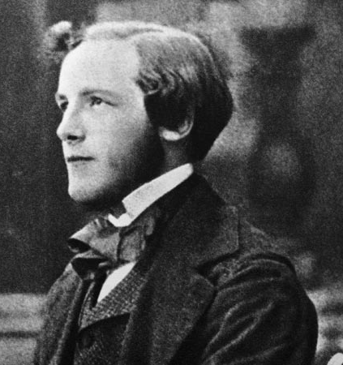
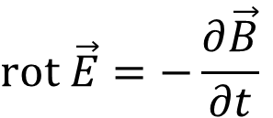



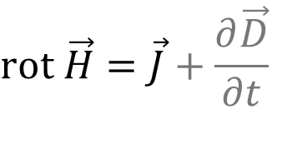

Maxwell describes it all using vector calculus
$$\text{div} \vec{D}=ρ$$
Gauss law (electricity)
$$\text{div} \vec{B}=0$$
Gauss law (magnetism)
$$\text{rot} \vec{E}=−\frac{∂\vec{B}}{∂t}$$
Faraday-Lenz law
$$\text{rot} \vec{H}=\vec{J}+\frac{∂\vec{D}}{∂t}$$
Ampère law (with correction)
$$\vec{D}=ε_{0}ε_{r}\vec{E}$$
constitutive laws
for (simple) materials
$$\vec{B}=μ_{0}μ_{r}\vec{H}$$
Notes:
In addition to the symbols already defined, we have:
- J as the (free) current density (A/m²)
- E as the electric field (V/m)
- D as the electric displacement field (C/m²)
- ρ as the (free) electric charge density (C/m³)
- ε as the electric permittivity (F/m)
- t as the time
The term with curl of E – which we will not comment more in this introduction – is connected to eddy currents: a variation of B with time induces an electric field. For magnets, this is sometimes annoying (for example, long time constants in solid yoke magnets) but it’s a fundamental principle exploited in magnetic measurements (ex. rotating coil).
The picture shows James Clerk Maxwell as a young man – he was around 30 when he first published these equations.

Slide 21



Let’s have a closer look at the 3 equations that describe magnetostatics
(1)
$$\text{div} \vec{B}=0$$
always holds
(2)
$$\text{rot} \vec{H}=\vec{J}$$
holds for magnetostatics
(3)
$$\vec{B}=μ_{0}μ_{r}\vec{H}$$
holds for linear materials
Notes:
In magnetostatics, as there are no time dependent fields, the equations for the electric and the magnetic parts become uncoupled.
We give these equations a number as we will use them much during this introduction.

Slide 22
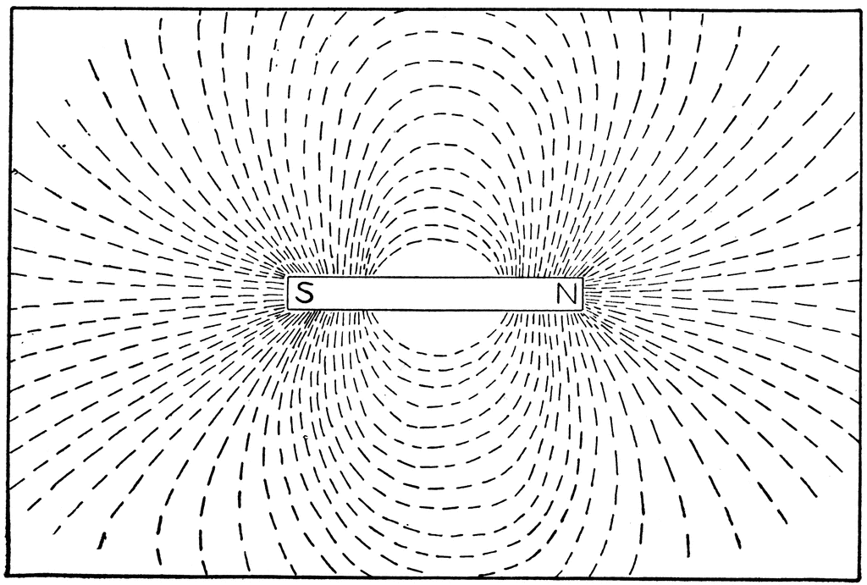
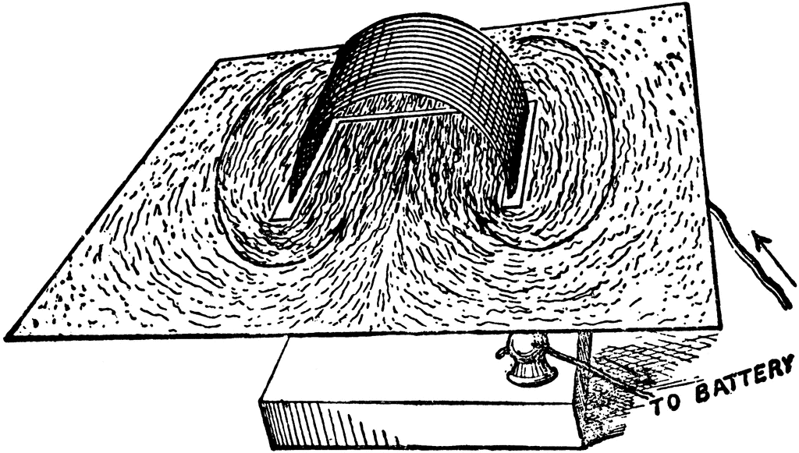
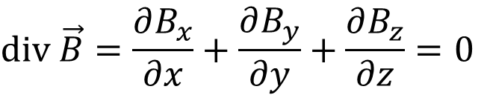
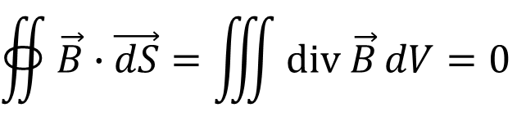
Eq. 1: the magnetic flux tubes wrap around, with neither sources nor sinks
$$\text{div} \vec{B}=\frac{∂B_{x}}{∂x}+\frac{∂B_{y}}{∂y}+\frac{∂B_{z}}{∂z}=0$$
$$∯{\vec{B}∙\vec{dS}}=\iiint{\text{div} \vec{B}}dV=0$$
divergence / Gauss theorem
Notes:
The B field is divergence free, or solenoidal.
The total flux entering a bounded region equals the total flux exiting the same region (by Gauss theorem): there are neither sources nor wells.
The surface integral is to be carried out on a closed boundary.

Slide 23
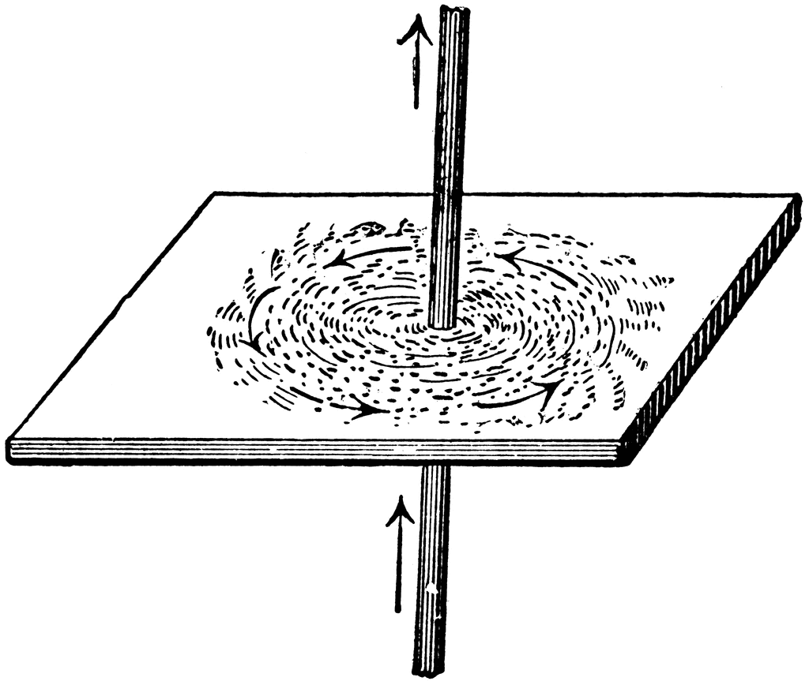
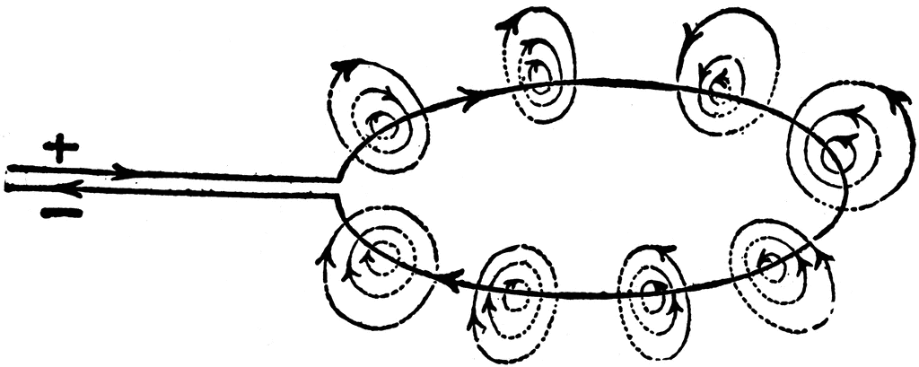
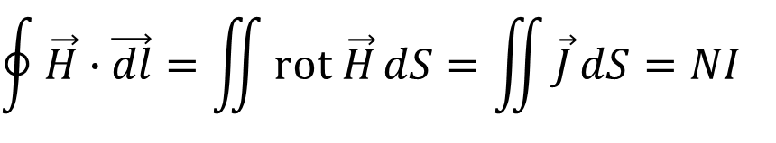
Eq. 2: electrical currents generate (“stir up”) a magnetic field
$$rot \vec{H}=\left(\frac{∂B_{z}}{∂y}−\frac{∂B_{y}}{∂z}\right)\vec{i_{x}}+\left(\frac{∂B_{x}}{∂z}−\frac{∂B_{z}}{∂x}\right)\vec{i_{y}}+\left(\frac{∂B_{y}}{∂x}−\frac{∂B_{x}}{∂y}\right)\vec{i_{z}}=\vec{J}$$
$$\oint{\vec{H}∙\vec{dl}}=\iint{rot \vec{H}}dS=\iint{\vec{J}}dS=NI$$
Kelvin–Stokes theorem
Notes:
The curl of the H field is generated by currents.
Applying Stokes’ theorem, the integral of H around a closed loop equals the total current passing through a surface that has that loop as a boundary. This is also known as Ampere’s law.
NI – i.e., the sum of concatenated currents – is generally called Ampere-turns.

Slide 24
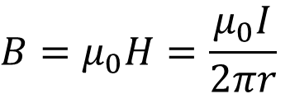
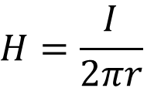
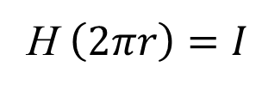

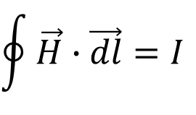
From Eqs. 2 and 3 we can derive Biot-Savart law
$$\oint{\vec{H}∙\vec{dl}}=I$$
I
H $\left(2πr\right)=I$
r
$$H=\frac{I}{2πr}$$
$$\vec{B}=μ_{0}\vec{H}$$
$$B=μ_{0}H=\frac{μ_{0}I}{2πr}$$
Notes:
Biot-Savart law can be derived from Eqs. 2 and 3, adding some symmetry considerations and the fact that μ_{r} = 1.

Slide 25



Eq. 3 relates the effect (B) to the cause (H)
In a linear material
$$\vec{H}$$
produces
$$\vec{B}$$
according to
$$\vec{B}=μ_{0}μ_{r}\vec{H}$$
Notes:
In a way, we can see H as the cause and B as the effect. H is generated by electric currents B in turns than interacts with the beam.
The relationship between B and H depends on the material.
For simple linear materials, there is just a proportionality between B and H, through the permeability μ. Sticking to linear materials, more in general μ is a second rank tensor, that is, it has different values along different axes, to describe anisotropy.
For more complex materials (for ex., iron) the relation between B and H is more complex, it can be a function of the field level (ex. saturation) or even of the cycle leading to that H (ex. hysteresis).

Slide 26
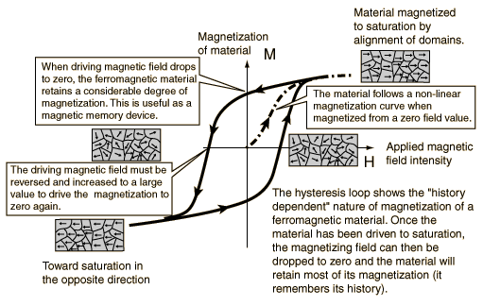

In a nonlinear material (with for ex. saturation and hysteresis), the constitutive law becomes more complex
$$\vec{B}=μ_{0}\vec{f}\left(\vec{H}\right)$$
B
H
Notes:
This hysteresis plot is taken from http://hyperphysics.phy-astr.gsu.edu.
You can look up in any (good) textbook the microscopic mechanism underlying the hysteresis loop, and the definition of remanence and coercitivity. Also, often another quantity is introduced, the magnetization M.

Slide 27
In most of our simulations we use a simple BH model for the material: this is a typical curve for an electrical steel
Notes:
For our simulations, most often we use the so-called “virgin curve” that goes through the origin, without any hysteretic effect.
As an example, we show here a typical curve for a not-oriented low Si electrical steel, M1200-100 A.
The saturation knee can vary a little depending on the grade of the material used. This explains why in practice using iron dominated resistive magnets above 2 T is not viable.

Slide 28
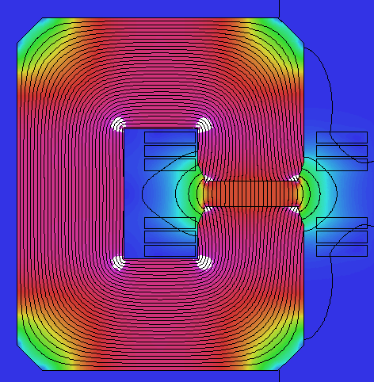
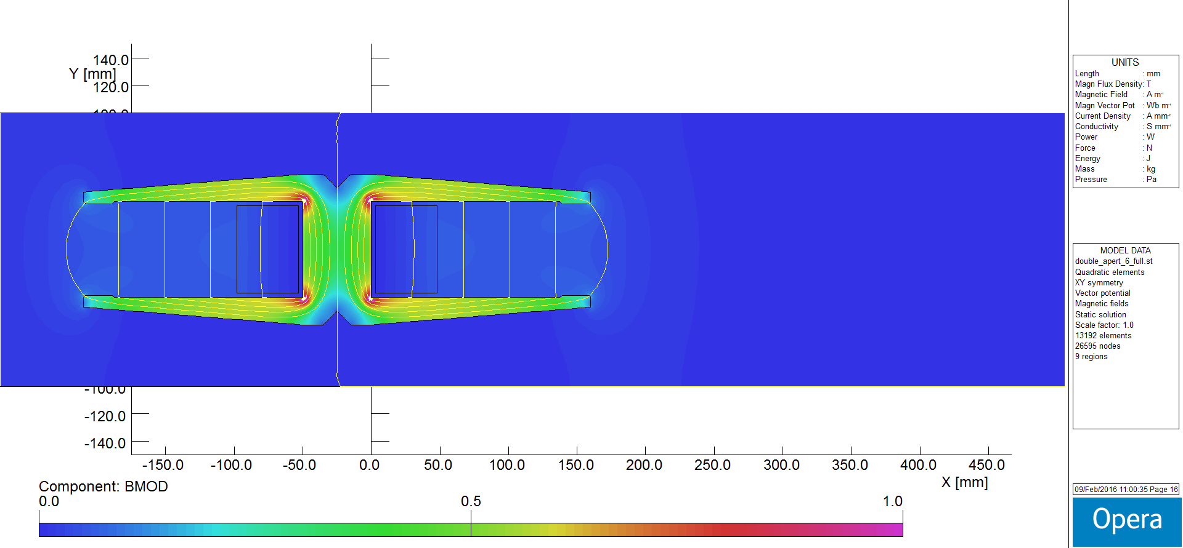
Now, why do the flux lines come out perpendicular to the iron?
0
0.8 T
1.6 T
Notes:
We plot as an example the cross section of the HIE-ISOLDE dipole, a CERN magnet which is representative of a typical resistive bending magnet.
We see that in the aperture, at the interface between iron and air, the flux lines come out (basically) perpendicular to the iron. Why?

Slide 29
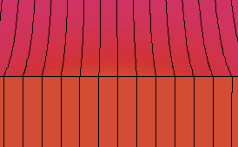

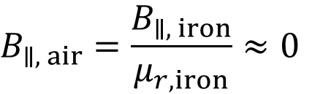



Because they obey to Maxwell!
iron
$$μ_{r}≫1$$
air
$$μ_{r}=1$$
$$H_{∥, air}=H_{∥, iron}$$
$$B_{∥, air}=\frac{B_{∥, iron}}{μ_{r,iron}}≈0$$
$$B_{⊥, air}=B_{⊥, iron}$$
Notes:
The first equation, about the continuity of the parallel component of H, can be derived from
over the thin rectangle shown in the picture; the contribution in the short sides is negligible, thus the one along the long sides has to be the same, so that the curl of H is 0.
The second equation follows from the first one by applying the constitutive equation in air and iron:
The third equation, about the continuity of the perpendicular component of B, is a consequence of the field being divergence free:
Since this is in 2D, the z component of the field is 0.
There is a discontinuity of |B| at the boundary.
$$\oint{\vec{H}∙\vec{dl}}=\iint{\vec{J}}dS=0$$
$$\vec{B}=μ_{0}μ_{r}\vec{H}$$
$$\frac{B_{∥, air}}{μ_{0}}=\frac{B_{∥, iron}}{μ_{0}μ_{r,iron}}$$
$$∯{\vec{B}∙\vec{dS}}=0$$

Slide 30
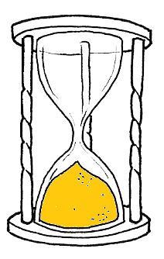

This is an “advanced introduction”, so let’s introduce the vector potential (3D)
$$\vec{B}=\text{rot} \vec{A}$$
always holds
Notes:
Another power concept is that of vector potential A, with units of Tm.
If we know A, then we can obtain B by applying the curl (i.e., with the proper derivatives).
On the other hand, if we know B, we can define A by integration, up to a constant, or better a “curl free” term. The choice of this term is referred to as gauge choice. That doesn’t really matter, as it’s transparent: when we apply the curl to compute B, it doesn’t contribute to it. In magnetostatics, a convenient choice is to pick this term so that the div of A vanishes.
The vector potential A is often used in simulation codes, both in 2D and 3D.
If you’re interested, you can have a look at Feynman’s insight on the topic, including a description of how the A field looks like, and about it being a mere mathematical construction or something “real”.
www.feynmanlectures.caltech.edu, Vol. II, chap. 15
There is also a magnetic scalar potential, which is particularly handy in 2D to figure out the ideal pole profiles for iron dominated magnets.

Slide 31




In magnetostatics, we can combine Eqs. 1 to 3 in a more compact form (3D)
$$\text{div} \vec{B}=0$$
holds for magnetostatics and in air
$$\text{rot} \vec{H}=0$$
$$∇^{2}\vec{A}=\vec{0}$$
$$\vec{B}=μ_{0}\vec{H}$$
Notes:
The first condition, that is B is divergence free, is automatically satisfied, as the div of a curl (of A in this case) is 0: just write out the components to prove that.
Then we can substitute H with B in the second condition:
This is equal to 0 – thus satisfying the second condition, if we choose A with a gauge so that its divergence is 0, which is possible.
The “condensed” equation on the right is Laplace equation: it says that the vector Laplacian of A is equal to 0 in air, that is
$$\frac{∂^{2}A_{x}}{∂x^{2}}+\frac{∂^{2}A_{x}}{∂y^{2}}+\frac{∂^{2}A_{x}}{∂z^{2}}=0$$
and so on for the other components.
$$\text{rot} \vec{H}\text{=}\text{rot}\left(\frac{\vec{B}}{μ_{0}}\right)=\frac{1}{μ_{0}}\text{rot} \left(\text{rot} \vec{A}\right)=\frac{1}{μ_{0}}\left[grad\left(div\vec{A}\right)−∇^{2}\vec{A}\right]$$

Slide 32

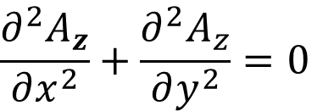
In 2D this becomes a scalar Laplace equation
$$∇^{2}A_{z}=0$$
holds for magnetostatics and in air
$$\frac{∂^{2}A_{z}}{∂x^{2}}+\frac{∂^{2}A_{z}}{∂y^{2}}=0$$
Notes:
If we stay in 2D – say in the (x,y) plane – then it means that the z component of B is 0. It turns out that only the z component of A matters: just work out the curl of B and set to 0 all the partial derivatives in z.
Now Laplace equation becomes a scalar equation. This fully describes our magnetostatic problem in 2D, in a region of space without electrical currents and in air (that is, in a material with relative permeability equal to 1).

Slide 33
Introduction
Fundamentals 1: Maxwell and friends
3. Fundamentals 2: harmonics

Slide 34
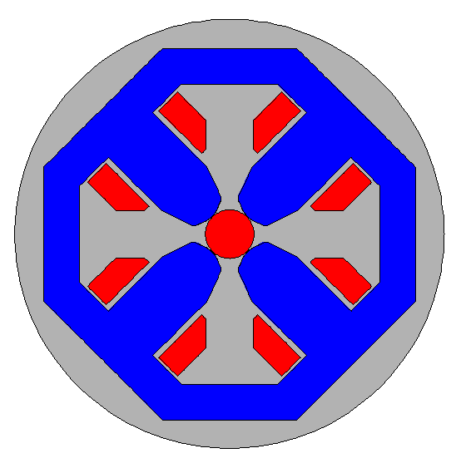
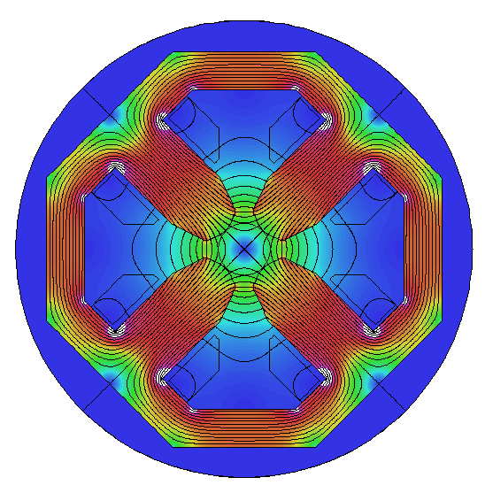
We look at the 2D first: how can we conveniently describe the field in the aperture, for ex. in a quadrupole?
SESAME quadrupole B_{pole} = 0.6 T
0
0.8 T
1.6 T
Notes:
So, Maxwell describes it all… but, is there a convenient way to characterize the field in the aperture of our magnets?
We can look at the 2D first.
For this quadrupole, for example, we would need to know at every point the two components of B. Can we fit these to some functions? What do our colleagues from beam dynamics like to handle?

Slide 35
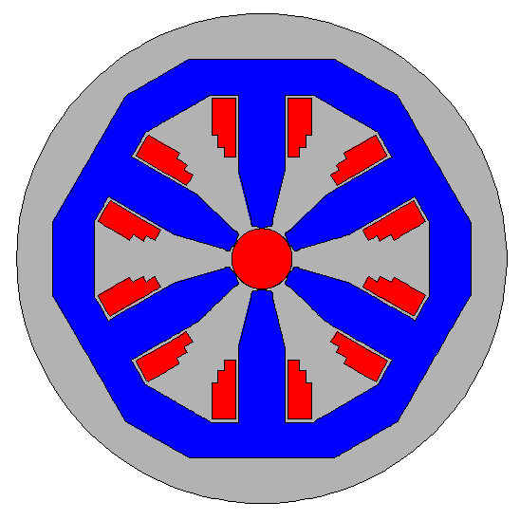
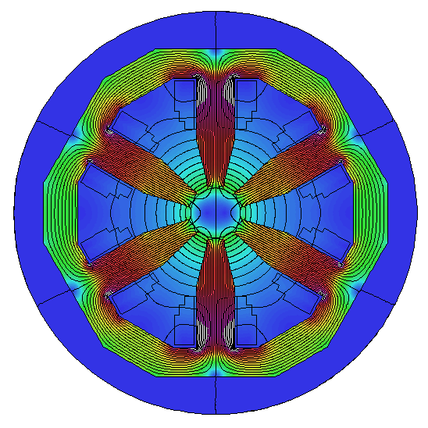
And in another resistive magnet, with a different configuration?
SESAME sextupole
+ vertical dipole corrector
0
0.5 T
1.0 T
Notes:
Ideally, we would want a set of functions to be used in quite a general way, for example also for a sextupole with combined correctors.

Slide 36
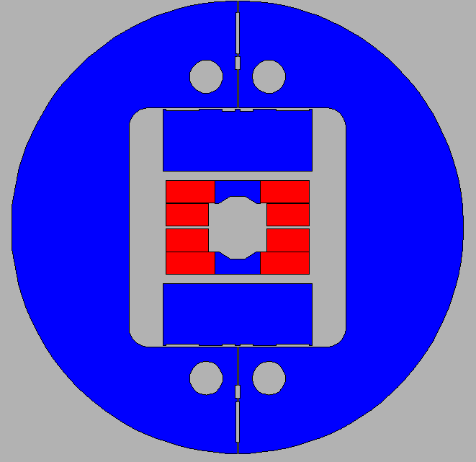
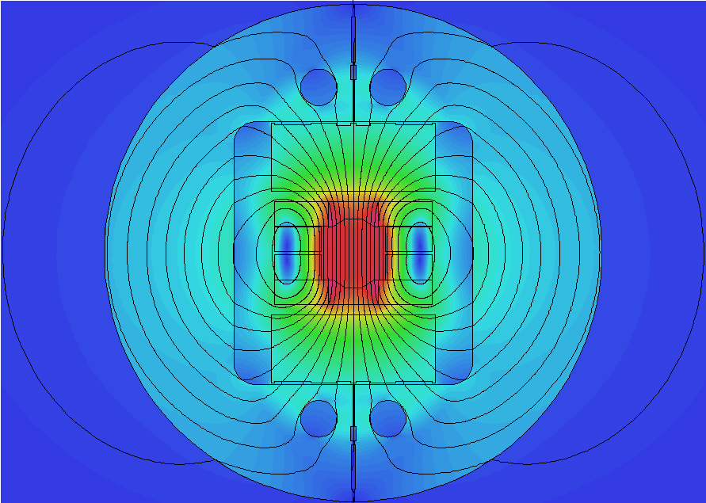
Can the same formalism also describe the field in the aperture of a superconducting dipole?
0
8 T
16 T
FRESCA2 dipole
13 T
Notes:
And also for a high field dipole.
That is, we are looking for a formulation which is rather general.

Slide 37



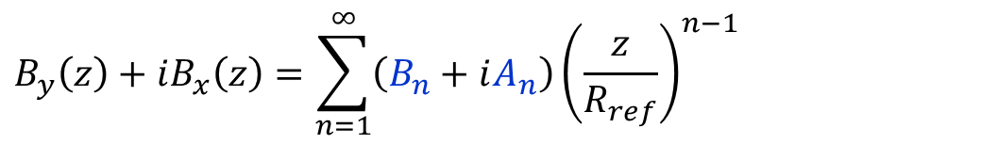
The solution is a harmonic (or multipole) expansion, describing the field (within a circle of validity) with scalar coefficients
$$B_{y}\left(z\right)+iB_{x}\left(z\right)=\sum_{n=1}^{∞}{\left(B_{n}+iA_{n}\right){\left(\frac{z}{R_{ref}}\right)}^{n−1}}$$
(4)
$$y$$
R_{max}
R_{ref}
$$z=x+iy=re^{iθ}$$
$$x$$
Notes:
The solution is the harmonic (or multipole) series expansion. We don’t derive it here, but it follows from Laplace equation on the vector potential (p. 32). Details can be found in many of the references at the end.
B (a 2D vector field) is then simply described by a series of scalar coefficients: B₁, A₁, B₂, A₂, etc. These are the so-called (not-normalized) harmonics, or multipoles. They have units of Tesla. The convenience is that we don’t need to keep all (that is, an infinity) of terms: a few ones of this convergent series are in general more than enough. [There are mathematical laws providing bounds for this convergence]
B_{n} are the so-called normal terms, whereas A_{n} are referred to as skew terms.
R_{ref} is a reference radius.
R_{max} is the maximum radius of validity (see next page).
The equation is so important that we give it a number too. On the other hand, there are different ways of writing it, for ex., with or without a reference radius, or with a different indexing (from 0 to ∞ instead of from 1 to ∞).

Slide 38
This decomposition has two characteristic radii: R_{ref} and R_{max}
R_{ref}
R_{ref}
R_{max}
R_{max}
Notes:
This 2D decomposition holds within a circle of radius R_{max}:
- without currents
- without (hard or soft) magnetic materials: in practice for us, in air or vacuum, and also in the walls of the vacuum chamber, which is not ferromagnetic (in stainless steel, for ex.)
The sketch on the left shows the poles of a typical resistive dipole: R_{max} is in this case dictated by the iron and it is half the distance between the poles.
On the right the sketch refers to a textbook superconducting (sector coil) dipole: here R_{max} is the inner coil radius.
On the other hand, there is no set rule to pick R_{ref}, which is a reference radius, used for normalization purposes. In practice, we tend to pick a value that defines the good field region needed for the beam. A typical value is 2/3 of the physical aperture.

Slide 39





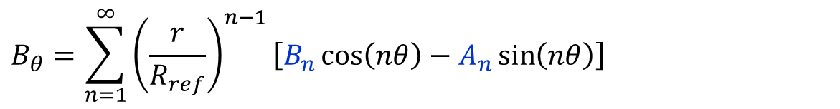

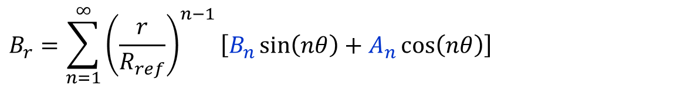
Expanding Eq. 4 in terms of radial and tangential components, we find sin and cos terms
$$B_{r}=\sum_{n=1}^{∞}{{\left(\frac{r}{R_{ref}}\right)}^{n−1}\left[B_{n}\sin\left(nθ\right)+A_{n}\cos\left(nθ\right)\right]}$$
$$B_{θ}=\sum_{n=1}^{∞}{{\left(\frac{r}{R_{ref}}\right)}^{n−1}\left[B_{n}\cos\left(nθ\right)−A_{n}\sin\left(nθ\right)\right]}$$
$$y$$
$$B_{θ}$$
$$B_{r}$$
$$r$$
$$θ$$
$$x$$
Notes:
If we expand Eq. 4 in terms of radial and tangential components of the field, we end up with a series containing sin and cos terms. In fact, the multipoles can also be seen as a Fourier decomposition.
In this way, we can see that each term can be computed independently from each other (that is, each component is orthogonal in a mathematical sense).
Moreover, if we pick up signals relative to the radial or tangential field – for ex. with a rotating coil – then we can do a standard Fourier analysis (FFT back in the days) to get the harmonic coefficients.
Finally, this description of the field in terms of B_{n}, A_{n} components is convenient to handle for our beam physics colleagues, both for optics calculations and for nonlinear resonances.

Slide 40

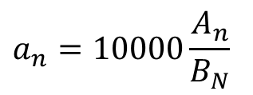
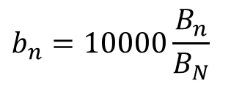
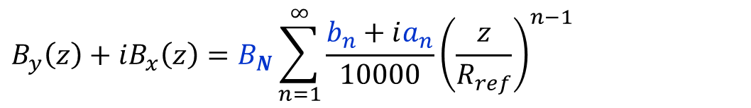
In most cases, there is a main fundamental component, to which the other terms are normalized
$$B_{y}\left(z\right)+iB_{x}\left(z\right)=\sum_{n=1}^{∞}{\left(B_{n}+iA_{n}\right){\left(\frac{z}{R_{ref}}\right)}^{n−1}}$$
(4)
$$b_{n}=10000\frac{B_{n}}{B_{N}}$$
$$a_{n}=10000\frac{A_{n}}{B_{N}}$$
$$B_{y}\left(z\right)+iB_{x}\left(z\right)=B_{N}\sum_{n=1}^{∞}{\frac{b_{n}+ia_{n}}{10000}{\left(\frac{z}{R_{ref}}\right)}^{n−1}}$$
field strength
field shape
Notes:
The top formula is again Eq. 4.
Typically there is a main (or fundamental component), say B_{N}, which can be used to normalize the coefficients, yielding b_{n} and a_{n}. These terms are now dimensionless and they are most often defined in units in 10⁻⁴. These terms should all vanish if the fundamental field were pure, so they are an indication of the field errors, or distortion.
The bottom expression is simply the top one rewritten using the normalized multipoles. In this way, there is a leading term (B_{N}) which defines the strength of the field, and a summation of other coefficients which describe the field shape.
Following this definition, b_{N} = 10000.

Slide 41
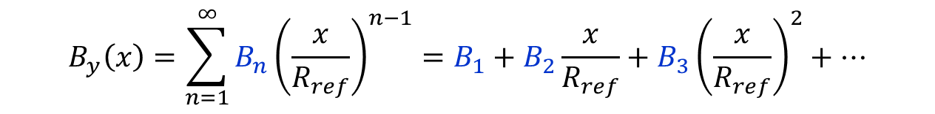



Another useful expansion derived from Eq. 4 is that of B_{y} on the midplane, i.e. at y = 0
$$B_{y}\left(x\right)=\sum_{n=1}^{∞}{B_{n}{\left(\frac{x}{R_{ref}}\right)}^{n−1}}=B_{1}+B_{2}\frac{x}{R_{ref}}+B_{3}{\left(\frac{x}{R_{ref}}\right)}^{2}+…$$
$$B_{x}\left(x\right)=\sum_{n=1}^{∞}{A_{n}{\left(\frac{x}{R_{ref}}\right)}^{n−1}}=A_{1}+A_{2}\frac{x}{R_{ref}}+A_{3}{\left(\frac{x}{R_{ref}}\right)}^{2}+…$$
$$y$$
R_{max}
R_{ref}
$$x$$
Notes:
This expansion is nothing new, that is, it can be derived from Eq. 4 by staying on the midplane, where y = 0. The normal terms (B_{n}) contribute only to the vertical field, and vice versa for the skew terms (A_{n}).
The top formula is the one that we use more frequently. It shows that B_{y} on the midplane has a constant term, a linear one, a quadratic one, and so on.
So, if we know the harmonics, we can write down this polynomial expansion.
On the other hand, if we know (for ex., from measurements) this polynomial expansion, we cannot strictly speaking derive the multipoles. We typically still do so, doing a polynomial fitting, but in this case the various terms are not orthogonal, that is, we get different results according to the coefficients that we retain in the series.

Slide 42
Each multipole corresponds to a field distribution: adding them up, we can describe everything (compatibly with Maxwell)
B₁: normal dipole
B₂: normal quadrupole
B₃: normal sextupole
A₁: skew dipole
A₂: skew quadrupole
A₃: skew sextupole
Notes:
Each term – taken individually – has a specific meaning, both to the magnet designer and the beam physicist.
The normal family involves a field perpendicular to the y = 0 line, that is, vertical field in the horizontal (usually) plane. In the skew family, the field is tangential to the same y = 0, that is, we have horizontal field in the horizontal (usually) plane.
The skew types are obtained from the normal ones with a 360/(4n) deg rotation, ex. 90 deg for dipole, 45 deg for quadrupole, 30 deg for sextupole.
Skew magnets are in practice just rotated normal magnets.

Slide 43


B₁ is the normal dipole
$$B_{y}$$
$$x$$
Notes:
With this notation, the dipole is the B₁ term, which provides a field constant in space.

Slide 44





B₂ is the normal quadrupole
$$B_{y}$$
$B_{y}=B′$x
$$x$$
$$G=\frac{B_{2}}{R}=\frac{∂B_{y}}{∂x}=B′$$
$$B_{pole}=B′R_{pole}$$
Notes:
Then B₂ is the quadrupole, where B_{y} changes linearly with x.
In the center, there is no field.
The gradient of a quadrupole is the slope of the B_{y} vs. x line. This is measured in T/m.
It turns out that B_{x} is also linear vs. y – in the vertical plane – with the same gradient. Just write down the components from Eq. 4 to see that.
This is why a quadrupole acts simultaneously on two planes for a beam: in particular, if it provides a focusing field on one plane, then it will be defocusing on the orthogonal plane.

Slide 45



B₃ is the normal sextupole
$$B_{y}=\frac{1}{2}B^{′′}x$$
$$B_{y}$$
$$x$$
$$B^{′′}=\frac{∂^{2}B_{y}}{{∂x}^{2}}=\frac{2B_{3}}{R^{2}}$$
$$B_{pole}=\frac{1}{2}B′′R_{pole}$$
Notes:
Then B₃ corresponds to a sextupole.
Here the field dependency is quadratic in x.
In the center, there is no field and no field gradient.
A sextupole is usually characterized by the second derivative of B_{y} vs. x, B’’.
The sextupole can be thought of as a quadrupole where the gradient (slope) changes linearly with the radial displacement x.

Slide 46




The allowed / not-allowed harmonics refer to the terms that shall / shall not cancel out thanks to design symmetries
fully symmetric dipoles: only B₁, b₃, b₅, b₇, b₉, etc.
half symmetric dipoles: B₁, b₂, b₃, b₄, b₅, etc.
Notes:
We like to divide the multipoles in two families: allowed and not-allowed (or random).
The not-allowed (or random) terms are the ones that should not be there, thanks to symmetries in the design. They then arise due to asymmetries introduced during the fabrication.
The allowed multipoles are the ones that are allowed by the symmetries, that is, that are expected by design even if no asymmetries are introduced during the fabrication. Part of the magnetic design focuses to optimize the geometry to cancel out these terms.
Taking resistive dipoles as an example, there are some fully symmetric layouts (top row, with H design and window frame / O design): here only the odd normal terms are allowed.
On the other hand, for a half symmetric dipole (ex. a C layout, as in the bottom row) all the normal terms are allowed.

Slide 47
These are the allowed harmonics for fully symmetric quadrupoles and sextupoles
fully symmetric quadrupoles: B₂, b₆, b₁₀, b₁₄, b₁₈, etc.
fully symmetric sextupoles: B₃, b₉, b₁₅, b₂₁, etc.
Notes:
The cases above show the allowed harmonics for most common quadrupoles and sextupoles, which are (or can be considered) fully symmetric.

Slide 48


We can change R_{ref} and scale up (or down) the harmonics
R_{ref,2}
R_{ref,1}
R_{max}
R_{max}
$$B_{n,2}=B_{n,1}{\left(\frac{R_{ref,2}}{R_{ref,1}}\right)}^{n−1}$$
$$b_{n,2}=b_{n,1}{\left(\frac{R_{ref,2}}{R_{ref,1}}\right)}^{n−N}$$
Notes:
Is it possible to change R_{ref}?
Yes, and this is done routinely. For ex. we measure at the largest possible radius (to have a better signal) and then we scale the multipoles down to a smaller reference value (defining for ex. the good field region).
Clearly R_{max} remains the same, as this is the region of validity of the expansion, not just a normalization term.
The equation on the left can be directly derived from Eq. 4.
The expression on the right follows from the definition of normalized harmonics.
The exponent for the normalization is different in the two case: for the absolute multipoles we scale by (n – 1) while for the relative ones we need to use (n – N), which depends on the order of the fundamental term N.

Slide 49
Let’s have a look at a real case: the measurements of 33 quadrupoles built for SESAME
mean ± rms | QF @ 250 A
b₃ | -0.2 ± 0.8
a₃ | -0.1 ± 0.9
b₄ | 0.3 ± 0.4
a₄ | -0.3 ± 0.1
b₅ | 0.0 ± 0.1
a₅ | 0.0 ± 0.1
b₆ | -0.1 ± 0.1
b₁₀ | -0.3 ± 0.0
b₁₄ | 0.3 ± 0.0
SESAME QF
harmonics in 10⁻⁴ at 24 mm radius
Notes:
As an example, we look at the multipoles measured at a fixed current for a series of resistive quadrupoles (QF for SESAME). In this case, the aperture diameter is 70 mm and the harmonics are reported at 24 mm radius.
Besides these terms, there are also b₁ and a₁, which are dipole components related to centering of the axis. In addition, there is the main component B₂ and the skew term a₂, related to the tilt (roll) of the quadrupole.
Here we look at the other terms: sextupole, octupole, decapole, and then we jump at the first allowed terms (for a quadrupole), that is b₆, b₁₀ and b₁₄. The rest is small and negligible. Since this is a series of several magnets (33), we list the mean and standard deviation.

Slide 50



Now, are our magnets 2D or 3D? In most cases what matters is the integrated strength = central strength × magnetic length
$$l_{m}B_{0}=\int_{−∞}^{∞}{B\left(z\right)dz}$$
Notes:
Now, we have a powerful decomposition in 2D, but are our magnets 2D or 3D?
Looking along the longitudinal (z) direction, the field B is maximum at the center (z = 0) of the magnet, it is more or less constant till reaching the ends, where it rolls off to reach a 0 value outside. The magnetic length l_{m} is defined as that length which – multiplied by the central field value B₀ – returns the same integrated field.
The same holds substituting the field B with the gradient B’, with the sextupole strength B’’, and so on.
For long magnets – where the longitudinal dimension is much larger than the gap – the behavior is dominated by the (long) central part, so taking the values of 2D simulations and multiplying by a length yields good results. For short magnets, the behavior is intrinsically 3D.

Slide 51


This 2D decomposition holds also for the integrated 3D field, as long as at the start / end B is constant along z
ok
ok
not ok
$$z$$
ok
$$z$$
Notes:
It turns out that the same harmonic decomposition holds in 3D for integrated fields. In this case, the integrals have to be performed on the not-normalized multipoles (B_{n}, A_{n}), and the normalized terms (b_{n}, a_{n}) are then obtained by dividing by the integral of the (integrated) fundamental harmonic.
Technically, this holds if at the beginning / end of the integration region there is no longitudinal field variation, that is, dB_{z}/dz = 0, which is the case if B is integrated along a straight line all the way through a magnet, as the field sooner or later will vanish.
A derivation can be found in several references, for ex. in the contribution of Animesh Kain in the CAS on Measurement and Alignment of Accelerator & Detector Magnets, 1997.

Slide 52
Thank you

Slide 53

If you want to know more…
Lectures about magnets in CERN Accelerator Schools
Special CAS edition on magnets, Bruges, Jun. 2009
N. Marks, Magnets for Accelerators, J.A.I., Jan. 2015
D. Tommasini, Practical Definitions & Formulae for Normal Conducting Magnets
Superconducting magnets for particle accelerators in USPAS
J. Tanabe, Iron Dominated Electromagnets
P. Campbell, Permanent Magnet Materials and their Application
K.-H. Mess, P. Schmüser, S. Wolff, Superconducting Accelerator Magnets
M. N. Wilson, Superconducting Magnets
A. Devred, Practical Low-Temperature Superconductors for Electromagnets
Notes:
This is a suggestion for a “reading decalogue”:
http://cas.web.cern.ch/cas/CAS%20Welcome/Previous%20Schools.htm
http://cdsweb.cern.ch/record/1158462/files/cern2010-004.pdf
http://indico.cern.ch/event/357378/session/2/#all
https://edms.cern.ch/document/1162401/3
for example, http://etodesco.web.cern.ch/etodesco/uspas/uspas.html
ISBN 9789812563811
ISBN 9780521566889
ISBN 9789810227906
ISBN 978-0198548102
CERN-2004-006, cds.cern.ch/record/796105

