Slide 1
Measuring the Properties of Superconductors
JUAS 2018 – Practical Work Day at CERN
  Experimental Work Divided into 3 Activities
  Activity 1: Levitation and Meissner Effect
  Activity 2: Critical Temperature Measurements and electrical Resistivity Experiment
  Activity 3: Critical Current Measurement and Critical Surface Parameterization
  Presented by March 12, 2018
  Rakesh Chandra Prajapati European Scientific Institute
Notes:
QuickStarter has created an outline to help you get started on your presentation. Some slides include information here in the notes to provide additional topics for you to research.

Slide 2
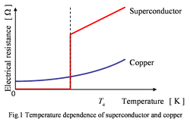
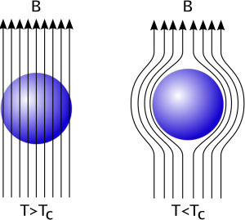
Introduction to Superconductor
Conducting Metal vs Superconductor
Property of Superconductor Below Critical Temperature
Electrical Resistance = 0
Meissner Effect
Meissner Effect
http://www.okayama-u.ac.jp/user/akimitsu/achievements/study_sc_chara_eng.html
Notes:
QuickStarter has created an outline to help you get started on your presentation. Some slides include information here in the notes to provide additional topics for you to research.

Slide 3
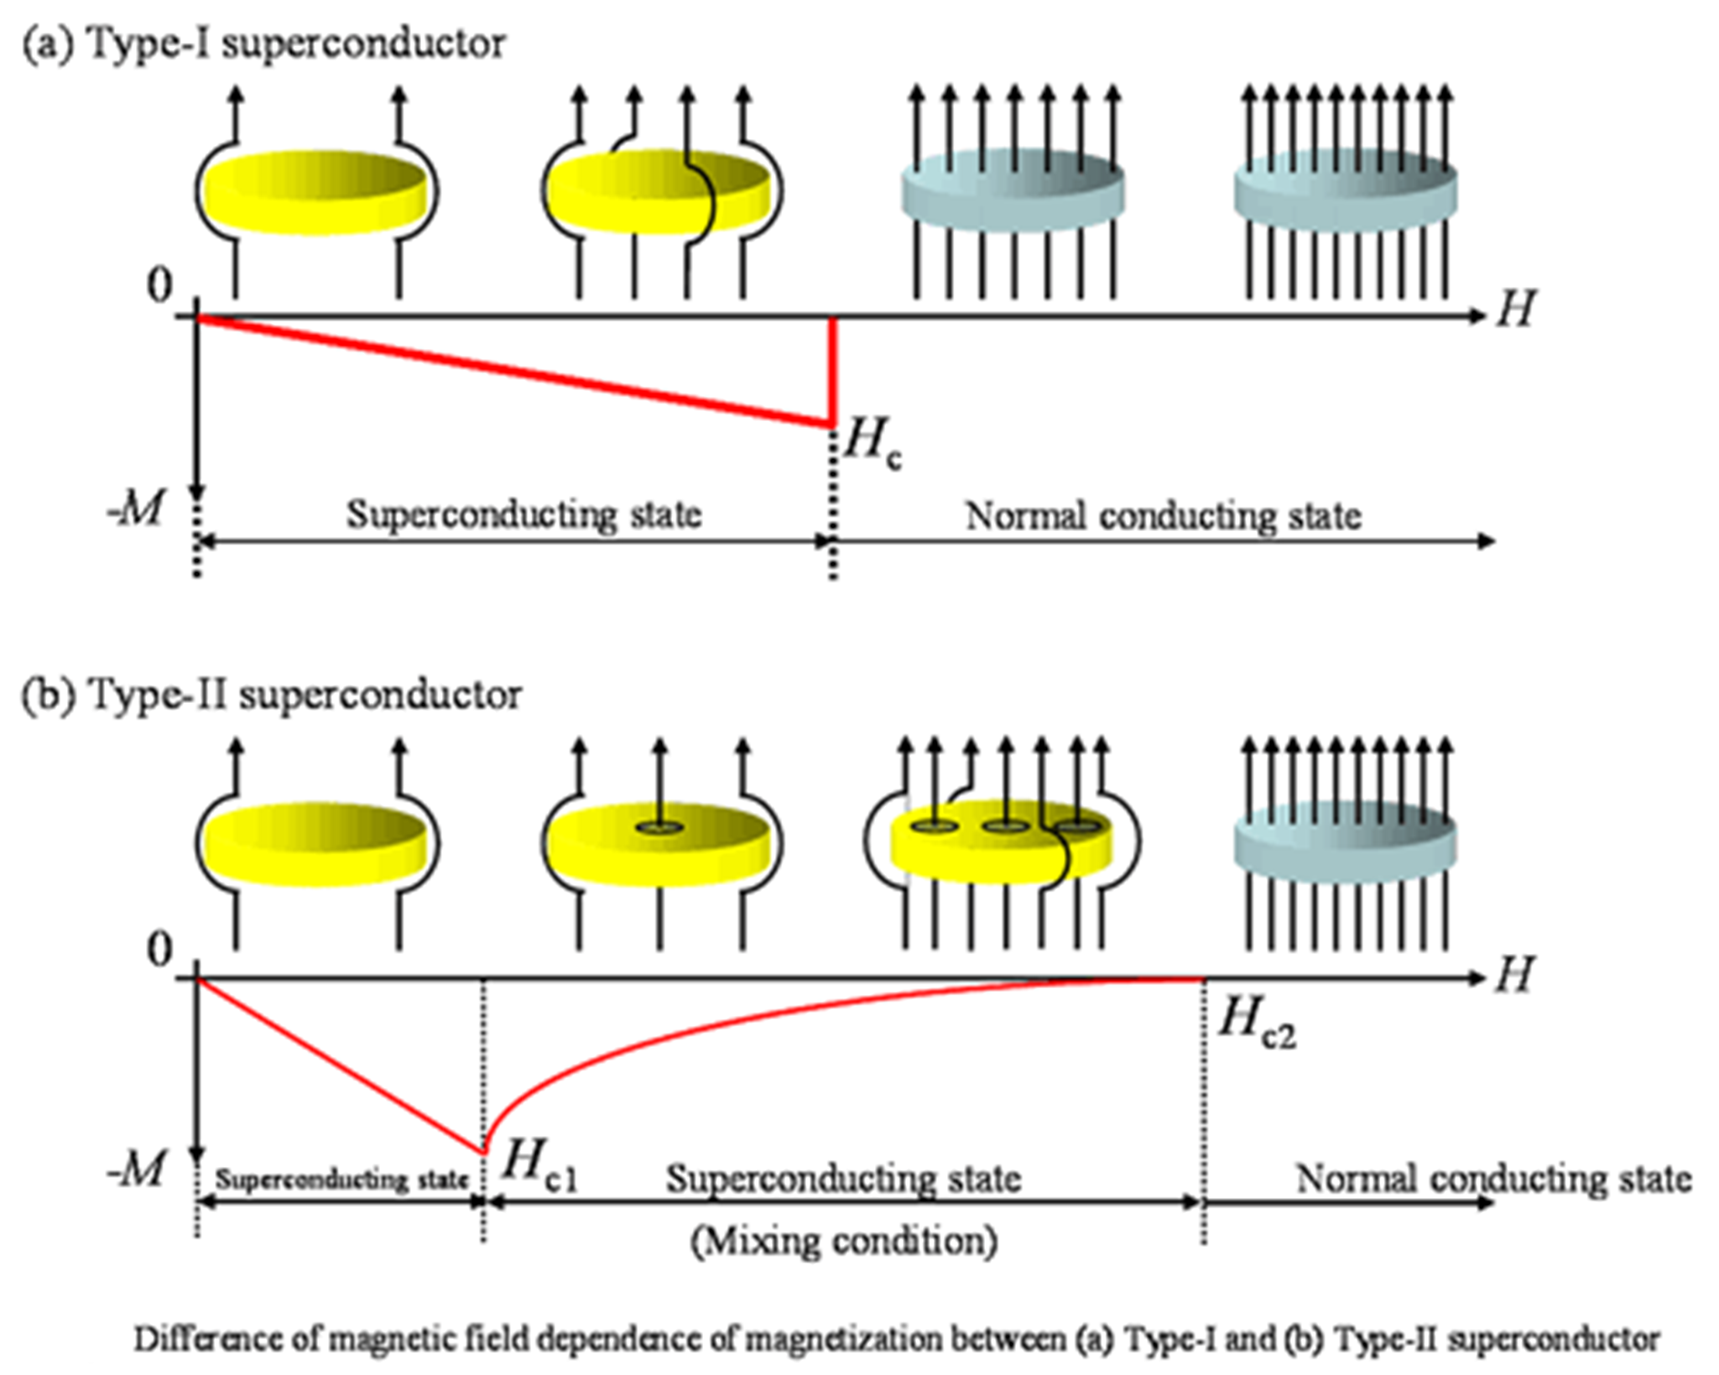
Type i and type ii superconductors
Type I
  Surface energy is positive
  Perfect Diamagnetism
  Superconductivity is lost above a Critical Field Hc
Type II
  Surface energy is negative
  Magnetic fields can penetrate
  Two critical fields (H_{c1} and H_{c2})
  Below Hc1, behaves as Type I superconductor
  Heigher critical magnetic field (H_{c2})
  Superconductivity is lost above H_{c2}.

Slide 4
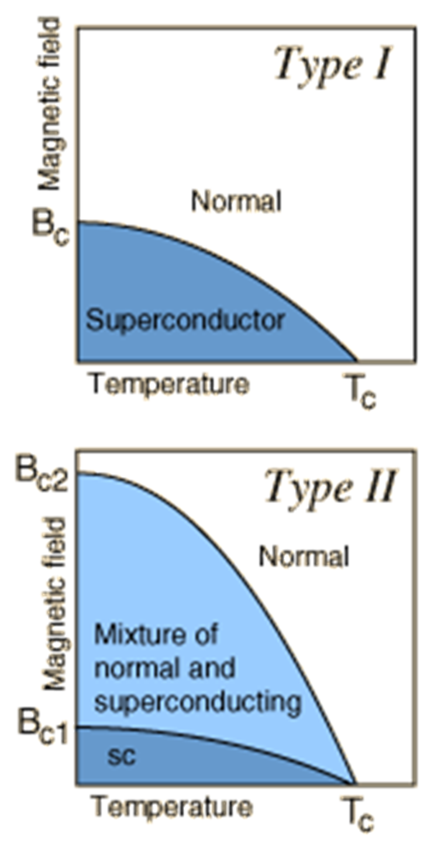
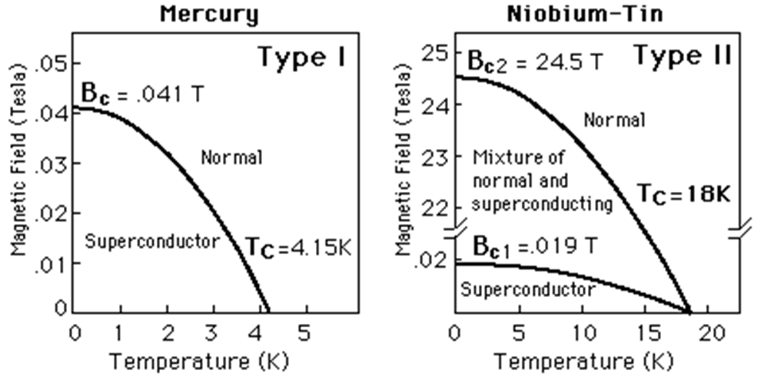
Example of ‘Type i’ and ‘type ii’ superconductors

Slide 5
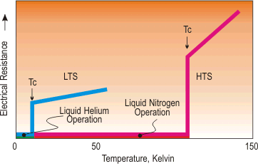
High Temperature and low temperature superconductors
LTS material (niobium-titanium alloy)
  Liquid helium at 4.2 K
HTS material (bismuth-based, copper oxide ceramic)
  Liquid nitrogen at 77 K

Slide 6
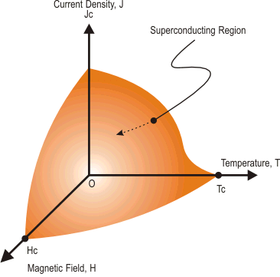
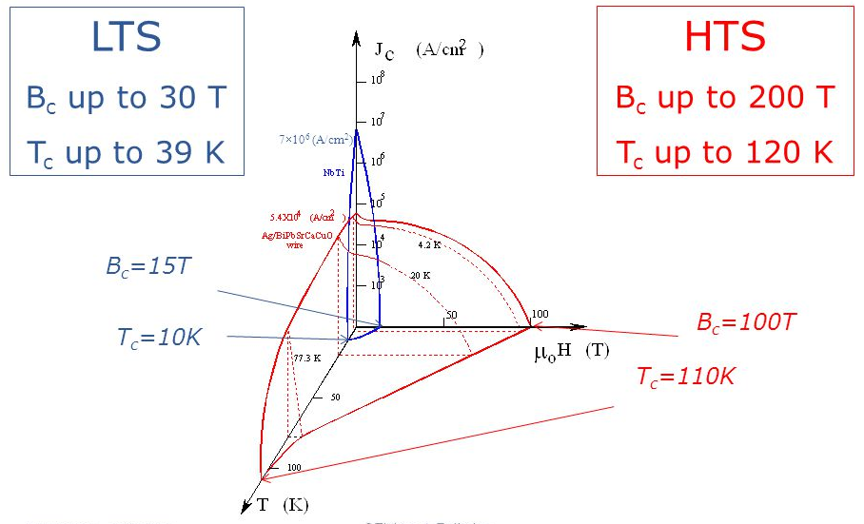
Critical surface of hts and lts superconductors

Slide 7
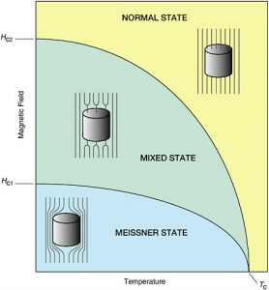
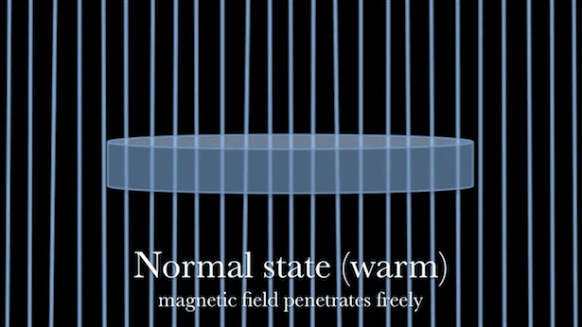
Use of type ii superconductor for practical work

Slide 8
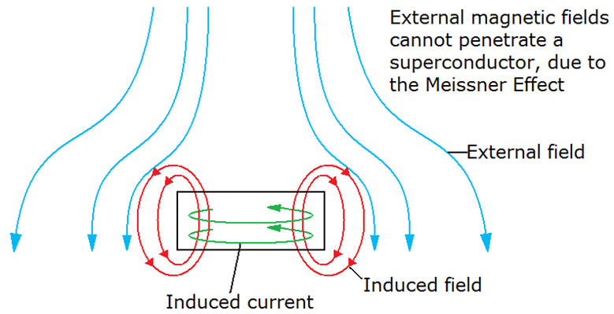
Activity 1: Levitation with zero field cooling
Levitation with Zero Field Cooling
  Repulsive force while bring magnet near (Meissner Effect)
  Push the magnet hard, and the magnet is pinned to the SC surface

Slide 9
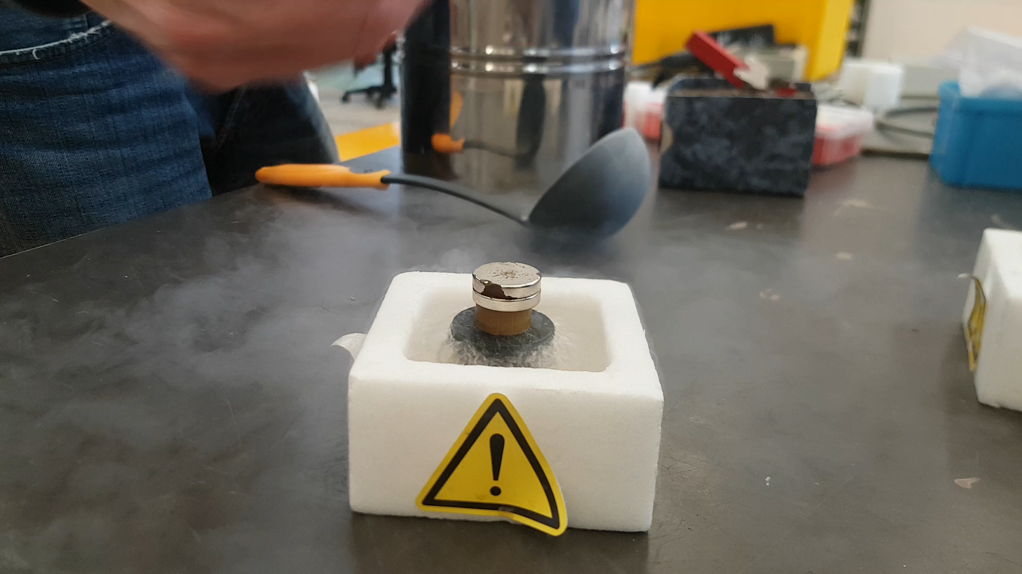
Activity 1: Levitation with field cooling
Levitation with Field Cooling
  Magnet is on-top of YBCO without interaction
  Pour Liquid Nitrogen
  Magnet is levitated

Slide 10
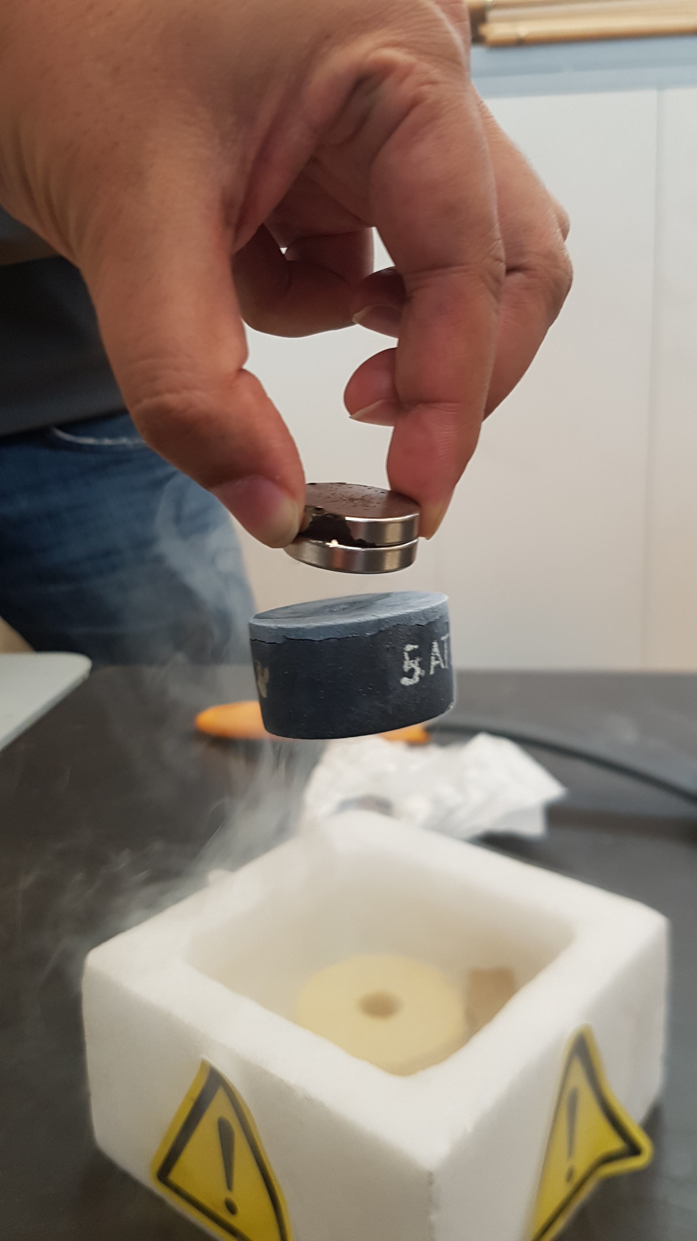
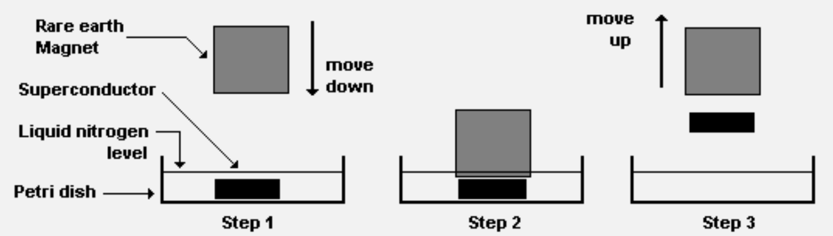
Activity 1: suspension
Started with Field Cooling
Slowly Magnet is lifted
YBCO is suspended
Suspension due to Flux pinning effect (Not Meissner Effect)

Slide 11
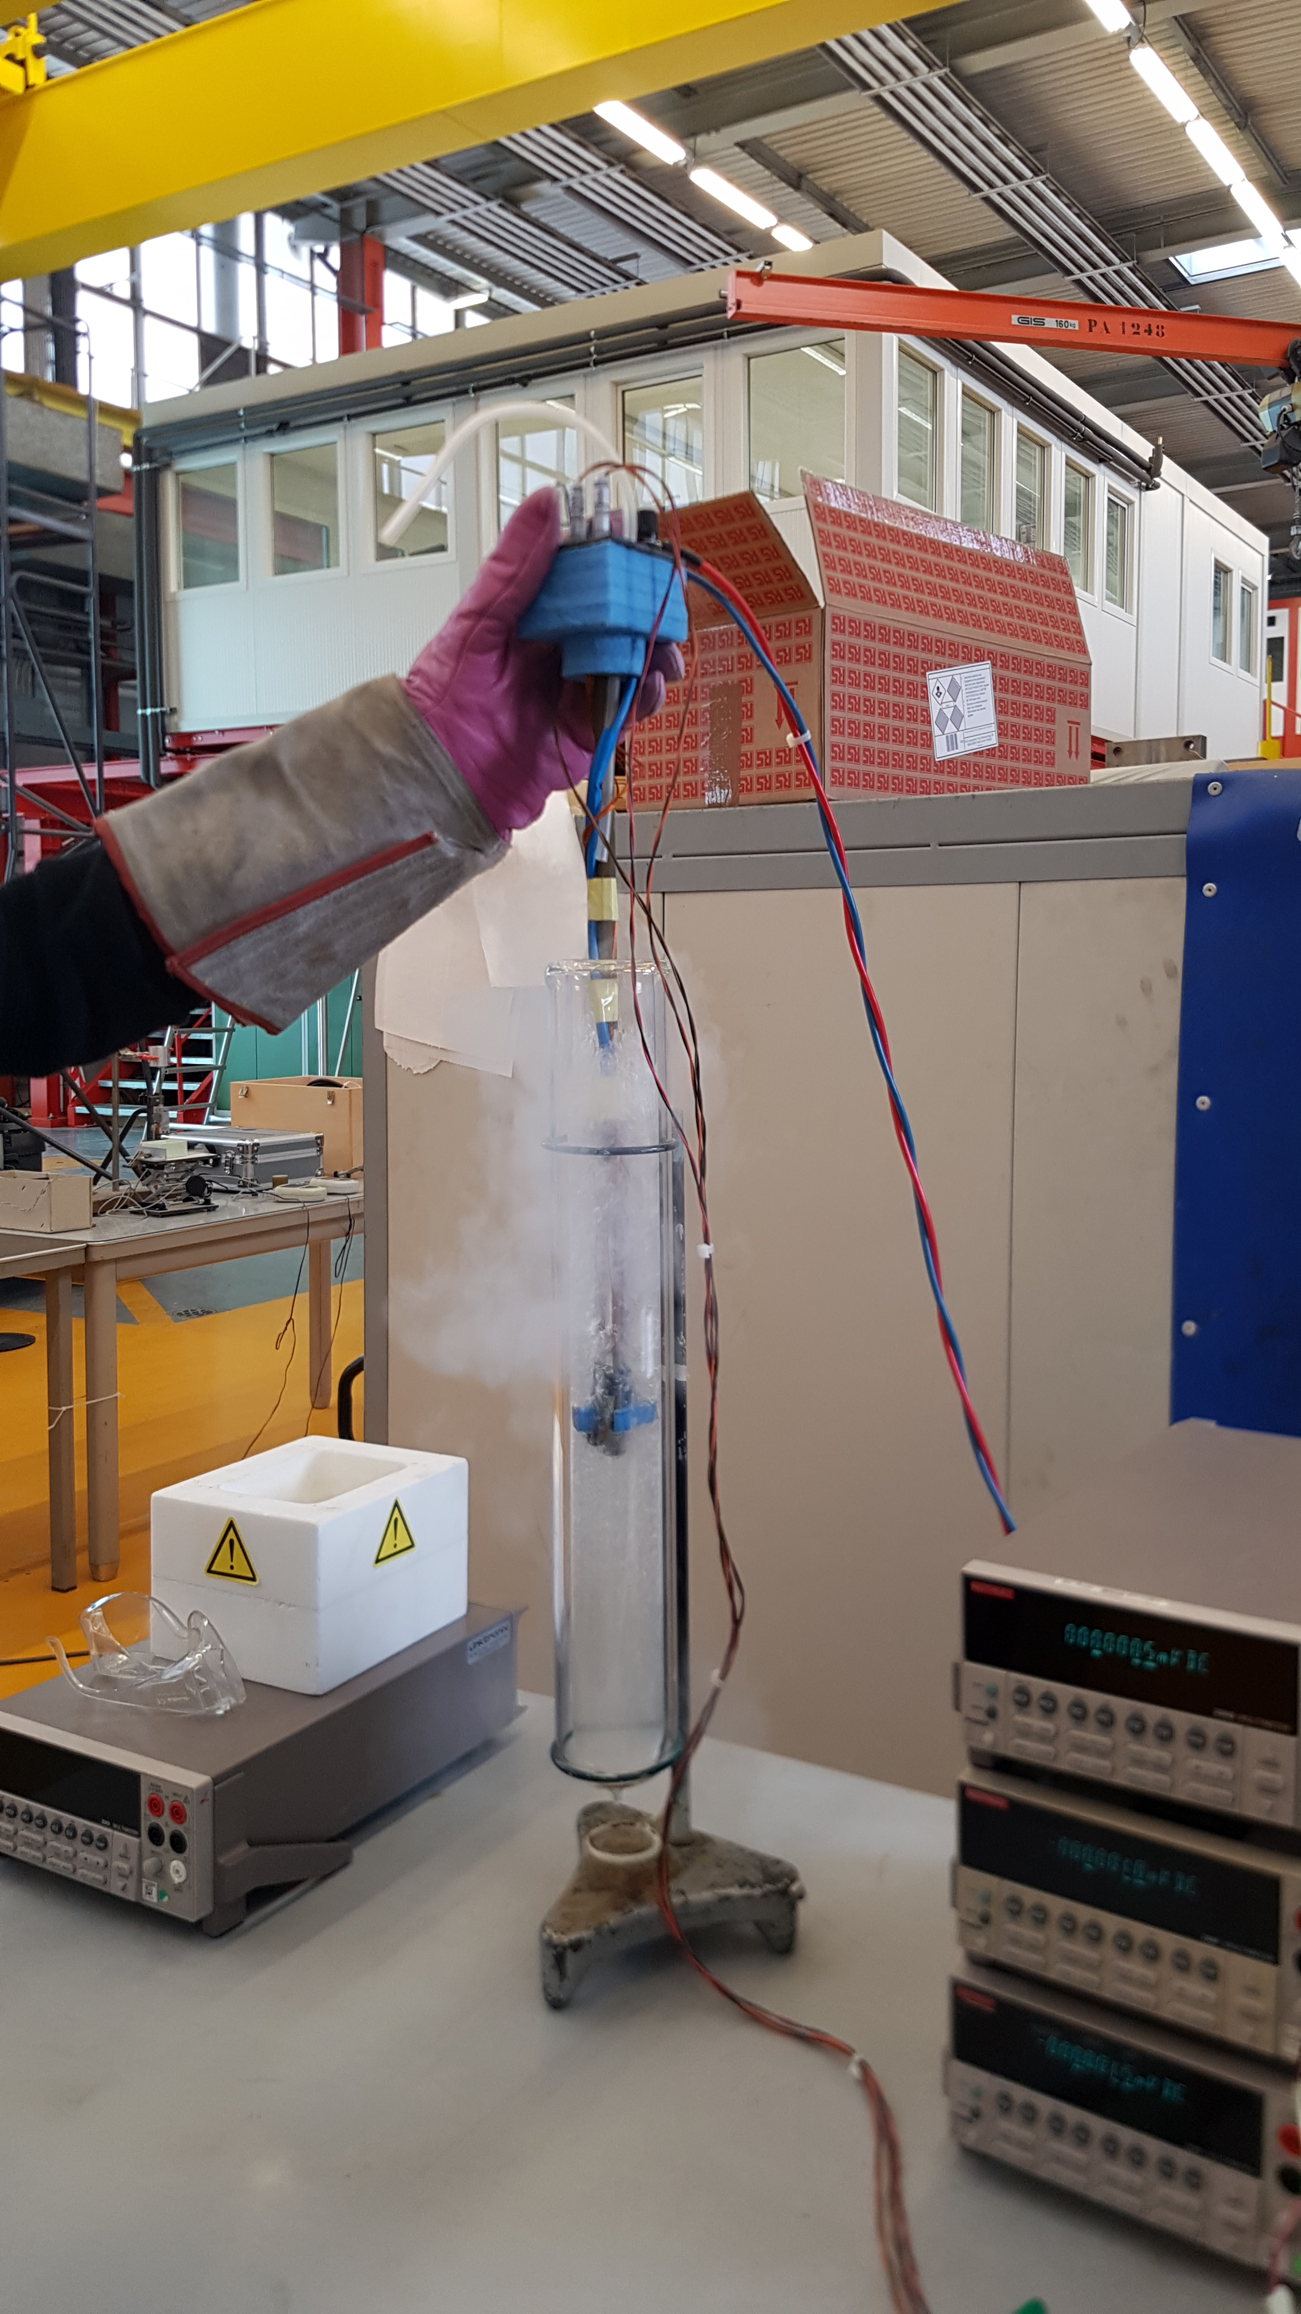
Activity 2: Electrical resistance of a superconductor
Tape 1, Tape 2, Tape 3
  Copper tape
  Stainless stell tape
  BSCCO semiconductor tape

Slide 12
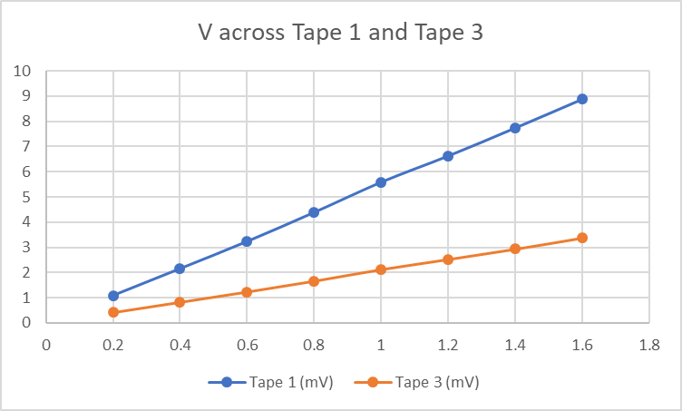
Activity 2: Identify which is the superconducting tape?
First Assumption
Stainless Steel
S. C.
Copper

Slide 13
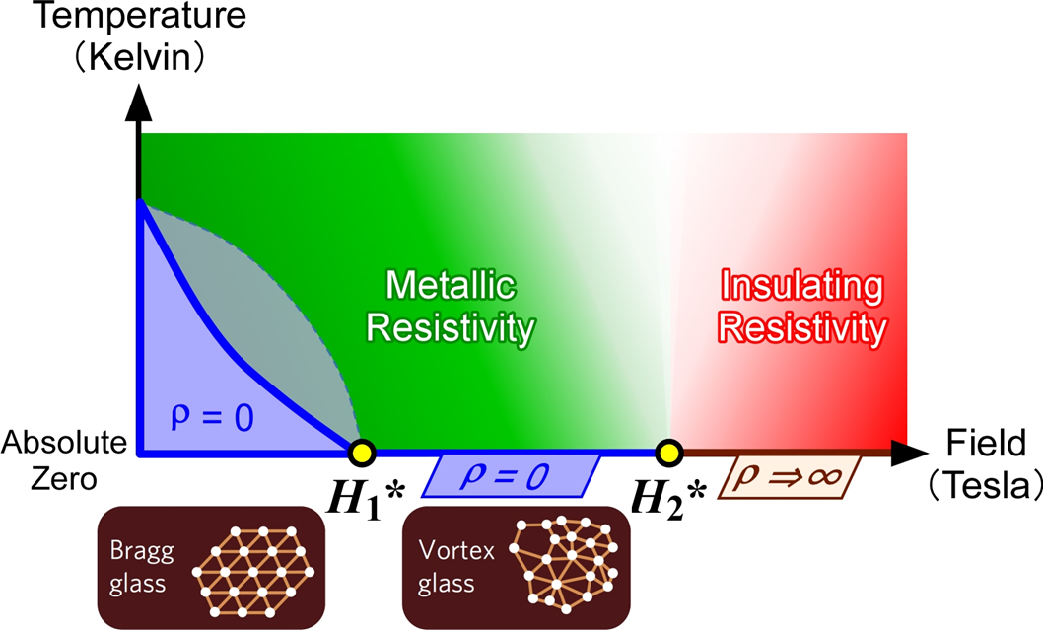
Activity 2: ‘Tape 1’ is the superconducting tape
Superconductor has metallic resistive above critical temperature
Therefore, Tape 1 is the Superconducting Tape

Slide 14
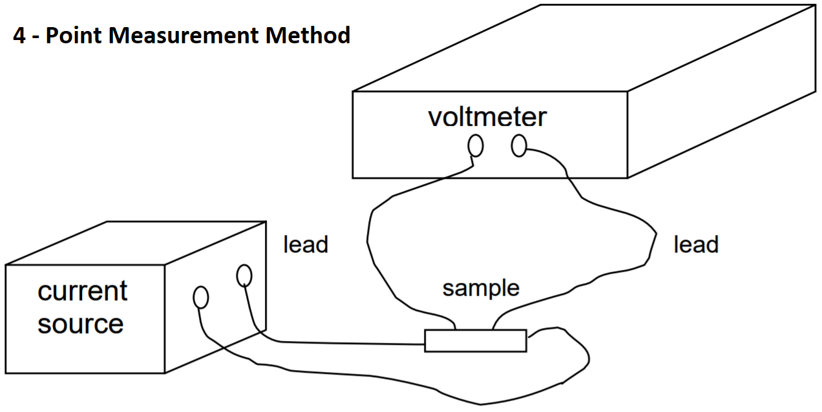
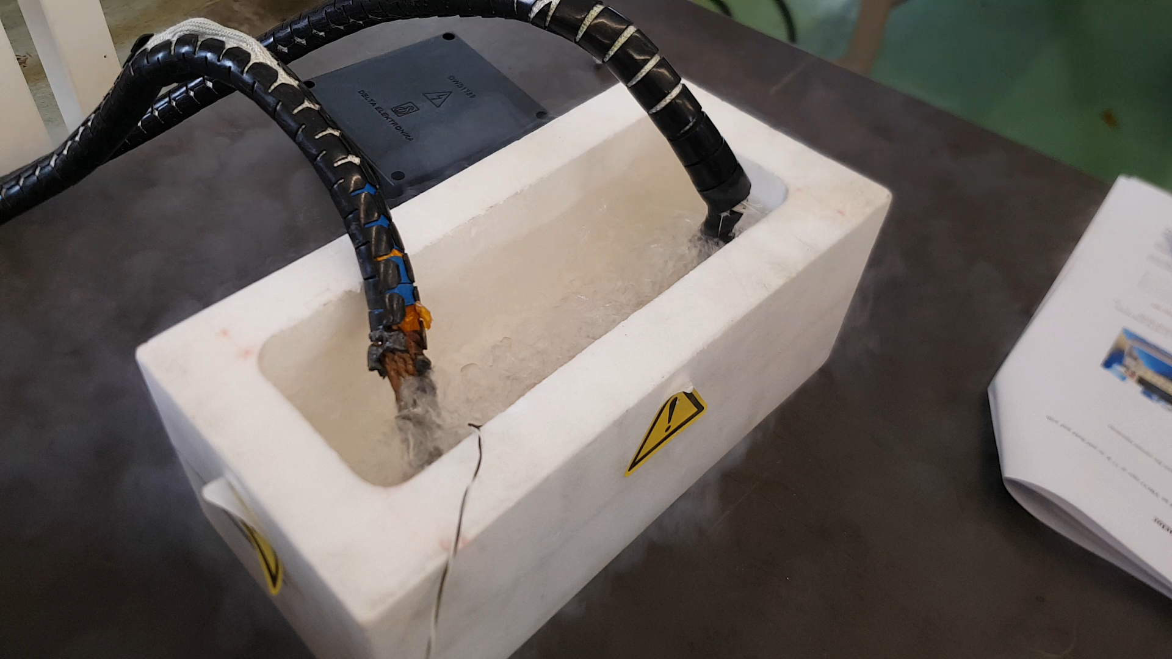
Activity 3: Critical Current Measurement

Slide 15
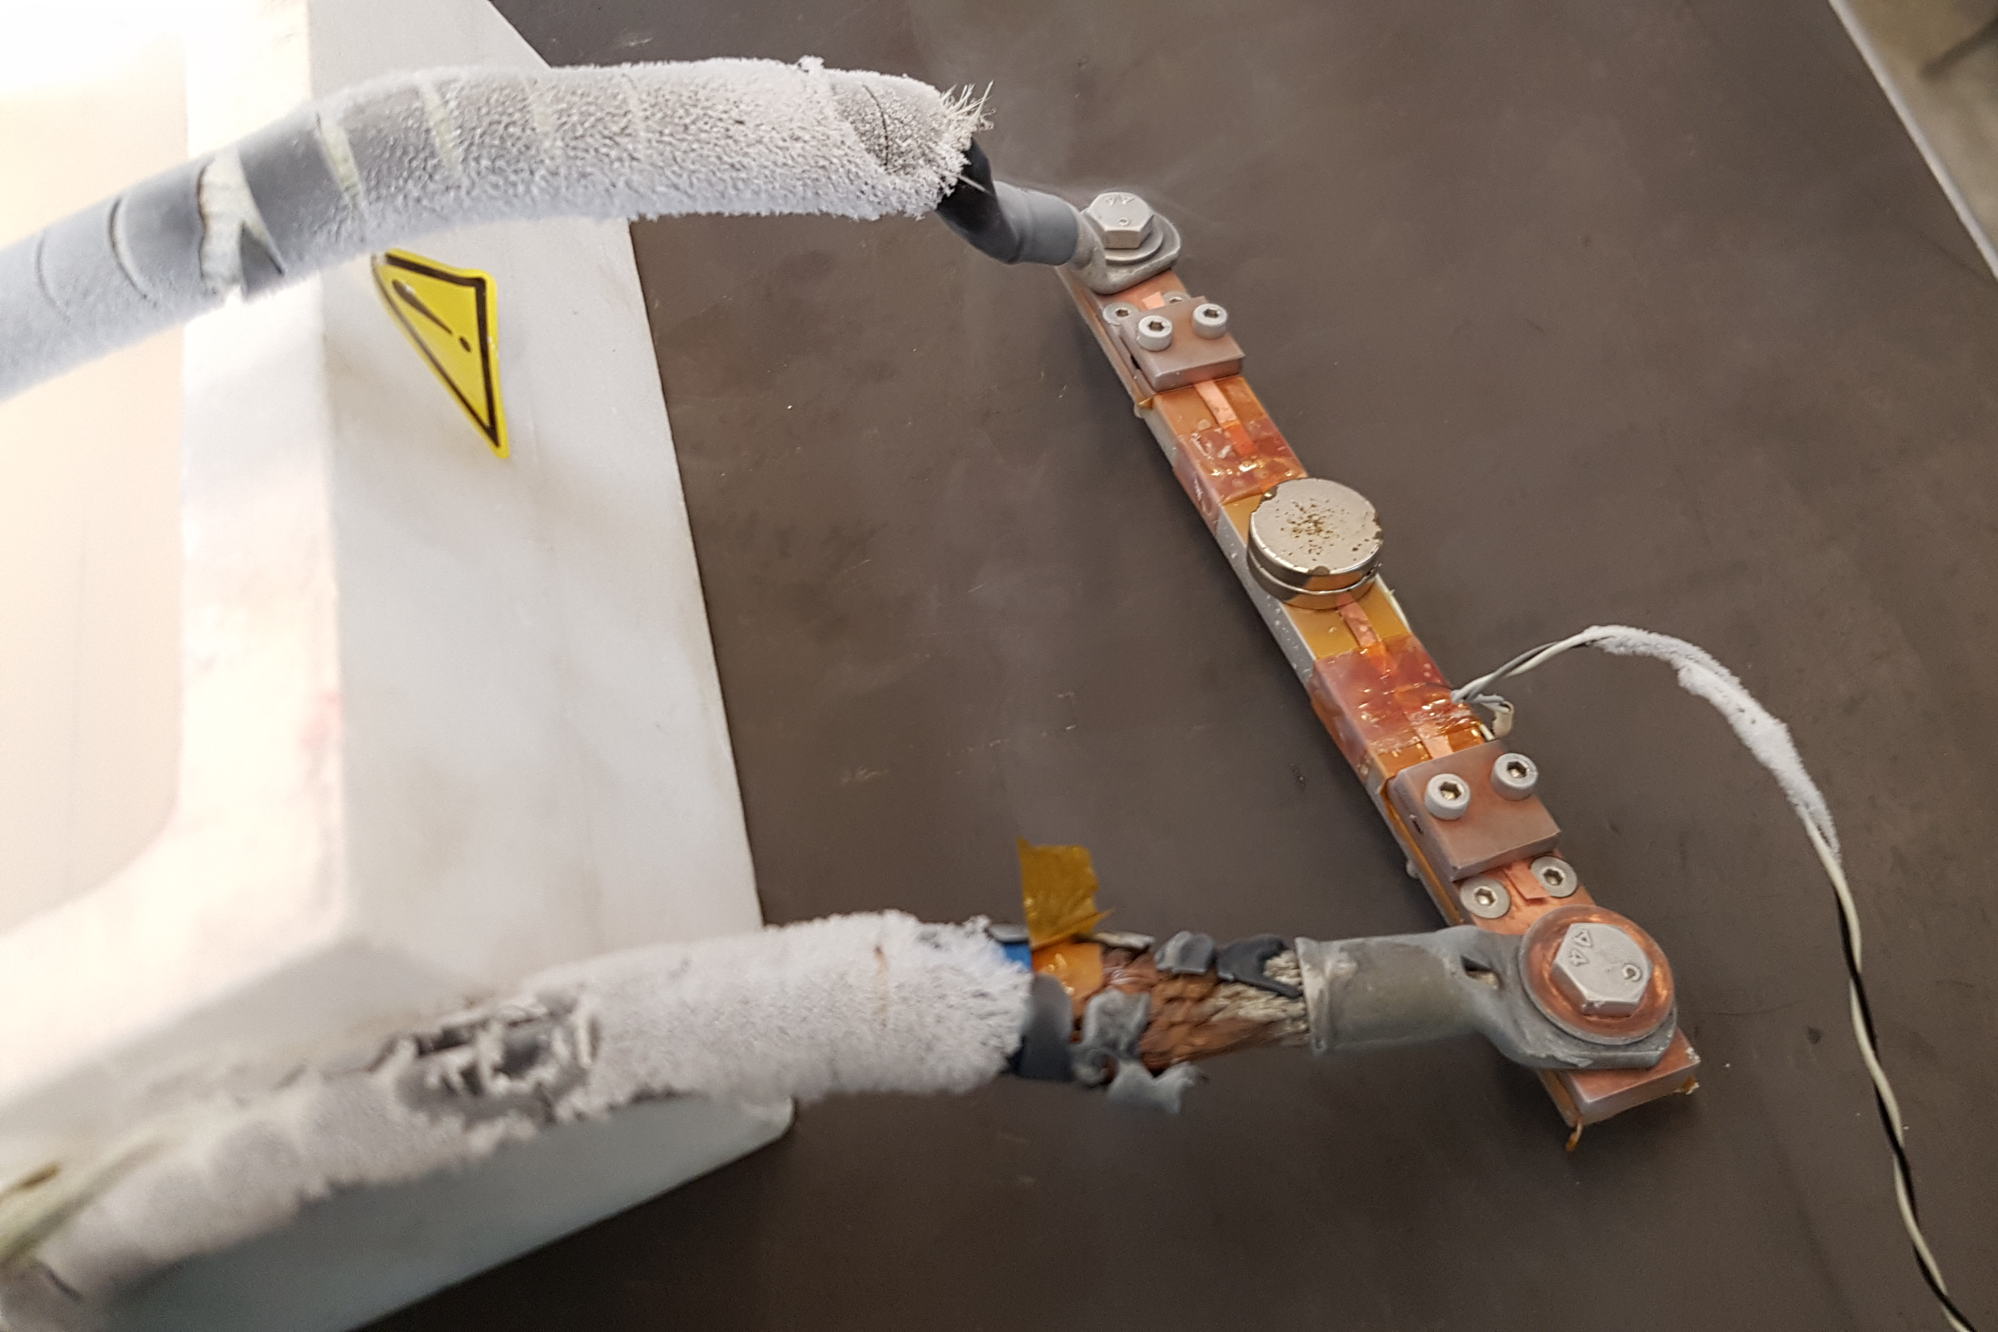
Activity 3: Critical Current Measurement

