Slide 2

Practical Days
Vacuum Systems
V. Baglin
CERN TE-VSC, Geneva

Slide 3
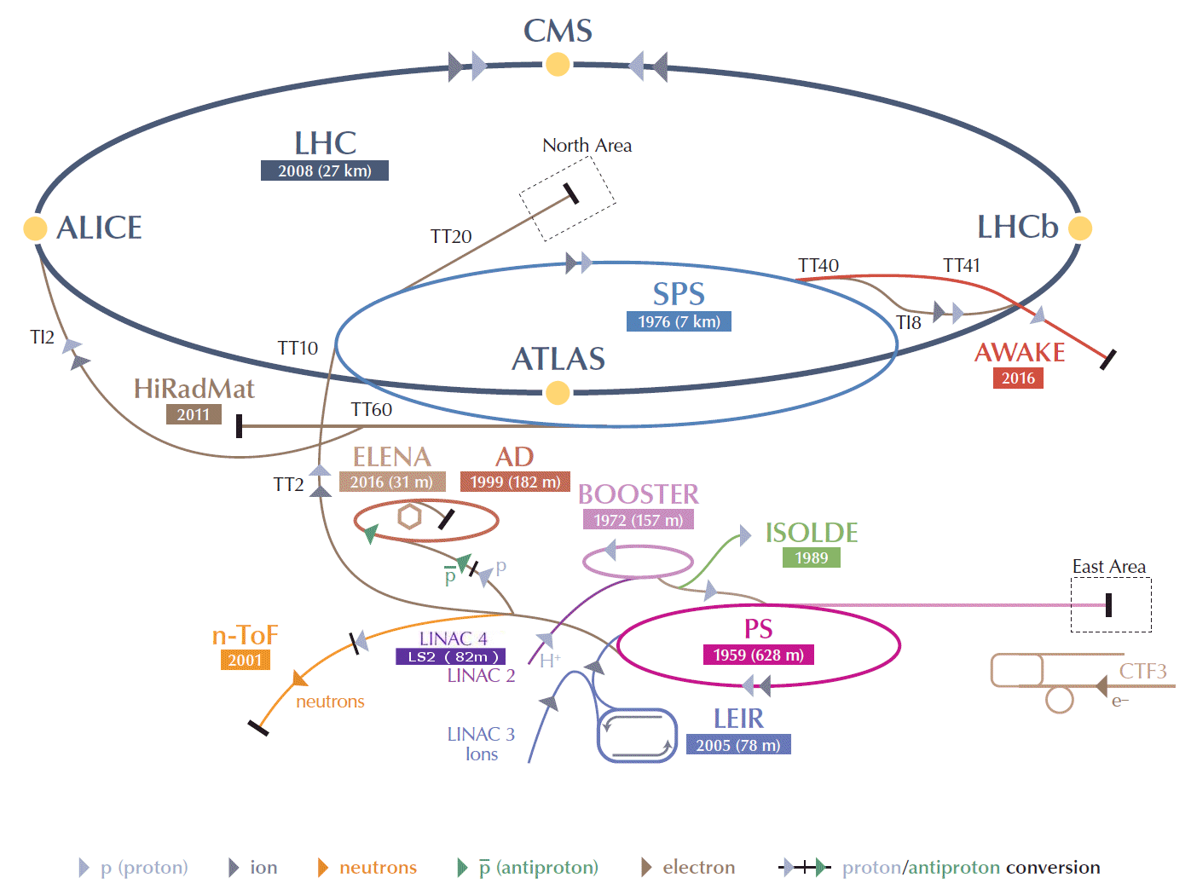
CERN accelerators complex

Slide 4
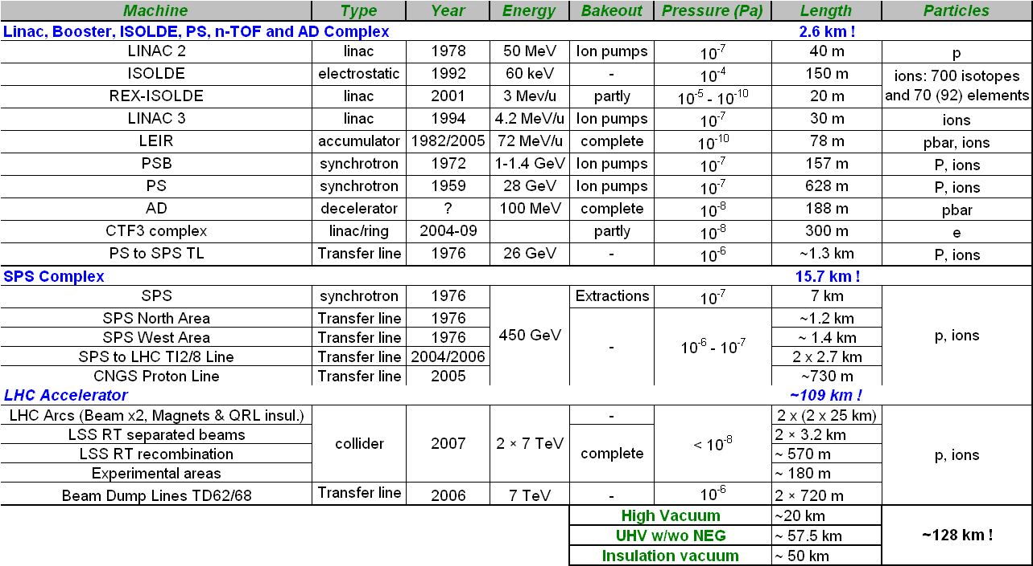
CERN vacuum systems
  2850 ion pumps, 450 turbomolecular pumps, 325 Ti sublimation pumps,…
  6 Km of NEG coated beam pipes, 2750 pressure gauges, 40 leak detectors and 100 RGAs,1930 roughing valves and 510 gate sector valves

Slide 5
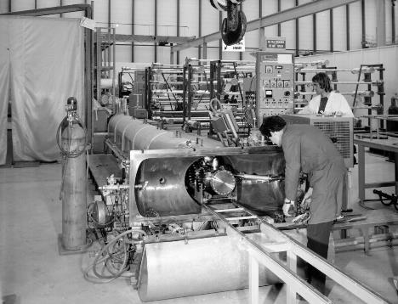
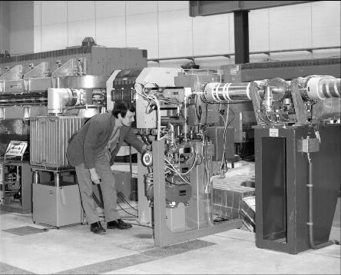
Intersecting Storage Rings
Discovery of :
  Vacuum stability and pressure runaway
  Beam induced multipacting (electron cloud)
Developments of laboratory studies and cleaning methods

Slide 6
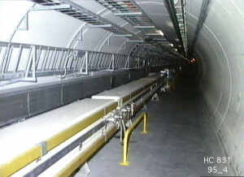
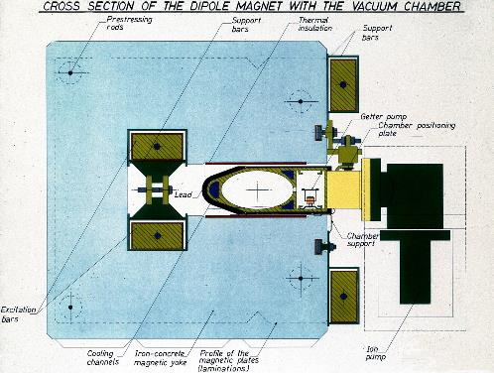
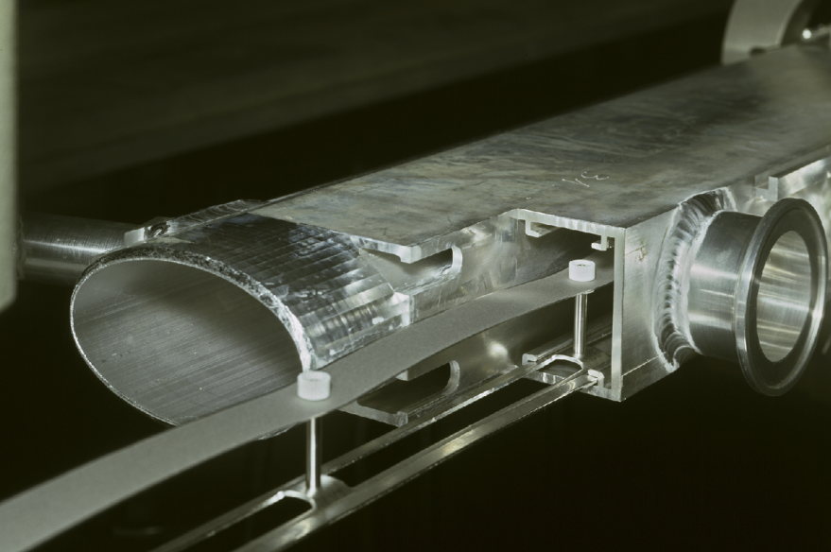
Large Electron Positron Collider
Synchrotron radiation in LEP:
  From 6 to 660 keV critical energy
  Gas desorption studies
Innovative pumping system
  Antechamber with NEG pumping strip
  Water cooled and lead shielded

Slide 7
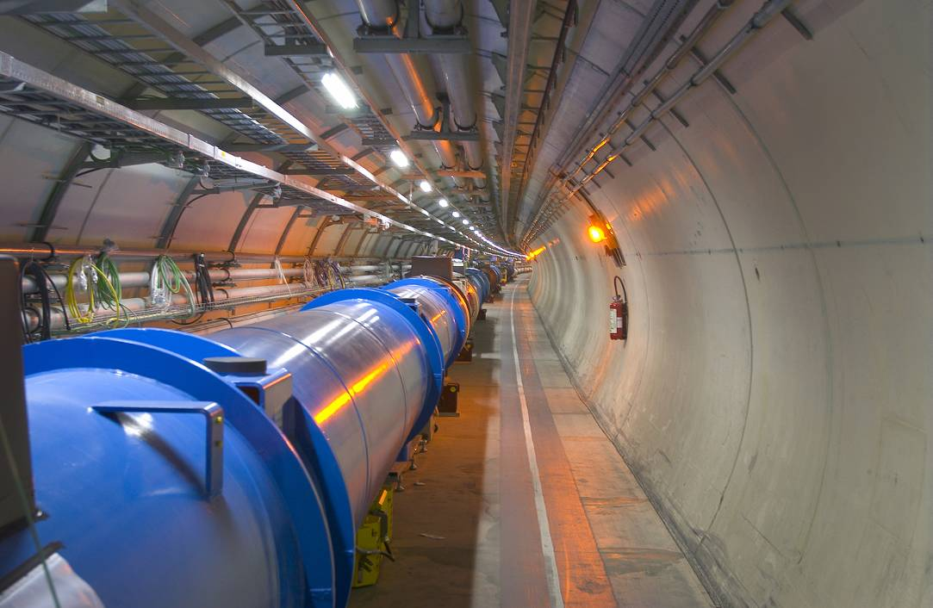
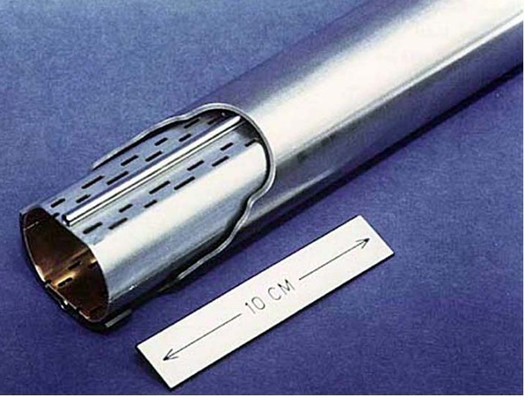
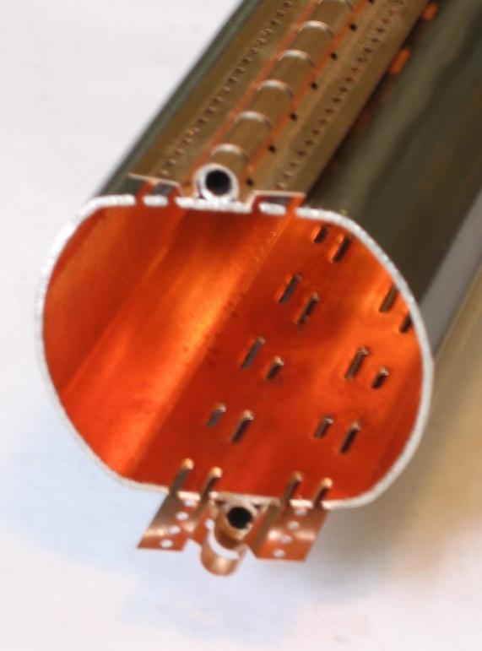
Large Hardon Collider
Cold bore (CB) at 1.9 K which ensures leak tightness
Beam screen (BS) at 5-20 K which intercepts thermal loads and acts as a screen

Slide 8
Vacuum, Surface and Coatings group
Design, construction, operation, maintenance and upgrade of high & ultra-high vacuum systems for Accelerators and Detectors.
Expertise and support on thin-walled vacuum chambers, windows and bellows compensation systems
Expertise in vacuum sealing and leak-tightness technology
Expertise in dynamic vacuum phenomena
Management of the industrial support contract for vacuum work in accelerators
Expertise in vacuum control systems, vacuum interlocks and monitoring tools
Coatings, surfaces treatments, surface and chemical analysis for Accelerators and Detectors. Expertise and support in the fields of:
Coatings, electroplating and surface cleaning techniques
UHV characterization and of material and surfaces
Degassing analysis and treatments

Slide 9
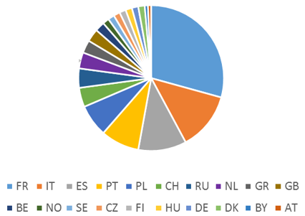
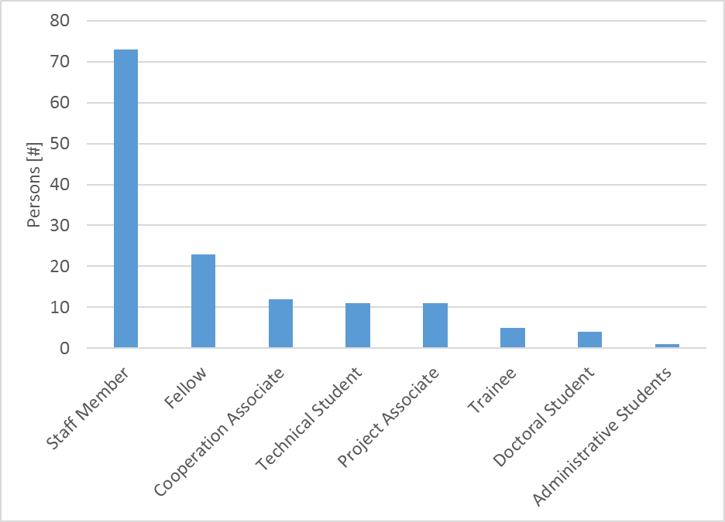
Vacuum, Surface and Coatings group
Design, construction, installation
and operation of the CERN vacuum systems
Several collaborators from different countries and institutes

Slide 10
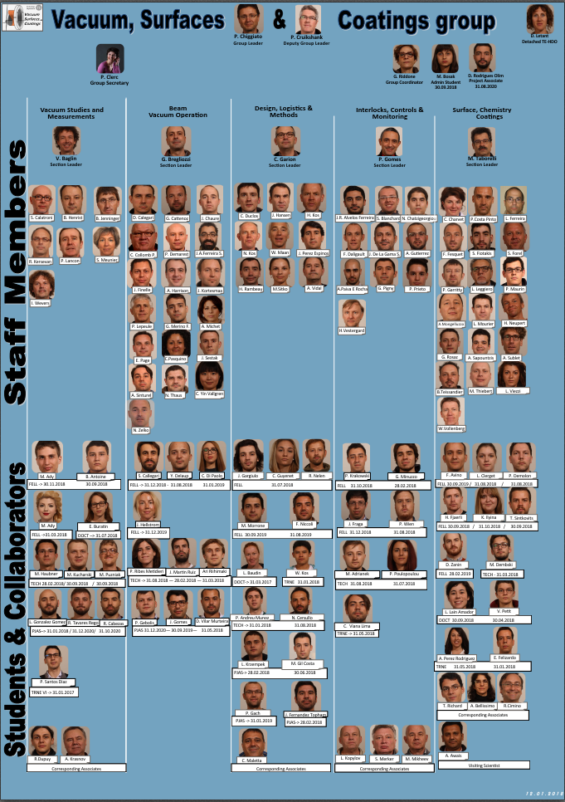
TE-VSC organisation
Group management
+ 5 sections:
Vacuum studies and measurements
Beam vacuum operation
Design, logistics & methods
Interlock, controls & monitoring
Surface, chemistry & coatings

Slide 11
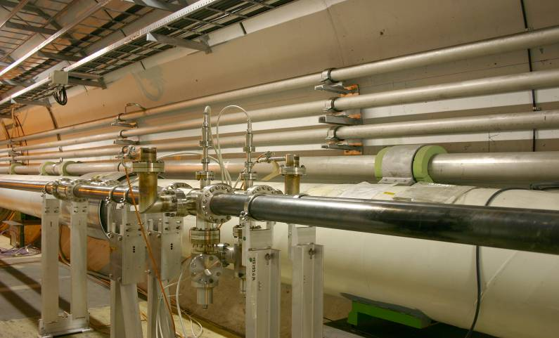
Laboratory activities: pump down
Pump down of a vacuum system:
  start pumping
  open roughing valve
  expected pump down curve

Slide 12
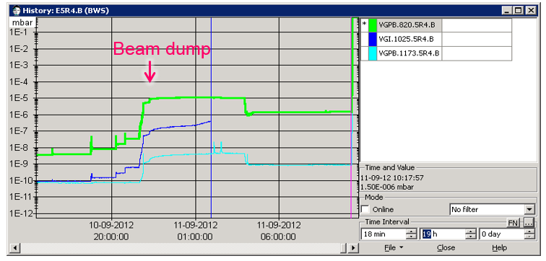
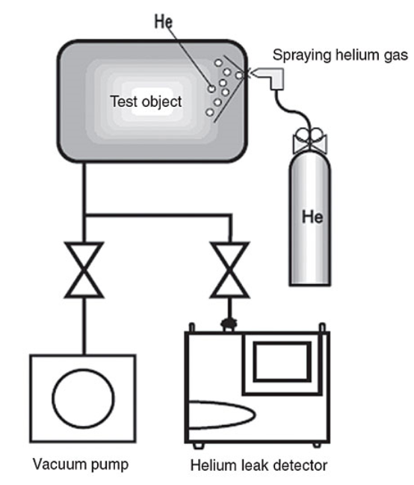
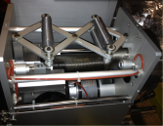
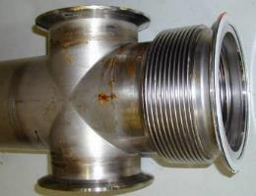
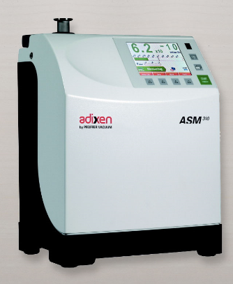
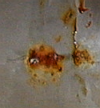
Laboratory activities: leak detection
How to locate / identify leaks in a vacuum system ?
He leak detector

Slide 13
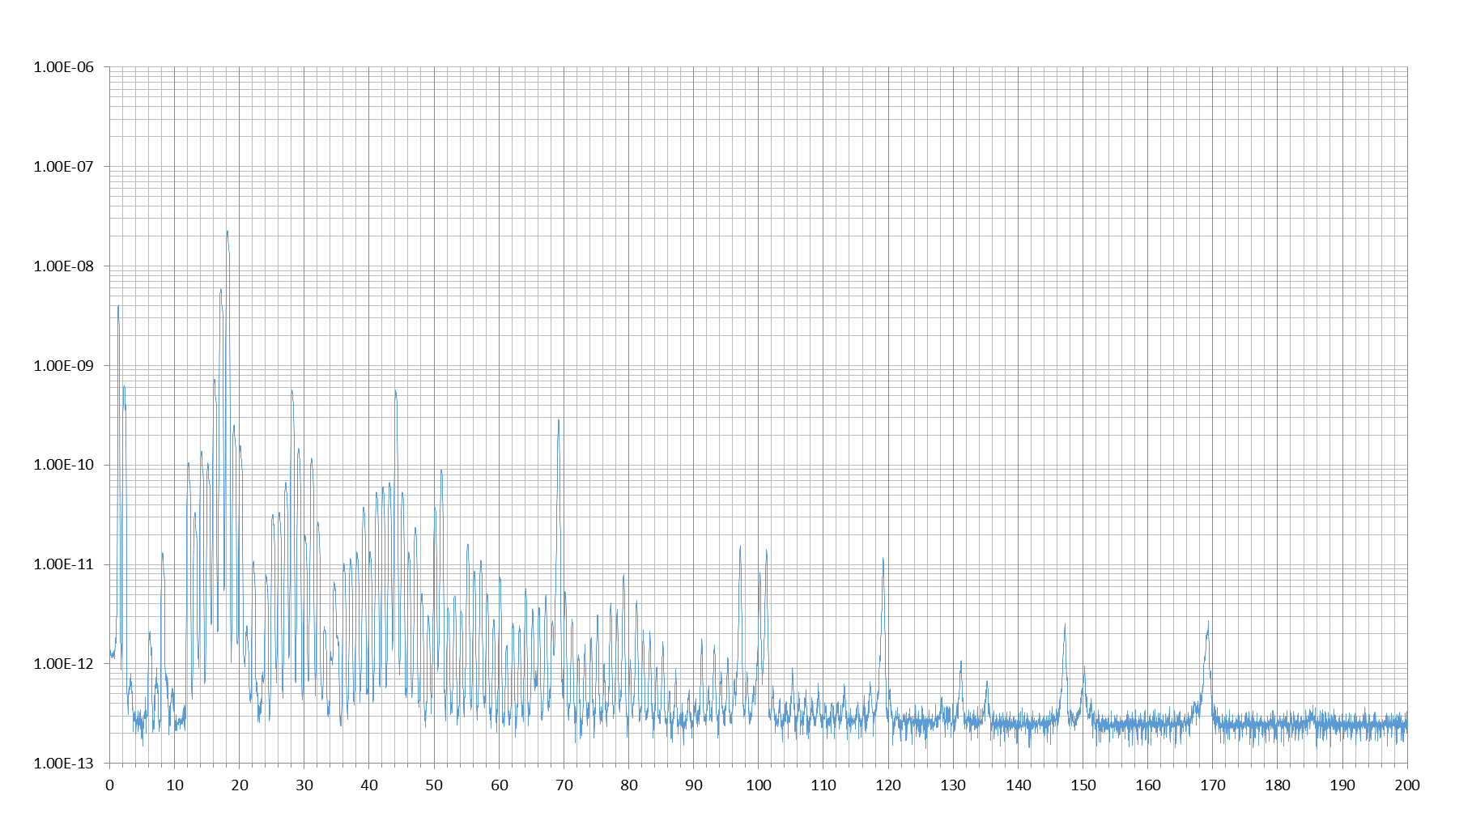
Laboratory activities: gas analysis
is my residual gas reasonable ?
Estimation of the partial pressure

Slide 14
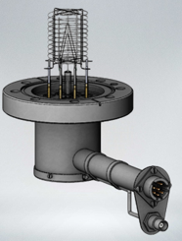
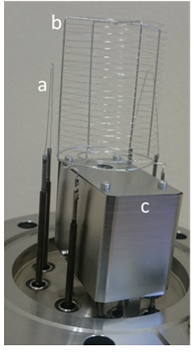
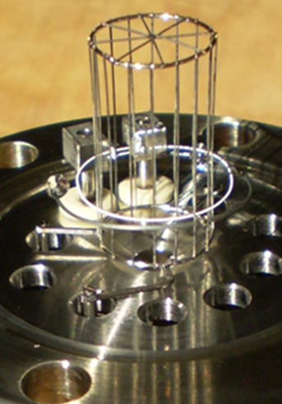
Laboratory activities: vacuum gauge
Vacuum gauges descriptions
Vacuum gauge calibration

Slide 15
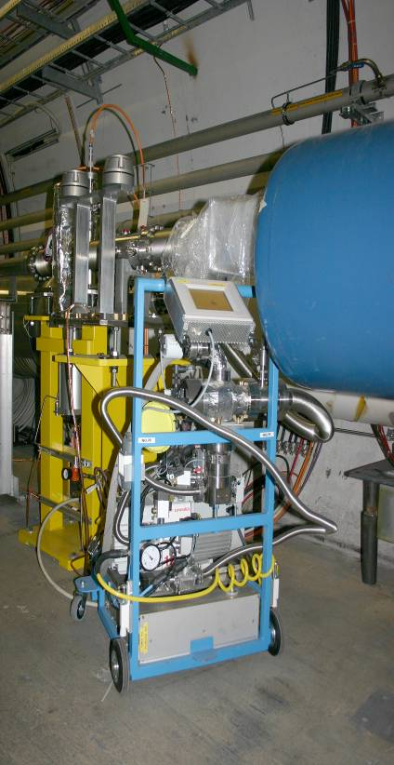
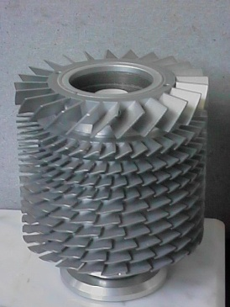
Laboratory activities: pumping speed measurement
Pumping speed measurement

Slide 16
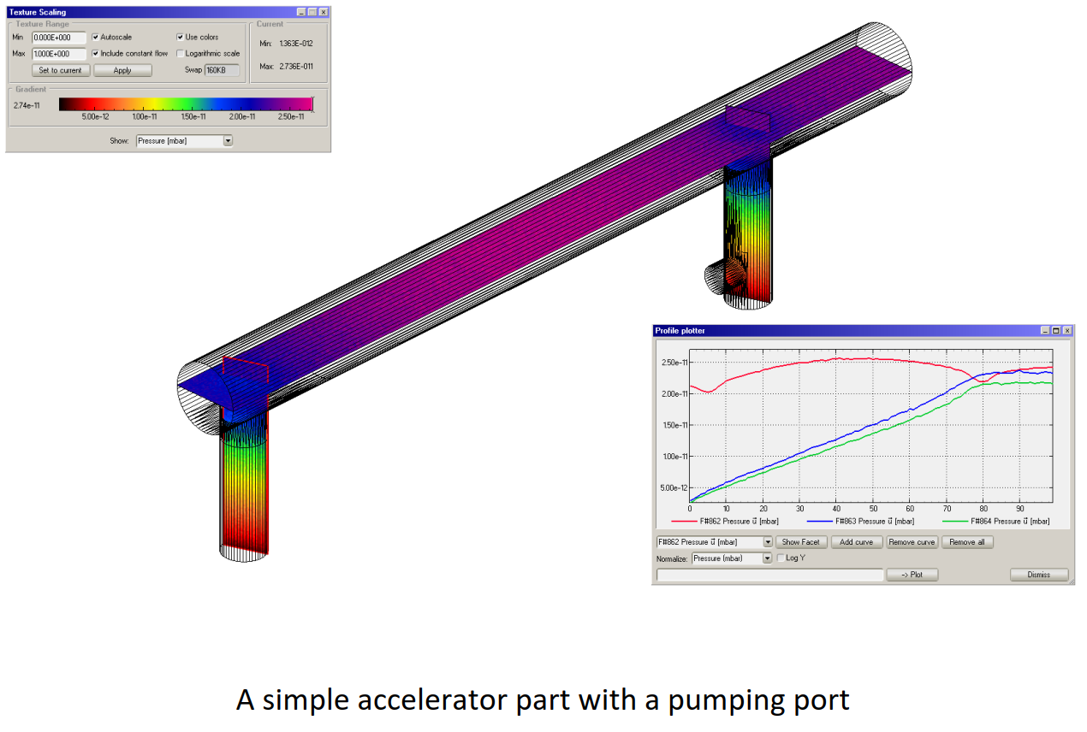
Design of vacuum systems
A test particle Monte-Carlo code for molecular flow
http://molflow.web.cern.ch/
R. Kersevan – M. Ady

Slide 17
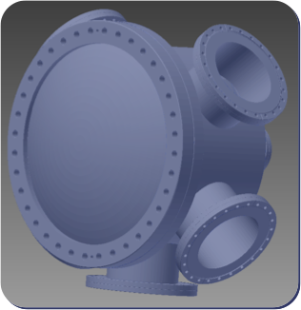
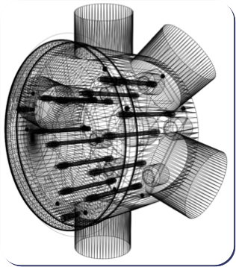
Step 1: creating geometry
CAD
Molflow+
STL format

Slide 18
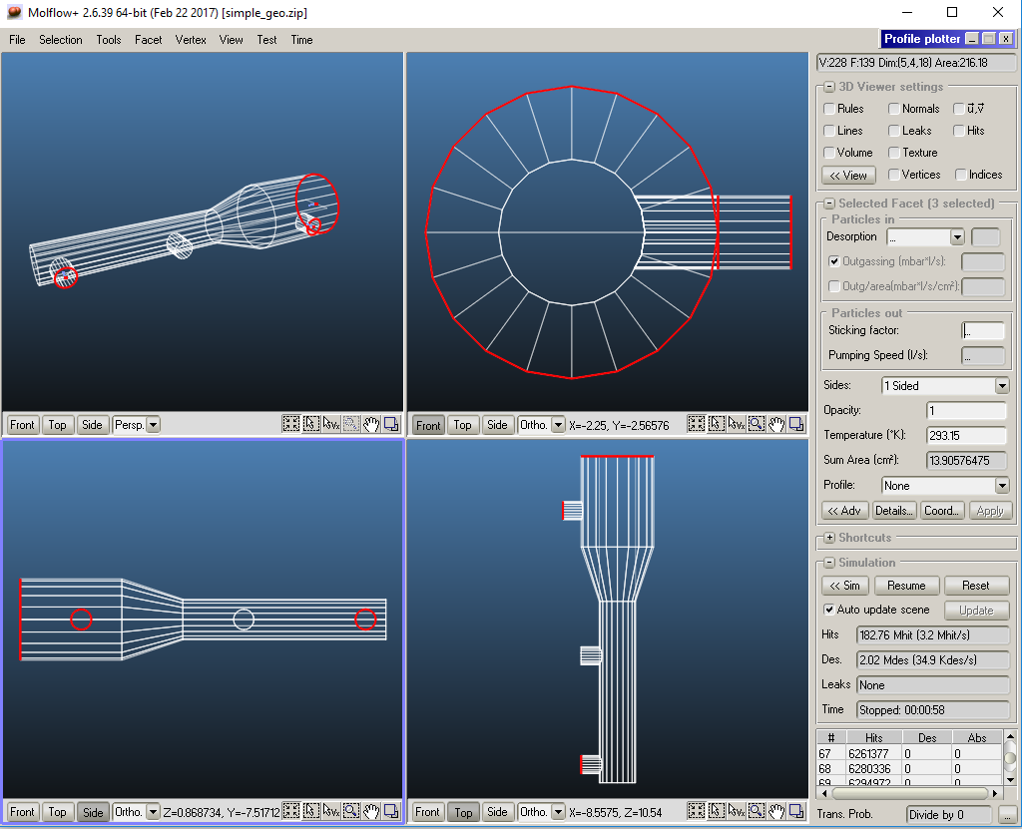
Step 2: adding physics

Slide 19
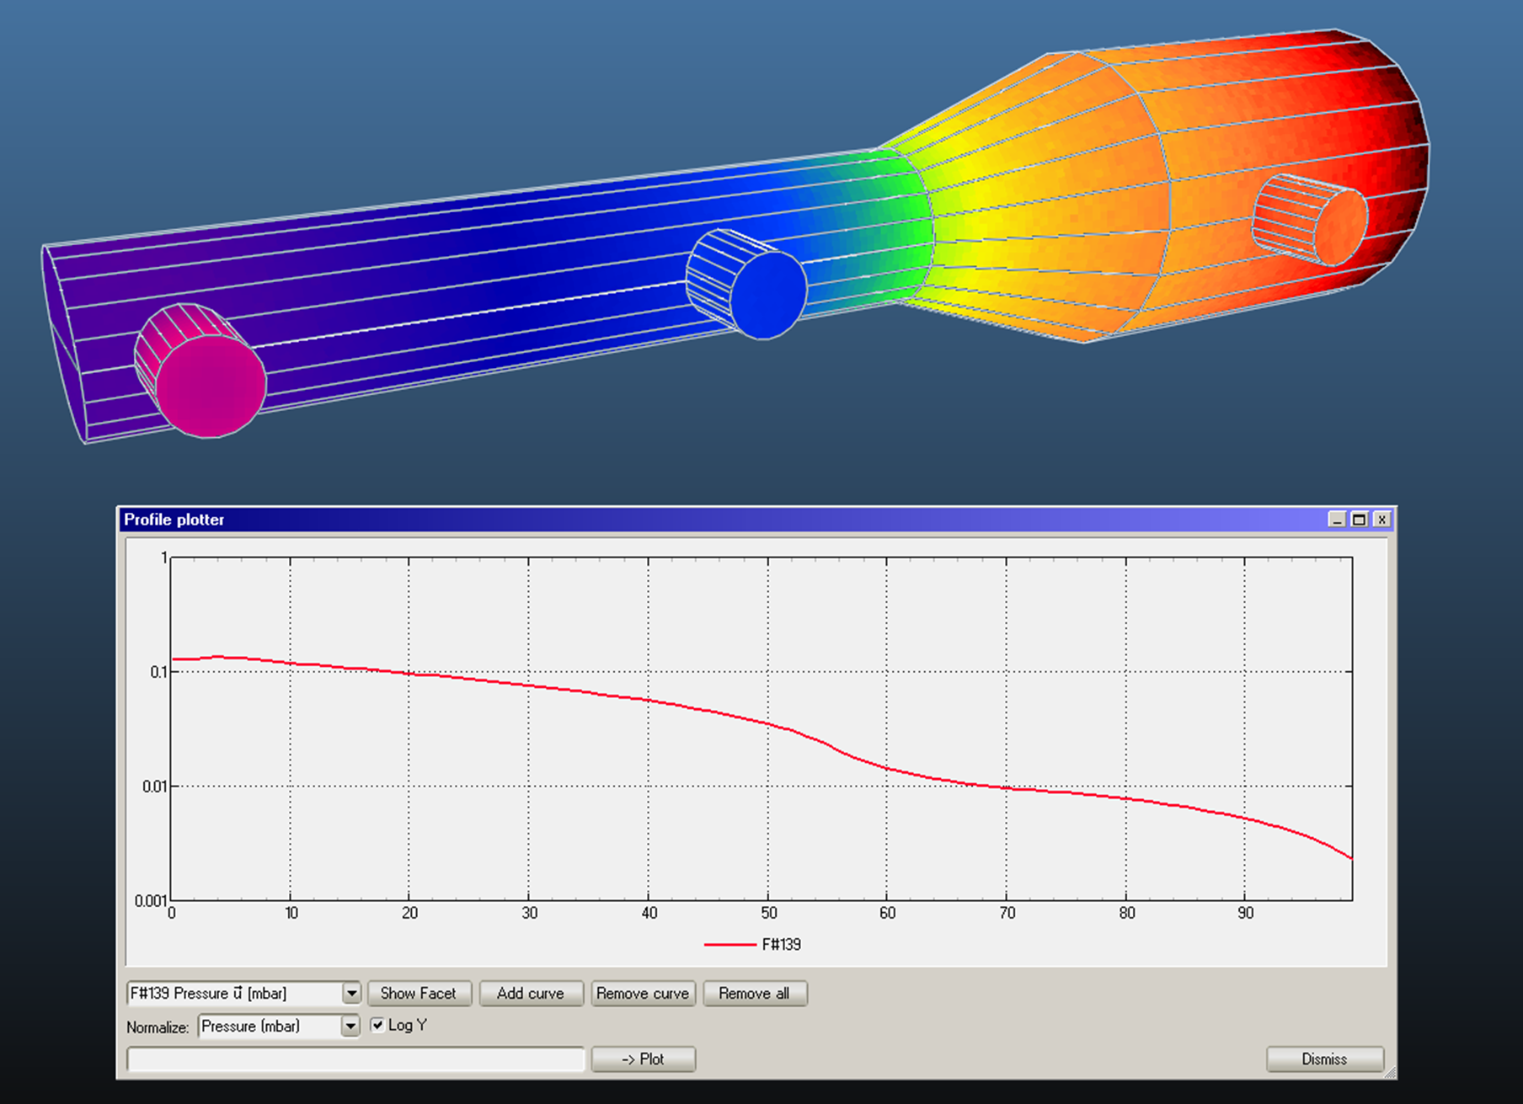
Step 3: simulation and results
100k molecules

Slide 20
You are welcome to join our group for the practical days !

Slide 21
Thank you for your attention !!!

