Slide 1
Test stand description and parameters clarification.

Slide 2
Outline
Current design of test-stand overview:
  Current status
  Future upgrade
Discussion:
  Beam parameters:
    Size - vacuum system
    Pulse structure
    Current
    Energy
  Planned measurements to be performed
  Requirements for beam diagnostics:
    Beam profile (YAG screen, pin-hole Faraday cup)
    Beam current (FC, current transformers)
    Longitudinal beam pulse structure (resolution)

Slide 3
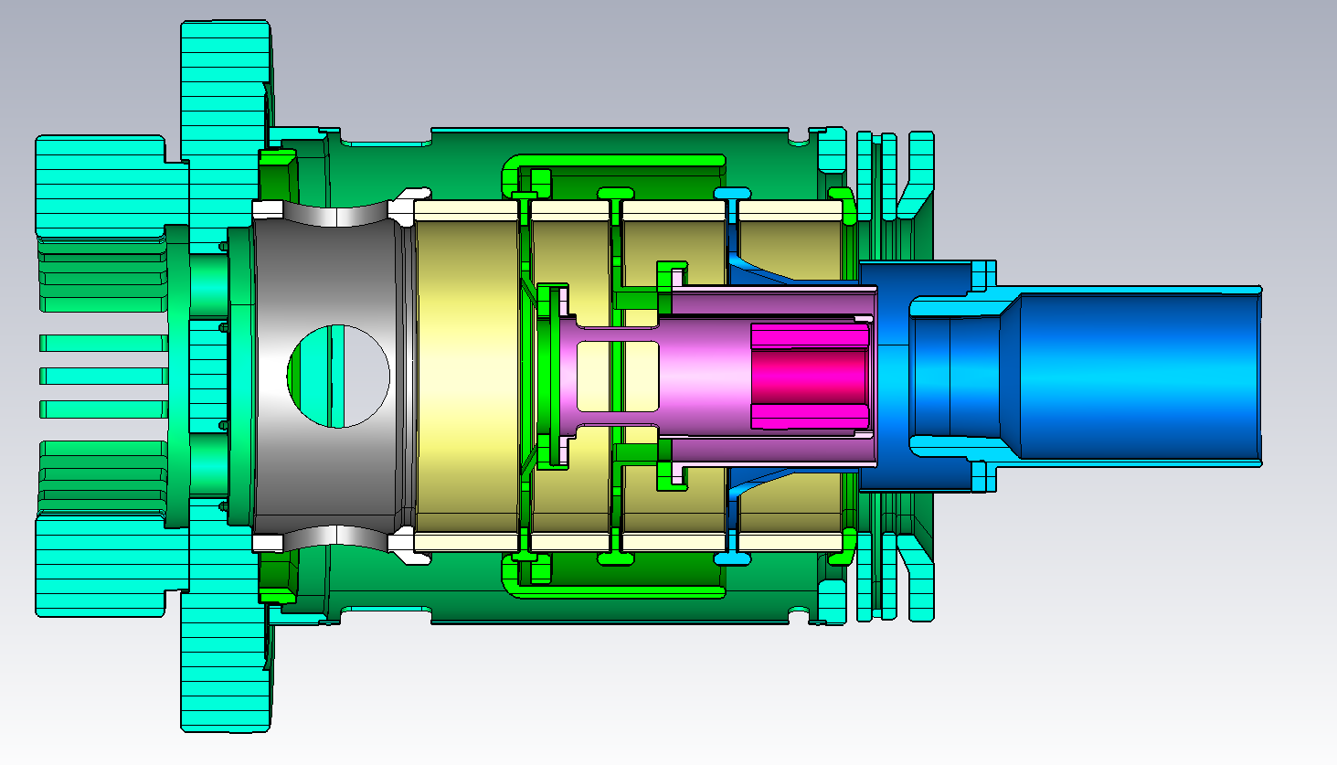
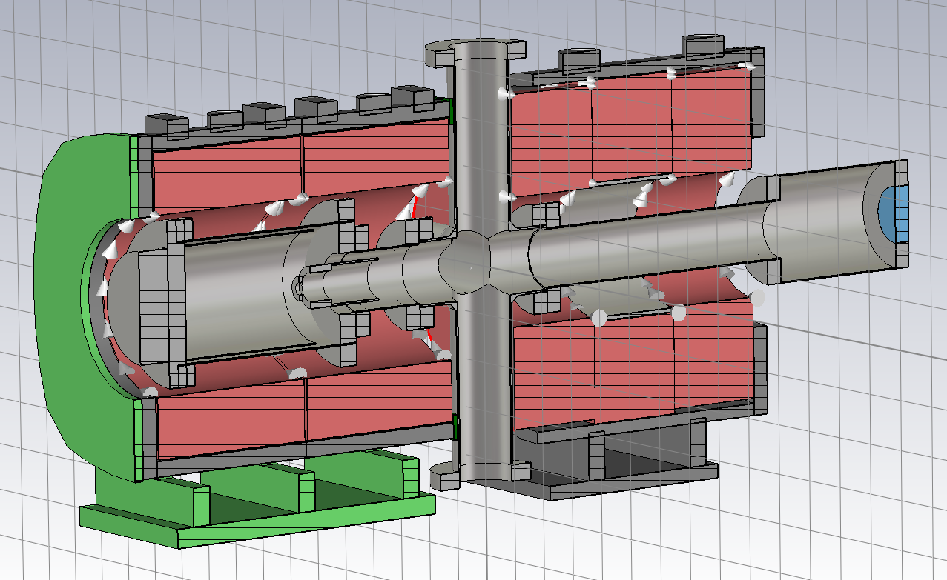
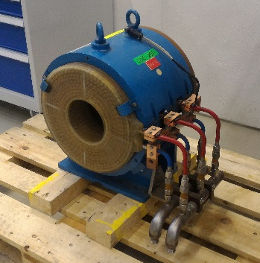
Current design overview
Cathode of the electron - gun
Collector / Faraday cup
Gun solenoid
“Diagnostics box”
Collector solenoid

Slide 4
Purposes
Test bench for tests electron guns and instrumentation:
  Development and commissioning diagnostics tools and procedures for beam parameters measurement (current, profile, energy distribution)
  Safety and technical aspects of operation
  Commissioning HV system
  Electron gun tests
  Tests with Beam Gas Curtain monitor

Slide 5
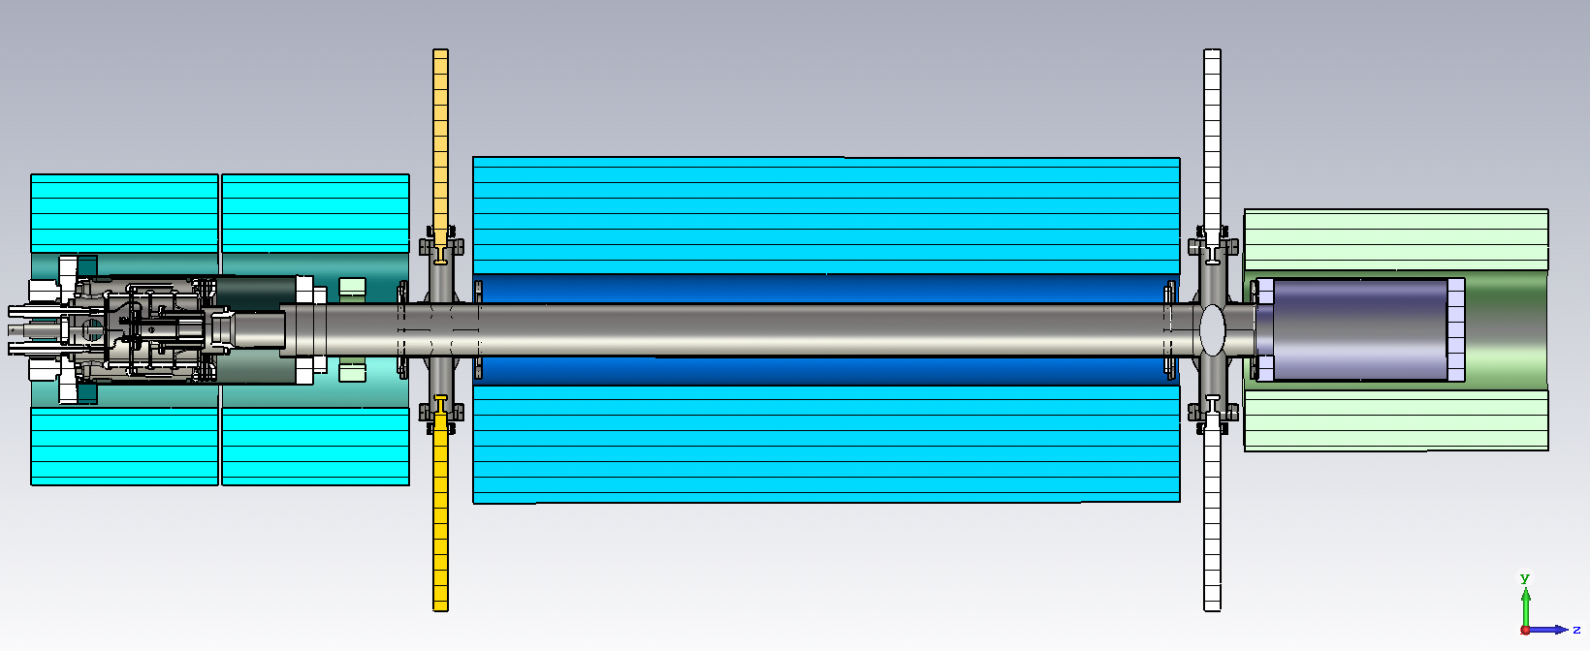
Upgrade
Purpose of this stage:
Study electron beam dynamics with drift/compression
Computer model validation (CST particle studio, WARP)
Test Beam Position Monitor ‘shoe-box’ with very HF modulation
Study electron beam dynamics in regime close to virtual cathode

Slide 6
Timeline:
Delivery time for several critical components (XYZ scanner for pinhole, HV pulse generator, …) is 16 weeks. Time for commissioning and integration should be taken into account.
Building preparation (water cooling system, power, HV safety) will require around 6 months.
Optimistically in 6 month after ordering all components test bench will be assembled.
Specification of the beam and requirements for beam measurements should be fixed before 11th December 2017. Components must be ordered this year.

Slide 7
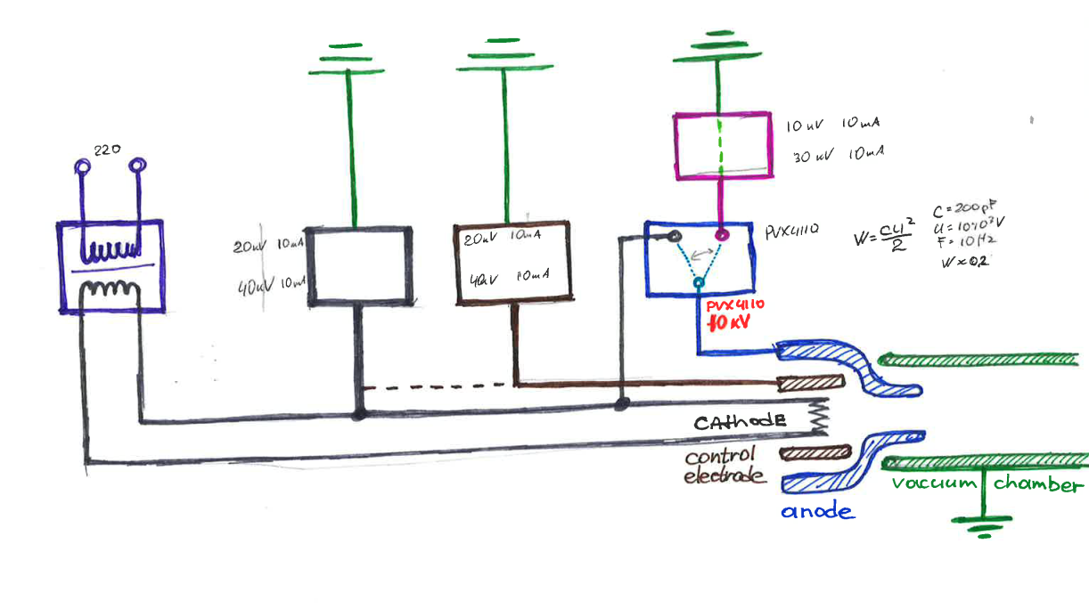
HV circuit
Current system is designed to use
pulsed beam for hollow electron gun tests:
  Extraction potential – 10 kV
  Electron beam energy – up to 15 kV
  Peak current – 5 A
  Pulse length – 10 us
DC beam (15 kV 20 mA)
To discuss:
beam parameters
Pulsed/DC
Current
Extraction potential
Energy
Frequency (if pulsed)
Filament
40V – 10 A
Profiler PS
20 kV – 2 mA
HV pulse generator
10 kV
Cathode PS
20 kV – 25 mA
Bias PS for Pulse generator
10 kV – 2 mA
* Collector PS will be added with biased collector
** Power supply connections will be reconfigured

Slide 8
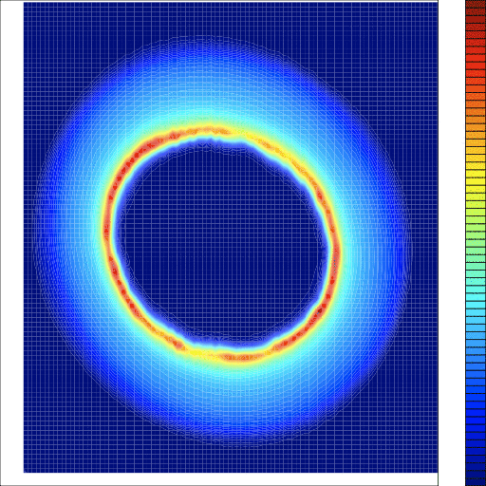
Diagnostics
Diagnostic tools for base-line configuration are installed in the diagnostic box:
Profile measurement
Current measurement
XYZ pin-hole Faraday cup (profile measurement pixel by pixel)
YAG screen (profile measurement in one pulse)
Faraday cup (total current measurement)
Giulio Stancari
https://cdcvs.fnal.gov/redmine/projects/elens/wiki/Hollow_Electron_Beam_Collimator/108

Slide 9
To discuss
Parameters of the beam:
  Size and geometry (can we use one diagnostic box for all measurements)
  Current, energy, DC/pulsed, length of the pulse
Requirements for the solenoids
  Magnetic field
Measurements that are planned to perform on the test bench
Timeline for the beam:
  When gun/vacuum system will be ready (necessary for integration)
  When measurements are planned to be performed
Requirements for diagnostics:
  Profile measurement (YAG screen, pin-hole FC)
  Longitudinal resolution for Faraday Cup

