Slide 1

AIDA-2020 WP15
Upgrade of beam and irradiation test infrastructure
Federico Ravotti (CERN) & Marcel Stanitzki (DESY)
WP15 Satellite Meeting @ 6th BTTB Workshop https://indico.cern.ch/event/683891/

Slide 2
Welcome!
The BTTB series has been a very successful forum for:
  test beam & irradiation facilities users (and coordinators)
  beam telescope users
AIDA-2020 WP15 has a large overlap of activities and participants (Tasks 15.2, 15.3, 15.4) …
Upgrade activities in test-beams and irradiation facilities (Task 15.5) are driven by users requirements …
… natural to take the opportunity to meet and discuss WP15 matters!
Repeat the event after the positive feedback from last year meeting in Barcelona (https://indico.cern.ch/event/591285/)

Slide 3
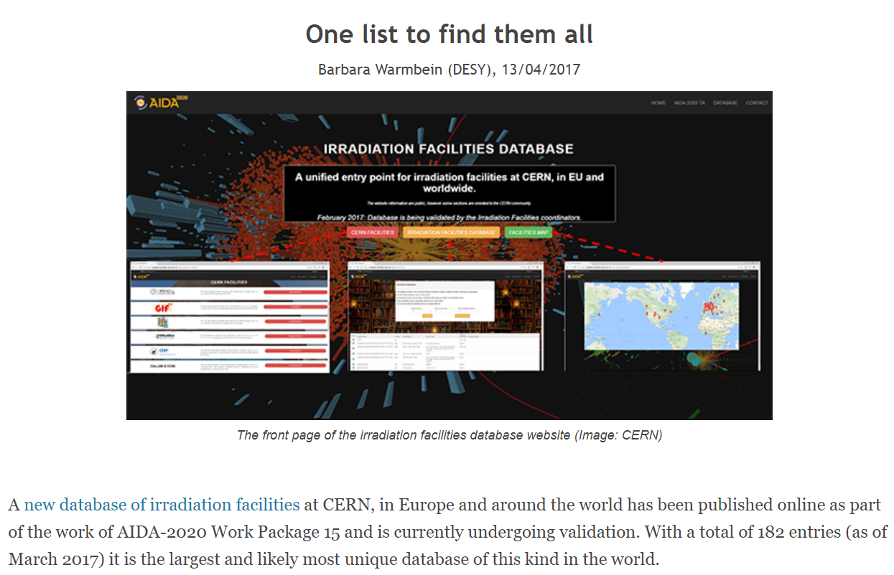
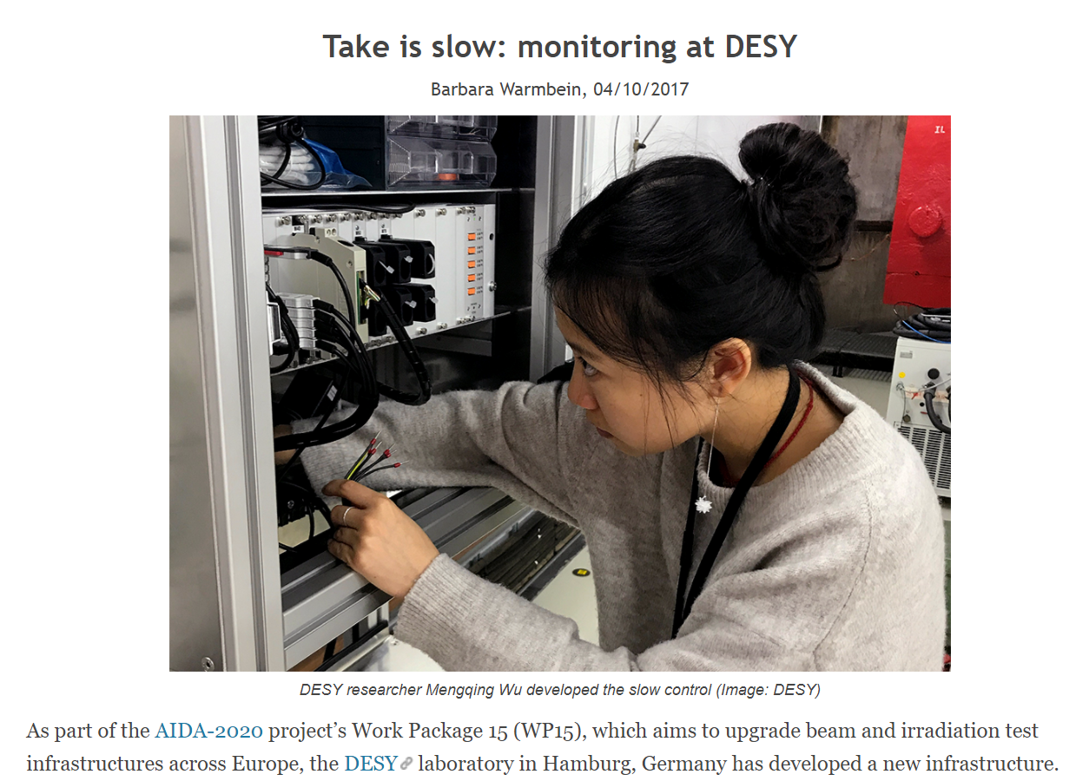
AIDA-2020 News
Third Annual Meeting:
  will be held in Bologna, Italy from 24 to 27 April 2018
  details will be circulated soon, … please, book the dates!
  Extension of AIDA-2020 (1Y) ?:
  no call for detectors closing in ‘18/’19
  no additional funding … but keeping community together!
  discussion (& decision) in Bologna
  On Track newsletter:
  http://aida2020.web.cern.ch/content/newsletter
  several articles on WP15 activities were prepared during 2017

Slide 4
WP 15 Structure
Task 15.1: Scientific coordination (CERN, DESY)
Task 15.2: Improvements of test beam infrastructure for high precision
tracking (CERN, DESY)
Task 15.3: Improvements of the DESY test beam infrastructure (DESY)
Task 15.4: Improvements of the test beam infrastructure at LNF (INFN)
Task 15.5: Improvements of the infrastructure for irradiation tests
(CERN, INFN, VU, INRNE, JSI, USFD*)
*associated partner linked to CERN

Slide 5
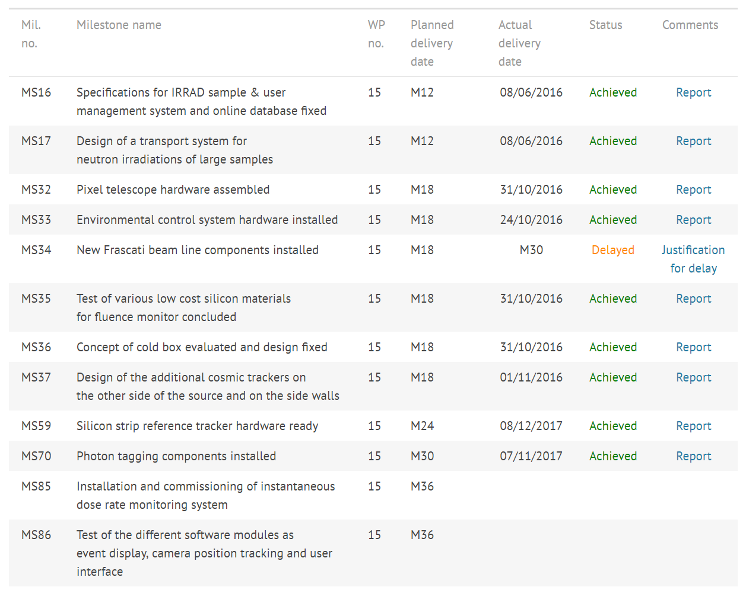
Milestones
components delivered first half 2018 ?
~M40
GIF⁺⁺ upgrade: expected by the end of 3rd year

Slide 6
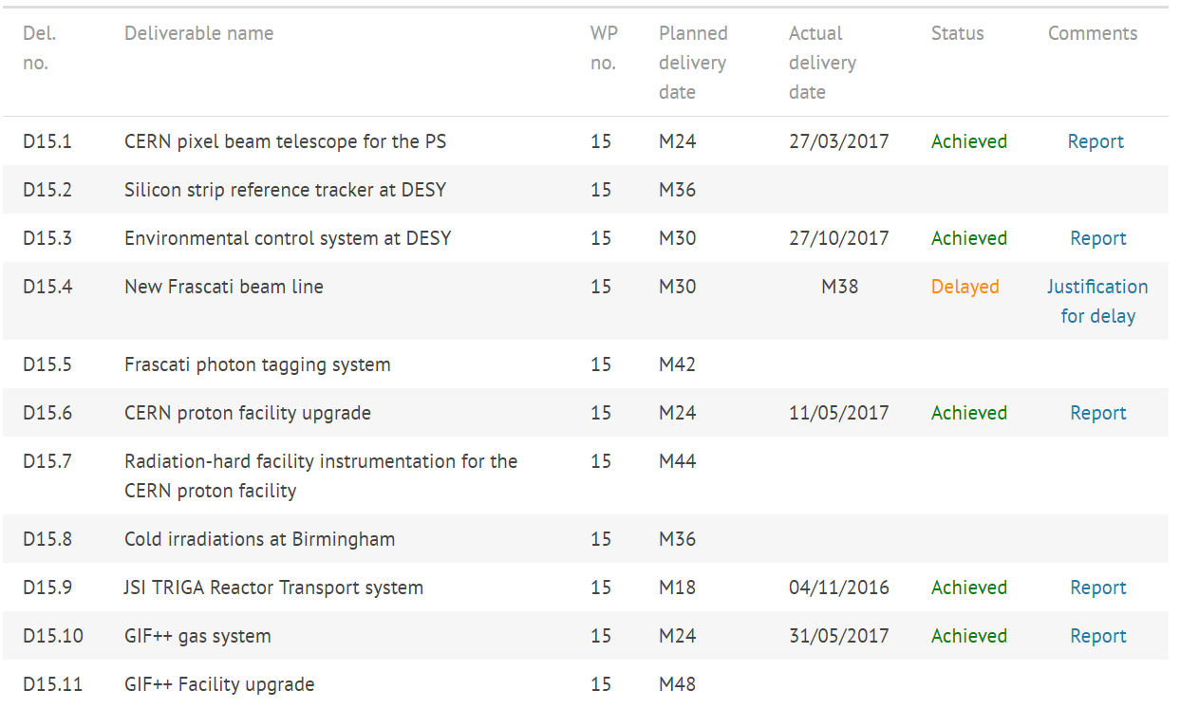
Deliverables
(end of 3rd year)
(delay of MS34)
M45 ?
(link with D15.4 ?)
(end of 3rd year)

Slide 7
Reports …
AIDA-2020 comes with a certain amount of paperwork:
  Annual Reports, Milestone Reports, Deliverable Reports, etc…
  contractual obligation with the EU
Deadlines:
  reports need to be read & edited by WP15 management, AIDA-2020 management before being uploaded on the EU system
  expect comments
Please, have the reports ready at the time we asked them to be! Thanks!

Slide 8
Outreach
Becoming more and more important!
  frequently asked/reminded by AIDA-2020 coordination
39 (+1) records for WP15 in CDS so far (including official reports)
  http://cds.cern.ch/collection/AIDA-2020?ln=en
Please, submit your publications related to WP15 activities:
  http://aida2020.web.cern.ch/content/submit-your-publication
  journal publications, conference/workshop papers, scientific/technical notes, academic dissertations, posters, presentations and handouts, press articles, etc …
and, please, remember the AIDA-2020 acknowledgement text!
  http://aida2020.web.cern.ch/science/publications

Slide 9
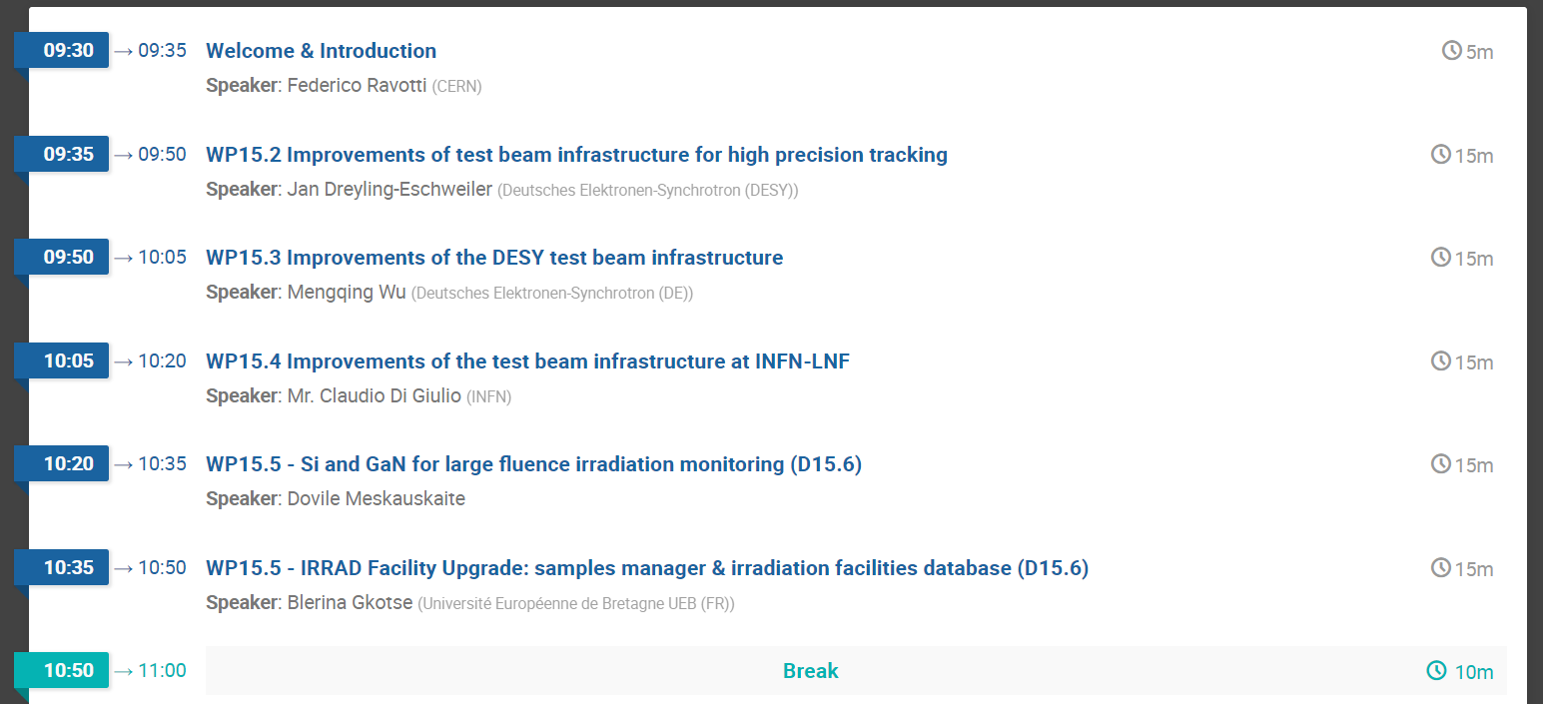
Today’s Program …
Test-beams & Tracking
Irradiation Facilities

Slide 10
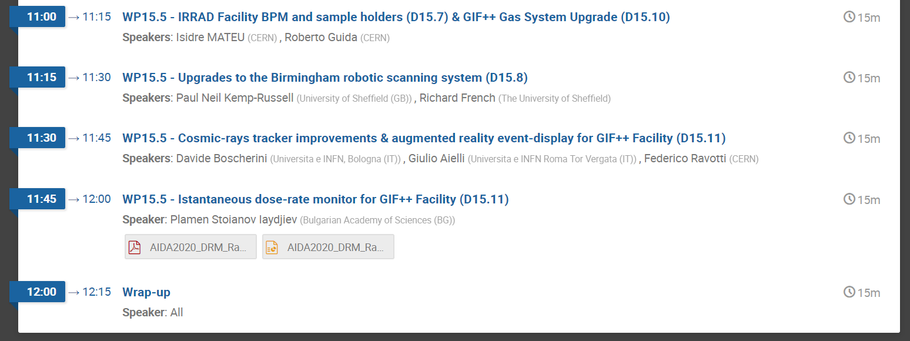
Today’s Program
Irradiation Facilities

