Slide 1


LHC Upgrades and
Future Circular Colliders
M. Benedikt
gratefully acknowledging input from HL-LHC project team, FCC coordination group global design study team and many other contributors.
HL-LHC
PS
FCC
SPS
Particular thanks to O. Bruning and F. Zimmermann for providing some read-to-use slides.
http://cern.ch/fcc
Work supported by the European Commission under the HORIZON 2020 project EuroCirCol, grant agreement 654305

Slide 2
Outline
HL-LHC motivation and goals
HL-LHC building blocks
FCC motivation and scope
  Parameters
  Design Status
  Technologies

Slide 3
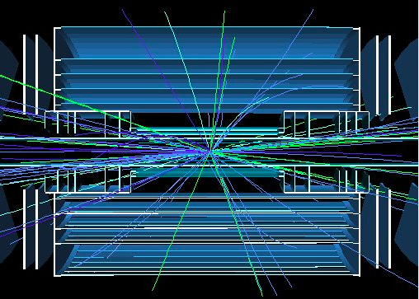
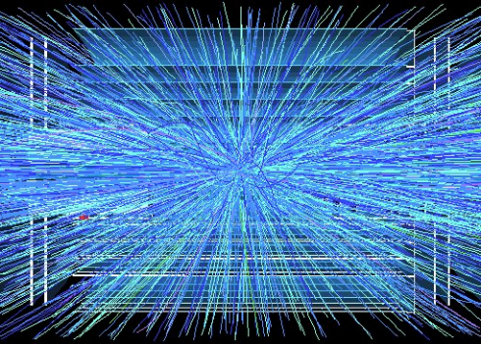
Goal of High Luminosity LHC (HL-LHC)
The main objective of HiLumi LHC Design Study is to determine a hardware configuration and a set of beam parameters that will allow the LHC to reach the
following targets:
Prepare machine for operation beyond 2025 and up to 2035
Devise beam parameters and operation scenarios for:
# enabling at total integrated luminosity of 3000 fb⁻¹
# implying an integrated luminosity of 250 fb⁻¹ per year,
# design oper. for μ = 140 (➔ peak luminosity 5 10³⁴ cm⁻² s⁻¹)
Operation with levelled luminosity! (beta*, crossing angle & crab cavity)
10x the luminosity reach of first 10 years of LHC operation!!
400
events
5 events

Slide 4
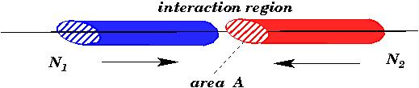
Recap: Luminosity
colliding bunches:
with:
is determined by the magnet arrangement & powering
ε_{n} is determined by the injector chain
goal:
high bunch intensity and many bunches
small β at IP and high collision energy
L_{peak} >2 x 10³⁵ cm⁻²s⁻¹

Slide 5
LHC upgrade goals: performance optimization
Luminosity recipe (round beams):
  maximize bunch intensities (1.1 → 2.2x10¹¹ )
  minimize the beam emittance (3.75→ 2.5 μm)
minimize beam size (β∗ 0.55 → 0.15 m);
compensate for ‘F’ geometry crossing;
improve machine ‘Efficiency’
Injector complex
Upgrade LIU
New triplets
Crab Cavities
minimize number of unscheduled beam aborts

Slide 6
LHC Limitations and HL-LHC challenges
Insertion quadrupole magnets lifetime and aperture:
➔ New insertion magnets and low-β with increased aperture
Geometric Reduction Factor: ➔ SC Crab Cavities
  ➔ New technology and first time for a hadron storage ring!
Performance Optimization: Pileup density ➔ Lumi levelling
  ➔ requires virtual luminosity >> target levelled luminosity
Beam power & losses ➔ addt’l collimators in dispersion suppressors
Machine effciency and availability:
  # R2E ➔ removal of all electronics from tunnel region
  # e-cloud ➔ beam scrubbing (conditioning of surface), etc
Technical bottle necks (e.g. cryogenics)
Civil Engineering (underground)

Slide 7
LHC technical bottleneck:
Radiation damage to triplet magnets at 300 fb-1
Cold bore insulation
≈ 35 MGy
Q2
27 MGy
MCBX3 20 MGy

Slide 8
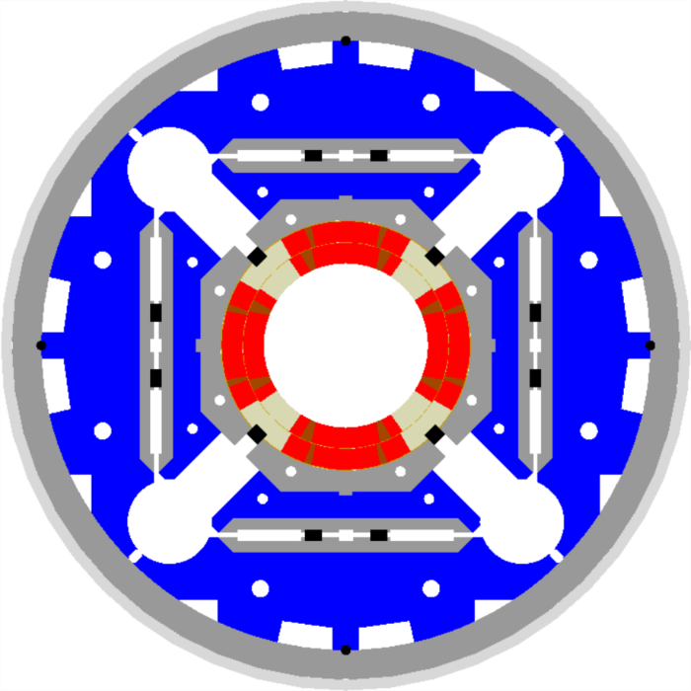
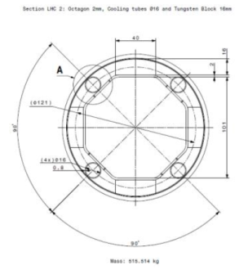
HL-LHC technical bottleneck:
Radiation damage to triplet magnets
Tungsten blocks
Need to replace existing triplet magnets with radiation hard system (shielding!) such that the new magnet coils receive a similar radiation dose @ 10 times higher integrated luminosity 3000 fb⁻¹! ➔ Shielding!
US-LARP MQXF magnet design
Based on Nb₃Sn
technology
Requires larger aperture!
New magnet technology
LHC: 70mm at 210 T/m ➔HL@ 150mm diameter 140 T/m
LHC: 8T peak field at coils ➔ HL> 12T field at coils (Nb₃Sn)!
Capillaries

Slide 9
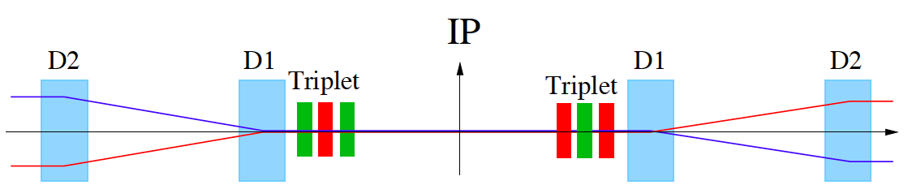
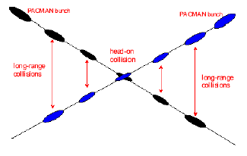
HL-LHC Challenges: Crossing Angle
Insertion Layout:
ca.130m ➔ 150m
ca.50m
Parasitic bunch encounters:
Operation with ca. 2800 bunches @ 25ns spacing ➔ approximately 30 unwanted collisions per
Interaction Region (IR).
Operation requires crossing angle prop. 1/√β*.
Factor 2 increase, 2 x 150 to 2 x 300 μrad)
Perturbations from long-range beam-beam interaction:
efficient operation requires large beam separation at unwanted collision points ➔ Separation of 10 -12 σ ➔ larger triplet apertures for HL-LHC!

Slide 10
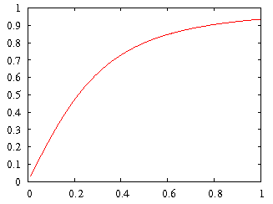
HL-LHC Upgrade Ingredients: Crab Cavities
Geometric Luminosity
Reduction Factor:
Crab Cavities:
Reduces the effect of geometrical reduction factor
Independent for each IP
Challenging space constraints:
➔ requires novel compact
cavity design
effective cross section
HL-LHC

Slide 11
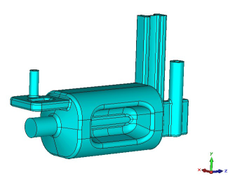
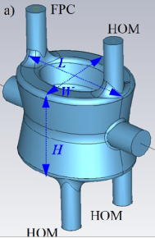
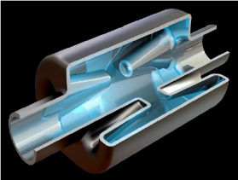
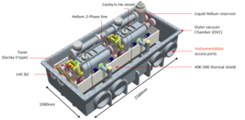
HL-LHC crab cavity designs
3 Advanced Design Studies with
Different Coupler concepts
RF Dipole: Waveguide or
waveguide-coax couplers
Double ¼-wave: Coaxial couplers with
hook-type antenna
Double ¼-wave installed in SPS
during last shutdown 2017/2018
4-rod: Coaxial couplers with different antenna types
Present baseline: 4 cavity/cryomod
TEST presently ongoing in SPS

Slide 12
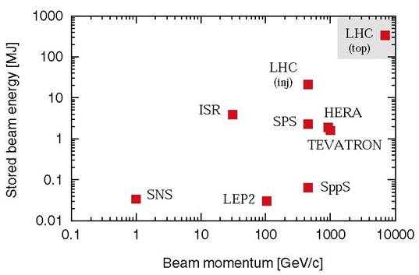
LHC Challenges: Beam Power
Unprecedented beam power:
potential equipment
damage in case
of failures
during
operation
In case of
failure the
beam must
never reach
sensitive
equipment!
Stored Beam power:
HL-LHC > 500 MJ / beam

Slide 13
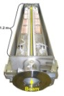
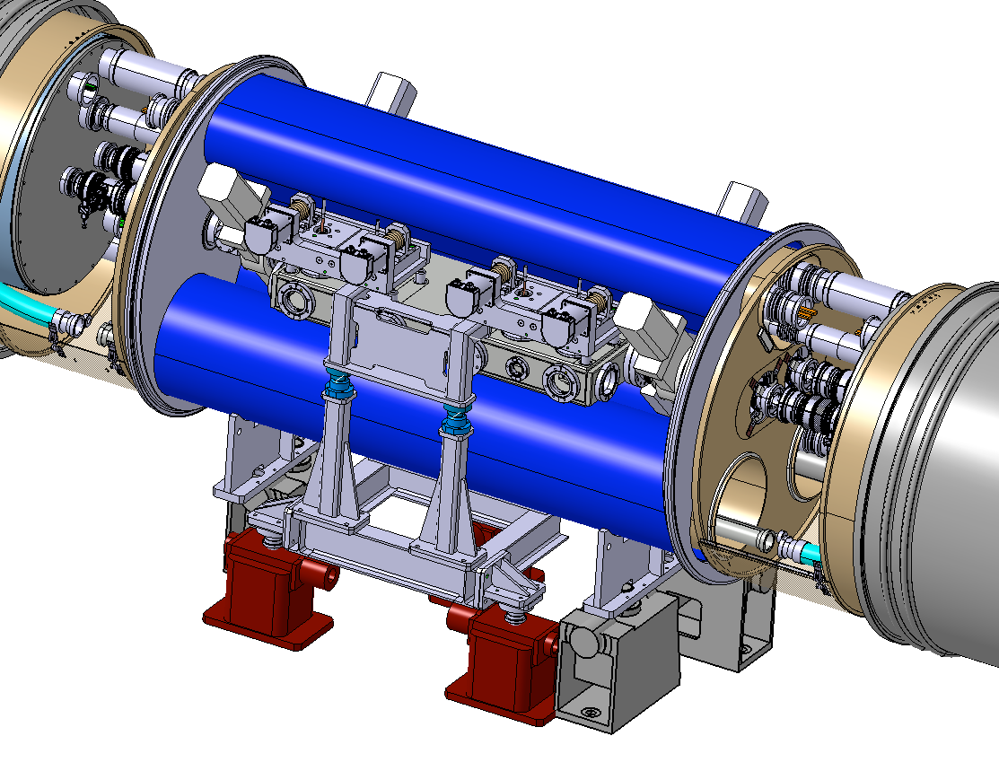
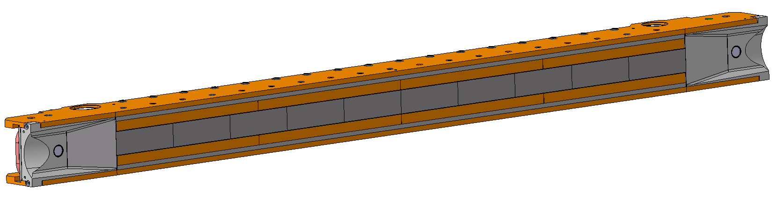
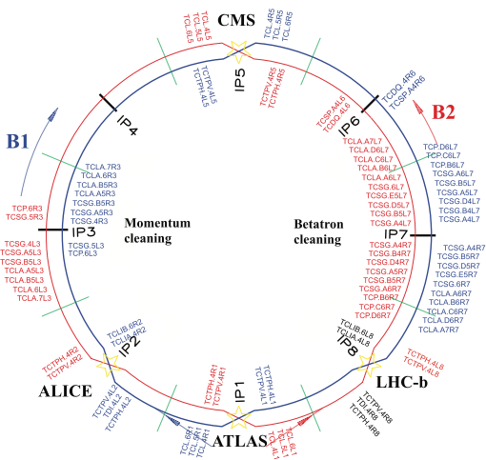
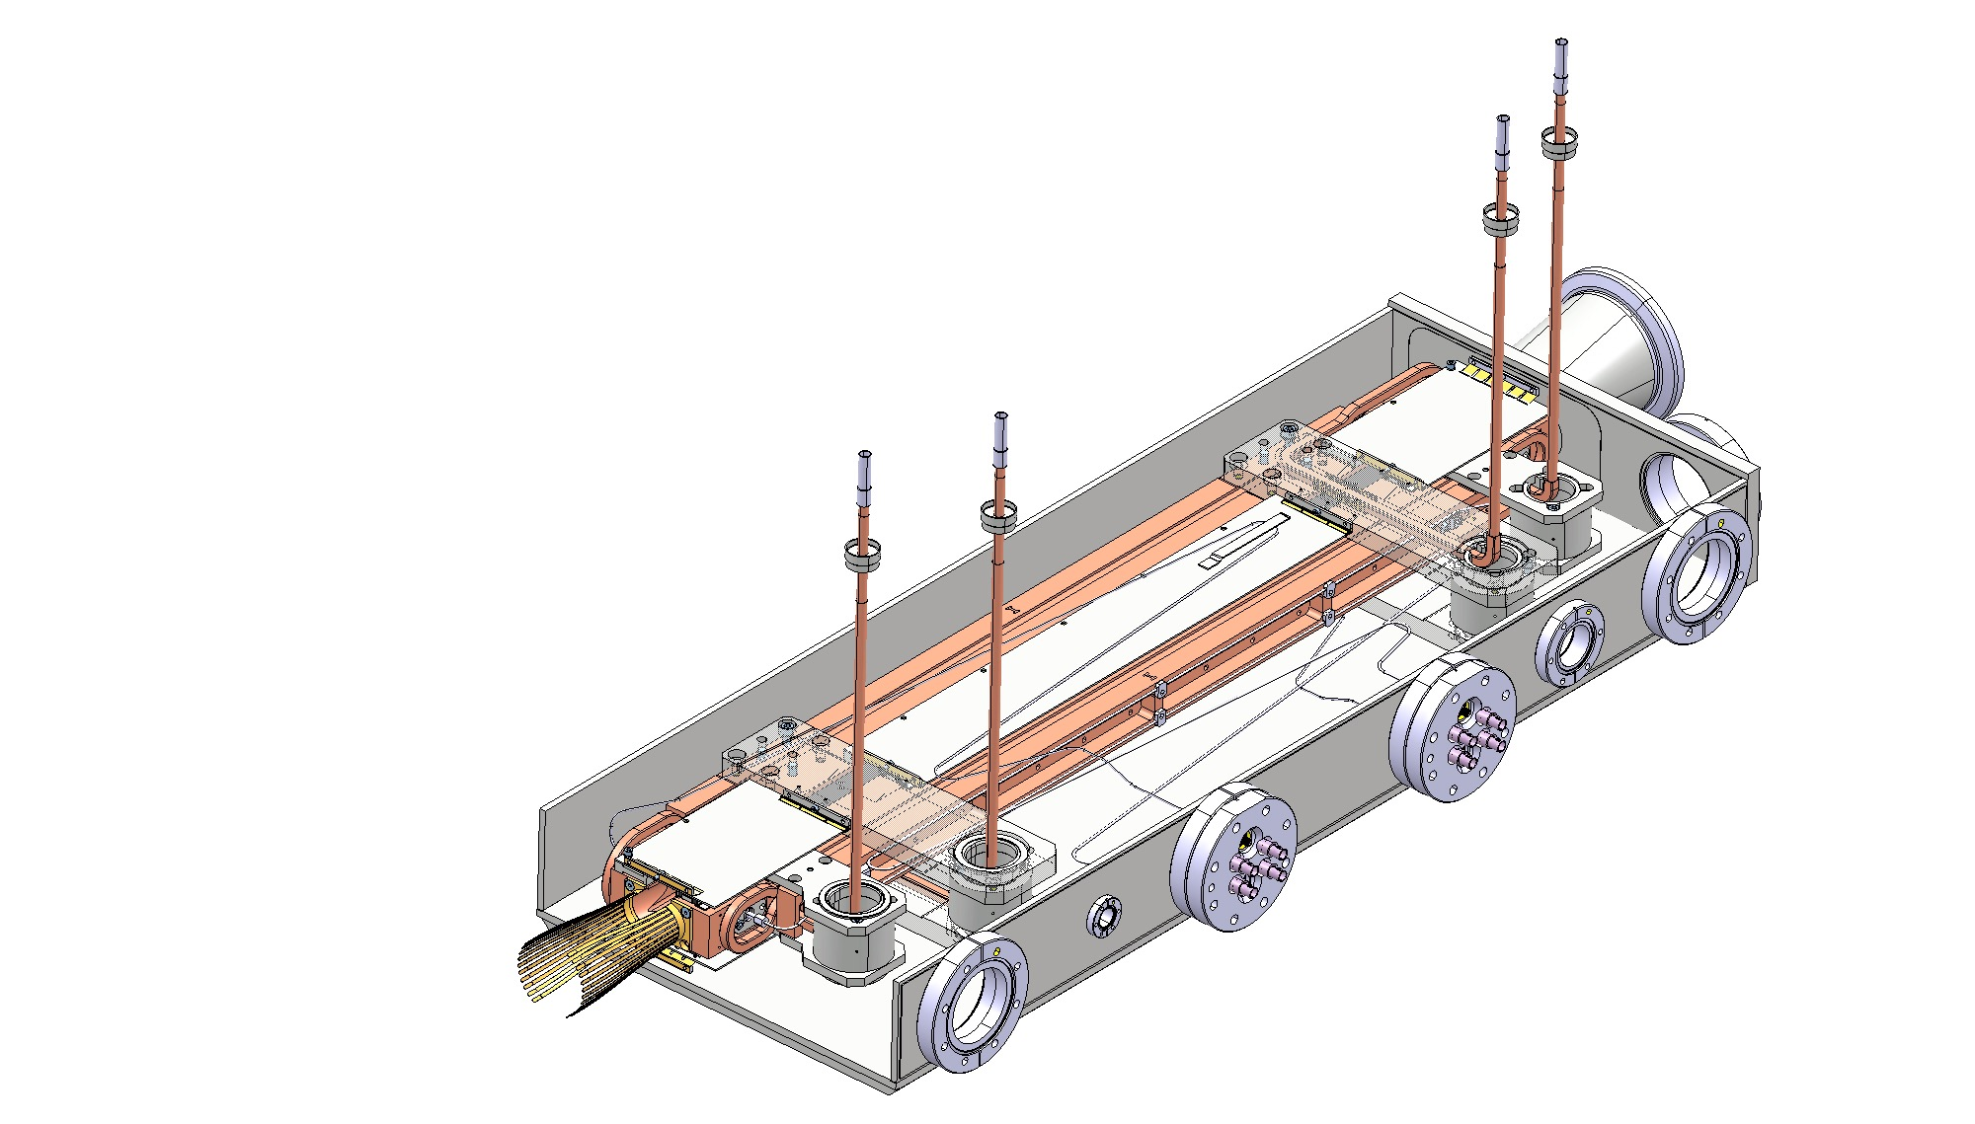
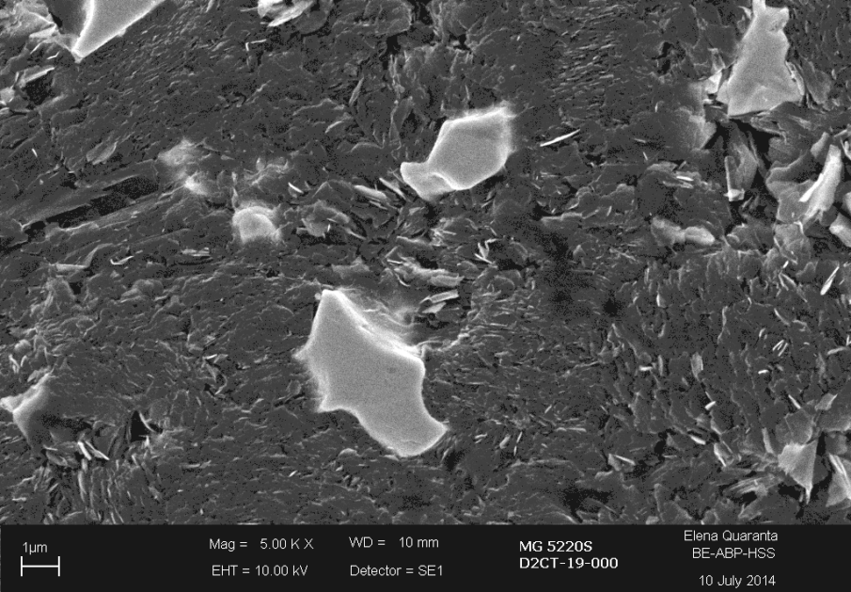
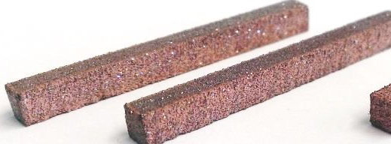
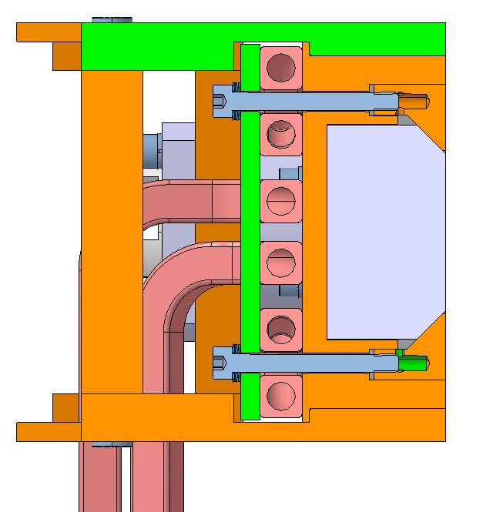
Collimation system upgrades
Completely new layouts
Novel materials.
IR1+IR5, per beam:
4 tertiary collimators
3 physics debris collimators
fixed masks
40 new collimators to be produced by LS3 in
the present baseline!
Cleaning: DS coll. + 11T dipoles, 2 units per beam
Ion physics debris:
DS collimation
Low-impedance, high robustness secondary collimators
S. Redaelli,
Chamonix 2016, 28-01-2016

Slide 14
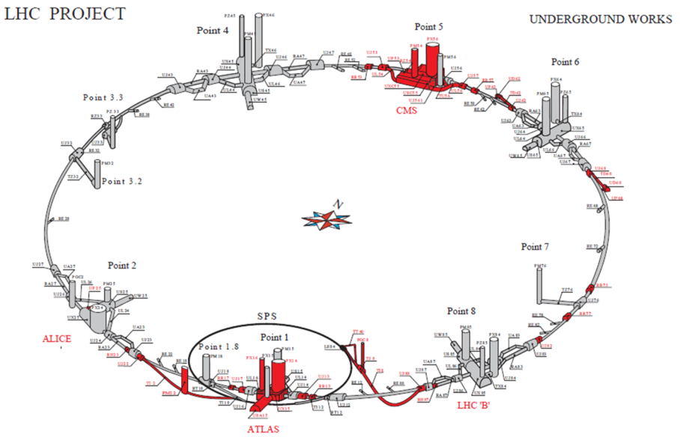
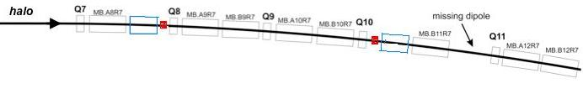

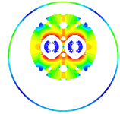

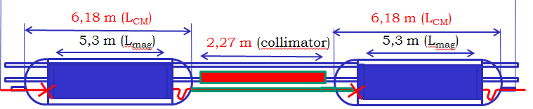
Dispersion Suppressor collimators –
11 T Nb3Sn Dipole (LS2 -2018)
MB.B8R/L
MB.B11R/L
11 T Nb₃Sn

Slide 15
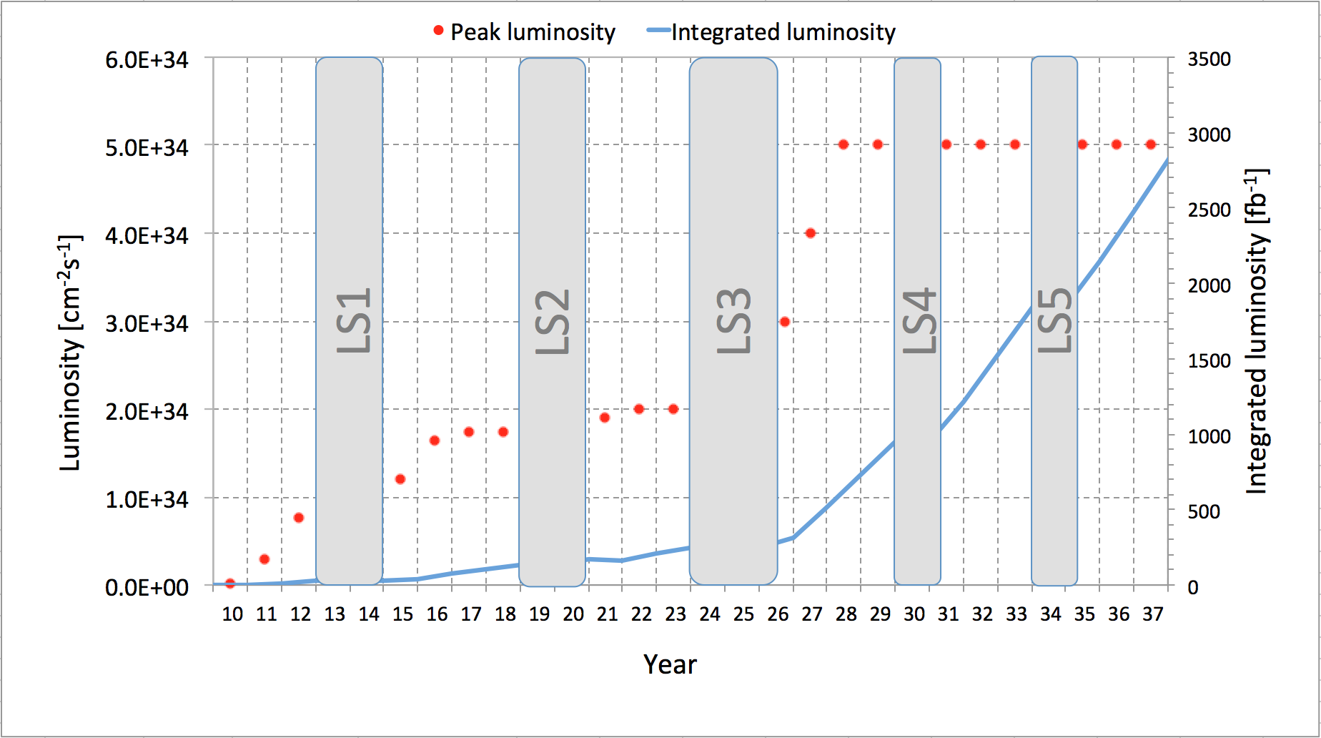
Implementation & Performance Projection:
Run I
Run II
Run III
1000 fb⁻¹
3000 fb⁻¹
Splices fixed
Injectors
upgrade
11 T dipoles
New
Low-β*
quads Crab
Cavity
Phase1
Detectors
Crab
Cavity
Phase2
25 fb⁻¹
LIU
Technical limits (in experiments, too)
Energy
6.5TeV
Intensity
Upgrade
300 fb⁻¹
0.75 10³⁴ cm⁻²s⁻¹
50 ns bunch
high pile up ∼40
1.5 10³⁴ cm⁻²s⁻¹
25 ns bunch
high pile up ∼40
1.5 -2.2 10³⁴ cm⁻²s⁻¹
25 ns bunch
very high pile up > 60
5 10³⁴ cm⁻²s⁻¹
levelled
25 ns bunch
very high pile up ∼140
Cryogenic limit, Radiation &
Damage of triplet magnets

Slide 16
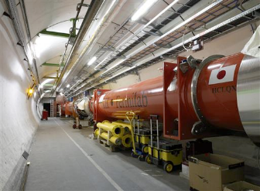





The critical zones around IP1 and IP5
ATLAS
CMS
3. For collimation we also need to change the DS in the continuous cryostat: 11T Nb₃Sn dipole
2. We also need to modify a large part of the matching section
e.g. Crab Cavities &
D1, D2, Q4 & corrector
New triplet Nb₃Sn
required due to:
-Radiation damage
-Need for more aperture
Changing the triplet region is not enough for reaching the HL-LHC goal!
More than 1.2 km of LHC !!
Plus technical infrastructure
(e.g. Cryo and Powering)!!

Slide 17
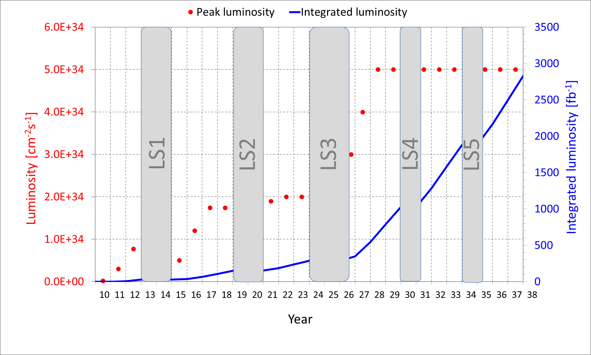
Luminosity profile : NOMINAL HL-LHC
After LS4, proton physics days increase from standard 160 days to 200 and after LS5 to 220

Slide 18


Energy frontier in the 21st century
Very large circular hadron collider - only feasible approach to reach 100 TeV c.m. collision energy in coming decades
Access to new particles (direct production) in few-TeV to 30 TeV mass range, far beyond LHC reach
Much-increased rates for phenomena in sub-TeV mass range → much increased precision w.r.t. LHC
M. Mangano
Hadron collider energy reach
FCC-hh aims at O(10) higher performance (E, L) than LHC
LHC: factor ~4 in radius, factor ~2 in field → O(10) in E_{cms}
$$E∝B_{dipole}{×ρ}_{bending}$$

Slide 19
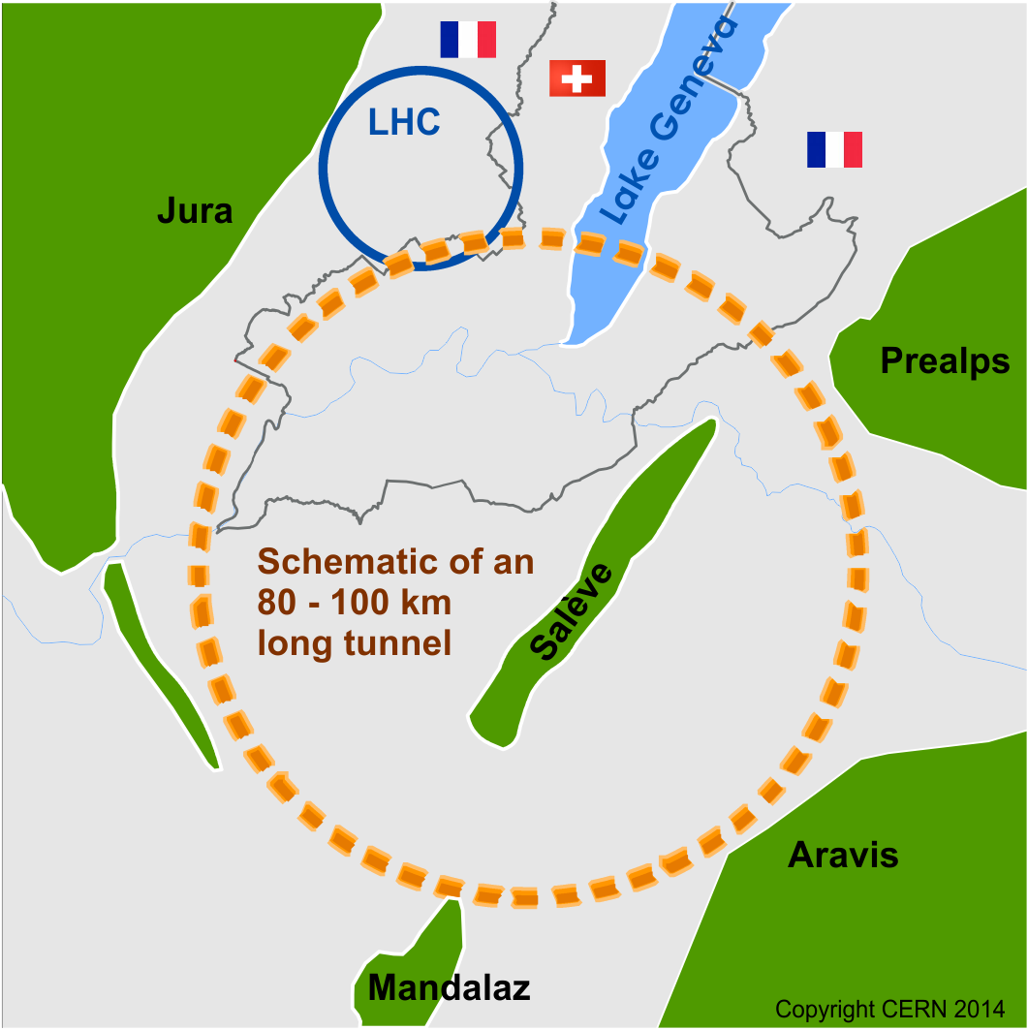
Future Circular Collider Study
Goal: CDR for European Strategy Update 2018/19
International FCC collaboration (CERN as host lab) to study:
pp-collider (FCC-hh) → main emphasis, defining infrastructure requirements
80-100 km tunnel infrastructure in Geneva area, site specific
e⁺e⁻ collider (FCC-ee), as potential first step
p-e (FCC-he) option, integration one IP, FCC-hh & ERL
HE-LHC with FCC-hh technology
~16 T ⇒ 100 TeV pp in 100 km

Slide 20
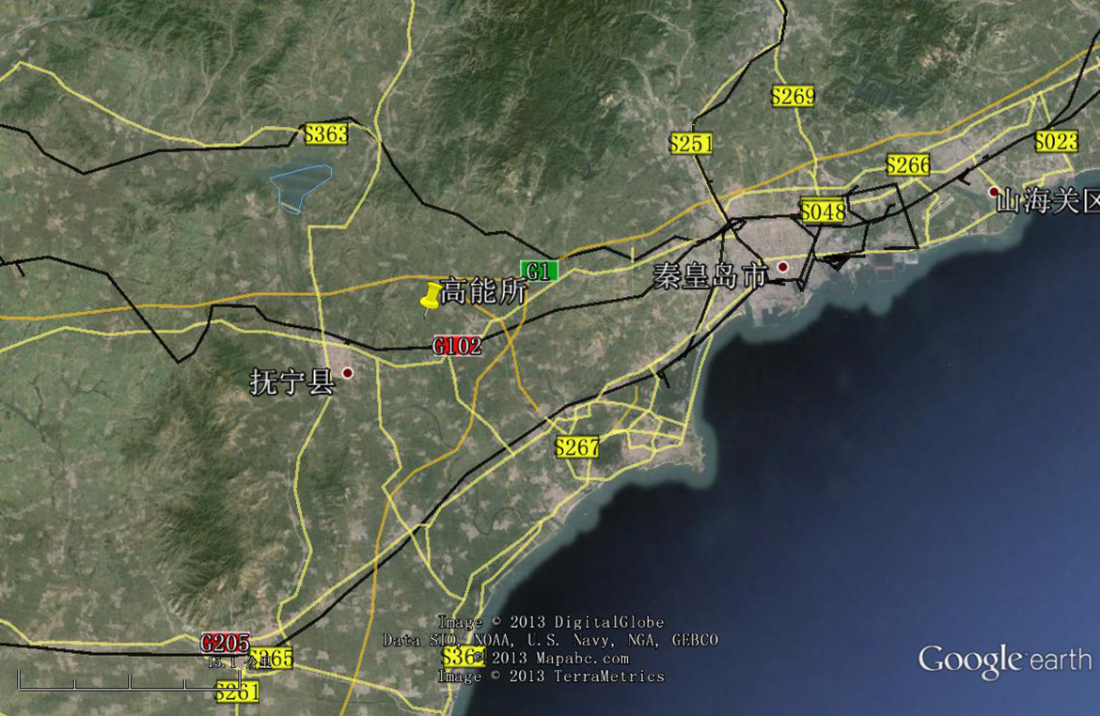
CepC/SppC study (CAS-IHEP) 100 km (new baseline!) , e⁺e⁻ collisions ~2028; pp collisions ~2042
Qinhuangdao (秦皇岛）
CepC, SppC
50 km
100 km
easy access
300 km east
from Beijing
3 h by car
1 h by train
“Chinese Toscana”
Yifang Wang

Slide 21
CERN Circular Colliders & FCC
1980
1985
1990
1995
2000
2005
2010
2015
2020
2025
2030
2035
2040
Constr.
Physics
LEP
Design
Proto
Construction
Physics
LHC – operation run 2
HL-LHC - ongoing project
Design
Construction
Physics
~20 years
FCC – design study
Design
Proto
Construction
Physics
Must advance fast now to be ready for the period 2035 – 2040
Goal of phase 1: CDR by end 2018 for next update of European Strategy

Slide 22
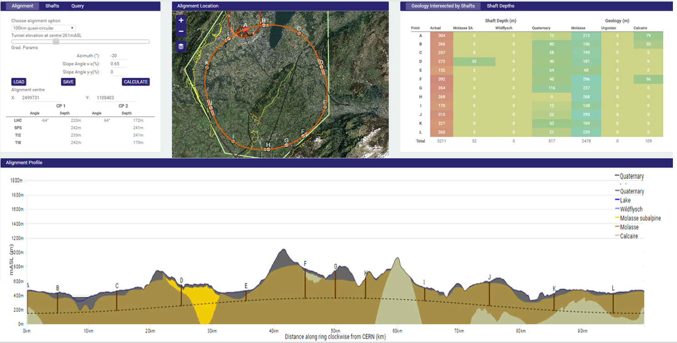
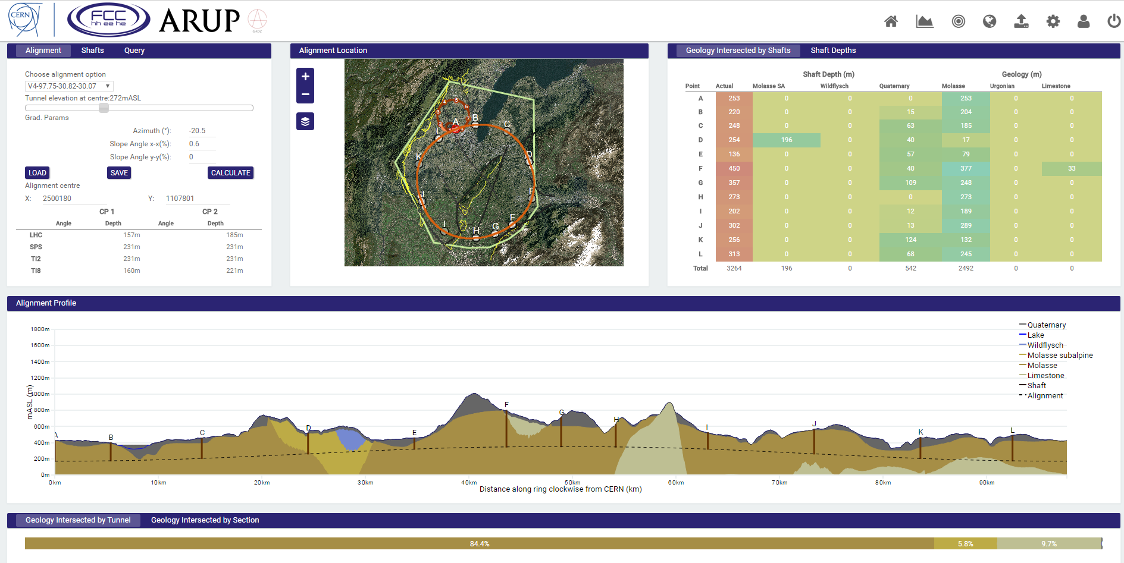
Progress on site investigations
Notes:
Use the latest slides from John/Charlie.
100 km machines, possibly with both versions intersecting and non-intersecting?

Slide 23
Progress on site investigations
90 – 100 km fits geological situation well
LHC suitable as potential injector
The 97.75 km version, intersecting LHC, is now being studied in more detail
Notes:
Use the latest slides from John/Charlie.
100 km machines, possibly with both versions intersecting and non-intersecting?

Slide 24
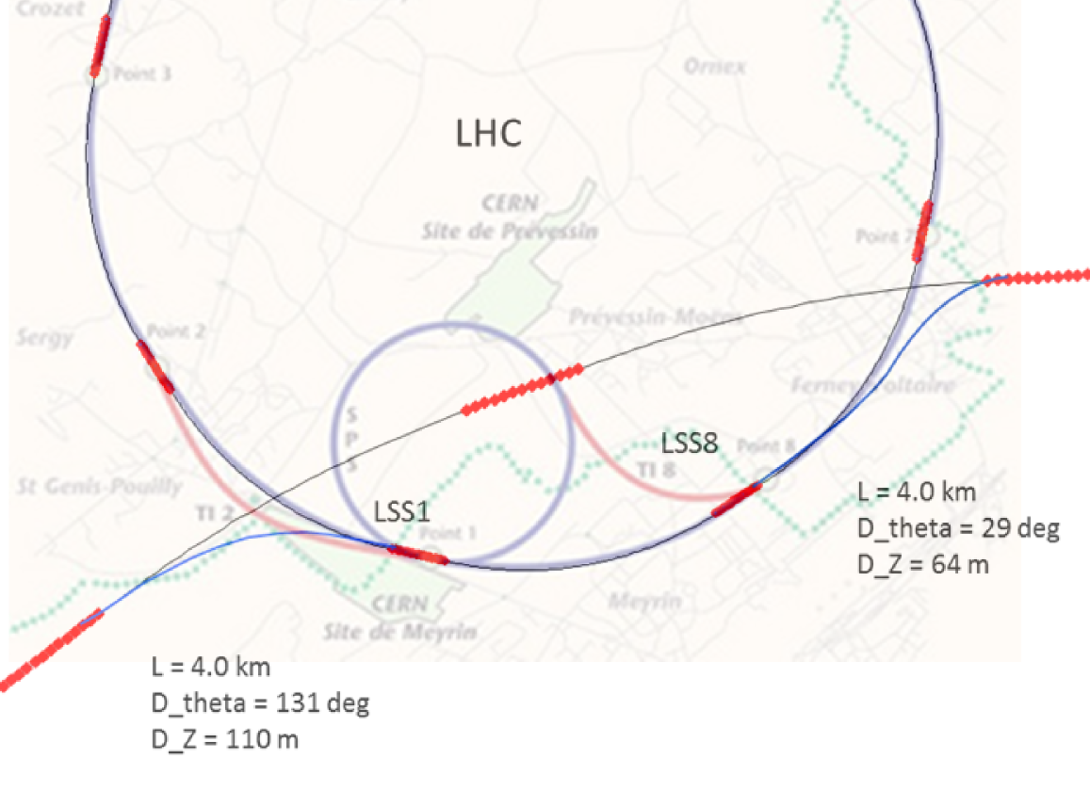
FCC-hh injector studies
Injector options:
SPS → LHC → FCC
SPS/SPS_{upgrade} → FCC
SPS -> FCC booster → FCC
FCC 100 km intersecting version
Current baseline:
injection energy 3.3 TeV LHC
Alternative options:
Injection around 1.3 – 1.4 TeV
compatible with: SPS_{upgrade}, LHC, FCC booster
SPS_{upgrade} could be based on fast-cycling SC magnets, 6-7T, ~ 1T/s ramp
  SC Magnet R&D program being launched (similar to SIS 300 parameters)
Notes:
See talk of Oliver on injection energy
Several options, present baseline is 3.3 GeV
Ínjection at 1.5 TeV studied as alternative, potentially compatible with SPS upgrade

Slide 25
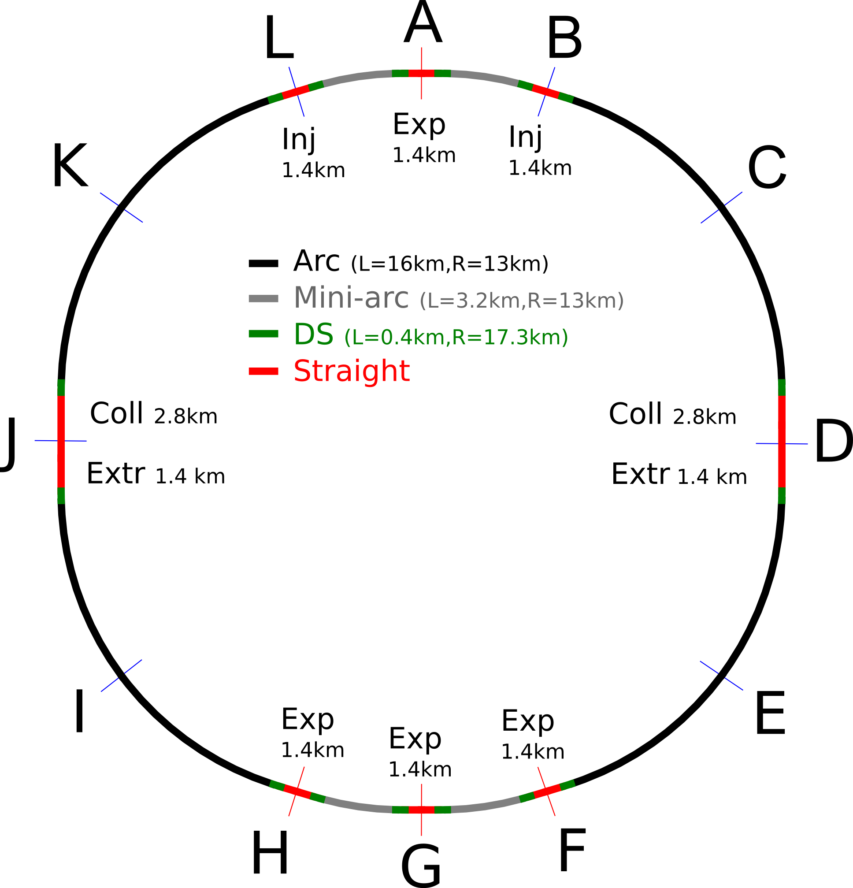
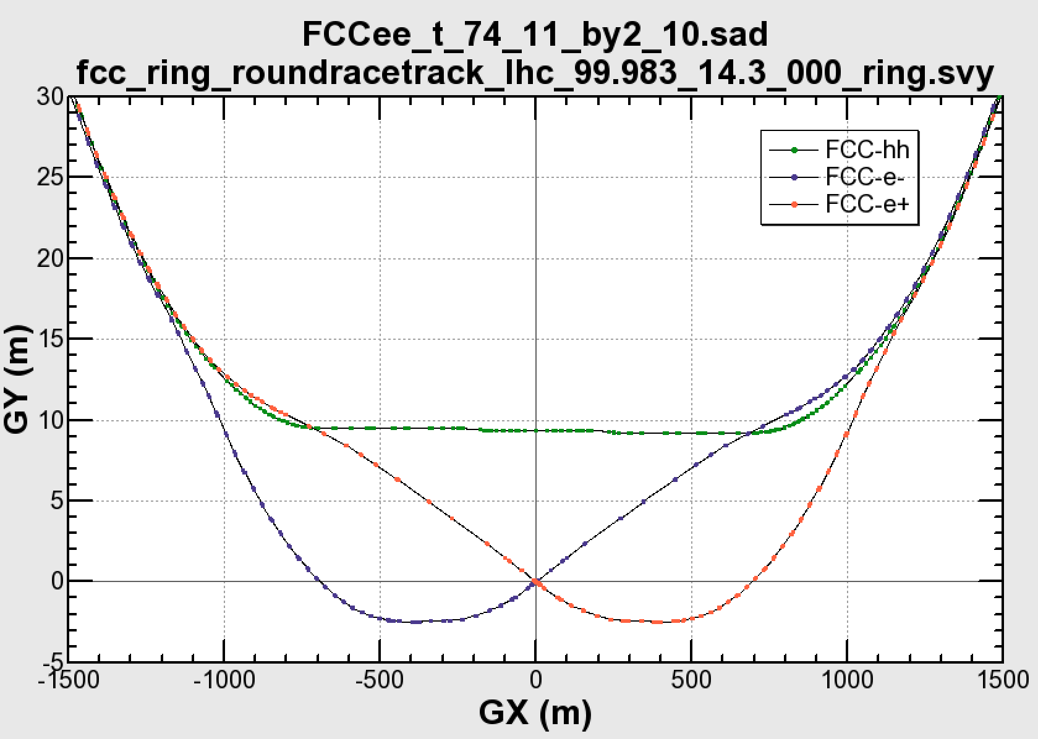

Common layouts for hh & ee
FCC-ee 1, FCC-ee 2,
FCC-ee booster (FCC-hh footprint)
11.9 m
IP
30 mrad
FCC-hh/
ee Booster
9.4 m
0.6 m
Lepton beams must cross over through the common RF to enter the IP from inside.
Only a half of each ring is filled with bunches.
FCC-hh
layout
Common
RF (tt)
Common
RF (tt)
Max. separation of 3(4) rings is about 12 m:
wider tunnel or two tunnels are necessary around the IPs, for ±1.2 km.
2 main IPs in A, G for both machines
asymmetric IR optic/geometry for ee to limit synchrotron radiation to detector
IP
Notes:
Check with Katsunobu to have latest layout.
Check with detector people if 9 m offset is acceptable for ee detector

Slide 26
hadron collider parameters (pp)
parameter | FCC-hh |  | HE-LHC | (HL) LHC
collision energy cms [TeV] | 100 |  | 27 | 14
dipole field [T] | 16 |  | 16 | 8.3
circumference [km] | 100 |  | 27 | 27
# IP | 2 main & 2 |  | 2 & 2 | 2 & 2
beam current [A] | 0.5 |  | 1.27 | (1.12) 0.58
bunch intensity [10¹¹] | 1 (0.2) | 1 (0.2) | 2.5 | (2.2) 1.15
bunch spacing [ns] | 25 (5) | 25 (5) | 25 (5) | 25
IP β*_{x,y} [m] | 1.1 | 0.3 | 0.45 | (0.15) 0.55
luminosity/IP [10³⁴ cm⁻²s⁻¹] | 5 | 30 | 16 | (5) 1
peak #events/bunch crossing | 170 | 1020 (204) | 460 (92) | (135) 27
stored energy/beam [GJ] | 8.4 |  | 1.4 | (0.7) 0.36
synchrotron rad. [W/m/beam] | 30 |  | 4.1 | (0.35) 0.18

Slide 27
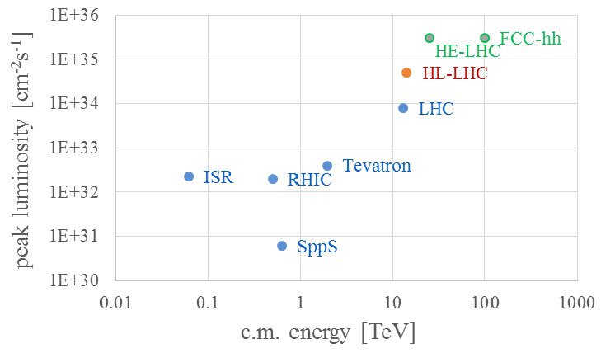
pp/p-pbar in the L-E plane

Slide 28
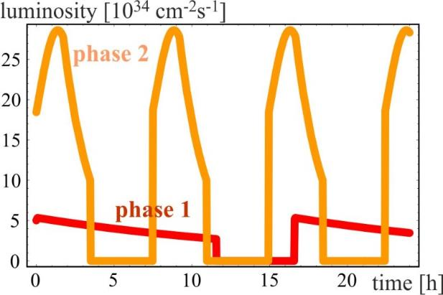
luminosity evolution over 24 h
radiation damping: τ~1 h
PRST-AB 18, 101002 (2015)
  for both phases:
  beam current 0.5 A, unchanged!
  total synchrotron radiation power ~5 MW.
phase 1: β*=1.1 m, ξ_{tot}=0.01, t_{ta}=5 h, 250 fb⁻¹ / year
phase 2: β*=0.3 m, ξ_{tot}=0.03, t_{ta}=4 h, 1000 fb⁻¹ / year

Slide 29
FCC-hh MDI status
Design of interaction region
Distance from IP to first machine quadrupole L*=45 m.
Allows integrated spectrometers and compensation dipoles (or fwd solenoids)
Optics and magnet optimization for beam stay clear and collision debris.
  Magnet (triplet) lifetime should be collider lifetime (from radiation damage).
Notes:
Add one slide showing optics, possibly with some smaller plots on insertions?
Detailed optimisation on optics of each insertion within overall defined boundaries.

Slide 30
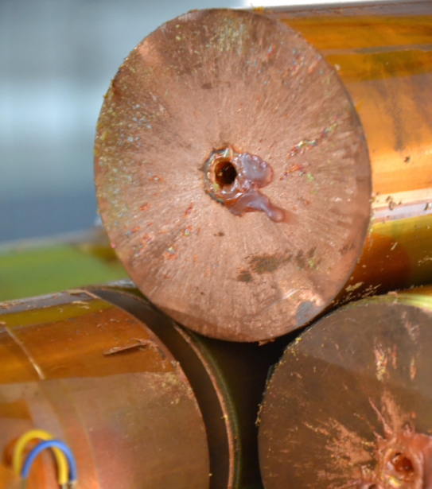

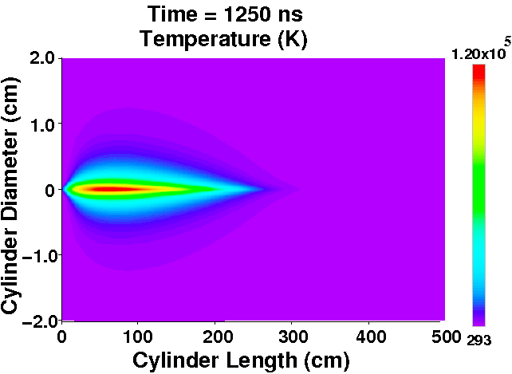
Beam power & machine protection
contributions: beam screen (BS) & cold bore (BS heat radiation)
Stored energy 8.4 GJ per beam
  Factor 25 higher than for LHC, equivalent to A380 (560 t) at nominal speed (850 km/h). Can melt 12t of copper.
  Collimation, control of beam losses and radiation effects (shielding) are of prime importance.
  Injection, beam transfer and beam dump all critical.
Damage of a beam with an energy of 2 MJ
Hydrodynamic tunneling:
beam penetrates ~300 m in Cu
Machine protection issues to be addressed early on!

Slide 31
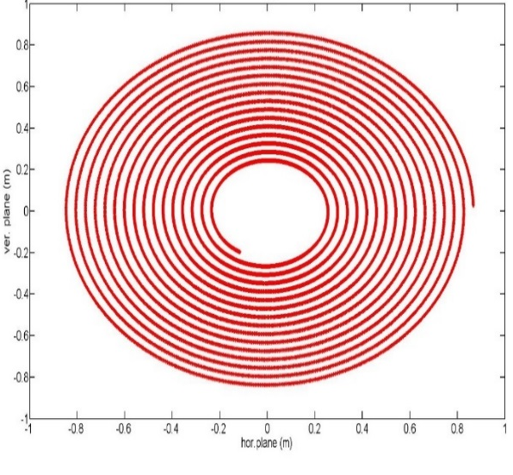
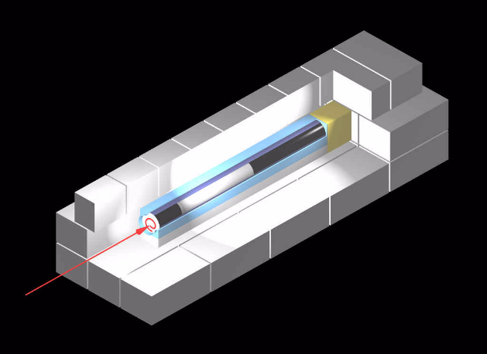
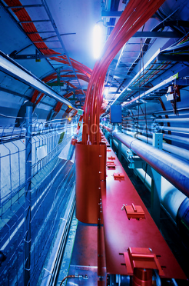
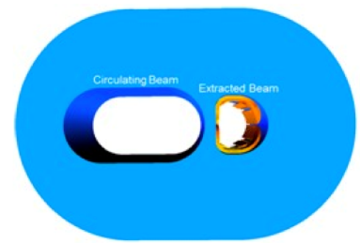
FCC-hh beam dilution system
Huge energy to be extracted and dumped => need large dump section
Beam rigidity: 167 T.km => need long way to dilute beam ~2.5km!
2m
2.5 km dump line
1.4 km dump insertion
2.8 km collimation insertion
Fluka studies:
Bunch separation >1.8 mm
Branch separation: 4 cm
Keeps T<1500°C
Kicker
Septum
10 mrad bend
Dilution
Absorber
Very reliable kickers, high segementation,
new methods for triggering (laser)
SC septum

Slide 32
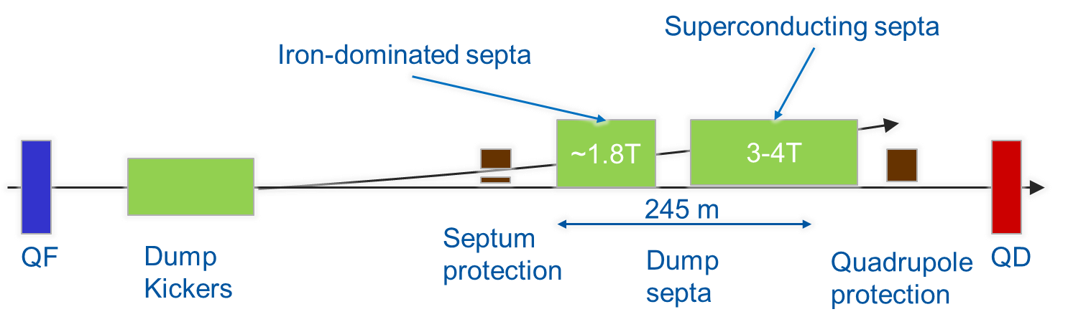
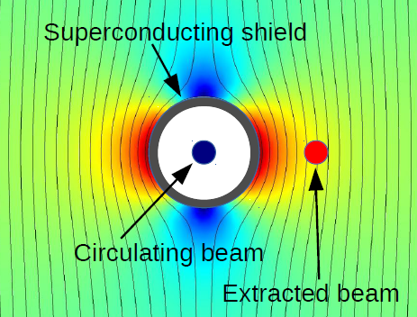
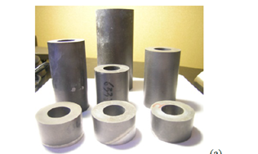
R&D on Superconducting Septa
Need an extraction system for safely removing the beam from the collider
hybrid system: short overall length with high robustness & availability
3 candidate technologies:
NbTi/Nb/Cu multilayer sheet
HTS tape/coating
Bulk MgB₂
SuShi concept:
SC shield creates field-free region inside strong dipole field

Slide 33
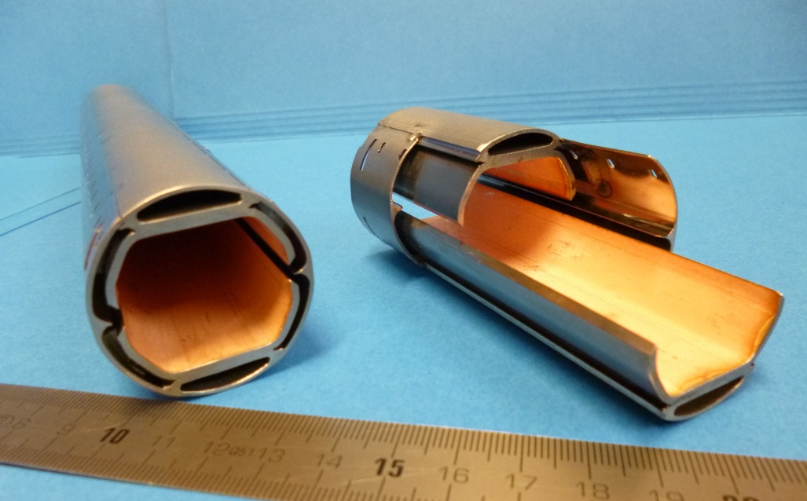
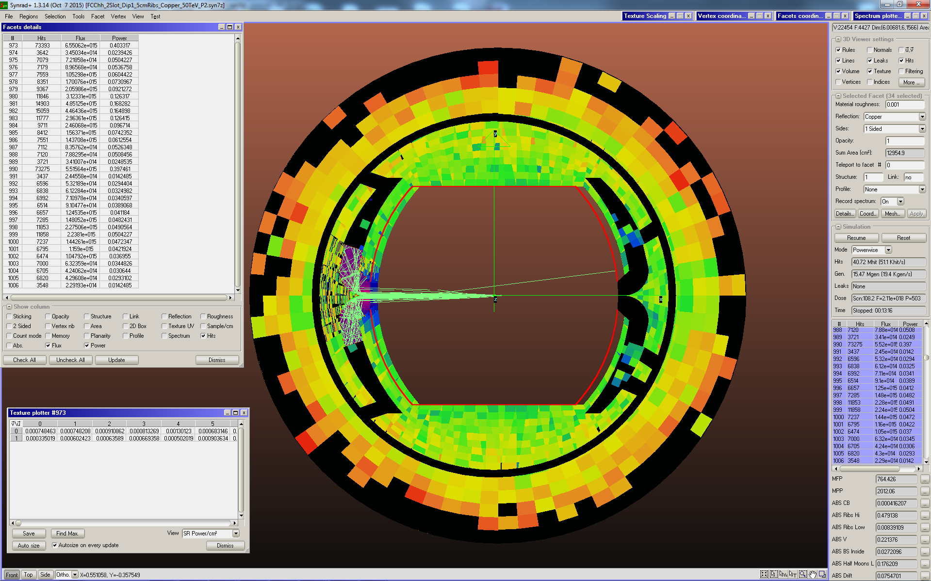
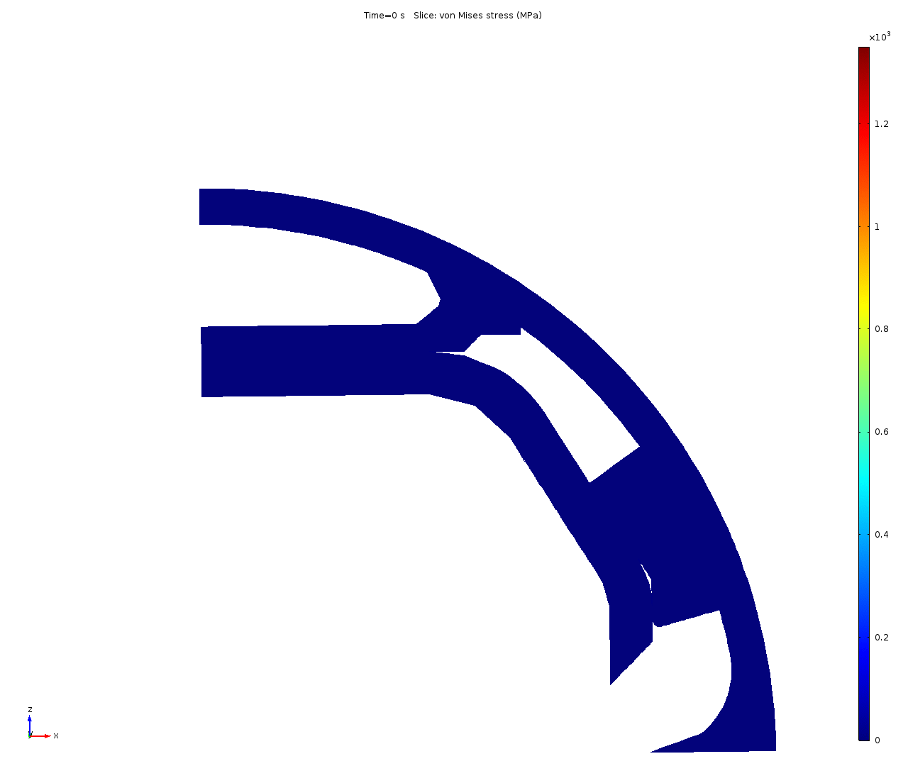
Synchrotron radiation
beam screen prototype
High synchrotron radiation load of proton beams @ 50 TeV:
~30 W/m/beam (@16 T) (LHC <0.2W/m)
5 MW total in arcs (@1.9 K!!!)
New Beam screen with ante-chamber
absorption of synchrotron radiation at 50 K to reduce cryogenic power
factor 50! reduction of cryo power
FCC-hh beam screen prototypes
Ready for Testing 2017 in ANKA within EuroCirCol study
Simulation of
quench behaviour
Photon distribution

Slide 34
Cryo power for cooling of SR heat
contributions: beam screen (BS) & cold bore (BS heat radiation)
Overall optimisation of cryo-power, vacuum and impedance
Termperature ranges: <20, 40K-60K, 100K-120K
300MW
200MW
100MW
Multi-bunch instability growth time: 25 turns 9 turns (ΔQ=0.5)

Slide 35
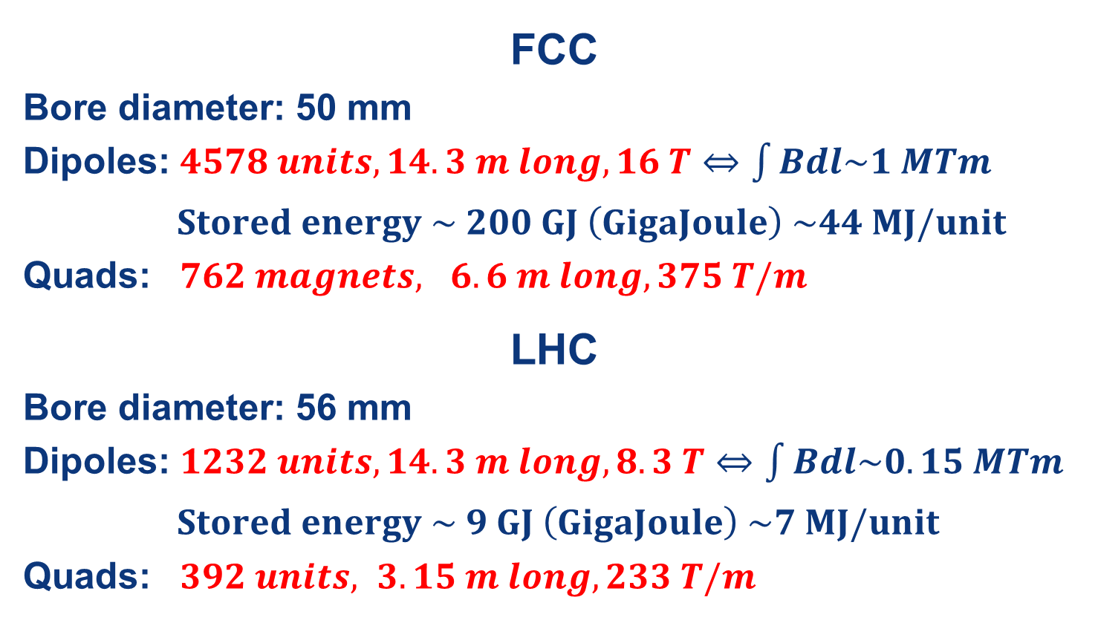
Main SC Magnet system
FCC (16 T) vs LHC (8.3 T)
FCC
Bore diameter: 50 mm
Dipoles: $4578 units, 14.3 m long, 16 T⇔\int{Bdl\sim 1 MTm}$
$Stored energy \sim 200 GJ \left(GigaJoule\right) \sim 44 MJ/unit$
Quads: $762 magnets, 6.6 m long, 375 T/m$
LHC
Bore diameter: 56 mm
Dipoles: $1232 units, 14.3 m long, 8.3 T⇔\int{Bdl\sim 0.15 MTm}$
$Stored energy \sim 9 GJ \left(GigaJoule\right) \sim 7 MJ/unit$
Quads: $392 units, 3.15 m long, 233 T/m$

Slide 36

Nb₃Sn conductor program
Nb₃Sn is one of the major cost & performance factors for FCC-hh and is given highest attention
Main development goals until 2020:
J_{c} increase (16T, 4.2K) > 1500 A/mm² i.e. 50% increase wrt HL-LHC wire
Reference wire diameter 1 mm
Potentials for large scale production and cost reduction
5400 mm²
3150 mm²
~1.7 times less SC
~10% margin
HL-LHC
~10% margin
FCC ultimate
Notes:
New slide from Davide.
Showing that conductor development is launched at international level, Russia, Japan, (Korea and Europe in preparation)
Underline importance of that development as main cost driver for the hadron collider machine.

Slide 37






16 T dipole options and plans
Cos-theta
Common coils
Swiss contribution
via PSI
Canted
Cos-theta
Blocks
Model production 2018 – 2022,
Prototype production 2023 - 2025
Notes:
New slide from Davide.
Showing that conductor development is launched at international level, Russia, Japan, (Korea and Europe in preparation)
Underline importance of that development as main cost driver for the hadron collider machine.

Slide 38

HE-LHC Option
HE-LHC
16-T dipole magnets
SPS+
higher energy
transfer lines
2-GeV Booster
Linac4

Slide 39
lepton collider parameters
parameter | Z | WW | H (ZH) | ttbar
beam energy [GeV] | 45 | 80 | 120 | 182.5
beam current [mA] | 1390 | 147 | 29 | 5.4
no. bunches/beam | 16640 | 2000 | 393 | 48
bunch intensity [10¹¹] | 1.7 | 1.5 | 1.5 | 2.3
SR energy loss / turn [GeV] | 0.036 | 0.34 | 1.72 | 9.21
total RF voltage [GV] | 0.1 | 0.44 | 2.0 | 10.9
horizontal beta* [m] | 0.15 | 0.2 | 0.3 | 1
vertical beta* [mm] | 0.8 | 1 | 1 | 1.6
horiz. geometric emittance [nm] | 0.27 | 0.28 | 0.63 | 1.46
vert. geom. emittance [pm] | 1.0 | 1.7 | 1.3 | 2.9
luminosity per IP [10³⁴ cm⁻²s⁻¹] | >200 | >25 | >7 | >1.4
identical FCC-ee baseline optics for all energies
FCC-ee: 2 separate rings, LEP: single beam pipe

Slide 40

FCC-ee exploits lessons & recipes from past e⁺e⁻ and pp colliders
LEP:
high energy
SR effects
B-factories:
KEKB & PEP-II:
high beam
currents
top-up injection
DAFNE: crab waist
Super B-factories
S-KEKB: low β_{y}*
KEKB: e⁺ source
HERA, LEP, RHIC:
spin
gymnastics
FCC-ee
DAΦNE
VEPP2000
combining successful ingredients of recent colliders → extremely high luminosity at high energies
Barry Barish
13 January 2011

Slide 41


FCC-ee optics design
Optics design for all working points achieving baseline performance
Interaction region: asymmetric optics design
Synchrotron radiation from upstream dipoles <100 keV up to 450 m from IP
Dynamic aperture & momentum acceptance requirements fulfilled at all WPs
Local chromaticity correction
+ crab waist sextupoles
Local chromaticity correction
+ crab waist sextupoles
IP
Beam
Notes:
New slide from Katsunobu on converged optics, final focus and ring optics
Sufficient dynamic aperture and momentum
Injection details missing

Slide 42



FCC-ee MDI optimisation
MDI work focused on optimization of
l*, IR quadrupole design
Detector, compensation solenoid
SR masking and chamber layout
CERN model of
CCT IR quadrupole
BINP prototype IR quadr.
2 cm aperture, 100 T/m
Notes:
New slide on MDI optimisation, L*, solenoid compensation, lumi monitoring, etc.
Slide from Mike Sullivan talk, synchrotron radiation IR, masking?
Possibly one slide on magnet design of Attilio?

Slide 43


Efficient 2-in-1 FCC-ee arc magnets
Dipole:
twin aperture yoke
single busbars as coils
Quadrupole:
twin 2-in-1 design
Novel arrangements allow for considerable savings in Ampere-turns and power consumption
Less units to manufacture, transport, install, align, remove,…

Slide 44



RF system requirements
Very large range of operation parameters
“Ampere-class” machines
Naive scale up from an hh system
 | V_{total} GV | n_{bunches} | I_{beam} mA | ΔE/turn GeV
hh | 0.032 |  | 500
Z | 0.4/0.2 | 30000/90000 | 1450 | 0.034
W | 0.8 | 5162 | 152 | 0.33
H | 5.5 | 770 | 30 | 1.67
t | 10 | 78 | 6.6 | 7.55
x6
x12
≈ 16 x 1 cell 400MHz,
“high gradient” machines
Voltage and beam current ranges span more than factor > 10²
No well-adapted single RF system solution satisfying requirements
Notes:
New slide from Olivier
Common design for hadron and lepton low energy-high currecnt system
Synergies HL-LHC, HE LHC, FCC-hh, FCC-ee Z pole

Slide 45
RF system R&D lines
400 MHz single-cell cavities preferred for hh and ee-Z (few MeV/m)
Baseline Nb/Cu @4.5 K, development with synergies to HL-LHC, HE-LHC
R&D: power coupling 1 MW/cell, HOM power handling (damper, cryomodule)
hh
Z
W
≈ 16 cells per beam
≈ 100 per beam
(+ 100 for booster ring)
≈ 210 per beam
(+ 210 for booster ring)
400 or 800 MHz multi-cell cavities preferred for ee-ZH, ee-tt and ee-WW
Baseline options 400 MHz Nb/Cu @4.5 K, ◄▬► 800 MHz bulk Nb system @2K
R&D: High Q₀ cavities, coating, long-term: Nb₃Sn like components
W
H
t
≈ 200 per beam
(+ 200 for booster)
≈ 800 per beam
(+ 800 for booster)
≈ common 2600 cells for both beams
(+ 2600 for booster)
Notes:
New slide from Olivier
Common design for hadron and lepton low energy-high currecnt system
Synergies HL-LHC, HE LHC, FCC-hh, FCC-ee Z pole

Slide 46
Summary
The HL-LHC upgrade project is in full swing and progressing towards first major installations in LS2.
The FCC study is advancing well towards the Design Report for end 2018
Clearly HL-LHC is a necessary first step in the development of technologies for future HE accelerators, in particular the FCC.
Superconductivity is the key enabling technology for LHC, HL-LHC, HE LHC and FCC.
The Nb3Sn program for HL-LHC triplets and 11 T dipoles is of prime importance towards development fo 16 T model magnets.
SC crab cavities are a major ingredient for HL-LHC and the development of high efficiency SRF systems is critical for FCC-ee.
Both HL-LHC project and FCC study show the importance of international collaboration in our field, to advance on all challenging subjects and to assure a long-term future!
In this sense we fully rely on your future contributions!

