Slide 1
Effect of divergence on the pressure profile
Marton Ady – 23.11.2017
updated 07.11.2017

Slide 2
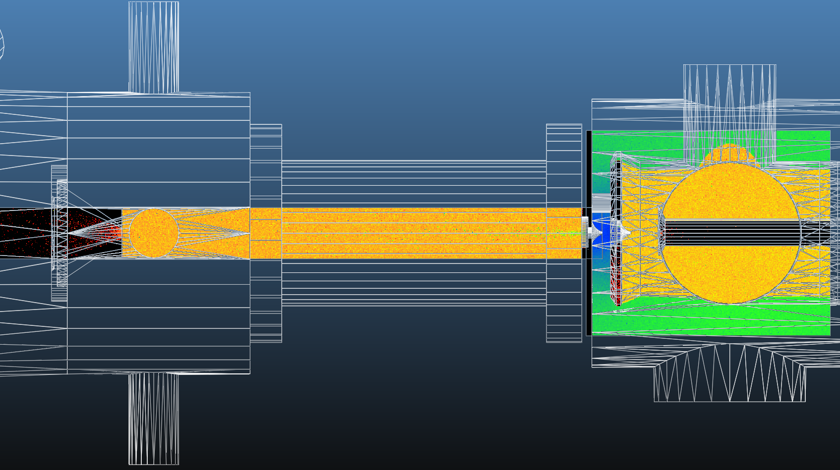
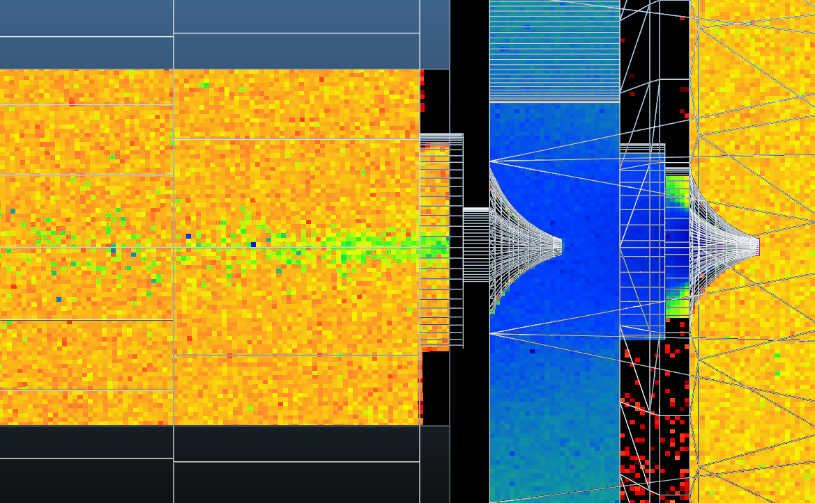
COSINE
Notes:
COS

Slide 3
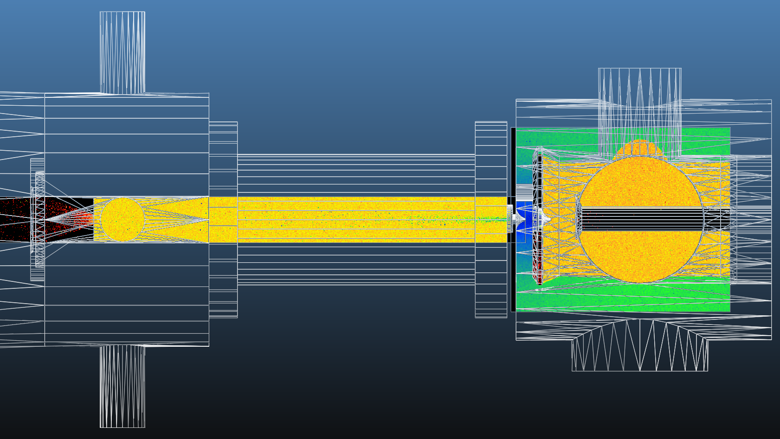
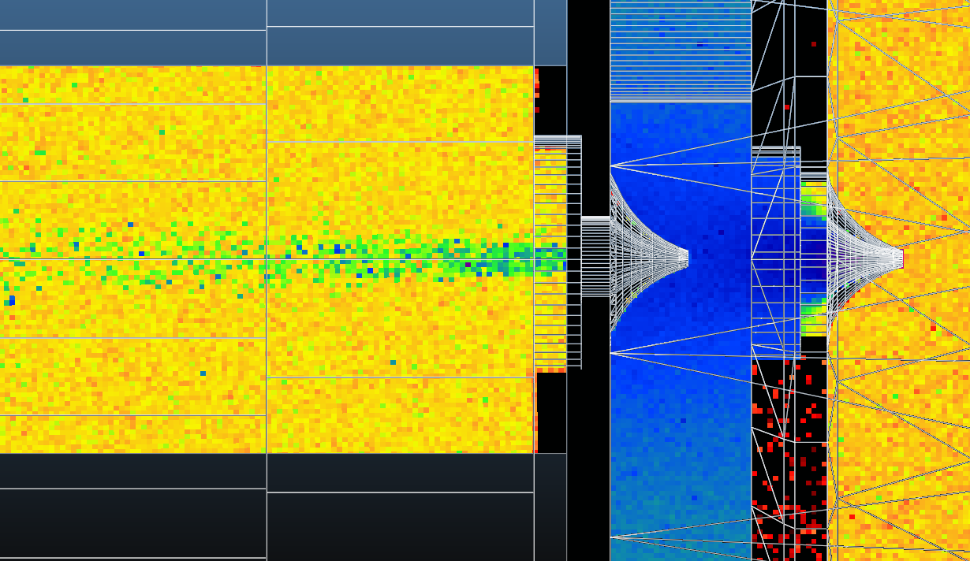
COSINE^10
Notes:
COS^10

Slide 4
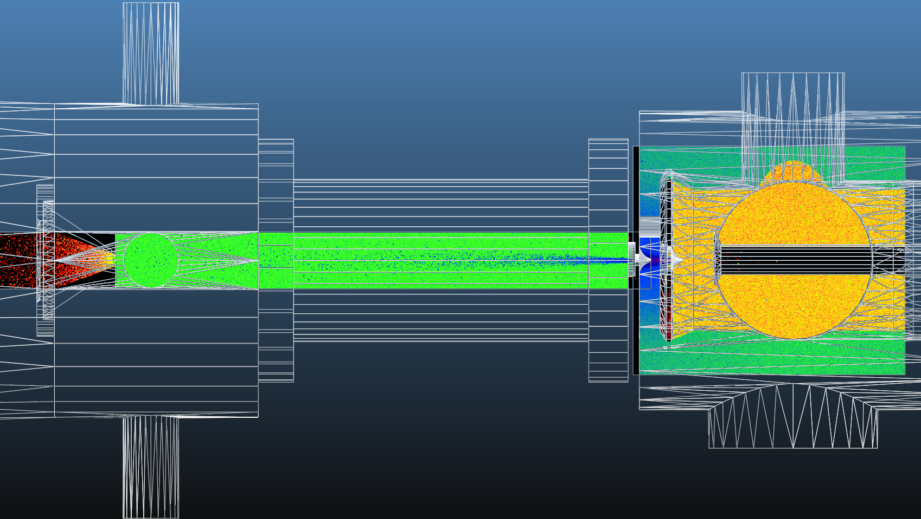
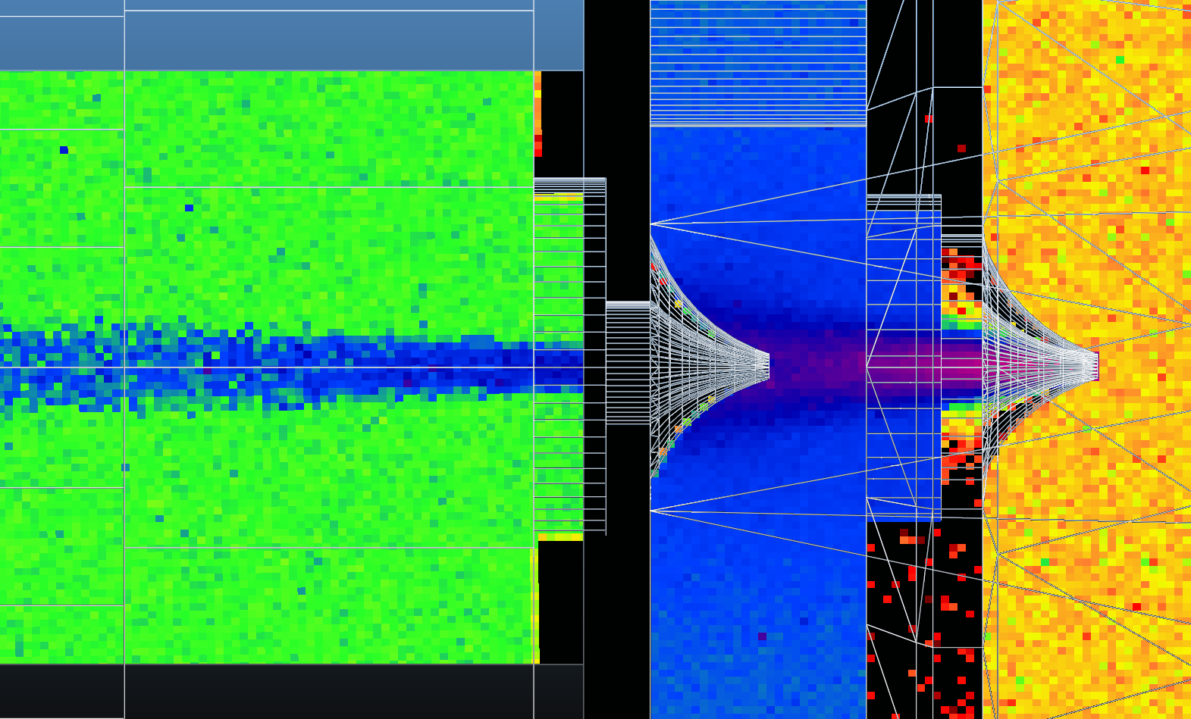
COSINE^100
Notes:
COS^100

Slide 5
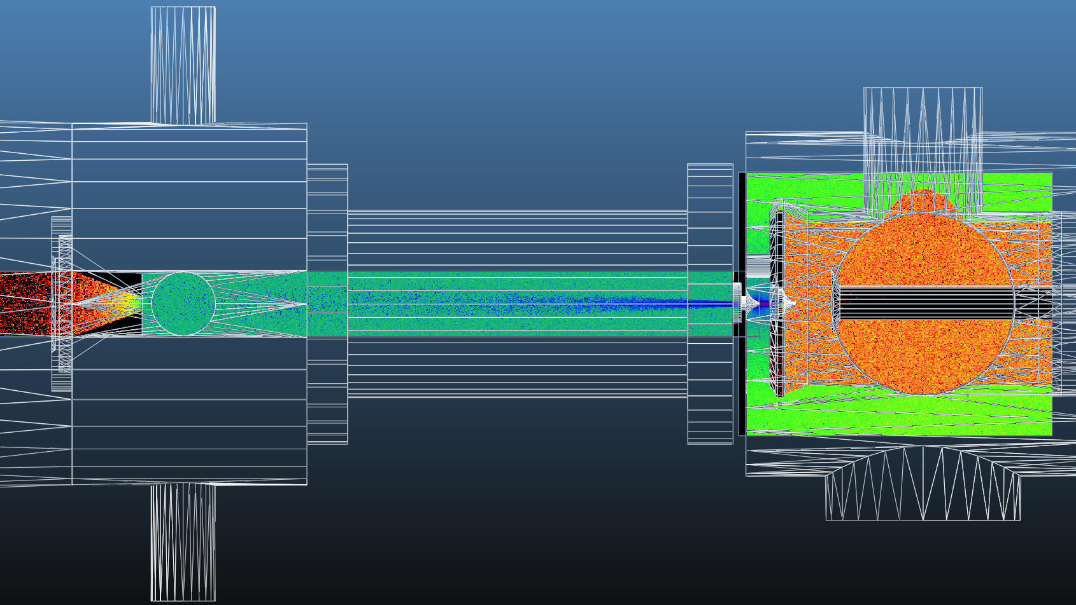
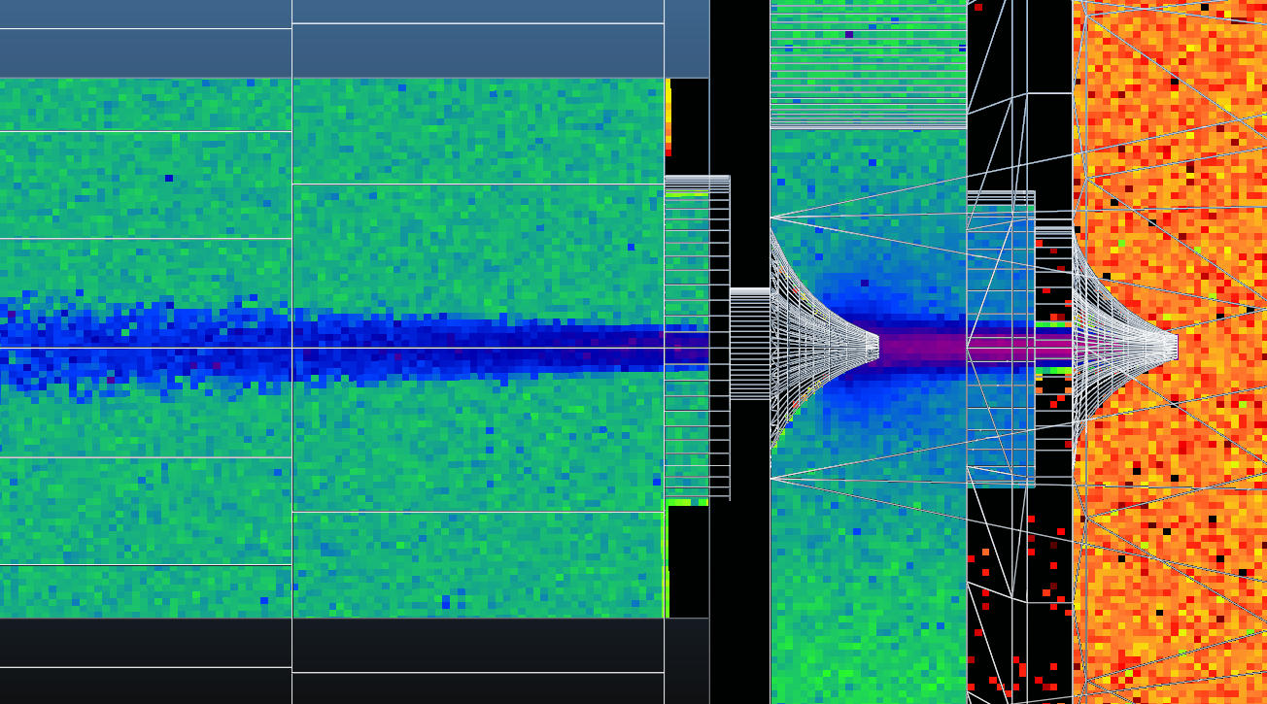
COSINE^500
Notes:
COS^500

Slide 6
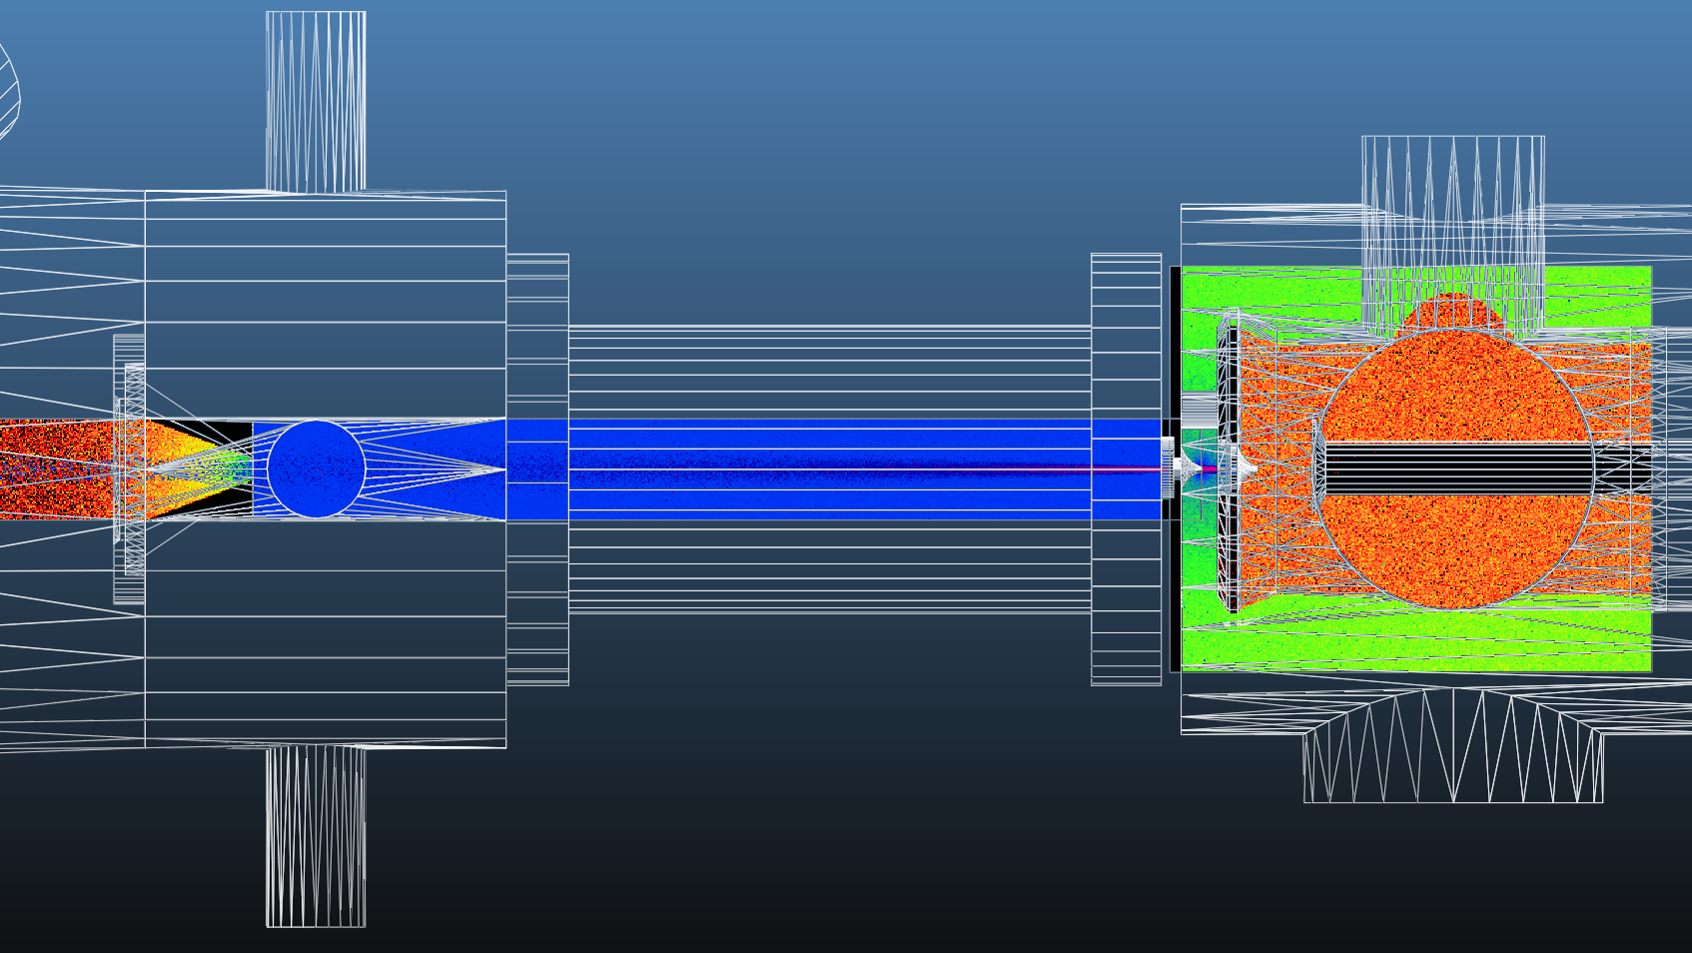
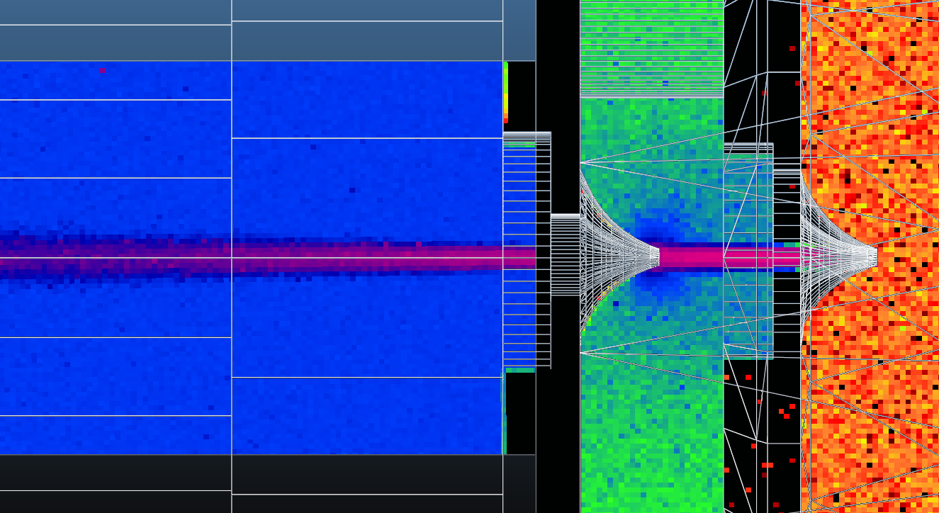
COSINE^2500
Notes:
COS^2500

Slide 7
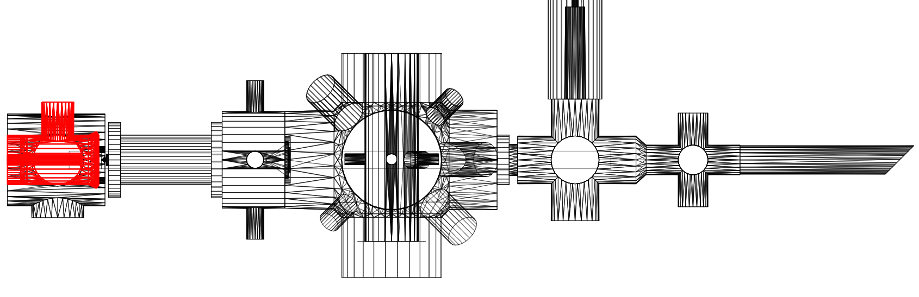
1
2
3
4
5
 |  | Norm.density and pressure
1 | Between skimmers 1 - 2 | 1.00E+00
2 | Between skimmers 2 - 3 | 7.80E-02
3 | Interaction chamber | 1.89E-05
4 | Ionization chamber | 1.51E-05
5 | Last pump | 1.04E-05

Slide 8
collimation
collimation

