Slide 1


Report on
Personnel and
Industrial Procurement
Emmanuel Tsesmelis
Head of Associate Member & Non-Member State Relations
Joint CERN-Serbia Committee
Belgrade
27 November 2017

Slide 2
Personnel

Slide 3
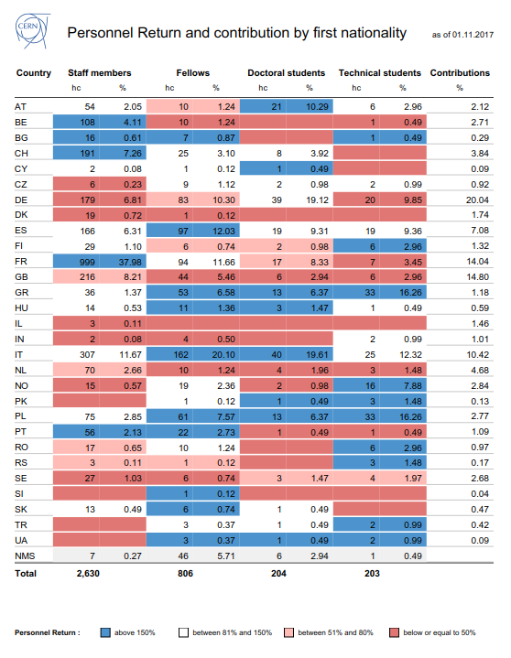
Notes:
I

Slide 4
Serbia @ CERN – Closer Look
COAS | RS | 3
ENTC | CH | 1
 | RS | 12
FELL | RS | 1
PJAS | DE | 1
STAF | FR | 2
 | RS | 3
TECH | RS | 3
USER | CH | 1
 | IL | 1
 | RS | 50
 | US | 1
VISC | RS | 2
Grand Total: |  | 81
Primary and second nationality
3 staff, 1F, 2M in
Grade 6, Limited Duration contracts

Slide 5
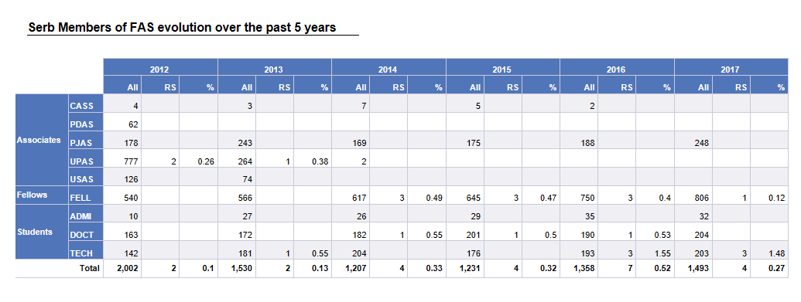
Fellow & Student Programmes

Slide 6
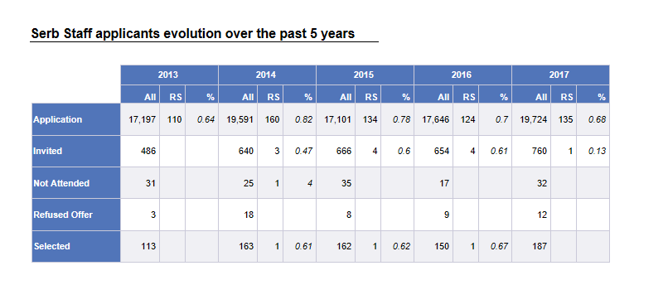
Staff

Slide 7

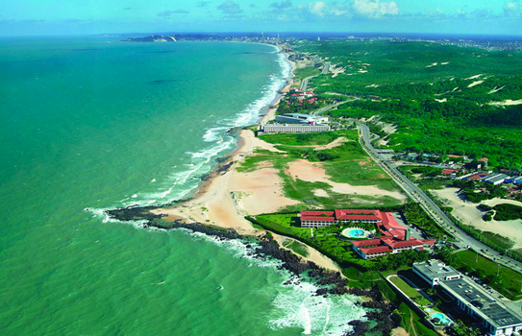

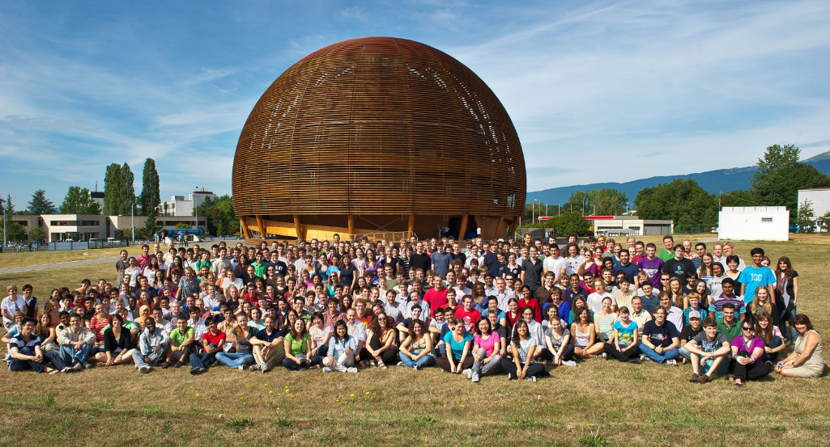
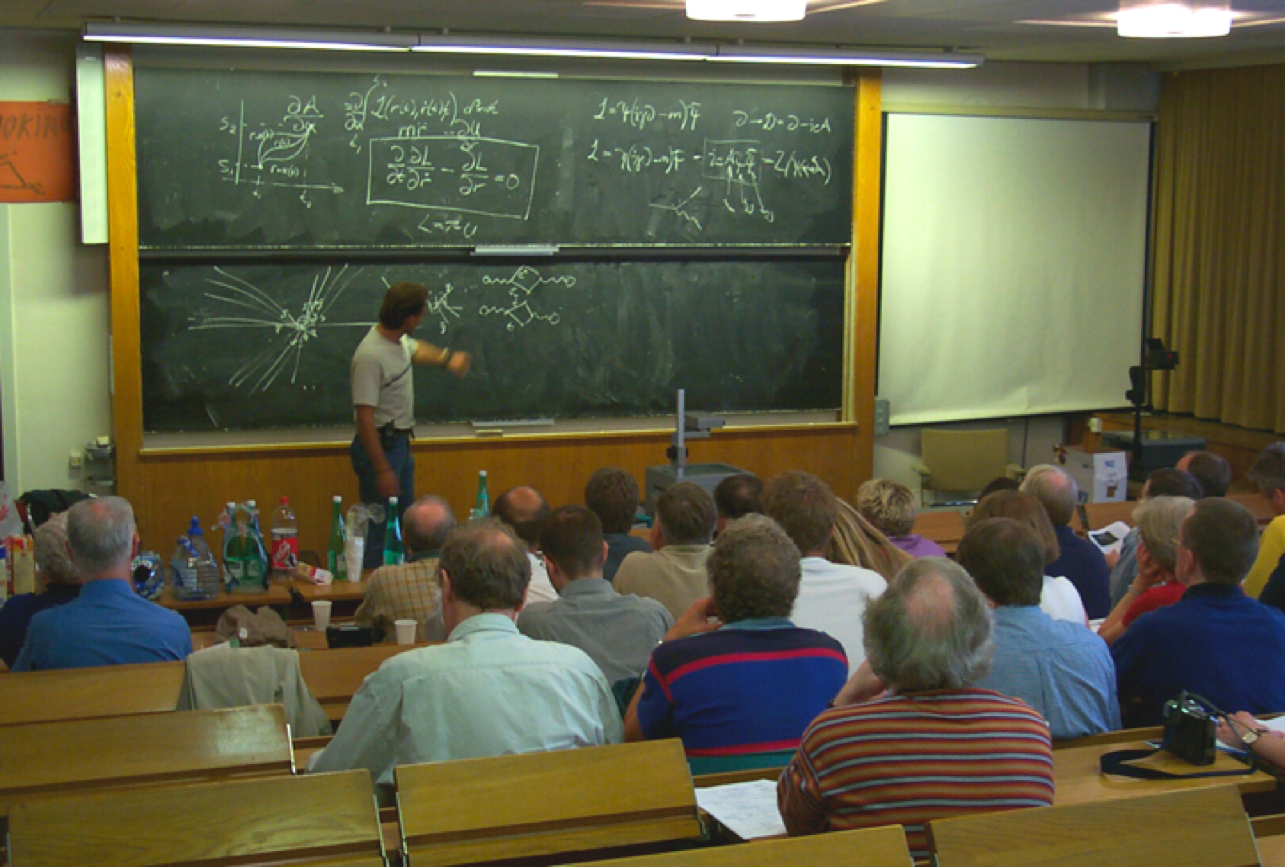
CERN Education Programmes
Asia-Europe-Pacific School of High-Energy Physics
Fukuoka, Japan, 2012
Puri, India, 2014
China, 2016
Latin American School of High-Energy Physics
Arequipa, Peru, 2013
Ibarra, Ecuador, 2015
San Juan del Rio, Mexico, 2017
Scientists at CERN
Academic Training Programme
Young Researchers
CERN School of High Energy Physics
CERN School of Computing
CERN Accelerator School
CERN School of Physics
Norway, June 2016
Undergraduates
Summer Students
Programme
CERN Teacher Schools
International and National Programmes
Public visitors
120 thousand per year

Slide 8
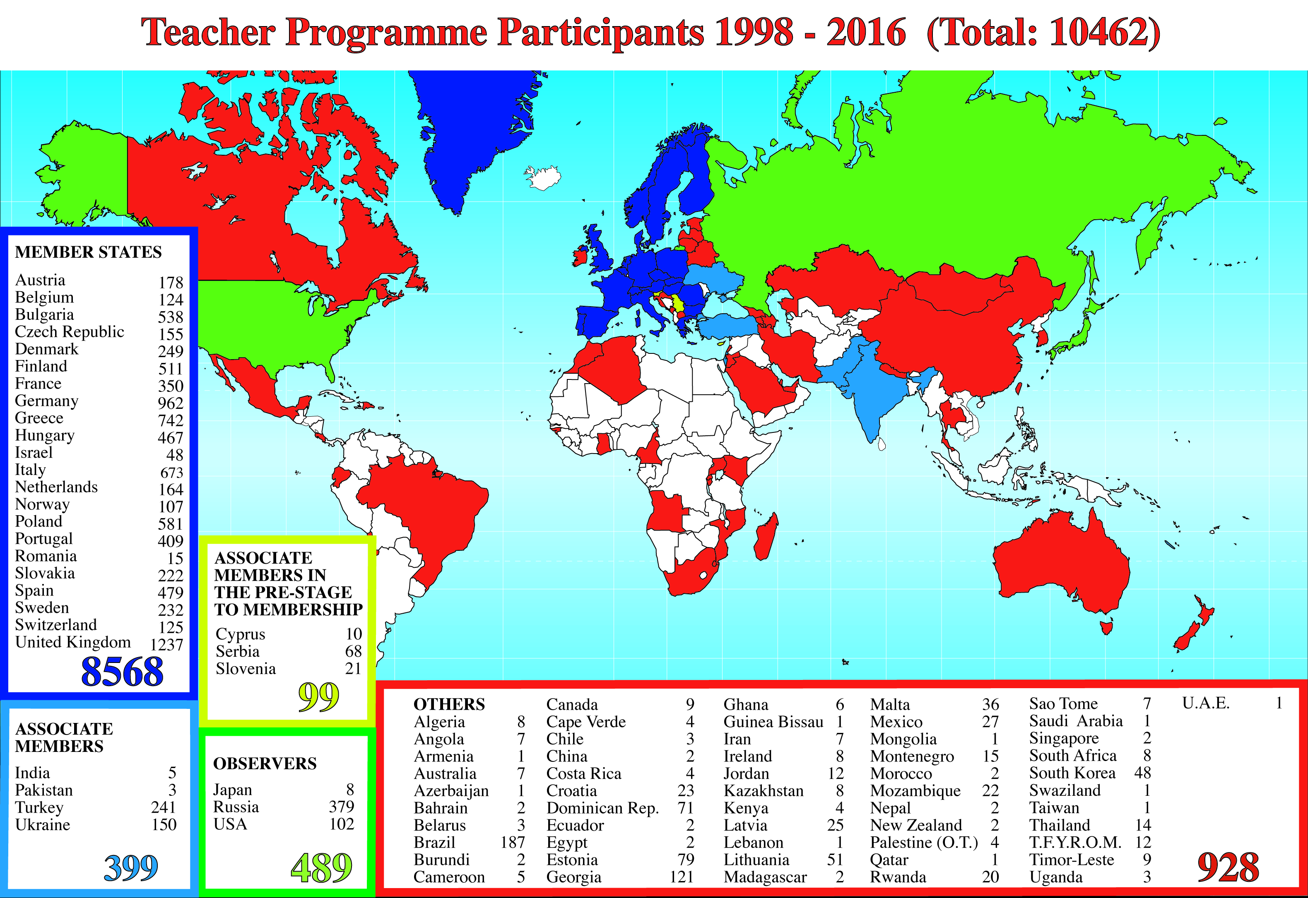
CERN Teacher Schools

Slide 9
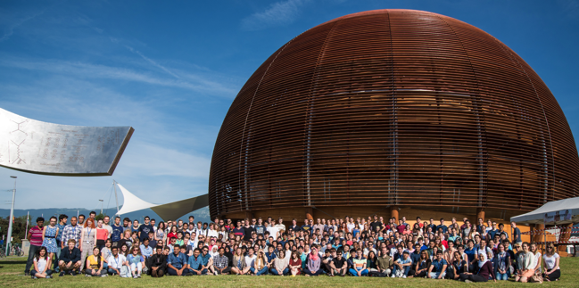
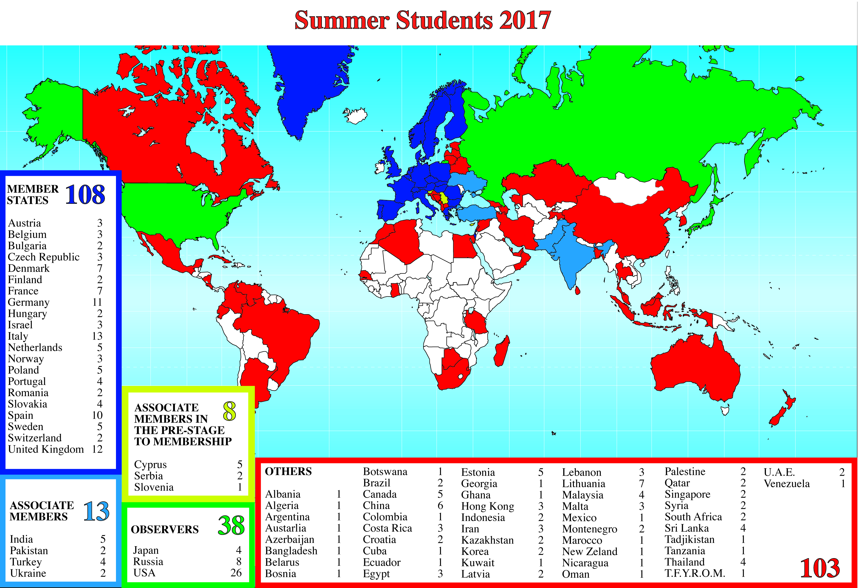
CERN Summer Student Programme

Slide 10

Next Application Deadlines
ASSOCIATES AND FELLOWS COMMITTEE (AFC)
22 May 2018
- deadline for applications - Fellows, 5 March 2018
- deadline for applications - Associates, 16 March 2018
TECHNICAL STUDENTS COMMITTEE (TSC)
5 June 2018
- deadline for applications, 16 April 2018
SUMMER STUDENTS
Selection in March 2018
Deadline for applications, 28 January 2018
TECHNICIAN TRAINING EXPERIENCE (TTE)
15 February 2018
Deadline for applications, 2 February 2018

Slide 11






Find out more…
Facebook
  Create engagement
  Attracting through referrals
Youtube
  Showcase CERN
  Explain jobs that are hard to understand
  Help on recruitment process
LinkedIn
  Engage with professional community
Twitter
  Increase CERN’s presence
Careers site
cern.ch/jobs

Slide 12
Industrial Procurement

Slide 13
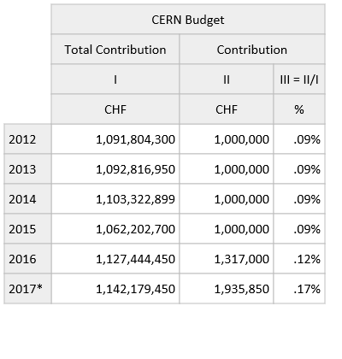
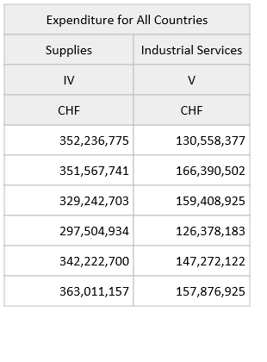
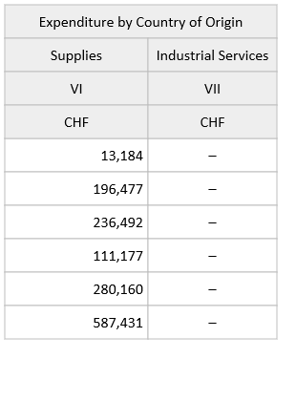

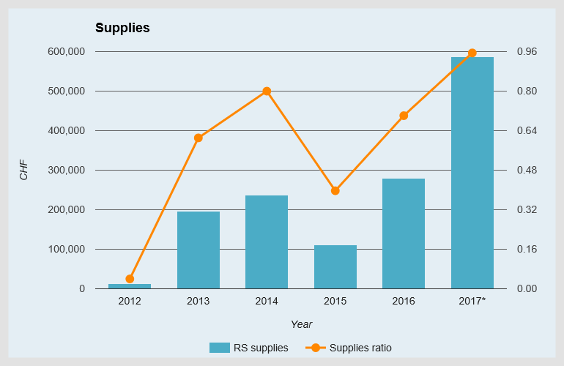
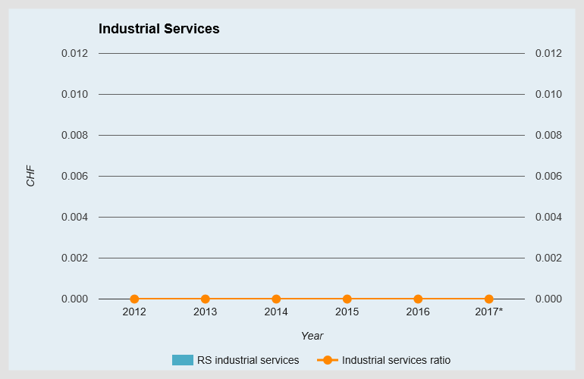
Industrial Returns (2012 to 2017)
* Provisional figures for the year

Slide 14
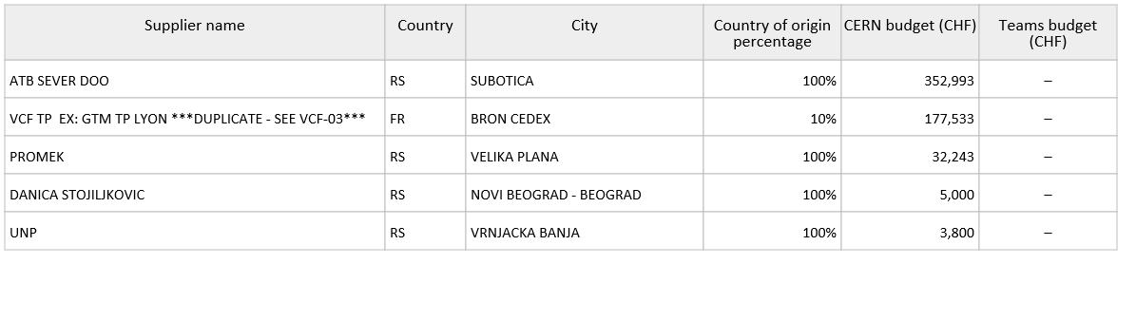
Suppliers with the highest turnover in 2017
(RS as the country of origin)

Slide 15


Thank You!
Accelerating Science and Innovation
Notes:
15

