Slide 1




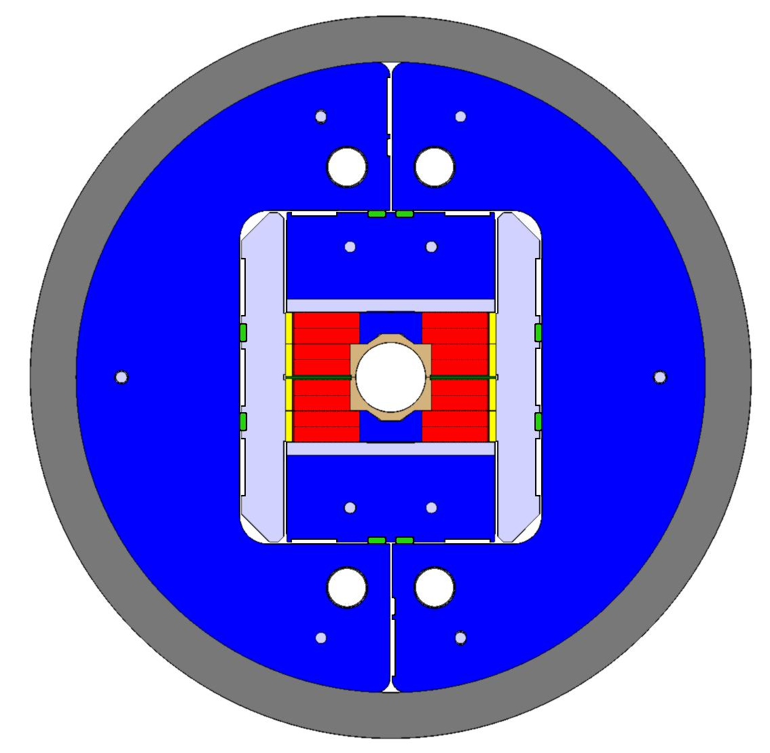
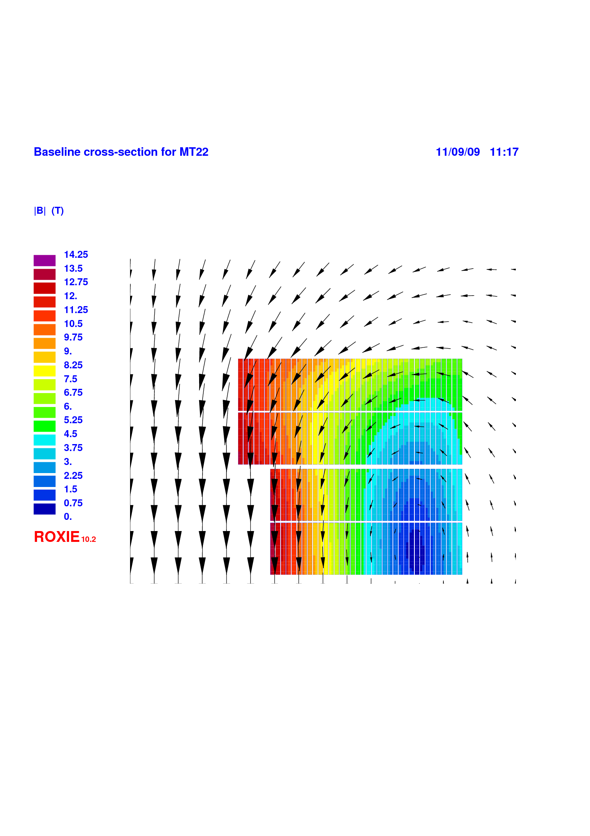
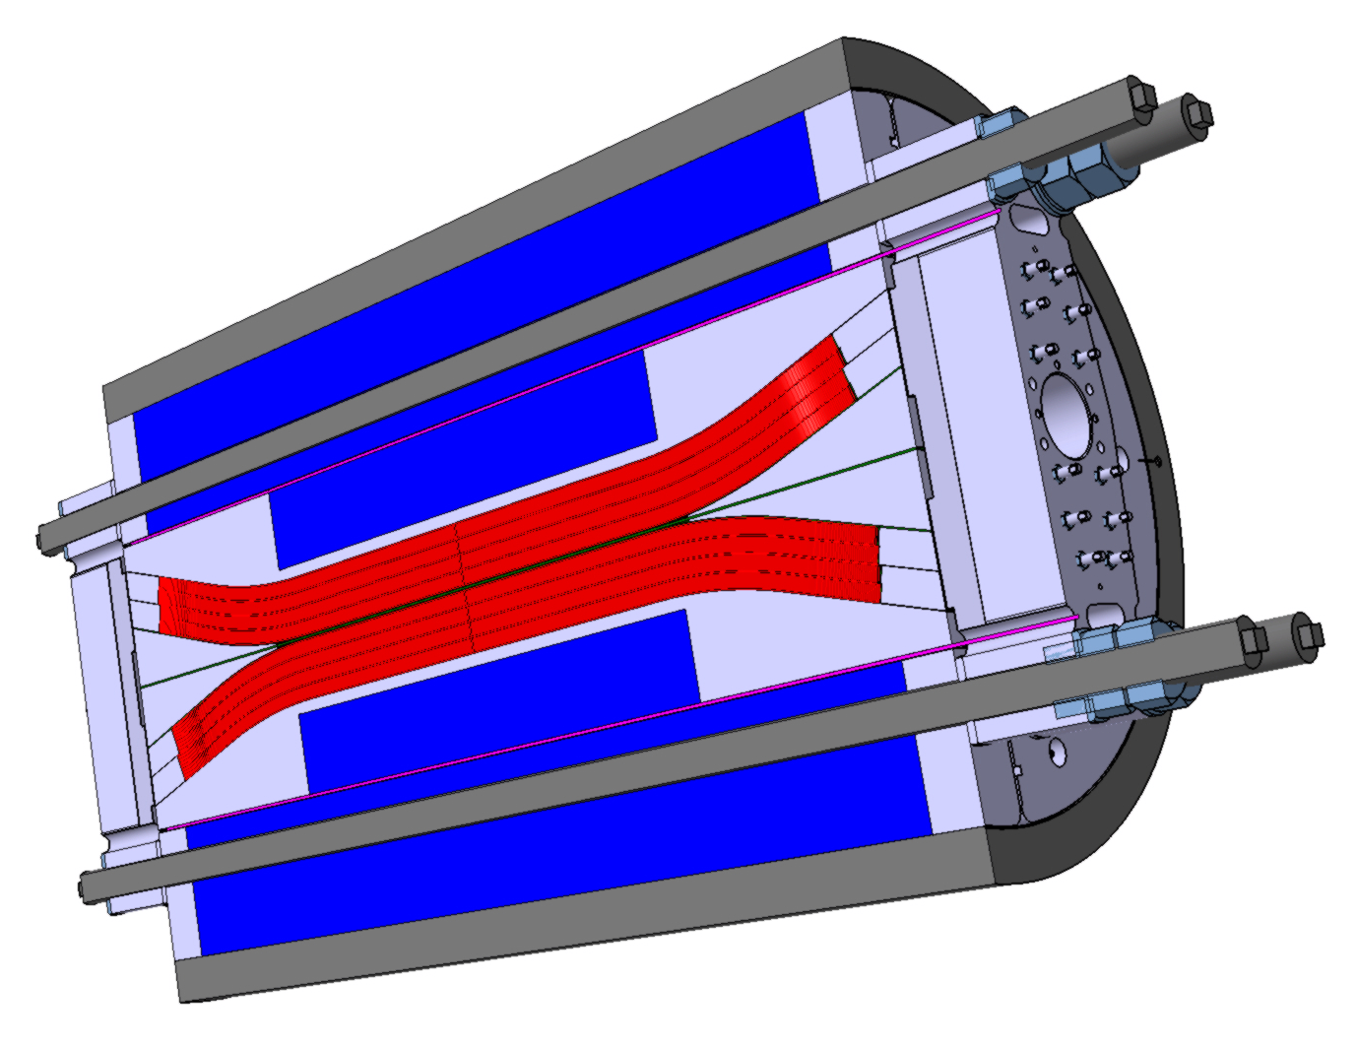
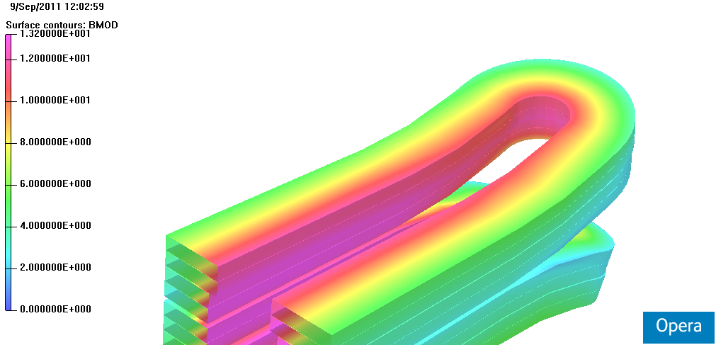
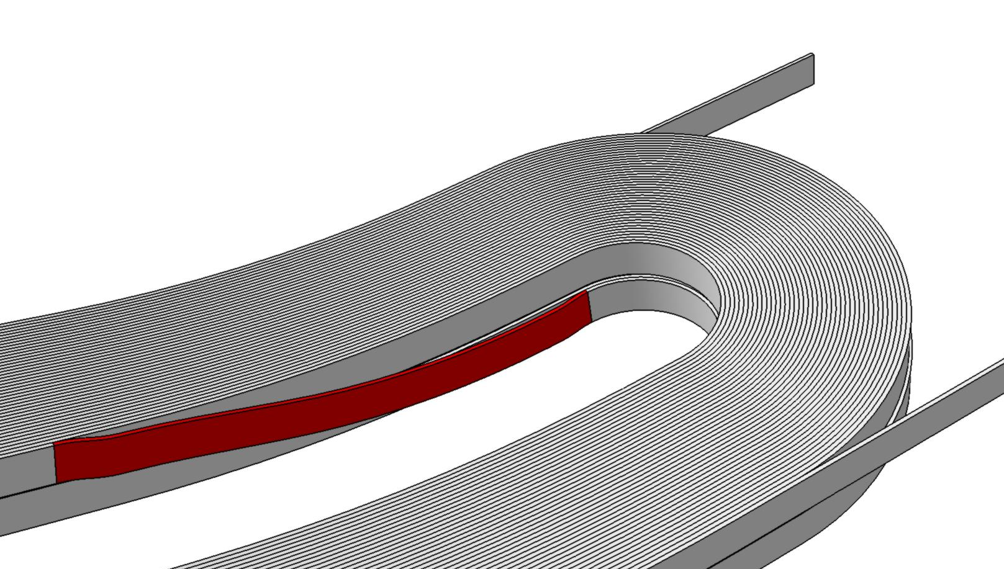
Design of the EuCARD high field model dipole magnet FRESCA2
A. Milanese¹, M. Devaux², M. Durante², P. Manil², J. C. Perez¹, J. M. Rifflet², G. de Rijk¹ and F. Rondeaux²
¹ CERN, Geneva, Switzerland − ² CEA Saclay, Gif-sur-Yvette, France
ABSTRACT
MECHANICAL DESIGN
This poster reports on the design of FRESCA2, a dipole magnet model wound with Nb₃Sn Rutherford cable. This magnet is one of the deliverables of the High Field Magnets work package of the European FP7-EuCARD project. The nominal magnetic flux density of 13 Tesla in a 100 mm bore will make it suitable for upgrading the FRESCA cable test facility at CERN. The magnetic layout is based on a block coil, with four layers per pole. The mechanical structure is designed to provide adequate pre-stress, through the used of bladders, keys and an aluminum alloy shrinking cylinder.
The mechanical structure is based on the so-called bladder and key concept. This approach was developed at LBNL and it has been successfully used in several model magnets.
The coil is surrounded by pads in the horizontal and vertical directions. These pads transfer forces to the outside split iron yoke through keys. These forces are finally contained by an aluminum alloy cylinder.
During assembly, bladders are inserted next to the keys and pressurized in order to create a clearance, which is used to shim the keys. During cool-down, the outer Al alloy cylinder provides an additional pre-stress to the coil. During powering, the Lorentz forces tend to separate the coils from the central islands, so that these interfaces are gradually unloaded as the current in the magnet rises.
The design aims at providing adequate pre-stress to the coil up to nominal field, limiting peak stresses at cryogenic temperatures and maintaining the cable supported along the central posts at the nominal current. About half the pre-stress is provided at room temperature and half is obtained during cool-down.
The peak horizontal stress in the coil after cool-down is estimated to be 135 MPa. At nominal current, the peak stress reaches 150 MPa. However, the peak field and the peak stress locations are not overlapped.
vertical pad
MAGNETIC DESIGN
Fe post
The coil design is based on a block layout. Each pole is made of four layers, wound as two double pancakes. The total number of turns per pole is 156, with 36 spires in each of the two layers closer to the midplane, and 42 in each of the other two layers. Each double pancake is wound with a continuous length of cable, then individually reacted, instrumented and impregnated with the respective central posts and horizontal rails. The aperture is given by the assembly of the two inner central posts, without any additional component.
The choice of this 2D layout for the coil, with no spacers in the cross-section and rectangular-like aligned double pancakes, has been favored mostly because it results in a minimum number of discontinuities of geometry and materials around the Nb₃Sn coil. A secondary effect is the expected ease of manufacturing and shimming.
Several ferromagnetic components are present: the central post for one double pancake, part of the vertical pad and the yoke.
Main conductor parameters
Parameter | Unit | Value
Critical current density (12 T, 4.2 K) | A/mm² | 2500
Critical current density (15 T, 4.2 K) | A/mm² | 1250
Assumed cabling degradation | % | 10
Copper to non-copper volume ratio | / | 1.25
Strand diameter | mm | 1
Number of strands | / | 40
Cable width (bare) | mm | 21.4
Cable thickness at 50 MPa (bare) | mm | 1.82
Insulation thickness (per face) | μm | 200
horizontal pad
coil
R = 450 mm
65 mm
key
Ti post
bladder location
Main cross-section parameters
Parameter | Unit | Value
Aperture (diameter) | mm | 100
Total number of turns per pole | / | 156
Nominal magnetic flux density | T | 13.0
Nominal current I_{nom} | kA | 10.8
Peak flux density on the coil at I_{nom} | T | 13.2
Total stored energy at I_{nom} | MJ | 3.6
Central flux density at short sample, 4.2 K / 1.9 K | T | 15.5 / 16.7
Short sample current, 4.2 K / 1.9 K | kA | 13.2 / 14.4
Load line margin, 4.2 K / 1.9 K | % | 18 / 25
Temperature margin at I_{nom}, 4.2 K / 1.9 K | K | 3.0 / 5.3
Radius for ΔB/B ≤ 1% / 2%, at I_{nom} | mm | 32 / 42
Lorentz forces at I_{nom}: F_{lat.} / F_{vert.} / F_{long.} (per octant) | MN | 5.1 / −2.1 / 0.7
Al shell
split Fe yoke
|B| (T)
13.5
12.0
150
10.5
9.0
100
7.5
6.0
50
4.5
3.0
room temperature
cryogenic temperature
nominal field 13 T
0
1.5
σ_{x} [MPa]
0.0
Fe yoke
Magnetic flux density in the coil (one quarter shown). The value in the center is 13.0 T, whereas the coil sees a peak of 13.2 T.
vertical pad
Looking at the 3D structure, the flared coils are supported by two steel wedges on the midplane, while the vertical pads follow the flared shape, getting progressively thinner. The coil blocks are completed with lateral rails and stainless end shoe pieces (reacted and impregnated with the conductor). The axial length of the shell is 1.6 m.
A longitudinal pre-compression system is in place: the four aluminum alloy rods are pre-tensioned and convey their load to the wedges / end shoes by means of a high resistance steel end plate. This last component is heavily loaded in bending.
The mass of the magnet is around 10 t; the yoke contributes with more than 5 t.
|B| (T)
3D field in the return end
The design uses flared coil ends to clear the aperture. From the straight section, the blocks are bent up in the plane of the cable, until an angle of 17 deg is reached; the minimum bending radius is 700 mm. Winding tests with Cu cable have guided the choice of the parameters for the ends geometry.
The overall coil end-to-end length is 1500 mm, whereas the straight section is 730 mm.
end plate
13.2
12.0
10.0
8.0
wedge
6.0
2nd chicane
4.0
connection bend
2.0
1st chicane
coil
0.0
Al axial rod
Al shell
Simulations show that the flux density concentrations in the ends can be controlled by tuning the geometry of the iron and that no spacers are needed in the coil.
At nominal current, the peak flux density in the coil ends is reduced by 1.0 T with respect to the straight section.
The ends accommodate the layer jumps within the two double pancakes. Each layer jump comprises two chicanes, where the cable bends out towards the central post before connecting to the next turn in the other layer, around a smooth connection curve along the ramp.
ACKNOWLEDGMENT
The research leading to these results has received funding from the EC under the FP7 Research Infrastructures project EuCARD, grant agreement no. 227579. We thank all the colleagues with whom we discussed the design of FRESCA2, in particular: G. Ambrosio, M. Bajko, B. Bordini, L. Bottura, S. Caspi, P. Fabbricatore, P. Ferracin, G. Kirby, F. Kircher, Y. Iwasa, P. Labrune, J.-F. Millot, T. Nakamoto, L. Oberli, A. Przybylski, L. Rossi and E. Todesco.

