Slide 1
Linear Colliders
Lecture 2
Subsystems I
Particle Sources
Damping Rings
Bunch Compressor
Main Linac

Slide 2
Reminder: Luminosity
Last lecture, we arrived at:
we want high RF-beam conversion efficiency η_{RF}
need high RF power P_{RF}
small normalised vertical emittance ε_{n,y}
strong focusing at IP (small β_{y} and hence small bunch length σ_{z})
could also allow higher beamstrahlung δ_{BS} if willing to live with the consequences (Luminosity spread and background)

Slide 3
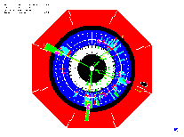
Generic Linear Collider
C.Pagani
Main Linac
Accelerate beam to IP energy without spoiling DR emittance
Collimation System
Clean off-energy and off-orbit particles
Final Focus
Demagnify and collide beams
Bunch Compressor
Reduce σ_{z} to eliminate hourglass effect at IP
Damping Ring
Reduce transverse phase space (emittance) so smaller transverse IP size achievable
Electron Gun
Deliver stable beam current
Positron Target
Use electrons to
pair-produce positrons
will see the different elements in the following…

Slide 4
e+ e- sources
we need large number of bunches of (polarized) leptons
electron sources:
  laser-driven DC photo injector
  circularly polarized photons
  on GaAs cathode
  (incompatible with RF gun)
  ε_{n} ~ 50 μm rad
  factor ~10 in x plane
  factor ~500 in y plane
  too large!!!
  dominated by space charge
  RF bunching system to generate bunch structure for the linac
  or laser with bunch time structure (=> even higher space charge)

Slide 5
e+ source
basic mechanism: pair production in target material
standard method: ‘thick’ target
primary e- generate photons
these convert into pairs
undulator source:
high energy e- produce photons
in wiggler magnet
thin conversion target

Slide 6
e+ source
undulator source:
  ~0.4 rad. length ⇒ much less energy deposition in the target
  (5 kW compared to 20 kW) ⇒ no parallel targets needed
  smaller emittance due to less coulomb scattering (factor ~2)
  but still much bigger than needed!!!
  ε_{n} ~ 10.000 μm rad !!!
  could produce polarised e+ by helical undulator
  but: need very high initial electron energy > 150 GeV !
    use primary e- beam
    consequences for the commissioning and operation
positrons are captured in accelerating structure inside solenoid
and accelerated

Slide 7
Damping rings
e- and particularly e+ from the source have a much too high ε
⇒ we have to reduce the transverse bunch size
solution: use synchrotron radiation in a damping ring
(remember lecture Synchr. Rad II)
γ emission with transverse component
acceleration only in longitudinal direction
radiation
damping!!!

Slide 8
Damping rings
exponential damping to equilibrium emittance:
initial emittance
(~0.01 m rad for e⁺)
final emittance
damping time
equilibrium
emittance
for e+ we need emittance reduction by few 10⁵
~7-8 damping times required
damping time:
2
r
c
E
4
P
=
e
3
(
m
c
2
)
3
ρ
2
P - emitted radiation power
o
LEP: E ~ 90 GeV, P ~ 15000 GeV/s, τ_{D} ~ 12 ms

Slide 9
Damping rings
suggests high-energy for a small ring. But
  required RF power:
  equilibrium emittance: limit E and ρ in practice
DR example:
    Take E ≈ 2 GeV
    ρ ≈ 50 m
    P_{γ} = 27 GeV/s [28 kV/turn]
    hence τ_{D} ≈ 150 ms - we need 7-8 τ _{D} !!! ⇒ store time too long !!!
Increase damping and P using wiggler magnets

Slide 10
Damping Wigglers
Insert wigglers in straight sections
in the damping ring
Average power radiated per electron with wiggler straight section
Energy loss in wiggler:
<B²> is the field square averaged over the wiggler length
wigglers

Slide 11
Damping ring: emittance limits
Horizontal emittance ε_{x}
defined by lattice
theoretical vertical
emittance limited by
  space charge
  intra-beam scattering (IBS)
  photon emission opening angle
DR emittance in the range of existing/planned light sources
In practice, ε_{y} limited by magnet alignment errors
[cross plane coupling by tilted magnets]
typical vertical alignment tolerance: Δy ≈ 30 µm
⇒ requires beam-based alignment techniques!

Slide 12
Bunch compression
bunch length from damping ring: ~ few mm
required at IP: ~ few 100 μm or shorter
solution: introduce energy/time correlation with chicane:
long.
phase
space
N.Walker

Slide 13
The linear bunch compressor
initial (uncorrelated) momentum spread: δ_{u}
initial bunch length σ_{z,0}
compression ratio F_{c}= σ_{z,0}/ σ_{z}
beam energy E
RF induced (correlated) momentum spread: δ_{c}
RF voltage V_{RF}
RF wavelength λ_{RF} = 2π / k_{RF}
longitudinal dispersion (transfer matrix element): R₅₆
conservation of longitudinal emittance (σ_{z} δ = const.):
fixed by DR
RF cavity
compress at low energy

Slide 14
The linear bunch compressor
chicane (dispersive section) linear part
Minimum bunch length for upright ellipse
⇒ correlation
Initial correlation
With δ²= δ_{u}²+ δ_{c}² we get
For high compression ratio (δ_{c}≫ δ_{u})

Slide 15
Bunch compressor - Example
Remark: we get a large energy spread after compression
⇒ large chromatic effects in the linac
Consider a two stage compression with acceleration in between
to reduce relative energy spread along the line

Slide 16
The Main Linac
Now we got small, short bunches
we ”only” have to accelerate them to collision energy
Accelerating cavities:
E_{z}
travelling wave structure:
need phase velocity = c
(disk-loaded structure)
bunch sees constant field:
E_{z}=E₀ cos(φ)
c
z
E_{z}
c
c
standing wave cavity:
bunch sees field:
E_{z} =E₀ sin(ωt+φ)sin(kz)
=E₀ sin(kz+φ)sin(kz)
z

Slide 17
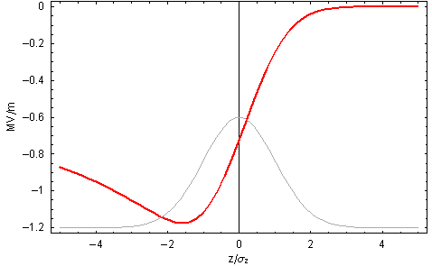
Single bunch effects: longitudinal
Beam absorbs RF power ⇒ decreasing RF field in cavities
Single bunch beam loading: longitudinal wake field
Particles within a bunch see a decreasing field
⇒ energy gain different within a bunch

Slide 18
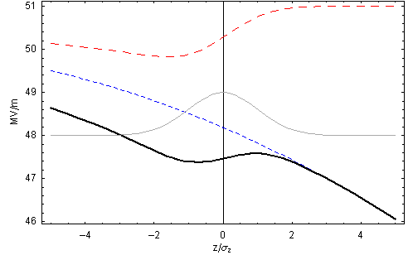
Beam-loading compensation
Run off crest and use RF curvature to compensate single bunch beam-loading
Reduces the effective gradient
wakefield
RF
φ = 15.5º
Total

Slide 19
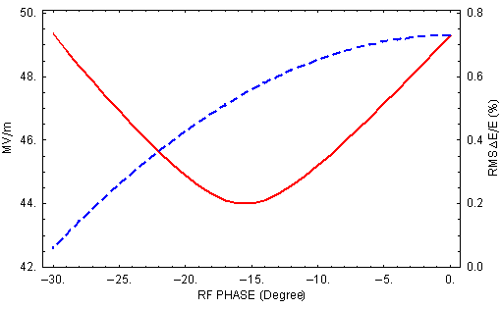
Beam-loading compensation
Minimize momentum spread
RMS ΔE/E
<E_{z}>
φ_{min} = 15.5º

Slide 20
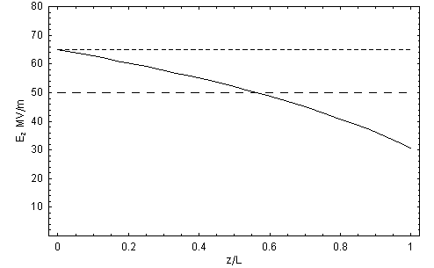
TW Cavity: Beam Loading
Beam absorbs RF power
⇒ gradient reduced along TW cavity for steady state
unloaded
av. loaded

Slide 21
TW Cavity: Beam loading
Transient beam loading (multi bunch effect):
  first bunches see the full unloaded field, energy gain different
  for all LC designs, long bunch trains achieve steady state quickly, and previous results very good approximation.
  However, transient over first bunches needs to be compensated
  ‘Delayed filling’ of the structure
V
unloaded
av. loaded
t

Slide 22
SW cavity: multi-bunch BL
With superconducting standing wave (SW) cavities:
Little losses to cavity walls
You can have afford long RF pulse with
  Many bunches
  Large time between the bunches
RF feed-back to compensate beam-loading before
the next bunch arrives

Slide 23
Linac: emittance dilution
Linac must preserve the small beam sizes, in particular in y
Possible sources for emittance dilutions are:
  Dispersive errors: (ΔE → y)
  Transverse wakefields: (z → y)
  Betatron coupling: (x, px → y)
  Jitter: (t → y)
All can increase projection of the beam size at the IP
Projection determines luminosity

Slide 24
Linac: transverse wakefields
Bunches induce field in the cavities
Later bunches are perturbed by these fields
Bunches passing off-centre excite transverse higher order modes (HOM)
Fields can build up resonantly
Later bunches are kicked transversely
=> multi- and single-bunch beam break-up (MBBU, SBBU)
Emittance growth!!!

Slide 25
Transverse wakefields
Effect depends on a/λ (a iris aperture) and structure design details
transverse wakefields roughly scale as W┴ ∝ f ³
less important for lower frequency:
Super-Conducting (SW) cavities suffer less from wakefields
Long-range minimised by structure design
Dipole mode detuning
Long range wake of a dipole mode
spread over 2 different frequencies
a₁
a_{N}
6 different frequencies
R₁
R_{N}

Slide 26
Damping and detuning
  Slight random detuning between cells makes HOMs decohere quickly
  Will recohere later: need to be damped (HOM dampers)
C. Adolphsen / SLAC

Slide 27
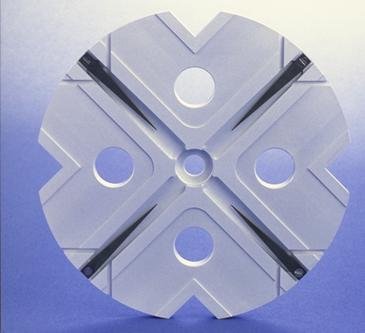
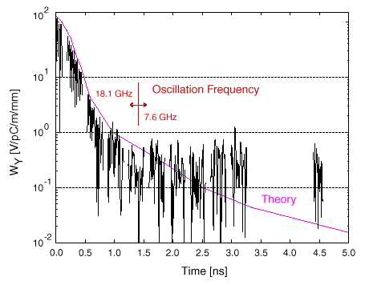
HOM damping
Each cell damped by 4 radial WGs
terminated by SiC RF loads
HOM enter WG
Long-range wake
efficiently damped
Test results

Slide 28
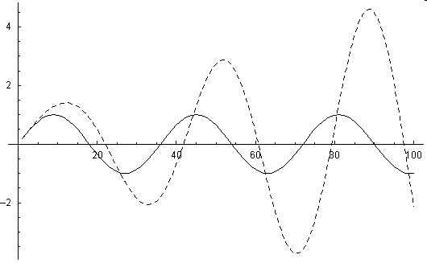

Single bunch wakefields
Head particle wakefields deflect tail particles
Particle perform coherent betatron oscillations
=> head resonantly drives the tail
Tail particle
Equation of motion:
tail
head
Driven Oscillator !!
More explicit:

Slide 29
Two particle model
head
2 particles: charge Q/2 each, 2σ_{z} apart
Bunch at max. displacement x:
    tail receives kick θ from head
π/2 in betatron phase downstream:
    tail displacement ≈βθ
π/2 in phase further (π in total):
    -x displacement, tail kicked by –θ
    but initial kick has changed sign
=> kicks add coherently
=> tail amplitude grows along the linac
tail

Slide 30
BNS damping
Counteract effective defocusing of tail by wakefield
by increased focusing (Balakin, Novokhatski, and Smirnov)
Done by decreasing tail energy with respect to head
By longitudinally correlated energy spread (off-crest)
Wakefields balanced by lattice chromaticity
2 particle model:
W┴ non linear
Good compensation achievable at the price of
  lower energy gain by off-crest running
  Larger energy spread

Slide 31
Random misalignments
BNS damping does not cure random cavity misalignment
Emittance growth:
For given Δε, it scales as
Higher frequency requires better structure alignment δY_{rms}
Partially compensated by: higher G, lower β, lower N
~

