Slide 1


An introduction to Magnets for Accelerators
Attilio Milanese
John Adams Institute
Accelerator Course
17 – 18 Jan. 2018

Slide 2
This is an introduction to magnets as building blocks of synchrotrons / transfer lines
//
// MADX Example 2: FODO cell with dipoles
// Author: V. Ziemann, Uppsala University
// Date: 060911
TITLE,'Example 2: FODO2.MADX';
BEAM, PARTICLE=ELECTRON,PC=3.0;
DEGREE:=PI/180.0;
QF: QUADRUPOLE,L=0.5,K1=0.2;
QD: QUADRUPOLE,L=1.0,K1=-0.2;
B: SBEND,L=1.0,ANGLE=15.0*DEGREE;
FODO: SEQUENCE,REFER=ENTRY,L=12.0;
QF1: QF, AT=0.0;
B1: B, AT=2.5;
QD1: QD, AT=5.5;
B2: B, AT=8.5;
QF2: QF, AT=11.5;
ENDSEQUENCE;
Notes:
This introduction is a first description of magnets commonly found in synchrotrons and transfer lines, aimed in particular to explain the magnetic elements as used in lattice codes.
Taking for example that FODO sequence in MAD-X:
* what is the field in the dipole? (is it achievable?)
* what is the difference between an SBEND and an RBEND?
* is the quadrupole length the actual physical length? from where to where?
* could we use a higher k₁ (normal quadrupole coefficient) and a shorter length?

Slide 3
If you want to know more…
N. Marks, Magnets for Accelerators, J.A.I. Jan. 2015
D. Tommasini, Practical Definitions & Formulae for Normal Conducting Magnets
Lectures about magnets in CERN Accelerator Schools
Special CAS edition on magnets, Bruges, Jun. 2009
Superconducting magnets for particle accelerators in U.S. Particle Accelerator Schools
J. Tanabe, Iron Dominated Electromagnets
P. Campbell, Permanent Magnet Materials and their Application
K.-H. Mess, P. Schmüser, S. Wolff, Superconducting Accelerator Magnets
M. N. Wilson, Superconducting Magnets
A. Devred, Practical Low-Temperature Superconductors for Electromagnets
L. Rossi and E. Todesco, Electromagnetic design of superconducting dipoles based on sector coils
Notes:
http://indico.cern.ch/event/357378/session/2/#all
https://edms.cern.ch/document/1162401/3
http://cas.web.cern.ch/cas/CAS%20Welcome/Previous%20Schools.htm
http://cdsweb.cern.ch/record/1158462/files/cern2010-004.pdf
for example, http://etodesco.web.cern.ch/etodesco/uspas/uspas.html
ISBN 9789812563811
ISBN 9780521566889
ISBN 9789810227906
ISBN 978-0198548102
CERN-2004-006, cds.cern.ch/record/796105
cds.cern.ch/record/1076301
[1] can be interesting also for your project this year, as it goes over the conceptual magnetic design of a high field superconducting dipole.
A heartfelt thank you to many colleagues – in particular those from which I borrowed much of the material for this short course.

Slide 4
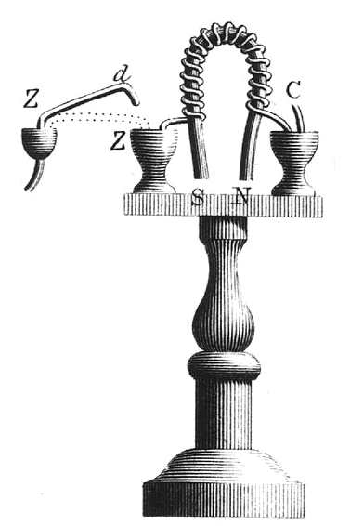
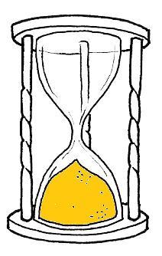
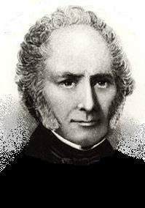
According to history, the first electromagnet (not for an accelerator) was built in England in 1824 by William Sturgeon
William Sturgeon
Notes:
sources:
Wikipedia
http://physics.kenyon.edu/EarlyApparatus/Electricity/Electromagnet/Electromagnet.html
In 1820 Hans Christian Oersted discovered that a current-carrying wire set up a magnetic field.
In the same year, André-Marie Ampère discovered that a helix of wire acted like a permanent magnet, and Dominique François Jean Arago found that an iron or steel bar could be magnetized by putting it inside the helix of current-carrying wire.
In 1824 William Sturgeon found that leaving the iron inside the coil greatly increased the resulting magnetic field. Sturgeon also bent the iron core into a U-shape to bring the poles closer together, thus concentrating the magnetic field lines. The electromagnet was made of 18 turns of bare copper wire (insulated wire had not yet been invented), with mercury cups acting as switches. He displayed its power by lifting nine pounds (4.1 kg) with a seven ounce (200 g) piece of iron wrapped with wire through which a current from a single battery was sent.

Slide 5
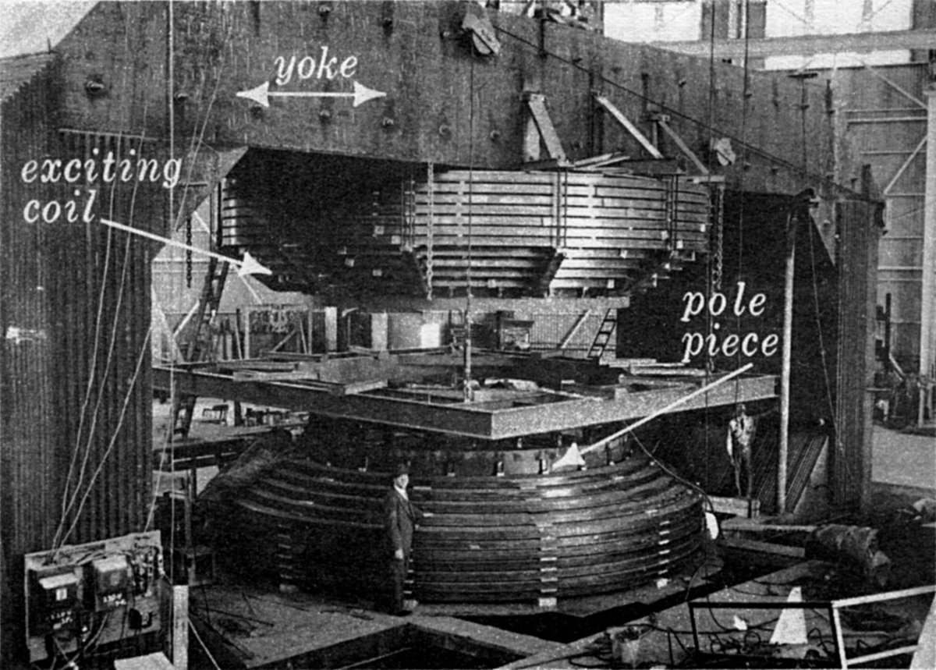
The working principle is the same as this large magnet, of the 184’’ (4.7 m) cyclotron at Berkeley (picture taken in 1942)
Notes:
This cyclotron magnet was built with 4000 tons of iron and 300 tons of copper. The maximum field was 2.34 T, for a dissipated power of 2.5 MW. By the way, that should be the largest single-magnet (synchro)cyclotron ever built.
It was able to accelerate protons up to 730 MeV. The CERN synchrocyclotron made it up to (only) 600 MeV.
We will not look into this kind of accelerator magnets, sticking to the ones found in (strong focusing) synchrotrons and related transfer lines.

Slide 6
This short course is organized in several blocks
Introduction, jargon, general concepts and formulae
Resistive magnets
Superconducting magnets
Tutorial with OPERA-2D

Slide 7
This is a classification of magnets based on their geometry / what they do to the beam
dipole
solenoid
quadrupole
combined function bending
sextupole
corrector
octupole
skew magnet
kicker
undulator / wiggler
Notes:
In brief:
* dipoles bend the beam, in fact they are also called bending magnets
* quadrupoles focus the beam
These are usually the main magnets in synchrotrons and transfer lines; thus, we will focus on them.
A combined function bending magnet is a superposition of a dipole and a quadrupole: it bends and focuses the beam at the same time. They are less popular now with respect to the early days of synchrotrons; still, they are used in some modern machines, for ex. light sources.

Slide 8
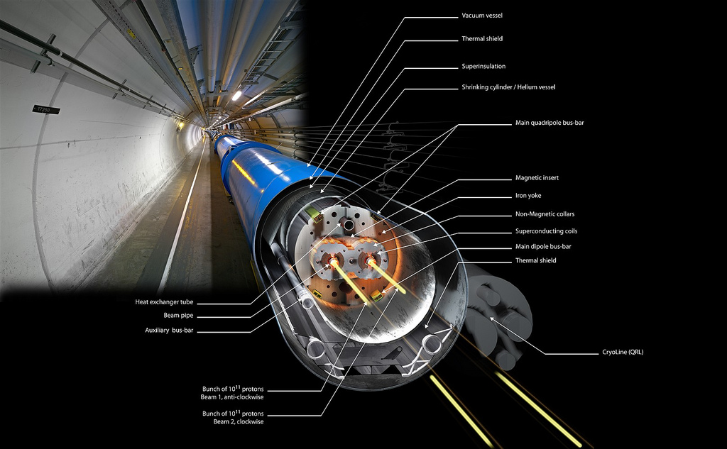
This is a main dipole of the LHC at CERN: 8.3 T × 14.3 m
Notes:
The LHC main dipoles (MB = Main Bending) are superconducting magnets, built in the 2000’s.
The coils are wound in Nb-Ti and they are cooled by superfluid helium at 1.9 K.
At the nominal current of 11.8 kA, the dipole field is 8.3 T, in a 56 mm diameter circular aperture.
Each dipole bends the beam by 360 / 1232 = 0.29 deg.
They are slowly ramped (about 20 min.) and then used in dc mode, as the LHC operates as a collider.
These magnets are the result of many years of R&D and they are very close to what can be achieved with Nb-Ti superconducting technology.
Note as of Jan. 2018: the LHC ran in 2017 at 6.5 TeV, corresponding to 7.71 T; 2 out of the 8 sectors have already been “trained” – with quenches – up to about 8.1 T.

Slide 9
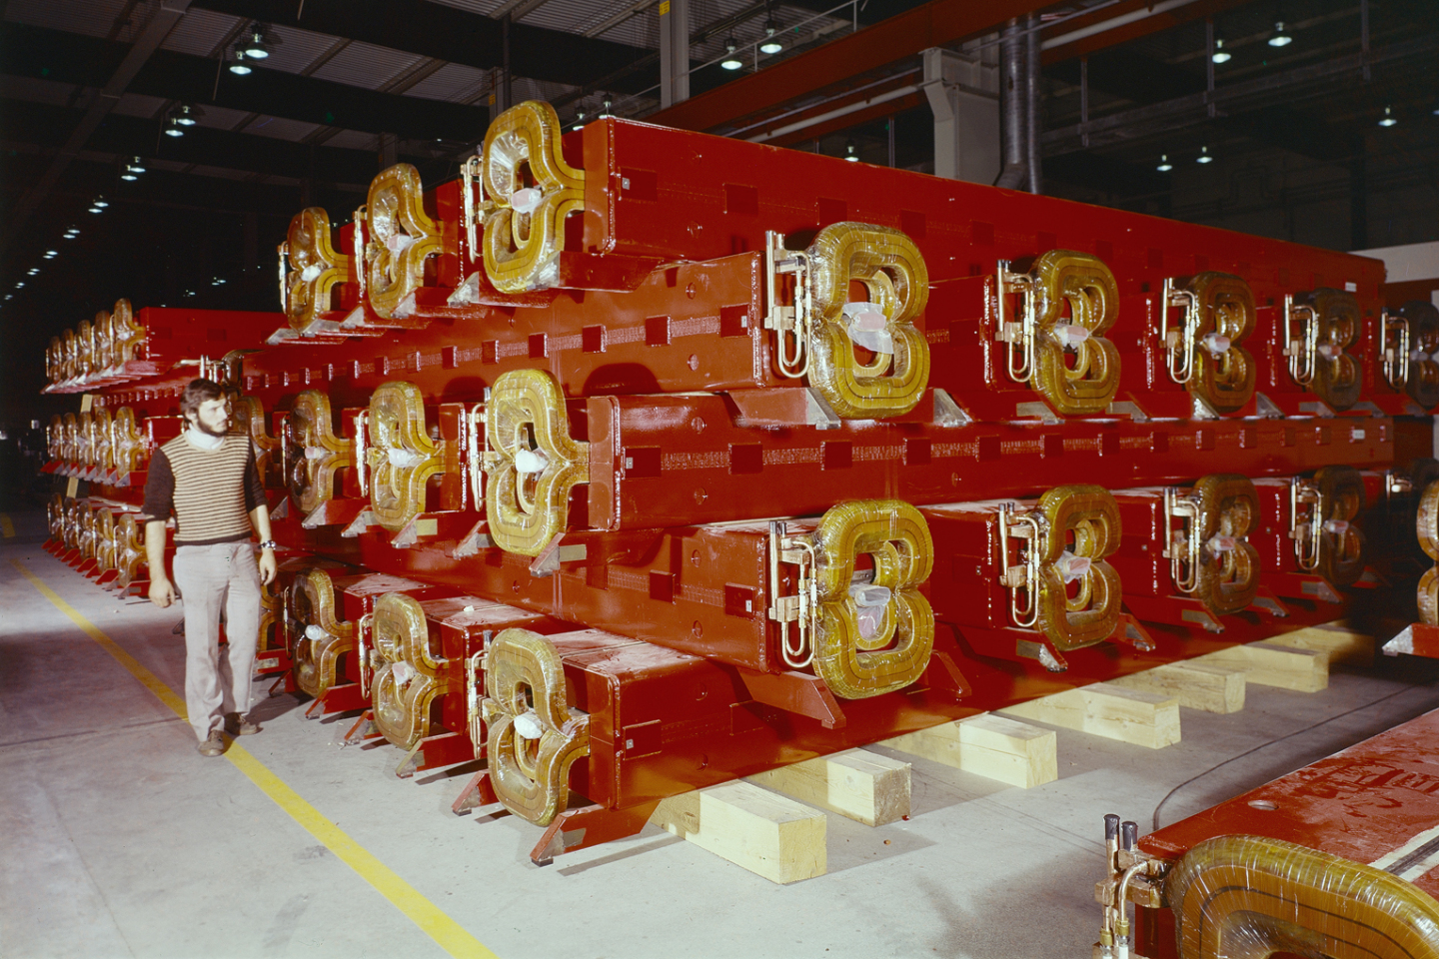
These are main dipoles of the SPS at CERN: 2.0 T × 6.3 m
Notes:
The SPS main dipoles are resistive magnets, with coils in copper. Demineralized water flows in the conductor to remove the Joule heating.
At the peak current of 5.8 kA, they provide a dipole field of 2.0 T in a rectangular aperture. Two types of magnets with a smaller (36 mm, MBA) and larger (52 mm, MBB) vertical aperture are used.
Each dipole bends the beam by 360 / 744 = 0.48 deg.
They now work in a cycled mode and they can be ramped in a few seconds.
In the 1970s, also a superconducting option was studied for the SPS, then abandoned.
The main SPS converters are designed for a peak (active) power of 144 MW, which is drawn directly from the 400 kV line. The average (rms) power depends on the duty cycle, though it is usually a factor of 2 less.
The photo was taken in 1974.

Slide 10
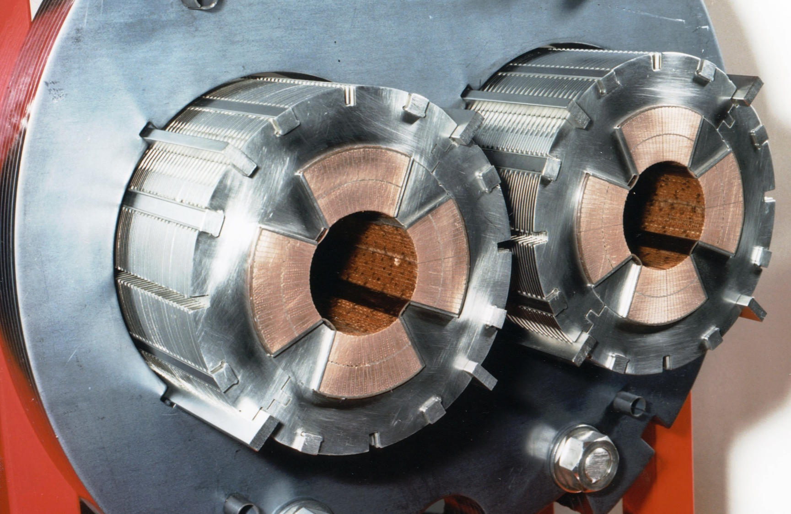
This is a cross section of a main quadrupole of the LHC at CERN: 223 T/m × 3.2 m
Notes:
The LHC main quadrupoles (MQ) are superconducting magnets.
The coils are wound in Nb-Ti and they are cooled by superfluid helium at 1.9 K, like the LHC dipoles.
At the nominal current of 11.8 kA, they provide a gradient of 223 T/m. Considering their aperture of 56 mm diameter, this corresponds to a pole tip field of 6.2 T ( = 223 × 0.028). The peak field in the conductor is about 10% higher, at 6.8 T.

Slide 11
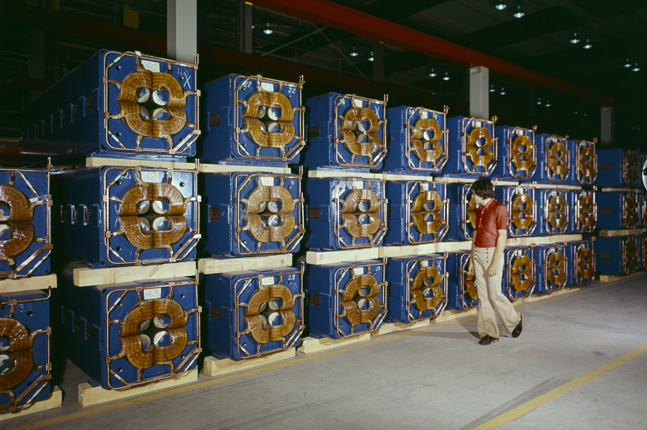
These are main quadrupoles of the SPS at CERN: 22 T/m × 3.2 m
Notes:
The SPS main quadrupoles are resistive magnets, with coils in copper.
Demineralized water flows in the conductor to remove the Joule heating, as for the SPS dipoles.
At the peak current of 2.1 kA, the quadrupole gradient is 22 T/m in a 88 mm diameter circular aperture. The pole tip field is then 1.0 T ( = 22 × 0.044).

Slide 12
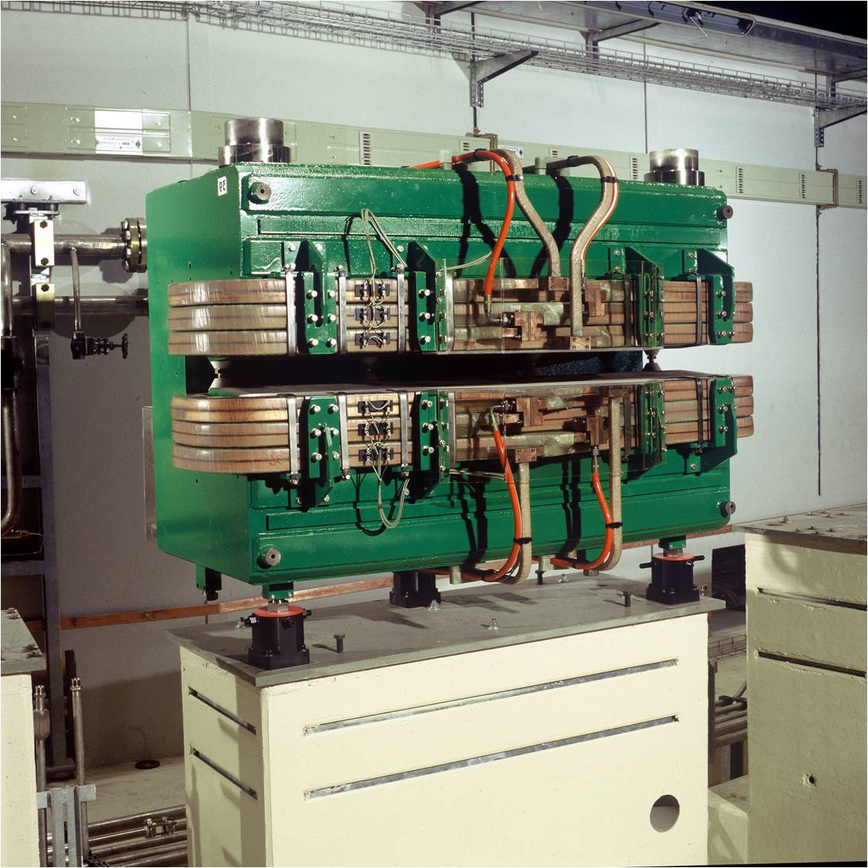
This is a combined function bending magnet of the ELETTRA light source
Notes:
This is an example of a combined function (dipole + quadrupole) bending magnet, found for example in third generation synchrotron light sources. The technology is the same as that for the SPS dipoles shown before, just with a different design of the ferromagnetic yoke.
In ELETTRA, there are 24 such magnets. At the nominal current of 1420 A, the dipole field is 1.2 T, together with a quadrupole gradient of 2.9 T/m. The vertical gap is 70 mm; the bending radius of the machine is 5.5 m.
These magnets were built in the 1990s.

Slide 13
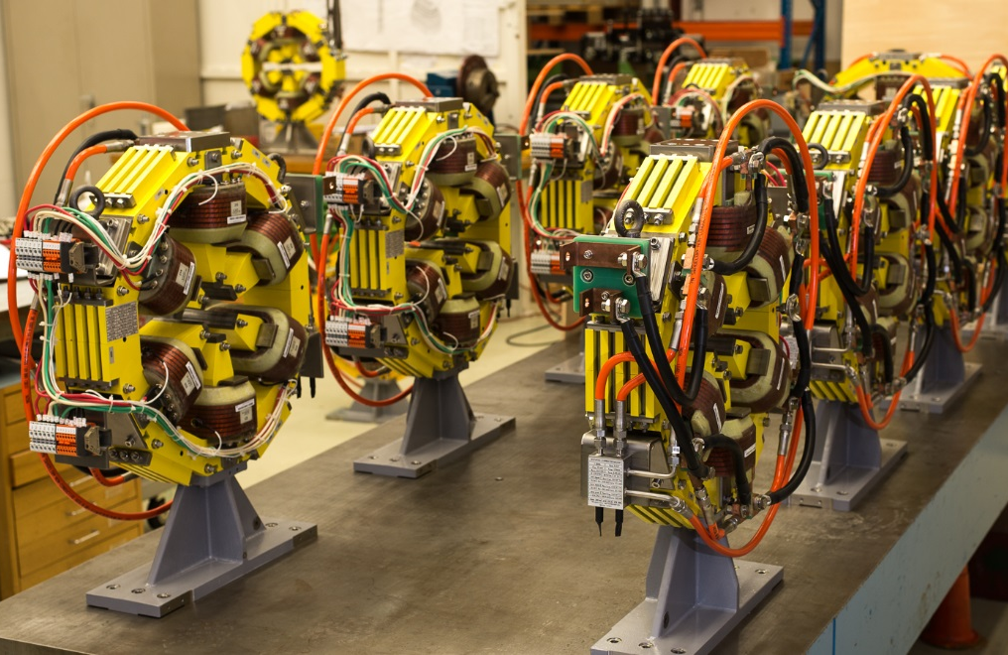
These are sextupoles (with embedded correctors) of the main ring of the SESAME light source
Notes:
This is an example of a common design found in synchrotron light sources, where the (short) sextupoles have additional windings so that they can be used also as corrector magnets.
In this case, the correctors are a horizontal / vertical dipole – providing up to 0.5 mrad kick at 2.5 GeV – and a skew quadrupole.

Slide 14
Different classifications of magnets are also possible, for example based on technology
electromagnet
permanent magnet
iron dominated
coil dominated
normal conducting (resistive)
superconducting
static
cycled / ramped slow pulsed
fast pulsed
Notes:
In electromagnets the field is produced by electrical currents going through the windings. In permanent magnets on the other hand the field is produced by hard magnetic material, such as NdFeB or SmCo.
Iron dominated magnets use a yoke (usually in electrical steel or iron) to guide, shape and reinforce the field; the position of the coil (or permanent magnet) is of minor importance for the strength and homogeneity of the field. Coil dominated magnets use the flux directly generated by the electric current flowing in the windings to shape the field; the position of the iron yoke (if any) is of minor importance for the strength and homogeneity of the field.
Normal conductive (or resistive) magnets have resistive coils, in copper or aluminum, and they are operated around room temperature. Joule heating has to be taken into consideration. Superconducting magnets have superconducting coils, with no Joule heating. The known technical superconductors need to be cooled at cryogenic temperatures to work.
The mode of operation can be static (dc, ex. main magnets in a collider or synchrotron light source), cycled / ramped / slow pulsed (ex. main magnets in a synchrotron for hadron therapy) or fast pulsed (ex. kickers).
In some cases, there might be some hybrids, e.g. an electromagnet with some permanent magnet.
We will not talk about permanent magnets and fast pulsed magnets.

Slide 15
Nomenclature
B magnetic field T (Tesla)
B field
magnetic flux density
magnetic induction
H H field A/m (Ampere/m)
magnetic field strength
magnetic field
μ₀ permeability of vacuum 4π·10⁻⁷ H/m (Henry/m)
μ_{r} relative permeability dimensionless
μ permeability, μ = μ₀μ_{r} H/m
Notes:
The jargon used in particle accelerator magnets is somewhat different from that used in classical electromagnetism.
B is usually referred to as the magnetic field and it is measured in Tesla [T], or Weber/m² [Wb/m²]. This is the field interacting with the beam through the Lorentz force.
H is mostly used when dealing with iron dominated magnets, in particular to compute the magnetomotive force, produced in a ferromagnetic material by the electrical current in the coils. H is measured in Ampere/m [A/m] and usually referred to simply as the H field, or as the magnetic field strength, although the latter can be misleading in this context.
Old units for B are Gauss [G] or kiloGauss [kG]: 10000 G = 1 T = 10 kG.
An old unit for H is Oersted (Oe): 1 Oe = 1000/(4π) A/m

Slide 16
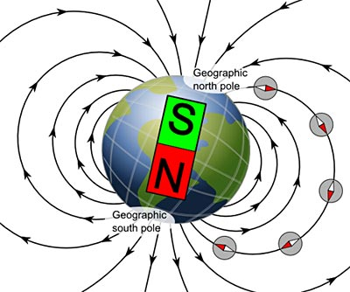
The polarity comes from the direction of the flux lines, that go from a North to a South pole
in Oxford, on 25/01/2017
|B| = 48728 nT = 0.048728 mT = 0.000048728 T
Notes:
The Earth’s magnetic field (for the moment) is oriented as in the figure, with the geographic North pole being a magnetic South pole, and vice versa.
The field at our latitudes is about 0.5 Gauss.
The value above was computed using the World Magnetic Model (WMM) and the latitude / longitude / elevation of Oxford. The date also matters, because the Earth’s magnetic field changes in direction and amplitude with time.
You can check that out at
www.ngdc.noaa.gov/geomag/WMM

Slide 17
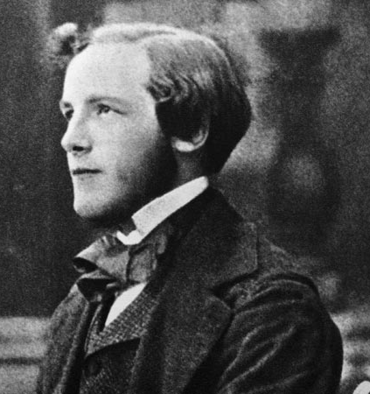

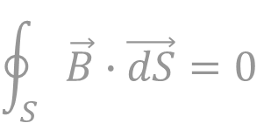
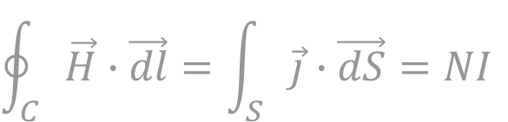


Magnetostatic fields are described by Maxwell’s equations, coupled with a law describing the material
$$\text{div} \vec{B}=0$$
$$\oint_{S}{\vec{B}∙\vec{dS}=0}$$
$$\text{rot} \vec{H}=\vec{J}$$
$$\oint_{C}{\vec{H}∙\vec{dl}}=\int_{S}{\vec{j}}∙\vec{dS}=NI$$
$$\vec{B}=μ_{0}μ_{r}\vec{H}$$
James Clerk Maxwell
Notes:
(top formulae)
The B field is divergence free, or solenoidal. The total flux entering a bounded region equals the total flux exiting the same region (by Gauss theorem): there are neither sources nor wells.
(middle formulae)
The curl of the H field is generated by currents. Applying Stokes’ theorem, the integral of H around a closed loop equals the total current passing through a surface that has that loop as a boundary. This is also known as Ampere’s law.
(bottom formula)
B and H are related by the permeability μ. The relative permeability can be a function of the field level (ex. saturation) or even of the cycle leading to that H (ex. hysteresis).
All other expressions shown later (harmonic decompositions, Biot-Savart law) can be derived from these three equations. An exception is the Lorentz force.
The picture shows James Clerk Maxwell as a young man – he was around 30 when he first published these equations.

Slide 18
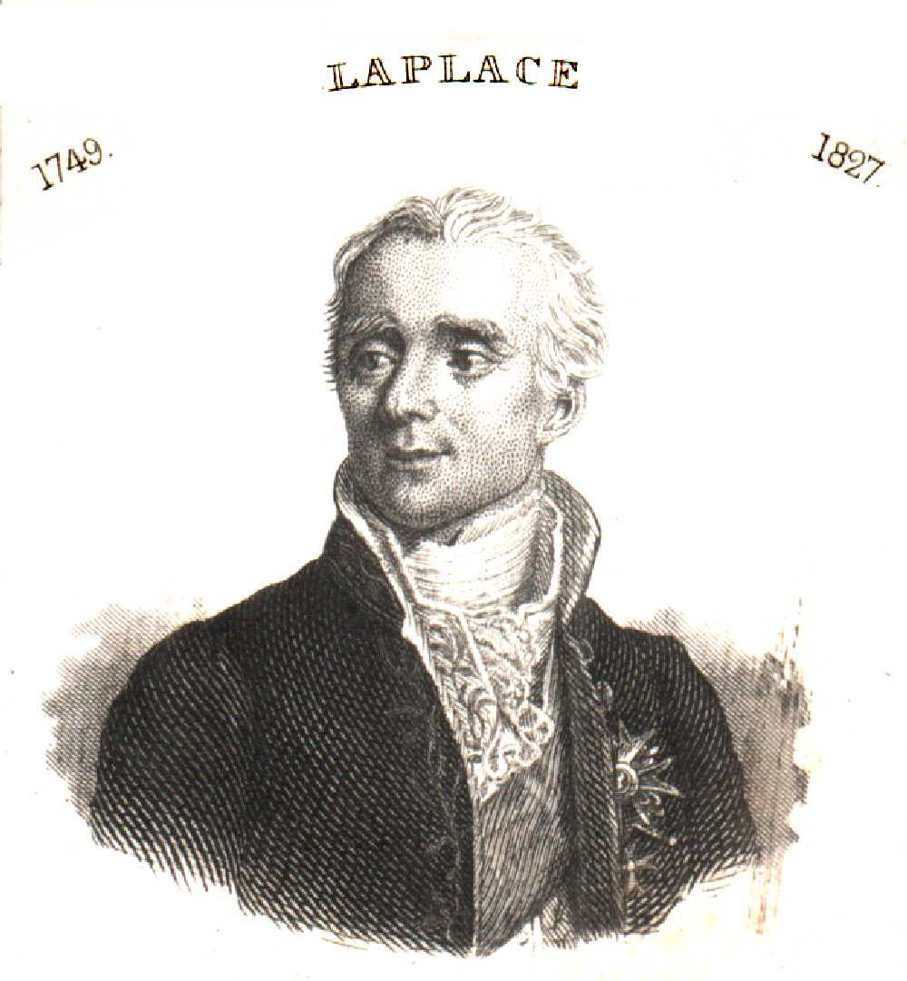
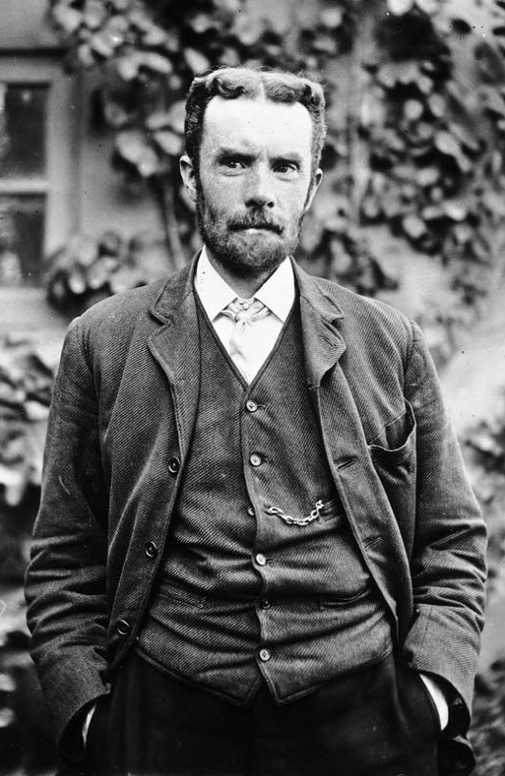
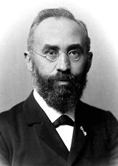


The Lorentz force is the main link between electromagnetism and mechanics
$$\vec{F}=q\left[\vec{E}+\left(\vec{v}×\vec{B}\right)\right]$$
$$\vec{F}=I\vec{ℓ}×\vec{B}$$
for charged beams
for conductors
Oliver Heaviside
Hendrik Lorentz
Pierre-Simon, marquis de Laplace
Notes:
The Lorentz force is the main link between electromagnetism and mechanics.
The force acting on a beam of charged particles exploits the magnetic field because of the (huge) leverage factor of the velocity v, which is often close to the speed of light in our accelerators.
The expression on the right is the one used to get the force F on a conductor carrying a current I in a field B. Especially in superconducting magnets, these forces have to be properly considered at the design stage. For example, the LHC dipoles at nominal field see a horizontal force of approx. 350 tons per m length.
In French, “force de Laplace” is that acting on conductors.
From wiki: The first derivation of the Lorentz force is commonly attributed to Oliver Heaviside in 1889 (39 years old), although other historians suggest an earlier origin in an 1865 paper by James Clerk Maxwell. Hendrik Lorentz derived it a few years after Heaviside.

Slide 19

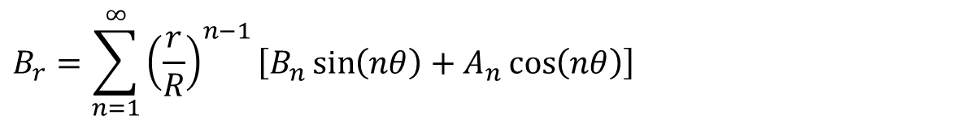



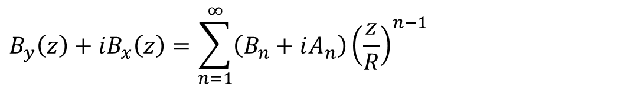


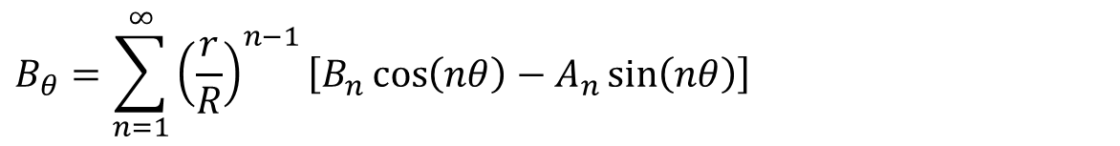

In synchrotrons / transfer lines magnets the B field as seen from the beam is usually expressed as a series of multipoles
$$y$$
$$B_{r}=\sum_{n=1}^{∞}{{\left(\frac{r}{R}\right)}^{n−1}\left[B_{n}\sin\left(nθ\right)+A_{n}\cos\left(nθ\right)\right]}$$
$$B_{θ}$$
$$B_{r}$$
$$r$$
$$B_{θ}=\sum_{n=1}^{∞}{{\left(\frac{r}{R}\right)}^{n−1}\left[B_{n}\cos\left(nθ\right)−A_{n}\sin\left(nθ\right)\right]}$$
$$θ$$
$$x$$
direction of the beam
(orthogonal to plane)
$$B_{y}\left(z\right)+iB_{x}\left(z\right)=\sum_{n=1}^{∞}{\left(B_{n}+iA_{n}\right){\left(\frac{z}{R}\right)}^{n−1}}$$
$$z=x+iy=re^{iθ}$$
Notes:
This 2D decomposition holds in a region of space:
* without currents
* without (hard or soft) magnetic materials (that is, basically, ferromagnetic material like iron and permanent magnets)
* where the z component (3rd dimension, longitudinal) of B is constant
B (a 2D vector field) is then simply described by a series of scalar coefficients: B₁, A₁, B₂, A₂, etc. These are the so-called (not-normalized) harmonics, or multipoles. They have units of Tesla. R is a reference radius.
The same decomposition can be used in 3D for integrated fields. Technically, this holds if at the beginning and end of the integration region dB_{z}/dz = 0, which is the case if B is integrated along a straight line all the way through a magnet.
The same decomposition can be expressed also in Cartesian coordinates (bottom equations), using complex variables. The use of complex numbers can be seen as a way of keeping the notation compact – or it can be given a deeper mathematical meaning (analytic function, Cauchy-Riemann conditions).
In some cases, instead of real B_{n} and A_{n} coefficients, complex terms of the form C_{n} = B_{n} + iA_{n} are used, to then talk about magnitude and phase of the harmonics.
You can find derivations of the above in the references, for ex. [1].

Slide 20
Each multipole term corresponds to a field distribution; they can be added up
B₁: normal dipole
B₂: normal quadrupole
B₃: normal sextupole
A₁: skew dipole
A₂: skew quadrupole
A₃: skew sextupole
Notes:
Each term – taken individually – has a sort of specific meaning, both to the magnet designer and the beam physicist.
The normal family involves a field perpendicular to the y = 0 line, that is, vertical field in the horizontal (usually) plane. In the skew family, the field is tangential to the same y = 0, that is, we have horizontal field in the horizontal (usually) plane.
The skew types are obtained from the normal ones with a 360/(4n) deg rotation, ex. 90 deg for dipole, 45 deg for quadrupole, 30 deg for sextupole.
We consider from now on only magnets in the normal family, not the skew ones, which are anyway just the same rotated.

Slide 21



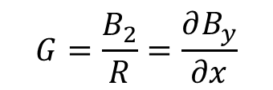
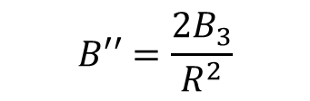




The field profile in the horizontal plane follows a polynomial expansion
$$B_{y}\left(x\right)=\sum_{n=1}^{∞}{B_{n}{\left(\frac{x}{R}\right)}^{n−1}}=B_{1}+B_{2}\frac{x}{R}+B_{3}\frac{x^{2}}{R^{2}}+…$$
$$B_{y}$$
$$B_{y}$$
$$B_{y}$$
$$x$$
$$x$$
$$x$$
B₁: dipole
B₂: quadrupole
B₃: sextupole
$$G=\frac{B_{2}}{R}=\frac{∂B_{y}}{∂x}$$
$$B′′=\frac{2B_{3}}{R^{2}}$$
Notes:
The field expansion along x – that is, in the horizontal (usually) plane – is a polynomial in x/R, with the same coefficients B_{n} of the multipole expansion.
The dipole is the B₁ term, which provides a field constant in space.
The quadrupole is connected to the B₂ term. A quadrupole has a linear variation of B_{y} vs. x. In the center, there is no field. The gradient of a quadrupole is the slope of the B_{y} vs. x line and it is measured in T/m. It turns out that B_{x} is also linear vs. y – in the vertical plane – with the same gradient.
The B₃ term corresponds to a sextupole. Here the field dependency is quadratic in x. In the center, there is no field and no field gradient. A sextupole is usually characterized by the second derivative of B_{y} vs. x. The sextupole can be thought of as a quadrupole where the gradient (slope) changes linearly with the radial displacement x.

Slide 22
For optics calculation, usually the field or multipole component is given, together with the (magnetic) length: ex. from MAD-X
Dipole
bend angle α [rad] & length L [m]
k₀ [1/m] & length L [m] obsolete
k₀ = B / (Bρ) B = B₁
Quadrupole
quadrupole coefficient k₁ [1/m²] × length L [m]
k₁ = (dB_{y}/dx) / (Bρ)
G = dB_{y}/dx = B₂/R
Sextupole
sextupole coefficient k₂ [1/m³] × length L [m]
k₂ = (d²B_{y}/dx²) / (Bρ)
(d²B_{y}/dx²)/2! = B₃/R²
Notes:
In a lattice code, usually magnetic elements are described as a uniform dipole / quadrupole / sextupole (or other) field times a magnetic length. The product of the 2D field (or gradient) times the length is the integrated strength.
In many cases, quadrupoles, sextupoles and the alike can be considered as thin lenses, so basically only the integrated strengths matter.
MAD-X normalizes the coefficients dividing by the beam rigidity Bρ. The length definitions for an SBEND (sector bending magnet) and an RBEND (rectangular bending magnet) are different and they can be found in the MAD-X documentation.
For quadrupole, sextupole and higher order magnets, to avoid ambiguity it is good to quote the pole tip field, or the field at the reference radius. The pole tip field is
quadrupole: B_{pole} = G*r = B₂*(r/R)
sextupole: B_{pole} = B₃*(r/R)²
where r is the radius at the pole tip, and R the reference radius for the harmonics. In a dipole, B_{pole} = B, since the field is uniform.
Note: for MAD-X, B₀ is a dipole, B₁ is a quadrupole, B₂ is a sextupole, etc. while for (most) magnet people n = 1 is a dipole, n = 2 is a quadrupole, etc.

Slide 23
Here is how to compute magnetic quantities from MAD-X entries, and vice versa
BEAM, PARTICLE=ELECTRON,PC=3.0;
DEGREE:=PI/180.0;
QF: QUADRUPOLE,L=0.5,K1=0.2;
QD: QUADRUPOLE,L=1.0,K1=-0.2;
B: SBEND,L=1.0,ANGLE=15.0*DEGREE;
(Bρ) = 10⁹/c*PC = 10^9/299792485*3.0 = 10.01 Tm
dipole (SBEND)
B = |ANGLE|/L*(Bρ) = (15*pi/180)/1.0*10.01 = 2.62 T
quadrupole
G = |K1|*(Bρ) = 0.2*10.01 = 2.00 T/m
Notes:
The BEAM command has several possible entries. In this case, PC is specified, which is the particle momentum times the speed of light, in GeV. The CHARGE is not specified, so the program assumes the default of 1 proton charge. Then the beam rigidity can be computed as
BRHO = PC / ( |CHARGE| * c * 1.e-9)
For an SBEND, the declared length is the arc length of the reference orbit, so the dipole magnetic field is computed as shown; by the way, 2.62 T is rather an uncommon value for the field – too high for a usual resistive magnet, too low (that is, not worth) for a usual superconducting one.
For an RBEND, some trigonometry is needed as (normally) the length is taken along a straight line joining the entry and exit point, so in that case
B = 2/L*sin(|ANGLE|/2)*(Bρ).
The gradient of a quadrupole per se does not mean much: what matters is gradient and aperture. In this case, for example, if we had a 100 mm bore diameter, then we would have 0.1 T ( = 2.0*0.050) as B_{pole}. This is quite low also for resistive magnets, so maybe – from the magnet viewpoint – we could have the same integrated gradient with a shorter but stronger magnet.

Slide 24

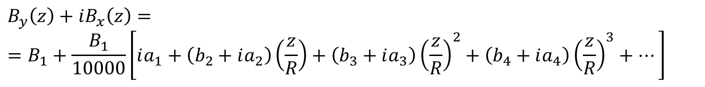
The harmonic decomposition is used also to describe the field quality (or field homogeneity), that is, the deviations of the actual B with respect to the ideal one
(normal) dipole
$${\vec{B}}_{id}\left(x,y\right)=B_{1}\vec{j}$$
$$B_{y}\left(z\right)+iB_{x}\left(z\right)==B_{1}+\frac{B_{1}}{10000}\left[ia_{1}+\left(b_{2}+ia_{2}\right)\left(\frac{z}{R}\right)+\left(b_{3}+ia_{3}\right){\left(\frac{z}{R}\right)}^{2}+\left(b_{4}+ia_{4}\right){\left(\frac{z}{R}\right)}^{3}+…\right]$$
$$b_{2}=10000\frac{B_{2}}{B_{1}} b_{3}=10000\frac{B_{3}}{B_{1}} a_{1}=10000\frac{A_{1}}{B_{1}} a_{2}=10000\frac{A_{2}}{B_{1}} …$$
Notes:
The simulated or measured field is often decomposed in multipole coefficients. This decomposition holds in 2D, or in 3D for the integrated field along the longitudinal direction, and it is valid up to a radius within which no current or magnetic material is present. R is a reference radius. This is often referred to as the good field region (GFR). A typical value for R is 2/3 of the physical aperture radius.
Taking for example a dipole, in the ideal case only one term – B₁ – is present in the series. In reality, all other terms are there, though most often only the lower order ones give a somehow significant contribution. We express these unwanted components (errors) normalized to the fundamental (or main) component, and multiplied by 10000. Usually the upper case B_{n}, A_{n} are used for the not normalized coefficients – measured in Tesla, according to our definition – while the lower case b_{n}, a_{n} are reserved for the normalized terms, which are expressed in units of 10⁻⁴.
The b_{n}, a_{n} terms are typically a few units for well designed and well built dipoles and quadrupoles. Higher values often come for sextupoles and correctors, whose absolute strength is anyway much smaller than the bending and focusing magnets in the lattice.
Note: some terms can also come from a misalignment of the magnet, for example for a dipole a₁ (skew dipole, or horizontal dipole) is connected to a roll angle misalignment.

Slide 25
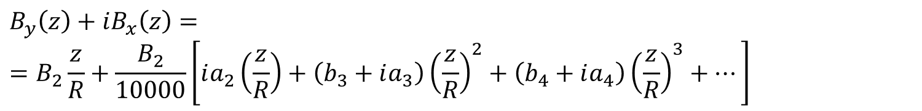
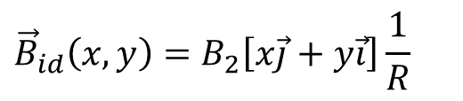
The same expression can be written for a quadrupole
(normal) quadrupole
$${\vec{B}}_{id}\left(x,y\right)=B_{2}\left[x\vec{j}+y\vec{i}\right]\frac{1}{R}$$
$$B_{y}\left(z\right)+iB_{x}\left(z\right)==B_{2}\frac{z}{R}+\frac{B_{2}}{10000}\left[ia_{2}\left(\frac{z}{R}\right)+\left(b_{3}+ia_{3}\right){\left(\frac{z}{R}\right)}^{2}+\left(b_{4}+ia_{4}\right){\left(\frac{z}{R}\right)}^{3}+…\right]$$
$$b_{3}=10000\frac{B_{3}}{B_{2}} b_{4}=10000\frac{B_{4}}{B_{2}} a_{2}=10000\frac{A_{2}}{B_{2}} …$$
Notes:
For a quadrupole, the relative multipole errors are a₂, b₃, a₃, b₄, a₄, etc., and they are obtained by normalizing the upper case coefficients by B₂.
Usually no dipole errors (b₁, a₁) are considered in a quadrupole, as these correspond to a transverse shift of the magnetic Centre (axis, in 3D); in that case, the harmonic decomposition is re-expressed taking as the center of the circle the point where there is no field (no integrated field in 3D).
Note: also for a quadrupole, some multipole errors can come from a misalignment of the magnet, for example a roll angle gives rise to an a₂ (skew quadrupole) term.

Slide 26
The allowed / not-allowed harmonics refer to some terms that shall / shall not cancel out thanks to design symmetries
fully symmetric dipoles
allowed: B₁, b₃, b₅, b₇, b₉, etc.
not-allowed: all the others
half symmetric dipoles
allowed: B₁, b₂, b₃, b₄, b₅, etc.
not-allowed: all the others
fully symmetric quadrupoles
allowed: B₂, b₆, b₁₀, b₁₄, b₁₈, etc.
not-allowed: all the others
fully symmetric sextupoles
allowed: B₃, b₉, b₁₅, b₂₁, etc.
not-allowed: all the others
Notes:
We like to divide the multipole errors in two families: allowed and not-allowed (or random).
The not-allowed (or random) terms are the ones that should not be there, thanks to symmetries in the design. They then arise due to asymmetries introduced during the fabrication.
The allowed multipoles remain even when perfect symmetries hold. Part of the magnetic design focuses to optimize the geometry to cancel out these terms.
The SPS (a hybrid between an H-shape and a window frame) main dipoles are fully symmetric dipoles. The HERA or Tevatron superconducting magnets are also fully symmetric.
Half symmetric dipoles are resistive magnets with a C-shape yoke, for ex. the ones of various light sources (ANKA, DIAMOND) or the LEP dipoles. The LHC main dipoles are also – technically speaking – in this family, since there is a double aperture breaking the full (left/right) symmetry, though the design of each aperture separately is fully symmetric.

Slide 27
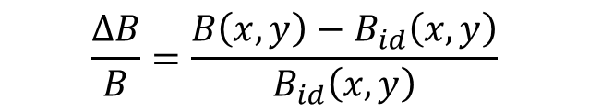
The field quality is often also shown with a ΔB/B plot
$$\frac{ΔB}{B}=\frac{B\left(x,y\right)−B_{id}\left(x,y\right)}{B_{id}\left(x,y\right)}$$
done on one component, usually B_{y} for a dipole
Notes:
The field quality is also often expressed in terms of ΔB/B, where ΔB is the difference between the actual field B and the ideal distribution B_{id}, normalized by the ideal distribution B_{id}. Since B is a vector field, this is often done either on one component (the main one) or on the modulus.
The plots on graph paper are measured field error curves (1970) inside the CERN PSB (PS Booster) prototype bending magnet inner gap. The abscissa is the radial position in the magnet aperture in mm. This particular magnet has a (wide) pole of 460 mm width, for 70 mm of vertical gap.
These ΔB/B plots are typically used for resistive dipoles, which often have much of a rectangular (i.e., not circular) aperture, so where using the standard harmonic decomposition is not possible.

Slide 28

ΔB/B can (at least locally) be expressed from the harmonics: this is the expansion for a dipole
$$B_{y,id}\left(x\right)=B_{1}$$
$$B_{y}\left(x\right)=B_{1}+\frac{B_{1}}{10000}\left[b_{2}\left(\frac{x}{R}\right)+b_{3}{\left(\frac{x}{R}\right)}^{2}+b_{4}{\left(\frac{x}{R}\right)}^{3}+…\right]$$
$$\frac{ΔB}{B}(x)=\frac{1}{10000}\left[b_{2}\left(\frac{x}{R}\right)+b_{3}{\left(\frac{x}{R}\right)}^{2}+b_{4}{\left(\frac{x}{R}\right)}^{3}+…\right]$$
Notes:
The ΔB/B can be built up starting from the harmonics, at least in the region where the harmonics hold. Going the other way around – from ΔB/B to multipoles – is not (mathematically speaking) really possible, but it is also done anyway.
In the case of a dipole, we consider the vertical field along the midplane, that is, B_{y}(x) along the y = 0 line. The ΔB/B plot is made up of several contributions coming from b₂ (quadrupole, linear), b₃ (sextupole, quadratic), b₄ (octupole, cubic) and so on.
Note 1: the harmonic expansion is valid only within a circle not containing current or magnetic material. For resistive dipoles – even with wide poles – the same polynomial expansion is used in practice with the coefficients of the powers in x/R still called “quadrupole”, “sextupole” and so on.
Note 2: deriving the multipoles from the ΔB/B is (mostly) done using some polynomial fitting, though the base functions are now not orthogonal…

Slide 29
Introduction, jargon, general concepts and formulae
Resistive magnets
Superconducting magnets
Tutorial with OPERA-2D

Slide 30
Resistive magnets are in most cases “iron-dominated” magnets: the BH response of the yoke material is important
curves for typical M1200-100 A electrical steel
Notes:
Iron greatly enhances the field in the aperture of a magnet up to about 2 T (max). It does so by collecting the flux lines – which tend to fill space with high relative magnetic permeability – and by adding its own magnetization to the field produce by the windings (or the permanent magnets).
Iron has a typical magnetic B-H characteristics. It is basically linear up to about 1.2-1.3 T – the actual knee depends on the grade of the material – to then saturate.
The same can be looked at in terms of relative permeability μ_{r} versus H, which has a peak of a few thousands to then decrease with the saturation.
At low field the permeability of the material is not well behaved: the iron has to be “waken up”. Then remanence effects due to hysteresis can be important.
In most cases, the material used in the yokes of resistive magnets is an electrical steel: Fe + a few % of other elements, mainly Si (up to about 3%), to increase the resistivity (and so decrease eddy currents) and to minimize the hysteresis cycle. These are called electrical steels, or Si steel. They are the same used for electrical machines like transformers, generators, motors, etc.

Slide 31
These are typical fields for resistive dipoles and quadrupole, taken from machines at CERN
PS @ 26 GeV
combined function bending B = 1.5 T
SPS @ 450 GeV
bending B = 2.0 T
quadrupole B_{pole} = 21.7*0.044 = 0.95 T
TI2 / TI8 (transfer lines SPS to LHC, @ 450 GeV)
bending B = 1.8 T
quadrupole B_{pole} = 53.5*0.016 = 0.86 T
Notes:
The range of B fields covered by resistive magnets can be wide. Just to have some terms of comparison, here we take a look at the fields in the gap of dipoles and pole tip fields of quadrupoles for the largest CERN (resistive) synchrotrons and transfer lines.
The PS – CERN’s oldest running machine – has combined function bending magnets with a central gap field of about 1.5 T. These magnets are C shaped.
The SPS – CERN’s largest resistive synchrotron – has bending magnets which run up to 2.0 T and quadrupoles with pole tip fields up to about 1.0 T. Pushing the central field above that in a large resistive machine is not realistic, because of the large electric consumption.
For the long transfer lines from the SPS to LHC (combined length of 5.6 km), the dipoles run at 1.8 T while the quadrupoles are designed for 0.9 T at the pole tip.
Note: the pole tip field of quadrupoles (and sextupoles, etc) is smaller than what can be achieved in a dipole, as this kind of magnets “collect flux lines in the yoke”, that is, there is more field in the iron that you do not have in the useful (good field region) part of the air gap.

Slide 32
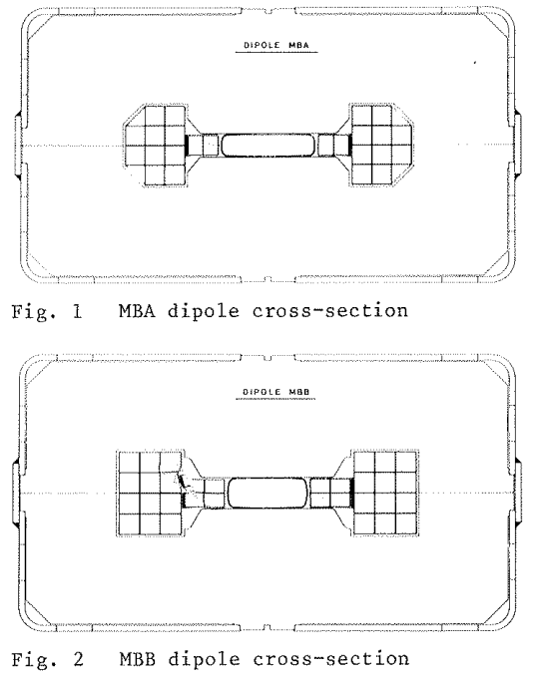
This is the transfer function field B vs. current I for the SPS main dipoles
Notes:
As an example of magnets working into saturation, we show the transfer function of the SPS main dipoles at CERN.
The plot is the actual calibration curve used by operation at CERN, which is the average of 388 + 361=749 bending magnets, powered in series. The dashed line is an extrapolation of the initial linear part, that is, it represents the field if there were no saturation. At 6 kA the efficiency (the ratio of the two curves) is 89%.
When injecting beams into the LHC, the SPS works up to 450 GeV, with a field of 2.02 T.

Slide 33
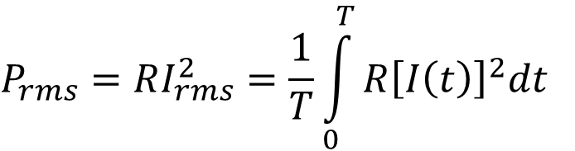
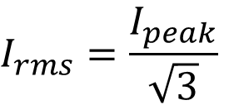
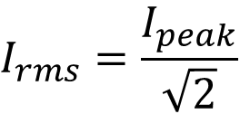
If the magnet is not dc, then an rms power / current is taken, considering the duty cycle
$$P_{rms}=RI_{rms}^{2}=\frac{1}{T}\int_{0}^{T}{R{\left[I\left(t\right)\right]}^{2}dt}$$
$$I_{rms}=\frac{I_{peak}}{\sqrt{2}}$$
for a pure sine wave
$$I_{rms}=\frac{I_{peak}}{\sqrt{3}}$$
for a linear ramp from 0
Notes:
The subscript rms stands for root mean square. I_{rms} is the effective current, that is, the one which is equivalent w.r.t. the losses per Joule heating in a cycle.
If the magnet is operated in dc, then peak and rms values are the same thing.
The same concept is used routinely in electrical systems working in ac. Duty cycles of synchrotrons often involves linear ramps up / down, and possibly some flats for beam injection / extraction – rather than pure sinusoidal oscillations – so the corresponding rms values have to be computed case by case.

Slide 34
This will be a cycle to 2.0 GeV of the PSB at CERN after the upgrade planned from 2019-2020
rms
Notes:
As an example of a computation of rms current, we show a typical cycle – current I vs. time t – of the main dipoles of the PS Booster at CERN. The machine at the moment accelerates beams up to 1.4 GeV, though an upgrade is planned to push it to 2.0 GeV. The peak current is 5.3 kA, but the rms current is (only) 2.2 kA.
The ramp up (with beam in) is much more gentle than the ramp down (without beam).

Slide 35
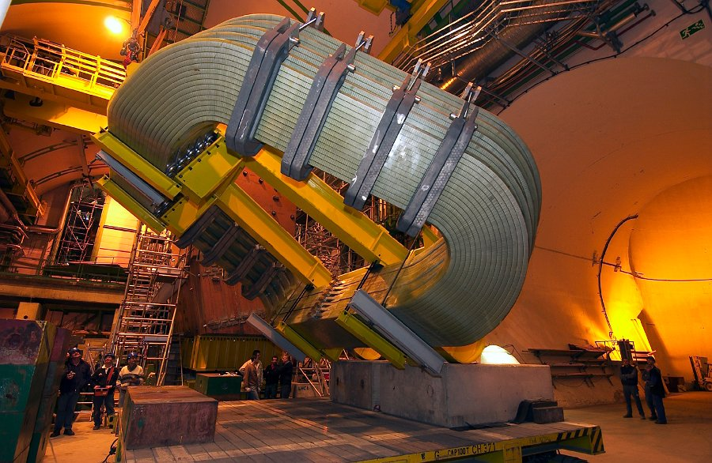
The material of the coils is most often copper, sometimes aluminum
Cu Al
raw metal price ≈ 5000 $/ton ≈ 1500 $/ton
electrical resistivity 1.72∙10⁻⁸ Ω/m 2.65∙10⁻⁸ Ω/m
density 8.9 kg/dm³ 2.7 kg/dm³
LHCb detector dipole
Al coils
coil mass 2 × 25 t
power 2 × 2.1 MW
Notes:
Usually resistive coils are either in copper or aluminum.
Copper is the most common choice nowadays for accelerator magnets, as it offers a lower resistivity. The SPS magnets at CERN have coils in copper. This was also the choice for all new magnets at CERN in the last years.
Sometimes aluminum becomes interesting because it is lightweight and less expensive, also when additional material is added to keep the resistance (and power) of the coil low. The PS main units at CERN are in aluminum, which was chosen for economical reasons. Also the LEP main bending magnets – always at CERN – were powered with aluminum busbars. Aluminum is used routinely in electrical power transmission lines.
The resistances are given at 20 °C. Both Cu and Al become more resistive as the temperature increases, with about a 4‰ increase per degree.
The raw metal prices evolve continuously, the values are just to give an idea.

Slide 36
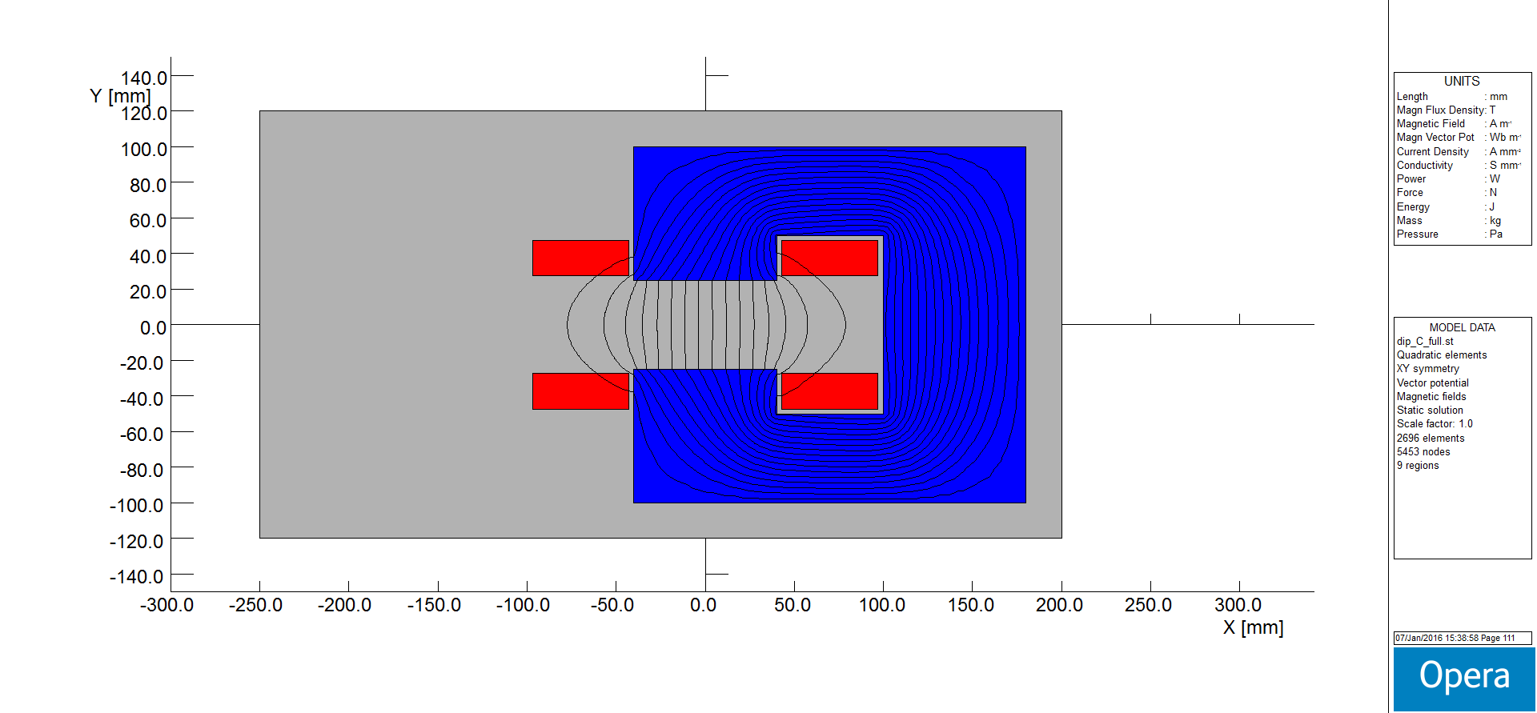
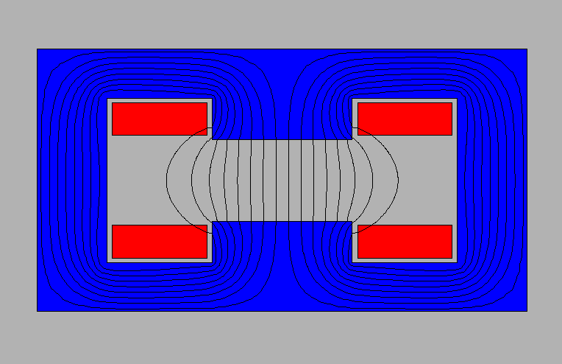
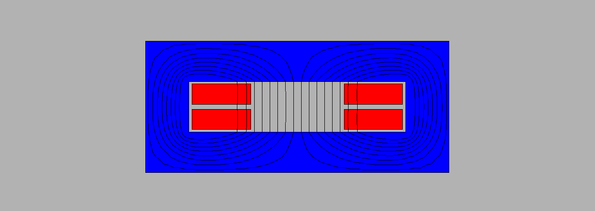
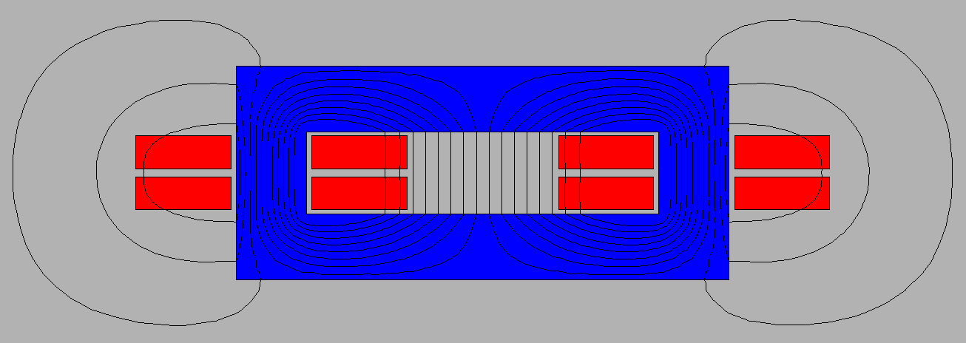
These are the most common types of resistive dipoles
“C”
“H”
window frame (“O”)
window frame (“O”)
with windings on both backlegs
Notes:
The C shape provides easy access to the gap for the vacuum chamber – for this it is often found in light sources – at the cost of a (slight) asymmetry, which introduces the even terms in the allowed multipoles, in particular the quadrupole (gradient).
The H shape is symmetric, at the cost of some access problems to the gap. For the same field, this is more compact and mechanically stable than a C. The coils can extend till the midplane – like in the SPS case, which is then a hybrid between an H and a window frame – though then they need to be bent up in the ends to clear the gap region. If the coil gets close to the aperture, then its position can have an impact on field quality.
The window frame geometry provides the best field quality, thanks to the extra wide pole; it has the same access problems of the H, plus there has to be enough room to dimension the coil properly. As for the other cases, the position of the windings can impact the field quality if the coil gets very close to the gap. This type is often used for correctors, where the field is low, with the coils wound on the return legs (figure on the bottom right). In this latter configuration, it is somehow inefficient in 2D – the outer conductors are useless to create field in the gap. In practice, this layout is still convenient for short magnets. The return current on the outside adds flux in the side legs of the magnets, so more material is needed if the working point becomes close to saturation – which is not an issue if the magnet works at low field, like a corrector.

Slide 37




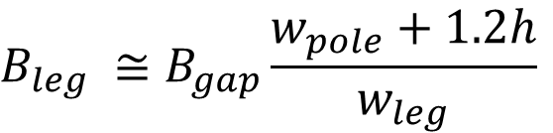
The magnetic circuit is dimensioned so that the pole is wide enough for field quality, and there is enough room for the flux in the return legs
$$w_{leg,1}$$
$$w_{leg,2}$$
h
$$w_{pole}$$
$$w_{pole} ≅w_{GFR}+2.5h$$
$$B_{leg} ≅B_{gap}\frac{w_{pole}+1.2h}{w_{leg}}$$
Notes:
The magnetic circuit is designed in 2D as follows:
* the pole is wide enough to provide the required field homogeneity in the good field region; its actual width depends if we have (or not) pole shims, if the magnet is saturated, if we want a field uniformity in the 10⁻², 10⁻³ or 10⁻⁴ level, etc., though the above formula provides a good first guess in many cases;
* to dimension the return legs, we consider that the flux in the yoke includes the flux in the gap, but also some stray flux. The stray flux extends about one gap width on either side of the aperture. The width of the legs is chosen to limit the B in the yoke, usually below saturation, so to work in the high permeability regime of the material.
Note: the density of the flux lines in the figure is – well – the flux density, that is, the B field (Faraday); in this example, B is higher in the top / bottom legs than in the back one.

Slide 38
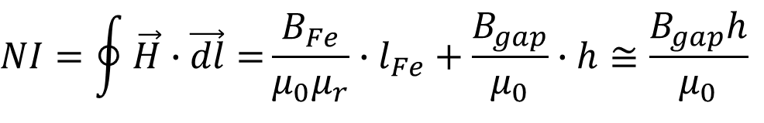
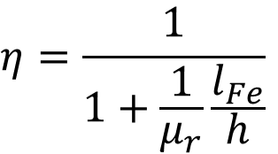
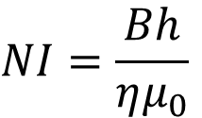

The Ampere-turns are a linear function of the gap and of the B field (at least up to saturation)
$$l_{Fe}$$
NI/2
h
NI/2
$$NI=\oint{\vec{H}∙\vec{dl}=}\frac{B_{Fe}}{μ_{0}μ_{r}}∙l_{Fe}+\frac{B_{gap}}{μ_{0}}∙h≅\frac{B_{gap}h}{μ_{0}}$$
$$NI=\frac{Bh}{ημ_{0}}$$
$$η=\frac{1}{1+\frac{1}{μ_{r}}\frac{l_{Fe}}{h}}$$
Notes:
The basic formula to compute the Ampere-turns needed for a given field and vertical gap can be derived from the circuitation of H around a flux line (Ampere’s law).
The term with B_{Fe}, l_{Fe} and μ_{r} is difficult to expand exactly – those can actually be interpreted as average ones along the integral – however it does not matter. In fact, B_{Fe} is similar to B_{gap}, while μ_{r} has a high value (thousands, unless the iron is heavyly saturated) which makes that contribution small. For this reason, the simple formula on the bottom, with just B, can be used.
The concept of magnetic efficiency η can also be introduced. Typical values are above 95%.

Slide 39
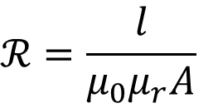
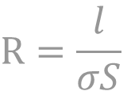
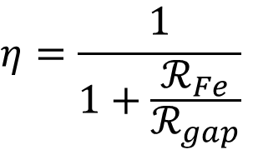
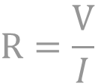
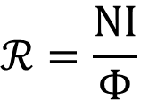
The same can be solved using magnetic reluctances and Hopkinson’s law, which is a parallel of Ohm’s law
$$ℛ=\frac{\text{NI}}{Φ}$$
$$R=\frac{\text{V}}{I}$$
$$ℛ=\frac{l}{μ_{0}μ_{r}A}$$
$$R=\frac{l}{σS}$$
$$η=\frac{1}{1+\frac{ℛ_{Fe}}{ℛ_{gap}}}$$
Notes:
There is a simple parallel between magnetic circuits and electrical ones:
* voltage drop ---> magnetomotive force
* resistance ---> reluctance
* current ---> flux
* Ohm’s law ---> Hopkinson’s law
NI – the Ampere-turns – is the magnetomotive force.
A and l are the cross section of the magnetic circuit and its length. In 2D, the area A is the width of the magnetic circuit * 1 m.
The B field (flux density) is then the flux Φ divided by the section A.
The Ampere-turns spent in the yoke are like the voltage drop spent in connection wires in an electric circuit.
For a C dipole, there are two main magnetic reluctances in series: the one for the air gap (usually predominant) and the one for the iron.

Slide 40
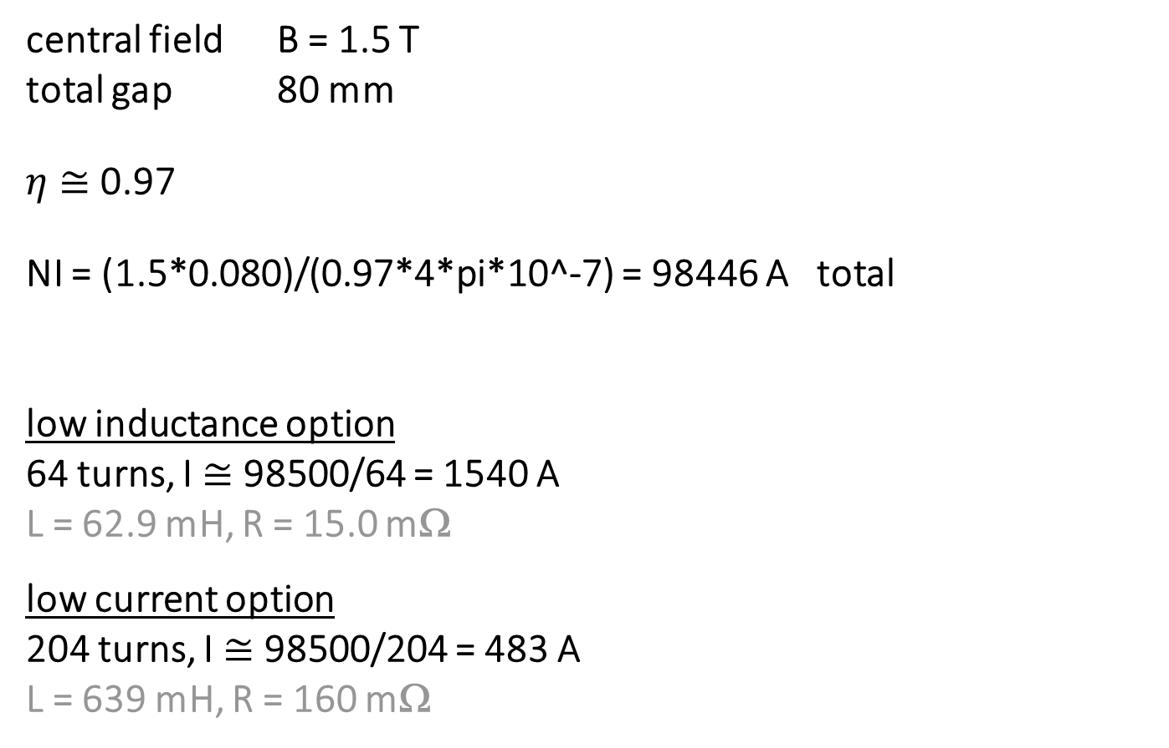

Example of computation of Ampere-turns and current
central field B = 1.5 T
total gap 80 mm
$η$ $≅$ 0.97
NI = (1.5*0.080)/(0.97*4*pi*10^-7) = 98446 A total
low inductance option
64 turns, I $≅$ 98500/64 = 1540 A
L = 62.9 mH, R = 15.0 mΩ
low current option
204 turns, I $≅$ 98500/204 = 483 A
L = 639 mH, R = 160 mΩ
$$NI=\frac{Bh}{ημ_{0}}$$
Notes:
These values are actually taken from existing magnets, designed in the 1970s at CERN: the so-called MCAs and MCBs. The yoke is identical in the two cases, just the coils are different, with a high current / low inductance and a low current / high inductance designs. The iron length is 2.5 m. As the magnetic energy (1/2*L*I^2) is basically the same, the inductance scales with (number of turns)^2.
Having a small number of turns carrying a large current brings down the inductance. This can be convenient if the machine is ramped or pulsed, as the inductive voltage L*dI/dt is the main voltage. On the other hand, high current means larger cables and connections.
The same Ampere-turns can be achieved with a higher number of turns carrying a smaller current each. In this case the inductance is high, which is not an issue if the magnet is almost dc. The size of the cables and of the connections is smaller if the current is smaller.
Best practice wants to design the coil considering also iterations of the parameters with the colleagues of power converters.

Slide 41
Besides the number of turns, the overall size of the coil depends on the current density j, which drives the resistive power consumption (linearly)
ex. NI = 50000 A (rms)
air cooled
(by conduction on external surface)
j = 1 A/mm²
A = 50000/1 = 50000 mm²
1 – 1.5 A/mm²
(for Cu)
water cooled
(hollow conductor)
j = 5 A/mm²
A = 50000/5 =
= 10000 mm²
j
(rms)
Notes:
Given the Ampere-turns – which depend basically on the field strength B, the gap h and (to a lesser degree) the saturation level of the iron – the size of the coil depends from the current density j.
The dc resistive power dissipated in the windings scales linearly with j – at fixed field (that is, for the same Ampere-turns).
Below 1 – 1.5 A/mm² (rms) the coils are usually not directly cooled, that is, they are “air cooled” on the exterior by natural air convection. Above those current densities, direct water cooling (with demineralized water circulating inside the conductor) is used. A typical value is now around 5 A/mm² (rms) for dipoles, usually higher for quadrupoles. For both air and water cooled cases, for dc or slow magnets, what needs to be removed is the resistive electrical power, that is R*I^2. For very fast magnets, there are also eddy currents inside the conductor, which are not treated here.
The choice of j depends on several factors. For large machines, we look for a balance between an overall optimum of capital + running cost: large coils = large capital cost = low running (electricity) cost, and vice versa.
In other cases and for single or few magnets that need to be very compact, the current density can be much higher, like tens of A/mm².

Slide 42
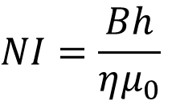


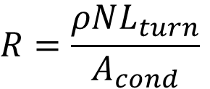
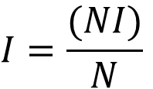
These are common formulae for the main electric parameters of a resistive dipole (1/2)
$$NI=\frac{Bh}{ημ_{0}}$$
Ampere-turns (total)
current
resistance (total)
inductance
$$I=\frac{(NI)}{N}$$
$$R=\frac{ρNL_{turn}}{A_{cond}}$$
$$L≅ημ_{0}N^{2}A/h$$
$$A≅{(w}_{pole}+1.2h)(l_{Fe}+h)$$
Notes:
NI [A] total (not per pole ) Ampere-turns
B [T] field in the aperture
h [m] full vertical gap
μ₀ [H/m] vacuum permeability, 4π∙10⁻⁷ H/m
η [/] magnetic efficiency, ≈0.95-0.98 (depends on iron saturation)
I [A] current
N [/] total (not per pole) number of turns
R [Ω] resistance
L [H] inductance
ρ [Ωm] resistivity, 1.72∙10⁻⁸ Ωm for Cu, 2.65∙10⁻⁸ Ωm for Al, at 20 °C
L_{turn} [m] average length of a coil turn
A_{cond} [m²] cross section of a single conductor (counting only the metal)
l_{Fe} [m] iron length, in 3D (longitudinal direction)
w_{pole} [m] pole width
The Ampere-turns NI are directly proportional to the field B and the vertical gap h. The formula holds in all cases, with the exception of the window frame layout with windings on both backlegs, where the Ampere-turns need to be doubled. The resistance depends on the resistivity ρ of the conductor and its cross section. The inductance depends quadratically on the number of turns; for the same gap, L is larger for a wider pole.

Slide 43
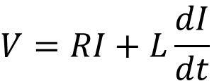


These are common formulae for the main electric parameters of a resistive dipole (2/2)
$$V=RI+L\frac{dI}{dt}$$
voltage
resistive power (rms)
magnetic stored energy
$$P_{rms}=RI_{rms}^{2}$$
$$=ρj_{rms}^{2}V_{cond}$$
$$=\frac{ρL_{turn}B_{rms}h}{ημ_{0}}j_{rms}$$
$$E_{m}=\frac{1}{2}LI^{2}$$
Notes:
V [V] voltage
dI/dt [A/s] current ramp rate
P_{rms} [W] resistive power (rms)
j_{rms} [A/m²] current density (rms)
V_{cond} [m³] volume of conductor
E_{m} [J] magnetic stored energy
The voltage has a resistive and an inductive part. In cycled magnets, often the inductive voltage is larger than the resistive one.
The resistive power is usually looked at in rms terms. The formula can be used also for the peak power, just with the peak current instead of the rms one. For a given coil size, the power scales linearly with the field B, the gap h and the current density j.
The magnetic stored energy could be computed also from the energy per unit volume (B²)/(2μ). Since the permeability is usually quite high in the yoke, the magnetic energy is basically all stored in the air volume.
In their more general form, these equations hold also for other magnets, not just dipoles.

Slide 44





These are useful formulae for the main cooling parameters of a water cooled dipole
$$Q_{tot}≅14.3\frac{P}{ΔT}$$
cooling flow
water velocity
Reynolds number
pressure drop
$$Q_{tot}≅N_{hydr}Q$$
$$v=\frac{1000}{15πd^{2}}Q$$
$$Re≅1400dv$$
$$Δp=60L_{hydr}\frac{Q^{1.75}}{d^{4.75}}$$
Notes:
Technical units are used in these formulae, taken from [2].
P [kW] power to be dissipated, that is, P_{rms} in most cases
ΔT [°C] water temperature increase between inlet and outlet
typically up to 30 °C, in many cases lower
Q_{tot} [l/min] total (not per hydraulic circuit) flow rate
Q [l/min] flow rate per hydraulic circuit
N_{hydr} [/] number of hydraulic circuits in parallel
v [m/s] water velocity; for Cu conductor, typically < 3 m/s to avoid erosion problems, which could start already at 1.5 m/s
d [mm] diameter of the cooling duct
Re [/] Reynolds number, typically 2000 < Re < 10⁵, to have moderately turbulent flow
Δp [bar] pressure drop, typically around 10 bar
L_{hydr} [m] length of each hydraulic circuit in parallel
this can be different from NL_{turn}, as there could be a difference between electrical and hydraulic circuits, with for example sub-coils all electrically in series, but hydraulically in parallel
The expressions are valid for water at around 40 °C. Other formulae are also used, see for ex. [4] and [6].
Also in this case, the equations hold for other magnets, not just dipoles.

Slide 45
The table describes the field quality – in terms of allowed multipoles – for the different layouts of these examples
 | C-shaped | H-shaped | O-shaped
b₂ | 1.4 | 0 | 0
b₃ | -88.2 | -87.0 | 0.2
b₄ | 0.7 | 0 | 0
b₅ | -31.6 | -31.4 | -0.1
b₆ | 0.1 | 0 | 0
b₇ | -3.8 | -3.8 | -0.1
b₈ | 0.0 | 0 | 0
b₉ | 0.0 | 0.0 | 0.0
b_{n} multipoles in units of 10⁻⁴ at R = 17 mm
NI = 20 kA, h = 50 mm, w_{pole} = 80 mm
Notes:
The allowed harmonics for the C and H designs contains rather large sextupoles b₃ and decapoles b₅. Solutions to improve field quality involve adding side shims (discussed later) or widening the pole. Still, the differences between the asymmetric C and the symmetric H layouts are rather small.
The window frame – as expected – is better, as the pole is indeed much wider.
Note 1: in these examples, w_{pole} does not follow the rule w_{pole} ≈ w_{GFR} + 2.5h, as here it is rather w_{pole} ≈ w_{GFR} + h; this is why the field quality is somehow poor, in the 10⁻² region.
Note 2: entries with a “0” correspond to not allowed harmonics
Note 3: it is possible to take the center of the C (for the beam) not in the middle of the pole, but where the good field region is wider. The improvement is minor.

Slide 46



These are the most common types of resistive quadrupoles
standard quadrupole
figure-of-8
(useful because narrow)
quadrupole with half the coils
(maybe not so common)
Notes:
Resistive quadrupoles are most often of the standard type shown in the central top figure, with four symmetrical quadrants.
Sometimes figure-of-8 (referred to also as Collins) quadrupoles are used, with the magnetic circuit split in two halves. In this way, the magnets can be quite compact transversally, which might be needed in very crowded regions. For example, some quadrupoles in light sources are of this kind, to make room for outgoing photon beam lines. We also have a few of these at CERN, as first quadrupoles in a extraction line or after a switch dipole. This layout breaks the symmetry, somehow like the C-shape does in dipoles.
A quadrupole with only half the coils also works just fine for weak strengths, though it is seldom used to my knowledge.
Note: in the simulations, the same current density is applied to the various configurations, corresponding to a pole tip field (for the standard quadrupole in the top) of 0.8 T. This value starts to be on the high side for quadrupoles, as extra flux is then collected in the yoke from the pole sides. As a term of comparison, the SPS quadrupoles – which are quite “pushed” – have 1.0 T on the pole tip.

Slide 47




These are useful formulae for standard resistive quadrupoles
Pole tip field
Ampere-turns (per pole)
current
resistance (total)
$$B_{pole}=Gr$$
$$NI=\frac{Gr^{2}}{2ημ_{0}}$$
$$I=\frac{(NI)}{N}$$
$$R=4\frac{ρNL_{turn}}{A_{cond}}$$
Notes:
These formulae consider a standard quadrupole with 4 coils.
NI [A] Ampere-turns per pole
G [T/m] field gradient in the aperture
r [m] aperture radius
μ₀ [H/m] vacuum permeability, 4π∙10⁻⁷ H/m
η [/] magnetic efficiency, ≈0.95-0.98 (depends on iron saturation)
I [A] current
N [/] number of turns per pole
R [Ω] total (not per coil) resistance
ρ [Ωm] resistivity, 1.72∙10⁻⁸ Ωm for Cu, 2.65∙10⁻⁸ Ωm for Al, at 20 °C
L_{turn} [m] average length of a coil turn
A_{cond} [m²] cross section of a single conductor (counting only the metal)
The Ampere-turns NI depend now quadratically on the gap (r²), not linearly as in the dipoles. The derivation is similar to that for the dipoles and it can be found in the references, ex. [4] and [6].
For the inductance, there is an approximate formula in [2]. For short magnets, 3D simulations or measurements are needed.
The resistive power can be computed from the current and the resistance, as for the dipoles.

Slide 48






The ideal poles for dipole, quadrupole, sextupole, etc. are lines of constant scalar potential
dipole
$$ρ\sin\left(θ\right)=±h/2$$
$$y=±h/2$$
straight line
quadrupole
$$ρ^{2}\sin\left(2θ\right)=±r^{2}$$
$$2xy=±r^{2}$$
hyperbola
sextupole
$$ρ^{3}\sin\left(3θ\right)=±r^{3}$$
$$3x^{2}y−y^{3}=±r^{3}$$
Notes:
It can be shown – see for ex. [1] – that the ideal pole profiles are curves of constant scalar potential. This follows from the definition of the scalar potential itself (not covered here) and from the fact that the flux lines are perpendicular to the iron pole, if the iron permeability is infinite.
The expressions are quite neat in polar coordinates, though they become cumbersome – already for a sextupole – in Cartesian coordinates.
The ideal pole profile for a dipole is simply a pair of straight lines.
The ideal pole profile for a quadrupole is a hyperbola.
In my opinion, these formulae are more of academic interest, as anyway the pole is of finite width and its profile is optimized using some simulation tools. My personal preference is for simple profiles – i.e., profiles that can be described with line segments and circular arcs. This is often possible without any detrimental effect on field quality, especially when the pole is not very wide.
All these profiles can be derived also using conformal mapping. There is quite a bit of elegant complex mathematics in it, details can be found in some of the references.

Slide 49
As an example, this is the pole tip used in the SESAME quadrupoles vs. the theoretical hyperbola
Notes:
As an example of theoretical vs. real pole tip profile, we consider the quadrupoles for the SESAME light source.
The hyperbola extends till infinity, without space for the coils: this is not practical. The real pole shape is not far from the theoretical one, and then it is terminated with shims, which are used at the design stage to minimize the allowed harmonics, that is, to improve field quality. In a way, those shims bring in extra material, which is in a way substituting the one going all the way to infinity in the theoretical profiles.
In this specific case, the central part of the pole tip is not a hyperbola and the profile is described with lines and circular arcs – with no compromise on field quality. When designed the pole tip in 2D (with OPERA), the starting point for the radius of the central part of the pole was the curvature radius of the theoretical hyperbola – which turns out to be simply equal to the aperture radius, 35 mm in this case.

Slide 50

This is the lamination of the LEP main bending magnets, with the pole shims well visible
Notes:
The ideal poles for a dipole are two infinite parallel lines. Wide poles indeed help for field quality – though they need to be terminated somewhere. At the extremes, shims are then introduced. For long magnets, their size and shape can be simulated in 2D to optimize the field quality. The real field quality will depend also on the mechanical tolerances and the possible asymmetry in the magnetic properties of the material.
Here the lamination for the LEP magnets is shown, where about ¼ of the pole width is actually used for shims.
These magnets were rather particular – see the right picture. The top field was only 110 mT, which allowed the yoke to be made in steel / concrete, with the steel being 30% in volume. This is referred to as dilution. We say that the stacking factor is 0.30. In the great majority of cases, the stacking factor is above 97%; the few % unoccupied by iron is taken up by insulation in within the laminations and voids.

Slide 51



In 3D, the longitudinal dimension of the magnet is described by a magnetic length
$$l_{m}B_{0}=\int_{−∞}^{∞}{B\left(z\right)dz}$$
Notes:
Looking along the longitudinal (z) direction, the field B is maximum at the center (z = 0) of the magnet, it is more or less constant till reaching the ends, where it rolls off to reach a 0 value outside. The magnetic length l_{m} is defined as that length which – multiplied by the central field value B₀ – provides the same integrated field.
The same holds substituting the field B with the gradient G, or with any multipole B_{n}, A_{n}. In this case, the integrals are carried out on the not-normalized (upper case) coefficients, and the normalized terms (lower case) are then obtained by dividing by the integral by the fundamental harmonic.
For long magnets – where the longitudinal dimension is much larger than the gap – the behavior is dominated by the (long) central part, so taking the values of 2D simulations and multiplying by a length yields good results. For short magnets, the behavior is intrinsically 3D.

Slide 52



The magnetic length can be estimated at first order with simple formulae
$$l_{m}>l_{Fe}$$
dipole
$$l_{m}≅l_{Fe}+h$$
quadrupole
$$l_{m}≅l_{Fe}+0.80r$$
Notes:
The magnetic length is larger than the iron length: there is some stray flux, that is, there is still some field left after the iron yoke terminates, since B rolls off in a continuous way.
The actual value of l_{m} depends mainly on the geometry of the pole ends – abrupt, with shims, with chamfers, with some rounded (Rogowski-like) profile – and on the iron saturation. The same magnet can actually have slightly different magnetic lengths when the excitation current – hence, the field level – is different. All these effects can be assessed precisely only by 3D simulations and measurements.
In most cases, though, it is possible to estimate at first order the length with the given simple formulae. In general, the higher the order of a magnet (quadrupole, sextupole, octupole, etc), the less stray field is found on the axis at the ends, and the closer are the values of l_{m} and l_{Fe}.
Note: since in lattice codes l_{m} is used, crowded regions – with many nearby magnets – might have to be looked at in detail, to make sure there is enough physical space for the magnets and their coil ends. Moreover, there might be also some magnetic coupling between magnets which are installed very close to each other.

Slide 53
There are many different options to terminate the pole ends, depending on the type of magnet, its field level, etc.
DIAMOND dipole
z
inner
central
outer
abrupt
SESAME dipole
Notes:
One option is to have square ends – the pole profile is simply extruded in 3D and then terminated abruptly (left figure). This introduces some field amplification in the end of the iron, that has to carry also the stray field that extends past l_{Fe}. This might lead to saturation and possible non-linear behavior at different excitation currents.
Another possibility is to have end shims. These are also used to trim the actual iron length so to have a closer magnet-to-magnet reproducibility of the field integrals. The bottom right figure shows the design used for the SESAME combined function bending magnets, with three separate stacks to control integrated dipole, quadrupole and sextupole component separately (if needed).
Popular options are also 45 deg chamfers, which are often used for quadrupoles and sextupoles.
In some cases, a rounded Rogowski-like profile, is used, to avoid flux concentration in the ends, like for the DIAMOND dipole shown in the top right figure.
In all cases, there is an impact on the magnetic length and on the integrated field quality; indeed, optimizing the termination of the poles is a main reason to set up 3D magnetic simulations.

Slide 54
Usually two dipole elements are found in lattice codes: the sector dipole (SBEND) and the parallel faces dipole (RBEND)
SBEND
top views
RBEND
Notes:
A sector dipole and a parallel faces (or rectangular) one both provide a region of space with constant field, though they have different focusing effects on the beam.
Other cases are possible, if the dipole ends are shaped with another angle with respect to the incoming / outgoing beam. This is not treated here.
Note: the curvature has no effect, it is just for saving material, otherwise the pole would have to be wider. In jargon, people talk about the sagitta of the beam going through a dipole and then evaluate whether to curve the magnet or not. The LHC dipoles are actually bent, by 9.1 mm. The SPS dipoles are not, that is, they are straight. In most light sources – where the bending radii are a few meters – the main dipoles are curved.

Slide 55
The two types of dipoles are slightly different in terms of focusing, for a geometric effect
SBEND
horizontal focusing
RBEND
vertical edge focusing
- and anything in between (playing with the edge angles) -
Notes:
In a dipole, since the field is constant, particles are bent according to the same bending radius – given by the field and the beam rigidity.
In a sector dipole, there is a difference in how much space is travelled within the uniform field depending on the transverse position: a sector dipole focuses horizontally.
This effect is not there in parallel ended dipoles. However, these have a edge effect. Actually, the edges are defocusing, but the overall magnet has zero focusing horizontally. Still it remains some vertical focusing at the edges. Most often, if the bending angle is not so high (at least up to 45 deg) parallel ended dipoles are more convenient to manufacture, as the yoke is built stacking up sheets of laminations (like a deck of cards) and the pole width is reduced because the sagitta of the beam does not need to be added.
These effects are handled differently in the various lattice codes, according to some assumptions on the field roll-off in the ends, that somehow gradually goes from a constant value (inside the dipole) to zero (outside). Some details about what MAD-X does are given in its documentation, in the section Bending Magnet.

Slide 56
Introduction, jargon, general concepts and formulae
Resistive magnets
Superconducting magnets (thanks to Luca Bottura for the material of many slides)
Tutorial with OPERA-2D

Slide 57

This is a history chart of superconductors, starting with Hg all the way to HTS (High Temperature Superconductors)
Notes:
Superconductivity was discovered in the lab of Heike Kamerlingh-Onnes in Leiden (Netherlands) in 1911:
… mercury at 4.2 K has entered a new state, which, owing to its particular electrical properties, can be called the state of superconductivity …
Since then, many superconducting material have been found, but only a few of them have some practical interest. The quest is (will ever be?) not over yet!
Note: the most used superconductor, Nb-Ti, is not shown on this plot… It was discovered in 1961 and it has a critical temperature of 9.2 K.

Slide 58
Superconductivity makes possible large accelerators with fields well above 2 T
Nb-Ti
conventional iron electromagnets
Notes:
Superconductivity implies zero electrical resistance, so that there is no power dissipated as Joule heating (in dc). The drawback is that refrigeration power is needed, as known superconductors work at cryogenic temperatures.
The figure shows a typical example of how much current density j can be sustained by Nb-Ti, the most widespread technical superconductor at the moment, vs. the B field: this is the so-called critical curve. The current density j goes up by order of magnitudes with respect to normal conductors, and the wall of 2 T field is breached.
We often say that the Ampere-turns are then cheap: no power consumption, no need of large coils.

Slide 59
This is a summary of (somehow) practical superconductors
 | LTS |  |  | HTS
material | Nb-Ti | Nb₃Sn | MgB₂ | YBCO | BSCCO
year of discovery | 1961 | 1954 | 2001 | 1987 | 1988
T_{c} [K] | 9.2 | 18.2 | 39 | ≈93 | 95 / 108
B_{c} [T] | 14.5 | ≈30 | 36…74 | 120…250 | ≈200
Notes:
Nowadays, we have basically two families of superconductors.
LTS (low temperature superconductors)
* Nb-Ti is the workhorse material, not only for accelerator magnets. It has the lowest critical current of the family, though it is easy to make into wires and cables ready for winding.
* Nb₃Sn also works around liquid helium temperatures. It can sustain higher field w.r.t. Nb-Ti, thought it is brittle. It often requires a heat treatment at high temperature (of the order of 650 °C) after winding. It is being used for some magnets of the HL-LHC upgrade. This is also being used in parts of ITER.
* MgB₂ is a more recent material, with a higher critical temperature than the classical LTS. This has not been used for accelerator magnets (yet), though mostly for power transmission cables, including in the future for superconducting links for the HL-LHC upgrade.
HTS (high temperature superconductors)
These materials have much higher critical currents / temperatures / fields, but – due also to their cost – they have seen limited application so far. For example, a type of BSCCO is used in the LHC current leads, to carry the current from the copper (room temperature) side to the Nb-Ti (liquid helium temperature) part. These materials open up possibilities, on paper, to reach even higher fields; some prototype magnets are being built.

Slide 60







The field in the aperture of a superconducting dipole can be derived using Biot-Savart law (in 2D)
$$B_{θ}=\frac{μ_{0}I}{2πρ}$$
Biot-Savart law for an infinite wire
$$B=\frac{2μ_{0}\sin{φ }}{π}jw$$
$$φ$$
for a sector coil
$$r$$
$r$+w
$$B=\frac{\sqrt{3}μ_{0}}{π}jw$$
$$j$$
for a 60 deg sector coil
Notes:
Since the iron plays a secondary role for the central B field, instead of reasoning in terms of magnetic reluctances and Hopkinson’s law (as for resistive magnets), it is possible to integrate the field in 2D given by the coils directly with Biot-Savart law.
There are several coil layouts that can be used. Besides personal preferences of the designers, the choice depends mainly on magnetic efficiency (how much B can you get with a given amount of superconductor), field quality in the bore and mechanical considerations (for the forces when cooling down / powering the magnet).
Here we give the formula for sector dipoles, which are representative of the accelerator magnets built so far. The choice of the 60 deg angle (formula on the bottom) for the sector cancels out the first allowed harmonic, that is, b₃.
The aperture radius r does not enter into the equation. Besides a geometric factor, the field is simply a product
B ∝ j w
field ∝ current density (overall) × coil width.

Slide 61


This is how it would look like one aperture of the LHC dipoles at 8.3 T, with two different current densities (without iron)
116 mm
656 mm
j = 400 A/mm²
w = 30 mm
NI = 1.2 MA
P = 14.9 MW/m (if Cu at room temp.)
j = 40 A/mm²
w = 300 mm
NI = 4.5 MA
P = 6.2 MW/m (if Cu at room temp.)
Notes:
You can get 8.3 T with
400 A/mm² × 30 mm coil width (left figure, similar to LHC)
or
40 A/mm² × 300 mm coil width (right figure, very hypothetical).
Besides the Ampere-turns, the power dissipation – if the coil were in normal conducting Cu at room temperature – would be prohibitive, without counting the amount of conductor needed, and the large stray field on the outside, as much more flux is generated.

Slide 62


This is the actual coil of the LHC main dipoles (one aperture), showing the position of the superconducting cables
Coil blocks
Magnet bore
Spacers
Superconducting cable
Notes:
The sector layout in practice is modified to a configuration with several blocks, 6 per quadrant in the case of the LHC (in its final version). Each coil is wound with superconducting cable, that is usually slightly tapered (keystone angle) so to help follow the azimuthal angle as the turns pile up. Spacers (wedges) are inserted in between the blocks. The overall geometry is optimized to improve field quality and maximize magnetic efficiency, which in this case implies avoiding field concentration on the coil w.r.t. the bore.
In the LHC dipoles the inner and outer layer are electrically in series, though they are wound with a slightly different conductor (grading): the current density is higher in the outer shell, where the field is lower. This allows saving of material.

Slide 63

Around the coils, iron is used to close the magnetic circuit
gap between coil and yoke
coil
Notes:
Also in this case the LHC dipole is taken as an example. The figure though is not the final design, it is actually among the very first ones: it dates back to 1987… more than 20 years before first beams in the machine!
The gap between the coil and the yoke is space reserved for collars, made in stainless steel (not magnetic) material. The collars are meant to counteract the Lorentz force on the coils when the magnet is powered.
The main function of the iron is to provide a return path for the flux, although it does also contribute to the field in the bore.

Slide 64

The allowable current density is high – though finite – and it depends on the temperature and the field
J_{c} [A/mm²]
T=1.9 K
J_{c} not J
T=4.2 K
B = 5 [T]
100,000
10,000
1,000
100
B [T]
T [K]
5
5
10
10
15
Notes:
Superconductors carry a high current density, but they have an upper limit: this is described by the so-called critical surface. The 3D plot is the critical surface of an LHC Nb-Ti wire. Generally speaking, this depends on the temperature T and the field B, and it is monotonically decreasing for increasing T and B.
To give an order of magnitude, the critical density at 5 T, 4.2 K as shown on the graph is about 3000 A/mm².
Note: the plot actually describes the current density in the superconductor itself. The current density that we used before – for example 400 A/mm² – is more an engineering current density, or overall current density, that includes the stabilizer in the superconducting wire, the insulation, the voids (filled by helium), etc.

Slide 65


The maximum achievable field (on paper) depends on the amount of conductor and on the superconductor’s critical line
Nb-Ti critical surface
I_{C} = J_{C} x A_{SC}
Nb-Ti critical current I_{C} (B)
7
6
5
4
3
Current density [kA/mm²]
5 T bore field
quench!
2
1
2
peak field
4
2
4
Temperature [K]
6
6
8
8
10
10
Field [T]
12
14
Notes:
The critical surface of the superconductor (the 3D plot for Nb-Ti on the left) is reduced to 2D fixing the temperature, 4.2 K in this case (I_{c} plot on the right). For convenience, the current is given instead of the current density, just multiplying by the superconductor area A_{sc}.
On the magnet side, there are two curves, which are very close to straight lines: the peak field on the conductor, at different currents, and the bore field (in the aperture). The intersection of the peak field line with the critical curve gives the maximum (theoretical) field that can be reached by the magnet. In jargon, this is often referred to as the short sample limit. There we expect the magnet to go resistive, i.e. to quench. In practice magnets are trained (training) to get close to that limit, with successive powering and quenches.
Note: short samples refer to performance of the superconducting wire (or cable) measured, well, in short samples… Often when doing the design one accounts also for a few % allowance, as cabling degradation.

Slide 66

In practical operation, margins are needed with respect to this short sample limit
current quench I_{Q}
loadline quench I_{max}
field quench B_{Q}
temperature quench T_{CS}
Notes:
The margin needed depends – among other things – on the superconducting material, the design (for example, coils impregnated, typically in epoxy, or not), the operating temperature.
Margins are ratios between an operating point (temperature, field, current) and the limit on the critical surface of the superconductor. Typical values for Nb-Ti at its limits (LHC main magnets) for the various margins are:
* margin along the loadline I_{op} / I_{max} ≈ 85%
* critical current margin I_{op} / I_{Q} ≈ 50%
* critical field margin B_{op} / B_{Q} ≈ 75 %
* temperature margin T_{CS} - T_{op} ≈ 1…2 K
The most used margin is probably the margin along the loadline, which is typically just referred to as margin. Other definitions are possible (and meaningful), for example the enthalpy margin, which is the integral of the heat capacity from the operating temperature up to T_{CS}.
Note: the subscript CS refers to current sharing temperature, because superconductivity is lost and the current starts to be shared with the resistive matrix of the stabilizer.

Slide 67

This is the best (Aug. 2017) critical current for several superconductors
Applied Superconductivity Center at NHMFL
Notes:
source:
https://nationalmaglab.org/magnet-development/applied-superconductivity-center/plots
Not only there is a range of superconducting materials, but also the technological route along which they are produced makes quite a difference in their performance. Some materials already show on a laboratory scale the possibility of further enhancing their critical current density, others (in particular, Nb-Ti) have already reached industrial maturity.
Nb-Ti provides useful current density till about 10 T: this is basically what set the limit for LHC.
Nb₃Sn can be pushed a little further. The records for prototype dipole magnets (not yet ready for an accelerator) today is 16 T.
HTS open theoretically the way to even higher fields, entering a region where the mechanical aspects – the containment of Lorentz forces and their stress on the materials – will become even more critical.

Slide 68







The overall current density is lower than the current density on the superconductor
superconductor
$$j_{overall}=\frac{I}{w_{cable}t_{cable}}$$
Cu
d$strand$
$$j_{cond}=\frac{I}{N_{strand}\frac{πd_{strand}^{2}}{4}}$$
$$j_{sc}=\left(1+υ_{Cu−sc}\right)j_{cond}$$
$$υ_{Cu−sc}=\frac{A_{Cu}}{A_{sc}}$$
insulation / void
h$cable$
w$cable$
Notes:
There are two current densities that matter the most:
j_{overall}, which are the A/mm² overall, that is dividing the Ampere-turns by the whole section of the coil, including insulation, voids, etc.
j_{sc}, which are the A/mm² just in the superconducting filaments, which are only a part of the strands, since there is a stabilizing matrix (usually in copper): this is the one that is used in the critical current plot.
Sometimes the ratio ν_{Cu-sc} is referred to as to copper over non-copper.

Slide 69


The forces can be very large, so the mechanical design is important
Nb-Ti LHC MB @ 8.3 T
F_{x} ≈ 350 t per meter
precision of coil positioning: 20-50 μm
F_{z} ≈ 40 t
Notes:
For superconducting magnets, the combination of high current density and high field results in very high electromagnetic forces.
As an example, the values for the LHC dipoles are reported. The axial force on the coil is comparable to the weight of the cold mass.
The deformations induced by these forces have to be controlled, as the position of the coil determines the field quality.
Moreover, a proper mechanical pre-stress is often used to minimize coil movements, which can trigger a quench, involving a longer training of the magnet to reach its design field.

Slide 70

The coil cross sections of several superconducting dipoles show a certain evolution; all were (are) based on Nb-Ti
Tevatron
HERA
RHIC
LHC
(one aperture)
Notes:
The cross sections (to scale) of four superconducting colliders show different design choices, such as single or double layers, wedges, coil blocks, in an effort to achieve high magnetic efficiency and field homogeneity.
All these designs are of the so-called cos-theta family. A cos-theta distribution of the current density with the azimuthal (theta) angle is known to yield a perfect dipolar field. These windings – which wrap around a cylindrical mandrel – are imagined to approximate this distribution, hence the name. An advantage with respect to other layouts is that they do not require an inner support structure, which eats in the available aperture.

Slide 71




Also the iron, the mechanical structure and the operating temperature can be quite diverse
Tevatron
76 mm bore
B = 4.3 T
T = 4.2 K
first beam 1983
HERA
75 mm bore
B = 5.0 T
T = 4.5 K
first beam 1991
RHIC
80 mm bore
B = 3.5 T
T = 4.3-4.6 K
first beam 2000
LHC
56 mm bore
B = 8.3 T
T = 1.9 K
first beam 2008
Notes:
All these machines are cooled with He. LHC is the only one to work with superfluid helium. These extra 2 K mean a lot – the cryogenic system becomes at once more complex and less thermodynamically efficient – though the heat transfer between the bath and the coil is much improved. From a magnetic viewpoint, working at 1.9 K instead of 4.2 K shifts the critical current curve of Nb-Ti significantly.
LHC is the only twin bore layout of these four.
The Tevatron is the only one with a warm iron yoke, that is, the iron is not in liquid helium.

Slide 72




This is how they look in their machines
Tevatron @ FNAL
(Chicago, IL, USA)
RHIC @ BNL
(Upton, NY, USA)
HERA @ DESY (Hamburg, D)
LHC @ CERN (Geneva, CH/FR)
Notes:
In most superconducting machines, not much can be seen of the magnets once installed if not their cryostats. An exception is the Tevatron, with its warm iron yokes.
There are also resistive magnets in the pictures:
* at HERA, for the electron ring, below the proton machine (C dipoles);
* at Tevatron, on top of the superconducting machine (H dipoles), for the main ring, which was a normal conducting synchrotron built before the superconducting one, for which it also was as an injector at the beginning, before the construction of a separate machine.

Slide 73
Introduction, jargon, general concepts and formulae
Resistive magnets
Superconducting magnets
Tutorial with OPERA-2D
as an example, we will do a simplified 2D model of FRESCA2, a large aperture (100 mm) high field (13 T) Nb₃Sn dipole (thanks to Paolo Ferracin and Etienne Rochepault)

Slide 74
There are different programs used for magnetic simulations
OPERA-2D and OPERA-3D, by COBHAM
ROXIE, by CERN
POISSON, by Los Alamos
FEMM
RADIA, by ESRF
ANSYS
Mermaid, by BINP
COMSOL
Notes:
There are many magnetic simulation software available. Back in the days, many individuals / institutes developed their own codes.
1. OPERA, http://operafea.com
This started in Rutherford Appleton Laboratory to then become one of the most used programs in this field, for both 2D and 3D.
2. ROXIE, https://cern.ch/roxie
This started at CERN, especially for superconducting magnets.
3. POISSON, http://laacg.lanl.gov/laacg/services/download_sf.phtml
This is a historical code, still used for magnetostatic simulations in 2D, developed at Los Alamos. It is based on a finite difference – not finite element, like many of the others, approach. (free)
4. FEMM, www.femm.info
It’s a user friendly 2D program. (free)
5. RADIA, developed at ESRF (free)
http://www.esrf.eu/Accelerators/Groups/InsertionDevices/Software/Radia
It has quite some users, as it handles also 3D. It has been used much for insertion devices (ex. undulators), but not only.
6. ANSYS, www.ansys.com
It is not particularly specialized for magnetic simulations.
7. Mermaid
It is a Russian code, developed at the Budker Institute of Nuclear Physics.
8. COMSOL
This is also a multi-physics environment.

Slide 75
Here are a few references for FRESCA2
A. Milanese et al., Design of the EuCARD high field model dipole magnet FRESCA2, MT22 conference, 2011
P. Ferracin et al., Development of the EuCARD Nb₃Sn dipole magnet FRESCA2, ASC conference, 2012
F. Rondeaux et al., “Block type” coils fabrication procedure for the Nb₃Sn dipole magnet FRESCA2, MT24 conference, 2015
E. Rochepault et al., Fabrication and assembly of the Nb₃Sn dipole magnet FRESCA2, ASC conference, 2016
G. Willering et al., Cold powering tests and protection studies of the FRESCA2 100 mm bore Nb₃Sn block coil magnet, MT25 conference, 2017
Notes:
FRESCA2 is the magnet we are going to model in the tutorial.
In this list, there are early papers on the design, such as [1] and [2], then papers reporting on the fabrication, like [3] and [4], followed finally with the results [5].
This gives also an idea of the time needed to develop this (single) superconducting dipole.

Slide 76

FRESCA2 is a high field, large aperture, dipole for a cable test facility at CERN
bore diameter 100 mm
outer diameter 1030 mm
nominal field 13.0 T
shell length 1.6 m
mass 10 t
material Nb₃Sn
coil
iron
Notes:
For more information, please refer for example to the references of the previous page or the MT-22 poster (uploaded with this tutorial).

Slide 77

These are the four superconducting coils before assembly
Notes:
Each coil is a double-pancake.
After winding, each coil undergoes a heat treatment (to react the Nb₃Sn). It is then instrumented with voltage taps and quench heaters, before being impregnated in epoxy under vacuum.

Slide 78

This is the FRESCA2 magnet ready to be tested in a vertical cryostat
1.6 m
Notes:
This picture was taken at CERN in January 2017 – one year ago.

Slide 79





For our exercise, we assume the following critical curve for the Nb₃Sn conductor of FRESCA2
$$C=0.90∙35000 AT^{1/2}{mm}^{−2}$$
$$T_{c0}=18 K$$
$$B_{c2}=28 T$$
$$J_{c}=\frac{C}{\sqrt{B}}{\left[1−\frac{B}{B_{c2}}\right]}^{2}{\left[1−{\left(\frac{T}{T_{c0}}\right)}^{2}\right]}^{2}$$
$$B_{c2}=B_{c20}\left[1−{\left(\frac{T}{T_{c0}}\right)}^{2}\right]\left\{1−0.31{\left(\frac{T}{T_{c0}}\right)}^{2}\left[1−1.77\ln\left(\frac{T}{T_{c0}}\right)\right]\right\}$$
Notes:
J_{c} is the critical current, in A/mm², in the superconductor.
B is the field in T.
T is the operating temperature in K.
This particular fit is called Summers’ parametrization.

Slide 80







With the geometry of the cable and the nominal current, we can then compute the current densities for FRESCA2
2.33 mm
22.35 mm
$$N_{str}=40$$
$d_{str}=1$ mm
$$ν_{Cu−sc}=1.25$$
$$I=11100 A$$
$$J_{ovr}=\frac{I}{w_{cable}{ t}_{cable}}=213.2 A/mm2$$
$$J_{cond}=\frac{I}{N_{str}\frac{πd_{str}^{2}}{4}}=353.3 A/mm2$$
×3.7
$$J_{sc}=\left(1+ν_{Cu−sc}\right){ J}_{cond}=795.0 A/mm2$$
Notes:
I is the current. The nominal current for FRESCA2 is taken here as 11100 A, which in our OPERA 2D model yields a central field of 13 T.
J_{ovr} is the overall current density, that is, including voids and insulation.
J_{cond} is the current density on each strand.
J_{sc} is finally the current density on the superconducting part of the strand.
N_{str} is the number of strands in the cable.
Each strand has a diameter d_{str}.
The copper to superconductor (or copper to non-copper) ratio is ν_{Cu-sc}.
The picture of the Rutherford cable is taken from
Luc Oberli, Development of the Nb₃Sn Rutherford Cable for the EuCARD High Field Dipole Magnet FRESCA2, ASC conference, 2012

Slide 81


Here are the field and flux lines as computed in 2D with our OPERA model, for a central field of 13 T
0
8 T
16 T
Notes:
The simulation is run with a current of 11100 A.
A nonlinear BH iron curve is used, namely “tenten”, which features typical values for a low carbon steel.
As an exercise, you can run the model without iron – you can leave it there, set a relative permeability μ_{r} = 1, and solve the model linearly. For the same current of 11100 A, the field in the center decreases to 10.98 T. The iron provides in this case a boost of 18% for the field, as it adds 2 T.
You can also evaluate the stray field outside of the return yoke.

Slide 82

Considering the symmetries, only one quarter of the dipole can be modeled; here we plot in particular the field in the coils
B_{center} = 13.00 T
B_{peak} = 13.31 T
I_{nom} = 11100 A
0
8 T
16 T
Notes:
The peak field in the coil is what is seen by the superconducting material. Usually for a dipole it is a few % higher than the central field. In this case, for 13 T in the center, we have a peak of 13.31 T in the coil closer to the midplane, which is 2.4 %. The other coil sees a peak field of 12.76 T, as the ferromagnetic pole draws away flux lines.
To do this plot in OPERA, you can select only the regions spanned by the coils:
contour component=bmod style=zone label=values automatic=yes lines=100 reg1=1 reg2=2 erase=yes
This shows B in regions 1 and 2; the automatic scale makes it easy to read the peak level.
#Bpeak=maximum
This other command line stores the maximum field in a variable.
In this kind of dipoles, part of the coil also works at low field levels, and even at no field at all – notice the blue island next to the midplane. For this reason, also grading is often used (for ex., in the LHC dipoles), where you have the part of the coil in low field packed with a higher current density superconductor, to be more efficient and save material.

Slide 83
This is the “load line” of FRESCA2 using our 2D model
Notes:
This kind of plots is usually called the load line of a magnet.
On one side, there is the central field and peak field (in the coil) as a function of the current. This is a characteristic of the magnet. This is close to be a line, besides some nonlinearity introduced by the saturation of the iron.
On the other side, there is the maximum current that can be provided by the superconducting material at a given field and temperature. This sets the maximum theoretical field that the magnet can achieve.

Slide 84
And this is a zoom of it, to show the “short sample” values
I_{nom} = 11100 A
(13 T)
I_{ss, 4.2 K} = 13410 A
11100/13410 = 83%
B_{ss, 4.2 K} = 15.3 T
I_{ss, 1.9 K} = 14630 A
11100/14630 = 76%
B_{ss, 1.9 K} = 16.5 T
Notes:
Most often, just the zoom of the load line around the nominal / high field part is shown.
The intersection between the B_{peak} curve (a characteristic of the magnet) and the J_{c} curve (a characteristic of the material) gives the so called short sample current. The B_{center} value corresponding to this current in jargon is the short sample field.
Besides other limitations – for example, of mechanical nature – the magnet can get at most up to this value. Usually this is attained with several quenches, following some training.
In the slide, 83% and 76% are the load line margins of the magnet when operated at 11100 A (that is, 13 T) at 4.2 K and 1.9 K, respectively.

Slide 85

The Lorentz forces can be quite impressive, as they scale as B²
at 13 T
coil 1
F_{x} = 3.33 MN/m
F_{y} = -0.56 MN/m
coil 2
F_{x} = 4.23 MN/m
F_{y} = -3.60 MN/m
in total
F_{x} = 1540 t/m
2
1
Notes:
The mechanics of these magnets is one of their main challenges. Not only these large Lorentz forces need to be contained, but the structure has to be stiff enough to limit the deformation of the coil pack (at least in a traditional approach).
Usually some pre-stress is applied at room temperature to the superconducting coils by means of their supporting structure during assembly. The differential contractions of the different materials then might change the pre-stress experienced by the coil after cool-down and it has to be carefully taken into account.
Most often, these mechanical computations are performed with ANSYS.
In OPERA, you can easily compute the transversal forces for example with the command
intarea reg1=1 reg2=2
where the numbers after reg1 and reg2 define the regions where the integration is carried out.

Slide 86
To complete the 2D analysis, these are the allowed multipoles, computed with our model
 |  | I = 500 A | I = 5000 A | I = 11100 A
B₁ | [T] | 1.17 | 6.86 | 13.00
b₁ | [1e-4] | 10000 | 10000 | 10000
b₃ | [1e-4] | 44.7 | 12.7 | 79.5
b₅ | [1e-4] | -221.3 | -36.8 | -28.0
b₇ | [1e-4] | 27.5 | 5.0 | 3.1
b₉ | [1e-4] | 8.0 | 0.8 | 0.1
b₁₁ | [1e-4] | -2.6 | -0.7 | -0.5
R_{ref} = 33.33 mm
Notes:
Here we show the allowed harmonics (i.e., the field quality) according to our model. All the even normal harmonics as well as all the skew harmonics are not-allowed (that is, zero on paper) thanks to the symmetries. Other effects, coming from example from persistent currents, also affect field quality; there are not covered here.
Here the coefficients vary considerably with the field level. This is due to the saturation of the iron, and most likely in particular of the pole, which is quite close to the aperture. Such variations are quite large, but FRESCA2 is not an “accelerator magnet”, but a one off to be used in a cable test station. This also explains the rather generous size of the coil, that works at a reduced current density with respect to more compact magnets designed for efficiency.
The multipoles can be computed directly in OPERA, for ex. with this script (valid for a one quarter model of a dipole with the aperture centred in 0,0)
#rref=50*2/3 |/ reference radius for the multipoles
harm x1=#rref y1=0 x2=0 y2=#rref curv=-1/#rref np=100 comp=br/#rref type=four seri=odd peri=4
$do #i_harm 3 11 2
#b%int(#i_harm)=A_%int(#i_harm)/A_1*10000
$end do
The multipoles can then be read in variables #b3, #b5, etc.

Slide 87
Here are a few references for your project – 16 T dipoles for HE-LHC
Proceedings of the Malta Workshop “The High-Energy Large Hadron Collider”, Oct. 2010, CERN-2011-003
E. Todesco et al., Dipoles for High-Energy LHC, MT23 conference, 2013
D. Tommasini et al., Baseline specifications and assumptions for accelerator magnet, EuroCirCol-P1-WP5-M5.2, Apr. 2016
Various contributions in the FCC week 2017
4.1 D. Tommasini, Baseline parameters of the 16 T dipoles for FCC
4.2 C. Lorin and M. Durante, EuroCirCol Block Electromagnetic Design
4.3 J. Munilla and F. Toral, Common Coil Configuration, Electromagnetic Computations
4.4 V. Marinozzi et al., EuroCirCol Cosine Theta Electromagnetic Design
5. D. Tommasini et al., Status of the 16 T Dipole Development Program for a Future Hadron Collider, presented at MT25, Aug. 2017
Notes:
These references are sorted chronologically (thanks to Davide Tommasini for the help).
[1] is an early collection of papers about HE-LHC, with in particular a conceptual design of high field dipoles.
[2] contains a parametric study of dipoles for HE-LHC, with an evolution of the design of [1].
[3] is a milestone report for EuroCirCol, a EU funded study for a 100 TeV circular machine. The note is a compilation of common assumptions / functional specifications for the high field dipole, to be used among the various institutes. It is available on cds.cern.ch/record/2150689.
FCC stands for Future Circular Colliders. HE-LHC is now covered by the FCC study. FCC week 2017 took place in late May, beginning of June 2017 – a few months before the MT conference. The presentations are available online at indico.cern.ch/event/556692. You might find quite a bit of interesting material, not just related to the dipole. For the 16 T dipole in particular, you can look at the four presentations [4.1] to [4.4].
[5] is a concise but comprehensive review of the status of the 16 T dipole development program – with 55 authors affiliated to 11 different institutes! This has been presented about 4 months ago, at the last Magnet Technology conference and it is rather up to date. It goes over the various design options and it also provides links to other papers – going more into the details of each layout – that have been presented at the same conference.

Slide 88
These are the J_{c} curves of Nb₃Sn – at 4.2 K at 1.9 K – that can be used in your design work
push of conductor
performance
Notes:
For FRESCA2, the early design values are used (equation given in a previous slide) while for the 16 T case we use the assumed values (different fit provided in reference [3]).
In both cases, there is a considerable gain – from the critical current perspective at high field – to operate at 1.9 K instead of 4.2 K.
The performances assumed for the 16 T conductor are improved with respect to what has already been used for FRESCA2, but they are quite close to the best Nb₃Sn material developed for HL-LHC.

Slide 89
Proposed steps for your 16 T dipole work
take the time to do a (limited) literature review; you could read [5] and some of the papers cited in there; also the presentations in [4] can be useful to see the various designs being explored
draft a functional specification, based on the input from the other groups (ex. optics) to define for ex. field and aperture; you can then also list the assumptions about the superconducting material (like J_{c} fit, operating temperature, amount of stabilizer, load line margin, cable size), following [3]
you can then sketch a cross-section, starting with a single aperture dipole, setting up a 2D magnetic model (one quarter), to decide on the number of turns, their position (for field quality), the size of the return yoke, etc.; this is an iterative process, where you might want to change the cable dimensions or other parameters set in 2.; you can adapt the scripts we used for FRESCA2
once you find a satisfying cross-section for a single aperture magnet, you can then move on to a double aperture one, again in an iterative way
at the end, you can write up your report, compiling in particular a table with basic properties of your design (like you find for the other layouts)
Notes:
This is just a proposal to give you some ideas and make sure you touch the basic points needed for a conceptual 2D magnetic design.
There are no mechanical computations – for ex., for the peak stress on the conductor, or for dimensioning the support structure – besides the evaluation of the Lorentz forces.
The references given in brackets refer to p. 87.
An alternative could be to pick one of the designs found in the literature and to set up a corresponding OPERA 2D magnetic model.

