Slide 1
Forward proton-proton scattering at high energies
István Szanyi
in collaboration with László Jenkovszky
UNU, BITP, Ukraine
Zimányi Winter School, 4-8 December, 2017, Budapest

Slide 2
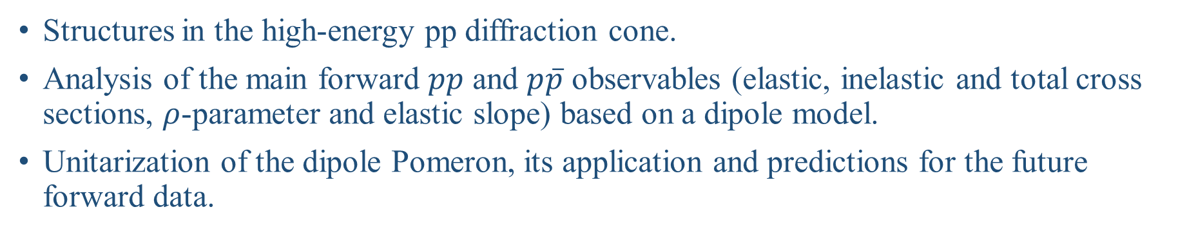
Outline
Structures in the high-energy pp diffraction cone.
Analysis of the main forward $pp$ and $p\overline{p}$ observables (elastic, inelastic and total cross sections, $ρ$-parameter and elastic slope) based on a dipole model.
Unitarization of the dipole Pomeron, its application and predictions for the future forward data.

Slide 3
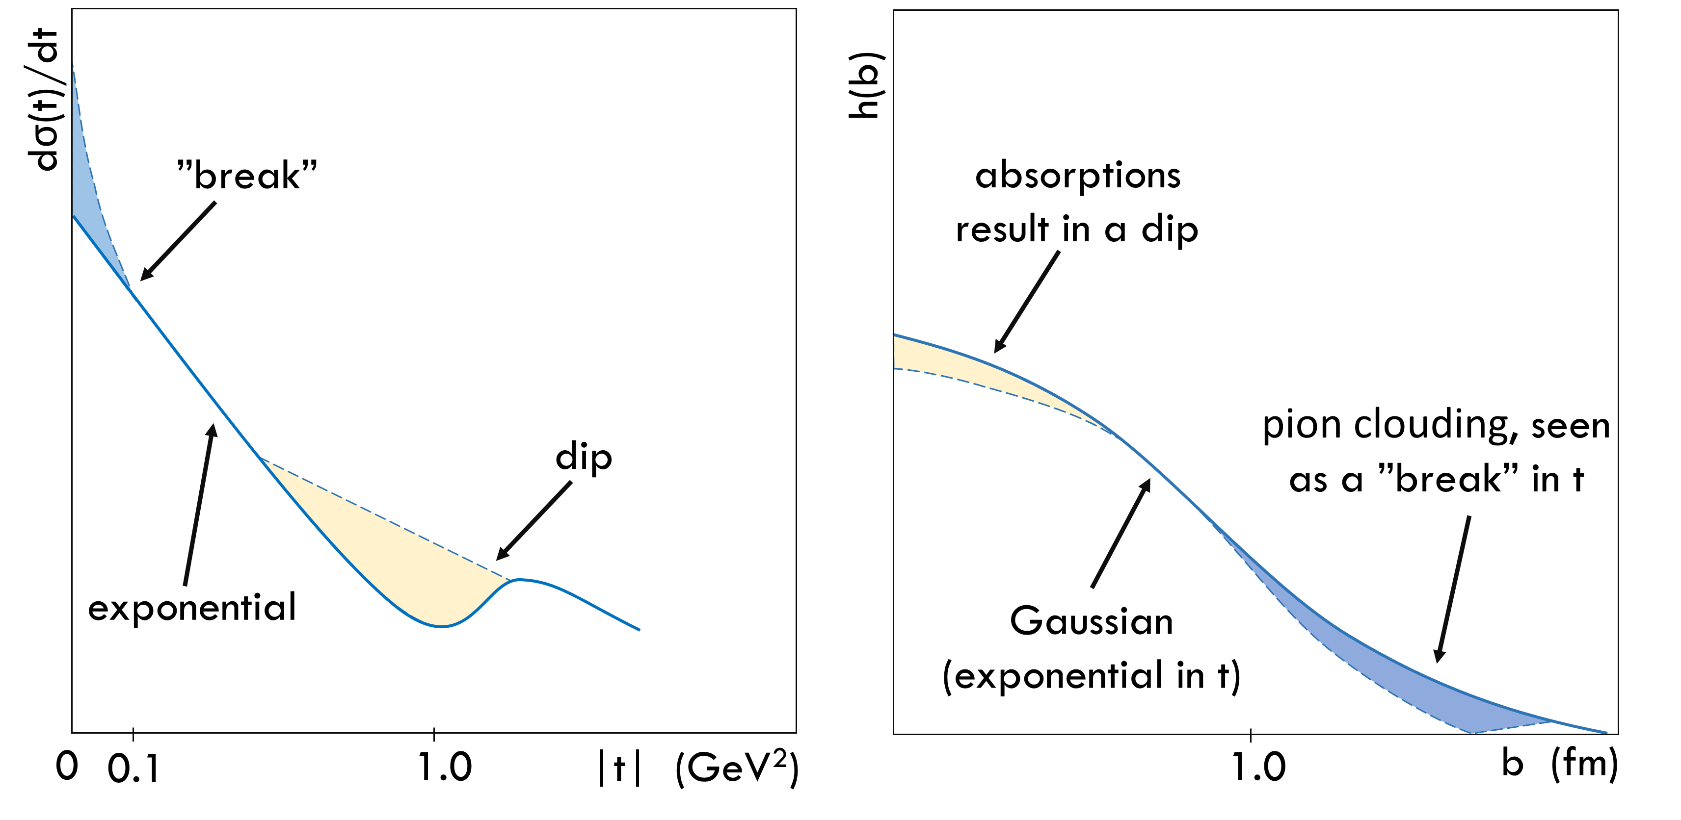
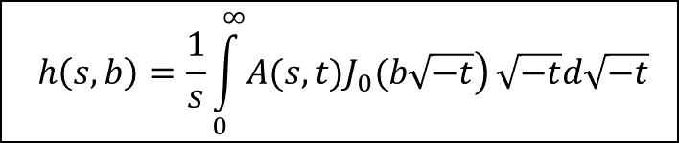
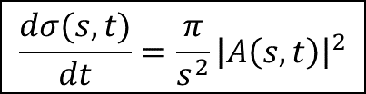
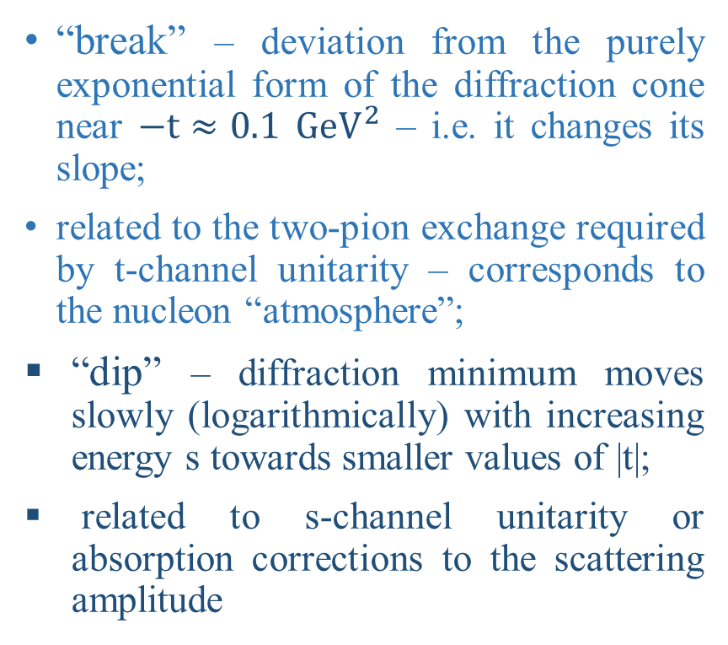
Structures of high-energy pp diffraction cone
“break” – deviation from the purely exponential form of the diffraction cone near $−t≈0.1$ $GeV^{2}$ – i.e. it changes its slope;
related to the two-pion exchange required by t-channel unitarity – corresponds to the nucleon “atmosphere”;
“dip” – diffraction minimum moves slowly (logarithmically) with increasing energy s towards smaller values of |t|;
related to s-channel unitarity or absorption corrections to the scattering amplitude
Shematic view of the pp elastic differential cross section in t and the impact parameter amplitude in b.
$$h\left(s,b\right)=\frac{1}{s}\int_{0}^{∞}{\left.A(s,t)J_{0}(b\sqrt{−t}\right)}\sqrt{−t}d\sqrt{−t}$$
L. Jenkovszky, I. Szanyi, Mod.Phys.Lett. A32 (2017) 1750116, arXiv:1705.04880
L. Jenkovszky, I. Szanyi, Phys. Part. Nuclei Lett., 14 (2017), arXiv:1701.01269
$$\frac{dσ(s,t)}{dt}=\frac{π}{s^{2}}{\left|A\left(s,t\right)\right|}^{2}$$

Slide 4

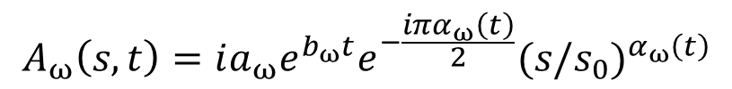
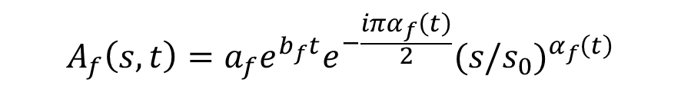
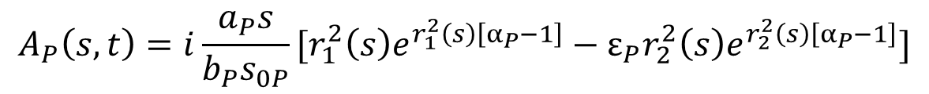

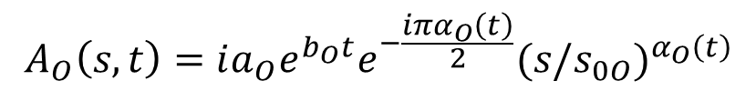



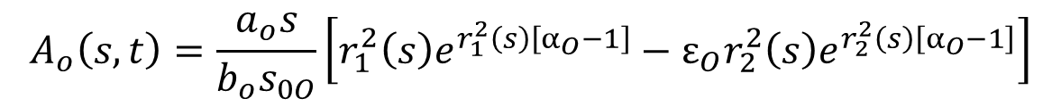
A dipole model
Scattering amplitude:
$${A(s,t)}_{pp}^{\overline{p}p}=A_{P}\left(s,t\right)+A_{f}\left(s,t\right)±A_{O}\left(s,t\right)±A_{ω}\left(s,t\right)$$
Pomeron term:
Reggeon terms:
$$A_{f}\left(s,t\right)=a_{f}e^{b_{f}t}e^{−\frac{iπα_{f}\left(t\right)}{2}}{(s/s_{0})}^{α_{f}\left(t\right)}$$
$$A_{P}\left(s,t\right)=i\frac{a_{P}s}{b_{P}s_{0P}}[r_{1}^{2}\left(s\right)e^{r_{1}^{2}\left(s\right)\left[α_{P}−1\right]}−ε_{P}r_{2}^{2}\left(s\right)e^{r_{2}^{2}\left(s\right)\left[α_{P}−1\right]}]$$
where
$$A_{ω}\left(s,t\right)=ia_{ω}e^{b_{ω}t}e^{−\frac{iπα_{ω}\left(t\right)}{2}}{(s/s_{0})}^{α_{ω}\left(t\right)}$$
$$r_{1}^{2}\left(s\right)=b_{P}+L−iπ/2$$
$$L≡ln⁡(s/s_{0P})$$
Reggeon trajectories:
$$r_{2}^{2}\left(s\right)=L−iπ/2$$
$$α_{f}\left(t\right)=0.703+0.84t$$
Pomeron trajectory:
$$α_{P}≡ α_{P}\left(t\right)=1+δ_{P}+α_{1P}t−α_{2P}\left(\sqrt{{4m}_{π}^{2}−t}−2m_{π}\right)$$
$$α_{ω}\left(t\right)=0.435+0.93t$$
Odderon term:
$$A_{o}\left(s,t\right)=\frac{a_{o}s}{b_{o}s_{0O}}\left[r_{1}^{2}\left(s\right)e^{r_{1}^{2}\left(s\right)\left[α_{O}−1\right]}−ε_{O}r_{2}^{2}\left(s\right)e^{r_{2}^{2}\left(s\right)\left[α_{O}−1\right]}\right]$$
$$A_{O}\left(s,t\right)=ia_{O}e^{b_{O}t}e^{−\frac{iπα_{O}\left(t\right)}{2}}{(s/s_{0O})}^{α_{O}\left(t\right)}$$

Slide 5
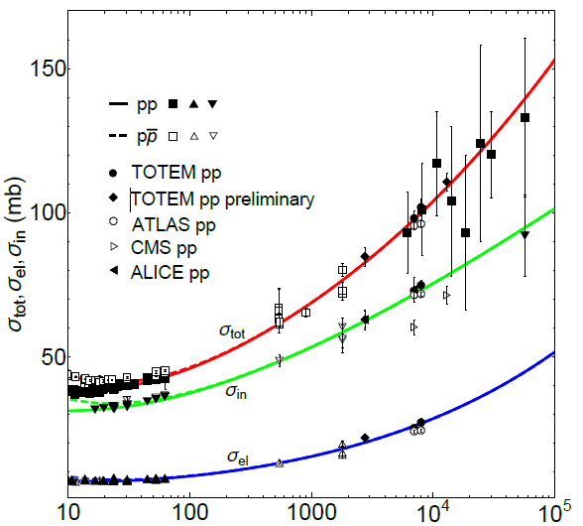


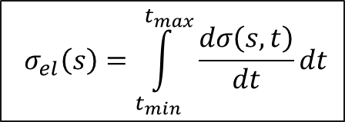
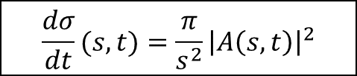
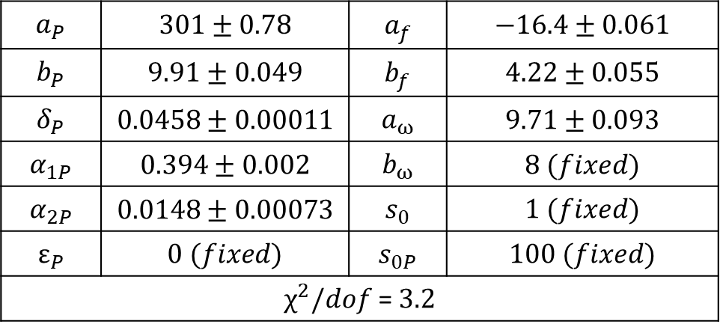
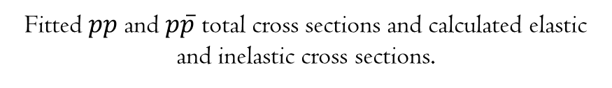
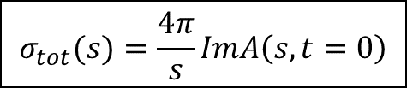
Elastic, inelastic and total cross sections
$$σ_{tot}(s)=\frac{4π}{s}ImA\left(s,t=0\right)$$
$${ σ}_{el}\left(s\right)=\int_{t_{min}}^{t_{max}}{\frac{dσ\left(s,t\right)}{dt}dt}$$
$$\frac{dσ}{dt}(s,t)=\frac{π}{s^{2}}{\left|A\left(s,t\right)\right|}^{2}$$
$$σ_{in}\left(s\right)={ σ}_{tot}\left(s\right) {− σ}_{el} \left(s\right)$$
$$a_{P}$$ | $$\text{301}±\text{0}\text{.}\text{78}$$ | $$a_{f}$$ | $$\text{−}\text{1}6.4±\text{0}\text{.}\text{0}\text{61}$$
$$b_{P}$$ | $$\text{9}\text{.}\text{91}±\text{0}\text{.}\text{049}$$ | $$b_{f}$$ | $$\text{4}\text{.22}±\text{0}\text{.}\text{0}\text{55}$$
$$δ_{P}$$ | $$\text{0}\text{.}\text{0458}±\text{0}\text{.}\text{00011}$$ | $$a_{ω}$$ | $$\text{9}\text{.}\text{7}1±\text{0}\text{.}\text{09}\text{3}$$
$$α_{1P}$$ | $$\text{0}\text{.}\text{394}±\text{0}\text{.}\text{002}$$ | $$b_{ω}$$ | $$\text{8} (fixed)$$
$$α_{2P}$$ | $$\text{0}\text{.}\text{0148}±\text{0}\text{.}\text{00073}$$ | $$s_{0}$$ | $$1 (fixed)$$
$$ε_{P}$$ | $$0 (fixed)$$ | $$s_{0P}$$ | $$100 (fixed)$$
$χ^{2}/dof$ = $3.2$
Fitted $pp$ and $p\overline{p}$ total cross sections and calculated elastic and inelastic cross sections.
Values of fitted parameters.
N. Bence, L. Jenkovszky, I. Szanyi Approaching the asymptotics at the LHC, arXiv:1711.06380

Slide 6
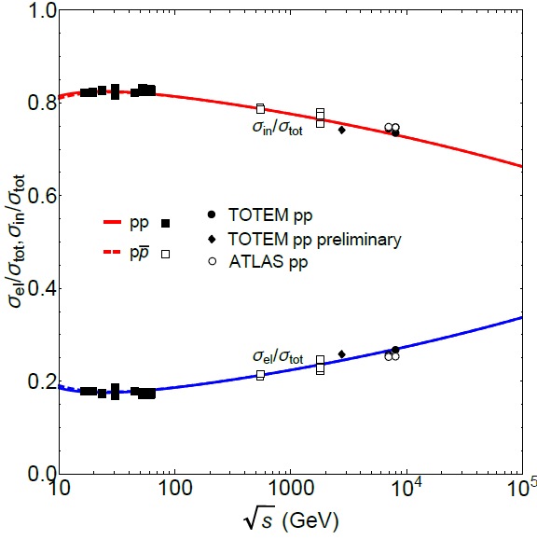
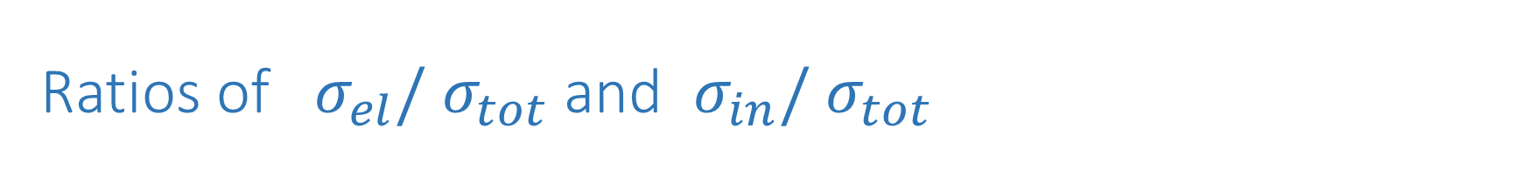
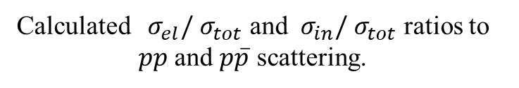
Ratios of ${ σ}_{el}/{ σ}_{tot}$ and ${ σ}_{in}/{ σ}_{tot}$
Calculated ${ σ}_{el}/{ σ}_{tot}$ and ${ σ}_{in}/{ σ}_{tot}$ ratios to $pp$ and $p\overline{p}$ scattering.

Slide 7
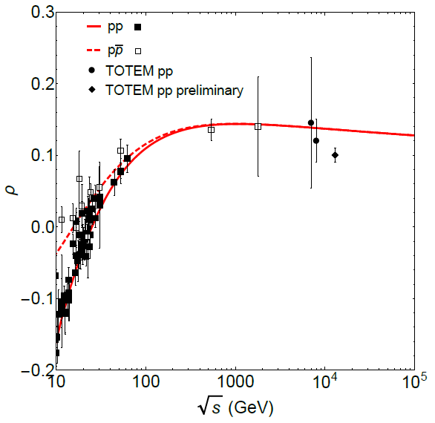
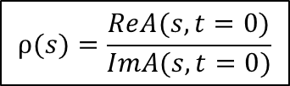


$ρ$-paramater
$$ρ(s)=\frac{ReA(s,t=0)}{ImA(s,t=0)}$$
K. Österberg, TOTEM experiment status report, LHCC open session 30.11.2017
Fitted $pp$ and $p\overline{p}$ $ρ$-paramater

Slide 8
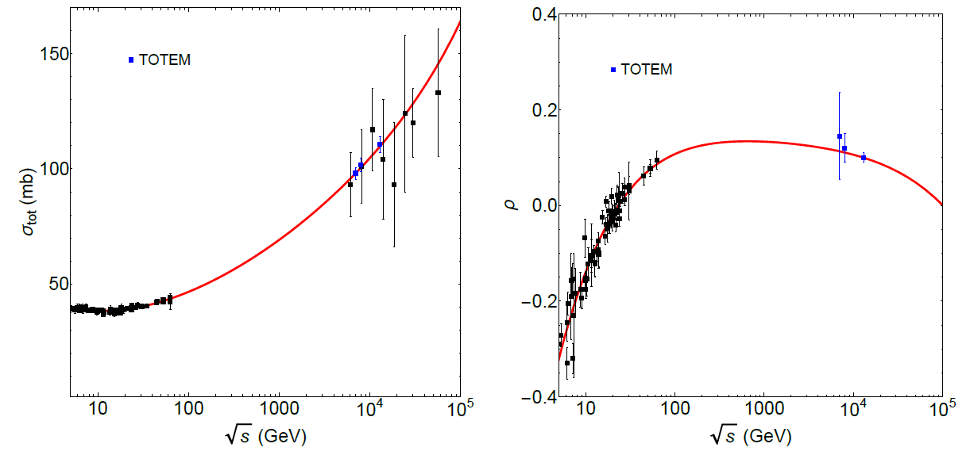
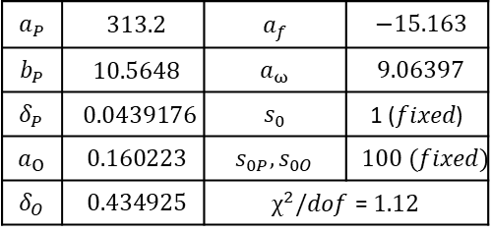

$ρ$-paramater and total cross section with odderon
$$a_{P}$$ | $$313.2$$ | $$a_{f}$$ | $$−15.163$$
$$b_{P}$$ | $$10.5648$$ | $$a_{ω}$$ | $$9.06397$$
$$δ_{P}$$ | $$0.0439176$$ | $$s_{0}$$ | 1 (𝑓𝑖𝑥𝑒𝑑)
$$a_{O}$$ | $$0.160223$$ | $$s_{0P},s_{0O}$$ | $$100 (fixed)$$
$$δ_{O}$$ | $$0.434925$$ | $χ^{2}/dof$ = $1.12$
Fitted $pp$ total cross section and $ρ$-paramater data.

Slide 9
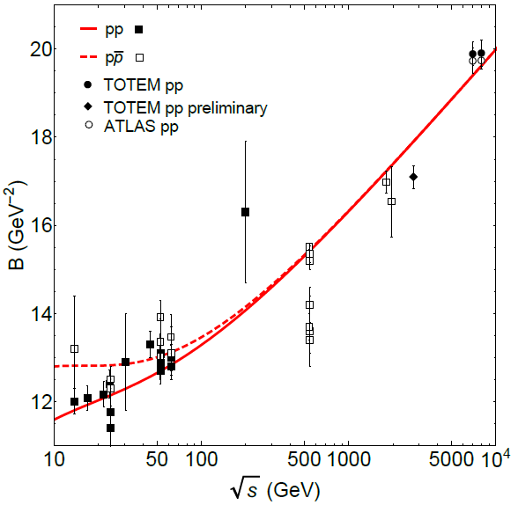
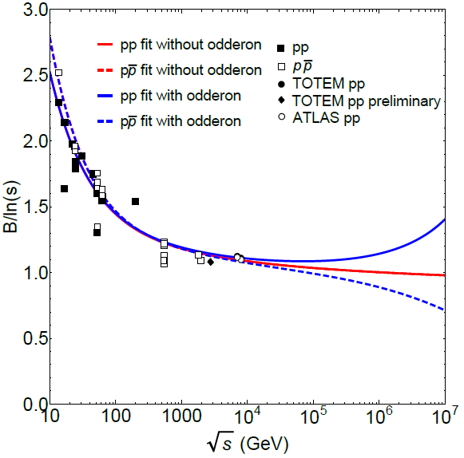




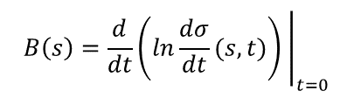
Elastic slope $B\left(s\right)$
$$B\left(s\right)=\frac{d}{dt}{\left.\left(ln\frac{dσ}{dt}(s,t)\right) \right|}_{t=0}$$
$$B\left(s\right) \sim ln\left(s\right)→\ln^{2}(s)$$
Calculated $pp$ and $p\overline{p}$ elastic slope.
Calculated $B\left(s\right)/ln\left(s\right)$.

Slide 10






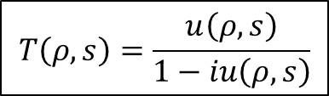

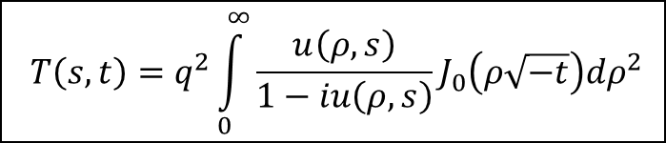



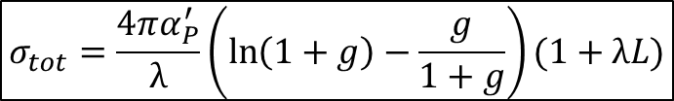
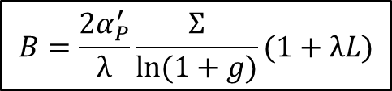
Unitarization ($u$-matrix)
Unitarized scattering amplitude:
Using the unitarized formulas for the forward measurables:
$$T\left(ρ,s\right)=\frac{u\left(ρ,s\right)}{1−iu\left(ρ,s\right)}$$
$$T\left(s,t\right)=q^{2}\int_{0}^{∞}{\frac{u\left(ρ,s\right)}{1−iu\left(ρ,s\right)}}J_{0}\left(ρ\sqrt{−t}\right)dρ^{2}$$
($ρ$ – impact parameter; $q$ – momentum in center-of-mass frame)
$$x=\frac{ρ^{2}}{4α_{P}^{′}L}$$
$$σ_{tot}=\frac{4πα_{P}^{′}}{λ}\ln\left(1+g\right)(1+λL)$$
$$σ_{el}=\frac{4πα_{P}^{′}}{λ}\frac{g}{1+g}(1+λL)$$
$$σ_{tot}=\frac{4πα_{P}^{′}}{λ}\left(\ln\left(1+g\right)−\frac{g}{1+g}\right)(1+λL)$$
$$\frac{σ_{el}}{σ_{tot}}=1−\frac{g}{\left(1+g\right)ln⁡(1+g)}$$
$$B=\frac{2α_{P}^{′}}{λ}\frac{Σ}{ln⁡(1+g)}(1+λL)$$
$$Σ=\int_{0}^{∞}{\frac{ge^{−x}xdx}{1+ge^{−x}}}$$
$$g=−\frac{λa_{P}}{{s_{0P}α}_{P}^{′}}e^{−b_{P}}$$
$$λ=(1−ε_{P})/b_{P}$$
$$L=ln⁡(s/s_{0P})$$
$$g\left(s\right)=g_{01}{(s/s_{01}) }^{ε_{1}}+g_{02}{(s/s_{02}) }^{ε_{2}}$$
A.N. Wall, L.L. Jenkovszky, B.V. Struminsky, Sov. J. Particles and Nuclei, 19 (1988)

Slide 11
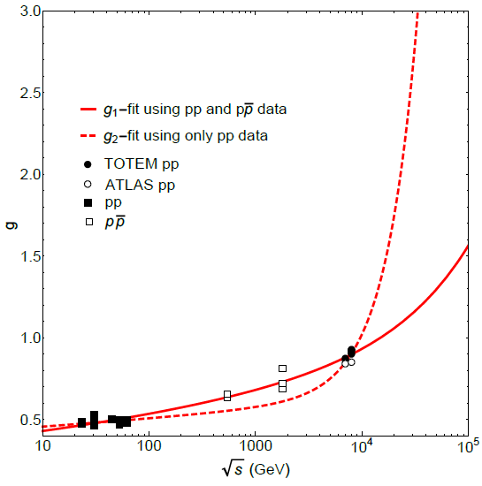
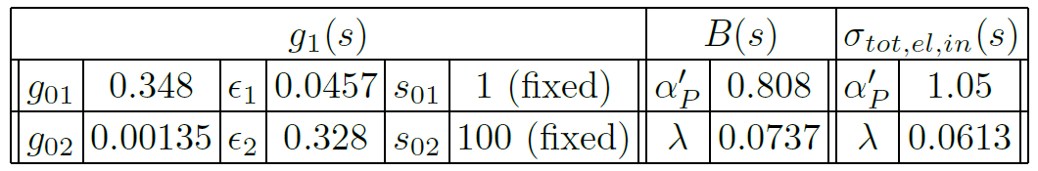
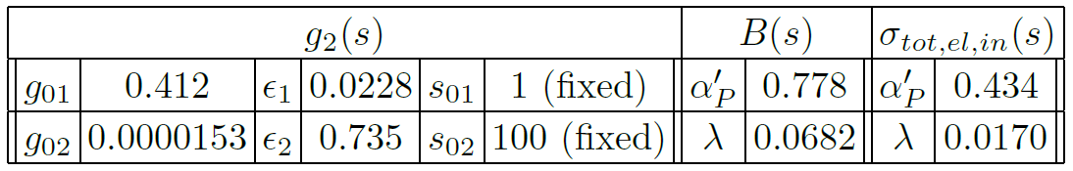
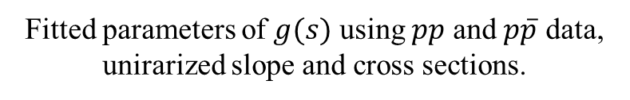
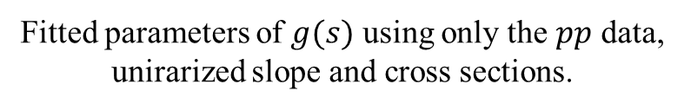

The energy dependence of the $g$ parameter
Fitted parameters of $g(s)$ using $pp$ and $p\overline{p}$ data, unirarized slope and cross sections.
Fitted parameters of $g(s)$ using only the $pp$ data, unirarized slope and cross sections.
Energy dependence of the g parameter.

Slide 12
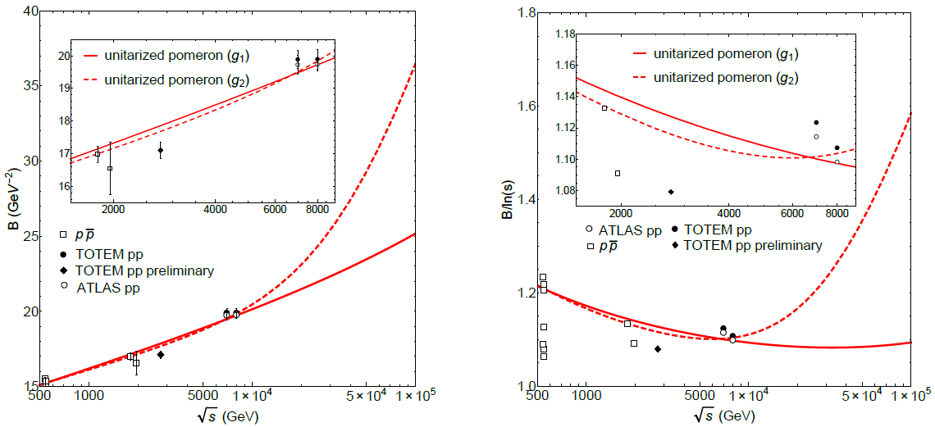

Unitarized elastic slope
Description for the elastic slope data using unitarization procedure.
$B/ln⁡(s)$ ratio.

Slide 13
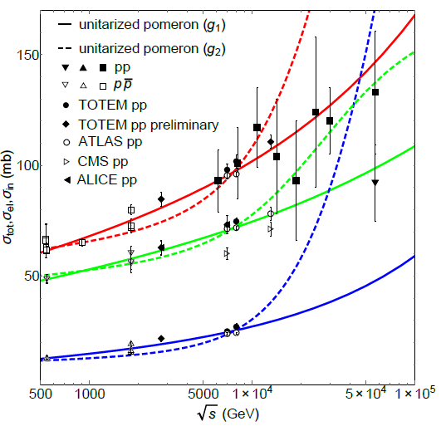
Unitarized cross sections
Description for total, elastic and inelastic cross section using unitarization procedure.

Slide 14
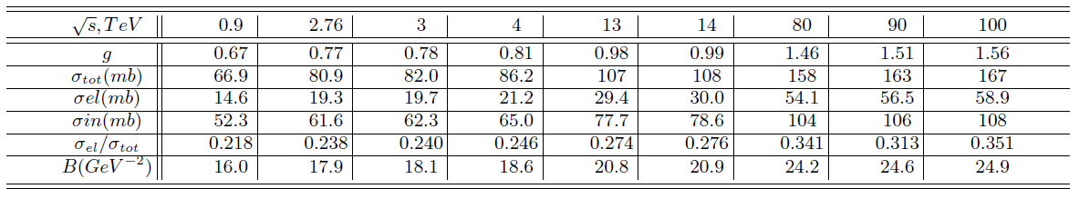
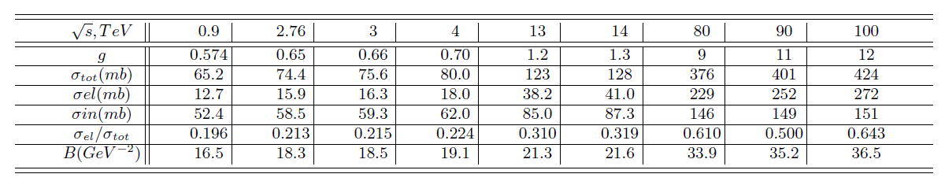
Predictions
Predictions for forward measurables using unitarization procedure with $g_{1}$.
Predictions for forward measurables using unitarization procedure with $g_{2}$.

Slide 15
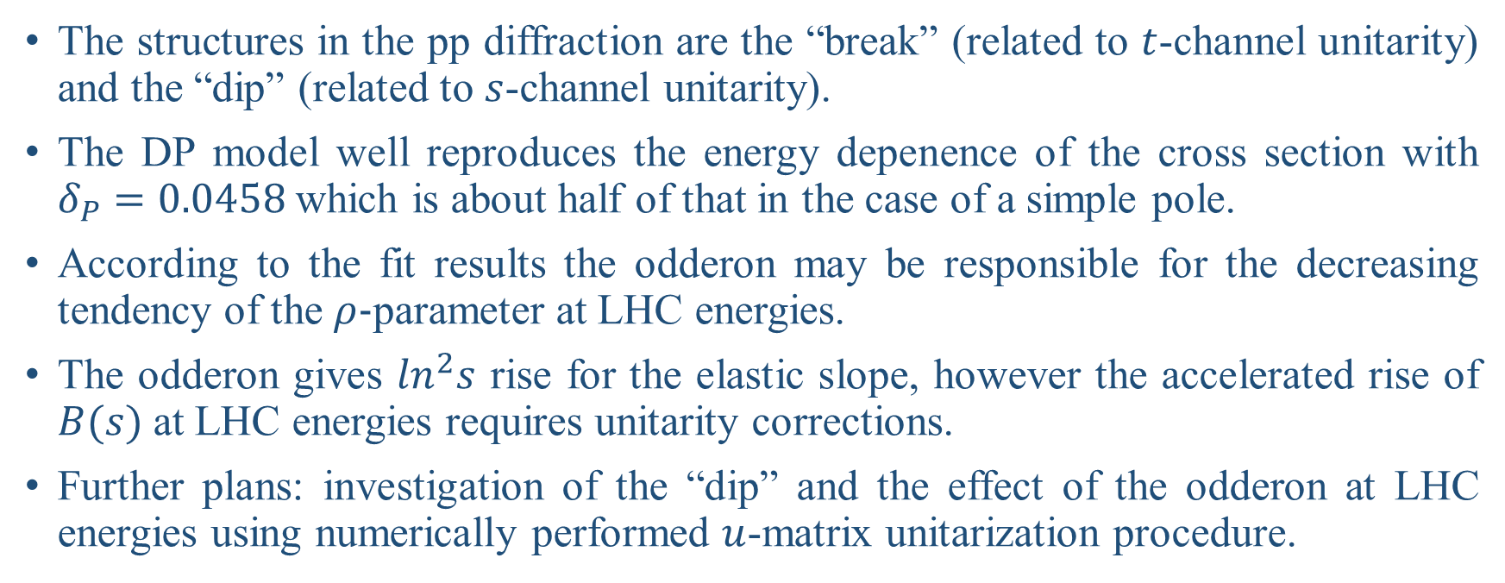
Summary
The structures in the pp diffraction are the “break” (related to $t$-channel unitarity) and the “dip” (related to $s$-channel unitarity).
The DP model well reproduces the energy depenence of the cross section with $δ_{P}=0.0458$which is about half of that in the case of a simple pole.
According to the fit results the odderon may be responsible for the decreasing tendency of the $ρ$-parameter at LHC energies.
The odderon gives $\ln^{2}s$ rise for the elastic slope, however the accelerated rise of $B(s)$at LHC energies requires unitarity corrections.
Further plans: investigation of the “dip” and the effect of the odderon at LHC energies using numerically performed $u$-matrix unitarization procedure.

Slide 16
Thank you for your attention!

