Slide 1

Main activities at cern
Senior fellow: A. Cattabiani
Supervisor: B. Bordini
Section Meeting 28/11/2017

Slide 2
OUTLINE
Quality assessment of Nb₃Sn wires
Study of the effect of the transverse load on the I_{c}
Scaling law: temperature dependence
Section Meeting 28/11/2017

Slide 3
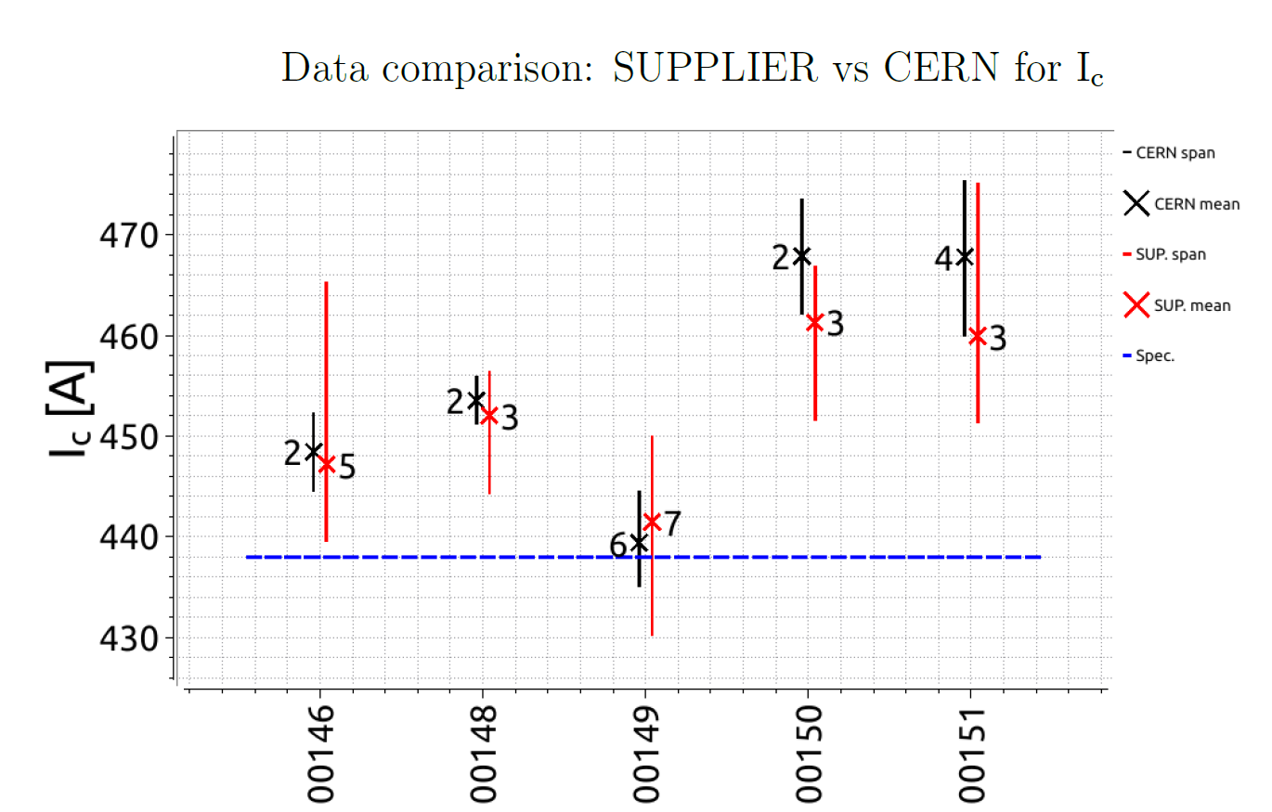
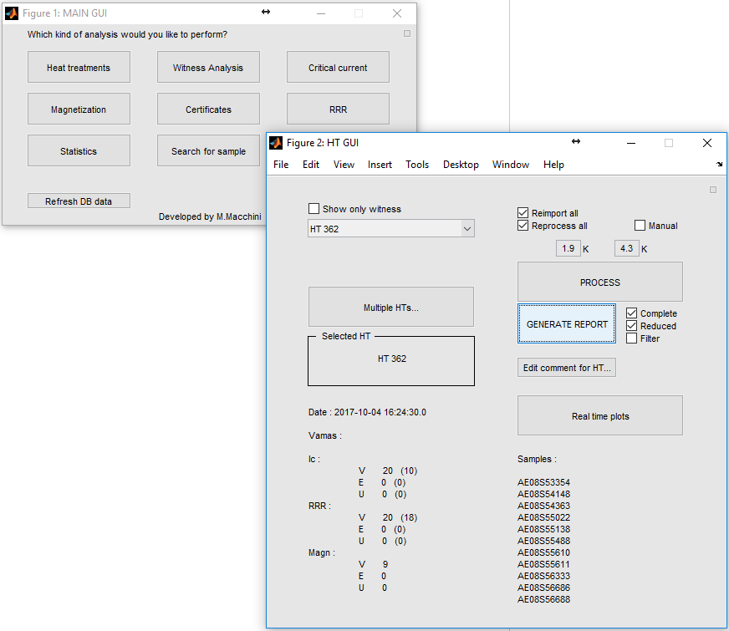
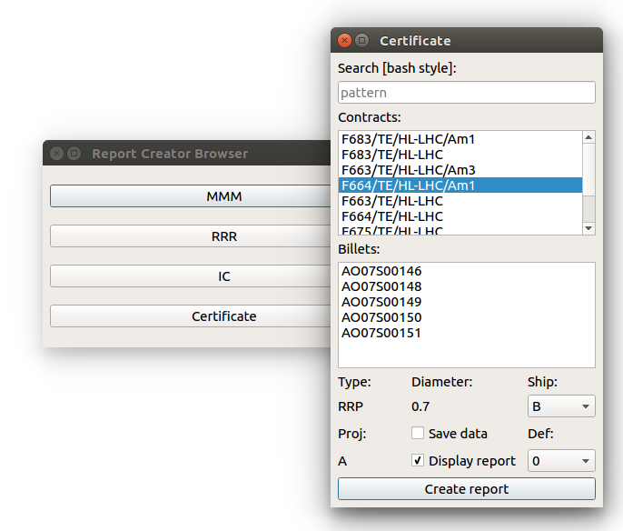
Quality of Nb₃Sn wires
Analysis of the raw data generated in the lab (bld. 163, I_{c}, RRR, etc.)
Generation of reports and internal notes about shipments, witnesses, etc.
Refactoring of the previous code (M. Macchini) into a standardized program (matlab → C++)
Creation of a Doxygen for documentation (http://www.stack.nl/~dimitri/doxygen/)
Section Meeting 28/11/2017

Slide 4
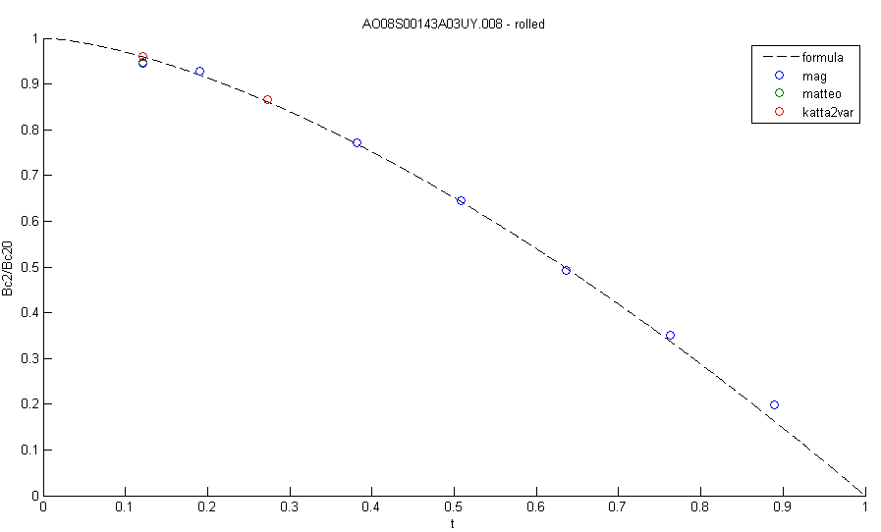
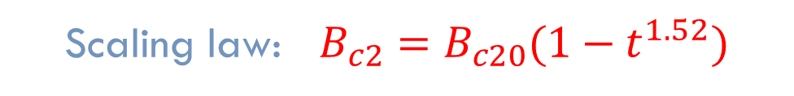
Scaling law: temp. dependence
Scaling law: $B_{c2}=B_{c20}(1−t^{1.52})$
Processing of the magnetization measurements (courtesy of D. Richter)
Comparison with the other lab data (i.e. I_{c})
Section Meeting 28/11/2017

Slide 5
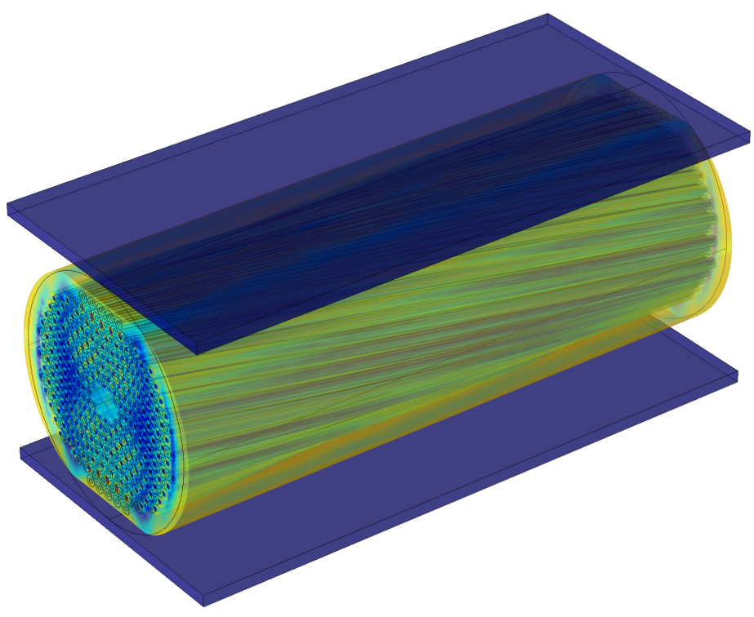
Effect of the transverse load on the I_{c}
Simulation of the rolling process
Simulation of the transverse load
Deformed Mesh
~2.5M DoFs (+ 135M of internal DoFs), ~18h of computation time on the cluster with 16 sockets/ 128 cores (1/4 of the total rack)
No homogenization
Necessity of a cluster (collaboration with M. Husejko)
Used to benchmark the new Comsol Linux cluster
Section Meeting 28/11/2017

Slide 6
Thank you for your attention, Questions?

