Slide 1

SCD Section meeting
28.11.2017
Tiziana Spina
Supervisor: A. Ballarino
Bld.-room: 112 R-028

Slide 2

Status of Agreement No. 16 - ITER HTS Current Leads
TASK 1: Improvement of 3D FE thermo-fluidodynamic model in Stationary regime. Comparison with experimental values.
TASK 2: Development of a new 3D FE thermo-electrical model in Transitory regime to simulate LOFA measurements. Comparison with experimental values.
High Lumi – LHC upgrade:
TASK 3: Dimensioning and optimization of HTS CLs to feed the 18kA HL-LHC magnets.
TASK 4: Study of the mechanisms behind the increase of the critical current density in Nb₃Sn wires after irradiation: artificial pinning.

Slide 3
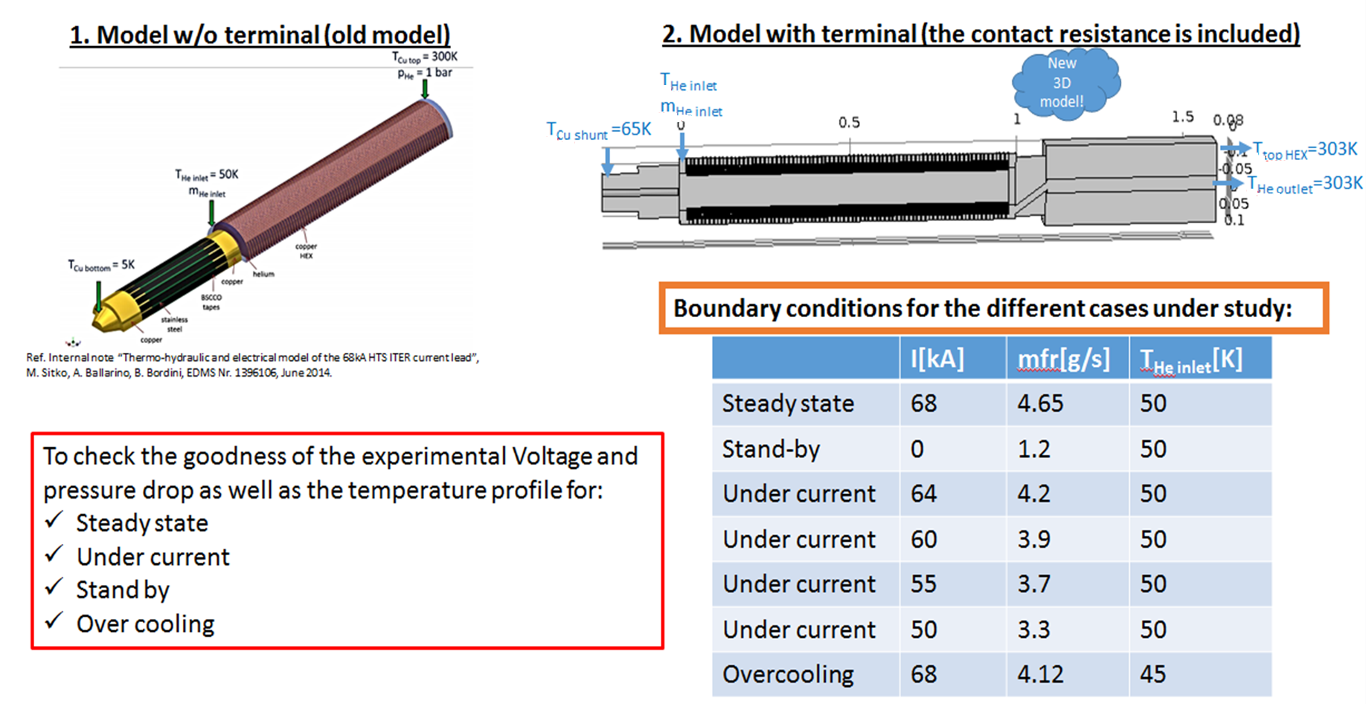
TASK 1: Improvement of 3D FE thermo-fluidodynamic model in stationary regime. Comparison with experimental values.
Notes:
This model has been developed to verify temperature profile, voltage and pressure drops measurements – and compare than with the data acquired during the two tests performed in Hefei (run2 and run3). The model was run for over-current, stand-by, overcooling and steady state cases.

Slide 4
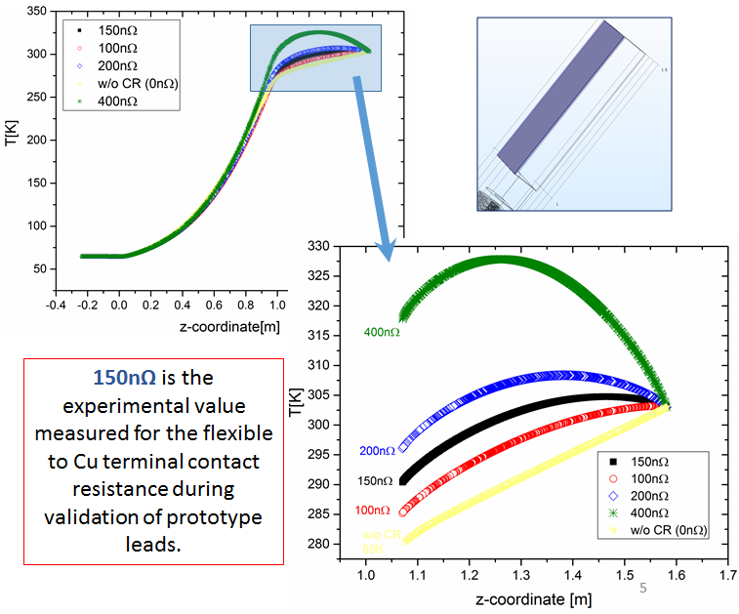
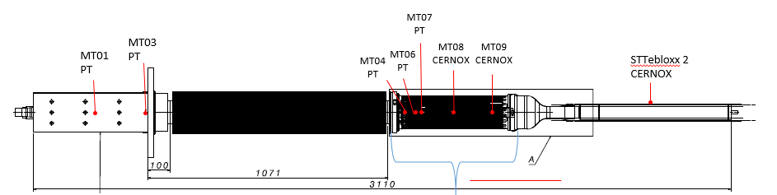
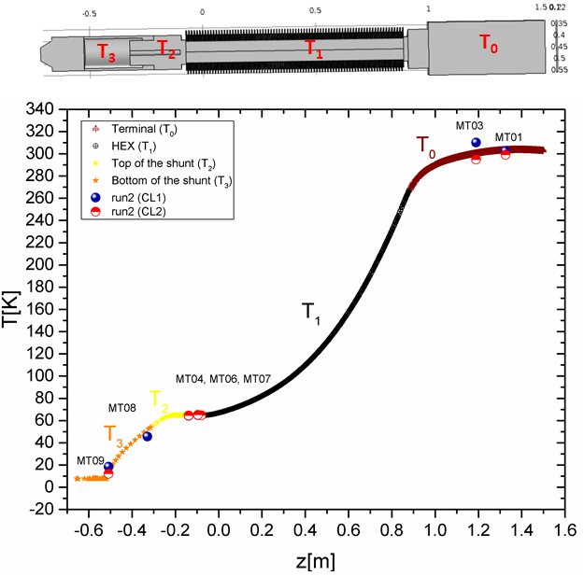
Effect of the contact resistance on the temperature profile
Experimental set up:
Temperature sensor positions
(Courtesy of P. Bauer)
Simulated Temperature profile in stationary regime (Steady state)
Perfect agreement between experimental and simulated values

Slide 5
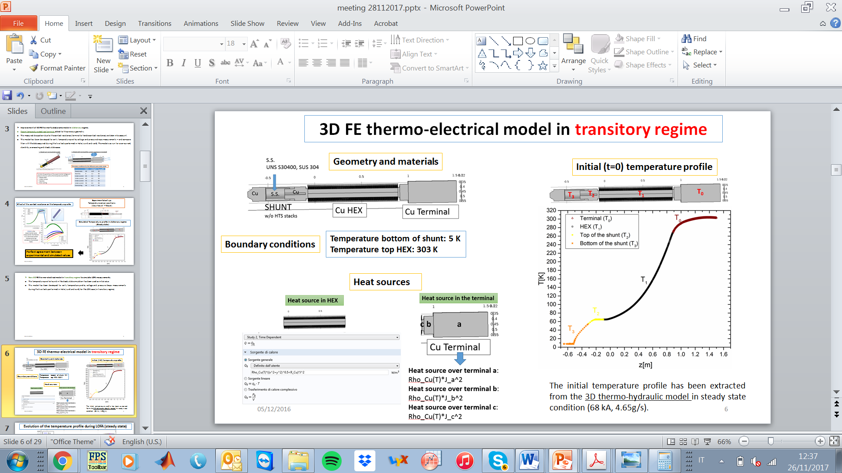
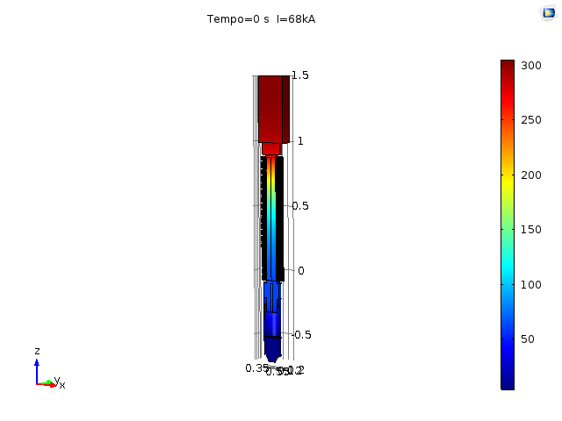
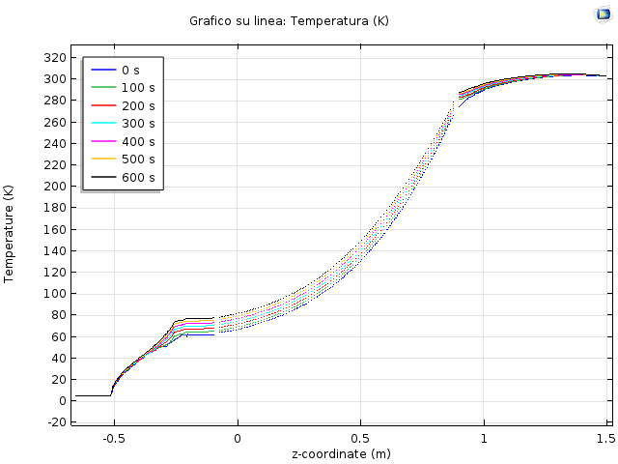
TASK 2: Development of a new 3D FE thermo-electrical model in transitory regime to simulate LOFA measurements. Comparison with experimental values.
Evolution of the temperature profile during LOFA (steady state)

Slide 6
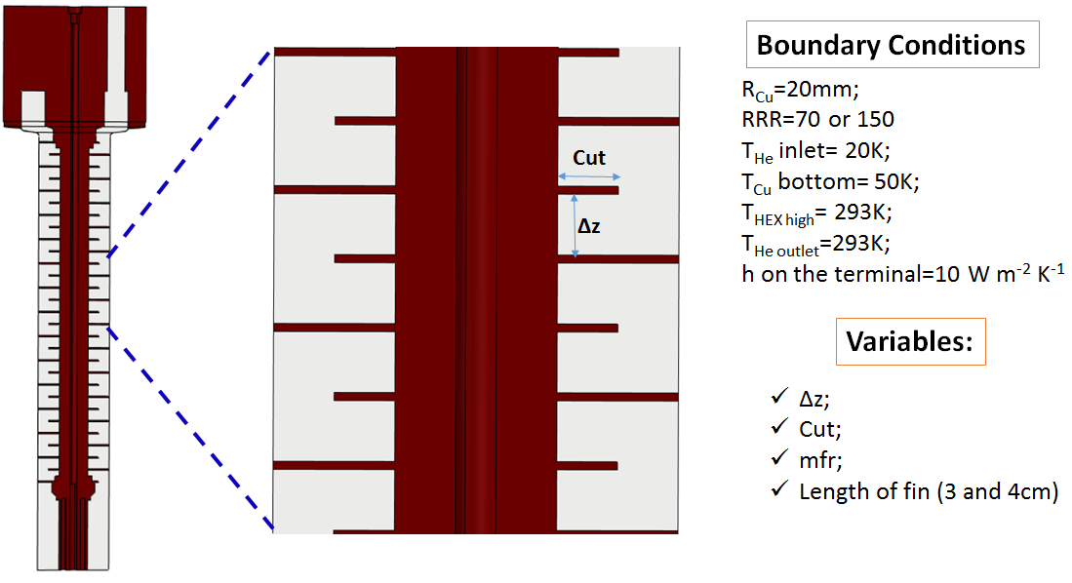
TASK 3: Dimensioning and optimization of HTS CLs to feed the 18kA HL-LHC magnets

Slide 7
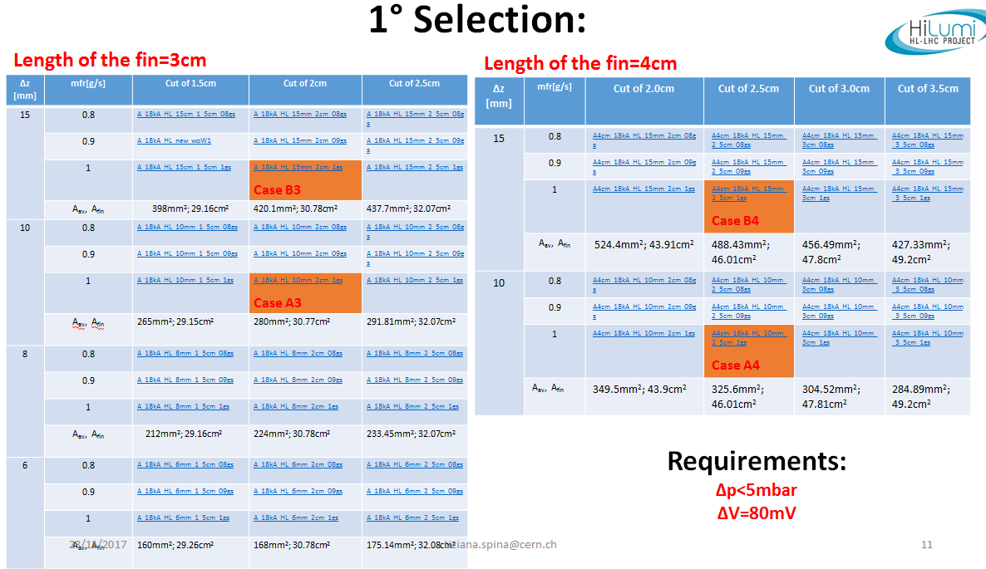
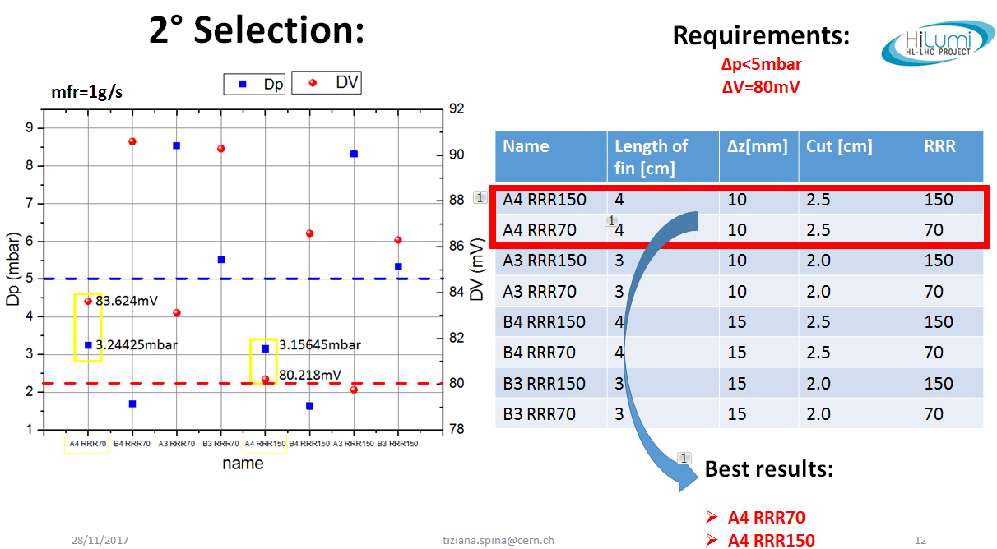

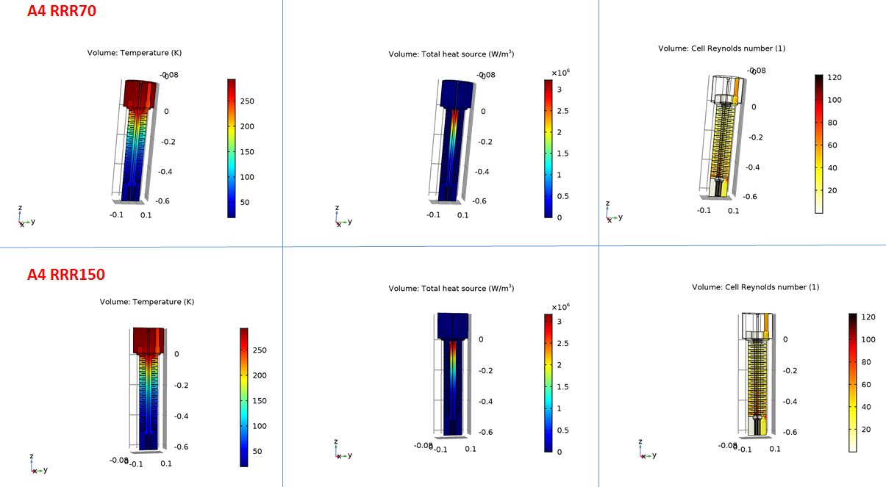

Slide 8
TASK 4: Study of the mechanisms behind the increase of the pinning force in Nb₃Sn wires after irradiation: artificial pinning.
“Irradiation Effects in Superconductors: the case of Nb₃Sn”, T. Spina and R. Flükiger et al., to be published in SUST (invited) 2018.
“Impact of the Number of dpa on the Superconducting Properties in HiLumi-LHC and FCC Accelerators”, R. Flükiger, T. Spina, F. Cerutti, M. I. Besana, C. Scheuerlein, A. Ballarino L. Bottura, to be published in IEEE Trans. App. Superc. and presented in EUCAS 2017, Geneva (CH).
“Variation of Tc, lattice parameter and atomic ordering in Nb₃Sn platelets irradiated with 12MeV protons: correlation with the number of induced Frenkel defects”, R. Flukiger, T. Spina, F. Cerutti, A. Ballarino, C. Scheurlein, L. Bottura, Y. Zubavichus, A. Ryazanov, R. D. Svetogovov, S. Shavkin, P. Degtyarenko, Y. Semenov, C. Senatore and R. Cerny, SuST vol. 30, no.5, 31 March 2017.
“Artificial Pinning in Nb₃Sn Wires”, T. Spina, A. Ballarino, L. Bottura, C. Scheuerlein and R. Flükiger, IEEE Trans, App. Superc., vol. 27, no. 4, June 2017
“Correlation Between the Number of Displacements Per Atom and T_{c} After High-Energy Irradiations of Nb₃Sn wires for the HL-LHC”, T. Spina, C. Scheuerlein, D. Richter, A. Ballarino, F. Cerutti, L. S. Esposito, A. Lechner, L. Bottura and R. Flükiger, IEEE Trans. App. Superc., vol. 26, no.3, April 2016

Slide 9



Slide 10
DOCUMENTATION
EDMS Nr: 1538422, “Test report of CC (10kA) and TF (68kA) HEX pressure drop measurements”, published January 2015.
EDMS Nr. 1572890, “Summary of FE models developed at CERN for the analysis of the ITER Current leads”, published January 2016.
EDMS Nr. 1563785 “A comparison between experimental pressure drop over HEX and 3D FE model for CC mock-up”, published April 2016.
EDMS Nr. 1563784, “Analysis of the measurements performed on TF prototype current leads tested in Hefei in July 2015”, published May 2016.
Presentation weekly meeting 23.03.2016: “LOFA Analysis – run2 (July 2015) and run3 (January 2016)”
EDMS Nr. 1716020, “Analysis of the measurements performed on TF prototype current leads tested in Hefei in January 2016 (run3-partial retest)”
EDMS (on going), “Comparison between experimental data and 3D FE thermo-hydraulic and electrical model”

Slide 11
TASK 2: Development of a new 3D FE thermo-electrical model in transitory regime to simulate LOFA measurements. Comparison with experimental values.
Evolution of the temperature profile during LOFA (steady state)

