Slide 2
AD Main Magnet Refurbishment *
Antony Newborough – TE/MSC
* other magnets in the AD which remain overall healthy

Slide 3
Renovation of the main bending magnets:
BHN (15), BHS (1) & BHW (8)
7th December 2017
Antony Newborough

Slide 4
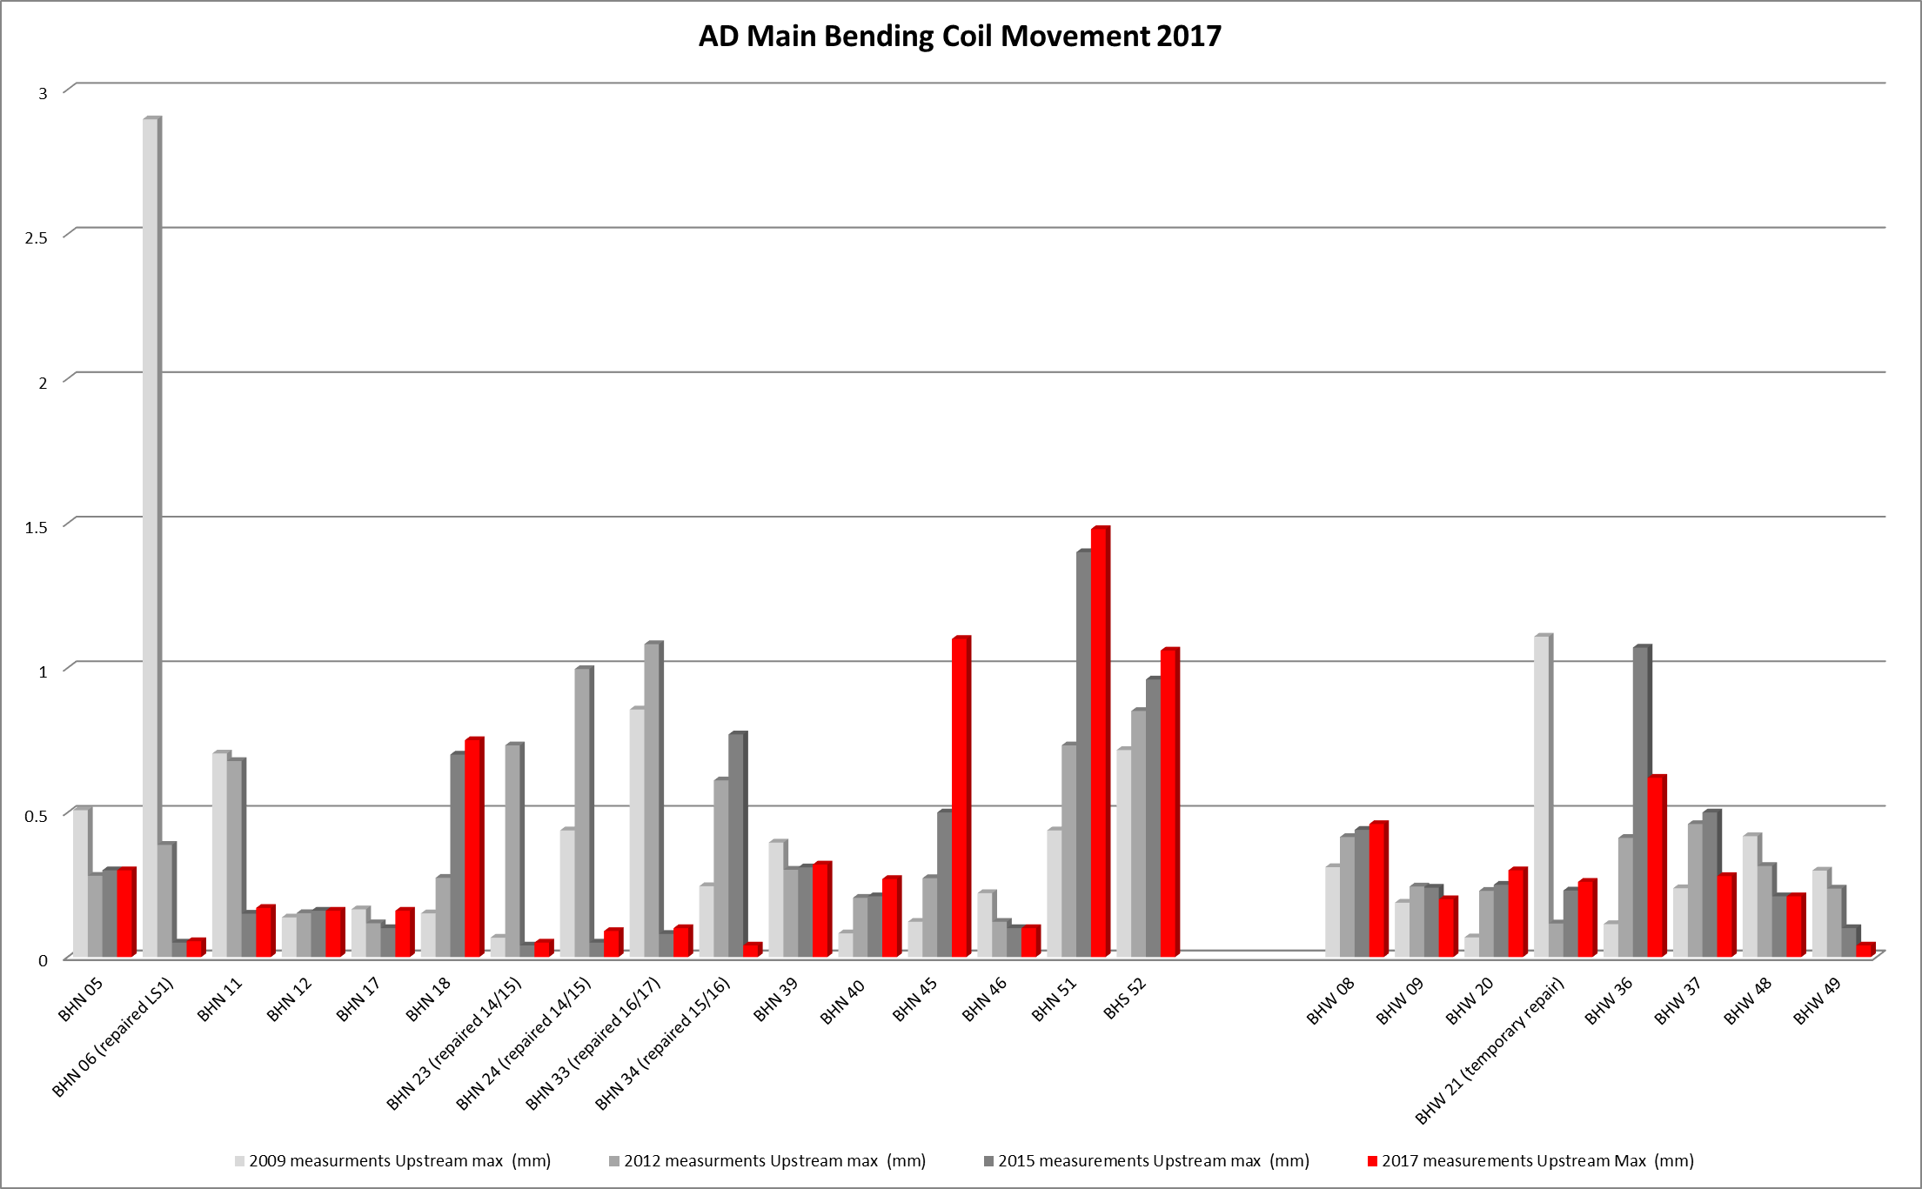
Main Bending Magnets - Why?
Aging magnets (née en 1986)
Poor shimming conception, coils now moving
Downtime if failure occurred during operation could be 2+ months if coils need replacing!
Refurbishment YETS 17/18

Slide 5
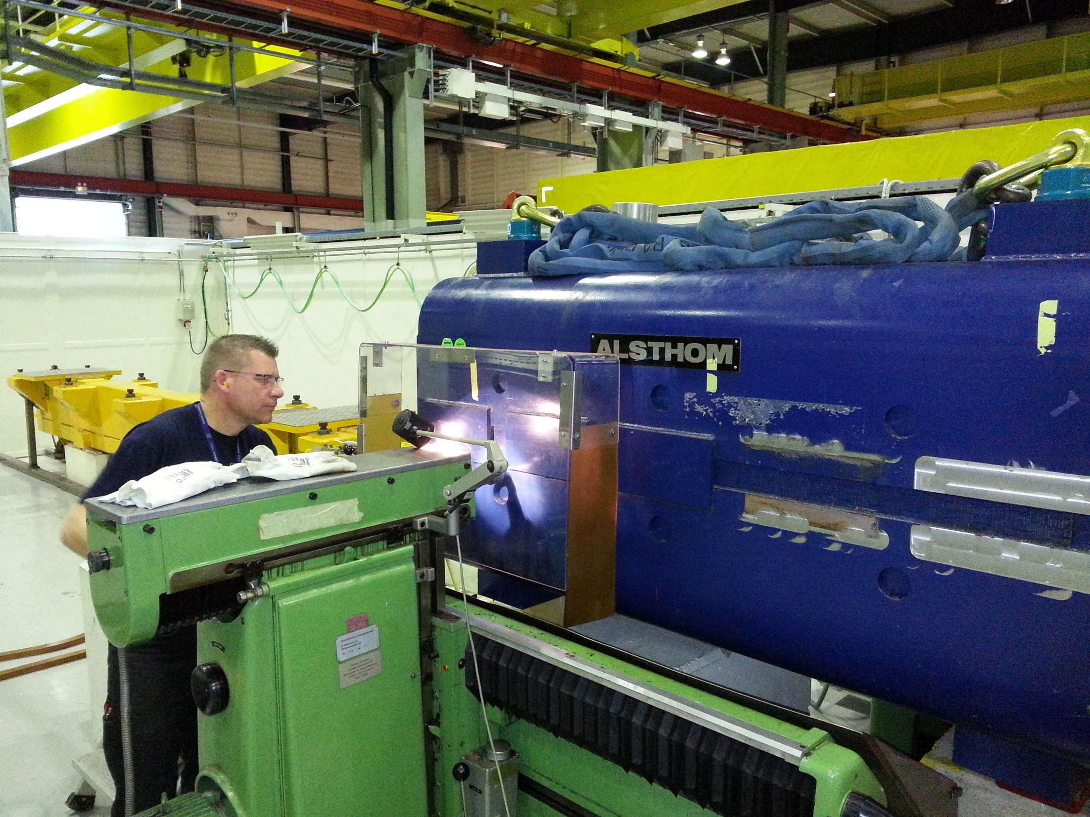
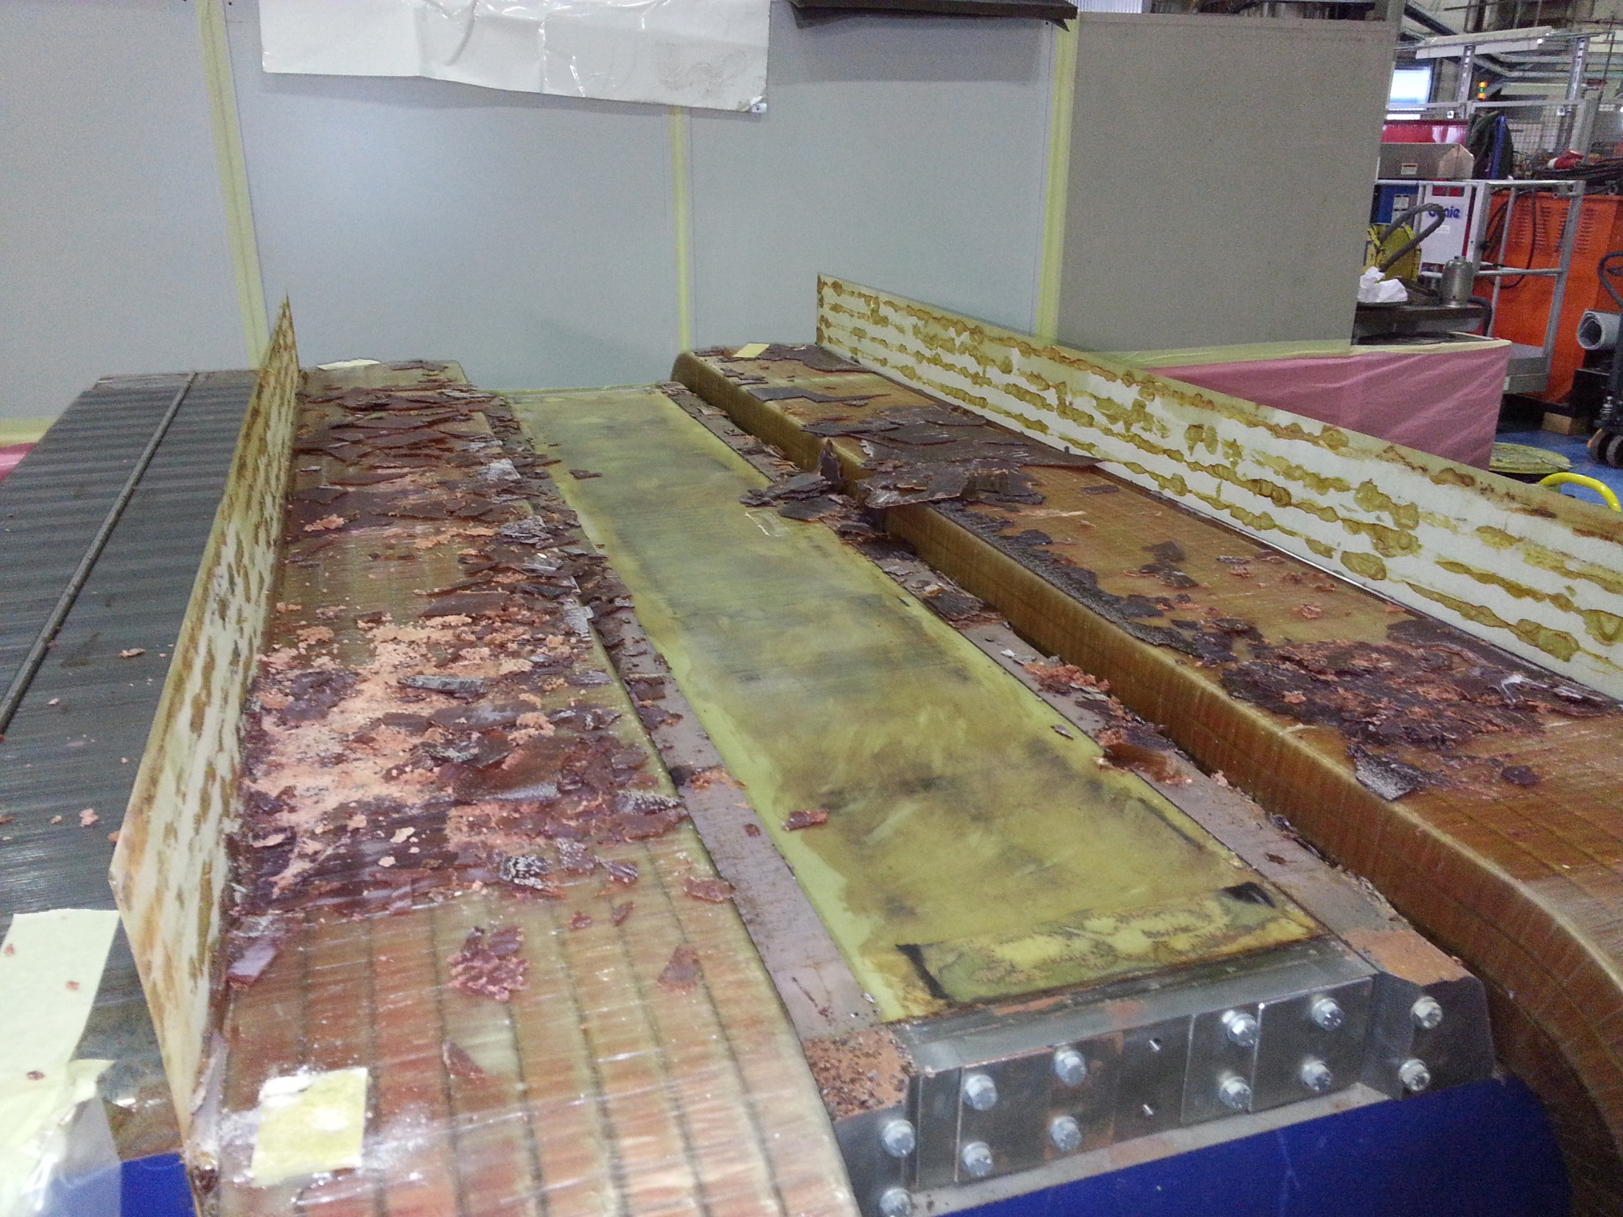
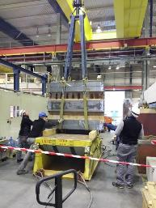
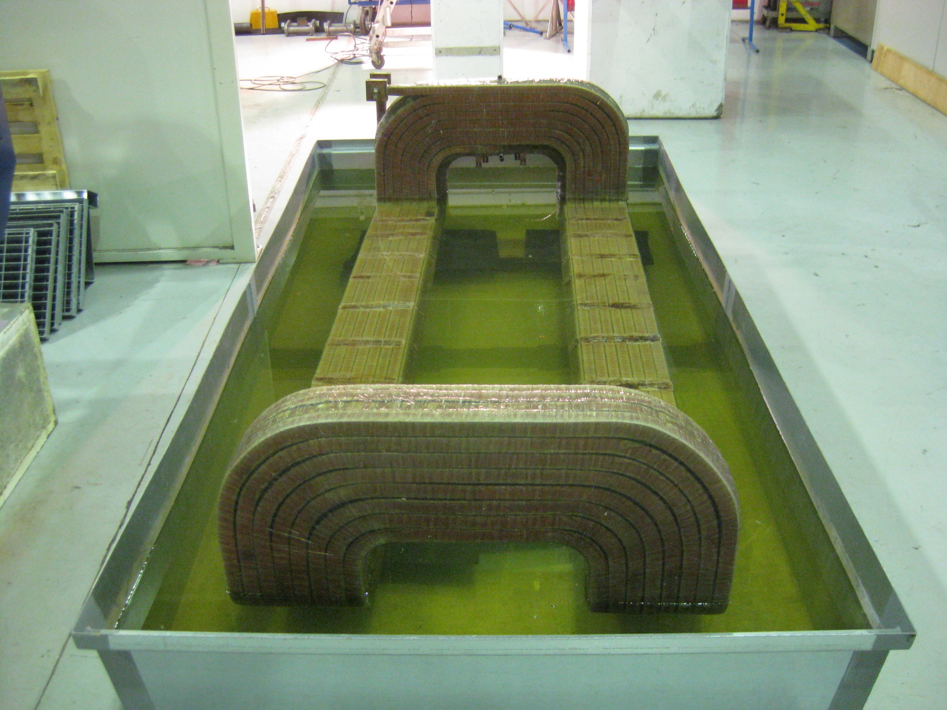
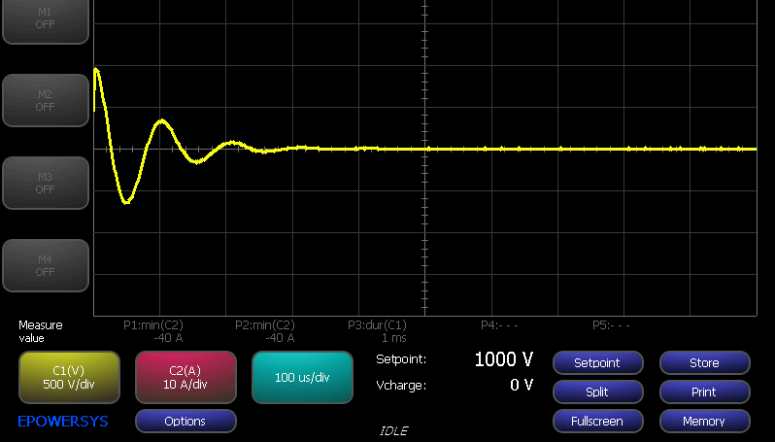
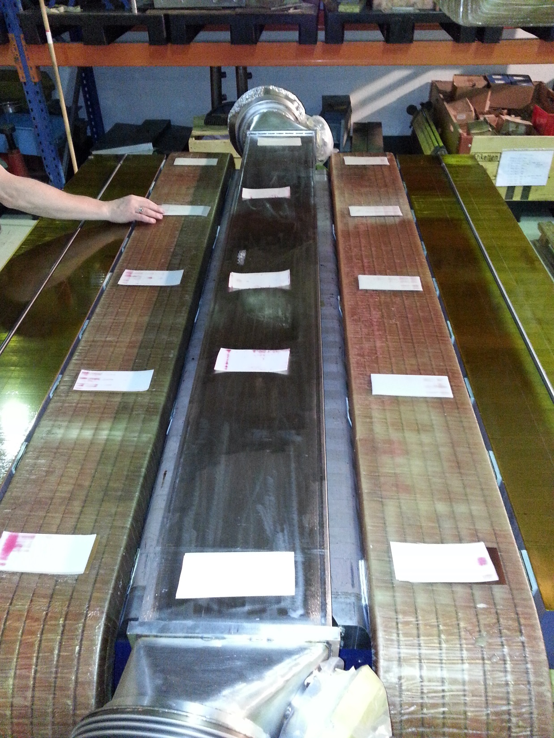
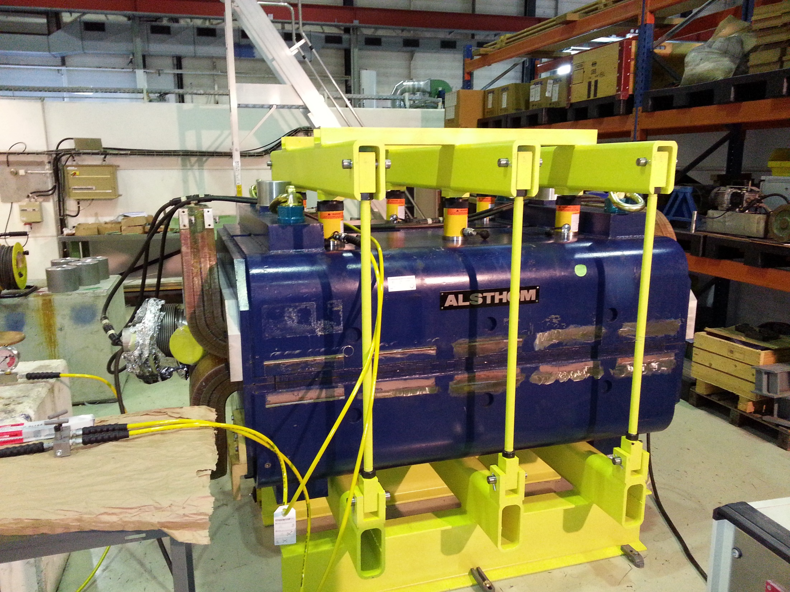
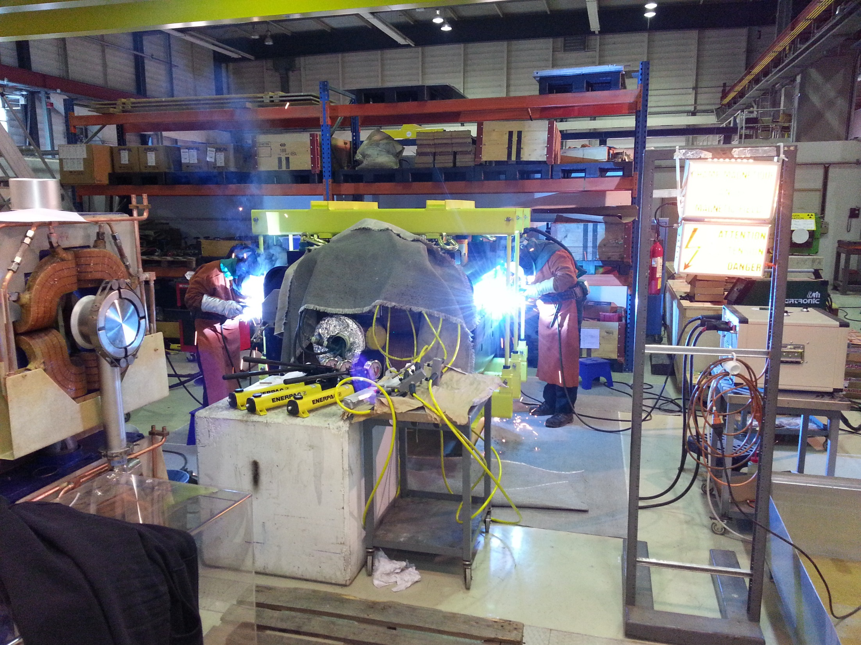
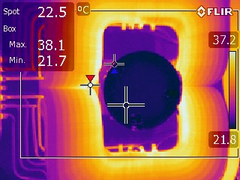
Min. 4 weeks per BHN magnet, max. 2 magnets in the workshop with 2 week overlap!
Opening
Cleaning
Testing
Handling
Measurement
& Shimming
Assembly
Closing
Certification

Slide 6
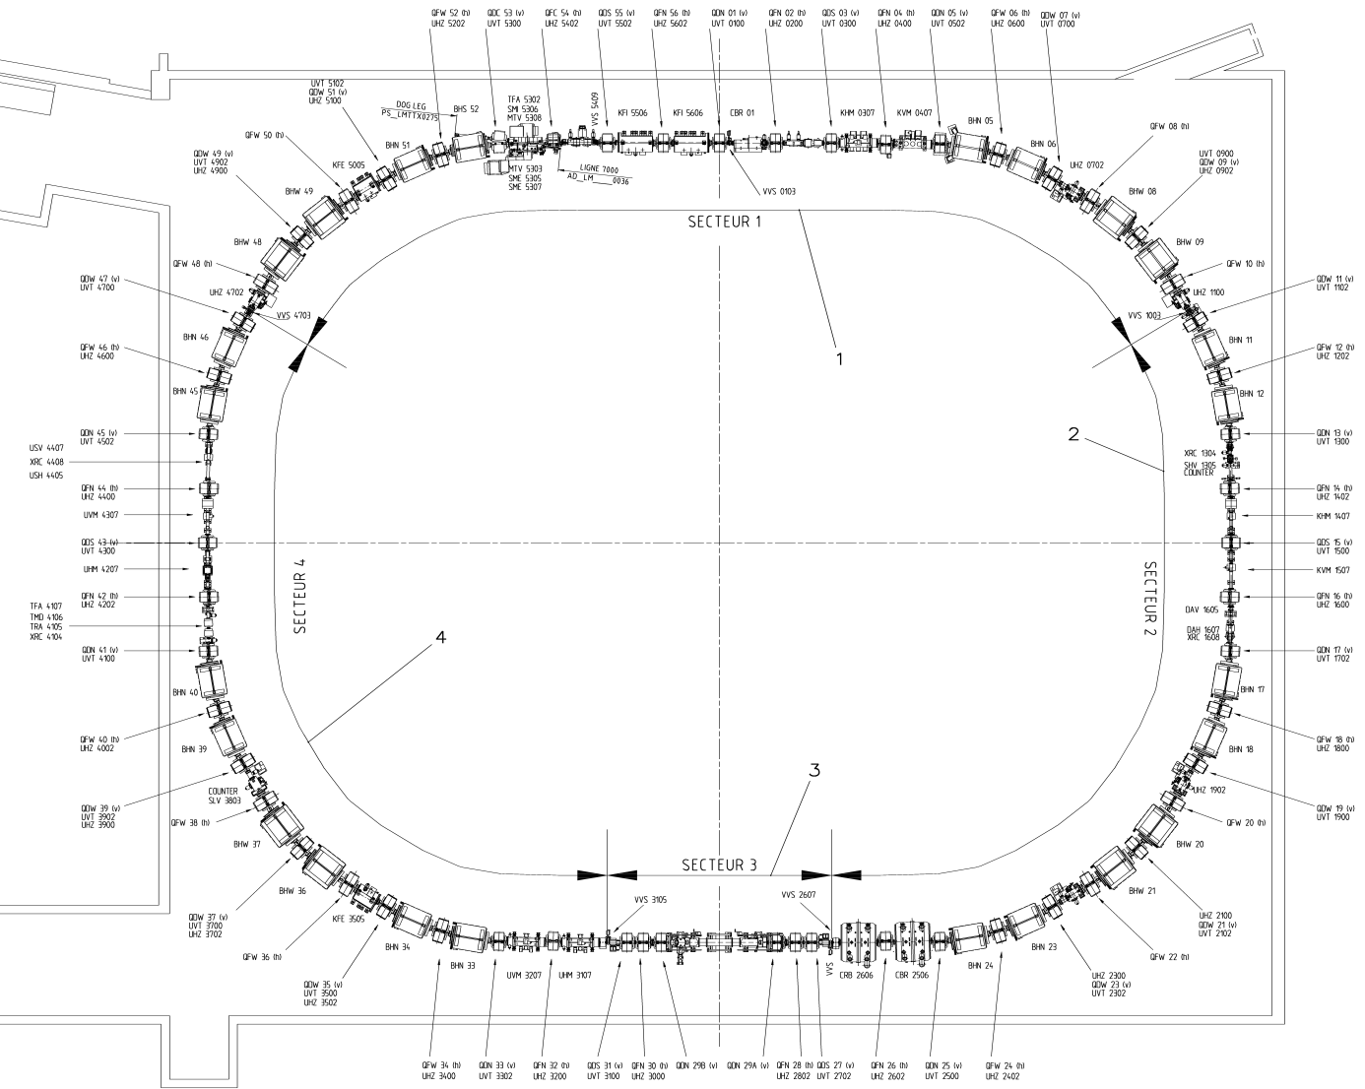
BHN - Refurbishment Progress
BHN - Refurbishment completed
BHN (BHS) – Refurbishment Pending (YETS17/18)
BHN – Refurbishment to be planned

Slide 7
BHN (10) – Refurbishment to be planned LS2 and beyond? Priority according to 2017 measurement campaign.
Coil Movement 1+ mm HIGH
Coil Movement 0.5 - 1 mm |
Coil Movement 0.25 – 0.5 mm |
Coil Movement <0.25 mm LOW

Slide 8
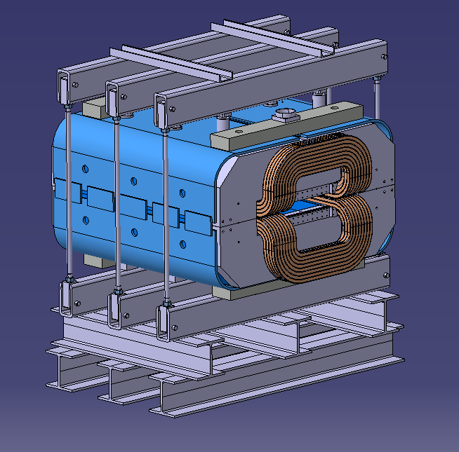
BHW after BHN or in parallel?
Missing the dedicated tooling, design is complete but needs to be ordered, ~40 kCHF.
First magnet would take perhaps 6-8 weeks for adjustment of tooling.
Do not seem as critical as the BHN but MSC are willing to perform in parallel if the organisation of the transport and handling is eased.

Slide 9
BHW (8) – Refurbishment to be planned LS2 and beyond? Priority according to 2017 measurement campaign.
Coil Movement > 1 mm HIGH
Coil Movement 0.5 - 1 mm |
Coil Movement 0.25 – 0.5 mm |
Coil Movement <0.25 mm LOW

Slide 10
BHN (10) & BHW (8) – Refurbishment to be planned LS2 and beyond? Priority according to 2017 measurement campaign.
Coil Movement > 1 mm HIGH
Coil Movement 0.5 - 1 mm |
Coil Movement 0.25 – 0.5 mm |
Coil Movement <0.25 mm LOW

Slide 11
Renovation of the main quadrupole magnets:
QW (28) & QN (28)
7th December 2017
Antony Newborough

Slide 12
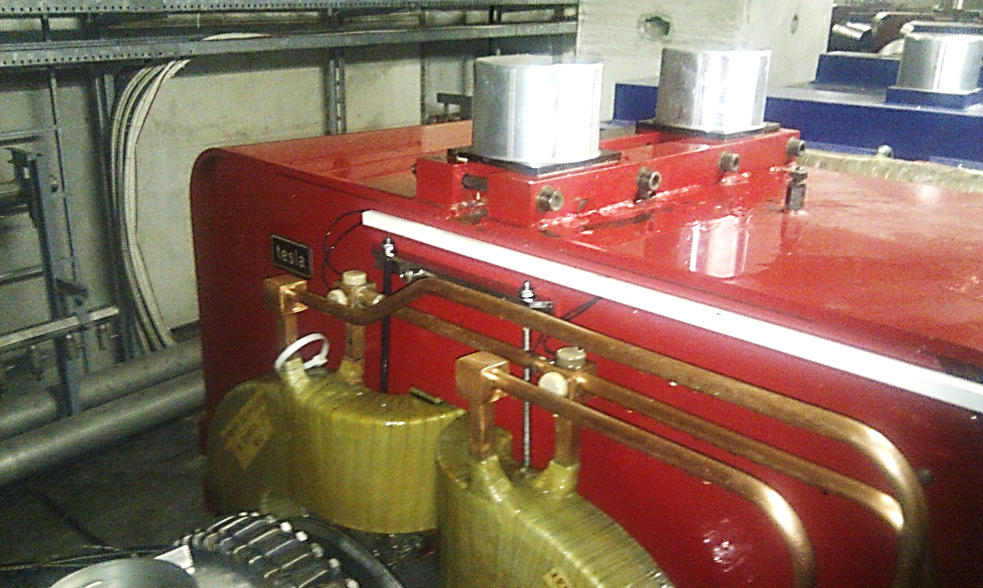
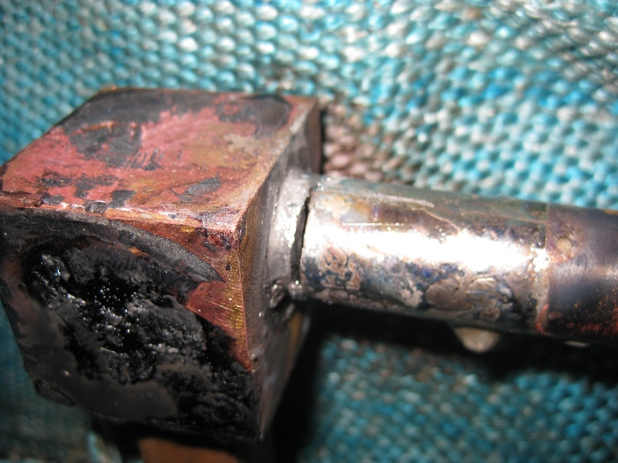
Main QW Magnets
Problems have been seen in the past and an in-situ repair campaign has already been completed. Regular checks are made to ensure the shimming is stable and that the coils are not moving.

Slide 13
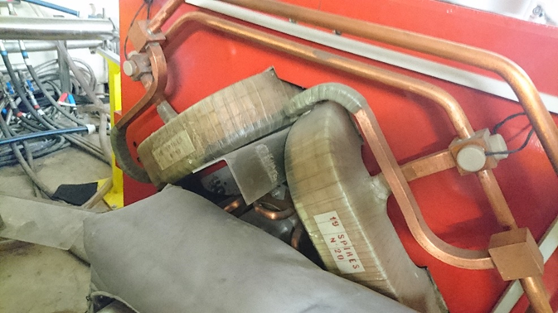
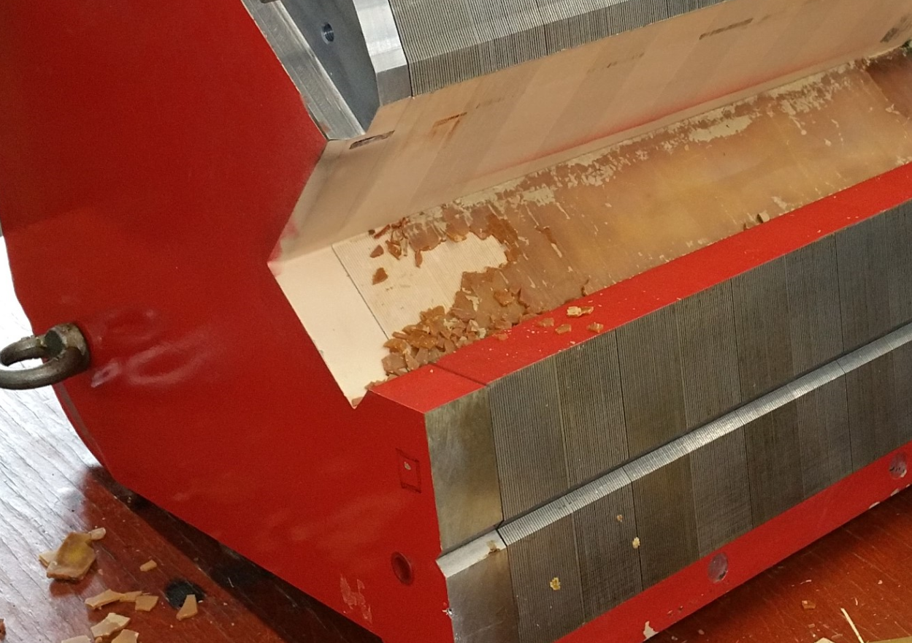
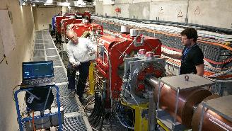
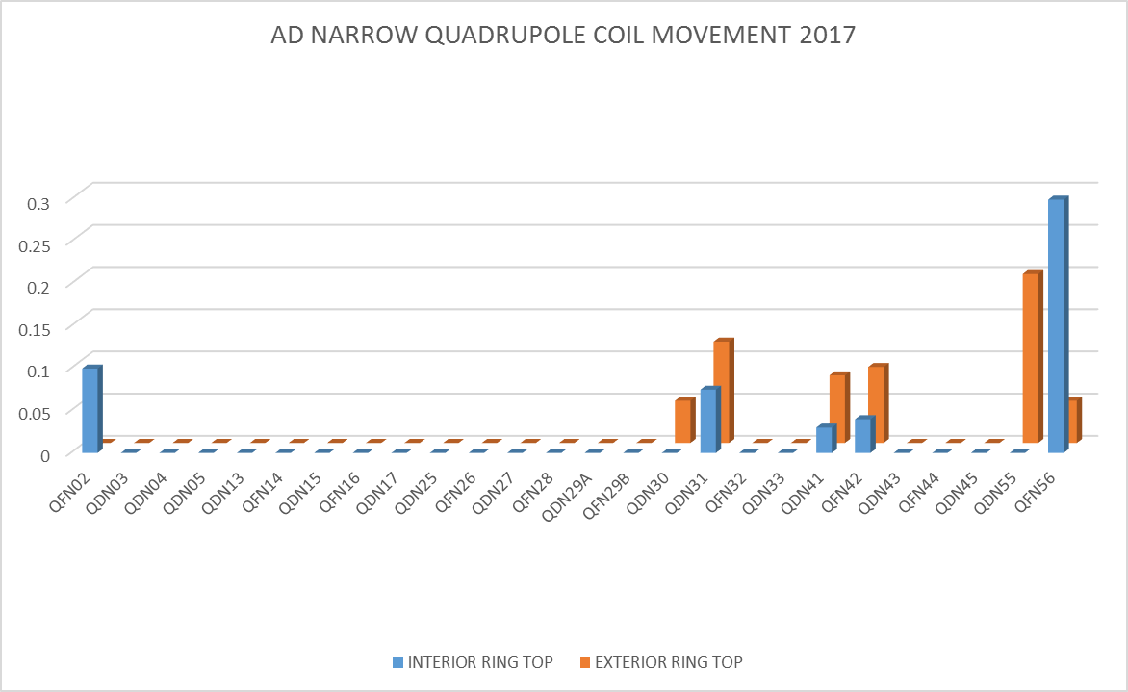
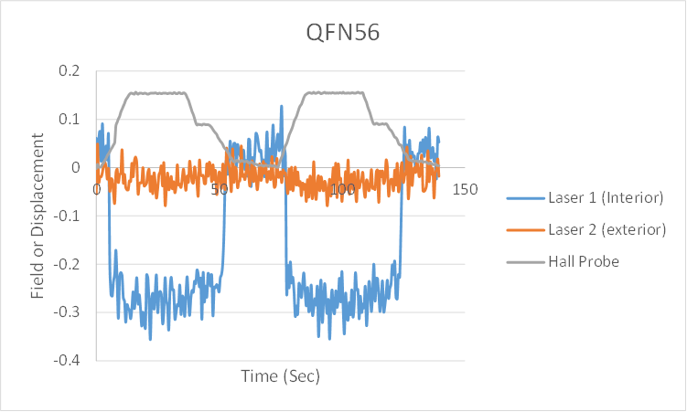
Main QN Magnets - Why?
QDS01, shims degraded and on the move!
Refurbishment YETS 17/18
Laser measurement campaign
Performed in 2017 as per the
Bending magnets

Slide 14
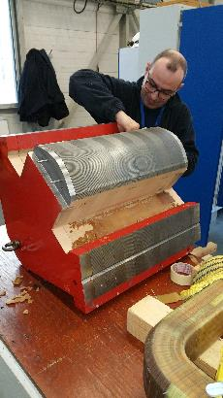
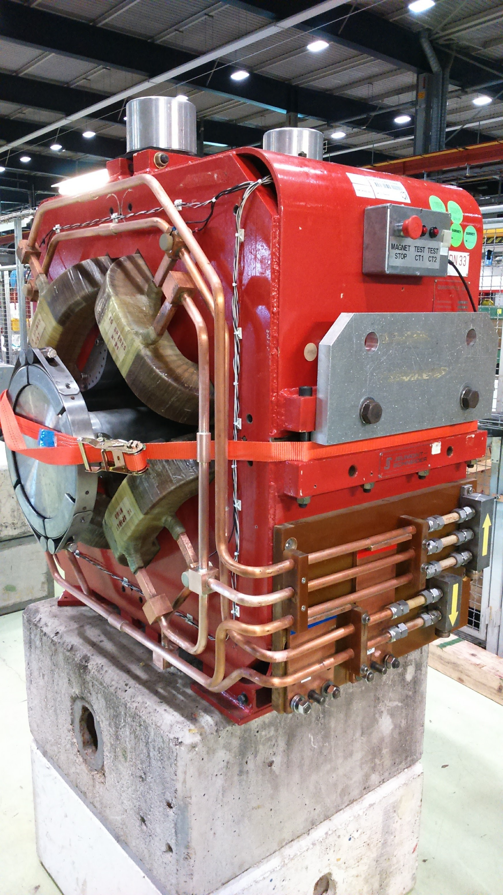
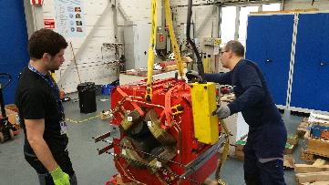
How?
Max 2 magnets in the workshop
at a time, 3 - 4 weeks per magnet:
  Pinning
  Opening
  Cleaning
  Assembly
  Brazing
  Testing
Dedicated closing tool needs to be developed during 2018 to ease the assembly process, Design + Fabrication ~ 40 kCHF

Slide 15
NARROW QUAD - Refurbishment progress
NARROW QUAD - Refurbishment completed
NARROW QUAD – Refurbishment Pending (YETS17/18) (HIGHEST PRIORITY)
NARROW QUAD – Refurbishment to be planned (NO PRIORITY)
NARROW QUAD (SPECIAL) – Refurbishment to be planned

Slide 16
So, what to do?
7th December 2017
Antony Newborough

Slide 17
Altogether, which BHN, BHW & QN Magnets in LS2 if we decide to ‘mix and match’?
Top 11 bending candidates according to measurement campaign,6 BHN & 5 BHW
Proposed QN candidates

Slide 18
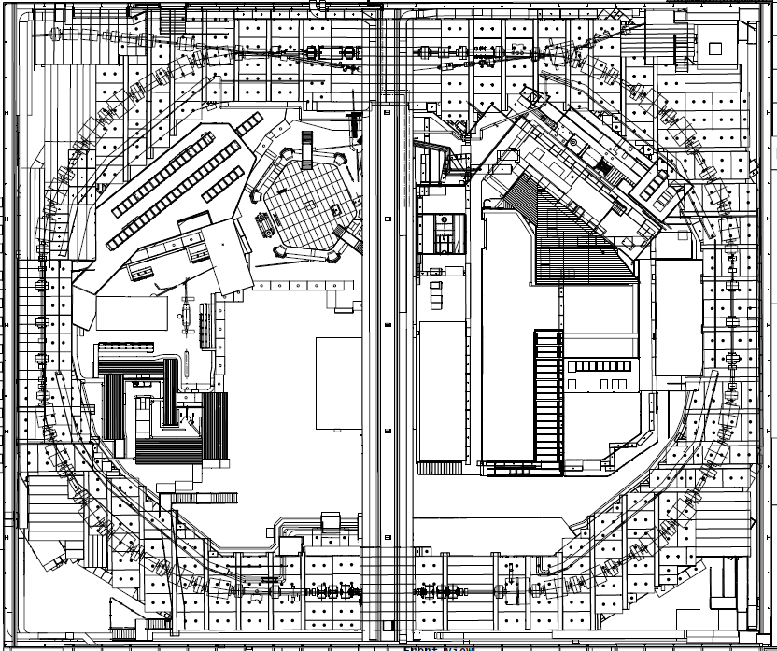
BHN (10) & BHW (8) &QN(?) Magnets
Planning and logistics:
Where to start?
What other works are planned in the ring?
When, compared to the ‘Global’ PS-complex LS2 planning?
Shielding removal and storage
What else in in the way?
BHN (10) & BHW (8) – Refurbishment to be planned LS2 and beyond? Priority according to 2017 measurement campaign.
Coil Movement > 1 mm HIGH
Coil Movement 0.5 - 1 mm |
Coil Movement 0.25 – 0.5 mm |
Coil Movement <0.25 mm LOW

Slide 19
Summary
To minimise the risk of downtime, we propose a preventive maintenance strategy during LS2 involving the refurbishment of up to 11 main bending (6 BHN & 5 BHW, prioritised according to the last coil movement measurement campaign) and 11 quadrupole magnets (for the moment chosen on the basis of logistical convenience)
  Our workshop has the capacity for:
    2 bending magnets at a time (minimum 4 weeks refurbishment)
    2 quadrupole magnets at a time (3 - 4 week refurbishment)
MSC is heavily involved in approved LIU and LHC injector chain consolidation work. To complete the proposed large refurbishment campaign during LS2, we need to prepare some tooling (2 x 40 kCHF) and we need to reinforce our team with at least 2 MY, ~150 kCHF (depending on PJAS or temporary staff)
After LS2, we would then have 70% / 50% of the main bending / quadrupole magnets refurbished
Transport*, Vacuum and Survey restraints need to be understood (Budget, Manpower & Schedule)
  * Transport both in the machine and the magnet workshop!

