Slide 1
YETS 2017-18 AD RING
AD Technical Coordination Meeting #3
2017-12-07
Aymeric BOUVARD
EN-EA-EC

Slide 2
YETS 2017-2018
From 18 dec 2017 to 16 or 30 march 2018
The access point will be in "general" mode during the entire shutdown with free access by the emergency exits.
An exception will be made at dangerous interventions requiring limited access to persons qualified for this work. During these periods, access control through impact will be awarded based.
All material out of the Ring will be stored in Buffer Zone and a TREC Request will be done for control, by the owner.
Each owner of equipment will be in charge of performing the EDH transport and handling referring to their equipment.
The visits will be subject to restrictions under the current work.

Slide 3
YETS AD Ring
Work Request
MSC
  Refurbishment of 3 Magnets: BHS52, QDN55, QFN56.
  Storage of the shielding blocs in AD Hall.
    BHS52:
      18 blocks 24168
      2 ventilation modules
      Cutting of the vacuum chamber in AD Hall before transfer to the b.867. This intervention will be supervised by RP and EN-EA.
    QDN55
      4 shielding blocks 24168
    QFN56
      6 concrete beams
    The exhibition magnets, near ELENA should be removed in another place in the AD Hall. Probably on the shielding in front of ASCUSA and ALPHA experimental areas.
  BCCC
  Installation of new controlled flow valve and insulation vacuum valve

Slide 4
YETS AD Ring
Work Request
BI
  General maintenance of the E.Cooler.
  General maintenance BTV
  Kickers:
  General maintenance + Test
CV:
  Removal of ventilation modules (BHS52)
  Maintenance of demineralized water.
  Water maintenance
  RP:
  Source Test:
    PMIA604
    PAXA604
    PAXT113
  EL:
  AUG Test
VSC
  Disconnection and reconnection: BHS52, QDN55, QFN56
  Works and Maintenance:
    Sector 1A
    Sector 1B
    Sector 2A
    Sector 2B
    Sector 3
    Sector 4
    DE Experimental Lines
  Bakeout Sector 1 (BHS52, QDN55, QFN56)
  Bakeout Sector 2A (SHV1305)
  SU
  Alignment: BHS52, QDN55, QFN56
  STI
  Replacement of the scraper SHV1305 (sector2)
  RF
  Maintenance + Test ADC02 and ADC10

Slide 5
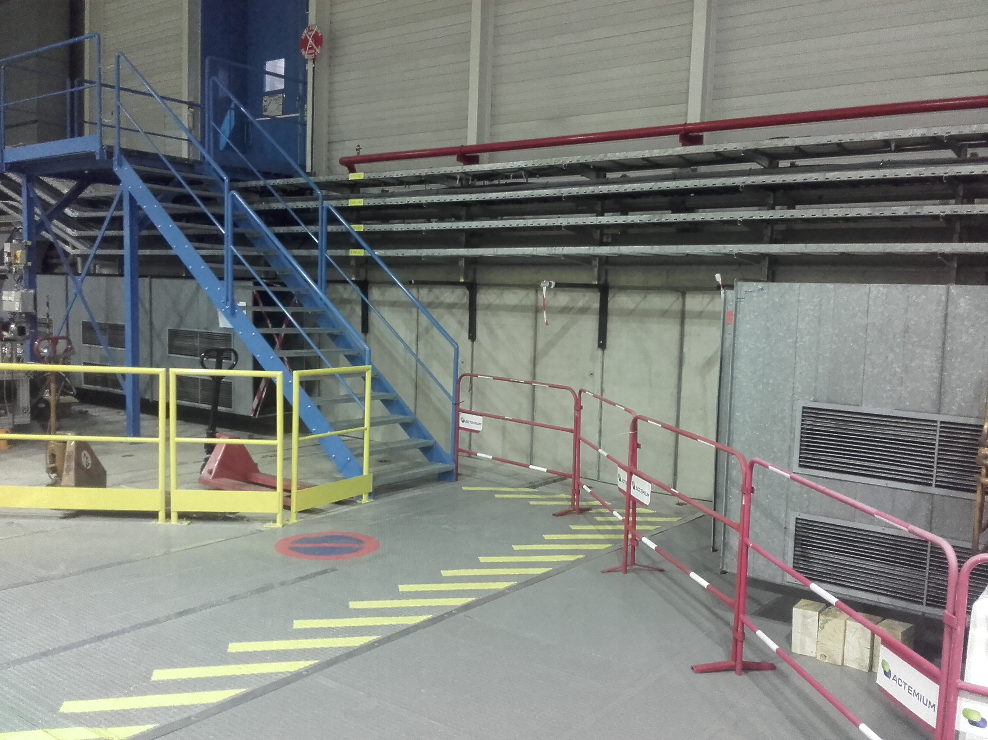
Planning
Works from W48 2017 to W02 2018
2017
W48
  CV: Removal ventilation
  modules. DONE
W50
  HE: Removal, exhibition magnets
  EA: Preparation of the shielding area
    Removal floor protection
    Removal gateway
    Removal railings
W51
  MSC:
    Removal BHS52
    Removal QDN55 and QFN56 (if possible)
  VSC: Cutting, vacuum chamber (RP supervision)
2018
W02
  MSC:
    Removal QDN55 and QFN56 if it was not possible to do it in week 51
    Beginning of refurbishment of magnets
  RP: Source test
  Kickers: General maintenance
  VSC: Works sector 2A and 2B
  BI: Maintenance e-cooler
  STI: Scraper SHV1305
  BCCC
    Installation of new controlled flow valve and insulation vacuum valve
    Warm-up and purge cryostat
  EL: Test AUG

Slide 6
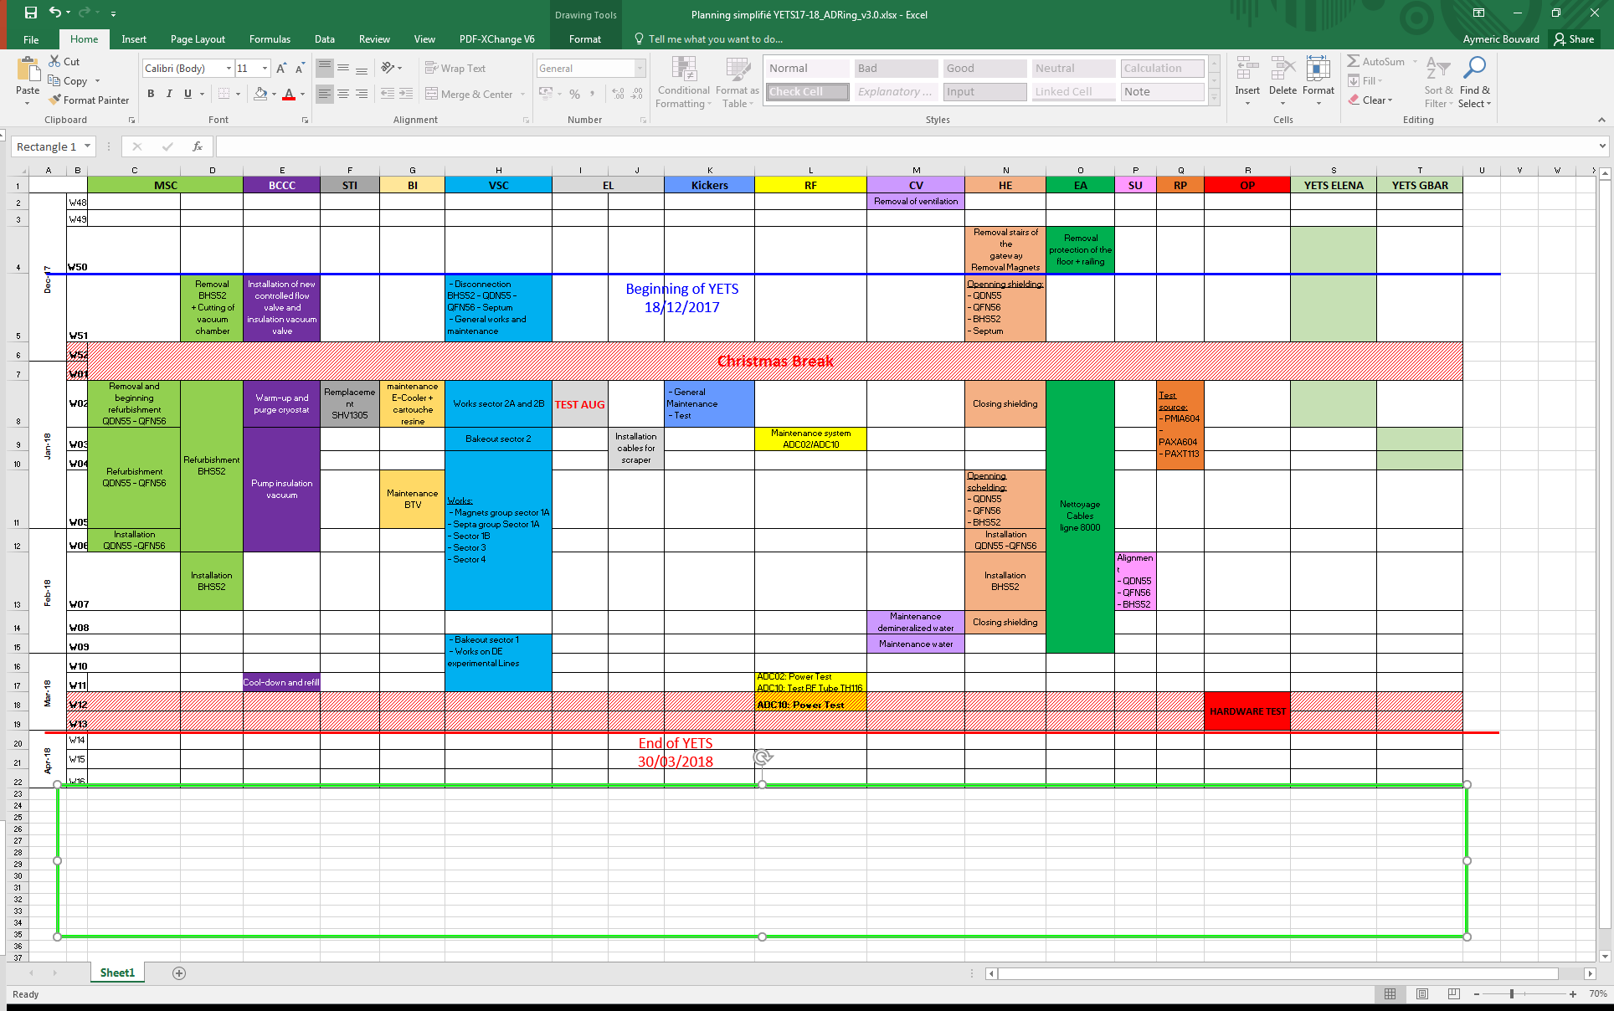
Planning

Slide 7
Planning
At the request of OP, we must study all the possibilities to allow to take beam as initially planned on March 19, 2018.
1. Possibilities:
  CV: Advance the demineralised water maintenance in week 07-> TBC
  Nothing more could be done to save time before the Hardware Test.
  OP: Reduce the Hardware Tests at 1 week-> TBC
2. Impact:
  BCCC: Cool-Down and Refill in w10 (initially in W11)
  RF:
    ADC02: Power test in w10 (initially in W11)
    ADC10: Test RF Tube TH116 in w10 (initially in W11)
    ADC10: Power Test in W11 (initially in W12) during the Hardware test.

Slide 8
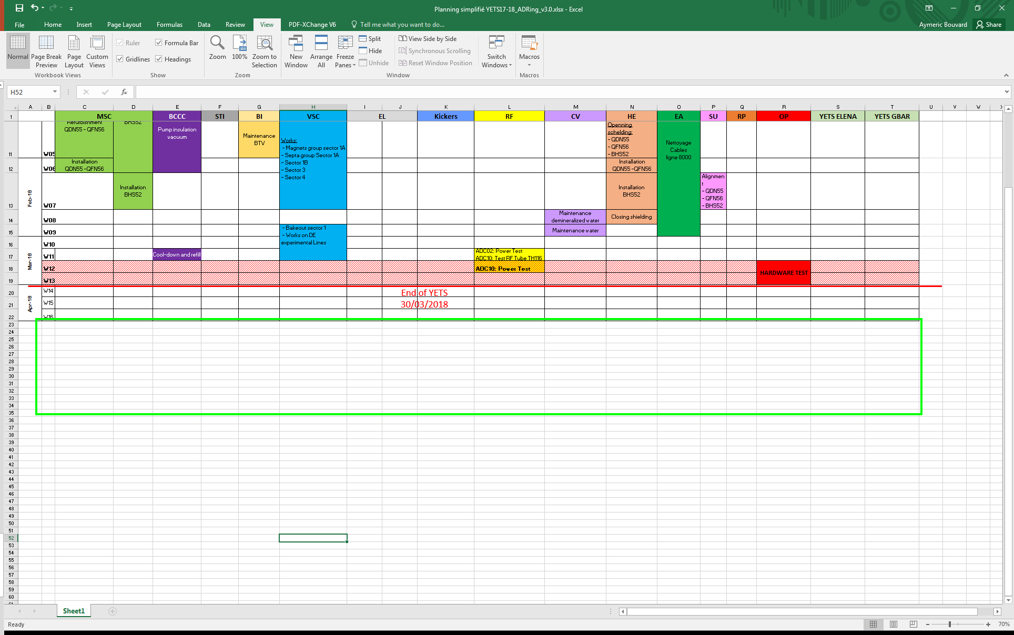
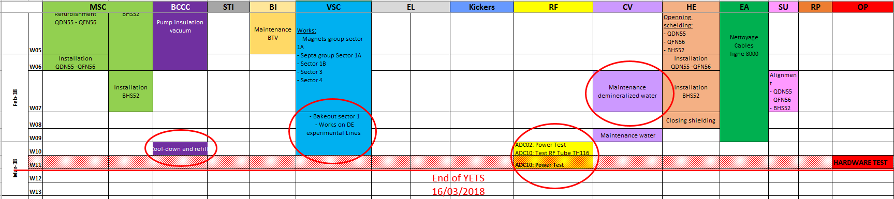
Planning
Current planning
Target

Slide 9
Thank You

