Slide 1
TE-CRG
2017 Plenary Meeting
Monday 27th of November 2017
D. Delikaris, TE-CRG

Slide 2
Outline
2017 group structure & resources
Safety
Budget
Operation & Maintenance
Cryolab
Projects & Consolidations
Perspectives & Challenges

Slide 3
Group structure & resources

Slide 4
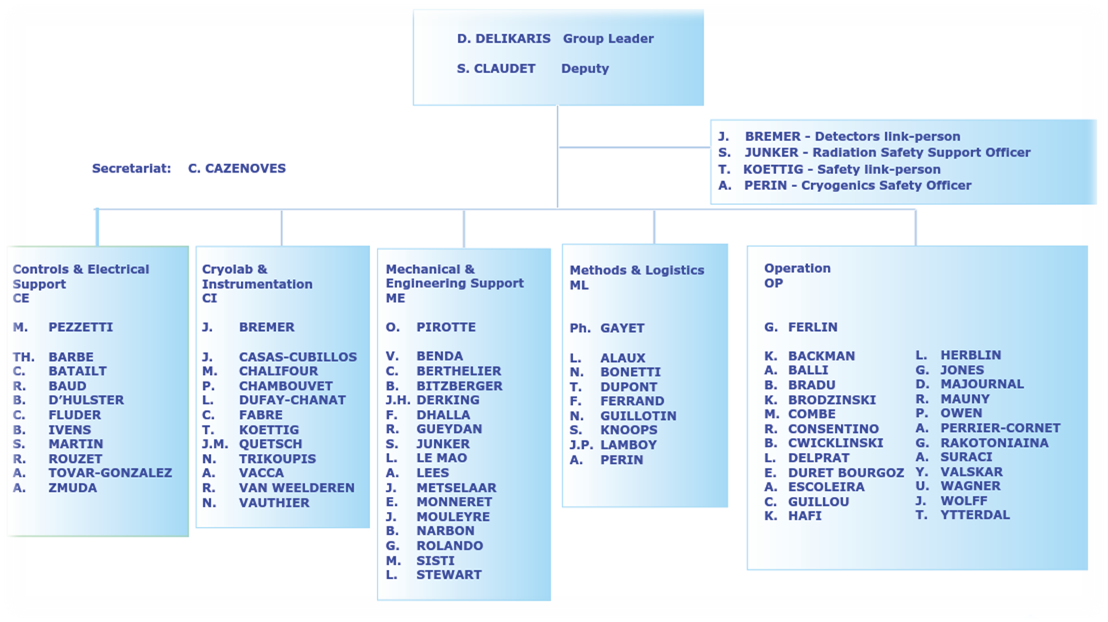
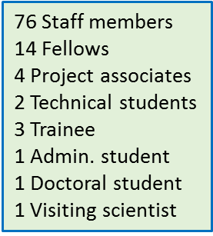
2017-18 Group structure & resources
Desktop Computing matters: M. Pezzetti
Cryogen contracts management: S. Claudet
Computing security: C. Fluder
Workshops link person: O. Pirotte

Slide 5
2017 OP section (Operation)
Section Leader Gérard Ferlin
OP Section mandate
Operation of the cryogenic systems and infrastructure of the LHC accelerator & detectors
Functional analysis follow-up and upgrade of the LHC accelerator & detectors cryogenic systems
Follow-up and upgrade of the cryogenic process operation simulator
Supervision of maintenance inspection tasks
Consultancy & projects in refrigeration process for large cryogenic systems

Slide 6
2017 ML section (Methods & Logistics)
Section Leader Philippe Gayet
ML Section mandate
• Development of methodology, quality assurance and tools leading to the improvement of the overall availability of the cryogenic systems
• Management of the industrial support contract for Maintenance & Operation;
Supervision of the non-LHC cryogenic systems and infrastructure exploitation
• Management of the CAMMS interface and tools, spare parts logistics and storage
• Coordination & scheduling of TE-CRG activities
• Interface with the central coordination for accelerators, detectors and test facilities
• Orders and distribution of cryogenic fluids CERN-wide

Slide 7
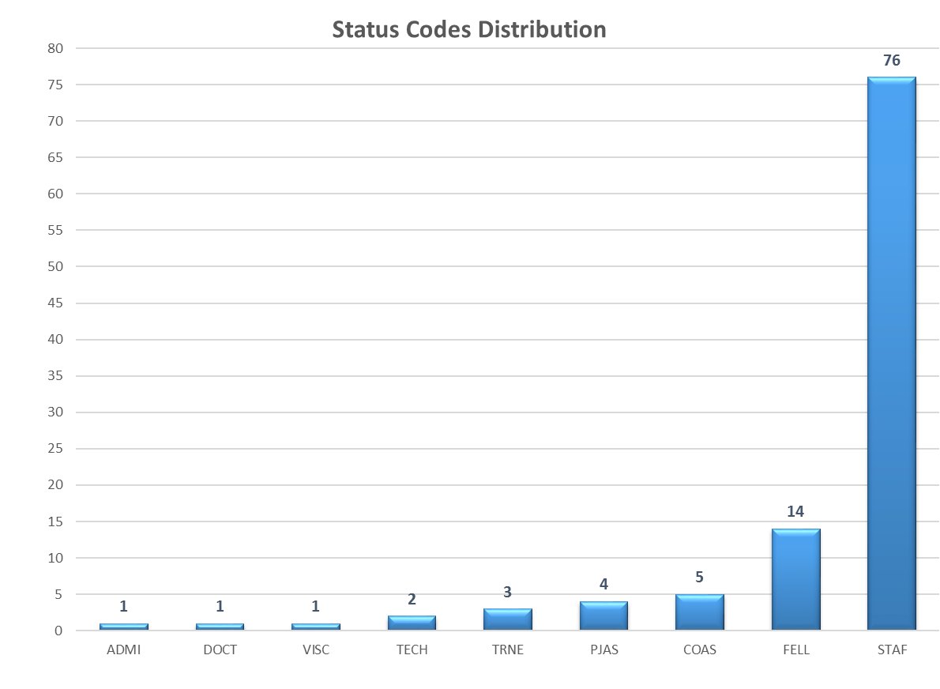
2017 Group structure & resources
Status Code | Name | First Name
ADMI | MARTINEZ CANO | Jose
VISC | LIBERADZKA | Joanna
DOCT | KOTNIG | Claudio
TECH | DORAU | Tim
TECH | LAMY | Raphael Benjamin
TRNE | GENIEVRE | Terence
TRNE | JUSDADO SERRANO | Fernando
TRNE | LUTHI | Victor
PJAS | DE PAOLA | Donato
PJAS | LES | Michal
PJAS | PEKSA | Pawel
PJAS | WOLAK | Tomasz
FELL | AABID | Fouad
FELL | BENETTI | Paolo
FELL | BERKOWITZ ZAMORA | Daniel
FELL | BUSTAMENTE DELGADO | Eduardo
FELL | CARRASCO MARTIN | Fernando
FELL | CERRO | Alessandro
FELL | CIRILLO | Roberta
FELL | CREUS PRATS | Joaquim
FELL | GROSSO XAVIER | Mario
FELL | KRIBOO | Remy
FELL | MASTYNA | Rafal
FELL | LEFEBVRE | Victor
FELL | ORLANDI | Roberto
FELL | TAVARES COUTINHO BORGES DE SOUSA | Patricia

Slide 8
2017 Group structure & resources: New arrivals
NAME | SECTION | STATUS | START DATE | SUPERVISOR
MONNERET Emmanuel | ME | STAF | 9/1/2017 | O. Pirotte
SISTI Michele | ME | STAF | 6/1/2017 | O. Pirotte
ZMUDA Andrzej | CE | STAF | 1/11/2017 | M. Pezzetti
BRADU Benjamin | OP | STAF | 4/3/2017 | G. Ferlin
BARBE Thomas Jean-Louis | CE | STAF | 4/3/2017 | M. Pezzetti
ROLANDO Gabriella | ME | STAF | 4/3/2017 | O. Pirotte
VALSKAR Yngve | OP | STAF | 3/1/2017 | G. Ferlin
NARBON Baptiste | ME | STAF | 1/5/2017 | O. Pirotte
CWICKLINSKI Berenger | OP | STAF | 1/5/2017 | G. Ferlin
GENIEVRE Terence | CE | VIA | 9/1/2017 | M. Pezzetti
KRIBOO Remy | CI | FELL | 7/3/2017 | J. Bremer
LEFEBVRE Victor | CE | FELL | 2/1/2017 | M. Pezzetti
CIRILLO Roberta | ML | FELL | 1/5/2017 | P. Gayet
GENTILE Ugo | ML | FELL |  | P. Gayet
BUSTAMANTE DELGADO Eduardo | CI | FELL-TTE | 8/1/2017 | J. Casas-Cubillos
CERRO Alessandro | CE | FELL-TTE | 4/3/2017 | M. Pezzetti
DORAU Tim | CI | TECH | 9/1/2017 | L. Dufay-Chanat
LAMY Raphael | CE | TECH | 2/1/2017 | M. Pezzetti
PEKSA Pawel | CE | PJAS | 7/3/2017 | M. Pezzetti
LES Michal | CI | PJAS | 6/1/2017 | J. Casas-Cubillos
WOLAK Tomasz | CE | PJAS | 5/2/2017 | M. Pezzetti
GIMEL Alexis | CE | TRNE-STAG | 7/31/2017 | M. Pezzetti
LUTHI Adrien | CE | TRNE-STAG | 7/17/2017 | M. Pezzetti
DONON Yann | CE | TRNE-STAG | 7/3/2017 | M. Pezzetti
VOLLENBERG Kasper | CI | TRNE-STAG | 4/3/2017 | L. Dufay-Chanat
MALECHA Ziemowit Milosz | CI | COAS | 8/21/2017 | J. Bremer
PYARALI Maisam | OP | SUMM NMS | 7/3/2017 | L. Delprat
MALECHA Ziemowit Milosz | CI | VISC | 6/12/2017 | R. Van Weelderen
ENFANT FONCTIONNAIRE | ME | CHIL | 6/12/2017 | R. Gueydan
As from 2016 challenges and perspectives conclusions:
“The prompt and efficient integration of the newcomers is a challenge and considered as an objective of the highest priority”

Slide 9
CRG group structure & resources

Slide 10
CRG group structure & resources

Slide 11
CRG group structure & resources
14 Nationalities / 22

Slide 12
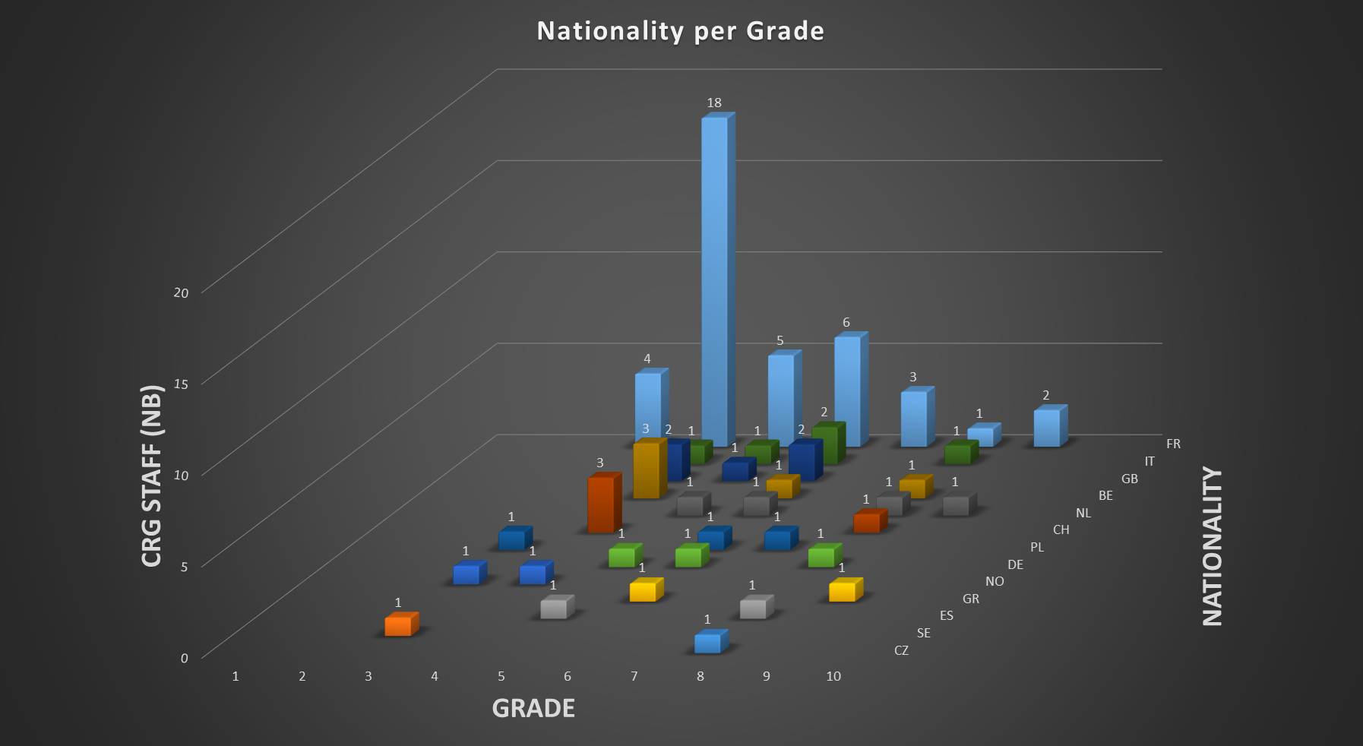
CRG group structure & resources

Slide 13
Industrial support resources (FSU, FTEs)
Preliminary forecast
Contractor | Contract | FSUnit | 2014 | 2015 | 2016 | 2017 | 2018 | 2019 | 2020 | 2021 | 2022
Serco/Ineo | S145 | TE01 | 15 | 8 | 8 | 7 | 8 | 15 | 15 | 10 | 10
Soteb/Altead | S146 | TE03 | 27 | 18 | 18 | 19 | 19 | 23 | 23 | 18 | 18
Preliminary forecast
 | 2017 | 2018 | 2019 | 2020 | 2021 | 2022
TE01-CRG-ME | 2 | 2 | 2 | 2 | 2 | 2
TE01-CRG-CI | 2 | 2 | 4 | 4 | 2 | 2
TE01-VSC | 3 | 6 | 9 | 9 | 6 | 6
TOTAL |  | 10 | 15 | 15 | 10 | 10
 | 2017 | 2018 | 2019 | 2020 | 2020 | 2020
TE03-CRG-CE | 7 | 6 | 9 | 9 | 6 | 6
TE03-CRG-CI | 2 | 2 | 2 | 2 | 2 | 2
TE03-CRG-ME | 10 | 10 | 12 | 12 | 10 | 10
TOTAL | 19 | 18 | 23 | 23 | 18 | 18

Slide 14
Industrial support resources (S176/TE, M&O)
The S176/TE Maintenance & Operation (M&O) contract was implemented, and completed his 1st operational year (01/07/2016-30/06/2017), regrouping resources for the Maintenance and the Operation of the cryogenic installations CERN wide
The FSU units TE-21 and TE-22 (26 FTE) for the operation and cryogen distribution have been terminated by the 30/06/2016
S176/TE M&O support contract: an important milestone for the CRG group:
Maintenance (preventive, corrective, predictive) for all cryogenic installations at CERN
Full delegation-results oriented operation for non-LHC cryogenics (KPIs)
Tasks oriented operation for LHC accelerator & detectors under CERN’s supervision
The implementation of the S176/TE M&O support contract induced the restructure of the Operations section in one and the Maintenance Management & Logistics section

Slide 15
Industrial support resources (S176/TE, M&O)

Slide 16
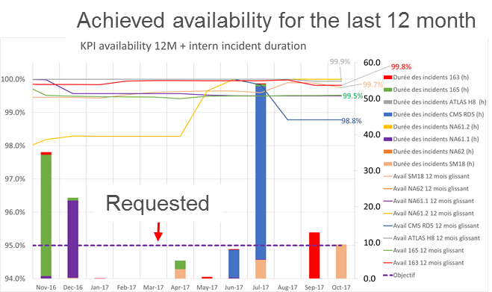
Industrial support resources (S176/TE, M&O)
Performance oriented Contract result- Non LHC Operation & Maintenance

Slide 17
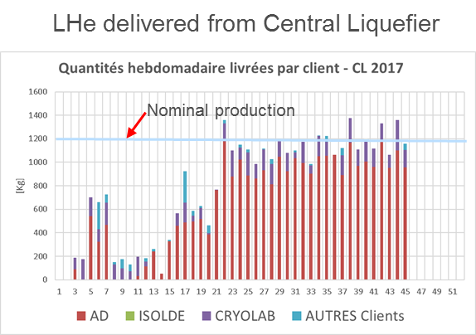
Industrial support resources (S176/TE, M&O)
Performance oriented Contract result- Non LHC Operation & Maintenance

Slide 18
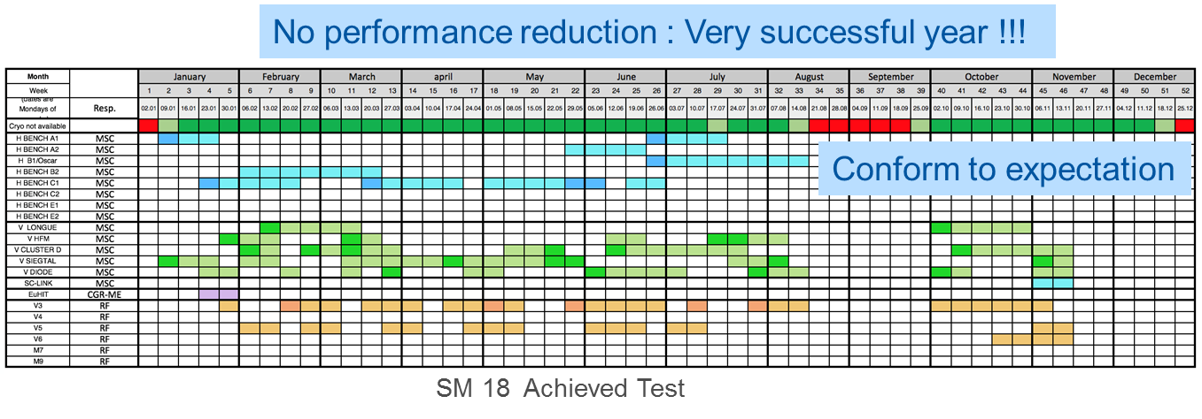
Industrial support resources (S176/TE, M&O)
Performance oriented Contract result- Non LHC Operation & Maintenance

Slide 19
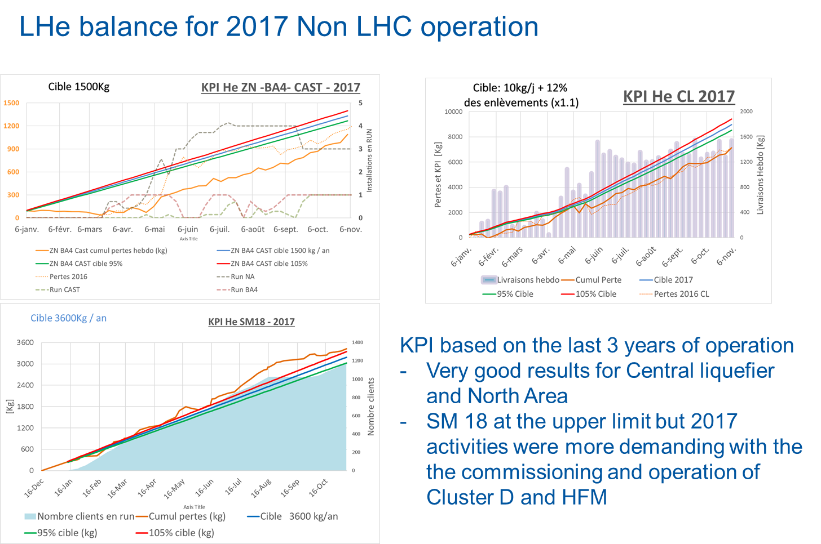
Industrial support resources (S176/TE, M&O)
Performance oriented Contract result- Non LHC Operation & Maintenance

Slide 20
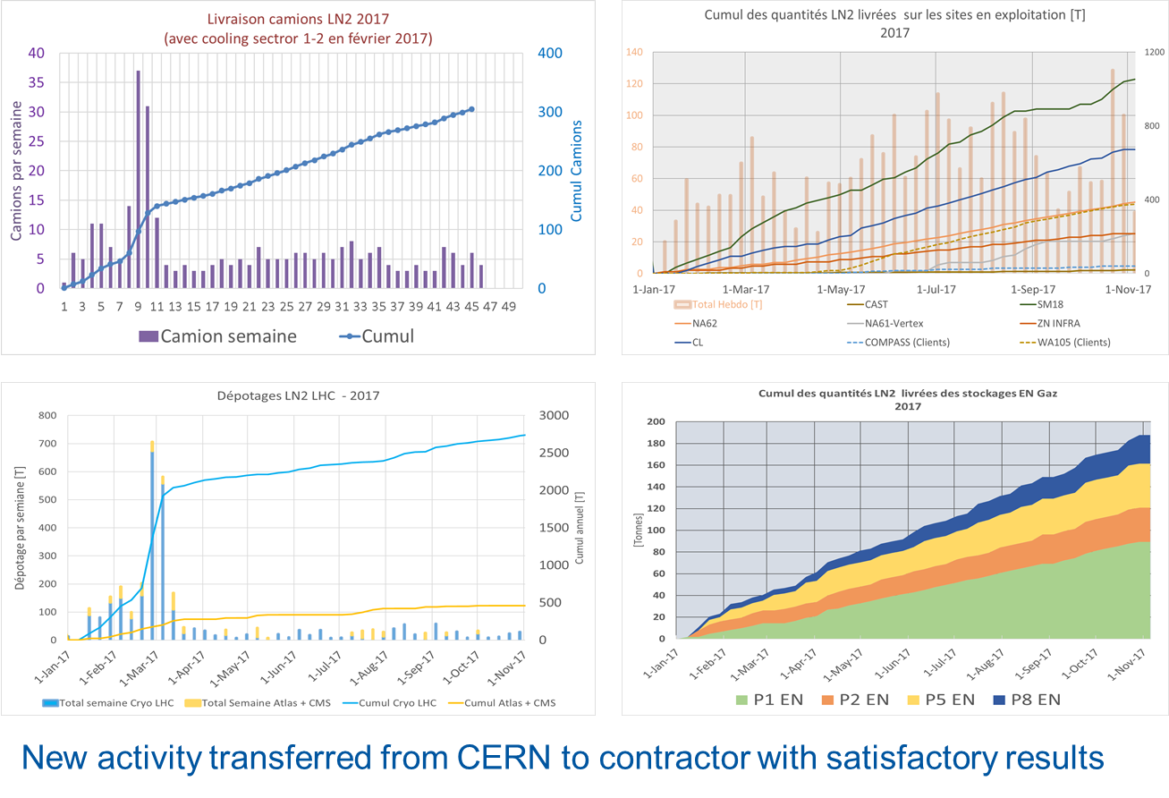
Industrial support resources (S176/TE, M&O)
Performance oriented Contract result- Liquid nitrogen supply

Slide 21
S176/TE service contract (5-years)
Maintenance & Operation of the Cryogenics installations CERN-wide
LS2 activities:
S176/TE; Limited impact on additional resources by using synergy from the Maintenance & Operation (reduced)
Major overhauling at manufacturer’s premises of helium compressors and 3.3 kV electric motors not included in the S176/TE (3 MCHF, operation budget)
Contract ends
30-06-2021
Yearly extensions
available
Contract started
01-07-2016

Slide 22
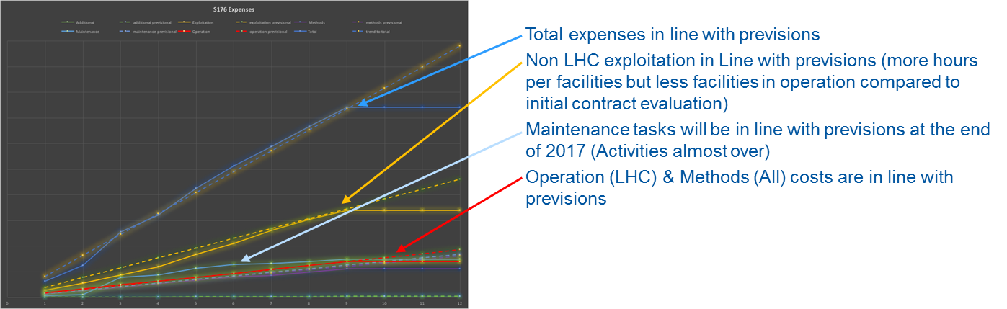
Industrial support resources (S176/TE, M&O)
Contract Budget Follow-up for 2017
On-budget

Slide 23
Safety

Slide 24
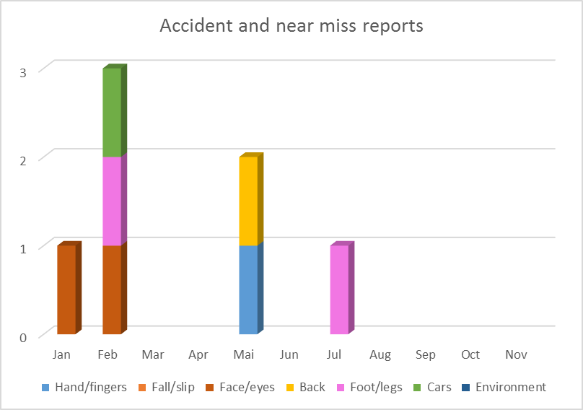
2017 CRG Safety
Statistics of accidents and near misses
Based on registered “A2 code” in the CRG group
2017
2016
2016: 14 accidents and near miss
2017: 7 accidents and near miss
2 accidents with long term absence from work

Slide 25
2017 CRG Safety
CRG provided cryogenic safety courses/training:
=> in collaboration with HSE:
- Fundamentals x5 => all users of Cryogens
- LHe transfer x6 => Hand transfer (AD, Isolde, Cryolab …)
- TSO x3 => HSE course
- Fire Brigade x3 => Newcomers and refresher
=> TE internal for TSO’s x1
=> Training for CRG Operators x1 (start version)

Slide 26
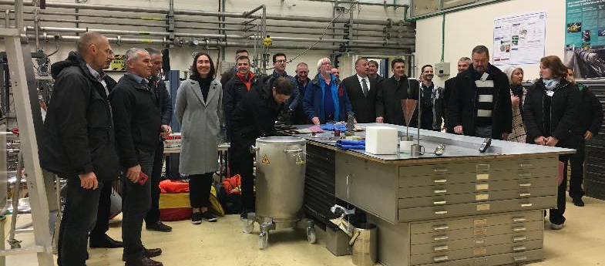
2017 CRG Safety
Cryogenic Safety Training
Cryogenic Safety Course for CTIF Hazardous Materials Commission & Visits
(Bi-Annual meeting, CTIF Hazardous Materials Commission)
The 50th meeting of the CTIF Hazardous Materials Commission took place from 15-18 November 2017 at CERN
CTIF is an international organisation whose aim is to promote cooperation between firefighters and experts in the field of fire and rescue throughout the world
The Hazardous Materials Commission meets twice a year to share information through national reports, lessons learned and specific working groups
During this edition, a workshop on cryogenic risk was organised, as well as a representative visit of the installations and activities of CERN

Slide 27
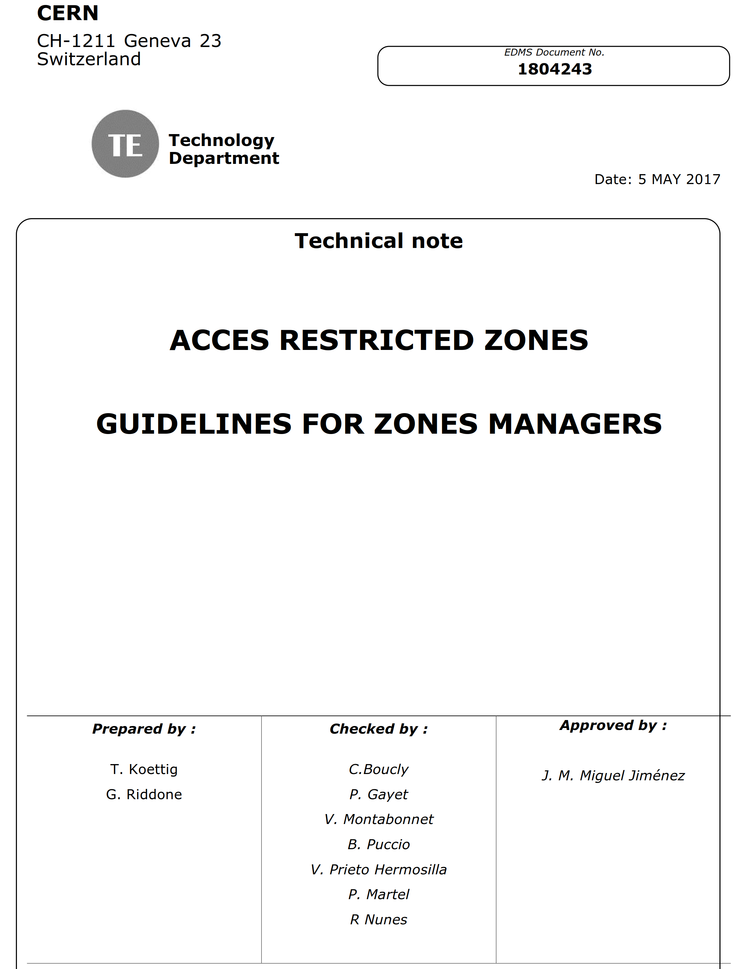
2017 CRG Safety
Restricted Access Zones - Guidelines
Instructions for zones managers are summarized in the following document
EDMS 1804243
Access request to zones in ADAMS => Permissions

Slide 28
2017 CRG Safety
TE Dept. access control strategy (buildings)
CRG implementation (list defined) on-going under the supervision of T. Koettig, safety link person
Safety related restricted access
Operational security
NWG | STORAGE |  | LAB |  | WORKSHOP |  | CONTROL
 | NWH | OWH | NWH | OWG | NWH | OWH | NWH | OWH
Staff (part of the group) | EDH authorization | EDH authorization for stand-by duty | EDH authorization | On special request, EDH authorization | EDH authorization | On special request, EDH authorization | EDH authorization | EDH authorization
Staff (outside the group) |  |  |  |  | On special request, EDH authorization
Industrial support of the group | EDH authorization | EDH authorization for stand-by duty | EDH authorization |  | EDH authorization |  | EDH authorization | EDH authorization
Cleaning service | EDH authorization | EDH authorization | EDH authorization | EDH authorization | EDH authorization | EDH authorization | EDH authorization | EDH authorization
Other services | For dedicated work, limited duration EDH authorization |  | For dedicated work, limited duration EDH authorization |  | For dedicated work, limited duration EDH authorization |  | For dedicated work, limited duration EDH authorization
New access regulations for NWH and OWH => to be implemented with ADaMS 3

Slide 29
2017 CRG Safety; TE-CRG Workshops
Following the approval of the new version of the General Safety Instruction GSI-SO-12 on Workshop Supervisor (WS), all CRG workshops have been scrutinized, supervisors and alternates nominated and formal access granted to CRG workshops on individual basis and qualification

Slide 30
Budget

Slide 31
2017 CRG budget status
Date: 17 Nov 2017
Query: Category of Accounts Materiel and Time Period This Year + Carry Over and Organic Unit TE-CRG
TE-CRG Budget 2017 |  | Charged to Budget Code (CHF) | Annual Commitment (CHF) | Payment Budget (CHF)
Non-Reccurent | Total of CE: | 256,516 | 260,221 | 278,000
 | Total of ME: | 375,285 | 568,391 | 418,000
 | Total of ML: | 406,836 | 744,859 | 640,000
 | HL-LHC WP9 | 750,131 | 926,127 | 1,247,000
 | SM18 Cryo Control Room | 8,555 | 14,021 | 26,000
 | Cold spares for the compressor station | 130,772 | 424,092 | 420,000
 | DFB Spares | 507 | 78,106 | 80,000
 | SM18 Cryoplant Infra. Upgrade | 123,840 | 3,263,860
 | Total Non-Reccurent | 2,802,571 | 7,205,805 | 4,356,000
Reccurent | Total of CE: | 576,990 | 900,782 | 685,000
 | Total of CI: | 691,303 | 805,619 | 873,000
 | Total of ME: | 1,035,068 | 1,402,032 | 1,415,000
 | Total of ML: | 5,069,678 | 6,880,456 | 6,909,000
 | Total of OP: | 1,140,852 | 1,167,683 | 1,230,000
 | CRG General (97) | 13,223 | 13,223 | 20,000
 | CRG General (98) | 32,721 | 36,094 | 35,000
 | Fax, Telephone CRG | 14,405 | 15,056 | 16,000
 | Office Informatics | 31,131 | 31,131 | 35,000
 | Confer.,Oth. Training | 78,997 | 78,997 | 80,000
 | Total of CRG general codes | 170,477 | 174,500 | 186,000
 | Total Reccurent | 8,684,368 | 11,331,072 | 11,298,000
 | Grand Total | 11,486,939 | 18,536,877 | 15,654,000

Slide 32
Operation & Maintenance

Slide 33
The updated 2017 Group’s four major forums for:
evaluating the Cryogenic Performance & Safety
ensure the follow up of Key Performance Indicators
adapt the Maintenance plan & activities to Operational experience and requirements
ensure the follow up of all Consolidations, Upgrade and Projects activities
CPL (chair: D. Delikaris) Cryogenic Performance for LHC accelerator and detectors | CPNL (chair: Ph. Gayet) Cryogenic Performance for Non-LHC equipment & infrastructure
OMP (chair: Ph. Gayet) Operation and Maintenance Panel | CRG-TM (chair: A. Perin) Group Technical Meeting for Consolidations, Upgrade and Projects

Slide 34
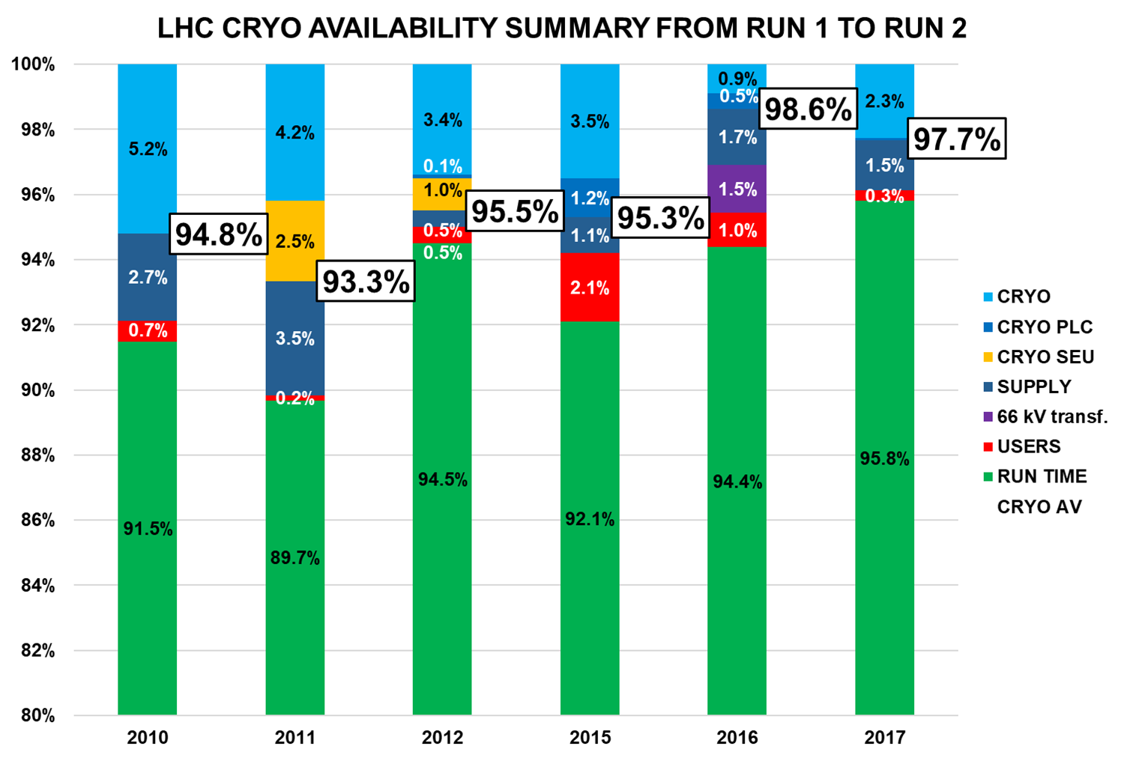
LHC Operation (2017)
Tuning of all 4.5 K cryoplants to adjust the non-isothermal load 4.5-20 K up to 10 kW (installed 7.7 kW) per sector thus coping with the e-cloud observed load
The Feed Forward implementation for BS and ITs improved dramatically the cryogenic dynamic behaviour
Measurement/calibration of available cooling power for selected sectors with high thermal load (request from Chamonix/Evian meeting)
Multiple thermal load measurement to provide data for electron cloud meetings & Beam Induced Heat Load Task Force
Test fill (all sectors) without levelling and constant luminosity validating 2.0*10³⁴ cm⁻² s⁻¹ luminosity in stable beams

Slide 35
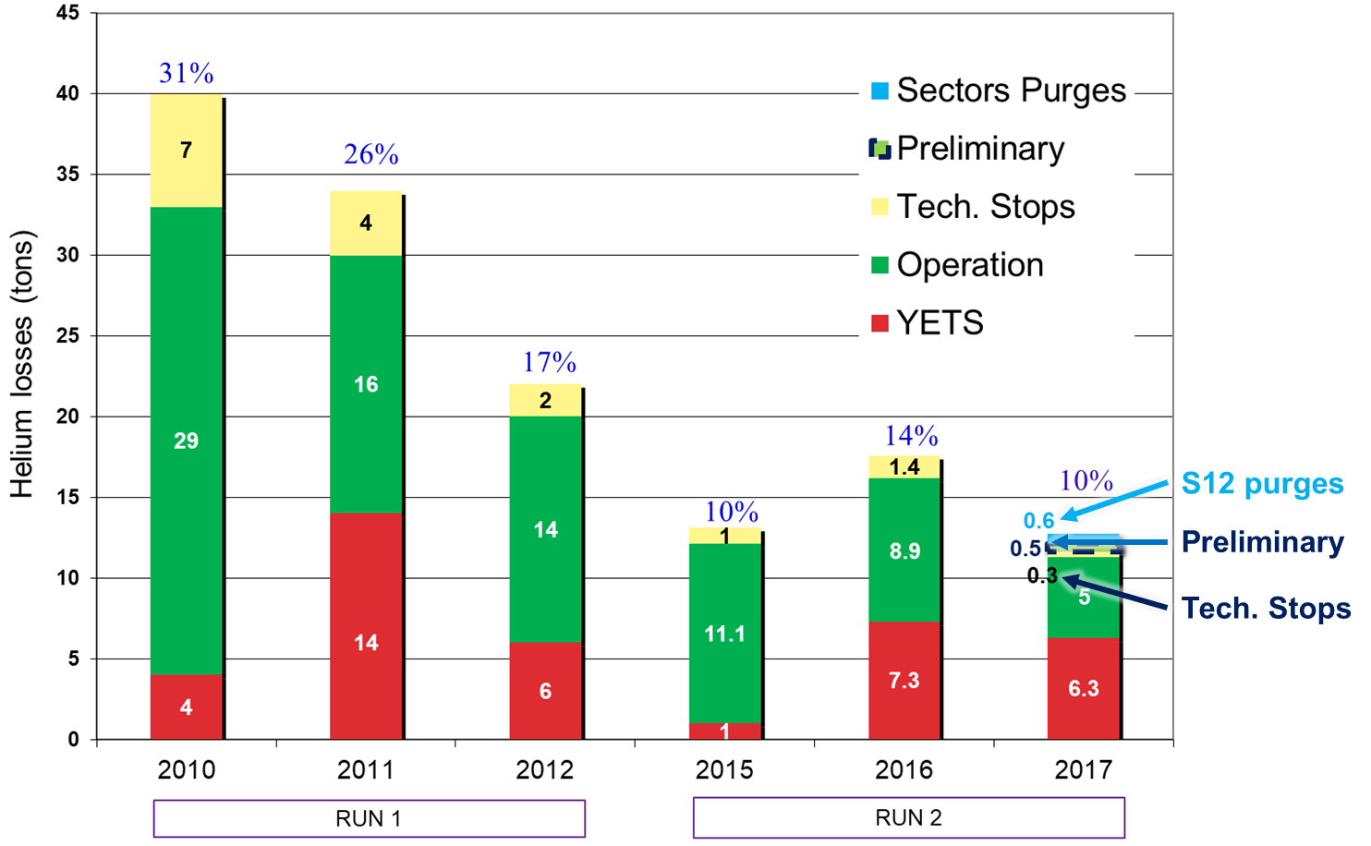
LHC Operation (2017); helium inventory
Very good operational results for 2017

Slide 36
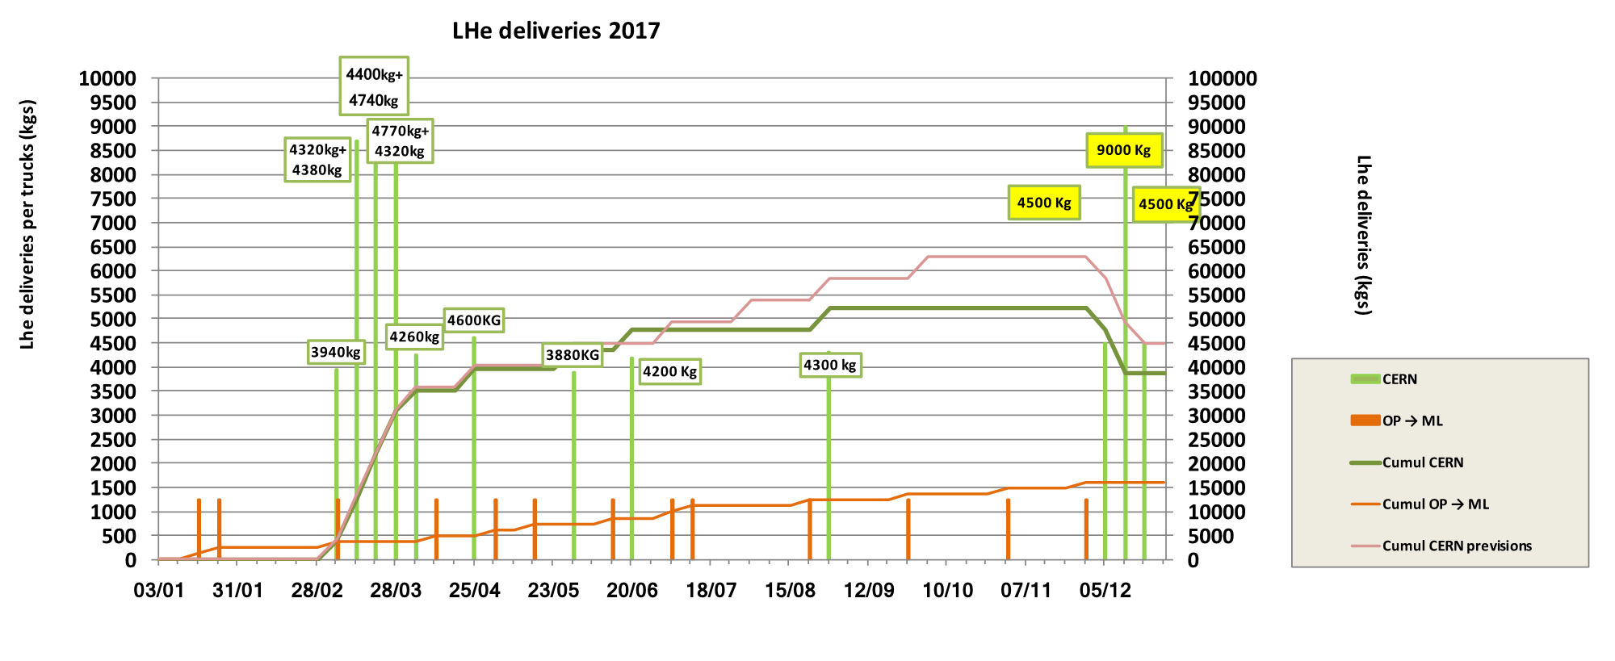
Liquid Helium supply at CERN (2017)

Slide 37
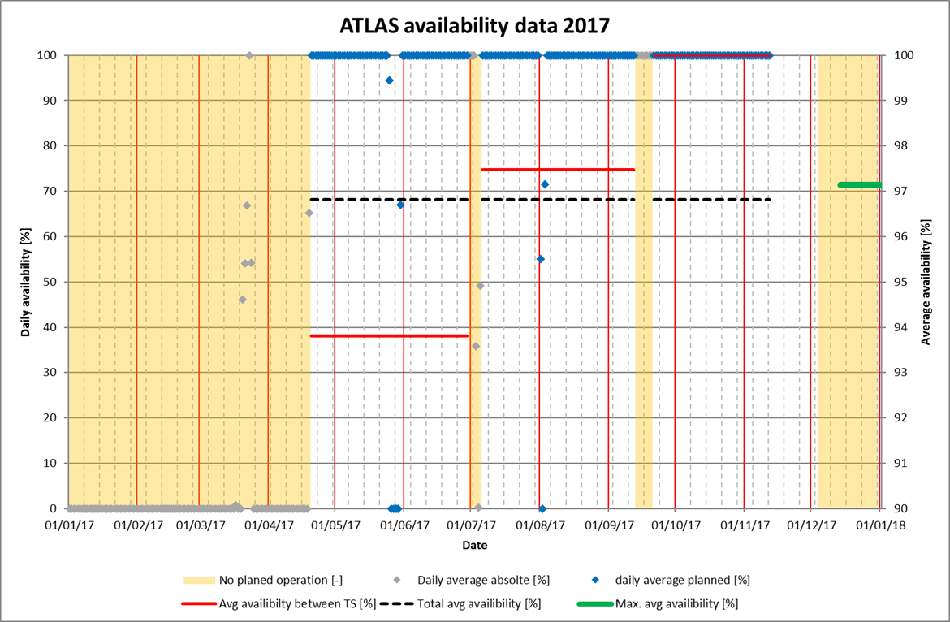
LHC Detectors (ATLAS He) Operation (2017)

Slide 38
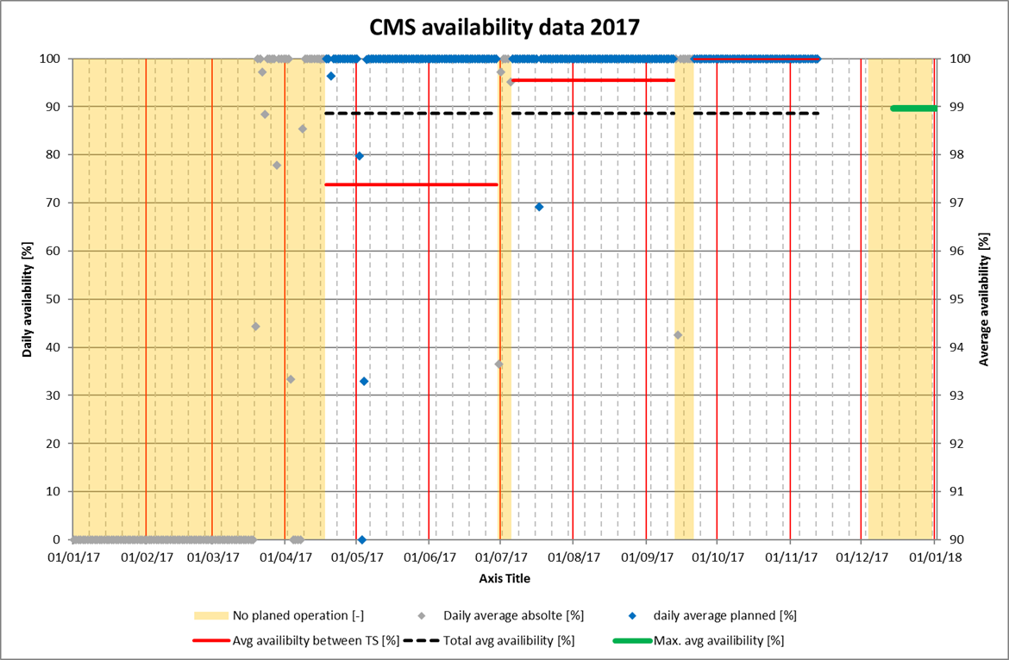
LHC Detectors (CMS) Operation (2017)

Slide 39
YETS 2017-18 Maintenance & Operation schedule

Slide 40
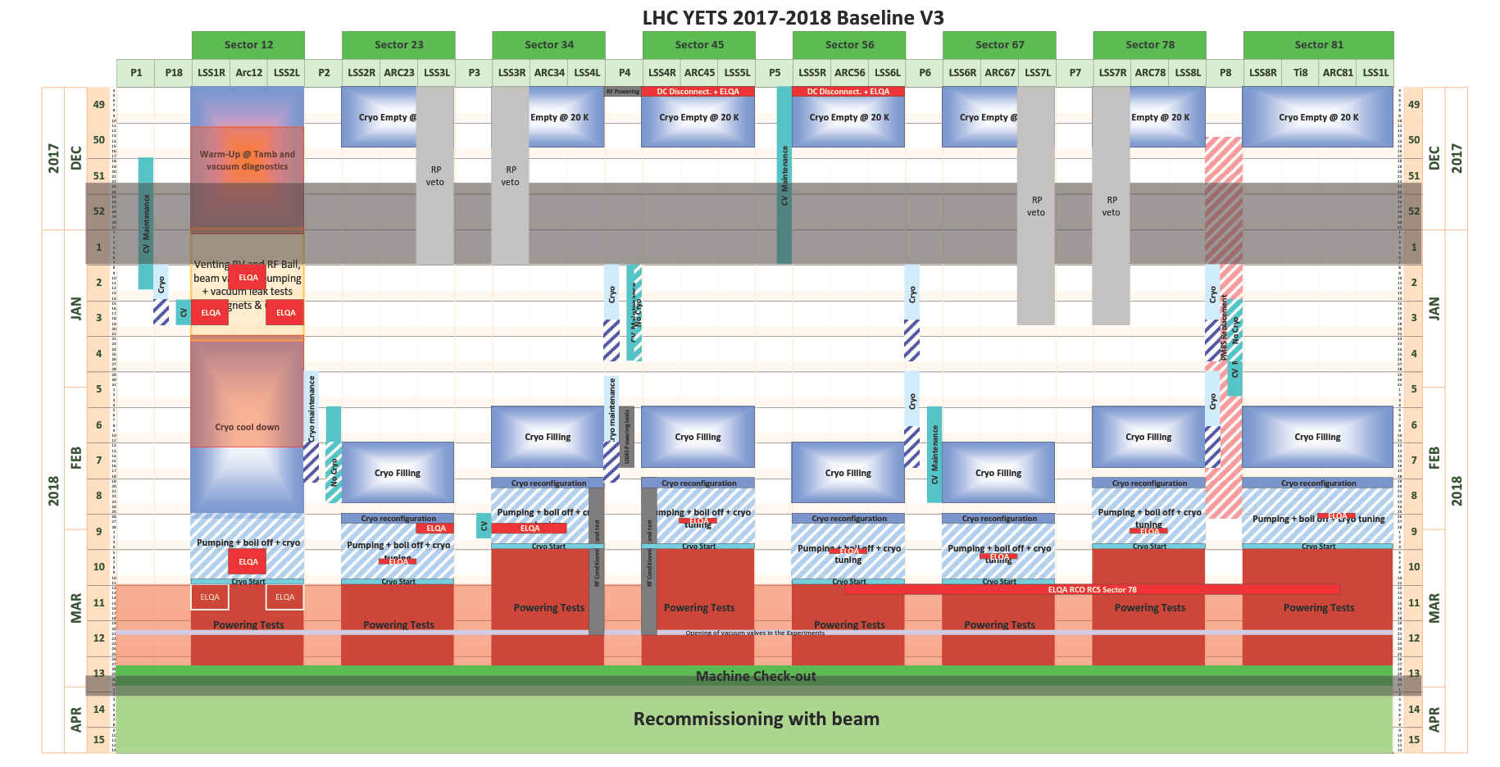
YETS 2017-18 Maintenance & Operation schedule

Slide 41
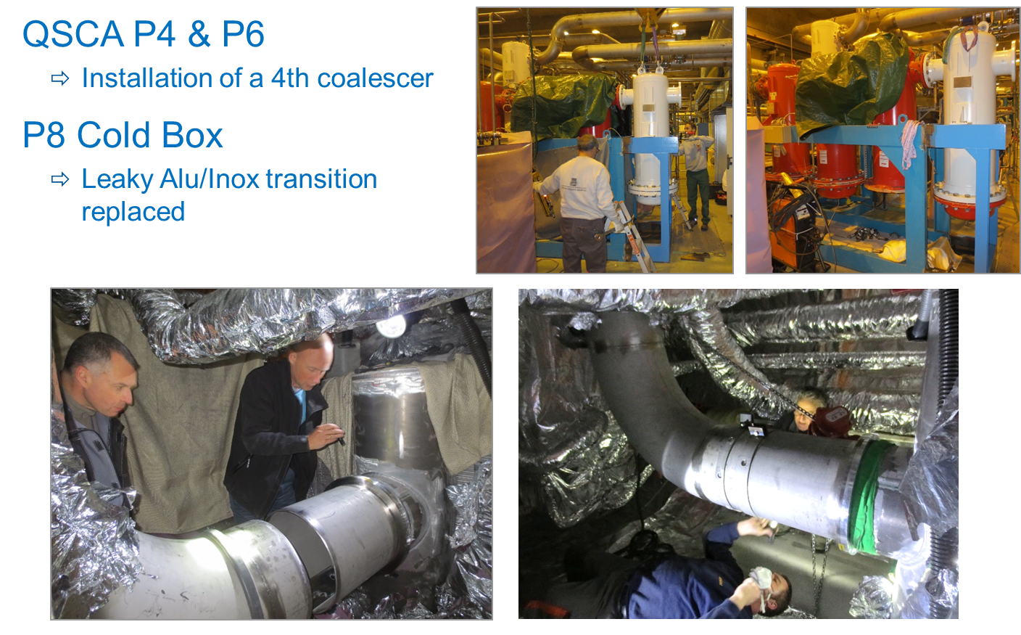
Maintenance (mechanics, operation); LHC accelerator

Slide 42
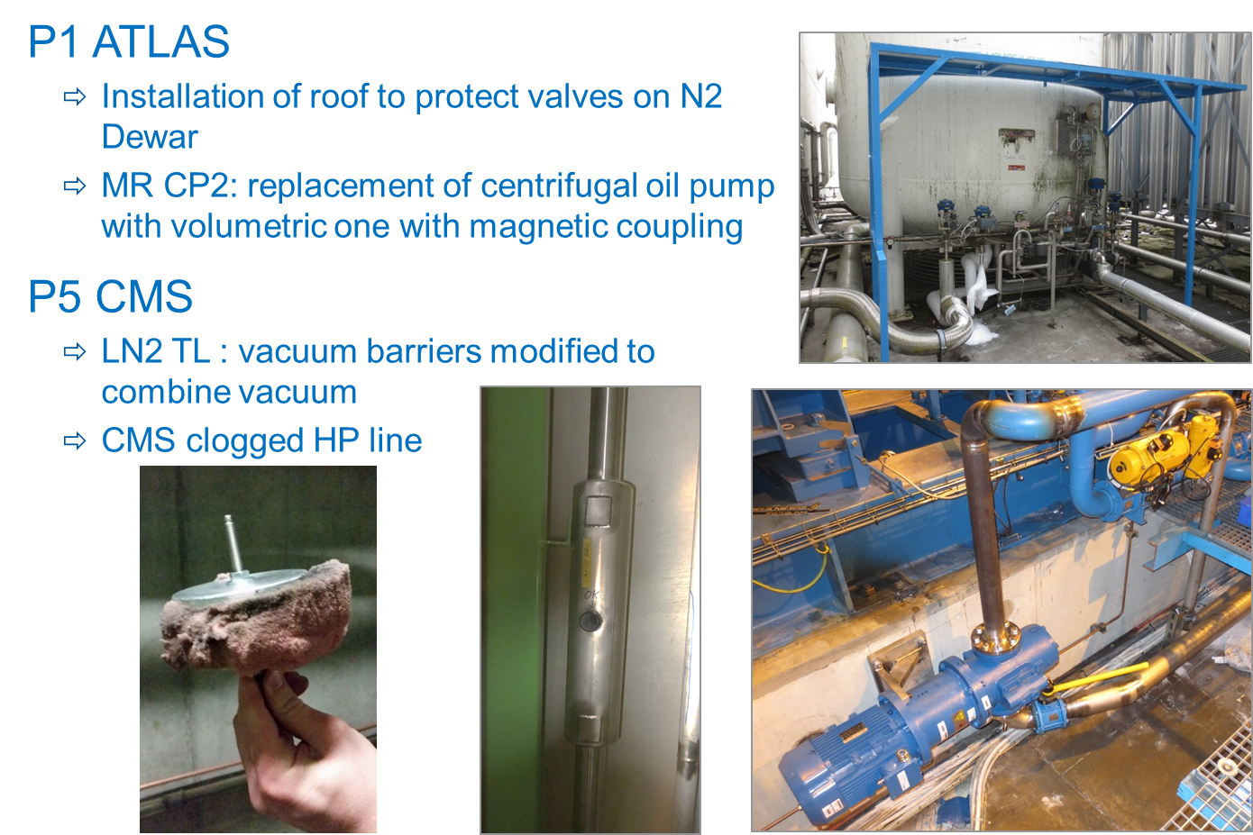
Maintenance (mechanics, operation); LHC detectors

Slide 43
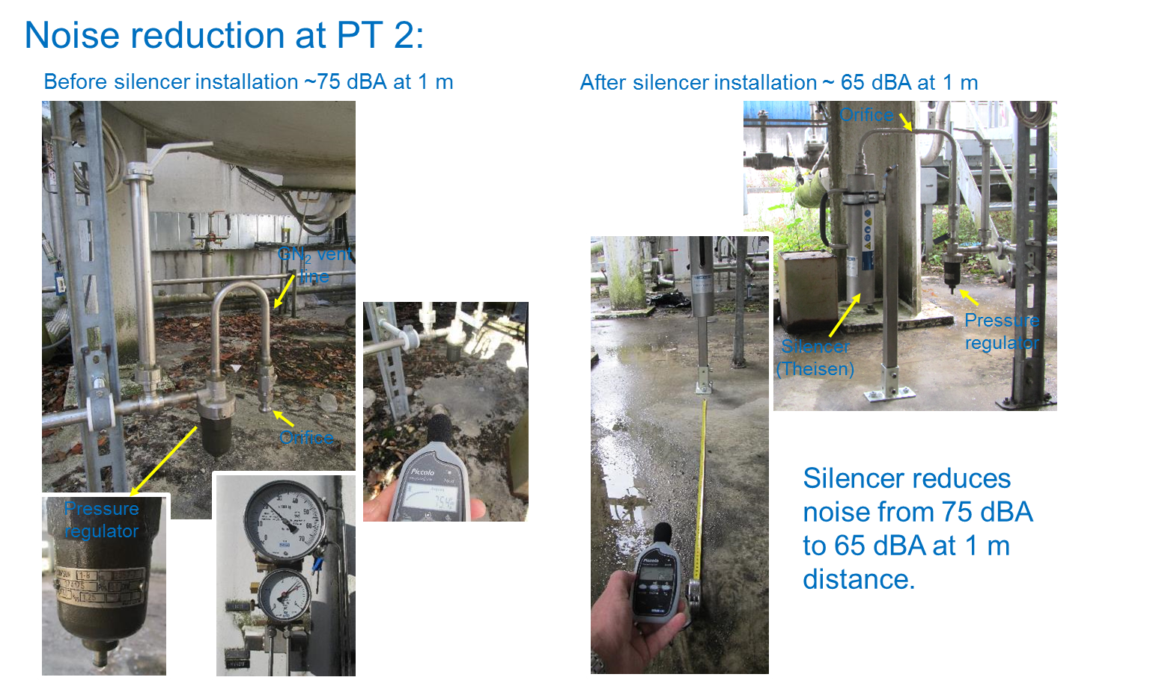
Mechanical support; LHC P2, liquid nitrogen dewars

Slide 44
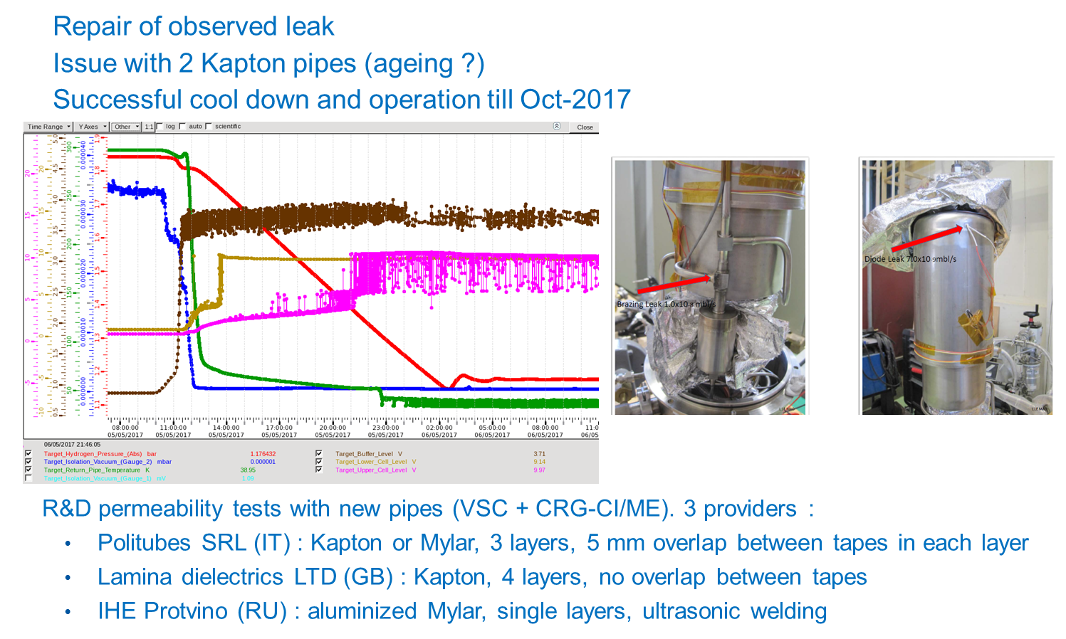
Mechanical support; Compass hydrogen target (NA)

Slide 45
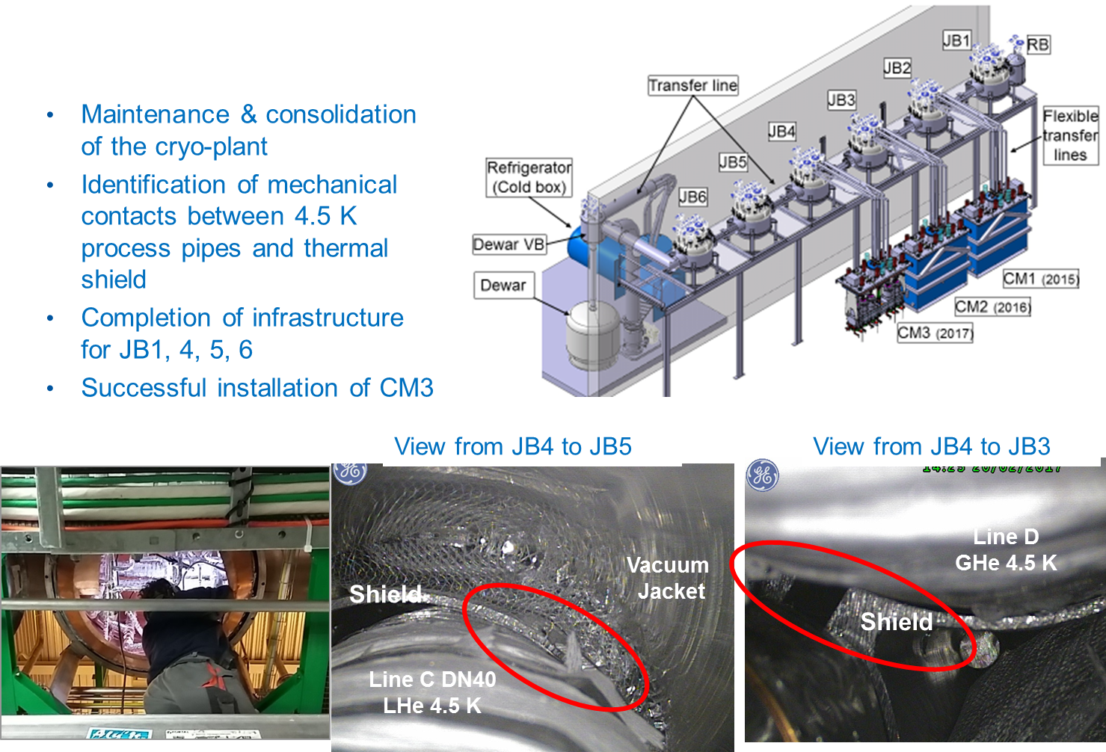
Mechanical support; HIE-Isolde Cryo-distribution

Slide 46
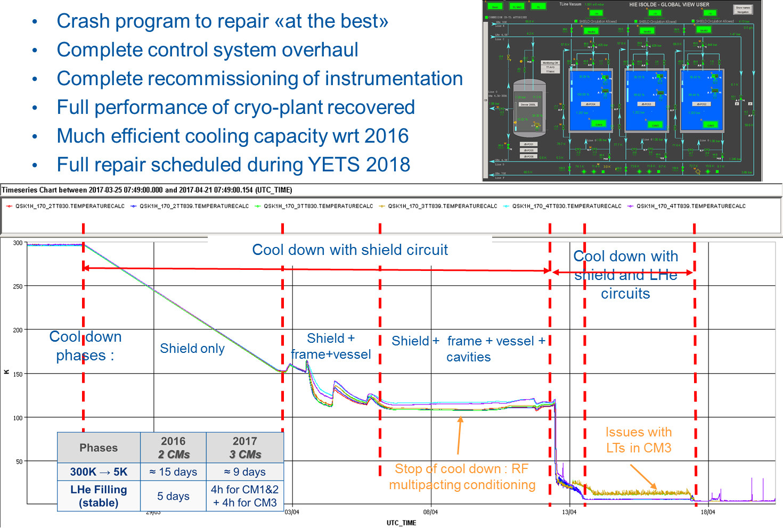
Mechanical support & operation; HIE-Isolde

Slide 47
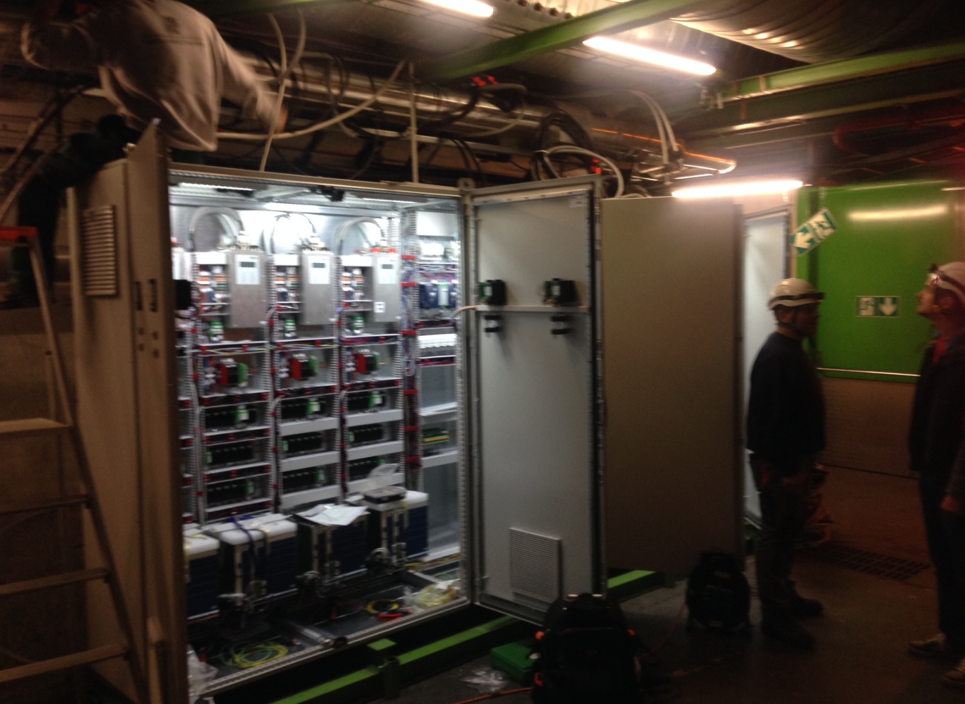
Maintenance (controls; electricity)
LHC P8 – QURCA (1.8 K units) electronics upgrade
QURCA installed with new VFD & AMB Mecos as P4 (QURCB ready but not installed)
New cables installed (CERN prepared); New 24 & 48 VDC redundant
New instrumentation (speed, relay etc.)
Updated Machine Protection for better diagnostic & operation
Updated CERN made internal control prototype in QURCA
SVC immunity re-established

Slide 48
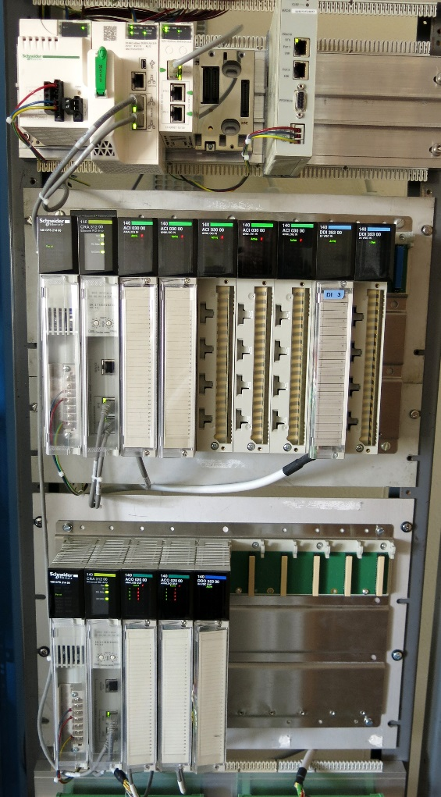
Maintenance (controls; electricity); ATLAS & CMS CP M580 upgrade
Full prototype validated and operating: ATLAS SR-CP & ANRS-CP
Hardware change
- new Power Supply
- obsolete Quantum CPU replaced by M580 CPU
- new Ethernet communication cards
- Quantum remote I/O interface cards and coax cable
upgraded to redundant Ethernet I/O
Software production
- automatic software production using Jenkins & tools
developed for LHC tunnel software production
- the newest UNICOS framework used
- updated dead-bands & archiving according protocol
Next upgrades:
- Prepare ATLAS MR CP-CB: deployment YETS 2017-2018
- Prepare CMS CP-CB: deployment 2018 YETS 2017-2018

Slide 49
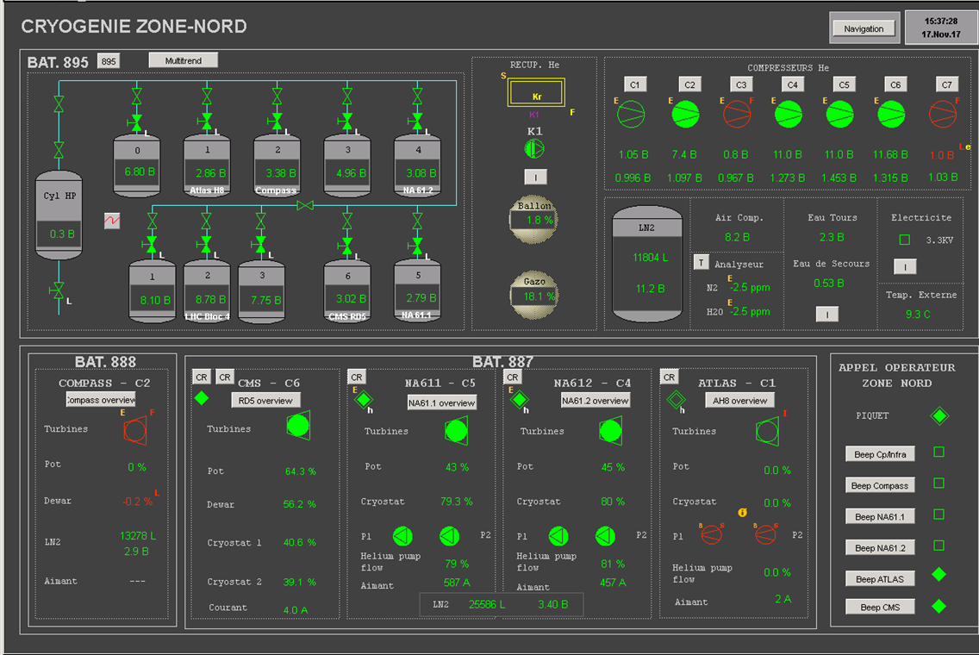
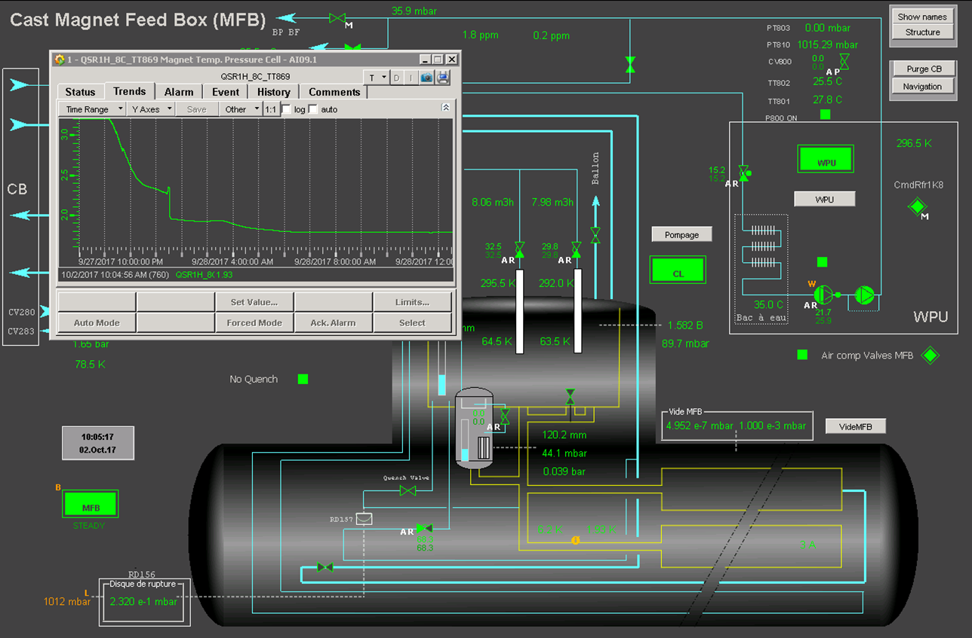
Maintenance (controls; electricity)
North Area & CAST cryoplants: transition to UNICOS control system completed
Upgrade ABB completed! More than 50 PLC replaced & migrated to UNICOS…In 10 years
SM18: CPC5 to CPC6 completed during the SM18 shutdown: cold box, RF M7&M9, Cluster G

Slide 50
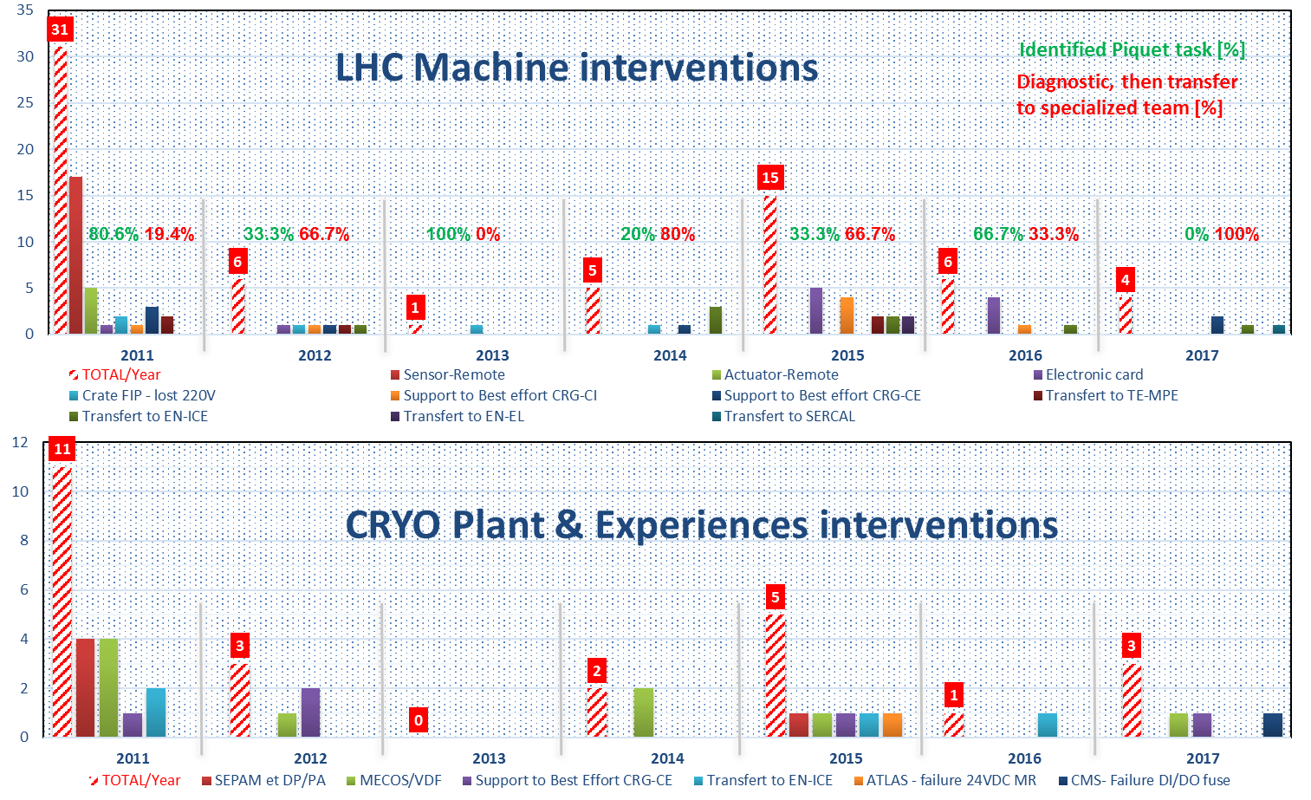
Maintenance (instrumentation, operation)

Slide 51
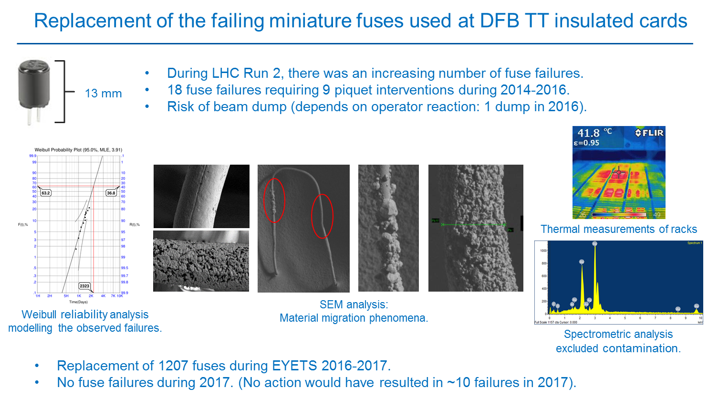
Maintenance (instrumentation)

Slide 52
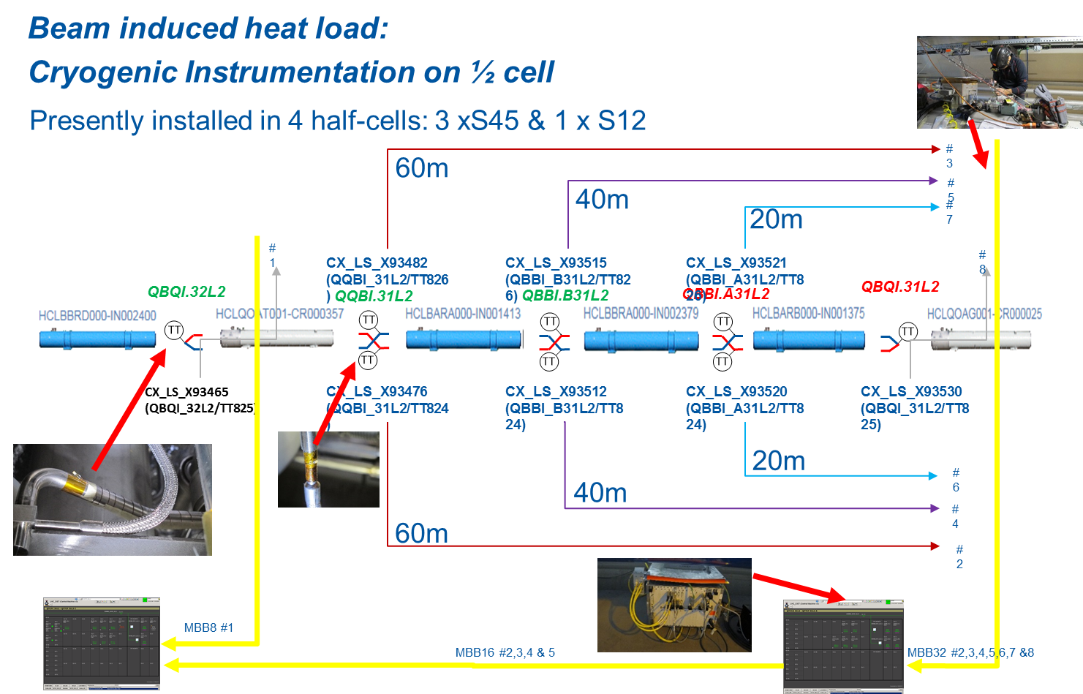
Maintenance (instrumentation, operation)

Slide 53
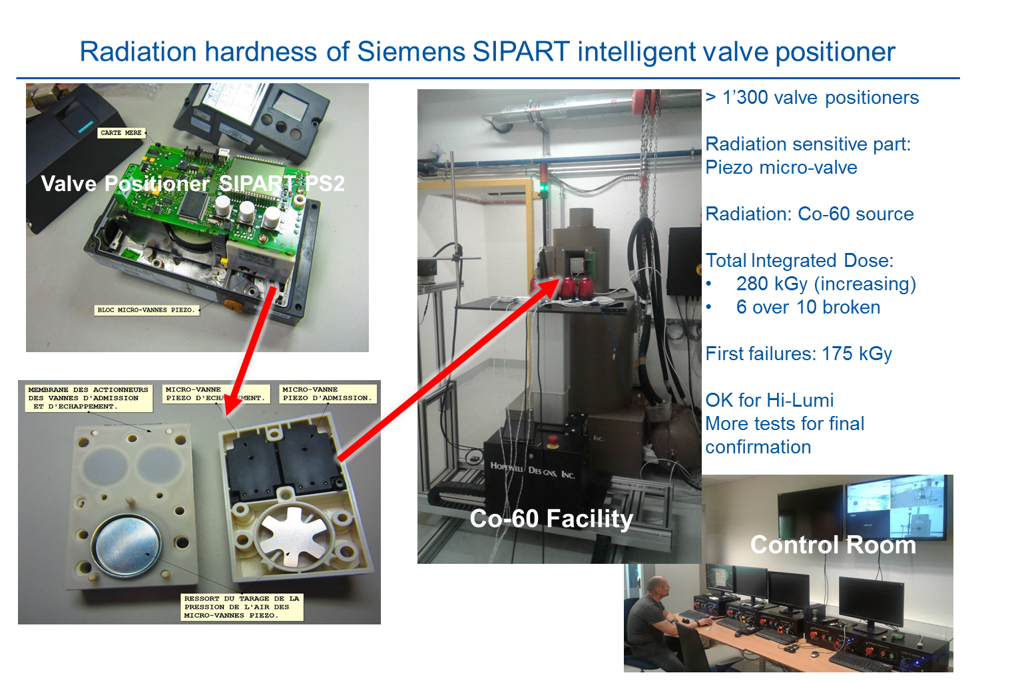
Maintenance (instrumentation)

Slide 54
Maintenance (Methods)
Methods Tools Evolution
CRG screens in INFOR EAM for Work orders, Positions, Assets, Parts have been simplified removing unnecessary fields and reorganized. Access rights have been adapted the users
The KIOSK has been installed in Building 915 for EASY ISSUE or RETURN of PARTS
The NEW Logbook developed by EN-ACE is ready for deployment. Based on INFOR-EAM for a better integration, it includes the majority of requests of the CRG operation teams
Methodological Evolution
Review of INFOR basic configuration to enable future developments of the CMMS
Taskforce for Mechanical maintenance Work Instructions and forms updates
    More than 200 documents reviewed
    Available S176 SharePoint & EDMS
    Taskforce for Mechanical maintenance Work Instructions and forms updates
CRG Working Groups from eYETS lessons learned
Safety working documents
Instrumentation templates
Planning and coordination

Slide 55
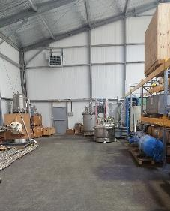
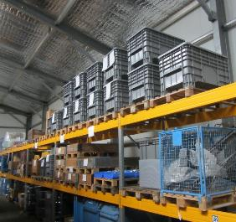
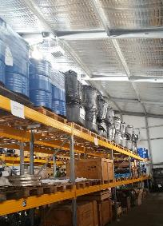
Maintenance, Methods & Logistics
Bldg. 686; Storage cleaning and tidying up
For 2018:
Tidying up completion at P4 and P6
Large equipment inventory & Equipment labelling
Store management in INFOR-EAM & Storage area optimization

Slide 56
Cryolab

Slide 57
Cryolab: 45 short and long term projects (consultancy – R&D) in 2017
AEgIS - Dilution refrigerator
AEgIS - SC shield Pb or Nb
BCCCA operation and upgrades
GM cryocooler heat exchanger
He II heat transport in Rutherford cables
n-TOF thermal shrink fitting Ti on Pb
RF- Cavity diagnostics
RF- TES
RF- CRAB support
Gas Permeability
Thermal conductivity test stand
FCC MLI test stand MSC
Beam Screen Hi-Lumi WP1
Beam Screen Hi-Lumi WP2
Cryo - Beam Loss Monitor
Cryo - Metrology reflector tests CRAB
RRR thin layers
RRR strips
RRR bulk samples
Diode Radiation test support
LHC magnets quench limit study
He II cooling simulation of Nb₃Sn magnets
Near Tc test stand Nb₃Sn strands
Traction machine 10 t upgrade
Traction machine 1 t for MLI
CAST Relics
Timepix 3
LAr thermal convection study
Magnetic permeability test stand
HFM cryostat - Lambda plate heat inleak
ARIA cooldown to 80 K
Helios cooldown and refill
FuSuMaTech
EASITrain
DarkSide
LKr Purity monitor NA62
LHC - Beam Screen vibration test
Laser Level Meter test
ITER cable in conduit thermal cycling
Thermal expansion test stand – Laser upgrade
EUCAS
Cryo Safety courses (Fundamentals, LHe, TSO, Fire brigade)
CTIF meeting CERN
Visits/Demonstrations Cryo LN₂
HSSIP
A Cryolab handbook on available technical means, personnel and skills resources for R&D and studies will be published early in 2018

Slide 58
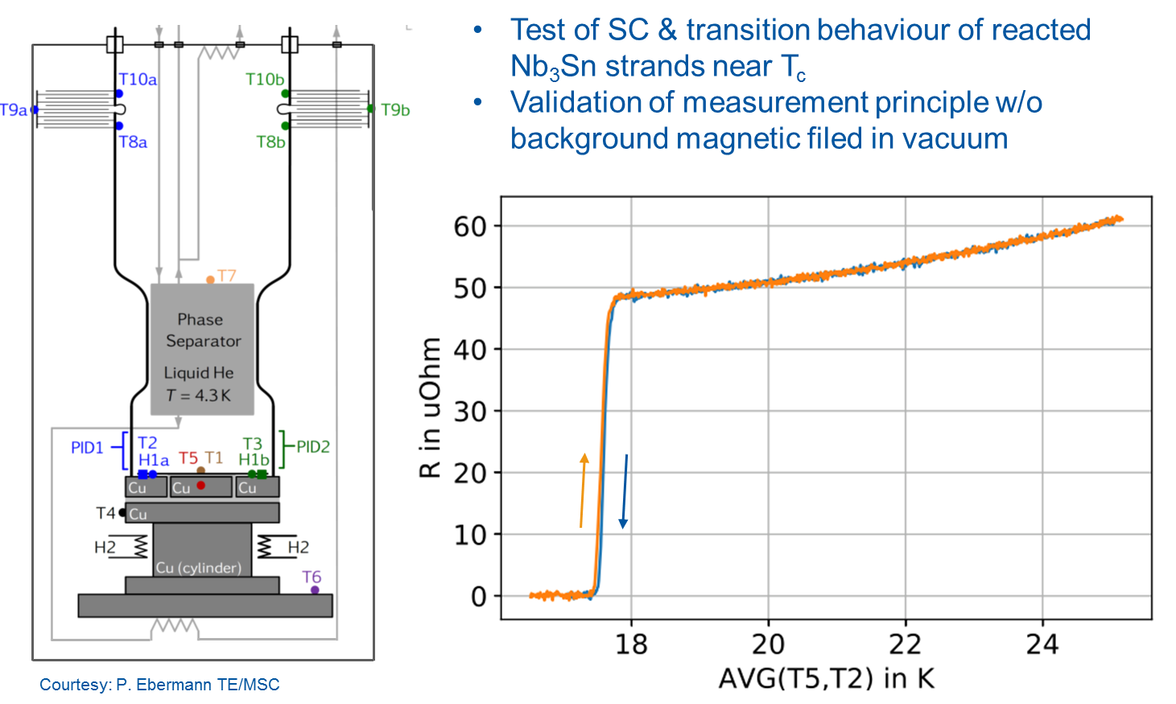
Cryolab: Near Tc characterisation of Nb₃Sn strands => TE/MSC

Slide 59
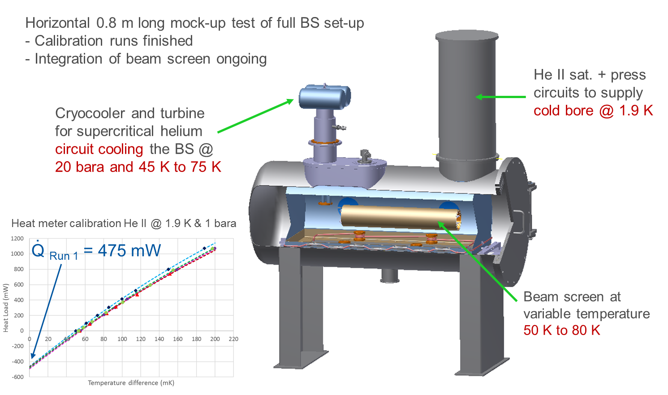
Cryolab: HL-LHC Beam Screen thermal performance tests => TE/VSC

Slide 60
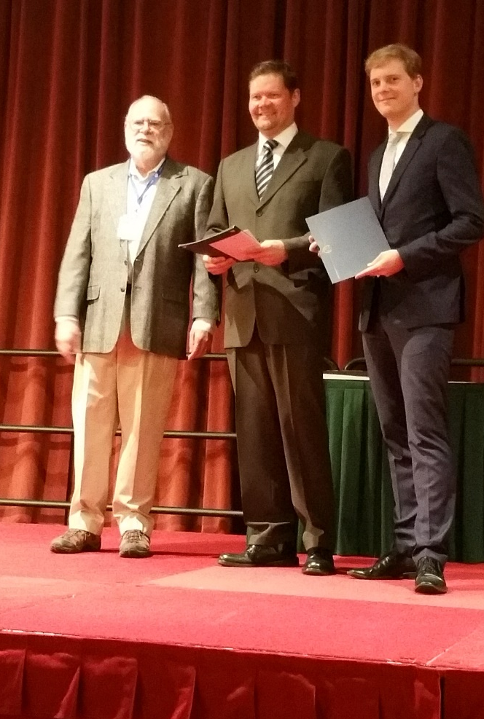
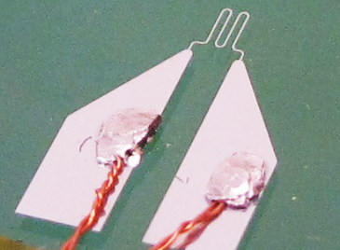


Cryolab: SRF Cavity diagnostics, Transition Edge Sensors => BE/RF
Second sound detection
$$T=1.6 K$$
$$I=0.9 mA$$
Heat flux: $1.40±0.07 W/m2$
Distance ~ $50 mm$
270 μV 2nd S. signal
50 μV p2p
noise
Heating power
The second sound signal is clearly identified and the velocity value measured!
T. Koettig et al. “TES sensors for cavity Quench localisation”
Best Research Paper Award from CEC 2015 => 2nd sound

Slide 61
Projects & Consolidations

Slide 62
Projects (CRG Master Schedule); 2017-2020
+ HE-LHC, FCC & ILC
on-going studies

Slide 63
Projects (CRG Master Schedule); 2017-2025
+ HE-LHC, FCC & ILC
on-going studies

Slide 64
Consolidations 2017-2020
Terminate what is approved today:
  Spares (compressors, motors, DFB’s)
  Controls (Unicos/PVSS)
Complement with more spares:
  (As a preparation towards aging issues and increased failure rates if it is not possible to study-implement a replacement)
Aging issues to be compensated within HiLumi operation context to be revisited (Capacity – Availability – Reliability):
  Capacity: 4.5K Refrigerator, 1.8K units, Cryogenic Distribution Line
  Availability: Sectorisation valves & temperature mixing chambers
  Reliability: Electrical cabinets, Motors, HP compressors P2/P8

Slide 65
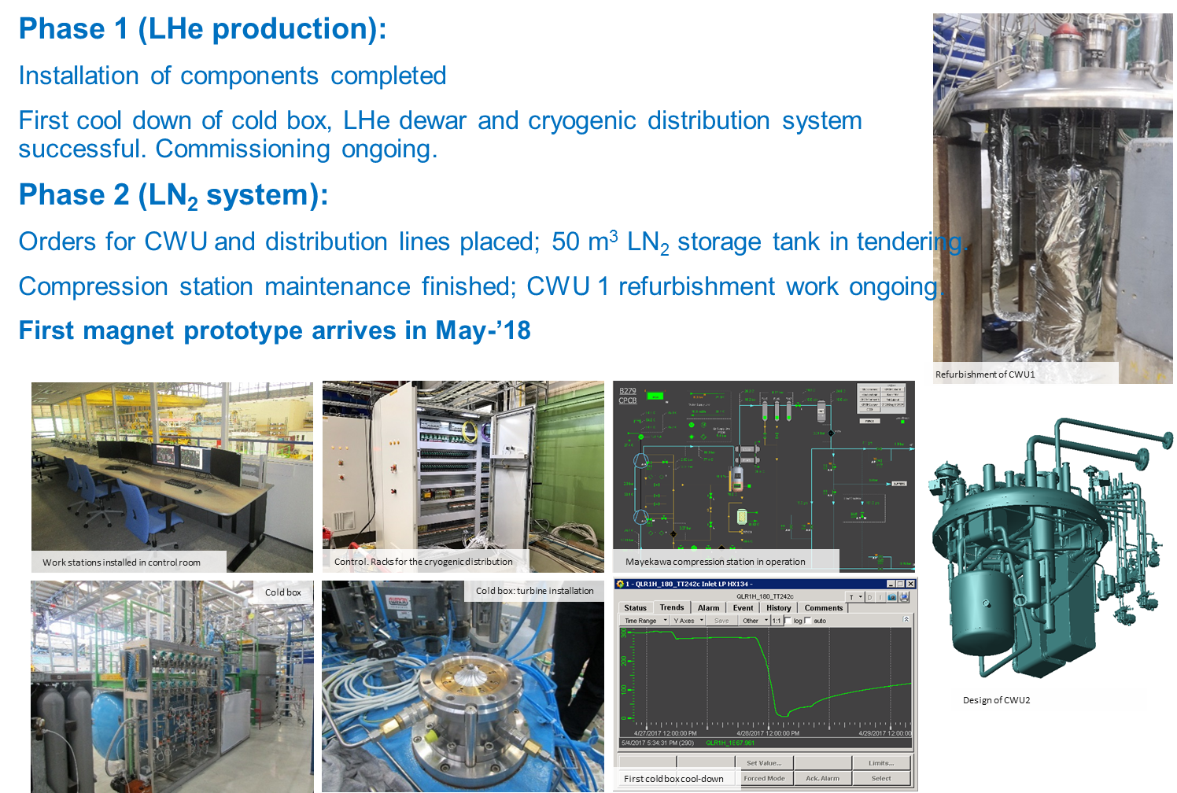
B.180; FAIR cryogenics

Slide 66
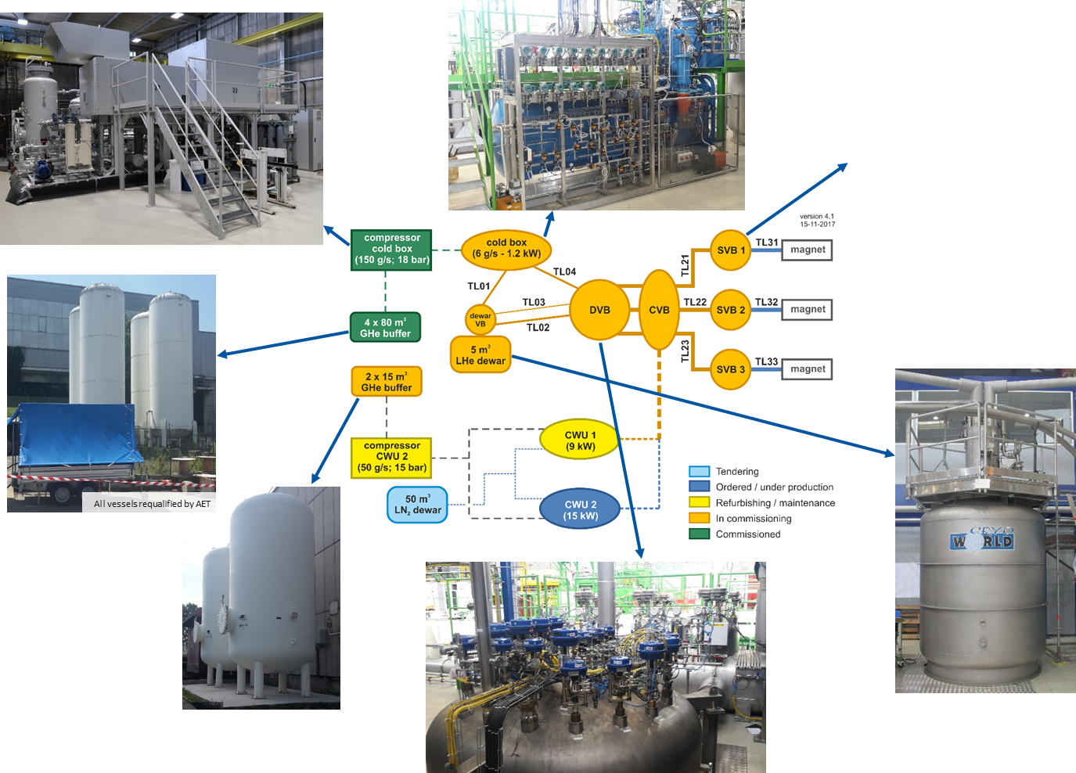
B.180; FAIR cryogenics

Slide 67
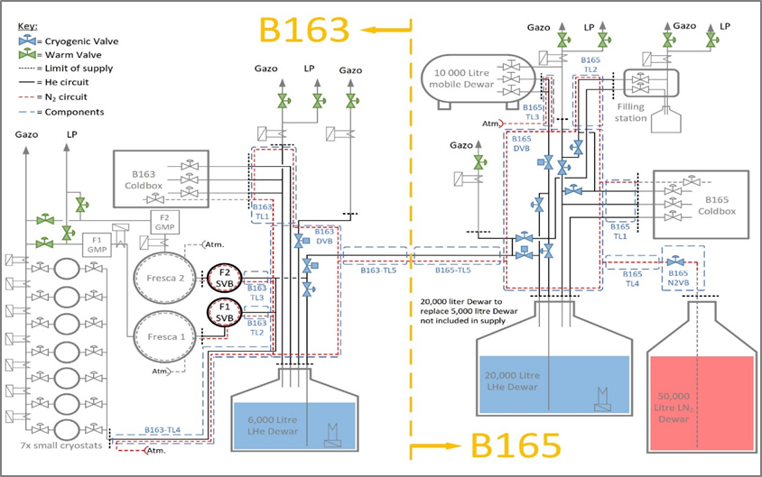
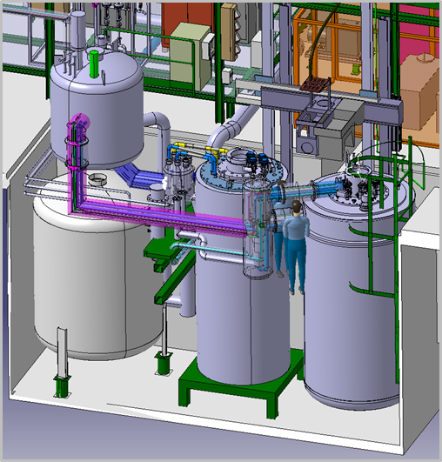
B.163 & B.165 cryogenics upgrade
Upgrade scheme for cryogenics retained by :
Combining the refrigeration capacity of the existing B.165 and B.163 cryogenic installations
Increasing the liquid helium buffering capacity (20’000 liters)
Implementing a new distribution valve box and transfer line under the B.163 & B.165 road
2017 revised cryogenics budget approved (1860kCHF)
  GHe storage:
  Jumbo cylinders (2nd DO underway)
  B163/B165:
  Layout & Integration studies well progressed
  Preliminary PID complete
  Final validation by MSC prior to IT

Slide 68
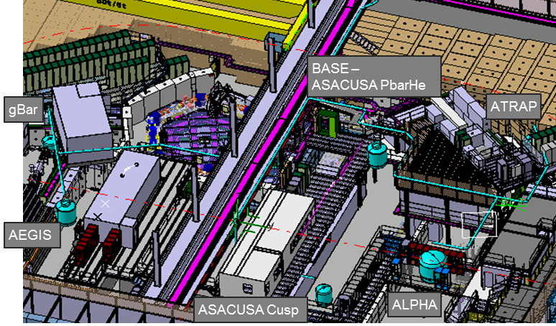
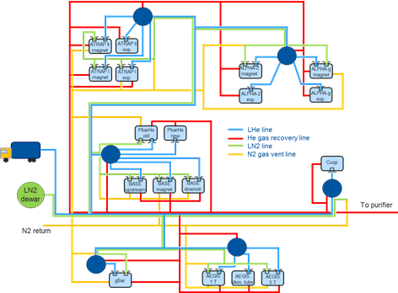
AD cryogenic distribution & infrastructure upgrade
User requirements and future needs collected from all the experiments
Layout study under discussion : identification of different options for mobile dewars delivery point and transfer line routing in the AD hall; Basic PFD produced
Technical option and preliminary budget drafted for a dedicated AD helium liquefier making use of the former Bloc-4 cold box

Slide 69
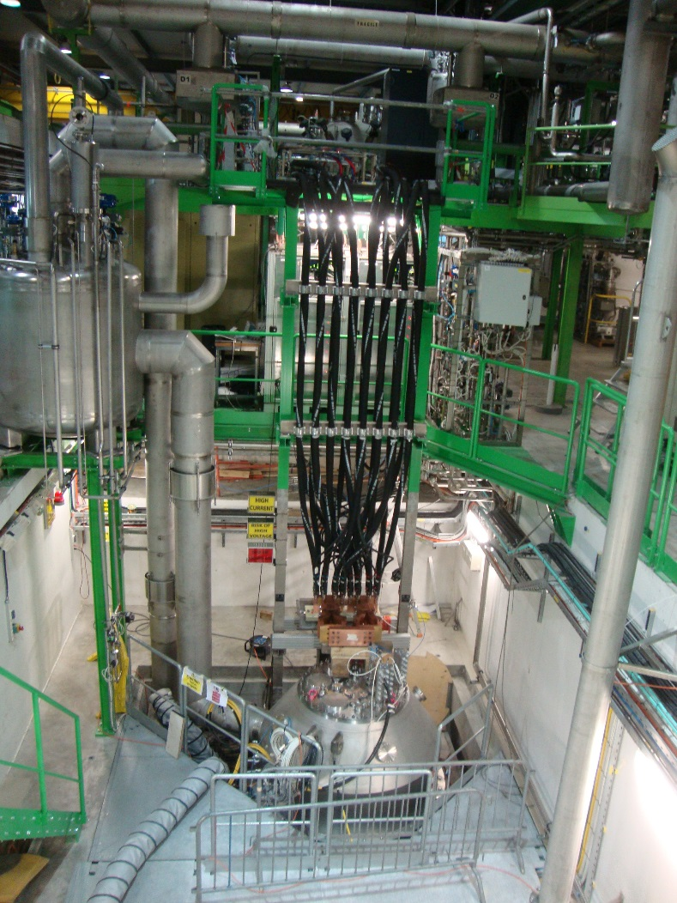
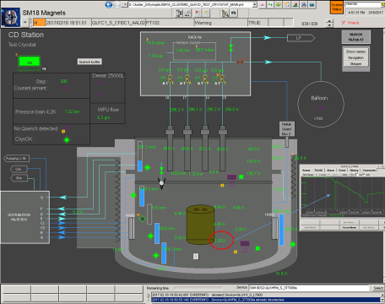
SM18 HFM & Cluster D status
Following the HFM switch to operation, completion & commissioning of Cluster D facility
Similar to HFM issue with heat in-leak at 1.9 K (λ-plate tightness); however the magnets tests program has been successfully tested; following consolidation (MSC/Cryolab for tests) the heat-in-leak losses have been significantly reduced

Slide 70
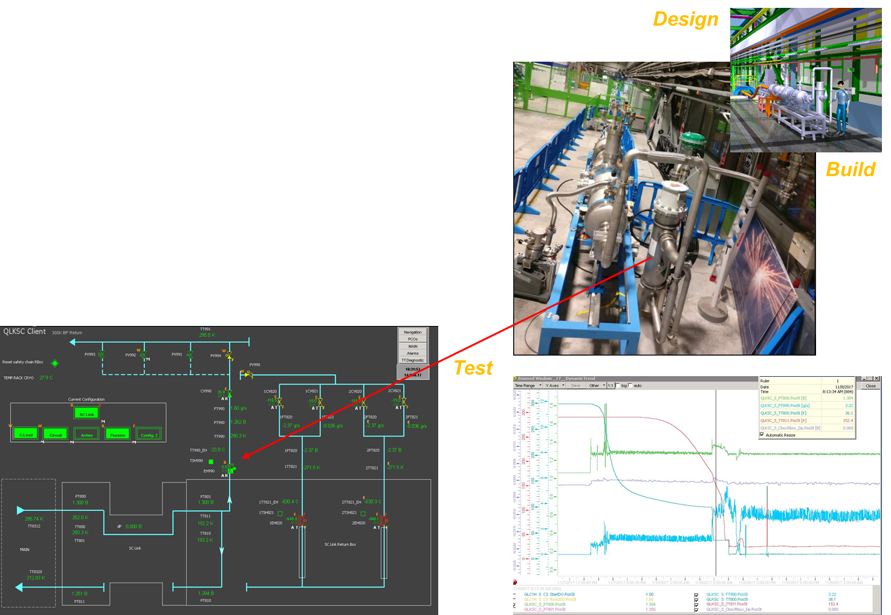
SM18 sc link test infrastructure
Integration of 60m SC Link test station completed in SM18 including warm return line
Process and control system updated; strong support to MSC colleagues
First cool down and 1st cryostat test (passive configuration) complete November 2017

Slide 71
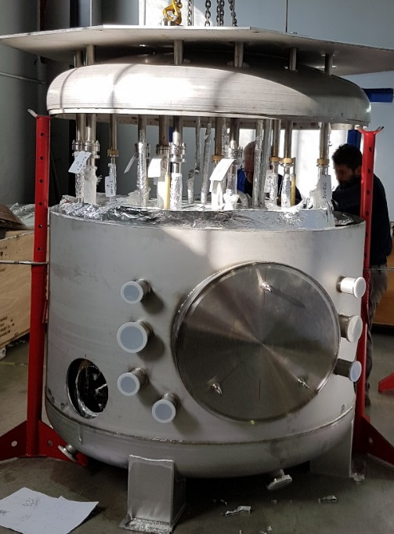





SM18 RF M7 cryogenic infrastructure status
Multifunction cryogenic valve box manufacturing severely delayed
In-house CERN plan B designed, manufacture and installed
Cryo-Module and Service Box connected to M7 infrastructure

Slide 72

SM18 upgrade; new 35 g/s helium liquefier status
Contract for the supply of a 35 g/s liquefier signed in July
Detailed definition and integration ongoing with the contractor
Rescheduled 2019 shutdown to 2 month duration
New concrete slab & reconfiguration of buffers & HP required by new schedule done during the shutdown

Slide 73
HL-LHC overall cryogenic layout
2 new cryogenic plants (18 kW @ 4.5 K) at P1 and P5 for high-luminosity insertions
1 new cryogenic plant (4 kW @ 4.5 K) at P4 for RF cryo-modules; (strong alternative study completed: upgrade of 1 existing LHC cryogenic plant)
1 new cryogenic plant (0.8 kW @ 4.5 K) as RF cold test facility with LHC beam type at SPS-BA6 (Crab-Cavities program)
HL-LHC cryogenics master schedule

Slide 74

HL-LHC SPS BA6 cryogenic infrastructure progress
80 m cryo distribution line installed during Feb-Mar 2017
From Cold-Box & Valve Box 1
To Valve Box 2 & RF Cryostat
7 contracts running with fabrication of Liquid Helium cryoplant, tanks, pipes, valve boxes to be installed this winter

Slide 75

HL-LHC SPS BA6 cryogenic infrastructure

Slide 76

HL-LHC SPS BA6 schedule
All required components expected on time (some already received)
Very challenging to have them all installed in January 2018 followed by the scheduled commissioning in February
Perspectives:
Cool-down Feb’18 and tests of cryo-module in March 2018
Following operation scenario and timing to be defined with BE_RF & BE-OP
Consolidation (if any) during LS2

Slide 77

HL-LHC P4 cryogenic upgrade proposed
77

Slide 78



HL-LHC P4 cryogenic upgrade proposed
Linde Upper & Lower cold boxes
1992
Reference for the upgrade: maximum cooling power (as now + 2kW@4.5K) based on 7 more efficient turbines (4-QSRA + 3-QURA) to be upgraded during LS2

Slide 79

HL-LHC P1 & P5 architecture

Slide 80

HL-LHC P1 & P5 cooling modes definition

Slide 81

HL-LHC P1 & P5 Evolution of the beam-screen heat loads from LHC to HL-LHC

Slide 82


HL-LHC on-going work on specific studies
Reﬁnement and application of a generic CFD toolkit covering the heat ﬂows in combined solid-liquid systems to investigate thermal quench limits of superconducting magnets
Start of “Experimental assessment on He II heat transport from Nb₃Sn coil segments in LHC cooling conditions for the HL-LHC upgrade: IT-quadrupoles (MQXF) and 11-T-dipole”

Slide 83

The Neutrino Platform
Reminder:
- WA 105 Dual Phase prototype; b. 182
- NP01: former ICARUS detector (600 m³ of liquid argon) to be installed at Fermilab as far detector of the short baseline
- NP03: the near detector of the short baseline neutrino program; Argon volume about 300 m³
- NP02: argon double phase prototype neutrino detector to be placed in the EHN1 extension; Argon volume about 550 m³.
- NP04: liquid argon prototype neutrino detector to be placed in the EHN1 extension; Argon volume about 600 m³
Design, manufacturing and installation of a cryogenic system for the WA 105 Dual Phase prototype,
  Mainly composed of:
    4 valves boxes
    Transfer lines
    1 liquid argon circulating pump
    Cold and warm purification process
Design, manufacturing and installation of four cryogenic systems for the Neutrino Platform proximity cryogenics,
  2 systems for CERN EHN1 (proto Dune detectors)
  2 systems for the Short Baseline Neutrino experiments located at Fermilab
  These 4 systems are mainly composed of:
      34 Valves boxes
      2 kms of transfer lines
      14 liquid circulating pumps (LN2 & Larg)
      1700t of liquid argon (only for CERN side)
      2t of copper pellets for the cold and warm purification process
Main goal
To achieve a liquid argon purity better than 100ppt O2 equivalent

Slide 84



The Neutrino Platform (WA105, B. 182 status)
WA 105 Dual Phase prototype
-End of installation the first quarter of 2017
-Start of commissioning the second quarter of 2017
-In operation since beginning of June 2017
-Main goal: To achieve a liquid argon purity better than 100 ppt O₂ equivalent; current value is 30-40 ppt

Slide 85


Slide 86


The Neutrino Platform (North Area status, NP02/NP04); cryogenic infrastructure
21 electrical cabinets/racks design, constructed, installed

Slide 87
Perspectives & Challenges

Slide 88
Perspectives & Challenges (1/3)
Maintain & update all existing safety files;
  Create the new ones according to the cryogenic installations coming in operation
LHC accelerator & detectors operation
  Maintain and improve the cryogenic availability
  Manage & secure the cryogen inventory (helium)
  Adapt the available cryogenic refrigeration capacity to the requirements
  Prepare the major YETS activities: S12 warming up; very tight schedule
  Cryolab
  2018 handbook publication on available technical means and personnel skills for R&D and studies CERN-wide thus valorizing the very high potential of the laboratory

Slide 89
Perspectives & Challenges (2/3)
Consolidate the good results of the S176/TE Maintenance & Operation contract
Non-LHC & test facilities operation
  SPS North Area: maintain the highest achievable cryogenic availability for the fixed targets physics users (consolidation program under evaluation for proposal)
  HIE-Isolde: maintain the availability for the present configuration, complete the cryogenic distribution consolidation and integrate the 4th cryo-module
  Maintain the high level of availability to the SM18 test facility
  Central liquefier area (B.165) and sc Wires & Cables facility (B.163): complete the launched and financed upgrade for the cryogenic refrigeration capacity and infrastructure
  AD complex: complete the study and launch the dedicated upgrade in order to consolidate the present and future requirements of the physics users

Slide 90
Perspectives & Challenges (3/3)
Challenging YETS activities, including the warming-up and cooling down of LHC S12 from room temperature
Pursue and complete on-time the LS2 preparation; first activities reviews demonstrates no-show-stoppers but analysis has to be deepened during 2018
In parallel with the cryogenic operation & maintenance activities CERN wide, provide the required strong CRG support to projects in particular for the on-going SM18 upgrade and HL-LHC activities; to that purpose optimise the organisation of the support sections
The updated structure of the CRG group, shall allow to significantly reinforce the projects oriented available resources and skills
The efficient & productive integration of the newcomers is an on-going challenge and considered as an objective of the highest priority

Slide 91
Safety, Respect
Furthering excellence at CERN through Integrity, Commitment, Professionalism, Creativity and Diversity
Rechercher l’excellence au CERN par l’intégrité, l’engagement, le professionnalisme, la créativité et la diversité

Slide 92
All my best wishes
to you and your family
for a healthy and happy
end of year period
Happy new year 2018

