Slide 1
Thermo-mechanical properties of Nb₃Sn coil and magnet materials
C. Scheuerlein, EuroCirCol preparation meeting, 24 January 2018

Slide 2
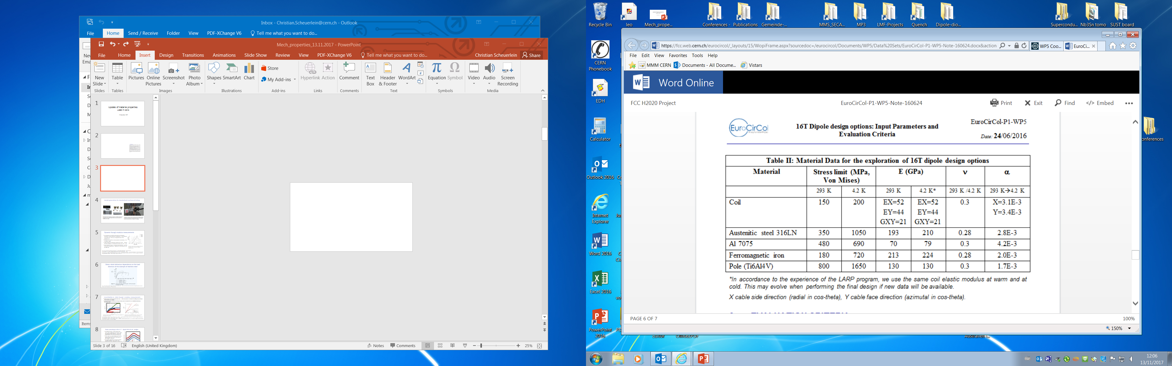

Slide 3
What are the mechanical materials properties required as input in the SC magnet FE models?
For which materials need the mechanical properties be known?
How is “stress limit” defined? How much plastic deformation is acceptable?
Can the 0.2% proof stress (R_{p0.2}) be exceeded? As an example at RT R_{p0.2} of Magnetil is about 120 MPa.
How are shear moduli taken into account in the FE models?
Is fatigue taken into account? If yes, how many load cycles need to be considered?
What are the principal stress directions (e.g. needed to take into account anisotropic materials properties)?
What is the meaning of the RT and 4.2 K conductor bock stress limits of 150 MPa and 200 MPa, respectively? How much plastic coil deformation is acceptable? (R_{p0.2} of fully annealed OFE Cu is at RT about 40 MPa)
For which materials pairs are the friction coefficients taken into account in the FE models?

Slide 4
Annealed Cu in the Nb₃Sn conductor block
The 0.2% proof stress (R_{p0.2}) of the annealed Cu in the Nb₃Sn conductor block is about 40 MPa.
The yield strength of annealed Cu is very difficult to measure, but it is probably roughly 10 MPa.
Stress-strain curve of fully annealed Cu wire (cold-drawn and after subsequent 695 °C HT) [ii].

Slide 5
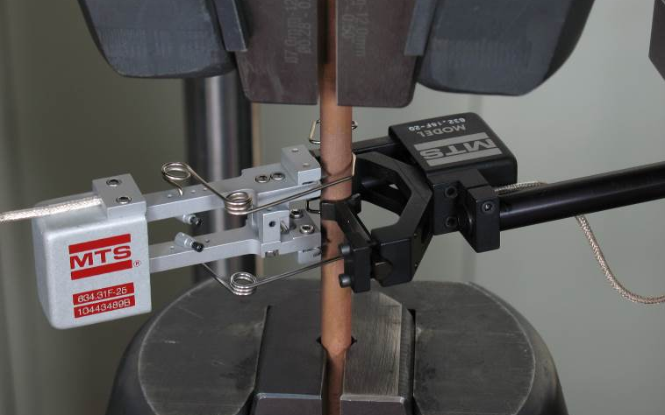
Young’s modulus (E), shear modulus (G), Poisson’s ratio (µ) relationship
Equation 1
For isotropic materials:
Equation 1 is confirmed for instance for the 11 T dipole Ti6Al4V pole wedges (E_{Ti6Al4V}=116 GPa, G_{Ti6Al4V}=44.1 GPa and µ_{Ti6Al4V}=0.32±0.03 are measured, and µ=0.32 is calculated from the measured E and G values).
The relationship is not valid for the strongly textured DISCUPC30/3 coil wedges (E_{DISCUP-L}=98.7 GPa, G_{DISCUP-L}=53.2 GPa and µ_{DISCUP}=0.43±0.02 are measured).
For DISCUP Equation 1 is not valid (it would give a negative µ value).
[i] C. Scheuerlein, F. Lackner, F. Savary, B. Rehmer, M. Finn, C. Meyer, “Thermomechanical behavior of the HL-LHC 11 Tesla Nb₃Sn magnet coil constituents during reaction heat treatment”, IEEE Trans. Appl. Supercond., 28(3), 2018, DOI 10.1109/TASC.2018.2792485

Slide 6
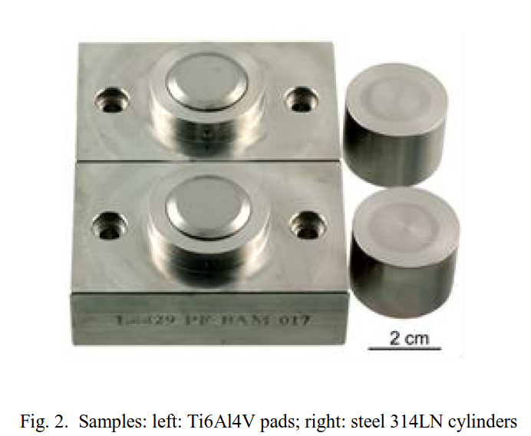
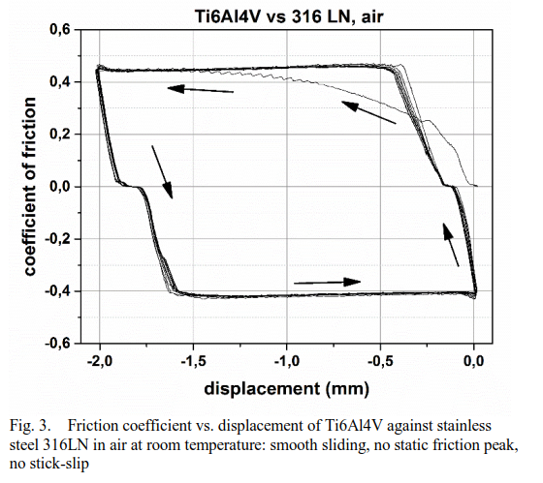
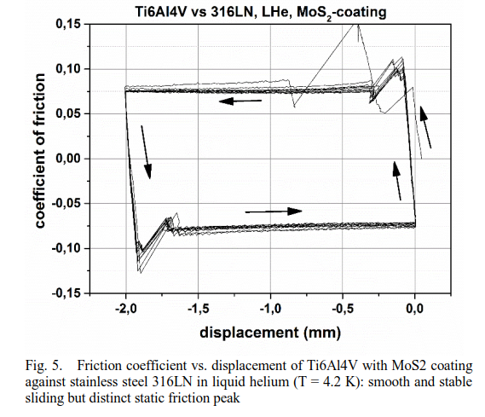
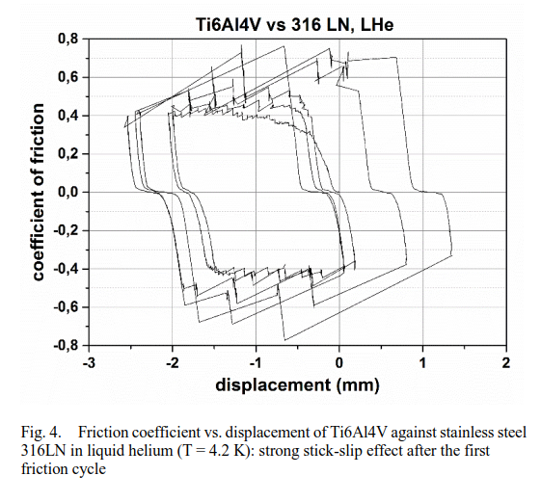
Friction coefficients
At RT in air at a pressure of 100 MPa Ti6Al4V shows smooth and stable sliding against 316LN with a friction coefficient of ~0.4.
At 4.2 K@100 MPa a strong stick-slip effect is observed, which could be one potential origin of magnet quenches.
Application of the solid lubricant MoS₂ lowers the 4.2 K friction coefficient to about 0.08.
In liquid He at 100 MPa Polyimide shows smooth and stable sliding against steel 316 LN with a friction coefficient of ~0.2.
T. Gradt, C. Scheuerlein, F. Lackner, F. Savary, “Friction-coefficient between the Ti6Al4V loading pole and the 316LN steel shims of the HL-LHC 11 T magnets”, IEEE Trans. Appl. Supercond., 28(3), 2018, 10.1109/TASC.2018.2792469

Slide 7
Temperature dependent expansion
Can be measured with a dilatometer using stress-free, homogeneous rectangular samples with typical dimensions 4 mm × 4 mm × 25 mm.
Nb₃Sn composite wires are not suited for dilation experiments, but the overall wire length change behaviour maybe described qualitatively.
Relative length change of DISCUP C30/3, Ti6Al4V, 316LN and Nb3Sn RRP type wire during (a) first heating and (b) cool down from 650 °C. The thermal expansions of Cu, Nb and Nb₃Sn bulk are shown for comparison.

Slide 8
Back-up slides

Slide 9
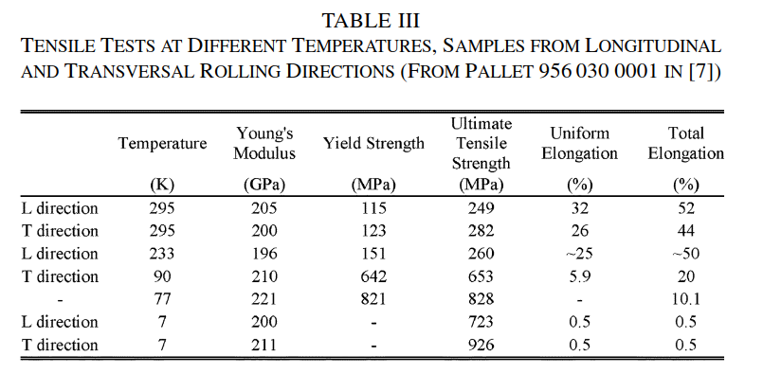
Magnetil mechanical properties
v
From: F. Bertinelli, S. Comel, P. Harlet, G. Peiro, A. Russo, A. Taquet, “Production of Low-Carbon Magnetic Steel for the LHC Superconducting Dipole and Quadrupole Magnets”, IEEE Trans. Appl. Supercond. vol. 16, no. 2, 2006, pp 1777-1781

Slide 10
Summary of some 11 T dipole elastic and plastic RT materials properties
Material | R_{p0.2} (MPa) | R_{m} (MPa) | A (%) | Z (%) | Young’s modulus dynamic (GPa) |  | Young’s modulus static (GPa)
 |  |  |  |  | Resonance | Impulse | Tensile | Compr.
316LN_L | 351±12 | 674±2 | 54±5 | 63±2 | 191±0.3 | 191±0.3 | 183±7 | n.m.
316LN_T | 324±4 | 658±1 | 53±5 | 63±1 | n.m. | n.m. | 203±15 | n.m.
Magnetil_L | 117±3 | 241±1 | n.m. | 73±3 | 196±0.8 | 196±0.3 | 208±19 | n.m.
Magnetil_T | 124±2 | 267±1 | 47±2 | 71±4 | 219±0.1 | 218±0.3 | 213±3 | n.m.
YUS-130_L | 401 | 793 | 71 | 66 | 196±0.9 | 196±0.3 | 196 | n.m.
YUS-130_T | 415 | 749 | 51 | 66 | 193±1.1 | 192±0.3 | 189 | n.m.
Ti-6Al-4V_L | 868±5 | 930±12 | 17±1 | 28±2 | 115 | 114 | 115±1 | 120±2
Ti-6Al-4V_T | n.m. | n.m. | n.m. | n.m. | n.m. | n.m. | n.m. | 116±2
DISCUP no-HT_L | 332±2 | 387±1 | 22±2 | 43±4 | 92.9±0.2 | 93.8±0.3 | 87±1 | 89±1
DISCUP no-HT_T | n.m. | n.m. | n.m. | n.m. | n.m. | n.m. | n.m. | 96±2
DISCUP HT_L | 284±1 | 376±1 | 26±1 | 48±1 | 96.7 | 96.3 | 91±1 | 87±2
[ii] C. Scheuerlein, F. Lackner, F. Savary, B. Rehmer, M. Finn, P. Uhlemann, “Mechanical properties of the HL-LHC 11 Tesla Nb₃Sn magnet constituent materials”, IEEE Trans. Appl. Supercond., 27(4), (2017), 4003007

Slide 11
Magnetil
Magnetil stress strain curves in longitudinal direction at RT.
Courtesy B. Rehmer, Federal Laboratory for Materials Research and Testing (BAM).

Slide 12
Summary elastic properties of Ti6Al4V pole wedge
[i] Ti6Al4V at RT:
E=116 GPa G=44.1 GPa µ=0.32±0.03
[ii] Ti6Al4V at RT:
E=113.8 GPa G=44.0 GPa µ=0.342.
[i] Ti6Al4V at 4.2 K*:
E=130 GPa G=50 GPa µ=0.34
*4.2 K values are extrapolated from temperature dependent measurements in the range 20 °C-700 °C [i].
Ti6Al4V exhibits linear elastic behaviour up to about 800 MPa (at RT), and mechanical properties are not strongly anisotropic.
[i] C. Scheuerlein, F. Lackner, F. Savary, B. Rehmer, M. Finn, C. Meyer, “Thermomechanical behavior of the HL-LHC 11 Tesla Nb3Sn magnet coil constituents during reaction heat treatment”, IEEE Trans. Appl. Supercond., 28(3), 2018, DOI 10.1109/TASC.2018.2792485
[ii] http://www.matweb.com/search/DataSheet.aspx?MatGUID=a0655d261898456b958e5f825ae85390

Slide 13
Summary mechanical properties of DISCUP C30/3 coil wedge
[i] DISCUP C30/3 at RT in longitudinal direction:
E=92 GPa G=54 GPa µ=0.43±0.02
[i] DISCUP C30/3 at 4.2 K in longitudinal direction*:
E=113 GPa G=62 GPa µ=???
*4.2 K values are extrapolated from temperature dependent measurements in the range 20 °C-700 °C [i].
Strong elastic anisotropy, maximum E at an angle of about 50° with respect to wedge extrusion direction.
[i] DOI 10.1109/TASC.2018.2792485

Slide 14
Elastic anisotropy in the 11 T dipole DISCUP coil wedges
In order to take into account anisotropic materials properties the principal stress directions need to be known.
The angular dependence of the DISCUP Young’s modulus has been calculated from texture data obtained by neutron diffraction and from Cu single crystal elastic constants.
The DISCUP wedges are strongly textured (multiples of random orientation MRD=16), which causes a strong elastic anisotropy of about 30%.
The DISCUP Young’s moduli derived from stress-strain compression tests are 89 GPa in the wedge extrusion direction and 96 GPa perpendicular to the extrusion direction [i].
These values are substantially lower than the values between 115 to 130 GPa found in literature for ODS Copper.
Voigt
Hill
Angular DISCUP Young’s modulus dependence with respect to the wedge extrusion direction. Calculated assuming equal strains (Voigt) and equal stresses (Reuss) in all grains, respectively. Measurement results from [i] are shown for comparison. Courtesy of W. Gan, Helmholtz-Zentrum Geesthacht.

