Slide 1
DAQ in practice… during summer 2017 beam tests
E. Noah
8 December 2017

Slide 2
T9 control room
T9 beam area
USB3 hub
Scripting C#
AFE
Host appli. V1.0.0.476
FEBv2
Firmware v5.3-268
Scripting C#
AFE
Host appli. V1.0.0.476
FEBv2
Firmware v5.3-268
FEBv2
Firmware v5.3-268
Scripting C#
AFE
Host appli. V1.0.0.476
FEBv2
Firmware v5.3-268
PC
FEBv2
Firmware v5.3-268
Scripting C#
AFE
Host appli. V1.0.0.476
FEBv2
Firmware v5.3-268
x6
FEBv2
Firmware v5.3-268
Remote desktop connection
PC
Win.7
FEBv2
Firmware v5.3-268
x6
x6
x6
Clock fanout board
USB3 hub
PC
Scripting C#
AFE
Host appli. V1.0.0.476
FEBv2
Firmware v5.3-268
Scripting C#
AFE
Host appli. V1.0.0.476
FEBv2
Firmware v5.3-268
Remote desktop connection
FEBv2
Firmware v5.3-268
Scripting C#
AFE
Host appli. V1.0.0.476
FEBv2
Firmware v5.3-268
FEBv2
Firmware v5.3-268
Scripting C#
AFE
Host appli. V1.0.0.476
FEBv2
Firmware v5.3-268
x6
FEBv2
Firmware v5.3-268
PC
Win.7
FEBv2
Firmware v5.3-268
x6
x6
x6
PC
Clock fanout board
Scripting C#
AFE
Host appli. V1.0.0.476
FEBv2
Firmware v5.3-268
Remote desktop connection
Clock fanout board
x1
Socket server
PC
Win.7

Slide 3
Signal paths from SiPM affecting signal levels (assume L1Hold does not…)
FEB
HV DAC
CITIROC
LG
31
MUX
FPGA
Pre-amp
LG
SiPM
Cable bundle
SSH
Peak det.
ADC
0
HG
31
MUX
Pre-amp
Peak det.
HG
SSH
ADC
0
31
31
FSH
Disc.
0
0
31
OR32
0
Disc.
Mask

Slide 4
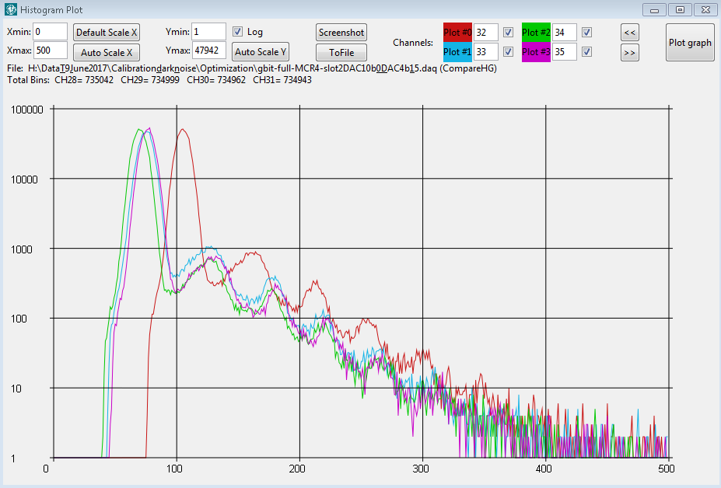
Gain and baseline changes
Gain change
Baseline change

Slide 5
Some parameters that are set
component | Parameter | Controllable? | Controllable per ch? | Gain | Baseline shift
SiPM | Device Operating V (f(T)) | No | No | - | -
Cable bundle |  |  |  | ? | ?
CITIROC | HV input DAC | Yes | Yes | Yes | ??
CITIROC | Pre-amp HG | Yes | Yes | Yes | ??
CITIROC | Shaper time constant | Yes | No | Yes? (TBM) | ??
Threshold
CITIROC | DiscriDAC10b | Yes | No | ?? | ??
CITIROC | DiscriDAC10b_t | Yes | no | ?? | ??
CITIROC | DiscriDAC4b_Trigger | Yes | Yes | ?? | ??
CITIROC | DiscriDAC4b_Trigger_t | Yes | Yes | ?? | ??
FPGA/ADC | Sampling point | Yes | No | ? | ?

Slide 6
Stages possibly affecting I/V levels for signals from SiPM to FPGA
 |  | Input stage |  |  | Output stage
Component | Parameter | Control? | Gain | Baseline shift | Control? | Gain | Baseline shift
SiPM | Operating V (f(T)) |  |  |  | No | - | -
Cable bundle | ?? | No | ?? | ?? |  | ?? | ?
CITIROC | Pre-amp | No | ?? | ?? | No | ?? | ??
Analogue data path
CITIROC | Slow Shaper (HG) | No | ?? | ?? | No | ?? | ??
CITIROC | Peak Detector (HG) | No | ?? | ?? | No | ?? | ??
CITIROC | Multiplexer (HG) | No | ?? | ?? | No | ?? | ??
ADC | ADC | No | ?? | ?? | no | ?? | ??
FPGA | - | No | ?? | ?? | No | ?? | ??
Trigger/Digital path |  | No | ?? | ?? | No | ?? | ??
CITIROC | Fast Shaper | No | ?? | ?? | No | ?? | ??
CITIROC | Discriminator_t | No | ?? | ?? | No | ?? | ??
CITIROC | Discriminator | No | ?? | ?? | No | ?? | ??
CITIROC | OR32 | No | ?? | ?? | No | ?? | ??

Slide 7
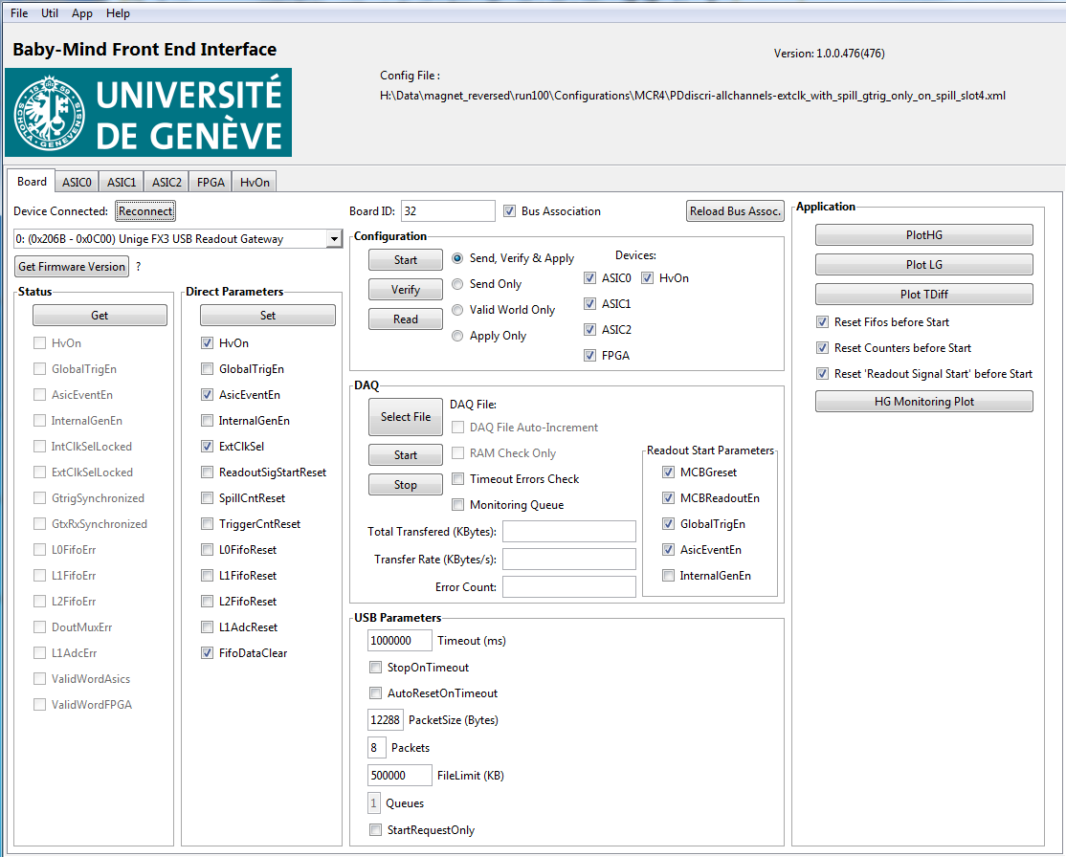
Host application run from Windows 7

Slide 8
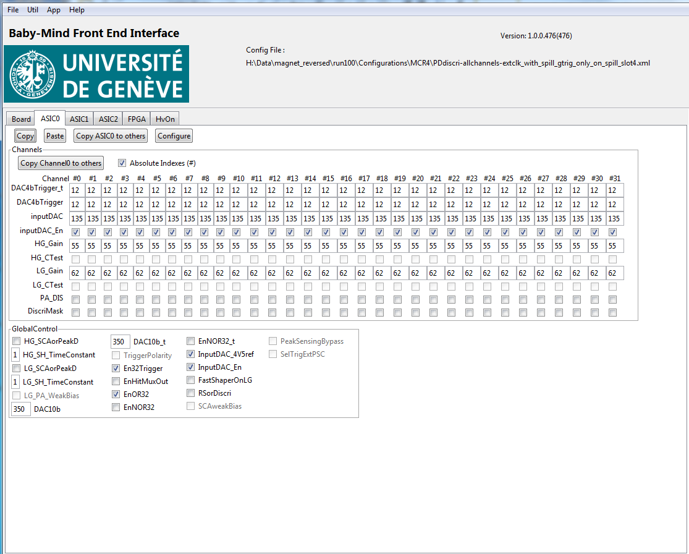
Host appli ASIC settings
Per Channel
Per ASIC

Slide 9
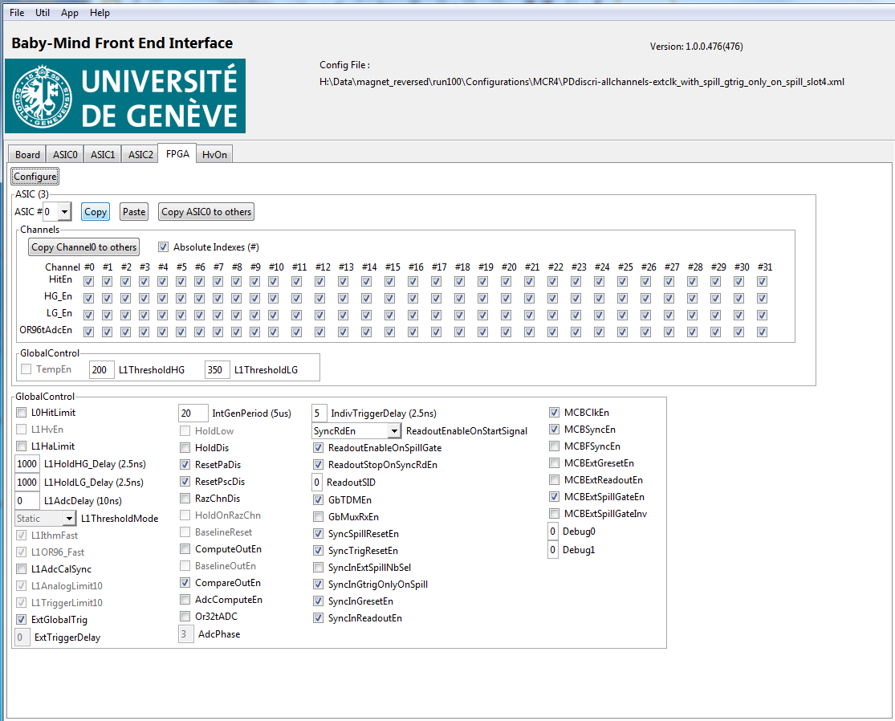
Host appli FPGA settings
Changed in script: HG=200, LG=20
L1Hold was 2.5 μs
Should be 9-10 μs at T2K
Per ASIC
Per Channel
All ASICs
L1Hold start:
Mostly from OR32 x3 during beam test
A few runs from OR96

Slide 10
How the settings were chosen (without the benefit of hindsight!)
Many issues with unpacking of data during beam tests:
with untested unpacking software and
without adequate diagnostic tools
Settings for discriminator DAQ and FPGA thresholds where chosen based on balancing:
  Reduction in readout errors experienced during tests (function of data acquisition rate)
  Efficiency in collecting “beam” data (as opposed to dark counts)
 | Run1000 (similar to all runs taken) | Run1100 (special run) | Run1200 (special run)
Or32tADC | False (OR32 x3) | True (OR96) | True (OR96)
HG_SH_TimeConstant (12.5 ns steps) | 1 | 4 | 1
LG_SH_TimeConstant (12.5 ns steps) | 1 | 4 | 1
L1_HoldHG_Delay (2.5 ns) | 1000 | 3000 | 1000
L1_HoldLG_Delay (2.5 ns) | 1000 | 3000 | 1000

Slide 11
Few notes for DAQ at J-PARC

Slide 12
DAQ hardware implementation proposal
Baby MIND control PC
Socket server
NA building
Ethernet
Data
Server
Configuration
Server
Neutrino monitor building
Ethernet network
PC
Ethernet network
PC
PC
USB3
PC
USB3
PC
USB3
FEBv2
Firmware V_y.y-yyy
PC
USB3
FEBv2
Firmware V_y.y-yyy
PC
USB3
FEBv2
Firmware V_y.y-yyy
FEBv2
Firmware V_y.y-yyy
PC
FEBv2
Firmware V_y.y-yyy
FEBv2
Firmware V_y.y-yyy
USB3
USB3
FEBv2
Firmware V_y.y-yyy
FEBv2
Firmware V_y.y-yyy
x6
FEBv2
Firmware V_y.y-yyy
FEBv2
Firmware V_y.y-yyy
x6
USB3
FEBv2
Firmware V_y.y-yyy
FEBv2
Firmware V_y.y-yyy
x6
FEBv2
Firmware V_y.y-yyy
FEBv2
Firmware V_y.y-yyy
x6
FEBv2
Firmware V_y.y-yyy
x6
FEBv2
Firmware V_y.y-yyy
x6
x6
x6

Slide 13
Beam time structures
2.6 s
T2K
~5 μs
2.4 s
PS T9
400 ms
SPS
30 s
10 s

Slide 14
T2K Beam bunch structure
2.6 s
T2K beam
~5 μs
80 ns
580 ns
Event rates per spill @ Baby MIND
(~ 7 m², 61 t Fe) for 750 kW:
WAGASCI events: < 0.01
ν interactions in Baby MIND: < 3
beam induced events (non-WAGASCI): < 4
on average 1 muon track per bunch
NIM A 694 (2012) 211-223:
PhysRev D90, 052010 (2014) ( a little more... x1.36 TBC )
e.g. event rates @ INGRID (~ 22 m², 99.4 t Fe):
ν events: 1.5 / 10¹⁴ POT
beam induced events cavern walls: 4 / 10¹⁴ POT
for runs I and II: max. 145 kW (3 × 10¹⁴ POT --> 750 kW)

Slide 15
Baby MIND data taking at WAGASCI T59
2.6 s
T2K beam
~5 μs
in spill
after spill
beam
delayed signal
MPPC calibration
cosmics
ν interactions in:
Baby MIND
... & beam induced muons from ν interactions in:
WAGASCI
sMRD
INGRID, cavern walls etc...
evaluate MPPC & electronics periodically:
all 4000 channels
a few channels per spill
every few hours
cosmics:
mean light yield
timing resolution
hit efficiency as a function of track angle
< 100 kHz dark cnts/ch
< 100 Hz cosmics
< 10 muon tracks per spill
< 100 hits per FEB per spill
… but depending on DAC threshold level, will also get dark counts
Need functionality to change ASIC configuration!

Slide 16
Optimising the readout of analogue signals from CITIROC

Slide 17
Readout with peak detector window set to 500 ns
2.6 s
T2K beam
~5 μs
80 ns
580 ns
Proton beam bunches
μ through sci.
FSB shaper
Digi hits
typ. < 100 digital hits per charge hit
typ. < 100 hits
SSH shaper
Peak detector
“gate”
500 ns
Charge readout
No readout possible
FEB i, Ch #: i_n
FEB i, Ch #: i_m

Slide 18
Readout with peak detector window set to 5-10 μs
Charge readout from two separate channels is possible
Use digital trigger hits to reconstruct event time
2.6 s
T2K beam
~5 μs
80 ns
580 ns
Proton beam bunches
μ through sci.
FSB shaper
Digi hits
typ. < 100 digital hits per charge hit
typ. < 100 hits
SSH shaper
Peak detector
“gate”
5-10 μs
Charge readout
FEB i, Ch #: i_n
FEB i, Ch #: i_m

Slide 19
Readout with peak detector window set to 5-10 μs: Channel occupancy >1 within spill
For a given channel “Peak detector” will only retain highest amplitude hit occuring in its 10 μs window
2.6 s
T2K beam
~5 μs
80 ns
580 ns
Proton beam bunches
μ through sci.
FSB shaper
Digi hits
typ. < 100 digital hits per charge hit
typ. < 100 hits
SSH shaper
Peak detector
“gate”
5-10 μs
Charge readout
No readout possible
FEB i, Ch #: i_n
FEB i, Ch #: i_n

Slide 20
Readout with peak detector window set to 5-10 μs: Channel occupancy >1 within spill
For a given channel “Peak detector” will only retain highest amplitude hit occuring in its 10 μs window
2.6 s
T2K beam
~5 μs
80 ns
580 ns
Proton beam bunches
μ through sci.
FSB shaper
Digi hits
typ. < 100 digital hits per charge hit
typ. < 100 hits
SSH shaper
Peak detector
“gate”
5-10 μs
Charge readout
No readout possible
FEB i, Ch #: i_n
FEB i, Ch #: i_n

Slide 21
Readout with peak detector window set to 5-10 μs: Channel occupancy >1 within spill
2.6 s
T2K beam
~5 μs
80 ns
580 ns
Proton beam bunches
μ through sci.
FSB shaper
Digi hits
ToT must resolve the two hits
SSH shaper
Peak detector
“gate”
5-10 μs
Charge readout
FEB i, Ch #: i_n

Slide 22
For summer 2017 beam test: L1Hold starts independently for all 44 FEBs
…. Consequence of this for operation with T2K beam
“Free hold” mode, all CITIROCs are “self-starting”
80ns
580ns
T2K ν‑beam
~30μs
~5μs
100ns
100ns
Beam trigger
Pre‑beam trigger
Beam trigger
~2.48s
100ms
800ns
Loss of analogue data
”Self-starting” L1_Hold
L1_Hold: FEB_00
Deadtime for analogue data
9 μs
Variable to defined as a function of
FPGA tunable parameters (typ. 100ns)
‘Self-starting” L1_Hold
Loss of analogue data
L1_Hold: FEB_44
‘Self-starting” L1_Hold
Deadtime for analogue data
Deadtime for analogue data
9 μs
9 μs

Slide 23
New CITIROC “L1_Hold” Mask and Hold Scheme for WAGASCI T59 - T2K beam operation
22 November 2017
“Forced hold” mode
80ns
580ns
T2K ν‑beam
~30μs
~5μs
100ns
100ns
Beam trigger
Pre‑beam trigger
Beam trigger
~2.48s
100ms
800ns
No Hold allowed in this period
L1_Hold_MASK
Forced L1_Hold start
L1_Hold: FEB_00
Tunable in FPGA
with res. 10ns
Max. 32 μs
> ADC read duration (~9 μs)
9 μs
Tunable in FPGA
with res. 10ns
Max. 64 μs
Variable to defined as a function of
FPGA tunable parameters (typ. 100ns)
L1_Hold: FEB_44
L1_Hold_MASK
Forced L1_Hold start
> ADC read duration (~9 μs)
9 μs
All FEBs have synchronised L1_Hold start and end

