Slide 1
Knowledge Transfer at CERN
Giovanni Porcellana
Medical Applications Officer, KT

Slide 2
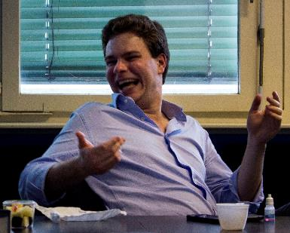


Who?
Nuclear Engineer
Global Shaper
From Turin, Italy
30 years young
What (and where)?
TERA Foundation (before) and CERN (now)
Medical Applications
Accelerators for hadrontherapy
Outreach
…

Slide 3
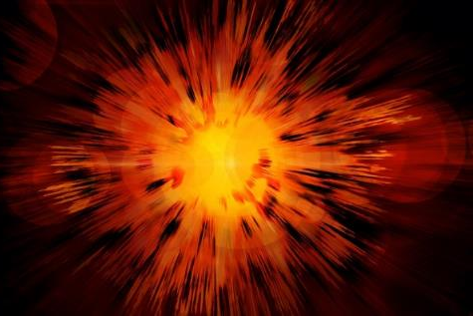
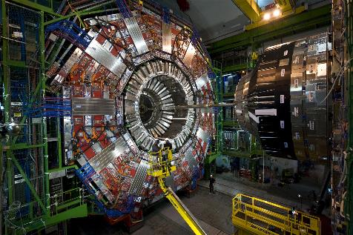
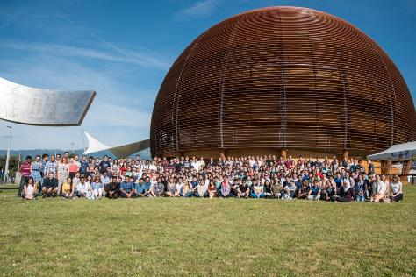
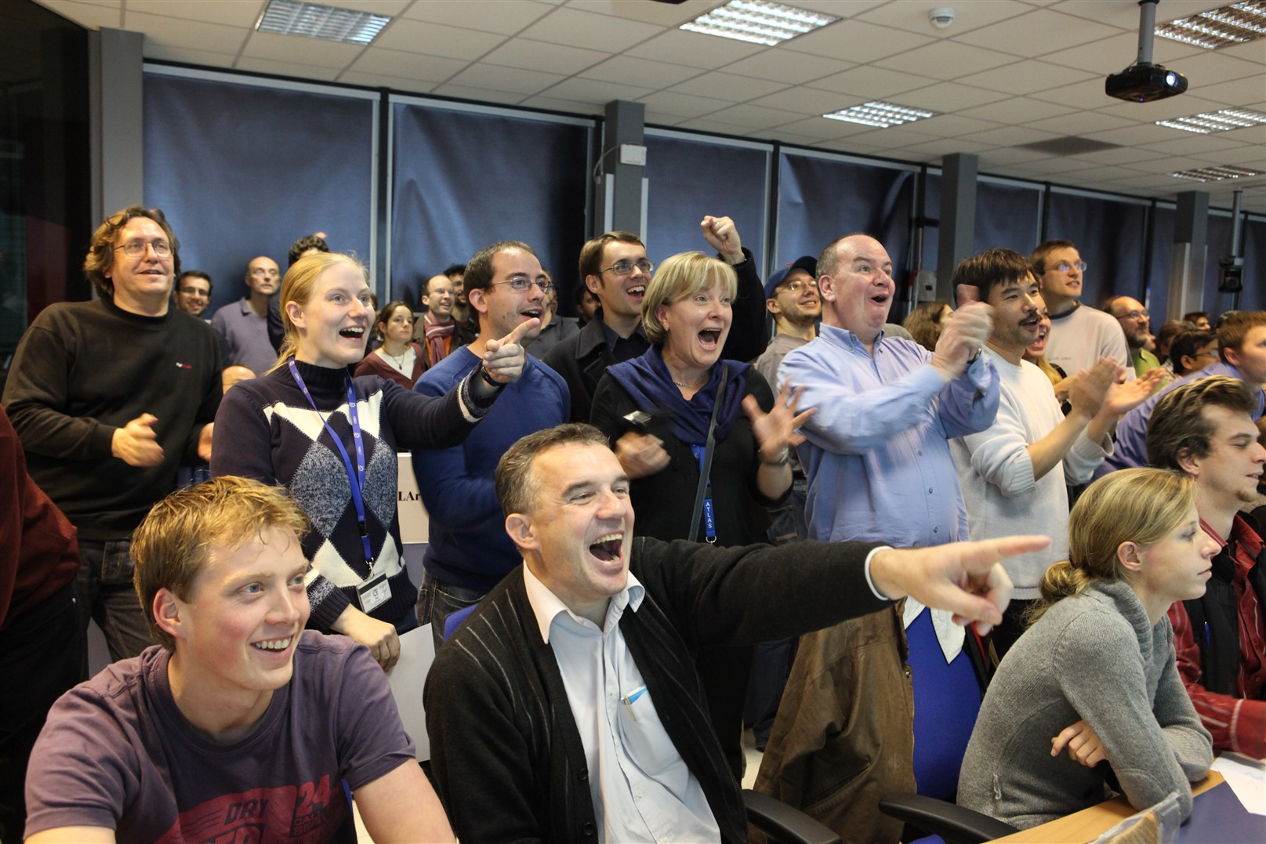
KT: part of CERN mission
Technology
Innovation
Research
Education
Collaboration

Slide 4
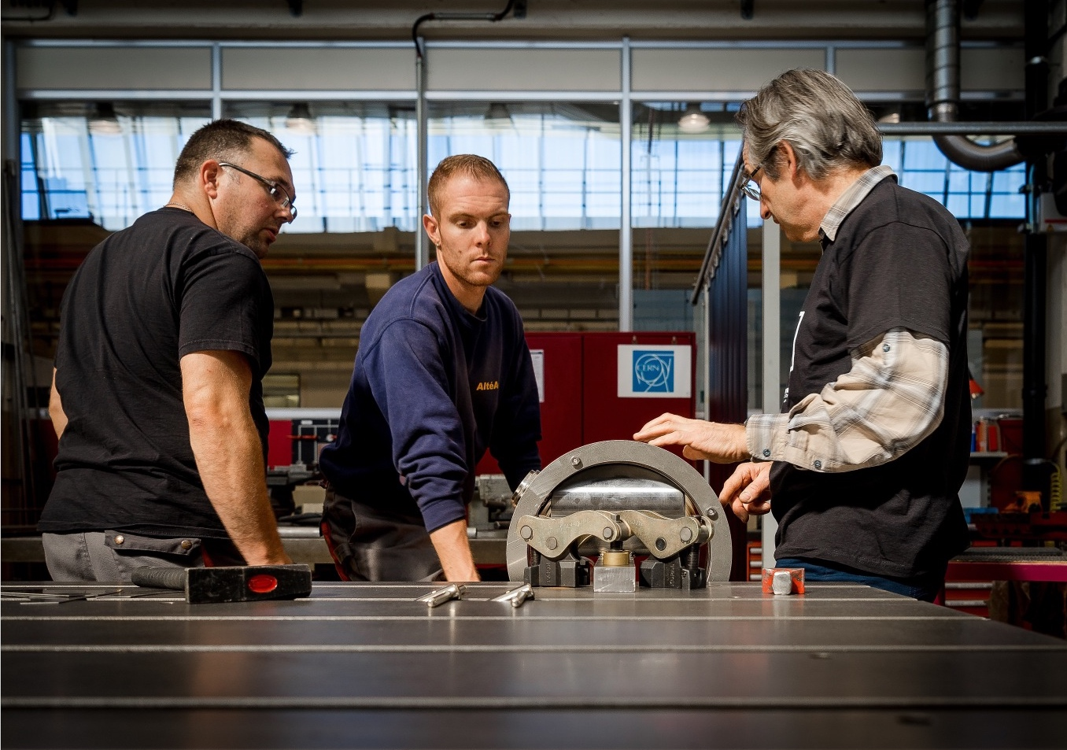
KT in everyday life

Slide 5
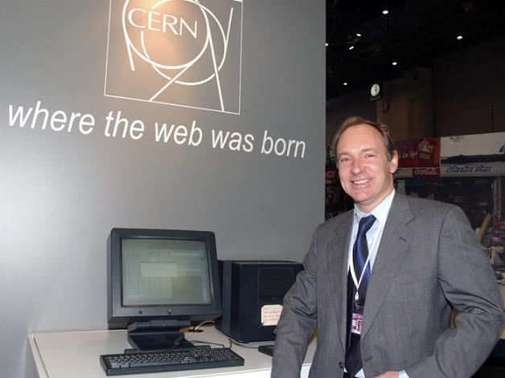
Example of KT

Slide 6
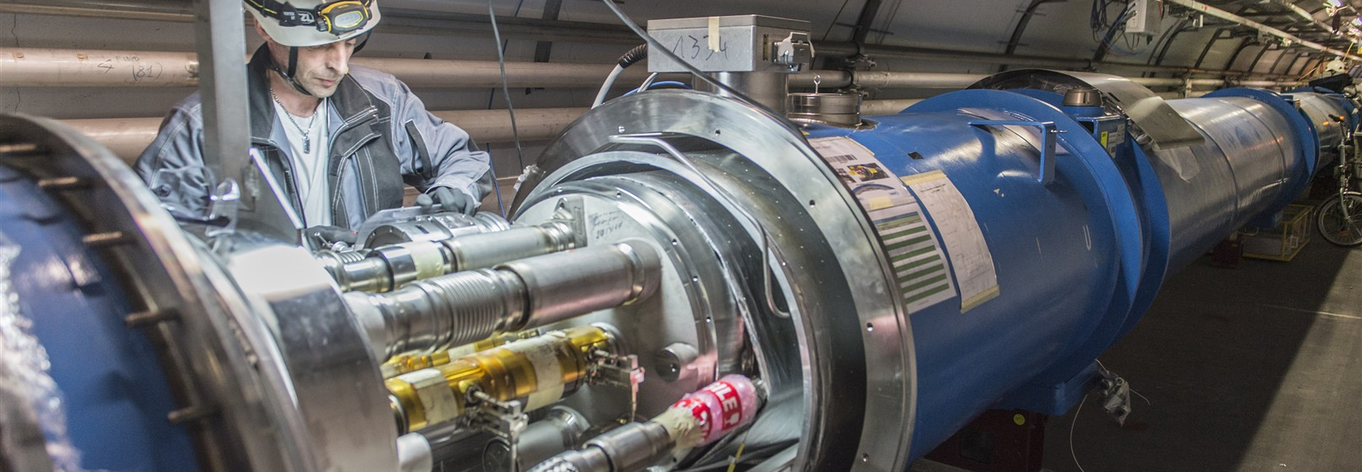
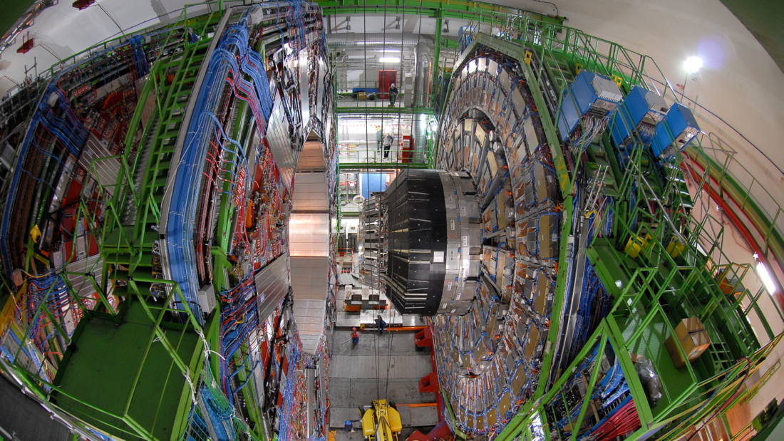

The three pillars

Slide 7
From Physics to…
Medicine
Aerospace
Safety
Global
Communities

Slide 8
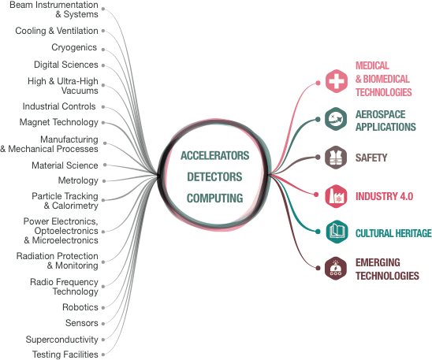
From CERN technologies…

Slide 9

The KT mission at CERN
Maximize the return to Society of our technologies and knowledge, especially in the Member States
Promote CERN’s image as a centre of excellence for technology
https://pixabay.com/en/hand-keep-globe-earth-continents-1030565/
Key words:
Dissemination and Impact!

Slide 10

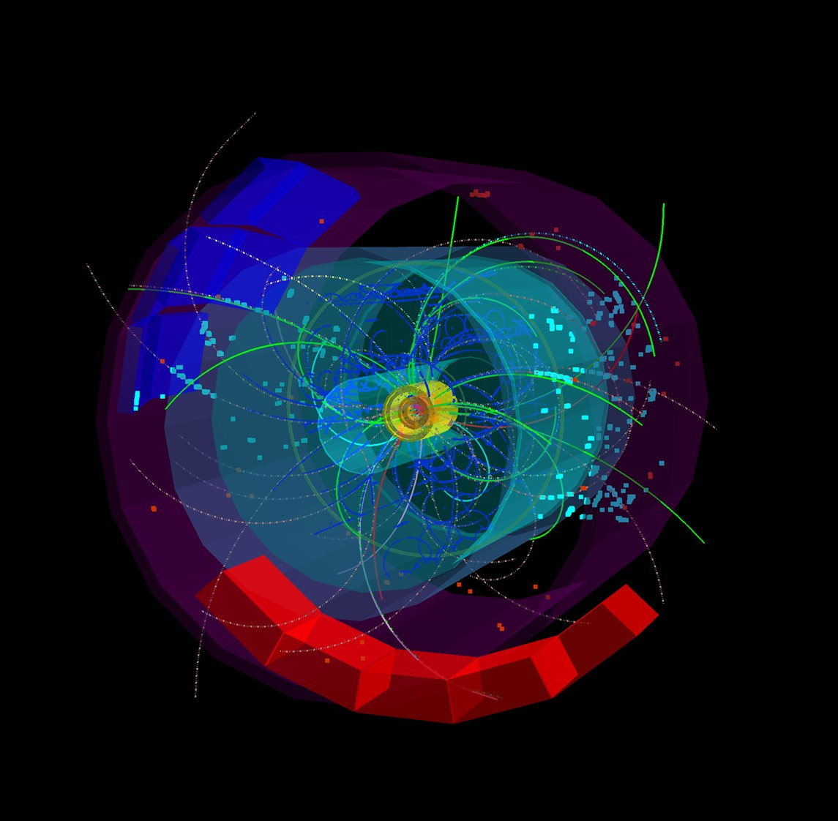
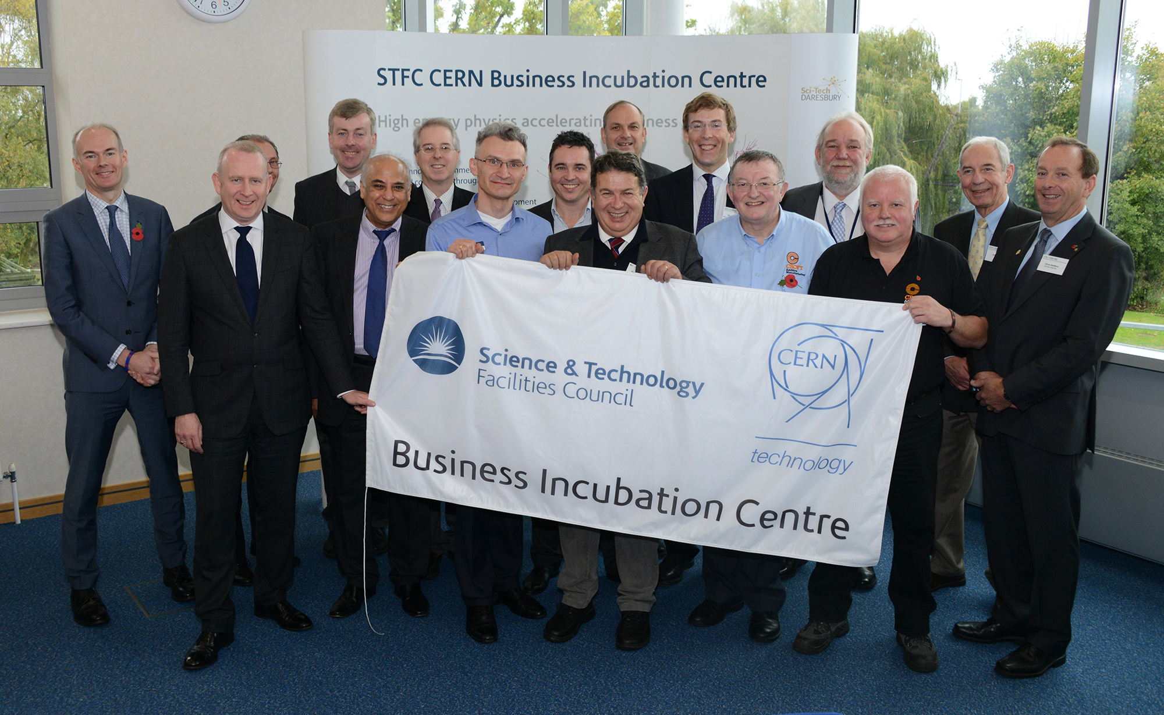
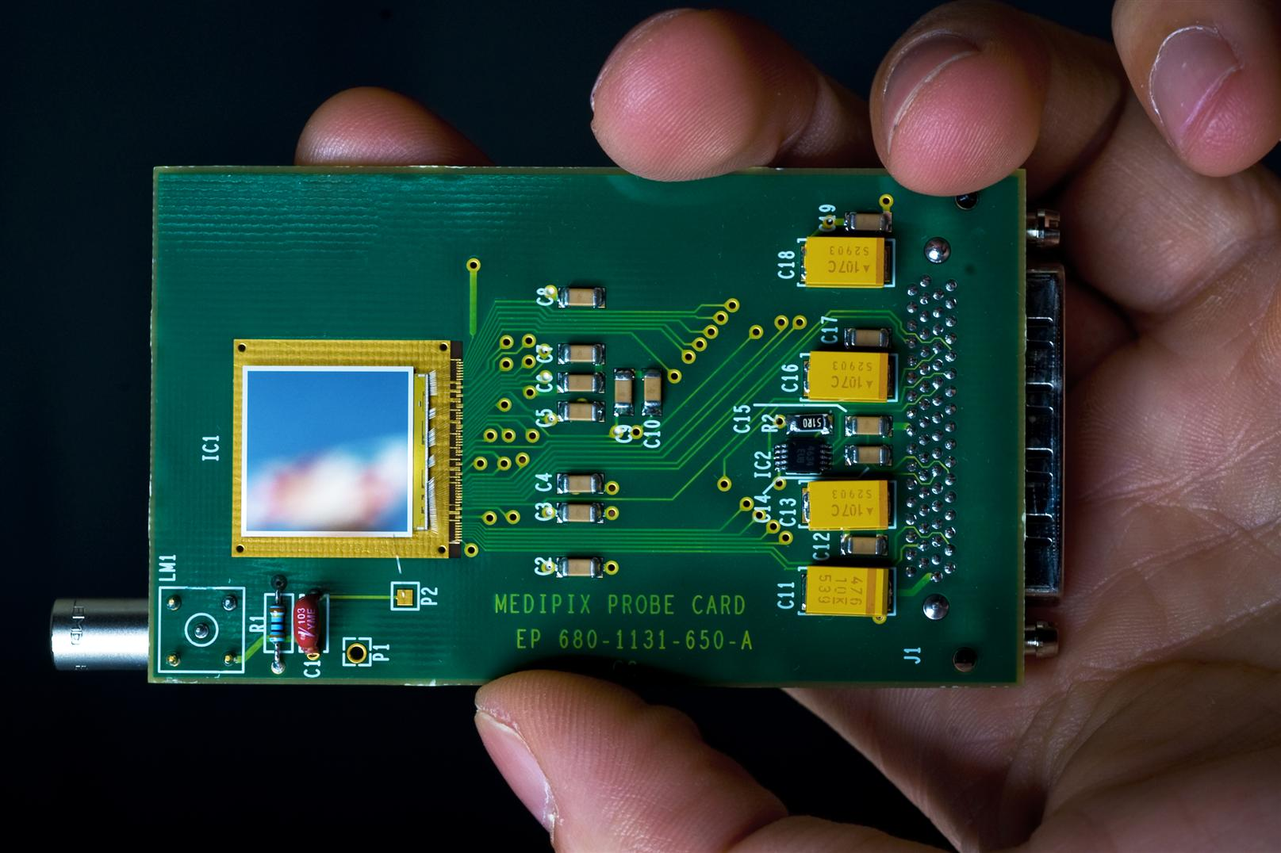
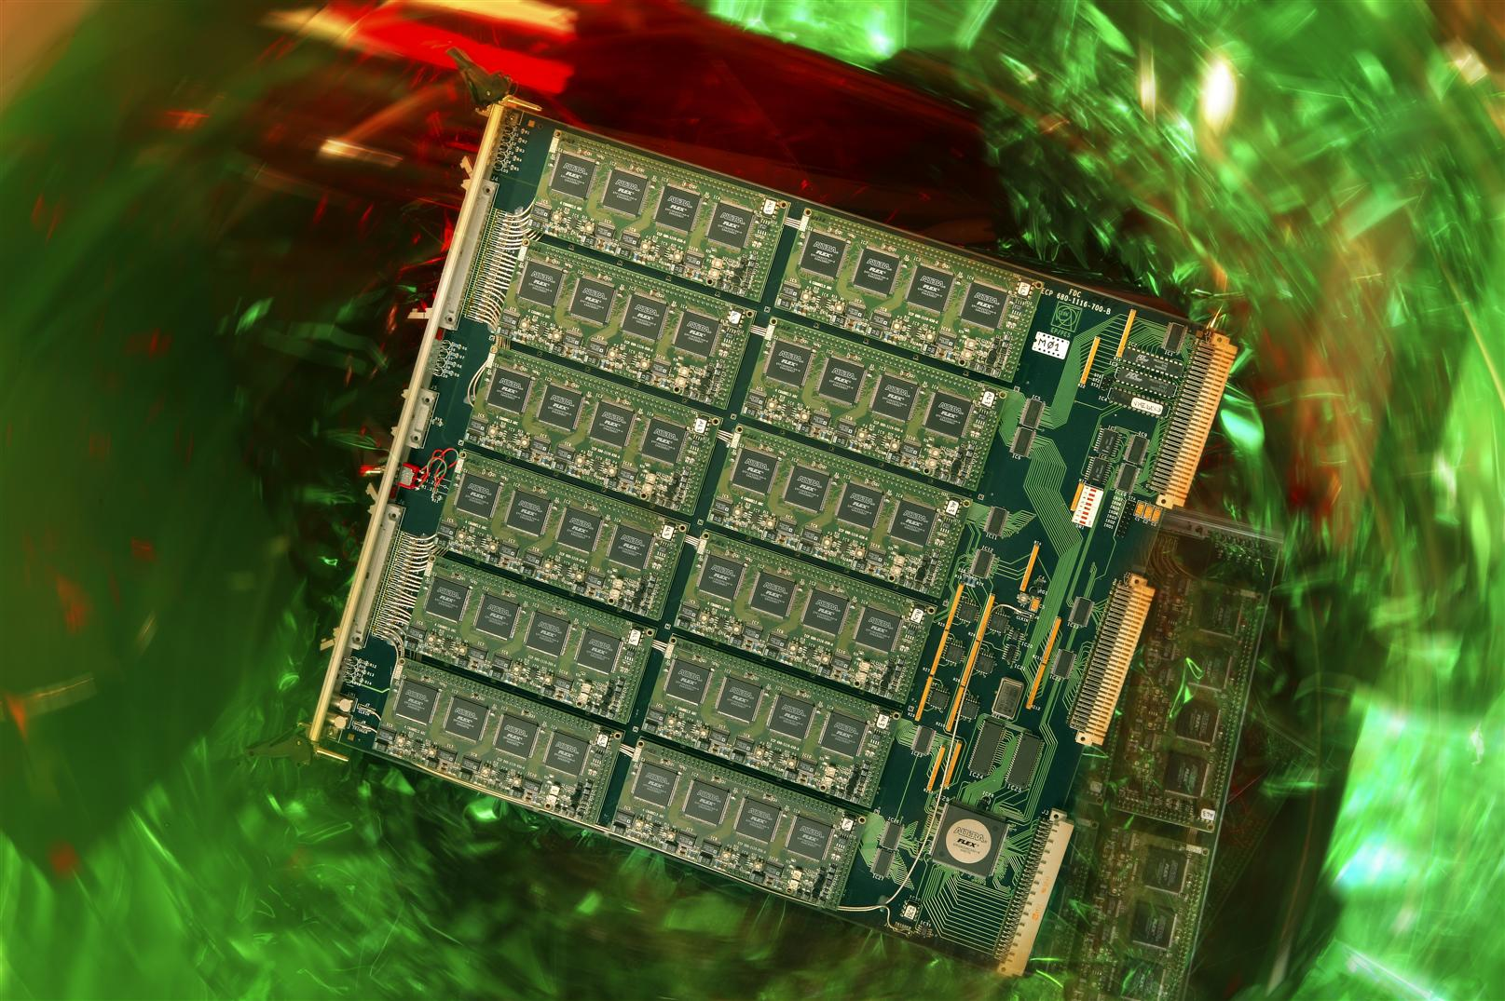

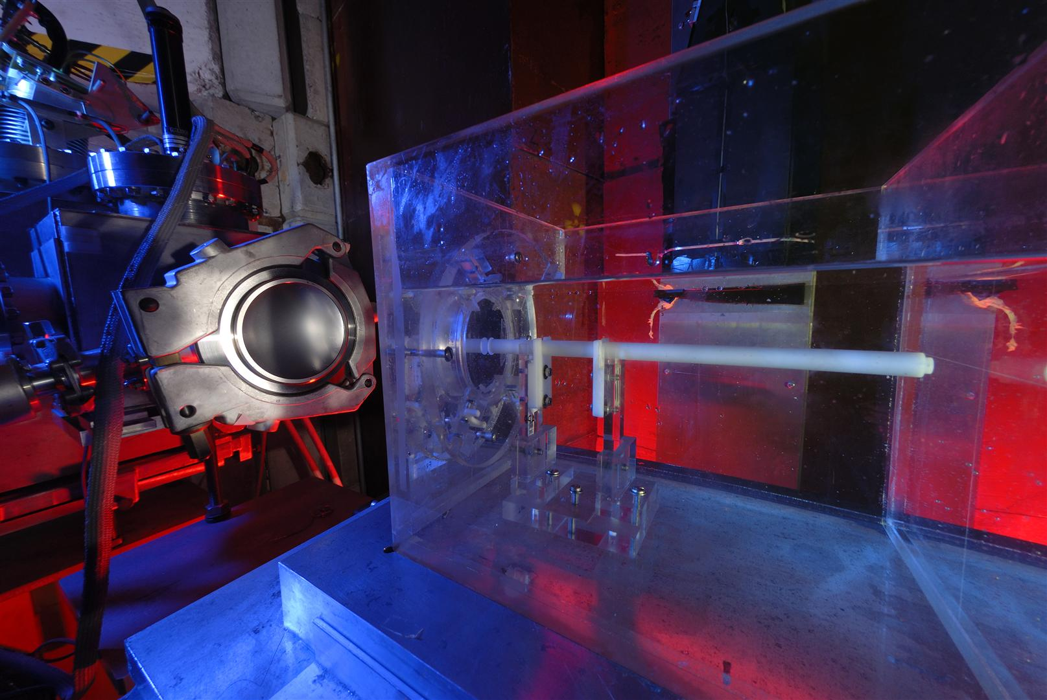
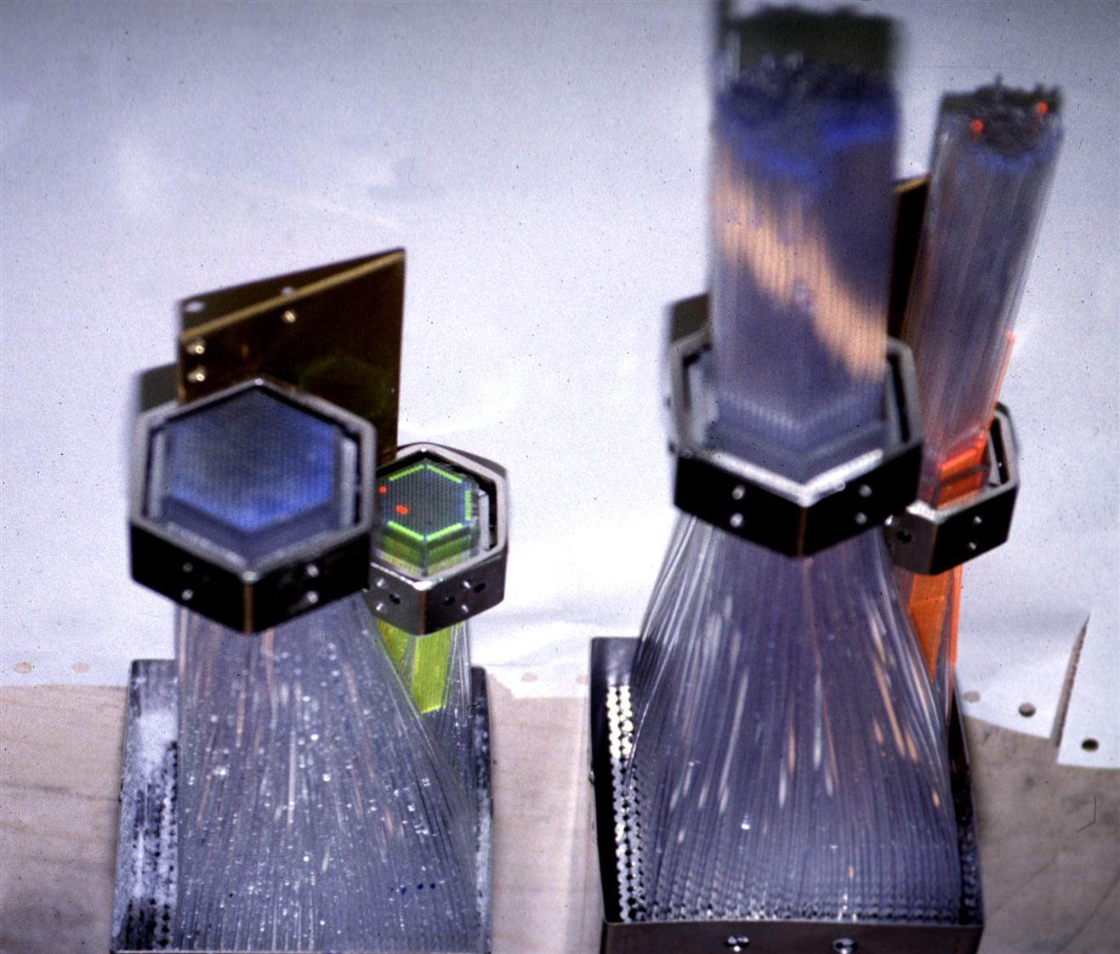
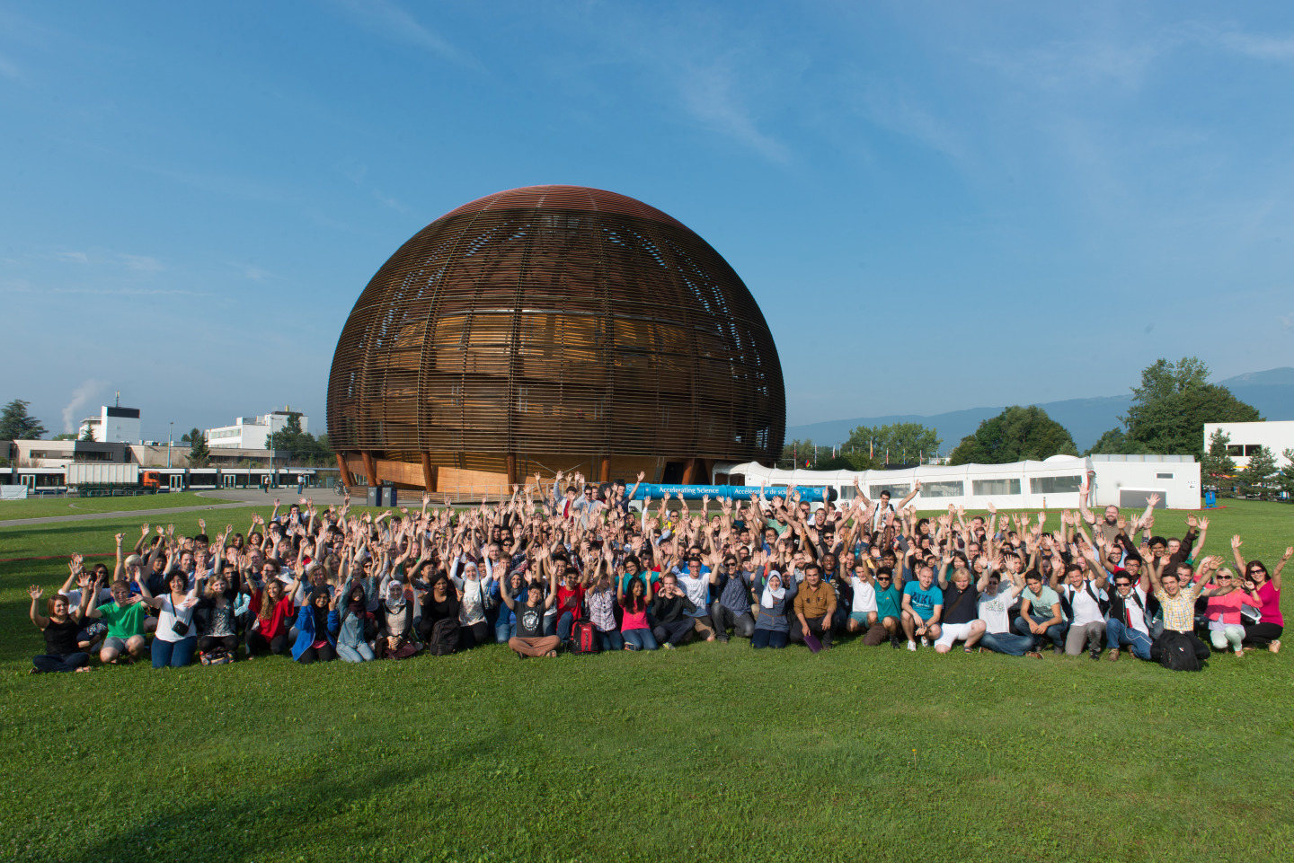

How to KT?
Easy Access IP
Licensing
Open Source Software
Open Hardware
Business Incubation
Procurement
Service and Consultancy
EU Projects
Training
R&D Collaborations

Slide 11
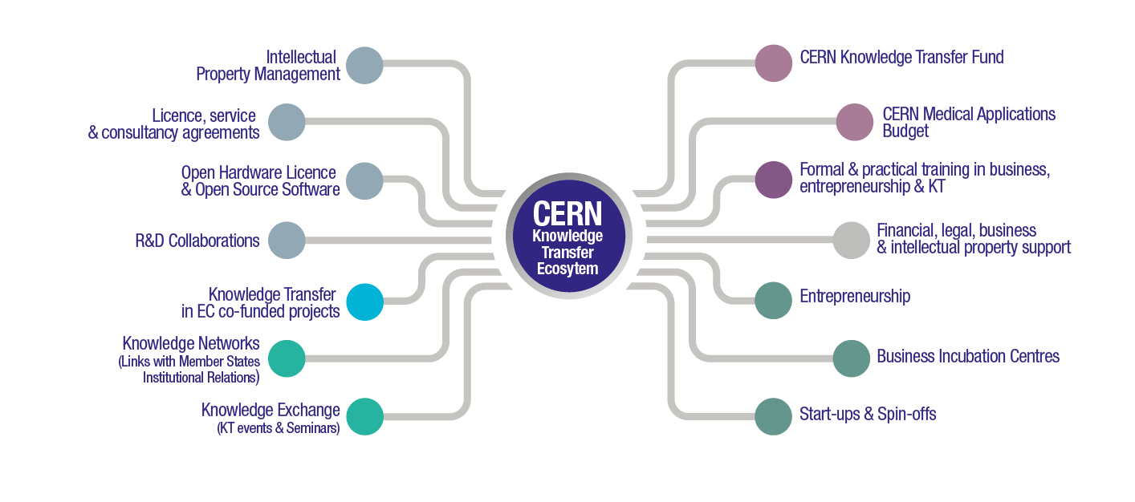
Accelerating Innovation

Slide 12
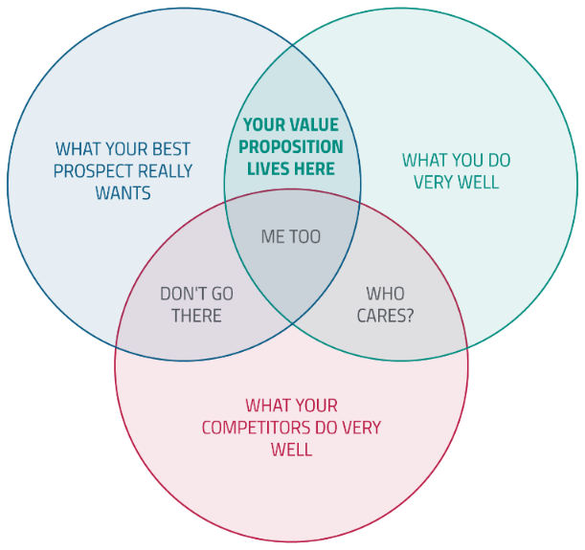
Value Proposition

Slide 13
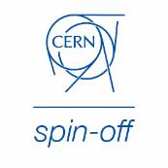
KT implementation ways
Market Pull
Transfer to Existing Companies
Technology Push
Creation of New Companies
Spin-Off Support

Slide 14
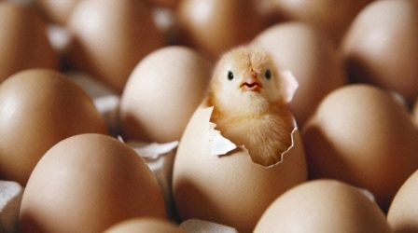
The Business Incubation Centres (BIC) in the Member States
The BICs of CERN technologies help
new entrepreneurs and SME to transform
innovative ideas into commercial realities

Slide 15
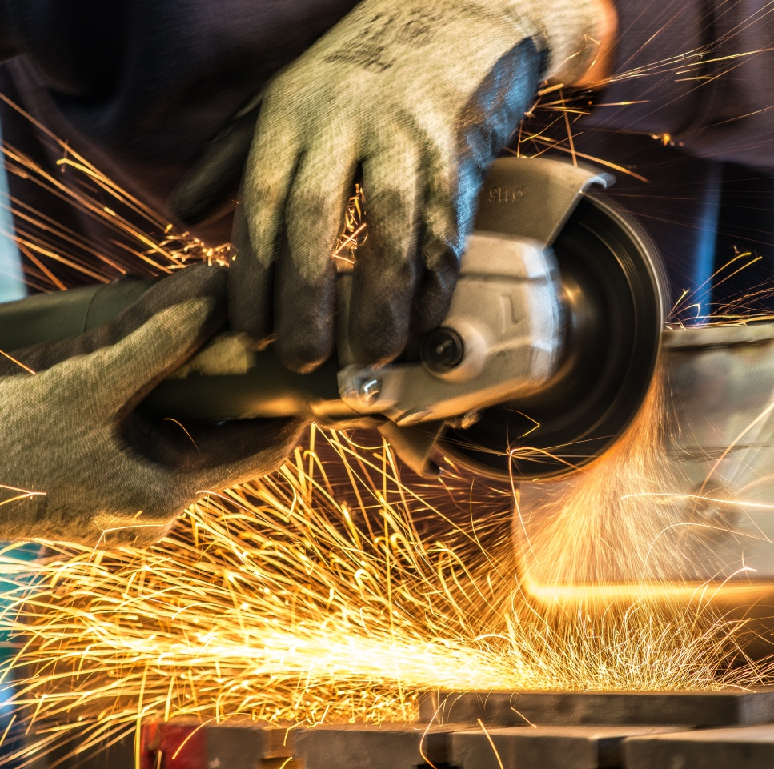
How the BICs work
CERN
- Technical visits to the Lab
- Contacts with the BICs
- Licences at favourable conditions
The BIC
- Office spaces
- Expertise in companies creation
- Support in networking
- Financing strategies

Slide 16
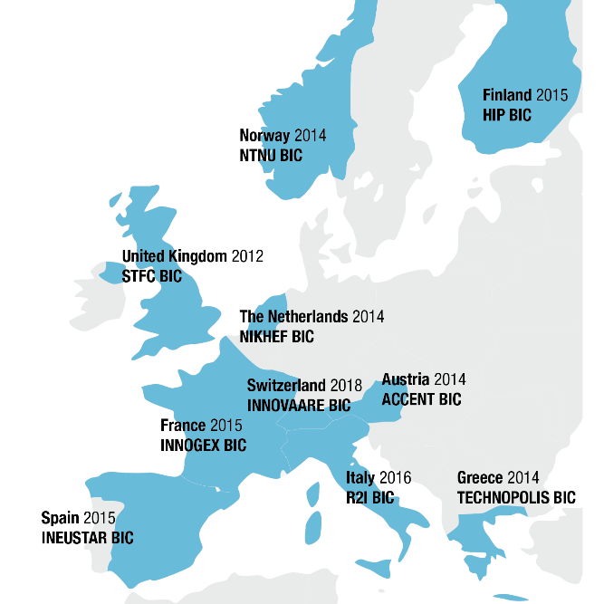

Slide 17
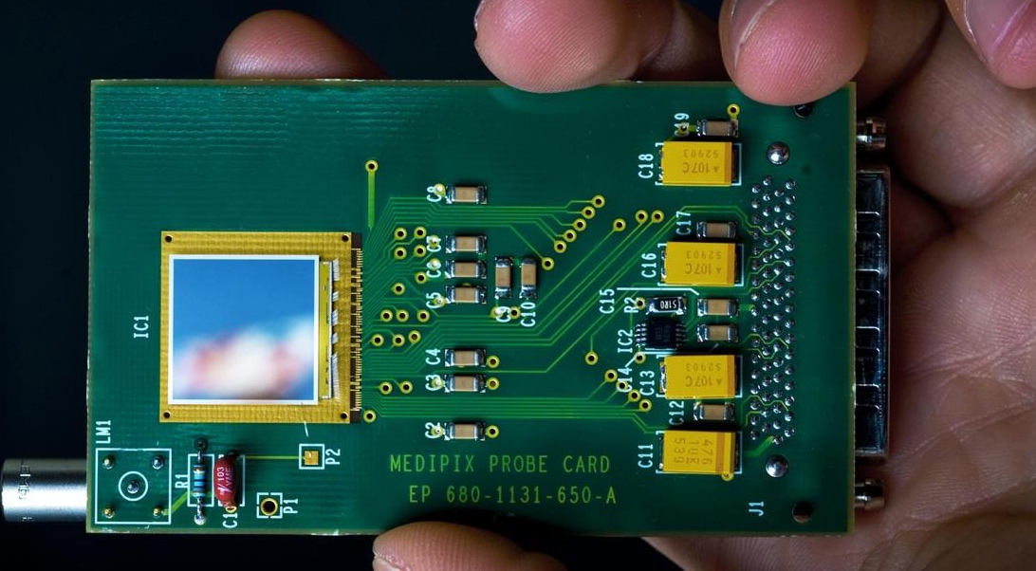
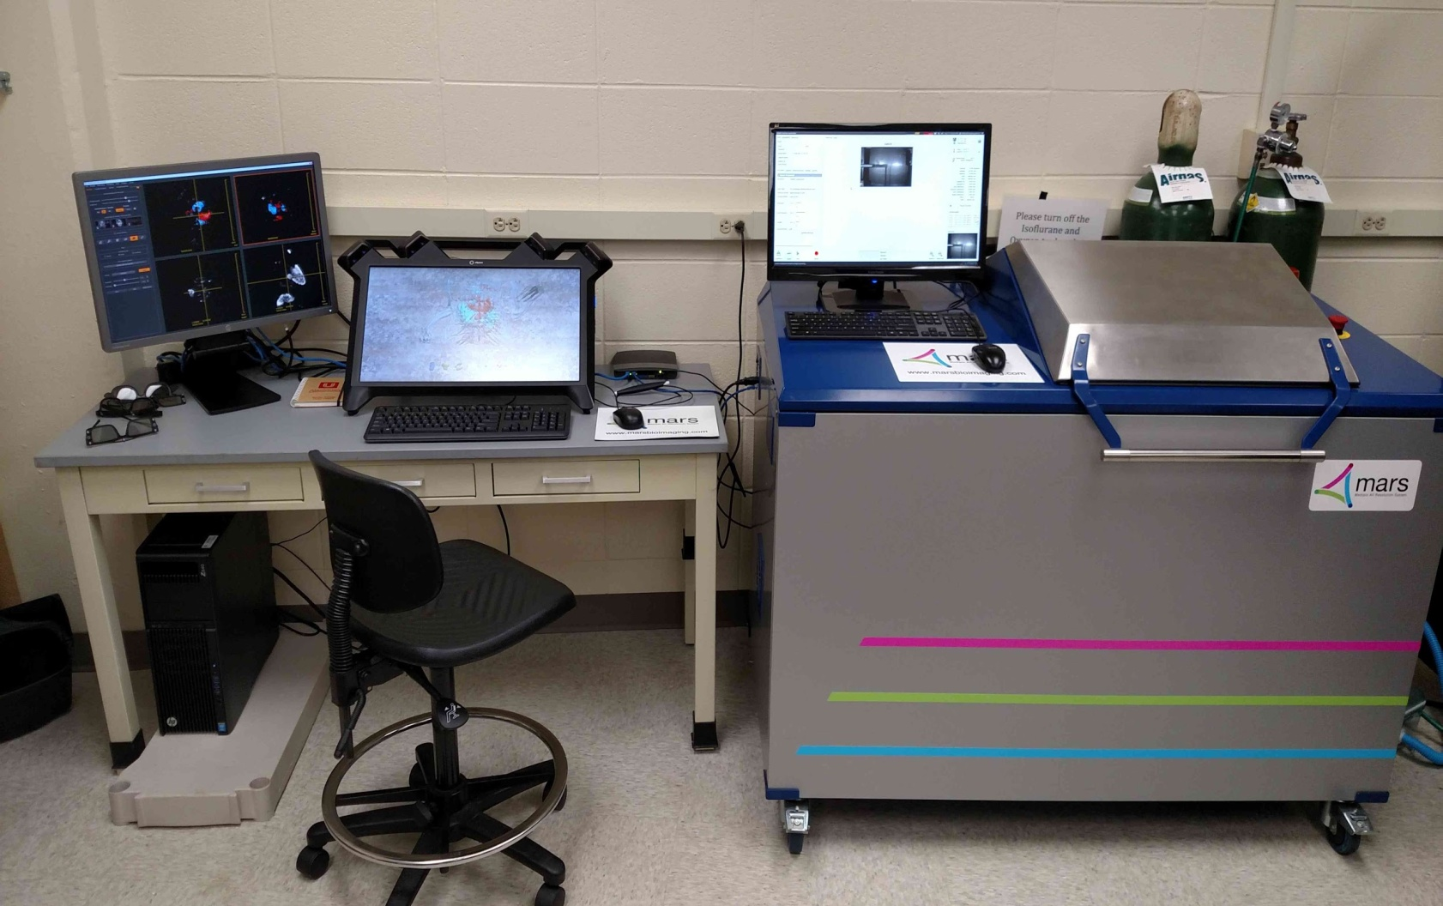
MARS Bioimaging
Slide courtesy of A. Butler, University of Canterbury
Notes:
SRB energy use CERN-patented vacuum technology to maximize the vacuum in the solar collectors, which makes it able to deal with temperatures up to 200 degrees. The company was founded by Cristoforo Benvenuti, and several solar plants made with SRB energy collectors are being used today for cooling and heating, including this example from the roof of Geneva airport

Slide 18
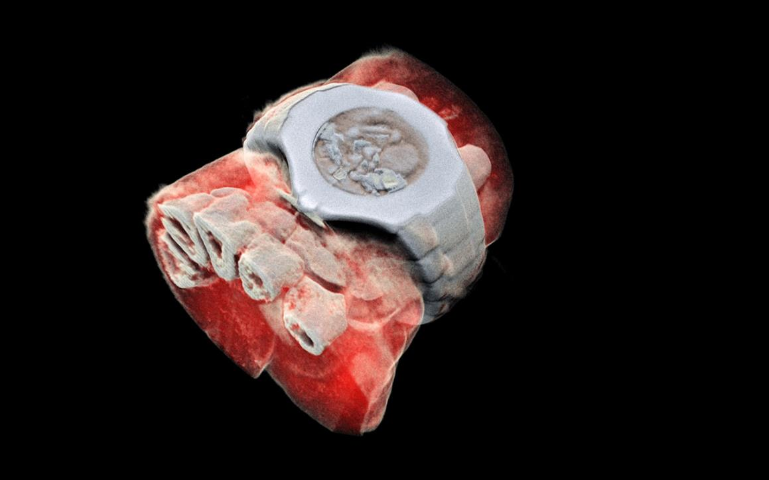
MARS Bioimaging
Photo: MARS Bioimaging
Notes:
SRB energy use CERN-patented vacuum technology to maximize the vacuum in the solar collectors, which makes it able to deal with temperatures up to 200 degrees. The company was founded by Cristoforo Benvenuti, and several solar plants made with SRB energy collectors are being used today for cooling and heating, including this example from the roof of Geneva airport

Slide 19
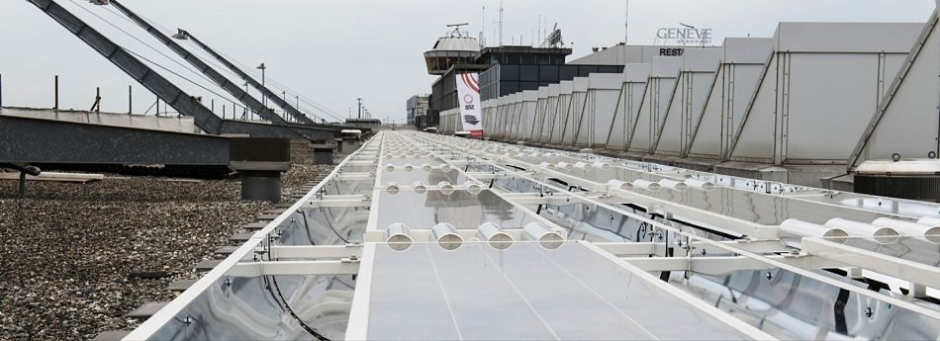
SRB Energy
Notes:
SRB energy use CERN-patented vacuum technology to maximize the vacuum in the solar collectors, which makes it able to deal with temperatures up to 200 degrees. The company was founded by Cristoforo Benvenuti, and several solar plants made with SRB energy collectors are being used today for cooling and heating, including this example from the roof of Geneva airport

Slide 20

TeraBee

Slide 21
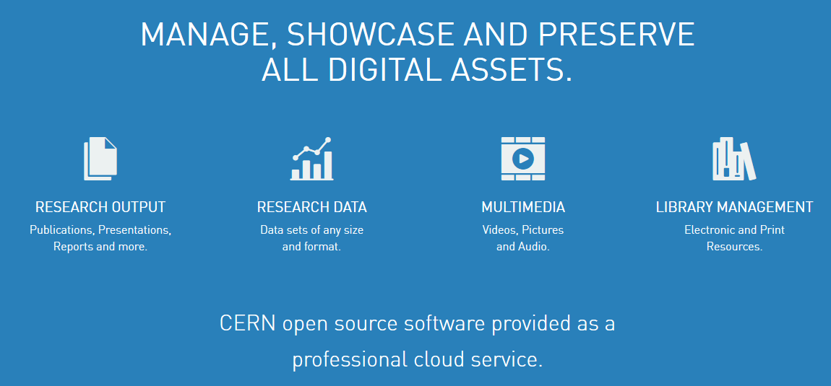
Norway: TIND

Slide 22
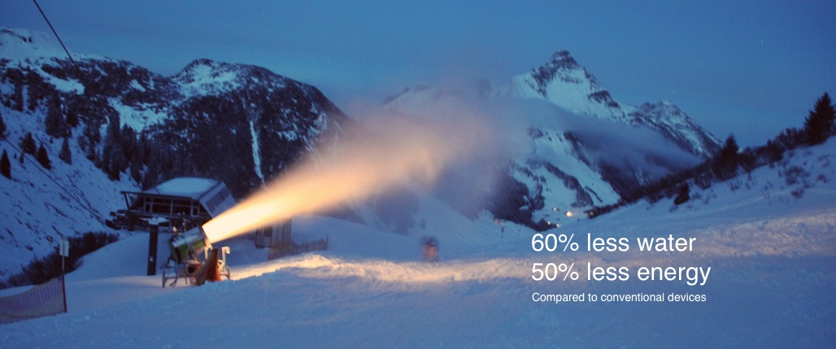
Austria: Neuschnee

Slide 23
SME Network
KT newsletter twice per year
Creation of an internal database of SMEs, but also bigger companies, research centers, universities…
From November 2015, more than 100 subscribed, among them 50 SMEs

Slide 24
The human capital

Slide 25
Fostering the entrepreneurial spirit
Activities and events
  Entrepreneurship meet-up
  Global Entrepreneurship Week
  CERN-NTNU Screening Week
  Support to THE Port Hackathon et IdeaSquare Challenge Based Innovation programmes
Material and documentation for CERN scientists and engineers
  Adapted and ad hoc business plans
  “User Friendly” financial tables for start-ups

Slide 26
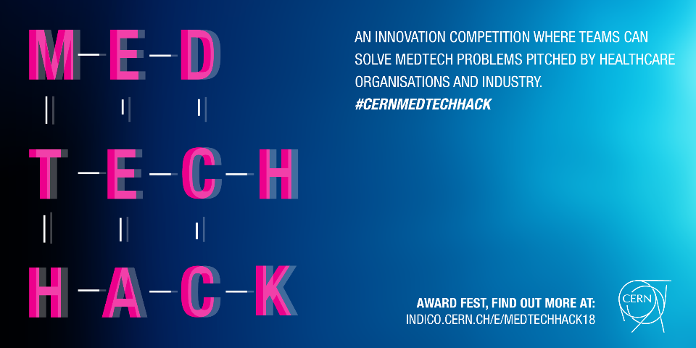








Slide 27
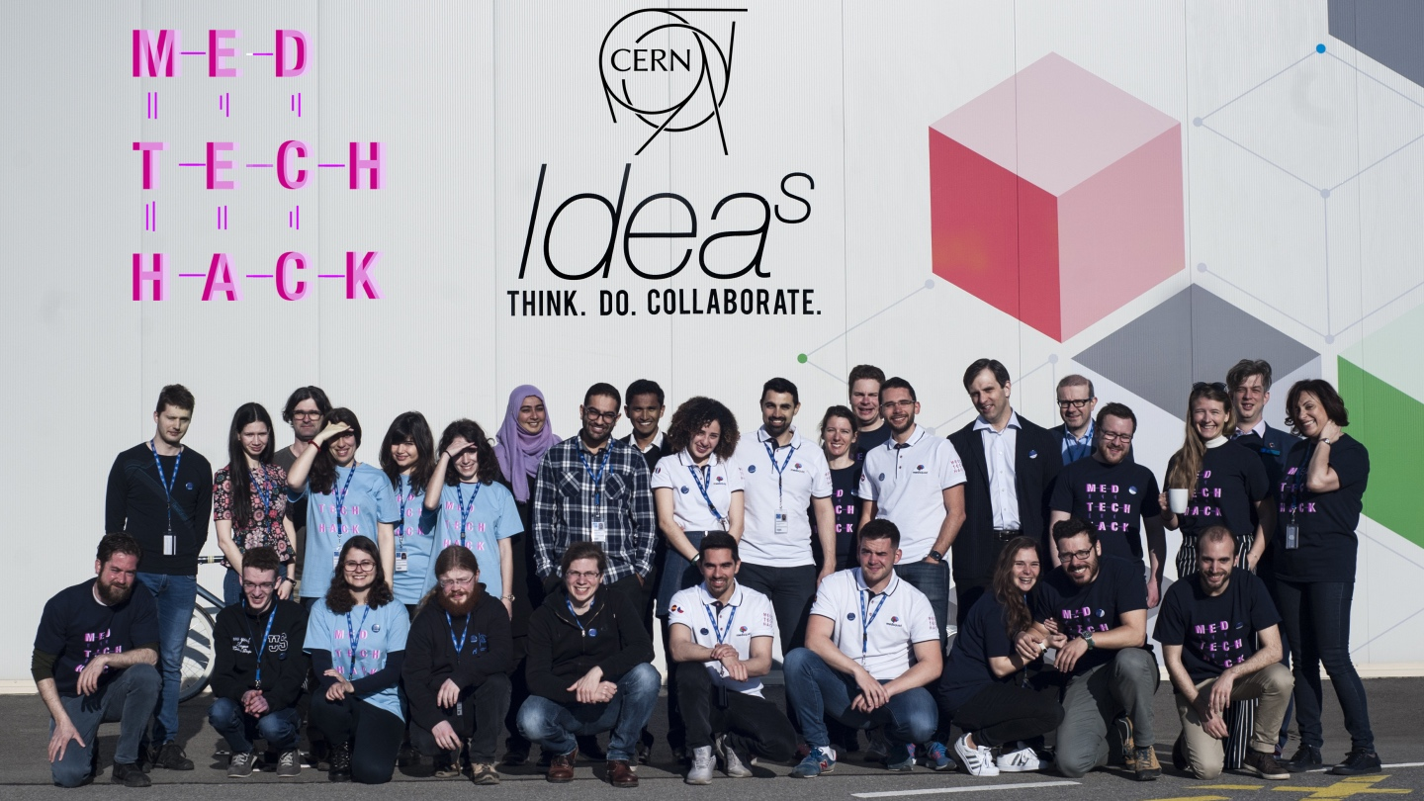

Slide 28
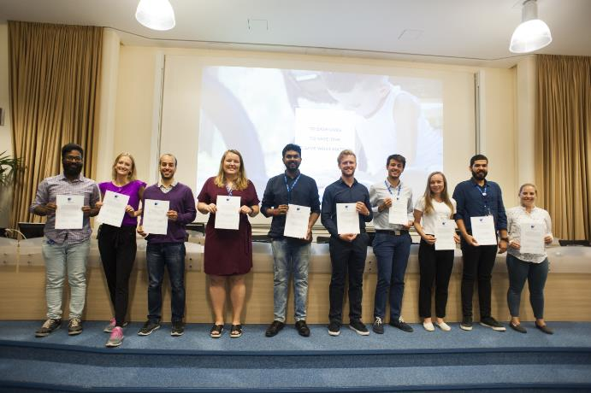
CERN Entrepreneurship Student Programme (CESP)
http://cdsweb.cern.ch/record/2638107?ln=ca
https://indico.cern.ch/event/707301/

Slide 31
kt.cern

Slide 32
Contacts
General enquiries: KT@cern.ch
KT Group Leader: Giovanni.Anelli@cern.ch
Medical Applications: Manuela.Cirilli@cern.ch
Aerospace Applications: Enrico.Chesta@cern.ch

Slide 33
The three pillars
Accelerators
Detectors
Computing

Slide 34
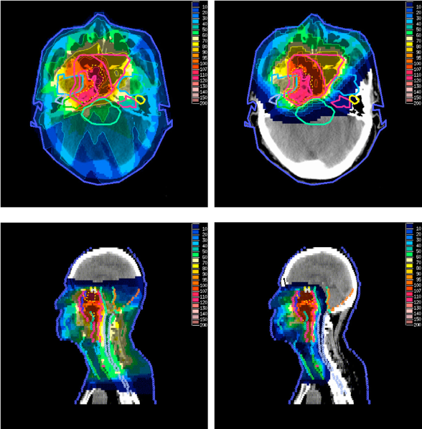
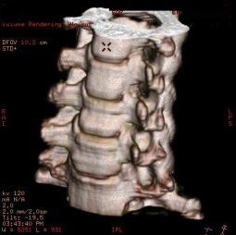

The three pillars
Radiotherapy
Medical data management and analysis
Medical Imaging

Slide 35
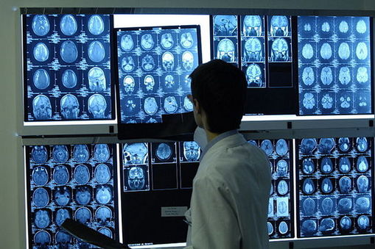
Medical Imaging

Slide 36
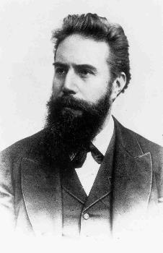
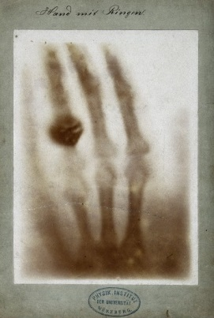

X-rays
Courtesy of Roentgen museum
  8 November 1895:
  X-rays discovery
  22 December 1895:
  first radiography
Wilhelm Röntgen
(1845–1923)
1901: Nobel prize
Notes:
Discovery of X-rays

Slide 37
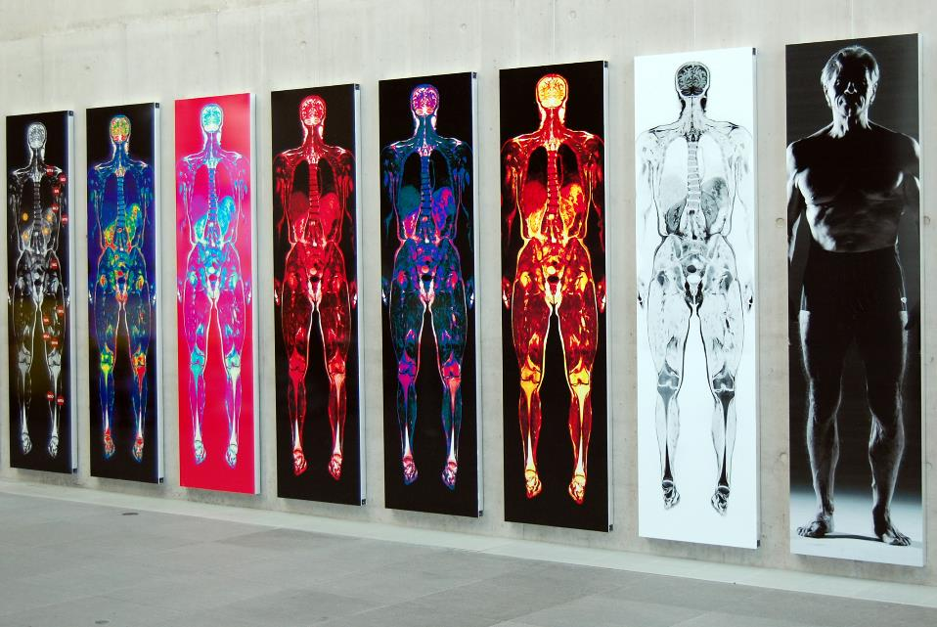
More and more details
Images courtesy of Dr. F. Fellner
Notes:
Need of a precise proton beam control in the body thanks to novel imaging tools

Slide 38
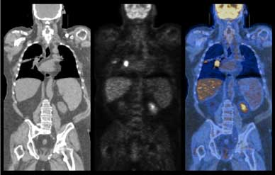
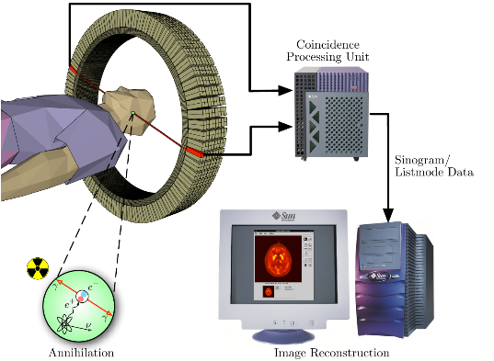

PET Scan
Notes:
Need of a precise proton beam control in the body thanks to novel imaging tools

Slide 39
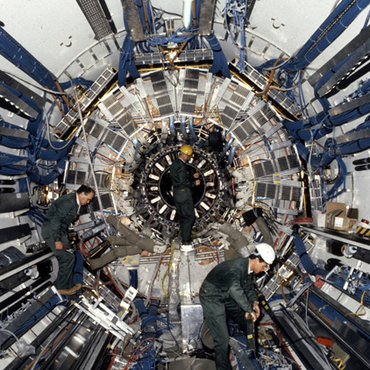
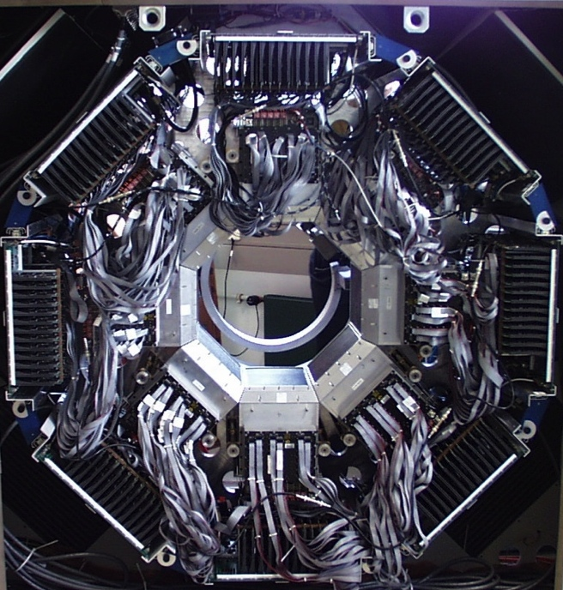
Medical imaging and particle physics: the same challenge?
Notes:
Particle Physics and medical imaging are facing the same challenges

Slide 40
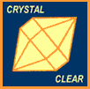
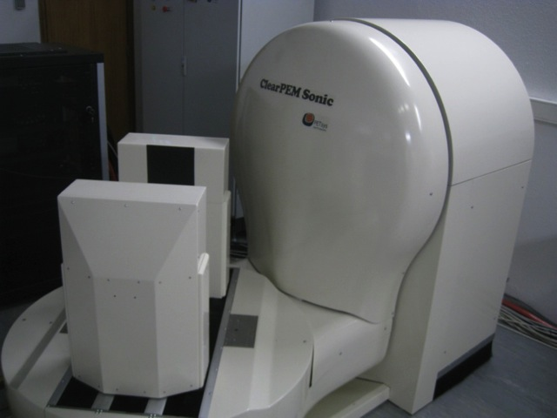
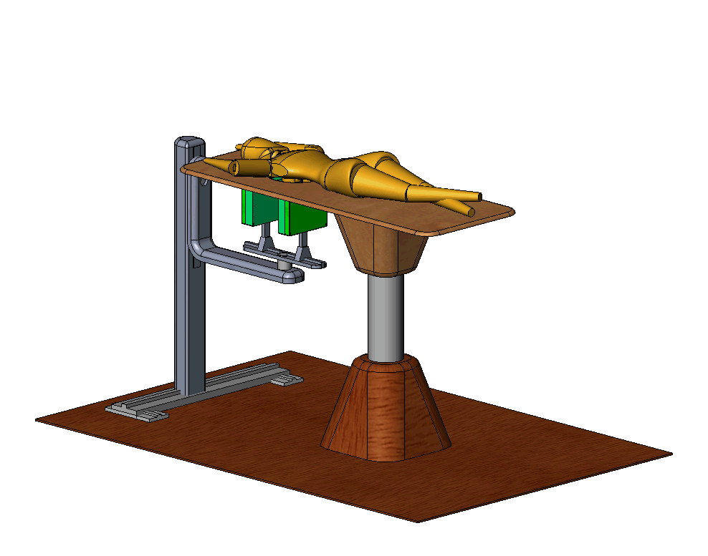
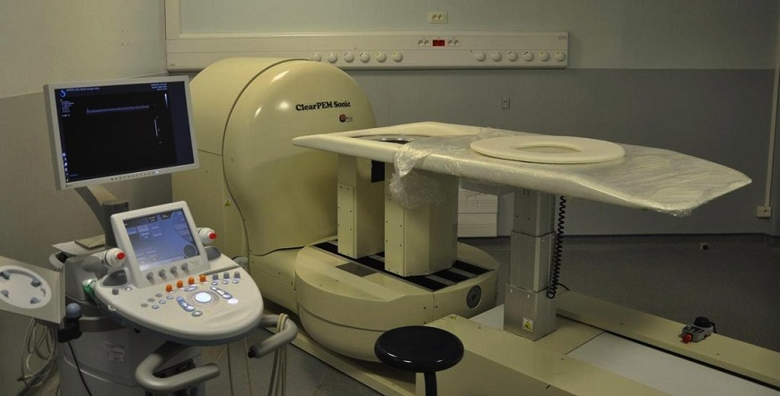
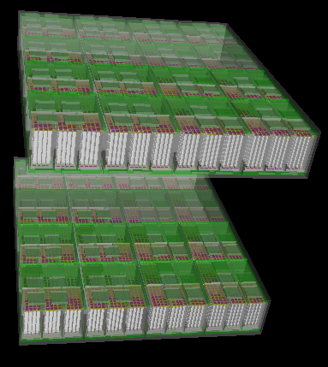
ClearPEM
Notes:
Particle Physics and medical imaging are facing the same challenges

Slide 41
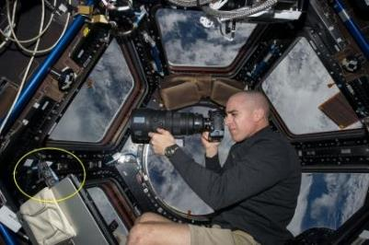

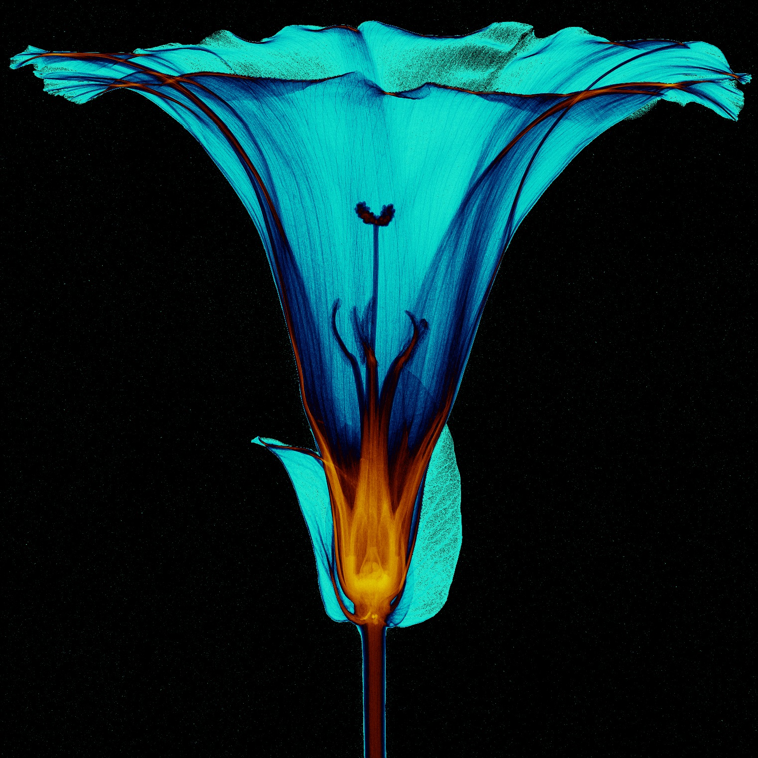
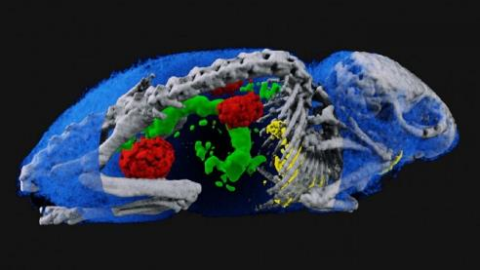
Medipix

Slide 42

Accelerators for medicine
Notes:
Particle Physics and medical imaging are facing the same challenges

Slide 43



Accelerators for radio-isotopes
Notes:
Particle Physics and medical imaging are facing the same challenges

Slide 44




Accelerators for cancer treatment
State of the art treatments
Chemotherapy
Radiotherapy
Surgery
Innovative practice
Hadrontherapy

Slide 45

Radiotherapy
Cheap:
  the least expensive cancer treatment method (around 5% of total cost)
Cure:
  good cure rate
Conservative:
  generally non-invasive, fewer side effects
Notes:
Particle Physics and medical imaging are facing the same challenges

Slide 46

Hadrontherapy
Notes:
Particle Physics and medical imaging are facing the same challenges

Slide 47

Protons vs X-rays
X-rays
Protons
Courtesy of MedAustron
Notes:
Particle Physics and medical imaging are facing the same challenges

Slide 48


PIMMS at CERN (1996-2000)
Proton Ion Medical Machine Study
linacs for
carbon ions
and protons
400 MeV/u synchrotron
p
p
p
C
C
RF cavity
Resonance sextupole
Sextupole horiz. chromaticity
Sextupole vert. chromaticity
Betatron
core
Circumference C = 76.84 m
Tune horizontal Q_{x} = 1.67
Tune vertical Q_{z} = 1.72
Sextupole vert.
chromaticity
Sextupole horiz. chromaticity
Electrostatic septum
CERN - TERA - MedAustron
Injection septum
Extraction septum
Notes:
Particle Physics and medical imaging are facing the same challenges

Slide 49





CNAO, Pavia (Italy)
Notes:
Particle Physics and medical imaging are facing the same challenges

Slide 50



MedAustron, Vienna (Austria)
Notes:
Particle Physics and medical imaging are facing the same challenges

Slide 51

European Centres
Notes:
Particle Physics and medical imaging are facing the same challenges

