Slide 1
Higgs Coupling Measurement with papas
Colin Bernet (IPNL)
FCC-ee Higgs Working Group
Dec 11, 2017

Slide 2
Goal
Measure the Higgs couplings for various detector hypotheses and scenarios
Need:
  fast simulation (papas)
  detector models
  fitting infrastructure
First step (today): reproduce existing results
  LEP3 note (validate papas vs CMS full simulation, analysis code)
  TLEP note (validate global fit method and model)
Later:
  update running scenario (√s, lumi)
  try other detector models and show improvement w/r CMS

Slide 3
Outline
Tools:
  papas
  heppy analysis framework
Analyses (vs LEP3 note)
  ZH→llX, ZH→llbb, ZH→ννbb
  yield extraction
Global fit for the couplings (vs TLEP note)
Summary and plans

Slide 4
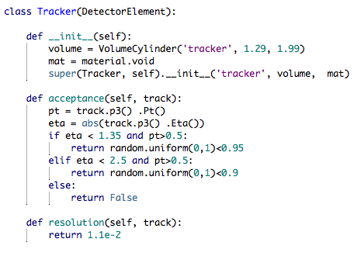
Papas: Tracker
Define:
  simple geometry (cylinder)
  acceptance model
  resolution model
  (+ B field)
Easy to create / easy to change
Python script → extreme flexibility w/r to a « card » system

Slide 5
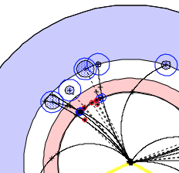
Papas: Calorimeters
Simple geometry
(2 cylinders)
Material
  hadron shower in ECAL
Energy resolution and response
Acceptance
  thresholds
Cluster size R
  models calorimeter granularity
R
Sum energy and create a merged cluster

Slide 6
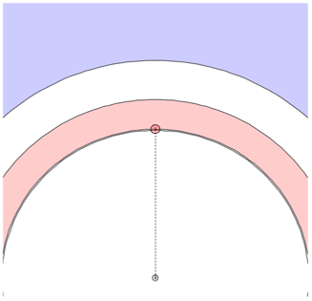
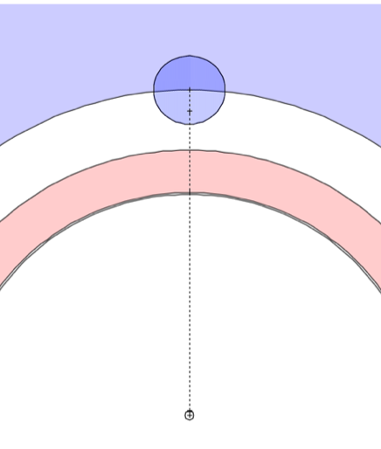
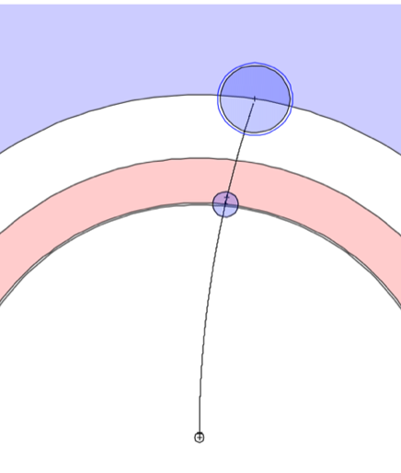
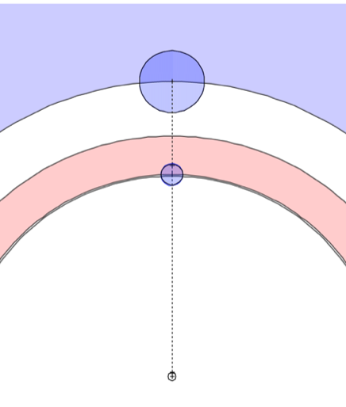
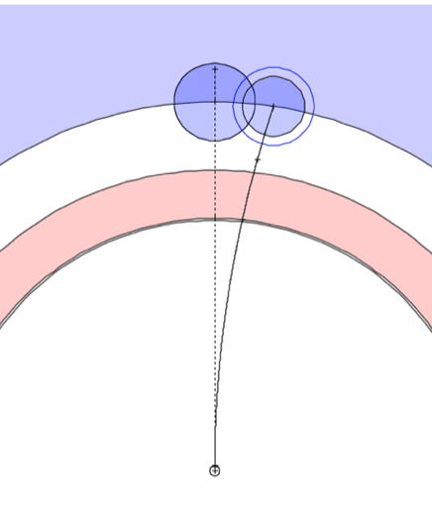
Papas: Particle Flow
photon
neutral hadron
charged hadron
Full PF algorithm
similar to CMS
neutral hadron
+ photon
charged and neutral hadrons

Slide 7
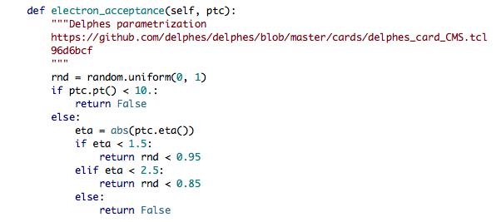
Papas: e and mu
Integration in PF would be very difficult
Treated separately
  no lepton / hadron fakes
Using the Delphes CMS parametrization
Isolation:
  particle-based isolation w/r to the surrounding particles
  from PF

Slide 8
Papas: Jets
Fastjet
  input:
  reconstructed particles
  ee_kt algorithm
  exclusive reconstruction
  (e.g. njets=2)
    different from our previous analyses where an a posteriori resummation was done
Jet energy correction:
  flat 1.1 factor
  (~ as in CMS)
b tagging:
  input = ROC curve
  set desired efficiency
  (fixes fake rate)
  gen b matching: fraction of rec jet energy arising from B hadron > 0.01
    extremely efficient and pure
  matched: apply efficiency
  unmatched: apply fake rate

Slide 9
heppy
Event processing framework
Modular
  ~ CMSSW, Gaudi, Athena, Marlin,
  but much lighter
Written in python
Can read from root trees, CMS, FCC, LCIO
Widely used in CMS
Many tools:
  batch processing, physics tools, …

Slide 10
Outline
Tools:
  papas
  heppy analysis framework
Analyses (vs LEP3 note)
  ZH→llX, ZH→llbb, ZH→nunubb
  yield extraction
Global fit for the couplings (vs TLEP note)
Summary and plans

Slide 11
ZH→llX: Analysis Sequence
gen
>1 e or >1 mu
(pt > 10)
papas
not Z
2 jets
jet E corr.
b tag
lepton iso (<0.5)
Z
(n>0)
Recoil
closest to Z mass
https://github.com/cbernet/fcc-ee-higgs/blob/master/analysis_ee_ZH_llbb.py

Slide 12
ZH→llX: Final Selection
Leptons:
  iso < 0.2, same flavour, opposite charge
Z candidate
  |m - 91| < 4 (not 5)
  p_{T} > 10
  p_{z} < 50
  acollinearity > 100
  cross > 10 (not acoplanarity)
if jets present, photon fraction < 0.8
The cuts in red are the ones that were used for the LEP3 note. But they differ from what is written therein.
(Thanks P. Janot)

Slide 13
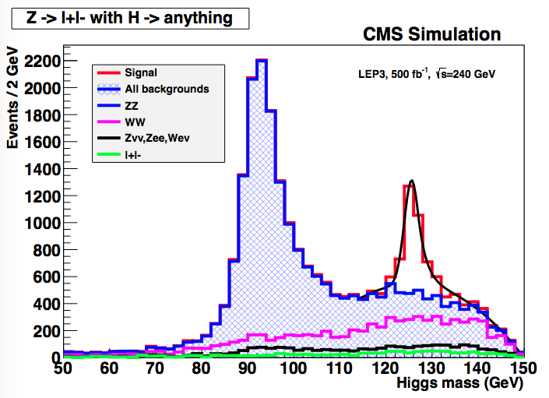
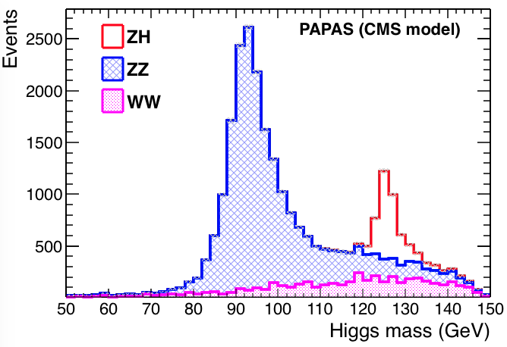
Recoil mass
Still missing minor backgrounds
Lepton (electron?) resolution slightly too bad?
10% too many events. lepton isolation too efficient?
Will not matter much anyway

Slide 14
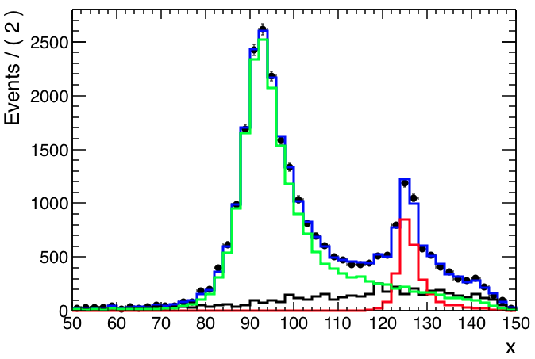
Yield extraction
fit had hoc function
  yield uncertainty overestimated
    function might not be adequate
    limited MC yield
template fit
  use the same templates to generate pseudodata and to fit
    both effects eliminated
    we will have an excellent knowledge of our templates when we take data

Slide 15
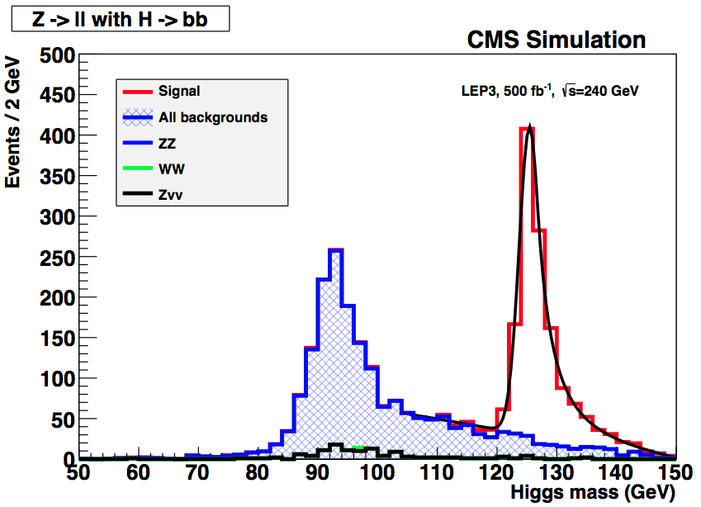
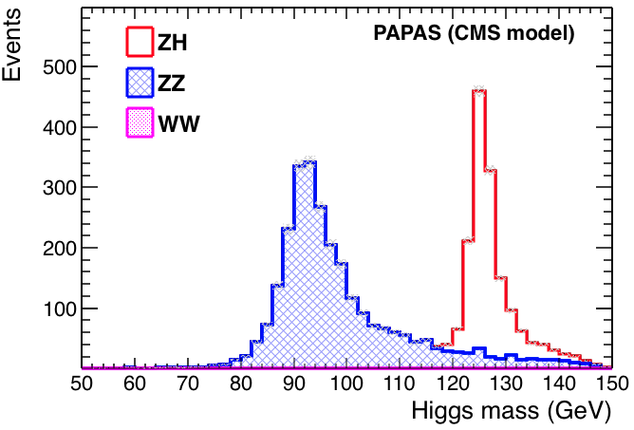
ZH→llbb
Tuned b tag:
eff = 60%, fake = 0.3%
b1 or b2
Still missing minor backgrounds
Lepton (electron?) resolution slightly too bad?
10% too many events. lepton isolation too efficient?
Will not matter much anyway

Slide 16
ZH→ννbb: Analysis Sequence
papas
2 jets
jet E corr.
b tag
Higgs
mass rescaling
Higgs mass rescaled:
  jet energy scaled by a common factor by to bring missing mass to mZ
  2nd degree equation
  only in final plot, not for the cuts
https://github.com/cbernet/fcc-ee-higgs/blob/master/analysis_ee_ZH_llbb.py

Slide 17
ZH→ννbb: Final Selection
Missing Z:
  65 < m_{miss} < 125
Higgs candidate
  b tag as in ZH→llbb:
    eff = 60%, fake = 0.3%
    b1 or b2
  p_{T} > 10
  p_{z} < 50
  acollinearity > 100
  cross > 10 (not acoplanarity)
The cut in red is the one that was used for the LEP3 note. But it differs from what is written therein.

Slide 18
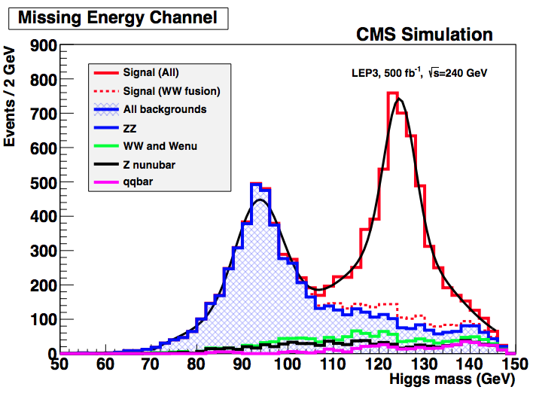
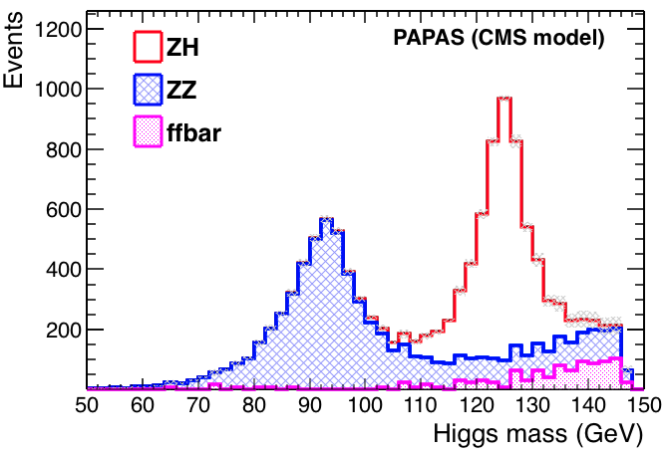
ZH→ννbb
Too many events at high mass (see next slide)
Resolution matches, indicates that the calorimeter model
and the particle flow in papas are fine.

Slide 19
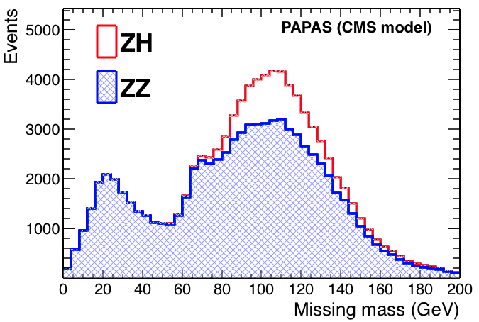
ZH→ννbb: missing mass
missing Z mass
too large
  jet energy too low
  jet energy calibration to be reviewed.
Poor man reoptimization:
  80 < m < 135
Low missing mass
→ high higgs mass

Slide 20
ZH→ννbb
Too many events at high mass (see next slide)
Resolution matches, indicates that the calorimeter model
and the particle flow in papas are fine.

Slide 21
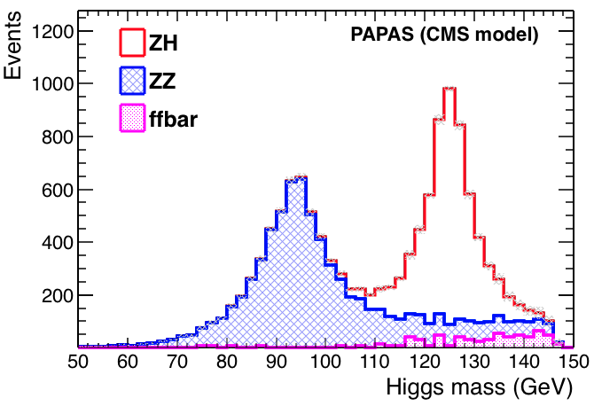
ZH→ννbb: missing mass: new cuts
Excess at high mass mostly disappears.
But 20% too many events overall.
Do proper jet energy correction and review…

Slide 22
Outline
Tools:
  papas
  heppy analysis framework
Analyses (vs LEP3 note)
  ZH→llX, ZH→llbb, ZH→nunubb
  yield extraction
Global fit for the couplings (vs TLEP note)
Summary and plans

Slide 23
Global Fit
Concept from M. Peskin
  https://arxiv.org/abs/1312.4974
Our implementation (M. Bachtis)
  https://github.com/bachtis/tlep-couplings
  used for the TLEP paper
  fitting code checked, looks correct to me
Rewritten to add goodness of fit tests:
  https://github.com/cbernet/tlep-couplings
  exact same results

Slide 24
Global Fit: kappa framework
coupling deviation
Deviation of the observed yield w/r SM
Measure a set of yields in various channels:
  i : ZH, WWH
  f : bb, ττ, …
Fit to find the best values of
Full width deviation assuming no other mode
Full width deviation allowing for invisible decay modes

Slide 25
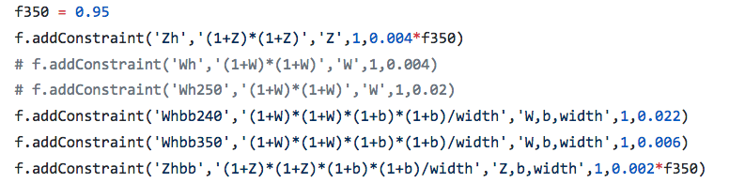
More precisely
yield uncertainty
(here at 240 GeV)
Fitting additive parameters instead of
yield ratio w/r SM set to 1
accounts for the fact that the 240 GeV measurement will also be done at 350 GeV
Gaussian pdf for all yields (σ = uncertainty)
Likelihood = product of the pdfs
The fit varies the parameters of interests
Uncertainty on the POIs finally taken from the fit

Slide 26
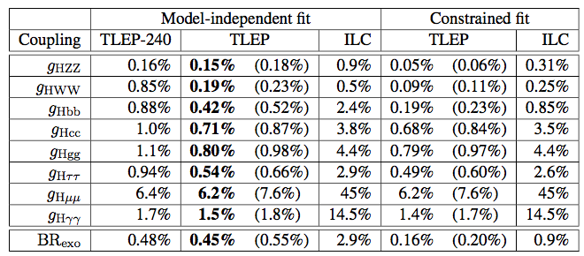
Trying the TLEP model
0.148
0.195
0.442
0.717
0.802
0.546
6.202
1.49
6.74
This should read BR_{inv}
Can reproduce all values except BRexo (factor 10 difference)

Slide 27
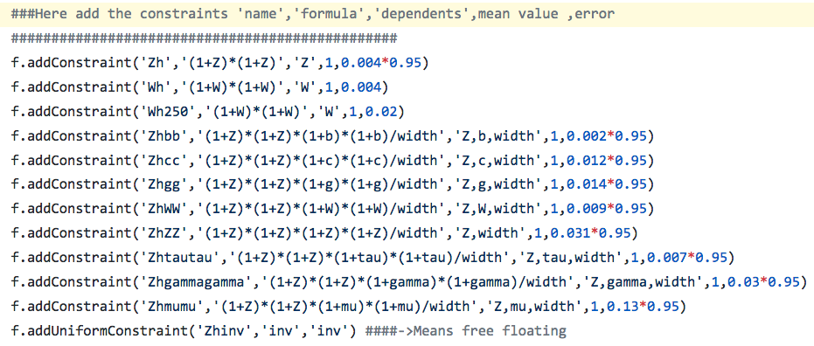
Check fit model
There is no inclusive WW→H measurement in the LEP3 / TLEP notes
Otherwise correct
https://github.com/bachtis/tlep-couplings/blob/master/runTLEP_250_350_Standalone_Floating.py#L21

Slide 28
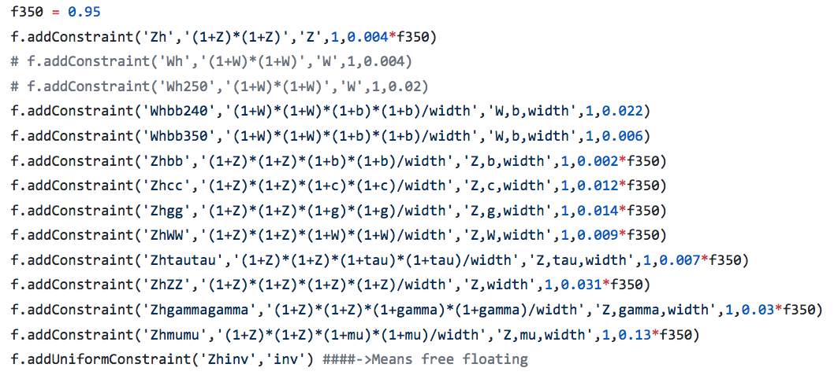
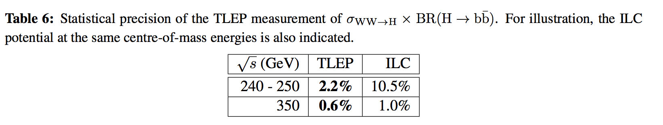
Fixing fit model

Slide 29
After the fix
0.148
0.195
0.442
0.717
0.802
0.546
6.202
1.49
6.74
0.149
0.329
0.463
0.745
0.840
0.580
6.206
1.504
6.77
Main change: uncertainty on W coupling almost x2

Slide 30
Including direct constraint on BR_{inv}
Bug found: the fit was defining:
Instead of:
Constraint model for BRinv:
- Gaussian centred on 0, σ = 0.3% (P. Janot)
- Allow values between 0 and 1%

Slide 31
Including direct constraint on BR_{inv}
0.149
0.329
0.463
0.745
0.840
0.580
6.206
1.504
0.46
BRinv now correct!
Actually, the direct constraints are not needed.
The bug fix is enough to bring BRinv to the correct value.
Mike had certainly found the bug but had not committed.

Slide 32
Summary and plans
Preparatory work:
  3 analyses done:
    ZH→llX, ZH→llbb, ZH→ννbb
  papas and global fit validated
    a few details to be checked (jet E correction)
  many analyses still uncovered
    ZH→ττ, ZH→WW, ZH→γγ, WWH→bb, …
      with many subchannels
  tools ready, let’s team up, happy to help
Do the study
  update running scenarios
  use other detector models
    CLIC-ILD ready in papas, parameter scan
  reoptimize analyses for each detector model
Thanks to Michalis Bachtis,
Patrick Janot, and Janik von Ahnen

Slide 33
Backup

Slide 34
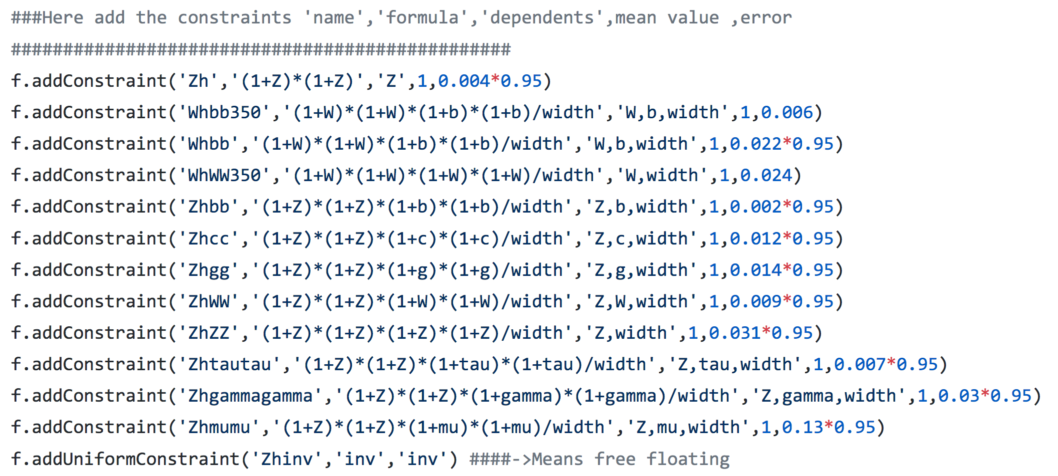
« 0p6 » model, also available in tlep-couplings
should not be there since Whbb350
is accounted for
analysis not mentioned anywhere?
https://github.com/bachtis/tlep-couplings/blob/master/runTLEP_250_350_Standalone_Floating_with_0p6.py

Slide 35
« 0p6 » model
TLEP model
my fix
0.148
0.195
0.442
0.717
0.802
0.546
6.202
1.49
3.369
0.149
0.329
0.463
0.745
0.840
0.580
6.206
1.504
3.387
0.148
0.317
0.460
0.744
0.838
0.578
6.206
1.485
3.376
The other model is close to my fix (but is not understood)
It is not the one used for the TLEP paper either
BRexo still 10 times larger
Uncertainty on W coupling almost x2

Slide 36
ILC (250 fb-1, 250 GeV)
0p6 TLEP model
TLEP model
ILC
(Peskin)
my fix
0.148
0.195
0.442
0.717
0.802
0.546
6.202
1.49
3.369
0.149
0.329
0.463
0.745
0.840
0.580
6.206
1.504
3.387
0.148
0.317
0.460
0.744
0.838
0.578
6.206
1.485
3.376
0.78
4.6
4.7
6.4
6.1
5.2
-
18.8
0.54
https://arxiv.org/abs/1312.4974 table 5
not directly comparable: twice smaller lumi, 250 instead of 240 GeV
BR inv < 1 % !

