Slide 1
Kickers, septa and beam transfer lines
Beam transfer devices
  Kickers
  Septa
  Protection devices
Beam transfer lines
  Distinctions between transfer lines and circular machines
  Linking machines/experiments together
  Emittance blow-up from mismatch
  Measure beam parameters (measurement lines)
Matthew Fraser, CERN (TE-ABT-BTP) based on lectures by
M.J. Barnes, W. Bartmann, J. Borburgh, B. Goddard, V. Kain and M. Meddahi

Slide 2
Reminder: injection, septum and kicker
Injected beam
‘boxcar’ stacking
intensity
injected
beam
Septum magnet
kicker field
t
Circulating beam
Kicker magnet
F-quad
D-quad
Kickers produce fast pulses, rising their field within the particle-free gap in the circulating beam (temporal separation)
Septa compensate for the relatively low kicker strength, and approach closely the circulating beam (spatial separation)
ABT Introductory Lectures – CERN Accelerator School, Constanta, Romania, 2018

Slide 3
Reminder: extraction, septum and kicker
Extracted beam
intensity
extracted beam
Septum magnet
kicker field
t
Circulating
beam
Kicker magnet
F-quad
Closed orbit bumpers
D-quad
Kickers produce fast pulses, rising their field within the particle-free gap in the circulating beam (temporal separation)
Septa compensate for the relatively low kicker strength, and approach closely the circulating beam (spatial separation)
ABT Introductory Lectures – CERN Accelerator School, Constanta, Romania, 2018

Slide 4
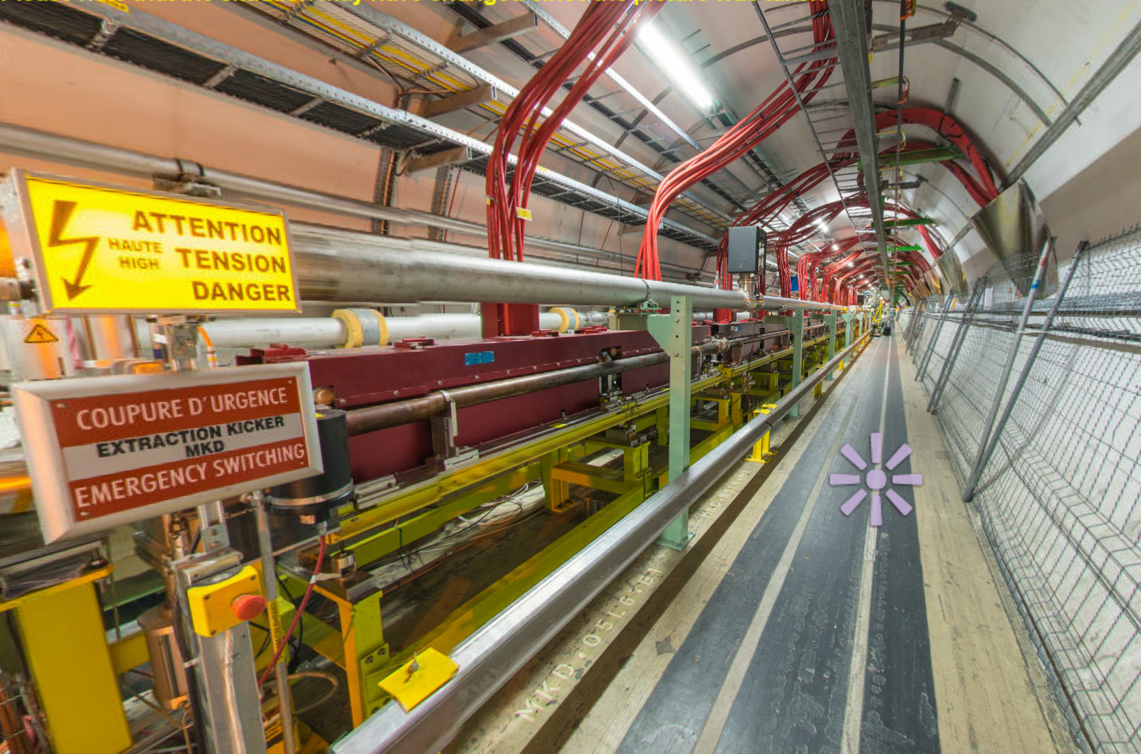
Kickers
LHC beam dump
kickers (MKD)
ABT Introductory Lectures – CERN Accelerator School, Constanta, Romania, 2018

Slide 5
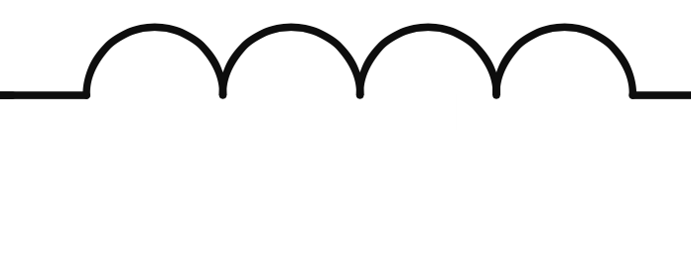
Magnets – design options
Type: “lumped inductance”
From generator
(e.g. PFN)
  simple magnet design
  magnet must be nearby the generator to minimise inductance
  exponential field rise-time:
  slow: rise-times ~ 1 μs
ABT Introductory Lectures – CERN Accelerator School, Constanta, Romania, 2018

Slide 6
Magnets – design options
Type: “lumped inductance” or “distributed inductance” (transmission line)
From generator
(e.g. PFN)
From generator
(e.g. PFN)
  simple magnet design
  magnet must be nearby the generator to minimise inductance
  exponential field rise-time:
  slow: rise-times ~ 1 μs
Cell 1…
Cell n - 1 …
Cell n
  complicated magnet design
  impedance matching important
  field rise-time depends on propagation time of pulse through magnet:
  fast: rise-times << 1 μs
ABT Introductory Lectures – CERN Accelerator School, Constanta, Romania, 2018

Slide 7
Magnets – design options
Type: “lumped inductance” or “distributed inductance” (transmission line)
Other considerations:
  Machine vacuum: kicker in-vacuum or external
  Aperture: geometry of ferrite core
  Termination: matched impedance or short-circuit
From generator
(e.g. PFN)
From generator
(e.g. PFN)
  simple magnet design
  magnet must be nearby the generator to minimise inductance
  exponential field rise-time:
  slow: rise-times ~ 1 μs
Cell 1…
Cell n - 1 …
Cell n
  complicated magnet design
  impedance matching important
  field rise-time depends on propagation time of pulse through magnet:
  fast: rise-times << 1 μs
ABT Introductory Lectures – CERN Accelerator School, Constanta, Romania, 2018

Slide 8
Simplified kicker system schematic
Matched impedance example
Main sub-systems (“components”) of kicker system;
  RCPS = Resonant Charging Power Supply
  PFL = Pulse Forming Line (coaxial cable) or PFN = Pulse Forming Network (lumped elements)
  Fast high power switch(es)
  Transmission line(s): coaxial cable(s)
  Kicker Magnet
  Terminators (resistive)
ABT Introductory Lectures – CERN Accelerator School, Constanta, Romania, 2018

Slide 9
Simplified kicker system schematic
Matched impedance example
PFL/PFN charged to voltage V₀ by the RCPS
Main switch is closed…
…voltage pulse of V₀/2 flows through kicker
Once the pulse reaches the (matched) terminating resistor full-field has been established in the kicker magnet
Pulse length controlled between t = 0 and 2τ_{p} with dump switch
ABT Introductory Lectures – CERN Accelerator School, Constanta, Romania, 2018

Slide 10
Simplified kicker system schematic
int.
kicker
field
time,
distance
Pulse forming network or line (PFL/PFN) charged to voltage V₀ by the resonant charging power supply (RCPS)
  RCPS is de-coupled from the system through a diode stack
ABT Introductory Lectures – CERN Accelerator School, Constanta, Romania, 2018

Slide 11
Simplified kicker system schematic
int.
kicker
field
time,
distance
Pulse forming network or line (PFL/PFN) charged to voltage V₀ by the resonant charging power supply (RCPS)
  RCPS is de-coupled from the system through a diode stack
  At t = 0, main switch is closed and current starts to flow into the kicker

Slide 12
Simplified kicker system schematic
int.
kicker
field
time,
distance
At t = τ_{fill}, the voltage pulse of magnitude V₀/2 has propagated through the kicker and nominal field achieved with a current V₀/2Z
  typically τ_{p} >> τ_{fill} (schematic for illustration purposes)
ABT Introductory Lectures – CERN Accelerator School, Constanta, Romania, 2018

Slide 13
Simplified kicker system schematic
int.
kicker
field
time,
distance
PFN continues to discharge energy into kicker magnet and matched terminating resistor
ABT Introductory Lectures – CERN Accelerator School, Constanta, Romania, 2018

Slide 14
Simplified kicker system schematic
int.
kicker
field
time,
distance
PFN continues to discharge energy into kicker magnet and matched terminating resistor
At t ≈ τ_{p} the negative pulse reflects off the open end of the circuit (dump switch) and back towards the kicker

Slide 15
Simplified kicker system schematic
int.
kicker
field
time,
distance
PFN continues to discharge energy into matched terminating resistor
At t ≈ τ_{p} the negative pulse reflects off the open end of the circuit and back towards the kicker
ABT Introductory Lectures – CERN Accelerator School, Constanta, Romania, 2018

Slide 16
Simplified kicker system schematic
int.
kicker
field
time,
distance
At t ≈ 2τ_{p} the pulse arrives at the kicker and field starts to decay
ABT Introductory Lectures – CERN Accelerator School, Constanta, Romania, 2018

Slide 17
Simplified kicker system schematic
int.
kicker
field
time,
distance
A kicker pulse of approximately 2τ_{p} is imparted on the beam and all energy has been emptied into the terminating resistor
ABT Introductory Lectures – CERN Accelerator School, Constanta, Romania, 2018

Slide 18
Simplified kicker system schematic
int.
kicker
field
time,
distance
Kicker pulse length can be changed by adjusting the relative timing of dump and main switches:
  e.g. if the dump and main switches are fired simultaneously the pulse length will be halved and energy shared on dump and terminating resistors
ABT Introductory Lectures – CERN Accelerator School, Constanta, Romania, 2018

Slide 19
Reflections
A simplified pulse forming circuit:
Match impedances to avoid reflections!
When the switch is fired the voltage is divided as:
ABT Introductory Lectures – CERN Accelerator School, Constanta, Romania, 2018

Slide 20
Reflections
A simplified pulse forming circuit:
Charging end of line
Load end of line
If matched:
Time
Match impedances to avoid reflections!
When the switch is fired the voltage is divided as:
In the matched case:
Mismatches will ring in the circuit causing ripples on the pulse, or post-pulse.
ABT Introductory Lectures – CERN Accelerator School, Constanta, Romania, 2018

Slide 21
Reflections
A simplified pulse forming circuit:
Charging end of line
Load end of line
Time
Match impedances to avoid reflections!
When the switch is fired the voltage is divided as:
In the matched case:
Mismatches will ring in the circuit causing ripples on the pulse, or post-pulse.
In general
(mis-matched):
ABT Introductory Lectures – CERN Accelerator School, Constanta, Romania, 2018

Slide 22
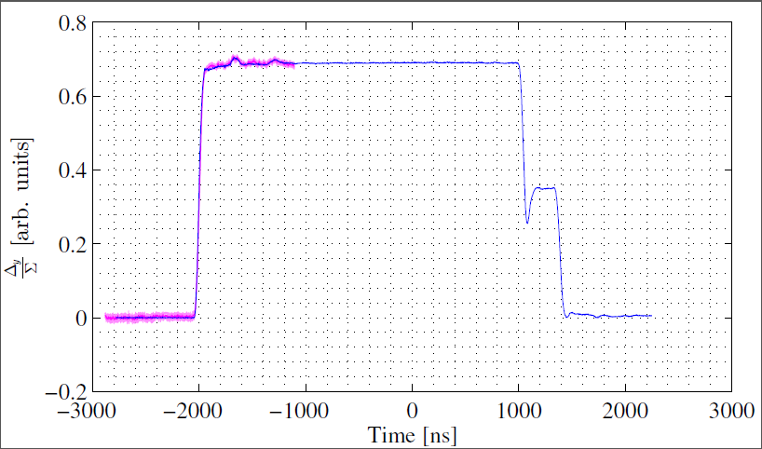
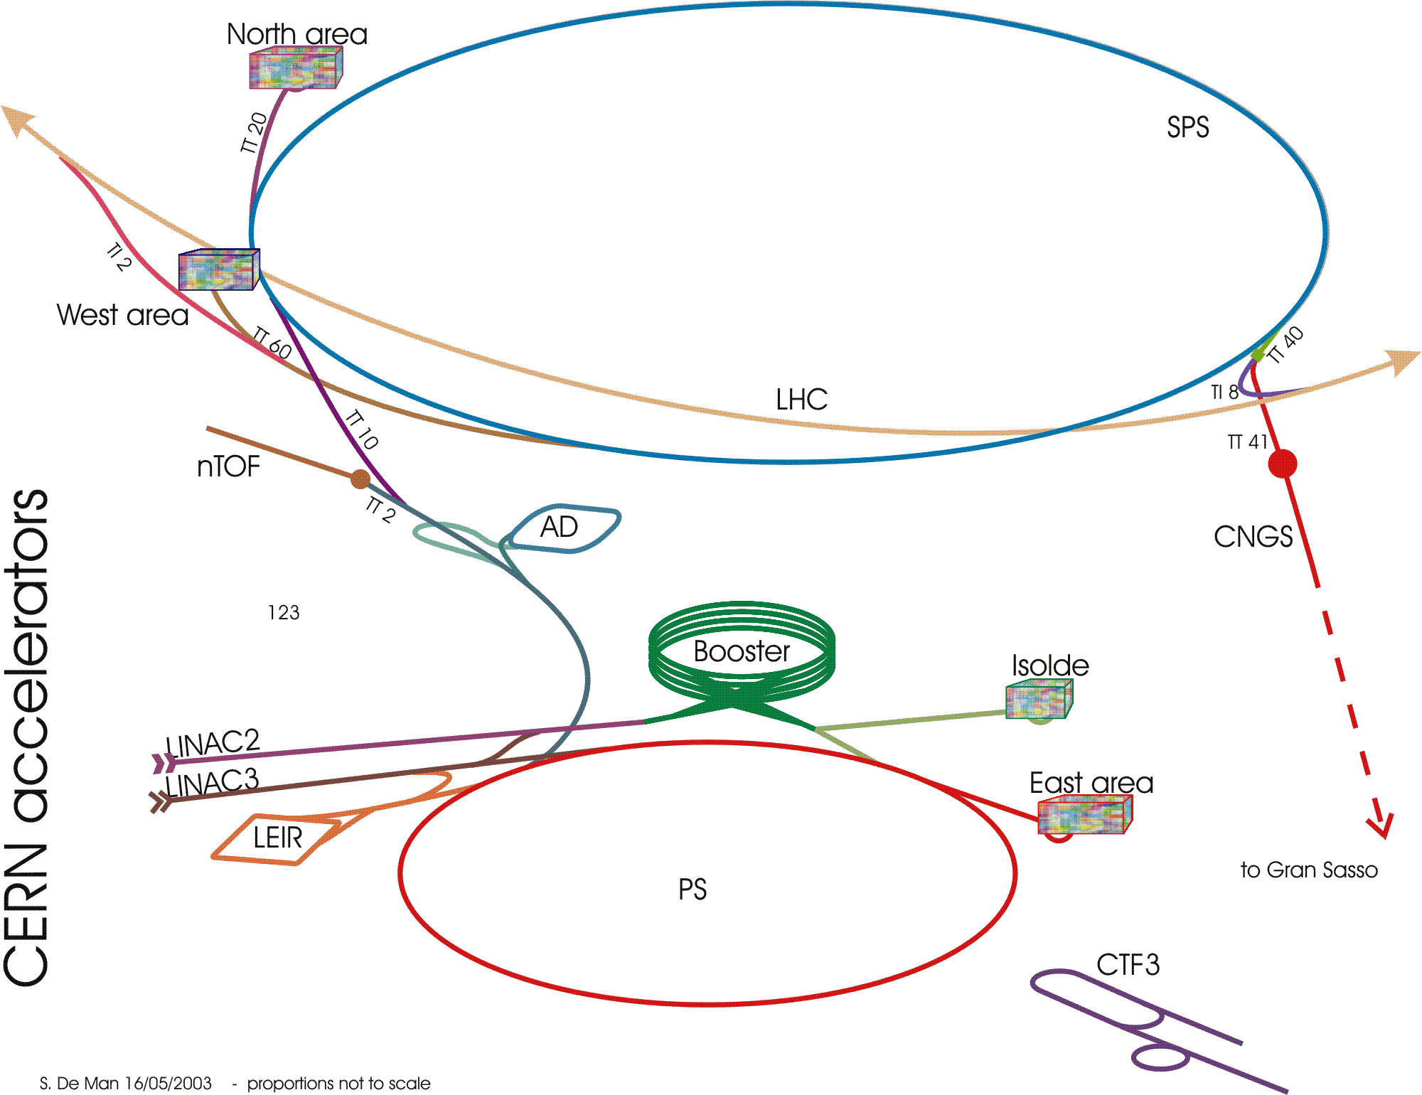
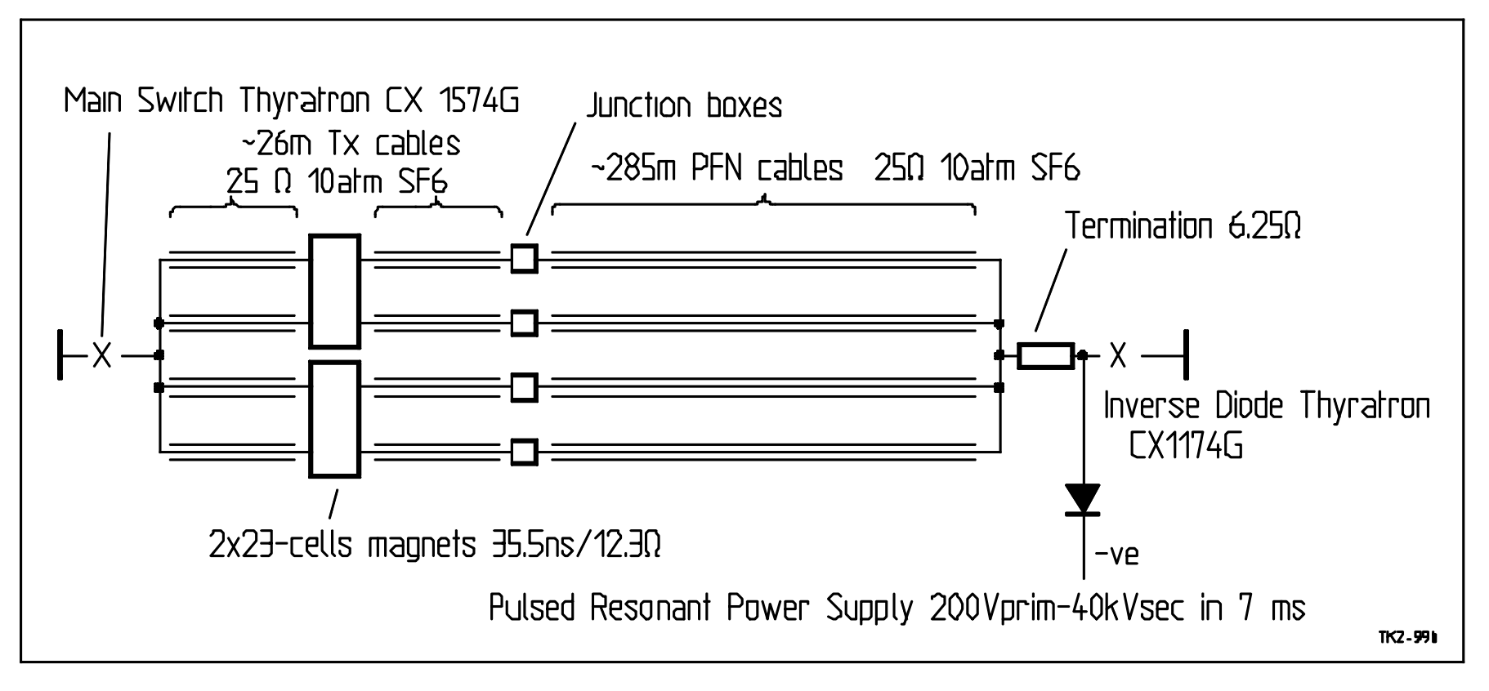
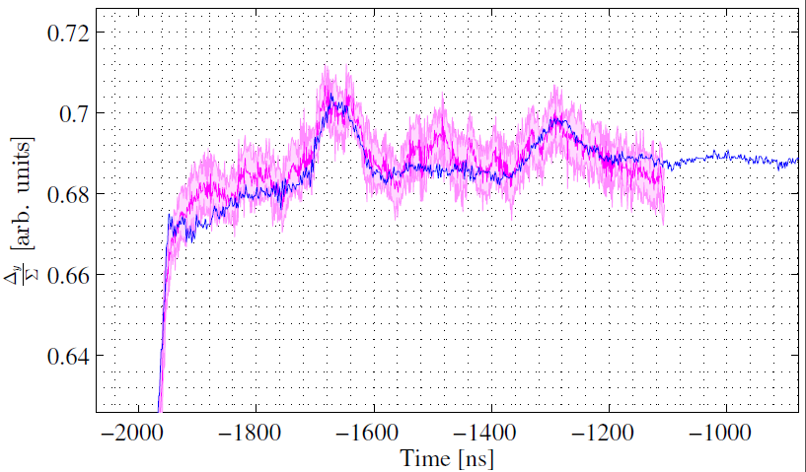
An example of reflections
PSB
PS
Field and measured kick [arb. units]
Recombination kicker KFA.20 deflects
PS booster rings 1 and 2 vertically into plane of PS at CERN
~ few %
Field and measured kick [arb. units]
BT.KFA20 circuit schematic: operates in “virtual” short-circuit
Current loop measurement (L. Sermeus)
Beam-based measurement (I=200e10 ppb)
Beam-based kicker measurements at higher intensities, V. Forte BT + PS injection kicker meeting, CERN (15th August 2016)
ABT Introductory Lectures – CERN Accelerator School, Constanta, Romania, 2018

Slide 23
Magnets – transmission line
Today’s fast (rise-times of < few hundred ns) kicker magnets are generally ferrite loaded transmission lines:
  Ferrite C-cores are sandwiched between HV plates
  Grounded plates are interleaved to form a capacitor to ground
ABT Introductory Lectures – CERN Accelerator School, Constanta, Romania, 2018

Slide 24
Magnets – transmission line
Today’s fast (rise-times of < few hundred ns) kicker magnets are generally ferrite loaded transmission lines:
  Ferrite C-cores are sandwiched between HV plates
  Grounded plates are interleaved to form a capacitor to ground
End View
Side View
Grounded end plate
HV conductor
HV
Return
conductor

Slide 25
Magnets – transmission line
Today’s fast (rise-times of < few hundred ns) kicker magnets are generally ferrite loaded transmission lines:
  Ferrite C-cores are sandwiched between HV plates
  Grounded plates are interleaved to form a capacitor to ground
End View
Side View
HV plate
HV conductor
HV
Return
conductor

Slide 26
Magnets – transmission line
Today’s fast (rise-times of < few hundred ns) kicker magnets are generally ferrite loaded transmission lines:
  Ferrite C-cores are sandwiched between HV plates
  Grounded plates are interleaved to form a capacitor to ground
End View
Side View
HV plate
HV conductor
Ferrite
HV
beam
B
Return
conductor

Slide 27
Magnets – transmission line
Today’s fast (rise-times of < few hundred ns) kicker magnets are generally ferrite loaded transmission lines:
  Ferrite C-cores are sandwiched between HV plates
  Grounded plates are interleaved to form a capacitor to ground
End View
Side View
Ground plate
HV conductor
Ferrite
HV
beam
B
Return
conductor

Slide 28
Magnets – transmission line
Today’s fast (rise-times of < few hundred ns) kicker magnets are generally ferrite loaded transmission lines:
  Ferrite C-cores are sandwiched between HV plates
  Grounded plates are interleaved to form a capacitor to ground
End View
Side View
HV plate
HV conductor
HV
beam
B
Return
conductor

Slide 29
Magnets – transmission line
Today’s fast (rise-times of < few hundred ns) kicker magnets are generally ferrite loaded transmission lines:
  Ferrite C-cores are sandwiched between HV plates
  Grounded plates are interleaved to form a capacitor to ground
End View
Side View
Ground plate
HV conductor
Ferrite
HV
beam
B
Return
conductor

Slide 30
Magnets – transmission line
Today’s fast (rise-times of < few hundred ns) kicker magnets are generally ferrite loaded transmission lines:
  Ferrite C-cores are sandwiched between HV plates
  Grounded plates are interleaved to form a capacitor to ground
End View
cell
Side View
Ground plate
HV conductor
Ferrite
HV
beam
B
Return
conductor

Slide 31
Magnets – transmission line
Today’s fast (rise-times of < few hundred ns) kicker magnets are generally ferrite loaded transmission lines:
  Ferrite C-cores are sandwiched between HV plates
  Grounded plates are interleaved to form a capacitor to ground
End View
cell
Side View
Ground plate
HV conductor
Ferrite
HV
beam
B
Return
conductor

Slide 32
Magnets – transmission line
Today’s fast (rise-times of < few hundred ns) kicker magnets are generally ferrite loaded transmission lines:
  Ferrite C-cores are sandwiched between HV plates
  Grounded plates are interleaved to form a capacitor to ground
End View
cell
Side View
and so on…
Ground plate
HV conductor
Ferrite
HV
beam
B
Return
conductor

Slide 33
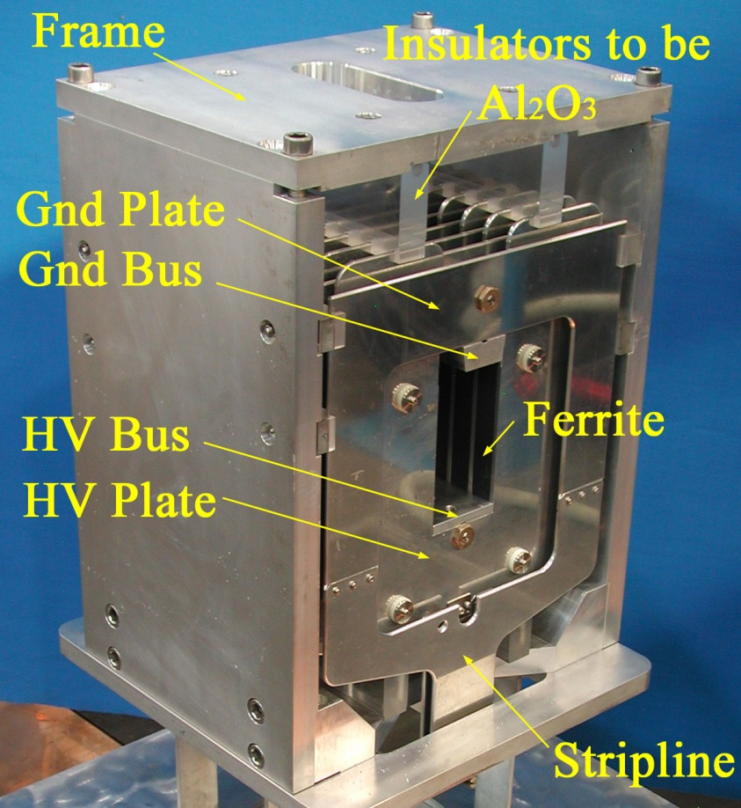
Magnets – transmission line
Today’s fast (rise-times of < few hundred ns) kicker magnets are generally ferrite loaded transmission lines:
  Kicker magnets consists of many, relatively short, cells to approximate a broadband coaxial cable
cell
Side View
and so on…
A real kicker…
Prototype for AGS injection kicker upgrade
beam
cell
#1
#2
#(n-1)
#n

Slide 34
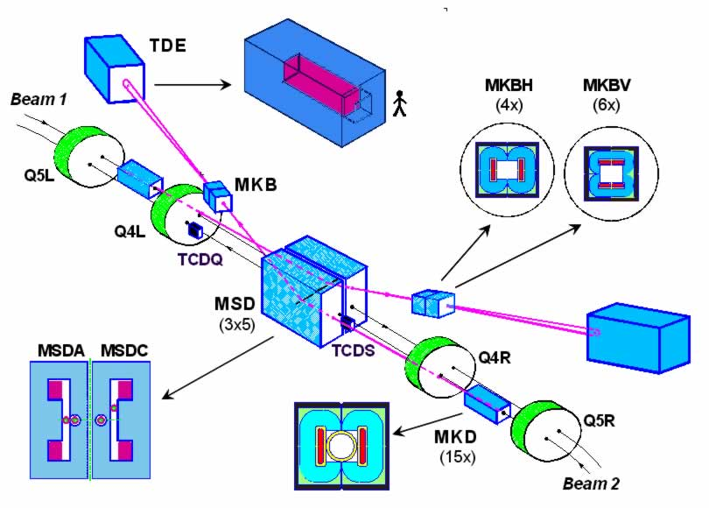
Magnets – lumped inductance
Lumped inductance kicker magnets are robust and reliable, and suitable for applications where the rise-time is typically > 1 μs:
  e.g. LHC beam dump extraction and dilution kicker magnets
ABT Introductory Lectures – CERN Accelerator School, Constanta, Romania, 2018

Slide 35
Magnets – lumped inductance
Lumped inductance kicker magnets are robust and reliable, and suitable for applications where the rise-time is typically > 1 μs:
  e.g. LHC beam dump extraction and dilution kicker magnets
2x C-cores back-to-back
single turn coil
insulation
Horizontal
dilution
Vertical
dilution
~ 90 μs
A damped series RLC circuit (switch closed after capacitor charged)
Cross-section of MKBH
(horizontal dilution magnet)
ABT Introductory Lectures – CERN Accelerator School, Constanta, Romania, 2018

Slide 36
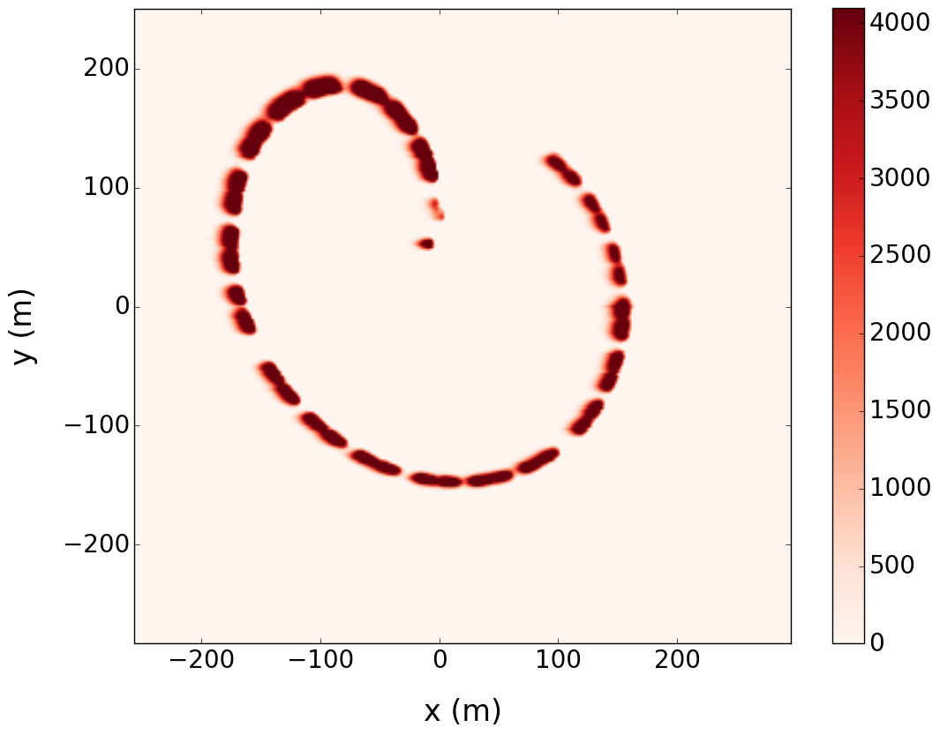
Magnets – lumped inductance
Lumped inductance kicker magnets are robust and reliable, and suitable for applications where the rise-time is typically > 1 μs:
  e.g. LHC beam dump extraction and dilution kicker magnets
Beam dump event at 6.5 TeV on 22nd July 2016
Relative intensity [arb. Units]
ABT Introductory Lectures – CERN Accelerator School, Constanta, Romania, 2018

Slide 37
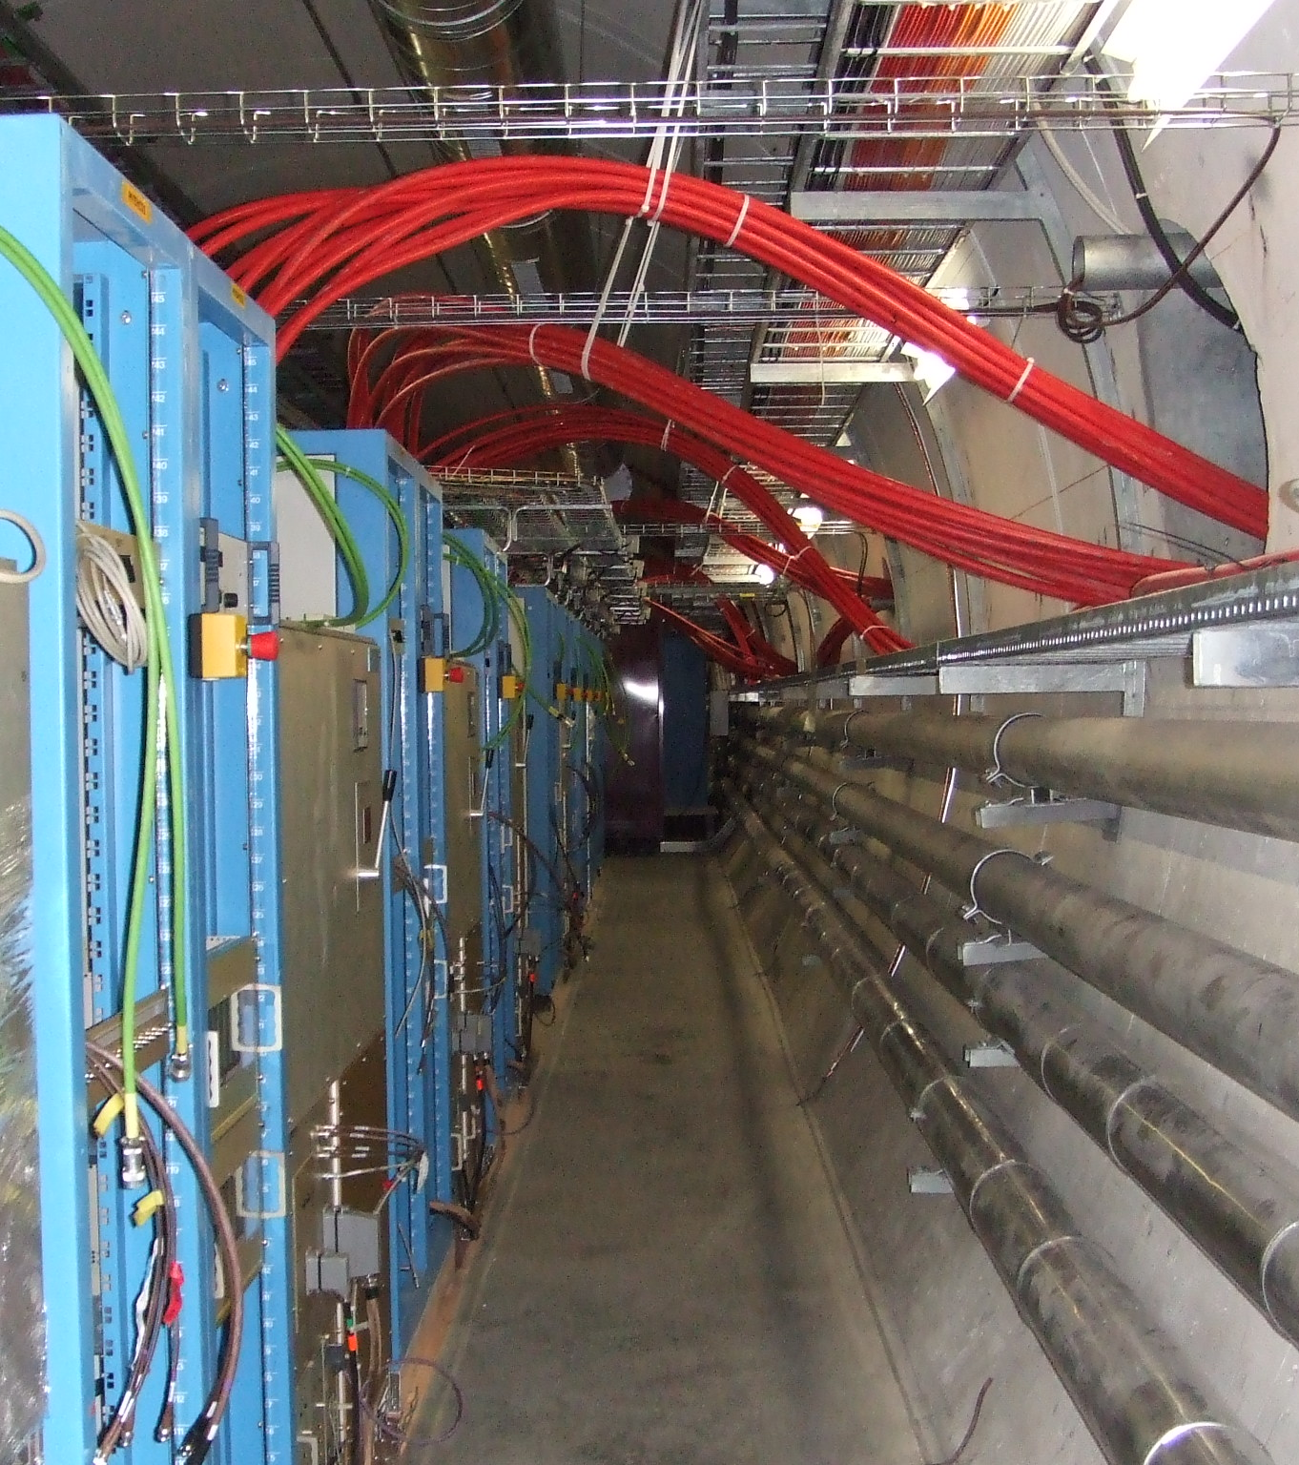
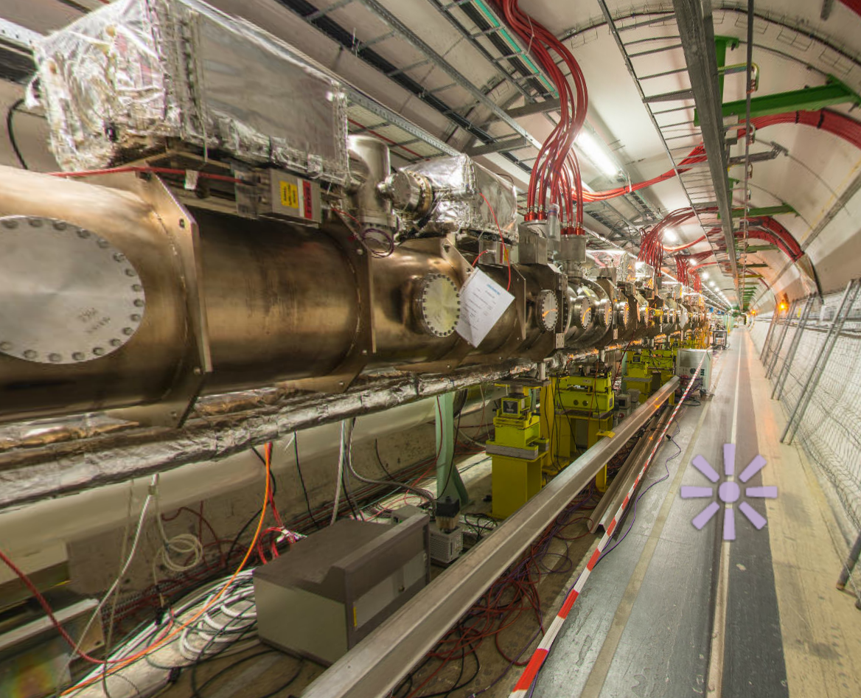
Magnets – lumped inductance
Lumped inductance kicker magnets are robust and reliable, and suitable for applications where the rise-time is typically > 1 μs:
  e.g. LHC beam dump extraction and dilution kicker magnets
Generators nearby in gallery
next to LHC tunnel
MKB dilution magnets in the LHC tunnel
ABT Introductory Lectures – CERN Accelerator School, Constanta, Romania, 2018

Slide 38
Magnetic parameters
HV conductor
Return conductor
Magnetic field
Ferrite
HV
Vertical aperture, V_{ap}
B
Derivation: remember Ampère’s Law:
μ₀
Magnet inductance
[per unit length]
μ_{r}
A C-core geometry,
commonly used at CERN
Horizontal
aperture, H_{ap}
Derivation: remember Faraday’s Law:
and
Dimensions H_{ap} and V_{ap} specified by beam parameters at kicker location
Ferrite (μ_{r} ≈ 1000) reinforces magnetic circuit and uniformity of the field in the gap
For fast rise-times the inductance must be minimised: typically the number of turns, N = 1
Kickers are often split into several magnet units, powered independently
ABT Introductory Lectures – CERN Accelerator School, Constanta, Romania, 2018

Slide 39
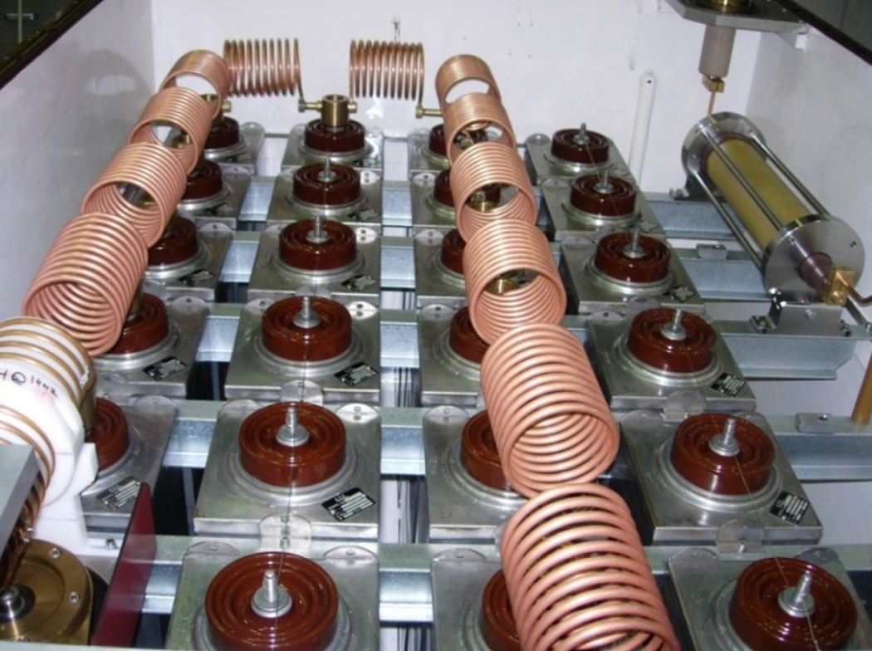
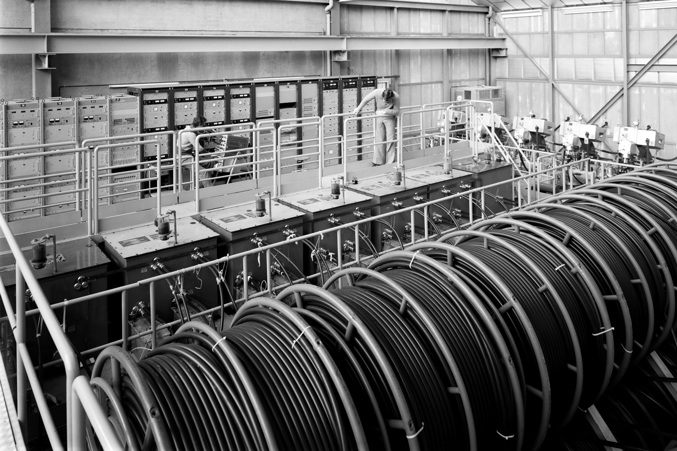
PFL/PFN
Pulse Forming Line (PFL)
Low-loss coaxial cable
Fast and ripple-free pulses
Attenuation (droop ~1%) becomes problematic for pulses > 3 μs
Above 50 kV SF6 pressurized PE tape cables are used
Bulky: 3 μs pulse ~ 300 m of cable
Pulse Forming Network (PFN)
Artificial coaxial cable made of lumped elements
For low droop and long pulses > 3 μs
Each cell individually adjustable: adjustment of pulse flat-top difficult and time consuming.
Reels of PFL used at the PS complex (as old as the photograph!)
SPS extraction kicker (MKE) PFN (17 cells)
ABT Introductory Lectures – CERN Accelerator School, Constanta, Romania, 2018

Slide 40
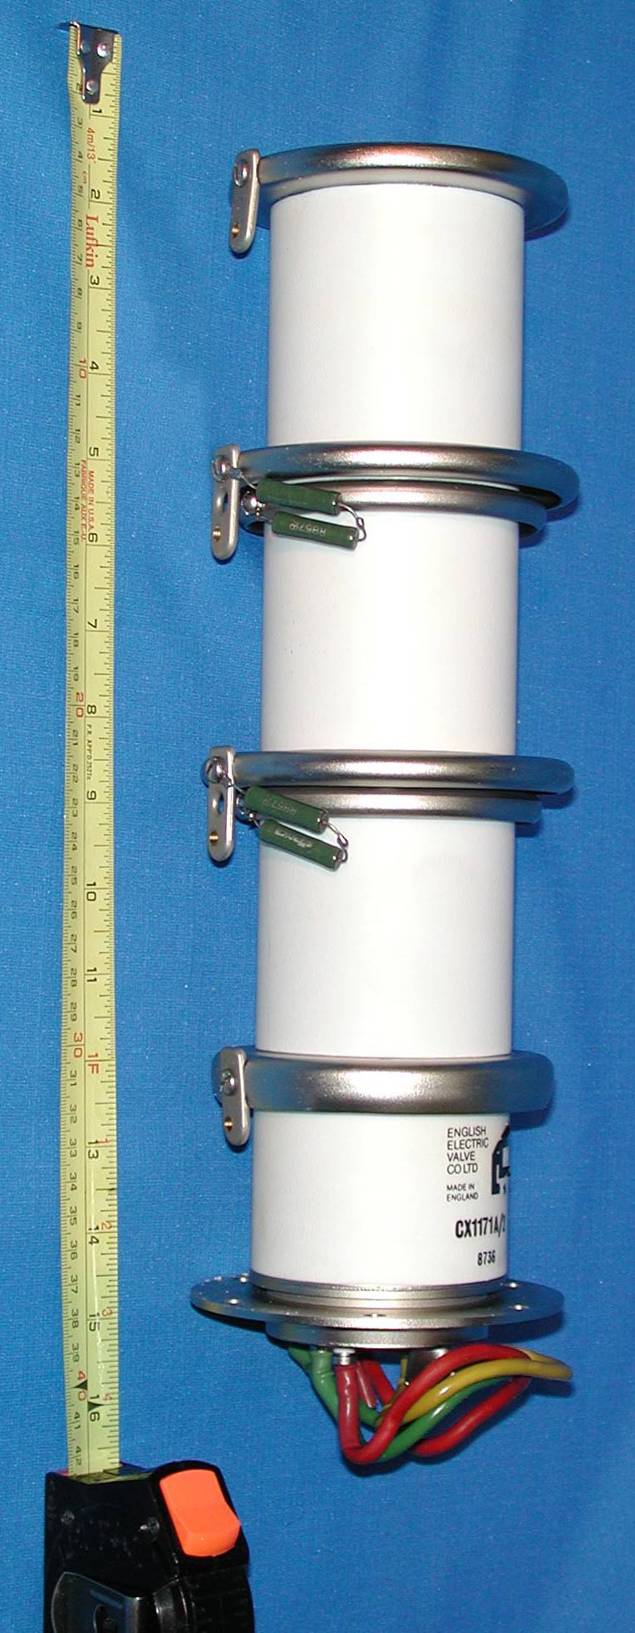
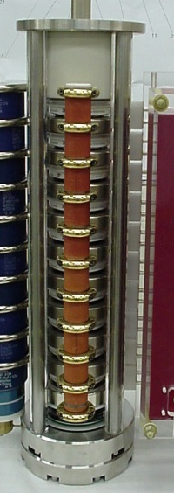
Switches
Thyratrons
Deuterium gas thyratrons are commonly used
Hold off 80 kV and switch up to 6 kA
Fast switching ~ 30 ns (~150 kA/μs)
Erratic turn-on: use with RCPS to reduce hold-off time
Power semiconductor switches
Suitable for scenarios where erratic turn-on is not allowed
For example, LHC beam dump kickers held at nominal voltage throughout operation (>10h) ready to fire and safely abort at any moment.
Hold off up to 30 kV and switch up to 18 kA
Slower switching > 1 μs (~18kA/μs)
Low maintenance
~ 340 mm
Stack of high-power semiconductor switches (GTOs)
Thyratron
ABT Introductory Lectures – CERN Accelerator School, Constanta, Romania, 2018

Slide 41
Terminated vs. short circuit
Short-circuiting the termination offers twice the kick (for a given kicker magnet):
  Fill time of kicker magnet is doubled
  Diode as dump switch provides solution for fixed pulse length
int.
kicker
field
Dump Diode
time,
Short Circuit
distance
ABT Introductory Lectures – CERN Accelerator School, Constanta, Romania, 2018

Slide 42
Terminated vs. short circuit
Short-circuiting the termination offers twice the kick (for a given kicker magnet):
  Fill time of kicker magnet is doubled
  Diode as dump switch provides solution for fixed pulse length
int.
kicker
field
Dump Diode
time,
Short Circuit
distance
ABT Introductory Lectures – CERN Accelerator School, Constanta, Romania, 2018

Slide 43
Terminated vs. short circuit
Short-circuiting the termination offers twice the kick (for a given kicker magnet):
  Fill time of kicker magnet is doubled
  Diode as dump switch provides solution for fixed pulse length
int.
kicker
field
Dump Diode
time,
Short Circuit
Boundary condition at short-circuit:
V = 0, doubling I
distance
ABT Introductory Lectures – CERN Accelerator School, Constanta, Romania, 2018

Slide 44
Terminated vs. short circuit
Short-circuiting the termination offers twice the kick (for a given kicker magnet):
  Fill time of kicker magnet is doubled
  Diode as dump switch provides solution for fixed pulse length
int.
kicker
field
Dump Diode
time,
Short Circuit
Boundary condition at short-circuit:
V = 0, doubling I
distance
ABT Introductory Lectures – CERN Accelerator School, Constanta, Romania, 2018

Slide 45
Terminated vs. short circuit
Short-circuiting the termination offers twice the kick (for a given kicker magnet):
  Fill time of kicker magnet is doubled
  Diode as dump switch provides solution for fixed pulse length
int.
kicker
field
Dump Diode
time,
Short Circuit
Boundary condition at short-circuit:
V = 0, doubling I
distance
ABT Introductory Lectures – CERN Accelerator School, Constanta, Romania, 2018

Slide 46
Terminated vs. short circuit
Short-circuiting the termination offers twice the kick (for a given kicker magnet):
  Fill time of kicker magnet is doubled
  Diode as dump switch provides solution for fixed pulse length
int.
kicker
field
Dump Diode
time,
Short Circuit
Boundary condition at short-circuit:
V = 0, doubling I
Initial pulse reflects of the diode
distance
ABT Introductory Lectures – CERN Accelerator School, Constanta, Romania, 2018

Slide 47
Terminated vs. short circuit
Short-circuiting the termination offers twice the kick (for a given kicker magnet):
  Fill time of kicker magnet is doubled
  Diode as dump switch provides solution for fixed pulse length
int.
kicker
field
Dump Diode
time,
Short Circuit
Boundary condition at short-circuit:
V = 0, doubling I
Initial pulse reflects of the diode
distance
ABT Introductory Lectures – CERN Accelerator School, Constanta, Romania, 2018

Slide 48
Terminated vs. short circuit
Short-circuiting the termination offers twice the kick (for a given kicker magnet):
  Fill time of kicker magnet is doubled
  Diode as dump switch provides solution for fixed pulse length
int.
kicker
field
Dump Diode
time,
Short Circuit
Diode conducts as voltage flips sign and match dump resistor absorbs energy
Boundary condition at short-circuit:
V = 0, doubling I
distance
ABT Introductory Lectures – CERN Accelerator School, Constanta, Romania, 2018

Slide 49
Terminated vs. short circuit
Short-circuiting the termination offers twice the kick (for a given kicker magnet):
  Fill time of kicker magnet is doubled
  Diode as dump switch provides solution for fixed pulse length
int.
kicker
field
Dump Diode
time,
Short Circuit
Diode conducts as voltage flips sign and match dump resistor absorbs energy
Boundary condition at short-circuit:
V = 0, doubling I
distance
ABT Introductory Lectures – CERN Accelerator School, Constanta, Romania, 2018

Slide 50
Terminated vs. short circuit
Short-circuiting the termination offers twice the kick (for a given kicker magnet):
  Fill time of kicker magnet is doubled
  Diode as dump switch provides solution for fixed pulse length
int.
kicker
field
Dump Diode
time,
Short Circuit
Diode conducts as voltage flips sign and match dump resistor absorbs energy
Boundary condition at short-circuit:
V = 0, doubling I
distance
ABT Introductory Lectures – CERN Accelerator School, Constanta, Romania, 2018

Slide 51
Terminated vs. short circuit
Short-circuiting the termination offers twice the kick (for a given kicker magnet):
  Fill time of kicker magnet is doubled
  Diode as dump switch provides solution for fixed pulse length
int.
kicker
field
Dump Diode
time,
Short Circuit
Diode conducts as voltage flips sign and match dump resistor absorbs energy
Boundary condition at short-circuit:
V = 0, doubling I
distance
ABT Introductory Lectures – CERN Accelerator School, Constanta, Romania, 2018

Slide 52
Terminated vs. short circuit
Short-circuiting the termination offers twice the kick (for a given kicker magnet):
  Fill time of kicker magnet is doubled
  Diode as dump switch provides solution for fixed pulse length
int.
kicker
field
Dump Diode
time,
Short Circuit
Diode conducts as voltage flips sign and match dump resistor absorbs energy
Boundary condition at short-circuit:
V = 0, doubling I
distance
ABT Introductory Lectures – CERN Accelerator School, Constanta, Romania, 2018

Slide 53
Terminated vs. short circuit
Short-circuiting the termination offers twice the kick (for a given kicker magnet):
  Fill time of kicker magnet is doubled
  Diode as dump switch provides solution for fixed pulse length
int.
kicker
field
Dump Diode
time,
Short Circuit
Diode conducts as voltage flips sign and match dump resistor absorbs energy
Boundary condition at short-circuit:
V = 0, doubling I
distance
ABT Introductory Lectures – CERN Accelerator School, Constanta, Romania, 2018

Slide 54
Terminated vs. short circuit
Short-circuiting the termination offers twice the kick (for a given kicker magnet):
  Fill time of kicker magnet is doubled
  Diode as dump switch provides solution for fixed pulse length
int.
kicker
field
Dump Diode
time,
Short Circuit
distance
ABT Introductory Lectures – CERN Accelerator School, Constanta, Romania, 2018

Slide 55
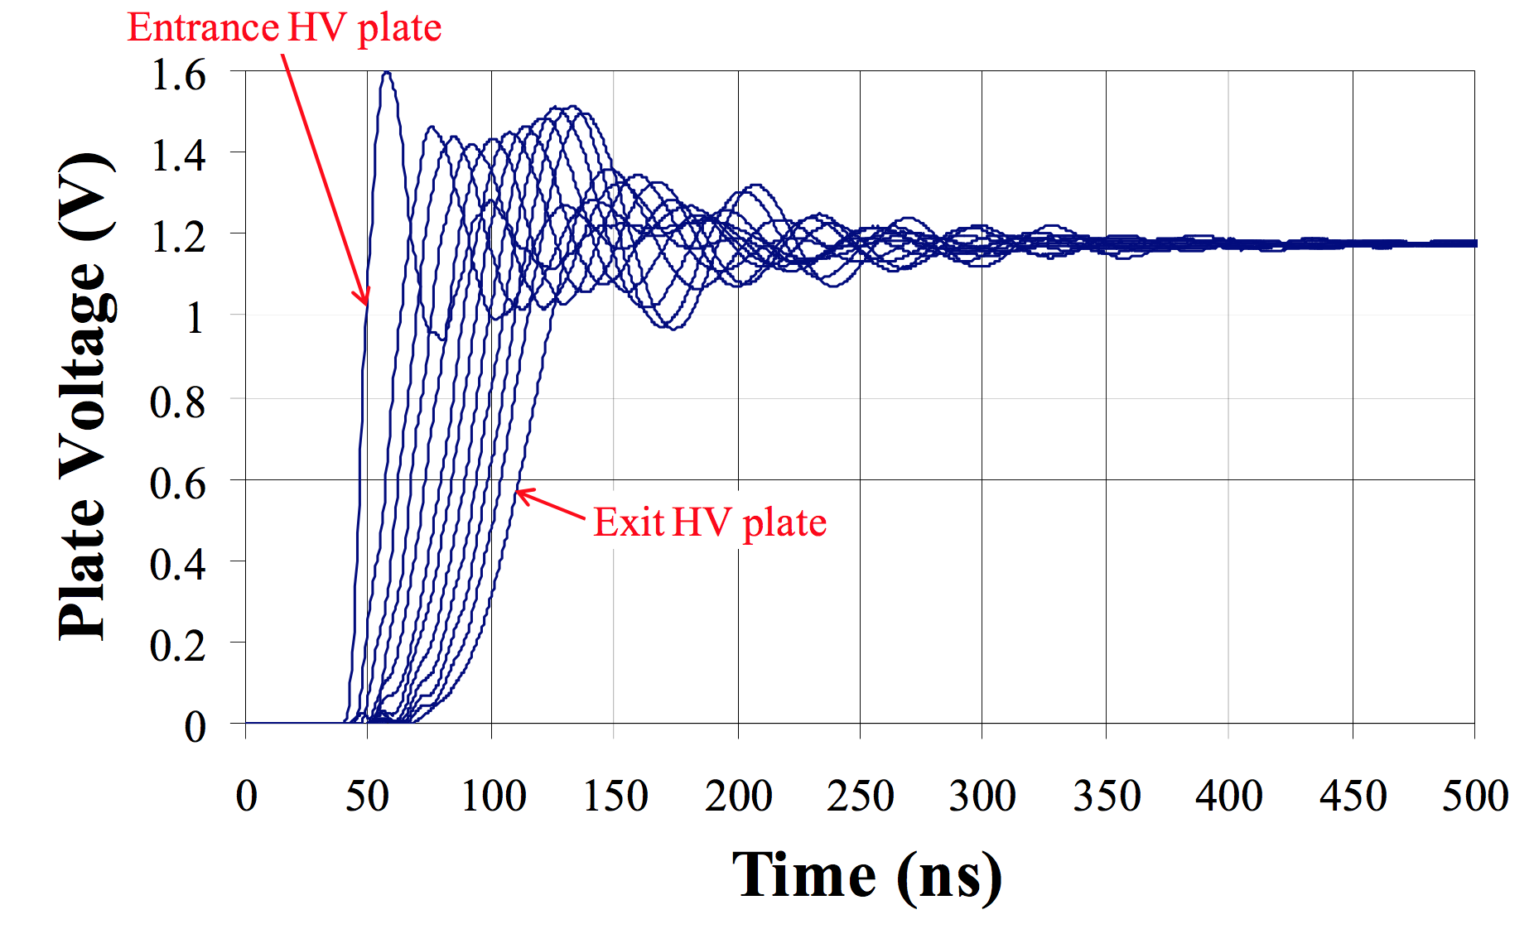
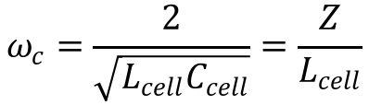
Other topics and considerations
Ripple: cells of a transmission line kicker have a cut-off frequency that introduces dispersion in pulse:
  Cut-off frequency:
In vacuum: aperture dimensions (H_{ap} and V_{ap}) minimised if in vacuum:
  For given B, lower I and L can be achieved with smaller H_{ap} and V_{ap}
  Machine vacuum is a reliable dielectric, recovers after flashover
  Costly and time consuming to construct/maintain (cleanliness, bake-out)
Beam coupling impedance: kickers are a source of beam impedance in accelerators (wakefields and beam instabilities)
  Ferrite is shielded from beam with beam screens or serigraphy by permitting a smooth conducting path for beam induced image charges
  Beam induced heating of ferrite yoke can heat it above the Curie temp.
Measurements on AGS kicker
$$ω_{c}=\frac{2}{\sqrt{L_{cell}C_{cell}}}=\frac{Z}{L_{cell}}$$
ABT Introductory Lectures – CERN Accelerator School, Constanta, Romania, 2018

Slide 56
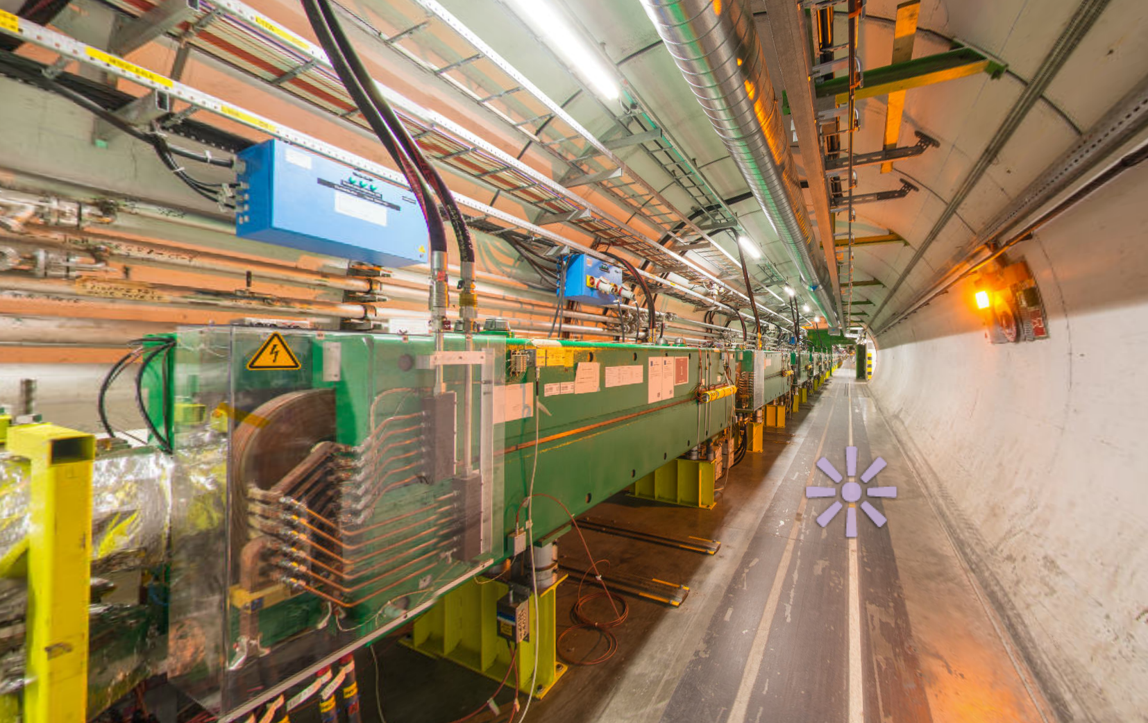
Septa
LHC beam dump
septa (MSD)
ABT Introductory Lectures – CERN Accelerator School, Constanta, Romania, 2018

Slide 57
Septa
Two main types:
  Electrostatic septa (DC)
  Magnetic septa (DC and pulsed):
    Direct drive septum
    Eddy current septum (pulsed only)
    Lambertson septum (deflection parallel to septum)
Region A
Field free region
(E_{A} = 0 and B_{A} = 0)
unperturbed circulating beam
Challenge: low leakage field
Region B
Uniform field region
(E_{A} ≠ 0 or B_{A} ≠ 0)
deflected extracted beam
Challenge: field uniformity
septum
Δx’
ABT Introductory Lectures – CERN Accelerator School, Constanta, Romania, 2018

Slide 58
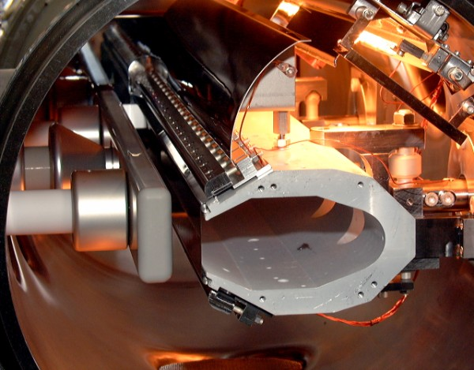
Electrostatic septum
Bake-out lamps for UHV
Grounded support
Foil Tensioners
circulating beam
d (typically 10 to 35 mm)
support
septum foil
(Mo or Z-Re)
V (up to 300 kV)
electrode
(Al, Ti, SS)
y
E
(up to 10 MV/m
in UHV)
z
extracted
beam
x
Foil
Electrode (HV)
Thin septum ~ 0.1 mm needed for high extraction efficiency:
  Foils typically used
  Stretched wire arrays provide thinner septa and lower effective density
Challenges include conditioning and preparation of HV surfaces, vacuum in range of 10⁻⁹ – 10⁻¹² mbar and in-vacuum precision position alignment
ABT Introductory Lectures – CERN Accelerator School, Constanta, Romania, 2018

Slide 59
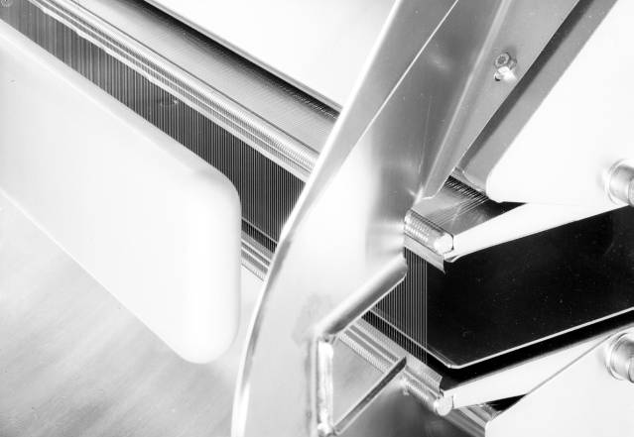
Electrostatic septum
  At SPS we slow-extract 400 GeV protons using approximately 15 m of septum split into 5 separate vacuum tanks each over 3 m long:
    Alignment of the 60 - 100 μm wire array over 15 m is challenging!
ABT Introductory Lectures – CERN Accelerator School, Constanta, Romania, 2018
Notes:
Adjustable gap width useful for:
Selective conditioning of Septum (e.g. increase gap width and increase voltage to condition feedthru’s, etc)
Permit compensation for “as built errors” in other equipment in the injection or extraction region (overkill would be to design with a big gap and voltage so as to accept any foreseeable beam size) – but the foil position has to be adjustable (and thin) to compensate for alignment errors.

Slide 60
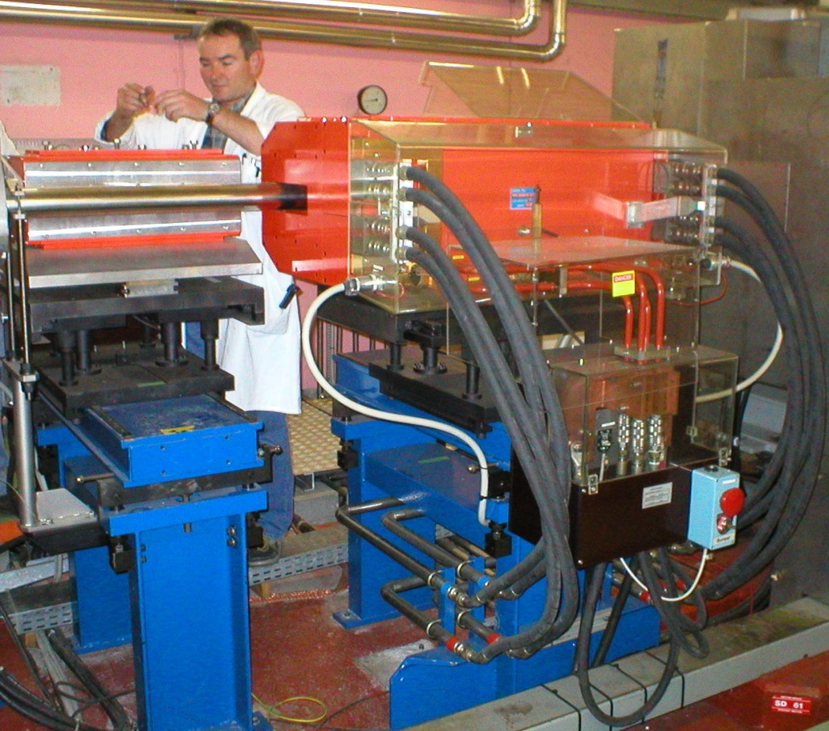
DC direct drive magnetic septum
Circulating beam
Electrical connections
magnet yoke (laminated steel)
septum
vacuum
chamber
B
g
(typically
25 - 60 mm)
x
rear
conductor
B
y
z
0
extracted
beam
x
x
septum
(typically 6 to 20 mm)
Cooling
Continuously powered, rarely under vacuum
Multi-turn coil to reduce current needed but cooling still an issue:
  Cooling water circuits flow rate typically at 12 – 60 l/min
  Current can range from 0.5 to 4 kA and power consumption up to 100 kW!
ABT Introductory Lectures – CERN Accelerator School, Constanta, Romania, 2018

Slide 61
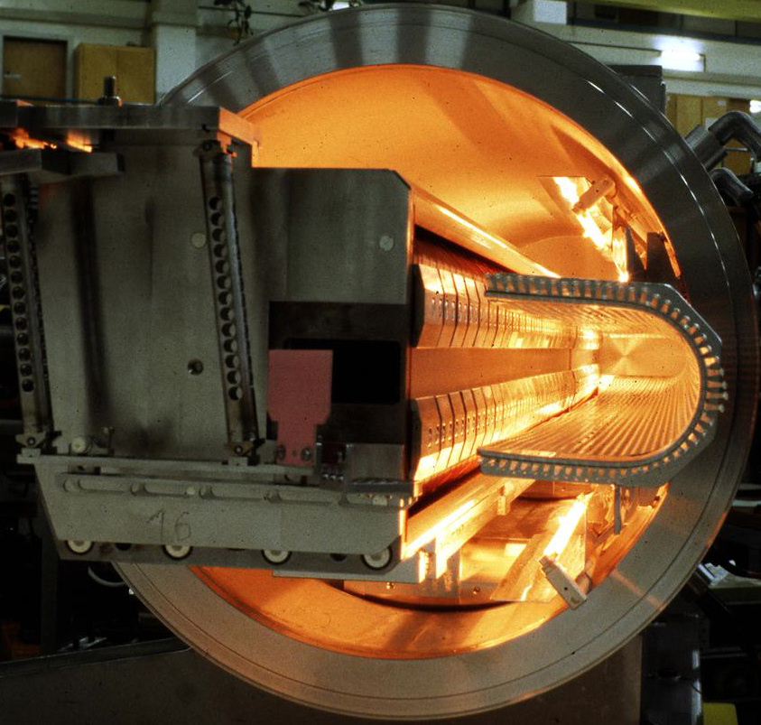
Direct drive pulsed magnetic septum
Bake-out lamps for UHV
Beam screen
magnet yoke (laminated steel)
septum
conductor
B
g
(typically
18 - 60 mm)
x
rear
conductor
circulating
beam
B
extracted
beam
y
z
0
x
x
septum
(typically 3 to 20 mm)
Beam “monitor”
Septum
In vacuum, to minimise distance between circulating and extracted beam
Single-turn coil to minimise inductance, bake-out up to 200 °C (~10⁻⁹ mbar)
Pulsed by capacitor discharge (third harmonic flattens the pulse):
  Current in range 7 – 40 kA with a few ms oscillation period
  Cooling water circuits flow rate from 1 – 80 l/min
ABT Introductory Lectures – CERN Accelerator School, Constanta, Romania, 2018
Notes:
Example: J to 300A/mm^2 peak

Slide 62
Eddy current septum
coil
return box
beam
screen
Coil removed from septum and placed behind C-core yoke:
  Coil dimension not critical
  Very thin septum blade
Magnetic field pulse induces eddy currents in septum blade
Eddy currents shield the circulating beam from magnetic field
Return box and magnetic screen reduce fringe field seen by circulating beam
B
g
(typically
10 - 30 mm)
I
I
•
magnetic
screen
y
B
z
0
x
x
septum
(typically 1 to 3 mm)
In or out of vacuum, single-turn coil
Pulsed by capacitor discharge (third harmonic flattens the pulse):
  Current ~10 kA fast pulsed with ~ 50 μs oscillation period
  Cooling water circuits flow rate from 1 – 10 l/min
ABT Introductory Lectures – CERN Accelerator School, Constanta, Romania, 2018

Slide 63
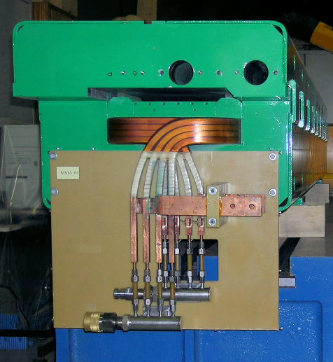
Lambertson septum
Steel yoke
Coil
I
Steel to avoid saturation
x
B
Circulating
Beam
•
I
Thin Septum
Magnetic field in gap orthogonal to previous examples of septa:
  Lambertson deflects beam orthogonal to kicker: dual plane injection/extraction
Rugged design: conductors safely hidden away from the beam
Thin steel yoke between aperture and circulating beam – however extra steel required to avoid saturation, magnetic shielding often added
ABT Introductory Lectures – CERN Accelerator School, Constanta, Romania, 2018

Slide 64
Two plane injection with Lambertson
Injected
beam
Horizontal plane
Lambertson septum (H-kick)
Kicker magnet
(V-kick)
D-quad
F-quad
Vertical plane
Circulating beam
F-quad
D-quad
ABT Introductory Lectures – CERN Accelerator School, Constanta, Romania, 2018

Slide 65
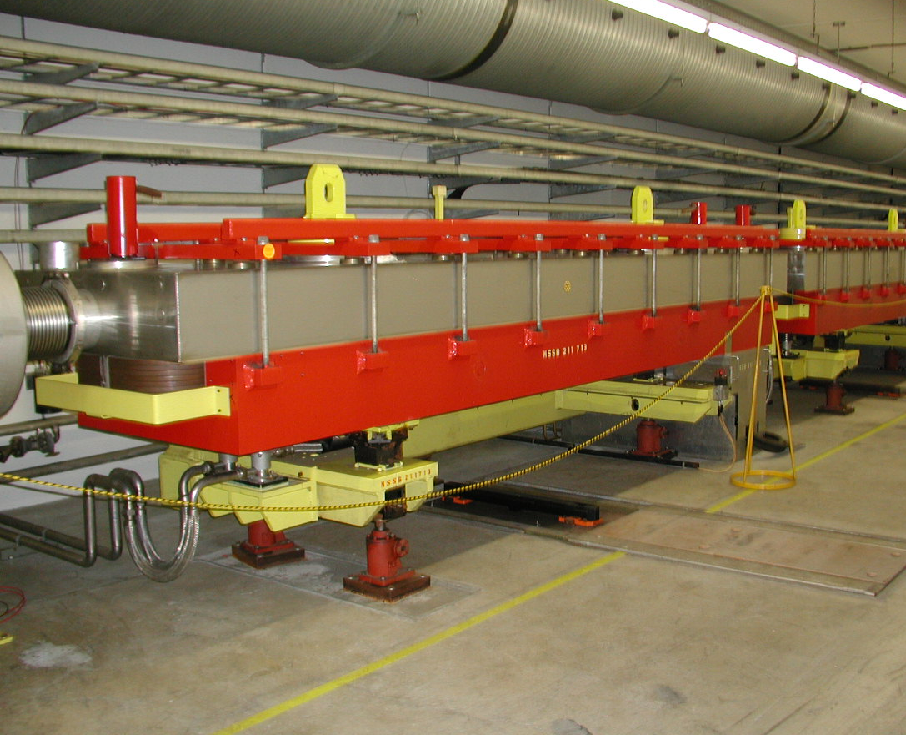
Lambertson septum
  At SPS we use Lambertson septa to split the 400 GeV slow-extracted proton spill (~ seconds) to different target stations simultaneously:
    These devices are radioactive: critical that coils are located away from the septum
Field-free region
Horizontally deflected by the B-field
Continues straight: no B-field
Losses (5-10%)
ABT Introductory Lectures – CERN Accelerator School, Constanta, Romania, 2018
Notes:
Adjustable gap width useful for:
Selective conditioning of Septum (e.g. increase gap width and increase voltage to condition feedthru’s, etc)
Permit compensation for “as built errors” in other equipment in the injection or extraction region (overkill would be to design with a big gap and voltage so as to accept any foreseeable beam size) – but the foil position has to be adjustable (and thin) to compensate for alignment errors.

Slide 66
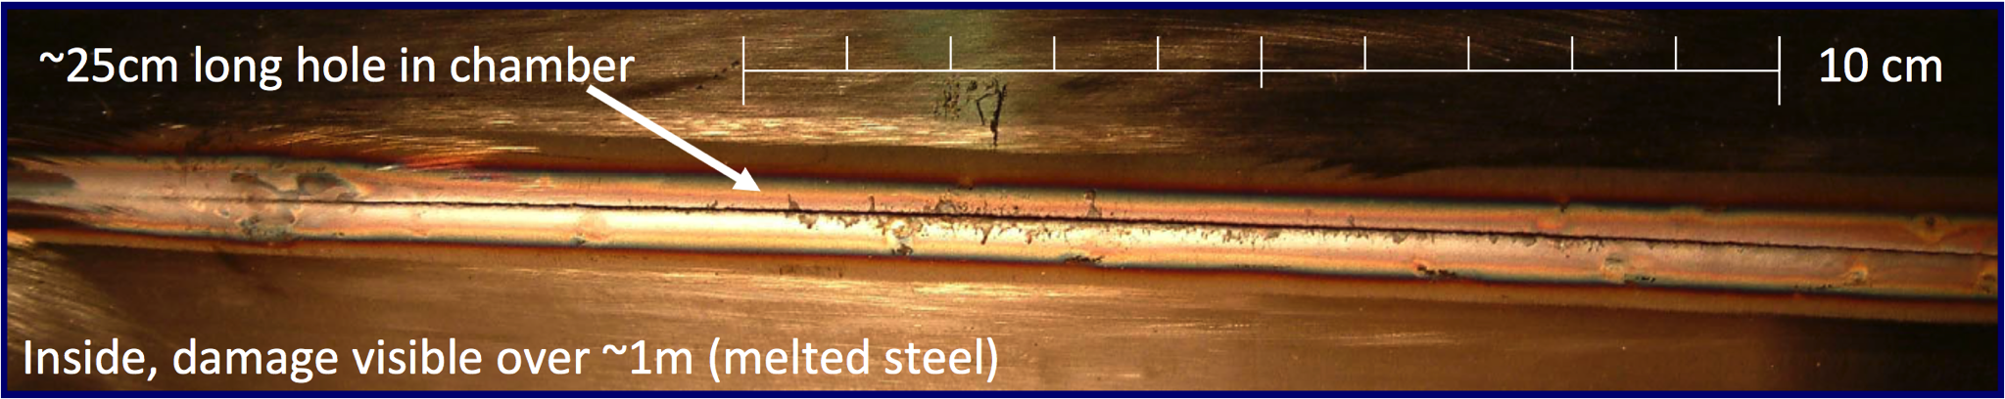
Protection devices
When things go wrong…!
  SPS extraction septum power supply tripped during setting-up of LHC beam, 25th October 2004:
  Septum field dropped by 5% in 11 ms
  3.4 x 10¹³ protons at 450 GeV, i.e. 2.5 MJ of beam energy dissipated on the aperture of the transfer line
  Vacuum chamber and quadrupole magnet damaged requiring replacement
  Upgraded fast interlock system was implemented to protect against such fast failures
ABT Introductory Lectures – CERN Accelerator School, Constanta, Romania, 2018

Slide 67
Protection devices
When beam energy exceeds damage limit for machine equipment one has to design for certain failure scenarios
Critical beam transfer systems have redundancy and multiple layers of protection:
  Passive protection devices form the last layer of this security
  Protection devices are designed to dilute and absorb beam energy safely
Failures associated with beam transfer equipment are typically very fast and difficult to catch, for example:
  No turn-on of kicker: injection protection
  Erratic turn-on of kicker: sweep circulating beam in the machine
  Flash-over (short-circuit) in kicker: impart the wrong kicker angle
  Transfer line magnet failure: steering beam onto aperture of downstream machine
ABT Introductory Lectures – CERN Accelerator School, Constanta, Romania, 2018

Slide 68
Injection protection: e.g. LHC injection
LHC has a dedicated injection dump (TDI) to protect against fast failures on the injection kicker
Injected beam
Septum magnet
TDI absorber jaws
Circulating beam
Kicker magnet
F-quad
D-quad
In reality the LHC injection is dual plane: Lambertson septum kick orthogonal to kicker
ABT Introductory Lectures – CERN Accelerator School, Constanta, Romania, 2018

Slide 69
Injection protection: e.g. LHC injection
LHC has a dedicated injection dump (TDI) to protect against fast failures on the injection kicker
  No turn-on of kicker: beam steered safely onto absorber:
Injected beam
Septum magnet
TDI absorber jaws
Circulating beam
Kicker magnet
F-quad
D-quad
In reality the LHC injection is dual plane: Lambertson septum kick orthogonal to kicker
ABT Introductory Lectures – CERN Accelerator School, Constanta, Romania, 2018

Slide 70
Injection protection: e.g. LHC injection
LHC has a dedicated injection dump (TDI) to protect against fast failures on the injection kicker
  No turn-on of kicker: beam steered safely onto absorber
  Erratic turn-on of kicker: circulating beam steered safely onto absorber:
Septum magnet
TDI absorber jaws
Circulating beam
Kicker magnet
F-quad
D-quad
In reality the LHC injection is dual plane: Lambertson septum kick orthogonal to kicker
ABT Introductory Lectures – CERN Accelerator School, Constanta, Romania, 2018

Slide 71
Injection protection: e.g. LHC injection
LHC has a dedicated injection dump (TDI) to protect against fast failures on the injection kicker
  No turn-on of kicker: beam steered safely onto absorber
  Erratic turn-on of kicker: circulating beam steered safely onto absorber
  Flash-over (short-circuit) in kicker: “worst-case” gives twice deflection:
Injected beam
Septum magnet
TDI absorber jaws
Circulating beam
Kicker magnet
F-quad
D-quad
In reality the LHC injection is dual plane: Lambertson septum kick orthogonal to kicker
ABT Introductory Lectures – CERN Accelerator School, Constanta, Romania, 2018

Slide 72
Extraction protection: e.g. SPS extraction
SPS has a dedicated absorber (TPSG) to protect the extraction septum in case of fast failures of the extraction kicker
Extracted
beam
Septum magnet
TPSG
absorber jaw
Circulating beam
Kicker magnet
F-quad
D-quad
Closed orbit bumpers and quads
ABT Introductory Lectures – CERN Accelerator School, Constanta, Romania, 2018

Slide 73
Extraction protection: e.g. SPS extraction
SPS has a dedicated absorber (TPSG) to protect the extraction septum in case of fast failures of the extraction kicker
  Erratic turn-on of kicker: asynchronous timing with particle-free gap and circulating beam swept across TPSG into transfer line:
Extracted
beam
Septum magnet
TPSG
absorber jaw
Circulating beam
Kicker magnet
F-quad
D-quad
Closed orbit bumpers and quads
ABT Introductory Lectures – CERN Accelerator School, Constanta, Romania, 2018

Slide 74
Extraction protection: e.g. SPS extraction
SPS has a dedicated absorber (TPSG) to protect the extraction septum in case of fast failures of the extraction kicker
  Erratic turn-on of kicker: asynchronous timing with particle-free gap and circulating beam swept across TPSG into transfer line
  Flash-over (short-circuit) in kicker: worst-case amplitude places the extracted beam onto the absorber jaw:
Septum magnet
TPSG
absorber jaw
Extracted
beam
Circulating beam
Kicker magnet
in short-circuit mode
F-quad
D-quad
Closed orbit bumpers and quads
ABT Introductory Lectures – CERN Accelerator School, Constanta, Romania, 2018

Slide 75
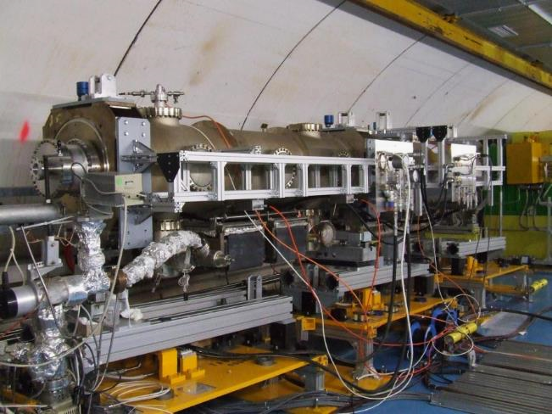
Extraction protection: e.g. SPS extraction
SPS has a dedicated absorber (TPSG) to protect the extraction septum in case of fast failures of the extraction kicker
TPSG and MSE (magnetic septum) installed at HIRADMAT irradiation test facility in 2012: impacted with LHC nominal intensity (288b and 1.1×10¹¹ p/b): both devices survived!
ABT Introductory Lectures – CERN Accelerator School, Constanta, Romania, 2018

Slide 76
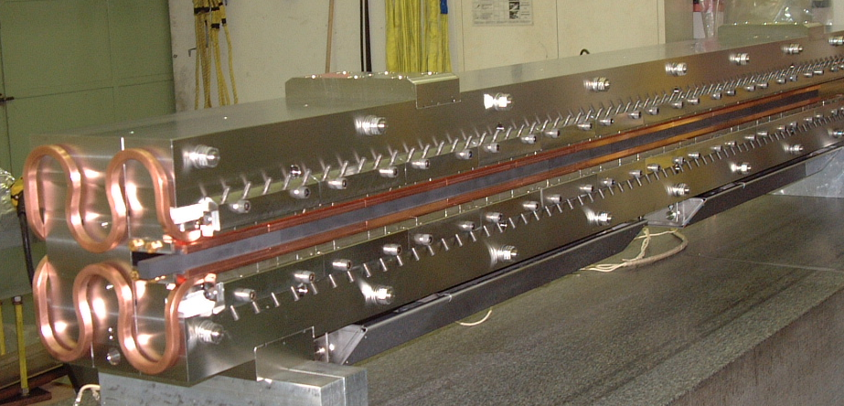
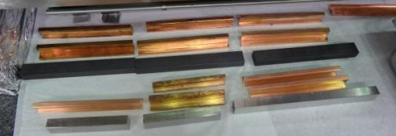
Extraction protection: e.g. TPSG
SPS has a dedicated absorber (TPSG) to protect the extraction septum in case of fast failures of the extraction kicker
  Diluter made of graphite, 2D carbon composite, titanium alloy and nickel based alloy:
  Designed to protect downstream septum from direct impact of 450 GeV LHC ultimate beam (288 bunches at 1.7×10¹¹ protons per bunch, 3.5 MJ)
3100 mm
CZ5
CfC 1.75
beam
Ti 6Al 4V
INCO718
Water cooling channel
Absorber blocks
Absorber blocks inspected after impact of HIRADMAT test #6: survived and re-installed
Comment: small emittance (high beam brightness) can be just as much a concern as the total intensity for thermo-mechanical stresses during beam impact
TPSG assembly without vacuum tank
ABT Introductory Lectures – CERN Accelerator School, Constanta, Romania, 2018

Slide 77
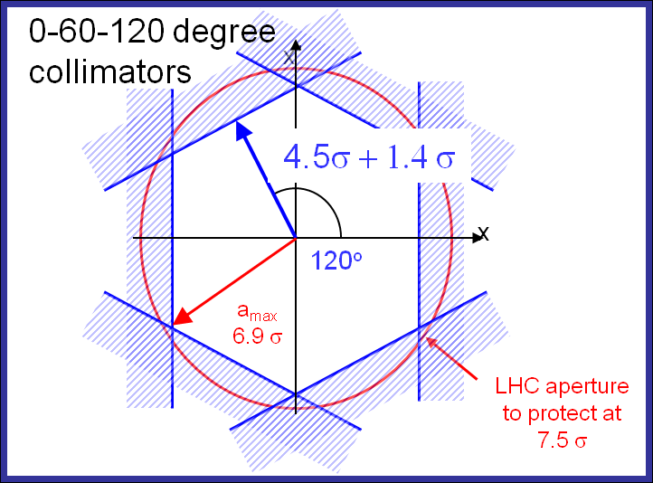
Transfer protection: e.g. SPS-to-LHC
SPS to LHC transfer lines have dedicated transfer line collimators (TCDIH and V) in case of fast failures to protect LHC aperture:
Δμ = 60°
TCDIH
SPS
TT40/60
TI 8/2
LHC
MKE
MKI
TDI
Δμ = 120°
Extracted beam ON nominal trajectory
ABT Introductory Lectures – CERN Accelerator School, Constanta, Romania, 2018

Slide 78
Transfer protection: e.g. SPS-to-LHC
SPS to LHC transfer lines have dedicated transfer line collimators (TCDIH and V) in case of fast failures to protect LHC aperture:
  Magnet power supply trips at time t after the last extraction interlock check: beam steered onto collimator
  Current (field) error depends on circuit:
Δμ = 60°
TCDIH
SPS
TT40/60
TI 8/2
LHC
MKE
MKI
TDI
Δμ = 120°
Failure of dipole here
Extracted beam OFF nominal trajectory
ABT Introductory Lectures – CERN Accelerator School, Constanta, Romania, 2018

Slide 79
Transfer protection: e.g. SPS-to-LHC
SPS to LHC transfer lines have dedicated transfer line collimators (TCDIH and V) in case of fast failures to protect LHC aperture:
  Magnet power supply trips at time t after the last extraction interlock check: beam steered onto collimator
  Current (field) error depends on circuit:
  Erratic turn-on of extraction kicker: sweep
  (asynchronous with particle-free abort gap)
Δμ = 60°
TCDIH
SPS
TT40/60
TI 8/2
LHC
MKE
MKI
TDI
Δμ = 120°
Asynchronous turn-on: sweep
Extracted beam OFF nominal trajectory
ABT Introductory Lectures – CERN Accelerator School, Constanta, Romania, 2018

Slide 80
Transfer protection: e.g. SPS-to-LHC
SPS to LHC transfer lines have dedicated transfer line collimators (TCDIH and V) in case of fast failures to protect LHC aperture:
  Magnet power supply trips at time t after the last extraction interlock check: beam steered onto collimator
  Current (field) error depends on circuit:
  Erratic turn-on of extraction kicker: sweep
  (asynchronous with particle-free abort gap)
sweep
Δμ = 60°
TCDIH
SPS
TT40/60
TI 8/2
LHC
MKE
MKI
TDI
Δμ = 120°
Asynchronous turn-on: sweep
Extracted beam OFF nominal trajectory
ABT Introductory Lectures – CERN Accelerator School, Constanta, Romania, 2018

Slide 81
Transfer protection: e.g. SPS-to-LHC
SPS to LHC transfer lines have dedicated transfer line collimators (TCDIH and V) in case of fast failures to protect LHC aperture:
  Magnet power supply trips at time t after the last extraction interlock check: beam steered onto collimator
  Current (field) error depends on circuit:
  Erratic turn-on of extraction kicker: sweep
  (asynchronous with particle-free abort gap)
sweep
Δμ = 60°
TCDIH
SPS
TT40/60
TI 8/2
LHC
MKE
MKI
TDI
Δμ = 120°
Asynchronous turn-on: sweep
Extracted beam ON nominal trajectory
ABT Introductory Lectures – CERN Accelerator School, Constanta, Romania, 2018

Slide 82
Transfer protection: e.g. SPS-to-LHC
SPS to LHC transfer lines have dedicated transfer line collimators (TCDIH and V) in case of fast failures to protect LHC aperture:
  Magnet power supply trips at time t after the last extraction interlock check: beam steered onto collimator
  Current (field) error depends on circuit:
  Erratic turn-on of extraction kicker: sweep
  (asynchronous with particle-free abort gap)
  Flash-over (short-circuit) in kicker:
Δμ = 60°
TCDIH
SPS
TT40/60
TI 8/2
LHC
MKE
MKI
TDI
Δμ = 120°
Non-nominal kicker deflection
Extracted beam ON nominal trajectory
ABT Introductory Lectures – CERN Accelerator School, Constanta, Romania, 2018

Slide 83
Transfer protection: e.g. SPS-to-LHC
SPS to LHC transfer lines have dedicated transfer line collimators (TCDIH and V) in case of fast failures to protect LHC aperture:
  Magnet power supply trips at time t after the last extraction interlock check: beam steered onto collimator
  Current (field) error depends on circuit:
  Erratic turn-on of extraction kicker: sweep
  (asynchronous with particle-free abort gap)
  Flash-over (short-circuit) in kicker
  Momentum mismatch at extraction:
Momentum collimator
(high dispersion)
Δμ = 60°
TCDIH
SPS
TT40/60
TI 8/2
LHC
MKE
MKI
TDI
Δμ = 120°
Beam follows dispersive trajectory
Extracted beam ON nominal trajectory
ABT Introductory Lectures – CERN Accelerator School, Constanta, Romania, 2018

Slide 84
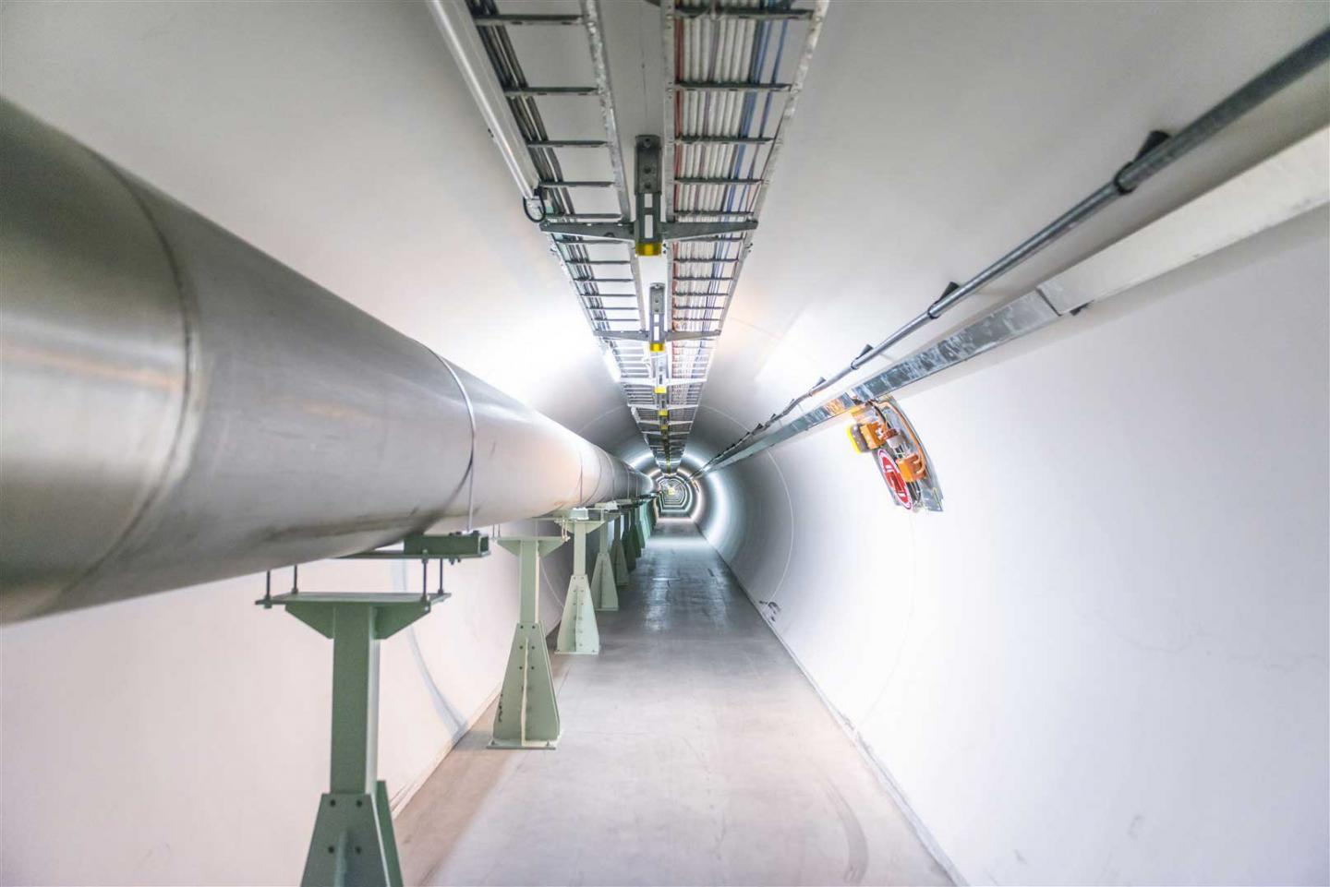
Beam transfer lines
LHC beam dump
extraction line (TD62/68)
ABT Introductory Lectures – CERN Accelerator School, Constanta, Romania, 2018

Slide 85
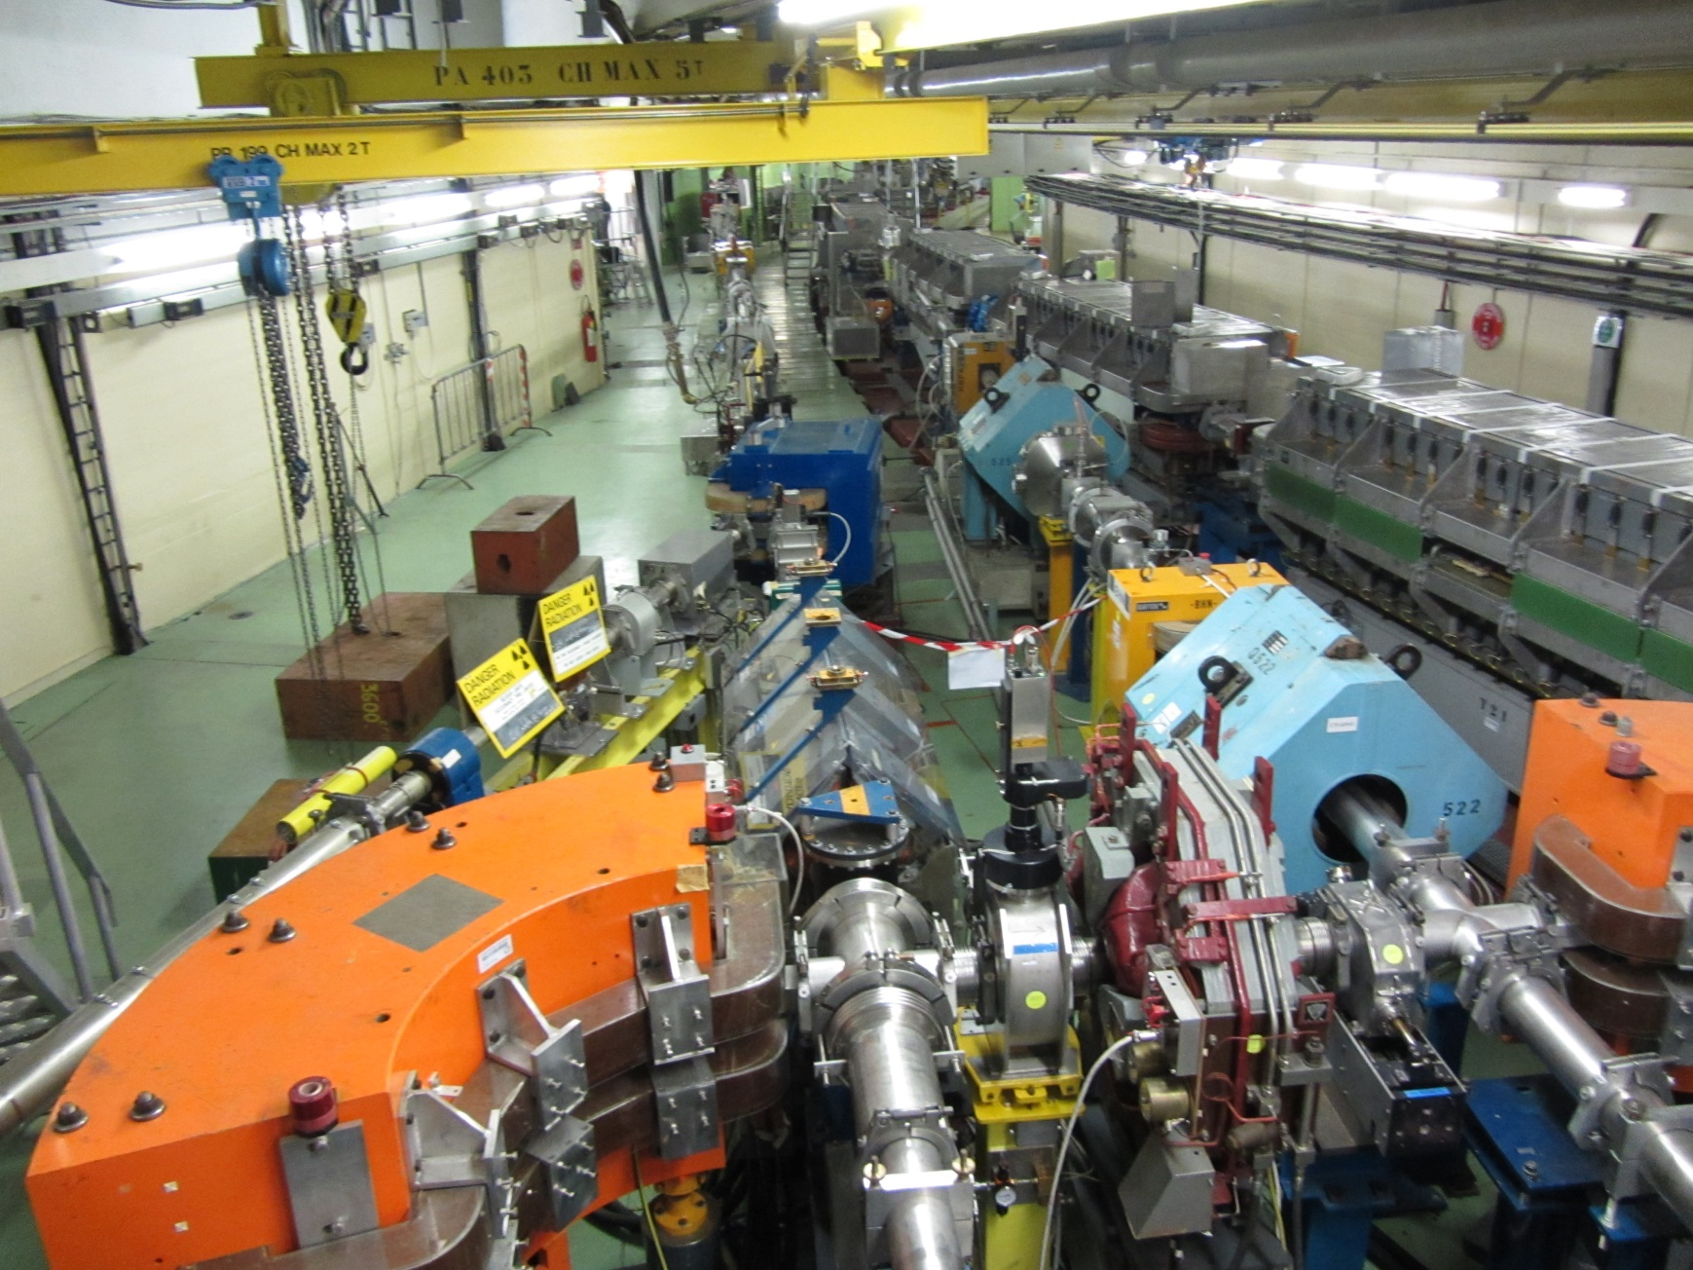
Beam transfer lines
PS “switchyard”
ABT Introductory Lectures – CERN Accelerator School, Constanta, Romania, 2018

Slide 86
Beam transfer lines
Beam transfer lines
  Functional requirements
  Distinctions between transfer lines and circular machines
  Linking machines/experiments together
  Emittance blow-up from mismatch
  Measurement of beam parameters (measurement lines)
ABT Introductory Lectures – CERN Accelerator School, Constanta, Romania, 2018

Slide 87
Beam transfer lines
Transfer lines transport beams between accelerators (extraction of one to injection of the next) and on to experimental targets and beam dumps
Requirements:
  Geometric link between machines/experiment
  Match optics between machines/experiment
  Preserve emittance
  Change particles’ charge state (stripping foils)
  Measure beam parameters (measurement lines)
  Protect downstream machine/experiment
ABT Introductory Lectures – CERN Accelerator School, Constanta, Romania, 2018

Slide 88
General transport
Beam transport: moving from s₁ to s₂ through n elements, each with transfer matrix M_{i}
y
s
y
s
2
x
1
x
The transfer matrix (M_{i}) can be expressed using the Twiss formalism:
ABT Introductory Lectures – CERN Accelerator School, Constanta, Romania, 2018

Slide 89
Circular Machine
Circumference = L
One turn:
The solution is periodic
Periodicity condition for one turn (closed ring) imposes α₁= α₂, β₁= β₂, D₁= D₂
This condition uniquely determines α(s), β(s), μ(s), D(s) around the whole ring
  i.e. a single matched ellipse exists for each given location, s
ABT Introductory Lectures – CERN Accelerator School, Constanta, Romania, 2018

Slide 90
Circular Machine
At a location with matched ellipse (α, β) a mismatched injected beam (α*, β*) with emittance ε₀, generates (via filamentation) a larger ellipse with the matched α, β, but larger emittance: ε > ε₀
Turn 1
Turn 2
Turn n >>1
Turn 3
Matched ellipse determines beam shape
ABT Introductory Lectures – CERN Accelerator School, Constanta, Romania, 2018

Slide 91
Transfer line
One pass:
No periodic condition exists
The Twiss parameters are simply propagated from beginning to end of line
At any point in line, α(s) β(s) are functions of α₁ and β₁
ABT Introductory Lectures – CERN Accelerator School, Constanta, Romania, 2018

Slide 92
Transfer line
Initial α, β are defined for a transfer line by the beam shape at the entrance
Propagation of this beam ellipse depends on the line
A transfer line optics is different for different input beams:
  Synchrotrons are often multi-purpose, accelerating different beams but extracting through a common line transfer line: optics must switch to match the input and output conditions for each beam type
ABT Introductory Lectures – CERN Accelerator School, Constanta, Romania, 2018

Slide 93
Transfer line
On a single pass of a finite transfer line there is no regular motion from entrance to exit
  Periodicity is not enforced: it’s actually a design choice
  Infinite number of possible starting ellipses are transported to an infinite number of final ellipses
x’
x’
α₁, β₁
α₂, β₂
α∗₁, β∗₁
x
Transfer Line
x
Entry
Exit
α∗₂, β∗₂
ABT Introductory Lectures – CERN Accelerator School, Constanta, Romania, 2018

Slide 94
Optics Matching
Initial
matching
section
Final
matching
section
Independently powered (tuneable) quadrupoles
Independently powered (tuneable) quadrupoles and (in this case) passive protection devices
Regular lattice (FODO)
(elements all powered in series
with same strengths)
SPS
LHC
SPS to LHC Transfer Line (3 km)
Extraction
point
Injection
point
ABT Introductory Lectures – CERN Accelerator School, Constanta, Romania, 2018

Slide 95
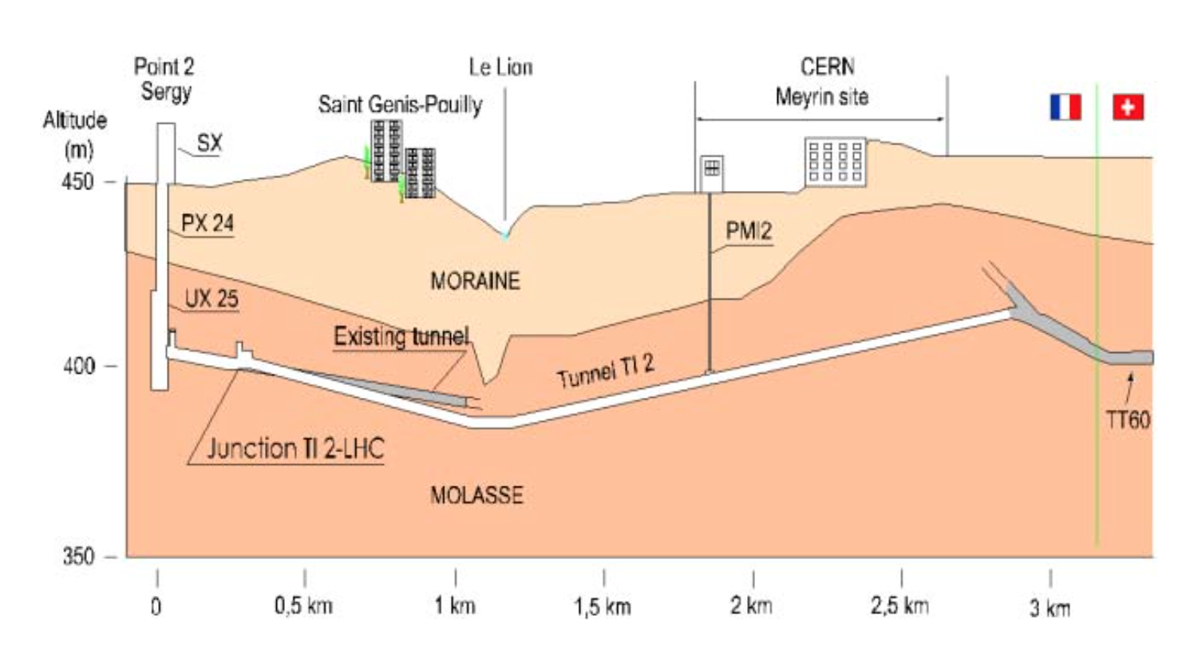
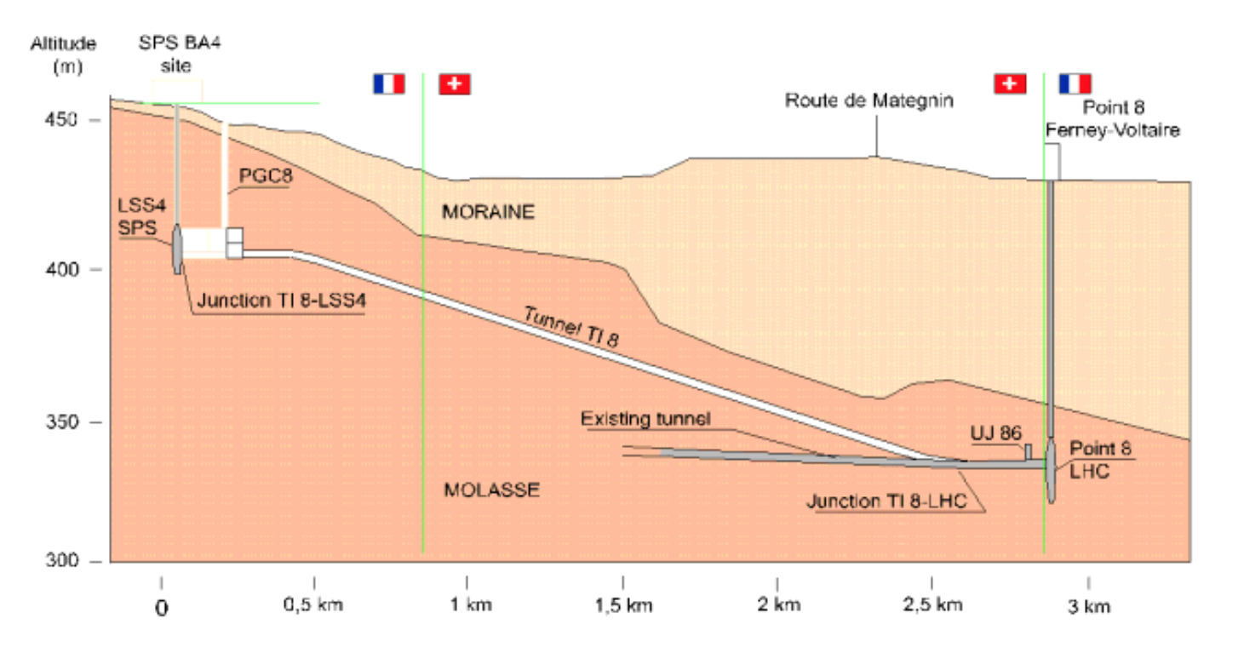
Linking Machines
Beams have to be transported from extraction of one machine to injection of the next machine:
  Trajectory must be matched in all 6 geometric degrees of freedom (x,y,z,θ,Φ,ψ)
Other important constraints can include:
  Minimum bend radius, maximum quadrupole gradient, magnet aperture, cost, geology or other obstacles, etc.
SPS to LHC transfer tunnel TI2 (Beam 1)
SPS to LHC transfer tunnel TI8 (Beam 2)
An example of how geology can influence transfer line design
ABT Introductory Lectures – CERN Accelerator School, Constanta, Romania, 2018

Slide 96
Linking Machines
Extraction
α_{1x}, β_{1x} , α_{1y}, β_{1y}
Transfer
α_{x}(s), β_{x}(s) , α_{y}(s), β_{y}(s)
s
α_{2x}, β_{2x} , α_{2y}, β_{2y}
Injection
The Twiss parameters can be propagated when the transfer matrix M is known
ABT Introductory Lectures – CERN Accelerator School, Constanta, Romania, 2018

Slide 97
Linking Machines
Linking the optics is a complicated process:
  Parameters at start of line have to be propagated to matched parameters at the end of the line (injection to another machine, fixed target etc. )
  Need to “match” 8 variables (α_{x}, β_{x}, D_{x}, D’_{x} and α_{y}, β_{y}, D_{y}, D’_{y})
  Matching done with number of independently power (“matching”) quadrupoles
  Maximum β and D values are imposed by magnetic apertures
  Other constraints exist:
    Phase conditions for collimators
    Insertions for special equipment like stripping foils
    Low beam energy (β<<1) re-bunching cavities might be necessary, i.e. RF gymnastics in the transfer line
Matching with computer codes and relying on mixture of theory, experience, intuition, trial and error.
ABT Introductory Lectures – CERN Accelerator School, Constanta, Romania, 2018

Slide 98
Optical Mismatch at Injection
Filamentation fills larger ellipse with same shape as matched ellipse
Turn 0
Time
x’
Turn N
x
Dispersion mismatch at injection will also cause emittance blow-up
ABT Introductory Lectures – CERN Accelerator School, Constanta, Romania, 2018

Slide 99
Blow-up from betatron mismatch
Optical errors occur in transfer line and ring, such that the beam can be injected with a mismatch
Filamentation will produce an emittance increase
In normalised phase space, consider the matched beam as a circle, and the mismatched beam as an ellipse
Mismatched
beam (α₂, β₂)
b
a
A
Matched
beam (α₁, β₁)
ABT Introductory Lectures – CERN Accelerator School, Constanta, Romania, 2018

Slide 100
Blow-up from betatron mismatch
Optical errors occur in transfer line and ring, such that the beam can be injected with a mismatch
Filamentation will produce an emittance increase
In normalised phase space, consider the matched beam as a circle, and the mismatched beam as an ellipse
Mismatched
beam (α₂, β₂)
The emittance after filamentation:
A/λ
where
b
a
A
Aλ
Matched
beam (α₁, β₁)
ABT Introductory Lectures – CERN Accelerator School, Constanta, Romania, 2018

Slide 101
Blow-up from betatron mismatch
Optical errors occur in transfer line and ring, such that the beam can be injected with a mismatch
Filamentation will produce an emittance increase
In normalised phase space, consider the matched beam as a circle, and the mismatched beam as an ellipse
Mismatched
beam (α₂, β₂)
The emittance after filamentation:
Writing λ as a function of the matched and mismatched Twiss parameters is an exercise in geometry:
A/λ
where
b
a
A
Aλ
Matched
beam (α₁, β₁)
See appendix for derivation
ABT Introductory Lectures – CERN Accelerator School, Constanta, Romania, 2018

Slide 102
Blow-up from betatron mismatch
A numerical example…
Consider b = 3a for the mismatched ellipse:
Mismatched
beam (α₂, β₂)
b=3a
a
See appendix for blow-up from dispersion mismatch
Matched
beam (α₁, β₁)
ABT Introductory Lectures – CERN Accelerator School, Constanta, Romania, 2018

Slide 103
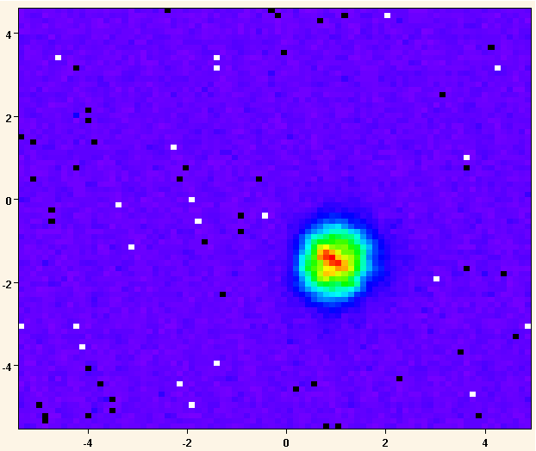
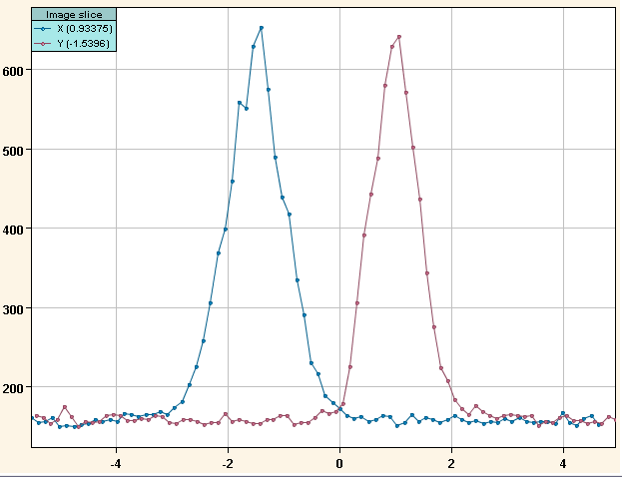
Optics measurement with screens
A profile monitor is needed to measure the beam size
  e.g. beam screen (luminescent) provides 2D density profile of the beam
Profile fit gives transverse beam size: σ
If optics (Twiss parameters) are known, ε can be calculated from a single screen:
ABT Introductory Lectures – CERN Accelerator School, Constanta, Romania, 2018

Slide 104
Optics measurement with 3 screens
Assume 3 screens in a dispersion free region and that the emittance is constant along the line:
Measurements of σ at s₁, s₂, s₃ plus knowledge of the two transfer matrices M₁₂ and M₁₃ allows determination of ε, α and β
s₀
s₁
s₂
beam
See appendix for derivation
σ₀
σ₁
σ₂
ABT Introductory Lectures – CERN Accelerator School, Constanta, Romania, 2018

Slide 105
Summary
Depending on the injection/extraction concept we chose a dedicated combination of septa (spatial separation of fields) and kickers (temporal separation of fields)
Transfer lines present interesting challenges and differences from circular machines:
  No periodic condition mean optics is defined by transfer line element strengths and by initial beam ellipse
  Matching is subject to many constraints
  Emittance blow-up is an important consideration, and arises from several sources: mis-steering, mismatch (betatron and dispersion)
  Measurement of beam parameters is important for ensuring beams are well matched between machines and/or experiments
ABT Introductory Lectures – CERN Accelerator School, Constanta, Romania, 2018

Slide 106
Summary
Depending on the injection/extraction concept we chose a dedicated combination of septa (spatial separation of fields) and kickers (temporal separation of fields)
Transfer lines present interesting challenges and differences from circular machines:
  No periodic condition mean optics is defined by transfer line element strengths and by initial beam ellipse
  Matching is subject to many constraints
  Emittance blow-up is an important consideration, and arises from several sources: mis-steering, mismatch (betatron and dispersion)
  Measurement of beam parameters is important for ensuring beams are well matched between machines and/or experiments
Thank you for your attention
ABT Introductory Lectures – CERN Accelerator School, Constanta, Romania, 2018

Slide 107

Further reading and references
Lot’s of resources presented at the recent CAS Specialised School:
Beam Injection, Extraction and Transfer, 10-19 March 2017, Erice, Italy
https://cas.web.cern.ch/schools/erice-2017
ABT Introductory Lectures – CERN Accelerator School, Constanta, Romania, 2018

Slide 108
Bibliography for Septa
M.J. Barnes, J. Borburgh, B. Goddard, M. Hourican, “Injection and Extraction Magnets: Septa”, CERN Accelerator School CAS 2009: Specialised Course on Magnets, Bruges, 16-25 June 2009, arXiv:1103.1062 [physics.acc-ph].
J. Borburgh, M. Crescenti, M. Hourican, T. Masson, “Design and Construction of the LEIR Extraction Septum”, IEEE Trans. on Applied Superconductivity, Vol. 16, No. 2, June 2006, pp289-292.
M.J. Barnes, B. Balhan, J. Borburgh, T. Fowler, B. Goddard, W.J.M. Weterings, A. Ueda, “Development of an Eddy Current Septum for LINAC4”, EPAC 2008.
J. Borburgh, B. Balhan, T. Fowler, M. Hourican, W.J.M. Weterings, “Septa and Distributor Developments for H- Injection into the Booster from Linac4”, EPAC 2008.
S.Bidon, D.Gerard, R.Guinand, M.Gyr, M.Sassowsky, E.Weisse, W.Weterings, A.Abramov, A.Ivanenko, E.Kolatcheva, O.Lapyguina, E.Ludmirsky, N.Mishina, P.Podlesny, A.Riabov, N.Tyurin, “Steel Septum Magnets for the LHC Beam Injection and Extraction”, Proc. of EPAC 2002, Paris.
J.M. Cravero & J.P. Royer, “The New Pulsed Power Converter for the Septum Magnet in the PS Straight Section 42”, CERN PS/PO/ Note 97-03, 1997.
J.P. Royer, “High Current with Precision Flat-Top Capacitor Discharge Power Converters for Pulsed Septum Magnets”, CERN/PS 95-13 (PO), 1995.
ABT Introductory Lectures – CERN Accelerator School, Constanta, Romania, 2018

Slide 109
Bibliography for Kickers
M.J. Barnes, L. Ducimetiére, T. Fowler, V. Senaj, L. Sermeus, “Injection and extraction magnets: kicker magnets”, CERN Accelerator School CAS 2009: Specialised Course on Magnets, Bruges, 16-25 June 2009, arXiv:1103.1583 [physics.acc-ph].
D. Fiander, K.D. Metzmacher, P.D. Pearce, “Kickers and Septa at the PS complex, CERN”, Prepared for KAON PDS Magnet Design Workshop, Vancouver, Canada, 3-5 Oct 1988, pp71-79.
M.J. Barnes, G.D. Wait, I.M. Wilson, “Comparison of Field Quality in Lumped Inductance versus Transmission Line Kicker Magnets”, EPAC 1994, pp2547-2549.
G. Kotzian, M. Barnes, L. Ducimetière, B. Goddard, W. Höfle, “Emittance Growth at LHC Injection from SPS and LHC”, LHC Project Report 1116.
J. N. Weaver et al., “Design, Analysis and Measurement of Very Fast Kicker Magnets at SLAC,” Proc of 1989 PAC, Chicago, pp. 411–413.
L. Ducimetière, N. Garrel, M.J. Barnes, G.D. Wait, “The LHC Injection Kicker Magnet”, Proc. of PAC 2003, Portland, USA, pp1162-1164.
L. Ducimetière, “Advances of Transmission Line Kicker Magnets”, Proc. of 2005 PAC, Knoxville, pp235-239.
W. Zhang, J. Sandberg, J. Tuozzolo, R. Cassel, L. Ducimetière, C. Jensen, M.J. Barnes, G.D. Wait, J. Wang, “An Overview of High Voltage Dielectric Material for Travelling Wave Kicker Magnet Application”, proc. of 25th International Power Modulator Conference and High Voltage Workshop, California, June 30-July 3, 2002, pp674-678.
J. Bonthond, J.H. Dieperink, L. Ducimetikrre, U. Jansson, E. Vossenberg, “Dual Branch High Voltage Pulse Generator for the Beam Extraction of the Large Hadron Collider”, 2002 Power Modulator Symposium, Holloywood, USA, 30 June-3 July 2002, pp114-117.
ABT Introductory Lectures – CERN Accelerator School, Constanta, Romania, 2018

Slide 110
Example parameters for kickers at CERN
Kicker Location | Beam momentum (GeV/c) | # Magnets | Gap Height [V_{ap}] (mm) | Current (kA) | Impedance (Ω) | Rise Time (ns) | Total Deflection (mrad)
CTF3 | 0.2 | 4 | 40 | 0.056 | 50 | ~4 | 1.2
PS Inj. | 2.14 | 4 | 53 | 1.52 | 26.3 | 42 | 4.2
SPS Inj. | 13/26 | 16 | 54 to 61 | 1.47/1.96 | 16.67/12.5 | 115/200 | 3.92
SPS Ext. (MKE4) | 450 | 5 | 32 to 35 | 2.56 | 10 | 1100 | 0.48
LHC Inj. | 450 | 4 | 54 | 5.12 | 5 | 900 | 0.82
LHC Abort | 450 to 7000 | 15 | 73 | 1.3 to 18.5 | 1.5 (not T-line) | 2700 | 0.275
ABT Introductory Lectures – CERN Accelerator School, Constanta, Romania, 2018

Slide 111
Example parameters for septa at CERN
Septum Location | Beam momentum (GeV/c) | Gap Height (mm) | Max. Current (kA) | B (T) | Deflection (mrad) | Septum thickness (mm)
LEIR/AD/CTF (13 systems) | Various | 25 to 55 | 1 DC to 40 pulsed | 0.5 to 1.6 | up to 130 | 1.7 - 19.2
PS Booster (6 systems) | 1.4 | 25 to 60 | 28 pulsed | 0.1 to 0.6 | up to 80 | 1 – 15
PS complex (8 systems) | 26 | 20 to 60 | 2.5 DC to 33 pulsed | 0.2 to 1.2 | up to 55 | 3 - 11.2
SPS Ext. | 450 | 20 | 24 | 1.5 | 2.25 | 4.2 - 17.2
ABT Introductory Lectures – CERN Accelerator School, Constanta, Romania, 2018
Notes:
SPS Inj: LHC Ions/LHC Protons
Flux density in kicker magnet aperture typically 100mT (however 300mT for LHC Abort[Dump])

Slide 112
Blow-up from betatron mismatch
General betatron motion:
Applying the normalisation transformation for the matched beam…
…an ellipse is obtained in normalised phase space:
ABT Introductory Lectures – CERN Accelerator School, Constanta, Romania, 2018

Slide 113
Blow-up from betatron mismatch
From general ellipse properties one can write:
where
Giving:
Mismatched
beam
A/λ
b
a
The co-ordinates of the mismatched beam can be expressed:
A
Aλ
Matched
Beam
Generally
ABT Introductory Lectures – CERN Accelerator School, Constanta, Romania, 2018

Slide 114
Blow-up from betatron mismatch
We can evaluate the square of the distance of a particle from the origin as:
The new emittance is the average for all particles with positions Ai over all phases:
If we’re feeling diligent, we can substitute back for λ:
where subscript 1 refers to the matched and 2 refers to mismatched cases
1/2
1/2
ABT Introductory Lectures – CERN Accelerator School, Constanta, Romania, 2018

Slide 115
Blow-up from dispersion mismatch
Dispersion mismatch will also introduce emittance blow-up through filamentation much like optical mismatch
Introducing normalised dispersion:
With a momentum error of the mismatch is:
Rotating the reference frame to a convenient reference (see plot):
And averaging over a distribution of particles, one can write the emittance blow-up as:
Mismatched
beam
λ_{D}A
A
Matched
beam
ABT Introductory Lectures – CERN Accelerator School, Constanta, Romania, 2018

Slide 116
Optics measurement with 3 screens
Remember how we propagate Twiss parameters from s₀ to s₁:
Giving us three simultaneous equations and three unknowns ε₀, α₀ and β₀:
After a bit of algebra… we find:
✕ ε
ABT Introductory Lectures – CERN Accelerator School, Constanta, Romania, 2018

Slide 117
Optics measurement with 3 screens
Some (more) algebra with the above equations and we can finally express the beta function at the first screen:
And therefore also the emittance and the divergence of the beta function:
Other methods of emittance measurement:
  Extension of the above method to multiple screens: tomography
  Quad scan: same as above but use one screen and change M_{quad➔screen}
  Direct measurements (lower intensity/energy beams):
    slit-grid or pepper-pot, laser “wire” for H- beams
ABT Introductory Lectures – CERN Accelerator School, Constanta, Romania, 2018

