Slide 1


C3F8-C2F6 blends optimisation
J. Direito
(EN/CV/DC)

Slide 2
Objectives
Increase the evaporation pressure at low temperatures of the fluid:
Evaporating at pressures above the atmospheric pressure (avoiding air flowing inside the system in case of leaks).
Evaporate at lower temperatures.
Minimize the effect of the pressure drop on the return line (useful for selecting components on the gas line).

Slide 3
Study of an Evaporation channel with a 50W stave, 2.6mm ID, and 0.8m length (IBL)
Recalculation of the cooling parameters for blends.
New correlation was used for fluorocarbon blends* pressure drop (takes into account 2 fluids on the correlation).
Evaporation temperature of -40°C.
Pressure & Temperature profiles with and without sub cooling.
Considering always a condensation temperature of 20°C (inner quality of 60% in the two-phase region).
* Piotr A. Domanski, Christian J. L. Hermes. An Improved Correlation for two-pjase pressure drop of R-22 and R-410A in 180° Return Bends. Proceedings of the 11th Brazilian of Thermal Sciences and Engineering – ENCIT 2006.

Slide 4
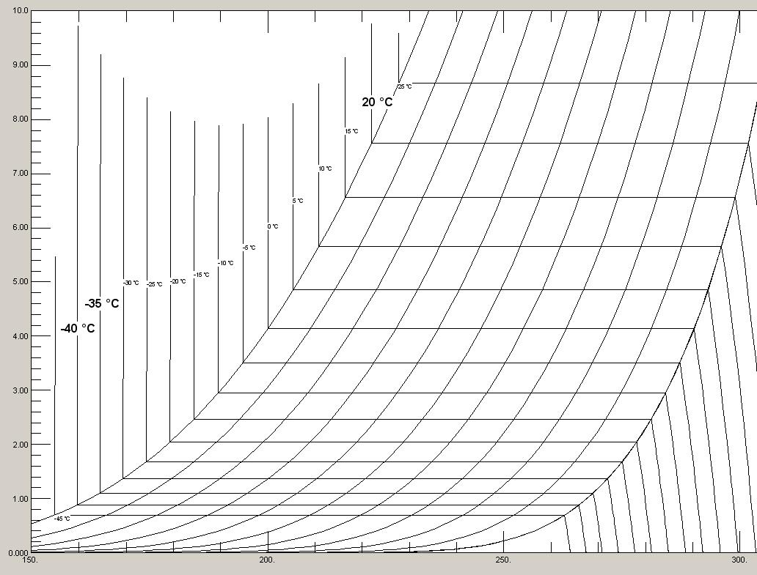
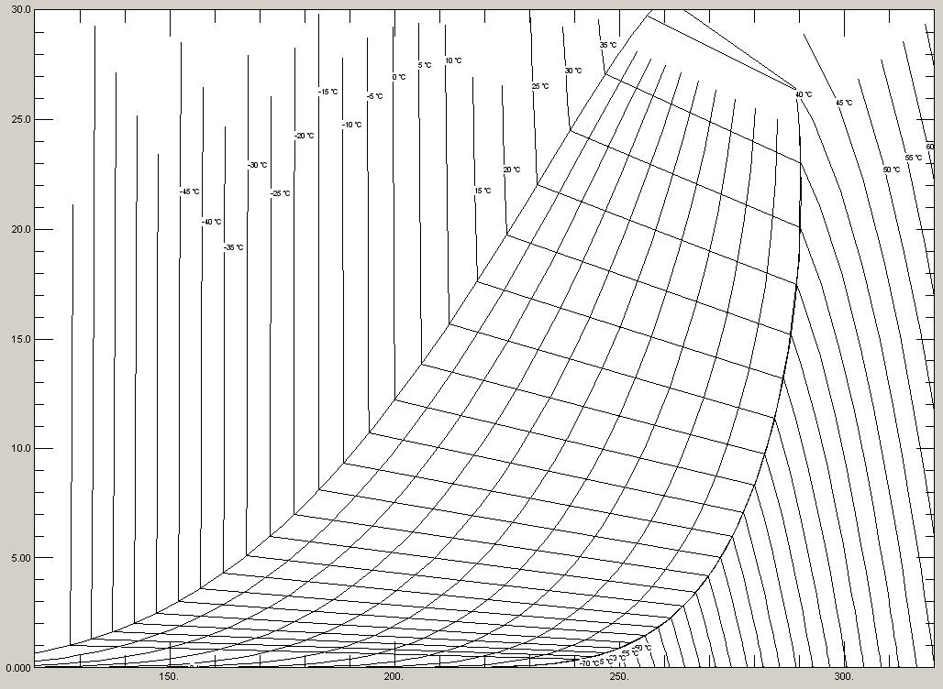
Initial Considerations With and Without Sub Cooling:
With Sub Cooling:
Xin = 0.2; Xout = 0.6; mass flow = ~1.2g/s
Without Sub Cooling:
Xin = 0.6; Xout = 0.9; mass flow = ~1.8g/s

Slide 5
Fluorocarbon Blends and Initial Conditions:
Blend |  | Pevap, T=-40°C bar(a) | Pcond, T=20°C Bar(a)
C3F8 |  | 0.9 | 7.6
90%C3F8 | 10%C2F6 | 1.5 | 10.5
80%C3F8 | 20%C2F6 | 2.0 | 13.1
70%C3F8 | 30%C2F6 | 2.5 | 15.4
60%C3F8 | 40%C2F6 | 2.9 | 17.6
50%C3F8 | 50%C2F6 | 3.3 | 19.8
40%C3F8 | 60%C2F6 | 3.7 | 21.8
30%C3F8 | 70%C2F6 | 4.1 | 23.9
20%C3F8 | 80%C2F6 | 4.4 | 26.0
10%C3F8 | 90%C2F6 | 4.9 | 28.2

Slide 6
Pressure & Temperature profiles with Sub Cooling

Slide 7
Pressure & Temperature profiles with NO Sub Cooling

Slide 8
Conclusion: Most favorable blend
80% C3F8 + 20% C2F6 without Sub Cooling
Low condensation pressure at 20°C (13.1bar)
High (enough) stave outlet pressure (2bar)
Low pressure drop/temperature variation along stave:
Temperature variation <2°C for a T_{evap} = -40°C
The use of sub cooling could be avoided

