Slide 1
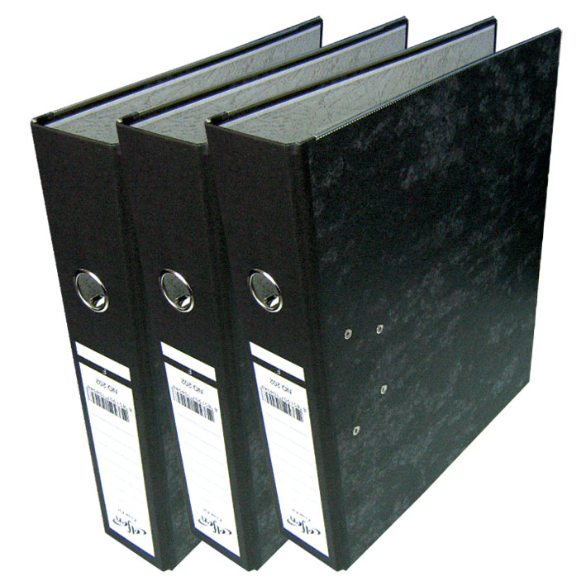
Thermosiphon quality management and documentation
Presentation done by Elena Perez Rodriguez
For further information contact elena.perez.rodriguez@cern.ch
EN/CV/DC

Slide 2
Index
Quality management
  EVM Project management
  Documentation
Construction and commissioning procedure
Test for concept validation procedure
EN/CV/DC

Slide 3

Quality management
EN/CV/DC

Slide 4
EVM Project management
This project will follow the Earned Value Management (EVM) technique
Definition
Conceptual design report
PBS
Project breakdown structure
Equipment coding convention
WBS & WU’s
Work breakdown structure
List of working units
RRM
Resource responsibility matrix
WUD
Work units dictionary
Project coordination schedule
Planning
EN/CV/DC

Slide 5
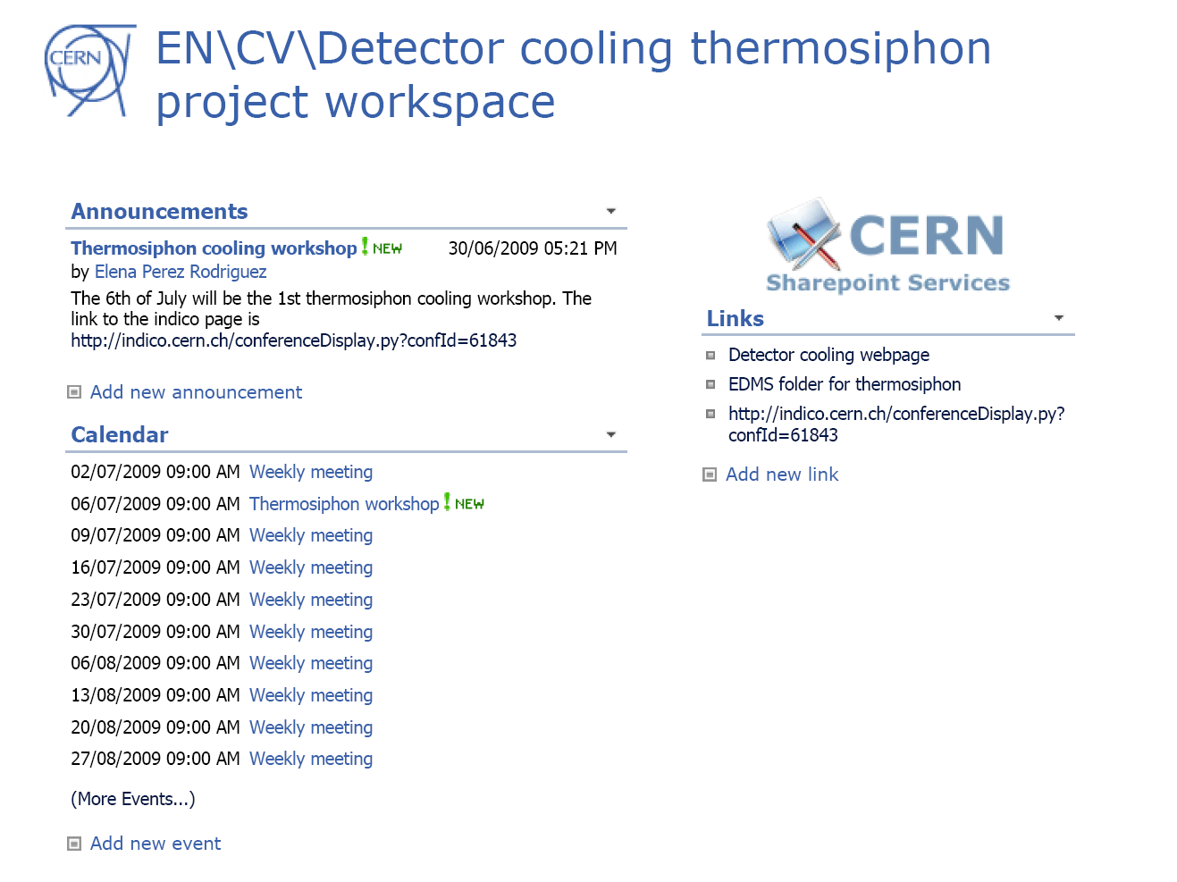
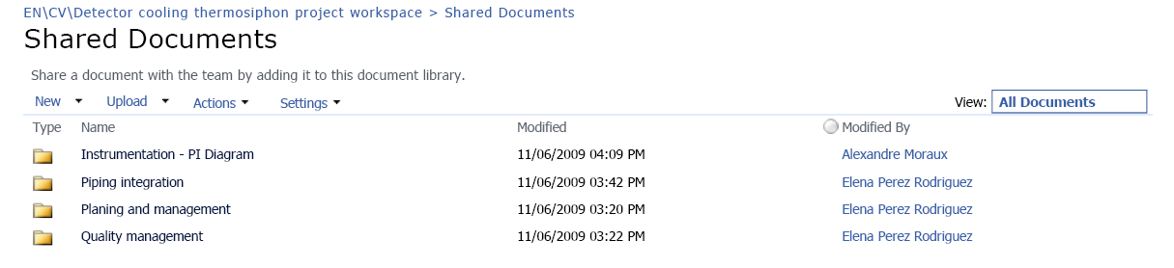
Documents in progress
Sharing working documents
  Workspace
  Includes announcements and useful links
Open read access
  https://espace.cern.ch/thermosiphon
  In case of access problems contact elena.perez.rodriguez@cern.ch
EN/CV/DC

Slide 6
Long term documentation
Publishing definitive documents
  EDMS folder for the thermosiphon project
  CERN-0000078075 v.0
Main quality documents
  Naming convention EDMS 1016399
  Construction and testing procedure EDMS 1016400
  Test for concept validation procedure EDMS 1016401
  Risk analysis EDMS 1029001
  Reports, as subdocuments of the procedures
  Users manual and technical documentation
EN/CV/DC

Slide 7
Construction and
Commissioning procedure
EN/CV/DC

Slide 8

Construction and commissioning procedure
Objective: guide for the purchase, construction and commission phases of the project
Construction main points
  Materials inox
  Connections
    Welds 100 % x-ray
    Flanges ISO-CF
    Connections VCR
  Leak-tightness standard
    Cryogenics standard
  Cleaning standard
EN/CV/DC

Slide 9
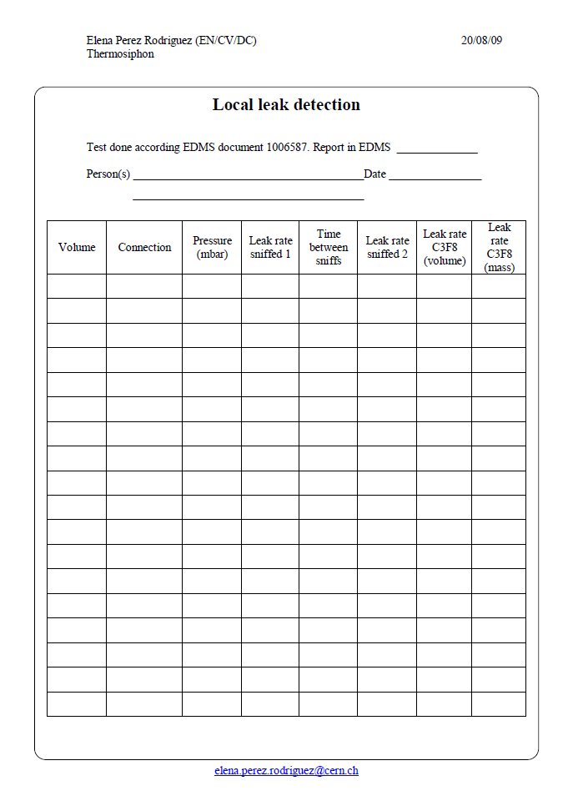
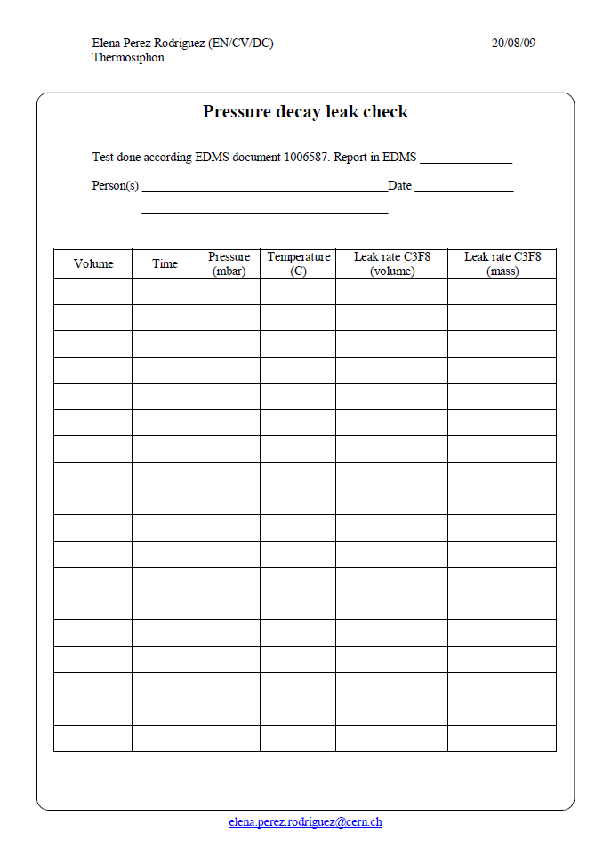
Construction and commissioning procedure
Commissioning main points
  Pressure test
    According to SR-M and GSI-M2
  Leak checking test
    Operational specification
    1% of mass/year
    Pressure decay method
    Overpressure method for local leaks detection
  Reports
  Mapping and electrical test
  Conditioning
EN/CV/DC

Slide 10
Test for concept validation procedure
EN/CV/DC

Slide 11
General concept
Objective : describe the test to be done after the installation is operational.
  Gain knowledge of the
  Thermosiphon systems
For both 191 and PX15 installations
Is NOT a commissioning procedure is a guide to what should be studied in the thermosiphon

Slide 12
Working conditions
Status
  Warm stop
  Cold stop
  Stand-by
  Run
Operations
  Filling
  Start-up from warm stop
  Start-up from cold stop
  Cool down
  Liquid recovery
  Degassing

Slide 13
Mini thermosiphon
The tests will be focused in nominal operation to gain a general working knowledge of the thermosiphon systems
The control of the mini-thermosiphon is more difficult that the control of the thermosiphon in PX15
Tests to be done
  Test 01: Start-up from warm stop, procedure 1
  Test 02: Start-up from cold stop
  Test 03: Liquid recovery
  Test 04: Start-up from warm stop, procedure 2
  Test 05: Short run
EN/CV/DC

Slide 14
Thermosiphon: operation
The tests will be divided in 3 groups
  Nominal operation
  Performance
  Failure modes
Nominal operation test: like in the mini-thermosiphon
  Test 20: Start-up from warm stop, procedure 1
  Test 21: Start-up from cold stop
  Test 22: Liquid recovery
  Test 23: Start-up from warm stop, procedure 2
EN/CV/DC

Slide 15
Thermosiphon: performance and regulation
Are based on the regulation loops and aim to describe the relationship between them and the performance of the station
Performance and regulation tests
  Test 30: Heater regulation in the test section
  Test 31: Evaporator performance in the by-pass
  Test 32: By-pass regulation and flow control in the loop
  Test 33: Temperature control in the loop
  Test 34: Short run
  Test 35: Long run
EN/CV/DC

Slide 16

Thermosiphon: failures
Objective: produce a controlled failure to understand the reaction of the safety system and modify it if necessary
Failure modes
  Test 40: Effect of the leaks and degassing procedure
  Test 41: Power cut
  Test 42: Mixed water cut
  Test 43: Chiller break down
  Test 44: Instrumentation failure
  Test 45 and more
Risk
analysis
EN/CV/DC

Slide 17
Conclusions
An important part of this project is quality management
There is a mayor change between the usual refrigeration standard and the cryogenics/vacuum standard that will be used in this project
Once the thermosiphon is built it will be used to test all the nominal conditions as well as failure conditions to assess its suitability for the ATLAS ID evaporative system.
EN/CV/DC

Slide 18

Thank you for your attention
Any
questions ?

