Slide 1
2nd Thermosyphon workshop
Cooling the ATLAS silicon tracker
with C₃F₈/C₂F₆ blends
Greg Hallewell
Centre de Physique des Particules de Marseille
+ 33 4 91 82 72 00
gregh@cppm.in2p3.fr
G. Hallewell , CPPM: ATLAS tracker operation with mixtures Oct 1, 2009

Slide 2
Fluorocarbon blending
Already experience with C₃F₈/C₄F₁₀
G. Hallewell, CPPM: ATLAS tracker operation with mixtures Oct 1, 2009

Slide 3
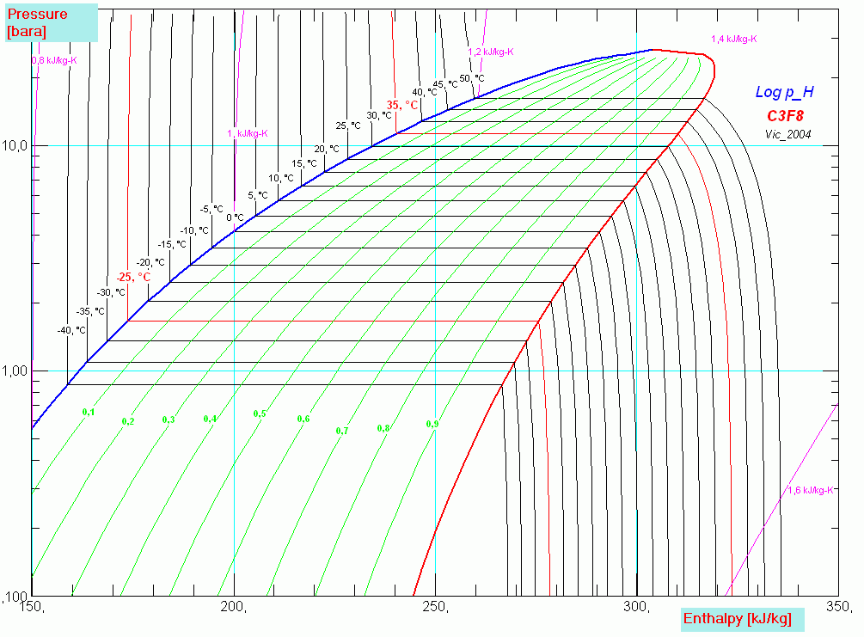
C3F8 properties: p-H diagram
C₃F₈, the third lightest saturated fluorocarbon
Present fluid: Perfluoro-propane (C₃F₈) for reference (T_{evap} ~ -25°C)
Liquid delivery @ < 60°C (T_{critical}): clearly no problem
But C₃F₈ evaporation @ -27°C ➔ P_{evap} < 1.7 bar_{a}*
Present C₃F₈ system will need modifications
(reduced exhaust pressure drops) for temperature margin to
achieve stable long-term operation with irradiated Si(see later)
G. Hallewell, CPPM: ATLAS tracker operation with mixtures Oct 1, 2009

Slide 4
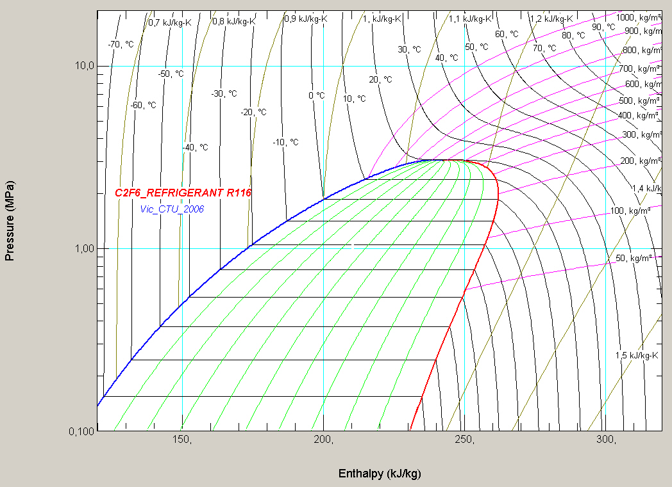
C₂F₆ , the second lightest saturated fluorocarbon…
Perfluoro-ethane (C₂F₆) less difficult to manipulate
Liquid delivery @ ≤ 20°C (T_{critical})
Evaporation at a higher temperature than possible with CF₄
e.g. Evaporation C₂F₆ @ -45°C ➔ P_{evap} 4.5 bar_{a}
Maximum enthalpy ~ 110 J.gm⁻¹

Slide 5
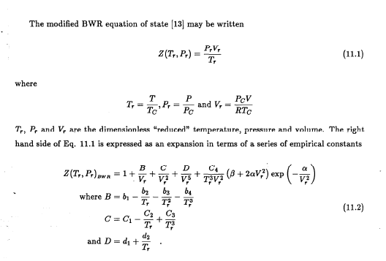
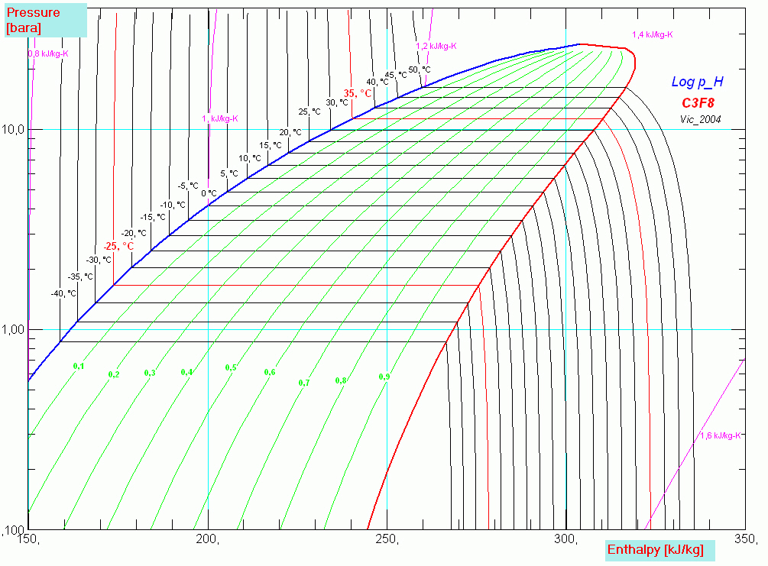
C₃F₈
1000
10.0
1.00
C₂F₆
Possible to calculate a blend for C₃F₈ and C₂F₆ having P_{evap}= 3 bar_{abs} @ -25°C
Using PC-SAFT molecular dynamics (Vacek, Prague) or modified Benedict-Webb-Rubin equation
of state, and avoiding low critical temperature problem of pure C₂F₆
(Sidesteps pressure drop problem and raises aspiration pressure)
But needs mixing set-ups and batch assay (ultrasonic or GC…)
Question of heat transfer coefficient: measurements needed
G. Hallewell, CPPM: ATLAS tracker operation with mixtures Oct 1, 2009
CERN/P.BONNEAU/02/12/2004

Slide 6
Fluorocarbons can be mixed (blended )
to arrive at compromise thermodynamic properties
(many modern refrigerants are blends)
This was tested (2000) with C₃F₈/C₄F₁₀ (2 papers in Fluid Phase Equilibria 2000-2001)
Mixture thermodynamic, transfer properties calculated & set up
as ‘temporary’ folders in NIST database
G. Hallewell, CPPM: ATLAS tracker operation with mixtures Oct 1, 2009

Slide 7
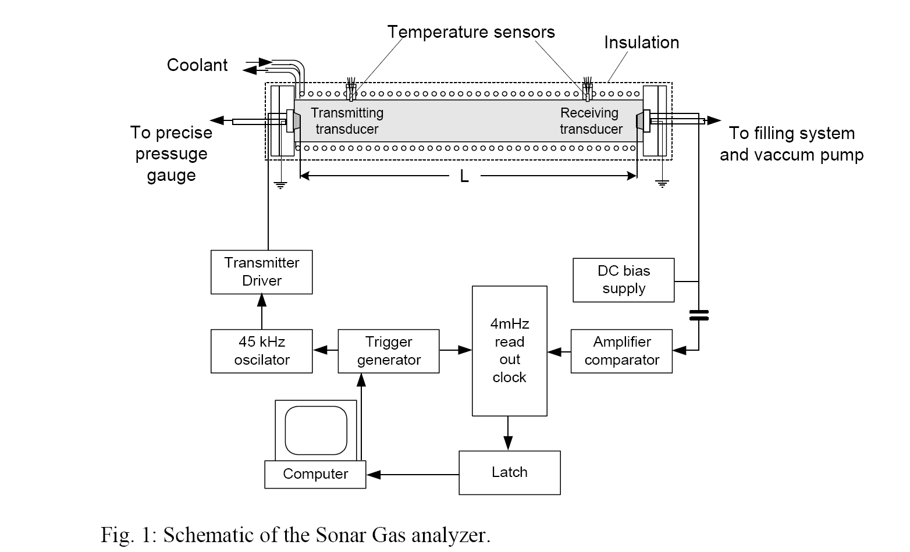
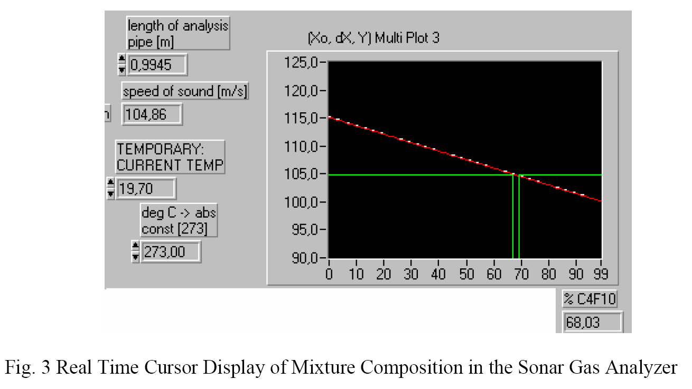
Fluorocarbon Blend Assay
Speed of sound the most convenient way to verify predictions of NIST calculations* for combined superheated state
* Modified Benedict-Webb-Rubin equation of state
Demonstatration (measurement) of differential condensation of the heavier component with increasing pressure:
* Test of NIST database prediction (~ 2%):
* Sound velocity increases once C₄F₁₀ concentration
in superheated phase starts to decrease (@ saturated liquid line)
G. Hallewell, CPPM: ATLAS tracker operation with mixtures Oct 1, 2009

Slide 8
Summer 2009: New theoretical approach replaces Benedict-Webb-Rubin equation of state for predicting properties of Saturated Fluorocarbons
Subcooled liquid, superheated vapour and saturated vapour
(Uses Perturbed-Chain-SAFT (Statistical Associating Fluid Theory)
Hallewell, Vacek &Vinš
Have tried new approach out on our pure C₃F₈ & C₄F₁₀
and blended C₃F₈ /C₄F₁₀ sound velocity measurements
made in 2000
Results look promising for the prediction of C₃F₈ /C₂F₆
blends; will start mixture ultrasound study with sonar.
G. Hallewell, CPPM: ATLAS tracker operation with mixtures Oct 1, 2009

Slide 9
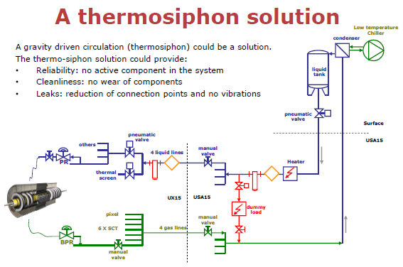
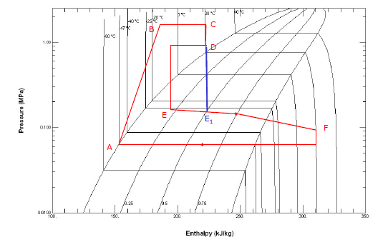
From Thermosyphon Working Group presentation,
M. Battistin: Thermosyphon workshop, July 6, 2009
G. Hallewell, CPPM: ATLAS tracker operation with mixtures Oct 1, 2009

Slide 10
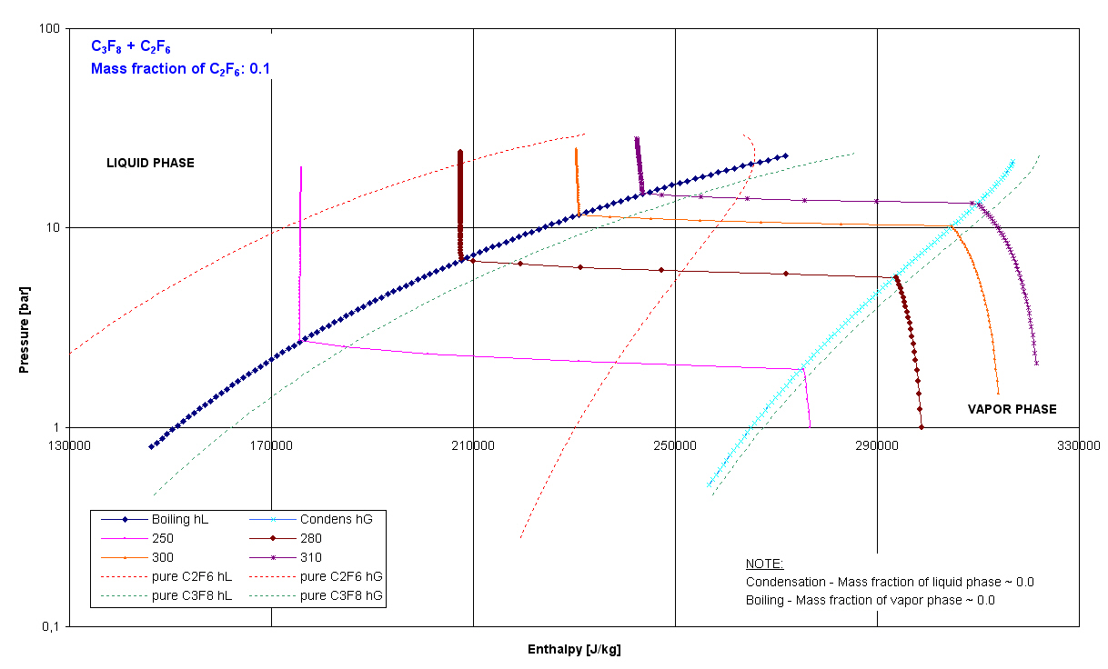
Example of a possible cycle: 10% C2F6 in C3F8
Pressure regulators & present choice of subcooling, capillary (Ø,L), etc…
DP liquid via
Gravity
Tune mixture to target evaporation temperature
-28ºC? Tune to ~ 2 bar_{abs}?
DP (DT) between Evaporation &
Condensation determined by sizing
of exisiting internal services
G. Hallewell, CPPM: ATLAS tracker operation with mixtures Oct 1, 2009

Slide 11
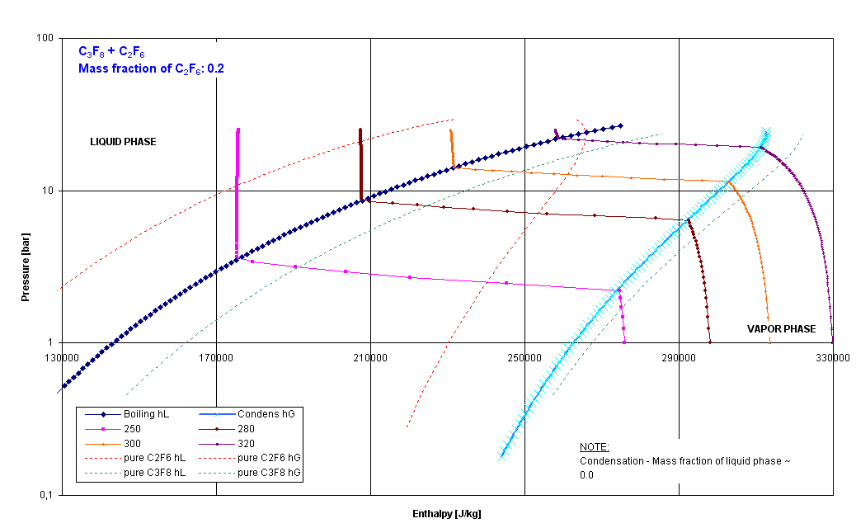
20% C2F6 in C3F8 for evaporation temp ~ -28C (present & future system)
Tune mixture to target evaporation temperature
-28ºC? Tune to ~ 3 bar_{abs}? Or 2 bar for -35C..?
G. Hallewell, CPPM: ATLAS tracker operation with mixtures Oct 1, 2009

Slide 12
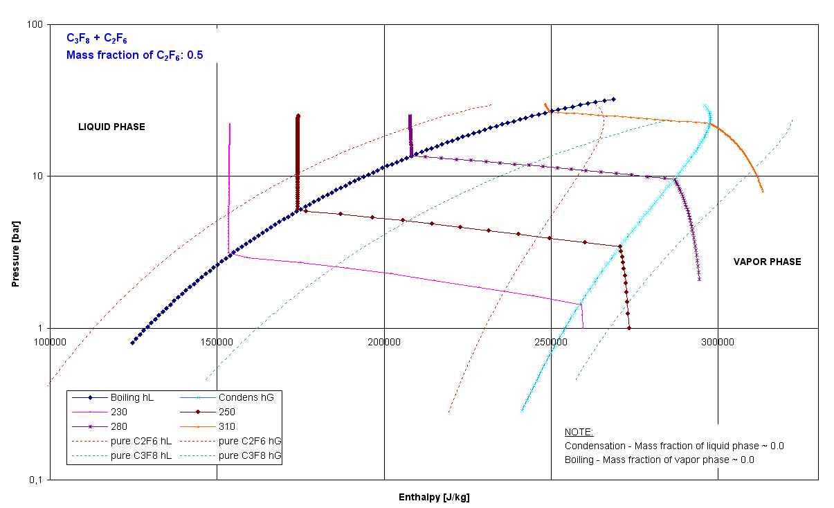
50% C2F6 in C3F8 for evaporation temp ~ -35C (future system)
Tune mixture to target evaporation temperature
@ -35ºC? Tune to ~ 2bar_{abs}?
G. Hallewell, CPPM: ATLAS tracker operation with mixtures Oct 1, 2009

Slide 13
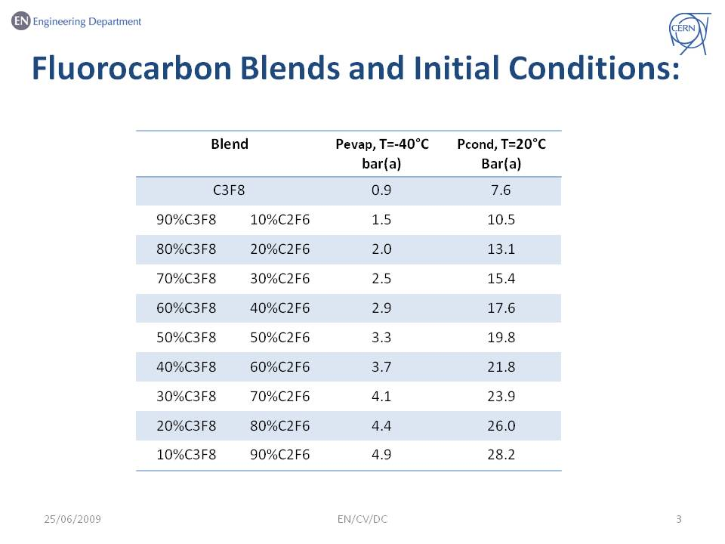
Second group now working on mixture property calculations
From Battistin, Direito, & Sivasankaran; Thermosyphon review, CERN July 6, 2009
G. Hallewell, CPPM: ATLAS tracker operation with mixtures Oct 1, 2009

Slide 14
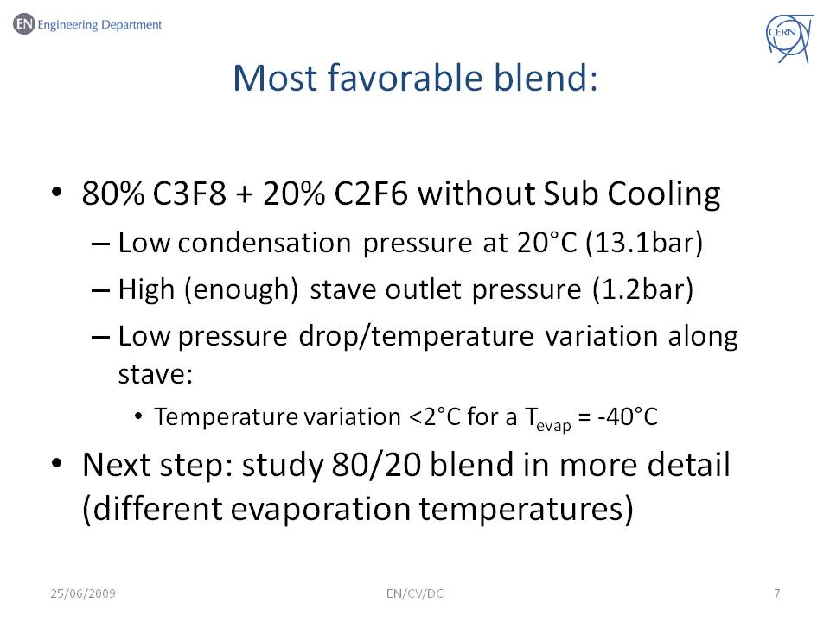
G. Hallewell, CPPM: ATLAS tracker operation with mixtures Oct 1, 2009

Slide 15
Preparation and on-line analysis of
C₃F₈/C₂F₆ binary mixtures via ultrasound
G. Hallewell, CPPM: ATLAS tracker operation with mixtures Oct 1, 2009

Slide 16
Speed of sound in a gas
(assuming here simplest ideal gas equation of state: PV=RT) is given by
V (ms⁻¹) = √(γRT/m) γ = Cp/Cv (ratio of specific heats (1➔ 1.66)
R = universal gas constant 8.314 J/kg⁻¹K⁻¹
T = absolute temperature m = molecular weight (expressed in kg)
G. Hallewell, CPPM: ATLAS tracker operation with mixtures Oct 1, 2009

Slide 17
Velocity vs. mass range; all gases
G. Hallewell, CPPM: ATLAS tracker operation with mixtures Oct 1, 2009

Slide 18
For a binary mixture of gases, the sound velocity depends on relative concentrations of the two components and the absolute temperature
The bigger the difference in molecular weight of the two components, the more precise the mixture ratio determination
G. Hallewell, CPPM: ATLAS tracker operation with mixtures Oct 1, 2009

Slide 19
Ultrasonic binary gas mixture analysis of gases first used in the context of a gas Cherenkov detector where particle identification capability depends on gas mixture refractive index
(difficult to measure on –line)
This application with C₅F₁₂/N₂ at 1 atm
G. Hallewell, CPPM: ATLAS tracker operation with mixtures Oct 1, 2009

Slide 20
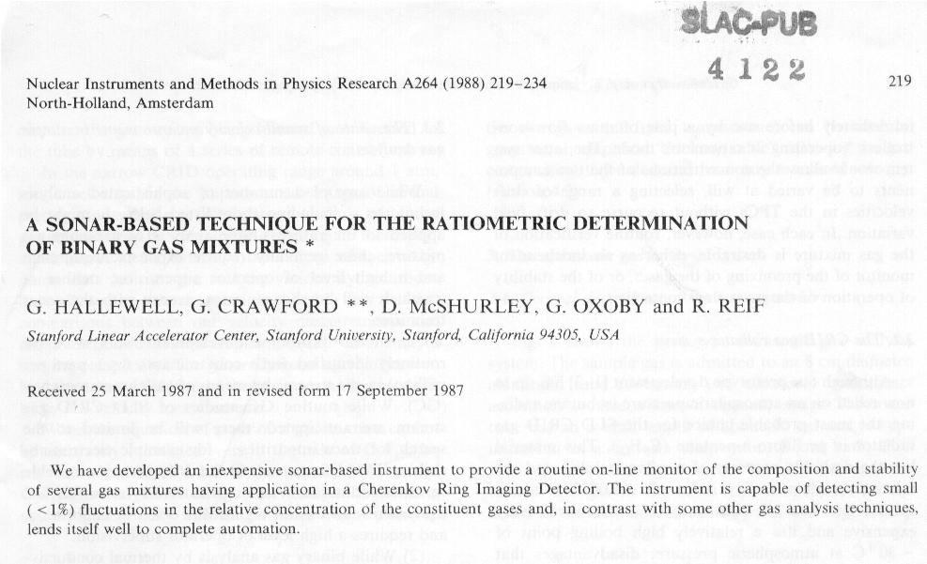
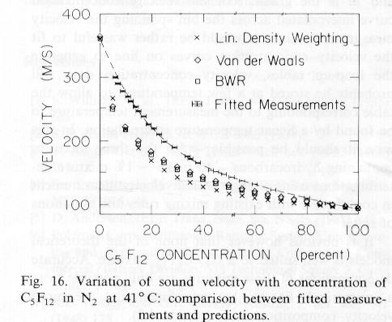
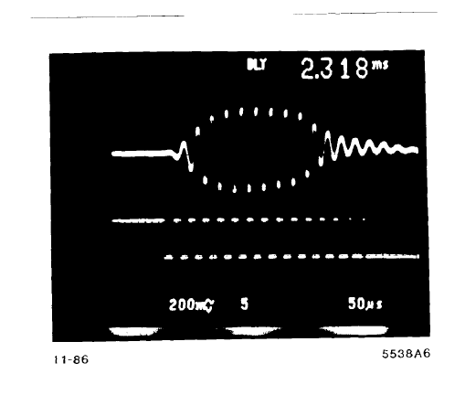
Not a new idea: C5F12/N2 mixed for SLD RICH and analysed by sonar (1988➔)
Paire de transduceurs ultrasoniques Polaroid (45kHz) ; écart ~1m (±1mm), dans un tube thermostaté ou l’enceinte du radiateur à gaz RICH
G. Hallewell, CPPM: ATLAS tracker operation with mixtures Oct 1, 2009

Slide 21
Sound velocity vs % C₃F₈ added to C₂F₆
(not the latest EOS technique –just for slope estimation)
Timing clock speeds of ~ few MHz
Would be sufficient (no massive
increase from previous system)
Sound Velocity (ms⁻¹)
Slope ~ 0.16ms⁻¹/%
%C₃F₈
G. Hallewell, CPPM: ATLAS tracker operation with mixtures Oct 1, 2009

Slide 22
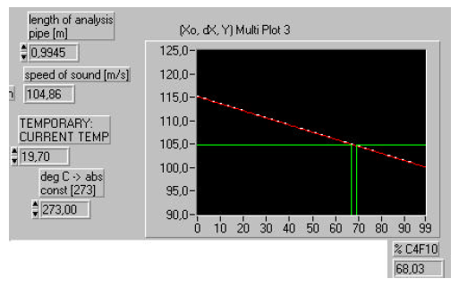
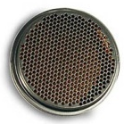
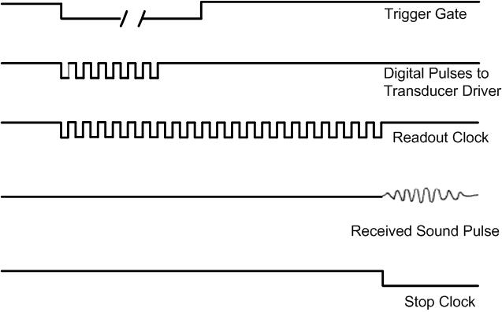
Computer screen real time display
Polaroid/SensTech model 6000
camera/robotics ultrasonic transducer
Real time ultrasonic Gas Analyzer
G. Hallewell, CPPM: ATLAS tracker operation with mixtures Oct 1, 2009

Slide 23
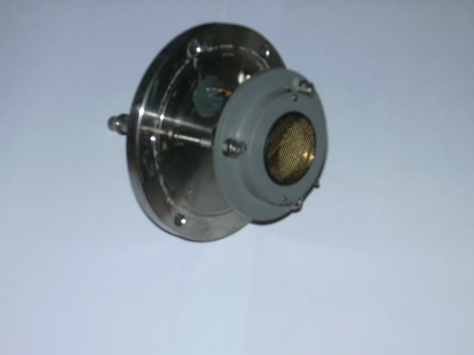
Transducer on carrier and tube end flange.
2 concentric (water jacketed) 50 cm tubes + 1*1m tube @ CPPM;
1 * 1m tube@ Prague
G. Hallewell, CPPM: ATLAS tracker operation with mixtures Oct 1, 2009

Slide 24
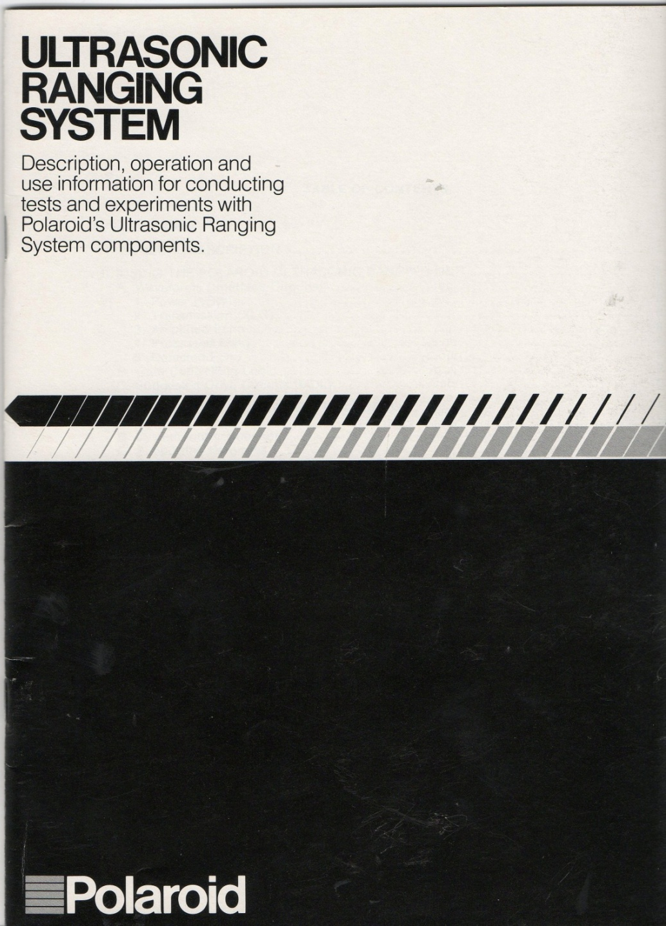
Details Polaroid 600 series instrument grade
and commercial grade ultrasonic transducers
G. Hallewell, CPPM: ATLAS tracker operation with mixtures Oct 1, 2009

Slide 25
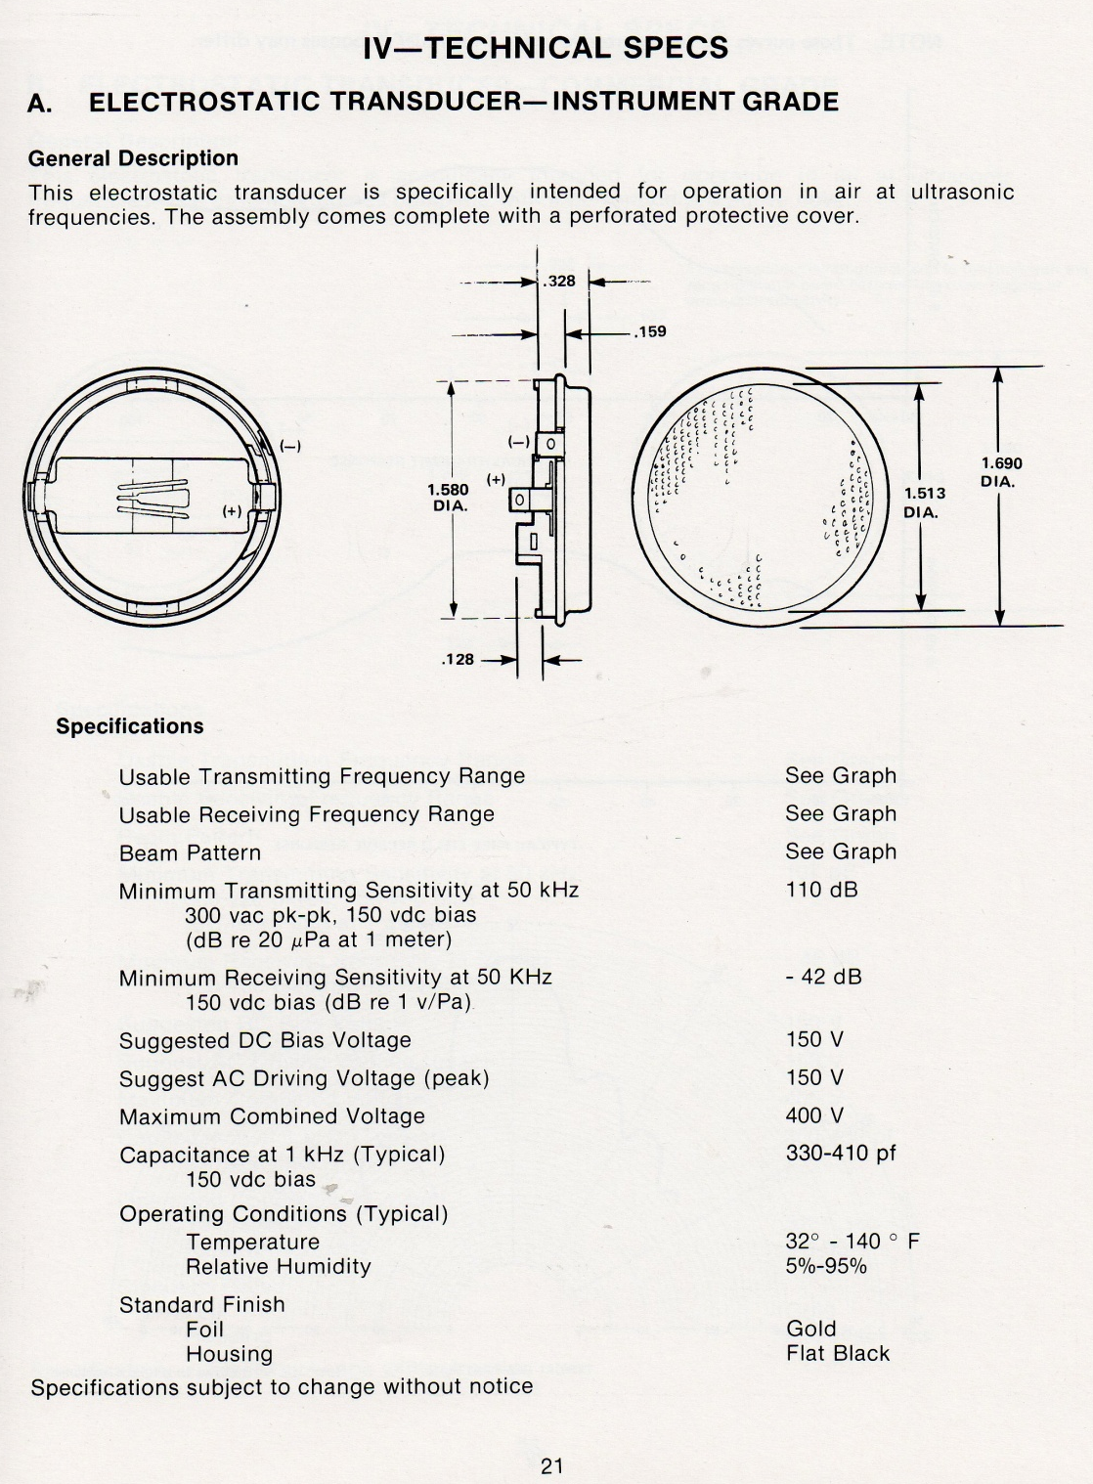
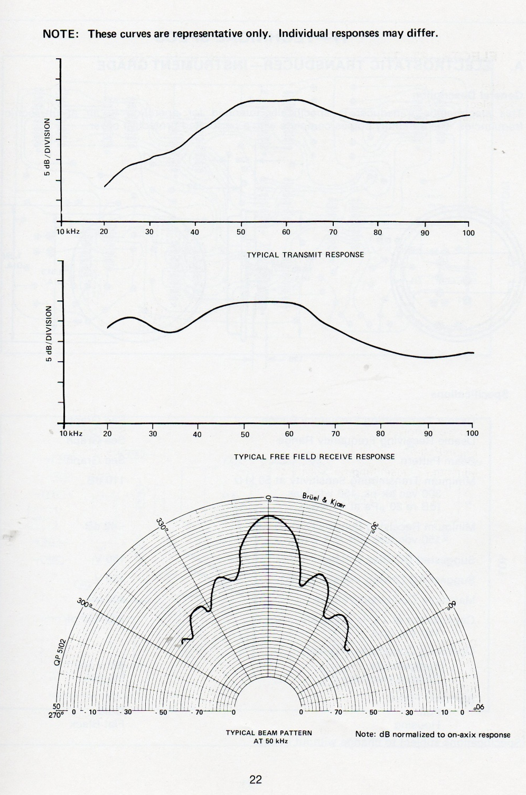
G. Hallewell, CPPM: ATLAS tracker operation with mixtures Oct 1, 2009

Slide 26
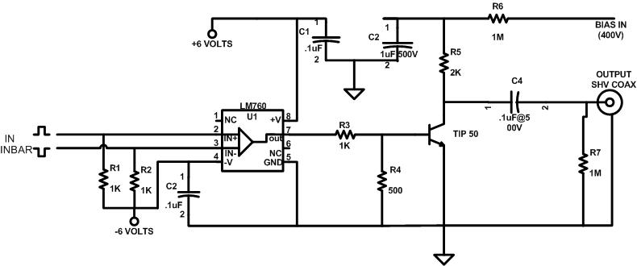
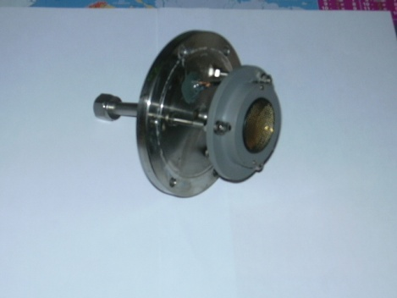
Square wave driver for Polaroid ultrasonic transducer (transmitter excited with 50kHz 400V square wave:
ECL long distance transmission from central clock card)
G. Hallewell, CPPM: ATLAS tracker operation with mixtures Oct 1, 2009

Slide 27
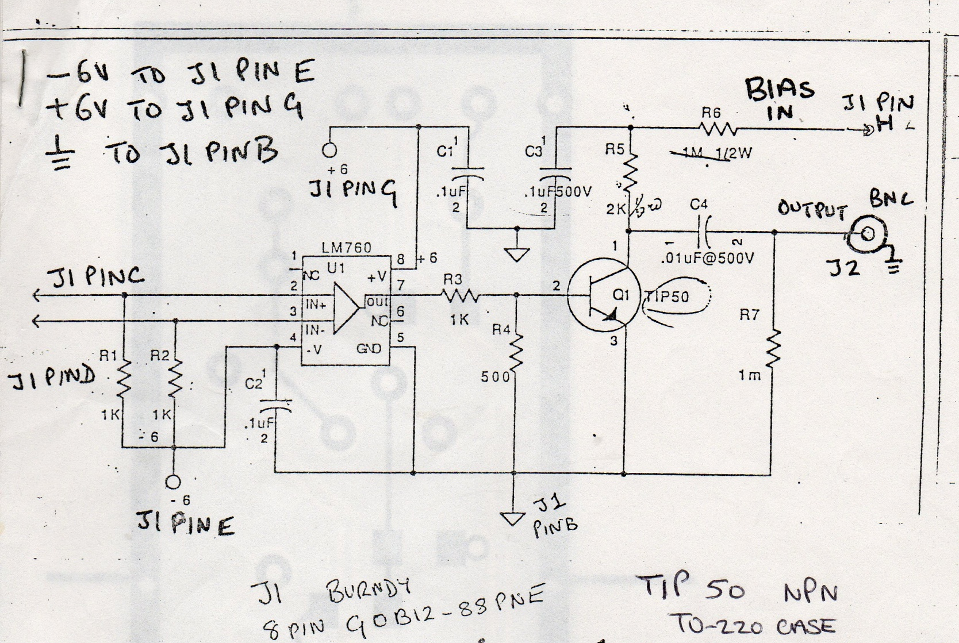
Driver schematic – log book details
G. Hallewell, CPPM: ATLAS tracker operation with mixtures Oct 1, 2009

Slide 28
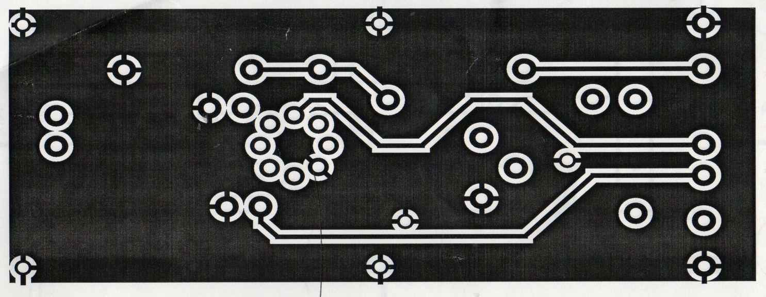
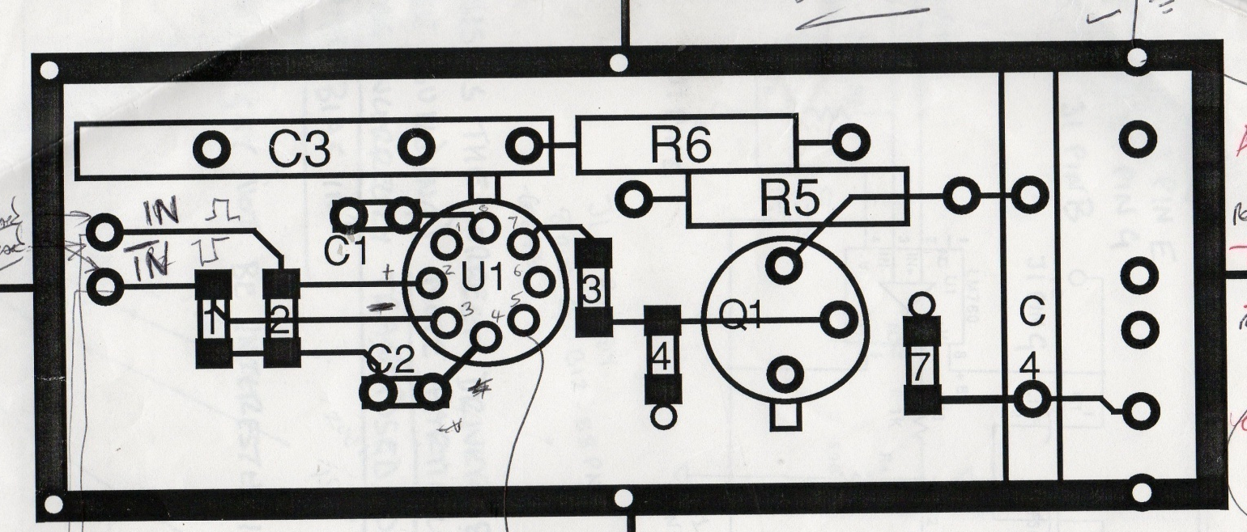
PC films, driver
G. Hallewell, CPPM: ATLAS tracker operation with mixtures Oct 1, 2009

Slide 29
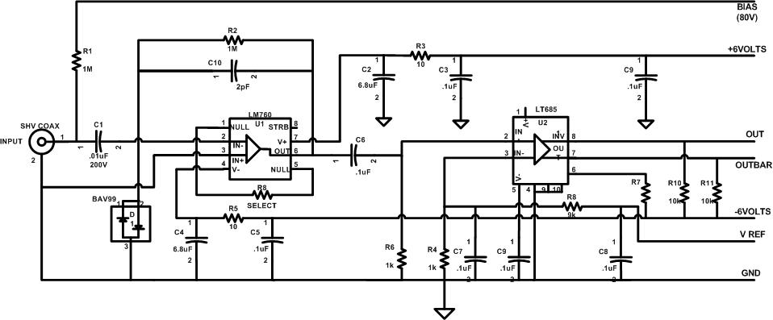
Receiver amplifier for Polaroid ultrasonic transducer (typically biased at +80V)
G. Hallewell, CPPM: ATLAS tracker operation with mixtures Oct 1, 2009

Slide 30
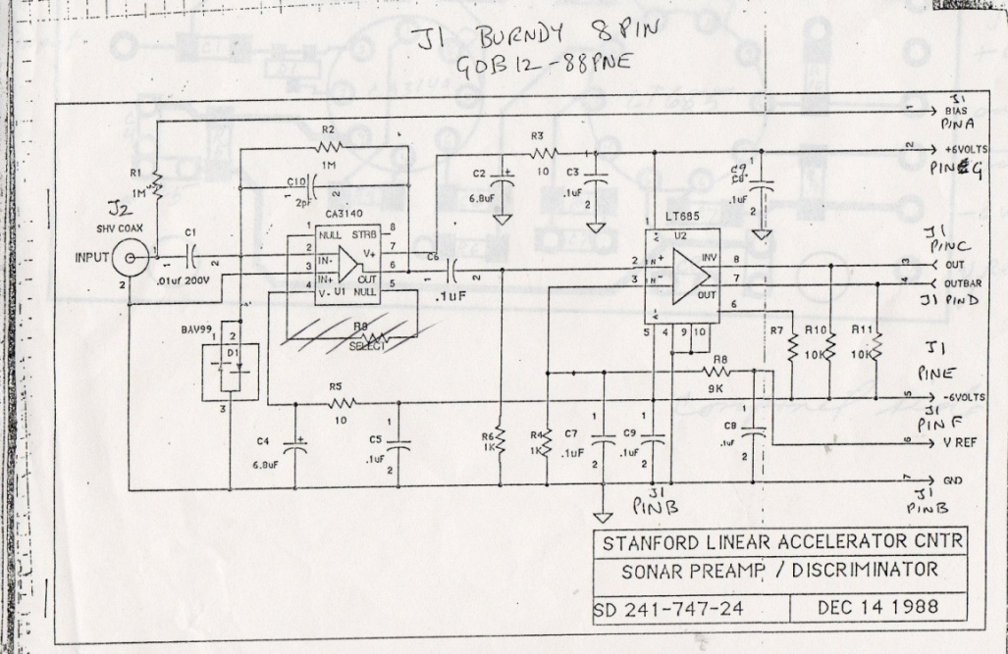
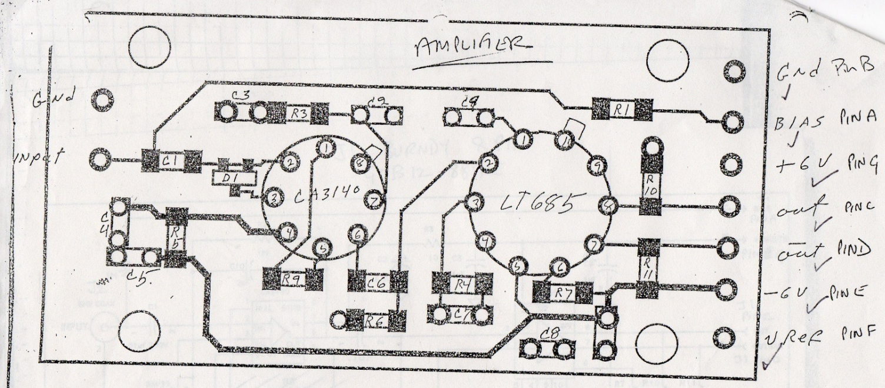
SLD Sonar, amplifier discriminator film and log book detail
G. Hallewell, CPPM: ATLAS tracker operation with mixtures Oct 1, 2009

Slide 31
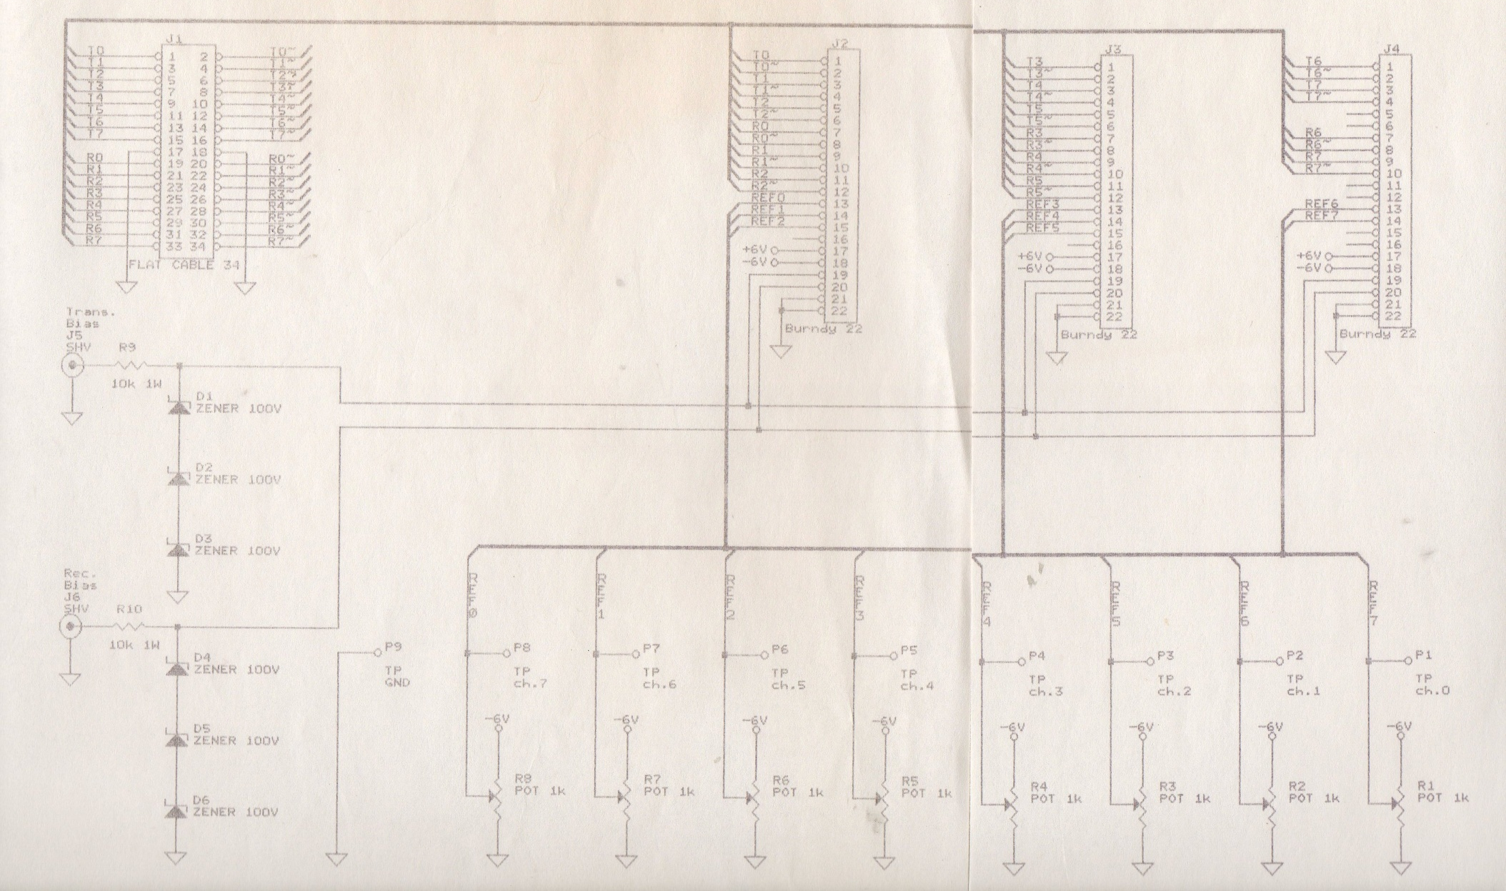
SLAC Sonar threshold generation and distribution
G. Hallewell, CPPM: ATLAS tracker operation with mixtures Oct 1, 2009

Slide 32
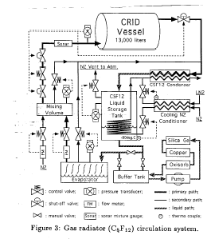
SLD-CRID: C₅F₁₂/N₂ mixture analyzer also a flow meter
G. Hallewell, CPPM: ATLAS tracker operation with mixtures Oct 1, 2009

Slide 33
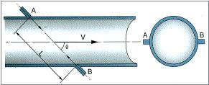
Ultrasonic flowmeter principle
Tdown = ( D / sinθ ) / ( c + V*cosθ ) (1)
Tup = ( D / sinθ ) / ( c - V*cosθ) (2)
where c is the sound speed in the fluid, D is the pipe diameter and V is the flow velocity (m/s)
averaged over the sound path.
Solving the above equations leads to
V = ( D / sinθ ) * ∆T / (Tup * Tdown), (3)
where ∆T = Tup - Tdown.
Therefore, by accurately measuring the upstream and downstream transit-time Tup and Tdown,
we can obtain the flow velocity V. Subsequently, the volume flow rate is calculated as,
Q = A* V,
where A is the inner cross-section area of the pipe (4)
G. Hallewell, CPPM: ATLAS tracker operation with mixtures Oct 1, 2009

Slide 34
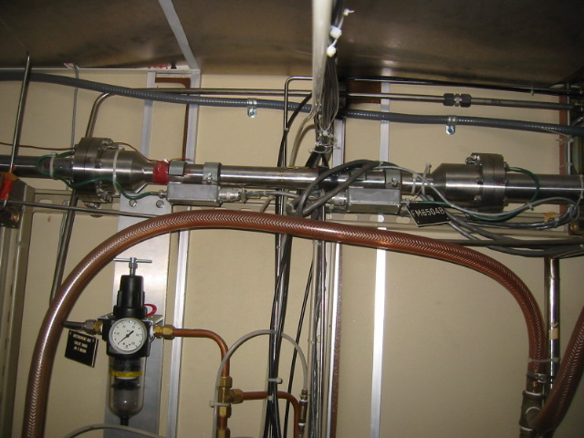
SLD CRID Combined Sonar Gas Analyzer/flowmeter in C₅F₁₂/N₂ injection/recovery/circulation system (1)
G. Hallewell, CPPM: ATLAS tracker operation with mixtures Oct 1, 2009

Slide 35
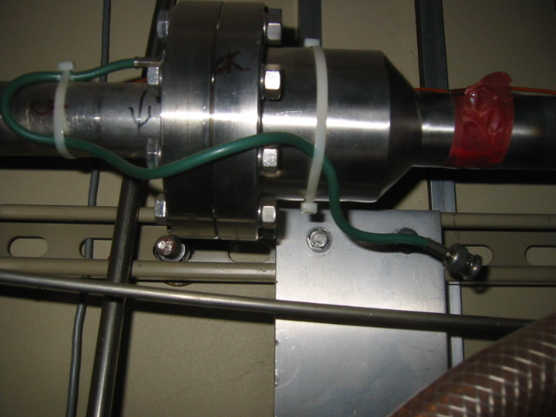
SLD CRID Combined Sonar Gas Analyzer/flowmeter: detail of transducer blister
G. Hallewell, CPPM: ATLAS tracker operation with mixtures Oct 1, 2009

Slide 36
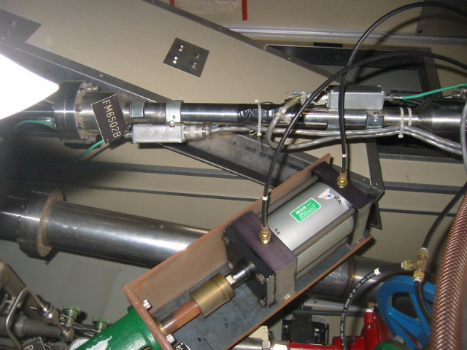
SLD CRID Combined Sonar Gas Analyzer/flowmeter in C₅F₁₂/N₂ injection/recovery/circulation system (2) with electronic driver/preamp/discriminator boxes
G. Hallewell, CPPM: ATLAS tracker operation with mixtures Oct 1, 2009

Slide 37
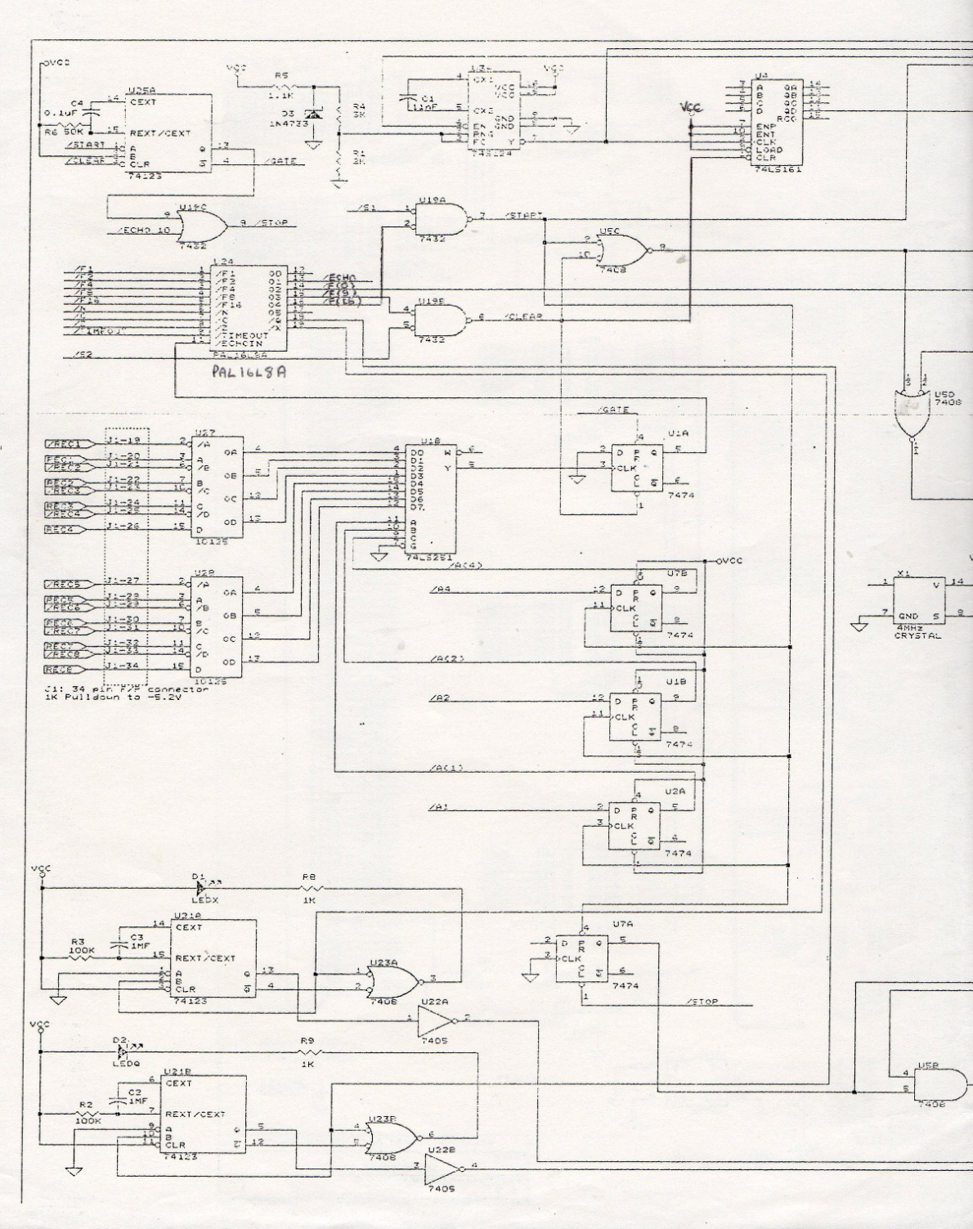
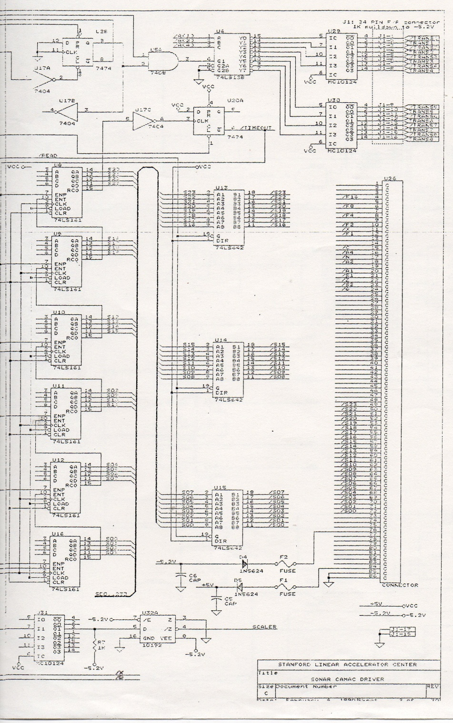
SLAC Sonar CAMAC driver (clocks only of possible interest)

Slide 38
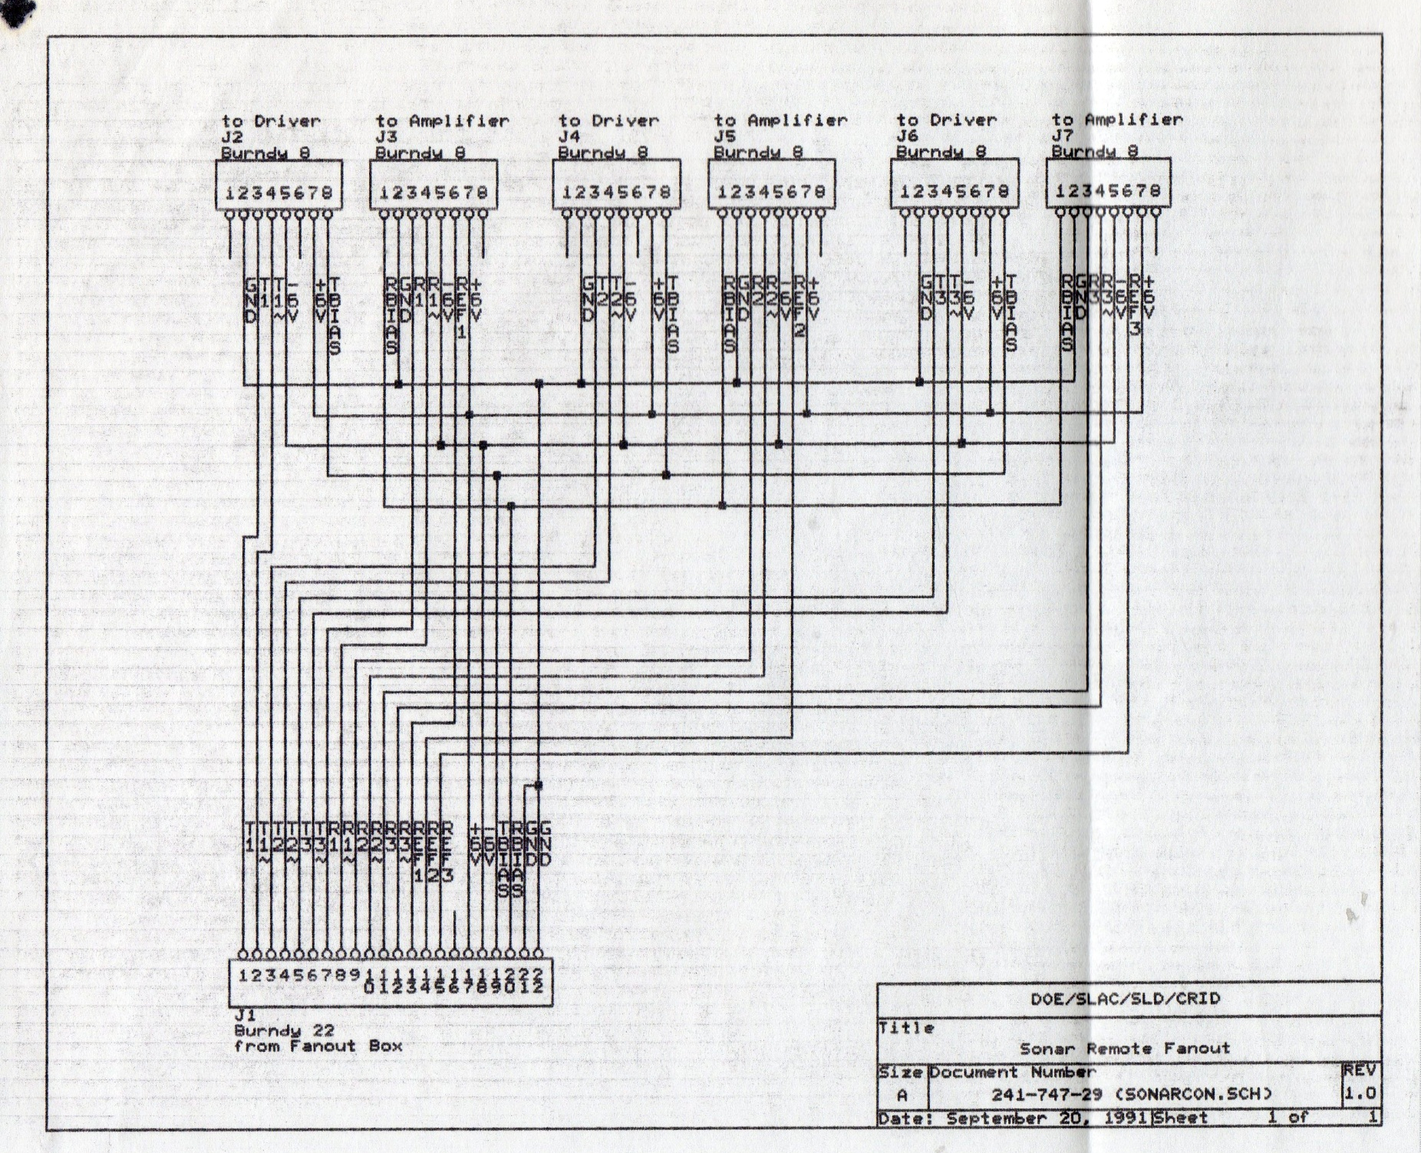
SLAC sonar fanout connector box ( 3 of 8 channels) general interest only

Slide 39
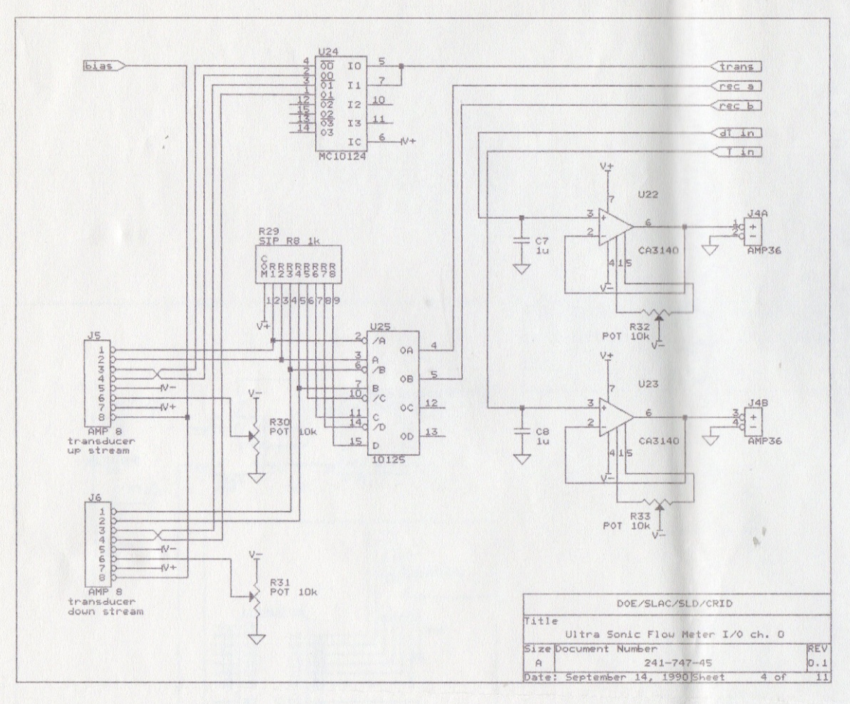

Slide 40
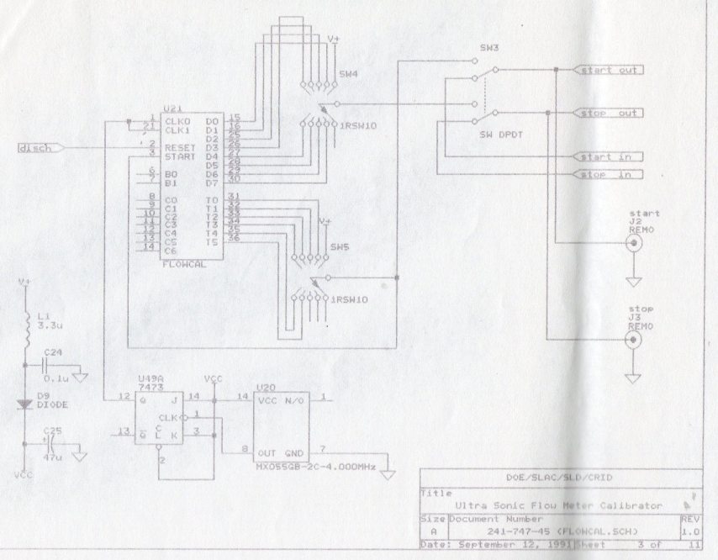

Slide 41
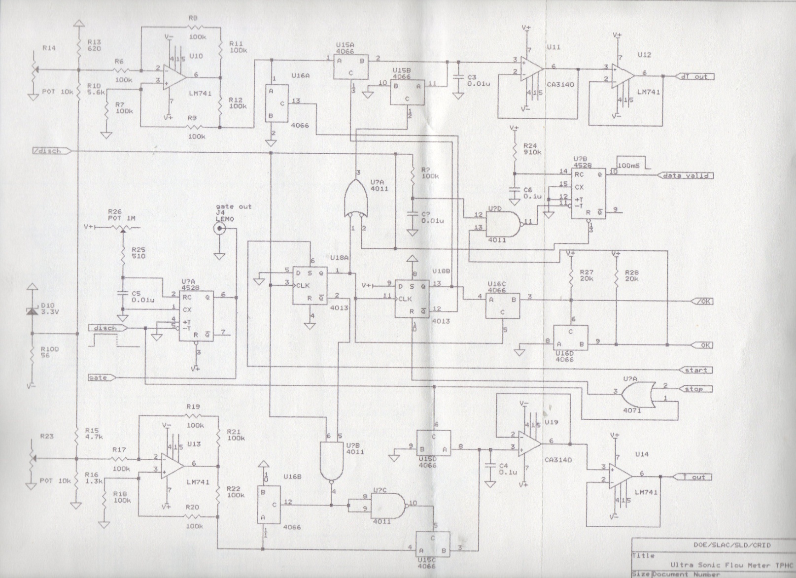

Slide 42
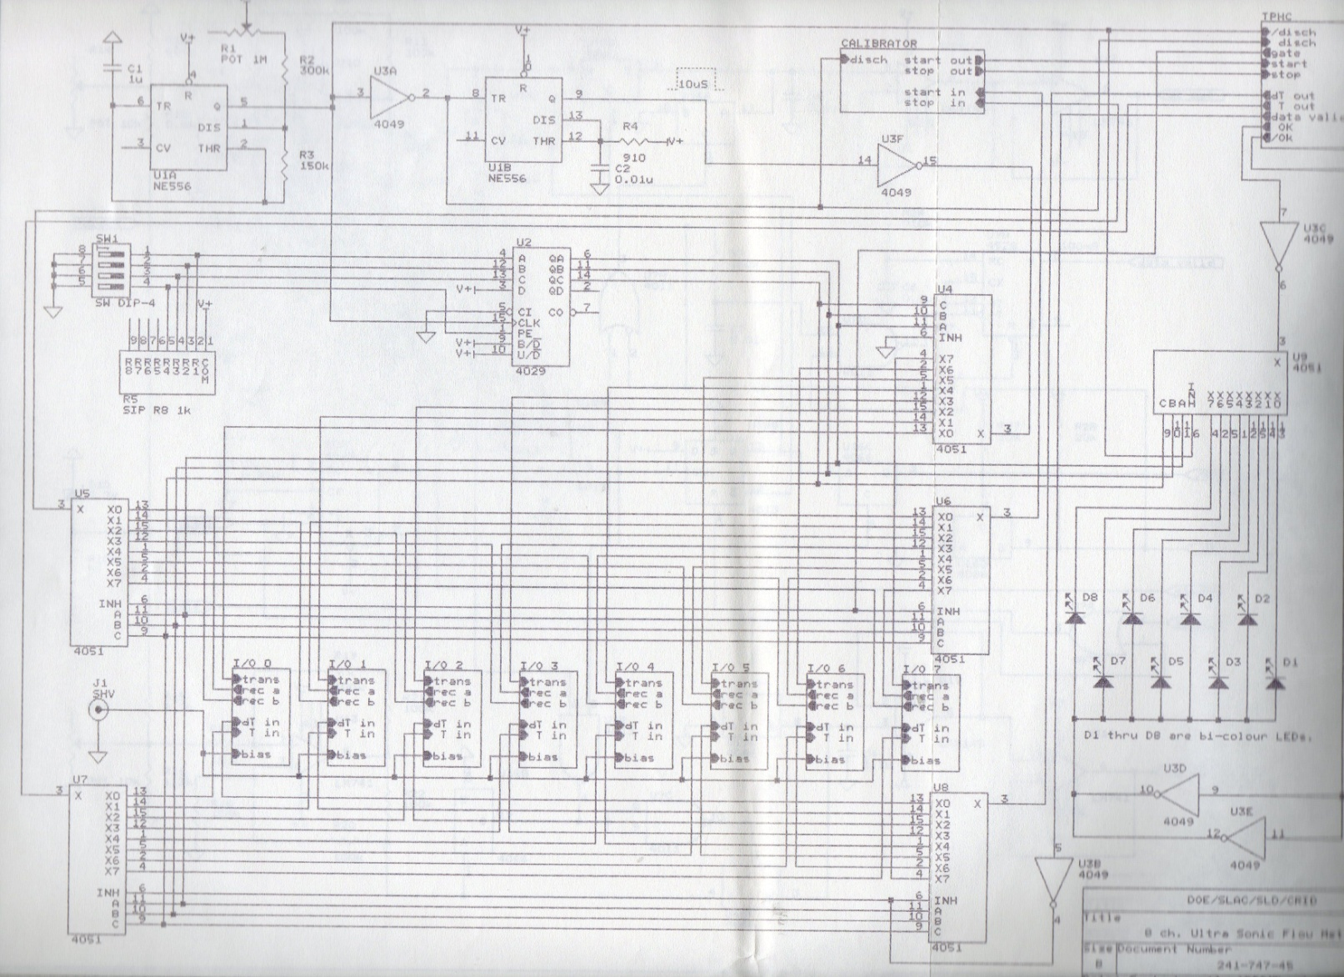

Slide 43
New Sonar Electronics Requirement
- Electronics will probably need to be sited in USA15;
- communication @ 45kHz via ECL or LVDS
as at SLAC (distances ➔ ~ 150m),
- also discriminator crossing signal back to central multiclock
➔ Multiple simultaneous distribution of 45kHz 8-cycle ‘chirps’, - simultaneous start of ‘fast’ readout clocks (range 4-12 MHz) ;
- individual stop of each clock channel by discriminator signal
- With direction switching for flowmetry
Interfacing to modern field-buses, on line display with ATLAS or LHC standard tools
G. Hallewell, CPPM: ATLAS tracker operation with mixtures Oct 1, 2009

Slide 44
Other developments (1)
With Panametrics Inc.
(now part of G.E.) in 1988-93 on adding molecular weight analysis capability to an existing ultrasonic flowmeter (firmware upgrade).
G. Hallewell, CPPM: ATLAS tracker operation with mixtures Oct 1, 2009

Slide 45
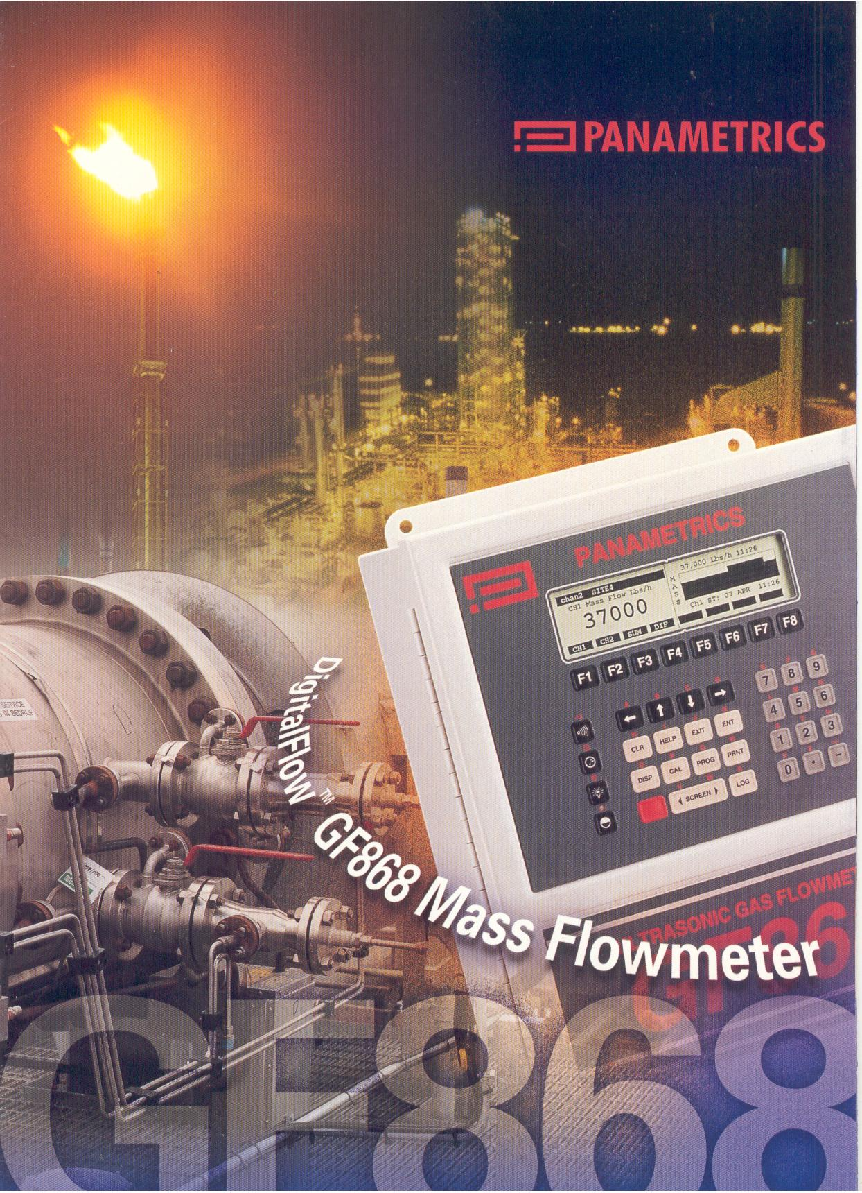
G. Hallewell, CPPM: ATLAS tracker operation with mixtures Oct 1, 2009

Slide 46
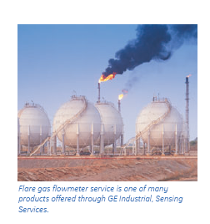
G. Hallewell, CPPM: ATLAS tracker operation with mixtures Oct 1, 2009

Slide 47
Other developments (2)
Addition of molecular weight analysis capability to an existing Gill ultrasonic clinical flowmeter.
Mixture analysis of full range of O₂/N₂O/heavy anesthesia vapours at hopital Cantonal de Genève (2001) using 2 cells
O₂/N₂O/halothane, O₂/N₂O/sevoflurane,
O₂/N₂O/enflurane, O₂/N₂O/isoflurane, O₂/N₂O/desflurane
G. Hallewell, CPPM: ATLAS tracker operation with mixtures Oct 1, 2009

Slide 48
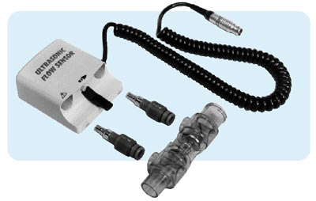
G. Hallewell, CPPM: ATLAS tracker operation with mixtures Oct 1, 2009

Slide 49
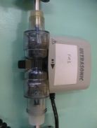
Principe de distribution et analyse ultrasonique des mélanges de gaz anesthésiques
G. Hallewell, CPPM: ATLAS tracker operation with mixtures Oct 1, 2009

Slide 50

Panneau avant du GUI “Graphical User Interface” pour l’analyse de mélange de gaz livré en anesthésie.
(Suite à une étude faite à l’hôpital Cantonal de Genève, août 2001)
G. Hallewell, CPPM: ATLAS tracker operation with mixtures Oct 1, 2009

Slide 51

Exemplaire de variation en vitesse du son dans un mélange 3 composants pendant l’anesthésie
La vitesse du son (Profondeur de l’anesthésie) suit un chemin sur cette surface
G. Hallewell, CPPM: ATLAS tracker operation with mixtures Oct 1, 2009

Slide 52
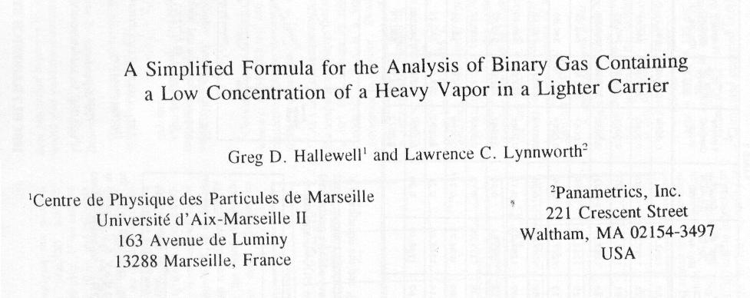
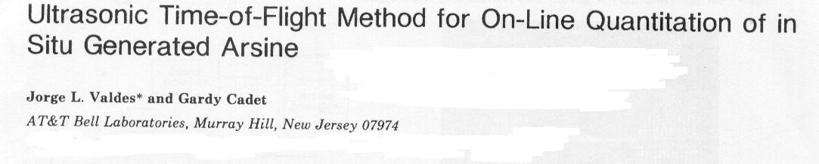


In semiconductor manufacture…
Toluene-Air
Tri-Methyl-Indium/H₂
G. Hallewell, CPPM: ATLAS tracker operation with mixtures Oct 1, 2009

Slide 53
Summary
Fluorocarbon blends are assuming a new urgency due to problems with presently-implemented system.
These blends well suited to surface condenser/compressorless primary loop operation: lower cold condensation temperatures than possible with CO2 (snow), and lower on-detector evaporation temperatures
An analytic instrument based on speed of sound measurements in the vapour state will be a valuable instrument for R&D and also for flowmetry/mixture analysis at several points in the UX➔USA15
(and USA15➔surface tubing in a future thermosyphon system)
Assistance for new electronics for sonars will be a great help
Questions of heat transfer coefficient and possible azeotropicity to be aswered: sonars in test stands needed.
G. Hallewell, CPPM: ATLAS tracker operation with mixtures Oct 1, 2009

