Slide 1
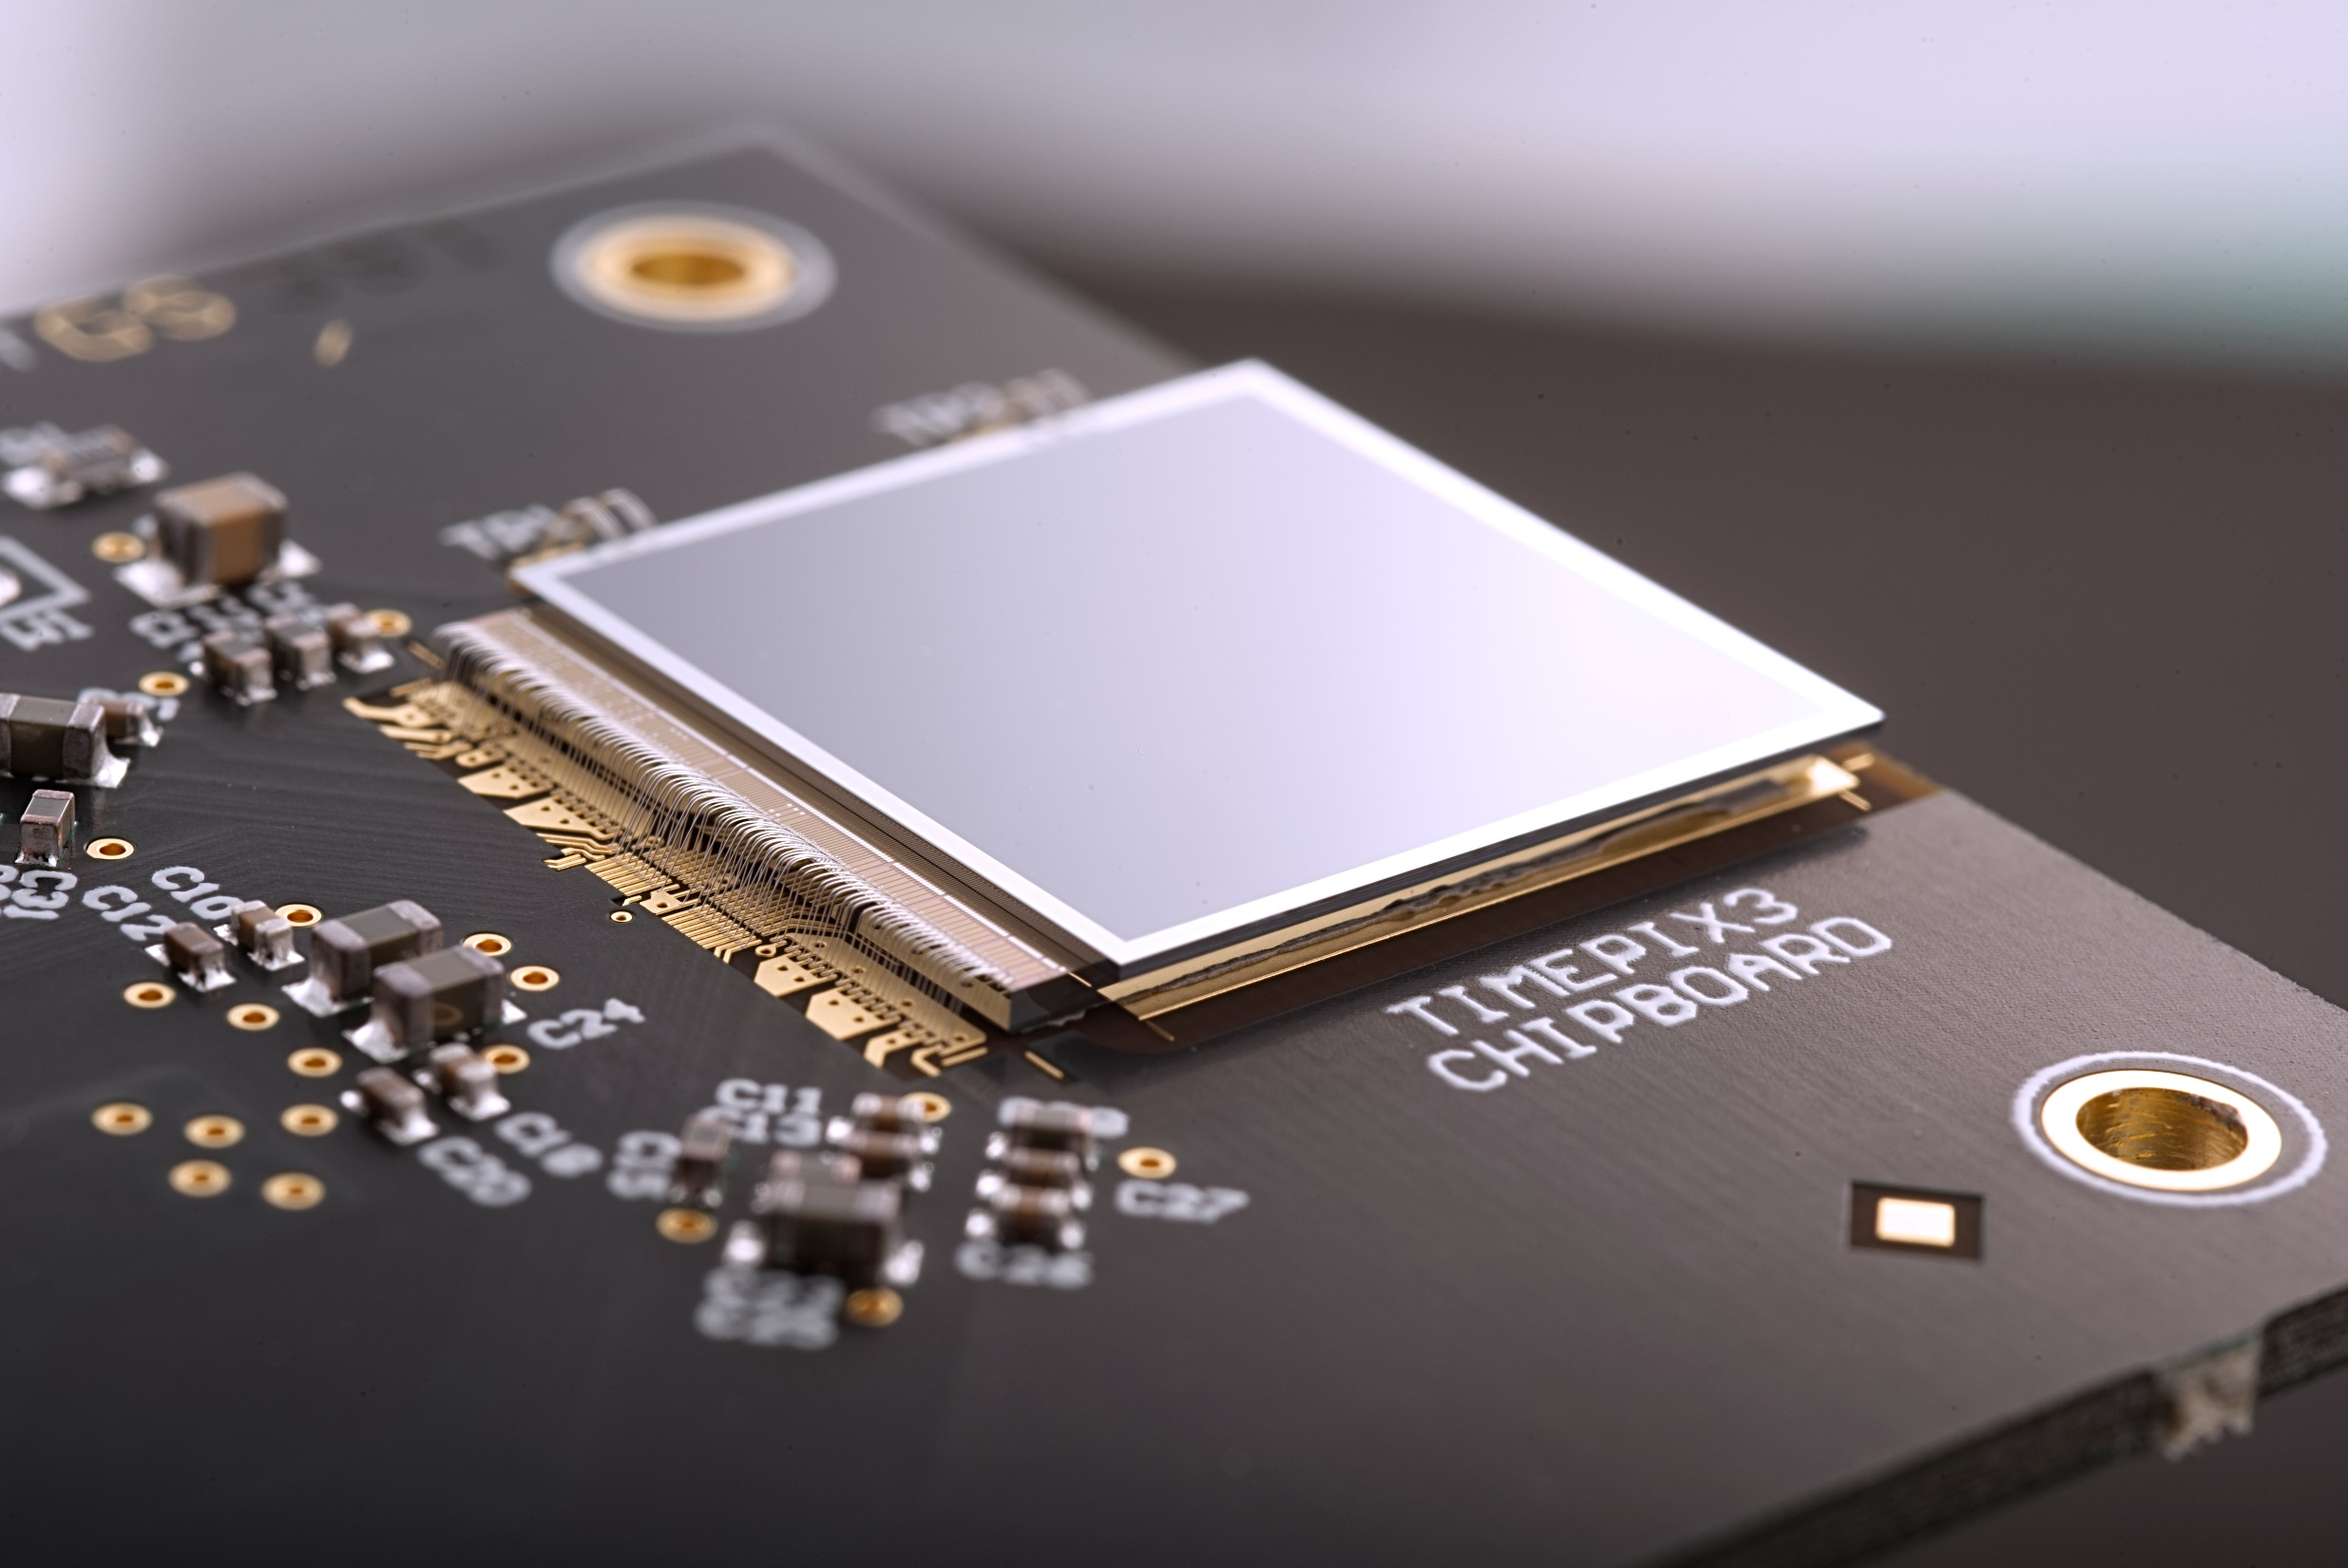

Microelectronics at CERN
Introduction to the Medipix Project
Notes:
What and why Microelectronics at CERN?
The LHC experiments are able to register 40 million collisions per second, continuously – a feat that was barely more than a dream when thoughts turned to building detectors for the big collider some 30 years ago. The start of the so called LAA project at CERN in 1986 led directly to the recruitment of young and creative electronic engineers as well as enabling financing of hardware and software tools, and by 1988 the first electronics design group had been set up at CERN. This allowed CERN to develop microelectronics, which together with the design of silicon strip and pixel detectors still today underlies many of the high-performing detectors at the LHC.

Slide 2
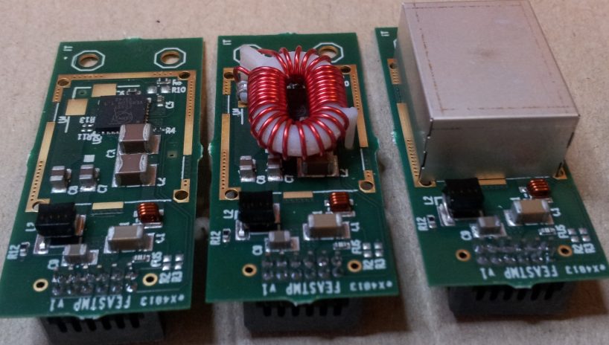
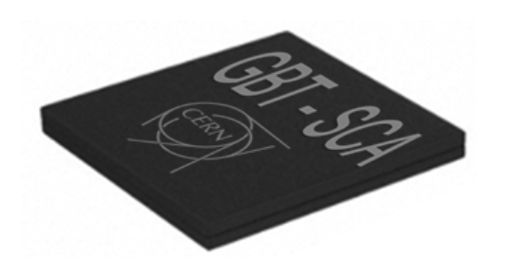
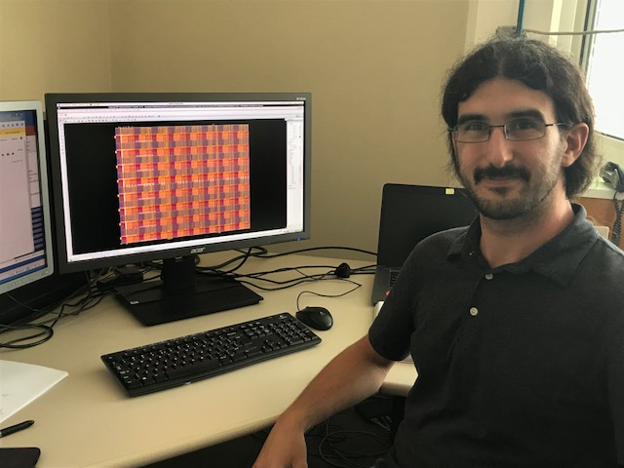
The Microelectronics section at CERN
Provides support to the HEP (High Energy Physics) community:
Radiation and multi-tesla tolerant chip design
GBT & Versatile Link
DC-DC Converters
Medipix
- These components are named ASICs (Application Specific Integrated Circuits)
DC DC converter modules
Radiation Hard Optical Link Project (Gigabit/s)
Chip designer Iraklis working on new pixel detectors
Notes:
Today the Microelectronics section at CERN continue supporting high energy physics by developing IC, i.e. integrated circuits, that are immune to the high radiation levels and multi-Tesla magnetic fields. You have, for example, the development of a radiation hard bi-directional optical link for use in LHC upgrade programs for the transport of data, timing and control signals. DC-DC converters are also developed specifically for the hostile environment of the LHC experiments. And of course there’s the Medipix family which aims at the development of X-ray pixel imaging chips and systems. Ever since its inception the chips, or rather the transistors, are getting smaller, and the miniaturization to submicrometre scales allow more functions to be compacted into a smaller volume in sophisticated, ASICs, as they’re called.

Slide 3
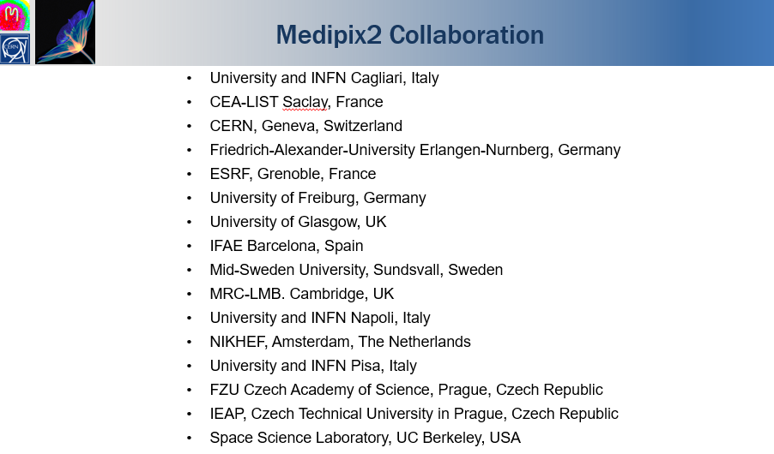
The Medipix Pixel detector
Medipix – a family of successive generations of hybrid pixel detectors
Collaboration with multiple institutes all around the world
Medipix1 chip was produced in the 1990s (1µm technology)
Medipix2 (0.25µm)
  Medipix2MXR, Timepix
Medipix3 (0.13µm)
  Timepix3, Medipix3RX
Medipix4: (65nm) Timepix4 (2019)
Notes:
Medipix is a family of read-out chips for particle imaging and detection developed by the Medipix Collaborations. The original concept of Medipix is that it works like a camera, detecting and counting each individual particle hitting the pixel when its electronic shutter is open. This enables high-resolution, high-contrast, noise free images – making it unique for imaging applications.
We’ll be focusing on the Timepix detector, since that’s what I’ve been using.
Transistors=engineered atoms of the read-out chip????
2:CERN, University of Glasgow, Mid Sweden University in Sundsvall
3: when an informal collaboration of 4 institutes demonstrated the potential of the new technology to provide noise-free singe-photon counting
4:Since then the Medipix family has expanded to include Medipix2 chip with improved spatial resolution and Timepix which is a modified version of Medipix2 with the additional functionality time or amplitude measurements.
5: During the first decade of the 2000’s the Medipix3 and Timepix3 where created, which have the ability to determine the energy level of each individual photon detected

Slide 4
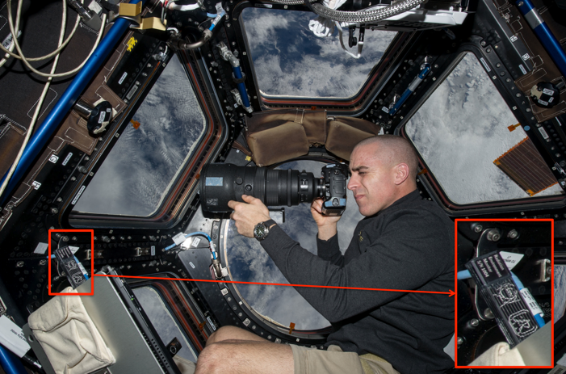
Technical Introduction of Timepix chip
ASIC (Application Specific Integrated Circuit)
Pixel Array: 256x256
Pixel Pitch: 55µm
Pixel functionality: PC, TOT and TOA
Application Areas and Commercialization
Medical Imaging
Education
Space Dosimetry
Material Analysis
Back to High-Energy Physics
Image of the astronaut Chris Cassidy working near the Timepix USB on the ISS
Notes:
The Medipix technology is one of CERN’s most successful technology-transfer cases. Each collaboration has triggered a significant number of commercial activities in widely different application areas. For example, the Medipix chip provides many advantages in radiography and computed tomography (CT), since X-ray photon are used to study the human body. In 2013 a kit especially designed for classroom-use based on the Timepix was put on the market. And today there’s multiple Timepix chips on the ISS or anywhere else in space, as they’re excellent space dosimeters as they provide a very compact and low-power solution to measure the radiation field. For basically the same reason as medical imaging the Medipix chip can also be used for Material Analysis, and in later years it has found its way back to its roots, the LHC, as it now, similar to its task in space, provides independent, real-time information about the radiation environment in the experimental cavern.

Slide 5
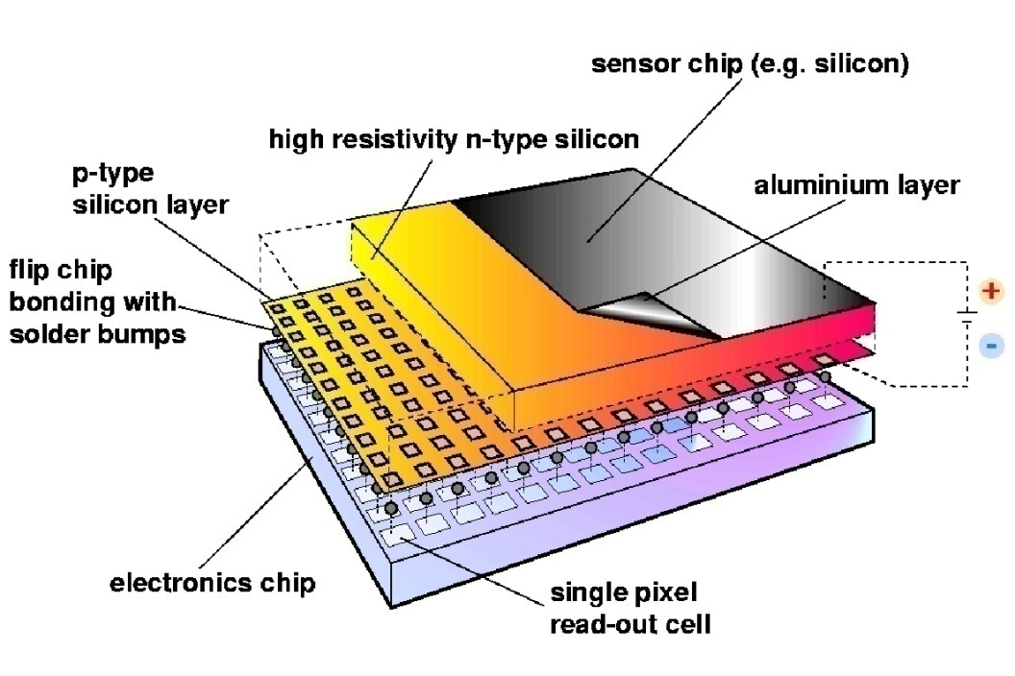
Hybrid Silicon Pixel Detectors
Standard CMOS can be used allowing on-pixel signal processing
Sensor material can be changed (Si, GaAs, CdTe..)
Notes:
Cross section of the full detector assembly, …. the readout chip is interconnected with the sensor via solder bumps, which basically means that their assembly is permanent.
As we can see, together with a detection medium – typically a semiconductor such as silicon – these chips form hybrid pixel detectors. The read-out chip is composed of a matrix pf pixels with signal processing circuitry. The electrode at the bottom face of the detection medium is pixelated as well and connected to the read-out chip pixel by pixel. A technique called bump-bonding is used, in essence creating a very small ball-like solder joint between the detection medium and the read-out chip, one for each pixel.
Charged particles interact with the semiconductor, resulting in the creation of electron-hole pairs. The charge is then transferred trough the bump-bond of each pixel and, in counting mode, the electronics adds up the number of particle hits per pixel. The separation of the detection medium and the read-out chip allows for noise-free detection of photons and, more importantly, the possibility to optimize the detection medium for different types of particles and energy ranges. Since the number of charge-carriers created is proportional to the energy of the incident particle it is possible to quantize the energy of the detected particle.

Slide 6
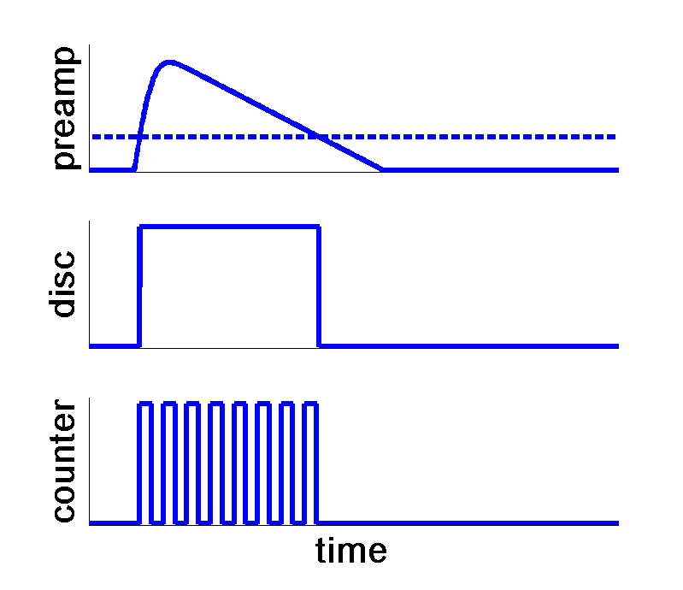
Hybrid Pixels Detector – Measuring Energy
Time over Threshold
Open shutter
Close shutter
Voltage
Qin ~ 4000e-
Threshold
threshold ~ 600e⁻
Amplifier output
noise ~ 60e⁻ rms
→ Noise hit free imaging
Time
Notes:
Charge accumulated in the feedback - Capacitor → converted to voltage → Amplified by preamplifier
The frontend of the read-chip/pixel

Slide 7
X-ray photon energy deposition
Fluorescence in High-Z Materials
γ
γ_{f}

Slide 8
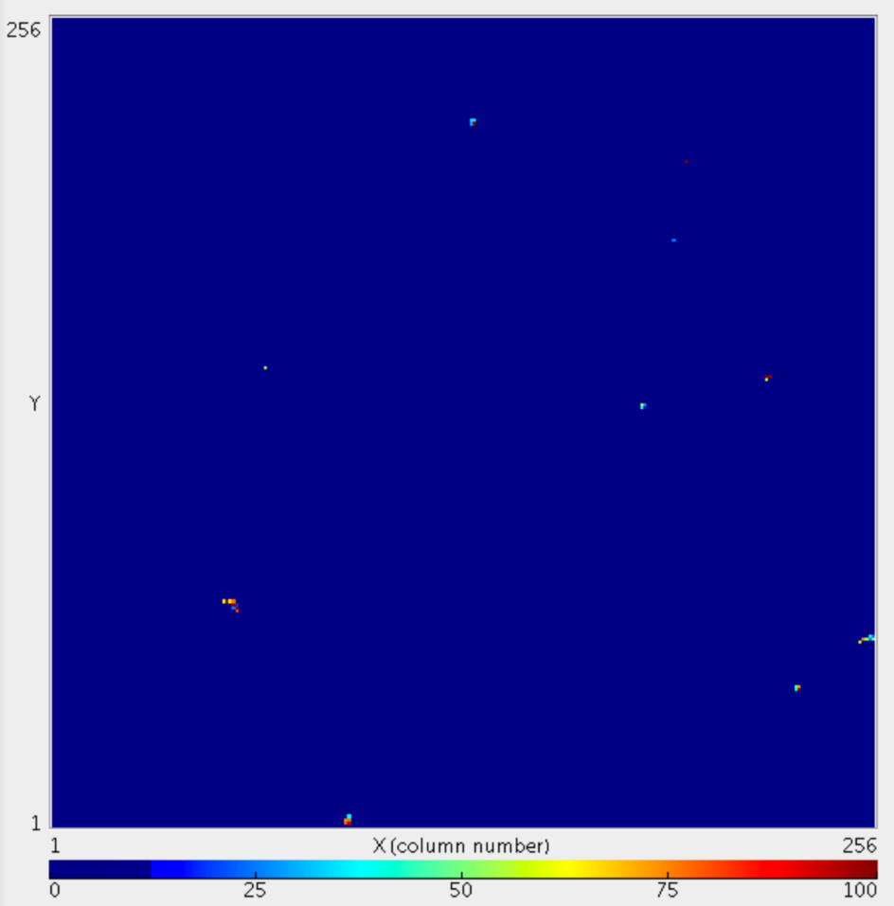
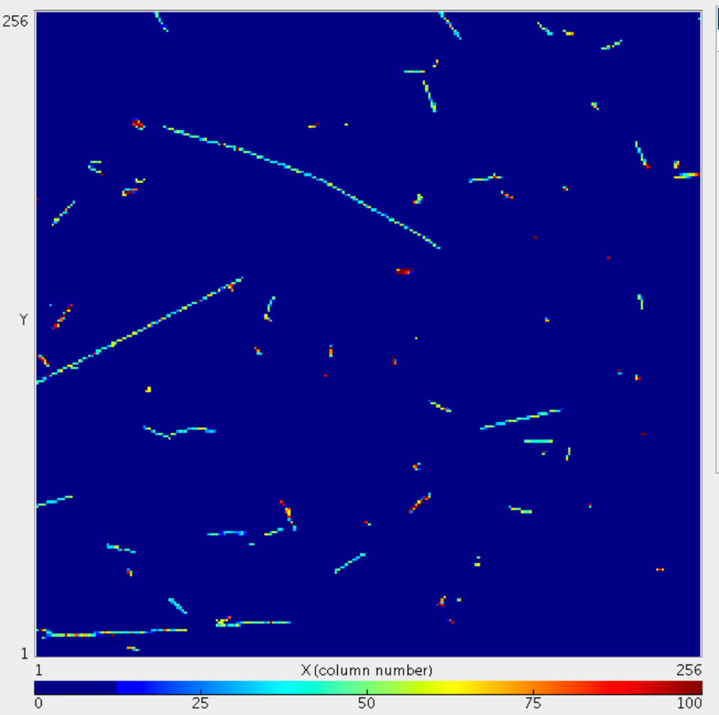
(Timepix chip) – 60s exposure
Near sea level
34 000 feet

Slide 9
Notes:
Readout software for the Timepix detector that allows us to do acquisitions with different parameters

Slide 10
My Internship
Does my proposed solution work?
Could the solution improve?
Will my solution be of use?
Is my supervisor satisfied?
Am I happy? What have I learned?
Probably!
YES!
Surprisingly YES!
Hopefully!

Slide 11
Thank you for your attention!
Special thanks to Jerome Alexandre Alozy

