Slide 1


High School Students Internship Programme

Slide 2

Agenda
Your programme agenda:
https://indico.cern.ch/e/SEHSSIP18
Please browse frequently – agenda subject to change!

Slide 3
Important phone numbers
Your teachers
+41 75 411 20 48 (or 16 20 48) OR +41 75 411 20 63 (or 16 20 63)
Your programme coordinator at CERN
Lennart
The HSSIP team
Ines Knapper (Programme Manager): +41 75 411 22 97 (or 16 22 97)
Mojdeh Abtahi: +41 75 411 67 27 (or 16 67 27)
Email: HSSIP-Admin@cern.ch
Our office: 33/R-020

Slide 4

In case of emergency
Emergencies at CERN:
Use the fixed phones located all over CERN
Fire brigade/Medical emergencies: 74444
Emergencies in Switzerland:
Ambulance: 144
Fire Brigade: 118
Police: 117
European SOS: 112

Slide 5


Meal vouchers
RESTAURANT 1 ONLY!
 | Opening Hours | Breakfast | Lunch | Dinner
Monday - Friday | 6h00 - 24h00 | 6h30 - 10h30 | 11h30 - 14h15 | 18h00 - 21h30
Weekend & bank holidays | 7h00 - 22h00 | 7h00 - 10h00 | 11h30 - 14h00 | 18h00 - 20h00

Slide 6
Navigate on the CERN campus
Campus maps:
Printed CERN map
https://maps.cern.ch/
Mobile version of CERN map available
Shuttle Service: http://smb-dep.web.cern.ch/en/ShuttleService
No 2: Prévessin
CERN Entrance gates:
Gate B: open 24h/24h

Slide 7

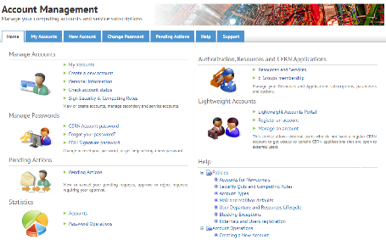
Login for the first time
cern.ch/account

Slide 8

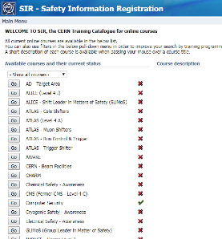
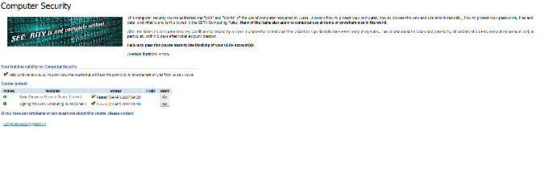
Safety training
Visit http://sir.cern.ch

Slide 9




Visits at CERN

Slide 10
What’s next?
Registrations – Building 55 – ID / passport needed
Introduction to Particle Physics
Lunch
Meet your supervisors – 13h30
Group picture – 13h30 – meeting point: UBS bank – main building
Work in groups
CERN treasure hunt – 19h00 – 22h00

Slide 11
Special quest
Tell your HSSIP Story - Surprise us!
Your group has:
2 weeks time
2 Go-Pro’s
3 minutes max.
Your creativity & imagination is the limit! Looking forward!

Slide 12
Enjoy the programme!
The HSSIP team

