Slide 1
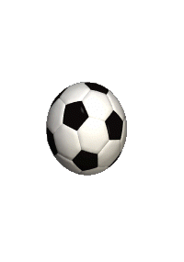
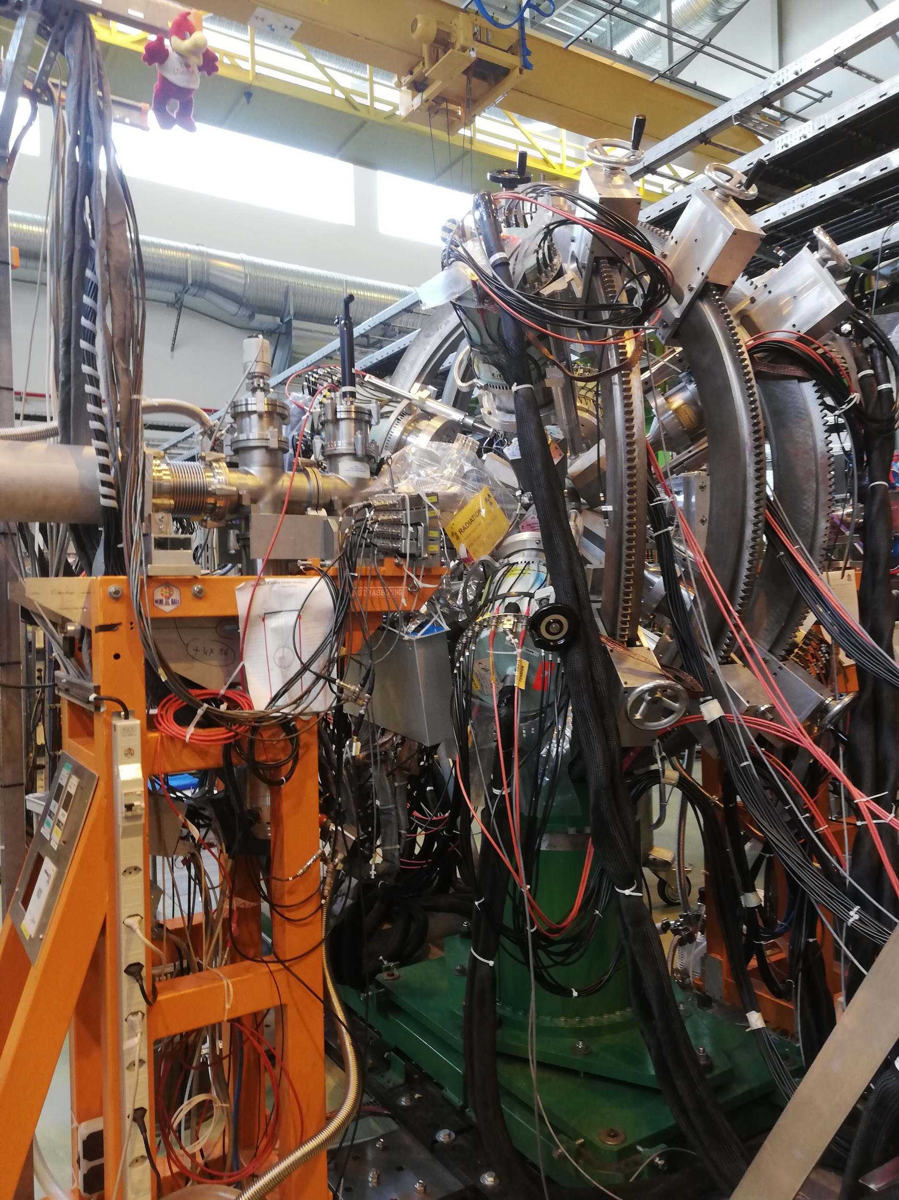
Miniball! :)
Notes:
Jakob

Slide 2
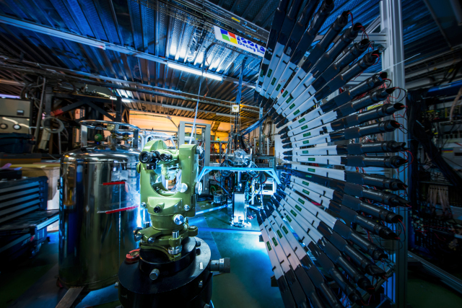

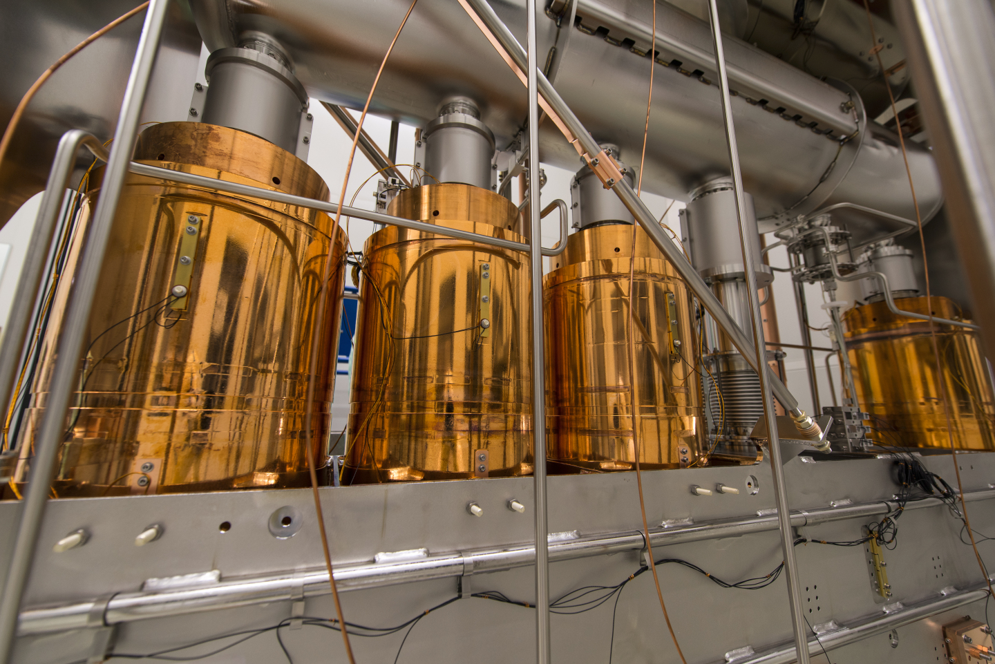
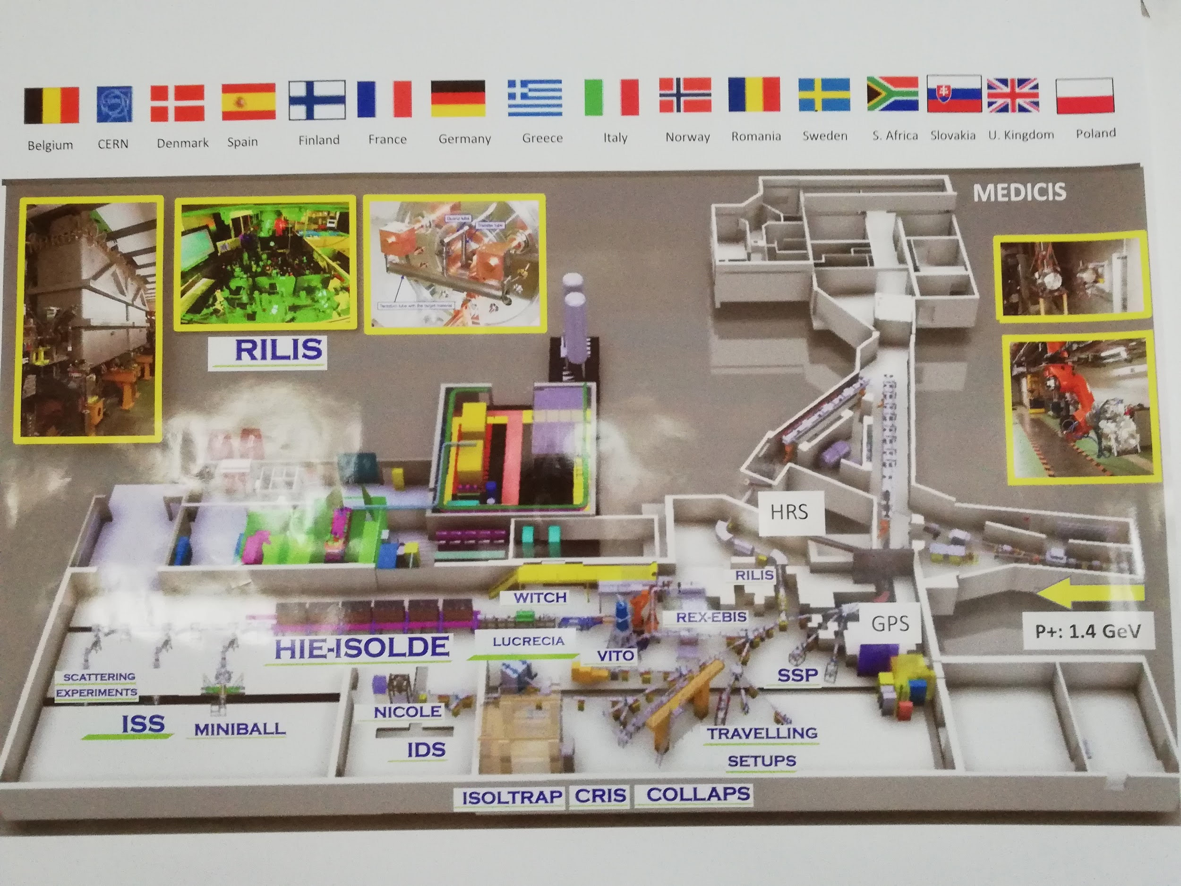
Notes:
Jakob
As an Isotope mass Separator On-Line facility, ISOLDE has been running and operational since the first experiments in 1967. For just over 50 years, ISOLDE has been working to push the boundaries of knowledge in the field of nuclear physics. With around 50 experiments per year, many of which are temporary, the facility has on its own discovered over 110 new isotopes and is on the forefront of nuclear science. I speak of ISOLDE as some sort of entity that operates itself, but just like how it is the members of a team that contribute to their overall success, it is the different parts of ISOLDE that make the success story what it is today. One such part is MINIBALL.

Slide 3

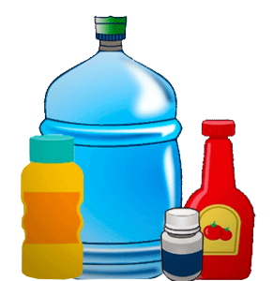
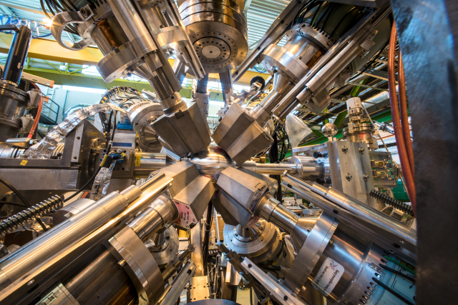
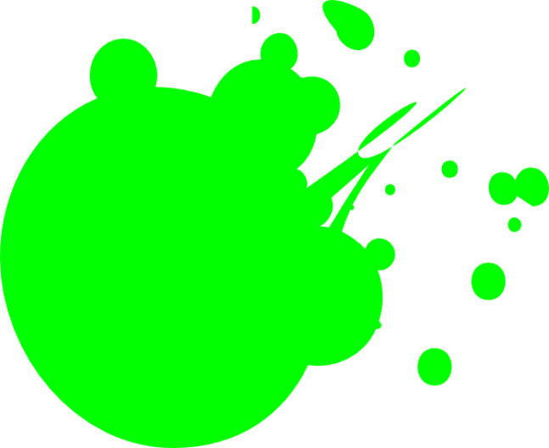
About Miniball!
-> 8·3·6 Germanium crystals
Notes:
Linn

Slide 4
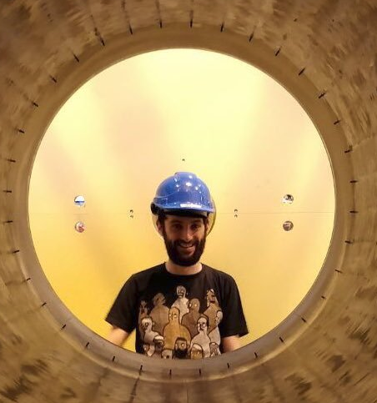
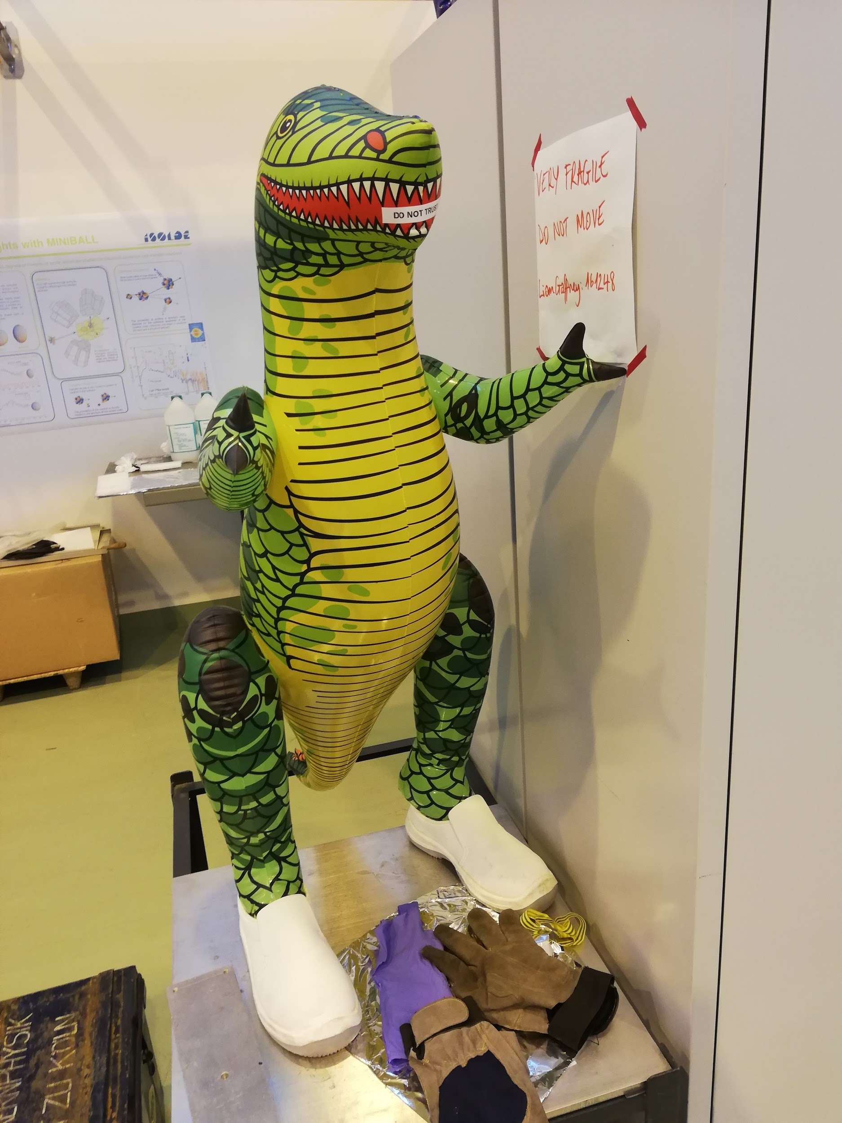
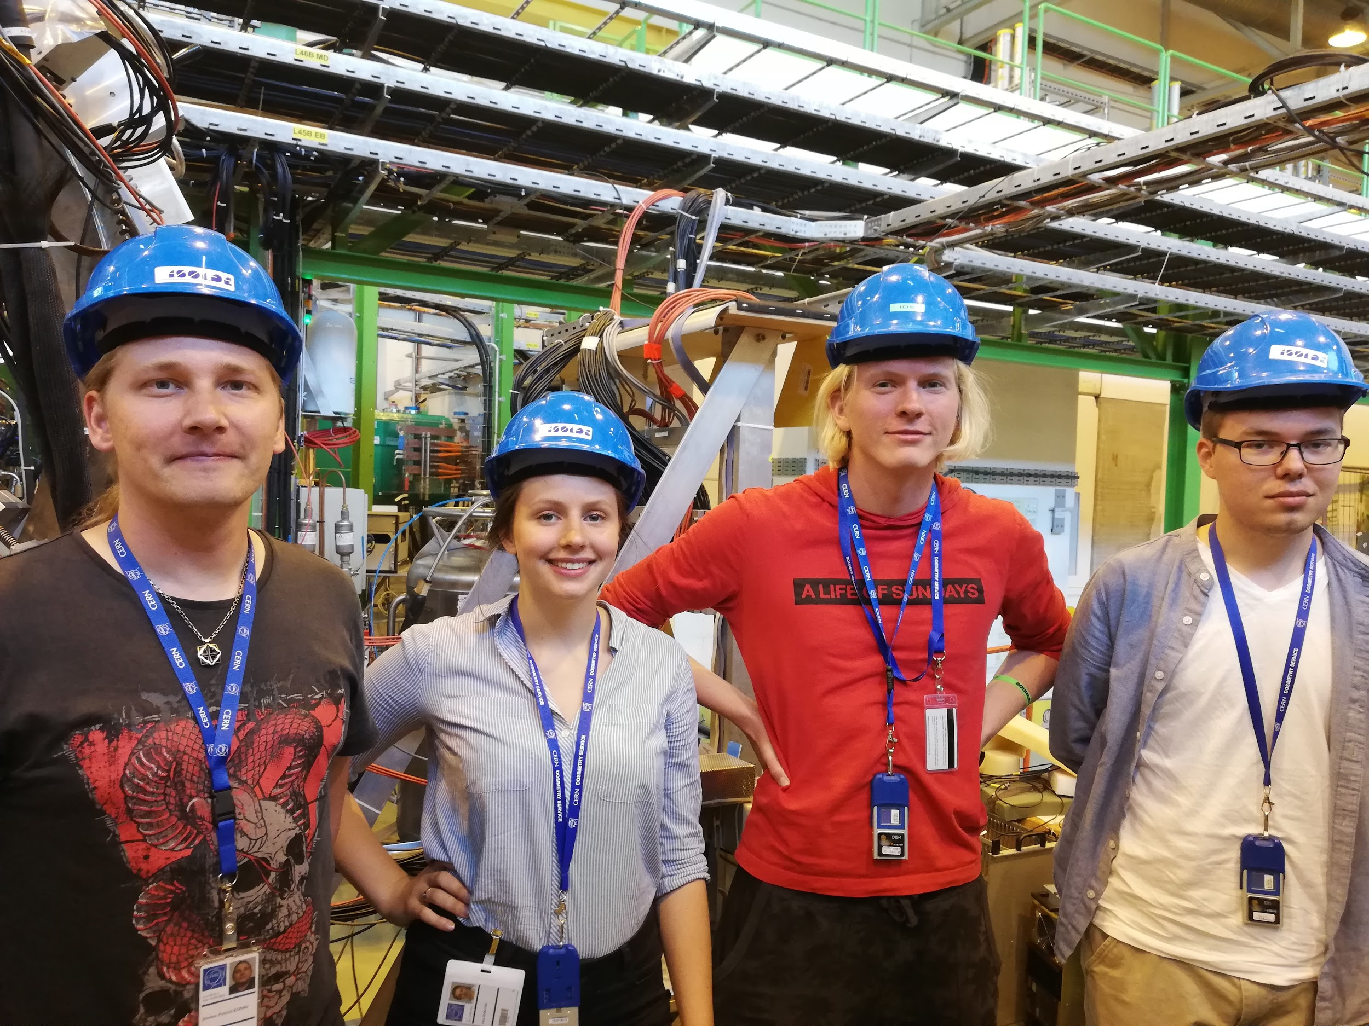
Squad
Notes:
Jakob
We would like to extend a particular thank you to Joonas for being our supervisor these two weeks. A person who not only stuck with us throughout our faults and misunderstandings, but also always encouraged and helped. With him, we were able to see that even the smallest of tasks can be crucial, and that even interns can make a difference! But even with him by our side, all was not easy-going in radioactive intern-land.

Slide 5
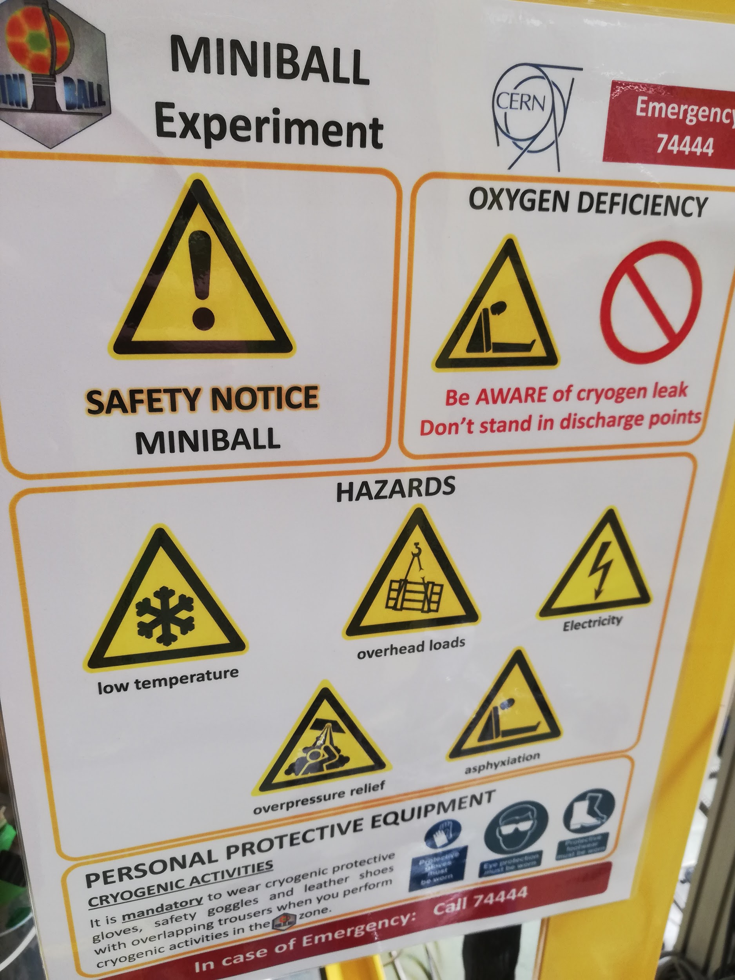
Training and preparation?
Notes:
Linn

Slide 6
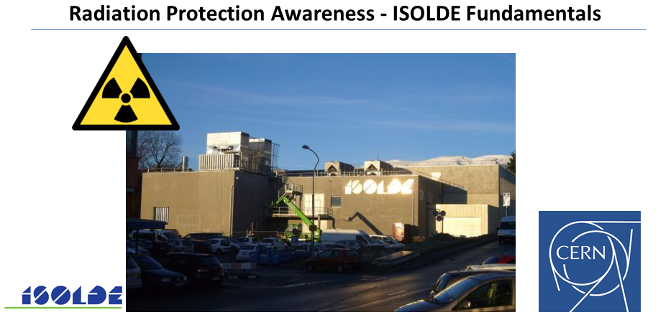
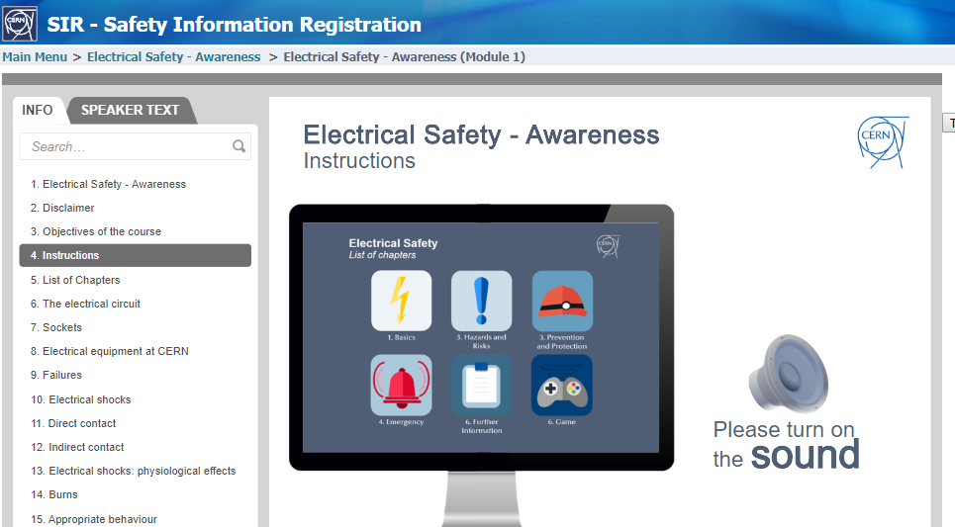
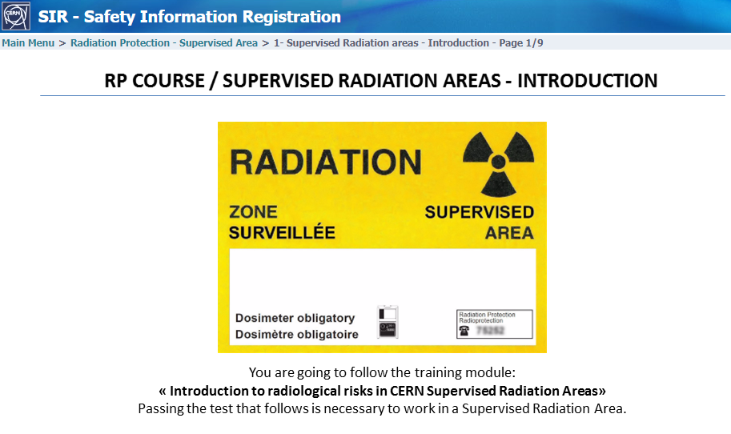
Notes:
Linn

Slide 7
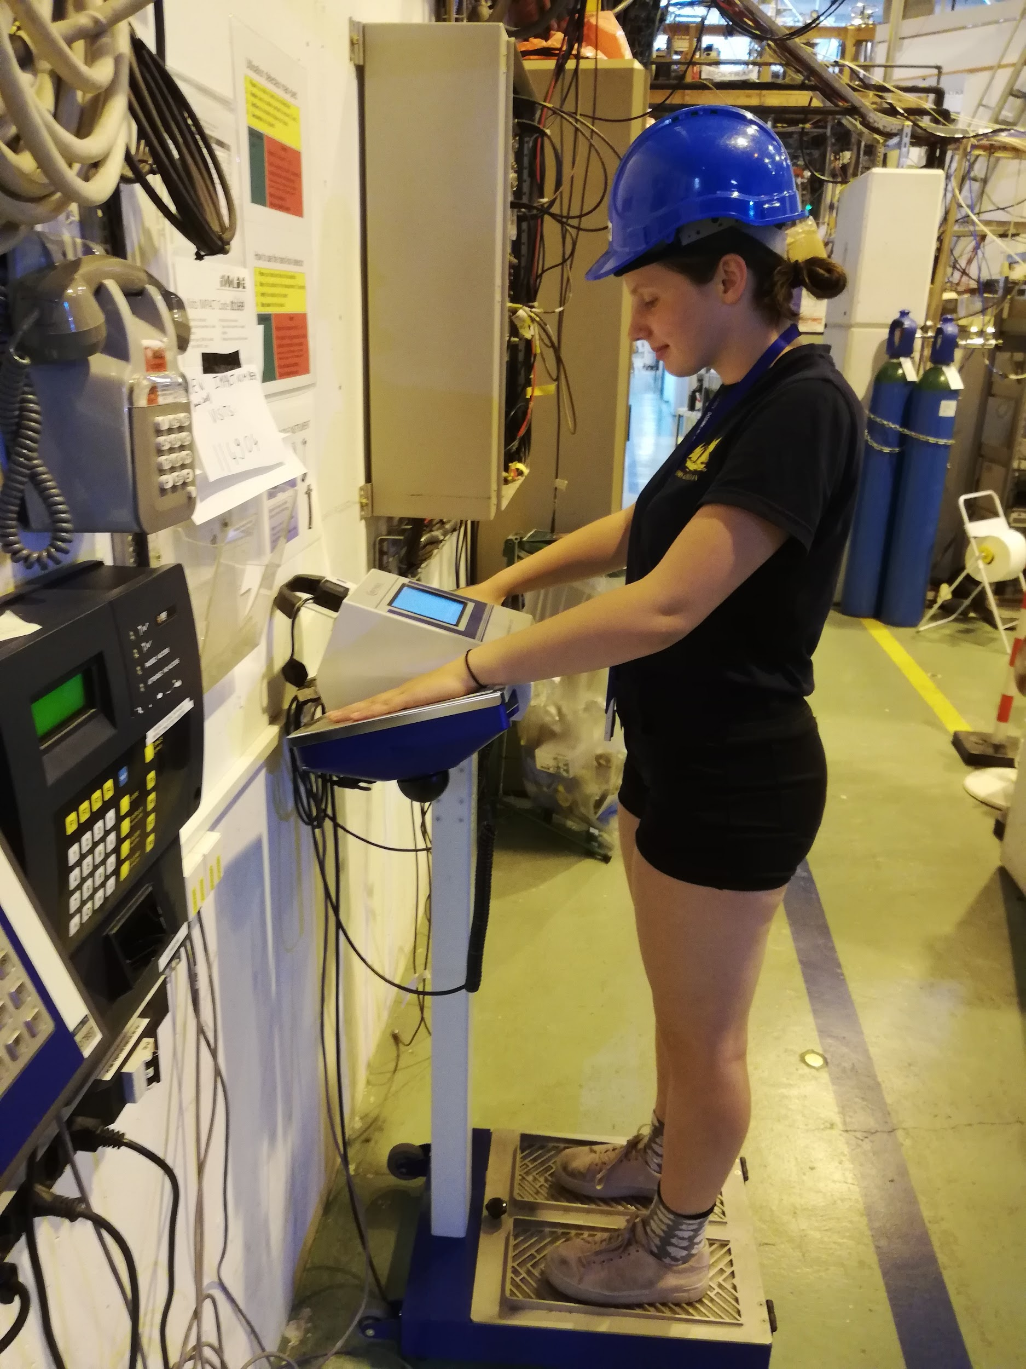
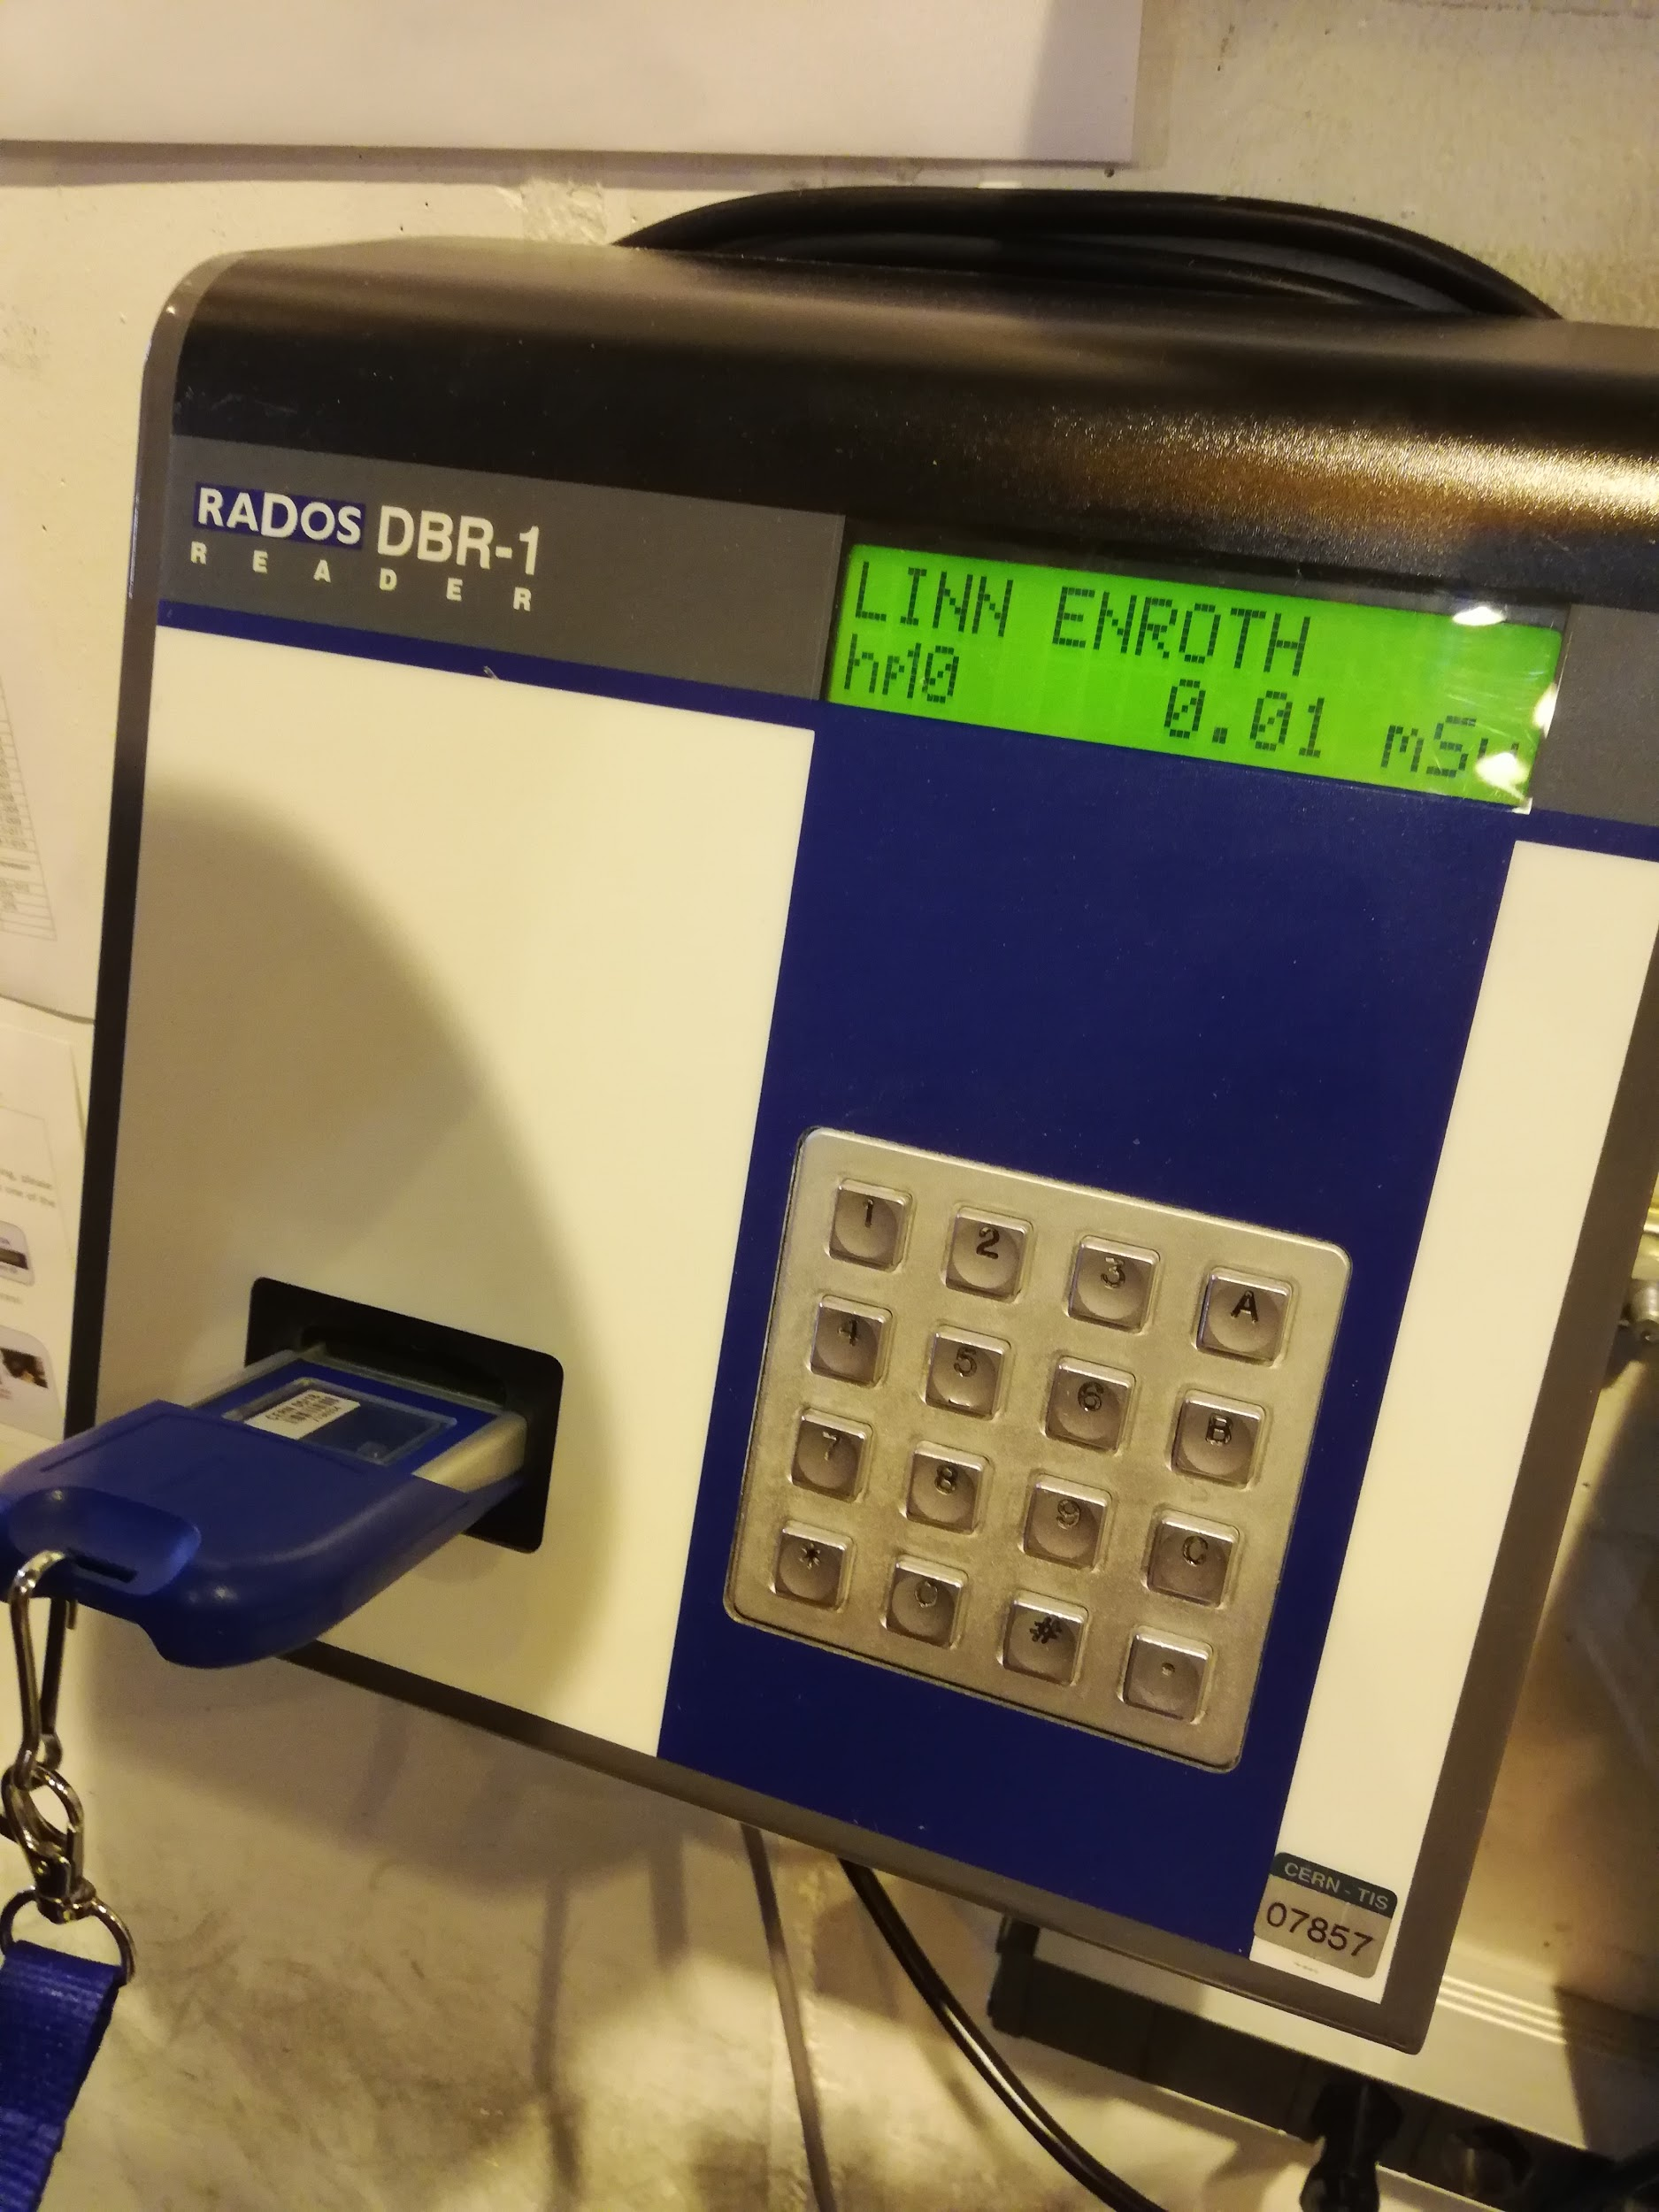
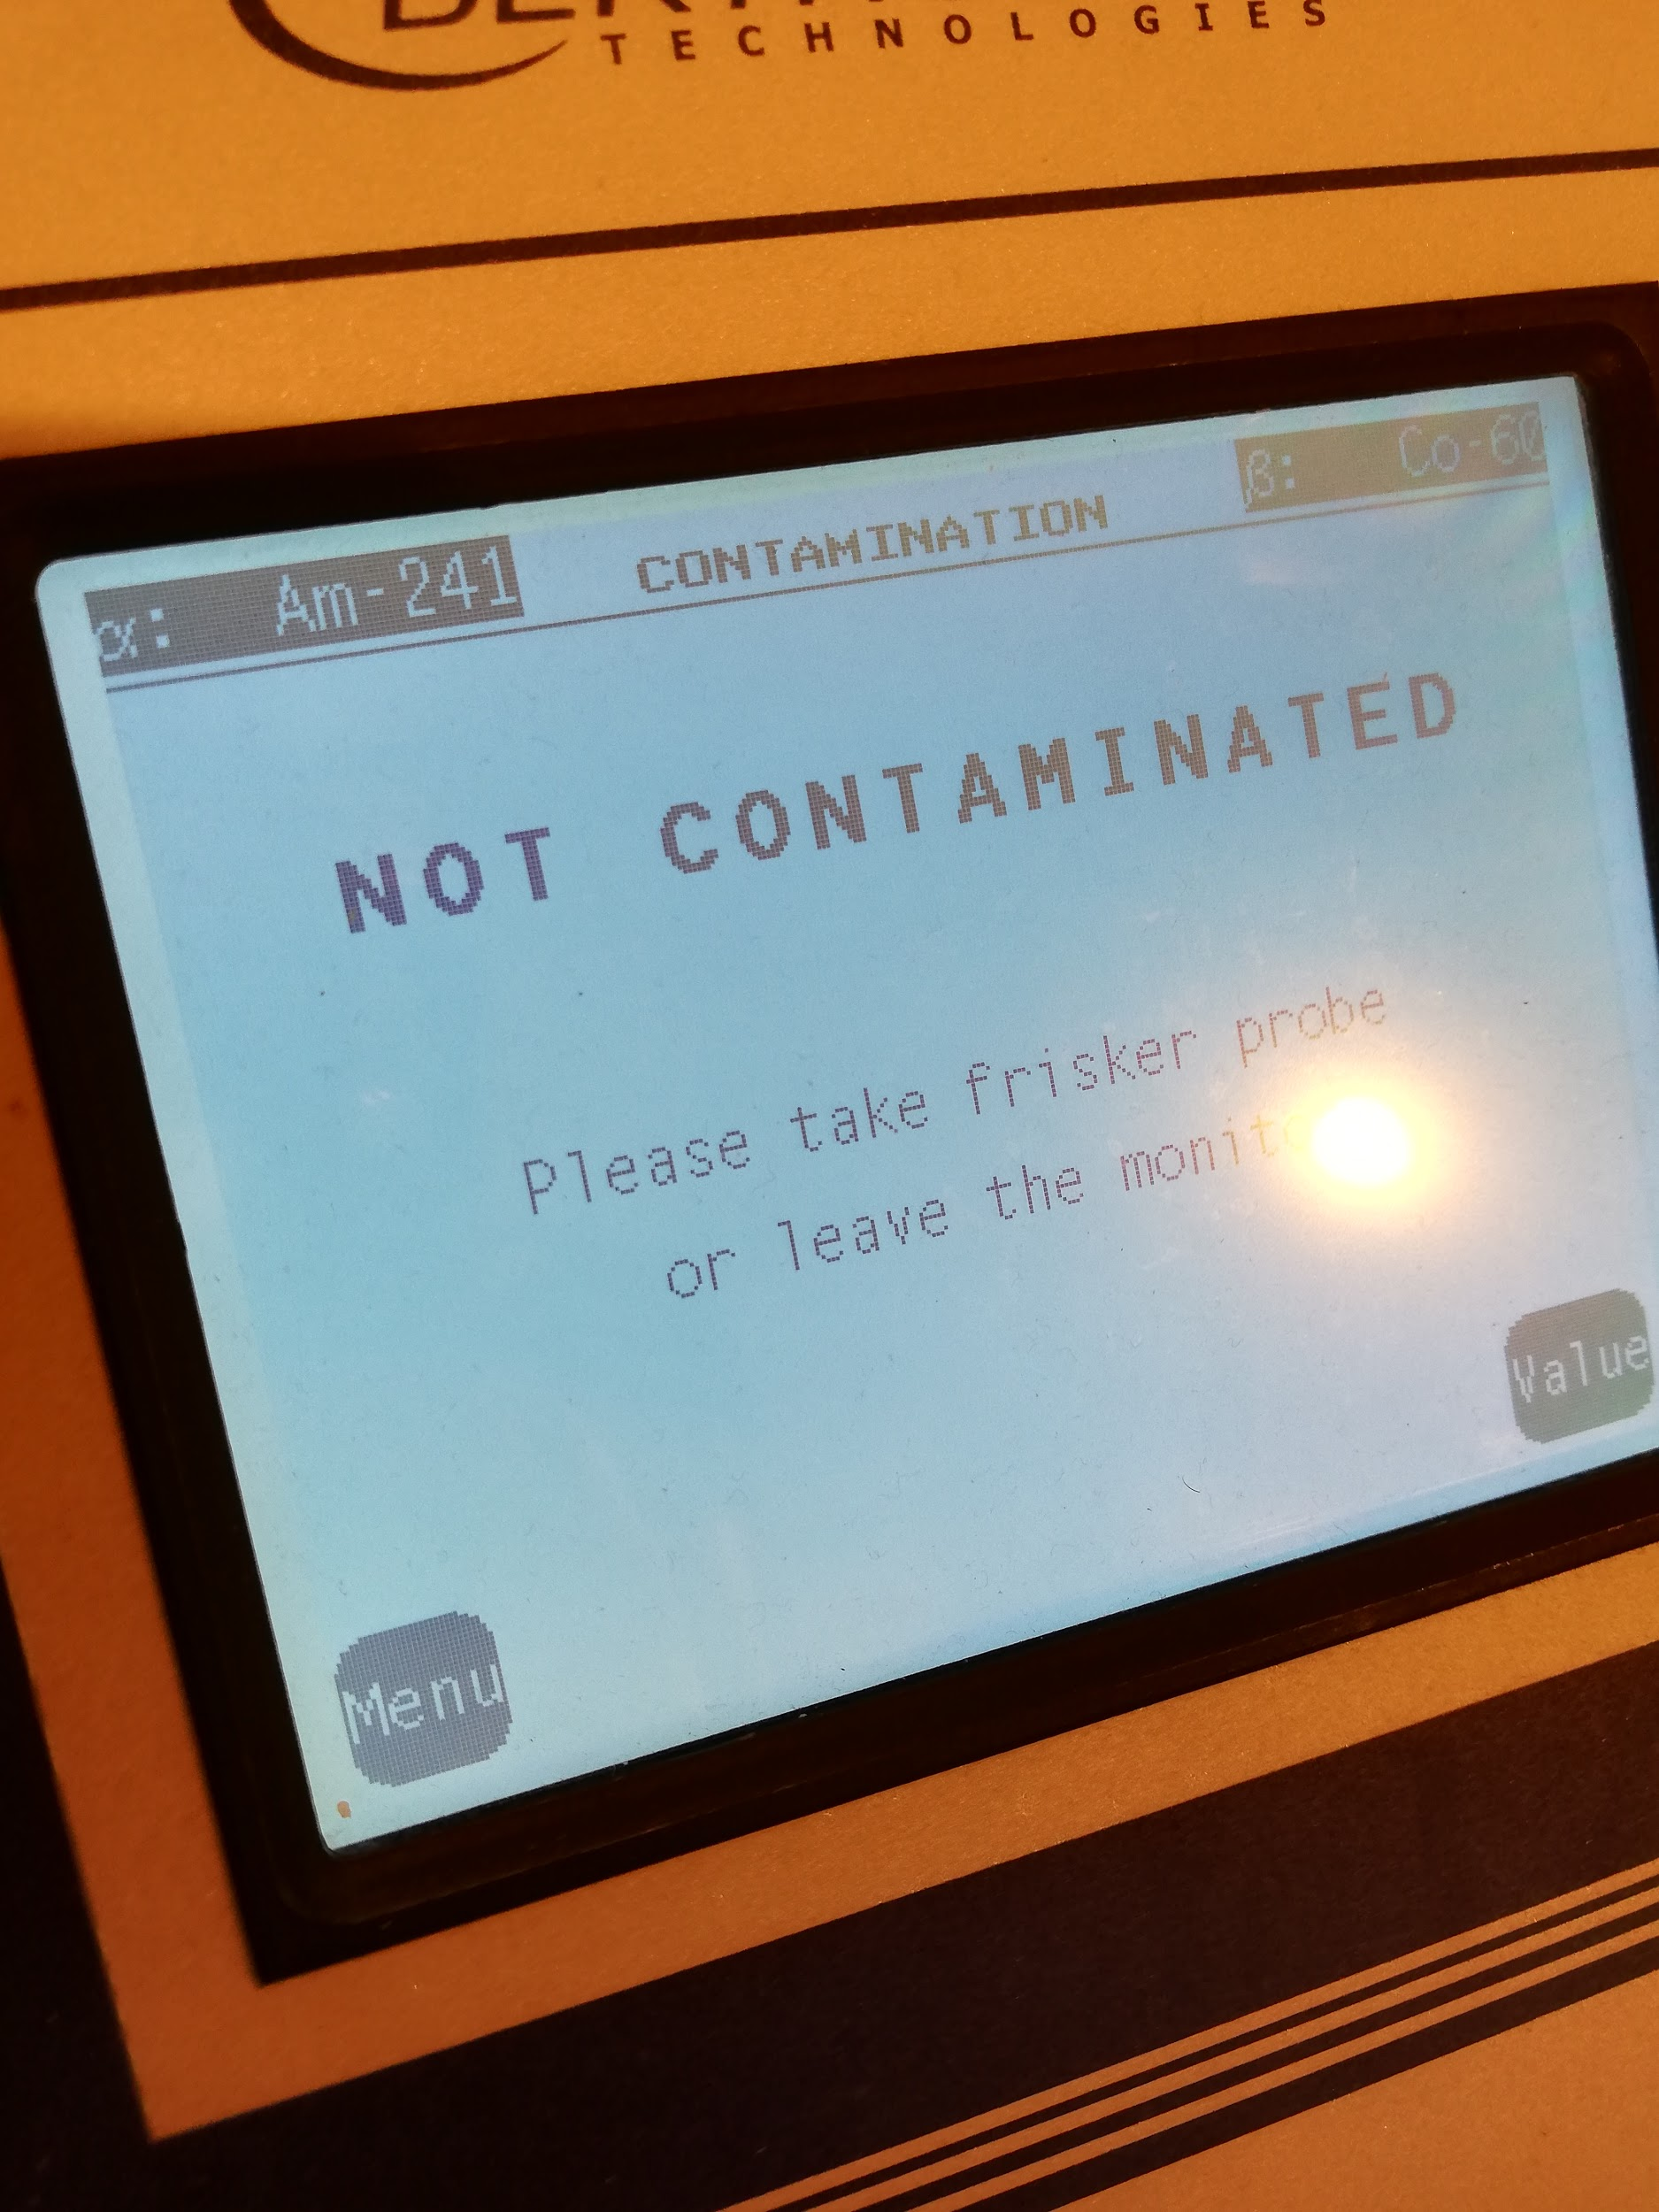
Notes:
Linn

Slide 8
Tasks and work!
133Ba/152Eu for energy
Stable 22Ne beam for angles
60Co for efficiency
133Ba/152Eu for efficiency
Stable A/Q=4 Beam
1
2
3
4
5
Setup of equipment
Calibrations
96Kr experiment
In July
Notes:
Jakob
Work and tasks. In order to get a sense of our role in the larger scale of what ISOLDE and specifically MINIBALL work with, let’s zoom out abit. Every year, Miniball analyses different exotic isotopes and runs several continuous experiments on that isotope in parallel. But just like the LHC has to go down for maintenance between every run, so does the MINIBALL project. And that’s where we come in. In between every experimental campaign, a series of setups and calibrations are required in order to make sure everything works properly. Splitting the calibration part into smaller pieces, me and Linn were responsible for the “second” step - using stable 22Ne beams in order to calibrate the angles of MINIBALL. This is mainly done through a computer programme, but this programme does need data to process. Our task was to feed it and optimise it with accurate and correct data in regards to 1. The doppler shift of gamma rays and 2. The angling position of the MINIBALL station.

Slide 9
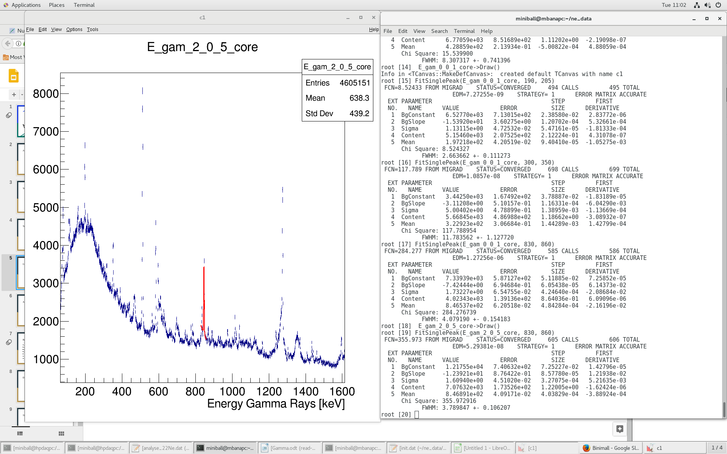
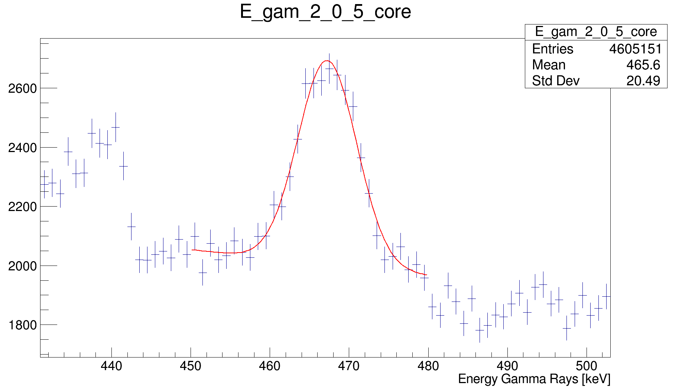
Doppler analysis
Draw graph of interest
Locate Doppler Shift
Fit peak(s)
Take note of important values
8·3·6 = 144 graphs!
Notes:
Jakob
So let’s explore that first part. As a moving particle releases a gamma ray the detected energy level is shifted to the right or left depending on the direction of particle flight. So if the detector is “behind” the reaction chamber, the received gamma ray energy will be shifted to a lower amount. Knowing that certain doppler shifts occur within certain parameters allows us to adjust in order to get the desired energy. But first we must identify the doppler shift. This was done through graph analysis. As each crystal detector collects recorded data, it was up to us to; draw the graph of interest, find the doppler shifted area and fit a gaussian graph in order to pinpoint the important values.

Slide 10
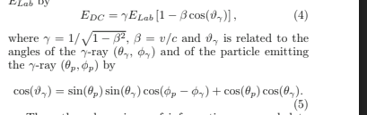
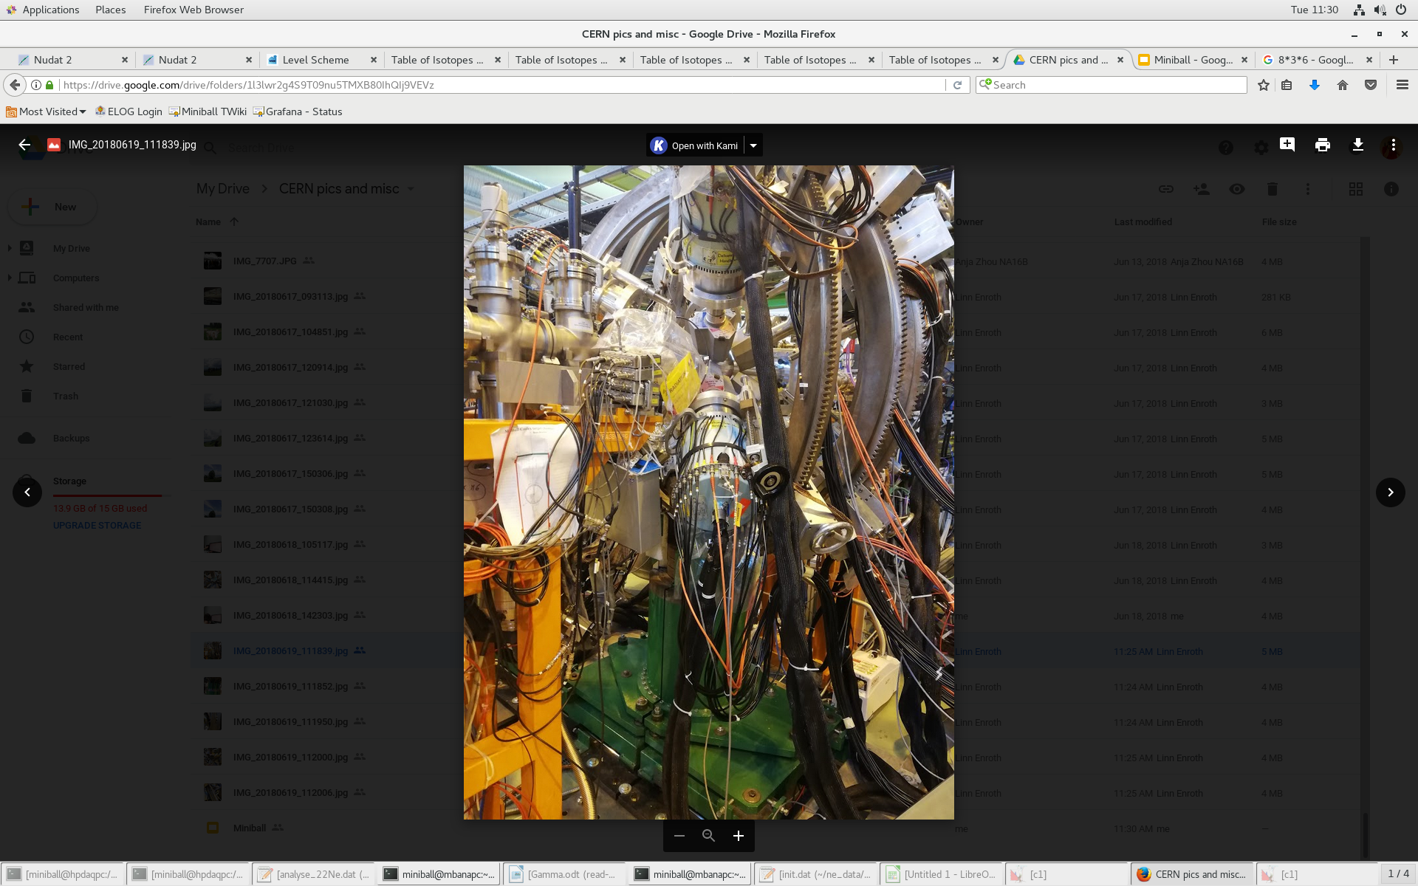
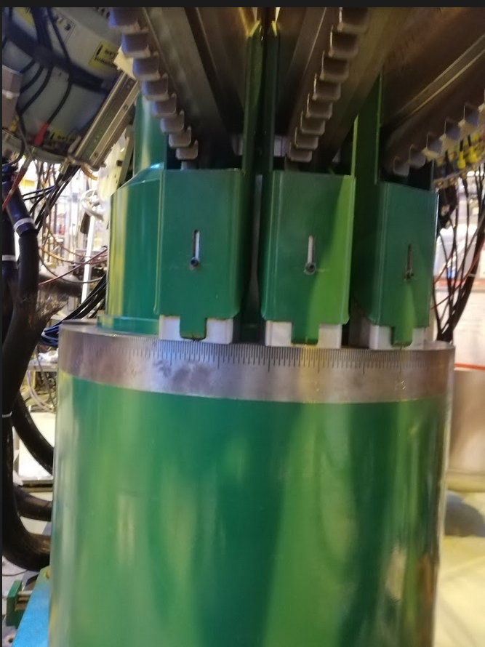
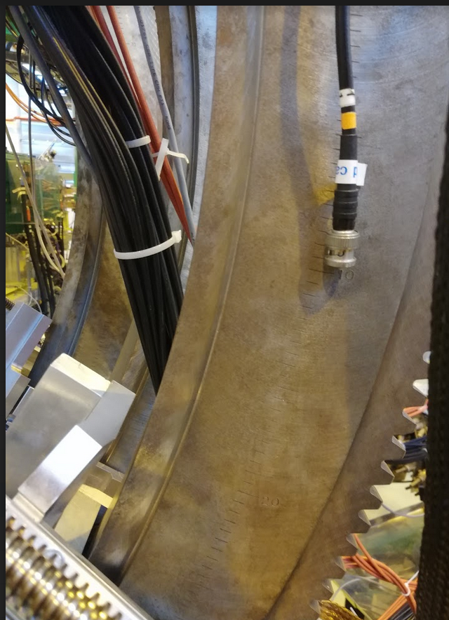
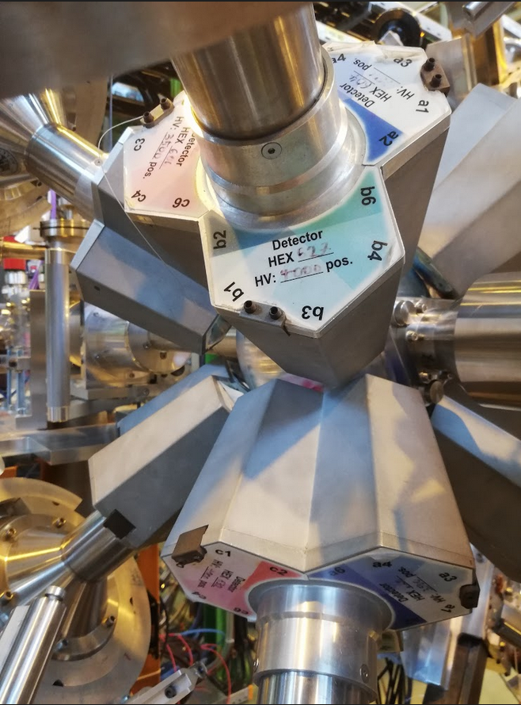
Angle analysis
Θ angle ɸ angle 𝞪 angle
Notes:
Jakob
The next step was to measure and determine the angular position of the MINIBALL setup, in order to adjust it later on. However, this is quite a bit more complex than it sounds. The miniball setup is composed of three different planes of angular rotation; Theta, Phi and Alpha along with a variable distance between the detectors and the collision chamber. All of the angles seen are actually quite difficult to accurately determine, sometimes due to the fact that the angle scale is placed beyond easy lines of sight, and sometimes due to the lack of an angular scale completely. And after collecting angle values, they must all in one way or another be mathematically manipulated in order to be used.

Slide 11
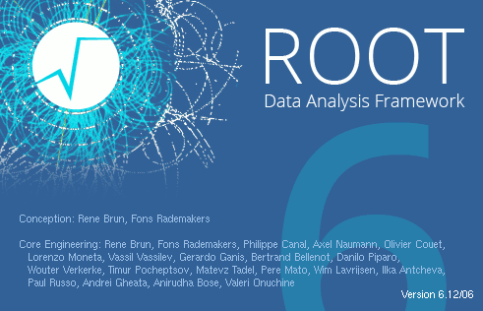
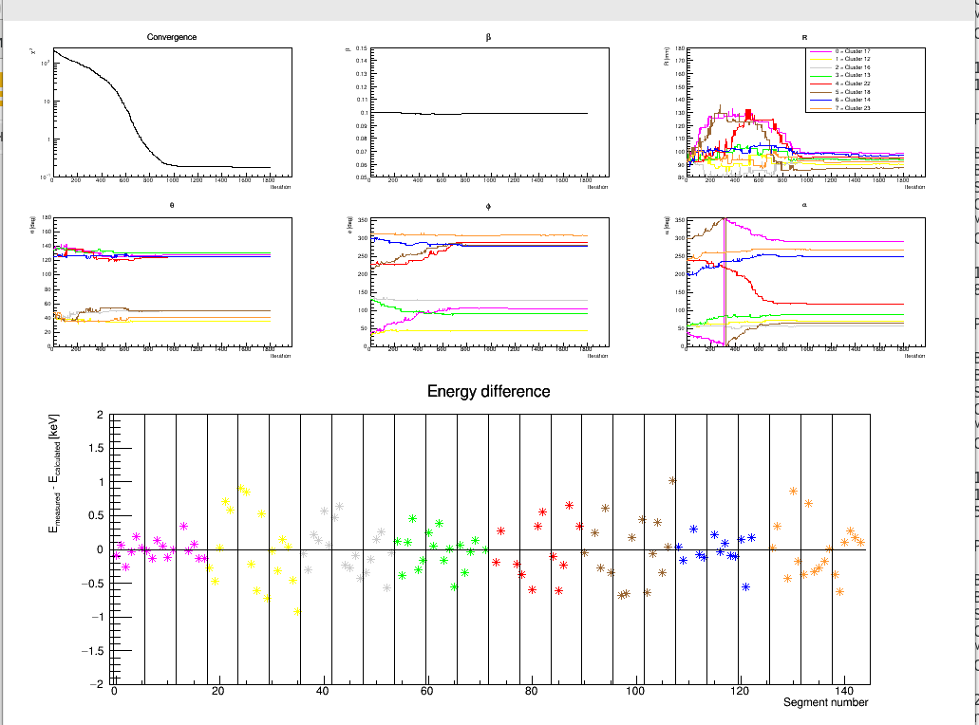

Angle manipulation
Notes:
Jakob
Once all the data is ready, it is put into an optimisation programme, which is used to numerically determine the optimal angles for detecting gamma rays. However, much like an old graphing calculator, the programme can only yield values that are based on what you give it, and it does not know if the values it feeds back to us are realistic or even useable. But after some head shaking, rerunning and redoing some data, we finally arrived at the good results that these graphs show (pointing at the graph).

Slide 12
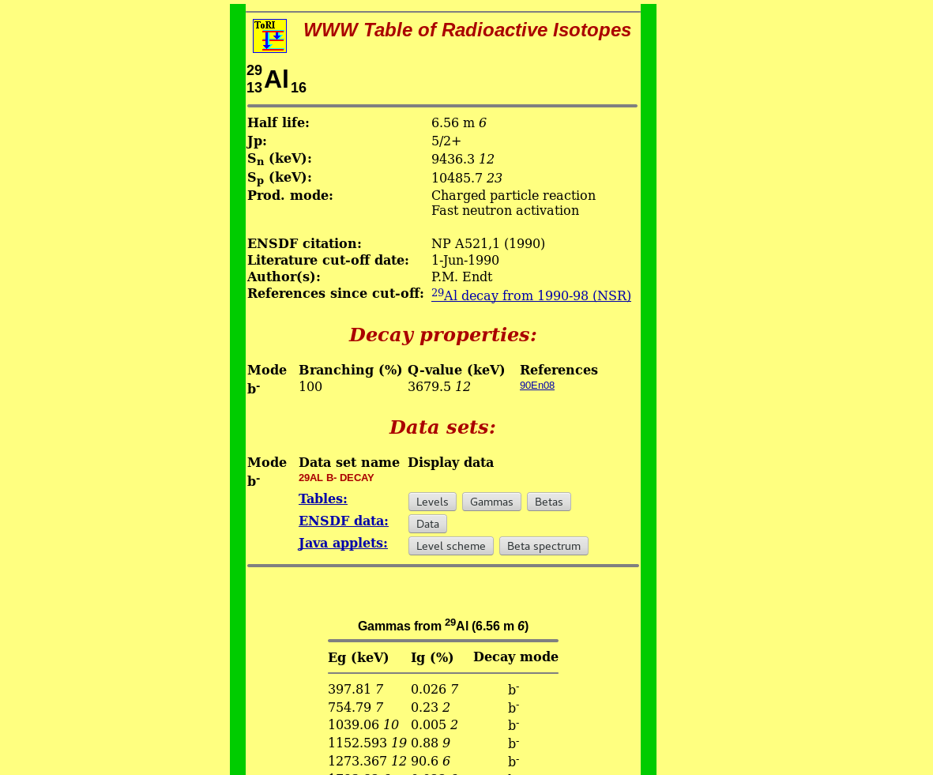
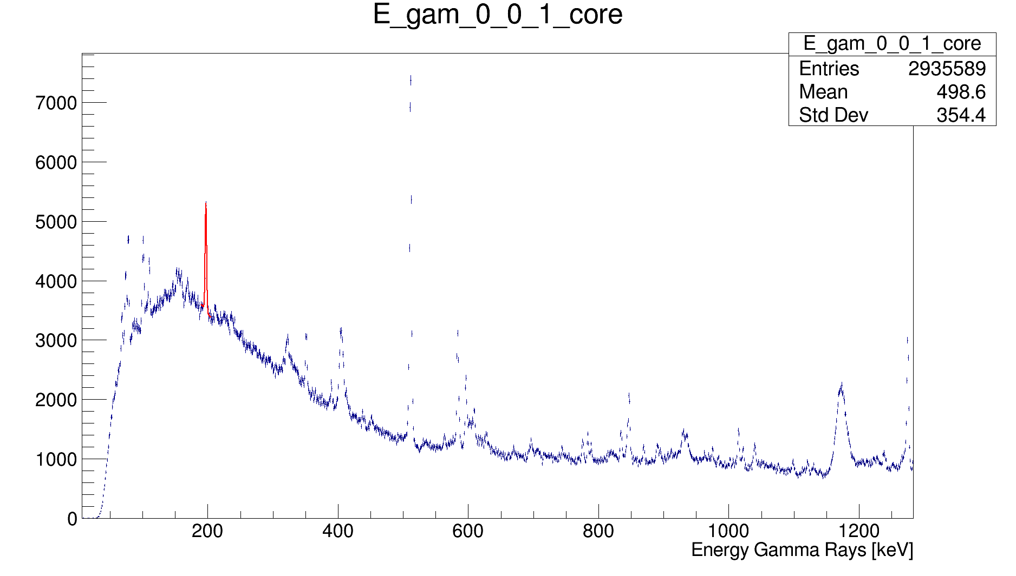
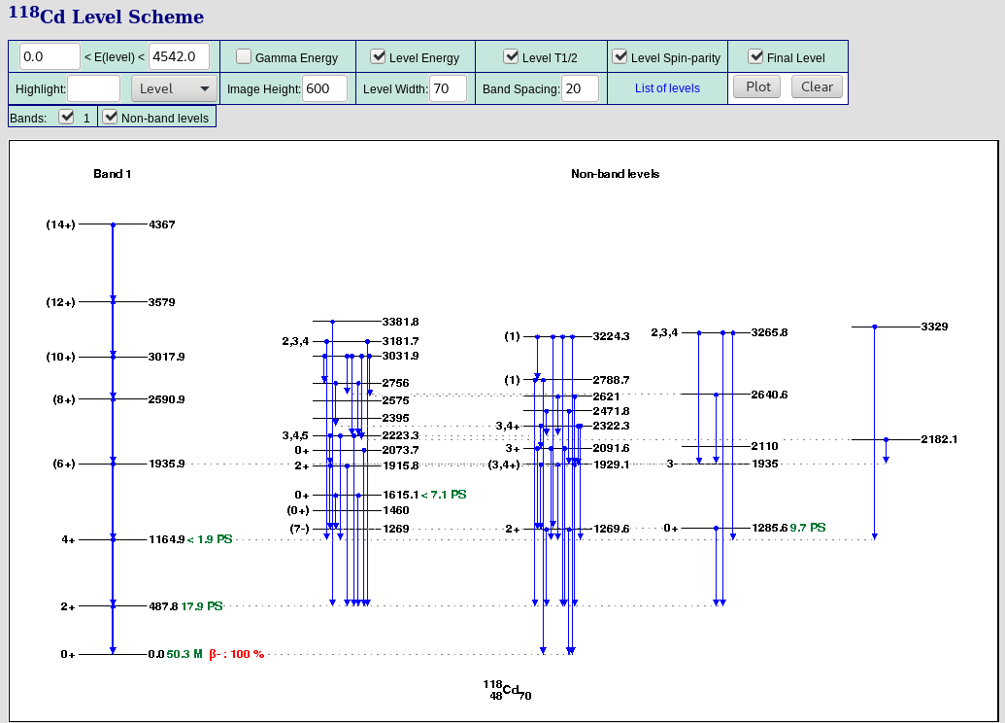
Background radiation detection!
⁷¹Cu 𝛽- 197.1 keV
²²Ne about 1201 keV, moving
²²Ne 1274 keV
⁵⁶Co 𝛽+ 846.7 keV
Notes:
NuDat and lunds nuclear data (yellow) Linn

Slide 13
Notes:
Linn

Slide 14
Experience
Notes:
Linn

Slide 15
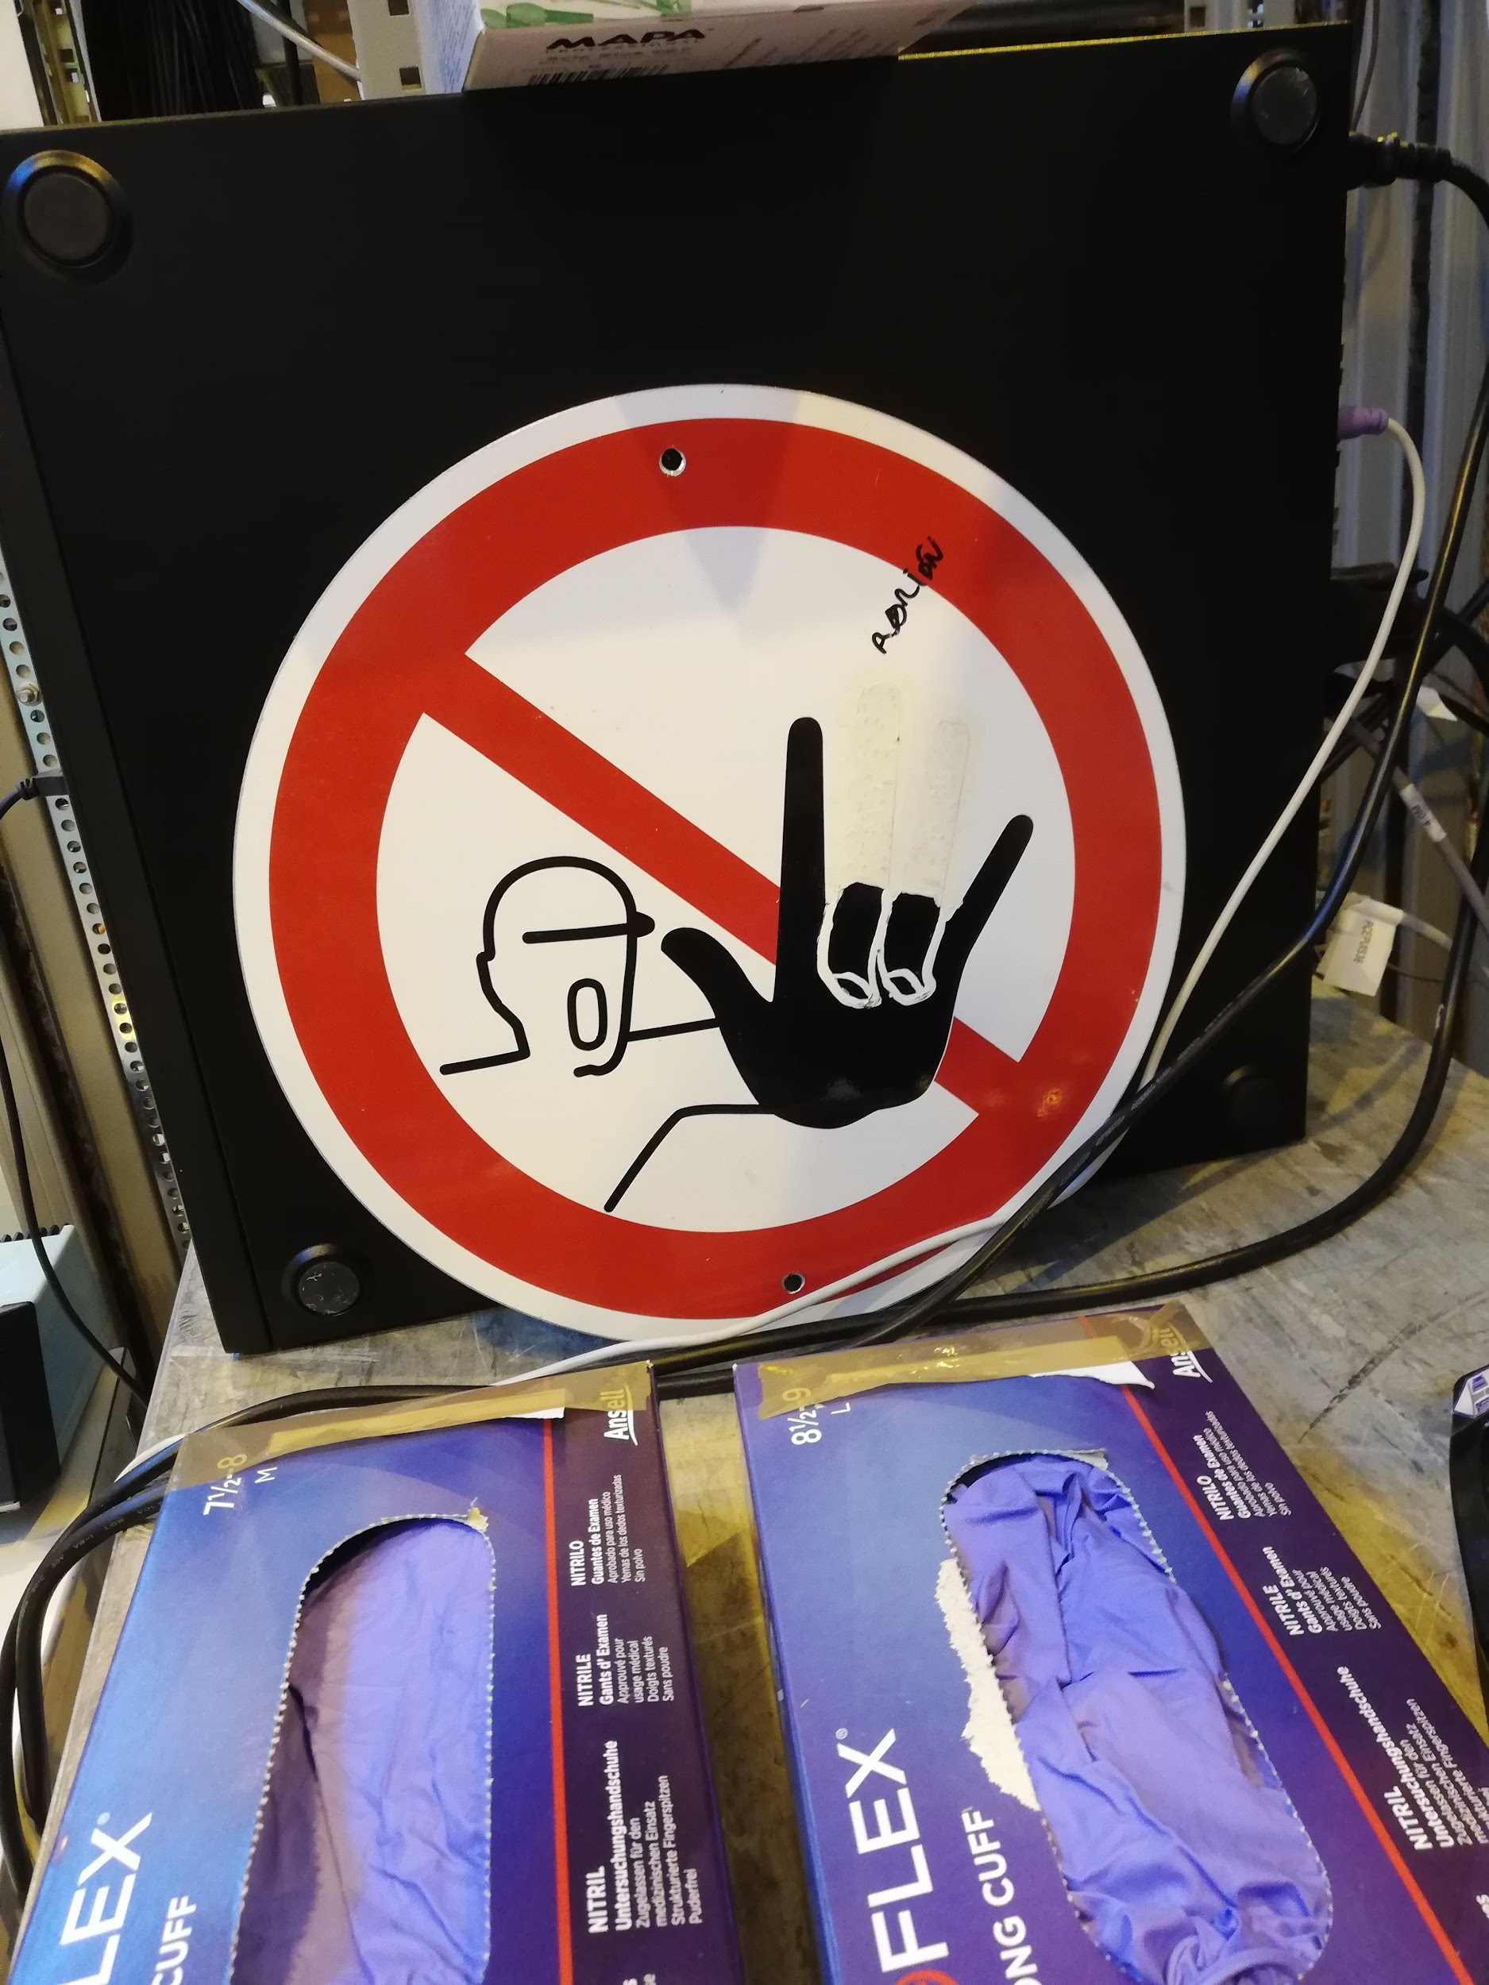
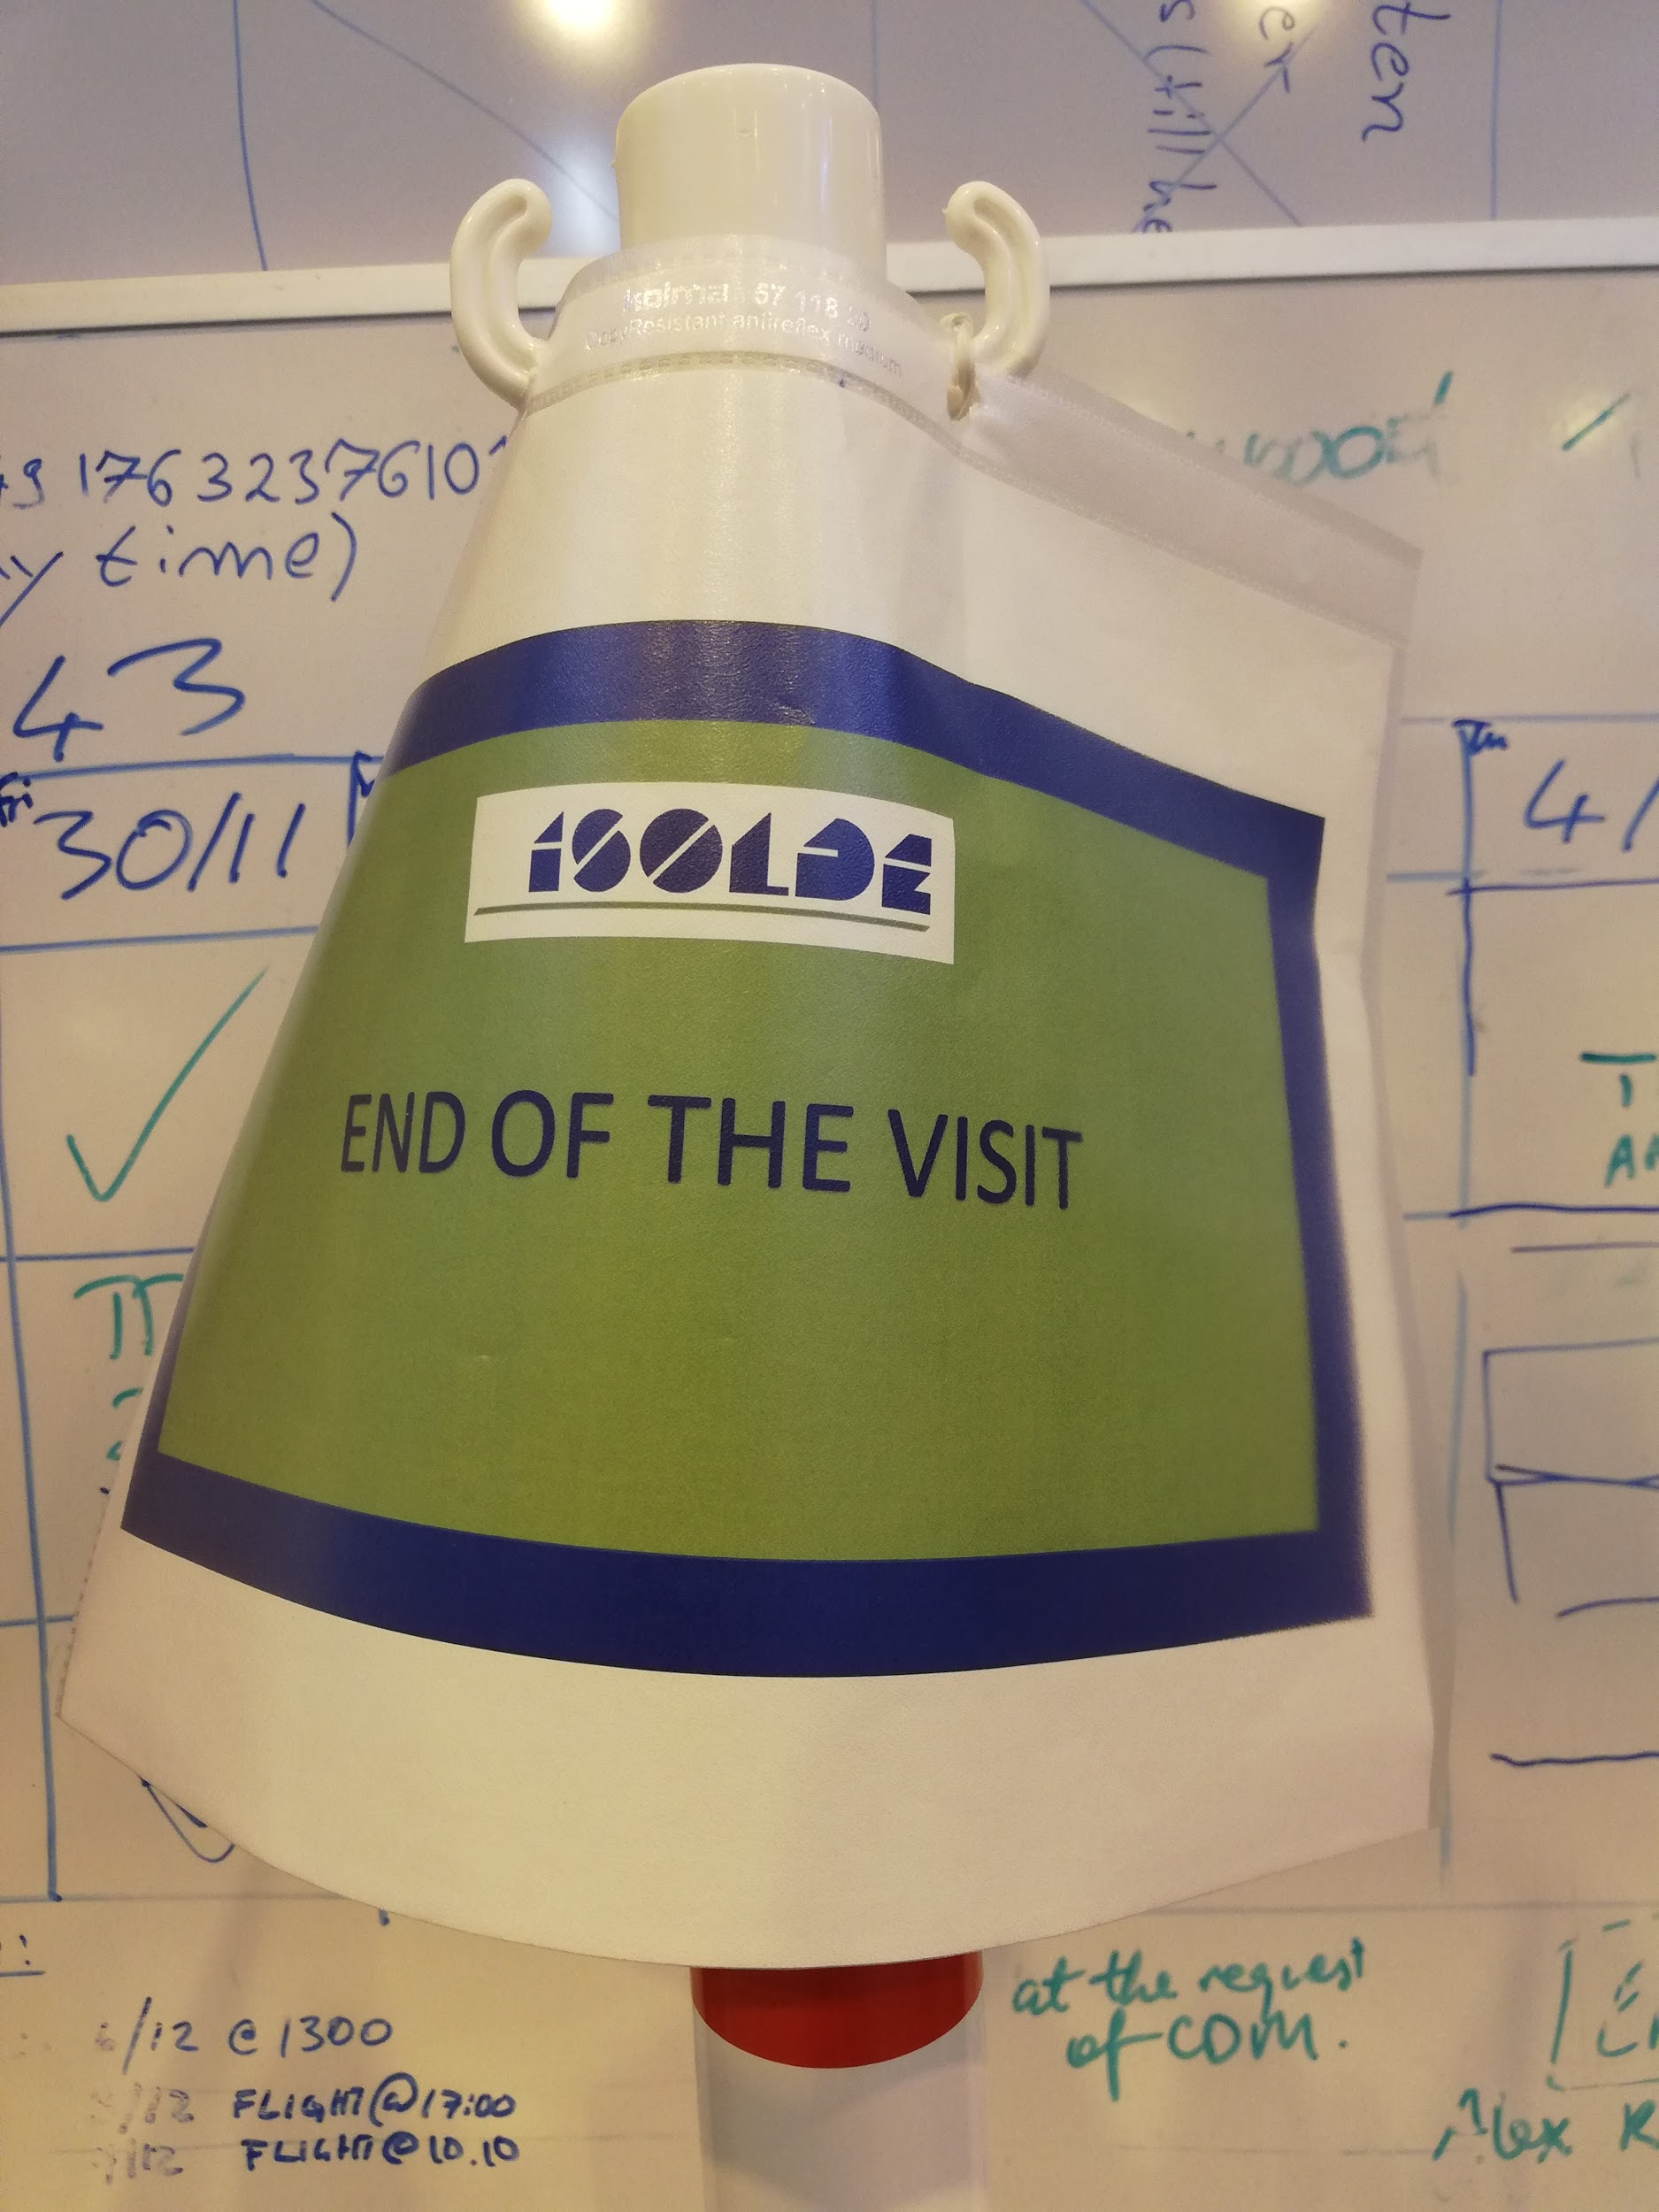
Thank you!
Notes:
Linn

