Slide 1
EEE
Extreme Energy Events
Alva Johansson, Lucas Vacha, Johanna Lindblom
Supervised by Despina Hatzifotiadou

Slide 2
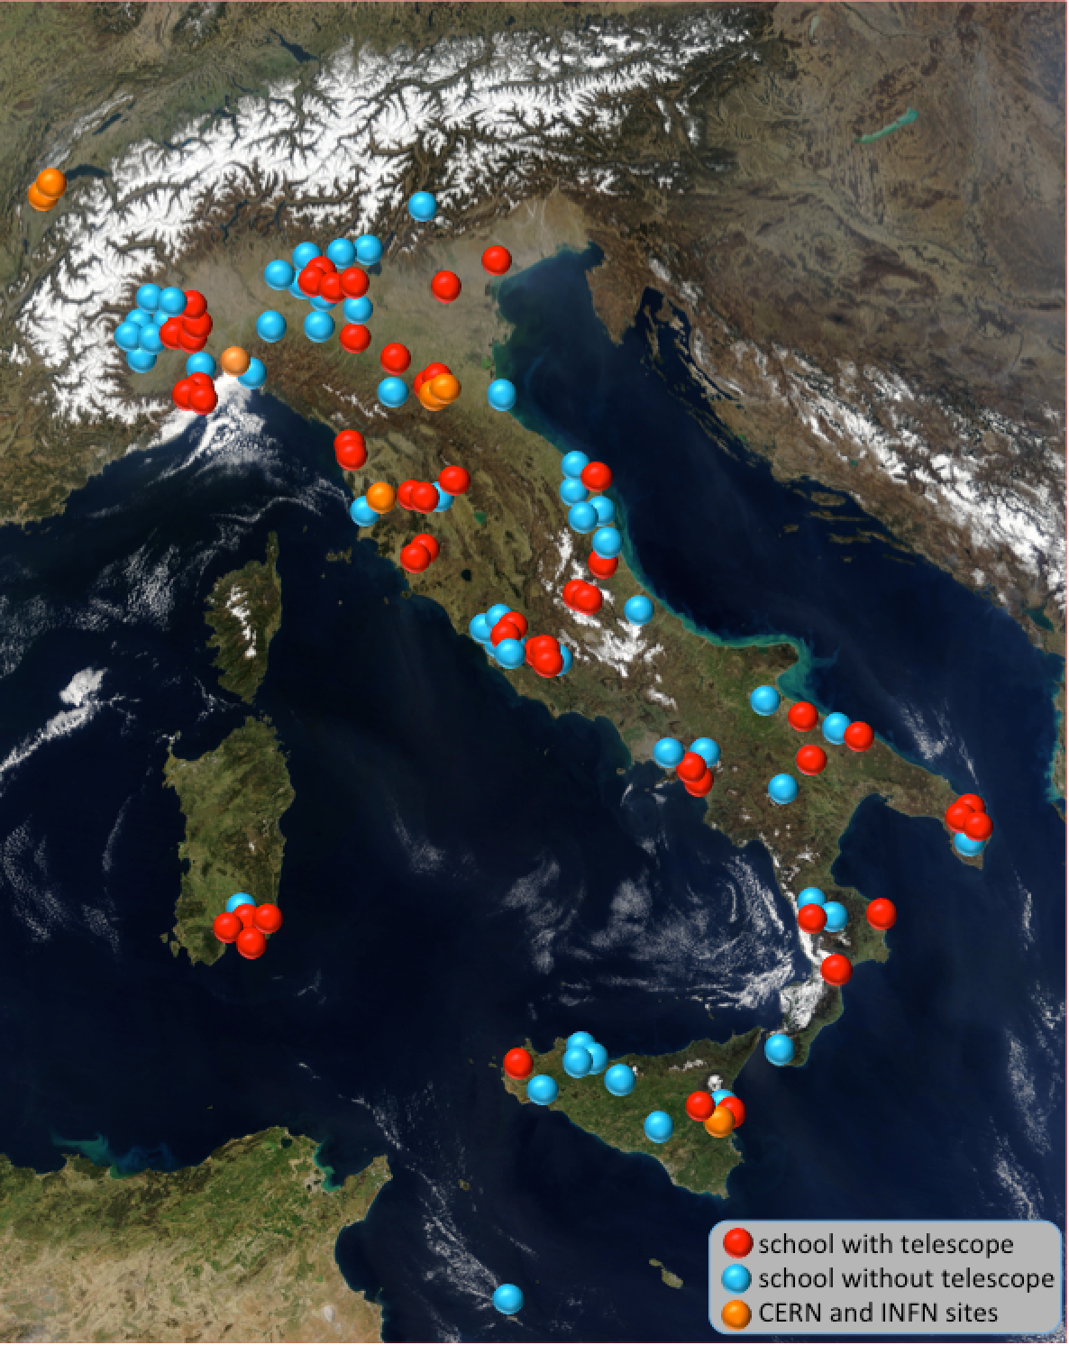
What is the EEE project?
A cosmic ray experiment to detect muons from outer space in order to search for their origin
It takes place in ~50 Italian schools

Slide 3
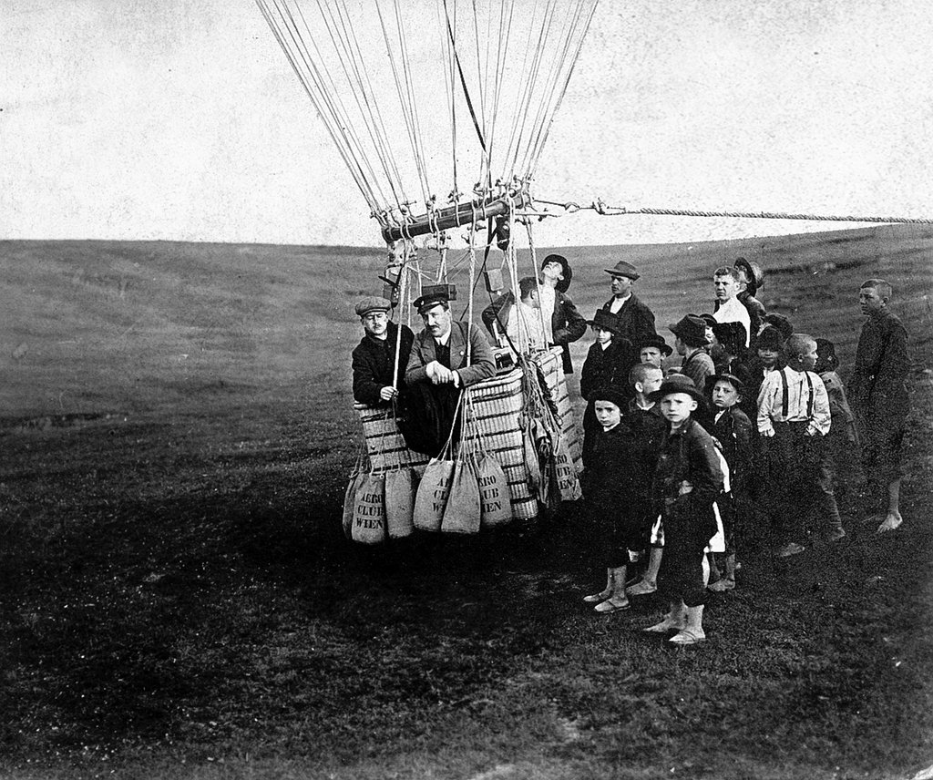
Background
At first people believed that all radiation originated from the ground
In 1912, Victor Hess conducted an experiment that proved them wrong

Slide 4
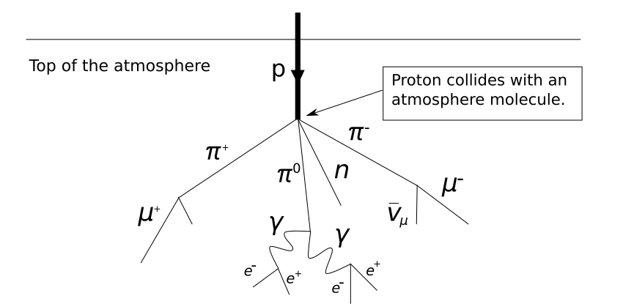
What are cosmic rays?
High energy-radiation
Mainly originating outside of the solar system, even from distant galaxies
Produces showers of secondary particles:
  positrons
  electrons
  photons
  muons
  and more...

Slide 5
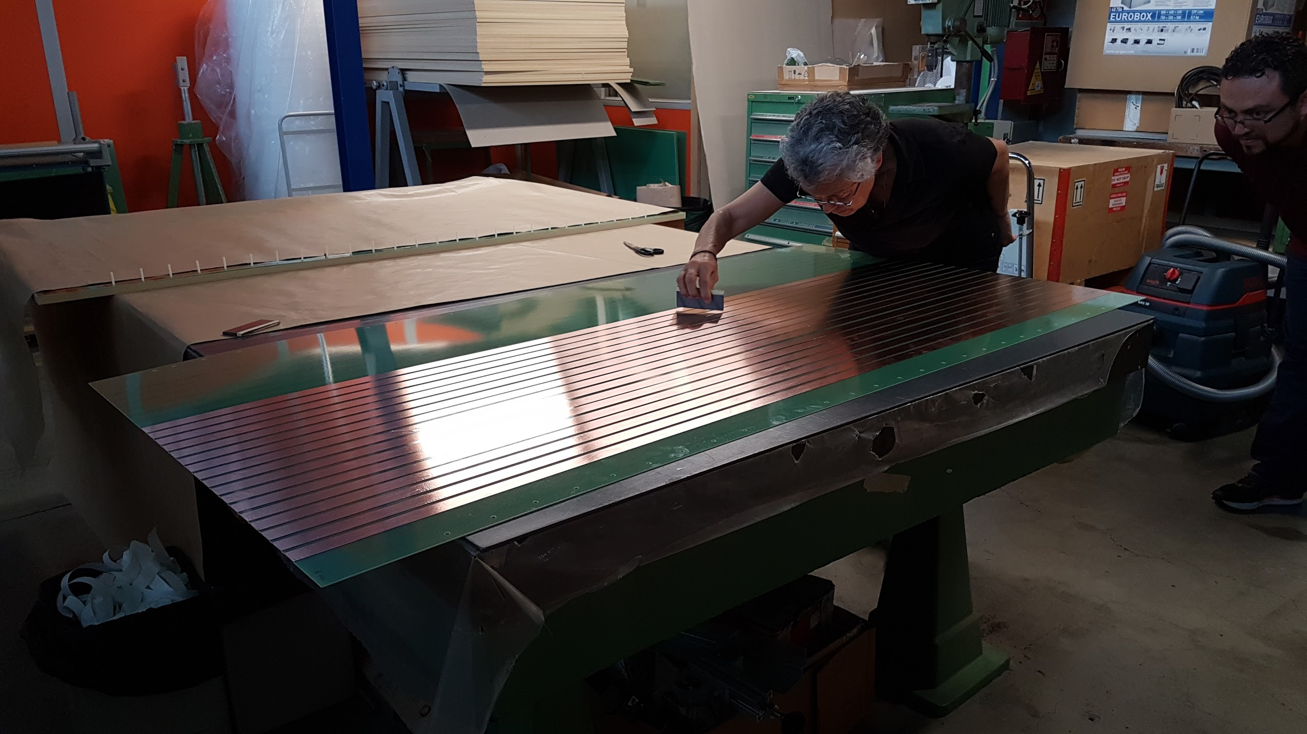
What we did

Slide 6
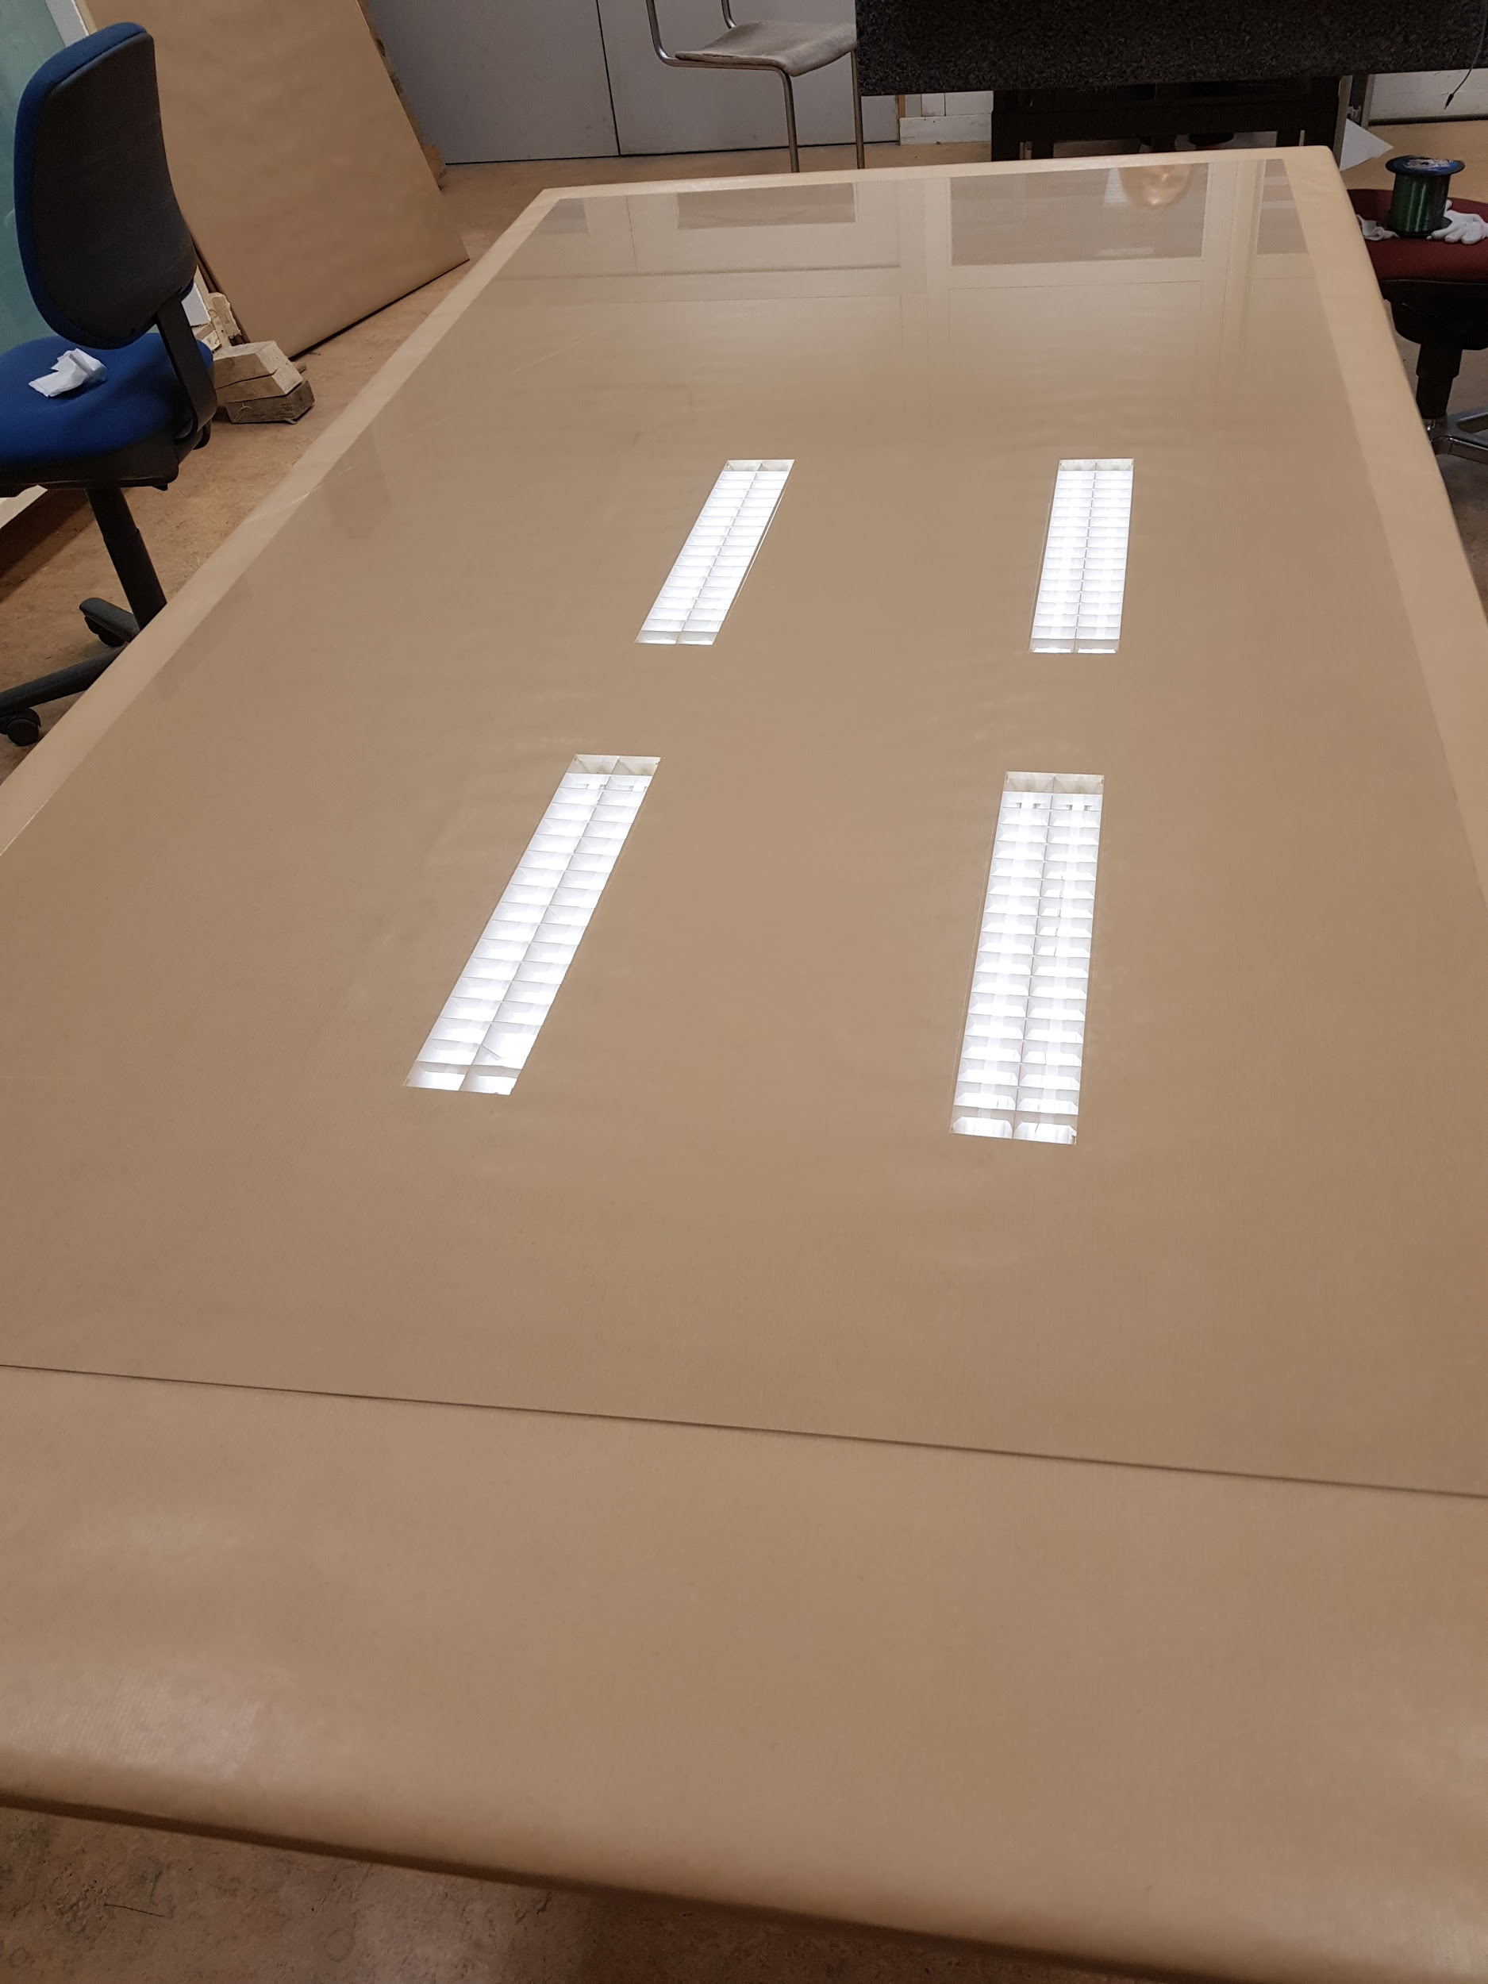
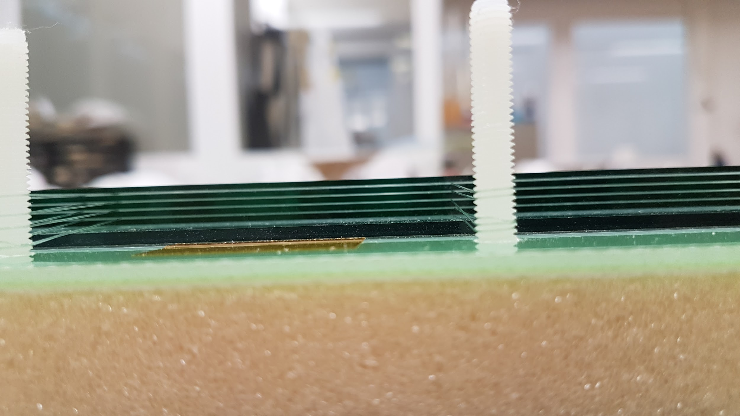
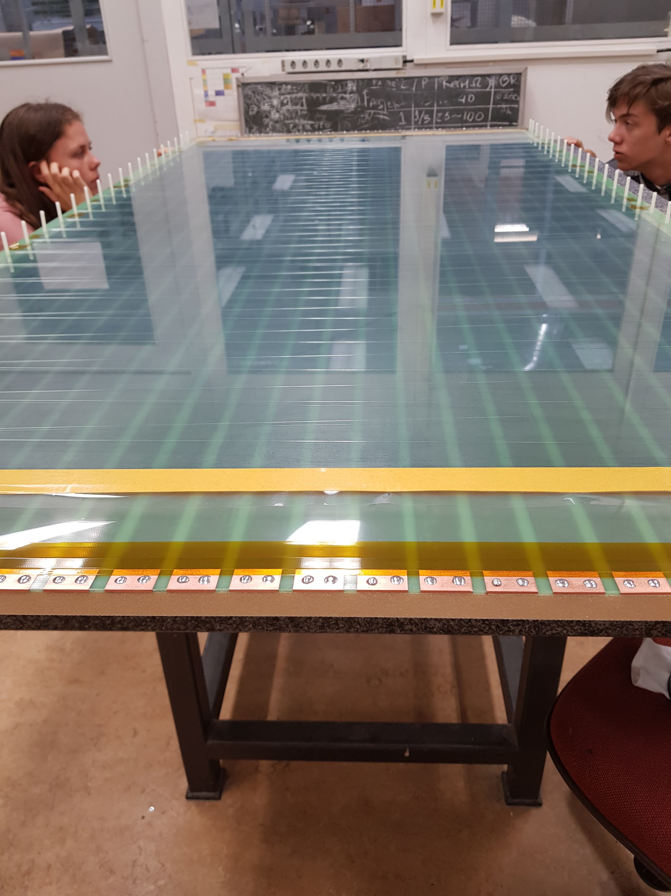
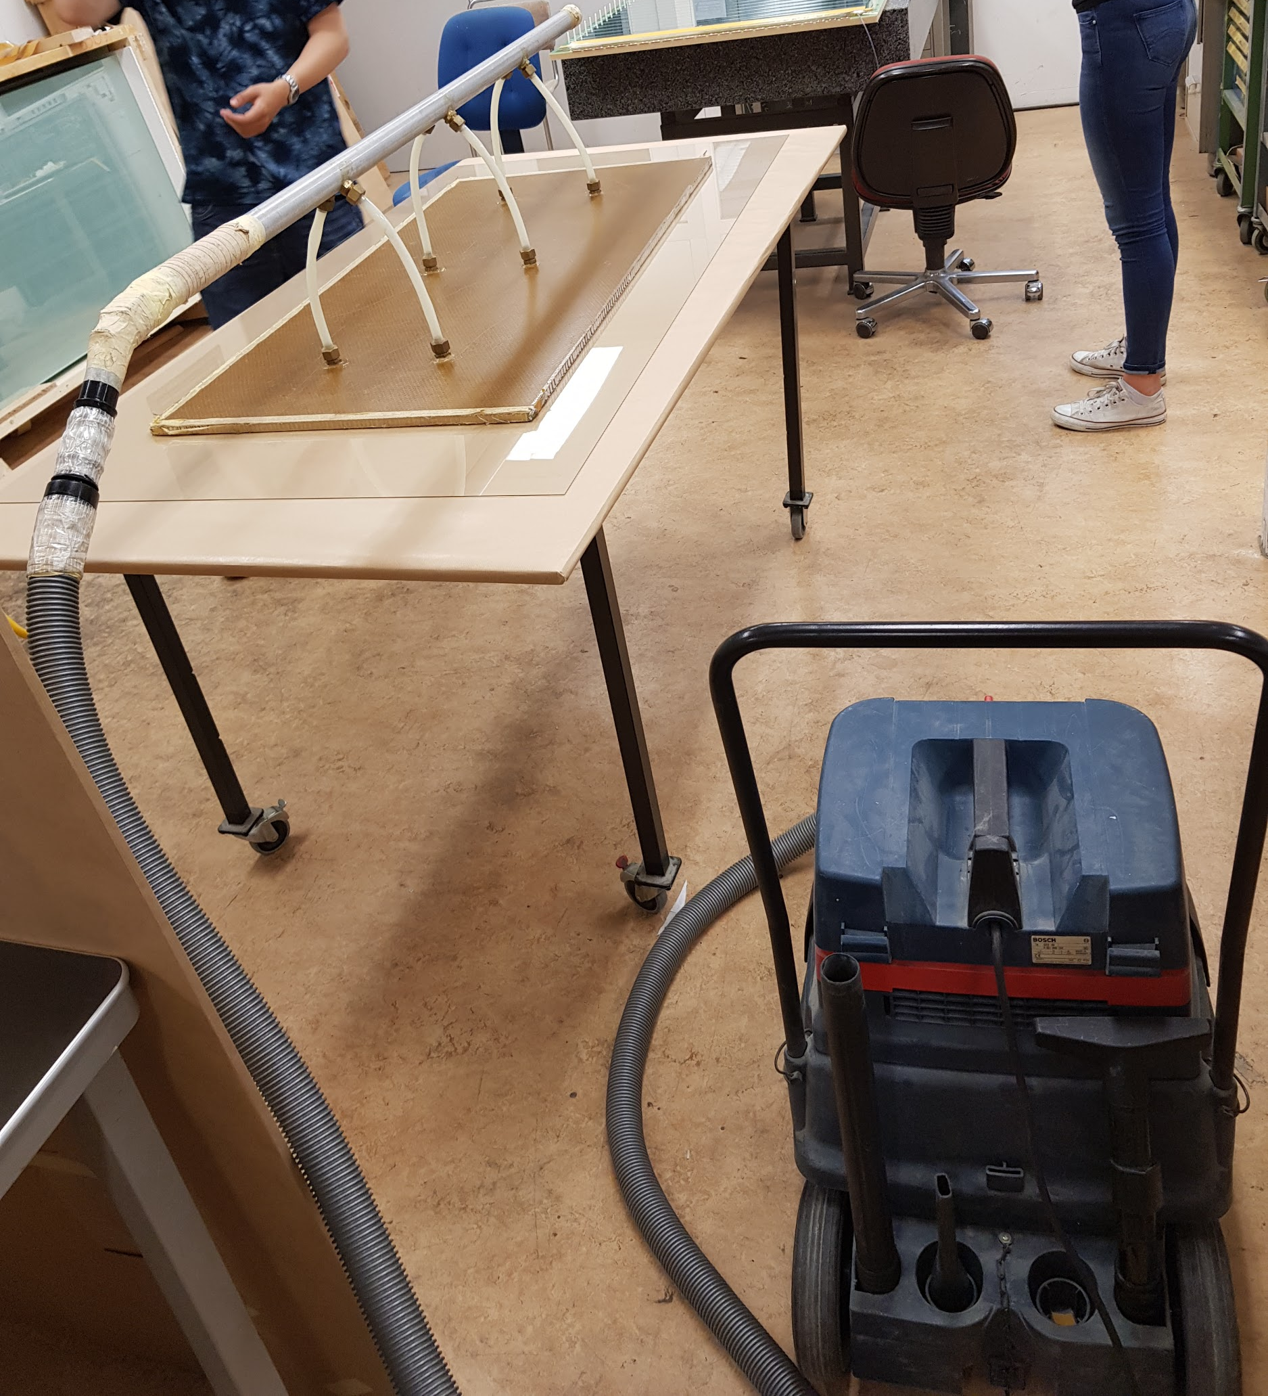
What we did

Slide 7
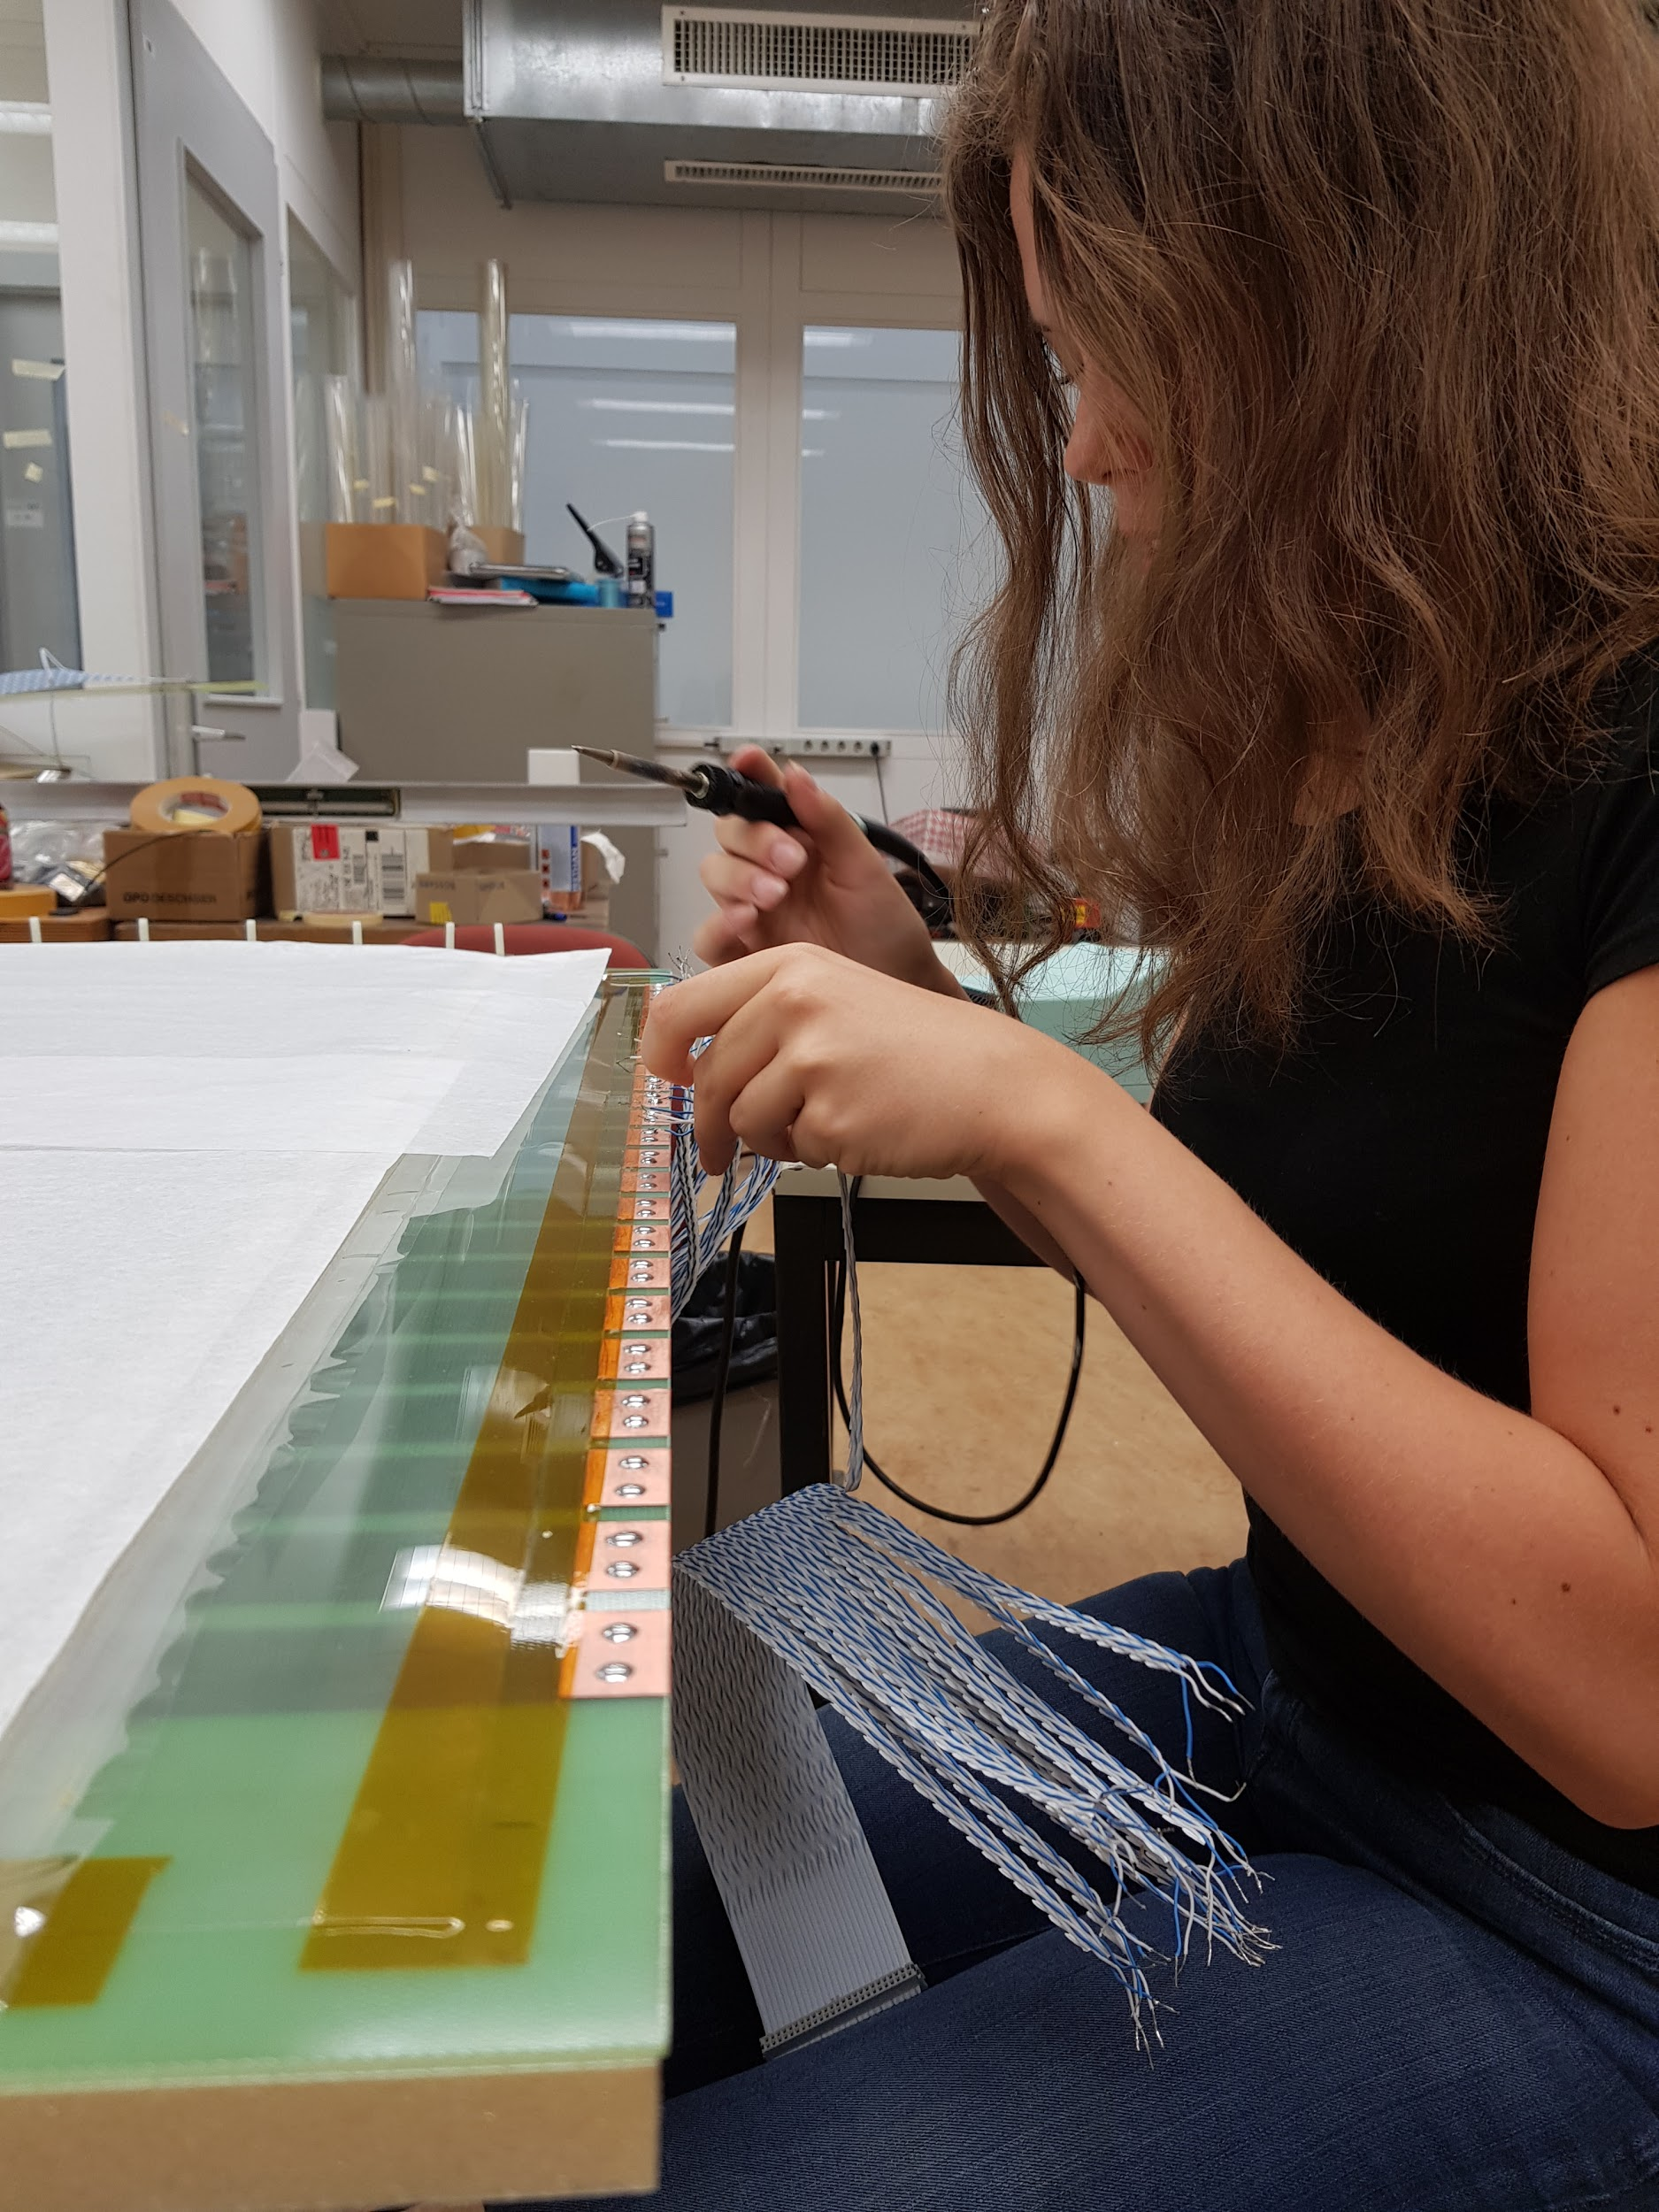
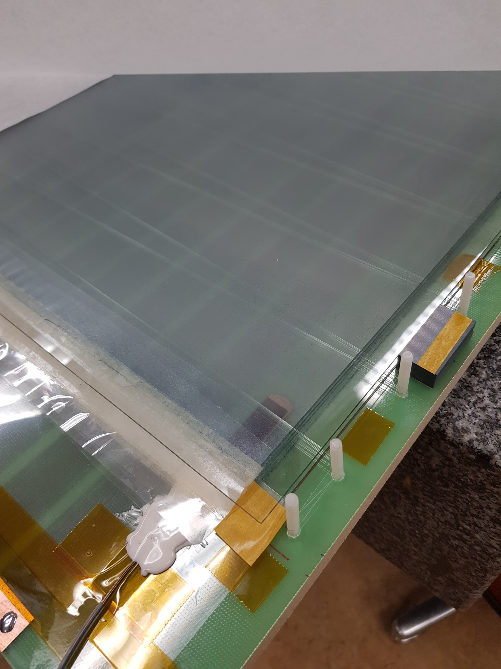
What we did

Slide 8
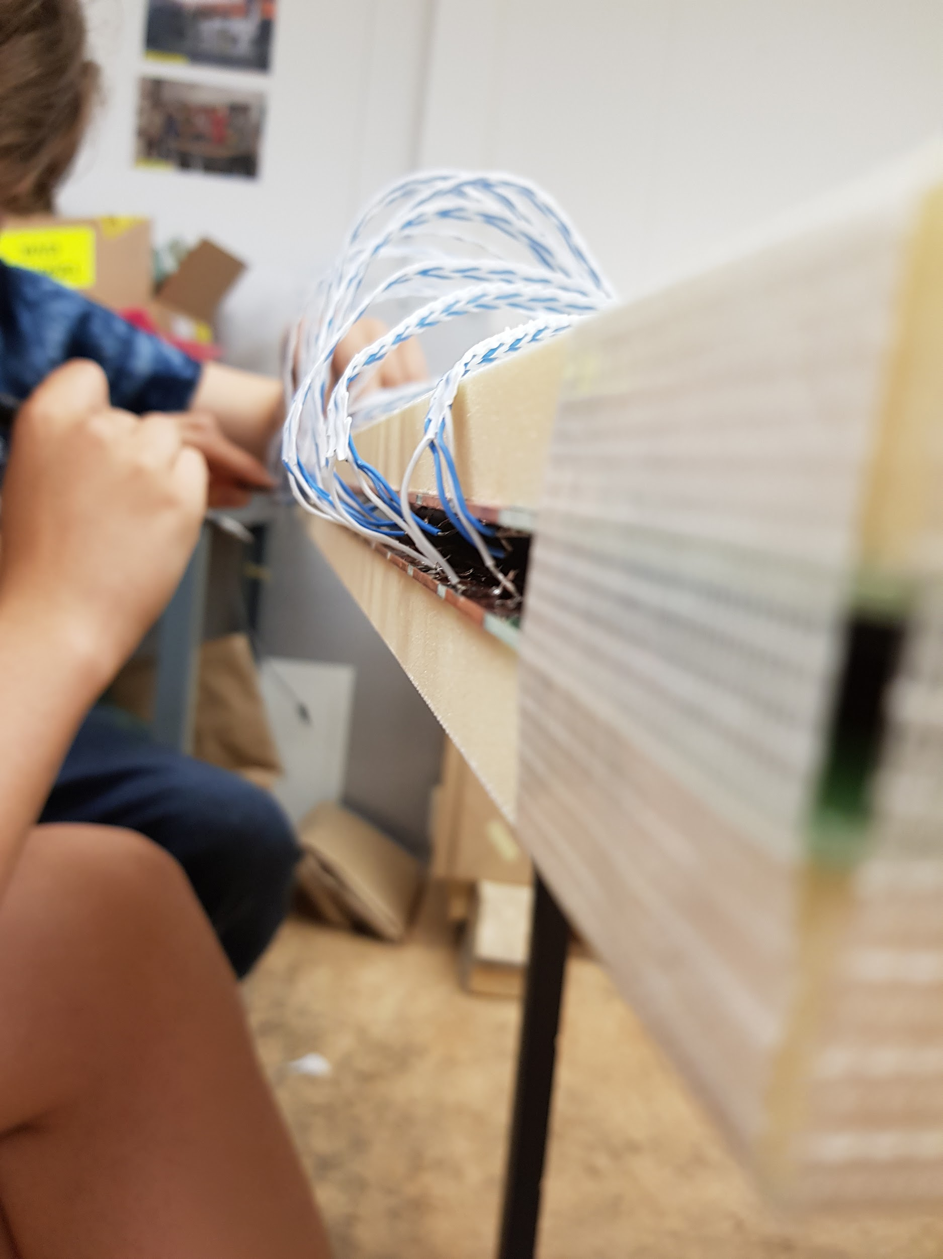
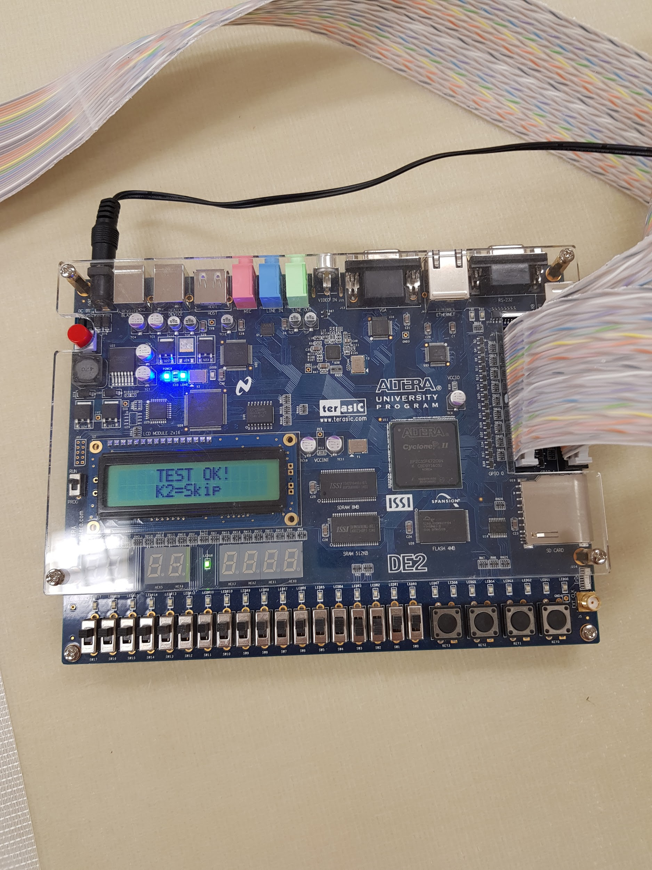
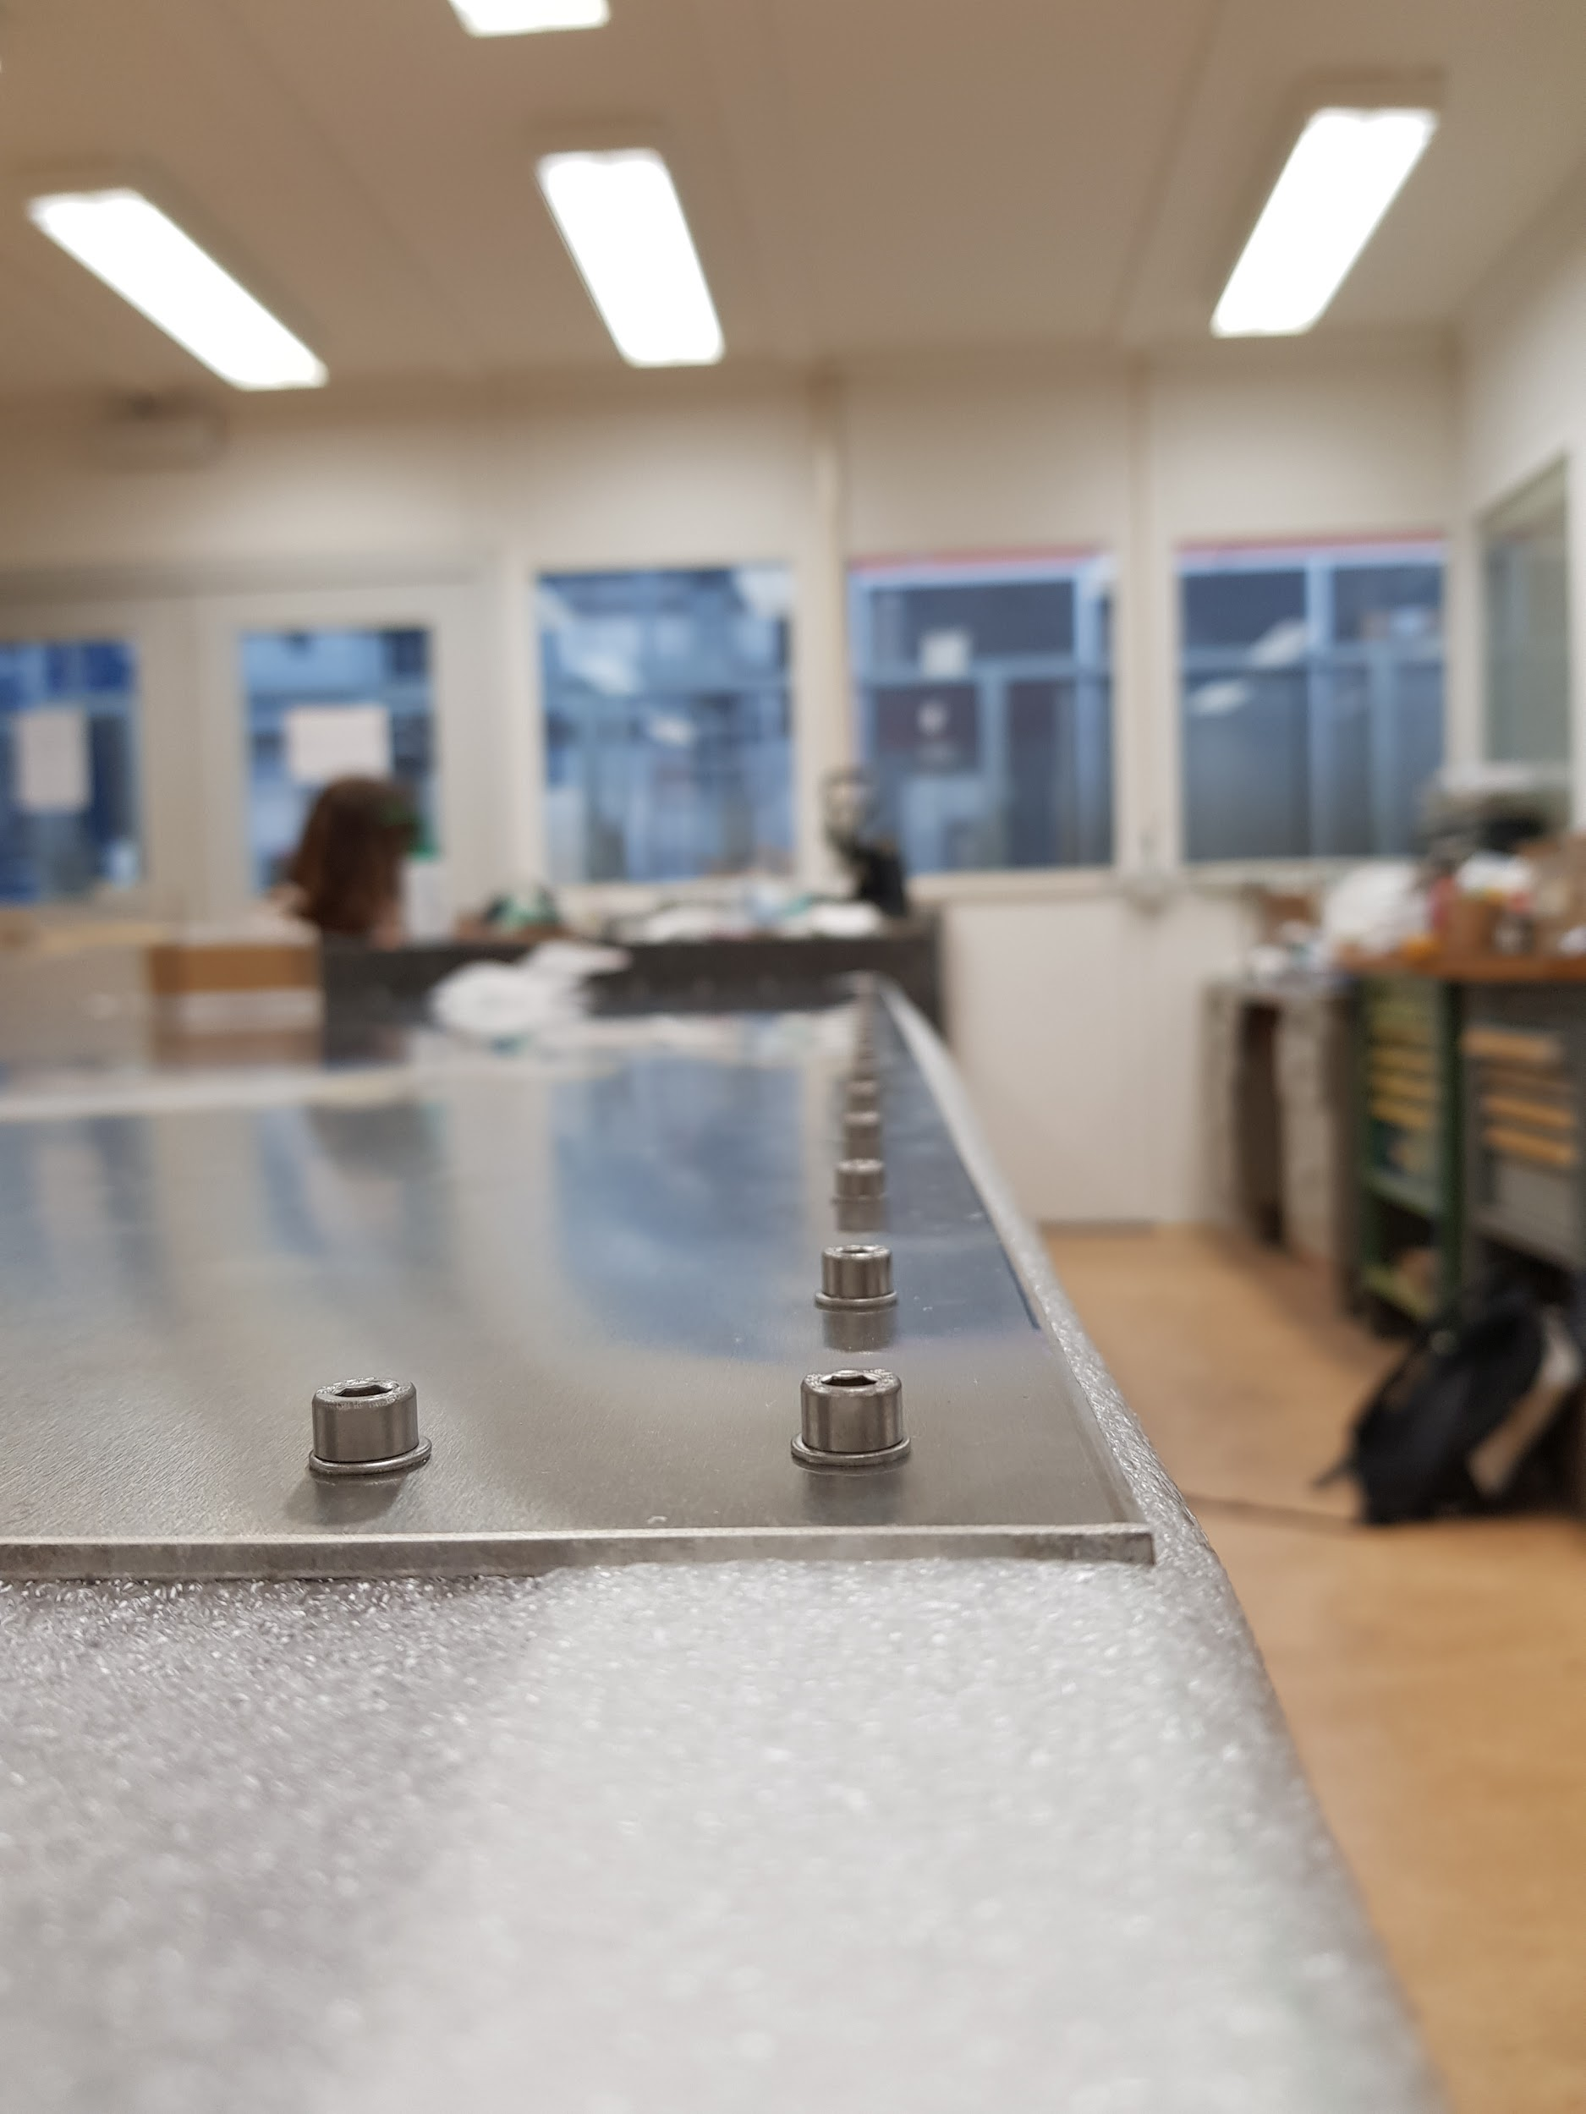
What we did

Slide 9
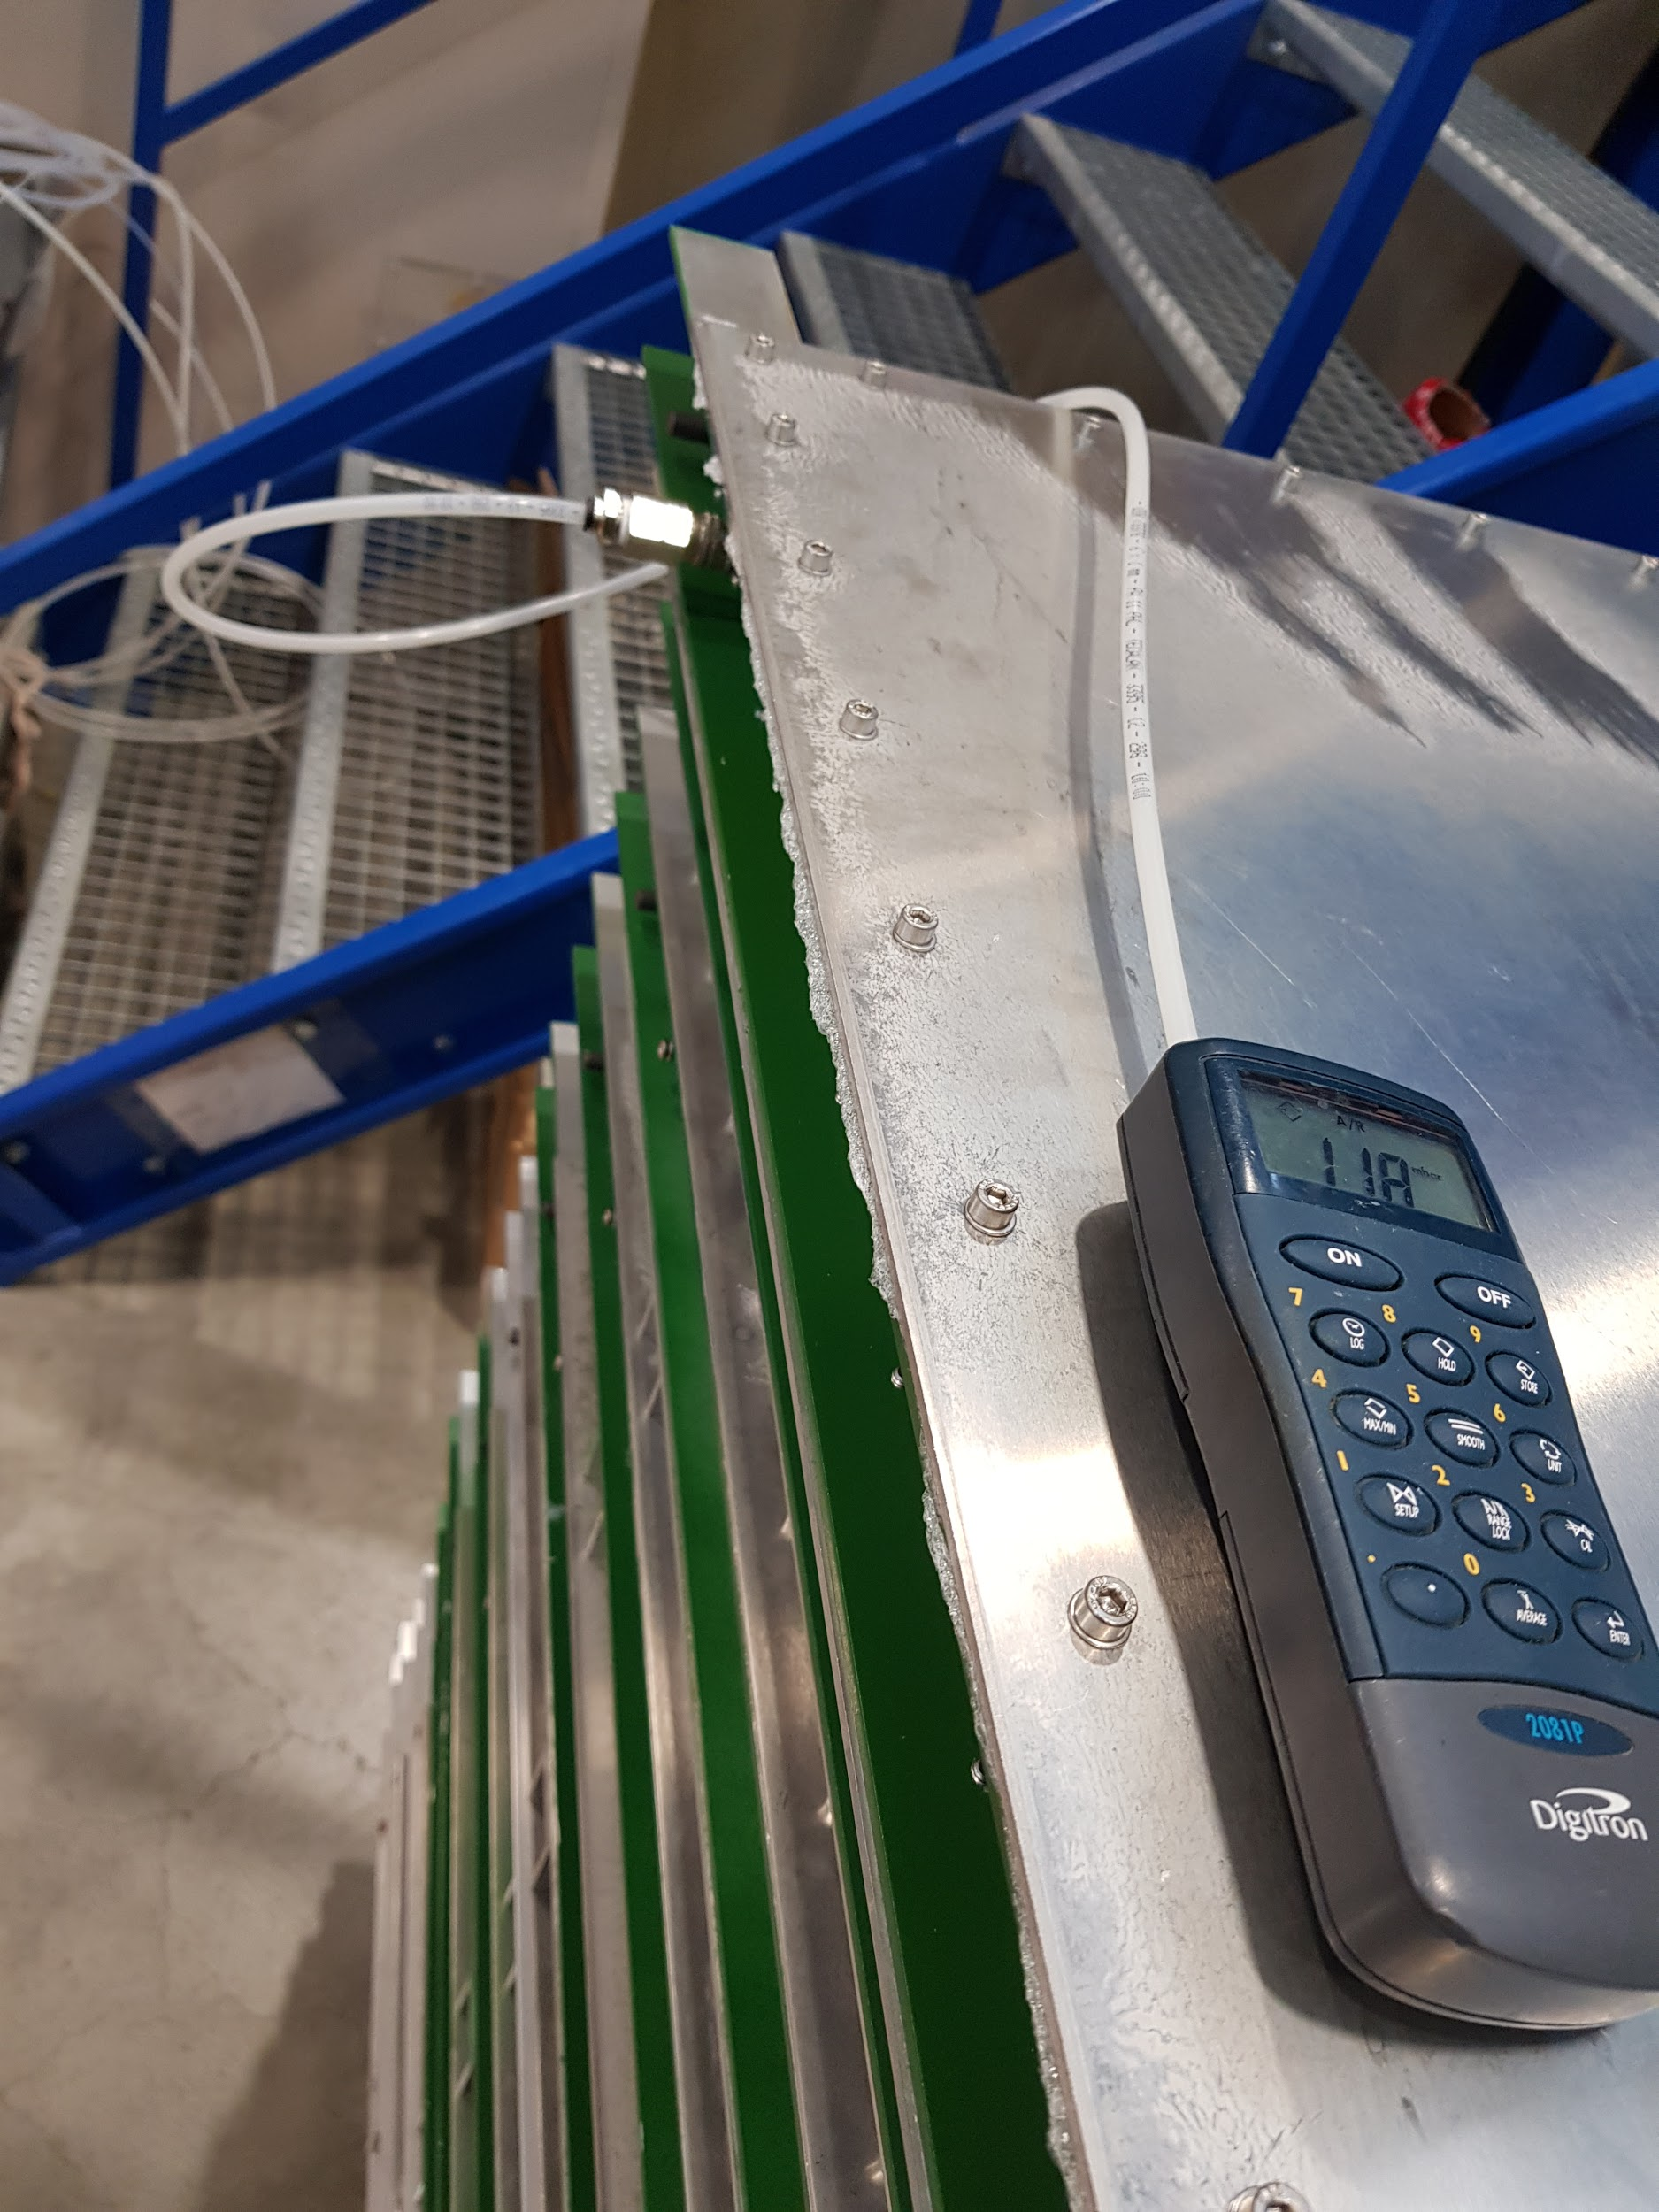
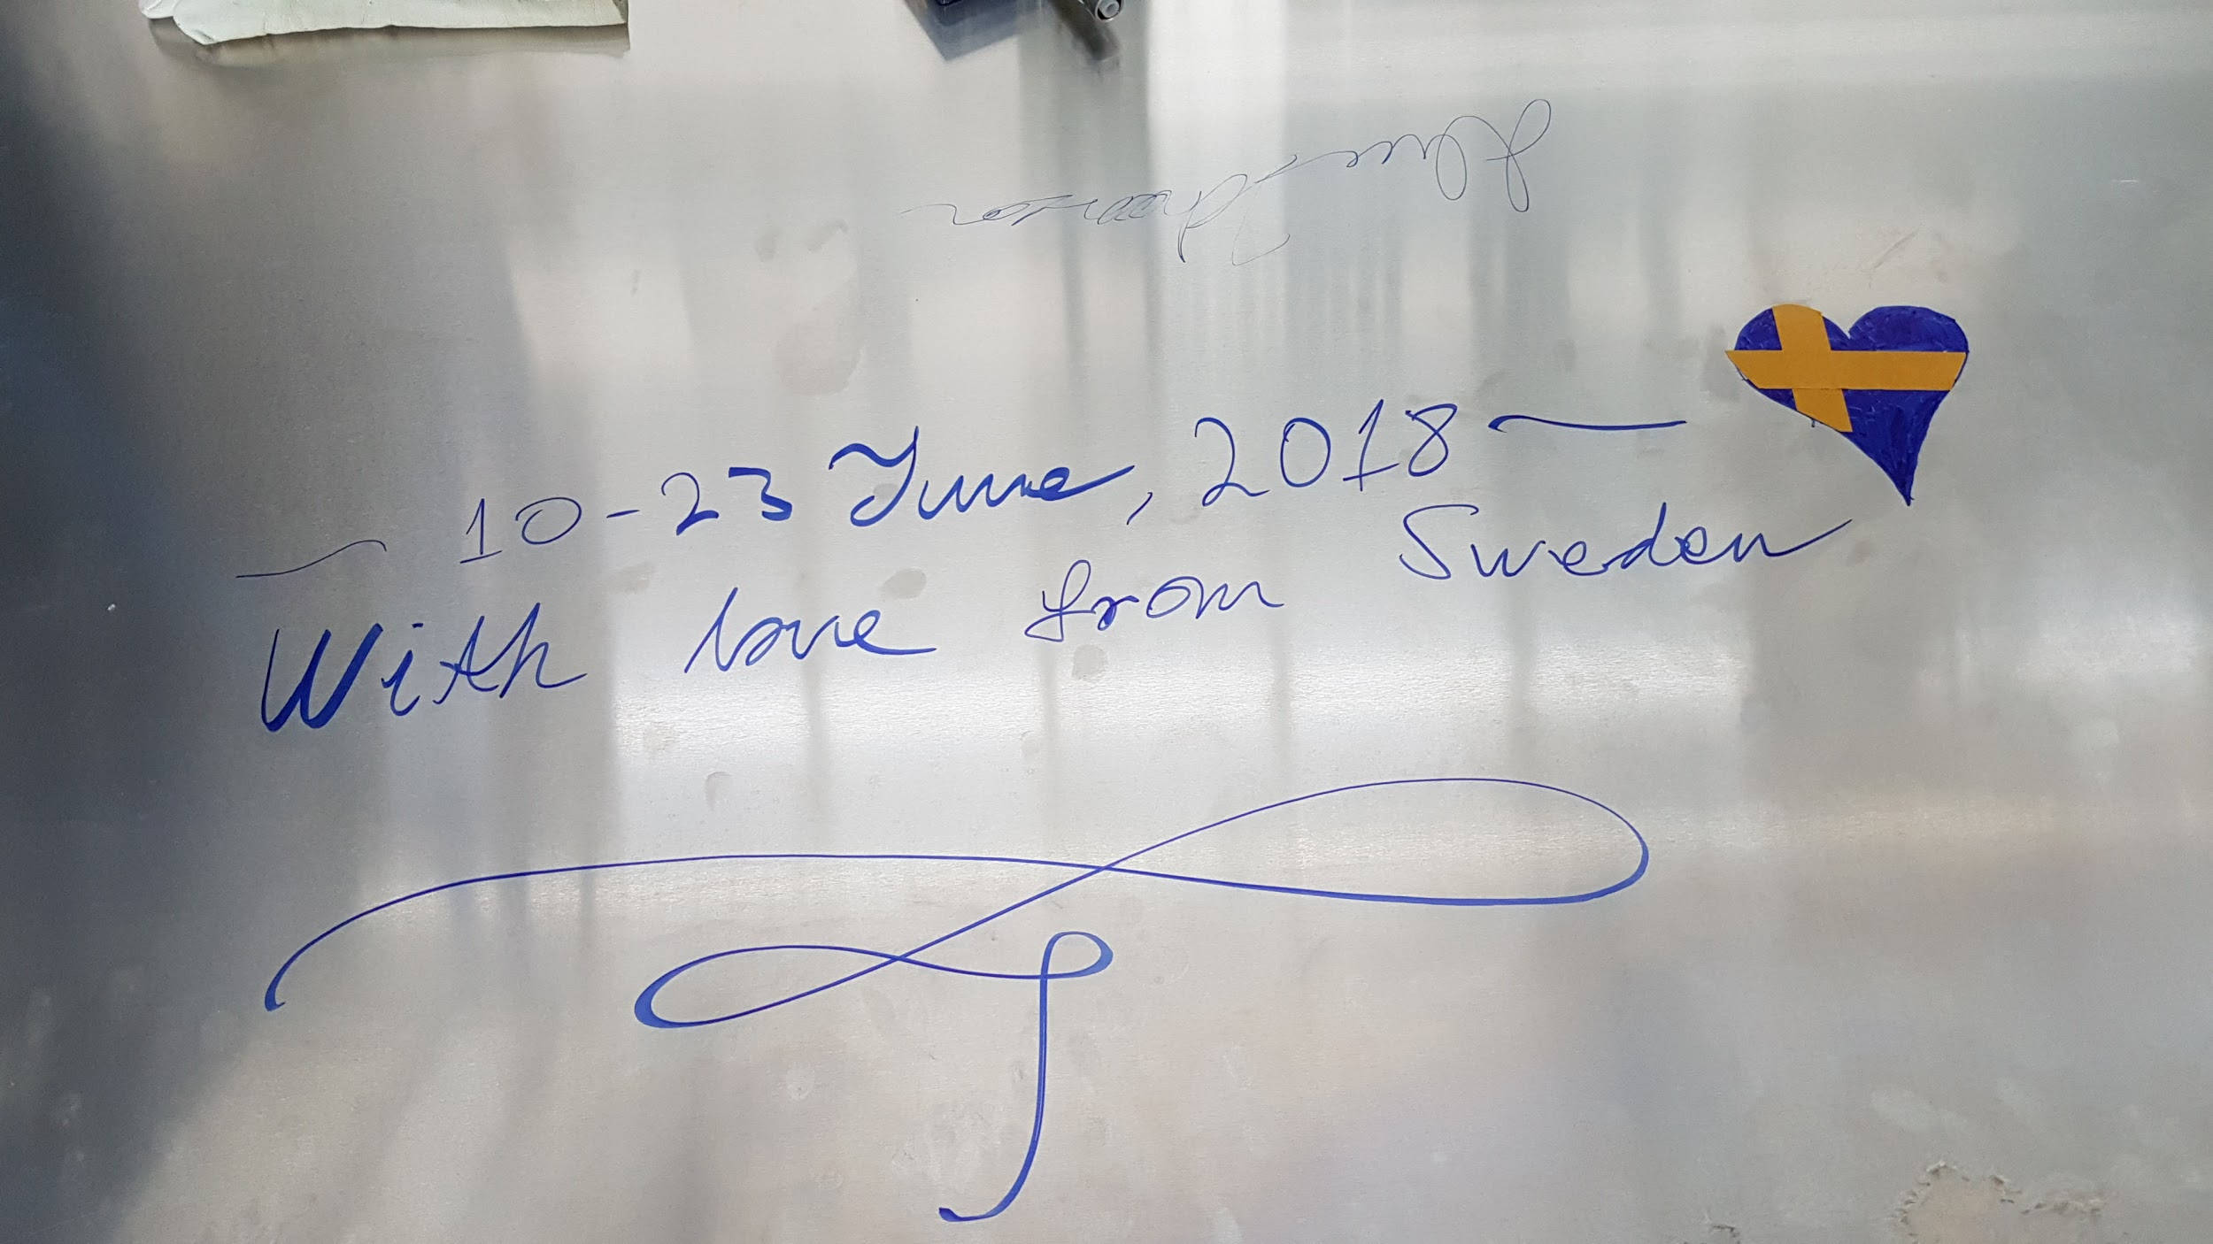
What we did

Slide 10
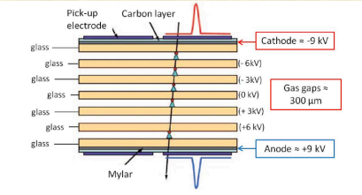
How a muon chamber works
The high energy muons hit the chamber and ionize the gas in the gaps
The movement of the electrons creates avalanches
As charges move inside the chamber, the disruption of the electric field is registered by the copper strips

Slide 11
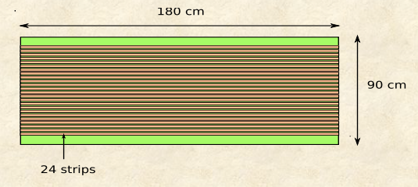
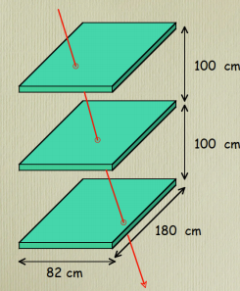
How a muon chamber works
The location of the hit is recognized by the difference of the times, which it takes for the signal to reach each side of the chamber, as well as which strip has been hit

Slide 12
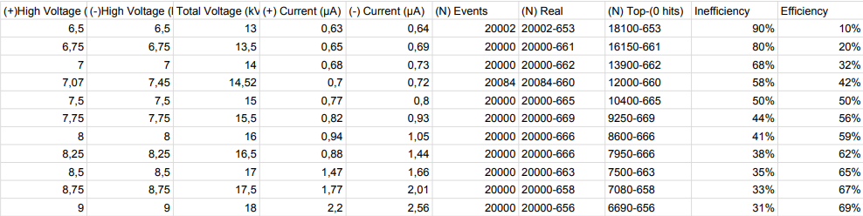
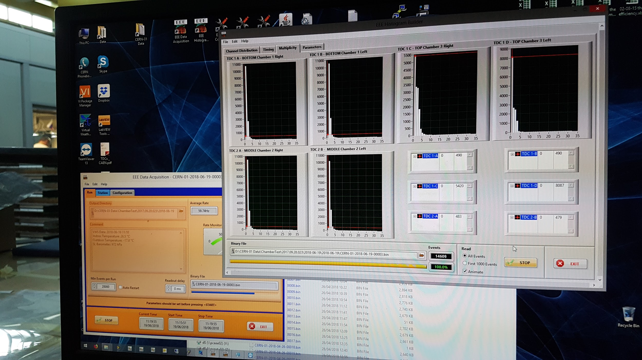
The Results

Slide 13
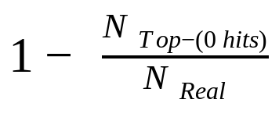
The Results

Slide 14
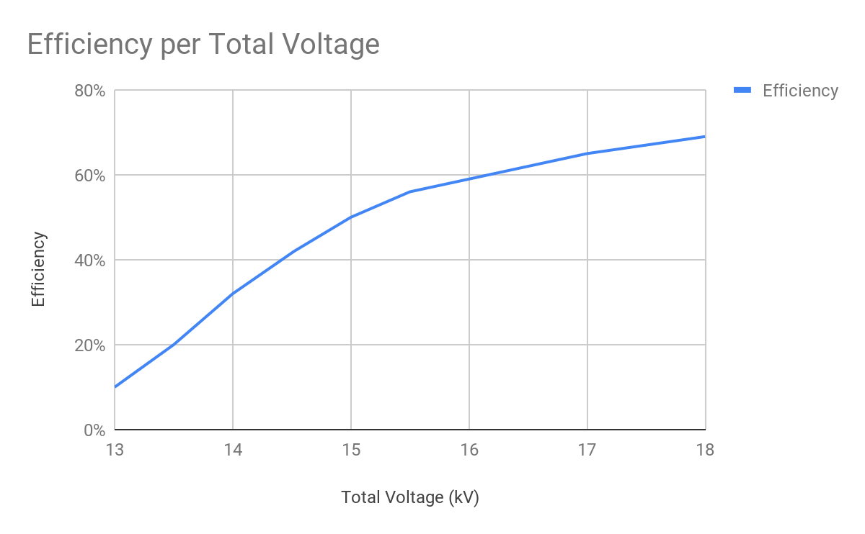
The Results

Slide 15
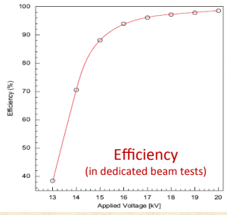

Slide 16


