Slide 2
Closure Swedish HSSIP 2018

Slide 3
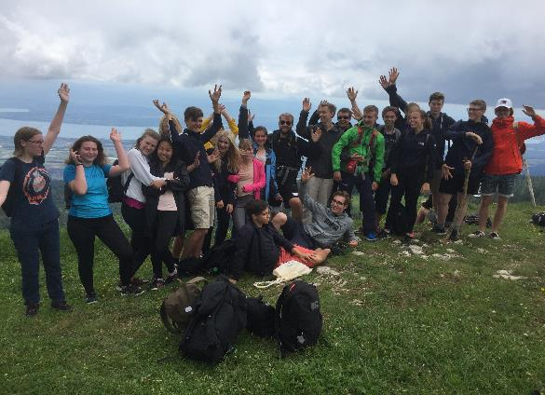
It was a real pleasure to have you here !!!
…and to share some of our our experience with you

Slide 4
It was a busy, but hopefully interesting programme…
Thanks for your very nice and professional presentations
Please, used them also in your schools if you can…

Slide 5
For this CERN wants to thank and congratulate you…

Slide 6
A big thanks to:
The HSSIP Management team:
  Ines Knäpper, and Stavroula Kotsi
The Swedish organising committee:
  Ann-Marie Pendrill, Kerstin Francke,
  Göran Tranströmer

Slide 7
A big thanks to:
The CERN organising committee:
  Lennart Jirden
All the Project / Stage supervisors

Slide 8

We all wish you a safe journey back home
Make the best of your studies
….and we hope to see you back in the future

