Slide 1
Cooling
Guy
Noam
Liya

Slide 2
Cooling systems in the atlas detectors
The new Israeli part will be placed close to the center of the detector.
That requires the part to be more precise in order to determine the exact location of the particles
In order to be precise, the new part has a lot more electronic components.

Slide 3
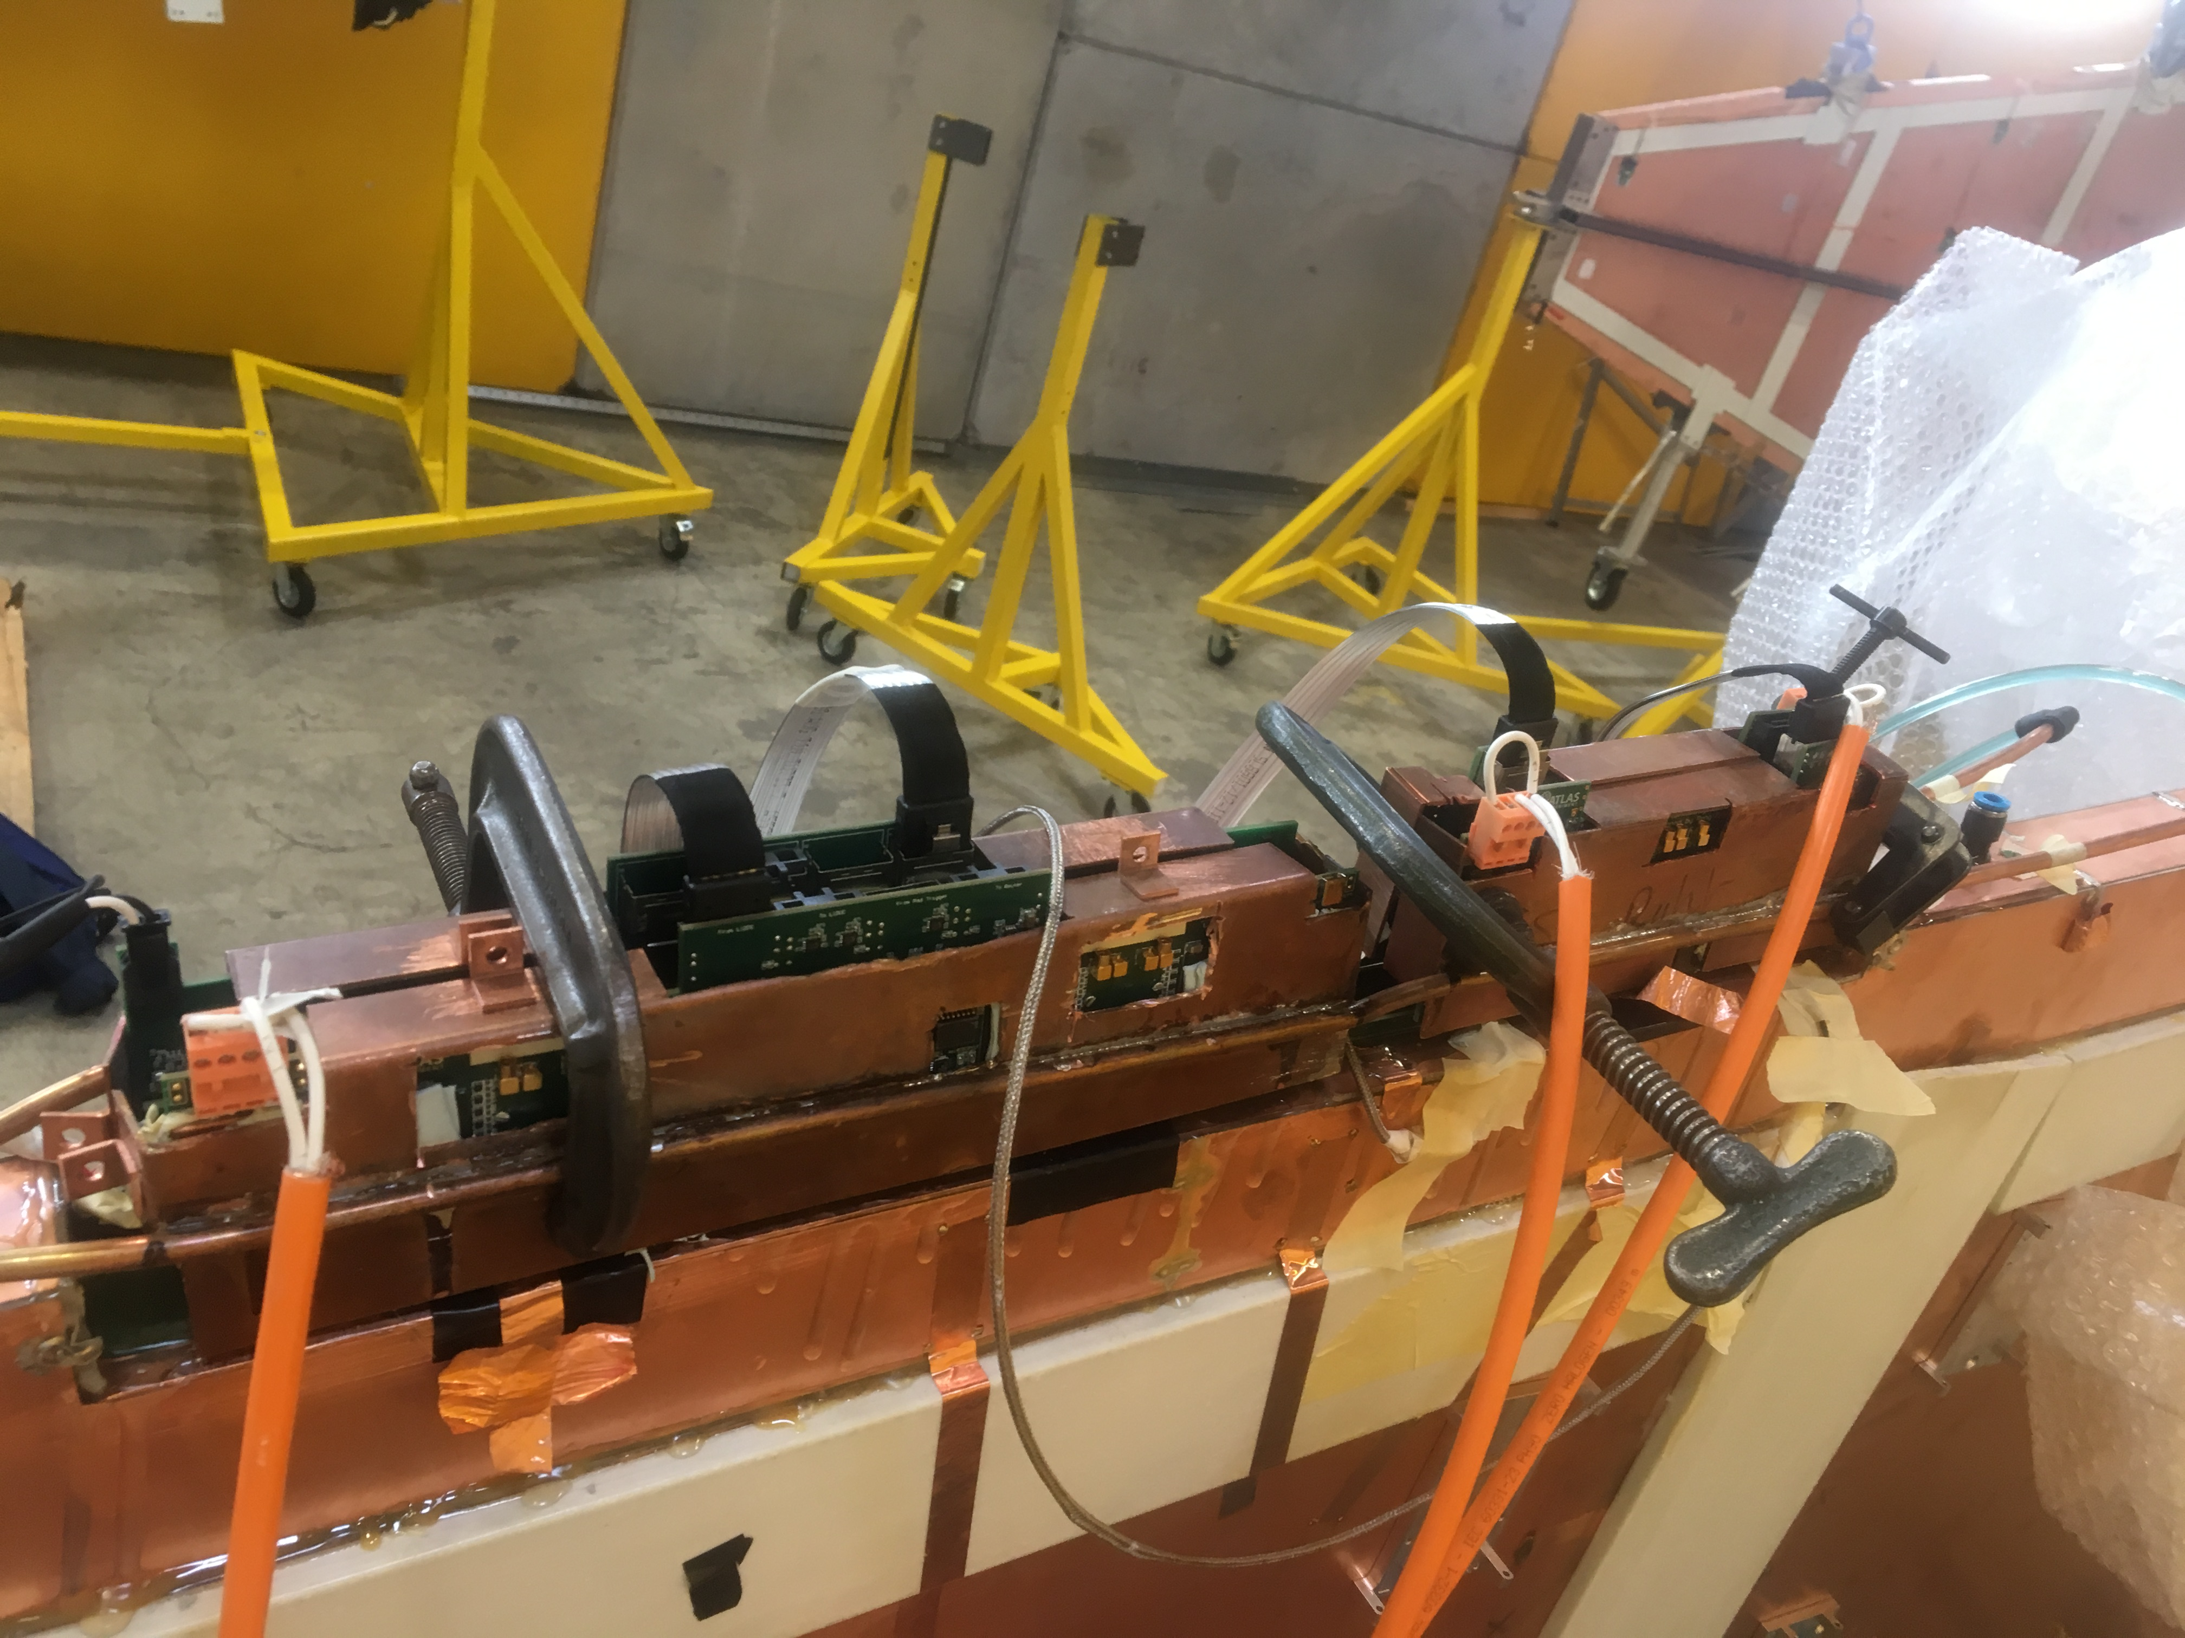
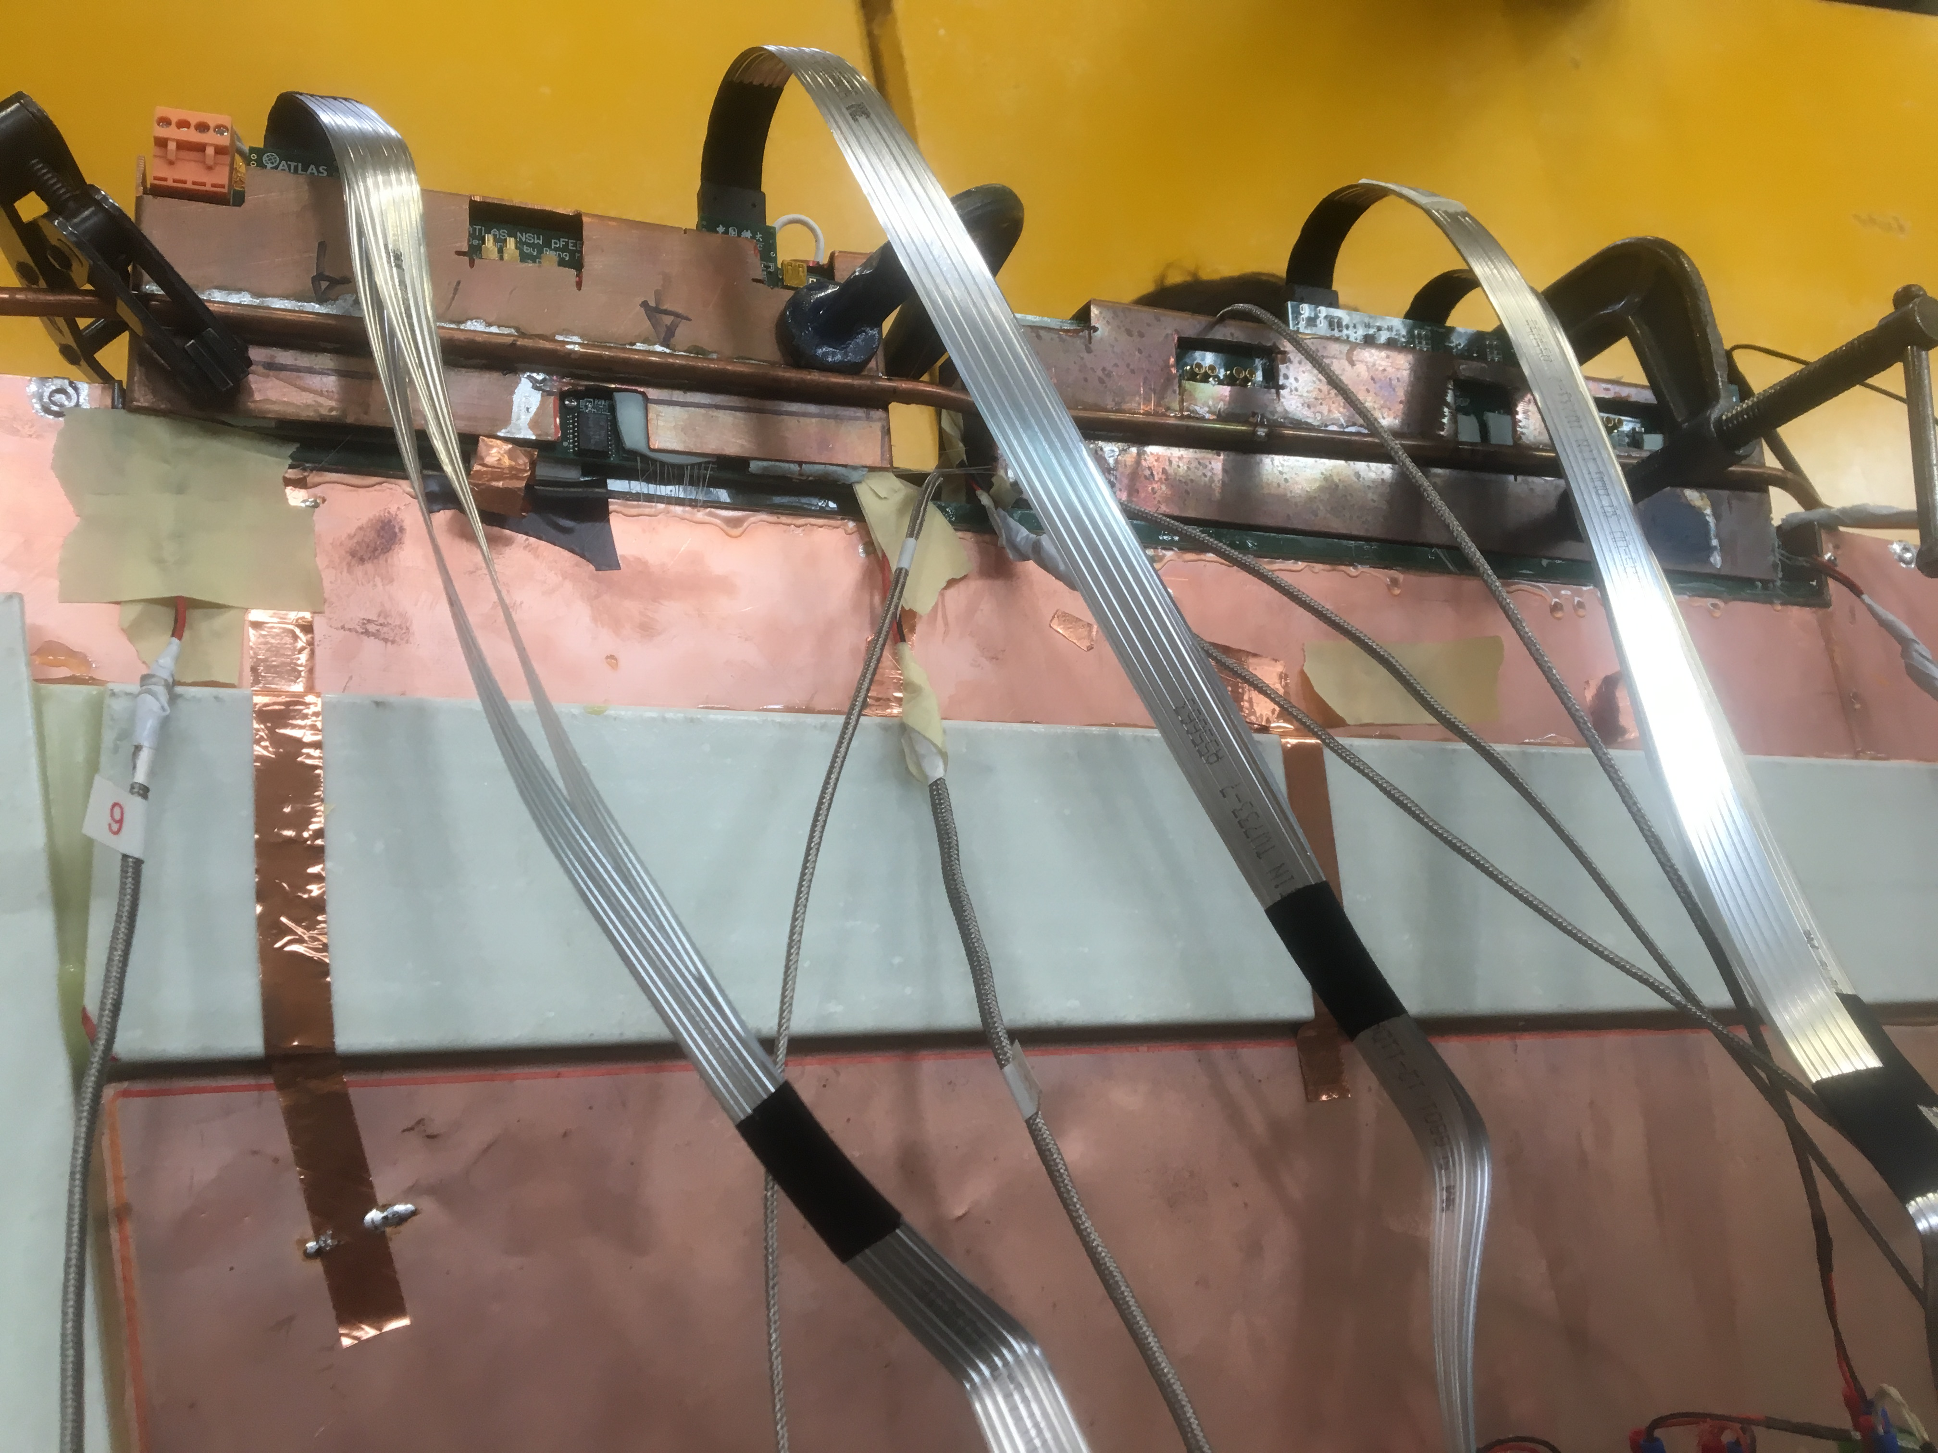
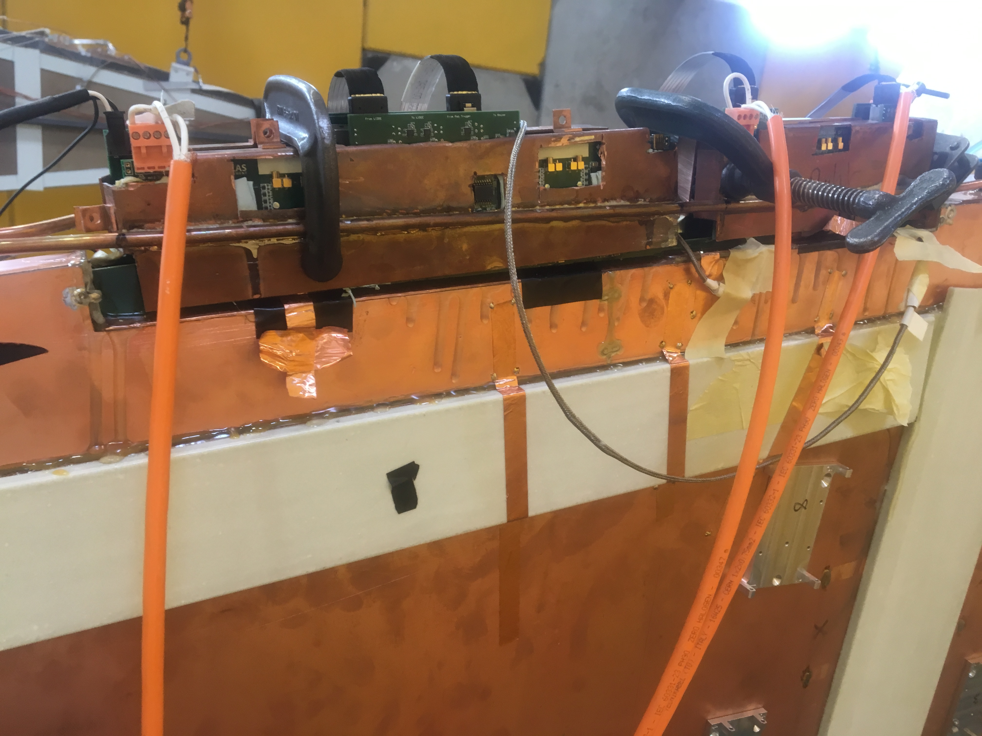
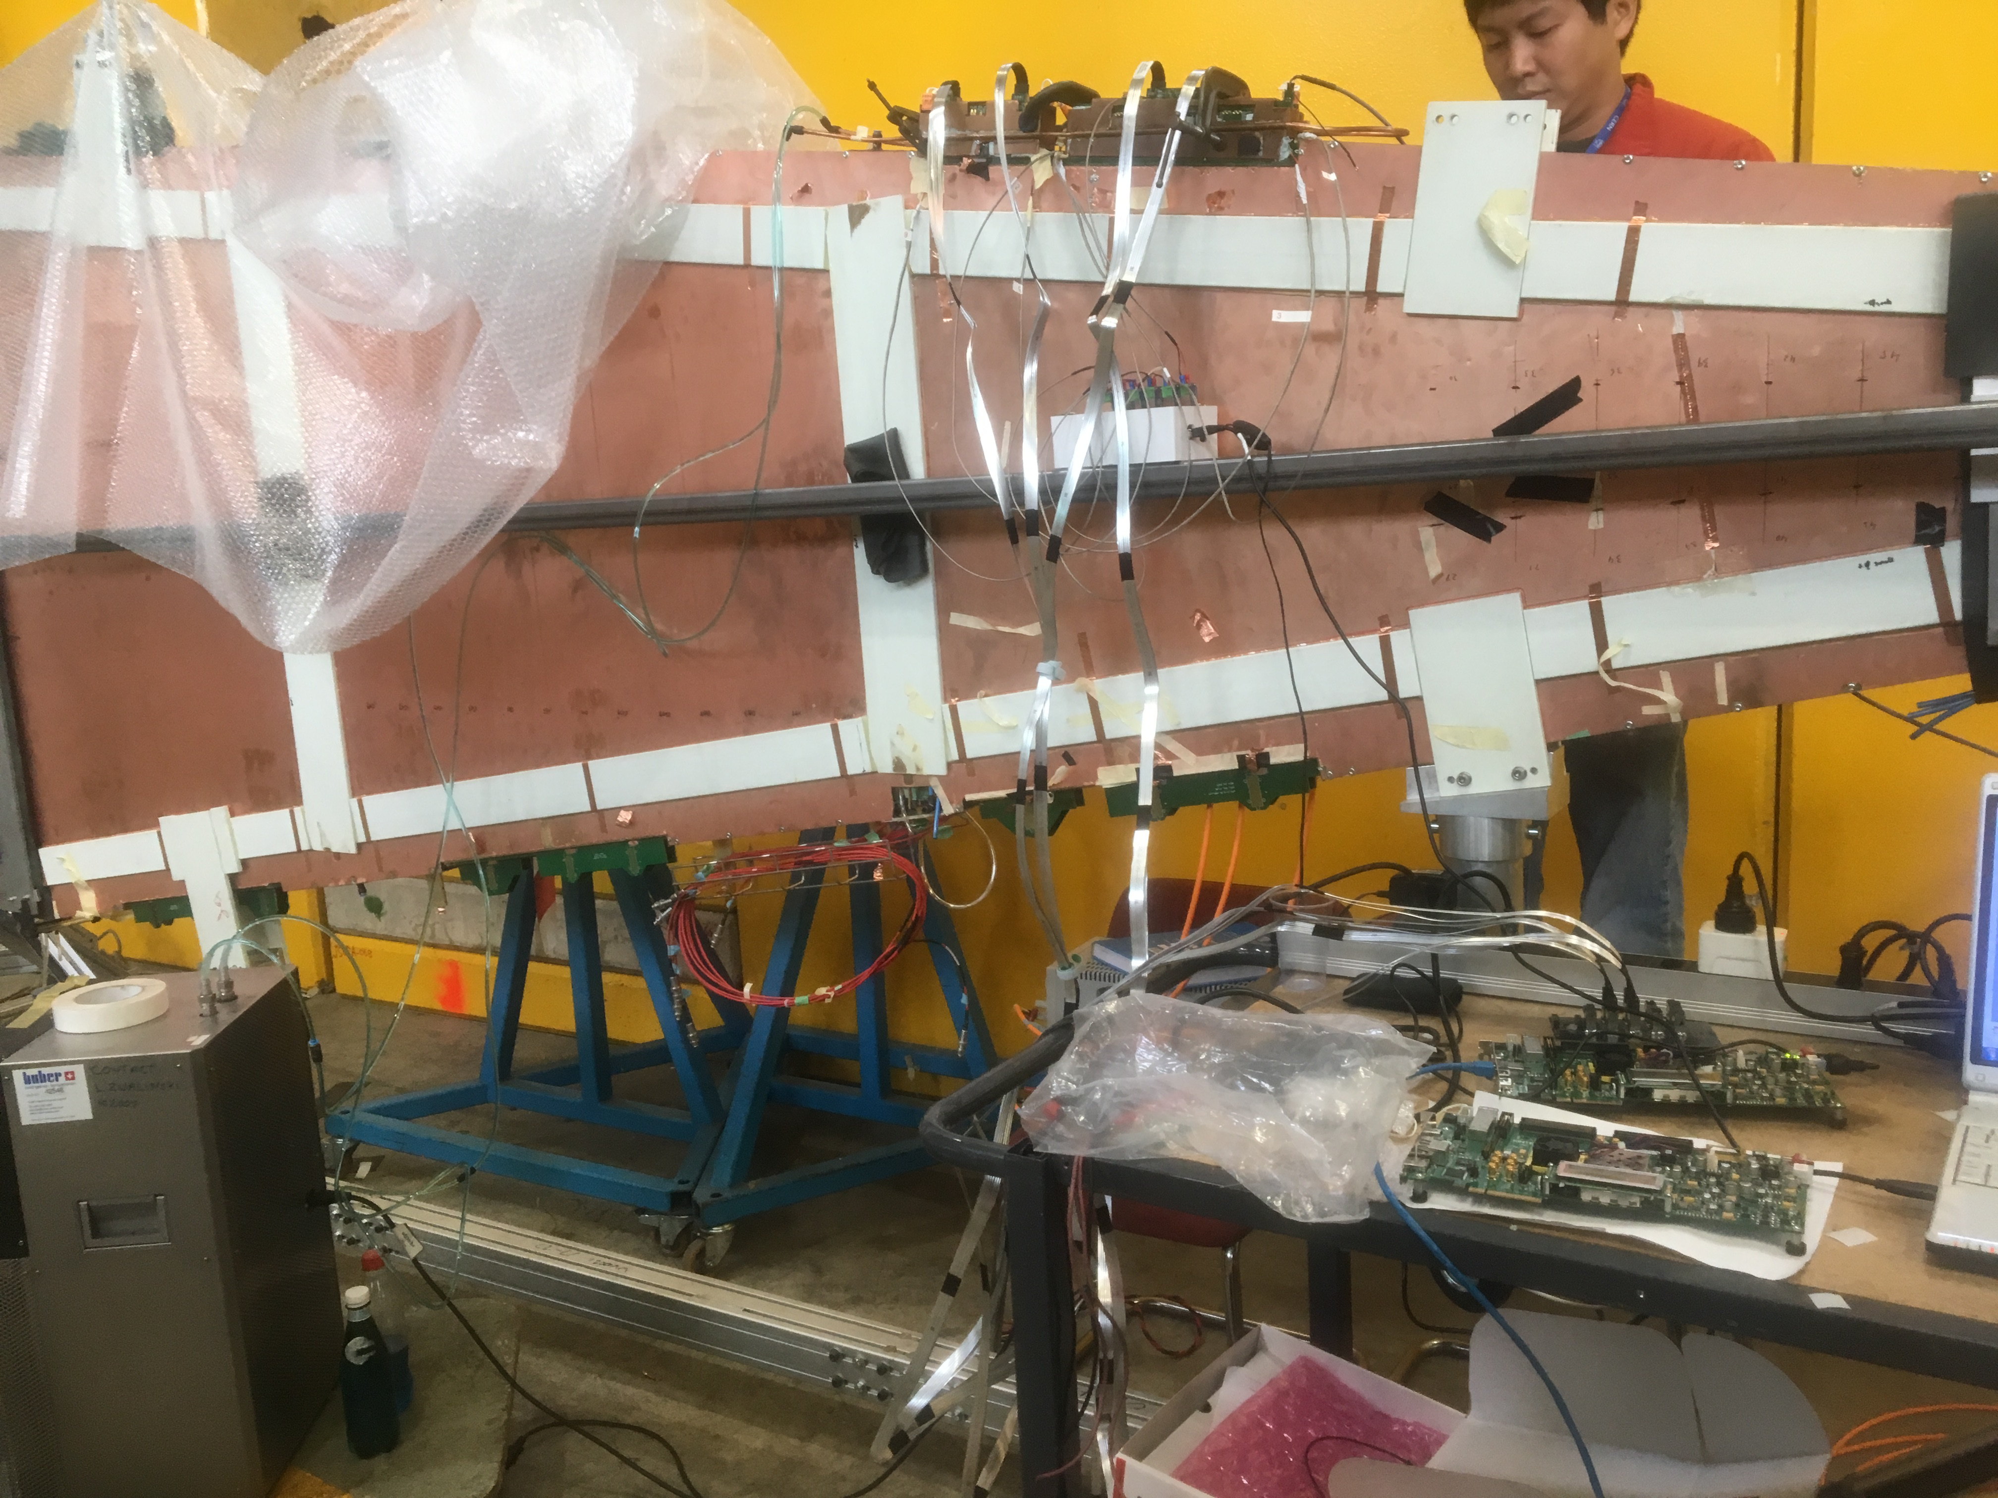

Slide 4
Copper
Resistor
Air flow
Cooling system
Water flow
Thermal paste
PCB

Slide 5
 | copper | water
Specific heat capacity (j/kg*c) | 380 | 4200
Density (kg/m³) | 8920 | 1000
Heat transfer coefficient (w/m2K) | 13.1 | 13.1 (inside copper)

Slide 6
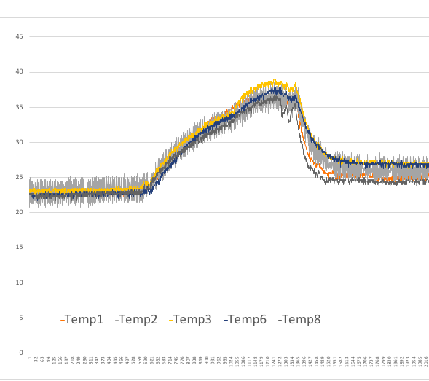
Temperature as a function of time

Slide 7
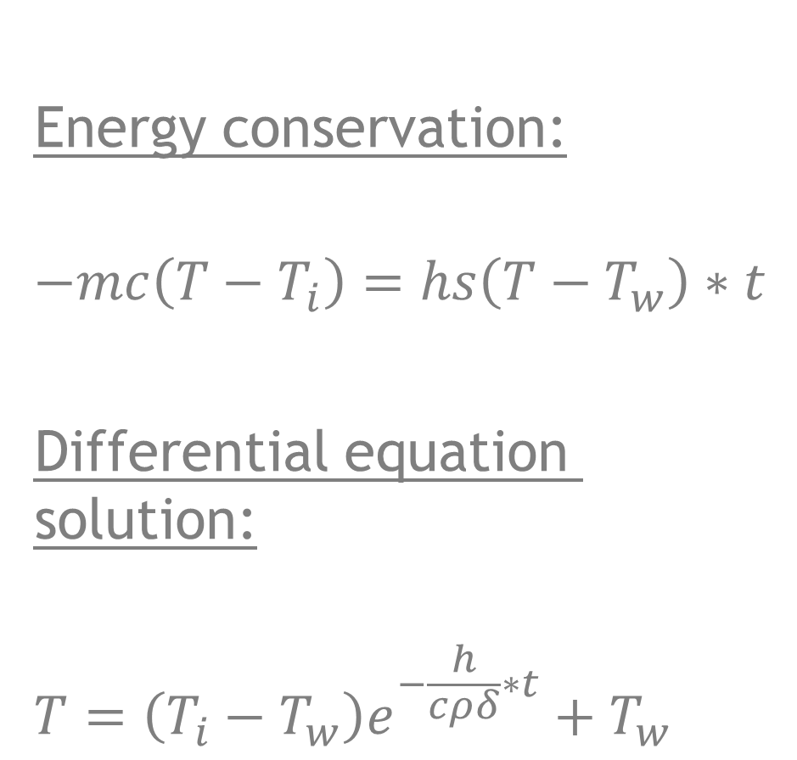
Cooling theory
Energy conservation:
$$−mc\left(T−T_{i}\right)=hs\left(T−T_{w}\right)∗t$$
Differential equation solution:
$$T=\left(T_{i}−T_{w}\right)e^{−\frac{h}{cρδ}∗t}+T_{w}$$
The overall heat transfer coefficient is used to calculate total heat transfer through a wall or heat exchanger construction. The overall heat transfer coefficient depends on the fluids and their properties on both sides of the wall, the properties of the wall and the transmission surface

Slide 8
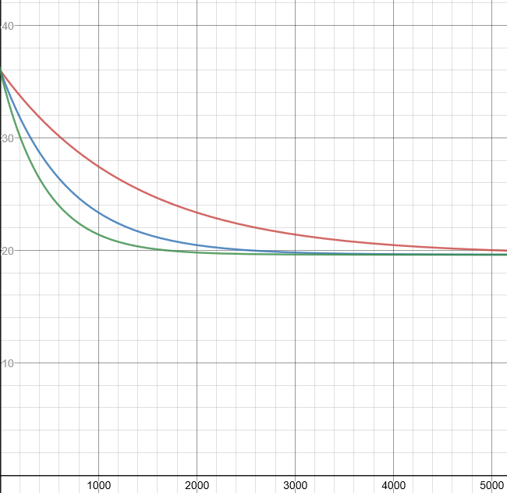
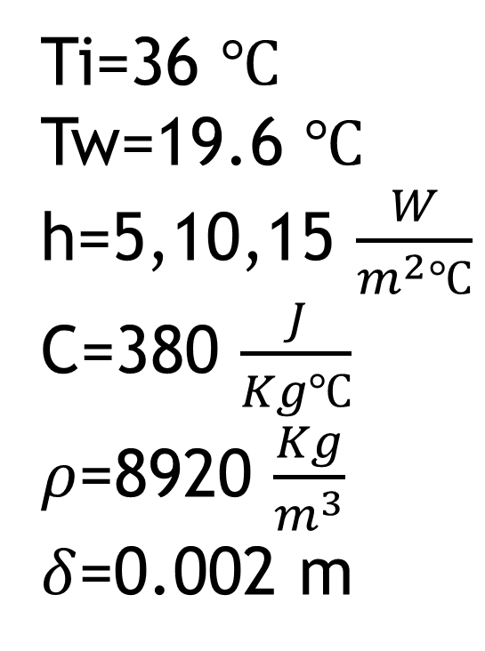
Ti=36 $℃$
Tw=19.6 $℃$ h=5,10,15 $\frac{W}{m^{2}℃}$
C=380 $\frac{J}{Kg℃}$
$ρ$=8920 $\frac{Kg}{m^{3}}$
$δ$=0.002 m
h=5
h=10
h=15

Slide 9
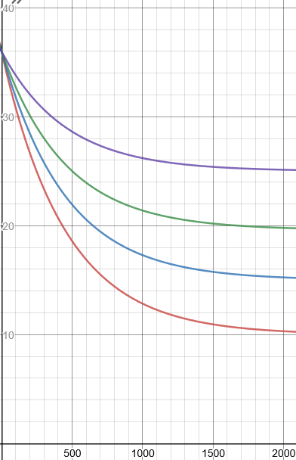
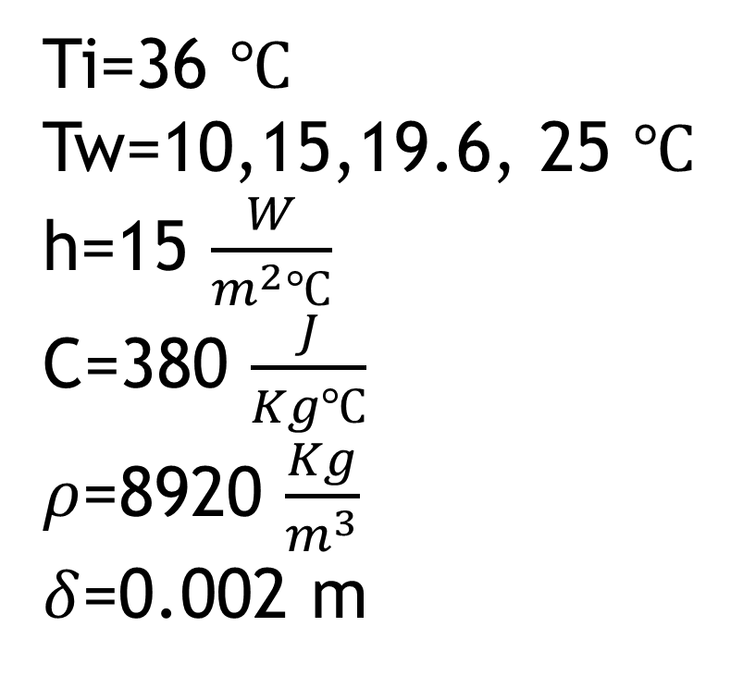
Ti=36 $℃$
Tw=10,15,19.6, 25 $℃$ h=15 $\frac{W}{m^{2}℃}$
C=380 $\frac{J}{Kg℃}$
$ρ$=8920 $\frac{Kg}{m^{3}}$
$δ$=0.002 m
Ti=25
Ti=19.6
Ti=15
Ti=10

Slide 10
Conclusions
The higher the heat transfer coefficient is, the faster the PCB will cool.
The lower the initial water temperature is the faster the PCB will cool and the PCB will reach lower temperature.

Slide 11

Suggestions to improve the cooling effect
In order to improve the heat transfer coefficient we can increase the water flow and increase the surface area.
Another way to improve the cooling is to use material that has a better heat transfer coefficient
Another way to increase the cooling effect is to use colder water

