Slide 1
K-modulation beta-beat measurements
Alexander Huschauer, Frank Tecker
with many thanks to the OP crew for the support!
Introduction
Measurement results
Comparison to MAD-X

Slide 2

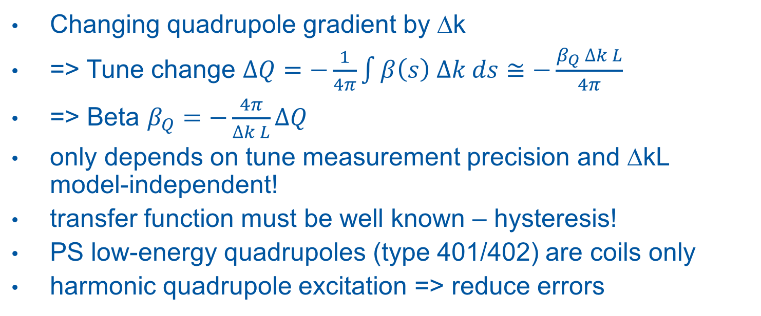
Introduction
Changing quadrupole gradient by ∆k
=> Tune change $∆Q=−\frac{1}{4π}\int{β\left(s\right) ∆k ds≅−\frac{β_{Q} ∆k L}{4π}}$
=> Beta $β_{Q}=−\frac{4π}{∆k L}∆Q$
only depends on tune measurement precision and ∆kL
model-independent!
transfer function must be well known – hysteresis!
PS low-energy quadrupoles (type 401/402) are coils only
harmonic quadrupole excitation => reduce errors

Slide 3
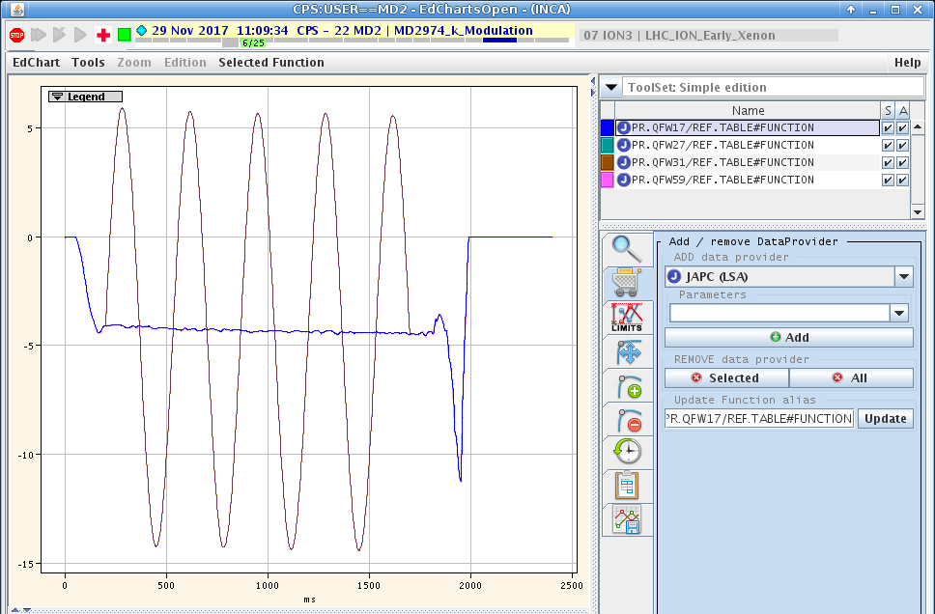
Quadrupole excitation
cycle with long injection flat bottom
tunes flattened
sine function added to individual quadrupoles

Slide 4
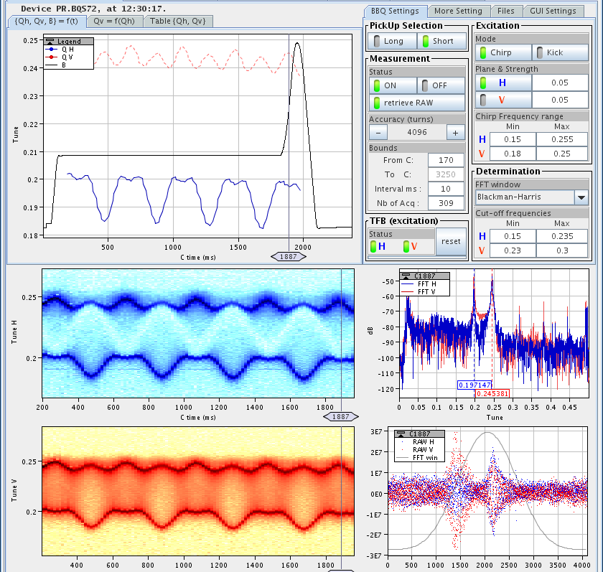
First try
expected sine tune variation
cropped sine due to strong coupling
skew quads used to decouple the planes
good sensitivity for decoupling

Slide 5
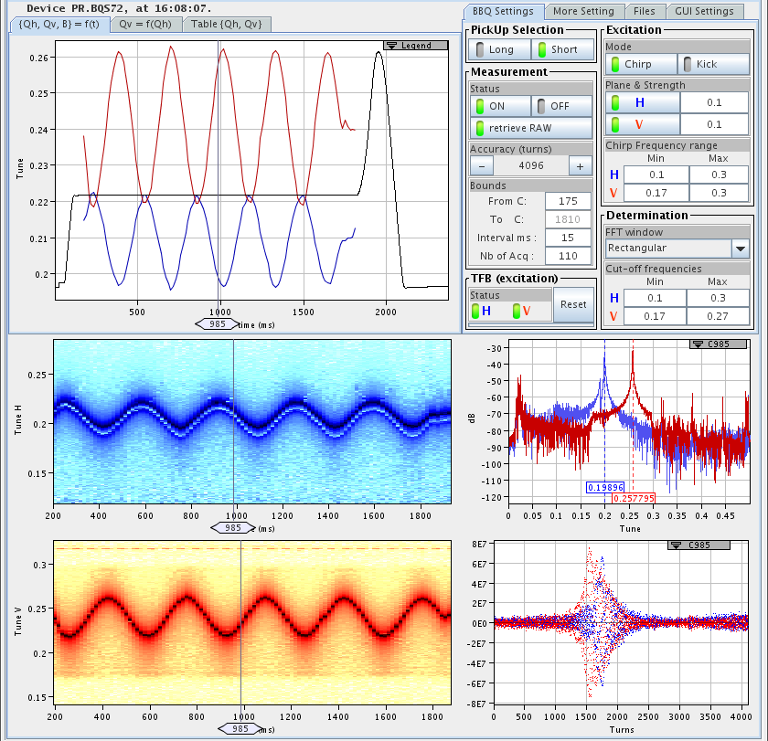
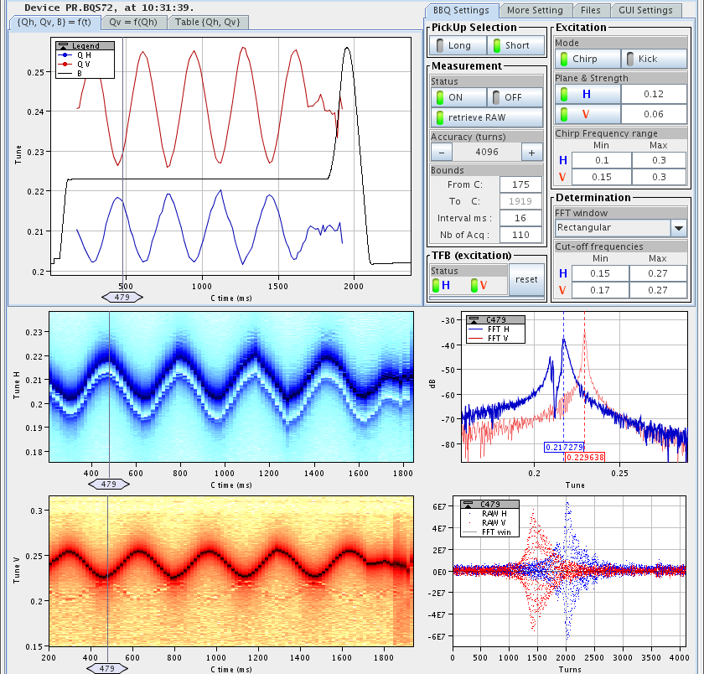
Uncoupled!
PR.QSKODD/EVEN 0.40 / -0.38 A
sinusoidal tune variation
excitation amplitude reduced
2 campaigns: QFN/QDN, QFW/QDW
Tunes H 6.21 / V 6.24

Slide 6
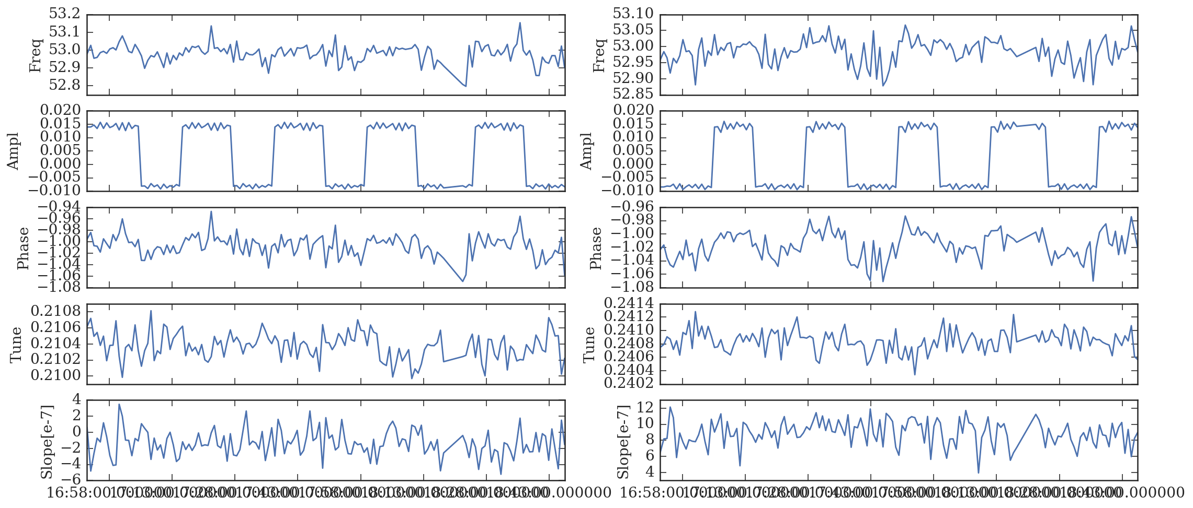
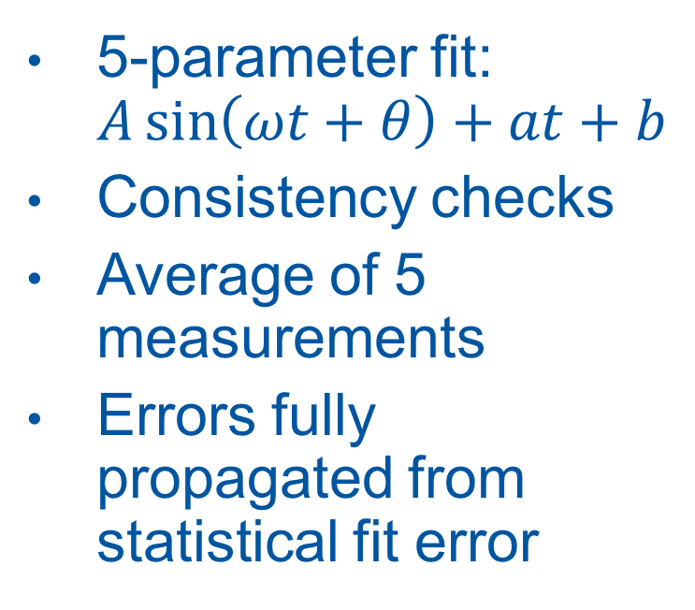
Analysis
Horizontal fit results
5-parameter fit:
$A\sin\left(ωt+θ\right)+at+b$
Consistency checks
Average of 5 measurements
Errors fully propagated from statistical fit error
QF
QD

Slide 7
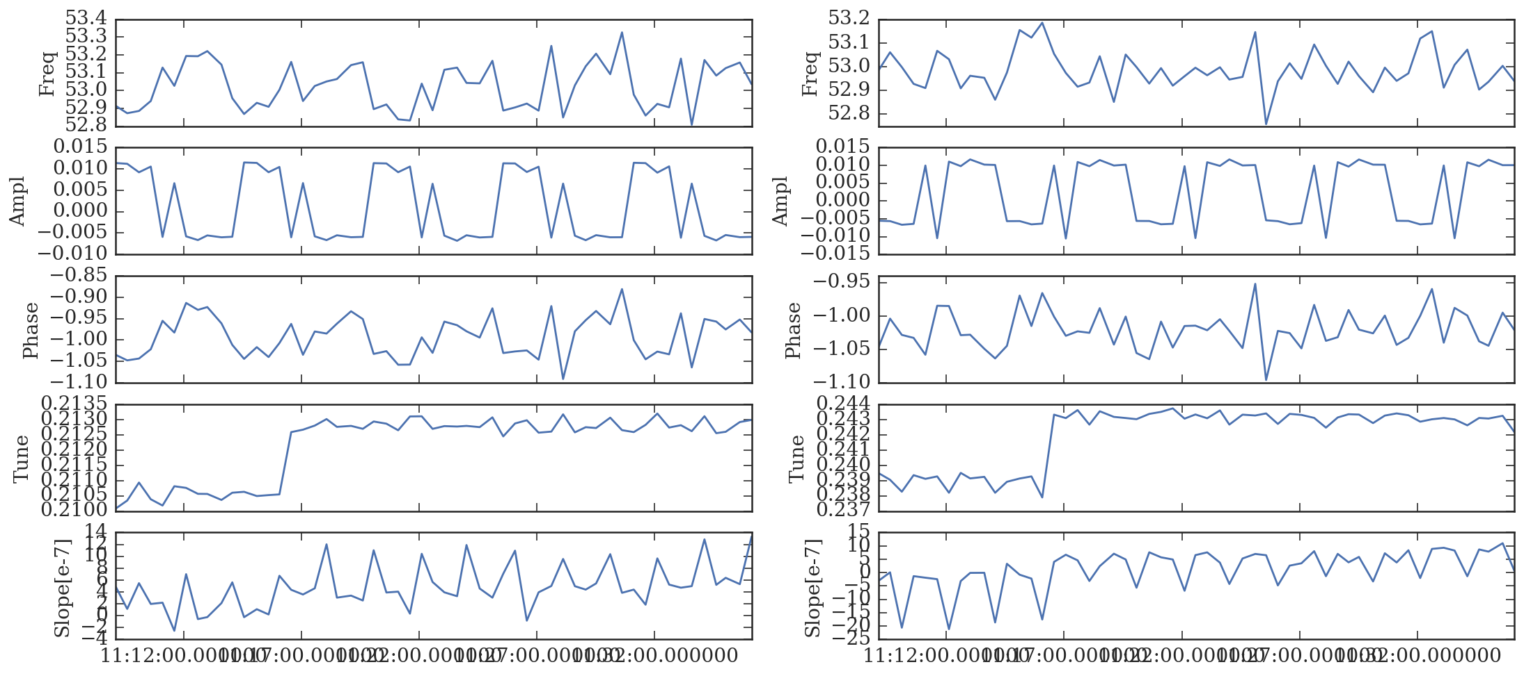
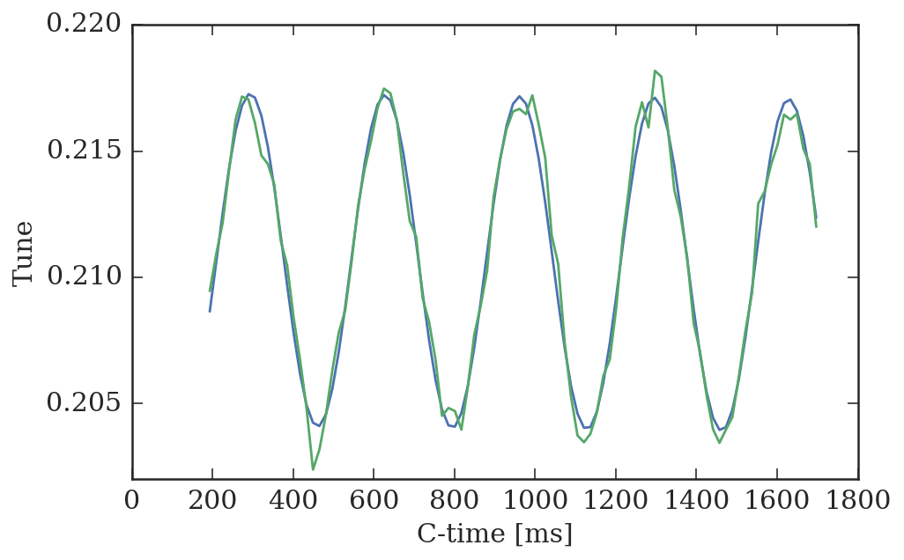
PR.QDW18 polarity
Fit amplitude
Amplitude of QDW18 inverted in both planes
=> inverted polarity!!!
17/4/17 Polarity check marked OK
Converter side OK
No intervention since 6/4/17
H
V
H

Slide 8
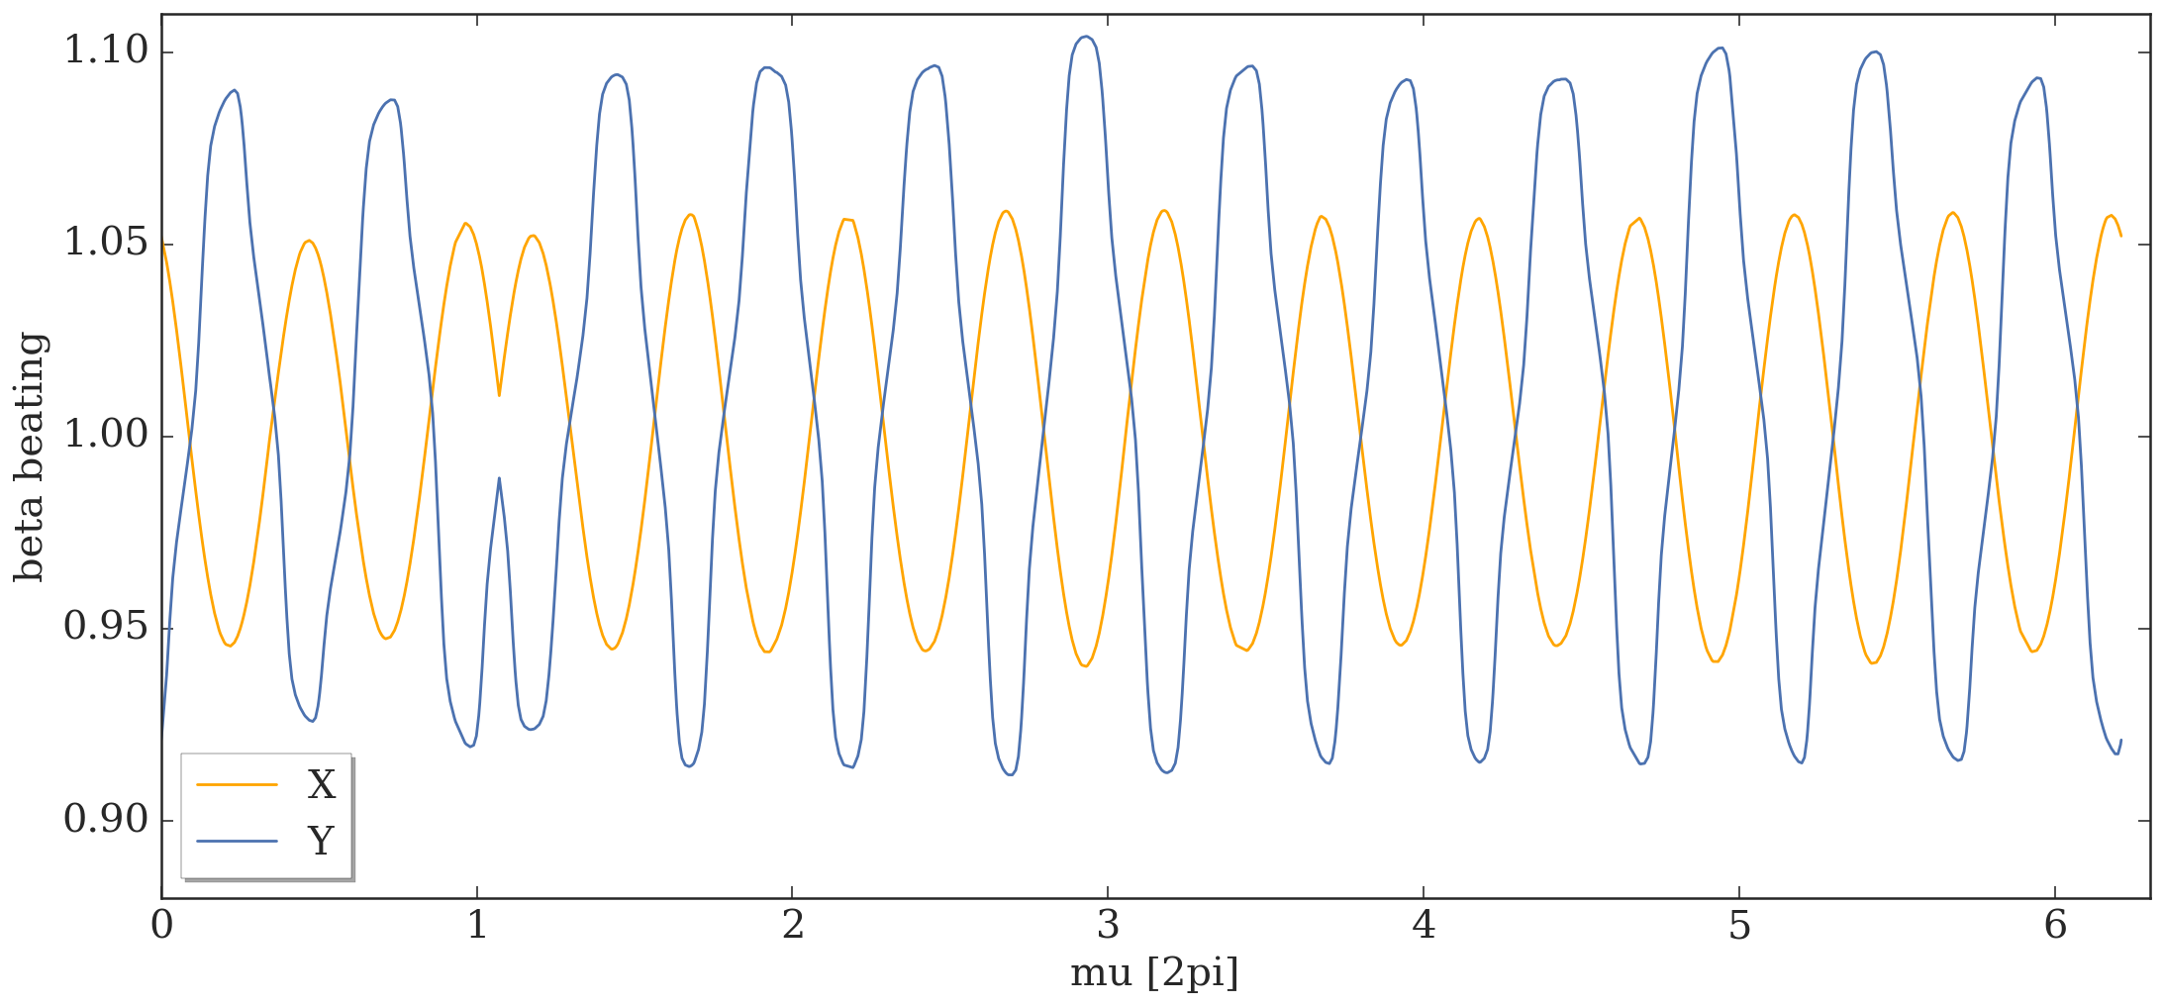
Beta-beating expected from QDW18 (vs. 6.21/6.24 nom.)
MAD optics 6.21/6.24 with LE quads vs.
optics with QDW18 inverted matched to the same tunes

Slide 9
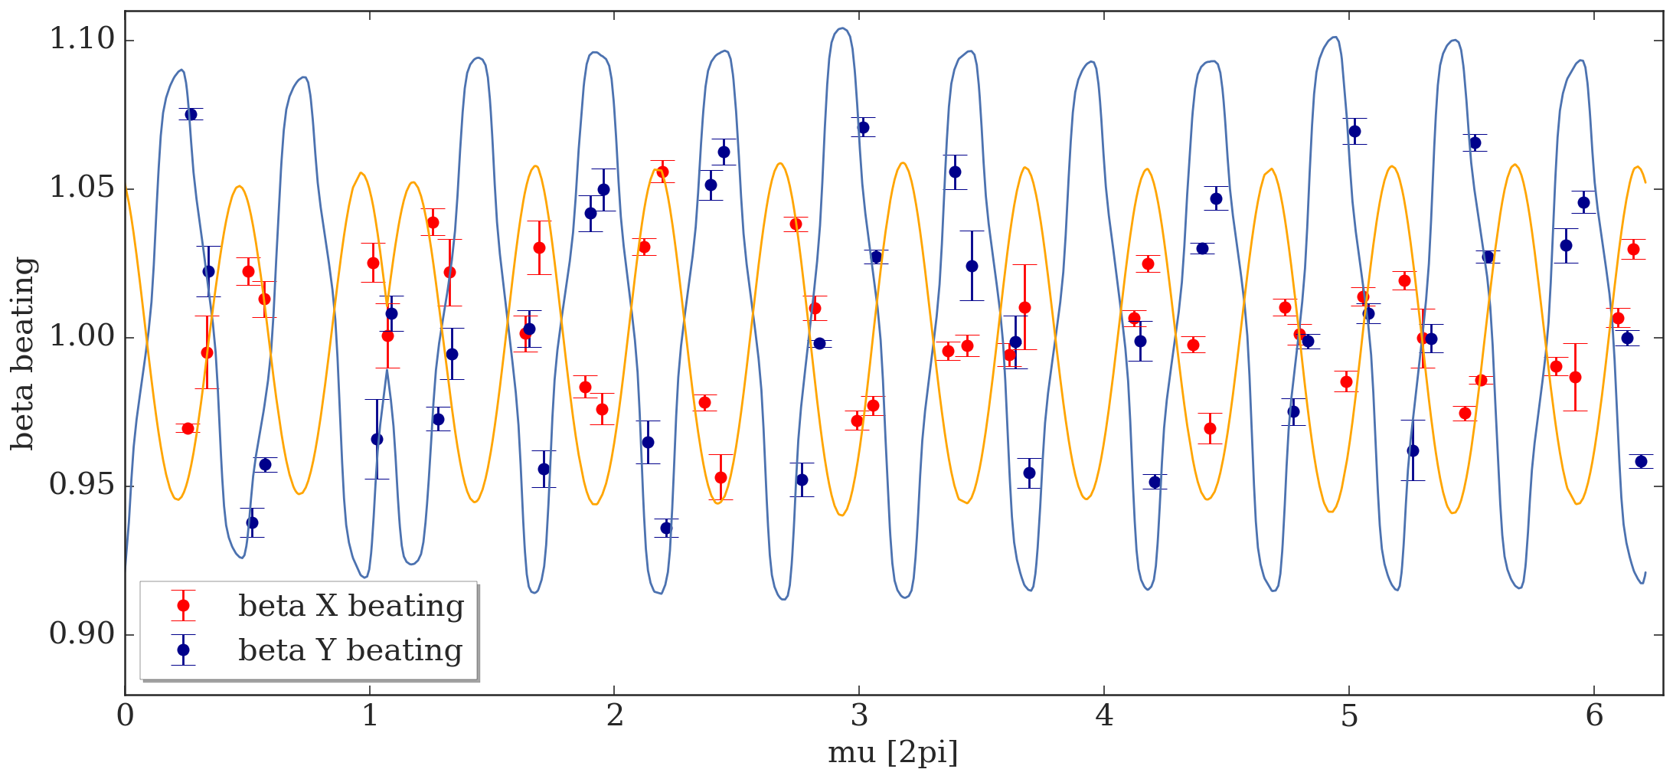
Beta-beating measured (vs. 6.21/6.24 nom.)

Slide 10
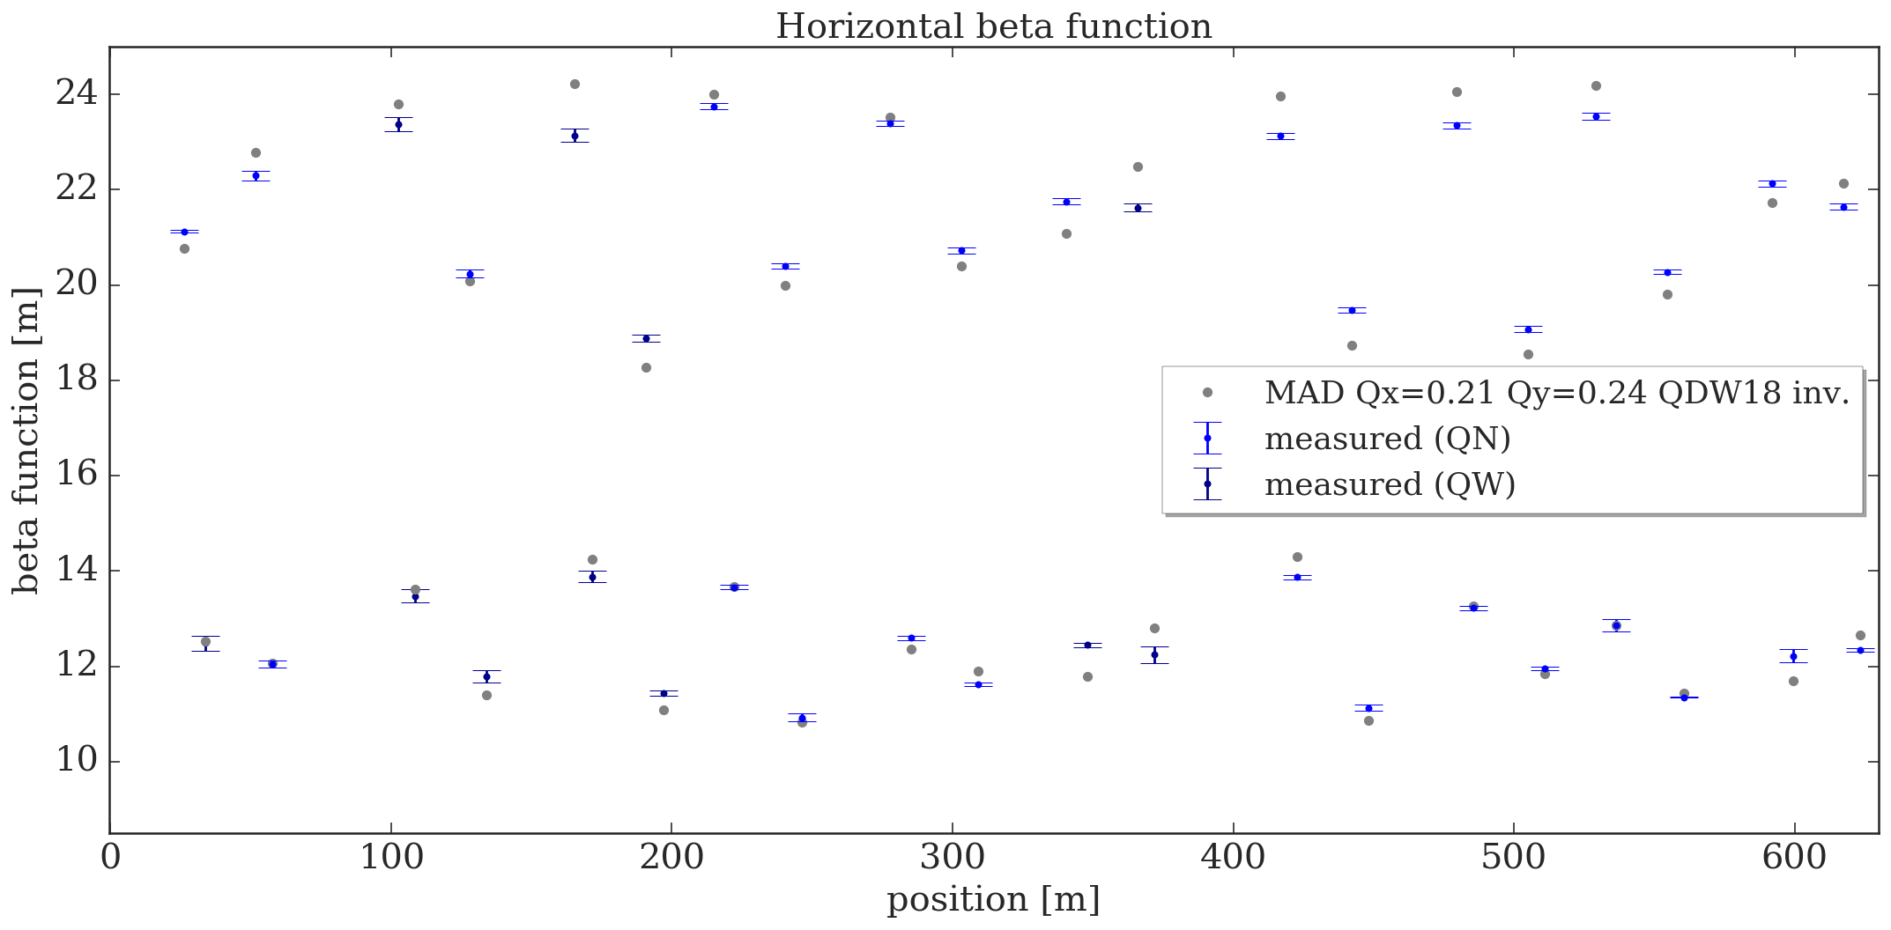
Beta-beating measured (vs 6.21/6.24 inv.)
Now comparing to the MAD optics with QDW18 inverted

Slide 11
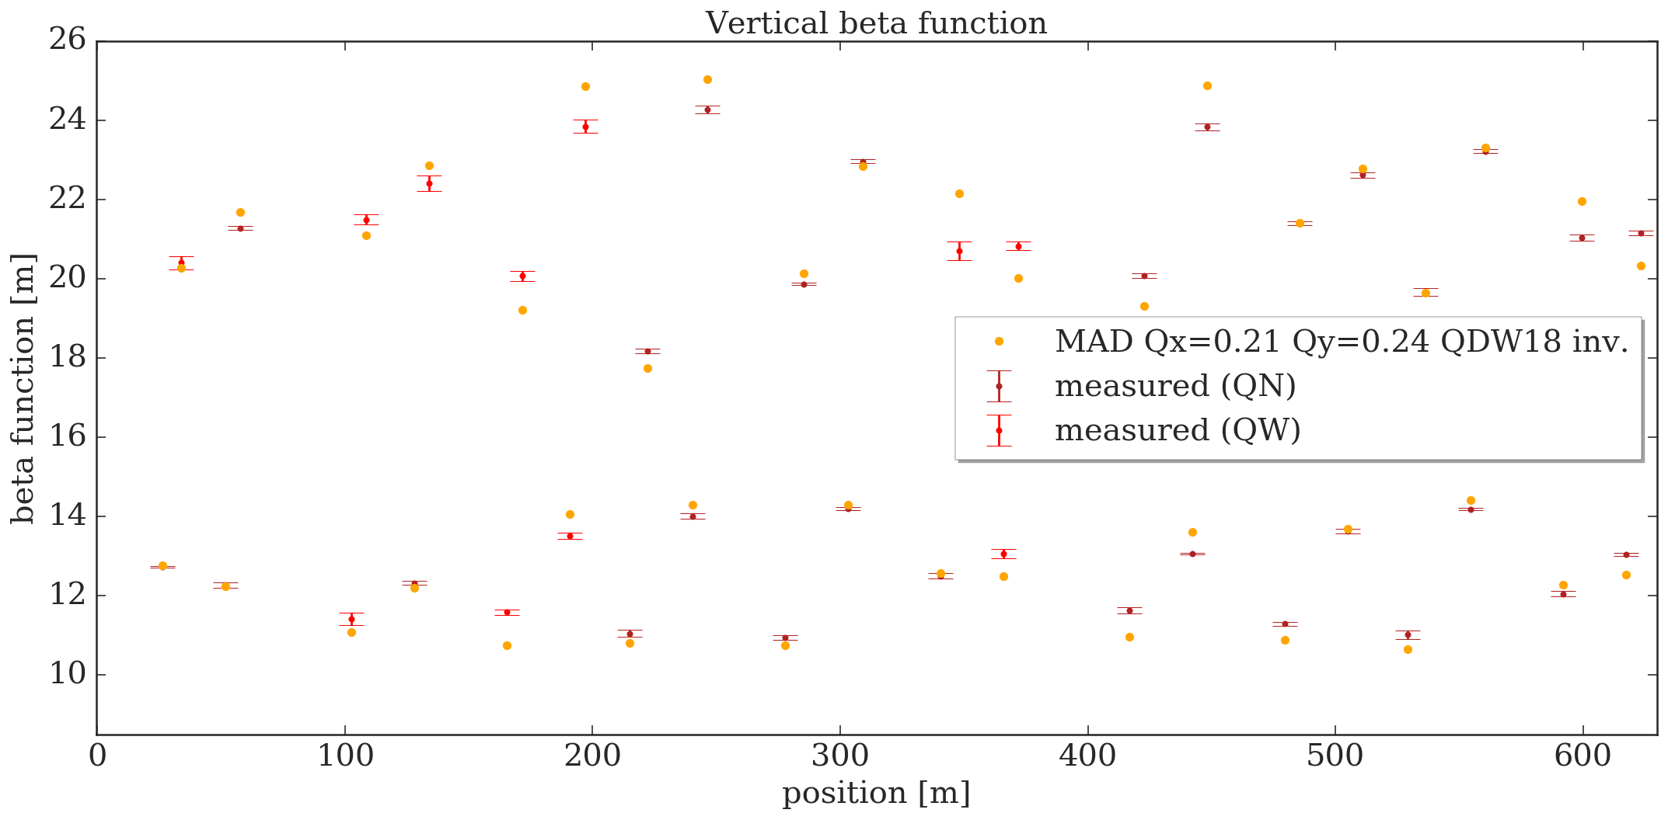
Beta-beating measured (vs 6.21/6.24 inv.)

Slide 12
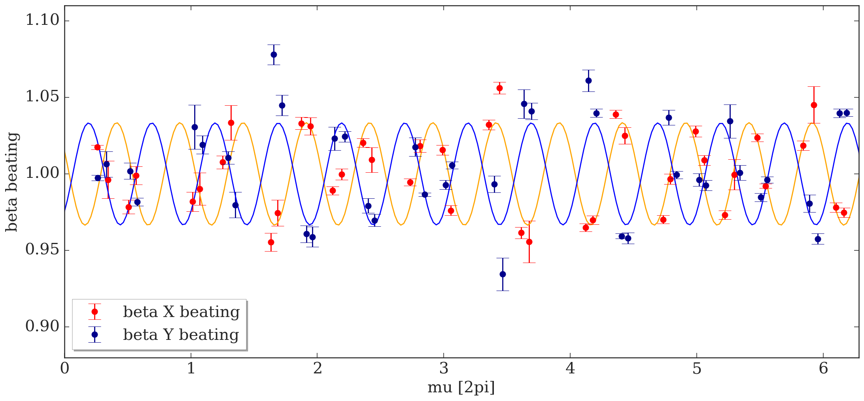
Beta-beating measured (vs 6.21/6.24 inv.)
meanX=1.00089 meanY=1.0040
=> systematic errors < 1%
Fit amplitude X and Y: 0.033

Slide 13
Conclusion
k-modulation successfully applied at the PS to measure the beta-function model-independent
Polarity inversion of PR.QDW18 found
Measured beating very close to expected one
Residual beating of ~3% in both planes
seems to have distributed source
Comparison with Panos’ phase-advance method ongoing
Measurement at 6.19/6.24 to be analyzed
Interesting to measure bare machine and again with corrected polarity

Slide 14
Spares

Slide 15
Fit results QN

Slide 16
Fit results QW

