Slide 1
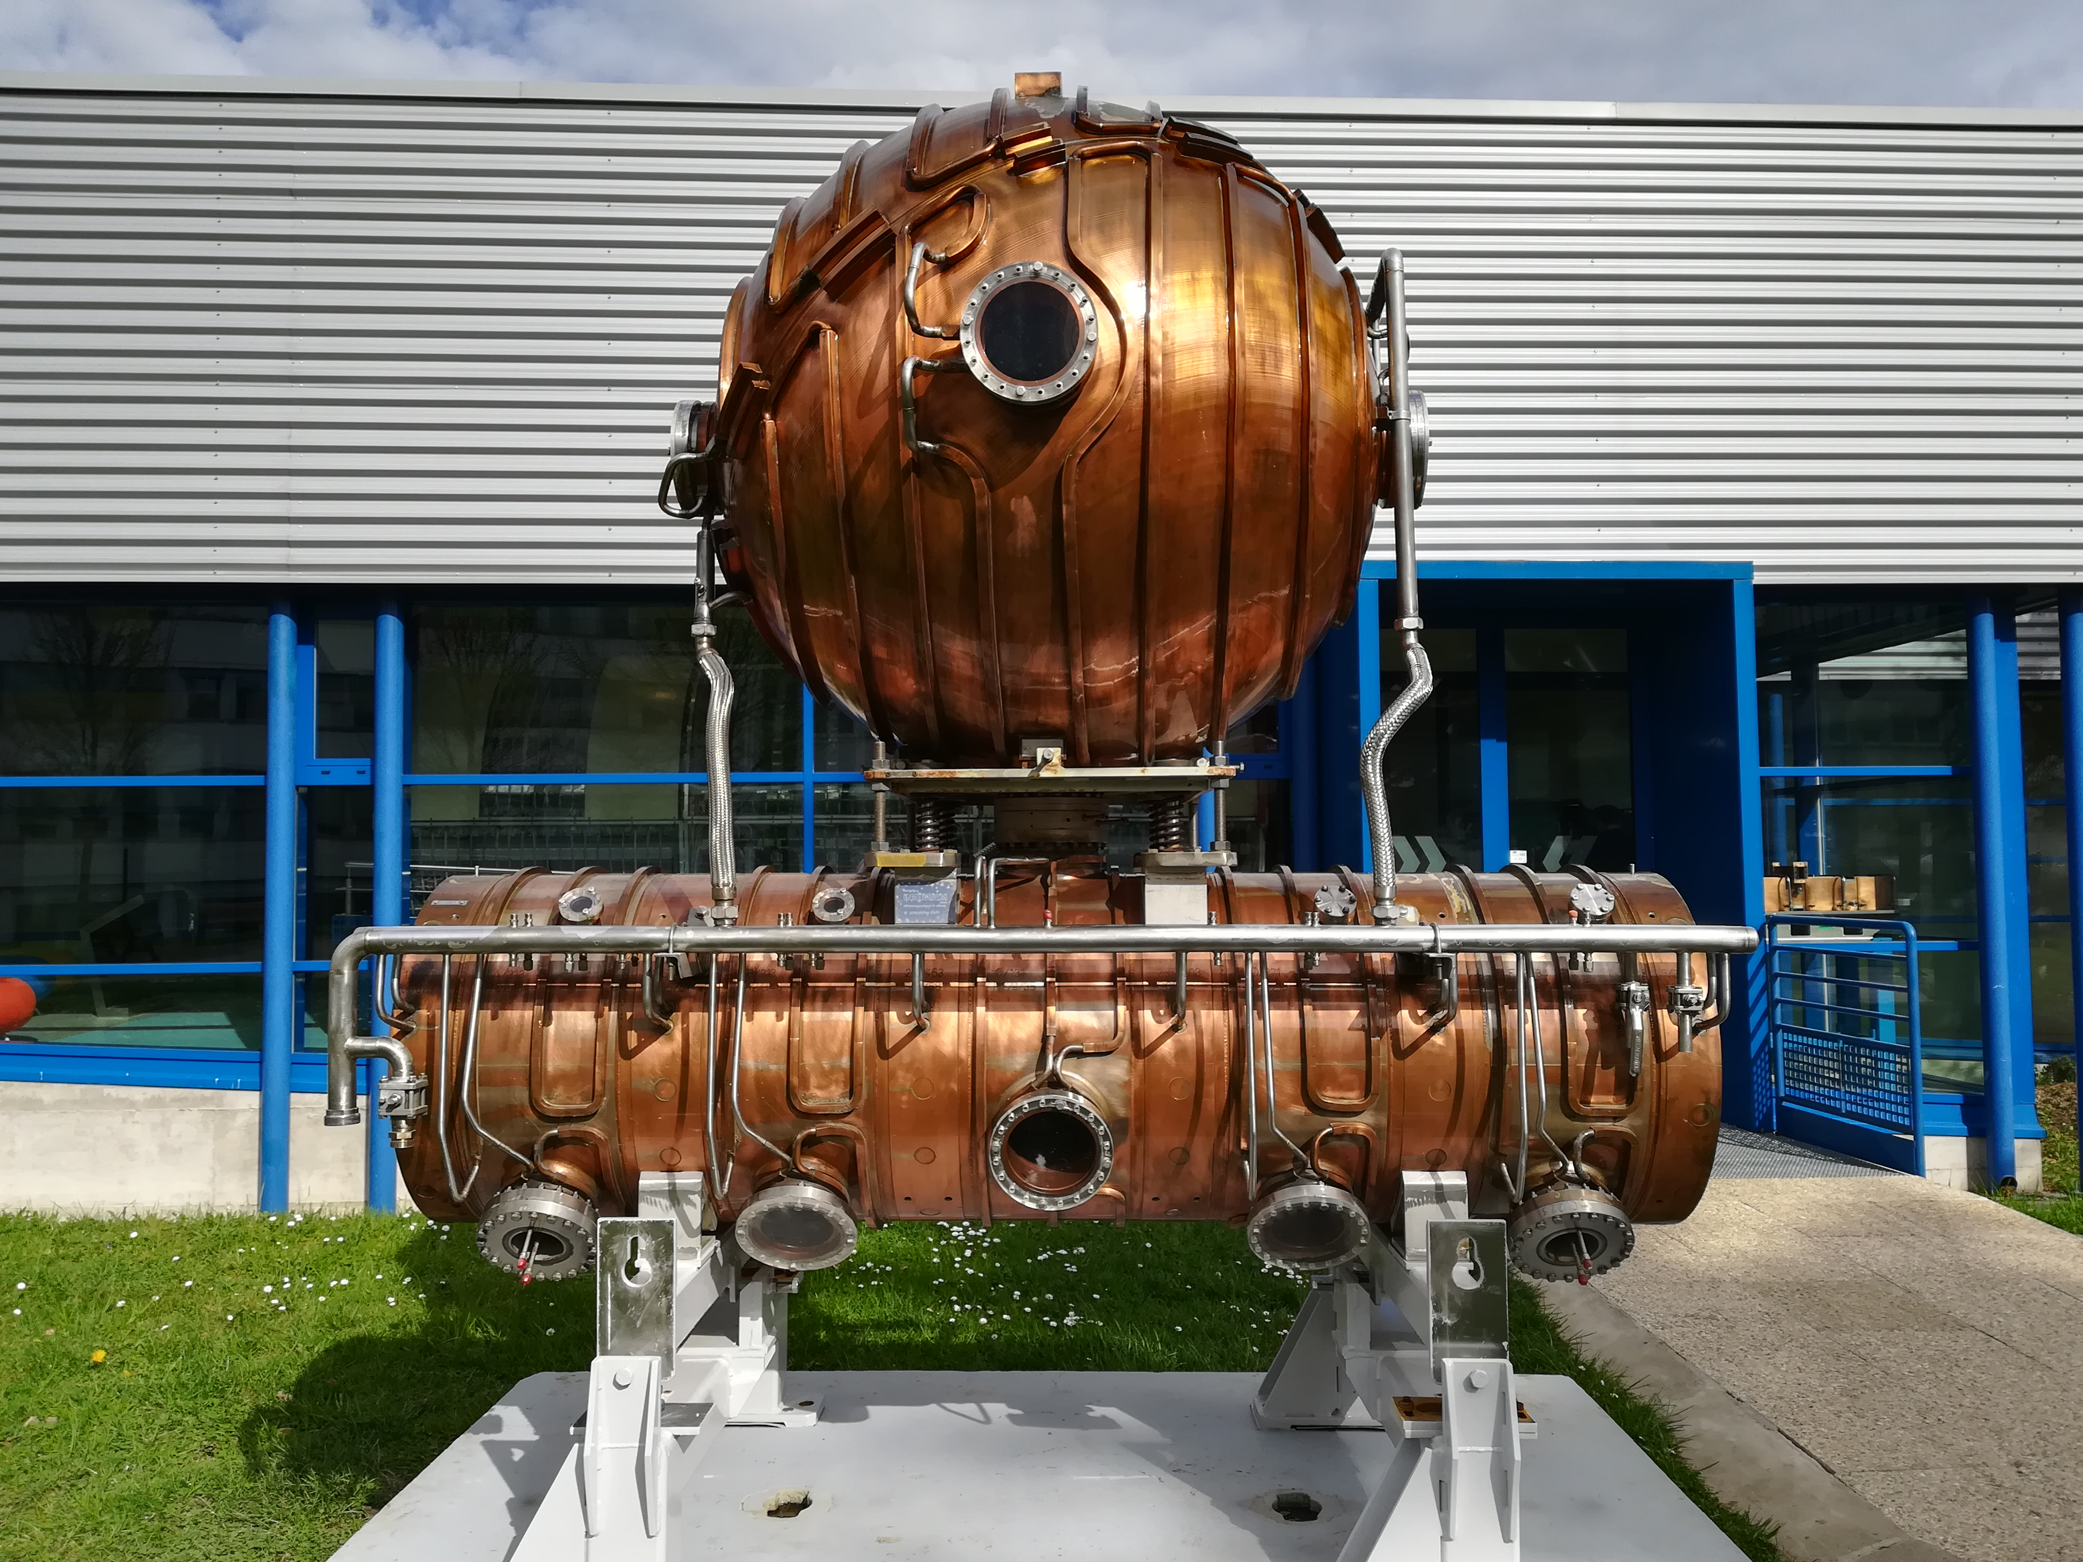
RF Simulations
Wiebke Liebscher and Salome Schwark
Supervisor: Hermann Pommerenke
Source: Microcosm (CERN)
Notes:
Topic: Radiofrequency Simulations → Cavities
Fast changing electrical field to accelerate particles
Background: Old Cavity

Slide 2
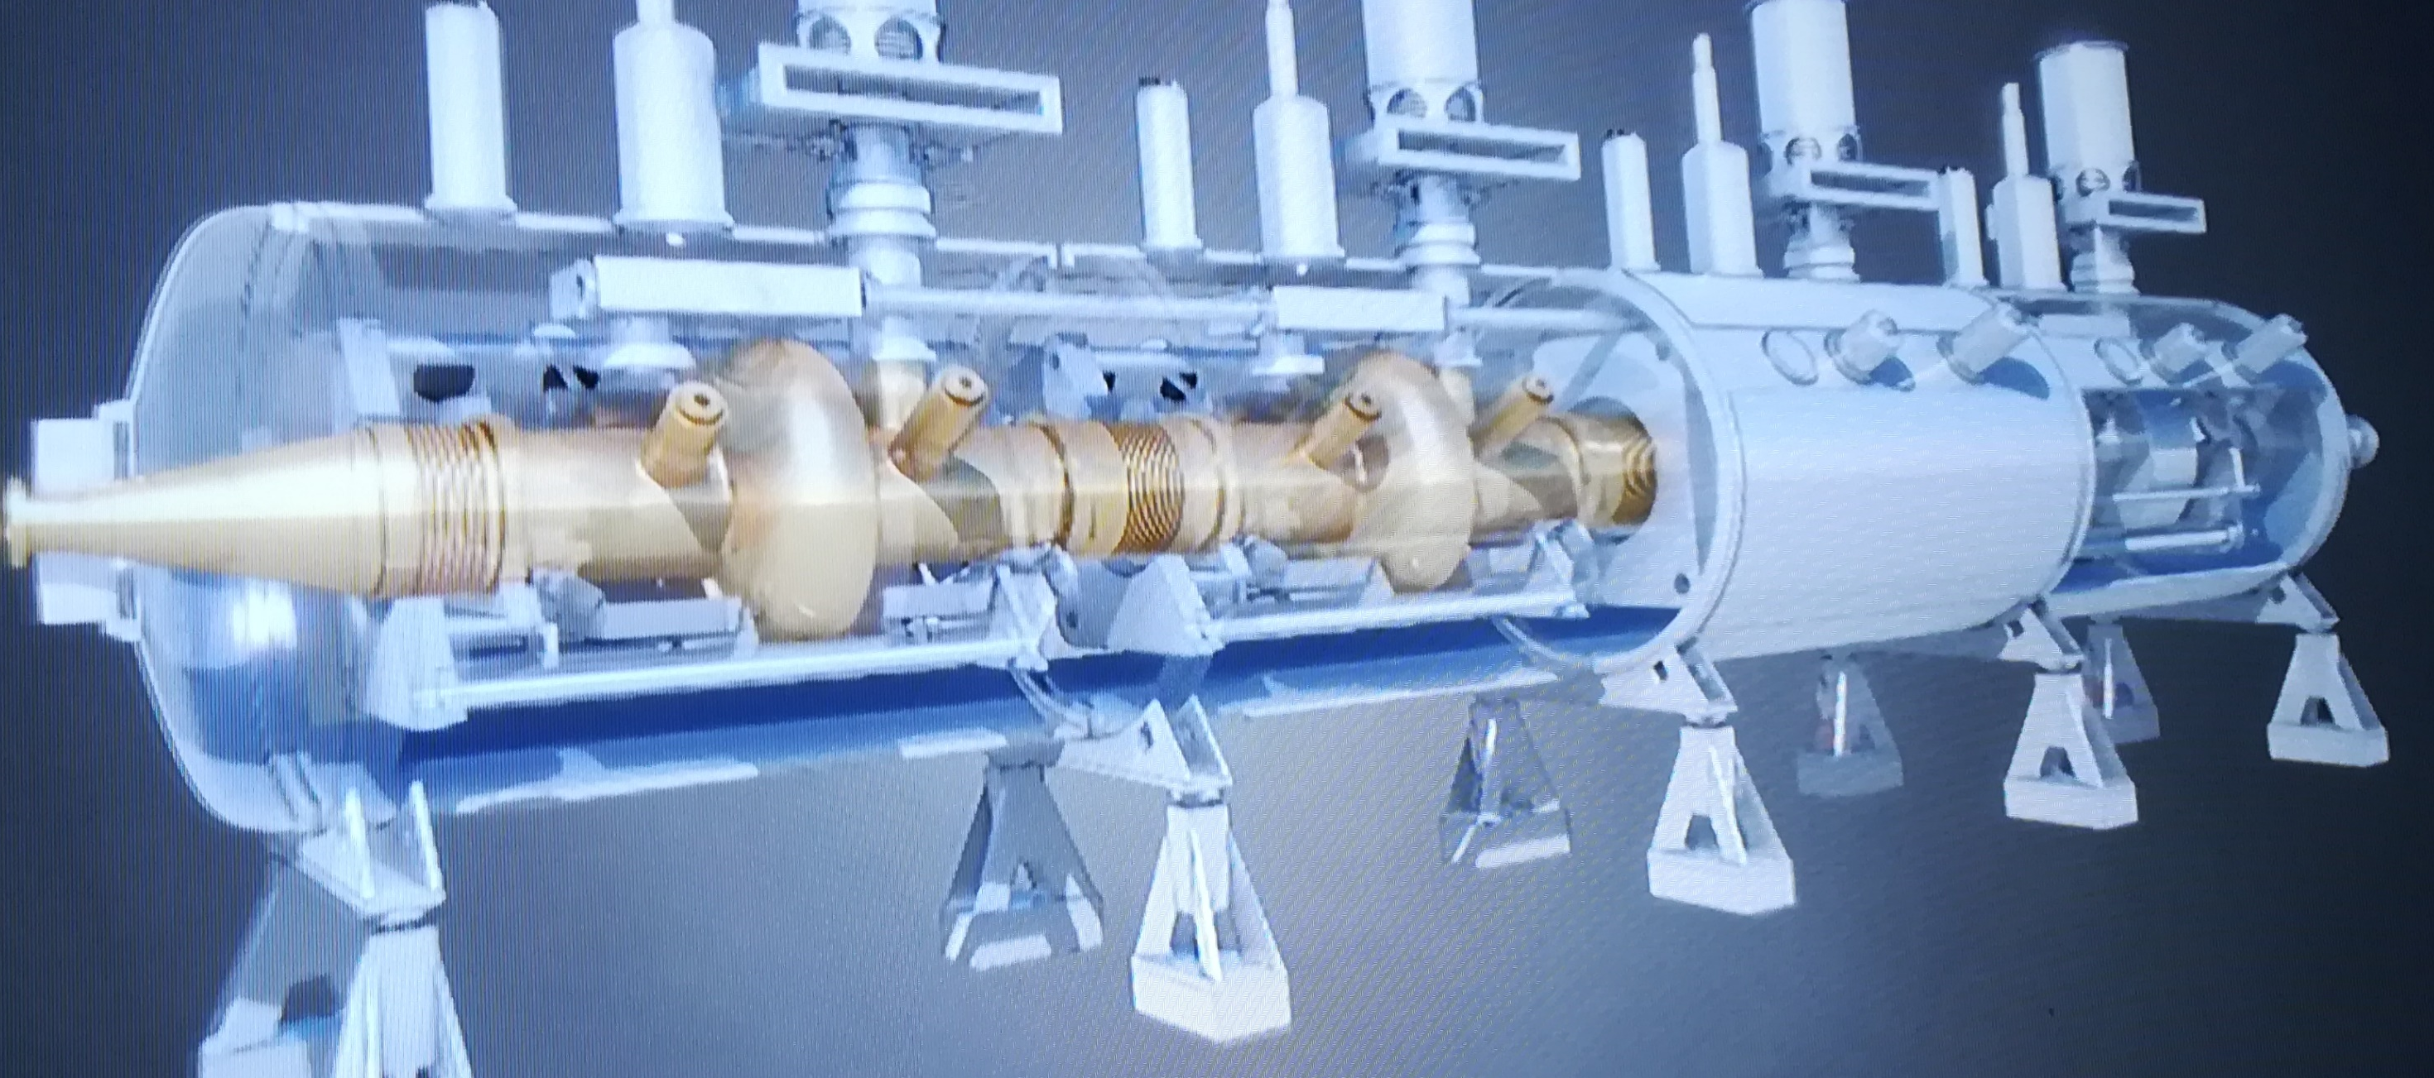
LHC Accelerating Cavities
Source: Microcosm (CERN)
Notes:
This is how it looks like in reality

Slide 3
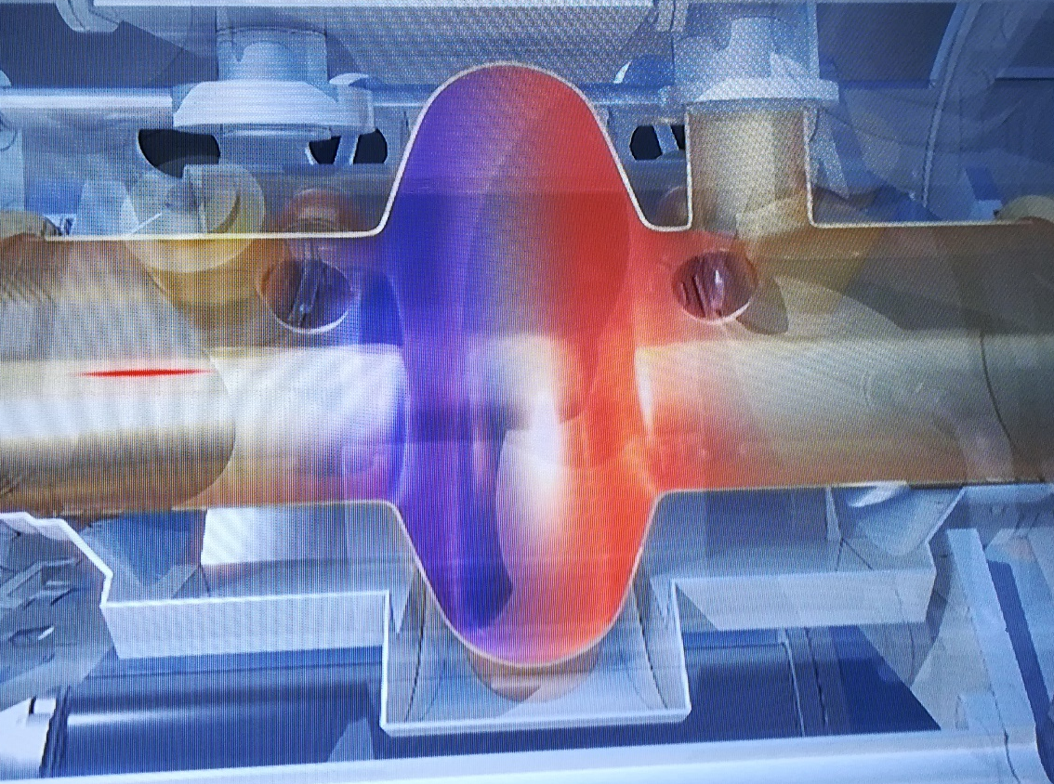
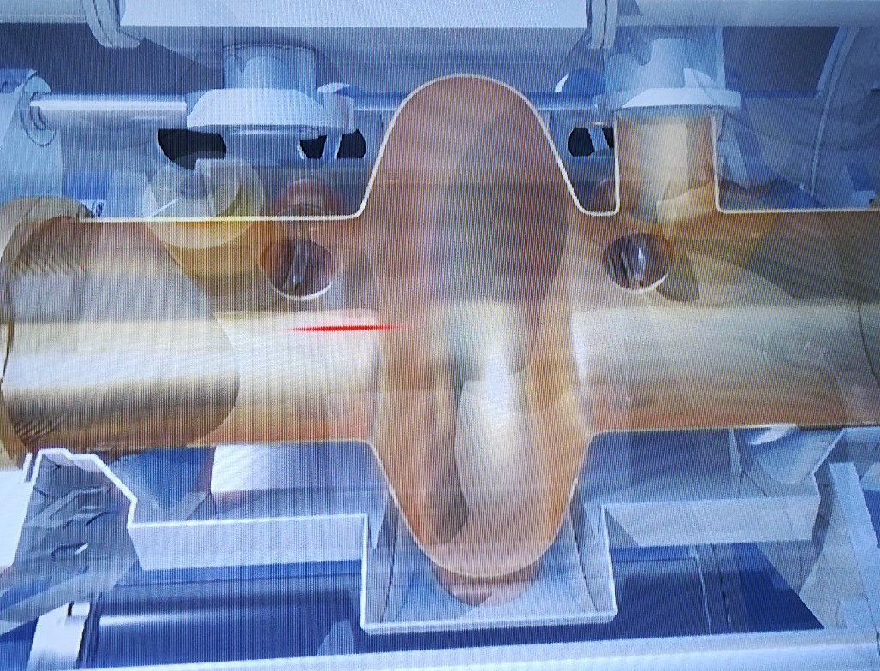
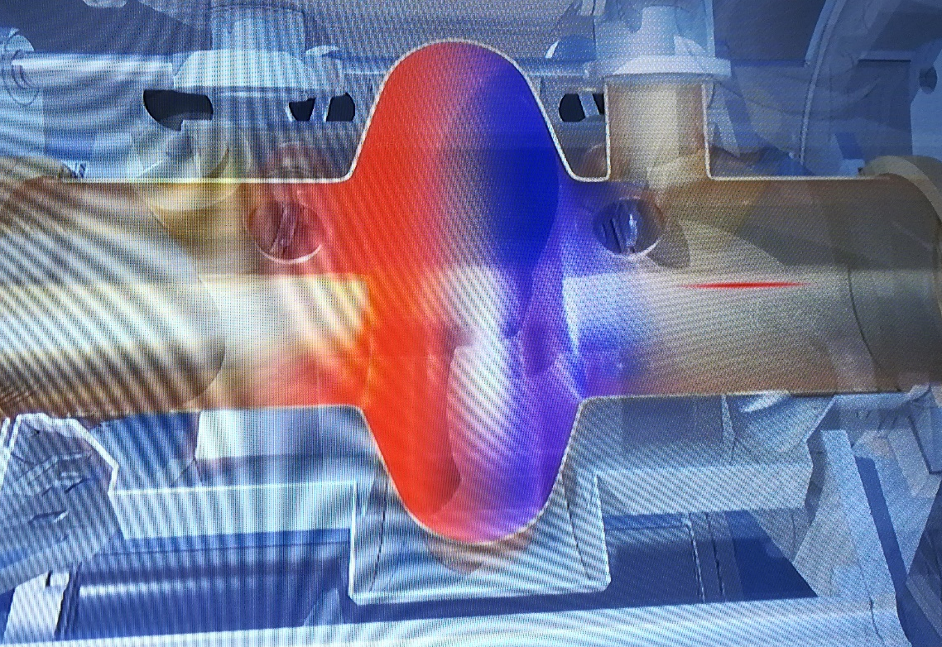
Source: Microcosm (CERN)
Notes:
How it works (alternating field)

Slide 4
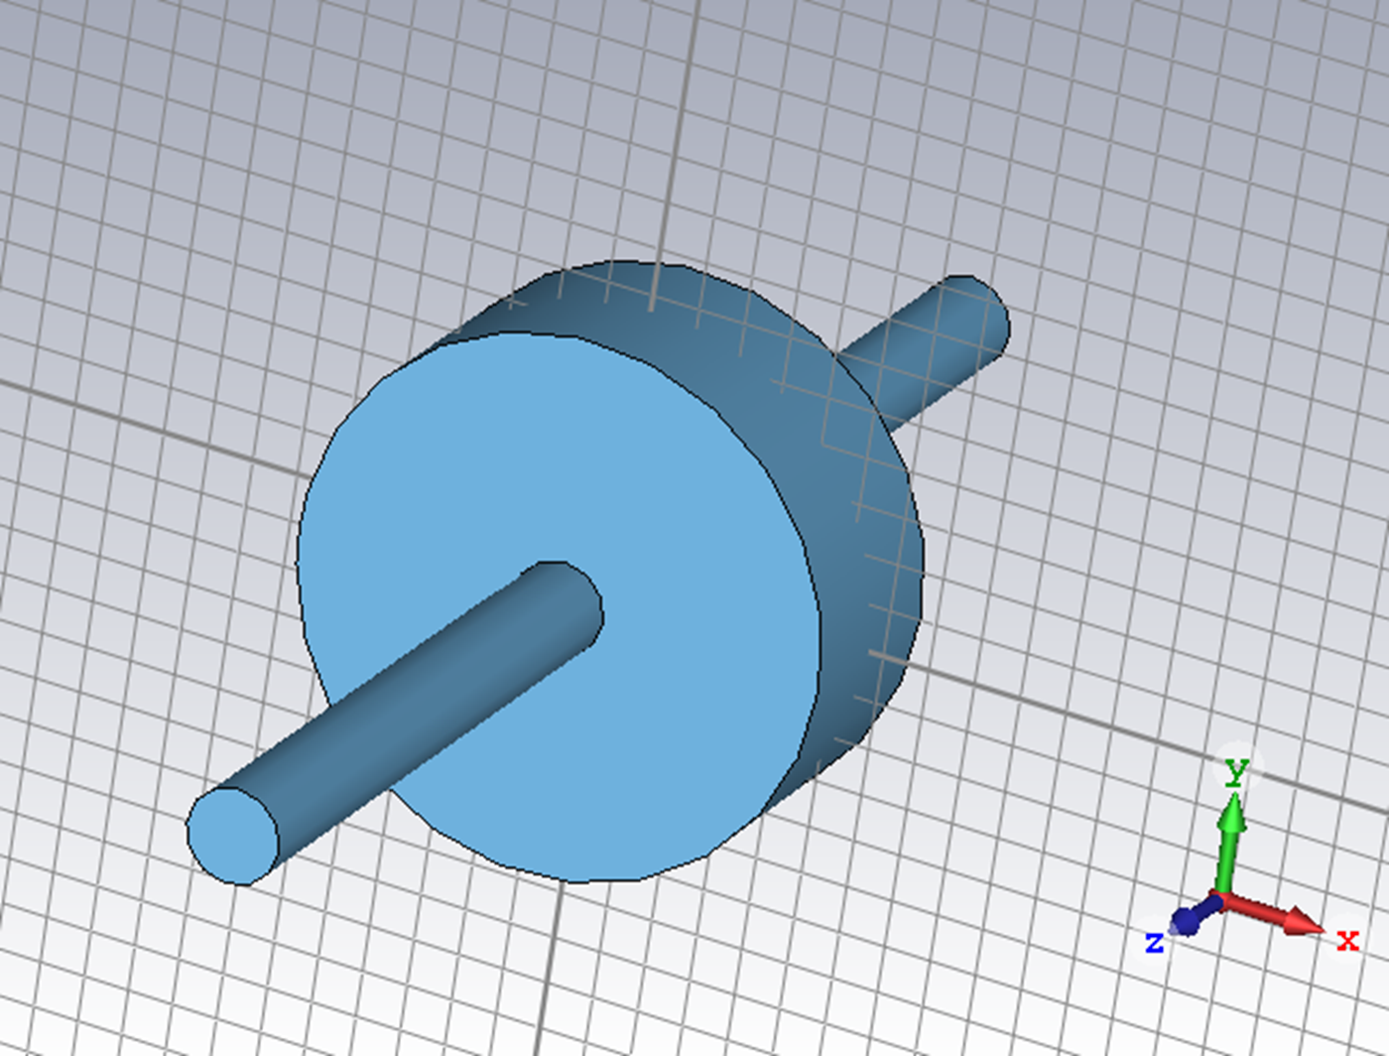
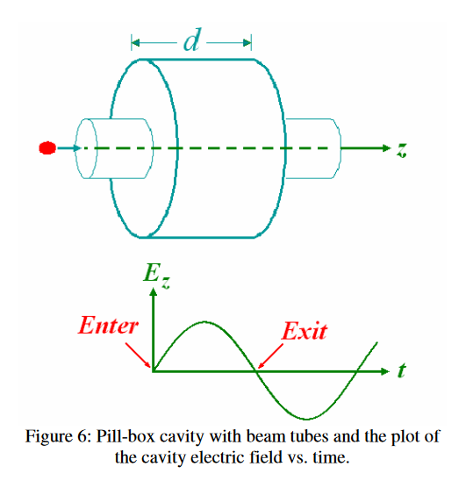
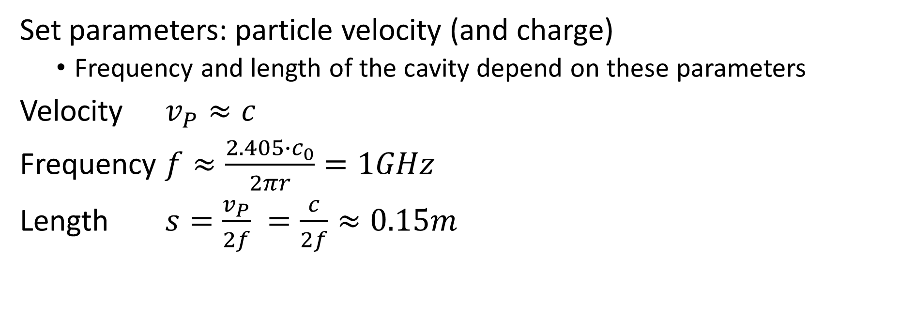
Pill Box Cavity
Set parameters: particle velocity (and charge)
  Frequency and length of the cavity depend on these parameters
Velocity $v_{P}≈c$
Frequency $f≈\frac{2.405∙c_{0}}{2πr}=1GHz$
Length $s=\frac{v_{P}}{2f} =\frac{c}{2f}≈0.15m$
https://www.classe.cornell.edu/public/SRF/2006/SRF060424-03/SRF060424-03.pdf; p.3
Notes:
R = Shunt impedance = U0^2 / Ps (Verlorene Leistung ueber der Oberflaeche)
Shunt impedanz = Oberflaechenverluste als Widerstand in einem Schwingkreis

Slide 5

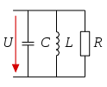
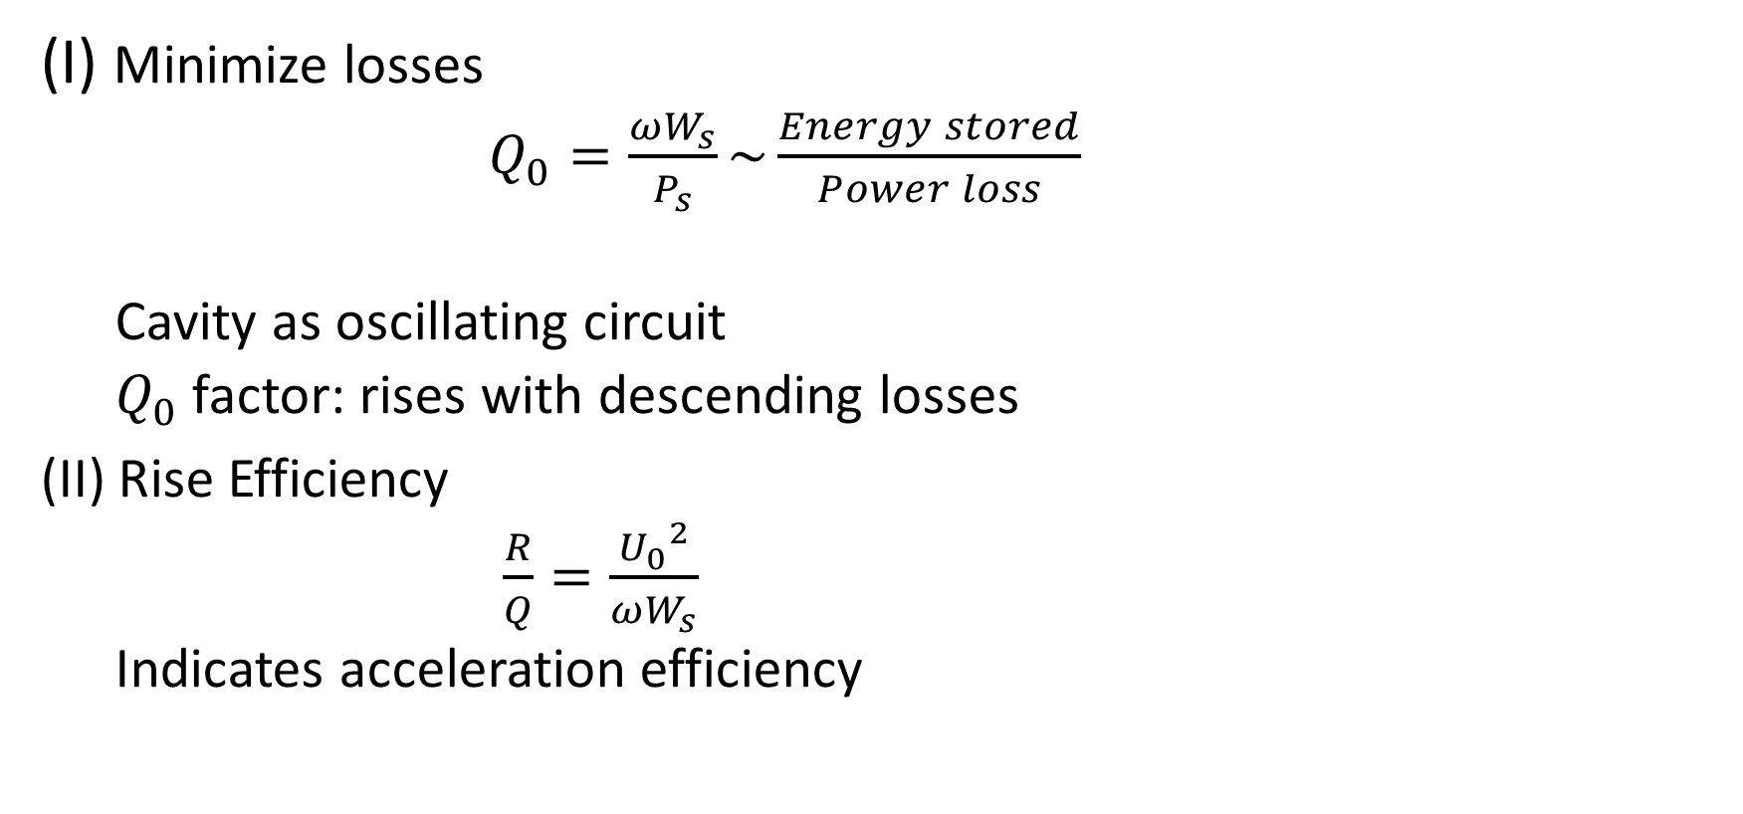
Further Optimization
(I) Minimize losses
  $Q_{0}=\frac{ωW_{s}}{P_{s}}\sim \frac{Energy stored}{Power loss}$
  Cavity as oscillating circuit
  $Q_{0}$factor: rises with descending losses
(II) Rise Efficiency
  $\frac{R}{Q}=\frac{{U_{0}}^{2}}{ωW_{s}}$
  Indicates acceleration efficiency
https://de.wikipedia.org/wiki/Schwingkreis#/media/File:Schwingkreis.svg
https://de.wikipedia.org/wiki/Parallelresonanz#/media/File:KondiSpuleWiderstandParallel.svg

Slide 6
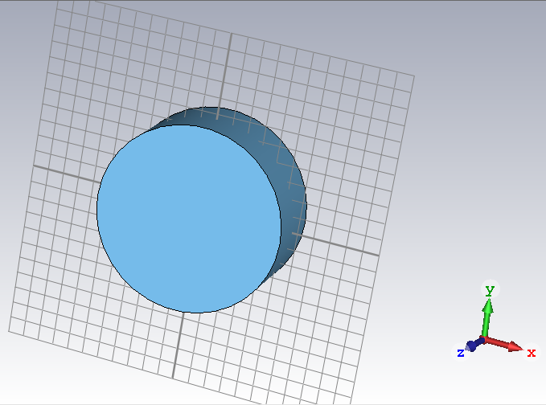
Notes:
First modelling approach: The pill box (Keksdose ☺)

Slide 7
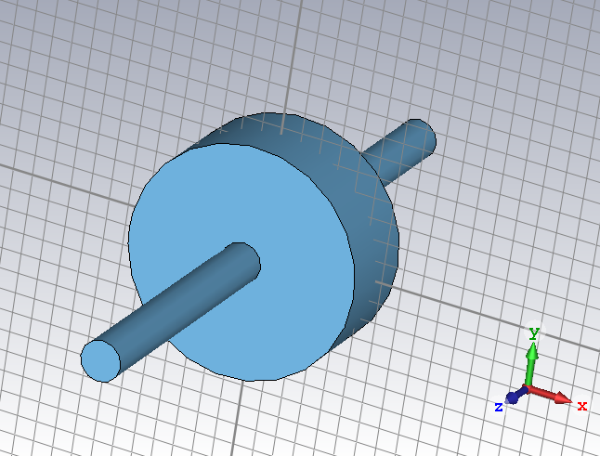
Notes:
Add a beam pipe

Slide 8
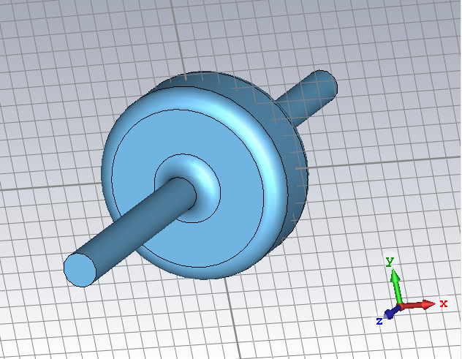
Notes:
Blend edges: At edges: Strong magnetic field → Strong surface currents → Huge losses

Slide 9
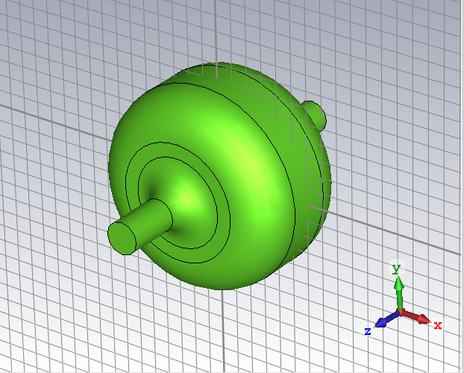
Notes:
Optimized ☺ (Losses, Frequency)

Slide 10
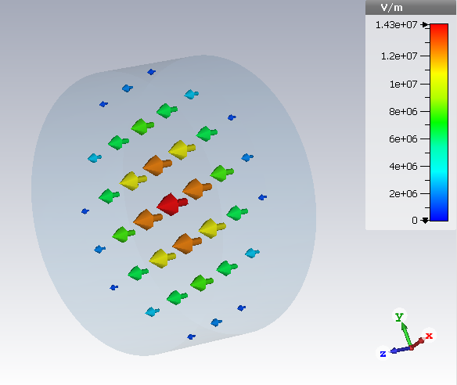
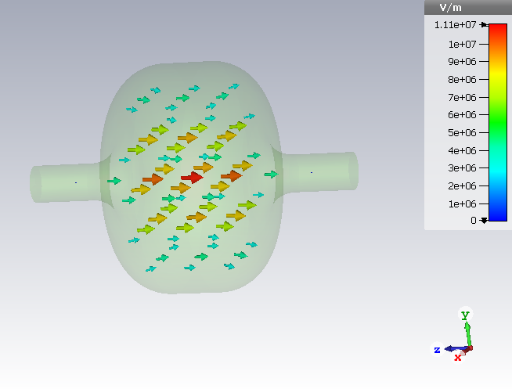
E-Field
Notes:
In the middle: Strongest field (for acceleration)

Slide 11
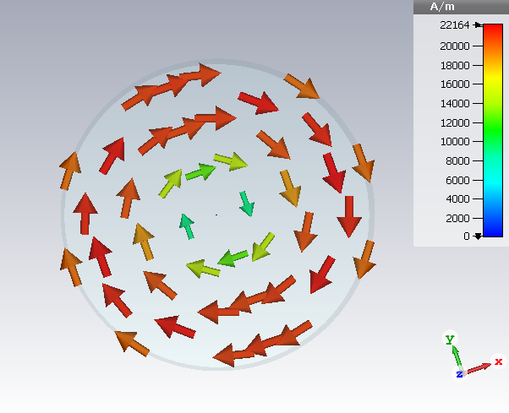
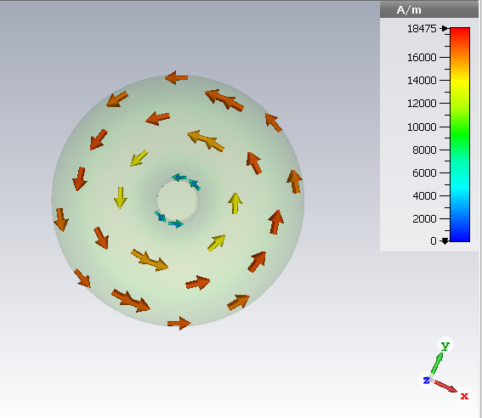
H-Field
Notes:
An electrical field always causes a corresponding magnetic field ☹ Even though we do not need it

Slide 12
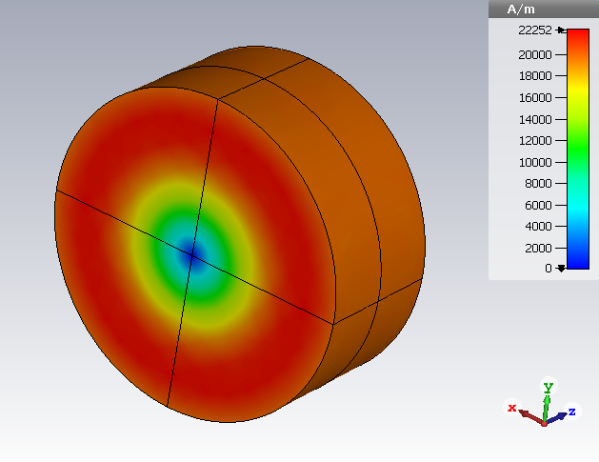
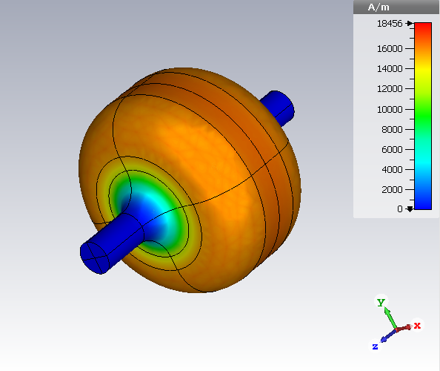
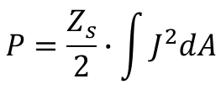

Surface Currents
$$P=\frac{Z_{s}}{2}∙\int{J^{2}dA}$$
$$J=n x H$$
Notes:
A magnetic field causes surface currents. As the material is not superconductive there is a resistance (Loss of Energy)
→They heat the cavity

Slide 13
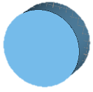
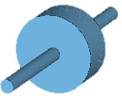
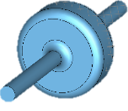
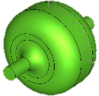
Notes:
Q₀: 1/Losses through surface currents; the bigger the better (Q0, a universal figure of merit characterizing the ratio of the energy stored in the cavity to the energy lost in one RF period)
1-4: Different steps of the optimization process (that we showed before)
As you can see: It gets better ☺ The blended edges minimize the surface currents and therefore the losses

Slide 14
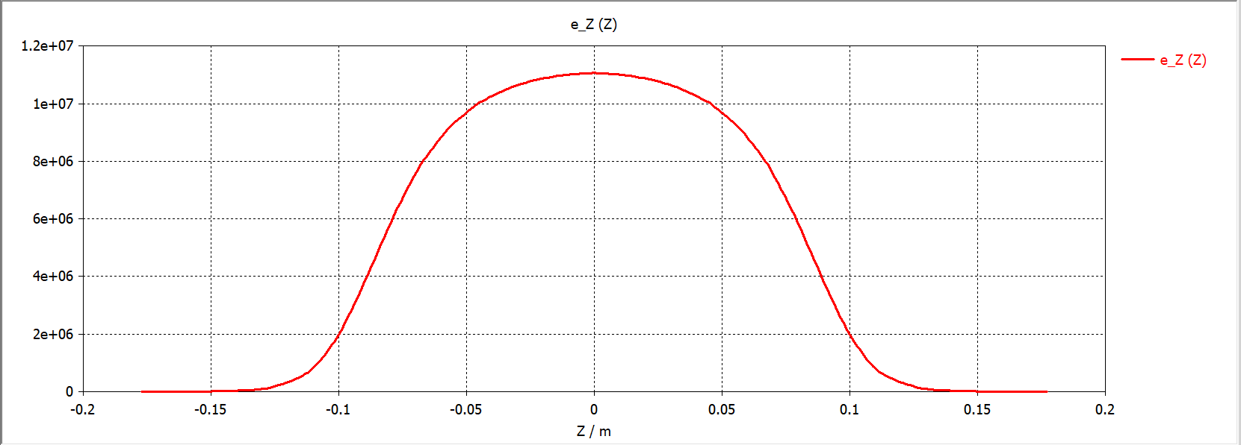
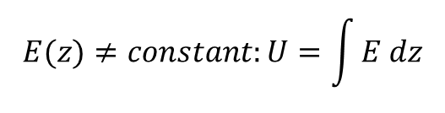

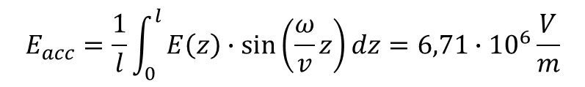
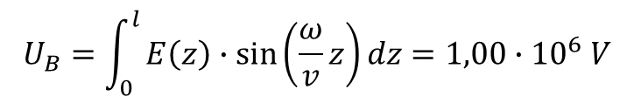

Acceleration of a Particle
$$v=β∙c_{0}$$
$$E(z)≠constant:U=\int{E dz}$$
$$U_{B}=\int_{0}^{l}{E\left(z\right)∙\sin\left(\frac{ω}{v}z\right)dz}=1,00∙{10}^{6} V$$
$$U=E∙d$$
$$E\left(t\right)≠constant:E(z,t)=\sin\left(ωt\right)∙E_{max}(z)$$
$$E_{acc}=\frac{1}{l}\int_{0}^{l}{E\left(z\right)∙\sin\left(\frac{ω}{v}z\right)dz}=6,71∙{10}^{6}\frac{V}{m}$$
Notes:
Electrical field in the cavity
X: Length (0 is the middle), Y the strength of the electrical field
U = E*d bzw bei E nich constant: U = integral of E d d, with Change of E during the Time: E(z) = sin(kz)* Emax(z)
The integral of the electrical field is equal to the

Slide 15
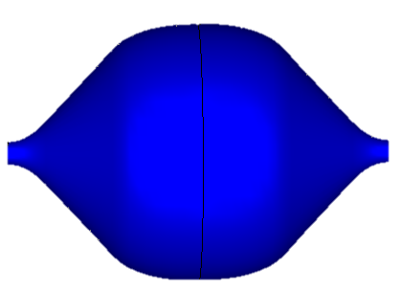
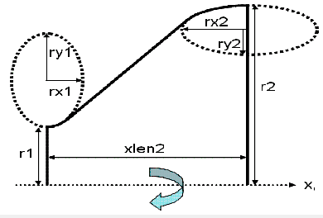
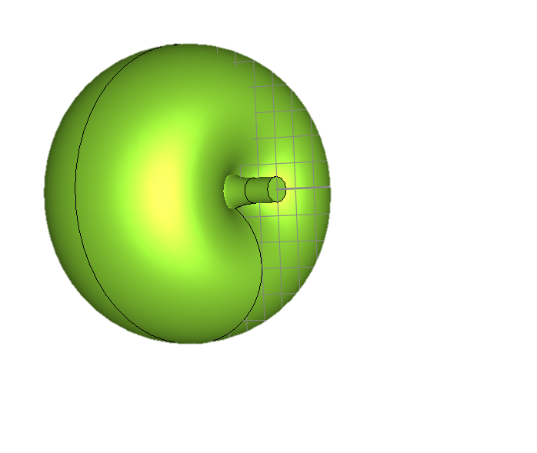
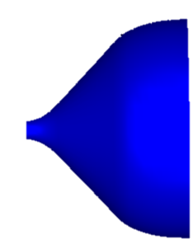
Elliptical Cavity

Slide 16
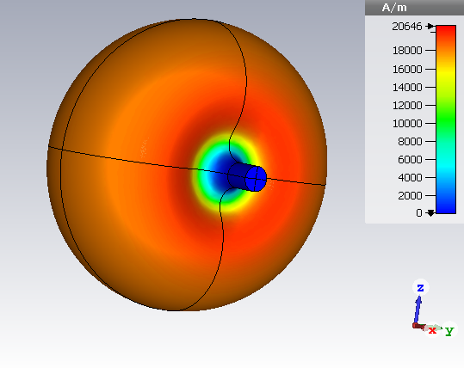
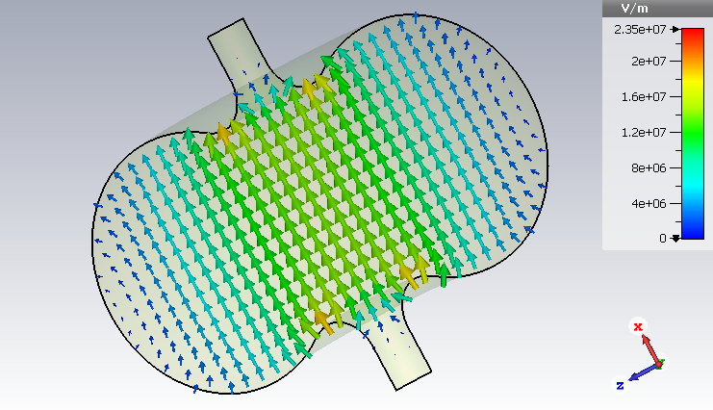
Surface currents
E Field

Slide 17

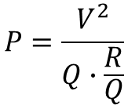


Comparison
 | Pill box cavity | Elliptical cavity
Voltage U [MV] | 1 | 1
Q₀ [1] | 37122 | 32309
R/Q [Ω] | 159 | 231
Surface emission [1] | 1.94 | 2.92
Magnetic quench [A/V] | 3.28 | 3.19
P [kW] | 169 | 134
$$\frac{E_{max}}{E_{acc}}$$
$$\frac{H_{max}}{E_{acc}}$$
$$P=\frac{V^{2}}{Q∙\frac{R}{Q}}$$
Notes:
Surface emission: Emax / Eacc → Emax am Rand (immer so) gegenueber dem Beschleunigungsfeld → moeglichst klein damit Feld moeglichst gross (Emax hat natuerliche Schranke)
Magnetic quench: Hmax / Eacc (Bei zu grossem Magnetfeld ist sie nicht mehr supraleitend → PUFF) Quenching: Aus Supraleitung rausfliegen → noch heisser → Snow ball effect

Slide 18
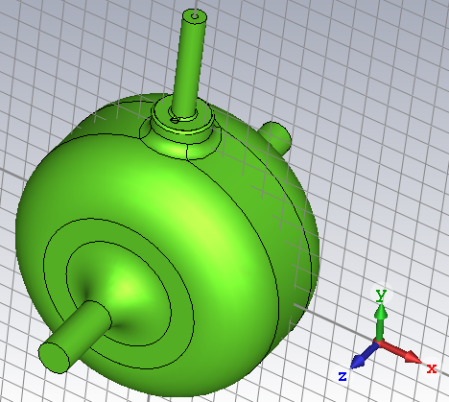
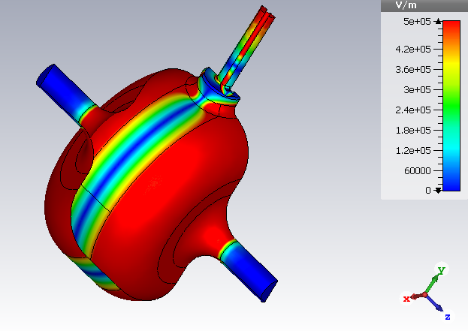
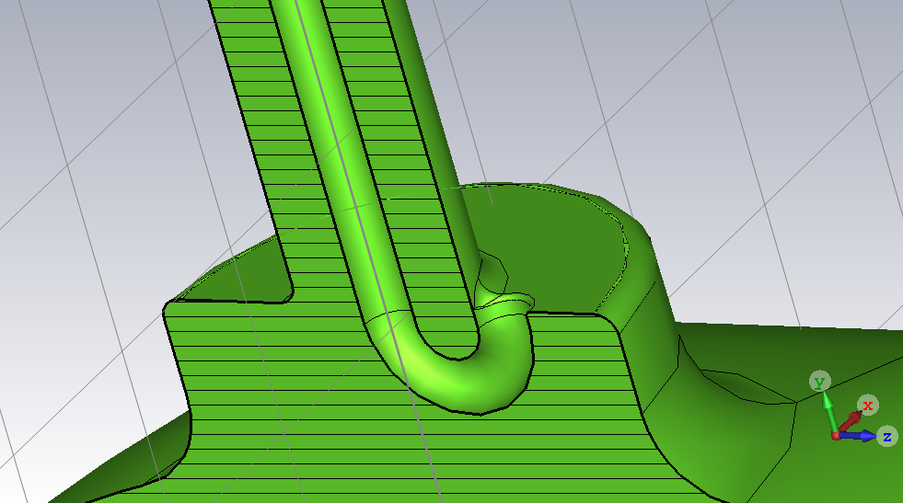
Feeding the Cavity:
The Power Coupler

Slide 19

Thank you for listening!

Slide 20
Sources
Belomestnykh, Sergey, and Valery Shemelin. "High-beta Cavity Design-A Tutorial." SRF International Workshop, Ithaca, New York. 2005.
https://de.wikipedia.org/wiki/Parallelresonanz#/media/File:KondiSpuleWiderstandParallel.svg
https://de.wikipedia.org/wiki/Schwingkreis#/media/File:Schwingkreis.svg
Microcosm at CERN
Used program for simulations: CST Microwave Studio

Slide 21

Coupler
!
  $$Q_{0}=Q_{ext}:matched$$
  $Q_{0}<Q_{ext}$: Not enough input
  $Q_{0}>Q_{ext}$: Too much input

Slide 22
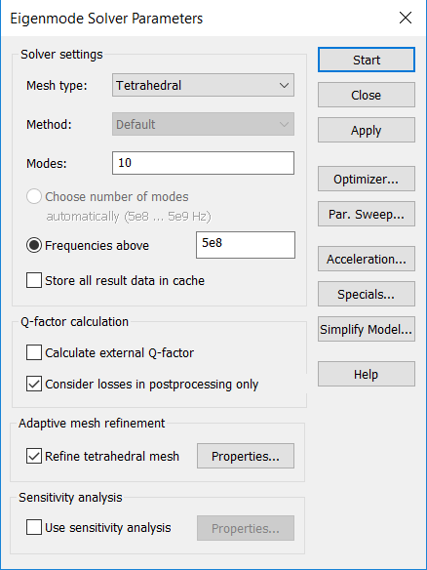
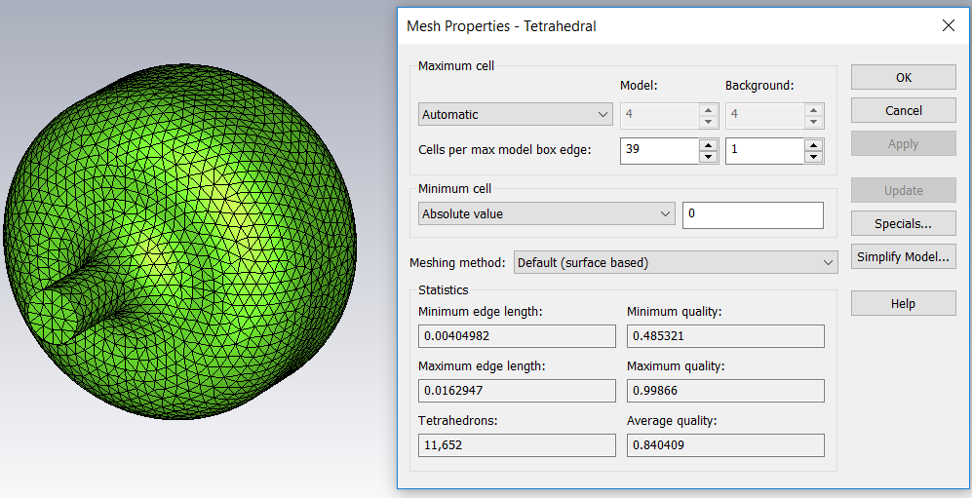
Solving Algorithm

