Slide 1
LES GÉOMÈTRES
@CERN
Brook Tewolde

Slide 2
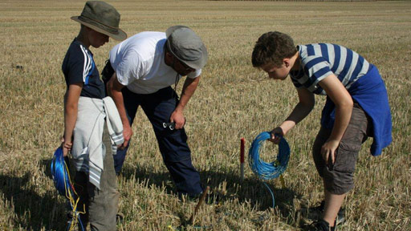
What we don’t do…
https://www.swr.de/blog/diedurchblicker/2014/10/13/huenenburg-auf-der-suche-nach-einer-versunkenen-grossstadt/

Slide 3
Content
Area of operations
Instruments
Project with Kostas
What I’ve been shown

Slide 4
What we actually do
The measurement and alignment of objects
  The position
  The orientation
  The size
  The form

Slide 5
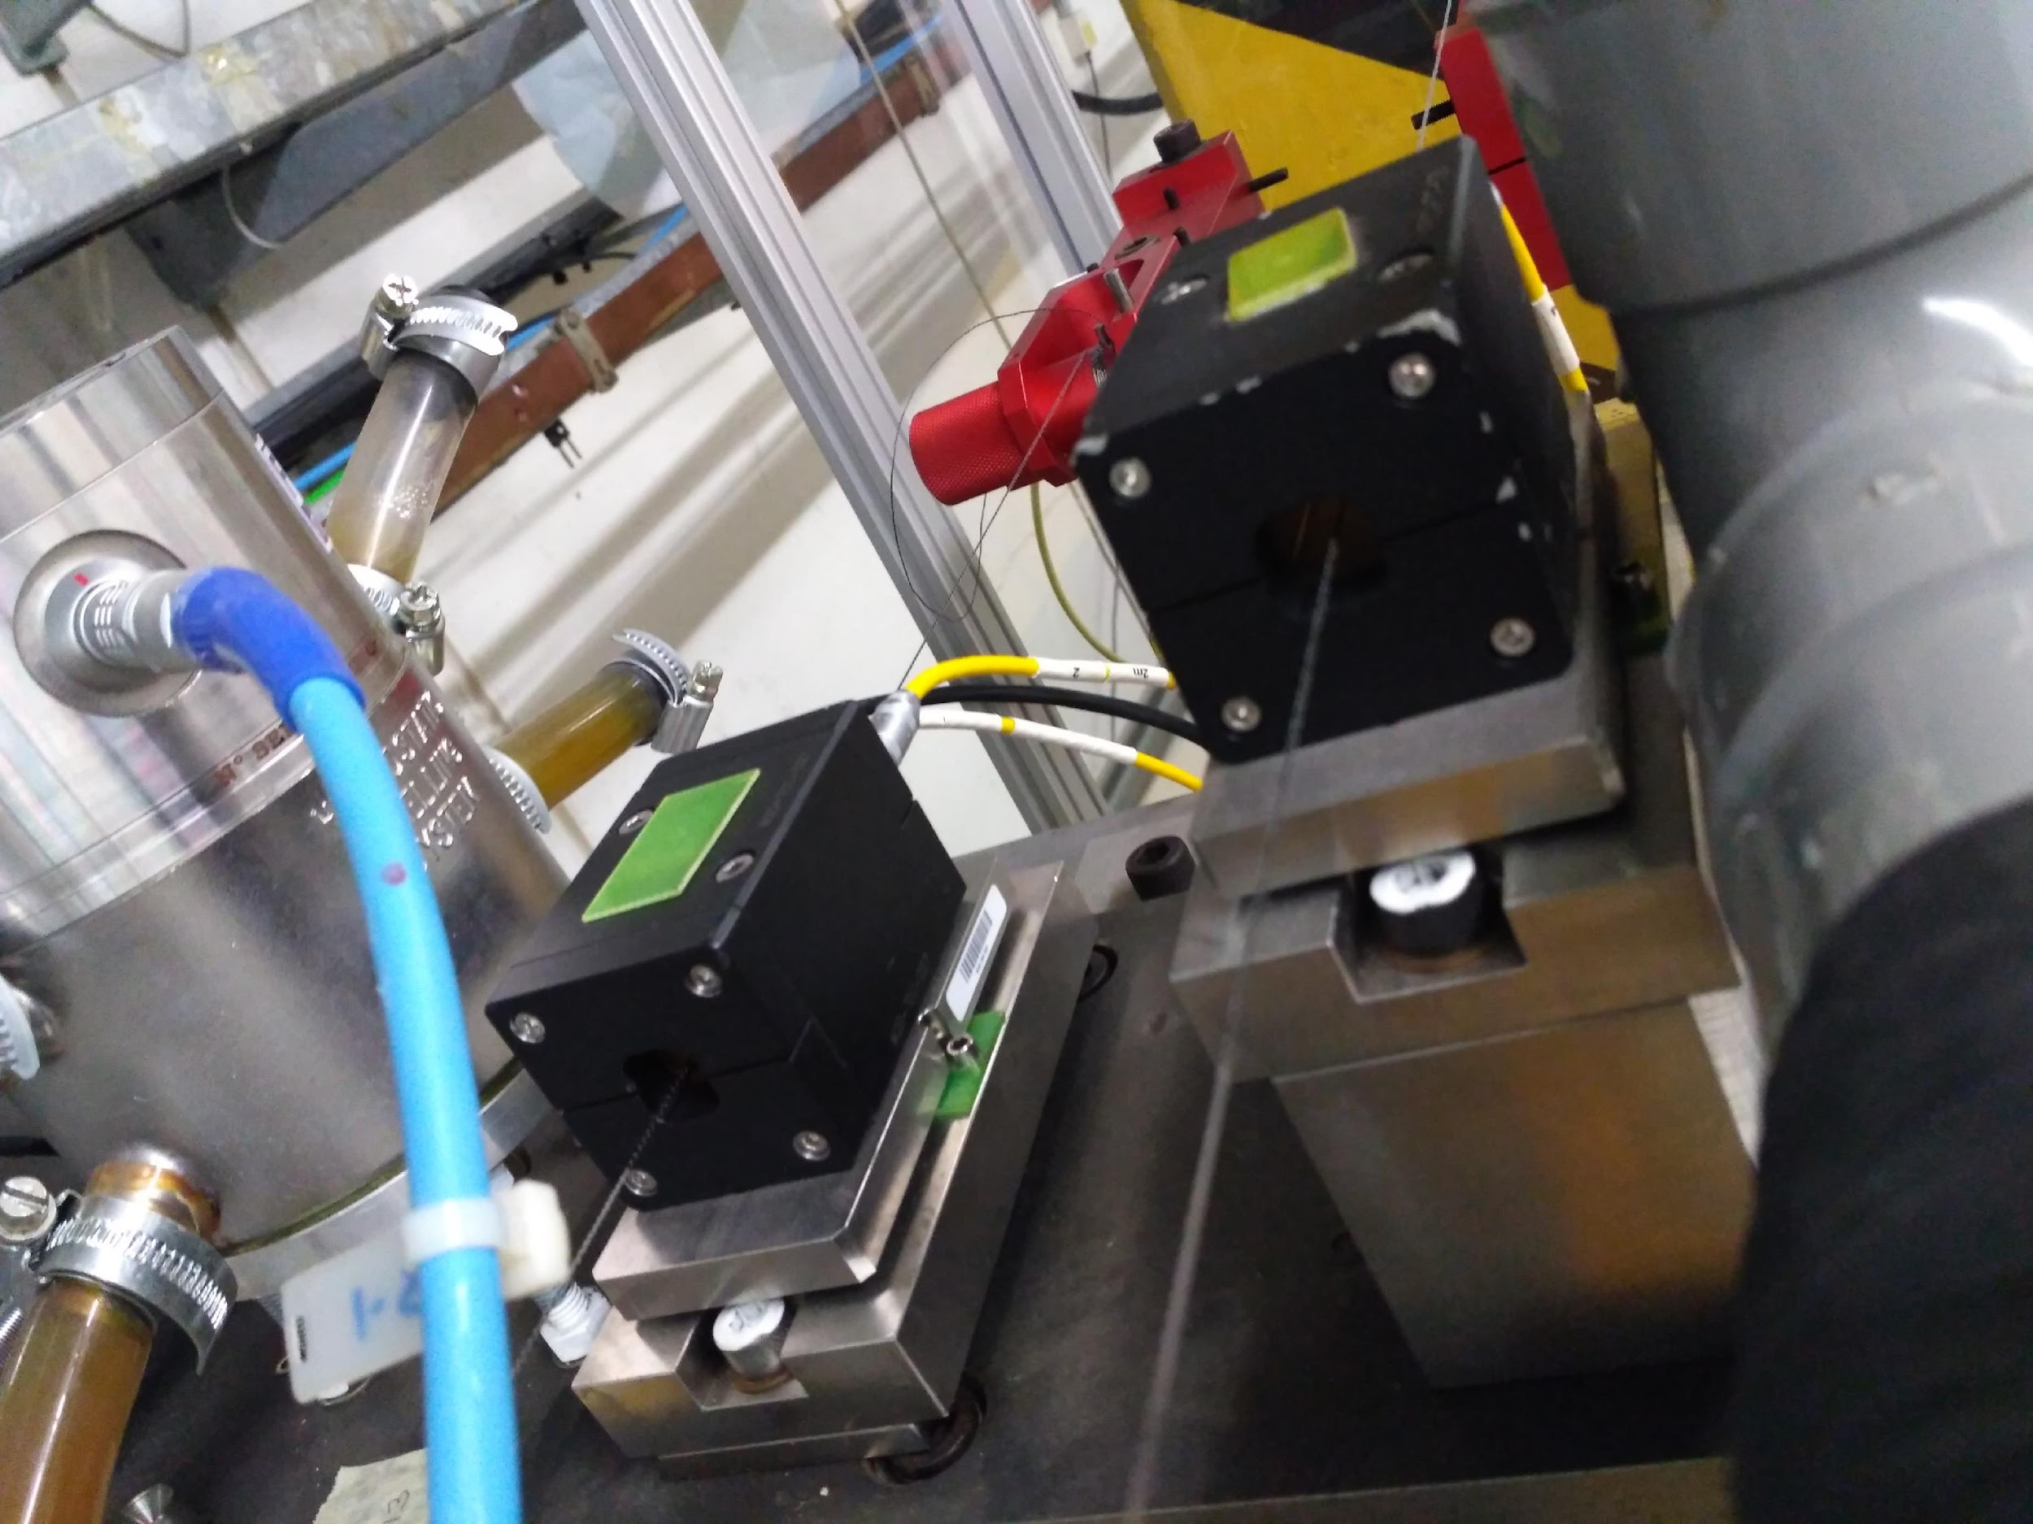
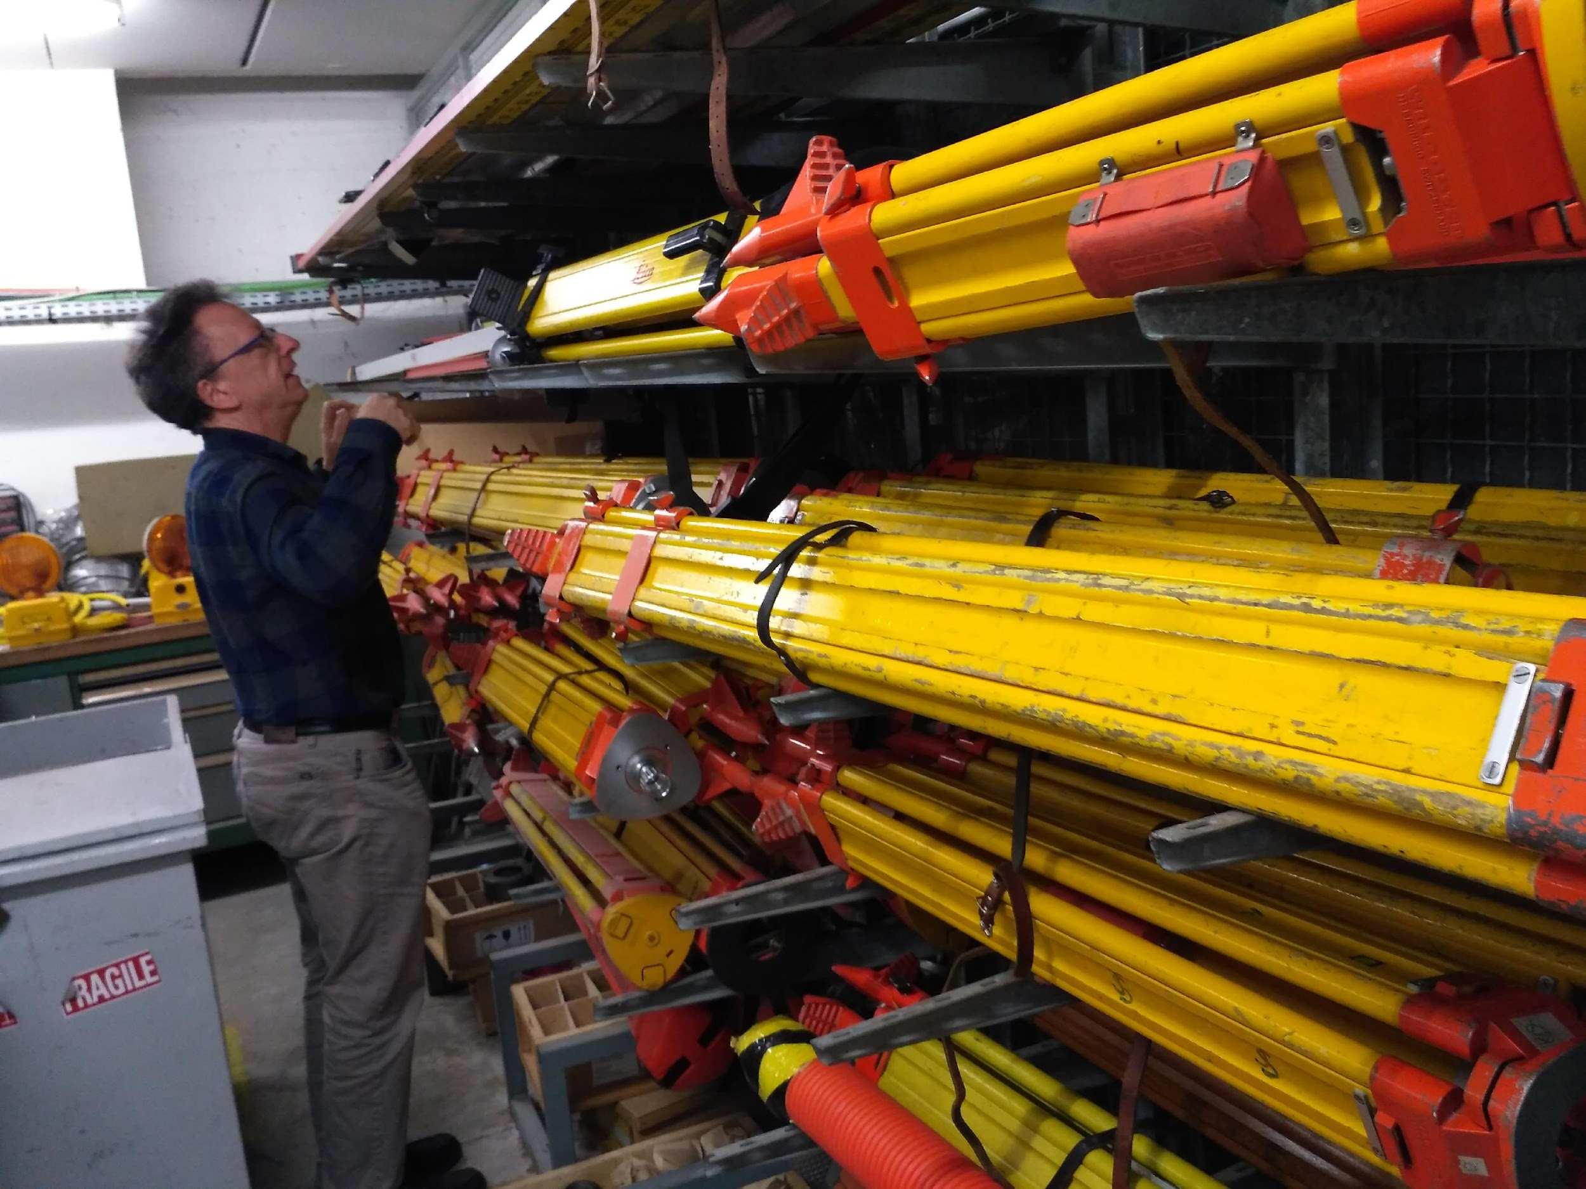
Instruments

Slide 6
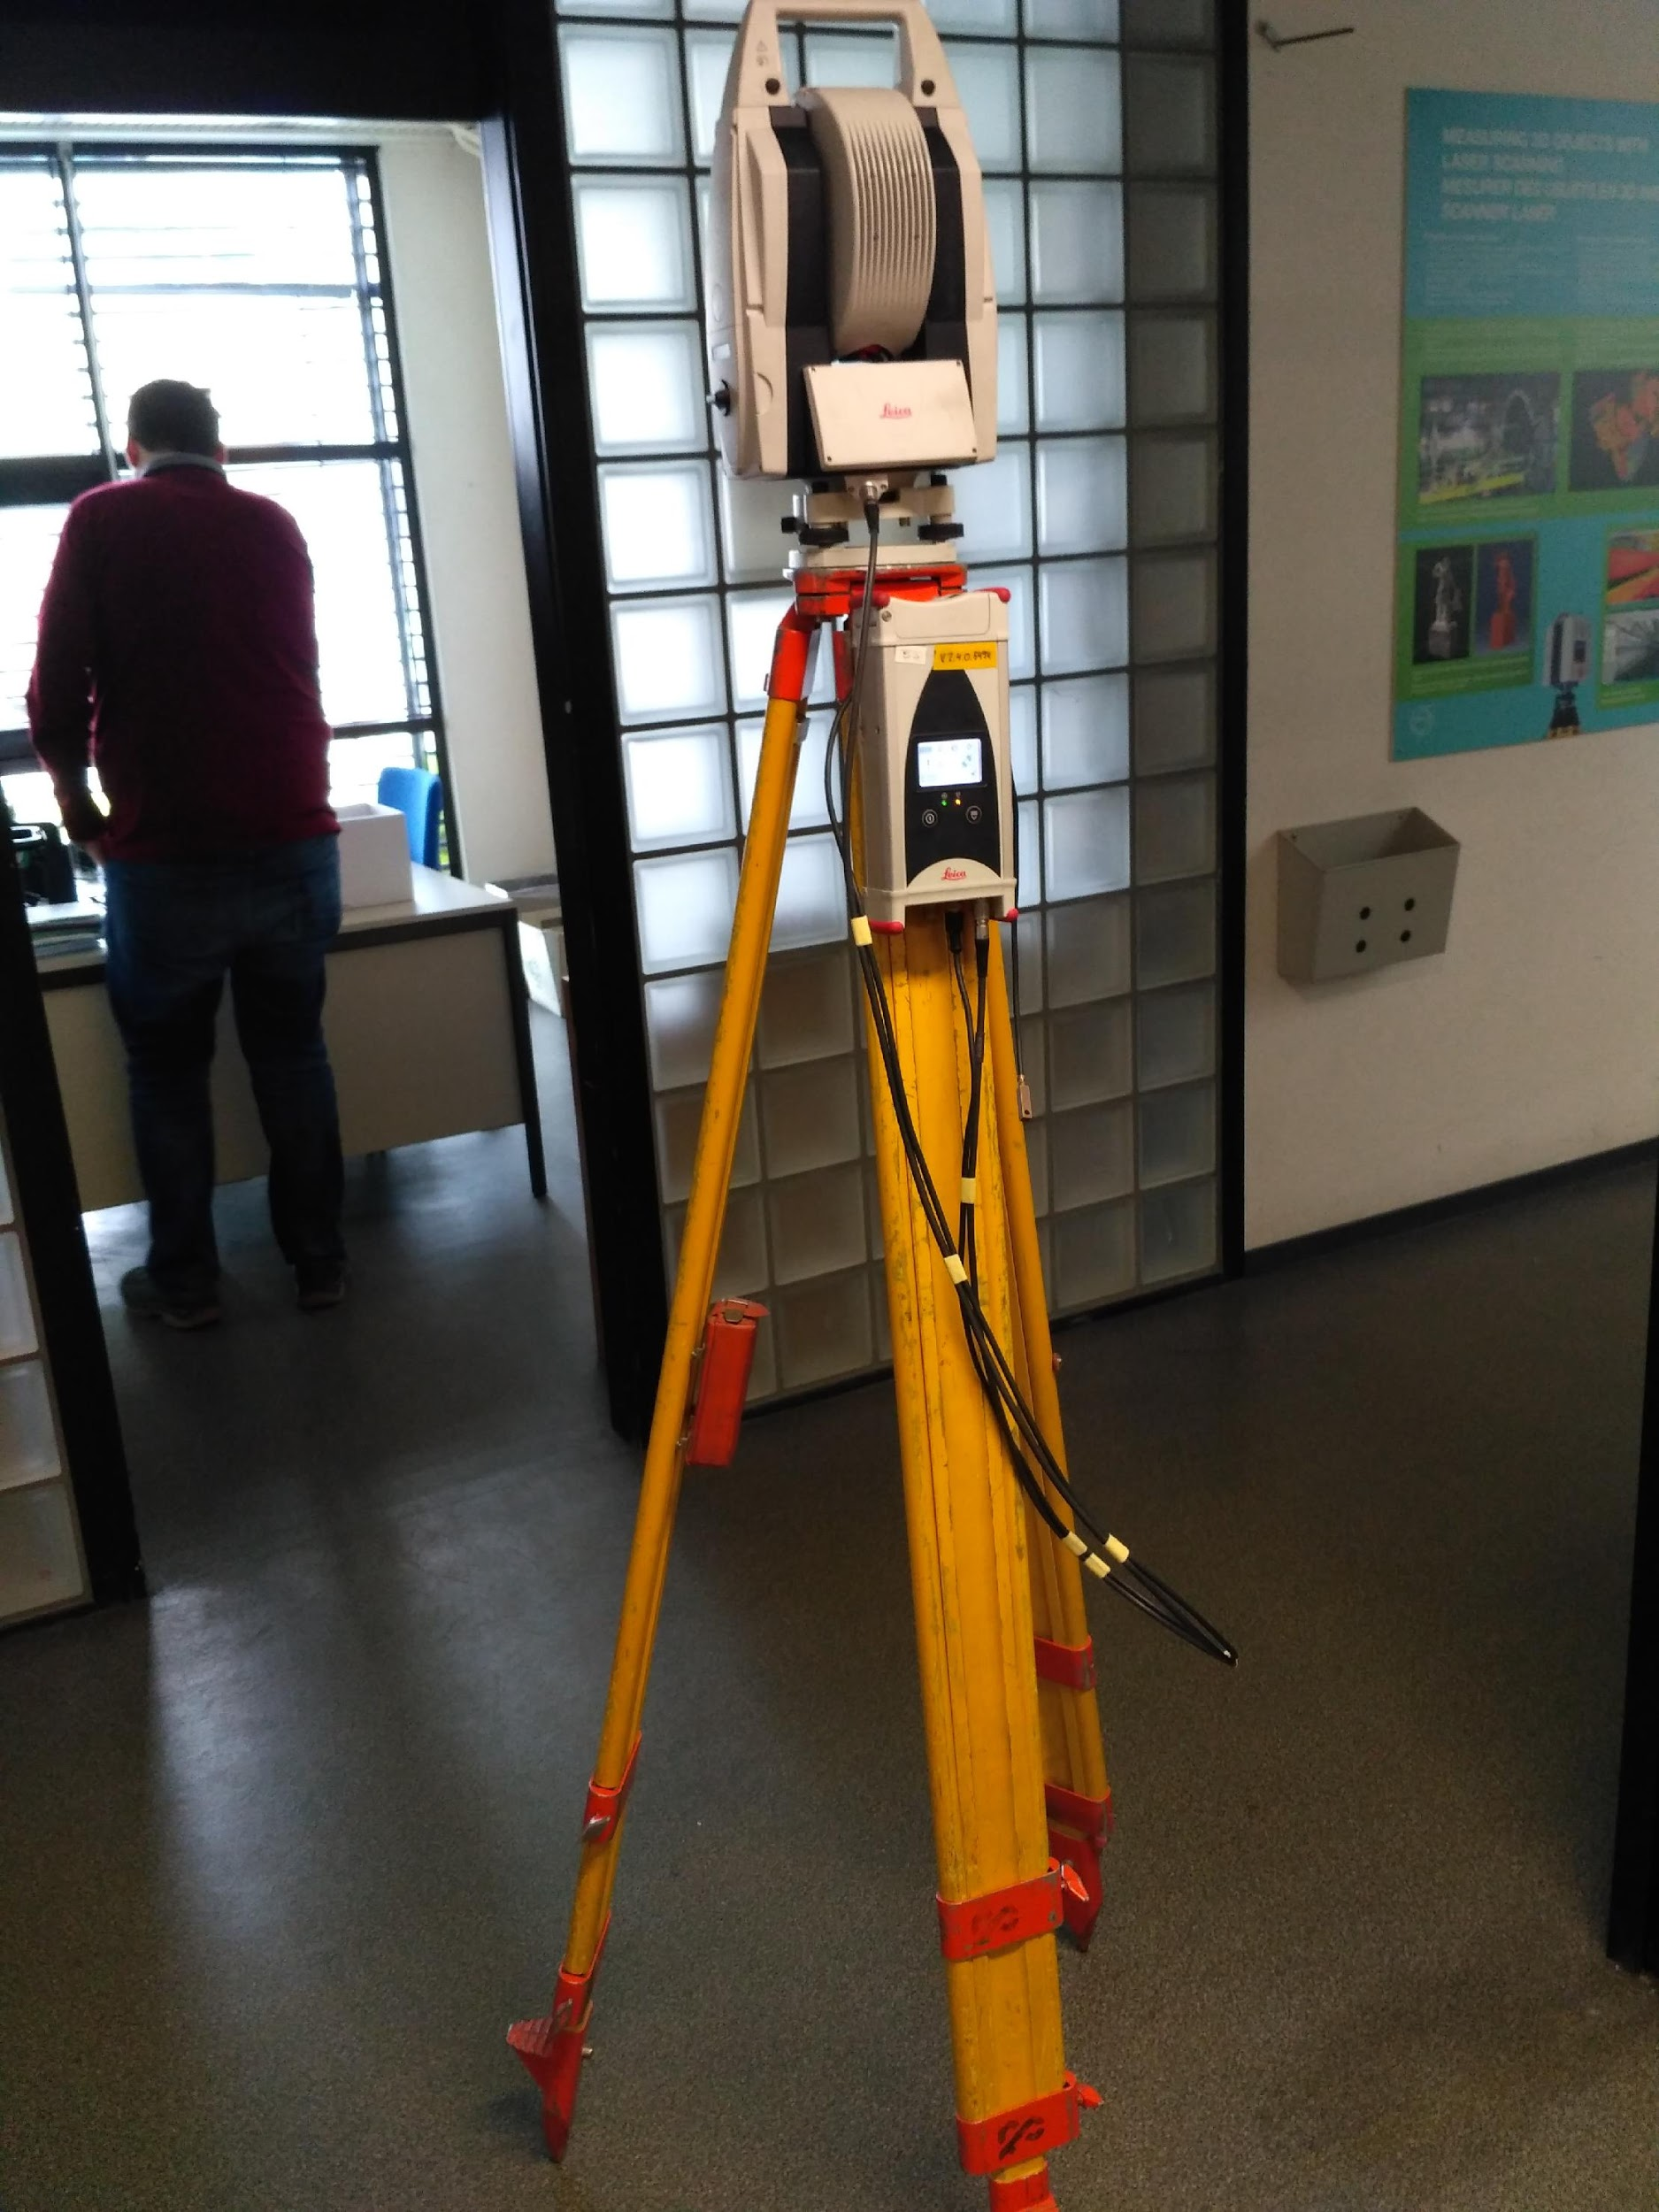
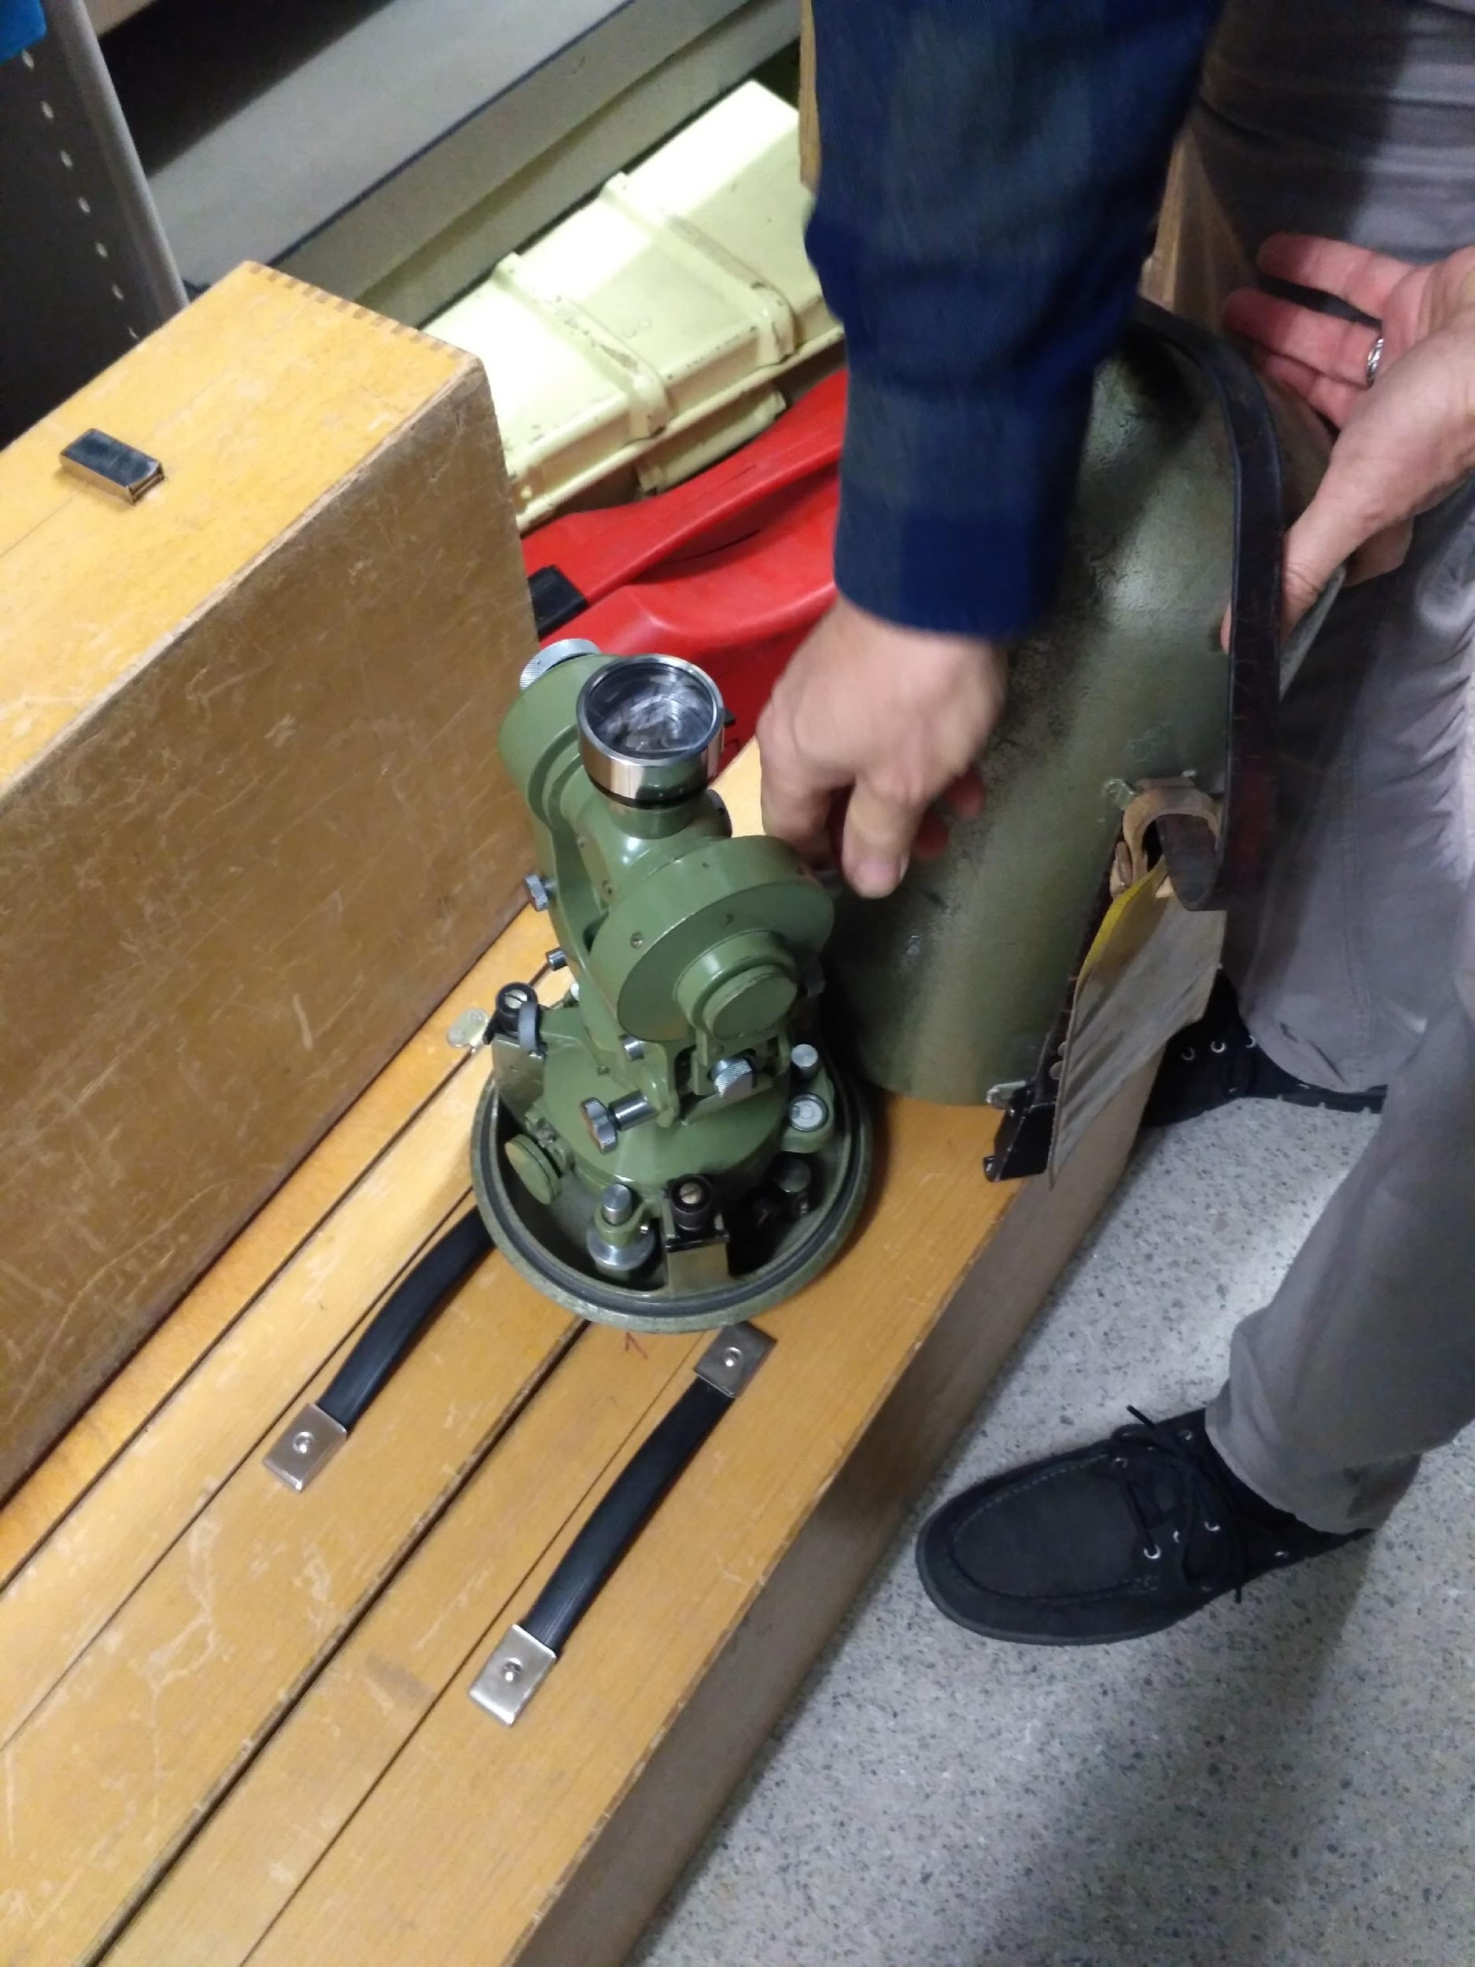
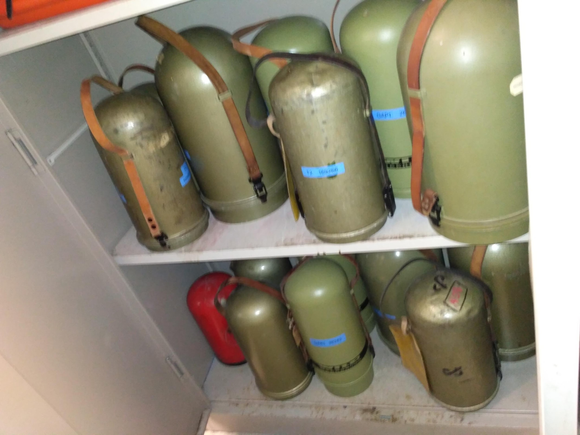
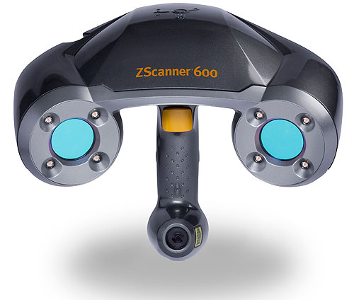
Instruments: Laser
https://www.makepartsfast.com/portable-3d-laser-scanner-from-z-corporation/

Slide 7
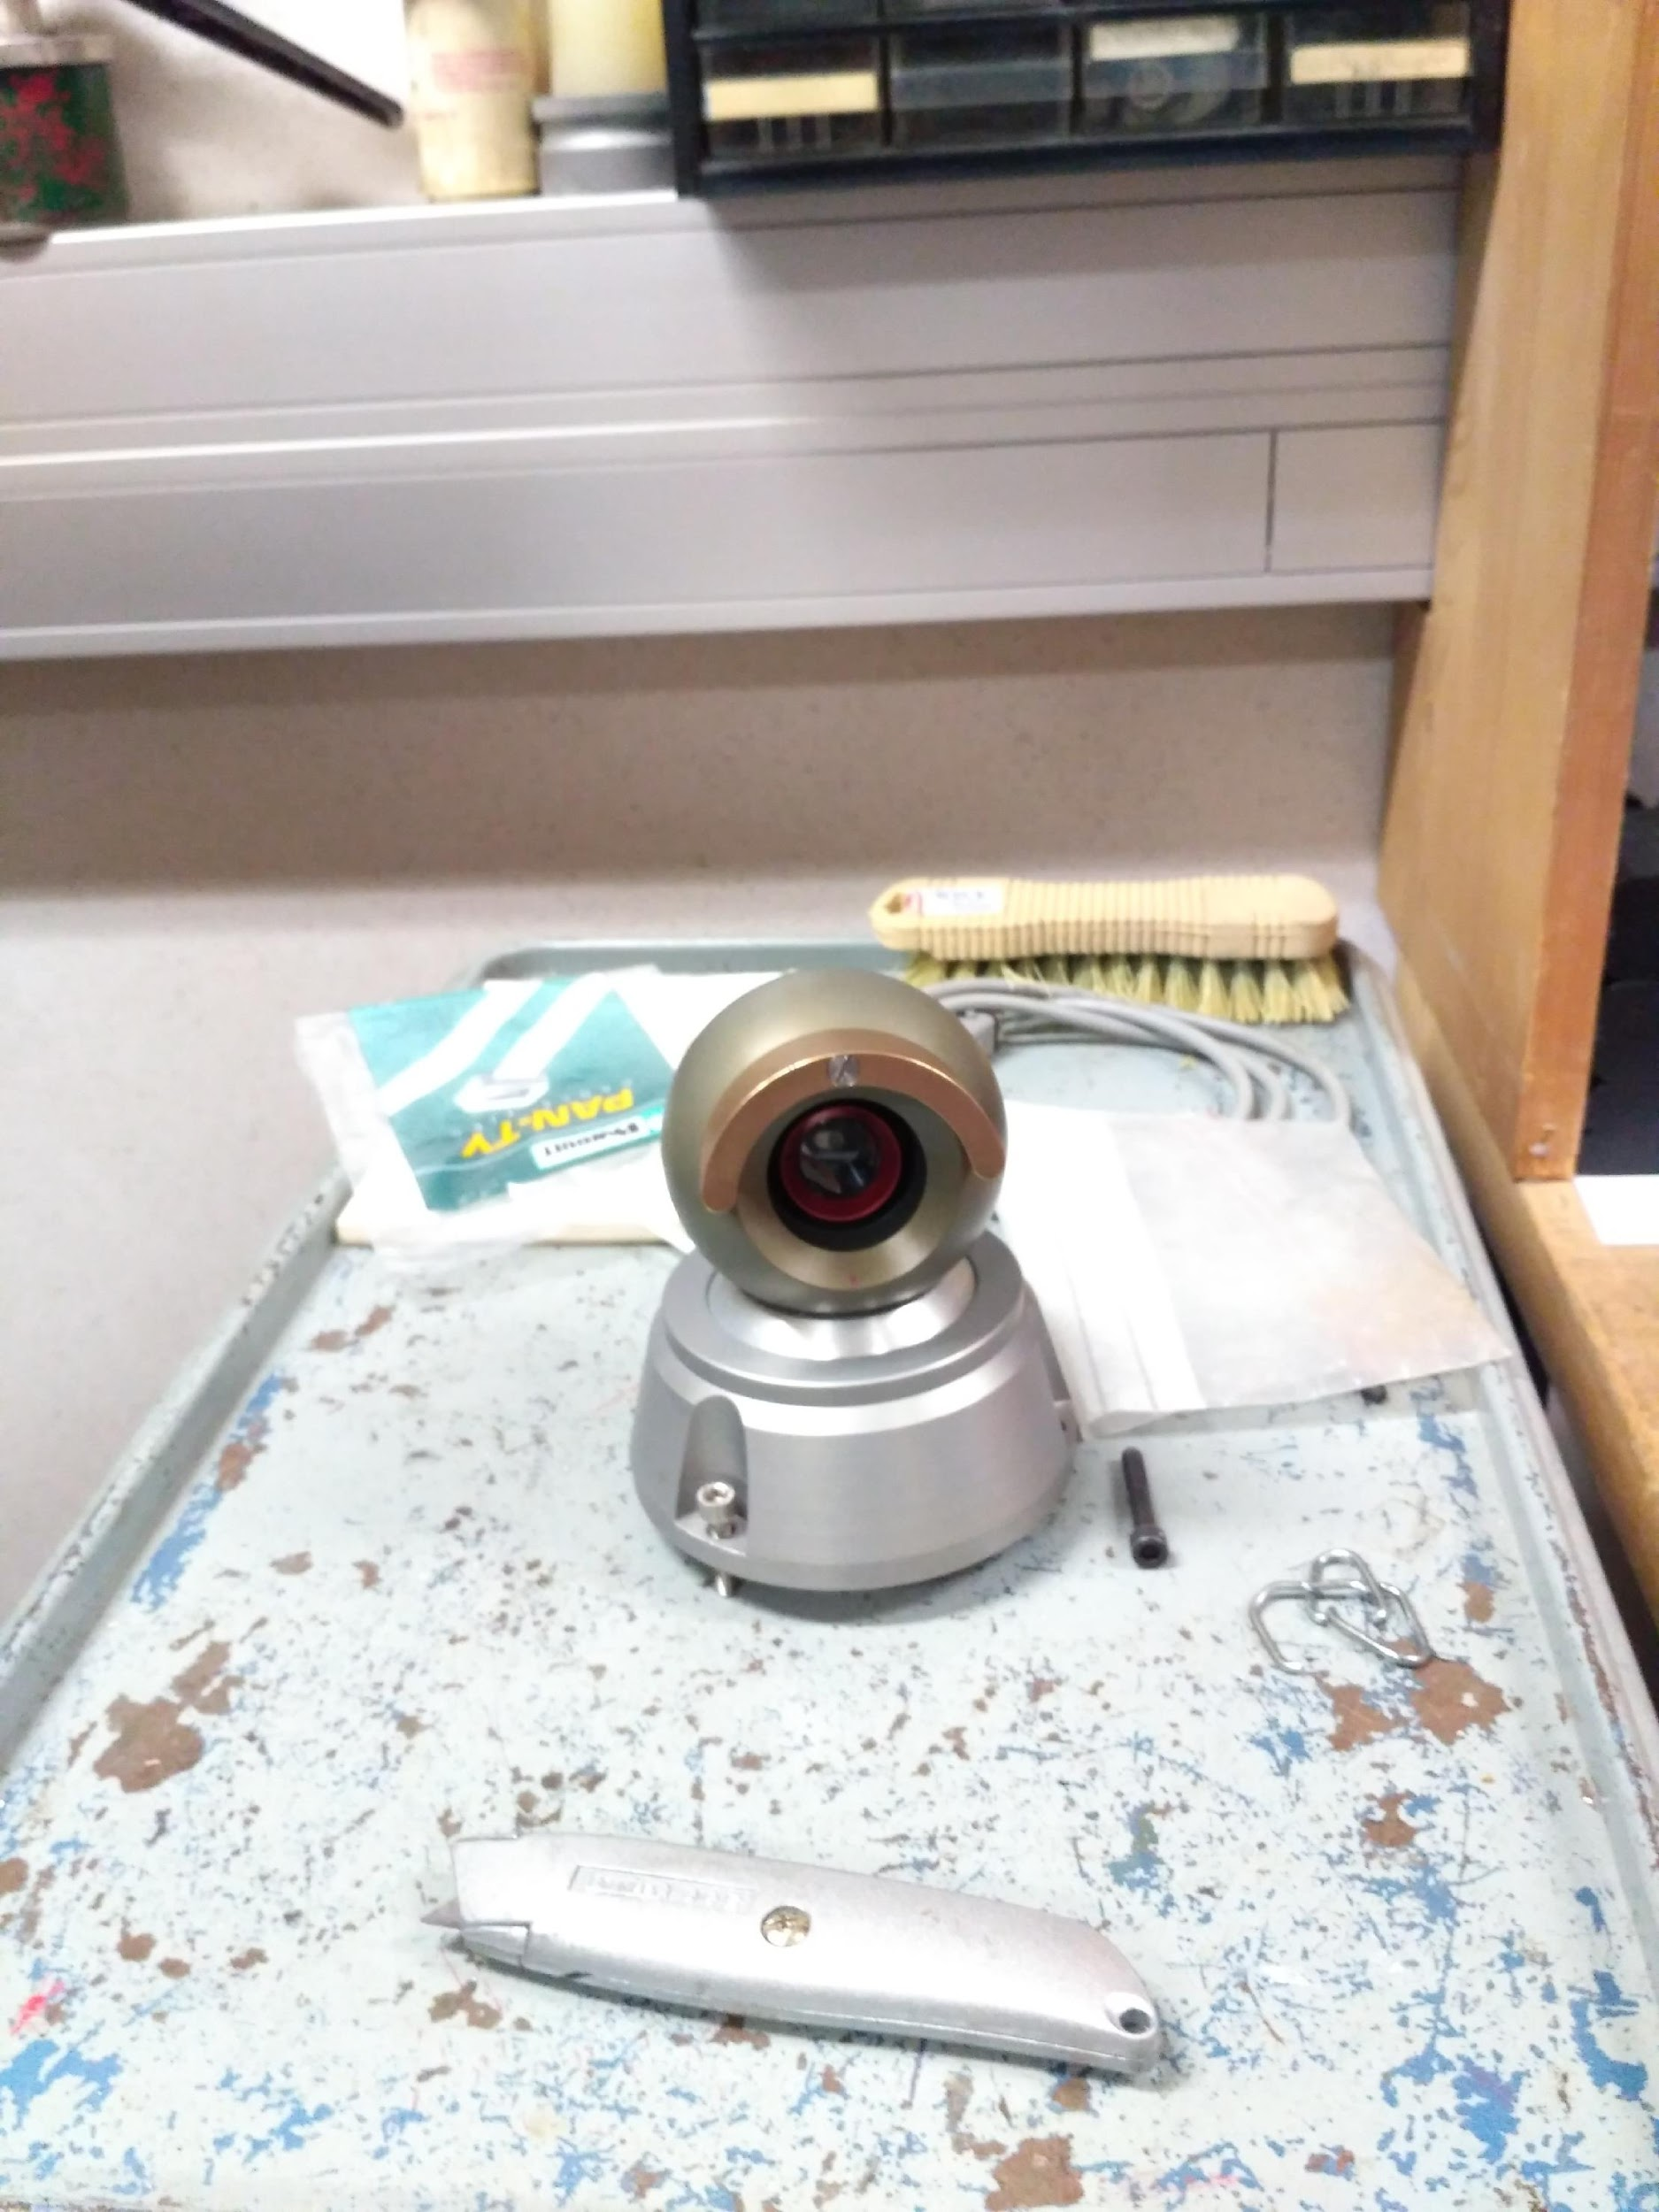
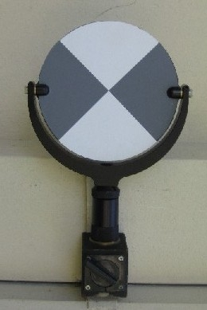
Instruments: Targets
http://www.leica-geosystems.ch/fr/Targets_19143.htm

Slide 8
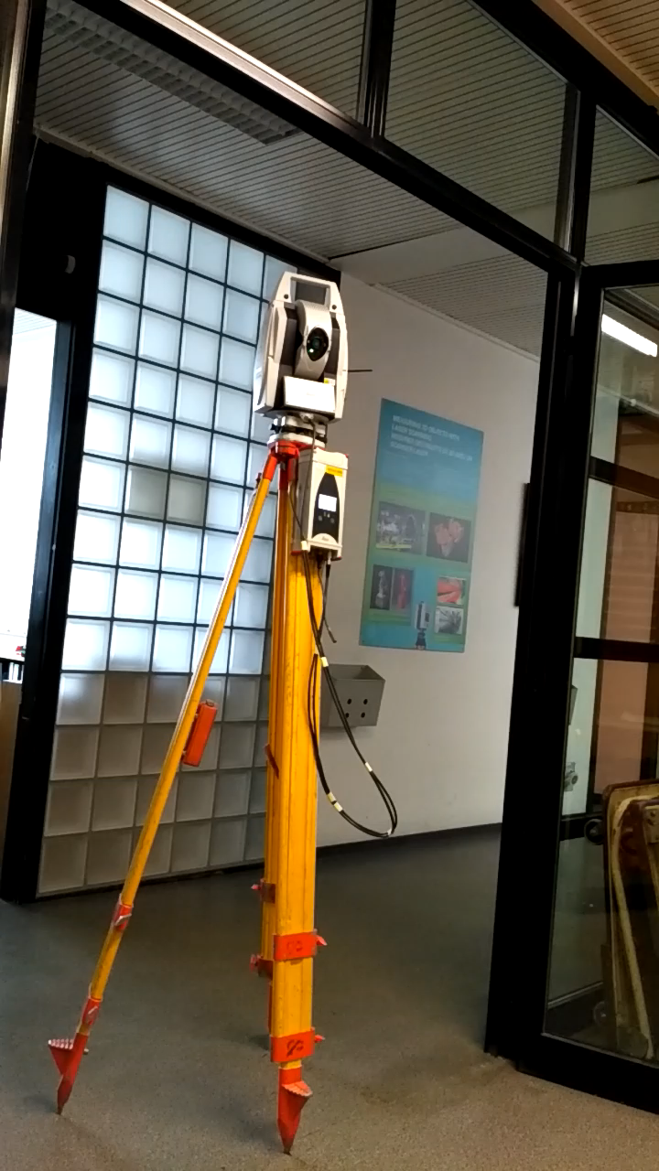

Slide 9
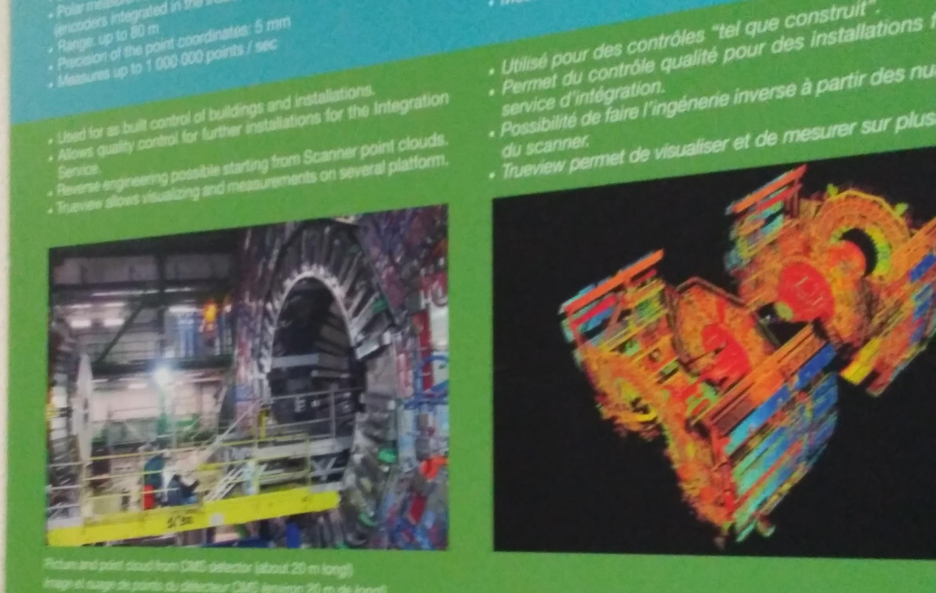
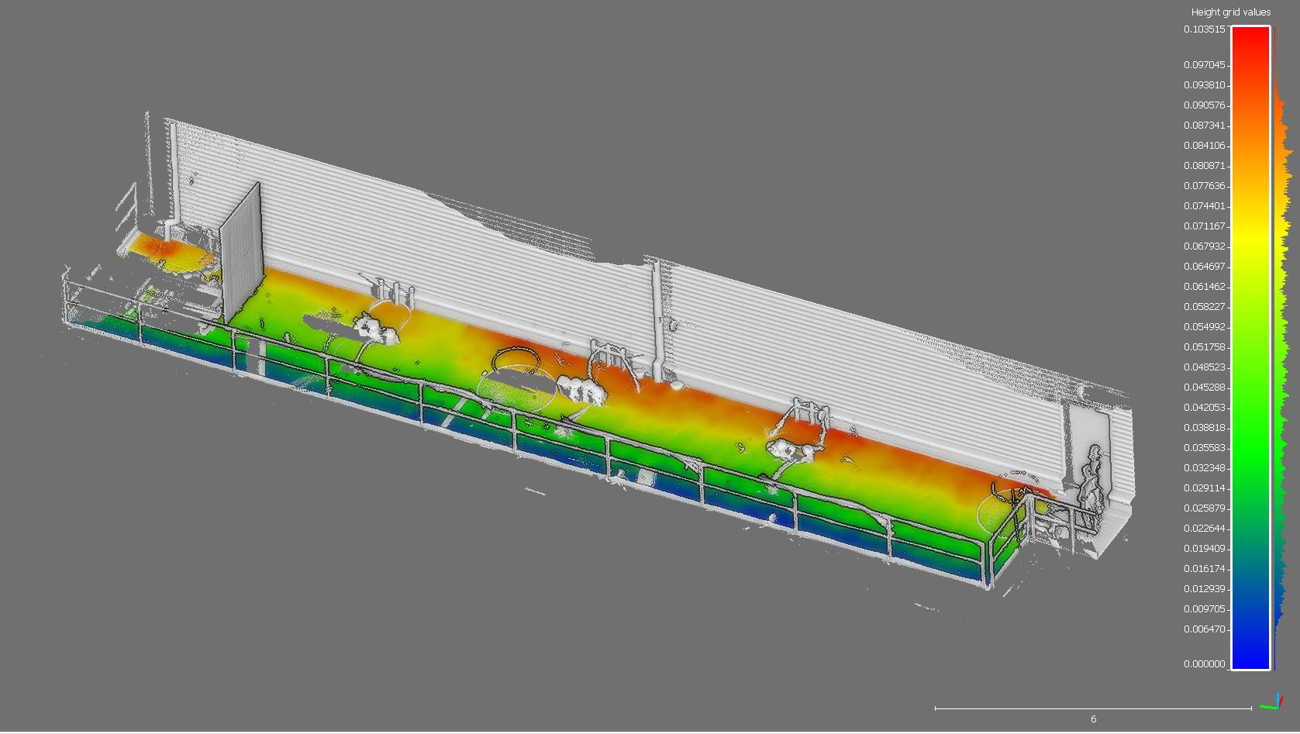
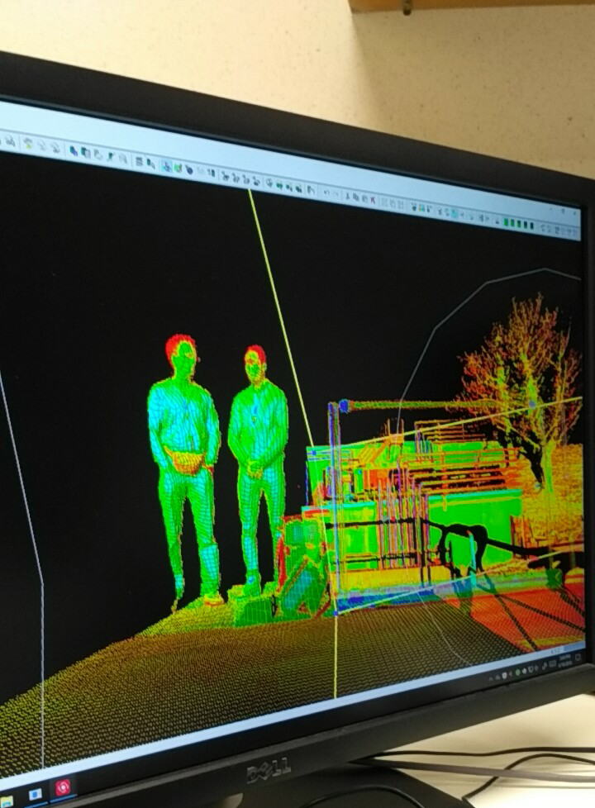
Instruments: Software

Slide 10
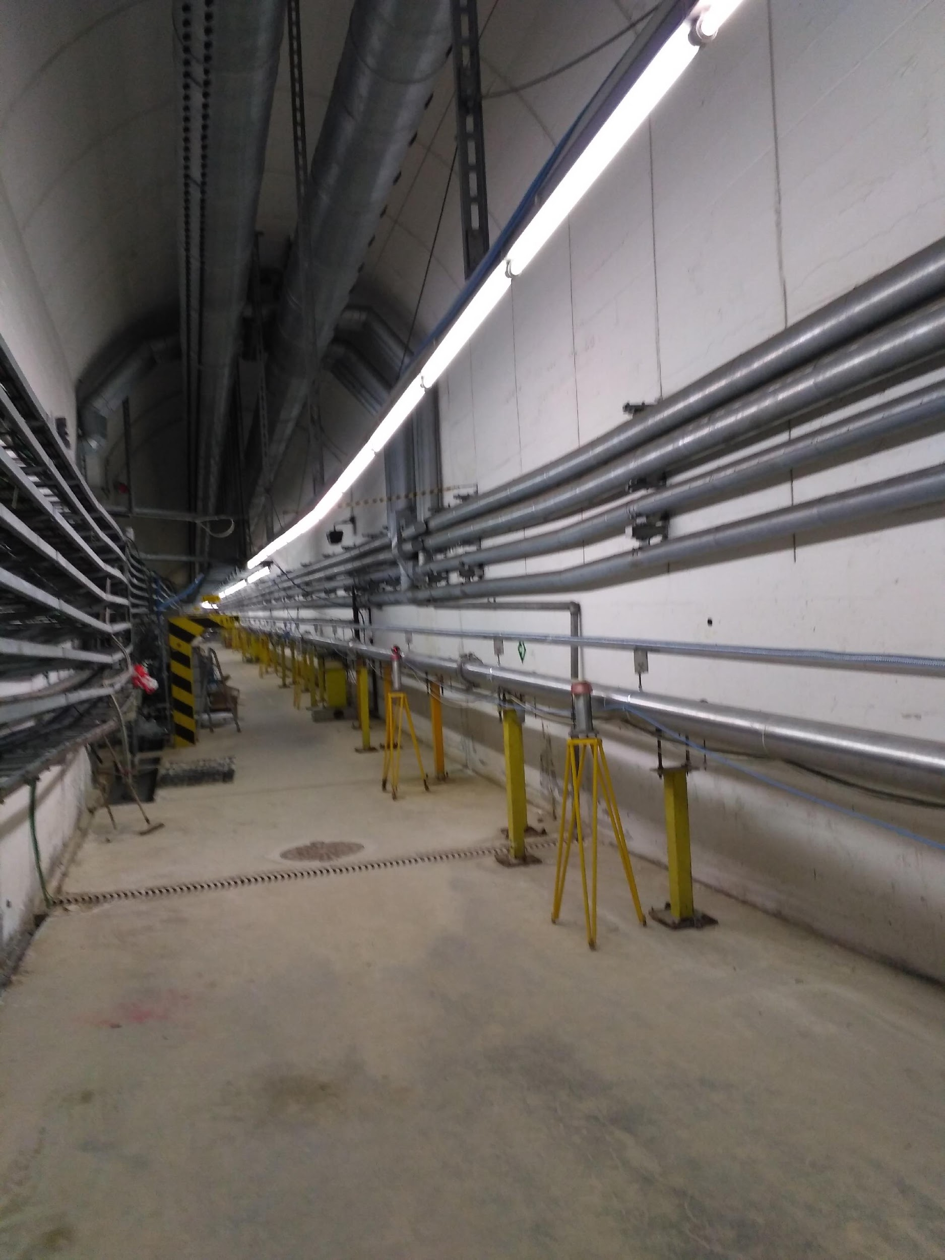
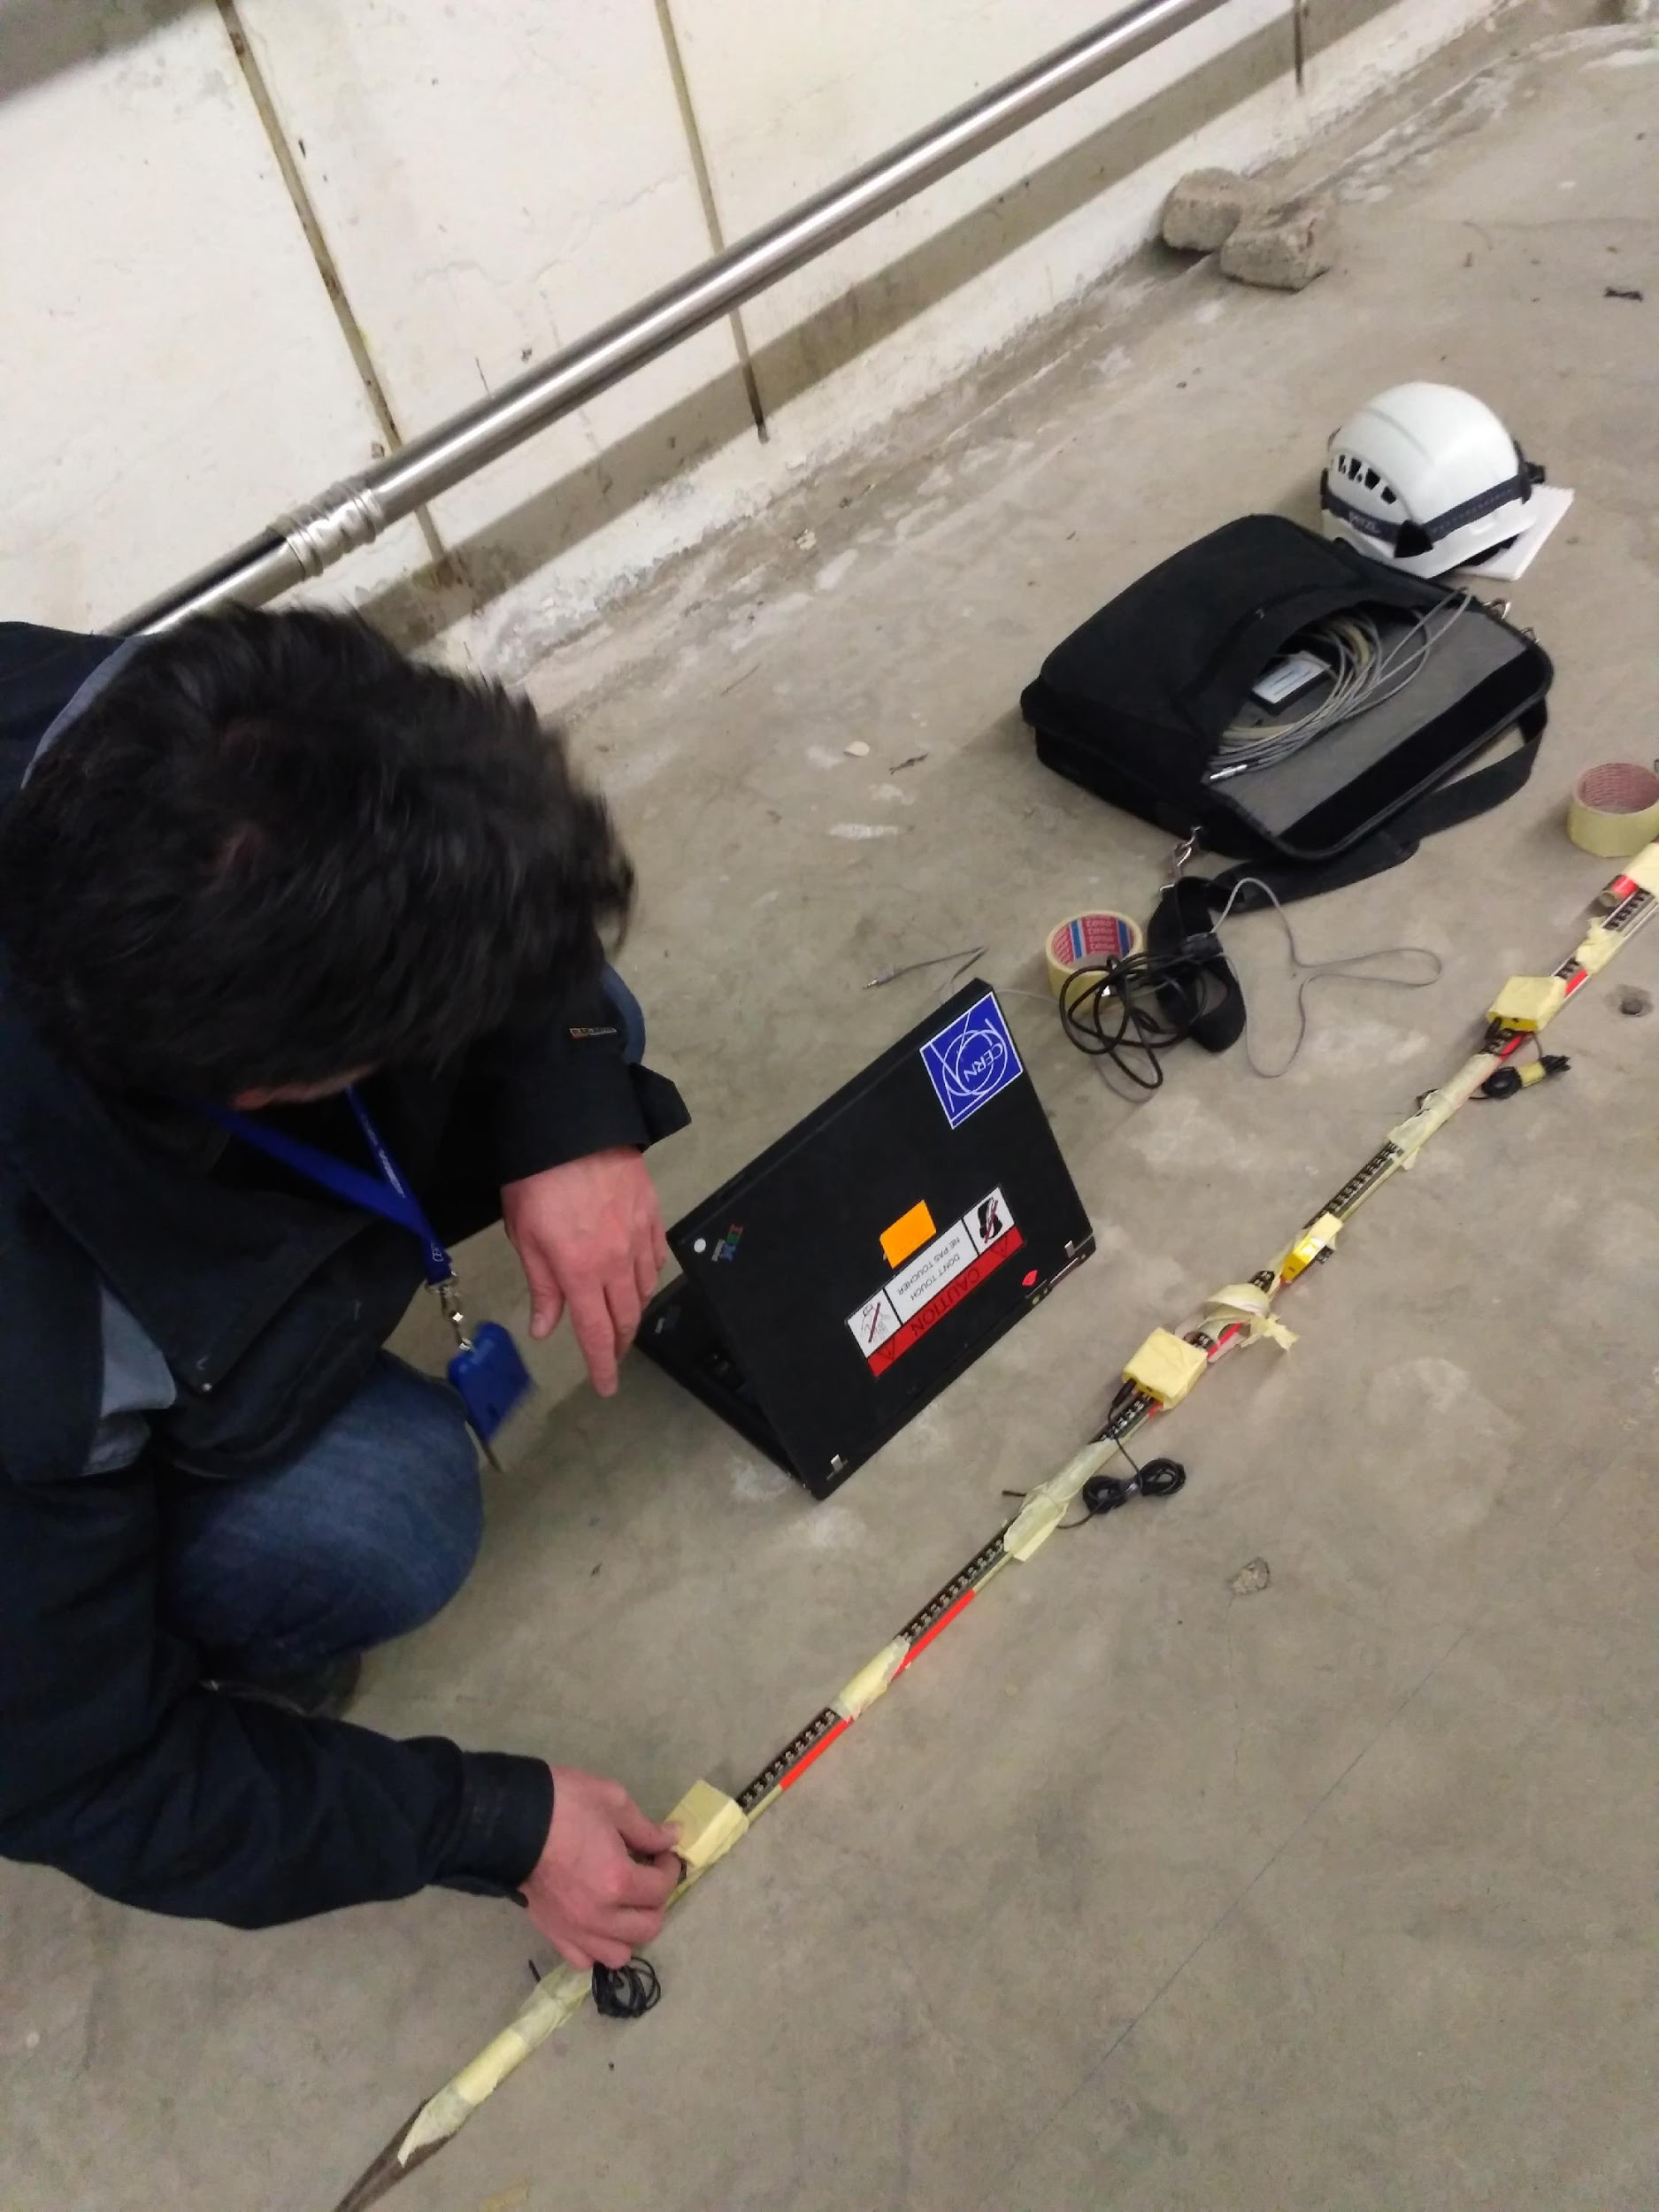
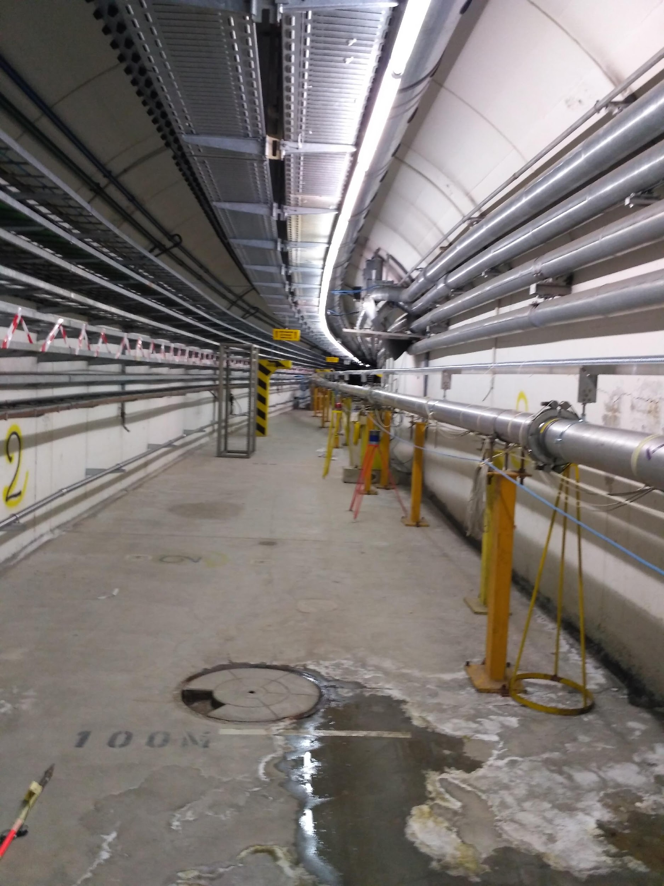
Project with Kostas – Set up

Slide 11
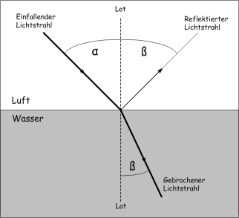
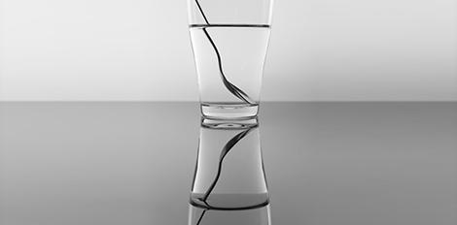
Theory
https://www.leifiphysik.de/optik/lichtbrechung
https://macsclassroom53.wordpress.com/tag/lichtbrechung/

Slide 12

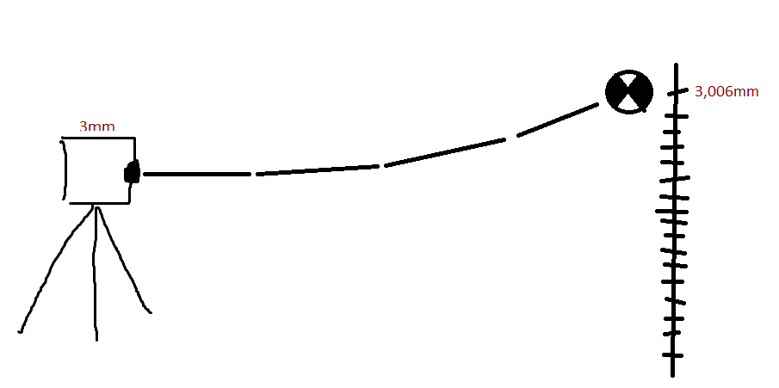
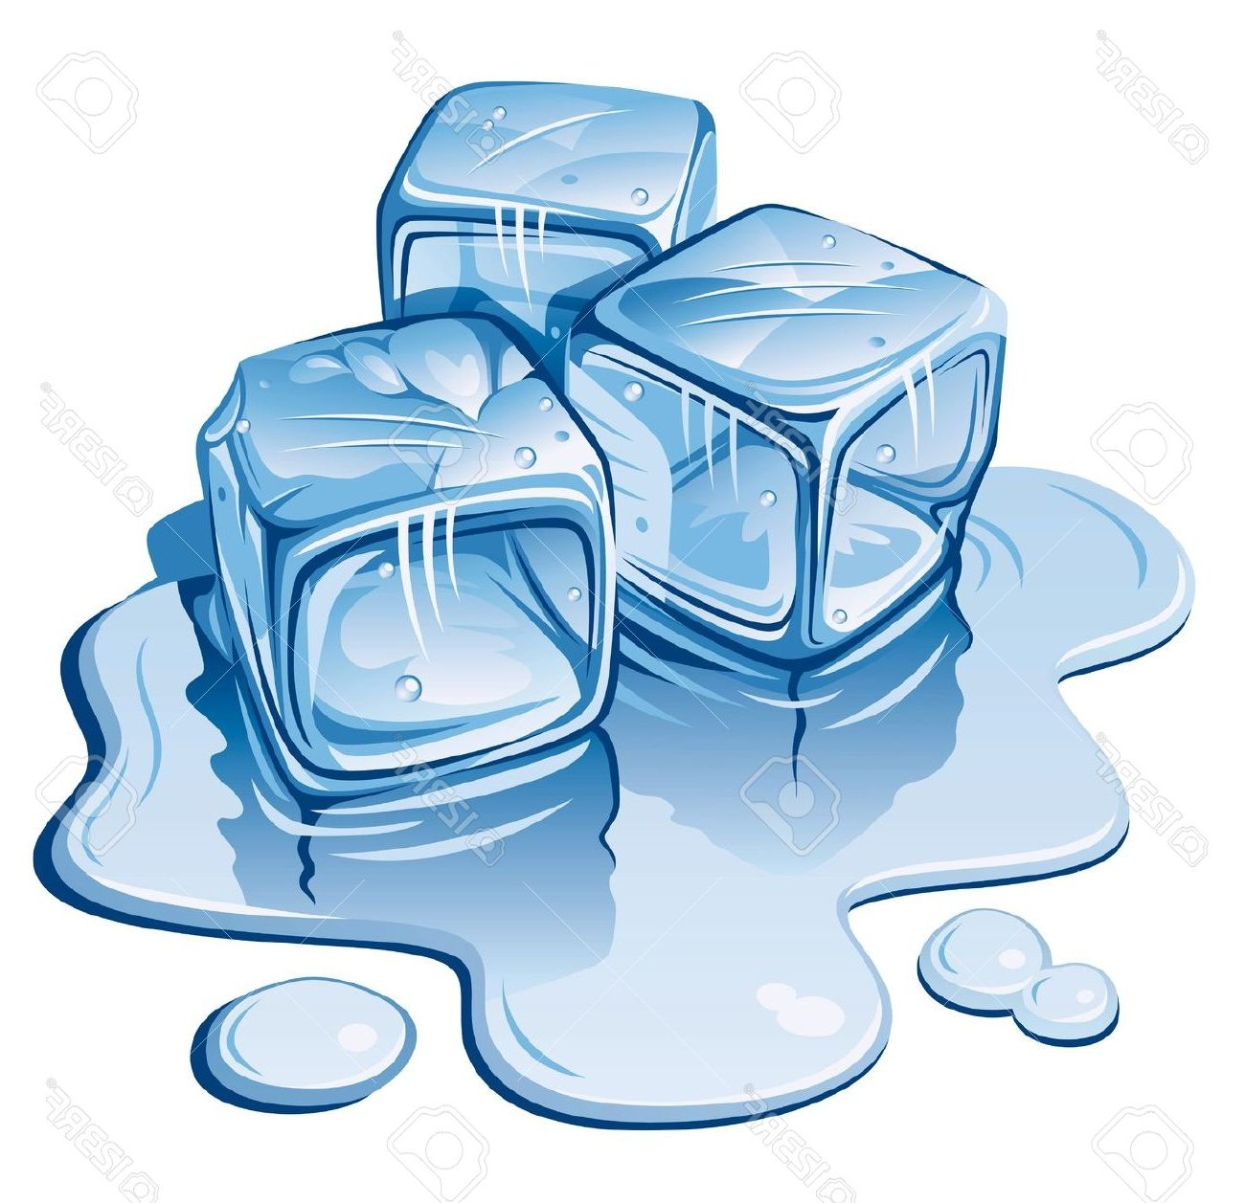
https://gallery.yopriceville.com/Free-Clipart-Pictures/Fire-PNG/Flame_Transparent_PNG_Clip_Art_Image#.WthhPmcUlaQ
http://lemonize.me/clipart-of-ice.html/clipart-of-ice-many-interesting-cliparts
Artist: Brook Tewolde

Slide 13
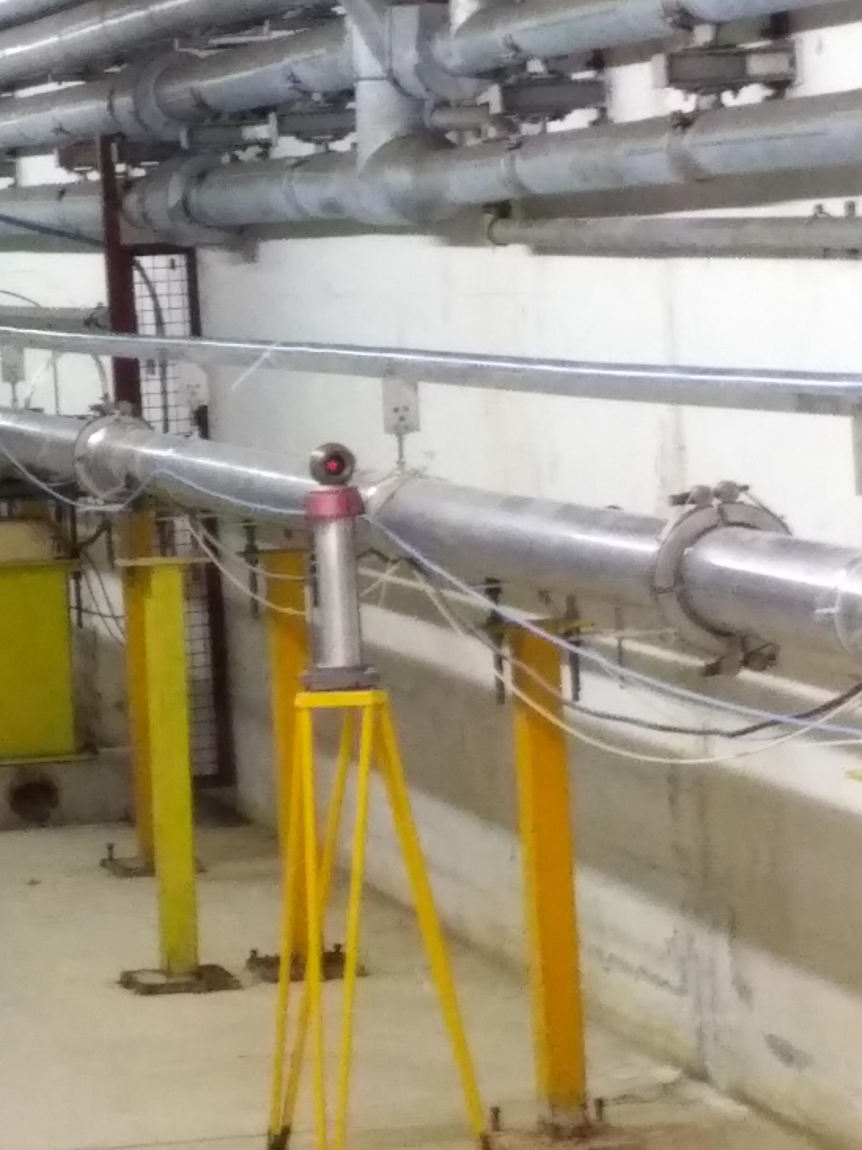
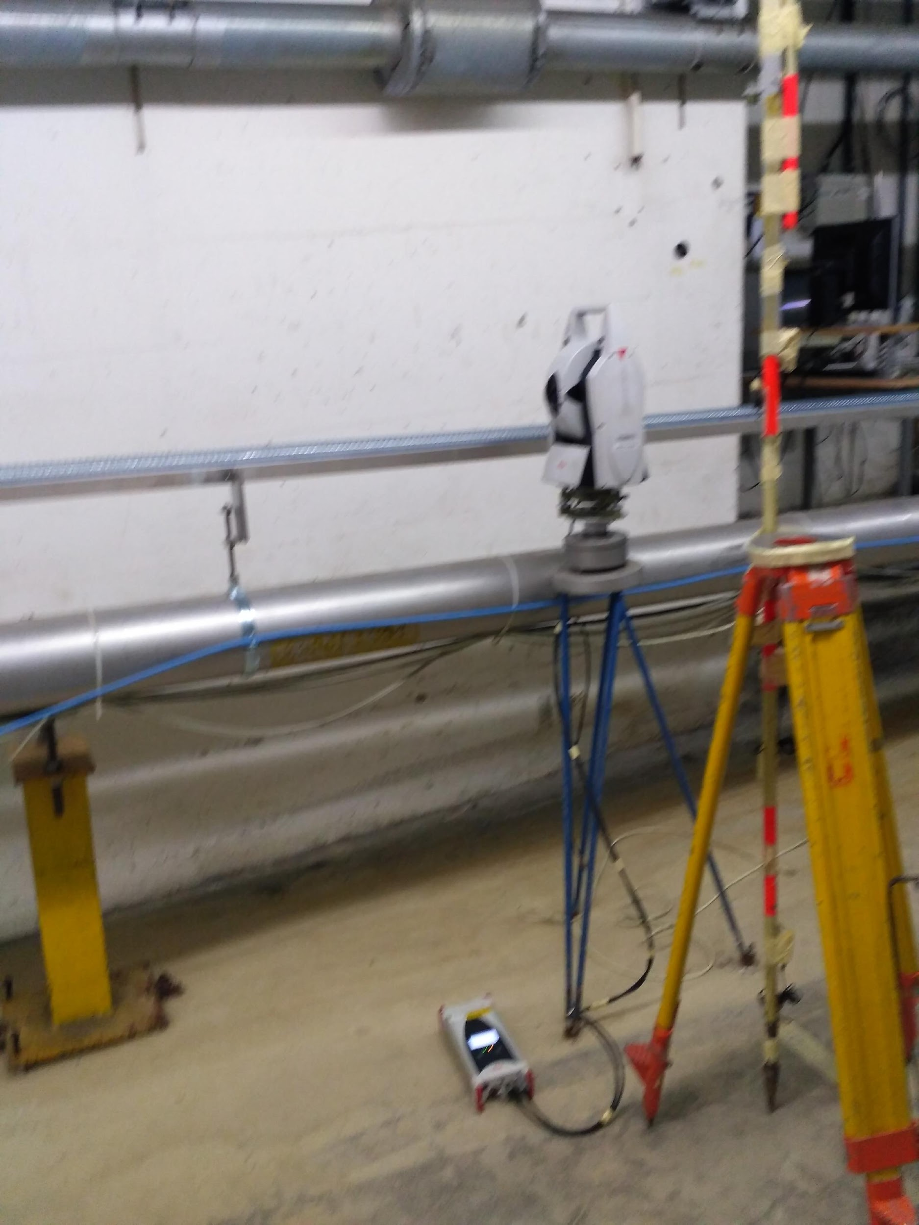
Measurements

Slide 14
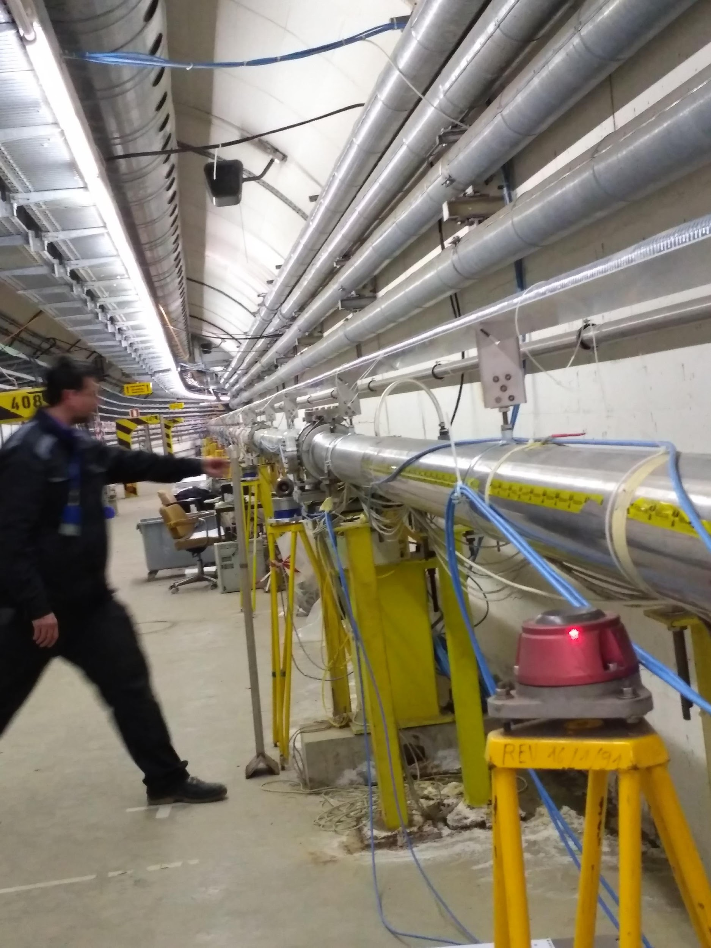
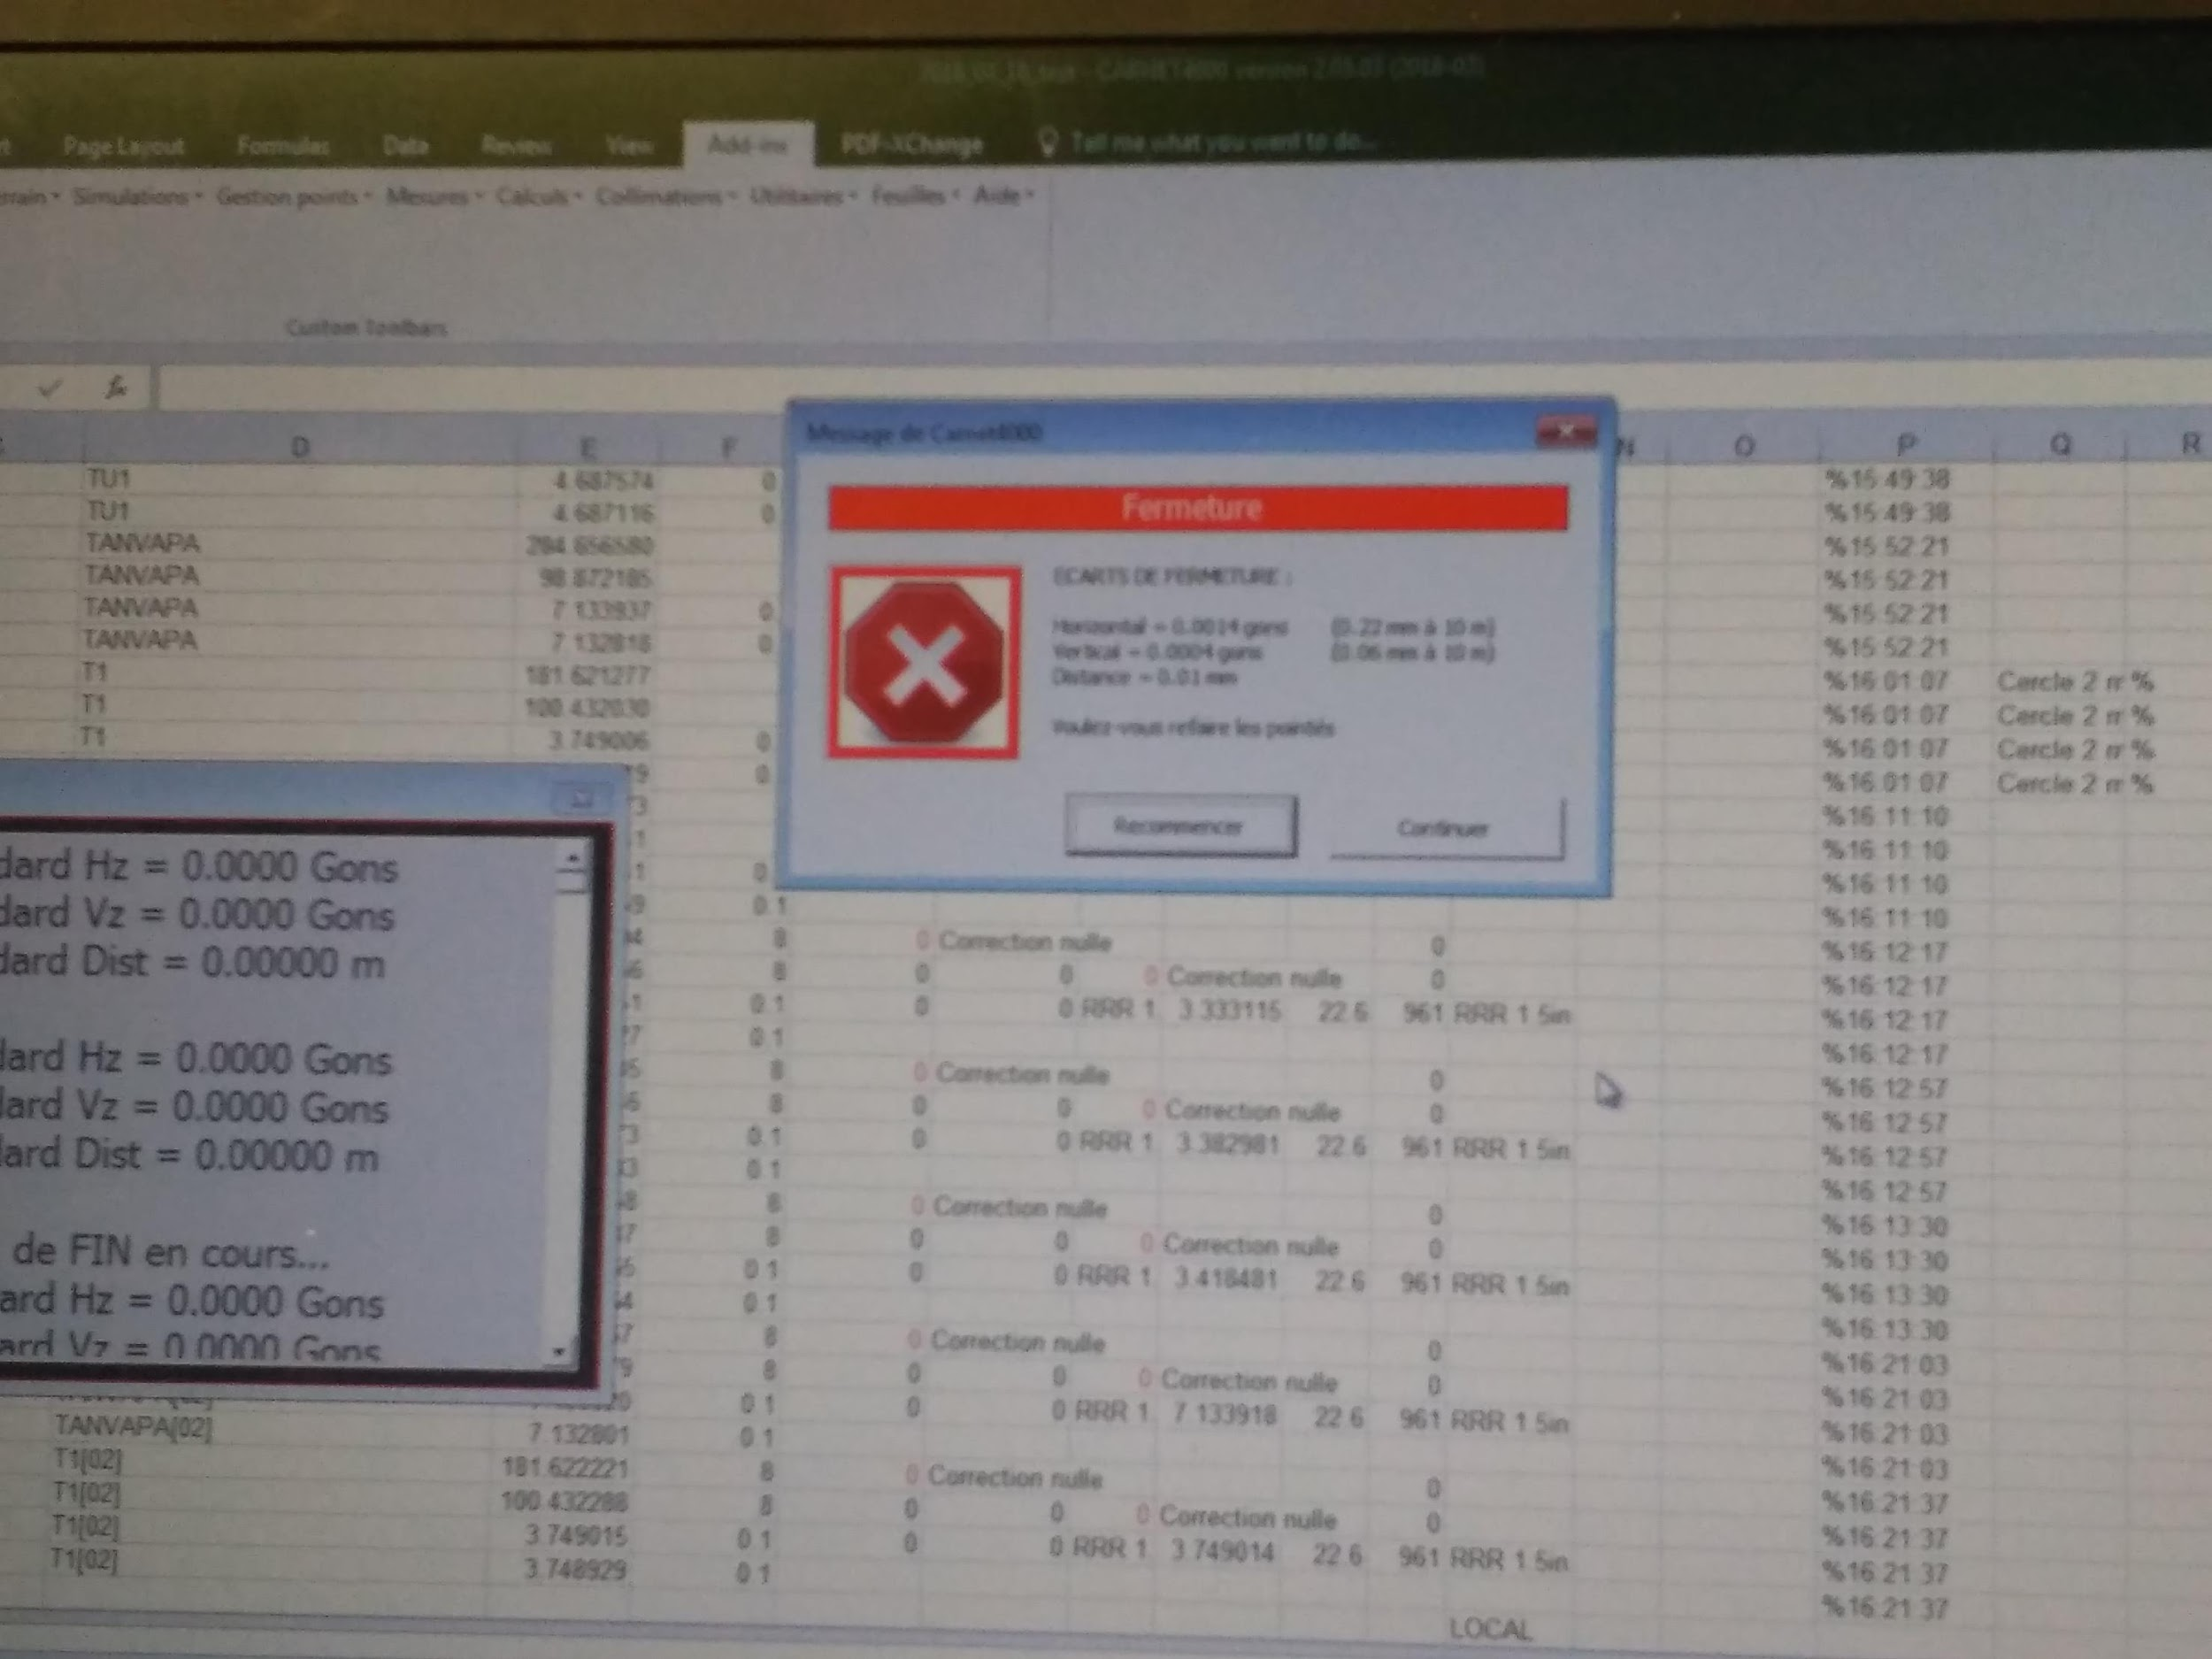
Troubleshooting

Slide 15
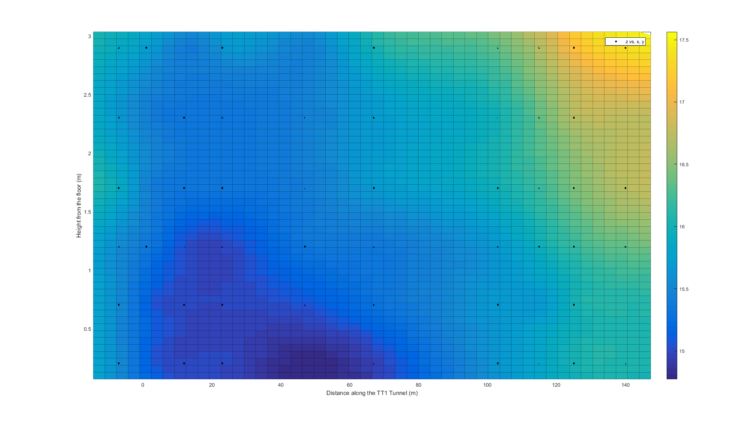
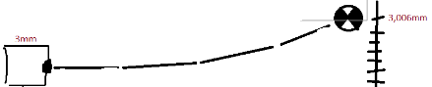
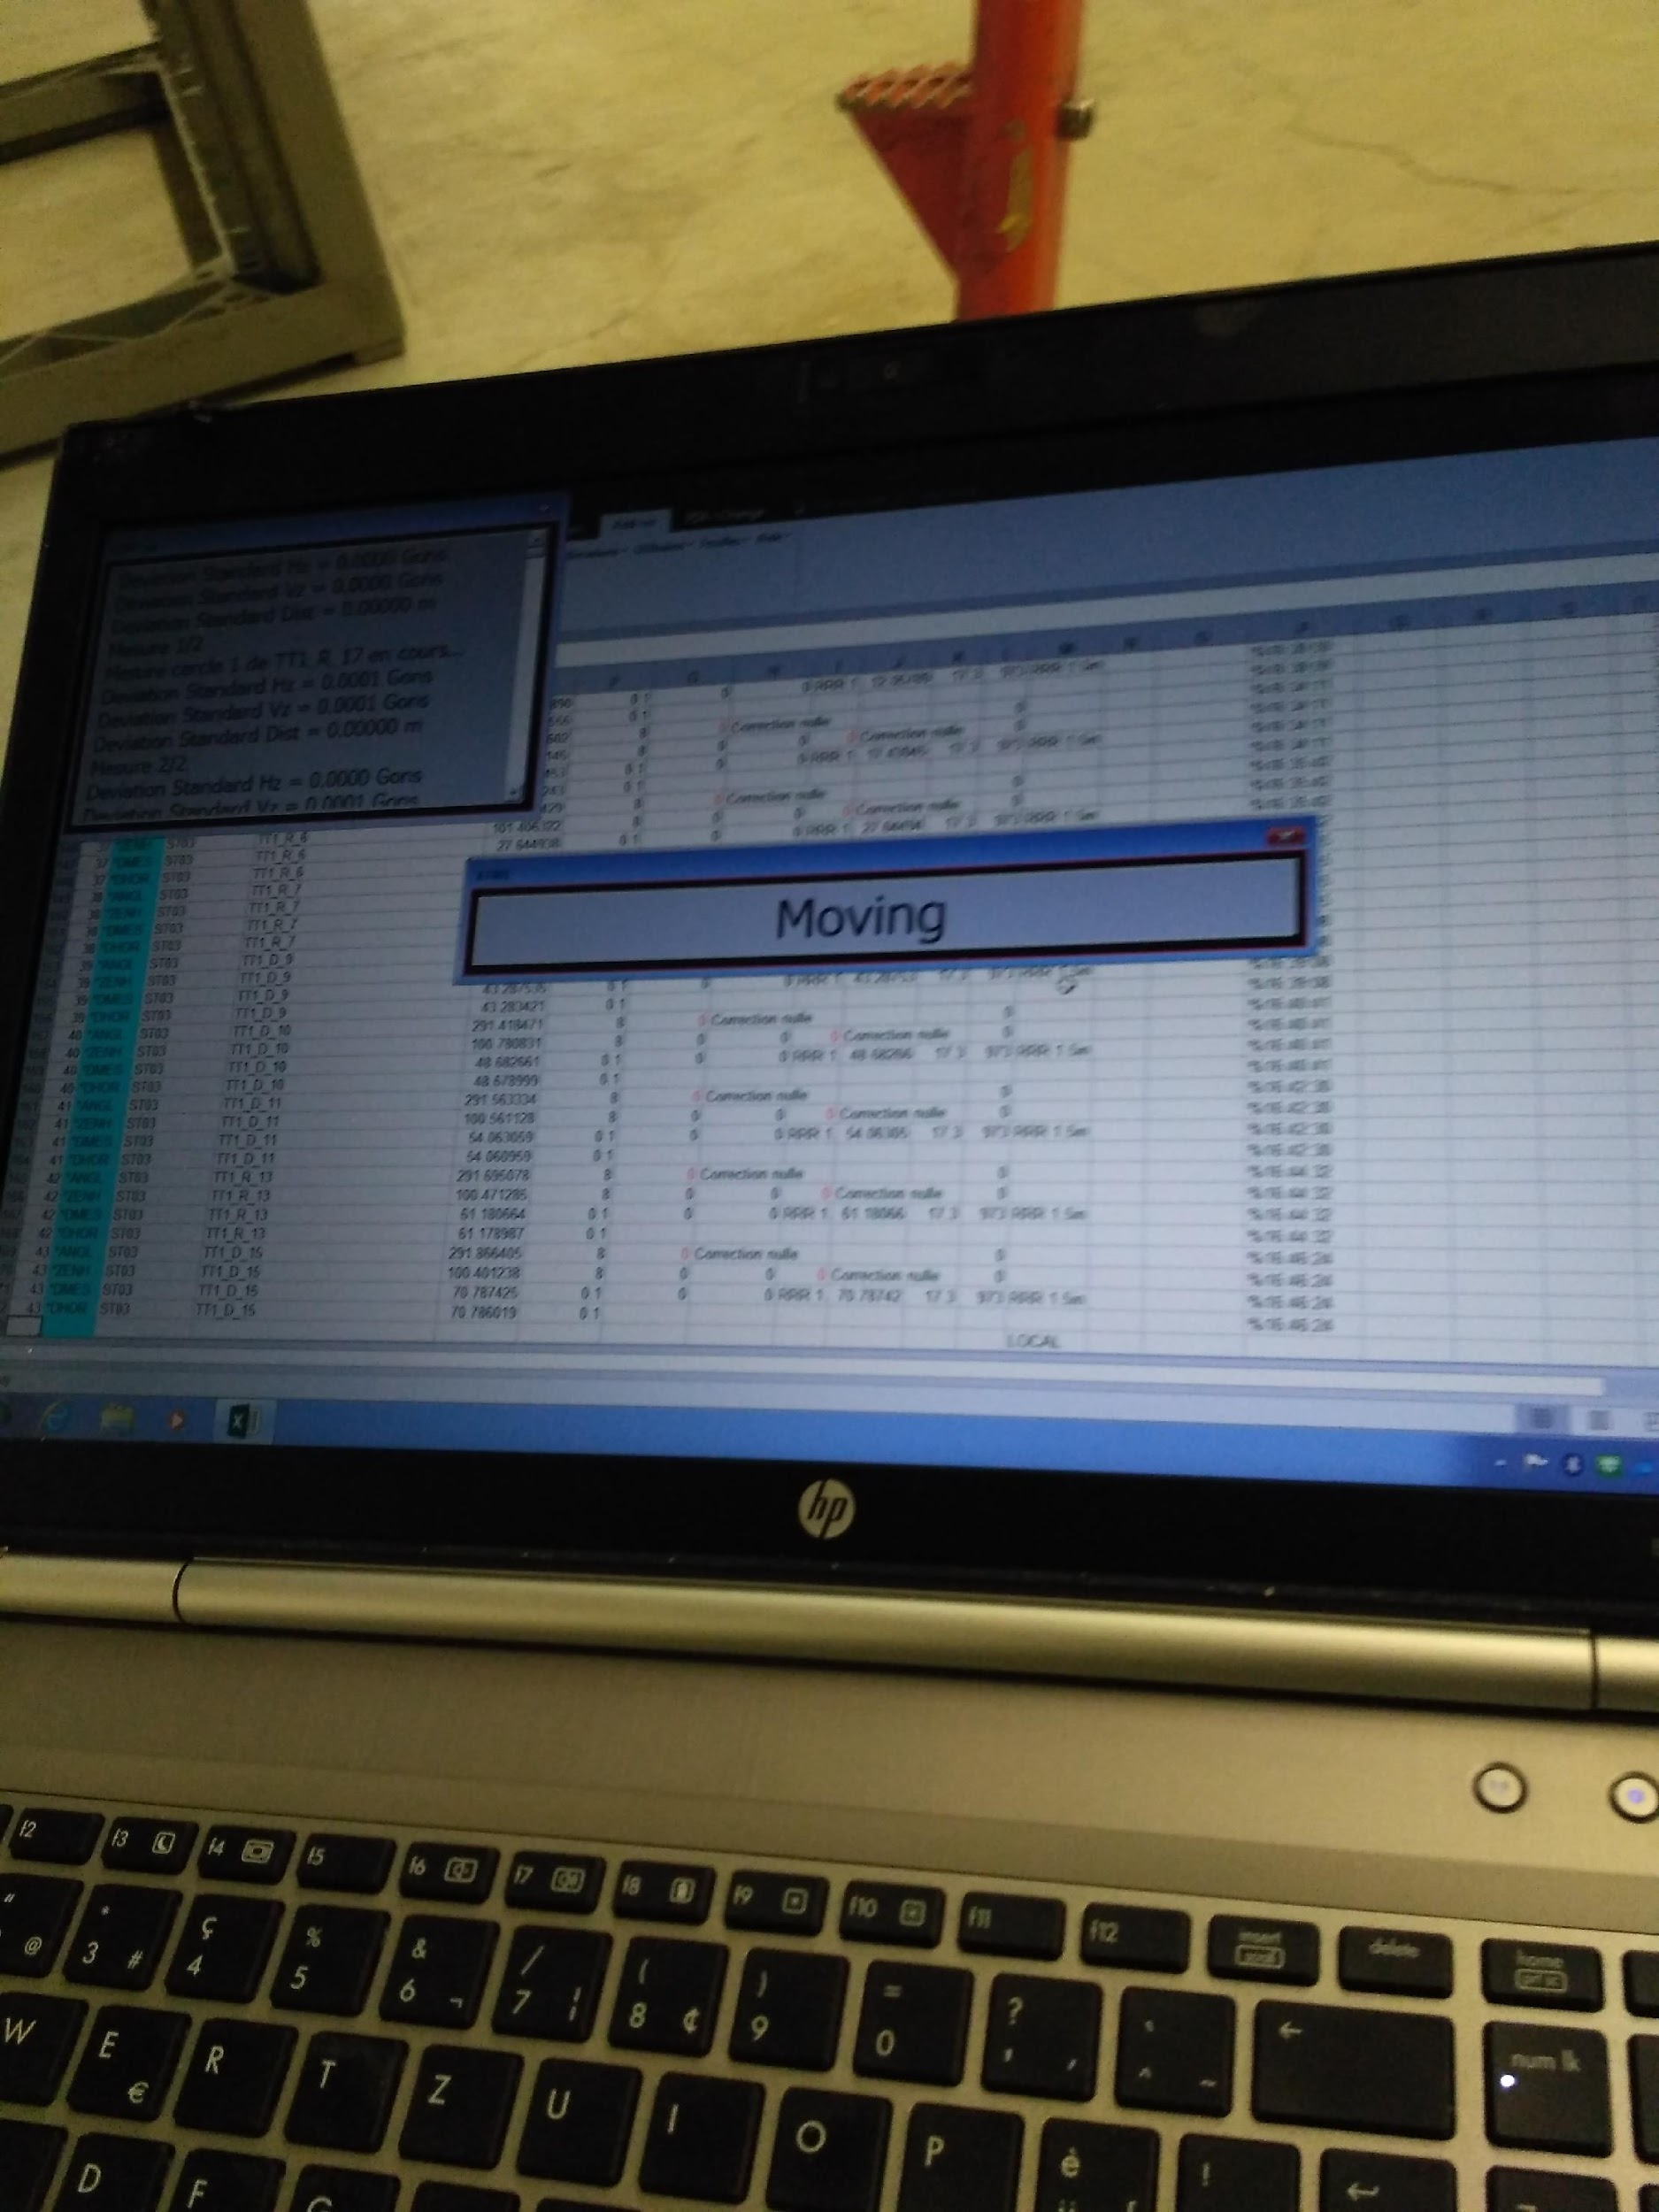

Slide 16
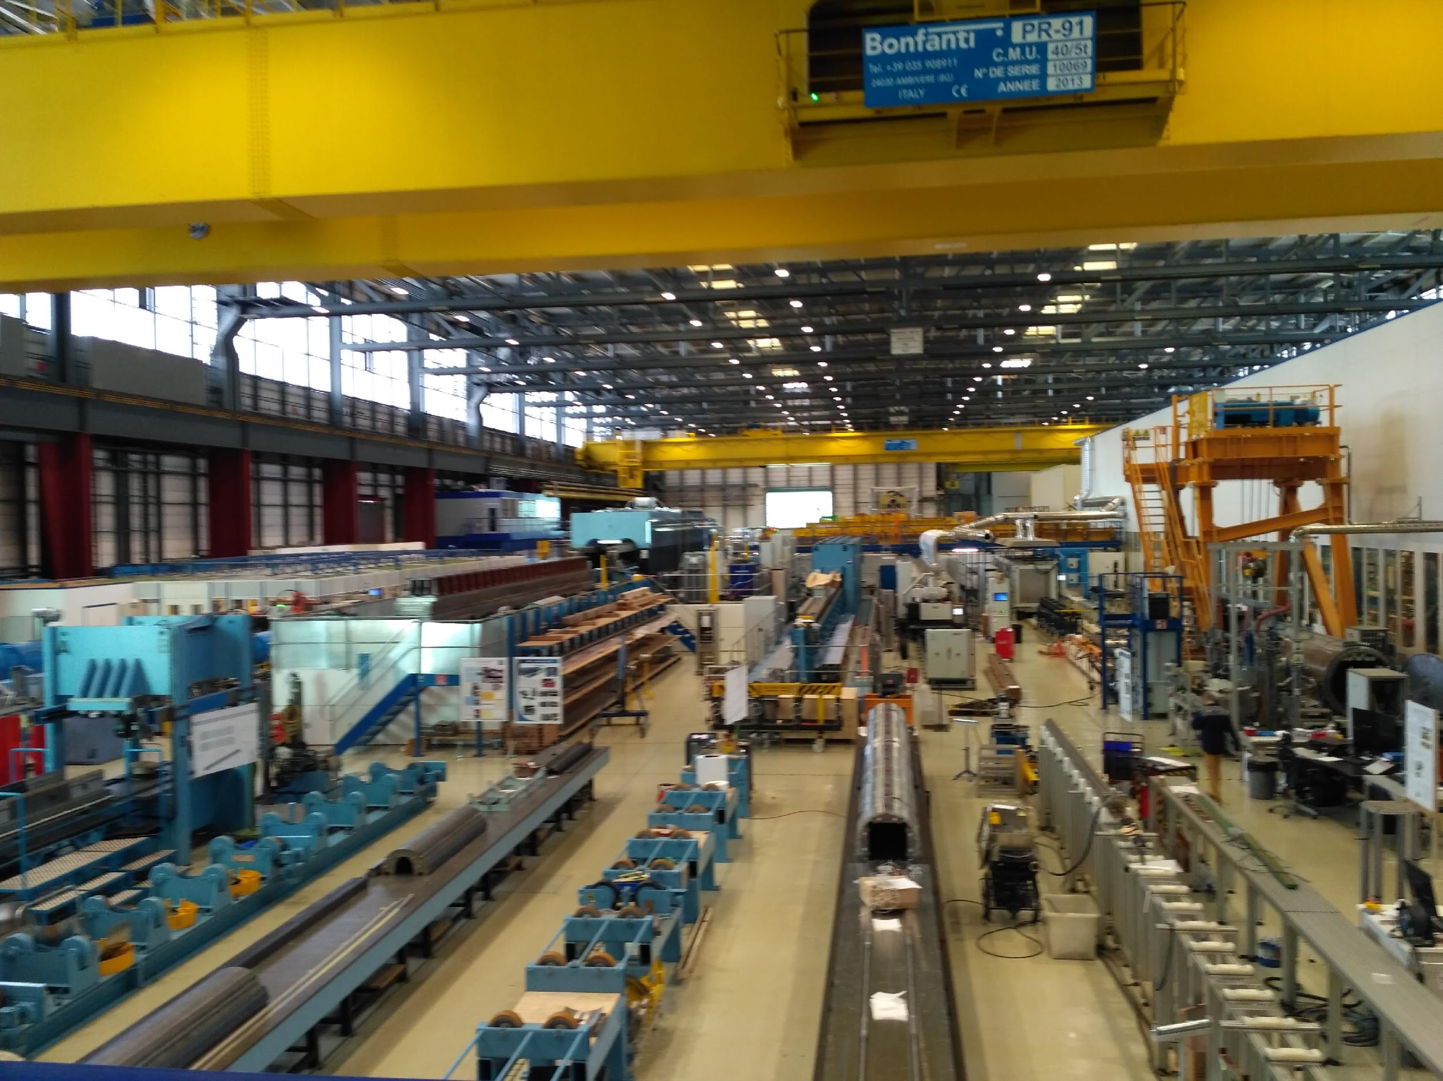
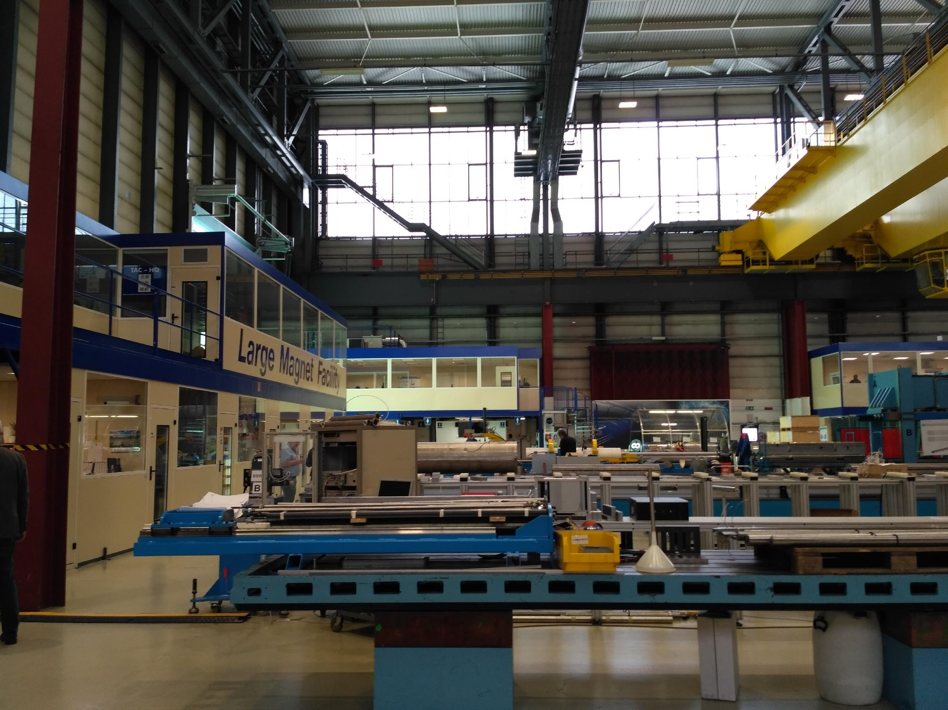
Other experience: LMF

Slide 17
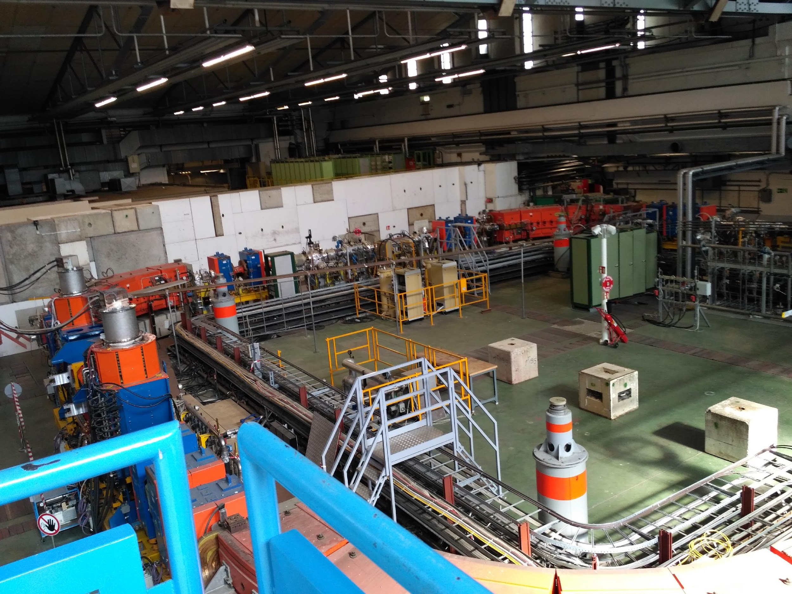
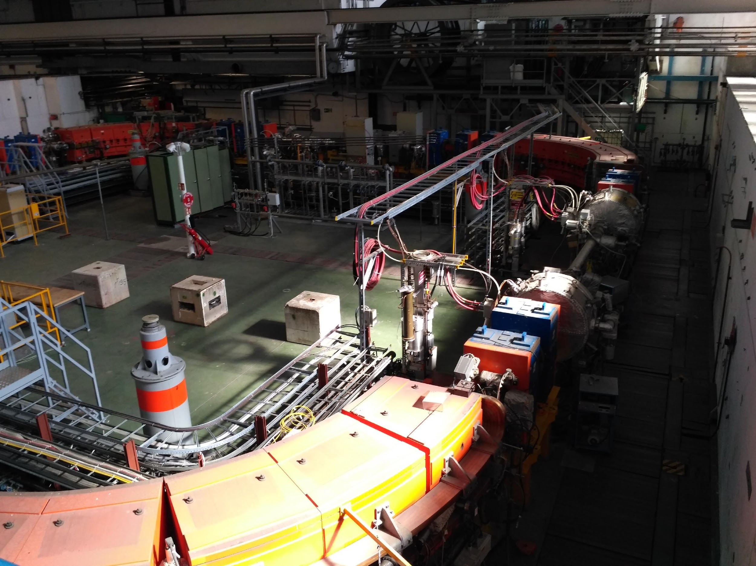
LEIR

Slide 18
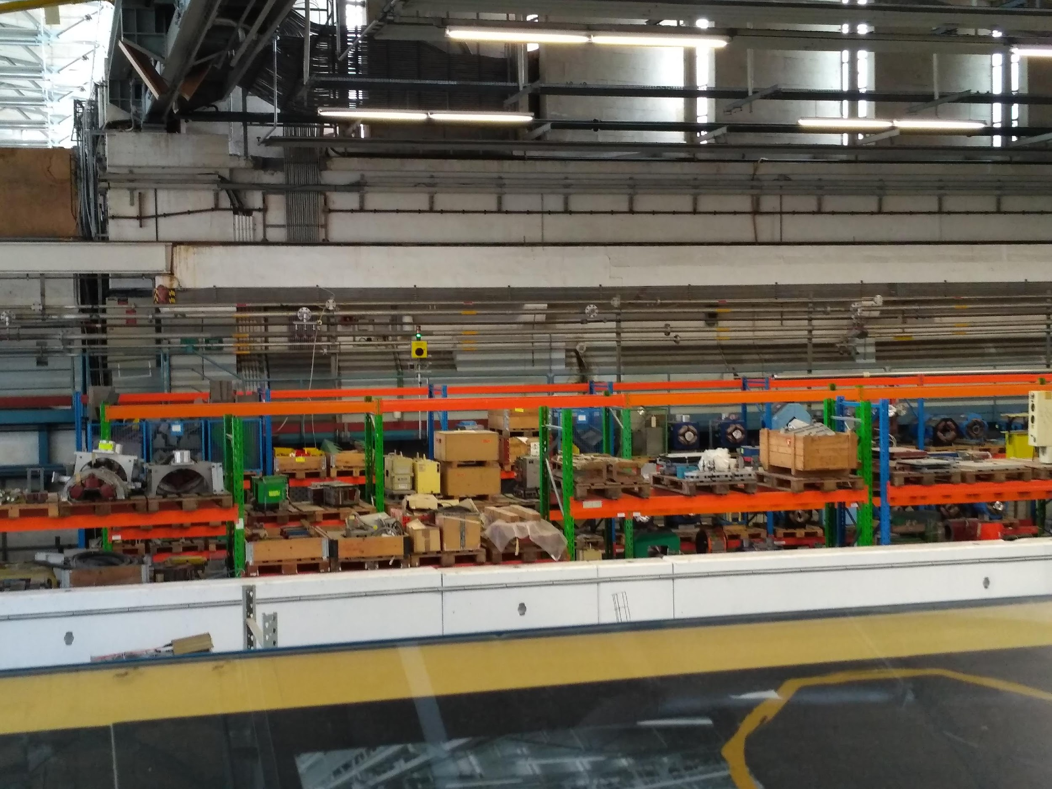
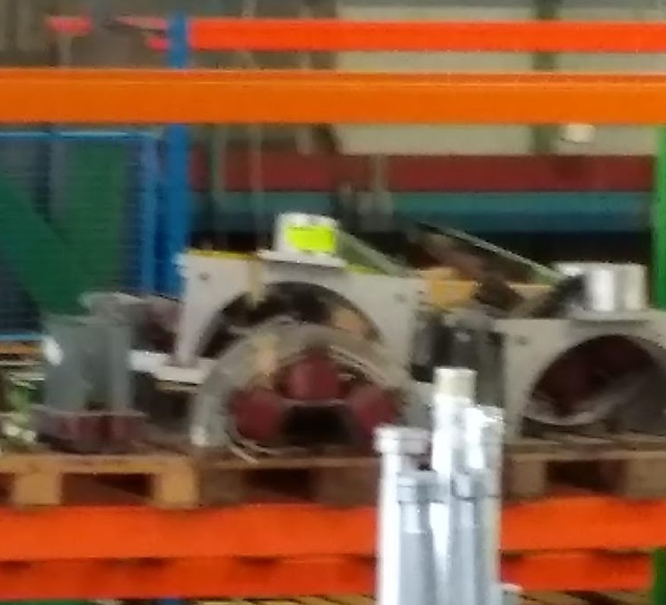

Slide 19
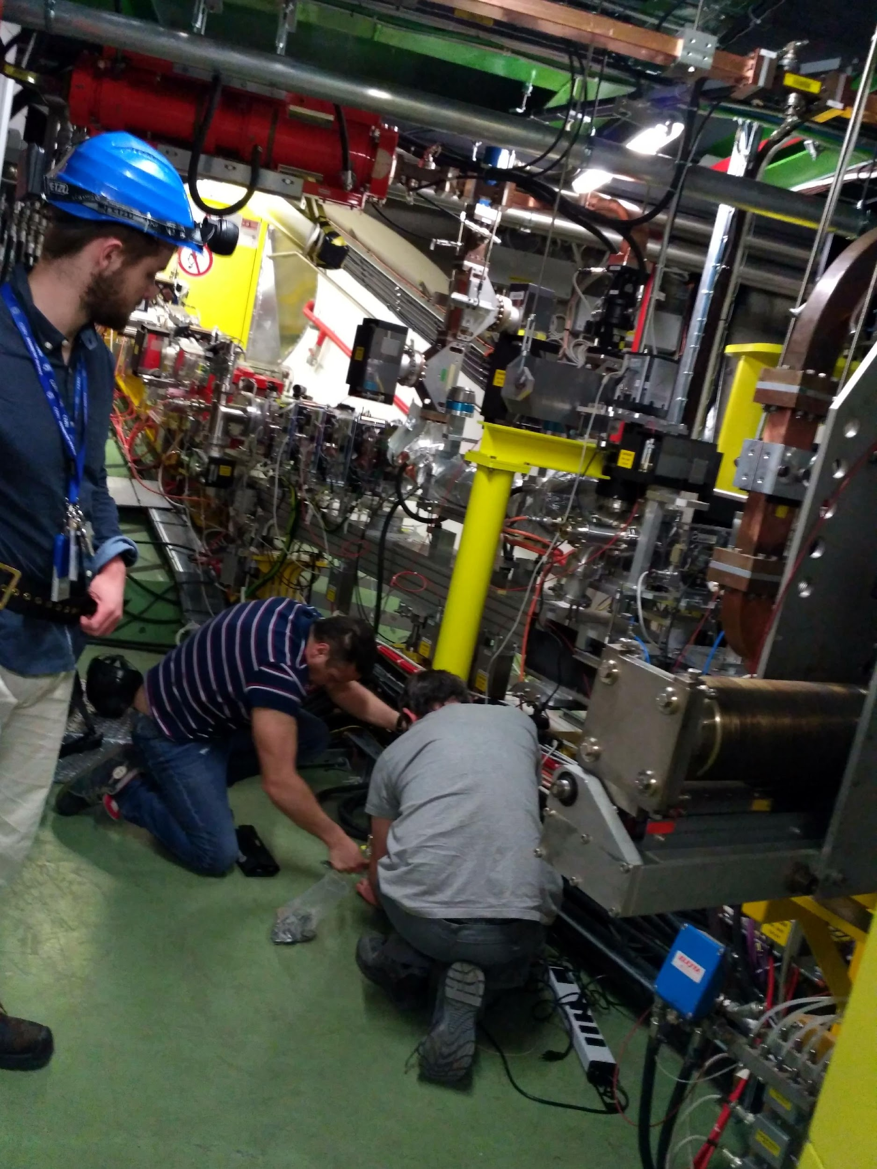
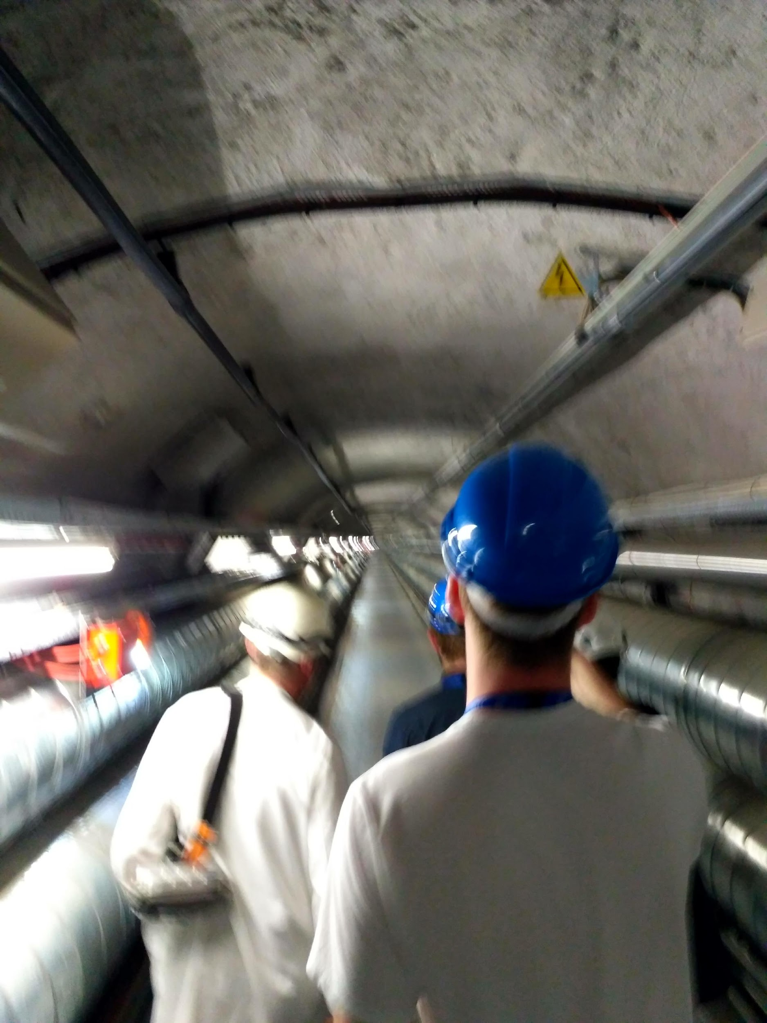
AWAKE

Slide 20
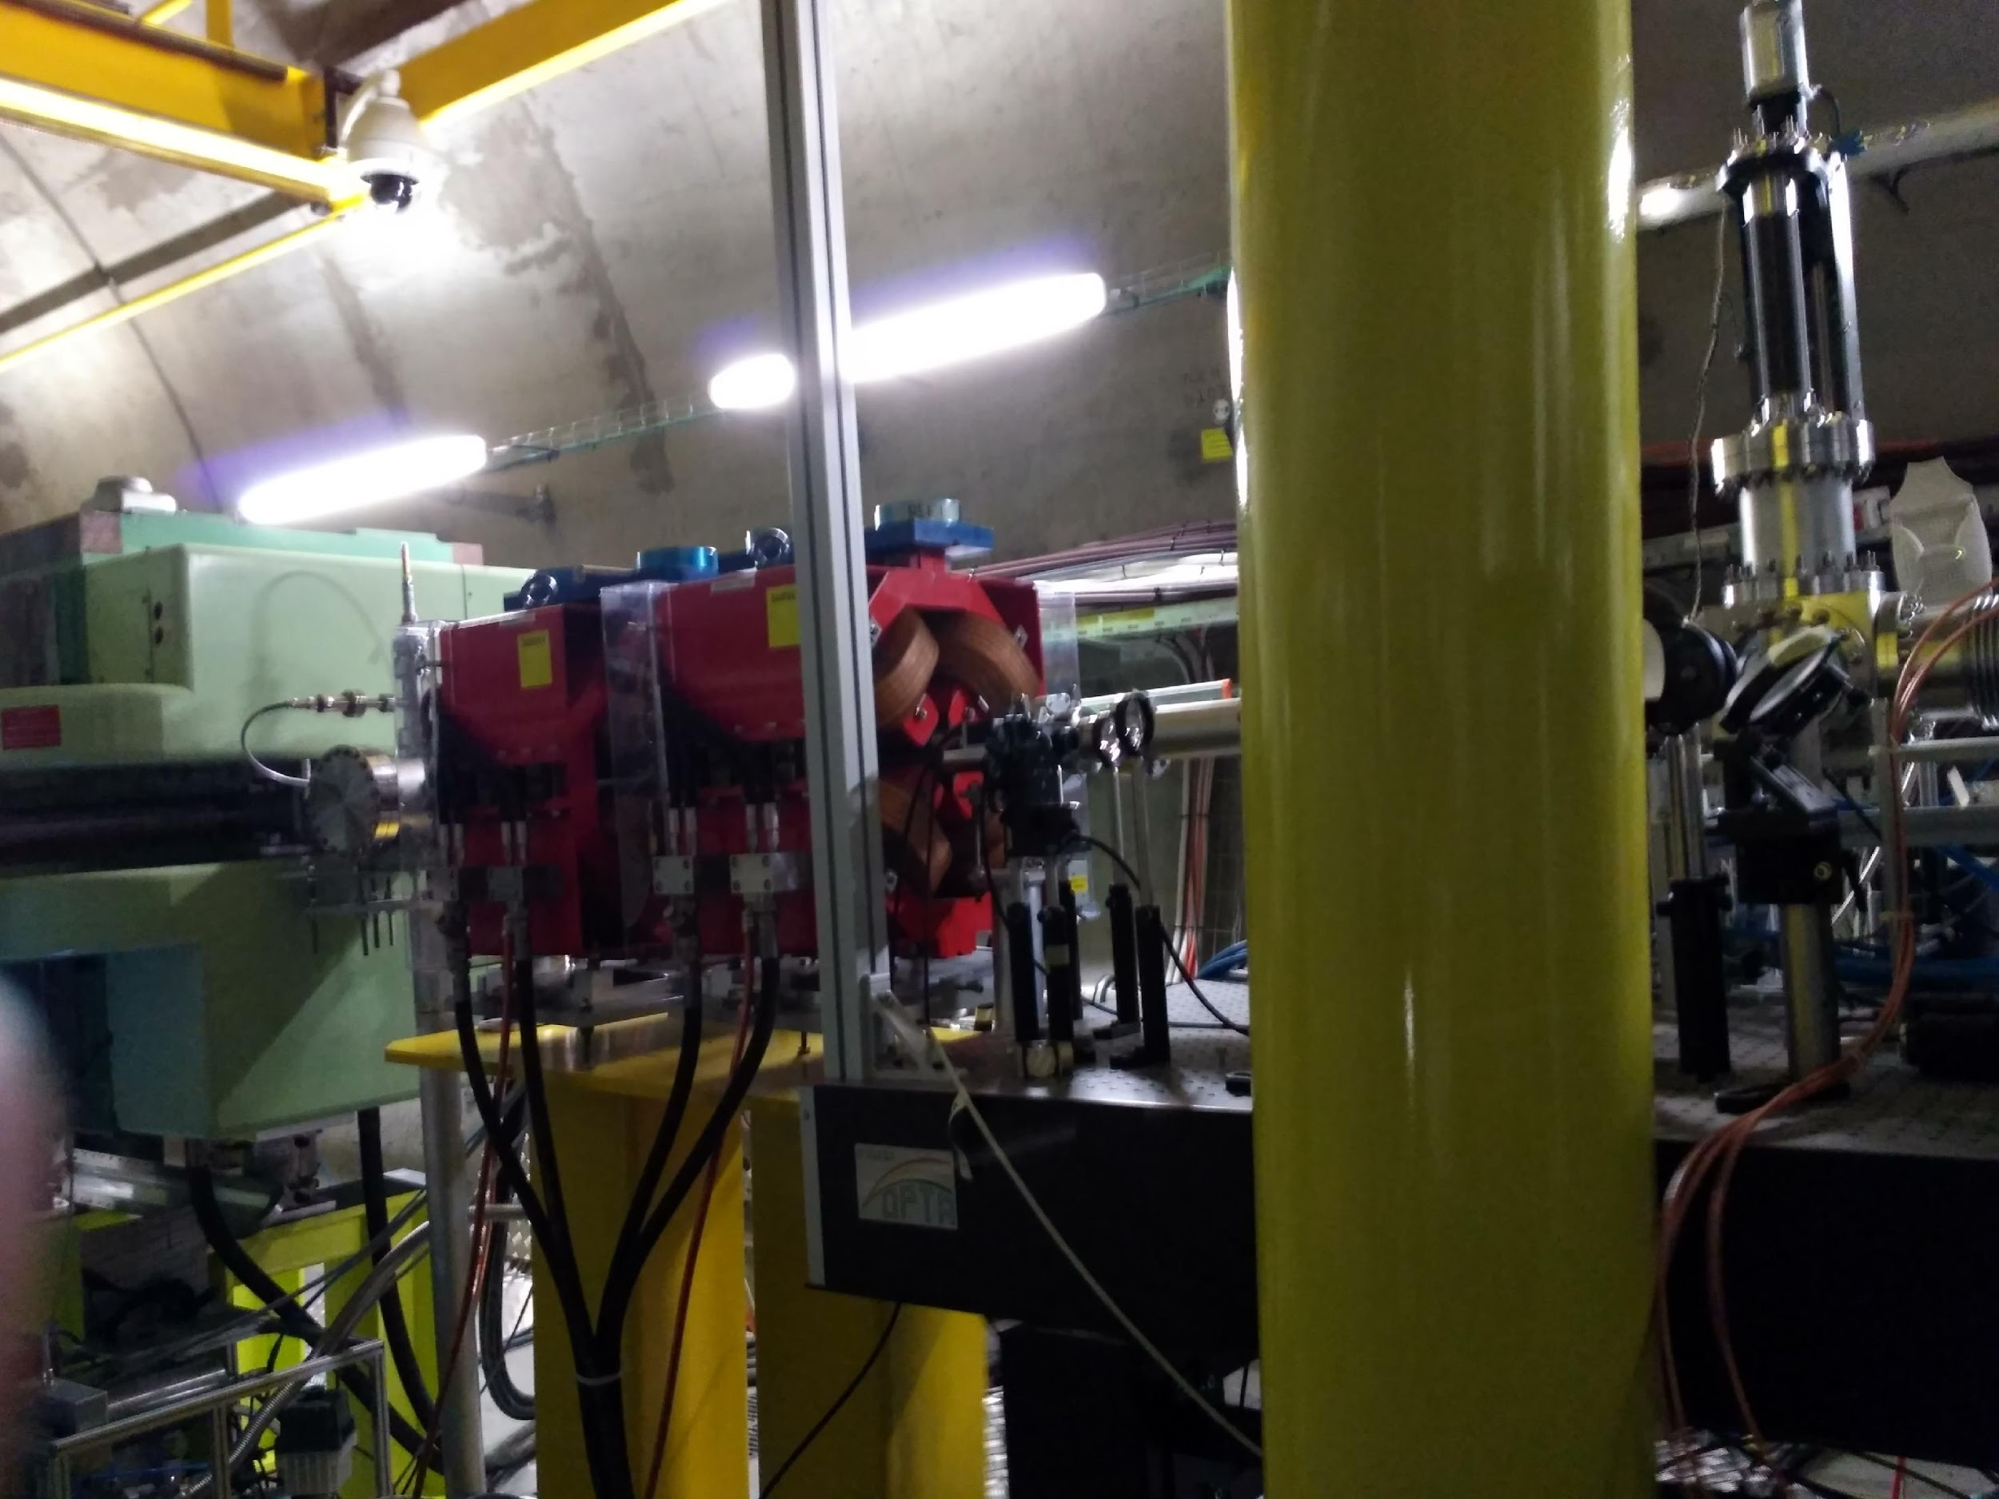
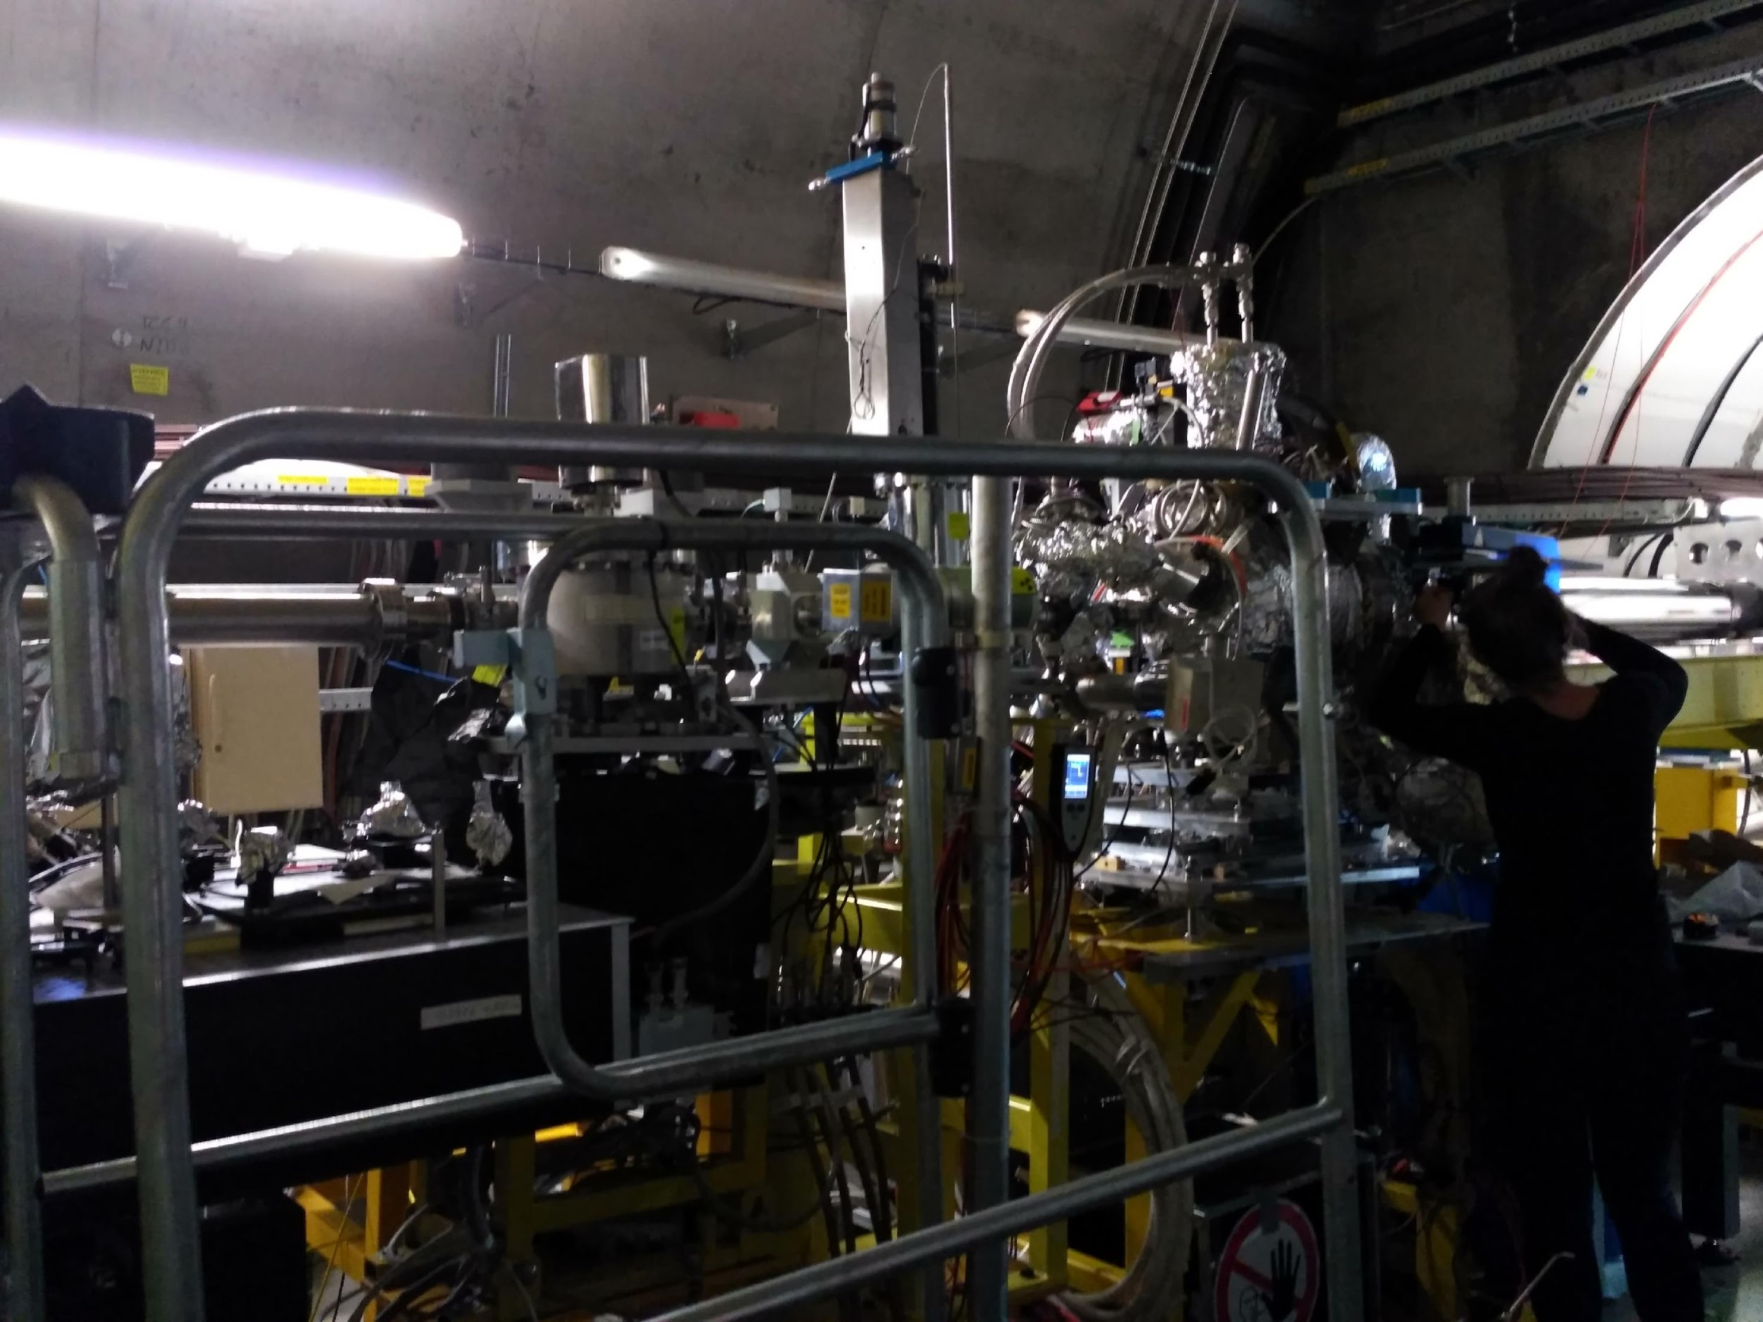
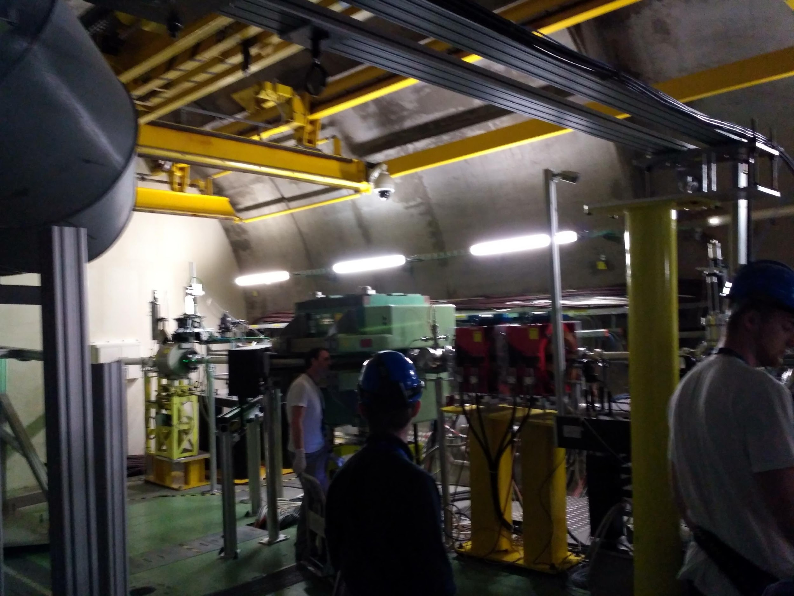

Slide 21
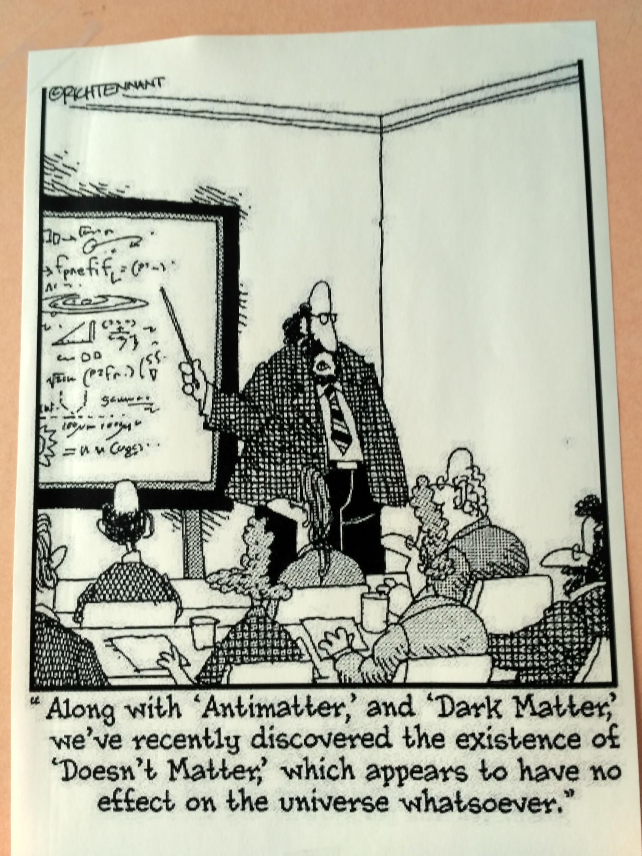
Thanks for Listening & a big thanks for the great experience

