Slide 1
Nb₃Sn Coils - Thermal Contraction Measurements
G. Vallone, P. Ferracin, C. Fichera
Technical Meeting
CERN, 01/12/2017

Slide 2
Outline
Introduction
Thermal contraction meas. techniques for Nb₃Sn (and NbTi)
Cable stack model
MQXF FE model calibration
Conclusion

Slide 3
Outline
Introduction
Thermal contraction meas. techniques for Nb₃Sn (and NbTi)
Cable stack model
MQXF FE model calibration
Conclusion

Slide 4
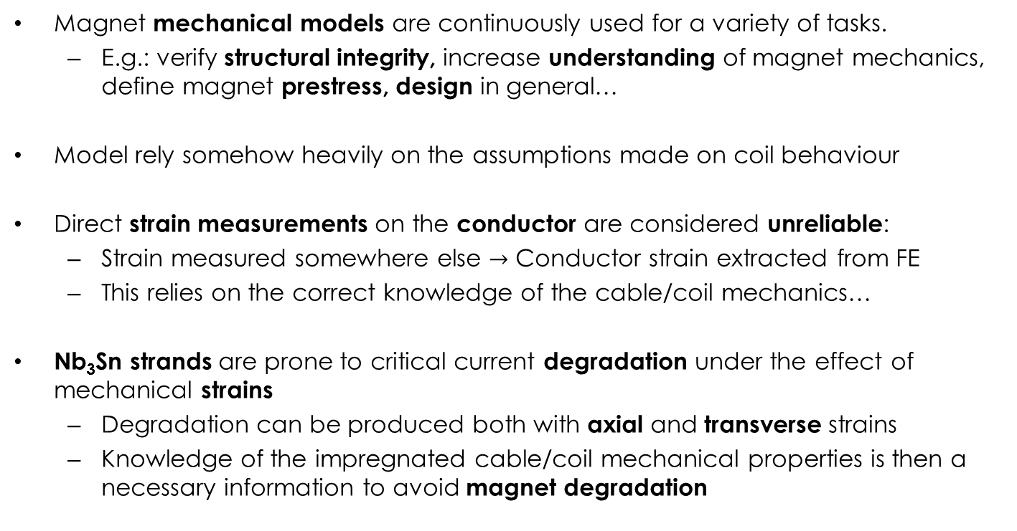
Introduction (1)
Magnet mechanical models are continuously used for a variety of tasks.
  E.g.: verify structural integrity, increase understanding of magnet mechanics, define magnet prestress, design in general…
Model rely somehow heavily on the assumptions made on coil behaviour
Direct strain measurements on the conductor are considered unreliable:
  Strain measured somewhere else $→$ Conductor strain extracted from FE
  This relies on the correct knowledge of the cable/coil mechanics…
Nb₃Sn strands are prone to critical current degradation under the effect of mechanical strains
  Degradation can be produced both with axial and transverse strains
  Knowledge of the impregnated cable/coil mechanical properties is then a necessary information to avoid magnet degradation

Slide 5
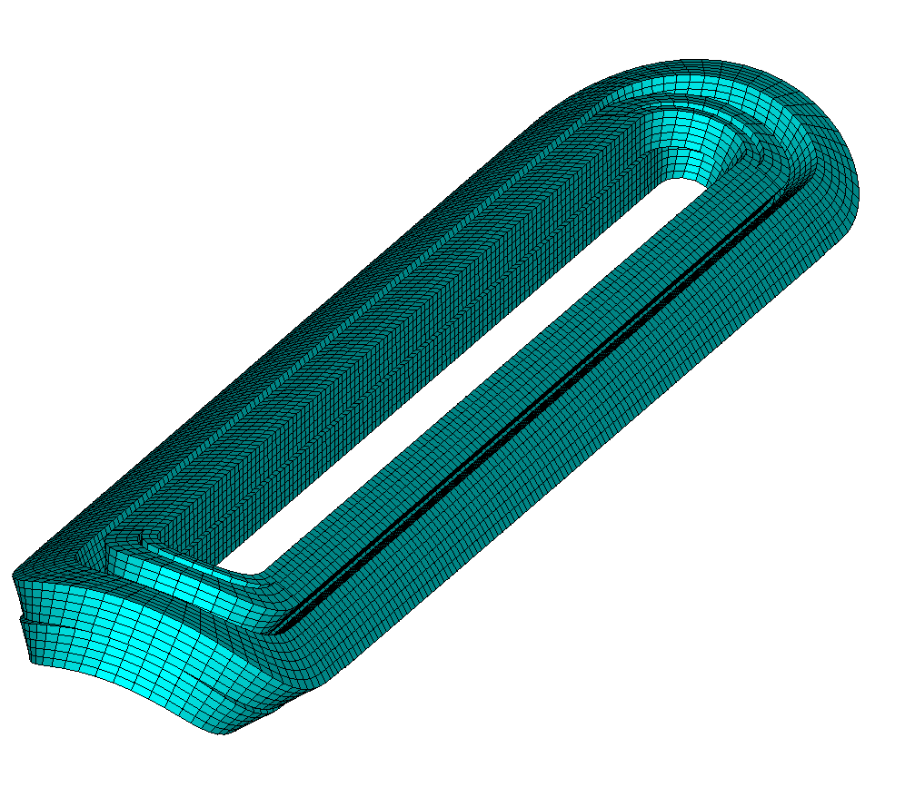
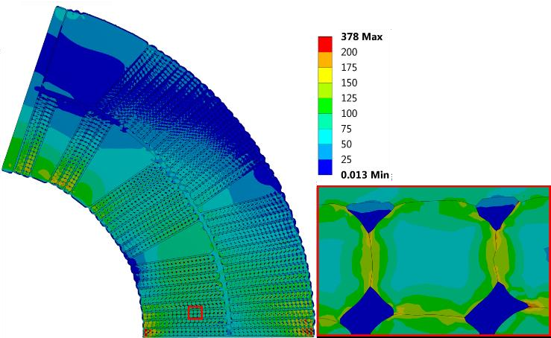
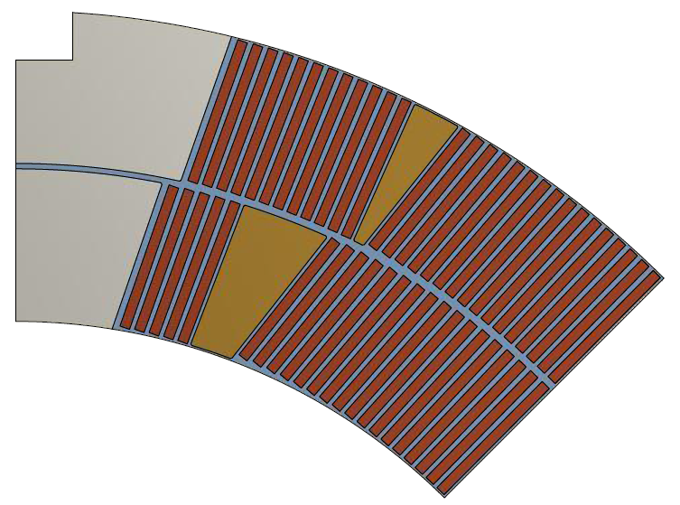
Modelling Strategies
Block Model
Cable Model
C. Löffler et al., EUCAS 2017
Strand Model
M. Daly et al., MT25, 2017
Block model is the current standard approach:
  Coil approximated as an uniform block with uniform mechanical properties
  Properties were measured in the past on impregnated coil stacks
  Orthotropic in 2D, isotropic in 3D
This consistent way of modelling also allowed to define an empirical limit on the coil equivalent stress (150:200 MPa - H. Felice et al., IEEE TAS, 2011)
New modelling strategies are currently under development

Slide 6
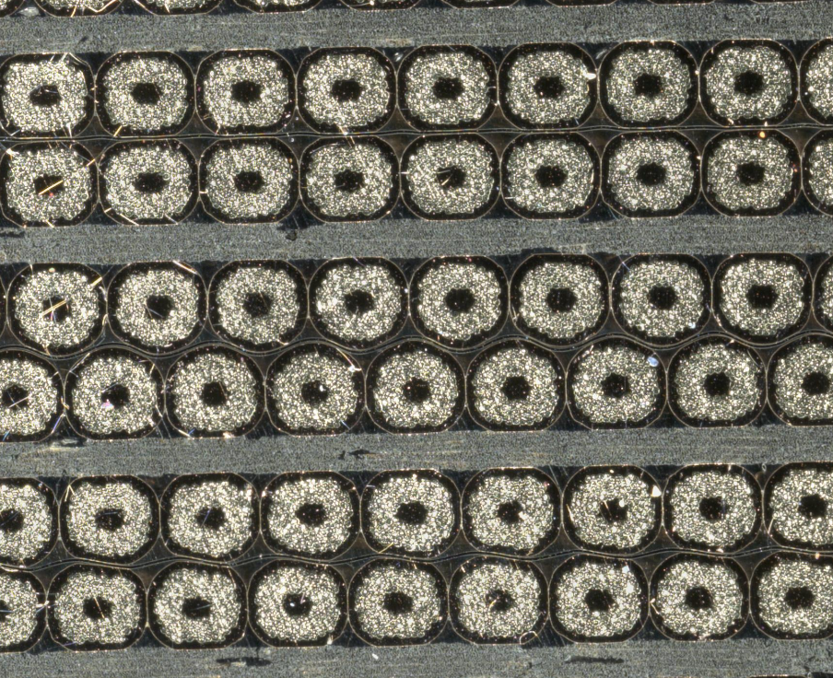
Coil Components
Coil components thermal contraction:
  Copper: 3.12 mm/m (NIST)
  Nb₃Sn: 1.85 mm/m (Mitchell, 2005)
  Epoxy: 6.56 mm/m (NIST), 11.7 mm/m (Kirby, 2015)
  Impregnated glass fiber: 7.49 mm/m (NIST)
  Mica: ?
If we want to use a block approach, we need to estimate the global coil contraction
Neglecting the epoxy, we would expect a contraction roughly between 2 and 5 mm/m

Slide 7
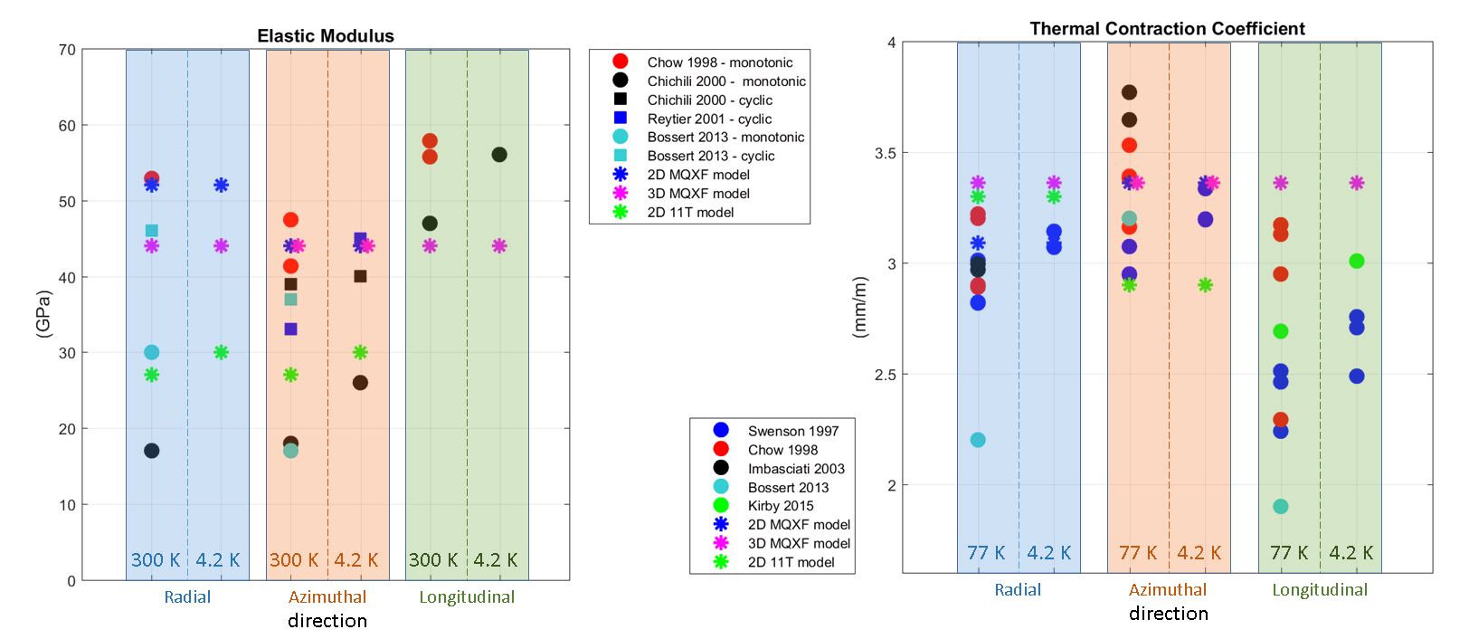
Coil Properties – Available Data
Y – azimuthal
Z – longitudinal
X – radial
Available coil properties measures highly dispersed
Measured Young modulus: 15-60 GPa. Also depends upon cyclic/monotonic loading phase
Measured thermal contraction: 2-4 mm/m

Slide 8
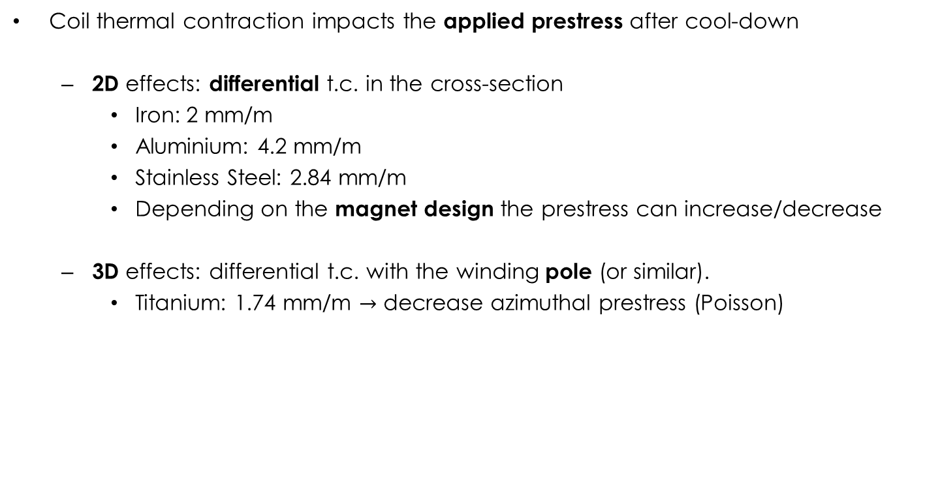
Introduction (2)
Coil thermal contraction impacts the applied prestress after cool-down
  2D effects: differential t.c. in the cross-section
    Iron: 2 mm/m
    Aluminium: 4.2 mm/m
    Stainless Steel: 2.84 mm/m
    Depending on the magnet design the prestress can increase/decrease
  3D effects: differential t.c. with the winding pole (or similar).
    Titanium: 1.74 mm/m $→$ decrease azimuthal prestress (Poisson)

Slide 9
Introduction (3)
Thermal contraction measurements:
  Results may be cycle/load/story dependent:
    E.g.: copper hardened during the first thermal cycle/loading…
  Initial stack softness may compromise the results (very low initial stiffness)
  Results may depend on the knowledge of the warm/cold specimen stiffness
Here we focus on the techniques used in the past on Nb₃Sn and NbTi cable stacks

Slide 10
Outline
Introduction
Thermal contraction meas. techniques for Nb₃Sn (and NbTi)
Cable stack model
MQXF FE model calibration
Conclusion

Slide 11
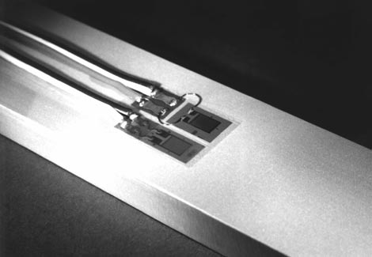
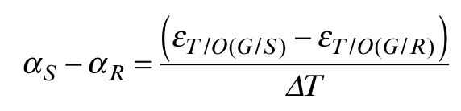
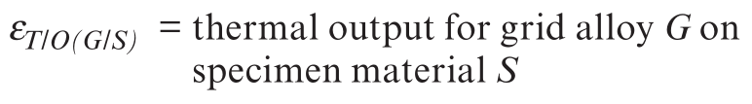
T1: Strain Gauges (1)
Strain gauges thermal output is produced by the resistivity variation of the gauge and the mechanical strain due to the thermal contraction/expansion.
Installing the same gauge on a material of known contraction and on the specimen we can deduce the thermal contraction of the specimen.
Technique explained in [1]. Used in [2]-[4].
[1] Vishay Precision Group, “Measurement of Thermal Expansion Coefficient Using Strain Gages,” Tech Note, no. TN-513-1, pp. 119–129, 2010.
[2] C. A. Swenson et al., “Measurement of Thermal Contraction Properties for NbTi and Nb3Sn Composites,” IEEE Trans. Appl. Supercond., vol. 7, no. 2, pp. 408–411, 1997.
[3] D. R. Chichili et al. “Investigation of cable insulation and thermo-mechanical properties of epoxy impregnated Nb3Sn composite,” IEEE Trans. Appl. Supercond., vol. 10, no. 1, pp. 1317–1320, Mar. 2000.
[4] R. Bossert et al., “Recent progress and tests of radiation resistant impregnation materials for Nb3Sn coils,” AIP Conf. Proc., vol. 1574 60, pp. 132–139, 2014.

Slide 12

T1: Strain Gauges (2)
Thoughts:
  Could be done easily
  Does not look so proper for a composite (we would measure on the resin)
  In literature, done with free specimen $→$ no prestress
  Can we modify the method to include a prestress specimen?

Slide 13
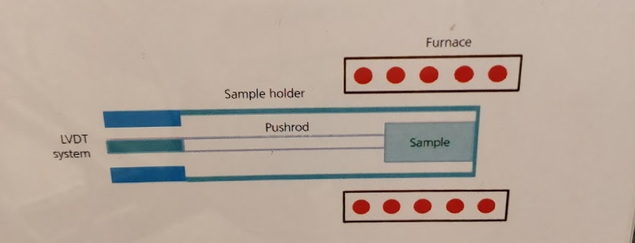
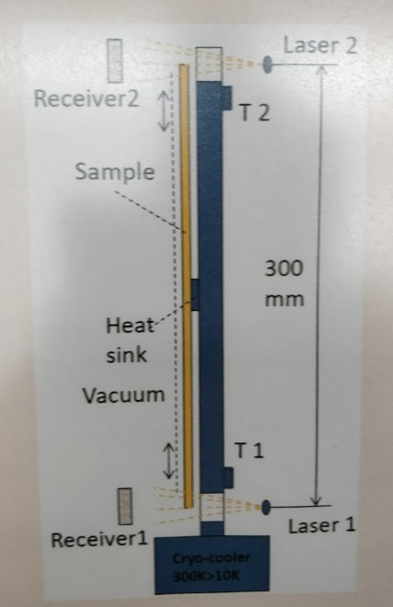
T2: Dilatometers
Sample in free condition, measure the displacement with LVDTs, lasers etc. [5], [6].
1 available in 927. Can be used for radial/longitudinal.
Pro: global measure (sg are local)
Concerns: no prestress, sample size (for azimuthal)
[5] V. N. Gladky et al., “Thermal contraction of superconducting magnet materials,” Cryogenics (Guildf)., vol. 35, no. 1, pp. 67–69, Jan. 1995.
[6] G. Kirby et al., “Thermal Contraction at Cryogenic Temperatures.”. 2015

Slide 14
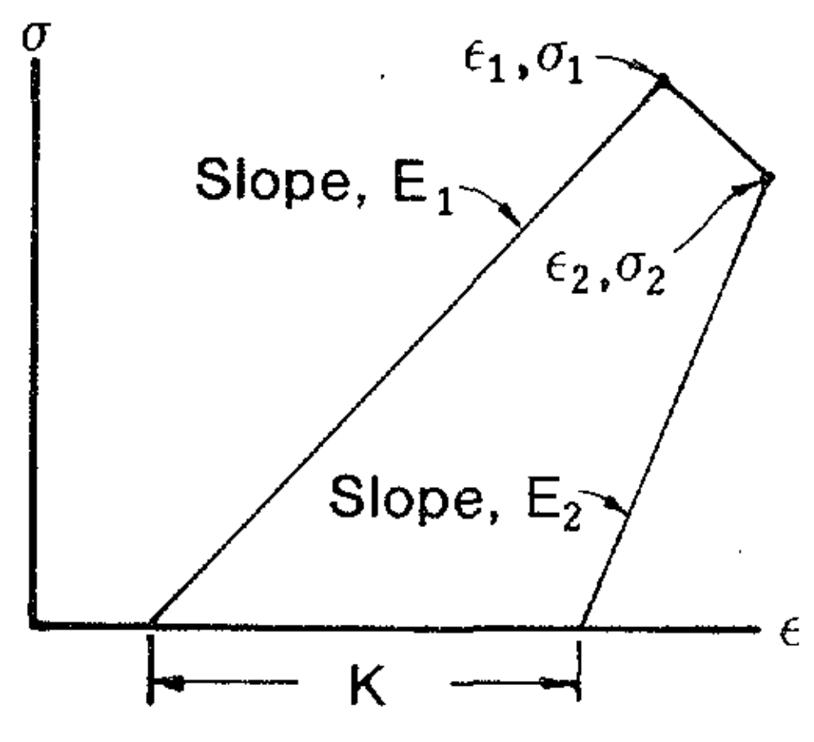
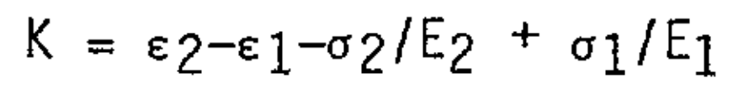
T3: Moulds (1)
Sample in a parallel spring loop with a reference
First proposed in [7], where the authors measured force (load cell) and displacement (LVDT) of the stack.
Pro: can apply a prestress, closer to what happens in a magnet
Cons: measurement depends on the knowledge of the stack modulus variation
[7] R. Meuser, S. Caspi, and W. Gilbert, “Measured mechanical properties of superconducting coil materials and their influence on coil prestress,” IEEE Trans. Magn., vol. 17, no. 5, pp. 2320–2323, Sep. 1981.

Slide 15
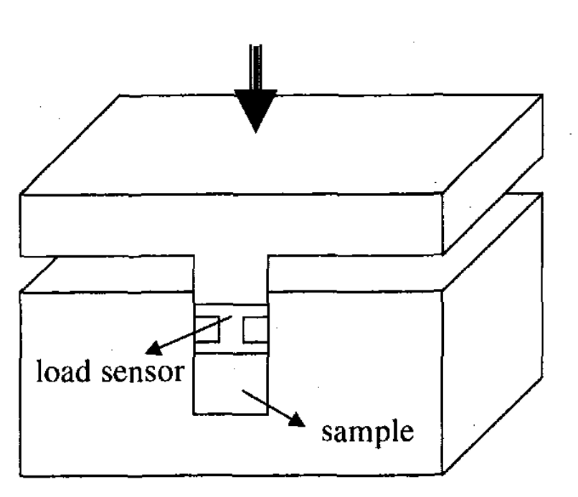
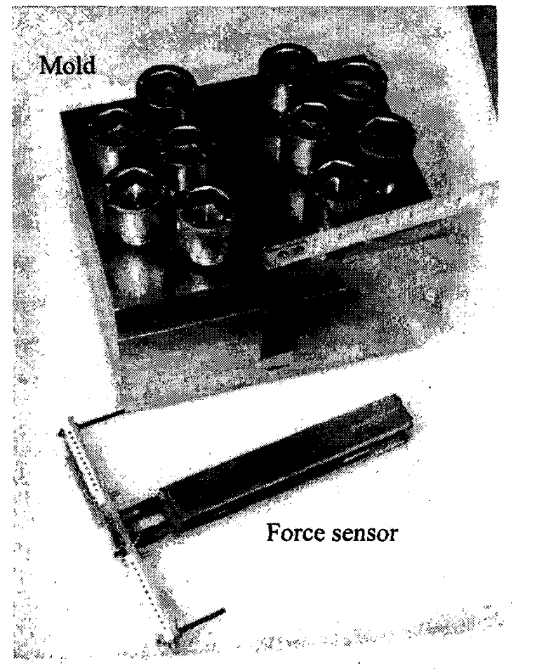
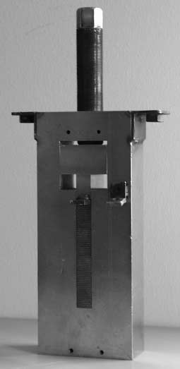
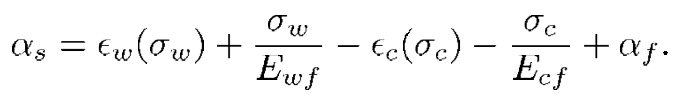
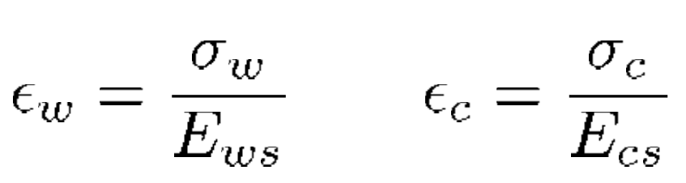
T3: Moulds (2)
In [8]-[10], it was shown that we can get rid of the displacement measure:
Force can be measured by means of load cells [7], strain gauges [8], [9], capacitive gauges [10].
[8] P. Vedrine et al., “Measurement of thermo-mechanical properties of NbTi windings for accelerator magnets,” IEEE Trans. Appiled Supercond., vol. 9, no. 2, pp. 236–239, Jun. 1999.
[9] M. Reytier et al., “Characterization of the thermo-mechanical behavior of insulated cable stacks representative of accelerator magnet coils,” IEEE Trans. Appiled Supercond., vol. 11, no. 1, pp. 3066–3069, Mar. 2001.
[10] K. Couturier, P. Ferracin et al., “Thermomechanical Properties of the Coil of the Superconducting Magnets for the Large Hadron Collider,” IEEE Trans. Appl. Supercond., vol. 12, no. 2, 2002.

Slide 16
Outline
Introduction
Thermal contraction meas. techniques for Nb₃Sn (and NbTi)
Cable stack model
MQXF FE model calibration
Conclusion

Slide 17
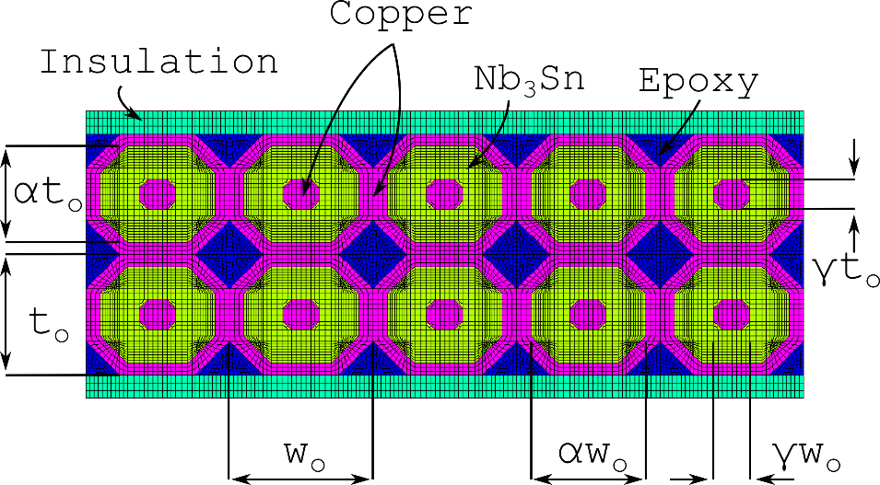
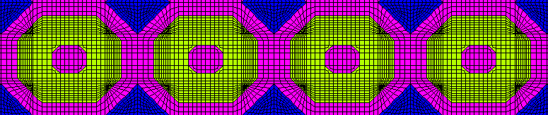
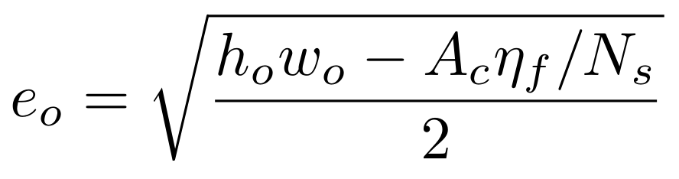
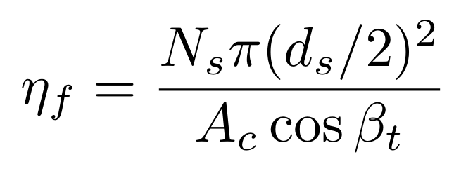
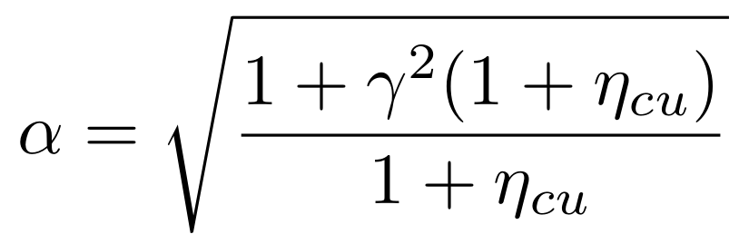
Cable Stack – FE Model (1)
2D FE model of the cable stack
Material properties from literature
Geometry from a mix of image analysis and simple geometric formulas to match the filling factor, copper-non copper etc.

Slide 18
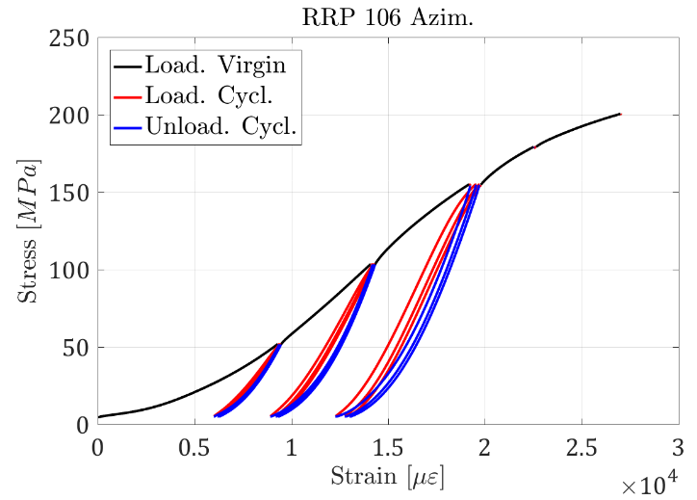
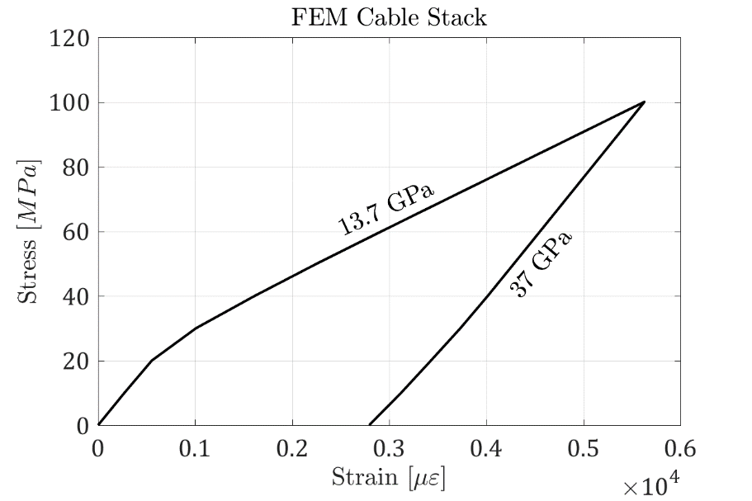
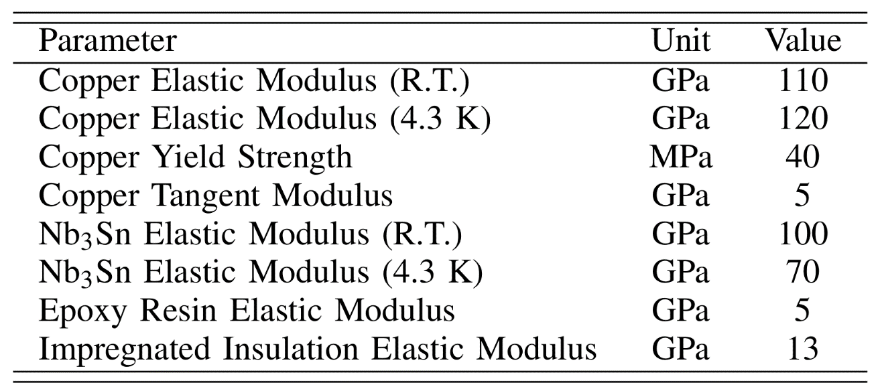
Cable Stack – FE Model (2)
Virgin/cyclic behaviour explained by copper plasticization
FE slope reasonably good, especially considering that no model calibration was necessary
Initial phase may be due to compaction
Thermal contraction (unloaded) ~3.5 mm/m

Slide 19
Outline
Introduction
Thermal contraction meas. techniques for Nb₃Sn (and NbTi)
Cable stack model
MQXF FE model calibration
Conclusion

Slide 20
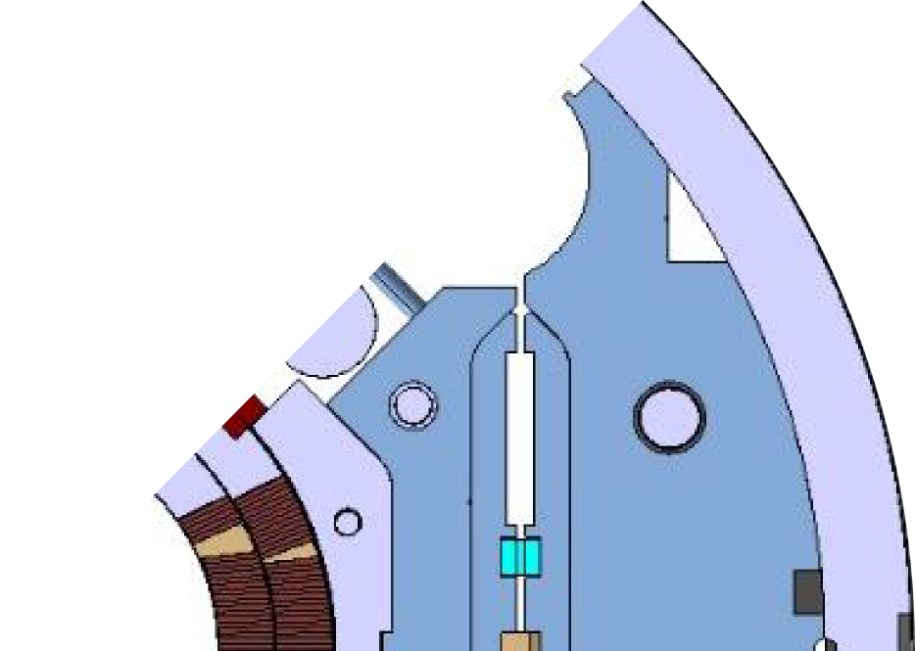

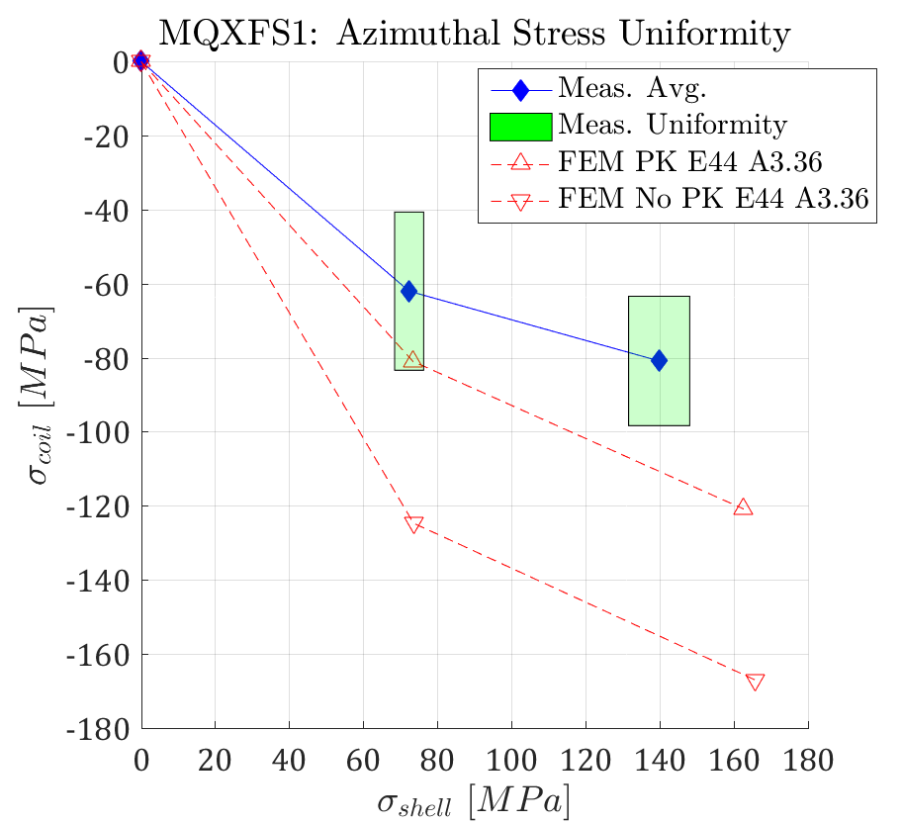
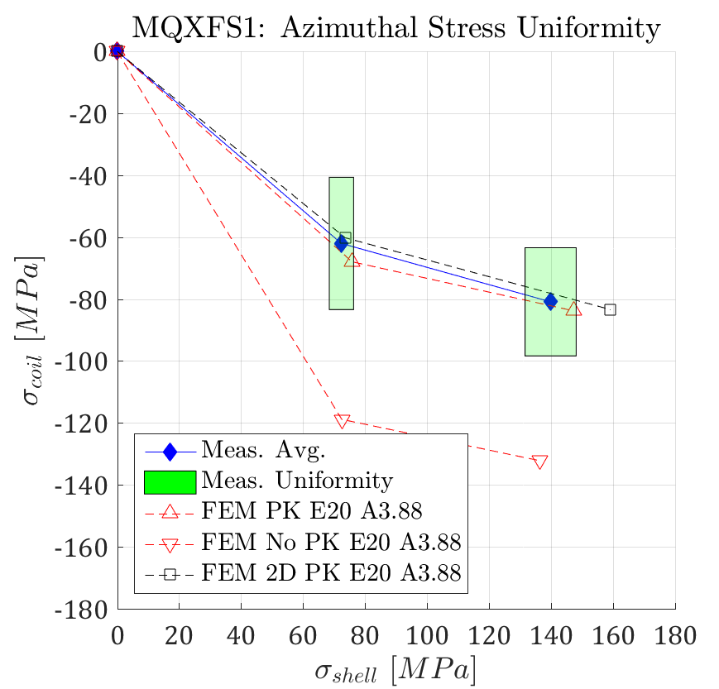
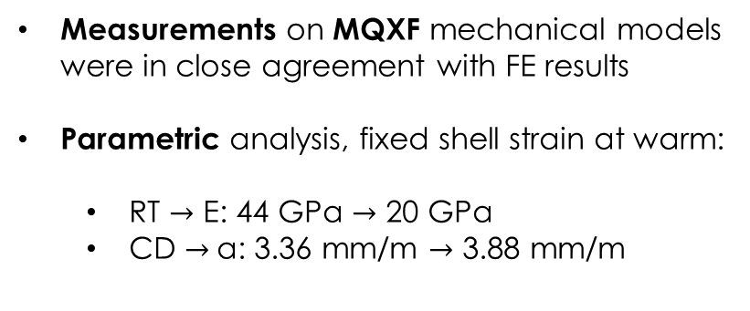
Azimuthal Pre-stress
Measurements on MQXF mechanical models were in close agreement with FE results
Parametric analysis, fixed shell strain at warm:
  RT $→$ E: 44 GPa $→$ 20 GPa
  CD $→$α: 3.36 mm/m $→$ 3.88 mm/m
Shell
Pole
Loading
Cool-Down

Slide 21
Outline
Introduction
Thermal contraction meas. techniques for Nb₃Sn (and NbTi)
Cable stack model
Conclusion

Slide 22
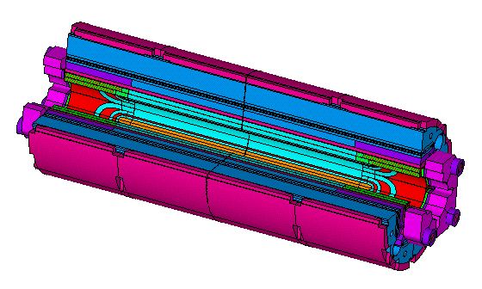
Conclusion
Knowledge of the coil thermal contraction is required to correctly estimate its strain-stress status at cryogenic temperature
Meas. approaches may be divided in 3 macro families:
  Strain gauges – differential strain on the free sample
  Dilatometer - displacement of the free sample
  Moulds – sample in a parallel spring configuration
Each of the approaches has its own advantages.
A simplified model of the cable stack might produce a reasonable estimate of the stack thermal contraction (3.5 mm/m)
For MQXF we are currently using 3.88 mm/m.

Slide 23
Extra

Slide 24
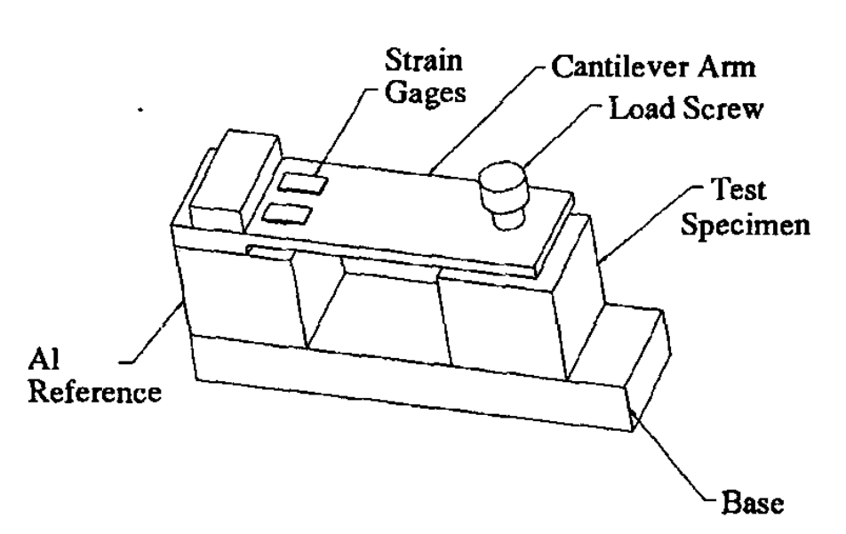
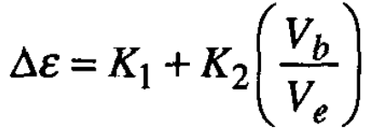
Cantilever Beam
Cantilever configuration proposed in [11].
Methodology seem to neglect the modulus variation
Prestress is not a variable anymore
[11] K. P. Chow and G. A. Millos, “Measurements of modulus of elasticity and thermal contraction of epoxy impregnated niobium-tin and niobium-titanium composites,” IEEE Trans. Appl. Supercond., vol. 9, no. 2 PART 1, pp. 213–215, 1999.

