Slide 1


Commissioning of high precision vibration measurement in experiments
QPr
before inclination
after inclination
after
before
Laser spot
Laser beam
before
Laser
2θ
after
θ
Cuvette with liquid
Horizontal surface of the liquid
(reference level)
Support S
N. Azaryan, J. Budagov, B. Di Girolamo, J.-Ch. Gayde, V. Glagolev, M. Lyablin, D. Mergelkuhl, A. Pluzhnikov, G. Shirkov, G. Trubnikov
CERN & JINR
42nd HL-LHC TCC Meeting – 7 December 2017

Slide 2
Outline
The Precision Laser Inclinometer instrument
  Principle
  Commissioning
Experimental setup at CERN
Measurements and achieved precision
Example of application for high luminosity colliders
Next steps

Slide 3
The Precision Laser Inclinometer (PLI)
This novel instrument, the PLI, has been conceived in JINR – Dubna in collaboration with CERN Survey team and ATLAS physicists
It is part of a large program of survey instrumentation carried out in Dubna with support also from BMBF
It has been developed and installed at CERN: several prototypes in TT1, now a production version
Original interest is the monitoring of the inclinations and oscillations of the ATLAS Cavern and interest has been shown for application in the monitoring of the oscillation of LHC and multi-TeV colliders induced by seismic movements

Slide 4
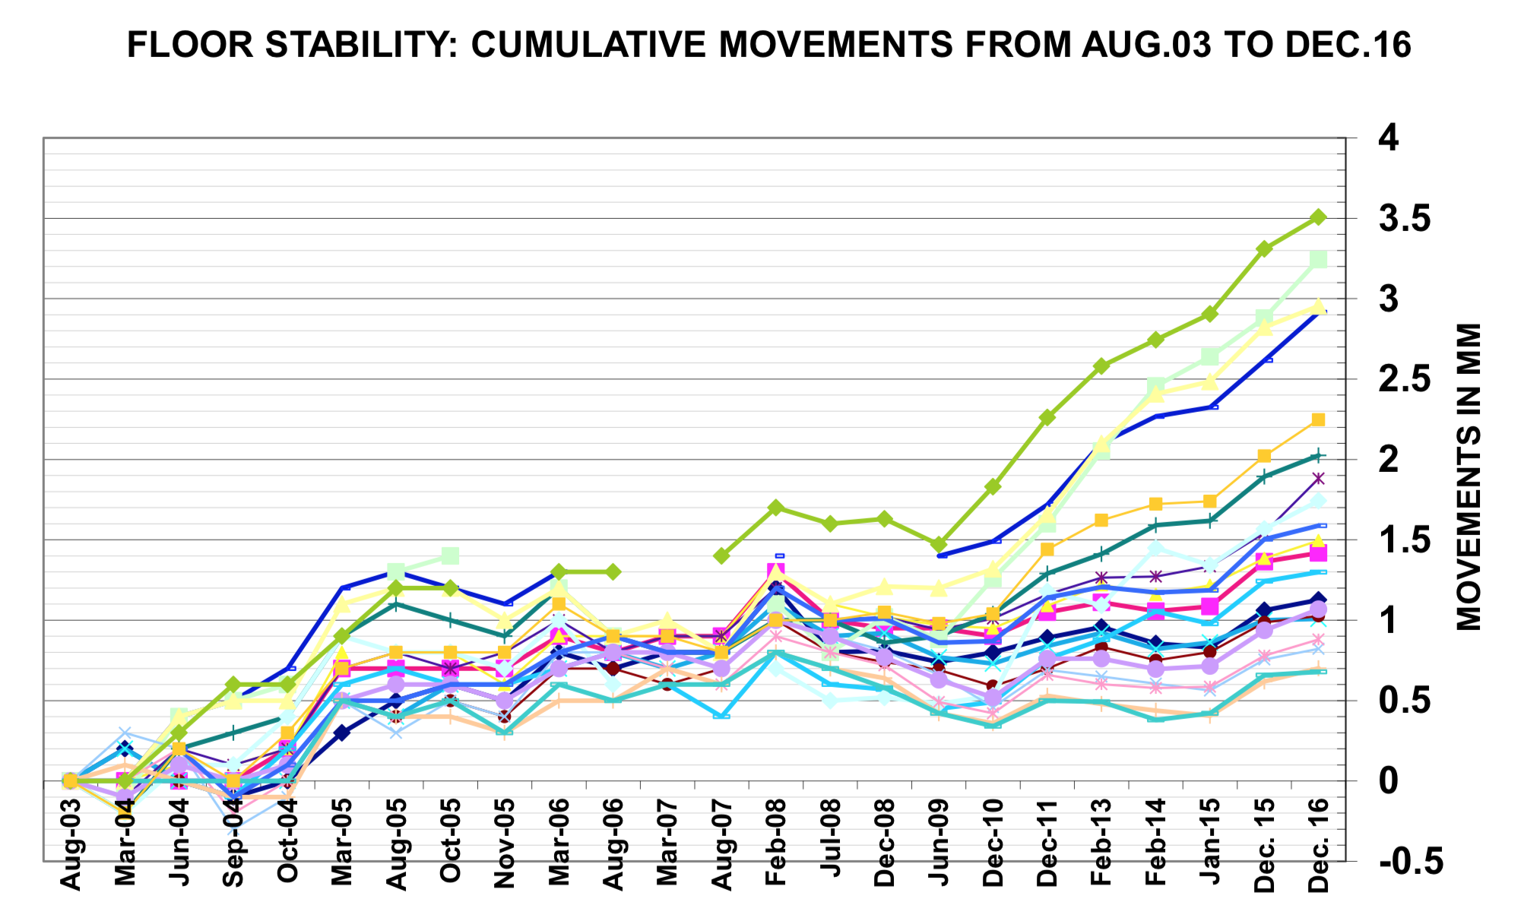
Monitoring of ATLAS Cavern by CERN Survey

Slide 5
Working principle
before inclination
after inclination
QPr
after
before
before
Laser
Laser spot
Laser beam
2θ
after
θ
Cuvette with liquid
Horizontal surface of the liquid
(reference level)
Support S
Gravity g, known with very high precision
The PLI uses the inclination of the laser ray reflected from liquid surface when the base support is tilted.
The angle of the reflected light is twice larger than the support tilt angle θ.
The detection is in both planes, therefore the combined slope and azimuth can be easily calculated

Slide 6
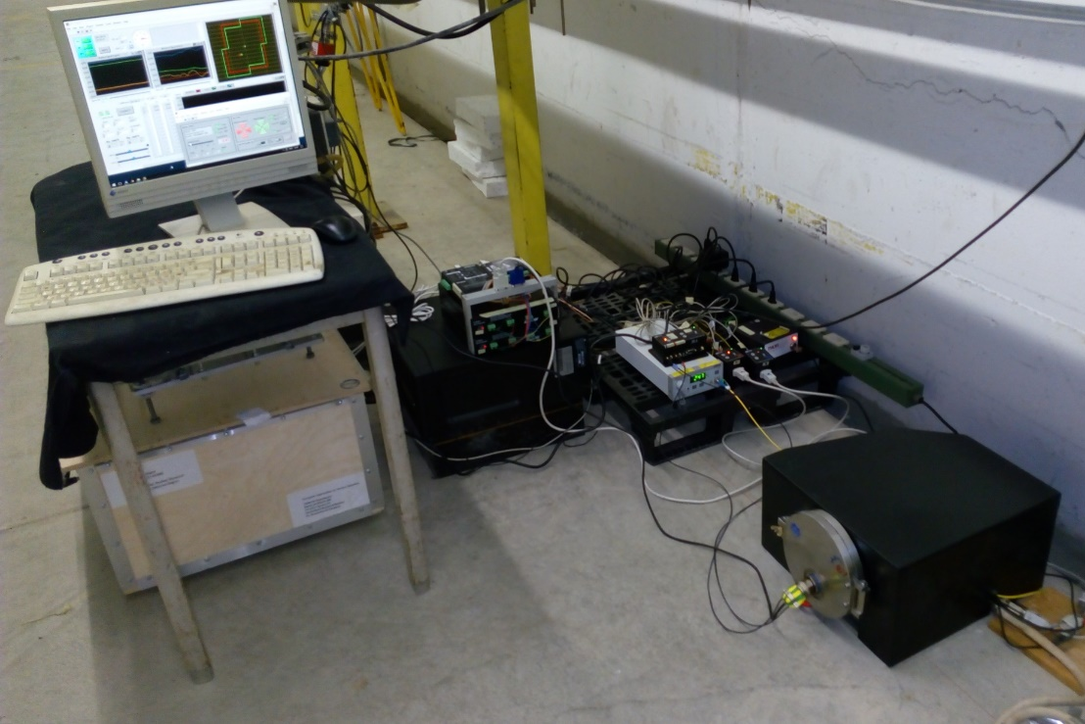
CERN-JINR Agreement P123/A1

Slide 7
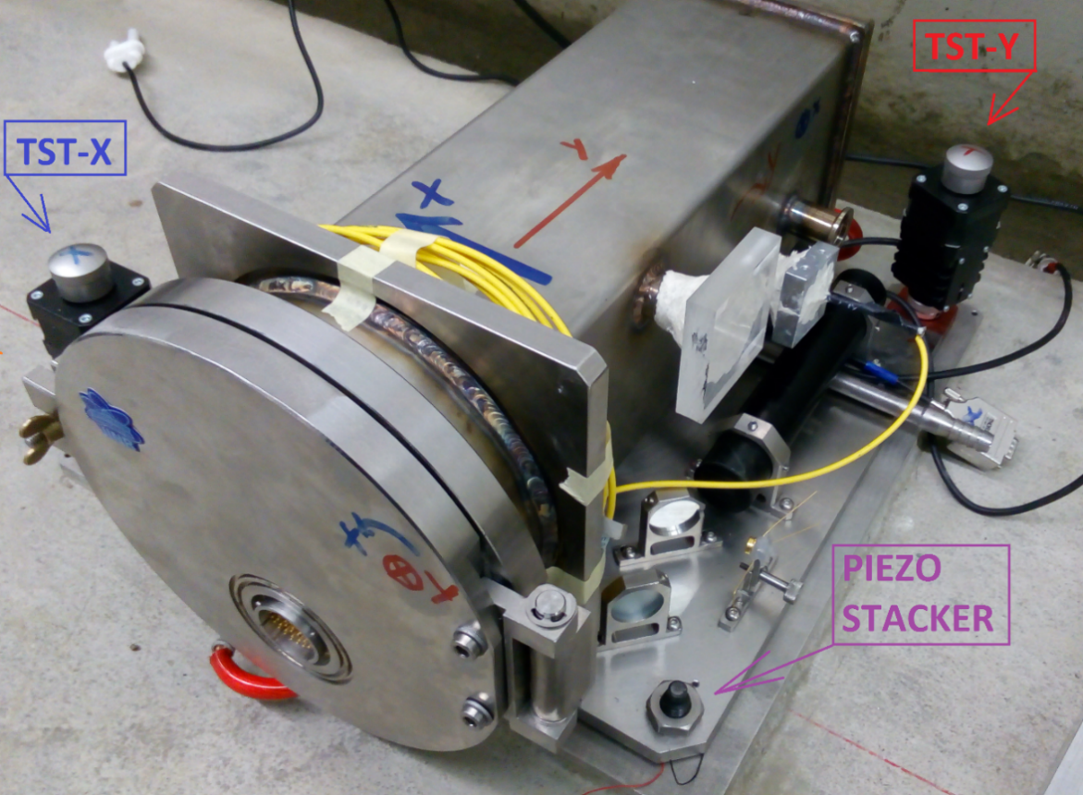
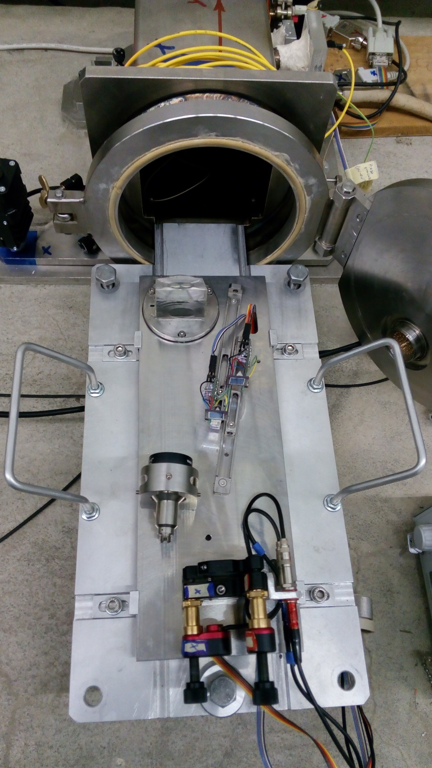
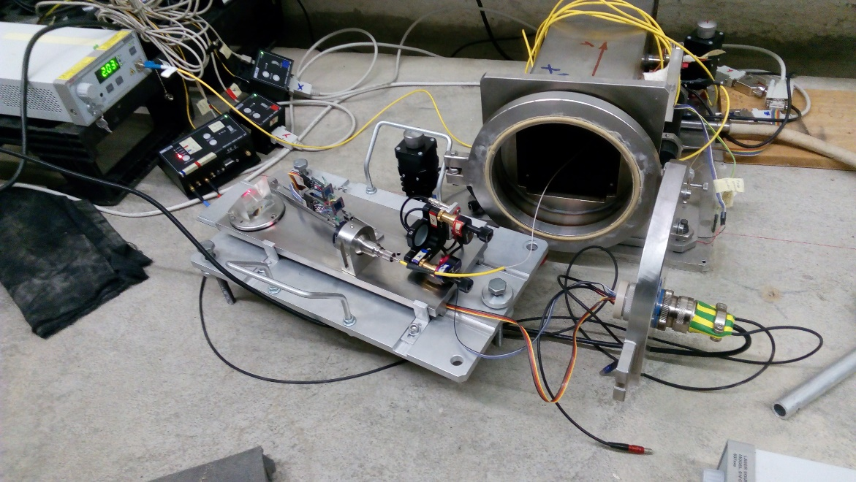

Slide 8
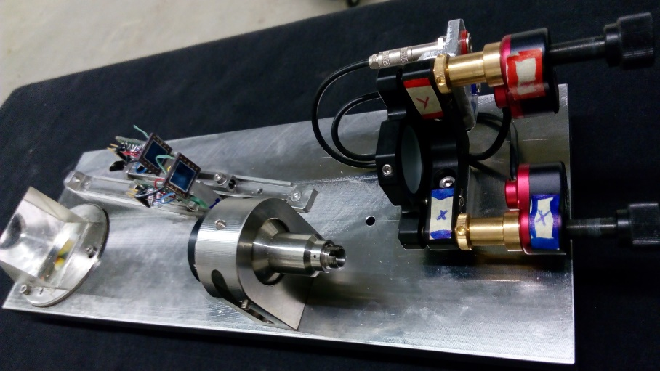
Accurate calibration
Again laser but for interferometric measurements
Periodic calibration with inclinations by a piezo motor moving the base plane

Slide 9
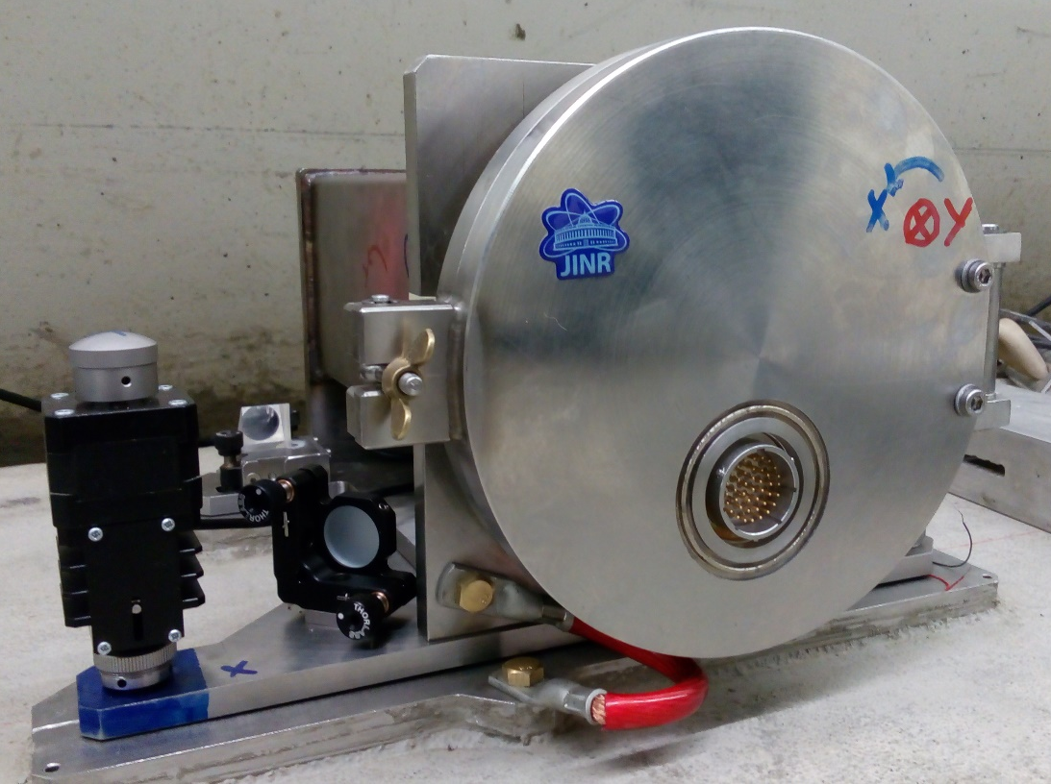
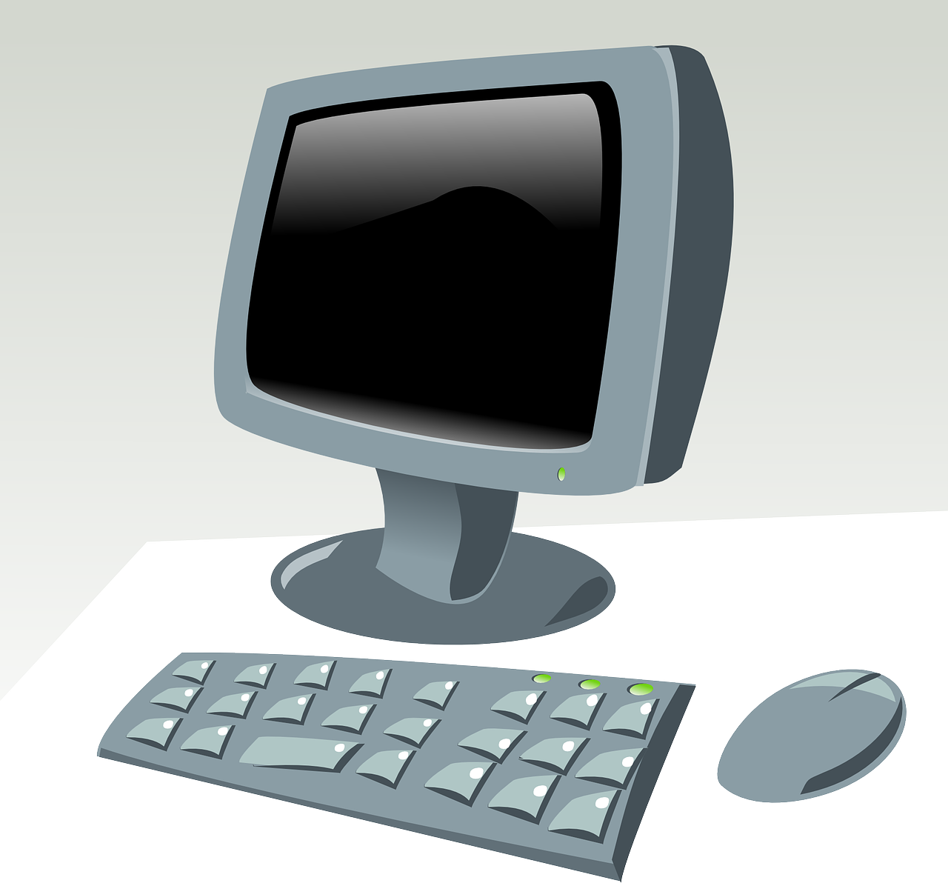
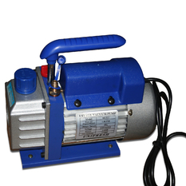
The production PLI and its readout schematic
24 bit ADC
Host computer
Control
DAQ
Calibration
Readout
Storage
Storage
vacuum

Slide 10
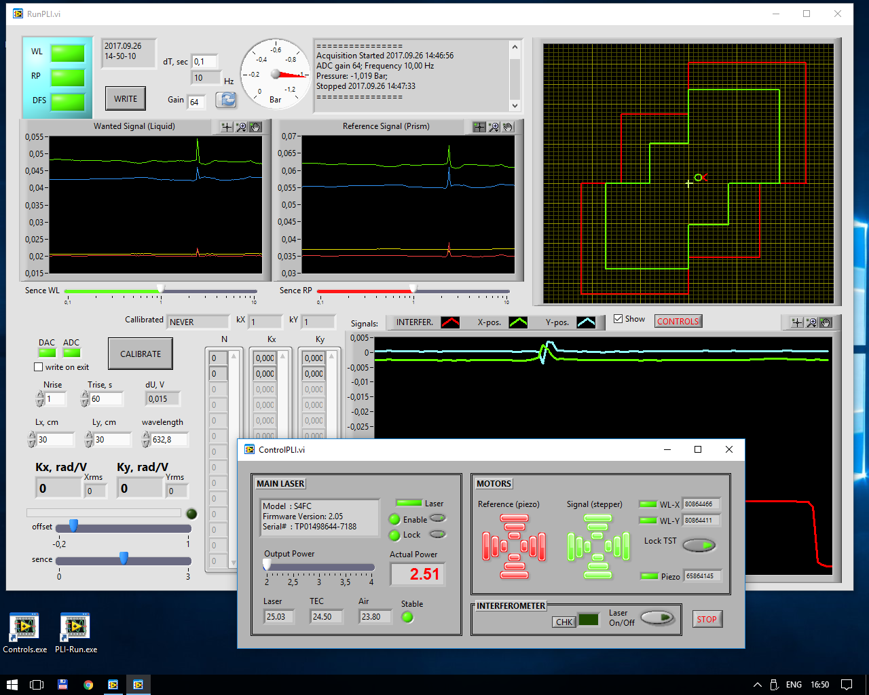

Slide 11
Laser ray wandering compensation
PLI calibration

Slide 12
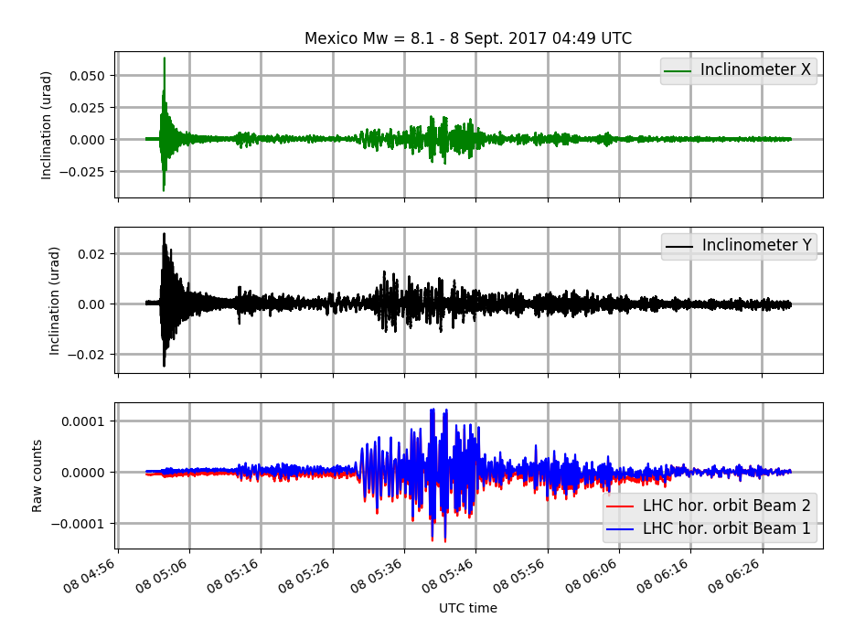
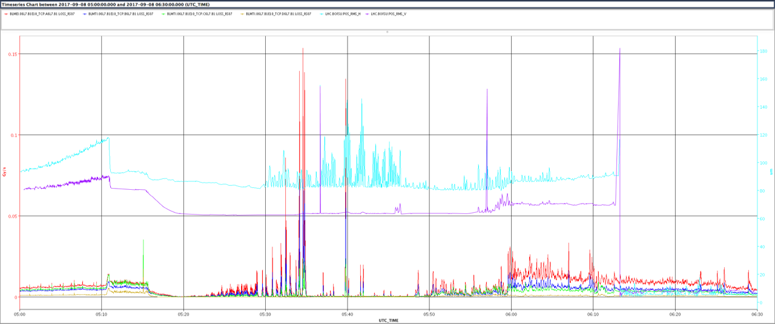
First observations
Mexico Earthquake
September, 2017

Slide 13
Experimental setup
The PLI has been fully operational at CERN in an underground Transfer Tunnel of the ISR (the TT1) since 2015. Very stable ground and temperature
Several improvements have been done, last being the placement in an under vacuum volume to limit the laser light jittering
We have performed comparative measurements with Hydrostatic Level Systems (HLS) used by CERN Survey for monitoring the ATLAS cavern and the position of LHC Inner Triplets

Slide 14
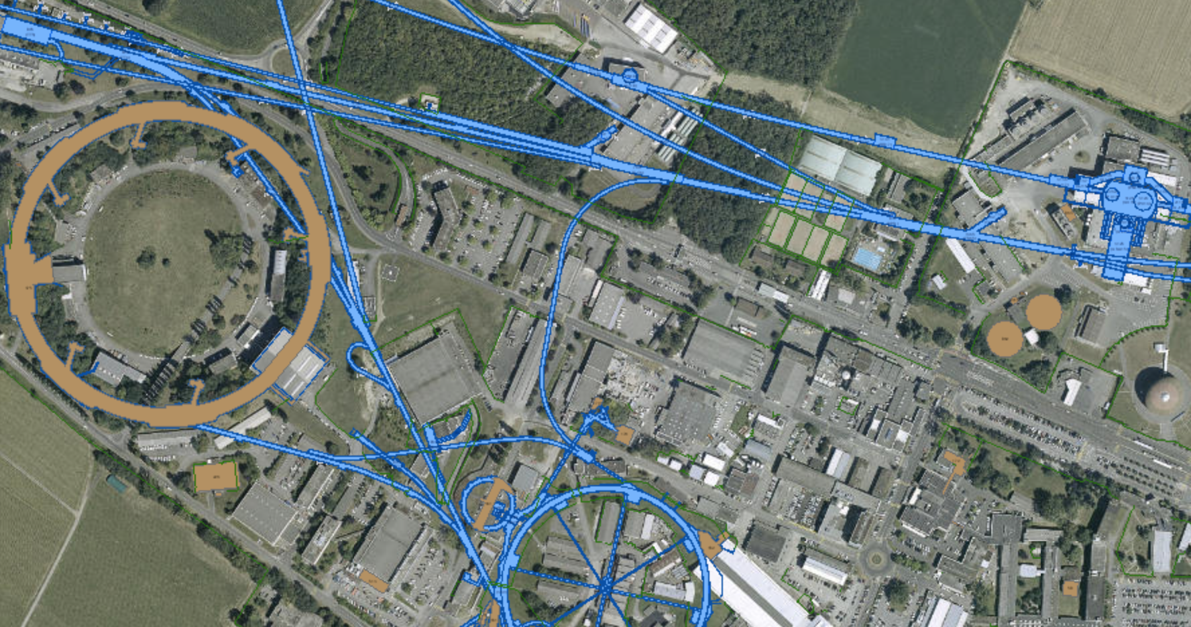
TT1 Tunnel - LHC
SPS
LHC
PLI
TT1
ISR
PS

Slide 15
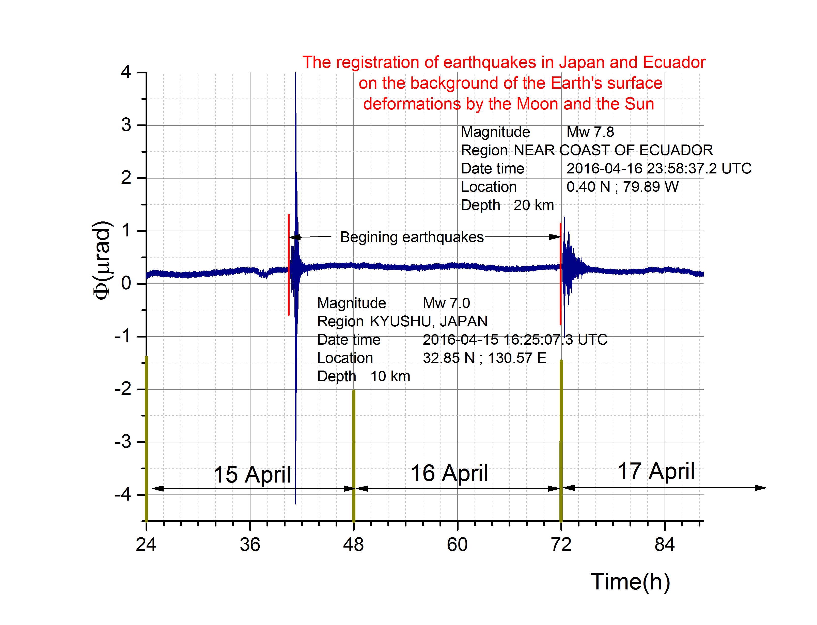
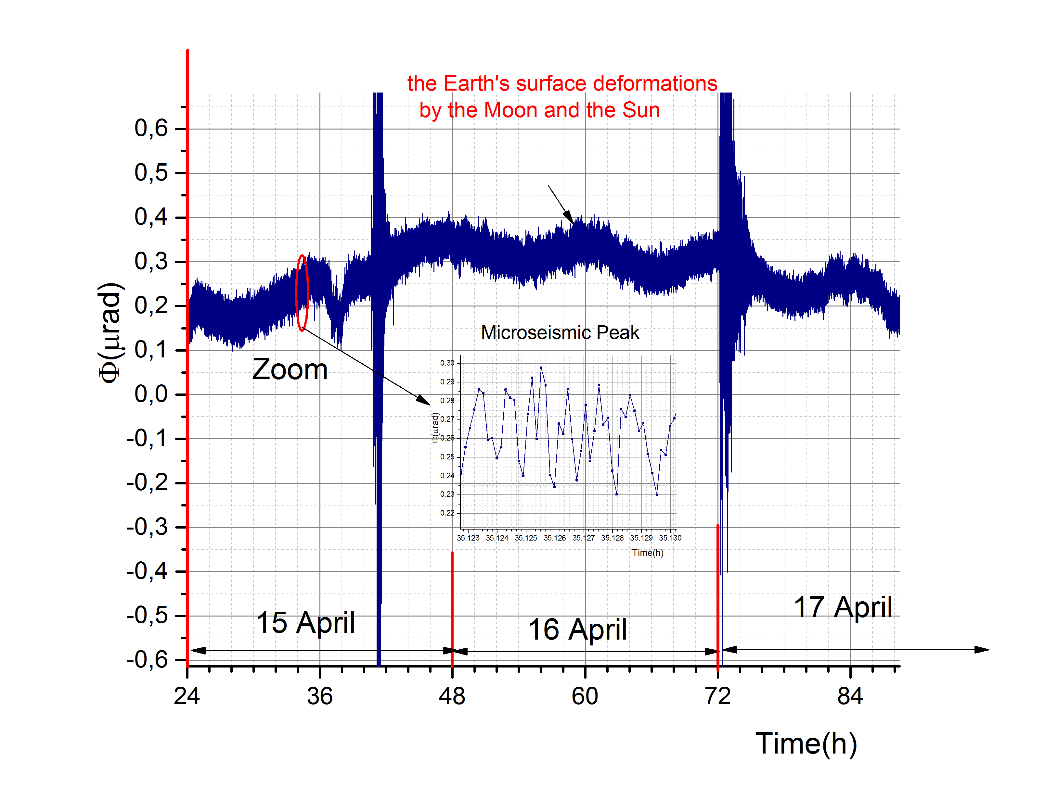
Simultaneous measurements
An example of the PLI reliability is the simultaneously recording at CERN of: the Earth Surface distortions by the Sun and Moon (C), by Ecuador (B) and Japan (A) Earthquakes in April 2016.
A
B
C

Slide 16
Precision of detection
The precision is dependent on the observation period and the frequency of calibration
Comparative measurements with well-established HLS system at CERN has shown for monitoring ground earth oscillation
  A precision of 10⁻¹⁰ rad/Hz^{1/2} in the frequency range [10⁻³,1] Hz
  A precision better than 10⁻⁹ rad/Hz^{1/2} in the frequency range [3.10⁻⁷, 1] Hz, 3.10⁻⁷ Hz corresponds to one month of observation
  Azaryan N. et al. Comparative Analysis of Earthquakes Data Recorded by the HLS and the PLI Instruments // Part. Nucl. Lett. (submitted)

Slide 17
Importance for high luminosity colliders
It is well known that accelerators and light source are sensitive to ground oscillations
Earthquakes are rare events, but very good calibration providers
Industrial and human noise are sometimes unavoidable constraints
High luminosity, low emittance colliders can suffer dramatically from ground oscillations (unforeseen dumps, impact on luminosity, among others)

Slide 18
In addition…
Specifically for HL-LHC project at CERN the civil engineering work of excavation for tunnels and two pits will be done during the LHC long shutdown exactly to avoid the negative impact of ground vibration
Let’s quantify the effects

Slide 19
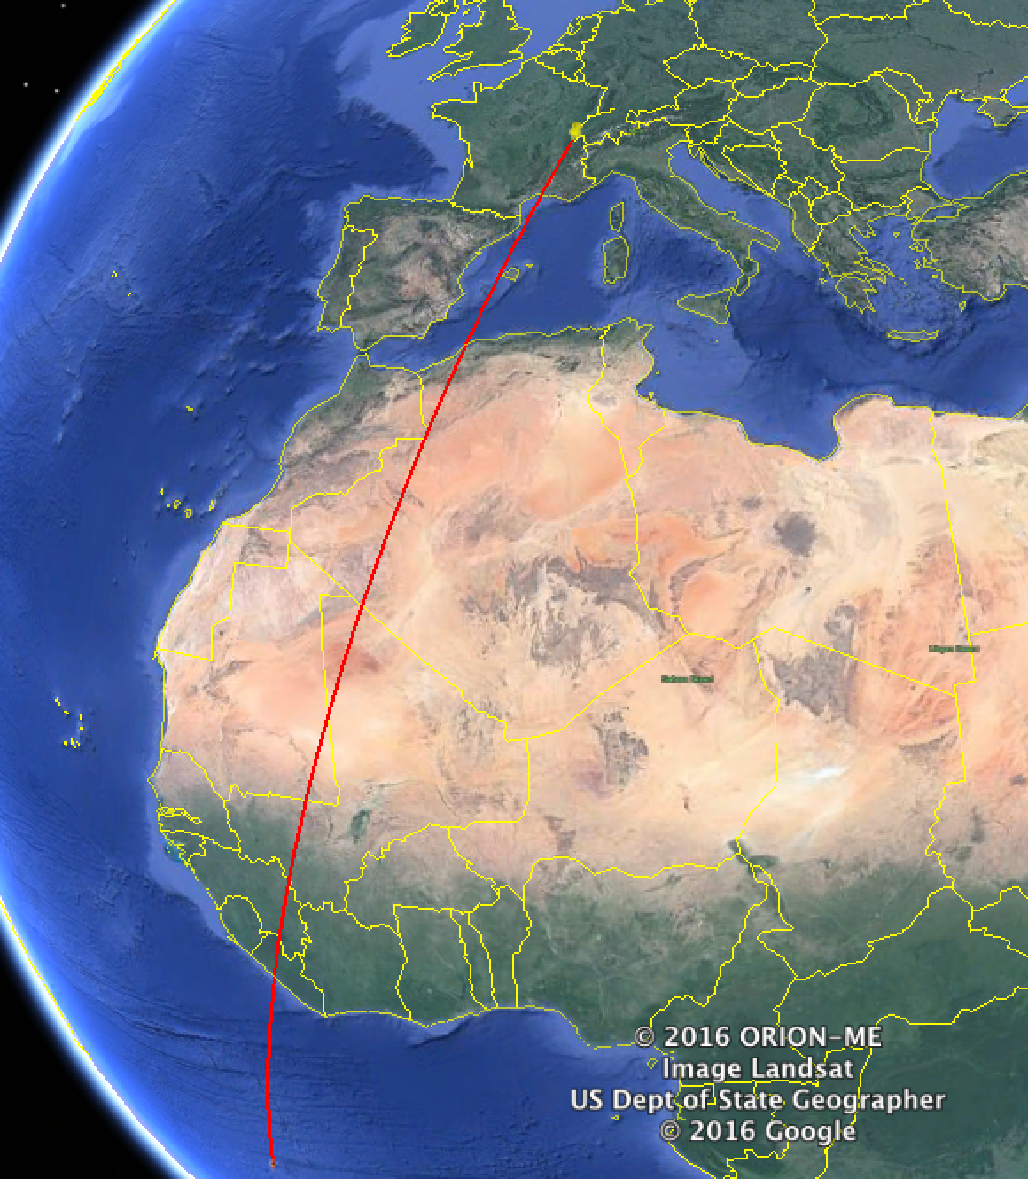
Ascension Islands Earthquake, 29th Aug. 2016
Magnitude 7.1 in Ascension Islands
Monday, August 29, 2016 at 04:29:57 UTC
LHC
LHC was in stable collisions
1h
Epicenter
Main frequencies: 0.05-0.1 Hz (10-20s)

Slide 20
Observations on the LHC Beam
Clear correlations between ground motion in TT1, orbit and losses in IP7.
Plots by M. Schaumann
Hor. Mean Orbit
BLM TPC CL7

Slide 21

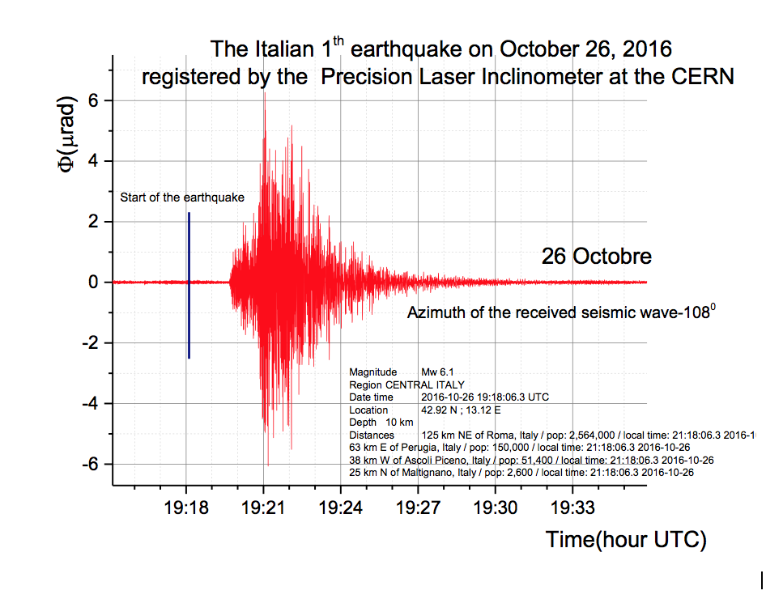
Italy Earthquakes, 26th Oct. 2016
Magnitude 6.1 in ITALY
October 26, 2016 at 19:18:06 UTC
Recording of the event by the PLI.
The recording provided the slope in two dimensions, it is therefore possible to calculate the slope and the azimuth to determine the direction of the wave w.r.t. LHC
LHC
~2min
epicenter
~ 600 km

Slide 22
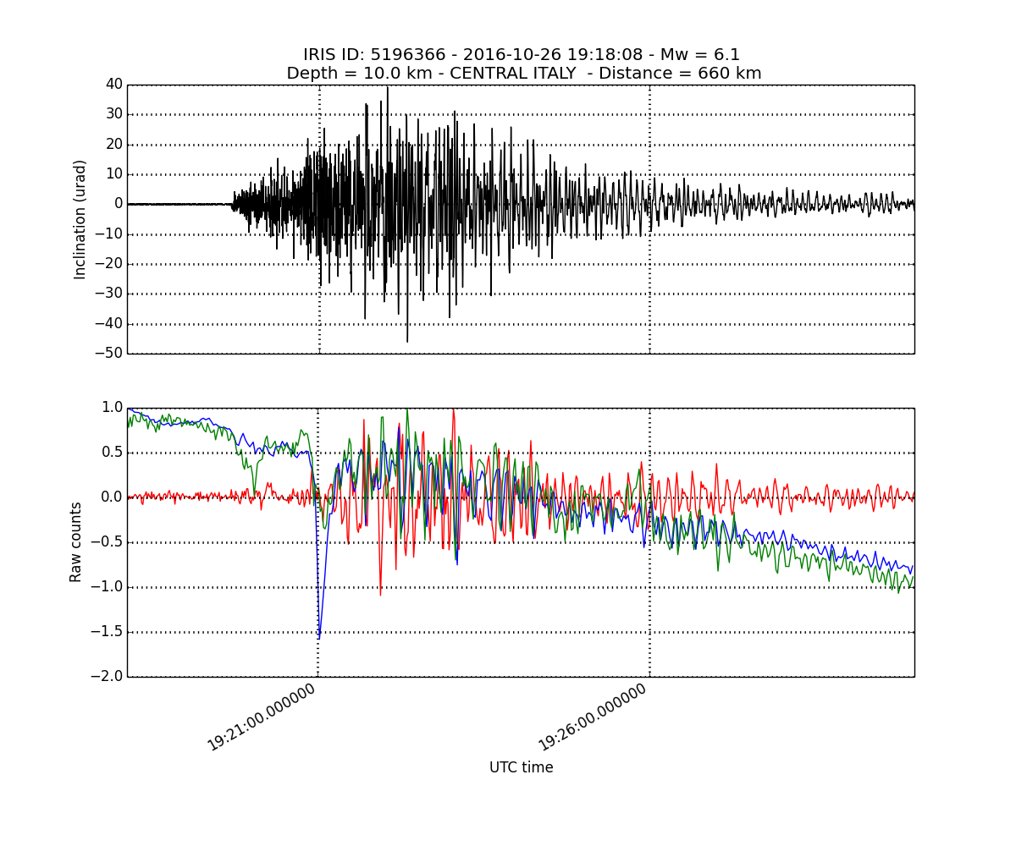
Effect on luminosity
PLI
LHC
ATLAS
CMS

Slide 23
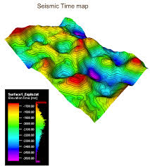
Next steps
The PLI is not a seismometer although detects earthquakes very well and it is not suffering from mechanical resonances
In the process of calibrating and transforming the PLI response (in angle) in the equivalent earth surface vertical displacement
Easy way: we would like to build a network

Slide 24
Next steps
We have drafted a second Addendum CERN-JINR to produce 5 PLIs to put in network
Yerevan collaborators are building the software
  Experience in seismology network transferred to PLI
  A PLI is already installed in Armenia to monitor seismic activity around a nuclear plant
In the meanwhile we built algorithms to transform the angular information in vertical displacement making use of the speed of propagation of Rayleigh waves and a single PLI

Slide 25
First results
Luminosity shows good correlation with ground motion in TT1.
ALICE/LHCb oscillate in phase with the ground motion.
ATLAS/CMS oscillate with a phase difference.
~7 % luminosity variation in ALICE
~0.8% luminosity variation in ATLAS
1.2 μrad amplitude of inclination measured by PLI
0.067 Hz frequency
Estimated focus displacement in ALICE of 0.48 μm

Slide 26
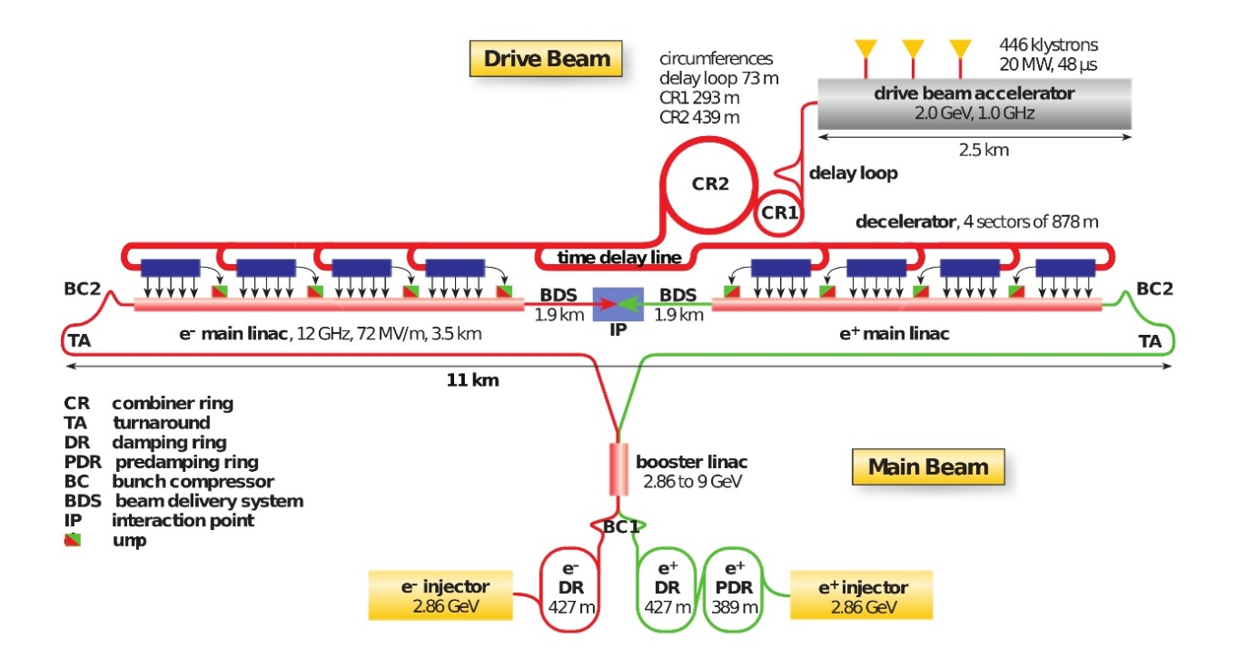
First results
For CLIC type of accelerators where the distance between the last magnetic elements around collisions is very long even the micro-seismic peak is relevant
In the typical frequency range [0.1,0.35] Hz we measure around 10⁻⁸ rad maximum inclination angle resulting in a surface wave amplitude that causes focus divergence in CLIC beam crossing area O(100 μm)

Slide 27
First results
For HL-LHC (~40 m) the effect of the micro-seismic peak is tiny, first effects only visible for seismic/human-induced noise between 1 to 5 Hz
For FCC e-e we are in the process of evaluating the effects of the micro-seismic peak and the limits in higher frequency ranges
Focus devices
Particle beam
Accelerator
50km
D
Article in preparation to be circulated soon

Slide 28
Possible applications
The PLIs can provide early warning because of their high sensitivity
The PLI can be used as part of a slow feedback system (as of today 10 Hz readout, improvements under study) and for comparison
It can be used to monitor vibrations from civil engineering: we are producing enough units that can be potentially installed
The dream: used as mechanical transistor to amplify tiny oscillations to correct and stabilize – a noise-canceling accelerator?

Slide 29
Conclusions
A novel instrument has been developed in collaboration by JINR, ATLAS and CERN
It is a baby, growing step by step to a brilliant future
The commissioning of the first production unit has been completed
Construction drawings are being corrected based on this first unit to be consolidated as an industrial-standard instrument

