Slide 1
Preliminary results of the BBLR compensation experiment in LHC during MD4
S. Fartoukh, Y. Papaphilippou, A. Rossi and G. Sterbini on behalf of the BBLR team
BBLR compensation MD team: D. Amorim, G. Arduini, H. Bartosik, R. Bruce, X. Buffat, L. Carver, G. Cattenoz, E. Effinger, S. Fartoukh, M. Fitterer, N. Fuster, M. Gasior, M. Gonzales, A. Gorzawski, G.-H. Hemelsoet, M. Hostettler, G. Iadarola, R. Jones, D. Kaltchev, K. Karastatis, S. Kostoglou, I. Lamas Garcia, T. Levens, A. Levichev, L. E. Medina, A. Mereghetti, E. Métral, D. Mirarchi, J. Olexa, S. Papadopoulou, Y. Papaphilippou, D. Pellegrini, M. Pojer, L. Poncet, A. Poyet, S. Redaelli, A. Rossi, B. Salvachua, H. Schmickler, F. Schmidt, K. Skoufaris, M. Solfaroli, G. Sterbini, R. Tomas, G. Trad, A. Valishev, D. Valuch, C. Xu, C. Zamantzas, P. Zisopoulos and all participants to the design, production and commissioning of the wire compensator prototypes (WP2, WP5, WP13 and LHC MD coordinators).
42nd HL-LHC TCC, 7th December 2017
Notes:
Good morning,
thank you for the opportunity to present on behalf of the team the results fo the Beam-beam long-range in LHC
1

Slide 2
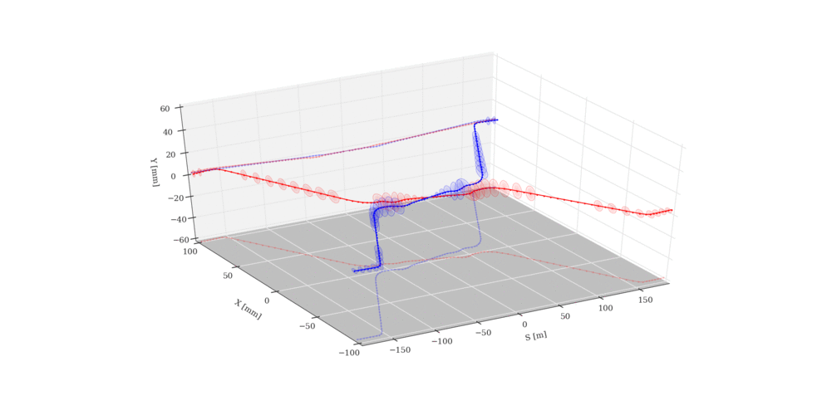
Aim of wire compensation in MD4
Using the IR5 wires to explore closer beam-wires distance to compensate the octupolar term of the beam-beam in IR5 (partial compensation).
Approach from S. Fartoukh et al., PRST-AB, 18, 121001 (2015)
BBCW
B2, right
BBCW
B2, left
1
2
3
Due to 2 dumps during the MD, we could explore only the position/currents set .
1
2

Slide 3
Differences between wires in MD1* and MD4**
1 July ’17 (MD1)
29 November ’17 (MD4)
Wire collimators jaws at 6 σ_{coll}
Max current in the wires (350/350 A in R/L wires)
β* = 40 cm
half-Xing angle = 120 μrad
1 train in B1, 3 bunches in B2
Global tune correction
Nominal octupoles.
Wire collimators jaws at 5.5 σ_{coll}
Current in the wires (340/190 A in R/L wires)
β* = 30 cm
half-Xing angle = 150 μrad
3 trains in B1, 2 bunches in B2
Orchestrated Q4/5 tune correction
Octupoles at the maximum in B1 and 0 A in B2.
Coronagraph (G. Trad).
* The results of the MD2202 in MD1 were presented in 102nd WP2, 33rd HL-LHC TCC and 7th HL-LHC CM.
** The results of the MD2202 in MD4 were discussed in 112nd WP2.
3

Slide 4
FILL6434 and FILL6435
FILL6434 dumped on an interlock of the Q4/5 in IR5 for Q-feedforward.
The 2 h at top energy were used for setup time.
FILL6435 dumped on a power supply trip (Q8, not related to the MD).
We could measure only during this fill.
4

Slide 5
Wires positioning, BU and powering
2
Horizontal blow-up
1
H/V alignment (collimation team)
3
Power cycle (3 x ON/OFF)
5

Slide 6
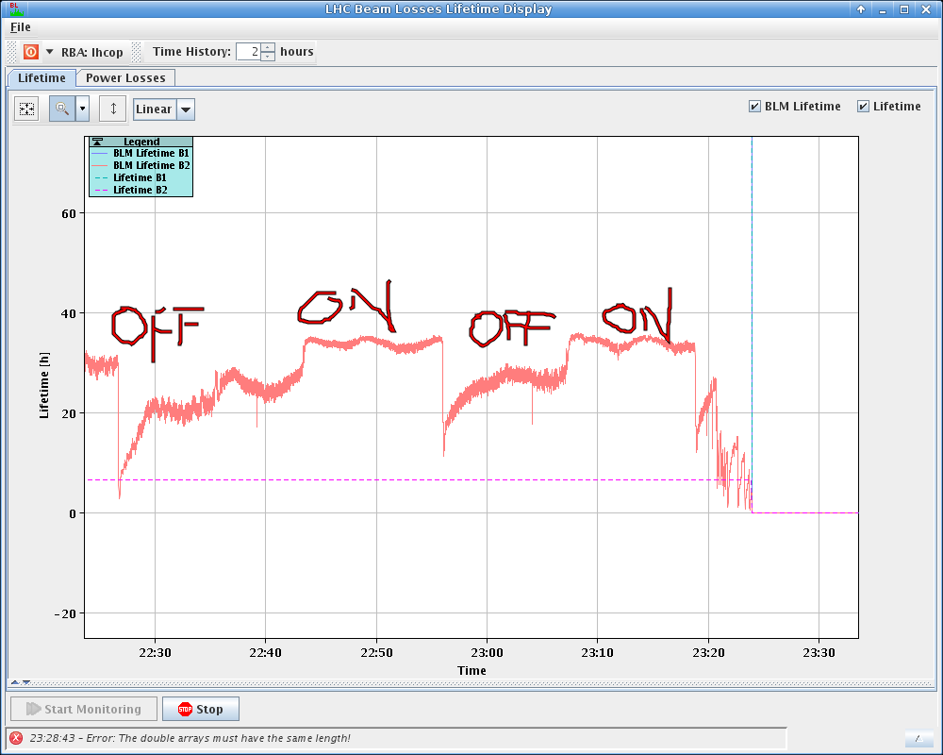
MD4 results at 340/190 A and jaw at 5.5 σ_{coll}
From elogbook
ON
OFF
ON
OFF
ON
OFF
Approx +7 h of lifetime
Positive effect of the wires visible on beam lifetime.
6

Slide 7
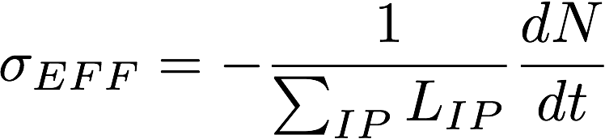
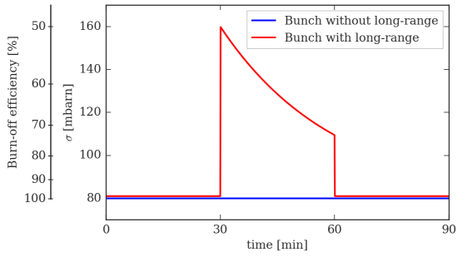
From lifetime to effective cross-section
The previous plot is (1) not bunch-by-bunch and (2) the comparison ON/OFF compensation is fair only assuming constant luminosity.
Both limits can be overcome by considering the bunch “effective cross-section”:
Intensity loss-rate
Instantaneous luminosity
The IDEAL compensation, 2 bunches in B2
WIIRES
ON
WIIRES
OFF
WIIRES
ON
7
Notes:
7

Slide 8
Result at 340/190 A and jaw at 5.5 σ_{coll}
A. Poyet
Positive effect of the wires visible on the bunch affected by the beam-beam long-range.
8

Slide 9
Summary and next steps
Despite we could perform only ~1/3 of the planned MD program, the results of the MD4 seem to confirm and improve the observations done during MD1.
In depth analysis of the experiment is ongoing (noise reductions of our observables, sanity checks, simulations and comparison with data from scraping and coronagraph).
In 2018 two additional wires in IP1 (sub-optimal positions): test the 2 IRs compensation (42 h of MD requested*). A meeting is going to be organized (second-half March ’18) to discuss also the 2018 wire MD proposals details.
Thank you for your attention and for HL-LHC,
WP2/5/13 support!
9
* In 2017 we had 21 h : 10 h (MD1) + 2 h (MD3, QPS problem) + 9 h (MD4).

Slide 10
BACK-UP SLIDES
10

Slide 11
FILL6435
Beam 2, losses dominated by blow-up
Beam 1, mild losses due to burn-off
11

Slide 12
Filling scheme
B1 was stable during the two fills.
12

Slide 13
Result at 340/190 A and jaw at 5.5 σ_{coll}
Horizontal stability
Vertical stability
Tune stability
13

Slide 14
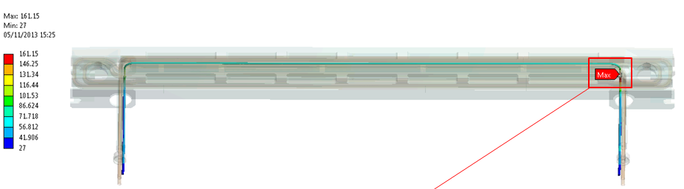
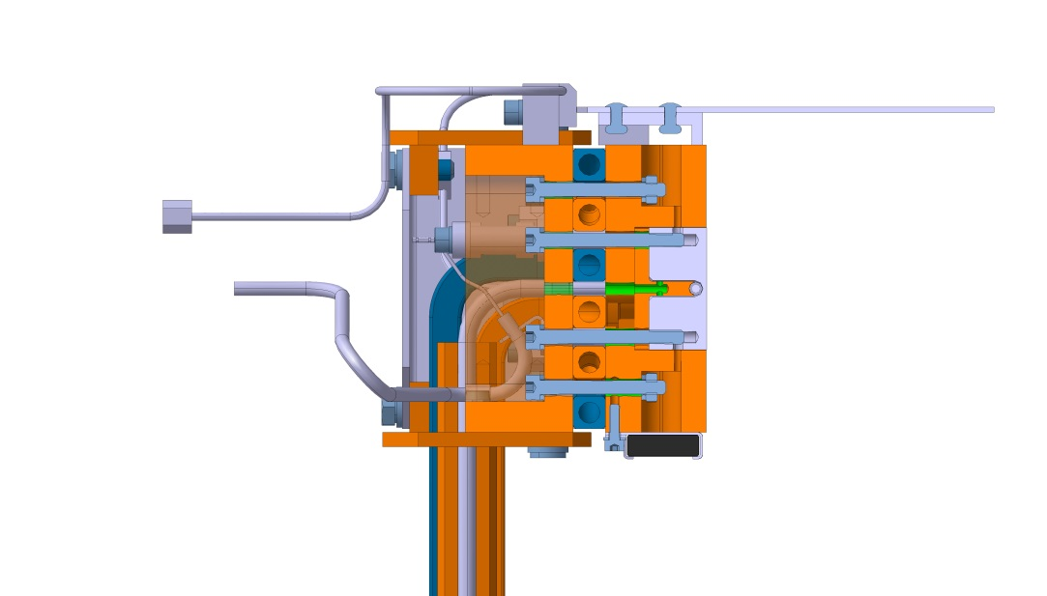
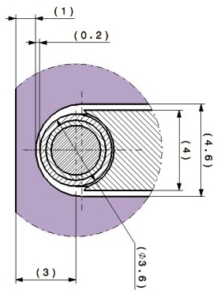
Integration of the wire in the collimator jaws
The wire-beam distance has to be of the order of few mm (function of θ_{c} and s-position): LHC wires prototypes are embedded in the jaw of two operational tertiary collimators.
≈1 m
Top view
Max. temperature at I_{W}=350 A: 161 ºC
Courtesy of F. Carra
Side view
3 mm
During the 2017, BE-BI, EN-STI and the Collimation teams performed a complete test campaign to ensure the correct functioning of the wire interlocks, the collimator motors and PUs when the wire is powered.
14
Notes:
The wire-beam distance has to be of the order of few mm.
14

Slide 15
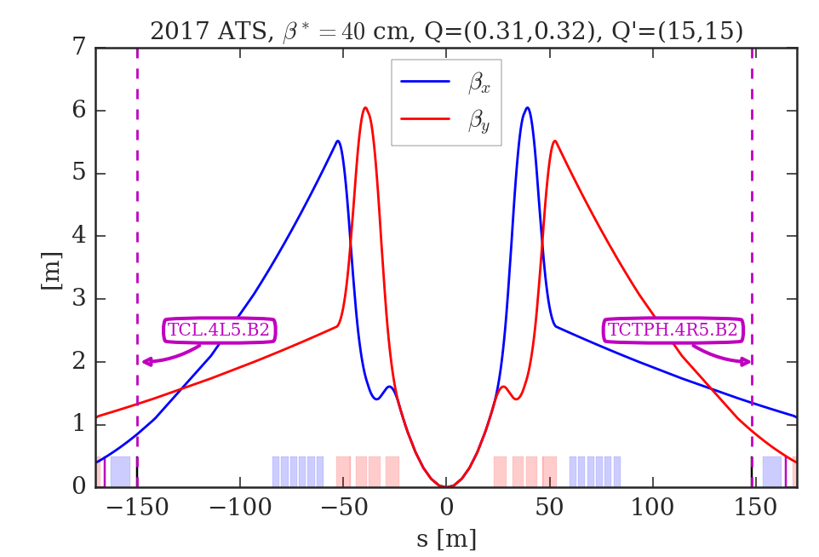
The BBCW position in LHC
The 2 BBCWs were installed in two H-collimators of B2 in IR5 (TCTPH.4R5.B2 and TCL.4L5.B2), close to the D2 separation dipoles.
Longitudinal position of the BBCW and optics used in the experiment
H-plane position of the BBCW
The ideal s-position of the BBCW is ±159 m from the IP5. The actual s-position are -150.03 and +147.94 m.
15
Notes:
15

Slide 16
STEP 3
Result on the compensation (II)
Wire
compensation
ON ⇾ OFF
ON ⇾ OFF
Using dBLM signals to compute the cross-section [credit to A. Poyet, A. Gorzawski]: improved time resolution.
A constant calibration factor was adopted to rescale the BLM reading to the FBCT losses.
First results from LLRB MD
16
Notes:
16

Slide 17
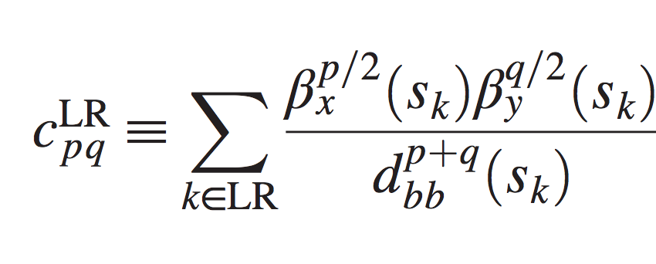
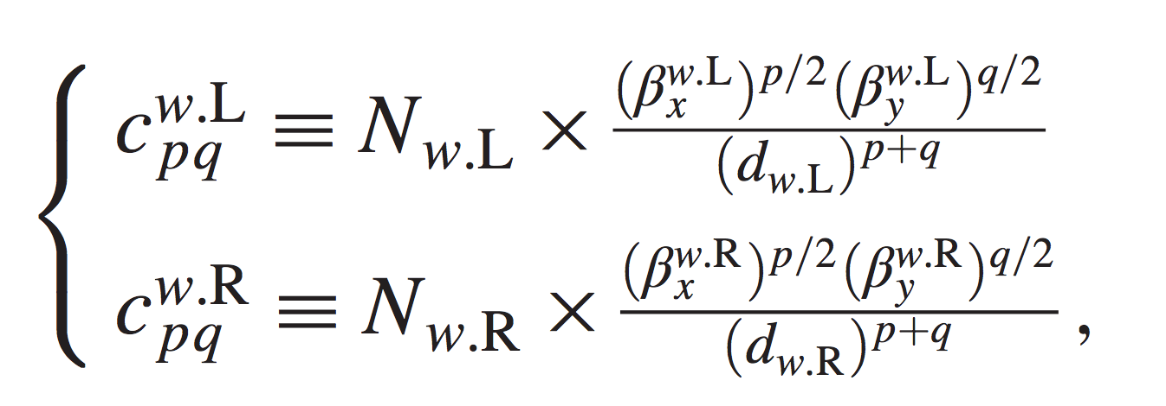
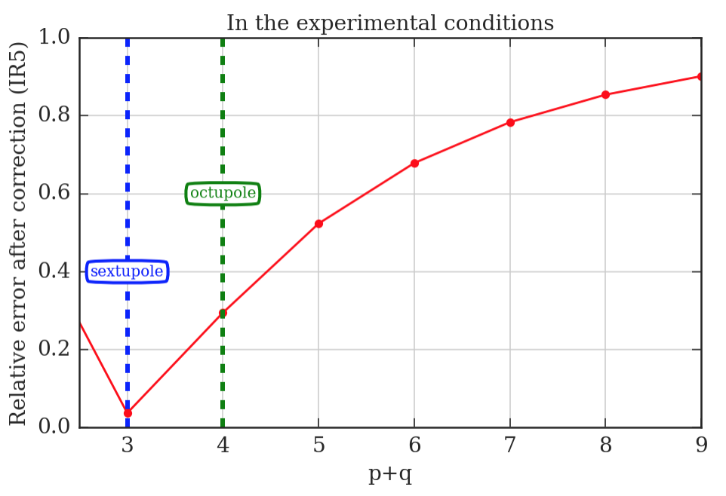
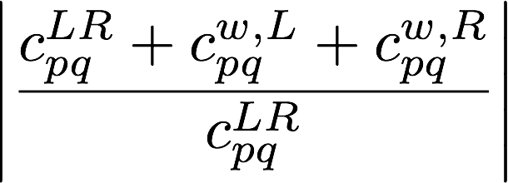
Analysis of the BBCW compensation
S. Fartoukh et al.
PRST-AB 18, 121001
Given the constraint on the minimal beam-wire distance, it was not possible to compensate all the resonances excited by the B1.
We used the maximum current of the wires (350 A) to attack as much as possible the BBLR octupolar term.
The octupolar terms induced by the BBLR in IR5 was reduced by 75%.
Strong-beam driven resonance
BBCW driven
resonance
17
Notes:
17

Slide 18
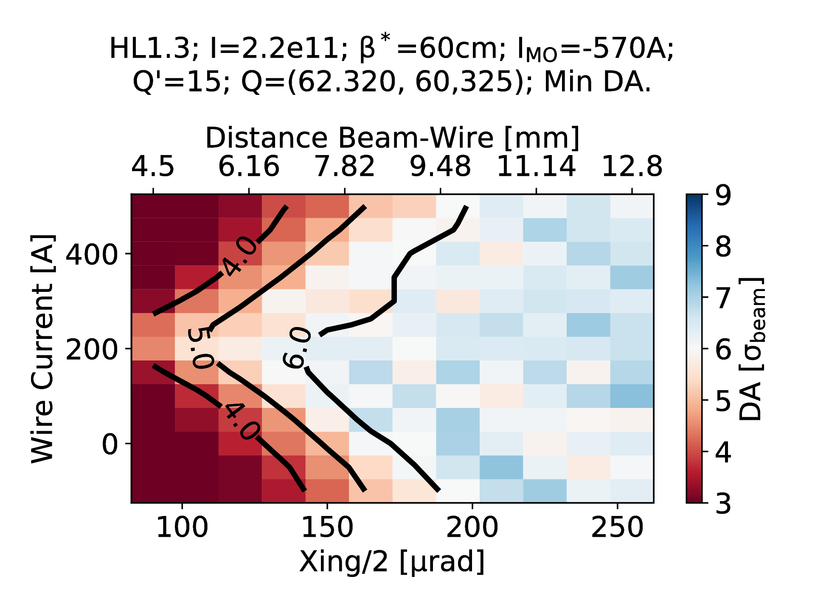
Compensation studies: from LHC to HL-LHC
In the beam-beam team significant efforts are put on the wire compensation tracking studies with the two-fold aim to benchmark the LHC results and optimize the HL-LHC scenario with the wires.
For HL-LHC, preliminary results without a full optimization of the longitudinal and transverse wire position, are showing an additional gain of the order of 30 μrad for the half-crossing angle.
Distance Beam-Wire [σ, ε_{n}=2.5 μm]
8.4
12.6
16.8
21
+ 30 μrad
Preliminary.
HL-LHC start of the levelling
Courtesy of D. Pellegrini
18
Notes:
18

Slide 19
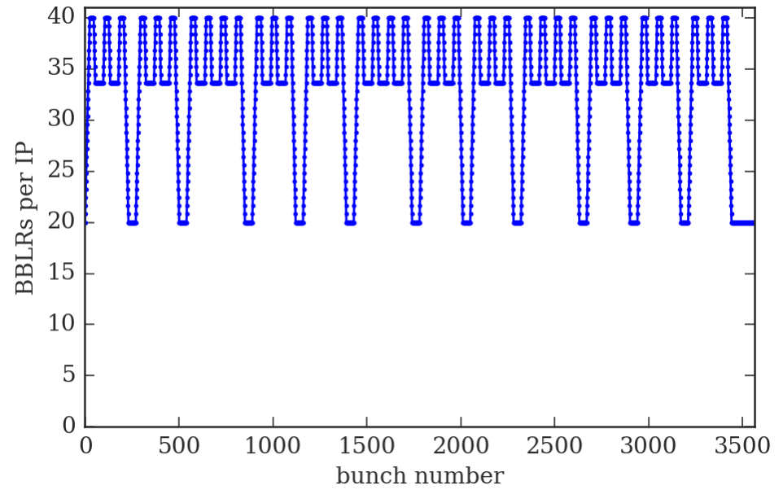
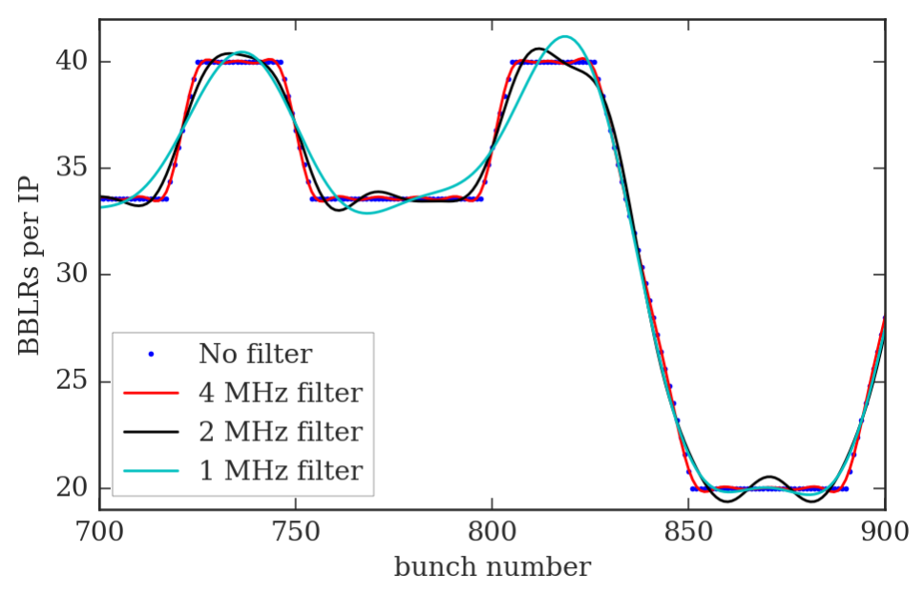
PACMAN bunches and I_{w} modulation
The needed I_{w} modulation BW is of the order of 4 MHz (x10 lower than the bunch frequency).
The wavelength in vacuum of a 4 MHz EM wave is ~75 m.
19

Slide 20
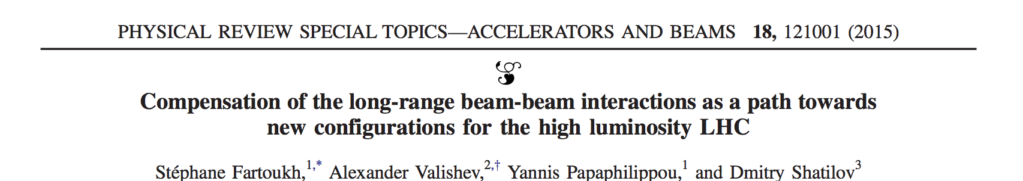
Numerical results from the RDT
We will use the RDT criterion presented and described in details in
Goal: compensate the BBLR RDTs by using 2 BBCs per IP.
Strong-beam driven RDTs
BBCW driven RDTs
Assuming
  the same N_{w} and d_{w} for both BBCWs,
  that the strong beam acts as a DC wire,
  that the phase advance between BBLRs and BBLRs/BBCW is 0 or 180 deg.
the paper gives N_{w} and d_{w} to compensate 4 RDTs (p1q1, q1p1, p2q2, q2p2) in closed form.
It is shown as a numerical evidence that by compensating 4 RDTs one can minimize ALL RDTs if the position of BBCW is conveniently chosen.
Using the paper’s formalism, we will show numerical results on the present LHC (2017 ATS).
20
Notes:
20

Slide 21
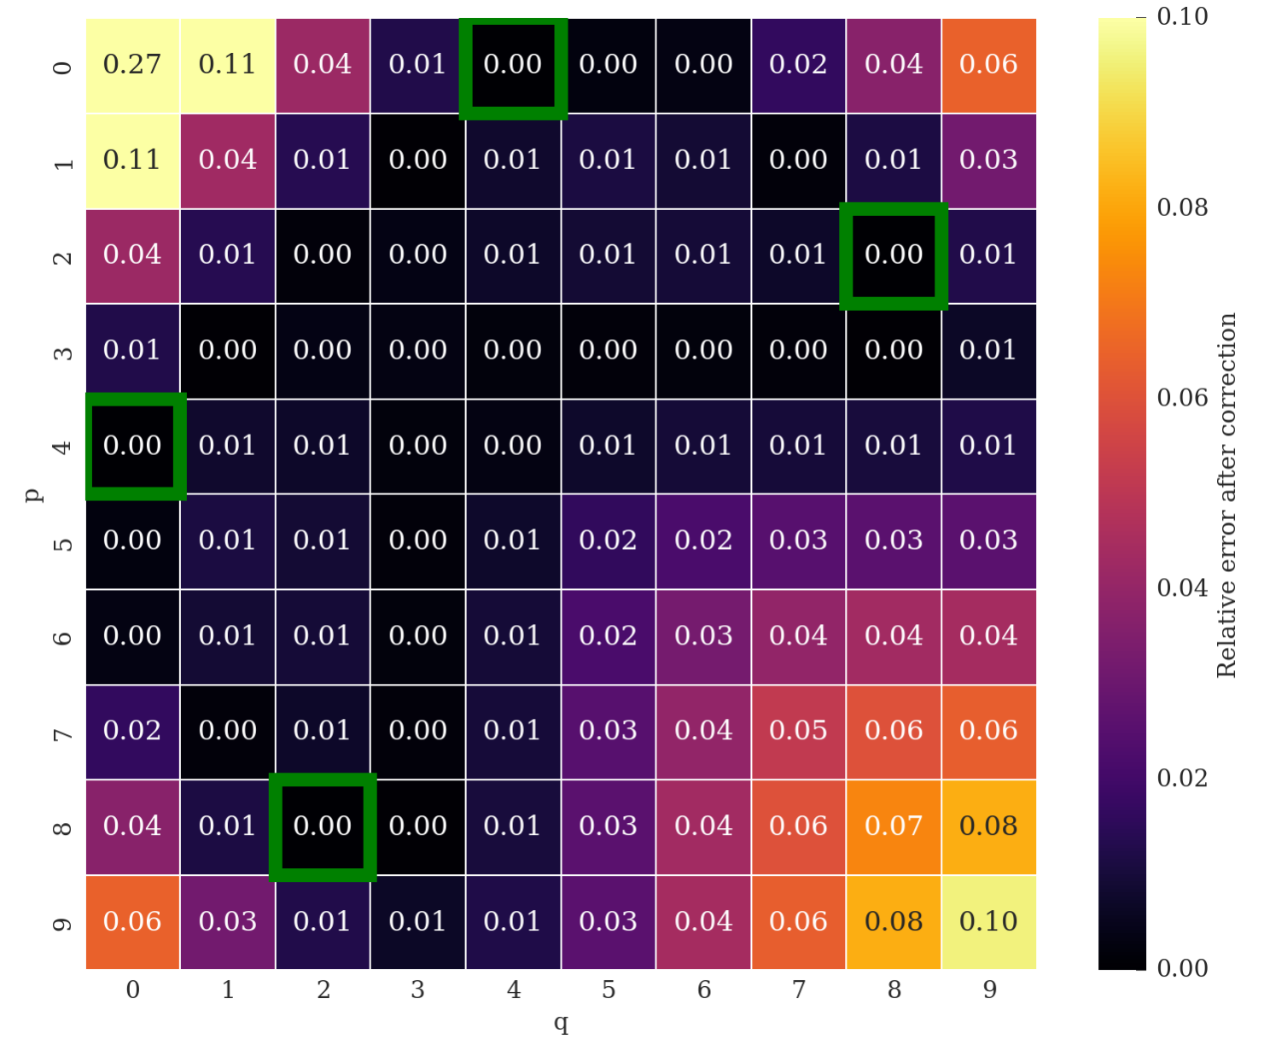
IDEAL CASE: 2 BBCW for IP at s_{opt}=+-159 m
RDT compensation map
dipole driven
quad driven
in color code
The green boxes are the 4 RDTs used to set N_{w} and d_{w}
As expected (under the mentioned assumptions) the compensation is covering many more RDTs than the 4 used to set the BBCWs (green boxes). The p+q=1 and p+q=2 could be addressed by using “local” linear magnets (Q4s and the Q4 correctors).
21
Notes:
21

Slide 22
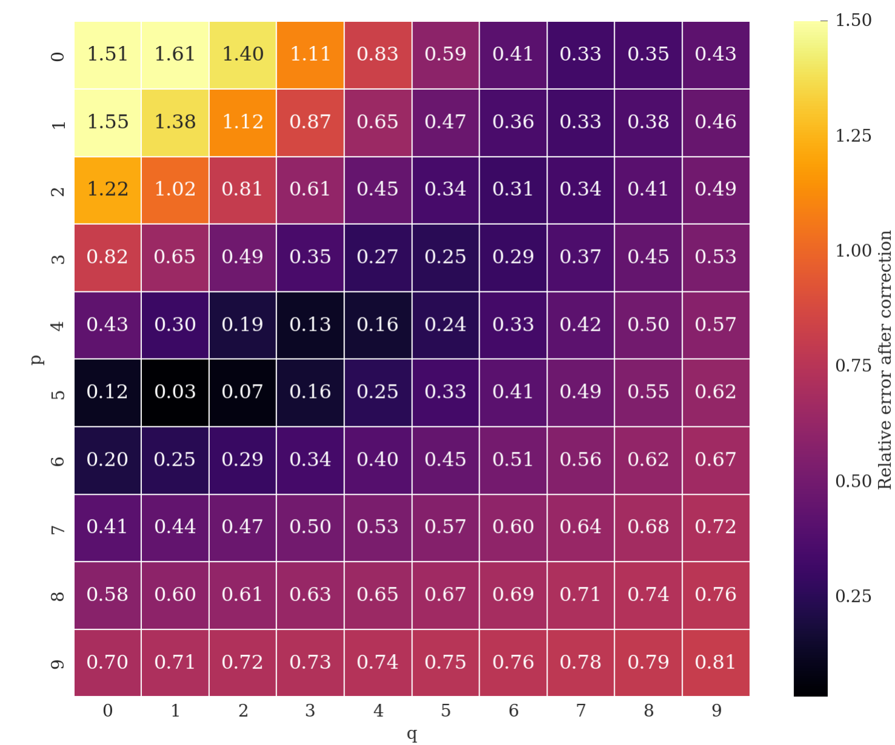
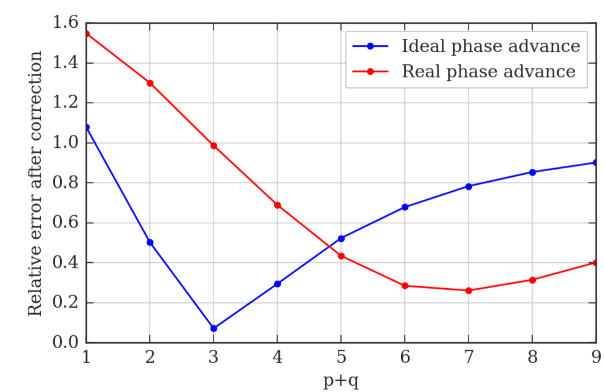
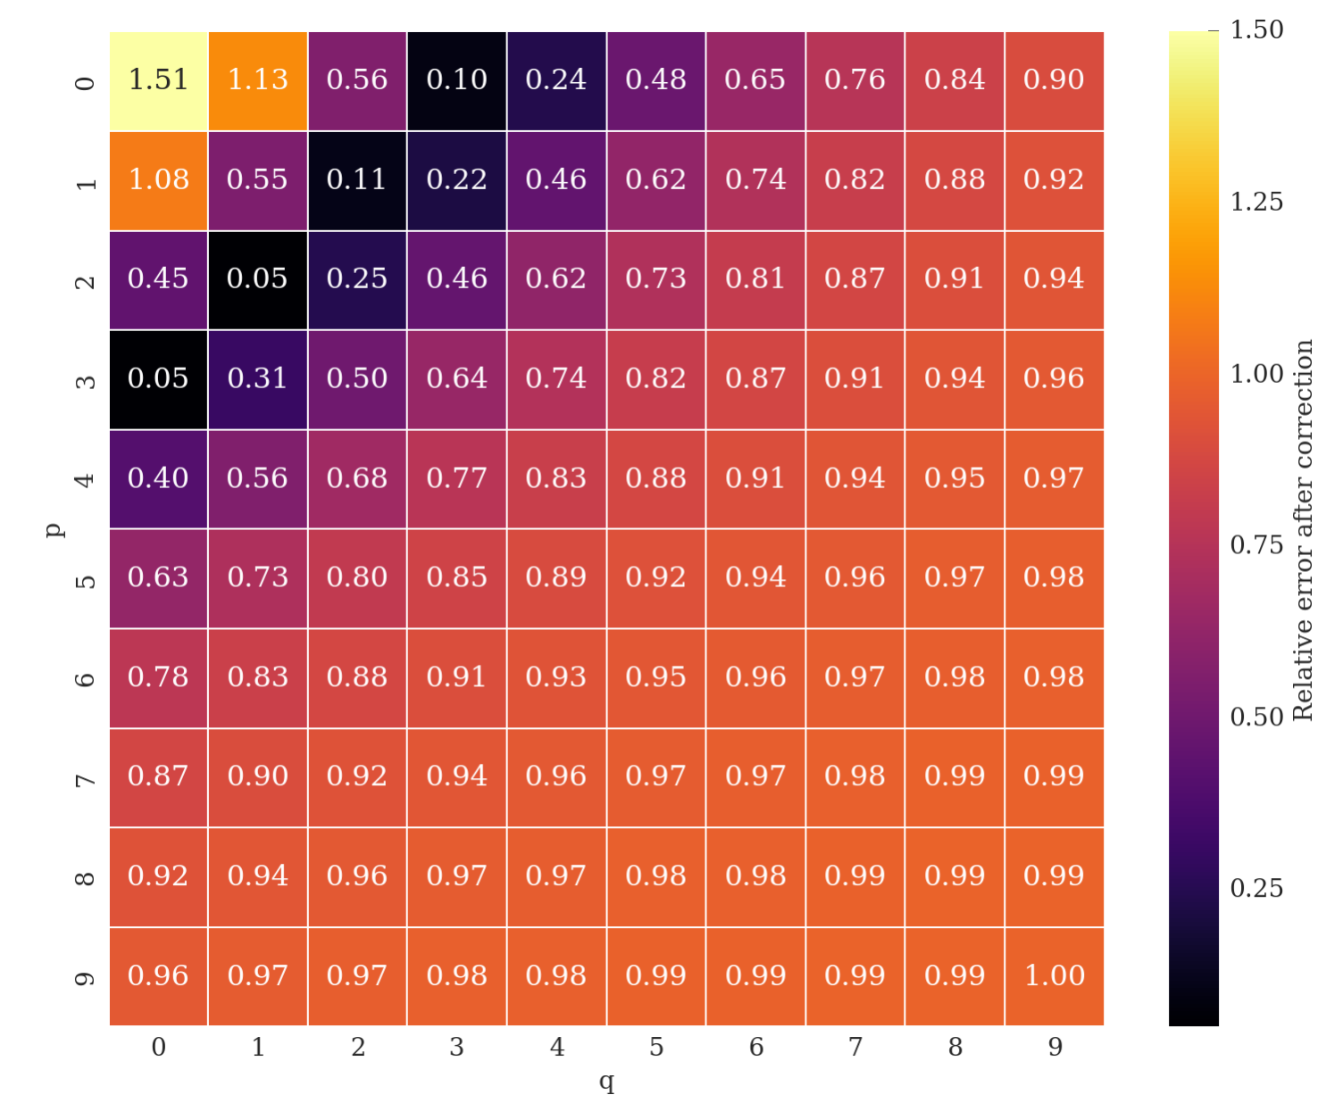
The MD results and the RDT
Real phase advance considered
The observed effect of the BBCW can be related to a partial compensation of the detuning terms.
Ideal phase advance considered (β*→0)
22
Notes:
22

Slide 23
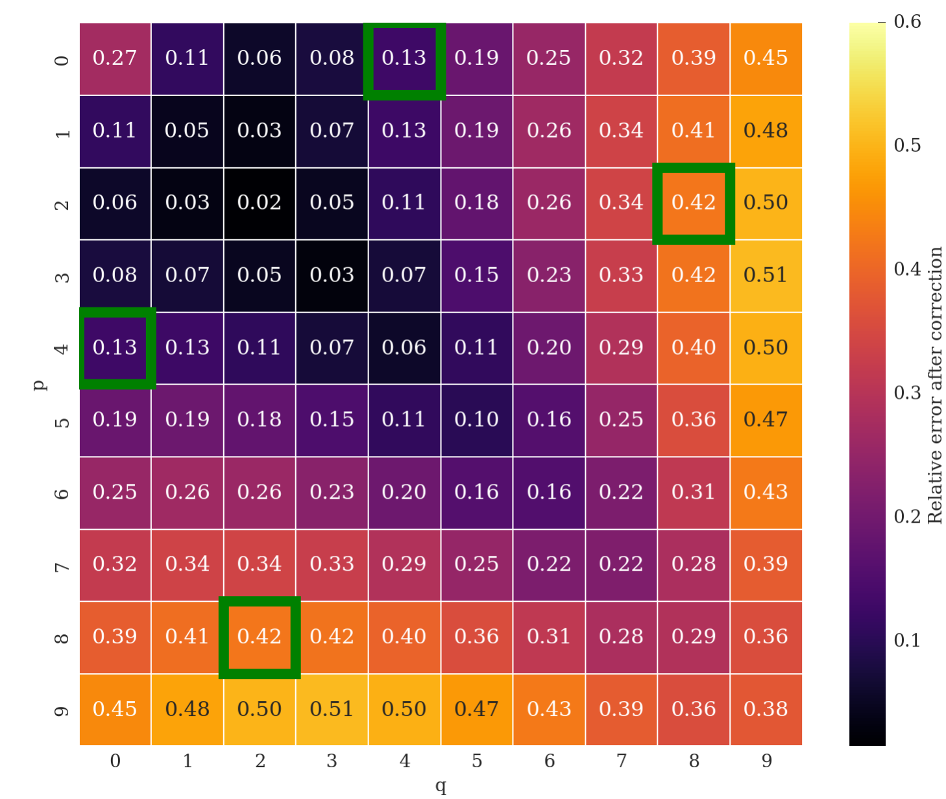
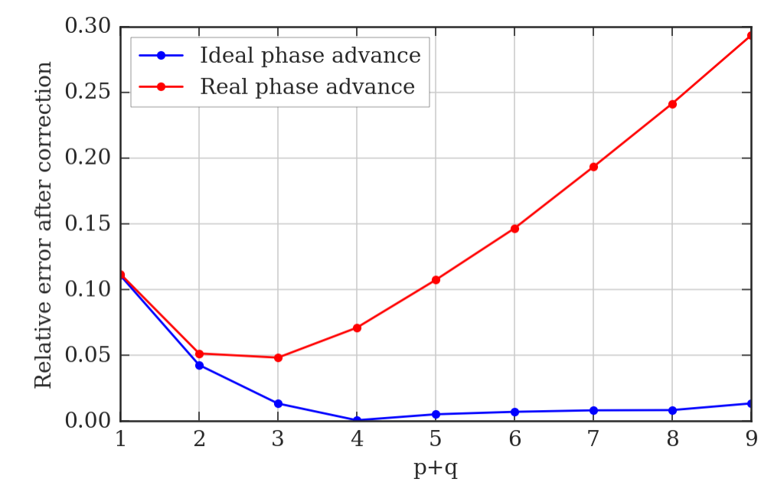
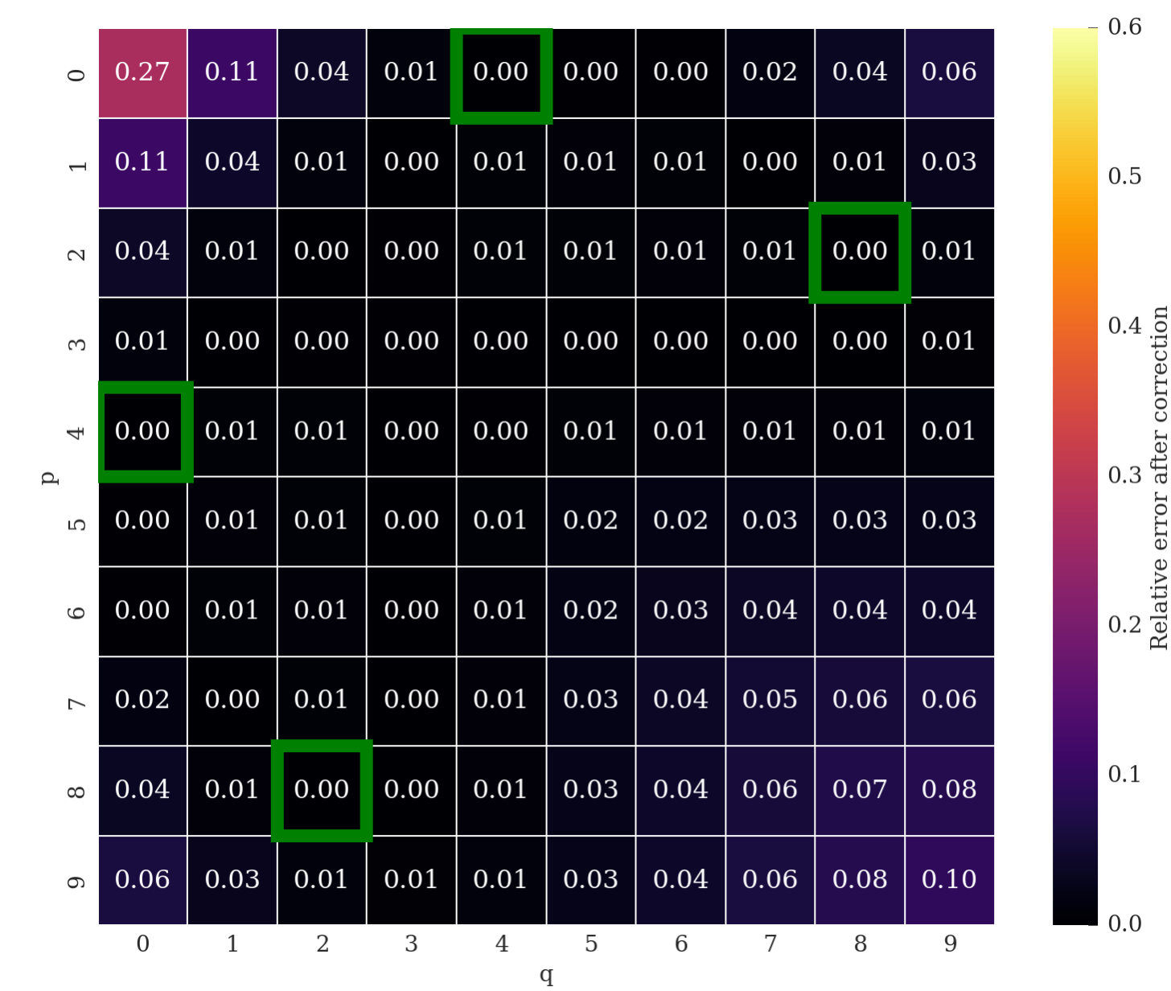
IDEAL CASE: considering the phase advance.
Real phase advance considered
Ideal phase advance considered (β*→0)
One can quantify a posteriori the effect of the phase advance.
The compensation of the RDT does degrade. The compensation of detuning terms (Q-footprint compression) is not affected.
23
Notes:
23

Slide 24
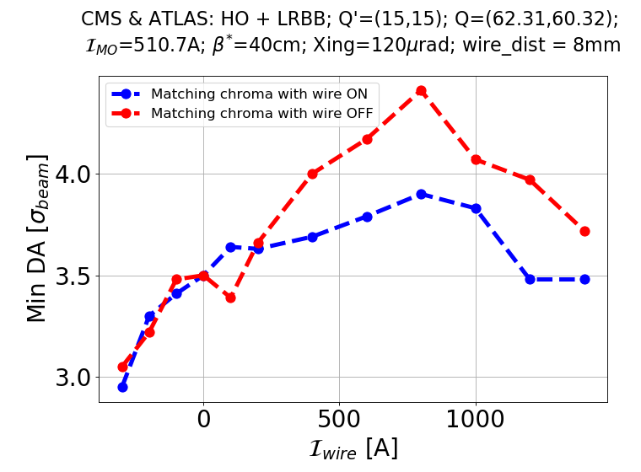
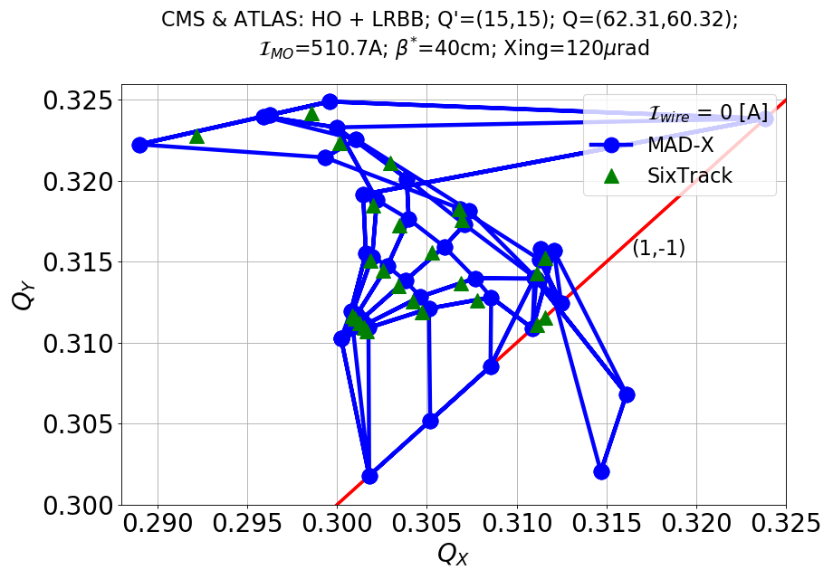
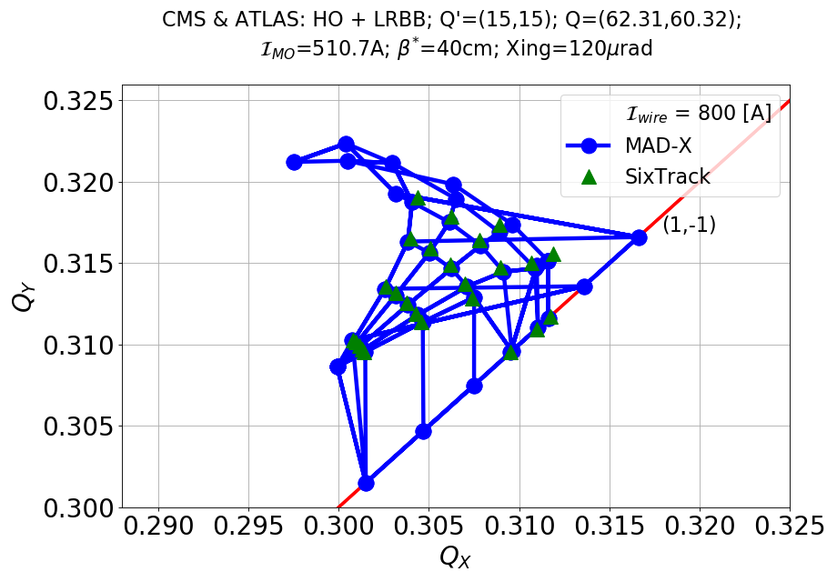
DA simulations with Wire in MD-like conditions I
MD-like conditions: d_{w}=8 mm. LR in IR1/5 but wire only in IR1, real aspect ratio at wire position, phase advances.
A modest gain of DA is observed for 8 mm wire-beam distance.
Optimal DA for 800 A.
With no rematch of the chromaticity (as in the MD), the gain of DA is improved.
Good agreement between footprints from MADX and Sixtrack.
Improvement observed but no clear identification of the optimum.
K. Skoufaris
24

Slide 25
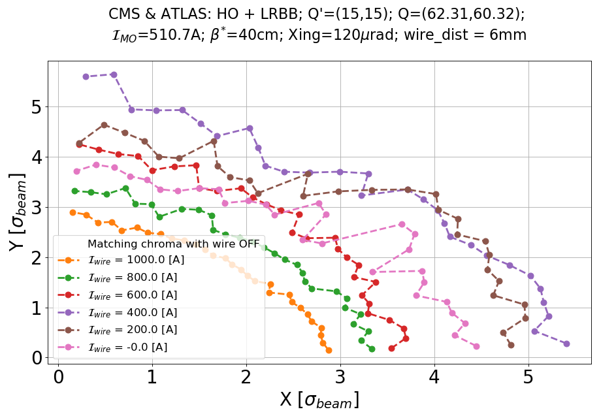
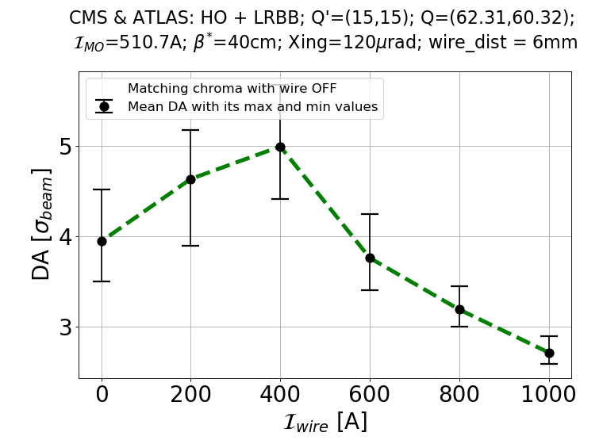
DA simulations with Wire in MD-like conditions II
Push d_{w} to 6 mm
Still not ideal conditions: LR in IR1/5 but wire only in IR1, aspect ratio at wire position, phase advances.
1σ (@2.5 μm) DA gained for an optimal wire current of ~400 A.
Clear improvement over all the angles.
400 A
0 A
K. Skoufaris
25

