Slide 1
LHCb Computing Report
Stefan Roiser
LHCC/WLCG Referees
29 May 2018

Slide 2
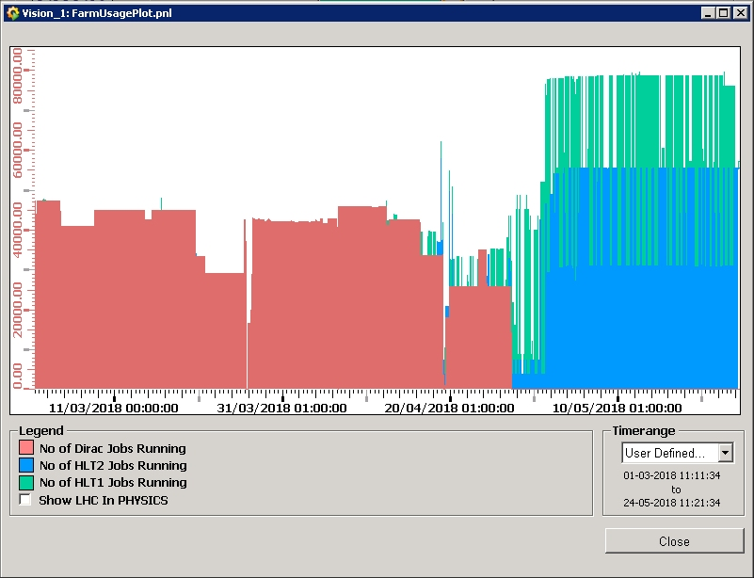
Operations
CPU/Wall time ~ 99 %
(for 99 % workflow time use)
Simulation @ ONLINE Farm
Start 2018 data taking
Job efficiency
> 95 %
Simulation (87 %)
End of Run2 re-stripping
Collision18 prompt reco
Online farm usage
Usage of Online farm during YETS for Simulation
  Short period of parallel usage with Trigger during ramp
Trigger
Usage dominated by Simulation
Run 2 restriping finished
Collision18 reconstruction running
  Start of remaining workflows imminent
Simulation

Slide 3
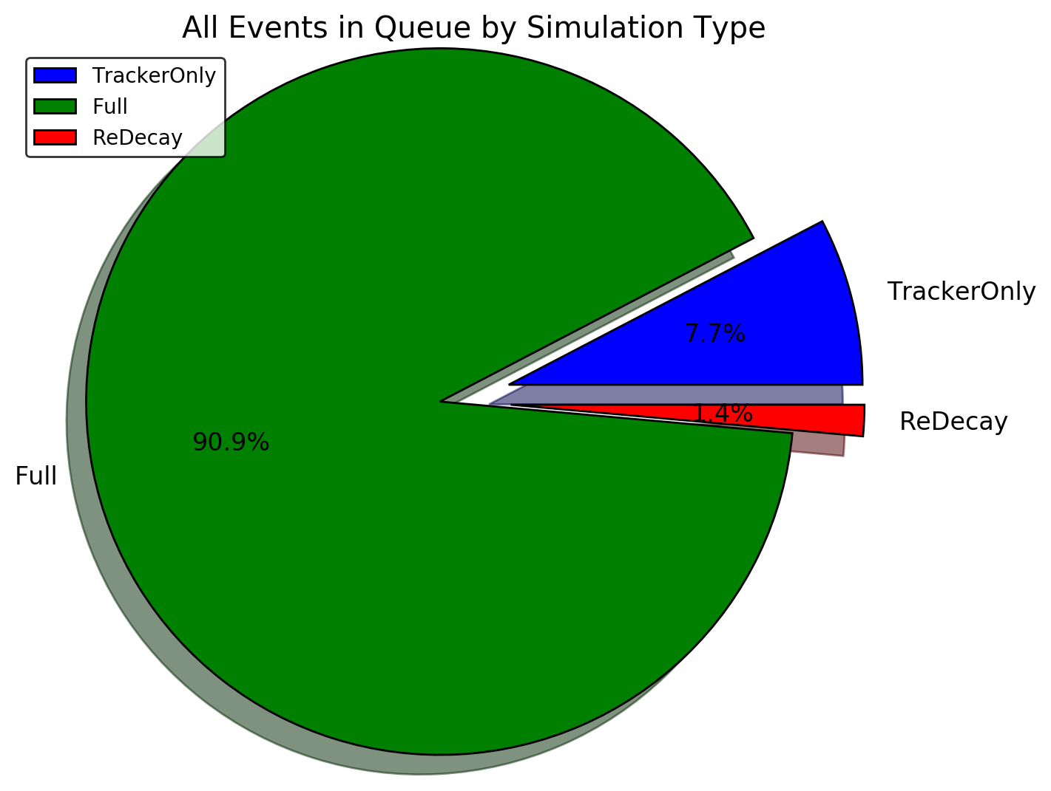
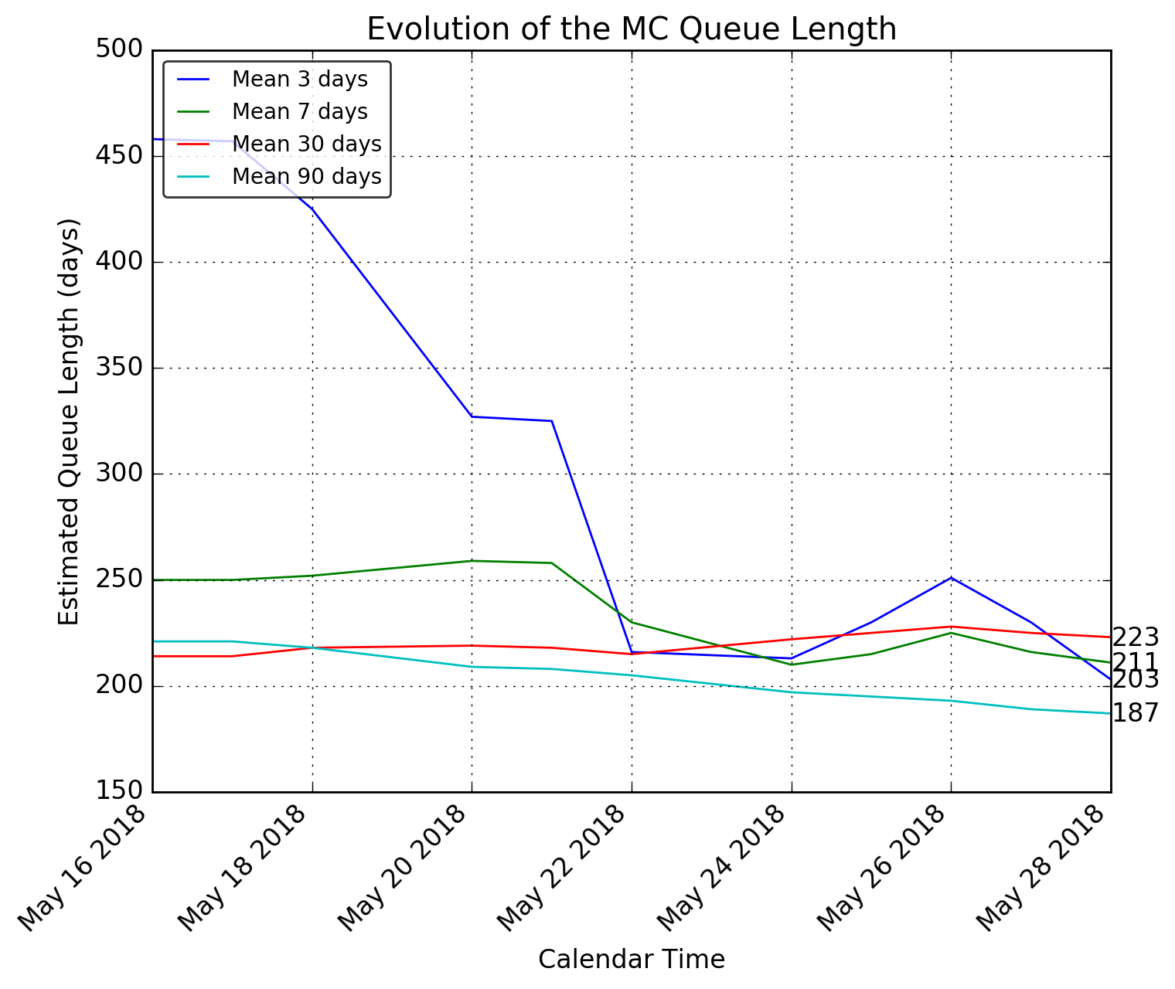
Monte Carlo Production Status
March LHCb Week
~3x
Also working on
increase of distributed
computing resources
(HPC, BOINC, …
Length of queue to produce
MC stays problematic
  Current estimate to empty
  the queue at ~ 6 months
Monitoring of MC requests put in place. Aiming to push for more usage of recently introduced fast monte carlo simulation types

Slide 4
Run 3 Software & Computing
TDR
Preview of the document has been given to referees in April
Final version of document uploaded to CDS
  https://cds.cern.ch/record/2310827
Describes engineering choices taken for application software engineering and distributed computing
Asking for approval by LHCC in Q3/2018 together with the computing model document

Slide 5
Run 3 Computing Model
First numbers for distributed computing resource requests available
10 GB/s output trigger bandwidth allows full exploitation of the upgrade physics program
Resource optimizations taken into account
  Reduction of Run 1 & Run 2 data and monte carlo to 1 disk replica at most
  All Turbo data reduces needs to almost no offline data processing
  Monte carlo microDST used for vast majority of data
  Exploiting full potential of fast monte carlo with several production types
In addition working on different additional resource optimization measures

Slide 6
Run 3 Computing Model
 | CPU |  |  | Disk |  |  | Tape
 | kHS06 | FCB | AYG | PB | FCB | AYG | PB | FCB | AYG
Baseline scenario by end of Run3 (2023) | 2.931 | 2.7 | 2.0 | 356 | 3.5 | 1.6 | 398 | 2.2 | 1.4
Baseline scenario by end of LS3 (2025) | 3.823 | 2.4 | 1.7 | 375 | 2.6 | 1.2 | 408 | 1.6 | 1.2
Baseline scenario numbers with 10GB/s HLT output rate, ~ 5 Mio s LHC collisions / year, ~ 2 disk replicas
  2nd and 3rd columns are factor of “constant budget” (FCB) and average yearly growth (AYG)
Fraction of LHCb resources on WLCG move from 10 % in 2018 → peak of 28 % for Disk in 2021 → ~ 16 to 22 % by end of LS 3

Slide 7
Summary
Continued very good usage of distributed computing resources
  CPU/Wall time efficiency close to maximum, > 95 % job success rate
Length of queue for production of monte carlo samples worrying
  Monitoring of queue length and requests put in place
  Aiming at higher usage of recently introduced fast monte carlo and expanding distributed computing resources further above pledge level
Run 3 upgrade activities continuing on schedule
  Software and Computing TDR describing the engineering has been submitted to the LHCC
  First numbers for upgrade distributed computing resource needs available

Slide 8
Backup

Slide 9
Run 3 Computing Model Details

