Slide 1
WLCG Update Strategy Document & review
Ian Bird
LHCC Referee’s meeting
CERN, 29th May 2018

Slide 2
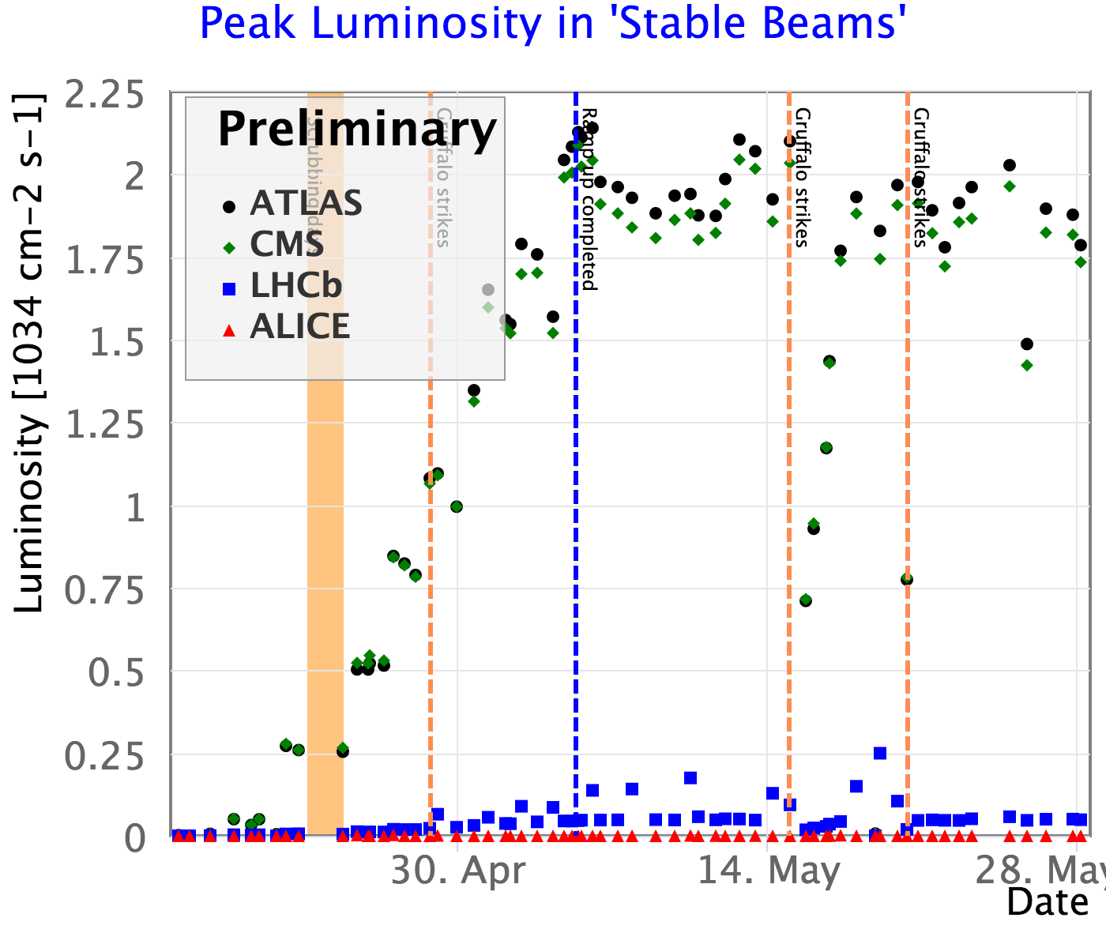
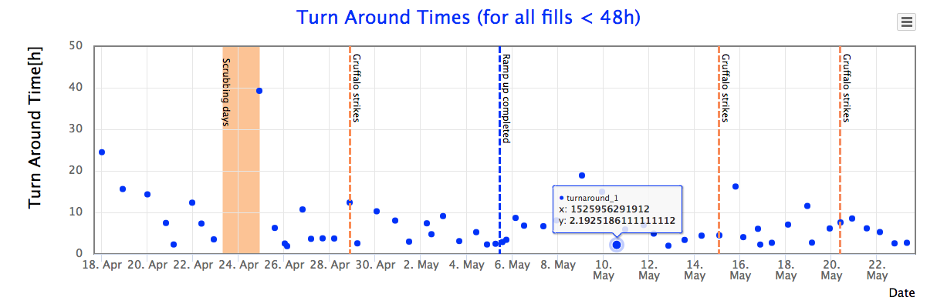
Progress - 2018

Slide 3
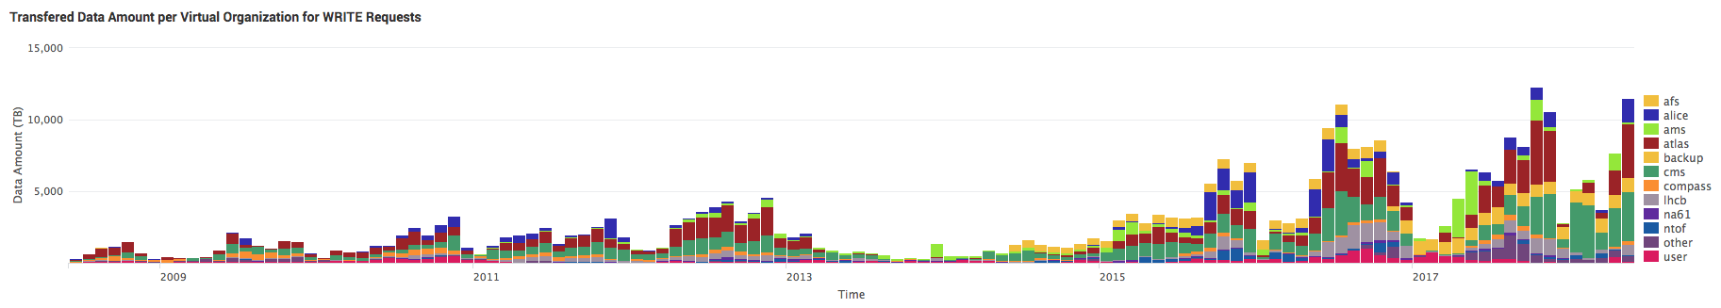
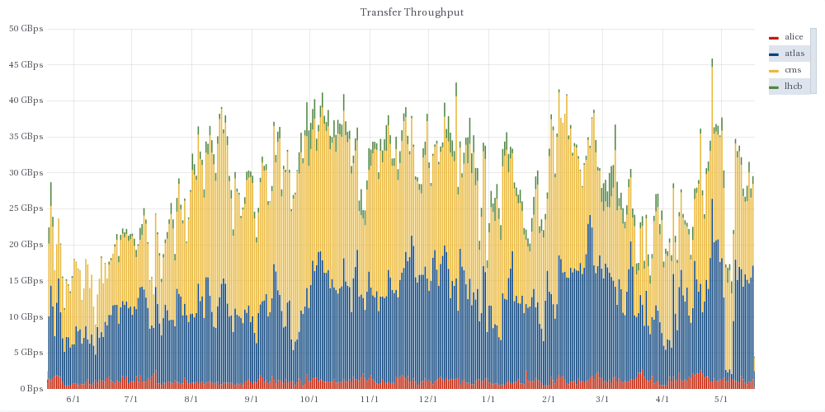
Data
2017: 40 PB
ALICE: 4.5 PB
ATLAS: 18 PB
CMS: 11.6 PB
LHCb: 5.6 PB
2018: 24.3 PB
ALICE: 1.8 PB
ATLAS: 6.7 PB
CMS: 14.5 PB
LHCb: 1.3 PB

Slide 4
CPU Delivered
New pledge year
New peak: ~221 M HS06-days/month
~ 740 k cores continuous
(From sites that pledge)

Slide 5
2018 Pledge situation
2018 pledges wrt requests: As given in REBUS

Slide 6

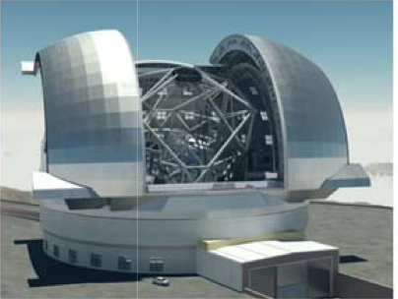
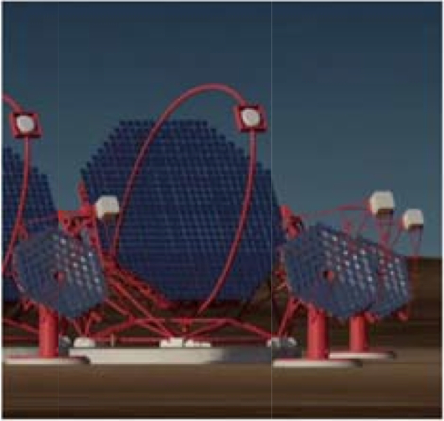
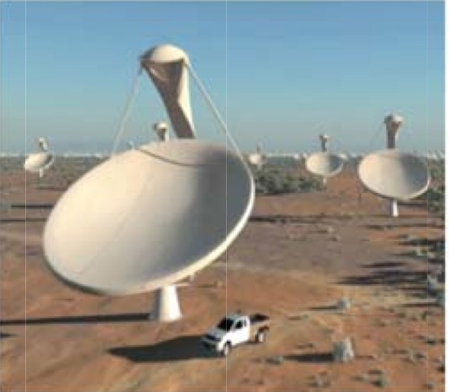
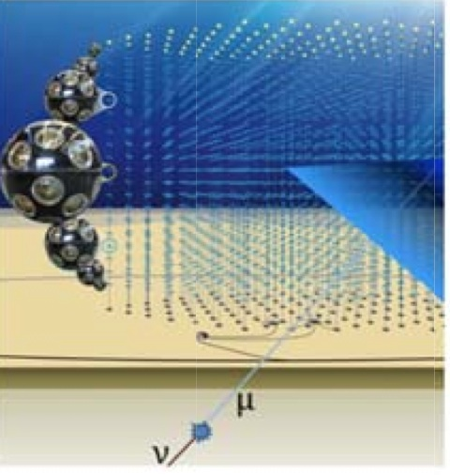
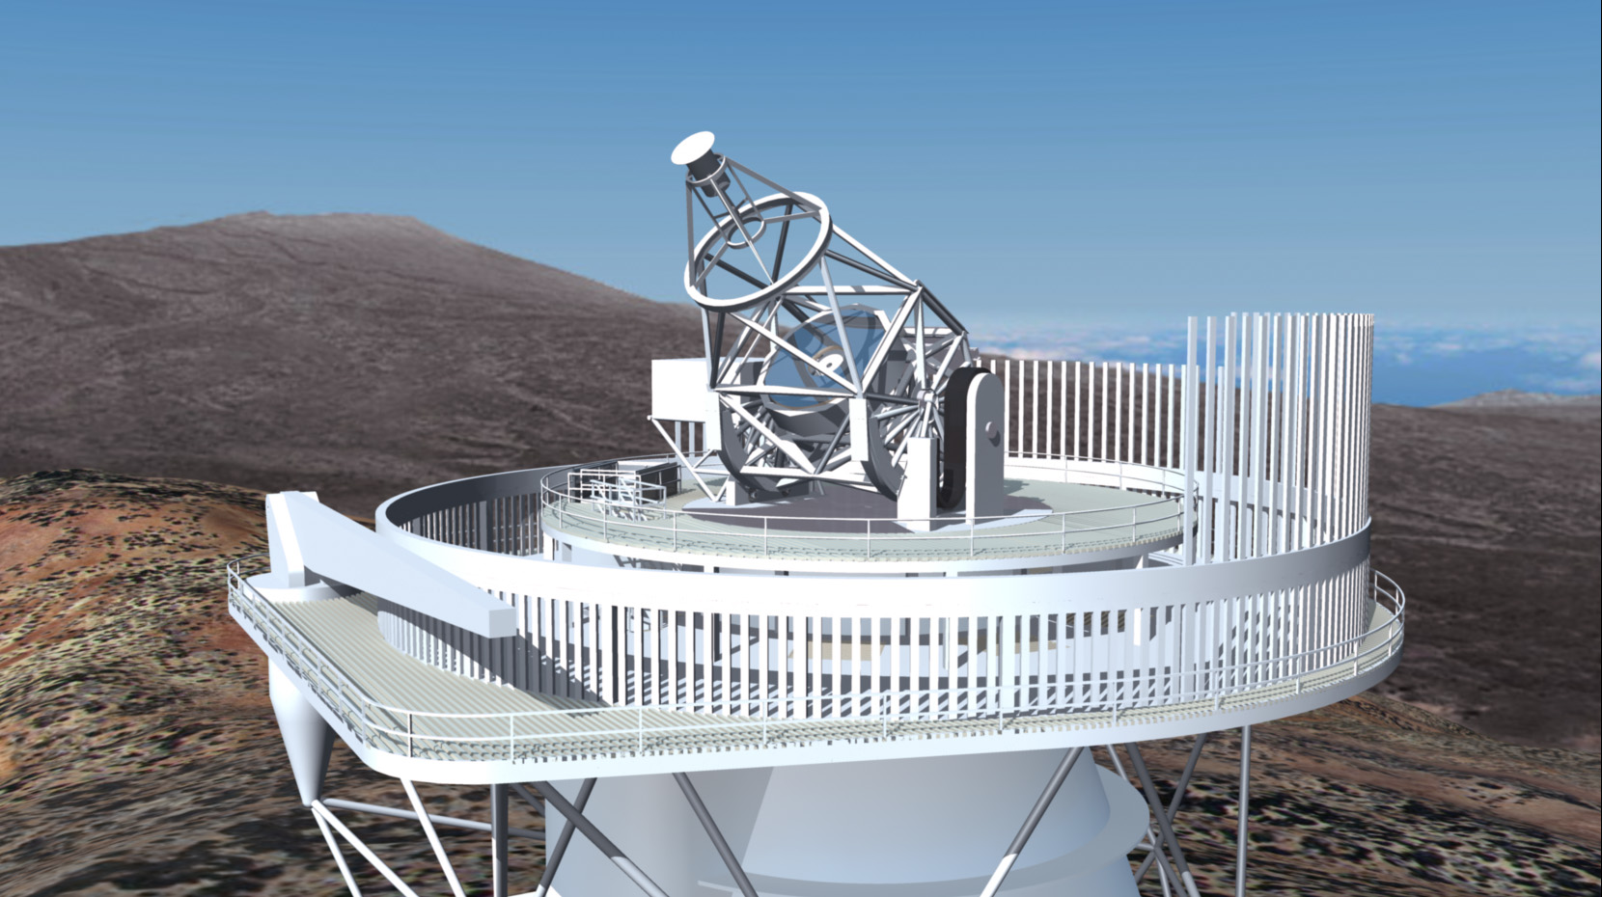
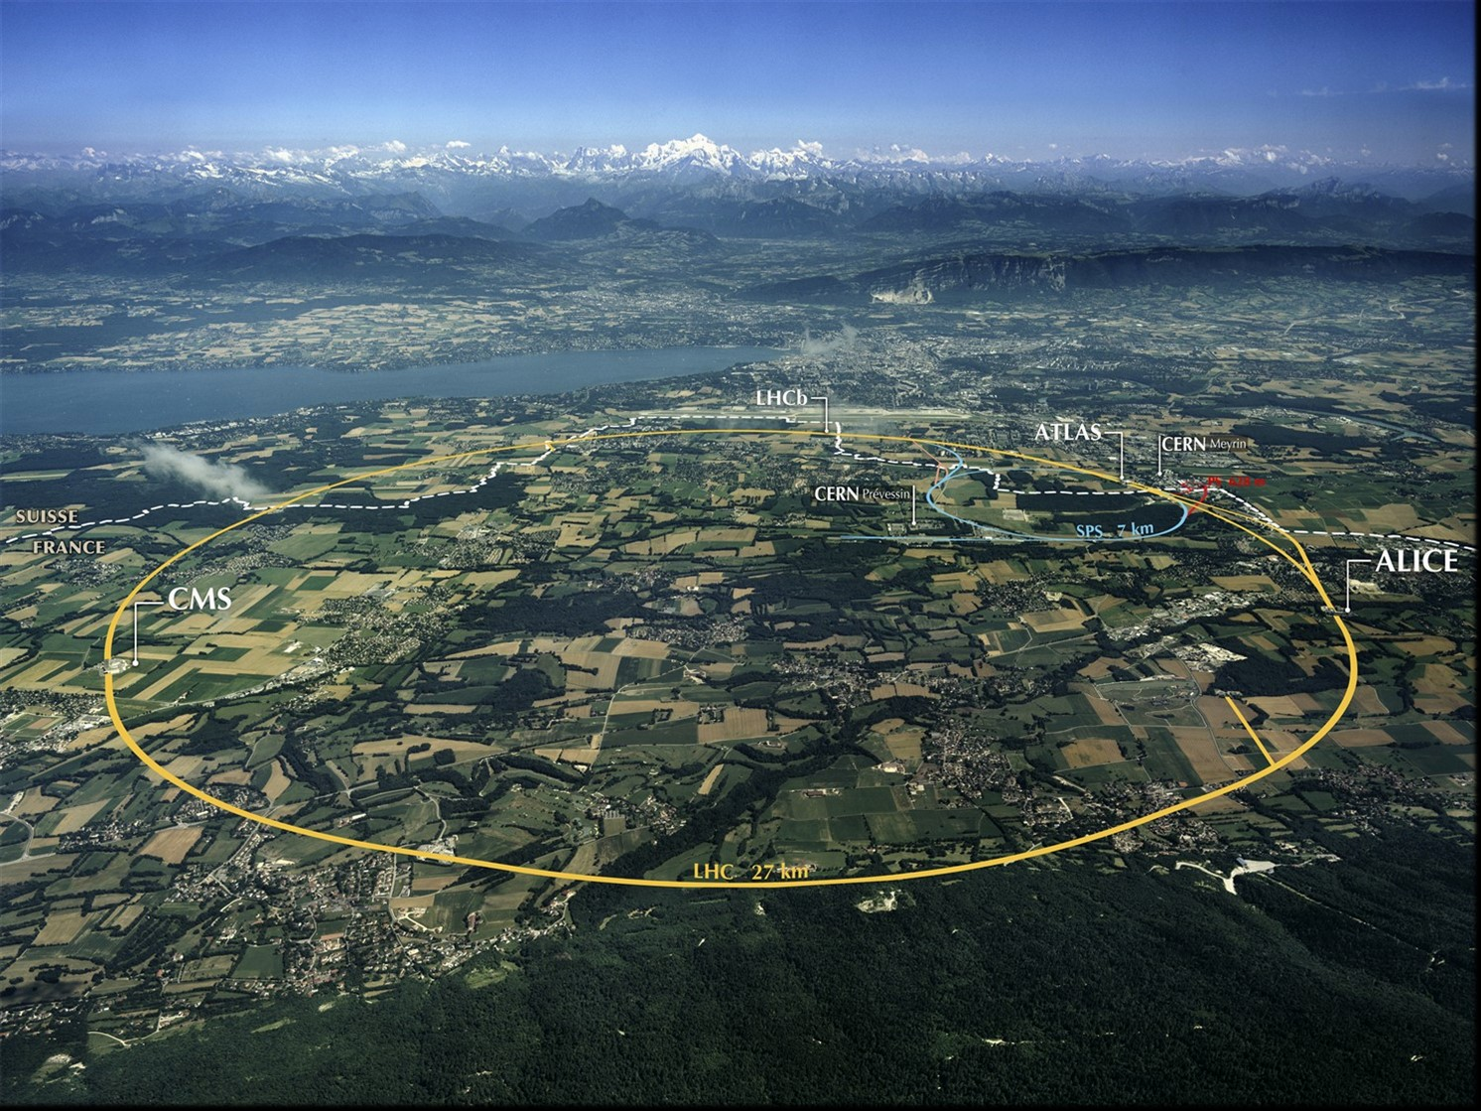
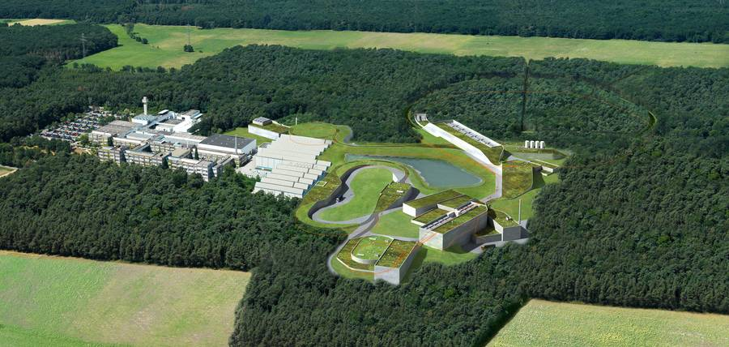
ESFRI Science Projects
HL-LHC SKA
FAIR CTA
KM3Net JIVE-ERIC
ELT EST
EURO-VO EGO-VIRGO
(LSST) (CERN,ESO)
Goals:
Prototype an infrastructure for the EOSC that is adapted to the Exabyte-scale needs of the large ESFRI science projects.
Ensure that the science communities drive the development of the EOSC.
Has to address FAIR data management, long term preservation, open access, open science, and contribute to the EOSC catalogue of services.
Work Packages
WP2 – Data Infrastructure for Open Science
WP3 – Open-source scientific Software and Service Repository
WP4 – Connecting ESFRI projects to EOSC through VO framework
WP5 – ESFRI Science Analysis Platform
Data centres (funded in WP2)
CERN, INFN, DESY, GSI, Nikhef, SURFSara, RUG, CCIN2P3, PIC, LAPP, INAF

Slide 7
Run 3 running conditions – 1
Following discussion with LHC operations
Still many unknowns
E.g. experiment planned trigger rates are tbd
Expected conditions:
7 TeV per beam, gives small reduction in beam size
The main limitation is the heat load in the cryogenics
Expect BCMS filling scheme; 25ns
2544/2556 bunches, β* = 27cm
1.3 x10¹¹ protons/bunch
2x10³⁴ (could be a bit higher) is the limit due to the inner triplet cooling
This will not change in LS2
This is a pile up of ~60

Slide 8
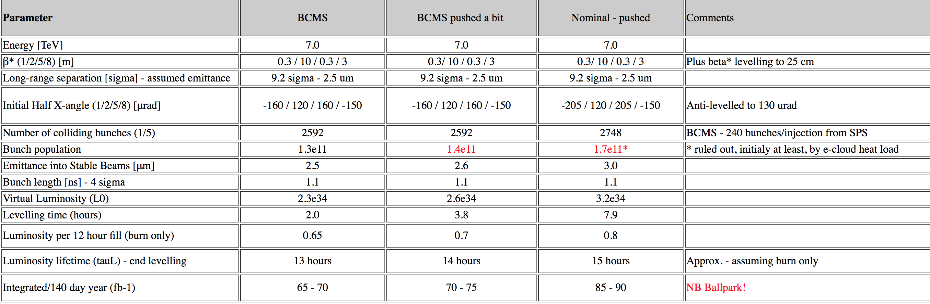
BUT:
http://lhc-commissioning.web.cern.ch/lhc-commissioning/performance/Run-3-performance.htm

Slide 9
Summary – Run 3:
Similar to 2018
If the experiments luminosity level at a higher pile-up and for longer ➔
Potentially higher average pileup
Non-linear increase in CPU time
Possibly less time between fills – more live time
Overall the best estimate is 30% (50% conservatively) more resources needed than in 2018
But we have not seen 2018 yet
For 2021: 1st year after LS2, could be only half-year live time but ramp up to optimal conditions rapidly
Unknown:
Still need plans for experiment trigger rates
And plans for luminosity levelling

Slide 10
Resource evolution
2010-2018 – pledges
2021 assume 1.5 x 2018

Slide 11
However …
ALICE and LHCb are upgrading during LS2, so the expectations of their needs do not follow the assumptions in the previous slides:
LHCb:
luminosity and pileup increase by factor 5.
Major changes in computing model result in higher trigger rate and HLT output bandwidth.
LHCC milestone for computing model in Q3/2018, together with engineering TDR – currently under review
ALICE:
Factor 100 increase in readout rate (50 kHz)
Data volume increase mitigated by online reconstruction and raw data compression in new O2 facility
O2 TDR is approved; summary needs are:
Increases in 2021 wrt 2018: CPU: 48%, disk: 74%, tape 90%

Slide 12
Planning at CERN
At CERN we are planning for procurements for 2021 as late as possible
Budget constraints mean that we try to minimize purchases during 2019, 2020
But we are pushed for additional resources during LS2
We probably cannot satisfy all requests
In addition logistics and infrastructure upgrades in the CC mean that we may lose some capacity during LS2

Slide 13
Summary
Run 3 is very hard to plan for …
2018 is already at ~ nominal Run 3 conditions, but hints that LHC conditions will be pushed …
Many unknowns from experiments – need some guidance on likely trigger rates, sustainable pile-up, etc.
Demands continue to increase – maximized trigger rates, parked data, much more HI data than foreseen, …
2021 is likely to be a short year, but 2022,23 could be very demanding on resources
We could reach limits of available budgets
This seems likely at CERN …
Strong hints remain that “constant budget” is the only realistic scenario
What happens when we hit a resource limit?

Slide 14
Planning for HL-LHC CWP & Strategy document

Slide 15
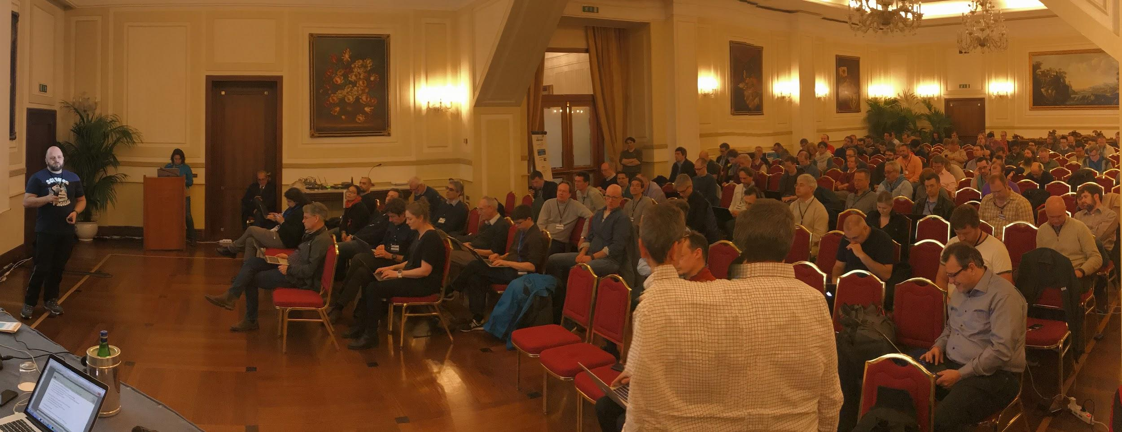
Naples workshop
WLCG + HSF – follow up to CWP
~200 attendees
Key areas – various projects/wg’s starting
Technology watch working group
Data Management R&D starting
Training group identified core skills as a prime first target
Common software libraries seriously discussed (VecCore, TrickTrack, Matriplex?)
Packaging group moving ahead with real tests
Software developers focus on performance and optimisation
Frameworks - take on the challenge of heterogeneity and organise workshop follow ups

Slide 16
Strategy document
Prioritize a program of work from the WLCG point of view:
A focus on HL-LHC, building on all of the background work provided in the CWP, and the experience of the past.
Themes
Software performance
Algorithmic improvements/changes
E.g. reco, fast MC, event generators
Reducing data volumes
Managing operations costs
Optimizing hardware costs
It defines an R&D program with rough timelines, organized in sections:
The HL-LHC challenge, hardware trends and a cost model
Computing Models
Experiments Software
System Performance and Efficiency
Data and Processing Infrastructures
Sustainability
Data Preservation and Reuse
Demonstrate that we are in control of costs, while maximizing physics output

Slide 17
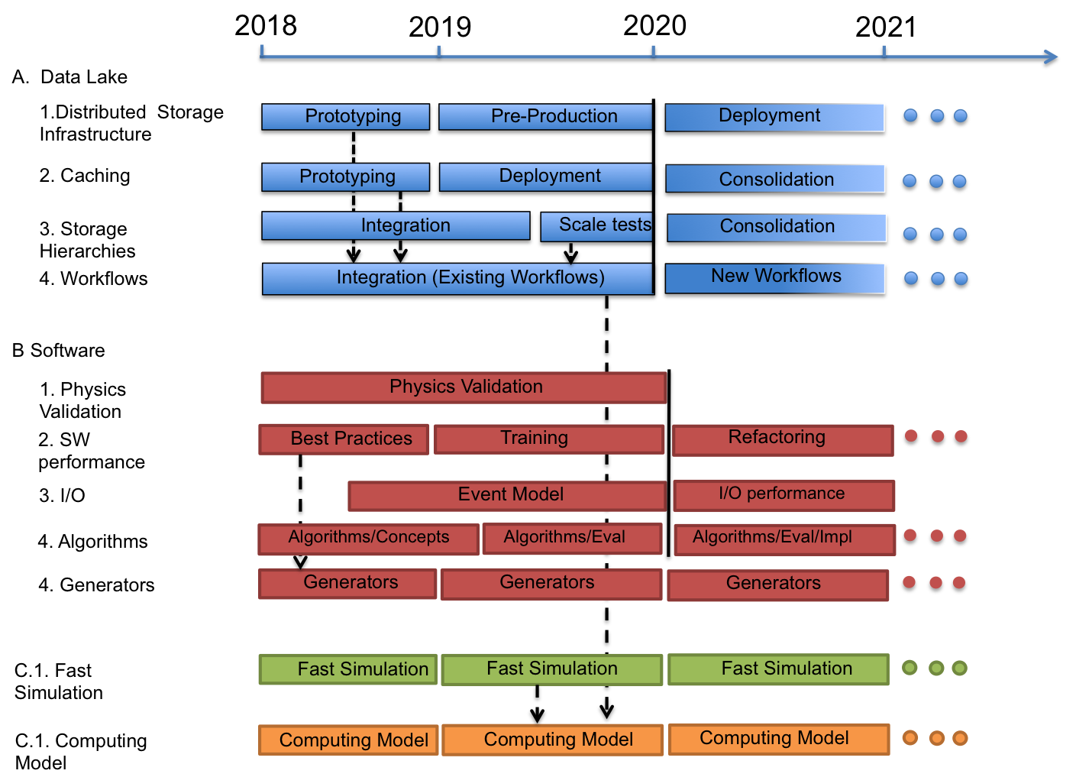
Timeline

Slide 18
Data and Compute Infrastructure
High Level Services
High Level Services
High Level Services
Storage Interoperability Services
Storage
Asynchronous
Data Transfer
Distributed Regional Storage
Distributed Storage
Data (Lake)
Infrastructure
Storage
Storage
Volatile
Storage
Storage
Content Delivering and Caching
Grid Compute
Grid Compute
Cloud Compute
HPC
Compute
@HOME
Grid Compute
Compute
Infrastructure
Compute Provisioning
Site N

Slide 19
Priorities
Setting up key projects to address the issues
NB. Several activities in hand in experiments, etc.
We launched a WLCG DOMA (Data Organization, Management, Access) project to address the first
Create a forum to discuss ideas and present results
Track progress, review status, evolve the strategy, prioritize
Discussed in the WLCG/HSF workshop, agreed in WLCG management and Grid Deployment Board, kick off on June 4th and 5th
We are discussing an equivalent initiative for Offline Software and the HSF is the natural umbrella for this
Manpower is very short, particularly in software, also for the current core tasks
Need to leverage commonality at all costs, this is why the HSF plays a huge role here
Need to address the problem of recognition and career opportunity for people working on software related tasks

Slide 20
Review of HL-LHC Computing preparations
As discussed in last LHCC
Should consider a review of the strategy
We think a review will be extremely useful in a broader context:
HL-LHC startup is ~2026/7 (optimistically)
TDR for computing in 2020 is perhaps not ideal – 6/7 years away from the need
Have a serious review of the strategy in early 2019, a TDR slightly later (2022-3??), in concert with experiment computing TDR’s (tbd).
Use the review and (updated?) strategy to validate resourced projects with FA’s
But do not wait for this – start key activities now

Slide 21
A Review straw-man
Scope: (tbd)
Comment on the appropriateness of the strategies to achieve an affordable and optimised computing model to maximize physics output for HL-LHC;
Are the ongoing work and proposed strategies realistic; and are there missing topics or opportunities?
Are the assumptions correct?
It would also be useful to bring in all aspects of the problem of HL-LHC computing that need to all be contributing to the overall solution including aspects that don’t traditionally regard themselves as “WLCG” like simulation and reconstruction. This would give a coherent overall picture.
Needs 2-3 days
High-level reviewers
➔ Needs some lead-time: likely timescale is thus early 2019

Slide 22
Review committee …
Chair person: experienced but not directly in LHC programme
Amber Boehnlein (e.g.)
Members: (this needs care)
Software expert – at least 1 senior person
Infrastructure expert
2-3 high-level national representatives: involved in LHC computing and responsible for national structures
Rep from LHCC
Other?

Slide 23
Review structure
Prospects for reduction of data volumes - needs experiment specific contributions and plans
up-front/online processing (like LHCb plan to do in Run 3)
data formats - nanoAOD etc
use of virtual data
full chain MC
optimization of number of replicas - caching rather than storing, etc.
Analysis evolution - who?
ROOT - what are future plans for analysis
Experiment outlook - what do they see as analysis needs - is ROOT sufficient?
Organized, local, cloud-based, etc. - Relative merits and costs
Infrastructures - who? - Data-lake project + Rucio + experiments?
Data management ideas (data lake/DM project goals) - how much can be common
Workflow management - highly organized to allow use of tape vs disk
prospects for commonality - e.g. move of “~Rucio” into common layers, common workflows?
Hardware evolution outlook
Cost models?
Use of HPC (infrastructure level - software portability dealt with above)
Event generators - someone very high-level (e.g. Ian Butterworth)
what are plans to re-engineer the code and support NLO, NNLO efficiently?
Other topics?
Some introduction - overview of scale of the challenge, physics drivers, trigger rates, MC fraction etc. Experiment physics coordinator?
Each of the following should give prospects for improvement - performance factor, reduction factor, etc.
Reconstruction
Improvements and prospects over coming 5 years - general view someone from common reconstruction activity
Experiment specific contributions and plans - ATLAS, CMS
Simulation
Speed up of GEANT4 (vectorisation, parallelisation, re-engineering for performance, etc.) - Geant team
Fast simulation - Geant team
Explain plans for the evolution of GEANT
Full chain MC - ATLAS and CMS specific contributions
Software performance and prospects in general - EP-SFT leading HSF activity, plus appropriate experts
portability (heterogenous architectures), I/O performance, EDM, etc
ROOT team should explain how they will help optimize I/O performance - what are plans?
Common activities (HSF) - parallelism, vectorisation, etc - how this will be managed
ATLAS and CMS - outlook for re-engineering core software?

Slide 24
Conclusions
Very efficient and heavy use of WLCG during the winter stop, new peak usage reached
Major incident at CNAF accommodated by other centres
Resources and infrastructure in place for 2018
Community White Paper published and WLCG Strategy document drafted –
R&D activities aimed at HL-LHC beginning

