Slide 1
WLCG Update
Ian Bird
LHCC Referee’s meeting
CERN, 11th September 2018

Slide 2
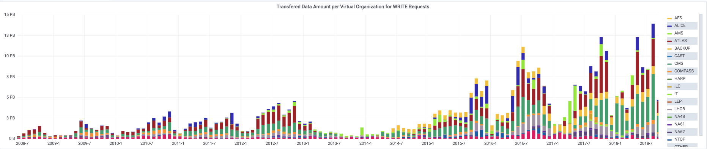
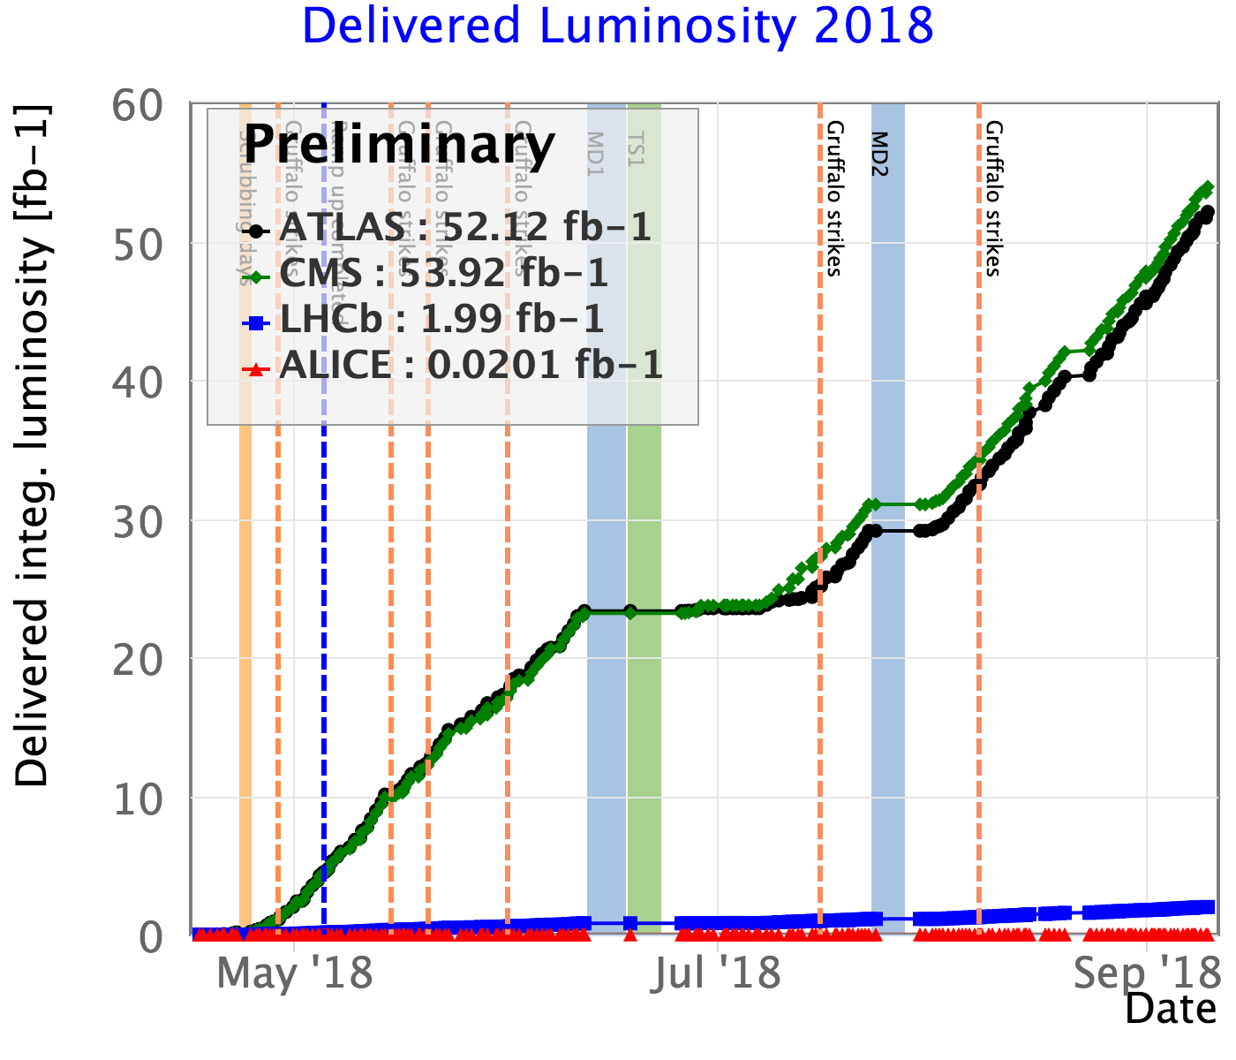
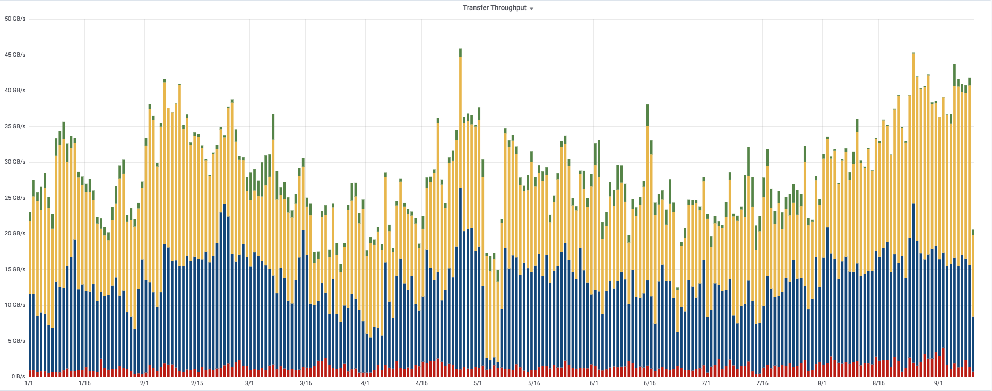
Data
2018: 53.3 PB
ATLAS: 16.0
CMS: 28.4
LHCb: 4.5
ALICE: 4.4
14 PB in August
inc. parked b-physics data
Data transfers

Slide 3
CPU Delivered
New pledge year
New peak: ~242 M HS06-days/month
~ 780 k cores continuous
(From sites that pledge)

Slide 4
Preparation for HI run
This week there will be a test of HI data taking; anticipate higher rates than we have seen before
  From DAQ → tape
  All experiments participating
    Generate data and send to Tier 0, check for bottlenecks and unforeseen problems
    (although LHCb is running production)
Aggregate data rates ~19 GB/s (ALICE 10 GB/s, 3x3-GB/s)
  IT will add some internal data eventually, to check limits
2-days (13+14 Sep). If problems are found, no chance to re-test, have to be corrected for the run

Slide 5
2019 Pledge situation
2019 pledges wrt requests:
As given in REBUS
- Final updates due for October RRB

Slide 6
Run 3 running conditions – 1
Following discussion with LHC operations
Still many unknowns
  E.g. experiment planned trigger rates are tbd
Expected conditions:
  7 TeV per beam, gives small reduction in beam size
  The main limitation is the heat load in the cryogenics
  Expect BCMS filling scheme; 25ns
    2544/2556 bunches, β* = 27cm
    1.3 x10¹¹ protons/bunch
  2x10³⁴ (could be a bit higher) is the limit due to the inner triplet cooling
    This will not change in LS2
    This is a pile up of ~60

Slide 7
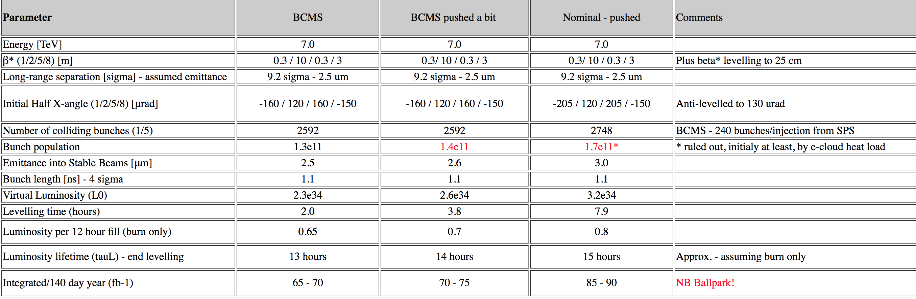
Planning for Run 3
Not much change in understanding since last meeting
  Best estimates:
    2021 will be ”light” commissioning year
    2022 → 1.3 – 1.5 x 2018 depending on trigger rates and levelling duration (and virtual luminosity)
  Still many unknowns:
    Accelerator conditions
    Trigger rates, pile-up, parked data, etc.
    ALCE and LHCb real needs above 2018
  Seems likely we will hit limits of “flat budgets”

Slide 8
Resource evolution
2010-2018 – pledges
2021 assume 1.5 x 2018

Slide 9
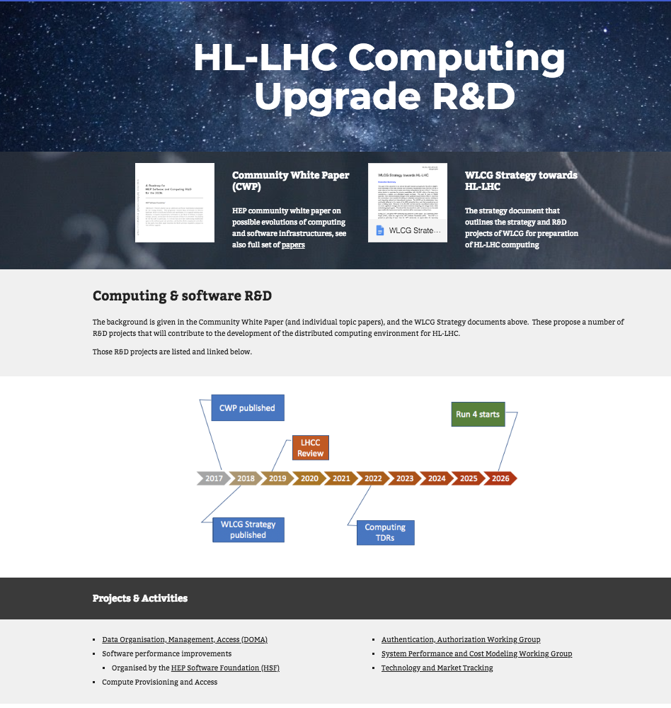
HL-LHC progress
Data (DOMA project): Activities ongoing in several areas:
  Caching and data access
  Third-party copy
  Investigation of lower-level protocols (with SKA and GEANT)
  Replacement of gridftp
Software activities – via HSF
  Software Institute proposal being funded by NSF
  HSF organizing for specific projects: first are
  simulation, reconstruction, analysis
Compute Provisioning & Access
  Not really started yet, but discussions with HPC providers
  (PRACE) being organized
Authentication, Authorization working group
  Converging on token-based models, looking at integration with services, etc.
  In collaboration with international partners and projects
System Performance and Cost Model working group
  Active since last year
Technology and Market Tracking
  Has been long-term activity

Slide 10

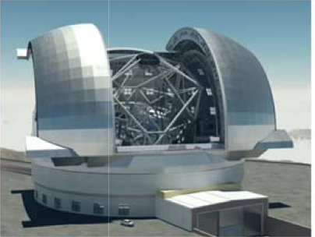
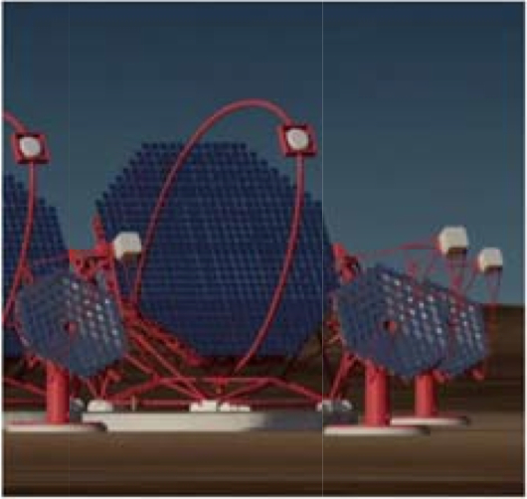
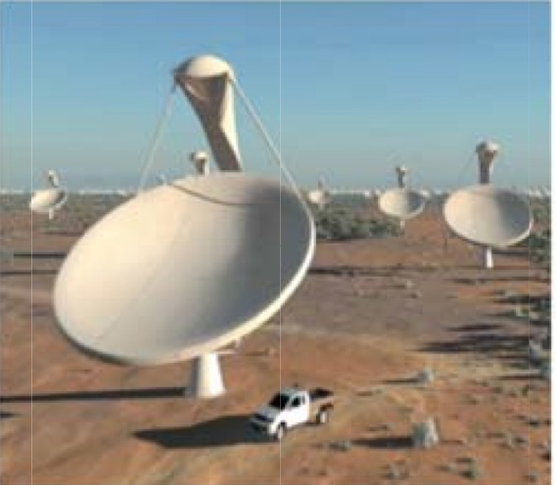
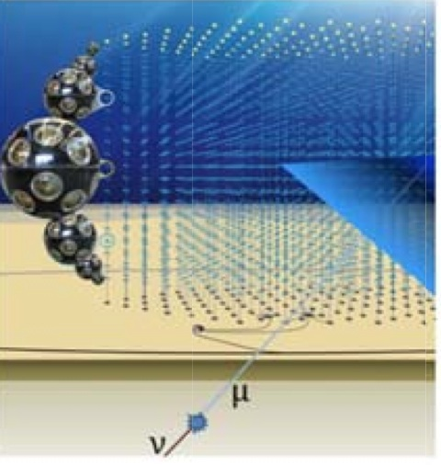
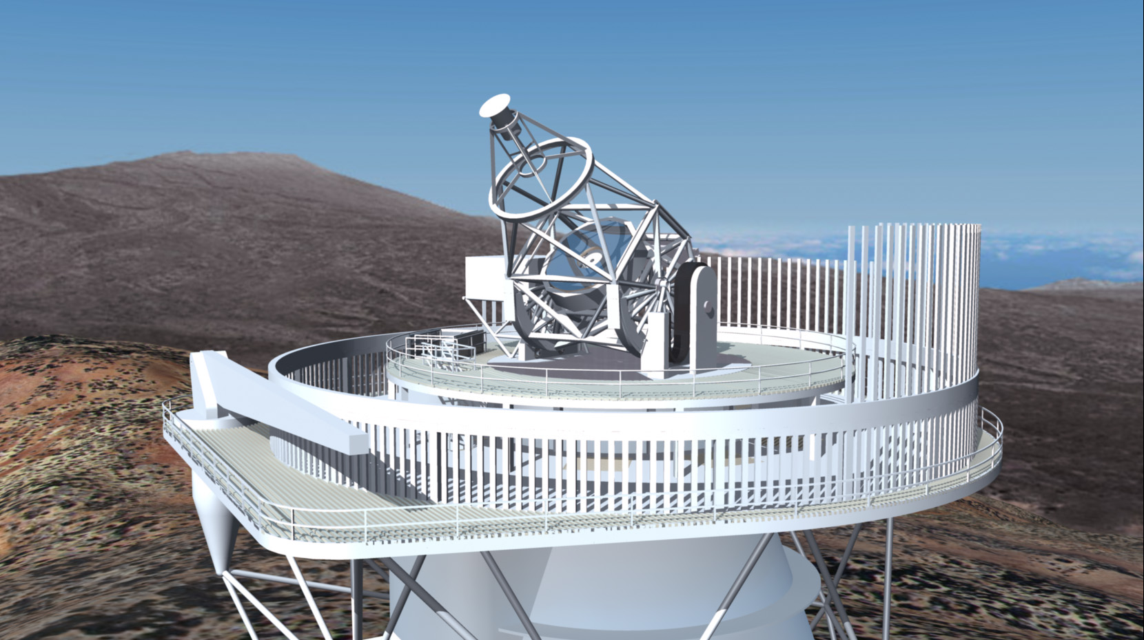
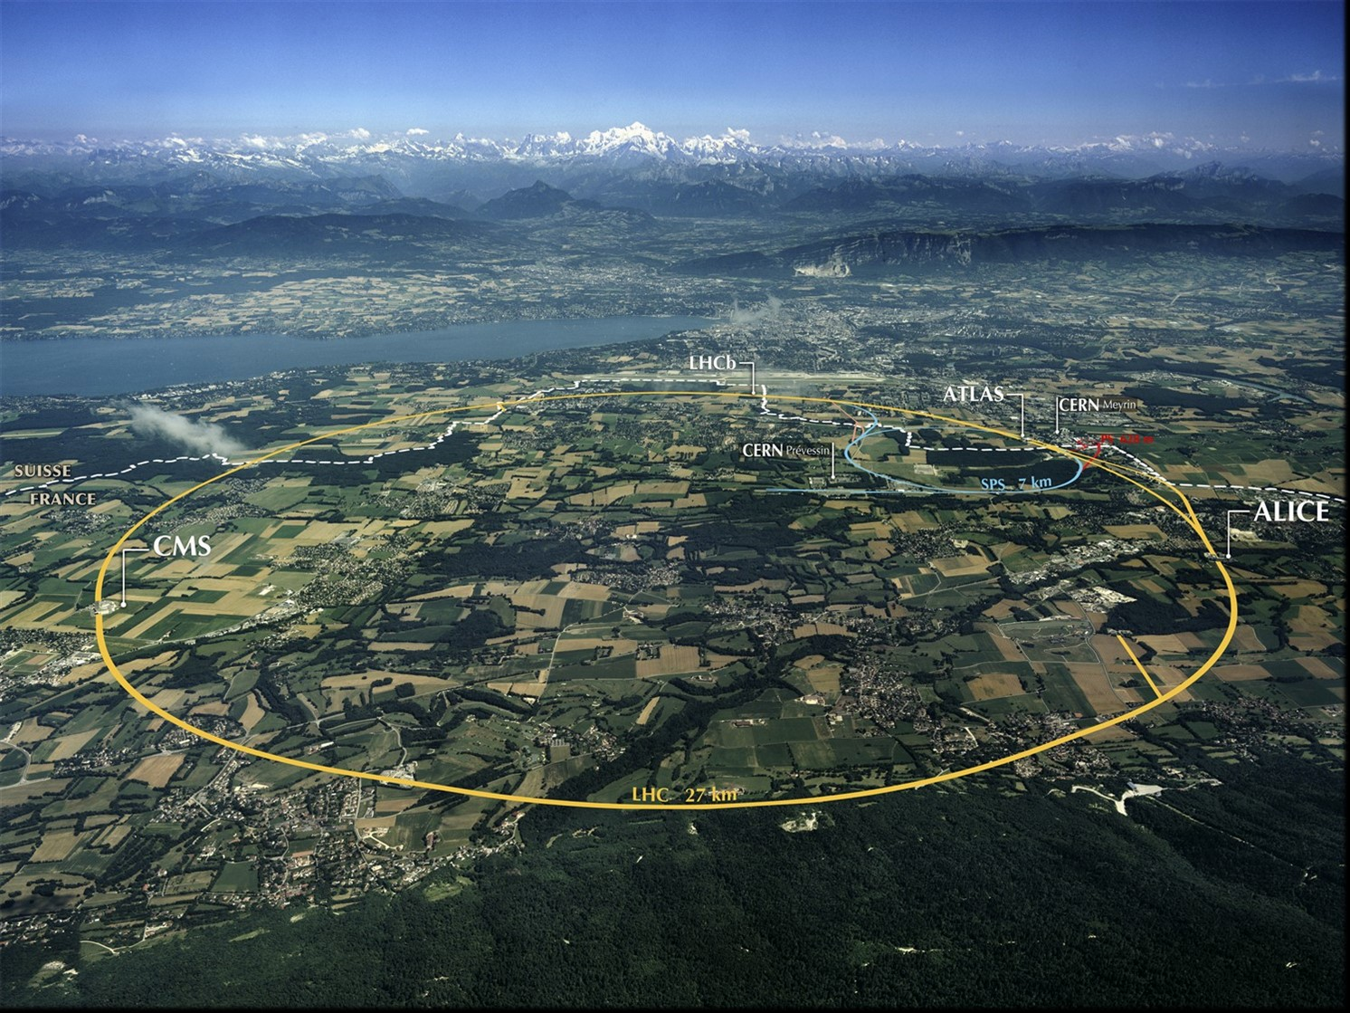
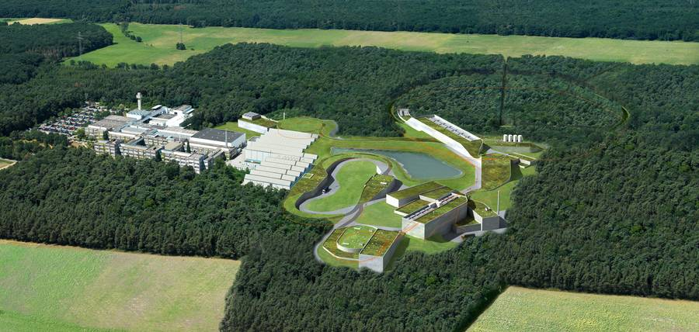
ESFRI Science Projects
HL-LHC SKA
FAIR CTA
KM3Net JIVE-ERIC
ELT EST
EURO-VO EGO-VIRGO
(LSST) (CERN,ESO)
Goals:
Prototype an infrastructure for the EOSC that is adapted to the Exabyte-scale needs of the large ESFRI science projects.
Ensure that the science communities drive the development of the EOSC.
Has to address FAIR data management, long term preservation, open access, open science, and contribute to the EOSC catalogue of services.
ESCAPE Project has been approved
Funded at the requested level
Project likely to start in January 2019
Work Packages
WP2 – Data Infrastructure for Open Science
WP3 – Open-source scientific Software and Service Repository
WP4 – Connecting ESFRI projects to EOSC through VO framework
WP5 – ESFRI Science Analysis Platform
Data centres (funded in WP2)
CERN, INFN, DESY, GSI, Nikhef, SURFSara, RUG, CCIN2P3, PIC, LAPP, INAF

Slide 11
Review of strategy
Fairly urgent to converge on a date for the review
WLCG-HSF workshop planned for w/b 18th March 2019
Would like to be able to use that also as preparation for review
Desire to be able to plan around a timetable

Slide 12
Summary
Data taking very smooth – no operational concerns,
  50 PB pp data so far, expect +25 during HI
ESCAPE project approved – will help fund data lake development and integration
Run 3 conditions still uncertain
  30-50% resource increase compared to 2018 (for ATLAS and CMS), more for ALICE and LHCb
Projects for HL-LHC starting in many areas
  As set out in the strategy

