Slide 1
LHCb Status
Stefan Roiser
LHCC / WLCG Referees Meeting
11 Sept 2018

Slide 2
Operations
CPU usage continues well above pledge levels
  Usage continues being dominated by Monte Carlo production
  2nd highest consumer now user analysis jobs
  Online farm second biggest CPU contributor, used in parallel & TS & MD

Slide 3
Operations (ctd)
Job success rate (97 %) and CPU efficiency continue at high levels
Using additional CERN resources on cloud and CPU on disk servers
Running Jobs @ CERN resources
Job Efficiency
3% failed
CPU time

Slide 4
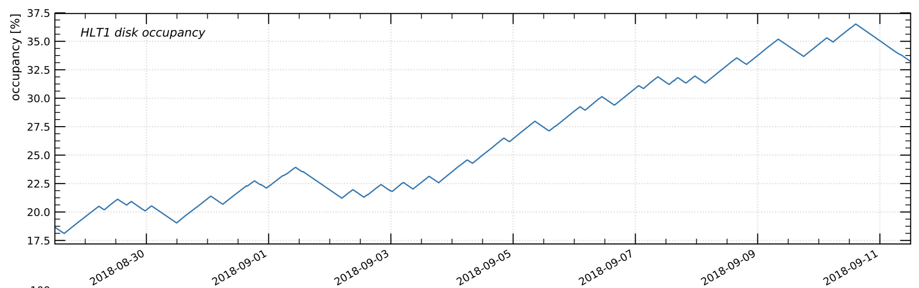
End of Run 2 pp & HI run & LS 2
During MD and TS, HLT continues to process buffered data
LHCb participating in HI run and to common infrastructure testing
Run 2 legacy re-stripping campaign foreseen for 2019

Slide 5
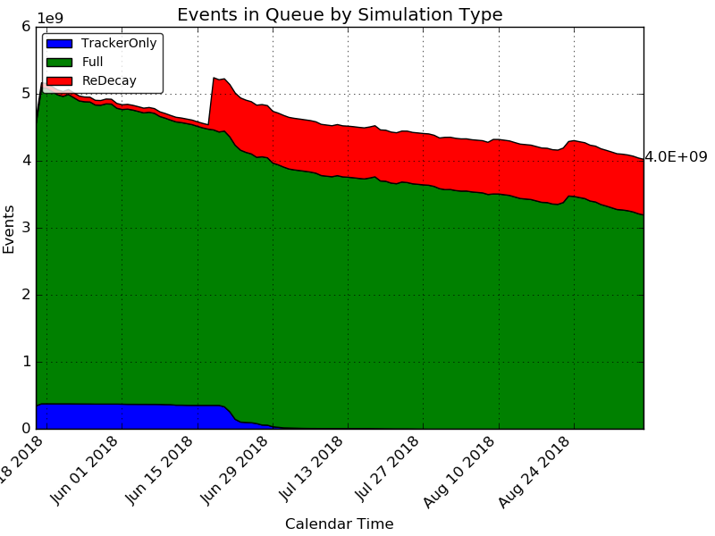
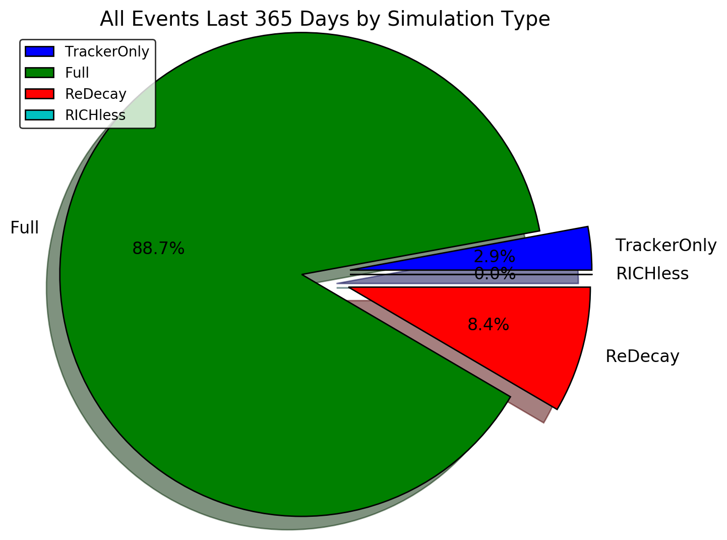
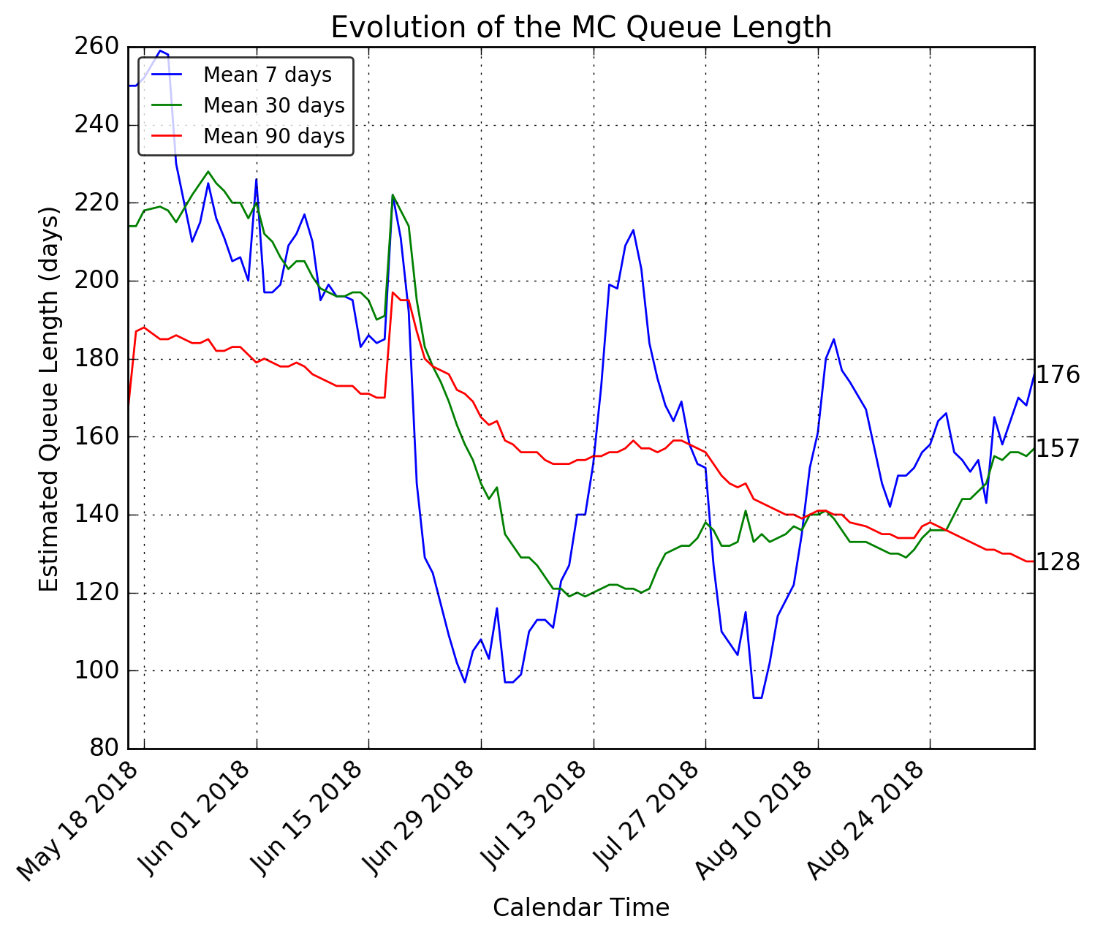
Simulation Queue
Queue of events to simulate is going down
  Expect new wave of requests with next simulation version releases

Slide 6
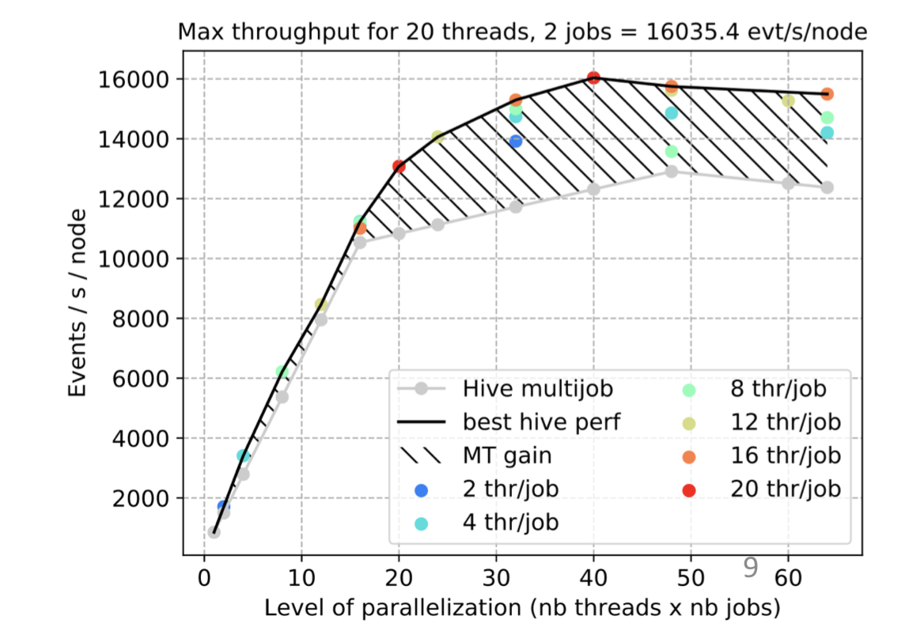
Upgrade Software
New scheduler of algorithms for core framework integrated
  Enables easier benchmarking with trigger sequences
Constant evolution of trigger (HLT1) event throughput
  Latest measurements at 16k events / s / node
  Achieved via continuous improvement of algorithm logic and code optimisations
  Work ongoing …

Slide 7
Run 3 Computing Resources – Baseline Scenario
Baseline model updated
  Assuming a “2021 commissioning year”
  10 GB/s HLT output bandwidth, all analysis data on disk
Storage, especially disk, keeps on being a tight resource
 | CPU |  |  | Disk |  |  | Tape
 | kHS06 | FCB | AYG | PB | FCB | AYG | PB | FCB | AYG
Baseline scenario by end of Run3 (2023) | 2.797 | 2.5 | 2.0 | 300 | 3.0 | 1.8 | 345 | 1.9 | 1.6
Baseline scenario by end of LS3 (2025) | 3.676 | 2.3 | 1.3 | 312 | 2.1 | 1.4 | 351 | 1.4 | 1.3
2nd and 3rd columns are factor of “constant budget” (FCB) and average yearly growth (AYG)

Slide 8
Baseline Scenario (ctd)
10 GB/s HLT output bandwidth
  including ~ 2 disk replicas
Storage usage driven by detector data
  Most of MC data will move to m(icro)DST format
  Further disk optimizations possible
CPU dominated by MC Simulation work
  Shared between full / fast and parametric simulation
3.0
1.9
2.8

Slide 9
Run 3 Computing Resources – Alternatives
For example:
Reduction in disk requirements of 33 %
Reduced HLT output bandwidth of 7.5 GB/s
Compared to “constant budget” for disk & tape
  Reach max factor of 1.6
  End of LS3 → 20 and 10 % above
Detailed presentation in LHCb/LHCC session

Slide 10
Summary
Run 2 Operations continues smoothly at high usage and efficiency
Data re-stripping campaigns foreseen for LS 2
Run 3 software engineering, performance continues to improve
Run 3 computing model being finalized and TDR document to be submitted soon

