Slide 1
ALICE Status Report
Predrag Buncic

Slide 2
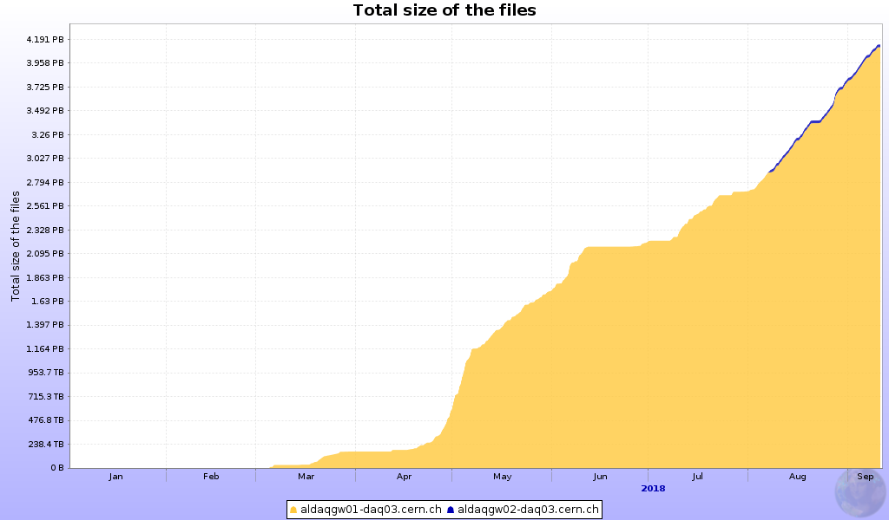
Data taking progress
Smooth data taking
4.1 PB registered and replicated to T1s
PERIOD | COLLISION | MAG FIELD (T) | INT. RATE (kHz) | muon_calo | CPass0/CPass1 | Manual Calib | PPass | QA and run lists
LHC18b | pp 13 TeV | B=-0.5 | Feb-80
LHC18c | pp 13 TeV | B=-0.2 | 125
LHC18d | pp 13 TeV | B=-0.5 | 195
LHC18e | pp 13 TeV | B=-0.5 | 190
LHC18f | pp 13 TeV | B=-0.5 | 195
LHC18g | pp 13 TeV | B=+0.5 | 20-160
LHC18h | pp 13 TeV | B=-0.5 | 195
LHC18i | pp 13 TeV | B=+0.5 | 20
LHC18j | pp 13 TeV | B=-0.5 | 190
LHC18k | pp 13 TeV | B=-0.5 (dipole 0) | 20-140-160
LHC18l | pp 13 TeV | B=-0.5 | 190 |  |  |  |  | Ongoing
LHC18m | pp 13 TeV | B=+0.5 | 5-50-190-250 | Running | Running
2018 pp data reconstruction going very well

Slide 3
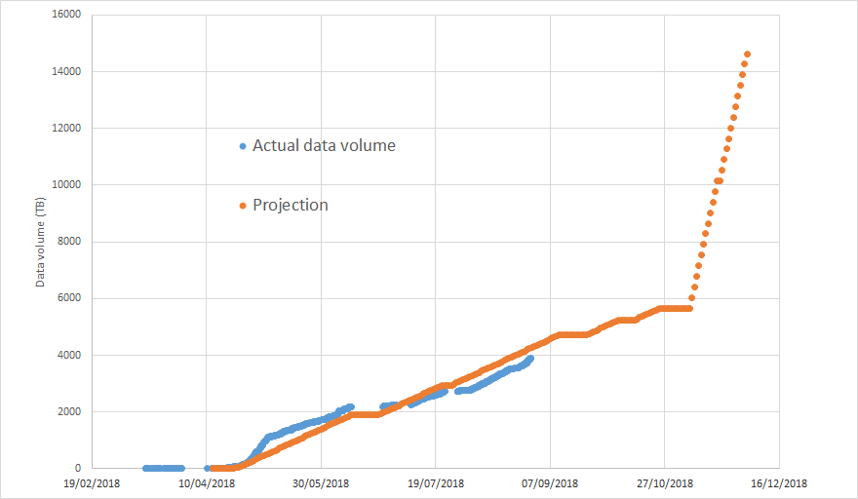
Data volume
Projection based on pp evt size of 1.7 MB (@ V0and = 150 kHz) and 430 Hz TPC read-out
Matches the expectations, no change in parameters used to calculate computing requirements

Slide 4
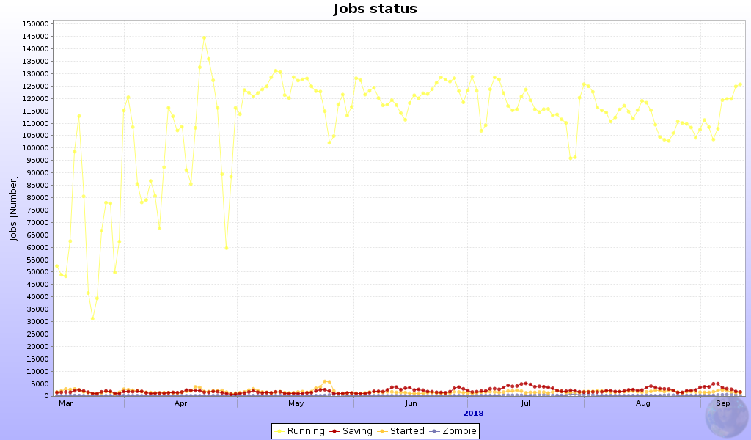
CPU Usage

Slide 5
CPU Usage
Good utilization of opportunistic CPU resources in particular at CERN
CPU efficiency remains constant at ~83%

Slide 6
Measures to address shortage of disk
For 2019 CERN decided to pledge only 5 PB of disk (out of 8.1 PB approved by C-RSG)
According to computing resource sharing procedure as defined by the ALICE Constitution, the CERN pledge reduced by 3.1 PB in 2019 will automatically increase obligations of other FAs in proportion to their M&O share.
Given that there was no significant changes is any of the relevant parameters used for the resources calculations, the overall request remains the same as presented in April except for rebalancing of the disk space as a result of reduced T0 pledge
  France will add +0.5 PB and Germany up to +1.0 PB on top of 20% year-on-year increase
  Russia, UK (and hopefully Italy) will implement at least their share
  Additional resources in Bergen (NorduGrid) should bring them above their nominal share

Slide 7
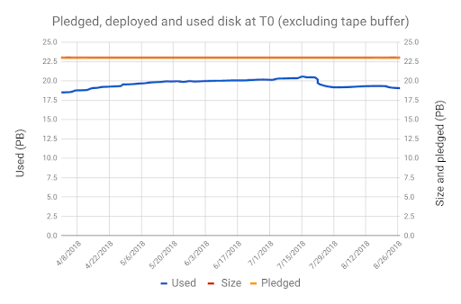
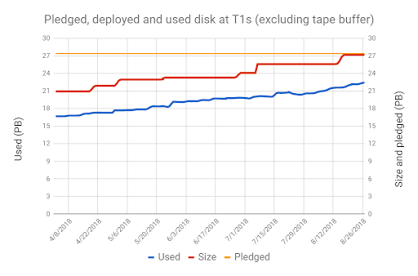
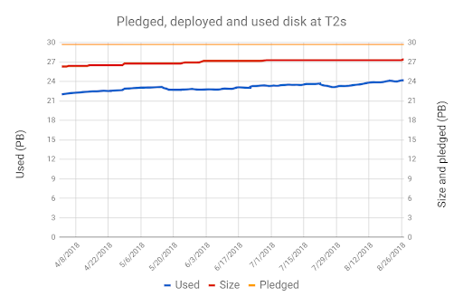
Disk Usage
Cleanup started across all tiers
Data moved from T0 to make a room for PbPB data taking

Slide 8
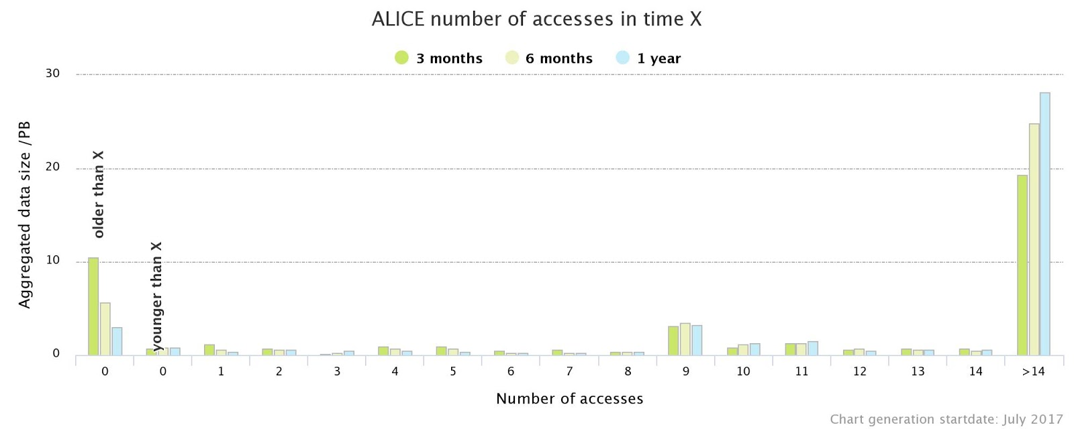
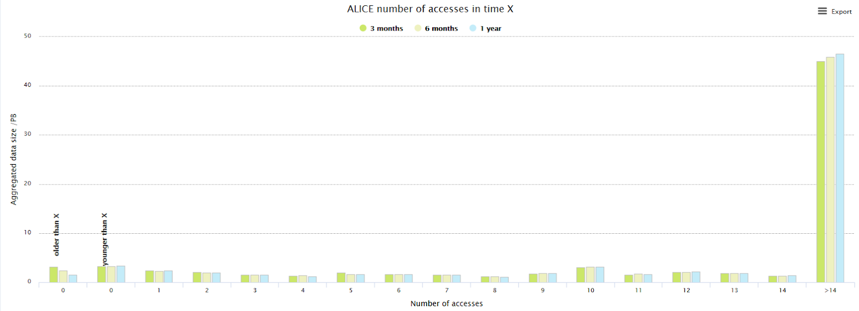
Data popularity
No dormant data left on disk

Slide 9
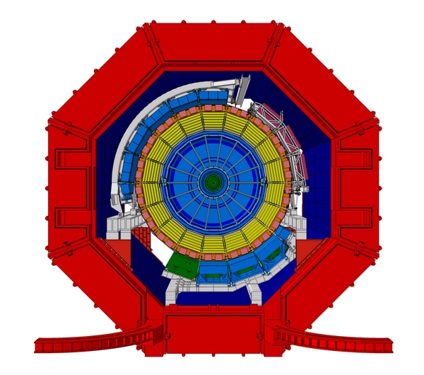
pp
PbPB
ANA
ANA
SIM
ANA
HLT
Compression
x7
HLT
SIM
SIM
1.2 GB/s
9 GB/s
82% full
83% full
89% full
T0
T1
T2
4 PB
20.2 PB
30.4 PB
33.9 PB
3PB
3 PB
EOS
+5 PB
+10.5 PB
+4.9 PB
3PB
3PB
RECO
RECO
This should be fine for 2018 data taking and 2019 data processing
During MDC3 there will be data challenge together with other experiments to verify that all system are functioning and can sustain the load
CASTOR
2 GB/s
5.4PB
9 PB
14.4 PB

Slide 10
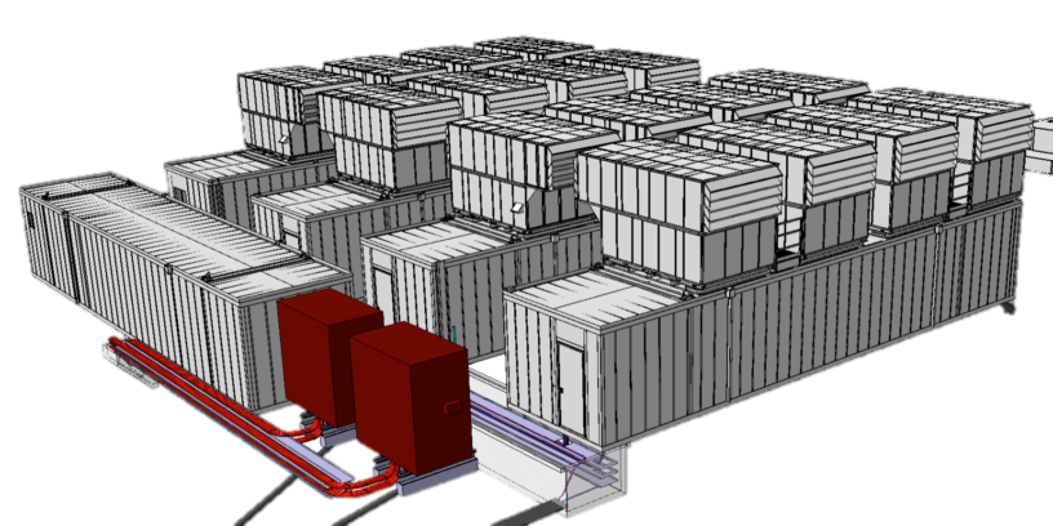
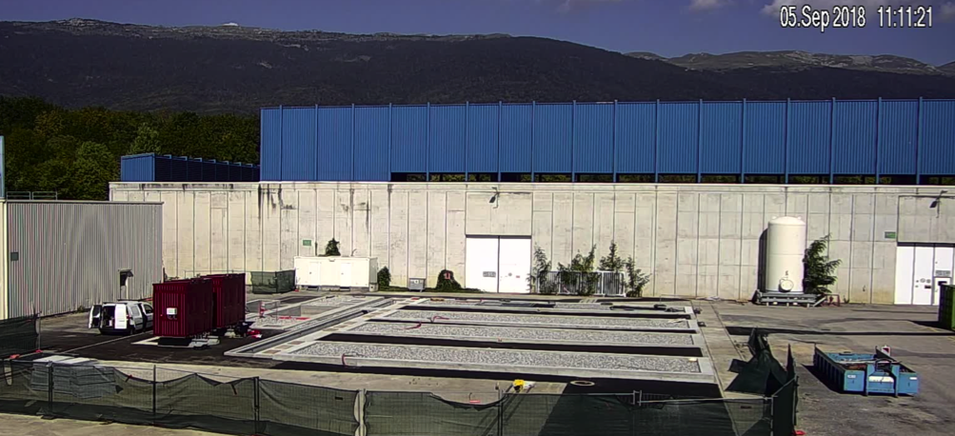
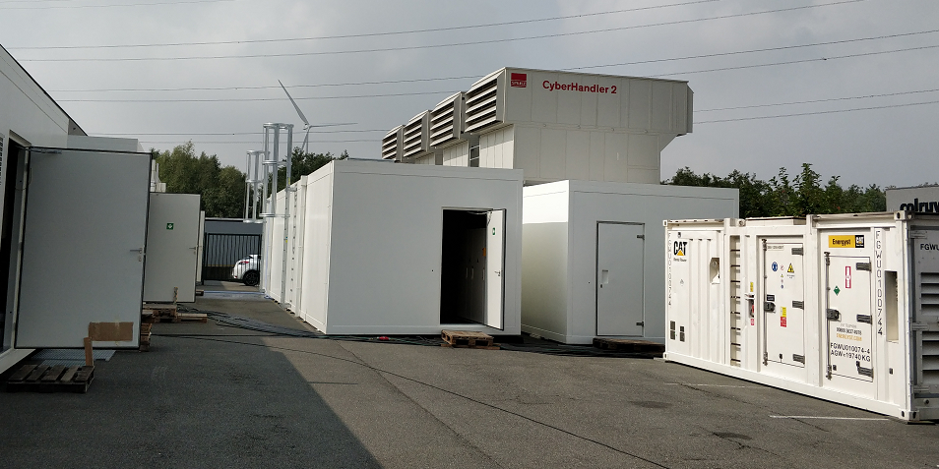
O² Facility – from a drawing board to reality
Installation (power module) starts next week….

Slide 11
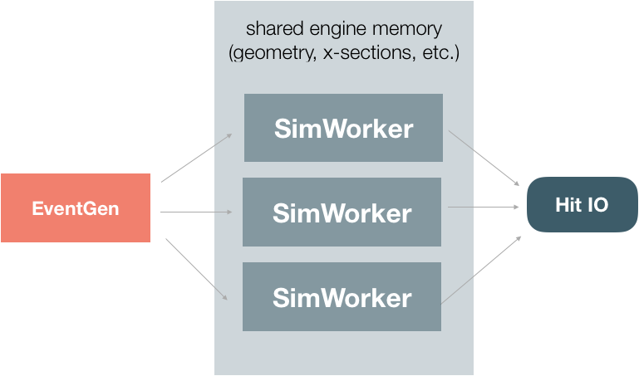
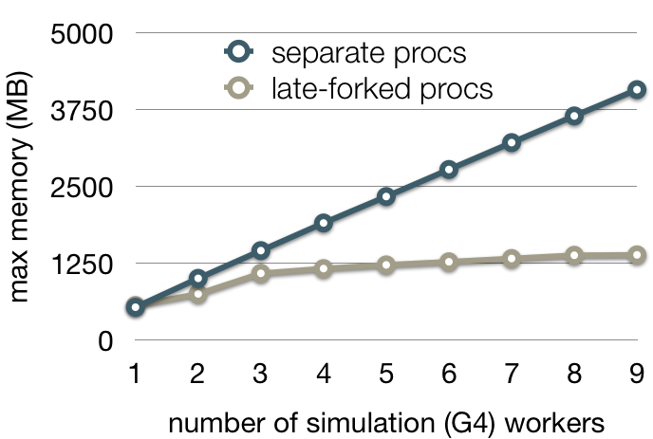
Run 3 software: Parallel high-performance simulation framework
Development of a scalable and asynchronous parallel simulation system based on independent actors and FairMQ messaging
Supports parallelization of simulation for any VMC engine
Supports sub-event parallelism
  Make simulation jobs more fine-granular for improved scheduling and resource utilization
Demonstrated strong scaling speedup (24 core server) for workers collaborating on few large Pb-Pb event
Small memory footprint due to particular ”late-forking” technique (demonstrated with Geant4)
In result, reduce wall-time to treat a Pb-Pb events from O(h) to few minutes and consequently gain access to opportunistic resources
S.Wenzel @ CHEP18

Slide 12
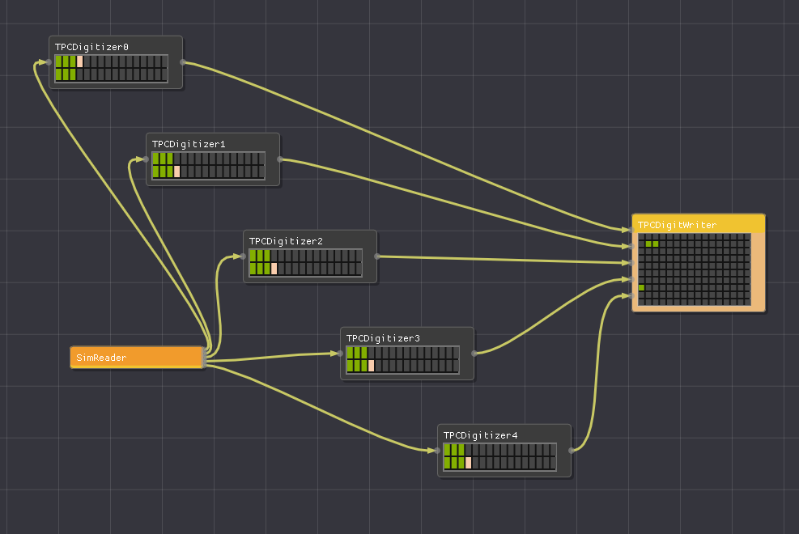
Run 3 software: Data Processing Layer (DPL)
O2Data Processing Layer (DPL) on top of ALFA to simplify and reduce user code and abstract away common problems of distributed systems
Simulation algorithms using hits (digitization, clusterization) integrated into the O² DPL
  “From purely sequential task-based processing to data-driven parallel treatment using FairMQ messaging”
Demonstrator for TPC
  Parallel, sector-based, digization and collaborative subtime-frame building
  Background-signal merging techniques
Data Processing Layer (DPL) GUI, debugging and developing environment

Slide 13
Summary
2018 data taking and processing is progressing well
CPU resources available and used beyond the pledge
Disk is critical in a view of the upcoming PbPb run
Given that CERN is not in position to fully implement the request in 2019 saving measures were implemented
  Disk liberated by (re)moving EOD/AODs, re-packing data archives and removing redundant information
  Completely removed dormant data from disk
Thanks to T1s who stepped in to fill the gap, are expect to be ready ready of PbPb data taking and data processing in 2019
  We will still require the additional disk resources in 2020 (no additional CPU and no additional tapes).
Good progress in development of parallel high performance simulation framework based on O2 DPL and ALFA for Run 3

