Slide 1
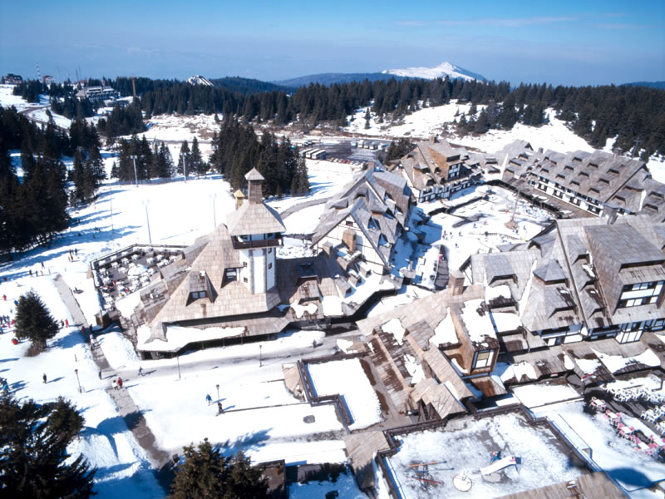
Heavy baryons in the chiral quark-soliton model: a possibility for exotica?
Michał Praszałowicz
M. Smoluchowski Institute of Physics
Jagiellonian University, Kraków, Poland
in collaboration with
M.V. Polyakov (Bochum, NPI Gatchina)
K.-C. Kim (Incheon Univ.)
G.-S. Yang (Soongsil University, Seoul)
Phys.Rev. D94 (2016) 071502
Phys.Rev. D96 (2017) 014009
and in preparation
Excited QCD, 2018,

Slide 2
Motivation

Slide 3
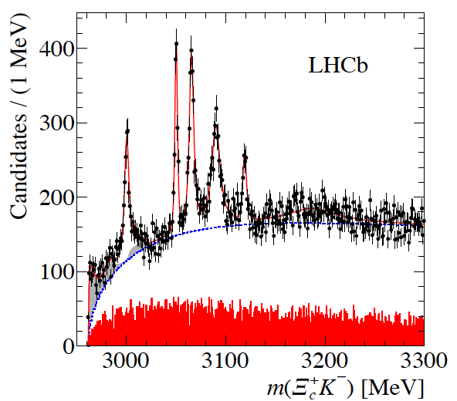
Motivation: 5 narrow Ω_{c}’s

Slide 4
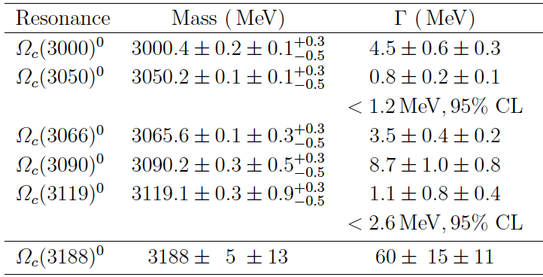
Motivation: 5 narrow Ω_{c}’s
70 MeV
not seen by Belle
Nov. 2017, but not excluded

Slide 5
Motivation: 5 narrow Ω_{c}’s
70 MeV

Slide 6
Reminder

Slide 7
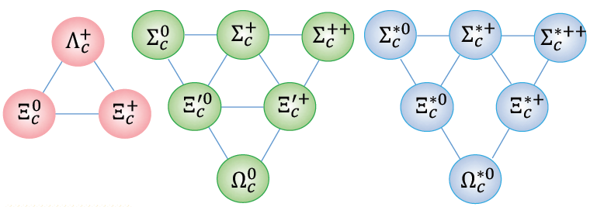
Heavy baryon ground states
© Linming Zhang, LHCb talk at APFB 2017
(3 1/2⁺) (6 1/2⁺) (6 3/2⁺)
2409 MeV 2580 MeV
average
multiplet
masses
before
hf splitting
70 MeV
2535 MeV 2602 MeV
s = 0 diquark + s = 1/2 HQ s = 1 diquark + s = 1/2 HQ

Slide 8
Heavy baryon ground states
© Linming Zhang, LHCb talk at APFB 2017
(3 1/2⁺) (6 1/2⁺) (6 3/2⁺)
2409 MeV 2580 MeV
average
multiplet
masses
before
hf splitting
70 MeV
2535 MeV 2602 MeV
s = 0 diquark + s = 1/2 HQ s = 1 diquark + s = 1/2 HQ

Slide 9
Heavy baryon ground states
© Linming Zhang, LHCb talk at APFB 2017
(3 1/2⁺) (6 1/2⁺) (6 3/2⁺)
2409 MeV 2580 MeV
5735 MeV 5908 MeV
average
multiplet
masses
before
hf splitting
70 MeV
2535 MeV 2602 MeV
5893 MeV 20 MeV 5913 MeV
same for the bottom

Slide 10
Heavy baryon ground states
© Linming Zhang, LHCb talk at APFB 2017
(3 1/2⁺) (6 1/2⁺) (6 3/2⁺)
b
b
b
b
b
b
b
b
b
b
b
b
b
171 MeV
173 MeV
2409 MeV 2580 MeV
5735 MeV 5908 MeV
average
multiplet
masses
b
b
before
hf splitting
70 MeV
2535 MeV 2602 MeV
5893 MeV 20 MeV 5913 MeV
hf splitting ratio ~ 0.3 ~ m_{c}/m_{b}
same for the bottom

Slide 11
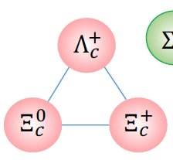
Heavy baryon excited states
(3 1/2⁻) (3 3/2⁻)
2724 MeV 30 MeV 2754 MeV
s = 0 diquark + s = 1/2 HQ + L= 1

Slide 12
Heavy baryon excited states
(3 1/2⁻) (3 3/2⁻)
5912 MeV 8 MeV 5920 MeV
b
b
b
b
b
b
2724 MeV 30 MeV 2754 MeV
not much known in the bottom sector

Slide 13
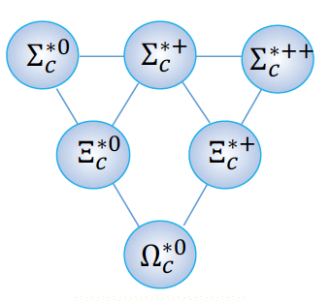
Sextet excitations 1/2⁻ and 3/2⁻?
s = 1 diquark + s = 1/2 HQ + L= 1
1/2, 1/2, 3/2, 3/2, 5/2 5 states!

Slide 14
Sextet excitations 1/2⁻ and 3/2⁻?
however:
one has to fit both
masses
and
widths
s = 1 diquark + s = 1/2 HQ + L= 1
1/2, 1/2, 3/2, 3/2, 5/2 5 states!

Slide 15
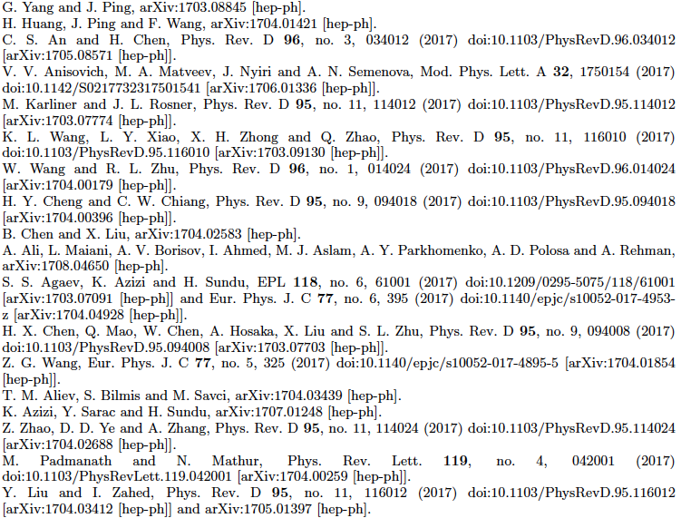

Slide 16
different approaches:
quark and quark-diquark models
quarks + resonating group method
chiral quark models
QCD sum rules
lattice
phenomenology
holographic QCD
outcome:
s – wave and p – wave excitations
both positive and negative parity
pentaquarks

Slide 17
Chiral Quark-Soliton Model

Slide 18
Why Chiral Quark-Soliton Model?
Why not?

Slide 19
Why Chiral Quark-Soliton Model?
Why not?
because it predicts small widths
for some specific decays

Slide 20
QCD: quarks and gluons
integrate out gluons
many quark nonlocal interactions
Lagrangian chirally symmetric
approximation:
manyq, nonl. 4q, local
Nambu Jona Lasinio model
spontaneous chiral symmetry breaking
semibosonization:
qqqq qqπ
Chiral Quark Model

Slide 21
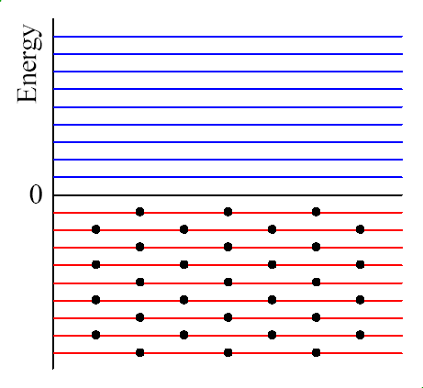
Chiral Quark Soliton Model
QCD vacuum:

Slide 22
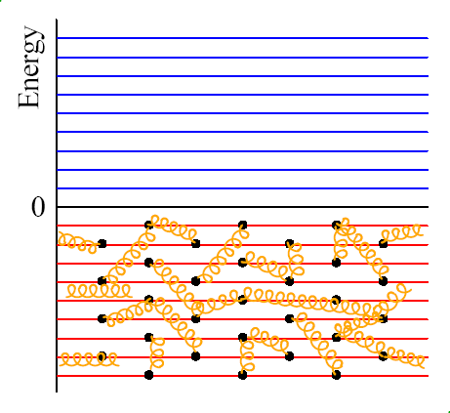
Chiral Quark Soliton Model
QCD vacuum:

Slide 23
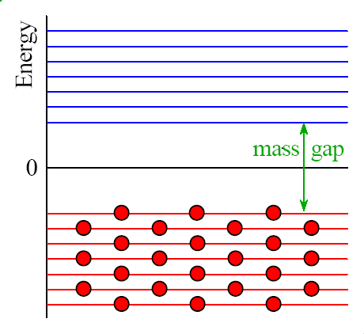
Chiral Quark Soliton Model
chiral symmetry breaking:
chirally inv. manyquark int.

Slide 24
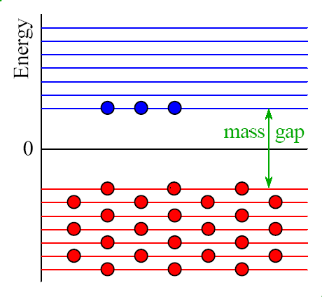
Chiral Quark Soliton Model
baryon:
adding vlence quarks:
chirally inv. manyquark int.

Slide 25
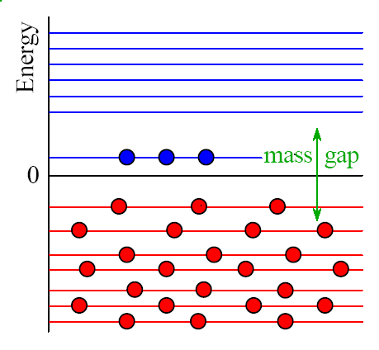

Chiral Quark Soliton Model
baryon:
“classical” baryon:
due to hedgehog symmetry
of the mean field only
grand spin
K = T + S
is a good quantum number
chirally inv. manyquark int.
soliton configuration
no quantum numbers except B

Slide 26
Chiral Quark Soliton Model
baryon:
“quantum” baryon:
chirally inv. manyquark int.
soliton configuration
no quantum numbers except B
rotation generates flavor and spin

Slide 27

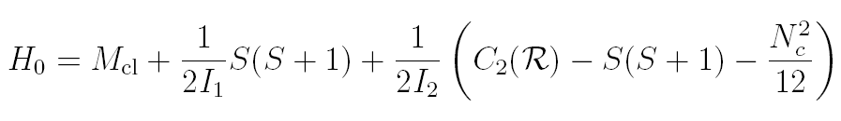
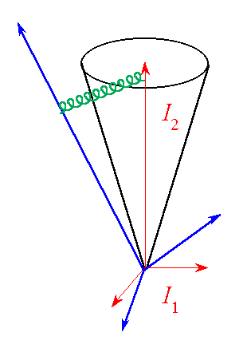
Mass formula
x
P.O. Mazur, M.A. Nowak, MP, Phys. Lett. 147B (1984) 137
E. Guadagnini, Nucl. Phys. B236 (1984) 35
S. Jain, S.R. Wadia, Nucl. Phys. B258 (1985) 713

Slide 28
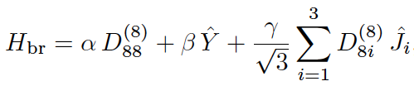

Mass formula
first order perturbation
in the strange quark mass
and in N_{c}:
x
P.O. Mazur, M.A. Nowak, MP, Phys. Lett. 147B (1984) 137
E. Guadagnini, Nucl. Phys. B236 (1984) 35
S. Jain, S.R. Wadia, Nucl. Phys. B258 (1985) 713

Slide 29
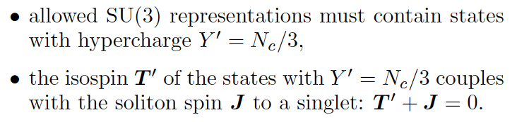
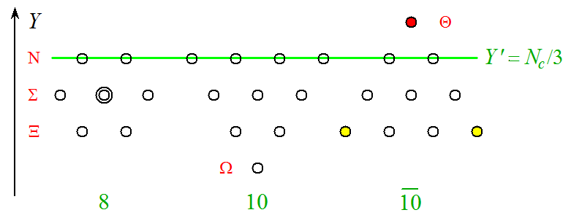
Allowed states
(1540 MeV)
# valence
quarks

Slide 30
Successful Phenomenology
Ch.V. Christov et al. Prog. Part. Nucl. Phys. 37 (1996) 91
In a ”model independent” approach
one can get both good fits to the existing data
(including very narrow light pentaquark Θ⁺)
one can fix all necessary model parameters:
M, I₁, I₂, α, β, γ

Slide 31
Successful Phenomenology
Ch.V. Christov et al. Prog. Part. Nucl. Phys. 37 (1996) 91
In a ”model independent” approach
one can get both good fits to the existing data
(including very narrow light pentaquark Θ⁺)
one can fix all necessary model parameters:
M, I₁, I₂, α, β, γ
but also one can recover the NRQM result
in a special limit
NRQM limit =
= squeezing the soliton to zero size
MP, A. Blotz, K. Goeke Phys. Lett. B354 (1995) 415

Slide 32
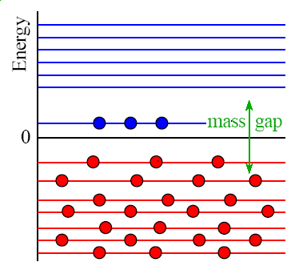
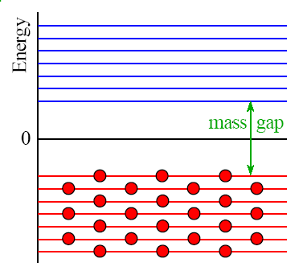
NRQM Limit
Diakonov, Petrov, Polyakov, Z.Phys A359 (97) 305
MP, A.Blotz K.Goeke, Phys.Lett.B354:415-422,1995
energy is calculated
with respect to the vacuum:

Slide 33
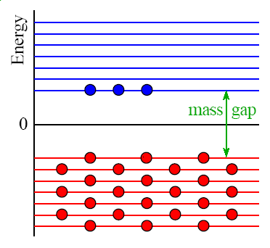
NRQM Limit
Diakonov, Petrov, Polyakov, Z.Phys A359 (97) 305
MP, A.Blotz K.Goeke, Phys.Lett.B354:415-422,1995
energy is calculated
with respect to the vacuum:

Slide 34
NRQM Limit
Diakonov, Petrov, Polyakov, Z.Phys A359 (97) 305
MP, A.Blotz K.Goeke, Phys.Lett.B354:415-422,1995
energy is calculated
with respect to the vacuum:
in the NRQM limit only valence level contributes

Slide 35
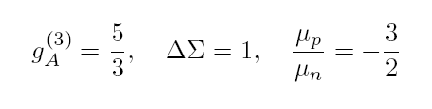
NRQM Limit
Diakonov, Petrov, Polyakov, Z.Phys A359 (97) 305
MP, A.Blotz K.Goeke, Phys.Lett.B354:415-422,1995
energy is calculated
with respect to the vacuum:
in the NRQM limit only valence level contributes

Slide 36

NRQM Limit
Diakonov, Petrov, Polyakov, Z.Phys A359 (97) 305
MP, A.Blotz K.Goeke, Phys.Lett.B354:415-422,1995
energy is calculated
with respect to the vacuum:
pentaquark width = 0 !
in the NRQM limit only valence level contributes

Slide 37
Heavy baryons in the
Chiral Quark-Soliton Model

Slide 38
Soliton with N_{c}− 1 quarks
if N_{c} is large, N_{c}- 1 is also large and one
can use the same mean field arguments
(N_{c}−1) ×
color factorizes!
plus one heavy quark
G.S. Yang, H.C. Kim, M.V. Polyakov, MP Phys. Rev. D94 (2016) 071502

Slide 39
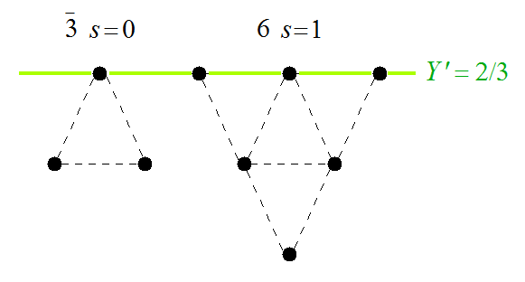
Allowed SU(3) irreps.
= (N_{c}−1)/3

Slide 40
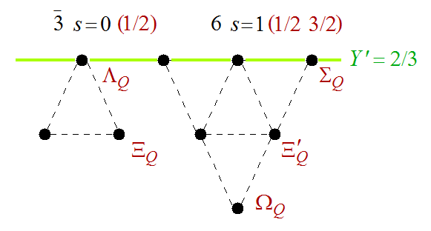
Heavy Baryons: soliton + heavy Q

Slide 41
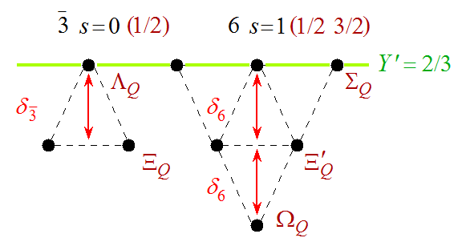


Splittings inside multiplets
= S_{L}
one has to add
h.f. interaction

Slide 42
Splittings inside multiplets
Equal splittings within
multiplets follow from
Eckhart-Wigner theorem
(GMO relations)

Slide 43
Splittings inside multiplets
Equal splittings within
multiplets follow from
Eckhart-Wigner theorem
(GMO relations)
however the
relation between
the deltas does not follow from
Eckhart-Wigner theorem

Slide 44
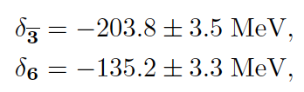
Splittings inside multiplets
from the fits
to the light
sector we get:
(exp.: 178 MeV)
13%
(exp.: 121 MeV)

Slide 45
Splittings inside multiplets
Successful phenomenology
from the fits
to the light
sector we get:
G.S. Yang, H.C. Kim, M.V. Polyakov, MP Phys. Rev. D94 (2016) 071502
(exp.: 178 MeV)
13%
(exp.: 121 MeV)

Slide 46
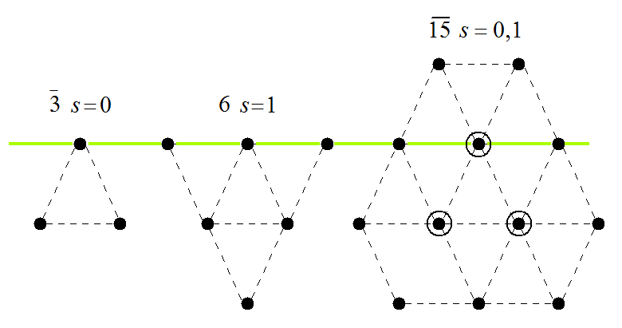
Rotational excitations: heavy pentaquarks
2/3
H.C. Kim, M.V. Plyakov, MP arXiv:1704.04082 [hep-ph]

Slide 47
Rotational excitations: heavy pentaquarks
soliton in 15 (quatroquark)
(spin 1 < spin 0)
+ heavy quark: 1/2 + 3/2
2/3
H.C. Kim, M.V. Plyakov, MP arXiv:1704.04082 [hep-ph]

Slide 48
Rotational excitations: heavy pentaquarks
soliton in 15 (quatroquark)
(spin 1 < spin 0)
+ heavy quark: 1/2 + 3/2
2/3
H.C. Kim, M.V. Plyakov, MP arXiv:1704.04082 [hep-ph]

Slide 49




Decays
axial-vector constants with X = 3, 8, 0
a₁ ~ N_{c} a₂ ~ O(1) a₃ ~ O(1) fixed from the data on weak hyperon decays
Goldberger-Treiman relation:
for strong decays use the same operator, but
example

Slide 50
Decays
axial-vector constants with X = 3, 8, 0
a₁ ~ N_{c} a₂ ~ O(1) a₃ ~ O(1) fixed from the data on weak hyperon decays
Goldberger-Treiman relation:
for strong decays use the same operator, but
example
~ N_{c}

Slide 51
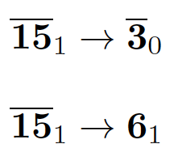
Decay constants
H.C. Kim, M.V. Polyakov, MP arXiv:1704.04082 [hep-ph]

Slide 52



Decay constants
In NRQM limit:
Expectations:
decays will be suppressed
H.C. Kim, M.V. Polyakov, MP arXiv:1704.04082 [hep-ph]

Slide 53
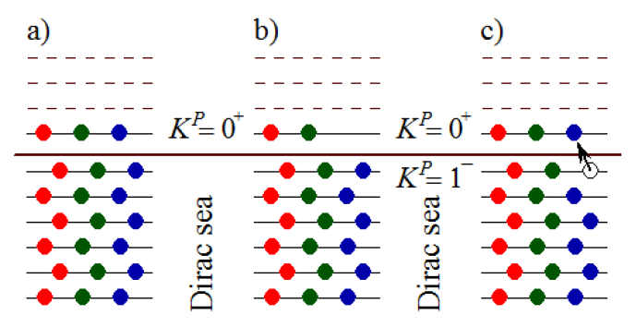
Quark excitations: non-exotic heavy baryons
V. Petrov, Acta Phys. Pol. B47 (2016) 59

Slide 54
Quark excitations: non-exotic heavy baryons
Rotations generate quantum numbers

Slide 55

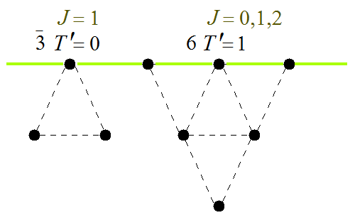
One K=1 quark excited solitons

Slide 56
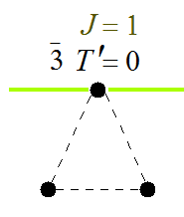


3bar excited heavy baryons
add heavy quark
total spin 1/2 and 3/2

Slide 57









3bar excited heavy baryons
experimentally:
add heavy quark
total spin 1/2 and 3/2
hyprfine
splitting
different
from the
ground
state

Slide 58
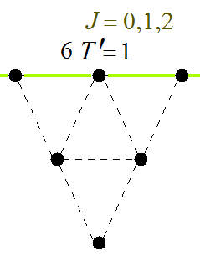

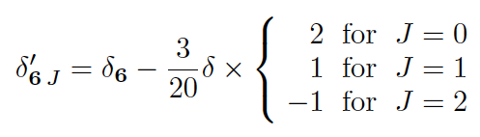
sextet excited baryons

Slide 59

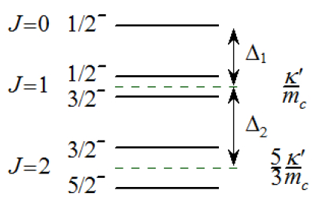
sextet excited baryons
excited Omega_Q spectrum,
5 states

Slide 60

5 states!

Slide 61
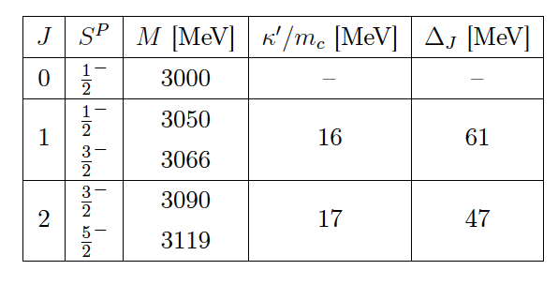
Scenario 1: all LHCb Omega’s are sextet states
violates constraints:

Slide 62
Scenario 1: all LHCb Omega’s are sextet states
violates constraints:
similar problem in the quark models

Slide 63
Scenario 2 force sextet constraints

Slide 64
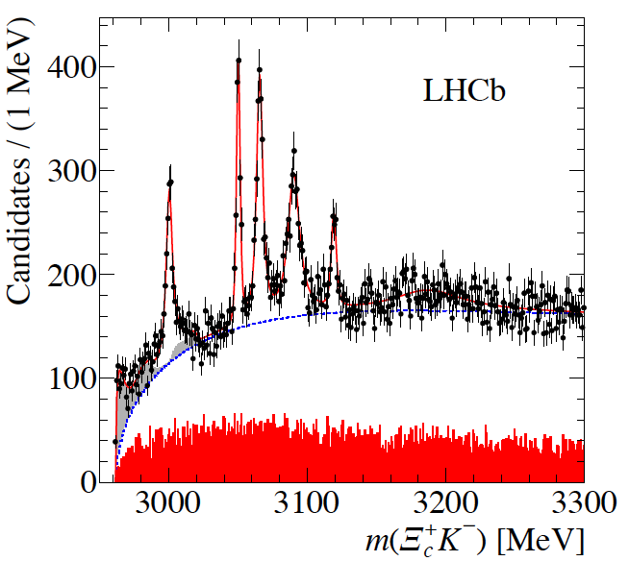




heavy
states
above
Ξ + D
threshold,
large p.s.
also to
Ω_{c}+ π,
can be
very
wide
=24

Slide 65


Two narrow
states
(1 MeV)
inerpreted as
pentaquarks
heavy
states
above
Ξ + D
threshold,
large p.s.
also to
Ω_{c}+ π,
can be
very
wide
=24

Slide 66
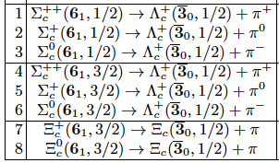
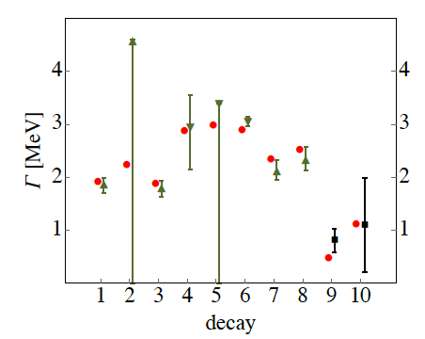


Charm decay widths
with one adjustable parameter that takes
into account the fact that soliton is built up
from N_{c} − 1 quarks. 15% correction to a₁

Slide 67
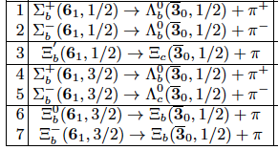
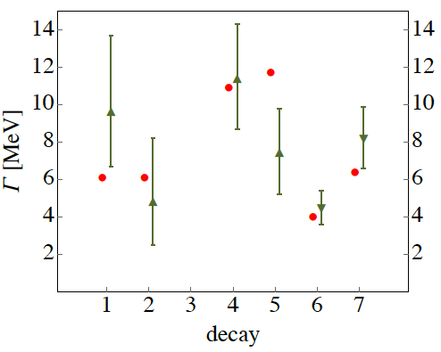
Bottom decay widths
experimental data
a little puzzling
beacuse of rather strong
isospin
violation

Slide 68
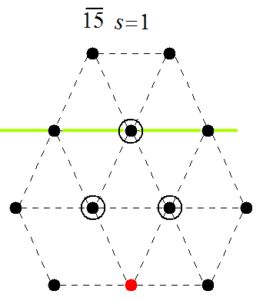
Consequences
Omega’s form isospin triplet,
easy to check experimentally

Slide 69
Consequences
rich structure -
many new states,
also in the case of b baryons
Omega’s form isospin triplet,
easy to check experimentally

Slide 70
Conclusions
soliton models ARE quark models
successful phenomenology in the light baryon sector
in soliton models pentaquarks are naturally light
in NR limit no decay of antidecuplet to octet (!)
heavy baryons can be desribed in terms of N_{c}-1 quark soliton
two types of excitations:
  rotations: 15-bar (exotic)
  quark excitations (regular)
decay widths agree well with the data with one free parameter
two of the LHCb Omega_c states may be interpreted as 5q

Slide 71
Backup slides

Slide 72
What is the experimental status of light pentaquarks today?
Θ⁺
Ξ

Slide 73
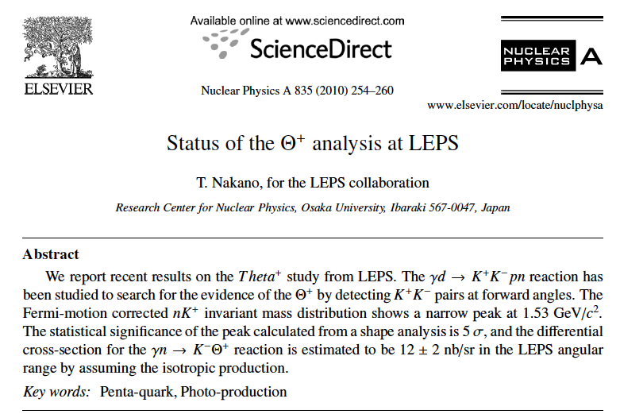
LEPS
and various conference
proceedings
e.g. T. Nakano
MENU 2016

Slide 74
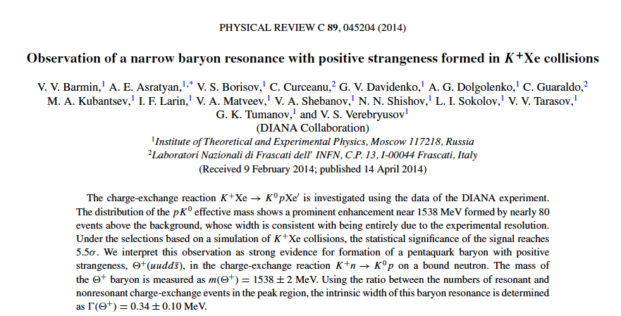
DIANA

Slide 75
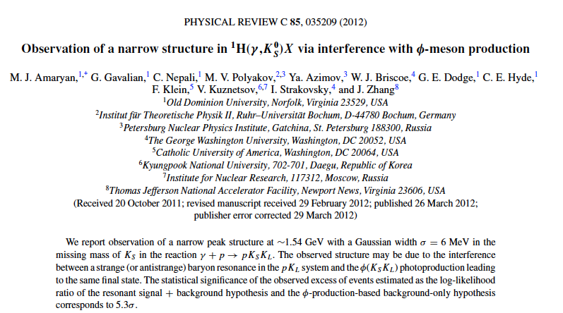
dissidents from CLAS

Slide 76
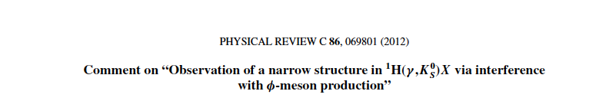

disicalaimer from CLAS

Slide 77
What is the experimental status of light pentaquarks today?
Θ⁺
Ξ

Slide 78
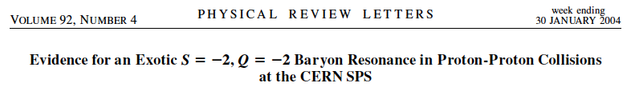
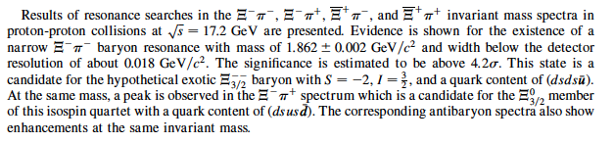
NA 49

Slide 79
What is the experimental status of light pentaquarks today?
Θ⁺
Ξ

Slide 80
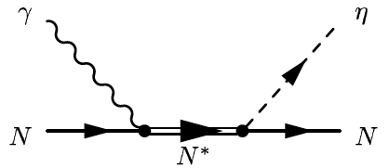
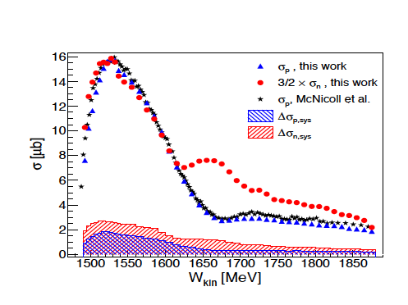
Pentanucleon?
D. Werthmuller et al. [A2 Collaboration]
Phys. Rev. Lett. 111 (2013) 23, 232001
Eur. Phys. J. A 49 (2013) 154
Phys. Rev. Rev. C 90 (2014) 015205

Slide 81
Pentanucleon?
M.V. Polyakov and A. Rathke,
On photoexcitation of baryon anti-decuplet
Eur. Phys. J. A 18 (2003) 691
natural (but not the only one) explanation if N* is a pentaquark

Slide 82
