Slide 1
Estimates of potential Efficiency Gains
Markus Schulz

Slide 2
Background
In collaboration with experiments and sites we have been looking at the efficiency of:
  Infrastructure
  Software
  Experiment workloads
  Failure rates
  Scheduling
  Operational effort based on the WLCG site survey
  Monitoring data
Looked at non HEP scientific code bases
  Instructions per cycle, level of vectorisation

Slide 3
Background
Found several potential improvements
  Compiler based
    Vectorisation , building for specific architectures, FDO ( feedback directed optimisation)
  Linker/loader strategies
  Analysis based on hardware counters
  Code profiles
Tried to estimate the quantitative impact of changes to storage organisation
  Centralisation
  Reduced redundancy within storage systems
  Reduced number of replication between sites
Tried to classify the effort needed to implement improvements
  Quantitatively very difficult
    Some experience is gained by LHCb and ALICE preparing for Run3

Slide 4
What we didn’t do
Not taking into account new algorithms, new paradigms
  Code that could be vectorised
  Machine learning
  Only one example of a radical rewrite: ALICE HLT tracking code based on Cellular Automatons
    Day one oriented to GPUs → vector oriented code
I don’t claim that this is 100% realistic!
  Very naive approaches in counting
  Maximum gains can’t be achieved (0% failure rate etc.)
  Effort to move towards these goals are significant
    And often isn’t available

Slide 5
Warning:
I am aware that most of the estimates are not very precise
I am aware that many of the assumptions are naive
I am aware that cost and effort can be justified differently
I am aware that maximum gains cannot be achieved
Unrealistic, outrageous quantitative estimates often reflect the lack of reliable/recent data on quite some fundamental aspects of what we do
If you feel uncomfortable don’t worry, our community has a tradition to avoid/ignore quantitative analysis when it comes to computing ☺

Slide 6
What can we learn from this?
Rough estimate of what can be gained without deep conceptual changes
  Can we gain 50% or a factor of 5 ?
How much can “small” improvements contribute?
What effort would be needed?
Getting a first quantitative idea of the impact of the transition to a different storage architecture

Slide 7
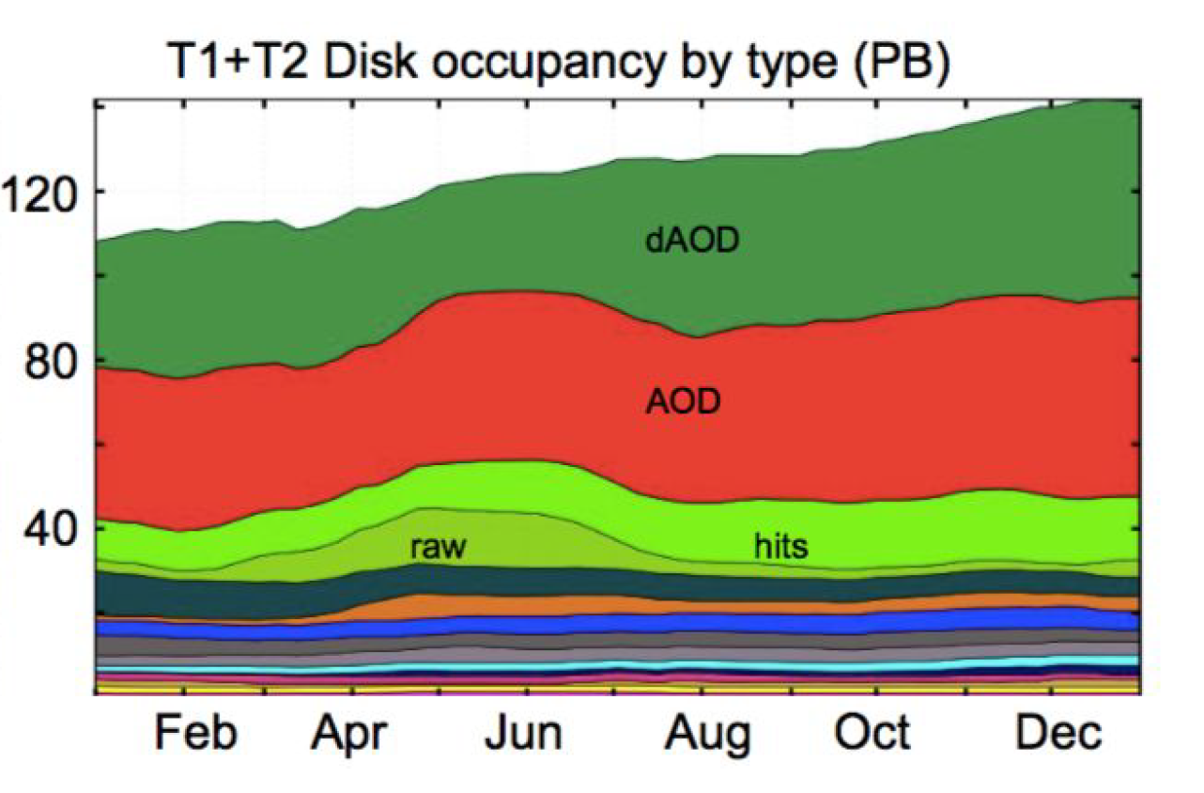
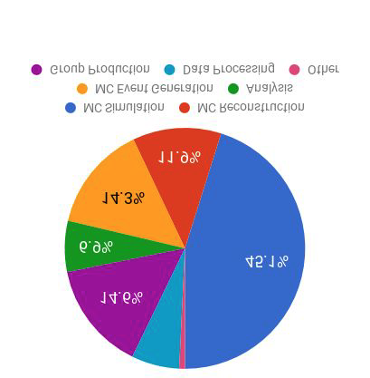
Reminder: Typical split between tasks
CPU @ T1&T2s
Most of the data outside the T0 is derived data

Slide 8
Storage Impact
Reduction of number of sites with disk storage
  Replacing them with caches
Reduction of data redundancy within storage systems
  Replacing them with nothing (virtual data or tape based backups)
Reduction of replicas
  And removing cold data

Slide 9
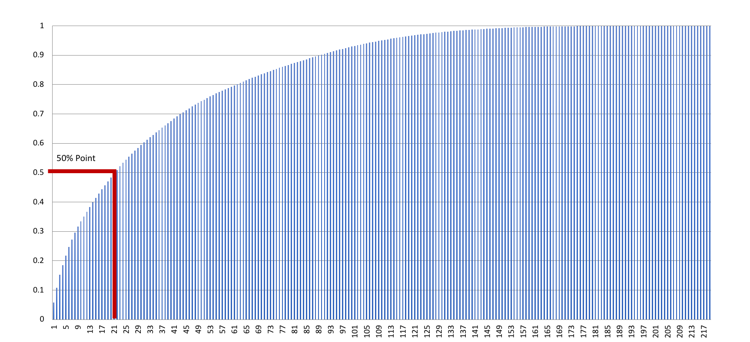
2016 contribution of SEs to total storage
The 21 largest SEs provide 50% of the overall capacity
Fraction
Number of the largest SEs contributing

Slide 10
Reduction of sites with disk storage
2015 site survey indicates that an average T1 requires 2.5 FTEs for (disk) storage operation a T2 0.75 FTEs (hopefully improved to 0.5)
  In the survey the correlation between size and effort is weak
  Doubling the size of an existing, large installation requires about 15% more effort
˜170 sites (with more than 200 SEs) to O(10) sites
  ˜21 largest SEs contribute 50%
  T1(style) sites remain, rest operates stateless buffer/cache systems
    Effort at the remaining sites increases to about 3 FTEs
  Buffer/caches require less effort (no stateful services to be maintained)
    4 hours a week for swapping broken disks and general system maintenance
13 * 2.5 + 157 * 0.5 = 111 15 * 3 + 155 * 0.1 = 60.5 roughly 40% decrease in effort
Some decrease in effort for the teams managing the experiments’ production
  Fewer stateful sites, simpler services have less complex error patterns
Started a study on the required sizes of caches for T2s (based on data popularity data)

Slide 11
Reduction of data redundancy within SEs
Currently most (all) storage systems use some form of redundancy to improve data availability and reliability
  RAID ( depending on RAID level )
  Duplication/Replication ( 2->n times )
  Erasure Encoding ( depending on desired behaviour 1.5 – X )
    But linking multiple servers
  http://iopscience.iop.org/article/10.1088/1742-6596/513/4/042017/pdf
Tape costs are about ¼ of disk costs (CERN based figures)
  Taking into account disk+server costs

Slide 12
Reduction of data redundancy within SEs
Most of the data can be reproduced
  Raw data has two archival copies anyway
  Reproducing data is associated with costs
Error rates of disks at the T0 are about 0.9%/a (0.86%/a)
  For a 70k disk system the average daily failure rate is 1.73 disks
  Data popularity studies can be used to calculate job failure rates
    And estimate recreation costs/staging costs (lower due to cold data)
With no internal replication 30%-50% of the disk costs could be saved
  Requires modifications to experiments’ workflow management systems
  Additional error rate is low compared to current observed job failure rates

Slide 13
Reduction of experiment replicas
Reported replication rates are in the order of 1.3-1.5
  Plus multiple versions of analysis data
  Plus overlaps in derived AODs
Using the published data popularity summaries it can be estimated that 20% of the data could be moved to a cheaper layer
  Less than 6 months since last reading
  More detailed studies needed (currently underway)
  Adding complexity and need for more archive facilities
  → 15% cost reduction

Slide 14
Scheduling and Site inefficiencies
Problem of schedulers, tessellation, not used cores on storage services, multi core workflows with periods of single core usage,....
Observation on (T0, T1s)
  Estimated losses 20-30% (conservative optimistic)
  Excellent compared to HPC where 40% utilisation is already good
  Backfill, asynchronous I/O, batch on storage allow to use about 90%
    With extra complexity
  → 10-20 % possible gain
Loss due to intermittent job failures
  Based on Andrea’s log studies 10 – 15% of the wallclock time is lost
  These could (theoretically) be reduced to >5% → 5-10% gain

Slide 15
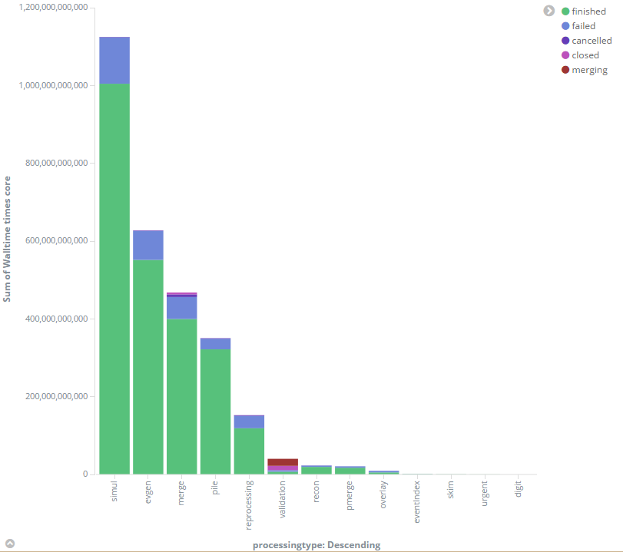
Inefficiency by processing type
Processingtype | Wallclock inefficiency (%) | WC contribution (%)
evgen | 12 | 23
merge | 15 | 17
simul | 9.5 | 37
reprocessing | 25 | 5
pile | 7.1 | 9
recon | 16 | 1
Most jobs fail early wasting little wall clock time
But number of failed jobs is significant adding to scheduling costs

Slide 16
Compiler/Code/Build based improvements
Studies over the last 3 years by Nathalie R., David Smith, Servesh M.
  Building code for specific platforms
    Currently none of the advanced features are used
  Vectorisation
  Intel Compiler
  Changes to the build/link approach
    Reducing shared library overheads by building “large” libs instead of loading many small libs
    Patch to the dynamic linker
  Feedback guided optimisation (Intel and gcc based AutoFDO)
  Looked at GEANT4, Reco-Code, NLO Generators
  Several 15-20% CPU improvements (not all can be combined)
    HEP code is very sensitive to compiler switches, significant work on Physics validation is necessary

Slide 17
Profiling Code and Hardware Counter
Profiling code shows up to 25% time spend in memory management
  Allocation and deallocation of small, extremely short lived objects (FOM tools)
    Using standard techniques 10% can be saved (some refactorization)
    Replacing standard template container classes (LHCb works on this for Run3)
Hardware Counter based analysis
  HEP code 0.8-1.5 Operations per cycle
  HPC code up to 4, some being vector instructions delivering up to 8 floating point ops (AVX-2)
  100% improvement should be feasible, but will require significant changes in the code
    While keeping the same algorithms
    Requires significant skills
    ALICE HLT tracking code, designed for GPUs produced also huge gains on CPUs with vector units
      David Rohr & ALICE, several talks and papers on cellular automaton

Slide 18
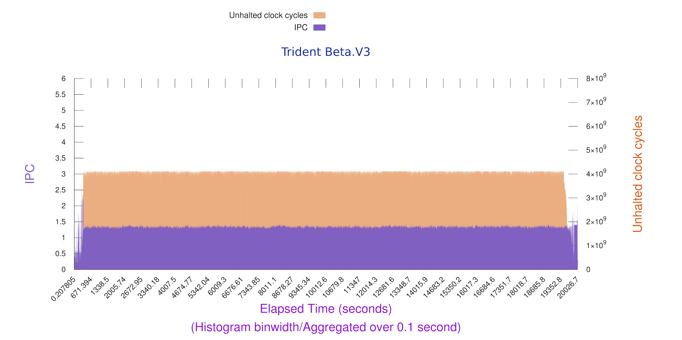
Some examples:
GEANT4

Slide 19
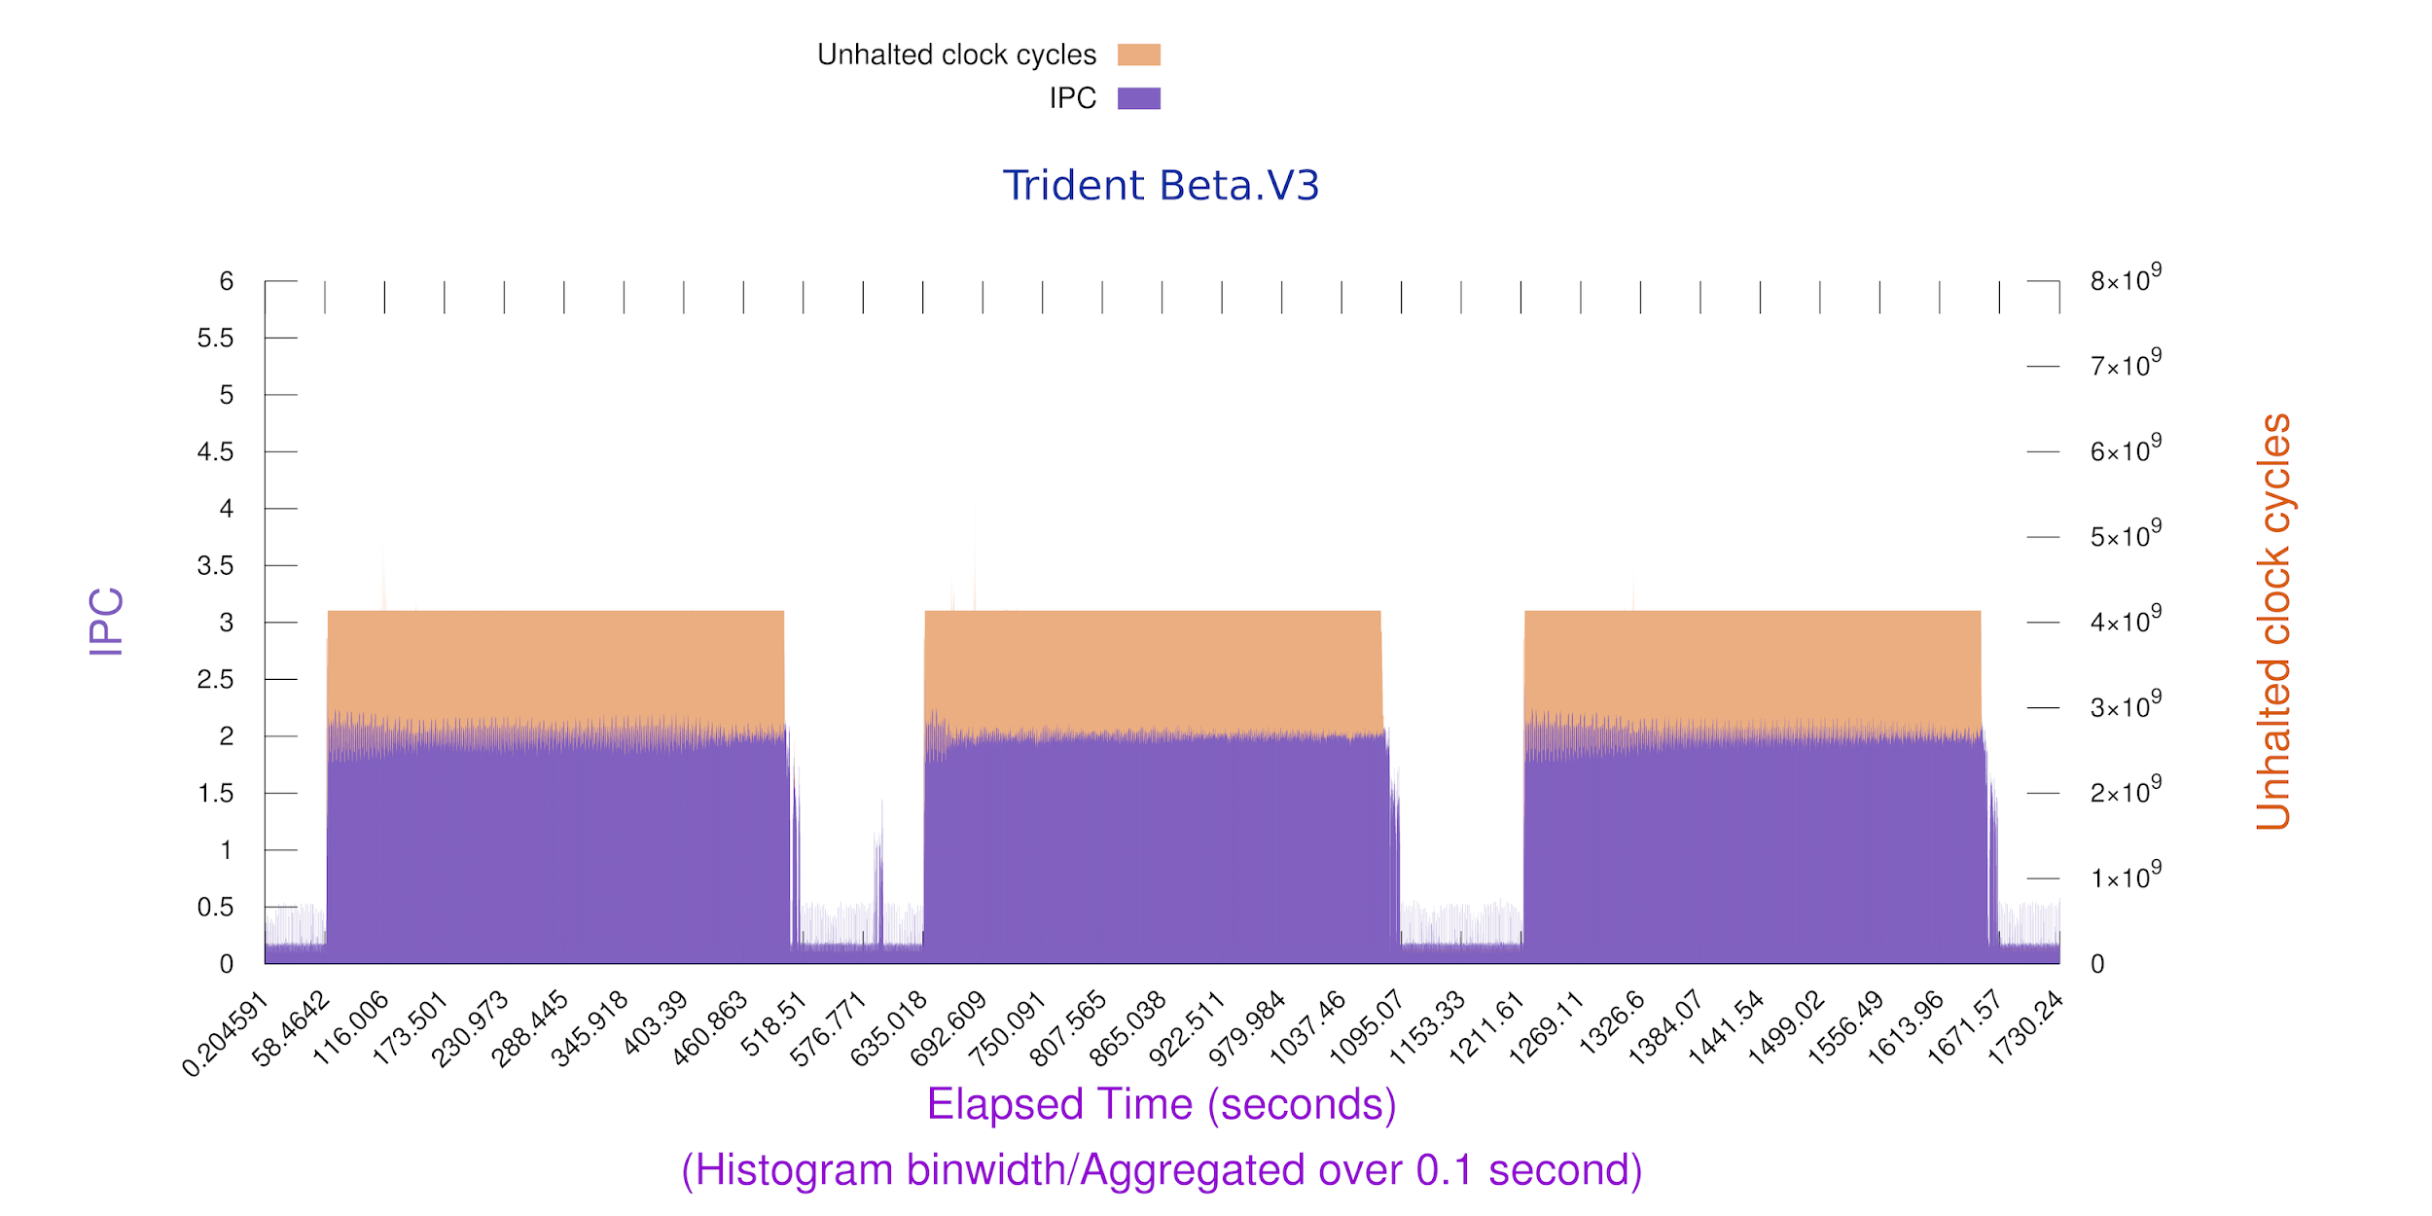
HEPspec 444

Slide 20
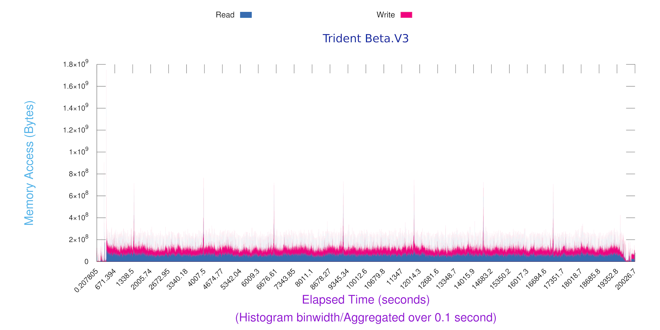
Geant Memory

Slide 21
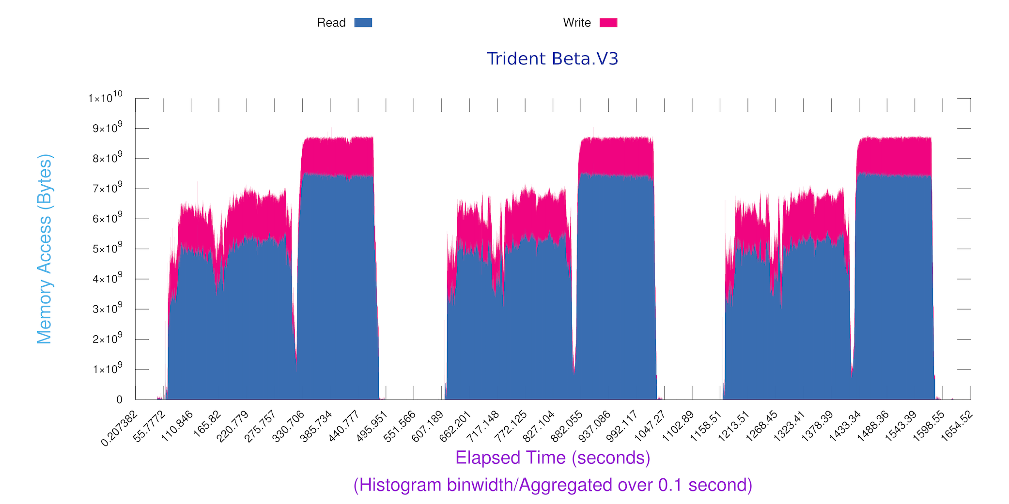
HEPSpec 450
GEANT

Slide 22
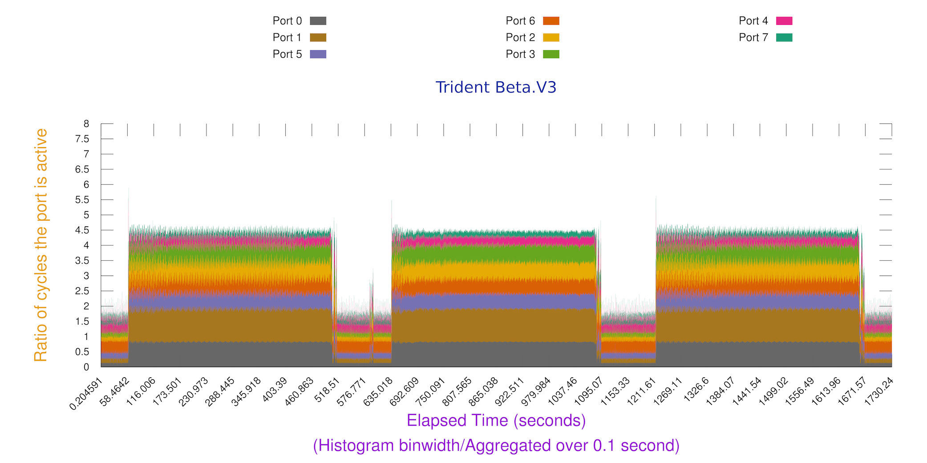
444 port usage (0,1,5,6 compute 0&1 AVX2)
Strong indication of vector ops

Slide 23
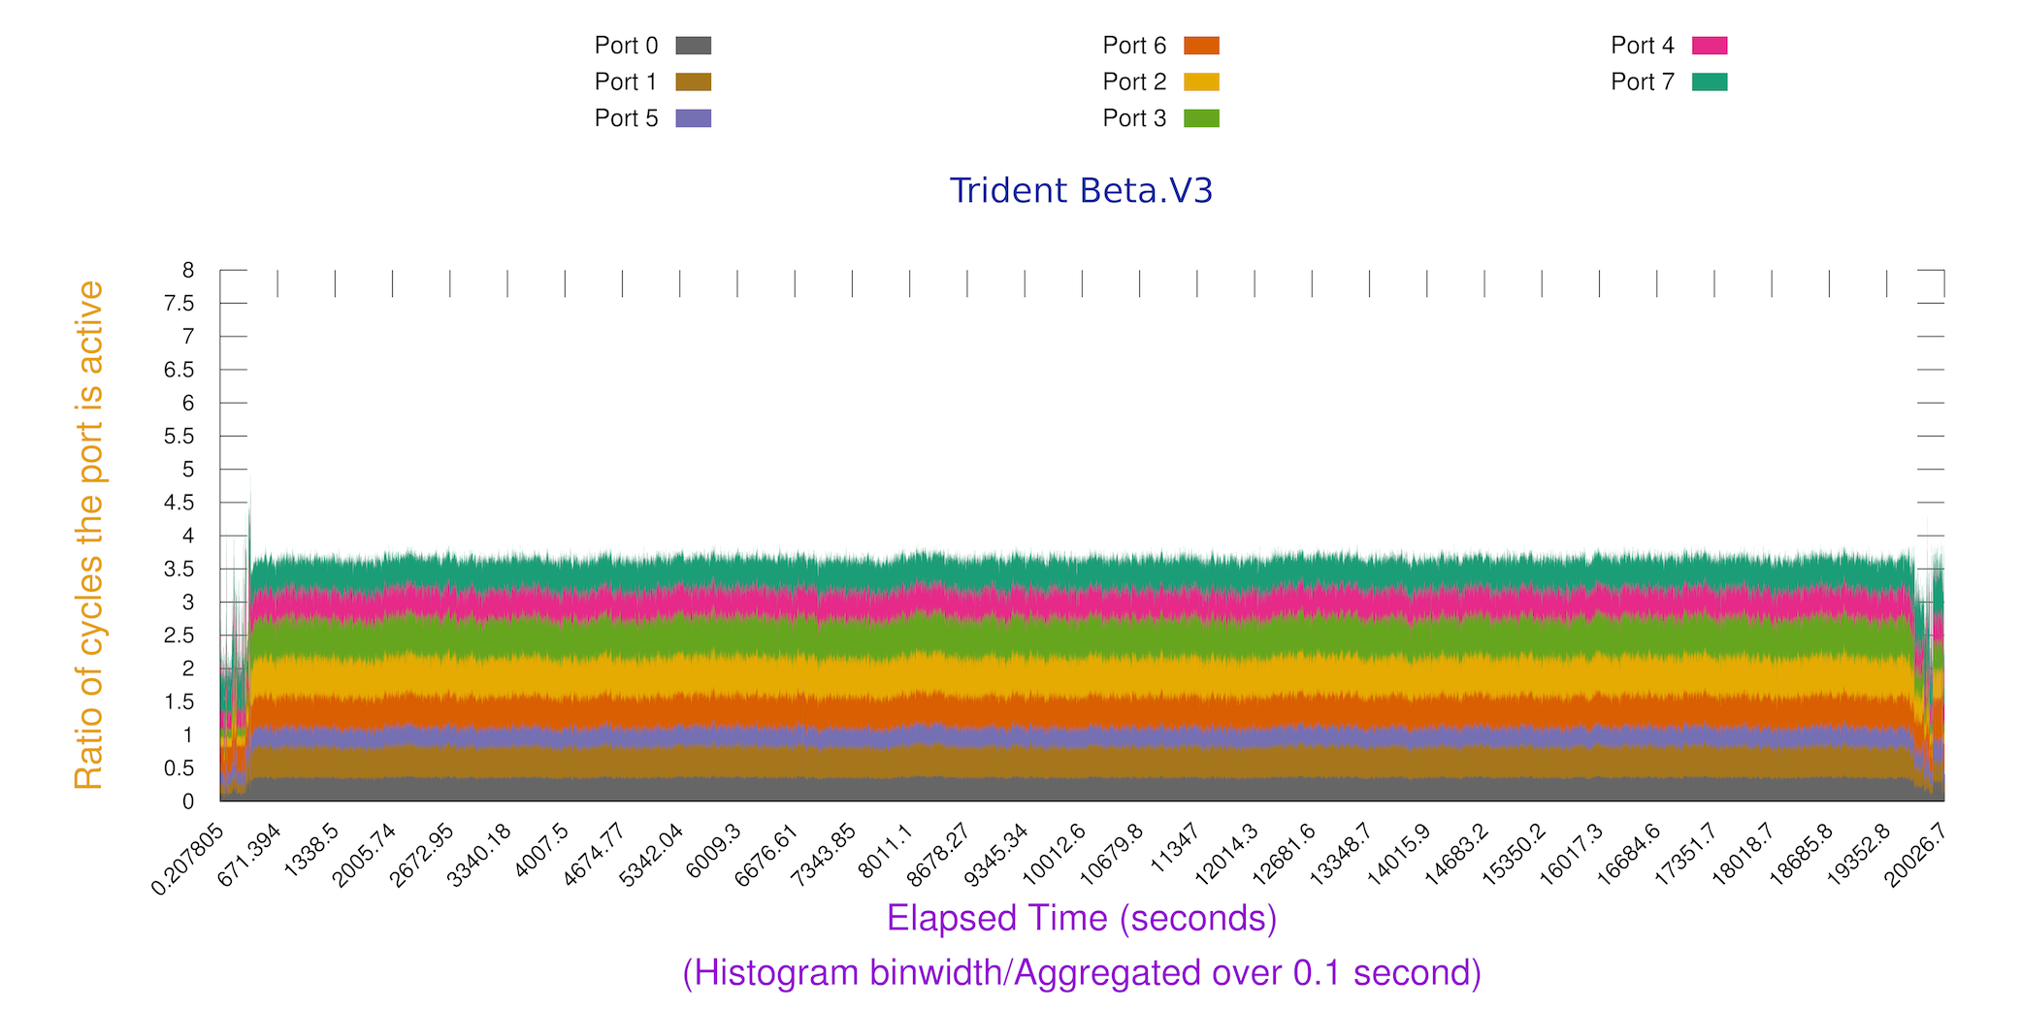
GEANT Port usage

Slide 24
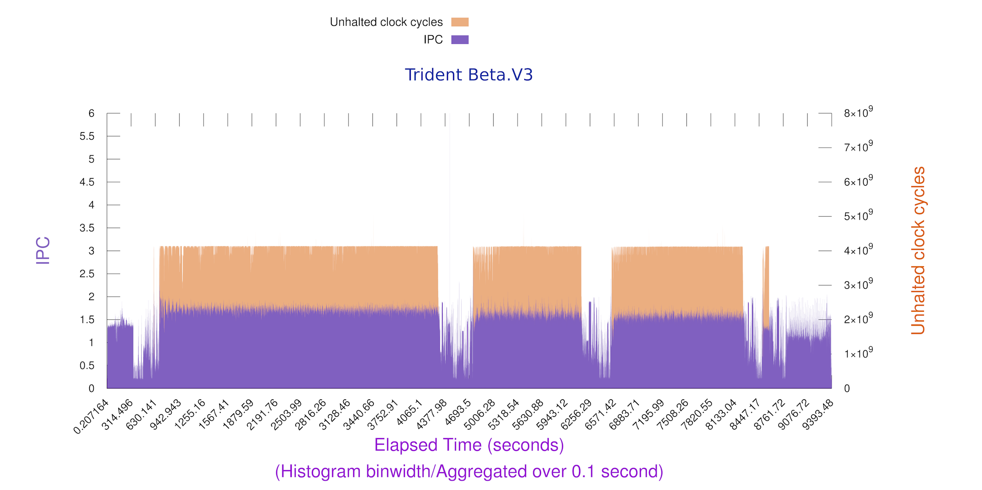
Pileup/digi/reco

Slide 25
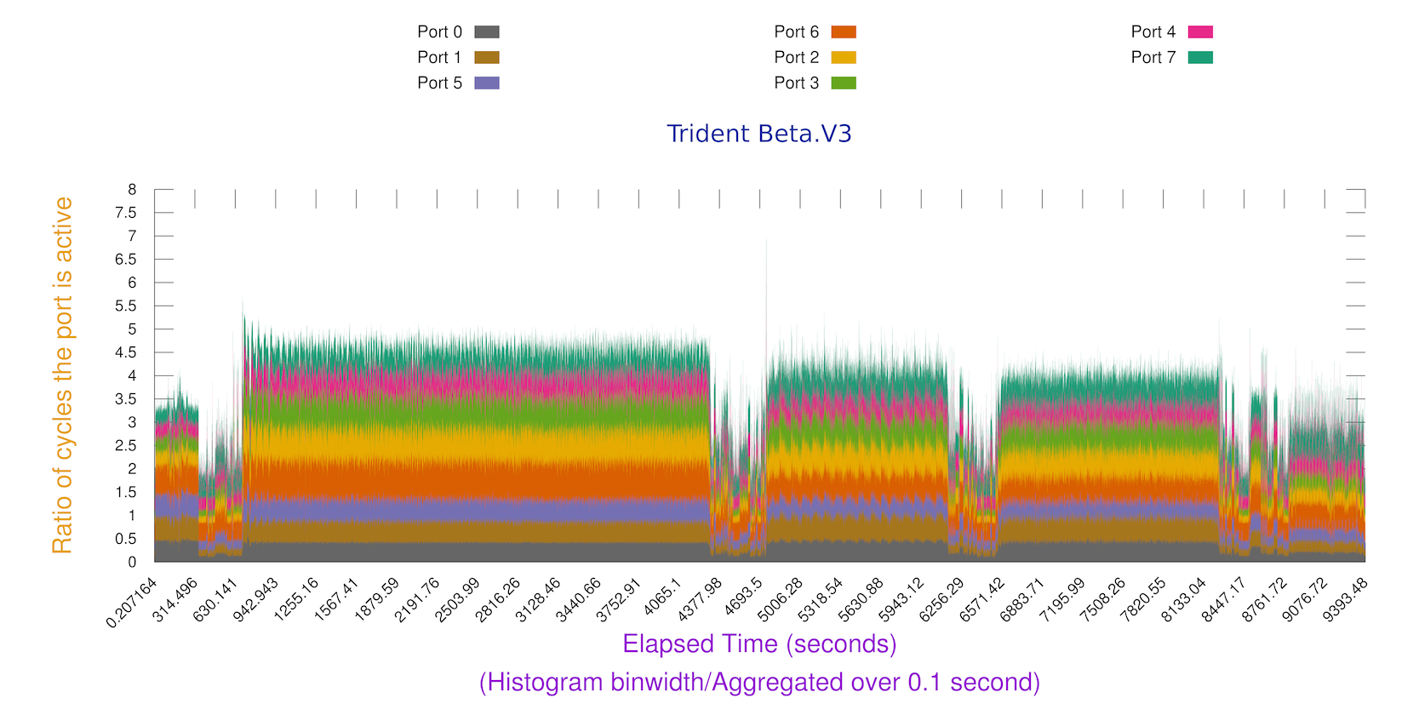
pile/digi/reco

Slide 26
I/O
Some studies comparing file sizes and block read operations (disk)
Full machines (less buffer spaces) 2.8 times increase in data read
  Blocking readahead reduced the overhead to a factor of 2
Some studies on overhead for object packing, unpacking, compression (ROOT)
  Significant compared to overall time spend on I/O
  But in absolute terms irrelevant
Lower priority since most of the workloads are not I/O limited
  80/20 rule ….
Started to work on latency hiding and cache efficiency

Slide 27
Current understanding
Without change in paradigms and algorithms
  But with added complexity and significant code work
  Storage costs could be reduced by up to 45%
  Effort in site storage operation up to 40%
  CPU all combined up to a 200% (50% at moderate cost)
This has to be compared to gains by:
  New analysis formats (CMS Mini/NanoAODs)
  Fast MC
  New algorithms (ALICE tracking code acceleration O(1000) )
  LHCb turbo stream (online calibration/no raw data).......

Slide 28
Summary
Change | Effort Sites | Effort Users | Gain
managed storage on 15 sites + caches | Some on large sites/gain on small sites | little | 40% decrease in operations effort for storage
Reduced data redundancy | Some large sites | Frameworks some | 30% disk costs
Reduced data replication and cold data | little | Frameworks some | 15% disk costs
Scheduling and site inefficiencies | Some | Some | 10-20% gain CPU
Reduced job failure rates | Little | Some-Massive | 5-10% CPU
Compiler and build improvements | None | Little-Some | 15-20% CPU
Improved memory access/management | None | Realistic | 10%-15% CPU
Exploiting modern CPU architectures | None | Massive | 100% CPU
Paradigm shift algorithms | Some | Massive-Infinite | Factor 2-100 CPU
Paradigm shift online/offline data | Little | Massive-Infinite | 2-10 CPU 10-20 Storage

Slide 29
The dilemma
Should we invest in gradual improvements?
  Easy to motivate
  No change in how we do physics
  Skills largely available
  Return of investment within short time
  Results somewhat limited
Should we focus work on more fundamental changes?
  Outcome often not clear at the start (R&D)
  Sometimes going against our culture (no raw data stored)
  Requires sometimes discourse on how we do physics
  Training investments needed
  Results potentially massive
Doing both with the low intensity?

