Slide 1
LBDS operation at 225 GeV
Viliam Senaj, Lower energy in LHC #7 meeting, 15/12/2017

Slide 2
Consequences to generator
MKBH/JU1: ~5k pulses & no problem; T_ref17.5% ~ +100 ns
MKD/JU3: ~50k pulses & no problem; T_rise ~ +1.14 us; R_1 ~ -3% (for the same R_2 and R_end)
Smaller retrigger signals Cts2ab, Cts3ab, Retrig PaPb
Ctf2ab, Ctf3ab identical (CT in series with snubber capacitor of compensation GTO - constant bias voltage)

Slide 3
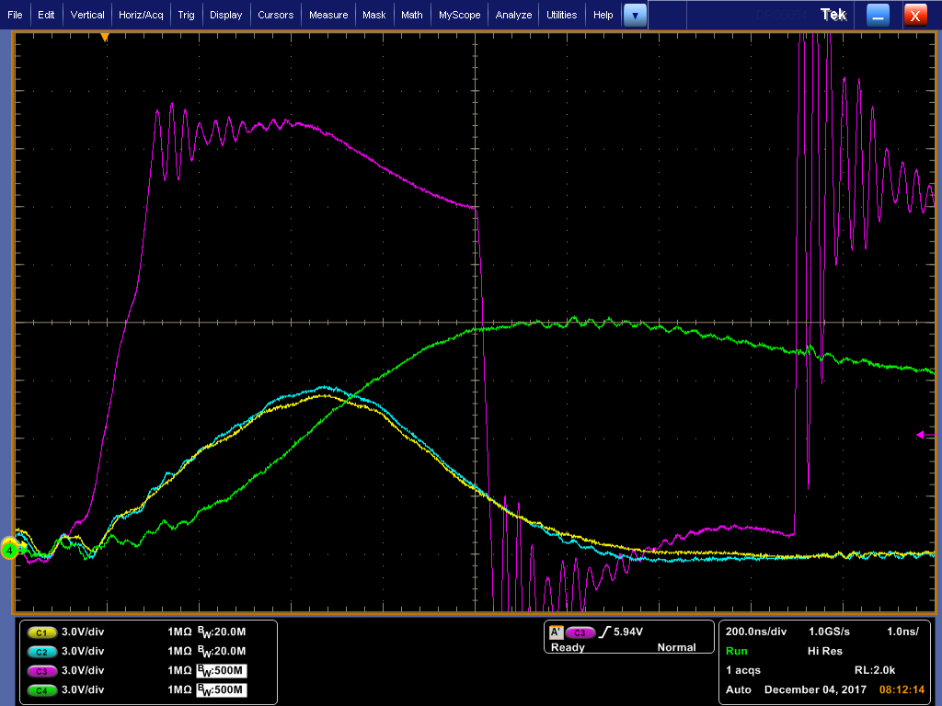
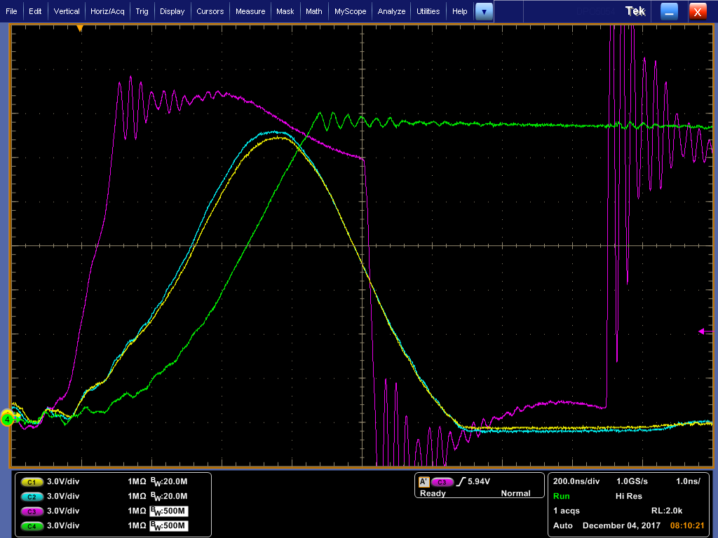
Retrigger signals Cts2ab, Ctf2a and Retrig Pa at 225 GeV vs. 450 GeV

Slide 4
Conclusion
No visible stopper on MKBH (same expected for MKBV)
MKD – operation is stable but with increased rise time (3.84 us at 225 GeV vs. 2.7 us at 450 GeV)
LBDS operation at 225 GeV feasible with increased abort gap duration (+~1.15 us)
Retriggering signals Cts2,3 and Retrig Pa,Pb will be attenuated but compensation branch snubber signals Ctf2,3 will be the same and will do their job
The only realistic erratic scenario is PTM erratic (or other non-generator related) and Ctf signals will do retriggering correctly
Still some issues to be solved on control and surveillance (BETS…)

