Slide 1
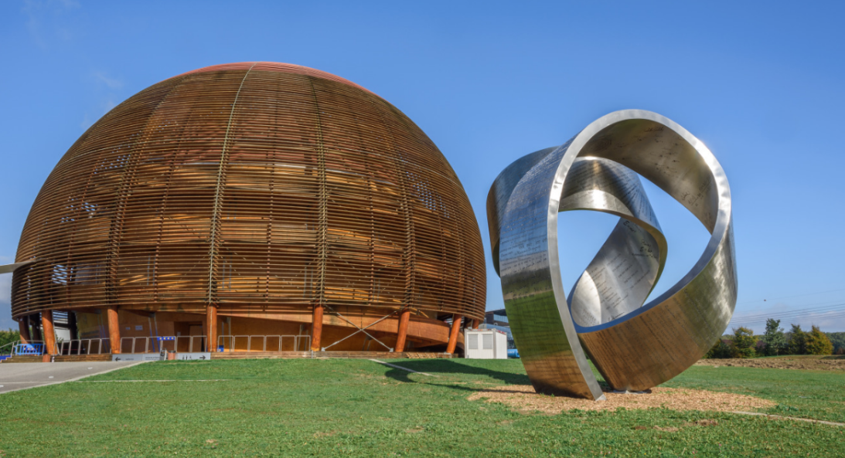
Good morning
And welcome to CERN!

Slide 2

During presentations
Pendant les presentations
User : Cern_GUEST
Code: Glob3FR33W1F1
Outside
A l’extérieur
CERN =
non-smoking
non-fumeur

Slide 3
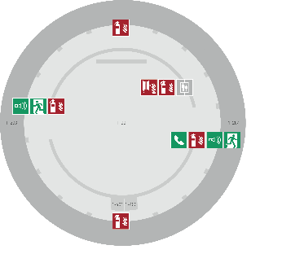
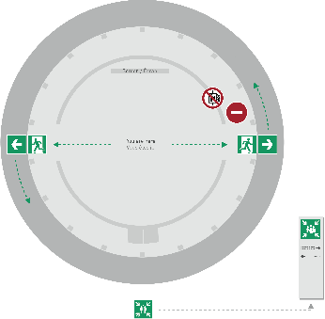
Emergency Procedure d’Urgence
When the alarm sounds
Lorsque le signal d’évacuation retentit
Evacuate immediately
Évacuez immédiatement
Don’t use the lift
N’utilisez pas l’ascenseur
Follow the signs
Suivez le balisage
Go to assembly point
Rendez-vous au point de rassemblement
74444
Escape routes
Voies d’évacuation
Fire hose
Lance d’incendie
Extinguisher
Extincteur
Assembly point
Point de rassemblement

Slide 4
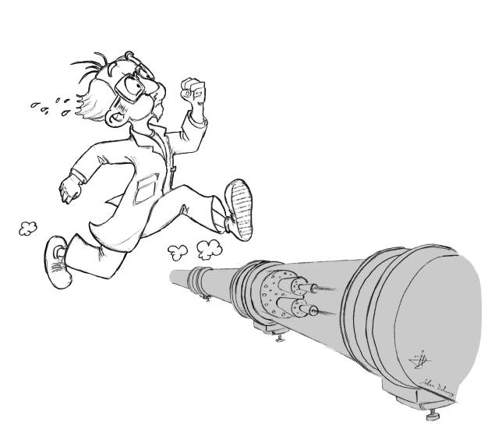
SCHEDULE (in Globe, until 11.30)
Time | Subject | Speaker
08.00 | Entrance formalities
10.00 | Welcome Head of HR Dept | James PURVIS
10.05 | Presentations
 | Global presentation HR | Erwin MOSSELMANS
 | CERN Service Portal | Isabel FERNANDEZ GONZALEZ
 | IT Service | Arash KHODABANDEH
 | Safety at CERN | Christoph BALLE
 | CERN Staff Association | Jenni SUUTULA
11.00 | Q&A: Ask the Experts
11.30 | End of session in Globe

Slide 5


First things to do …
Les premières choses à faire…
Fill out the documents in your folder
Compléter les documents se trouvant dans votre pochette
Go to one of the desks, according to your status
Aller à l’une des tables, en fonction de votre statut

Slide 6


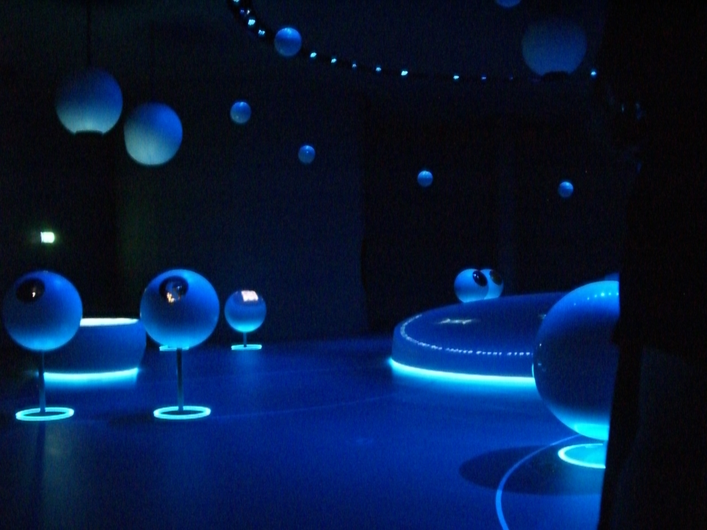
After the entrance formalities, you can…
Après les formalités d’arrivée, vous pouvez…
Grab a coffee
Prenez un café
Meet new colleagues
Rencontrez des nouve.aux.elles collègues
Visit the Exhibition on the ground floor
Visitez l’Expo au RdC du Globe
Please be back at 09:00 (start presentations)
Veuillez svp être de retour à 09h00 (début présentations)

Slide 7
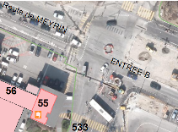

After the entrance formalities, you can…
Après les formalités d’arrivée, vous pouvez…
Grab a coffee
Prenez un café
Meet your neighbours
Rencontrez vos voisins
Go to building 55 (for your access card, vehicle registration and computer account activation)
Allez au bâtiment 55 (carte d’accès, enregistrement véhicule et activation des comptes informatiques)
Visit the Exhibition on the Globe ground floor
Visitez l’Expo au RdC du Globe
Please be back at 10:00 for the presentations
Veuillez svp être de retour à 10h00 pour les présentations

Slide 8
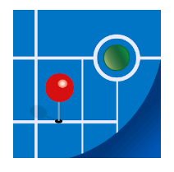
Find your way around CERN with ease – download …
Trouvez votre chemin avec facilité
avec l’application …
MapCERN
iOS and Android

Slide 9

Meet colleagues for lunch! Join …
Retrouvez vos collègues au déjeuner, rejoignez
https://lunchcollider.ch/

Slide 10
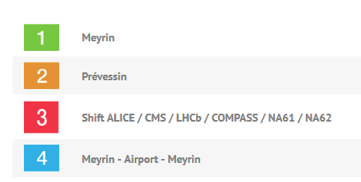
CERN Shuttle service
Navettes CERN
http://cern.ch/ShuttleService
inside Meyrin
between Meyrin and Prevessin
7 days a week

Slide 11
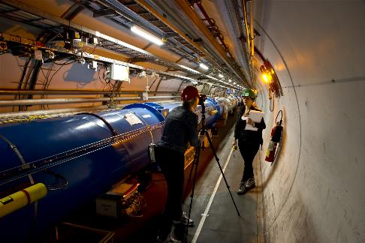
Working at CERN is about…
Purpose
Le travail au CERN c’est….
Un but commun
CERN's people are driven by a shared goal, a single purpose.
They want to achieve the impossible,
to do what’s never been done before.
Everyone here strives to be the best they can be,
true specialists and industry "firsts" are created regularly – not just in the world of physics.

Slide 12
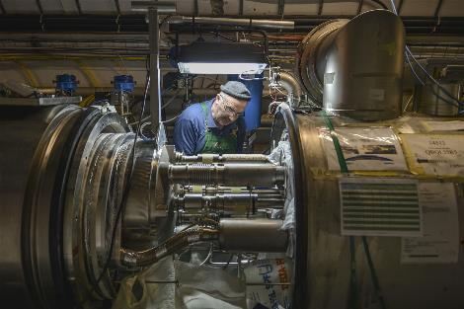
Working at CERN is about…
Challenge
Le travail au CERN c’est….
Relever les défis
Unravelling the mysteries of the universe: it’s a big task. And that’s one of the reasons that experts come to CERN – to test themselves, push their abilities and help create history with groundbreaking discoveries.
But this is not just about physics. The engineering and technical skills needed to make the experiments succeed are as world-class as the science behind them. If you want to help answer the world’s toughest questions, this is the place to do it.

Slide 13
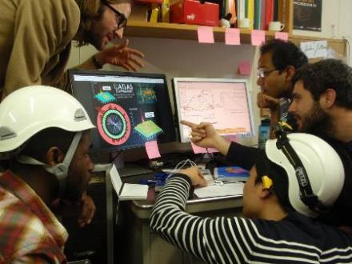
Working at CERN
is about …
Integrity
Le travail au CERN c’est….
L’intégrité
This is a word that is included in the CERN values, but it’s something that can be claimed by any number of organisations, so what does it actually mean here?
Respect isn’t handed out automatically at CERN – it’s earned.
But, because of the nature of the work, people act with integrity.
People are driven by scientific discovery. Their motivations are pure.
They trust and are trusted.

Slide 14
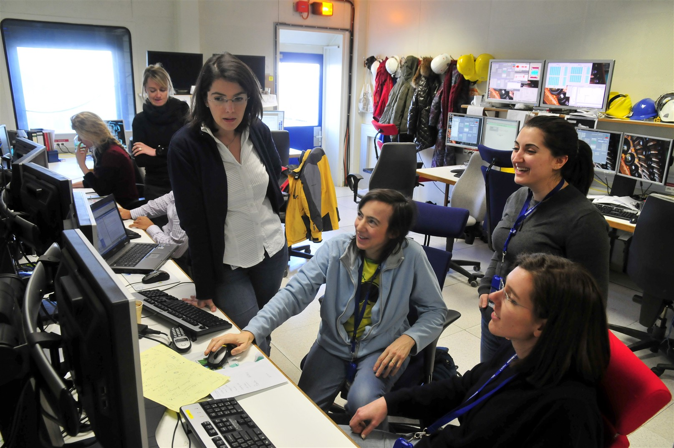
Working at CERN is about…
Collaboration
Le travail au CERN c’est….
La collaboration
CERN is an employer, a university and a state: a whole community working towards a shared goal – scientific discovery. This creates a collaborative world.
Seniors work with graduates. Physicists need engineers.
Countries forget politics and collaborate to achieve.
And knowledge – CERN’s main commodity – is shared throughout CERN, its member states and the rest of the world.

Slide 15
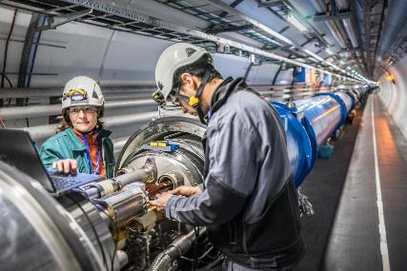
Working at CERN is about…
Imagination
Le travail au CERN c’est….
L’imagination
This is work without boundaries.
People here are realising the impossible.
Pushing what is known and accepted with the courage to ask, “what if?”
They have the freedom to think differently, to imagine, and to find improbable solutions to problems that have never been asked before.
They are free to take chances, to challenge ideas and to enjoy unrestrictive working practices.

Slide 16
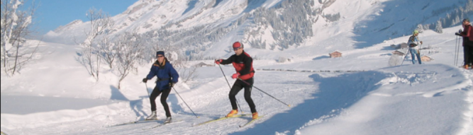
Working at CERN is about…
Quality of life
Le travail au CERN c’est….
La qualité de vie
People here enjoy living a truly cosmopolitan life, in the heart of Europe.
The environment offers a myriad of leisure activities, both on Lake Geneva and the surrounding mountains.
With excellent benefits, great remuneration and the freedom to work flexibly, it’s not just the work and atmosphere that makes people enjoy their jobs, it’s the tangible elements that they receive too.

